Slide 1
A quantum protocol for sampling correlated equilibria unconditionally and without a mediator
Iordanis Kerenidis, LIAFA, Univ Paris 7, and CNRS
Shengyu Zhang, The Chinese University of Hong Kong

Slide 2
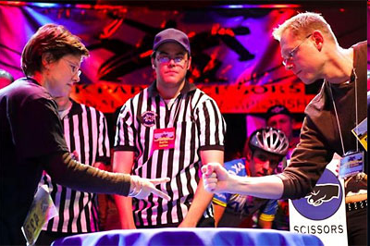
Normal-form games
k players: P₁, …, P_{k}
P_{i} has a set S_{i} of strategies
P_{i} has a utility function u_{i}: S→ℝ
S = S₁ × S₂ × ⋯ × S_{k}
strategic (normal) form

Slide 3
Representing a game
 | 0, 0 | 1, -1 | -1, 1
 | -1, 1 | 0, 0 | 1, -1
 | 1, 1 | -1, 1 | 0, 0

Slide 4
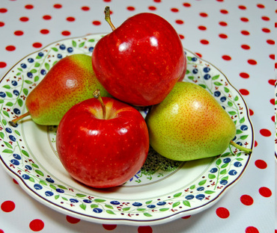
Nash equilibrium
Nash equilibrium: each player has adopted an optimal strategy, provided that others keep their strategies unchanged

Slide 5
Nash equilibrium
Pure Nash equilibrium: a joint strategy s = (s₁, …, s_{k}) s.t. ∀i, u_{i}(s_{i},s_{-i}) ≥ u_{i}(s_{i}’,s_{-i})
s_{-i} = (s₁, …, s_{i-1}, s_{i+1}, …, s_{i-1})
Each Player i can also choose her strategy s_{i} randomly, say, from distribution p_{i}.
(Mixed) Nash equilibrium (NE): a product distribution p = p₁ × … × p_{k} s.t. ∀i, E_{s←p}[u_{i}(s_{i},s_{-i})] ≥ E_{s←p}[u_{i}(s_{i}’,s_{-i})]
[vNM44,N51] Any game with a finite set of strategies has an NE.

Slide 6
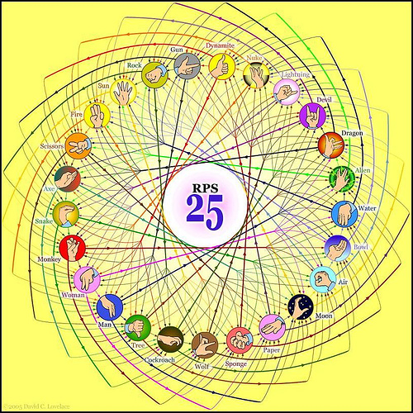
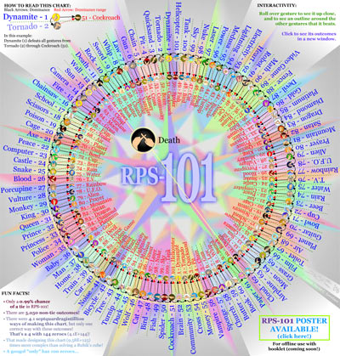
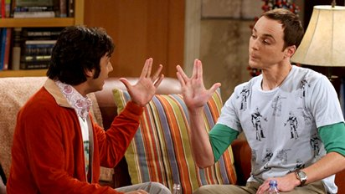
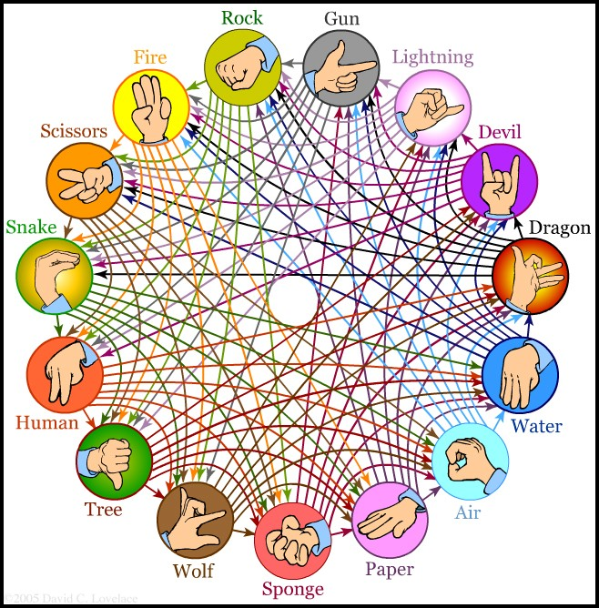
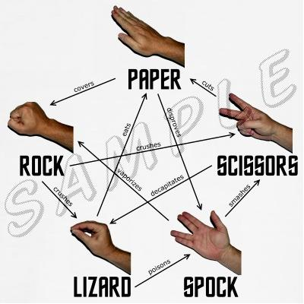
Algorithmic game theory
What if we have a large number of strategies?
Or large number of players?

Slide 7
intractability
How computationally hard is it to find a Nash equilibrium (even in a two-player game)?
Optimal one: NP-hard. [Gilboa-Zemel’89]
Any one: PPAD-hard. [Daskalakis-Goldberg-Papadimitriou’06, Chen-Deng’06]
Computationally Unfriendly!
Even worse, inefficient in game-theoretic sense!
Notes:
NP-hardness: Gilboa and Zemel, 1989
PPAD-hardness: Daskalakis, P.W. Goldberg, and C.H. Papadimitriou, 2006

Slide 8
correlated equilibrium: game
2 pure NE: go to the same game. Payoff: (2,4) or (4,2)
Bad: unfair.
1 mixed NE: each goes to preferred w.p. 2/3.
Good: Fair
Bad: Low payoff: both = 4/3
Worse: +ve chance of separate
CE: (Baseball,Softball) w.p. ½, (Softball,Baseball) w.p. ½
Fair, high payoff, 0 chance of separate.
Battle of the Sexes
city | Baseball | Softball
Baseball | 2 4 | 0 0
Softball | 0 0 | 4 2

Slide 9
Correlated equilibrium: definition
Formally, CE is a joint distribution p on S₁×S₂
A trusted mediator samples (s₁,s₂)←p,
and recommend Player i take strategy s_{i}.
Upon seeing only s_{i}, Player i doesn’t deviate.
Measure: Expected payoff, averaged over p(∙|s_{i}).
E_{s←p}[u_{i}(s)|s_{i}] ≥ E_{s←p}[u_{i}(s_{i}’s_{-i})|s_{i}], ∀i, s_{i}, s_{i}’.

Slide 10
Correlated equilibrium: math
Game theory
natural
Math
nice
Set of correlated equilibria is convex.
The NE are vertices of the CE polytope (in any non-degenerate 2-player game)
All CE in graphical games can be represented by ones as product functions of each neighborhood.

Slide 11
Correlated equilibrium: Computation
Game theory
natural
Math
nice
CS
feasible
Optimal CE in 2-player games can be found in poly. time by solving a LP.
natural dynamics → approximate CE.
A CE in some succinctly representable games can be found in poly. time.
Recall: finding even one NE is PPAD-hard.

Slide 12
Why doesn’t this solve all the issues
While NE is hard to find, CE is easy to compute, even for the optimal CE.
So why not simply compute the optimal CE, and then implement it.
Solves the hardness concern of NE.
Issue: In real life, who can serve as the mediator?

Slide 13
Mediator issue and classical solution
Classical solution:
[Dodis-Halevi-Rabin’00] Mediator can be removed, assuming
the players are computationally bounded,
Oblivious Transfer exists.
Can we remove the assumptions?
Quantum: Sharing pure state?
[Deckelbaum’11] ∃CE that cannot be implemented by sharing pure quantum state!
Notes:
Dodis, Halevi and Rabin

Slide 14
Our result
This paper: If we use quantum communication, then we can remove the mediator without any computational assumption.
For any targeted CE p, the honest player gets payoff at least E_{s←p}[u_{i}(s)] – ε.
ε: arbitrarily small.

Slide 15
Quantum tool: Weak coin flipping
Coin flipping: Two parties want to jointly flip a coin.
Issue: they don’t trust each other.
Security :
Both are honest: Pr[a = 1] = ½
One is honest: honest party doesn’t lose too much.
ε-Strong coin flipping: the honest party gets ½ - ε ≤ Pr[a = 1] ≤ ½ + ε
Quantum: min ε = $\frac{1}{\sqrt{2}}−\frac{1}{2}$. [K03; A01,SR01,NS03,KN04,CK09]
Notes:
K03: Kitaev,
A01: Ambainis. SR01: Spekkens and Rudolph. NS03: Nayak and Shor. KN04: Kerenidis and Nayak. CK09: Chailloux and Kerenidis]
Classical: min ε = 1/2.

Slide 16
Quantum tool: Weak coin flipping
Coin flipping: Two parties want to jointly flip a coin.
Issue: they don’t trust each other.
Security :
Both are honest: Pr[a = 1] = ½
One is honest: honest party doesn’t lose too much.
ε-Weak coin flipping:
Parties have (different) preferences
The honest party gets desired outcome w.p. ≥ ½ - ε.
Quantum: min ε = arbitrarily small. [SR02, A02, KN04, M07]
Notes:
SR02: Spekkens and Rudolph. A02: Ambainis. KN04: Kerenidis and Nayak. M07: Mochon
Classical:

Slide 17
Protocol
Assumptions:
2 players, each has n strategies.
Each utility function is normalized to range⊆[0,1].
p is uniform distribution over a multiset of size K, where K=2^{k}, with k=poly(n).
So s←p can be written as s¹s²…s^{k}.
These are for illustration purpose only. (Can be removed.)

Slide 18
Protocol
Idea: Let the players sample bit-by-bit.
For each bit i, and the two possible values of s^{i}, each player j computes his/her expected payoff ${\text{E}}_{s^{i+1}…s^{k}←p(∙|{\overline{s}}^{1}…{\overline{s}}^{i})}\left[u_{j}\left({\overline{s}}^{1}…{\overline{s}}^{i}s^{i+1}…s^{k}\right)\right]$, where ${\overline{s}}^{1}…{\overline{s}}^{i}$ are the bits that have been sampled.
They then know their preferences of s^{i}.
If their preferences are the same, then both go for it. (Formally, set ${\overline{s}}^{i}$ to be that value.)
If not the same, they run the weak coin flipping.

Slide 19
Protocol
After the sampling, they get a joint strategy s.
They play s.
Catch: After the sampling, both know s
As opposed to Player i only knows the i^{th} part of s.
We add an extra “checking” phase:
If a player finds that the other didn’t play according to s: Output “rejection” and both get payoff 0.

Slide 20
About the extra phase
Dodis et al. also has this punishment move
Doesn’t change original CE.
Classical model augmented with the same phase: no use.
One important case: the CE is a convex combination of some pure NE.
Then don’t need the extra stage---knowing pure strategy s doesn’t give any player incentive to deviate.

Slide 21
Summary
Though Nash equilibrium is hard to find…
CE is better in fairness, social welfare, and computational tractability.
Quantum communication can implement CE without mediator, unconditionally.

Slide 22
Thanks

