Slide 1
Tutorial 7: General Random Variables 3
Yitong Meng
March 13, 2017

Slide 2
Revise - Joint PDF
Two continuous random variables $X,Y$ satisfying
$$P\left(\left(X,Y\right)∈B\right)=\iint_{(x,y)∈B}{f_{X,Y}\left(x,y\right)dxdy}$$
for every subset $B$

Slide 3
Revise - Marginal Probability
$P\left(X∈A\right)=P\left(X∈A, Y∈\left(−∞,∞\right)\right)$
$$=\int_{A}{\int_{−∞}^{∞}{f_{X,Y}\left(x,y\right)dy}dx}$$
The marginal PDF of $X$ is
$$f_{X}\left(x\right)=\int_{−∞}^{∞}{f_{X,Y}\left(x,y\right)dy}$$

Slide 4
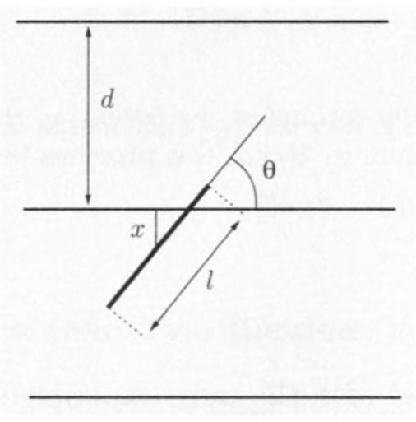
Example: Buffon’s Needle
A surface is ruled with parallel lines, which at distance $d$ from each other.
Suppose we throw a needle
of length $l$ randomly.
What is the prob. that the
needle will intersect one of
the lines?

Slide 5
Example: Buffon’s Needle
Assume $l<d$ so that the needle cannot intersect two lines simultaneously.
$X$, the distance from the middle point of the needle and the nearest of the parallel lines
$θ$, the acute angle formed by the needle and the lines

Slide 6
Example: Buffon’s Needle
We model $(X,θ)$ with a uniform joint PDF so that
$$f_{X,θ}\left(x,θ\right)=\left\{\begin{aligned}\frac{4}{πd}, if x∈\left[0,\frac{d}{2}\right] and θ∈[0,\frac{π}{2}] \\ 0, otherwise\end{aligned}\right.$$

Slide 7
Example: Buffon’s Needle
The needle will intersect one of the lines if and only if
$$X≤\frac{l}{2}\sin{θ}$$

Slide 8
Example: Buffon’s Needle
So the probability of intersection is
$$P\left(X≤\frac{l}{2}\sin{θ}\right)=\iint_{X≤\frac{l}{2}\sin{θ}}{f_{X,θ}\left(x,θ\right)dxdθ}$$
$$=\frac{4}{πd}\int_{0}^{π/2}{\int_{0}^{\left(\frac{l}{2}\right)\sin{θ}}{dxdθ}}=\frac{4}{πd}\int_{0}^{π/2}{\left(\frac{l}{2}\right)\sin{θ}dθ}$$
$$=\frac{2l}{πd}\left(−\cos{θ}\right)\left|{\frac{π}{2} \atop 0}\right.=\frac{2l}{πd}$$

Slide 9
Example: Multivariate Gaussian
Let $X∈R^{n}$ be a n-dimensional normal random variable. The PDF of $X$ is then
$$f_{X}\left(x\right)={\frac{1}{{\left(2π\right)}^{\frac{n}{2}}{\left|Σ\right|}^{\frac{1}{2}}}}^{−\frac{1}{2}{\left(x−μ\right)}^{T}Σ^{−1}\left(x−μ\right)}$$

Slide 10
Example: Multivariate Gaussian
The mean and variance
$$E\left(X\right)=μ$$
$$V\left(X\right)=Σ$$
(Recall)
$$f_{X}\left(x\right)={\frac{1}{{\left(2π\right)}^{\frac{n}{2}}{\left|Σ\right|}^{\frac{1}{2}}}}^{−\frac{1}{2}{\left(x−μ\right)}^{T}Σ^{−1}\left(x−μ\right)}$$

Slide 11
Example: Multivariate Gaussian
To draw: suppose we have $Z_{i}\sim ℕ(0,1)$ i.i.d and
$$Z_{}=\left(Z_{1},…,Z_{n}\right)$$
We have
$$μ+AZ\sim ℕ(μ,Σ)$$
where $AA^{T}=Σ$.

Slide 12
Example: Multivariate Gaussian
Element-wise variance
$$Σ_{ij}=Cov\left(X_{i},X_{j}\right)$$
Degenerate case
$$Σ =diag(v_{1},v_{2},{…,v}_{n})$$

Slide 13
Example: Multivariate Gaussian
Fact: in degenerate case, elements of $X$ are independent
Proof: As the coefficient of $x_{i}x_{j}$ is zero in ${\left(x−μ\right)}^{T}Σ^{−1}\left(x−μ\right)$, the PDF can be decomposed into the product of $x_{i}$ part and $x_{j}$ part.

Slide 14
Example: Multivariate Gaussian
For conditional distribution: Gaussian variable condition on Gaussian variable is still Gaussian. We omit the proof.

