Slide 1
Tutorial 6: General Random Variables 2
Yitong Meng
March 6, 2016

Slide 2
Outline
Extend the notion of PDF to the case of multiple random variables
Jointly continuous PDF
Marginal PDF
Conditional PDF
Exercises

Slide 3
Continuous PDF
Recall that $X$ is continuous if there is a function $f(x)$ (the density) such that
$$P(X≤t)=\int_{−∞}^{t}{f_{X}\left(x\right)dx}$$ We generalize this to two random variables.

Slide 4
Jointly continuous PDF
Definition Two random variables $X$ and $Y$ are jointly continuous if there is a function $f_{X,Y}\left(x,y\right)$ on $R^{2}$, called the joint probability density function, such that
$$P\left(X≤s, Y≤t\right)=\iint_{x≤s, y≤t}{f_{X,Y}\left(x,y\right)dxdy}$$

Slide 5
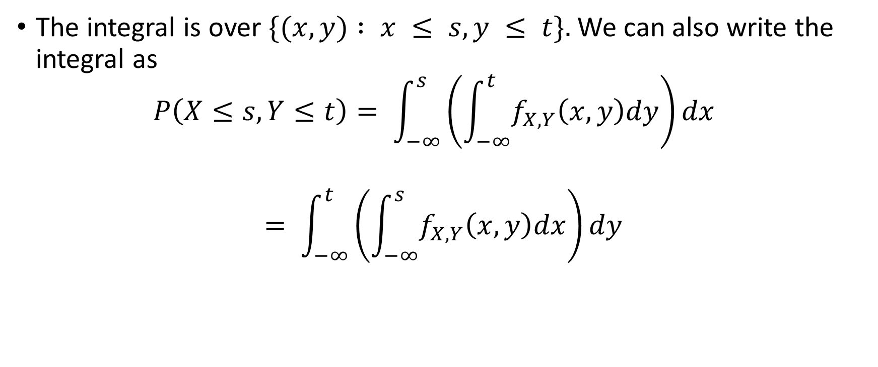
Jointly continuous PDF
The integral is over $\{(x, y) : x ≤ s, y ≤ t\}.$We can also write the integral as $P\left(X≤s, Y≤t\right)= \int_{−∞}^{s}{\left(\int_{−∞}^{t}{f_{X,Y}\left(x,y\right)dy}\right)dx}$
$$= \int_{−∞}^{t}{\left(\int_{−∞}^{s}{f_{X,Y}\left(x,y\right)dx}\right)dy}$$

Slide 6
Jointly continuous PDF
In order for a function $f(x, y)$to be a joint density it must satisfy
$$f(x, y)≥ 0$$
$$\int_{−∞}^{∞}{\int_{−∞}^{∞}{f_{X,Y}\left(x,y\right)dx}dy}=1$$

Slide 7
Jointly continuous PDF
Just as with one random variable, the joint density function contains all the information about the underlying probability measure if we only look at the random variables $X$ and $Y$ .
In particular, we can compute the probability of any event defined in terms of $X$ and $Y$ just using $f(x, y).$

Slide 8
Jointly continuous PDF
Here are some events defined in terms of $X$ and $Y$ :
$\left\{X ≤ Y \right\}$
$\{X^{2}+{ Y}^{2} ≤ 1\}$
$\{1 ≤ X ≤ 4, Y ≥ 0\}$
They can all be written in the form $\{(X, Y)∈B\}$for some subset $B$ of $R^{2}$.

Slide 9

Jointly continuous PDF
Proposition. $For B ⊂R^{2}$,
$$P\left(\left(X,Y\right)∈B\right)=\iint_{(x,y)∈B}{f_{X,Y}\left(x,y\right)dxdy}$$
The two-dimensional integral is over the subset B of $R^{2}$

Slide 10
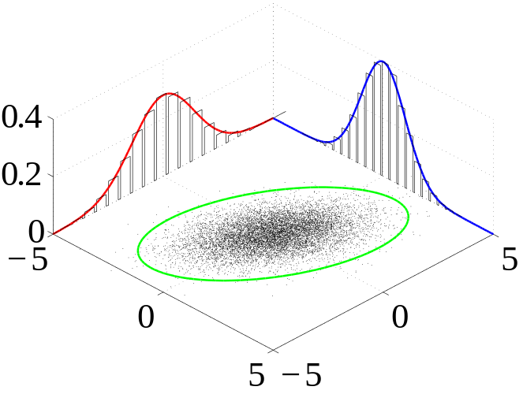
Jointly continuous PDF
Typically, when we want to actually compute this integral we have to write it as an iterated integral.
It is a good idea to draw a picture of $B$ to help do this.
Many sample observations are shown from a joint probability distribution. The marginal densities are shown as well.

Slide 11

Exercise
$f\left(x,y\right)=\left\{\begin{aligned}\frac{1}{6}\left(x+y\right), if 1≤x≤2 and 4≤y≤5 \\ 0, otherwise\end{aligned}\right.$
What it the probability of $1≤x≤1.5 and 4.5≤y≤5$ ?
$$X$$
$$Y$$

Slide 12

Solution
$$P(1≤x≤1.5 , 4.5≤y≤5)$$
= $\int_{1}^{1.5}{\int_{4.5}^{5}{f_{X,Y}\left(x,y\right)dy}dx}$
=$\int_{1}^{1.5}{\int_{4.5}^{5}{\frac{1}{6}\left(x+y\right) dy}dx}$
=0.25

Slide 13
Marginal PDF
Suppose we know the joint density $f_{X,Y}\left(x,y\right)$ of $X$ and $Y$ . How do we find their individual densities $f_{X}\left(x\right)$ , $f_{Y}\left(y\right)$ . These are called marginal densities. The CDF of $X$ is
$$F_{X}\left(x\right)= P\left(X ≤ x\right)= P\left(−∞ < X ≤ x, −∞ < Y < ∞\right)$$
=$\int_{−∞}^{x}{ \left[\int_{−∞}^{∞}{f_{X,Y}\left(x,y\right)dy}\right] dx}$

Slide 14
Marginal PDF
Differentiate this with respect to $x$ and we get
$$f_{X}\left(x\right)=\int_{−∞}^{∞}{f_{X,Y}\left(x,y\right)dy}$$ In words, we get the marginal density of X by integrating y from $−∞$ to $∞$in the joint density.

Slide 15
Marginal PDF
Proposition. If $X$ and $Y$ are jointly continuous with joint density $f_{X,Y}\left(x,y\right)$, then the marginal densities are given by $f_{X}\left(x\right)=\int_{−∞}^{∞}{f_{X,Y}\left(x,y\right)dy}$
$$f_{Y}\left(y\right)=\int_{−∞}^{∞}{f_{X,Y}\left(x,y\right)dx}$$

Slide 16
Conditional PDF
Definition. Suppose X and Y are continuous random variables with joint probability density function f(x,y) and marginal probability density functions $fX(x)$ and $fY(y)$, respectively. Then, the conditional PDF of $Y$ given $X = x$ is defined as:
$h(y|x)=f(x,y)/fX(x)$
provided $fX(x) > 0$.

Slide 17
Exercise
Suppose the continuous random variables X and Y have the following joint probability density function:
$f(x,y)=3/2$
for $x2 ≤ y ≤ 1$and $0 < x < 1$.
What is the conditional distribution of Y given X = x?

Slide 18

Solution
We can use the formula:
$h(y|x)=f(x,y)/f\text{X}\text{(}\text{x}\text{)}$
to find the conditional PDF of Y given X.

Slide 19
So, we basically have a plane, shaped like the support, floating at a constant 3/2 units above the xy-plane. To find $fX(x)$ then, we have to integrate:
$f(x,y)=3/2$
over the support x² ≤ y ≤ 1.

Slide 20

That is:
$f_{X}\left(x\right)=\int_{s2}{f\left(x,y\right)dy}$
$=\int_{x^{2}}{\frac{3}{2}dy}$
= $\frac{3}{2}$ (1- $x^{2}$)
for 0 < x < 1.

Slide 21
Now, we can use the joint PDF $f(x,y)$that we were given and the marginal PDF $fX(x)$ that we just calculated to get the conditional PDF of Y given X = x:
$$h\left(y | x\right)=\frac{f\left(x,y\right)}{fX\left(x\right)}=\frac{\frac{3}{2}}{\frac{3}{2}(1−x^{2})}=1\left(1−x^{2}\right),$$
$$0<x<1,x^{2}≤y≤1$$

Slide 22
That is, given x, the continuous random variable Y is uniform on the interval (x², 1).
For example, if x = ¼, then the conditional PDF of Y is:
$$h(y|1/4)=11−{\left(\frac{1}{4}\right)}^{2}=1/(15/16)=16/15$$
$$for 1/16 ≤ y ≤ 1.$$

Slide 23

And, if x = ½, then the conditional PDF of Y is:
$$h(y|1/2)=11−{\left(\frac{1}{2}\right)}^{2}=1/(1−1/4)=4/3$$
$$for 1/4 ≤ y ≤ 1.$$

