Slide 1
Tutorial 5: General Random Variables 1
MENG Yitong
ytmeng@cse.cuhk.edu.hk
27, February, 2016

Slide 2
Outline
Continuous random variables, PDFs, CDFs
Uniform distributions
Exponential distributions
Normal distributions
Laplace distributions

Slide 3
Continuous r.v. and PDFs
A random variable 𝑋 is called continuous if there is a function $f_{X}≥0$, called the probability density function of 𝑋, or PDF, s.t. $P(X∈B)=\int_{B}{f_{X}\left(x\right)dx}$ for every subset $B⊆ℝ$.
In particular, when $B=[a,b]$,
$$P(a≤X≤b)=\int_{a}^{b}{f_{X}\left(x\right)dx}$$ is the area under the graph of PDF.

Slide 4
Continuous r.v. and PDFs

Slide 5
Cumulative Distribution Function
The cumulative distribution function, or CDF, of a random variable $X$ is
$F_{X}\left(x\right)=P\left(X≤x\right)$
$=\left\{\begin{matrix}\sum_{k≤x}{p_{X}\left(x\right)}, & \text{discrete} \\ \int_{−∞}^{x}{f_{X}\left(x\right)dx}, & \text{continuous}\end{matrix}\right.$
The CDF $F_{X}\left(x\right)$ “accumulates” probability “up to” the value $x$.

Slide 6
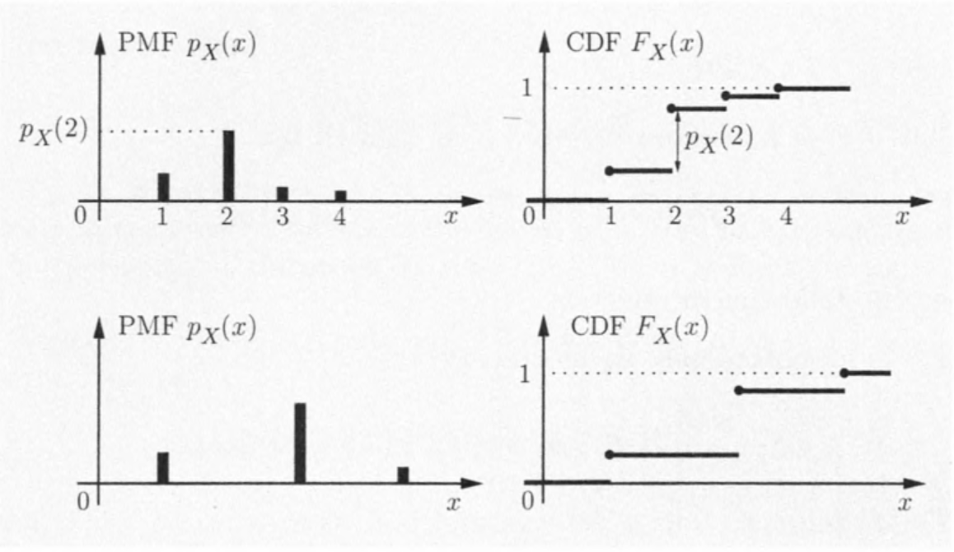
CDF for discrete case

Slide 7
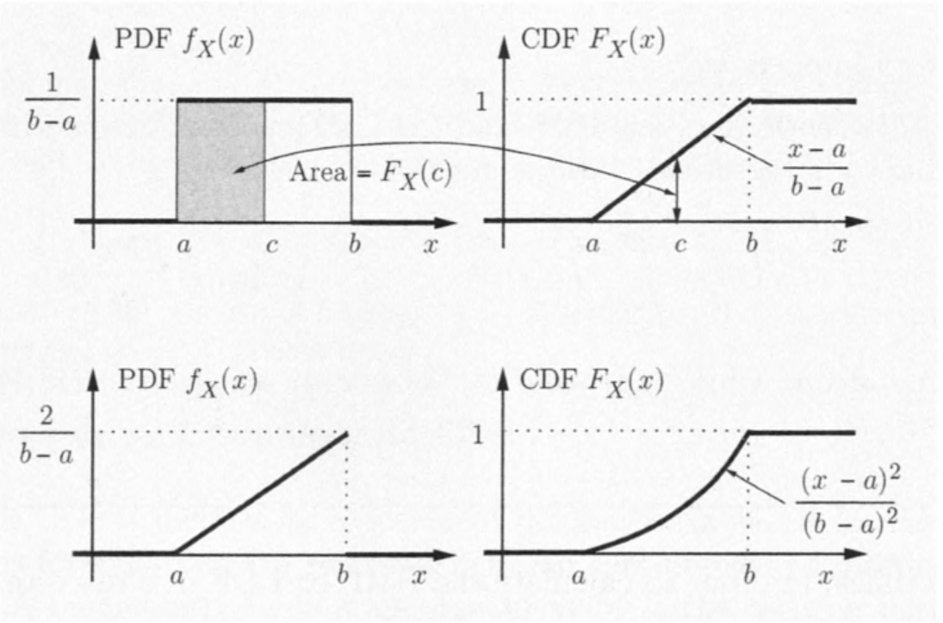
CDF for continuous case

Slide 8
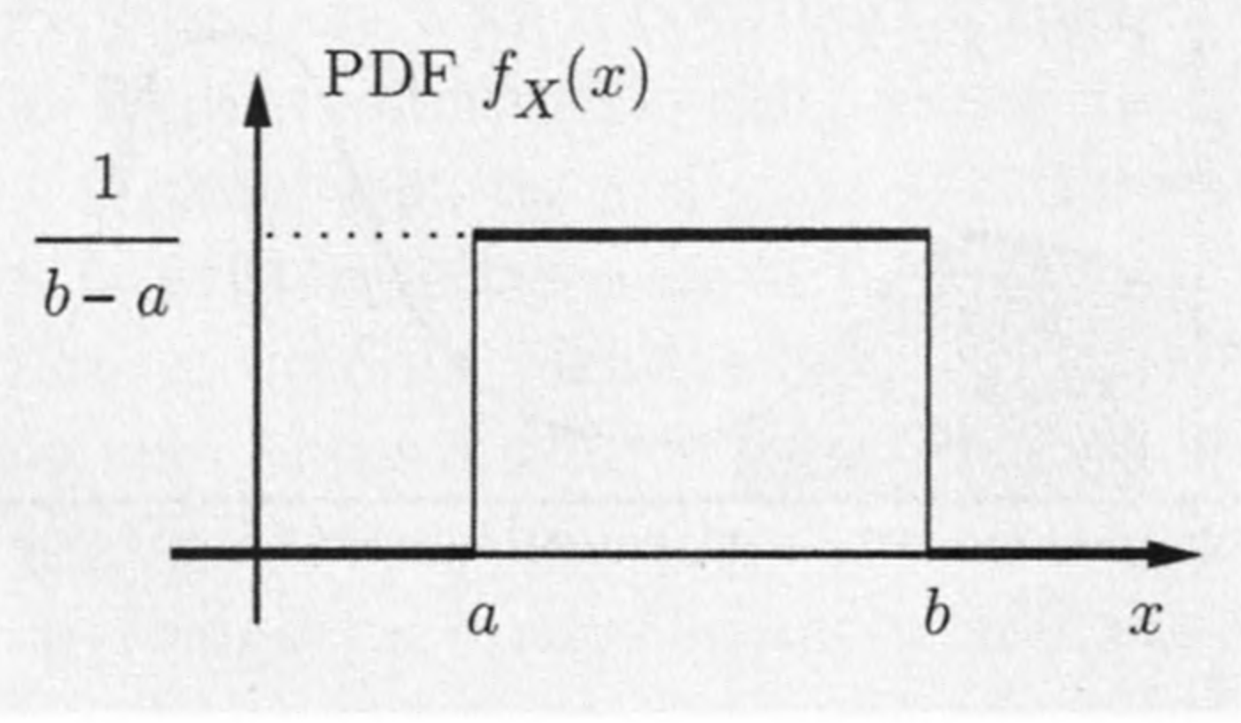
Uniform distributions
Its PDF has the form
$$f_{X}\left(x\right)=\left\{\begin{aligned}\frac{1}{b−a}, \text{if} a≤x≤b \\ 0, \text{otherwise} \end{aligned}\right.$$

Slide 9
Example 1
Let $X$ be uniformly distributed in the unit interval $[0,1]$. Consider the random variable $Y=g(X)$, where
$$g\left(x\right)=\left\{\begin{aligned}1, if x≤2/3, \\ 2, if x>2/3.\end{aligned}\right.$$
Find the expected value of $Y$.
$$E\left[Y\right]=1×\frac{2}{3}+2×\frac{1}{3}=\frac{4}{3}$$
X | $$[0,2/3]$$ | $$(\frac{2}{3},1]$$
Y | $$1$$ | $$2$$
P | $$2/3$$ | $$1/3$$

Slide 10
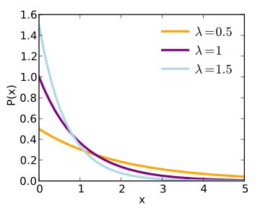
Exponential distributions
An exponential random variable has PDF
$$f_{X}\left(x\right)=\left\{\begin{aligned}λe^{−λx}, \text{if} x≥0 \\ 0, \text{otherwise}\end{aligned}\right.$$
Mean: $\frac{1}{λ}$, mode:0, variance: $\frac{1}{λ^{2}}$
Its CDF is
$$F_{X}\left(x\right)=\int_{0}^{x}{λe^{−λt}dt}=\left(−e^{−λt}\right)\left|{x \atop 0}\right.$$
$$=1−e^{−λx}$$

Slide 11
Example 2
Alice goes to a bank to make a withdrawal, and is equally likely to find $0$ or $1$ customers ahead of her.
The service time of the customer ahead, if present, is exponentially distributed with parameter $λ$.
Find the CDF of Alice’s waiting time.
When $x≥0$
$$F_{X}\left(x\right)=P\left(X≤x\right)=\frac{1}{2}+\frac{1}{2}F_{exp}\left(x\right)=\frac{1}{2}+\frac{1}{2}\left(1−e^{−λx}\right)=1−\frac{1}{2}e^{−λx}$$

Slide 12
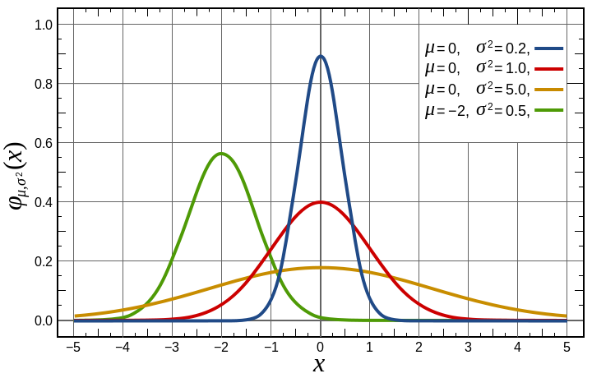
Normal distributions
A continuous random variable 𝑋 is normal, or Gaussian, if it has a PDF
$$f_{X}\left(x\right)=\frac{1}{\sqrt{2π}σ}e^{−\frac{{(x−μ)}^{2}}{2σ^{2}}}$$
for some $σ>0$.
Mean: $μ$, Mode:$μ$,
variance: $σ^{2}$

Slide 13
Example 3: Normal random variables
Let $X$ and $Y$ be normal random variables with means $0$ and $1$, respectively, and variance $1$ and $4$, respectively.
(a) Find $P(X≤1.5)$ and $P(X≤−1)$.
$$P\left(X≤1.5\right)=Φ\left(1.5\right)=0.9932$$
$$P\left(X≤−1\right)\text{=}Φ\left(−1\right)=1−Φ\left(1\right)=1−0.8413=0.1587$$

Slide 14
Example 3: Normal random variables
Let $X$ and $Y$ be normal random variables with means $0$ and $1$, respectively, and variance $1$ and $4$, respectively.
(b) Find the PDF of $(Y−1)/2$
Since $Y$ is a normal random variable with mean $1$ and variance $4$, so $(Y−1)/2$ is a standard normal random variable.
(c) Find $P(−1≤Y≤1)$
$$P\left(−1≤Y≤1\right)=P\left(−1≤\frac{Y−1}{2}≤0\right)=Φ\left(0\right)−Φ\left(−1\right)=Φ\left(0\right)−\left(1−Φ\left(1\right)\right)=Φ\left(1\right)−0.5=0.8413−0.5=0.3413$$

Slide 15
Example 4:
Let $X$ be a normal random variable with zero mean and standard deviation $σ$.
Use the normal tables to compute the probabilities of the events $\{X≥kσ\}$ and $\{\left|X\right|≤kσ\}$ for $k=1,2,3.$
$X/σ$ is a standard normal random variable
$P\left(X≥kσ\right)=P\left(\frac{X}{σ}≥k\right)=1−P\left(\frac{X}{σ}≤k\right)=1−Φ(k)$
$P\left(\left|X\right|≤kσ\right)=P\left(−k≤\frac{X}{σ}≤k\right)=P\left(\frac{X}{σ}≤k\right)−P\left(\frac{X}{σ}≤−k\right)=Φ\left(k\right)−Φ\left(−k\right)=2Φ\left(k\right)−1$

Slide 16
Example 5: Laplace random variable
Let $X$ has the PDF
$$f_{X}\left(x\right)=\frac{λ}{2}e^{−λ\left|x\right|},$$
where $λ$ is a positive scalar.
(a) Verify that $f_{X}$ satisfies the normalization condition
$$\int_{−∞}^{∞}{\frac{λ}{2}e^{−λ\left|x\right|}}dx=\int_{−∞}^{0}{\frac{λ}{2}e^{λx}}dx+\int_{0}^{∞}{\frac{λ}{2}e^{−λx}}dx=2\int_{0}^{∞}{\frac{λ}{2}e^{−λx}}dx=\left(−e^{−λx}\right)\left|{∞ \atop 0}\right.=1$$

Slide 17
Example 5: Laplace random variable
Let $X$ has the PDF
$$f_{X}\left(x\right)=\frac{λ}{2}e^{−λ\left|x\right|},$$
where $λ$ is a positive scalar.
(b) Find the mean and variance of $X$
$$E\left[X\right]=\int_{−∞}^{∞}{x}\frac{λ}{2}e^{−λ\left|x\right|}dx=0$$

Slide 18
Example 5: Laplace random variable
Let $X$ has the PDF
$$f_{X}\left(x\right)=\frac{λ}{2}e^{−λ\left|x\right|},$$
where $λ$ is a positive scalar.
(b) Find the mean and variance of $X$
$$var\left[X\right]=\int_{−∞}^{∞}{x^{2}}\frac{λ}{2}e^{−λ\left|x\right|}dx=2\int_{0}^{∞}{x^{2}}\frac{λ}{2}e^{−λx}dx=\int_{0}^{∞}{x^{2}d(−e^{−λx})}=x^{2}\left(−e^{−λx}\right)\left|{∞ \atop 0}\right.+\int_{0}^{∞}{e^{−λx}2xdx)}=\frac{2}{λ}\int_{0}^{∞}{xd(−e^{−λx})}=\frac{2}{λ}x\left(−e^{−λx}\right)\left|{∞ \atop 0}\right.+\frac{2}{λ}\int_{0}^{∞}{e^{−λx}dx}=\frac{2}{λ^{2}} \left(−e^{−λx}\right)\left|{∞ \atop 0}\right.=\frac{2}{λ^{2}}$$

Slide 19
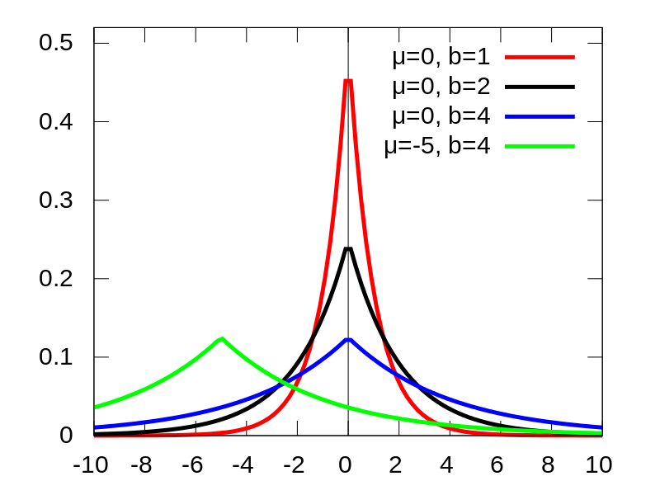
Example 5: Laplace random variable
Let $X$ has the PDF
$$f_{X}\left(x\right)=\frac{λ}{2}e^{−λ\left|x\right|},$$
where $λ$ is a positive scalar.
$b=\frac{1}{λ}$
This is for the general form
$$f_{X}\left(x\right)=\frac{λ}{2}e^{−λ\left|x−μ\right|}$$

