Slide 1
Tutorial 4: Discrete Random Variables 2
Baoxiang Wang bxwang@cse
Spring 2017

Slide 2

Geometric Random Variables
The PMF of a geometric random variable is
$$p_{X}\left(k\right)={(1−p)}^{k−1}p$$
$E\left[X | X>1\right]=1+E[X]$

Slide 3
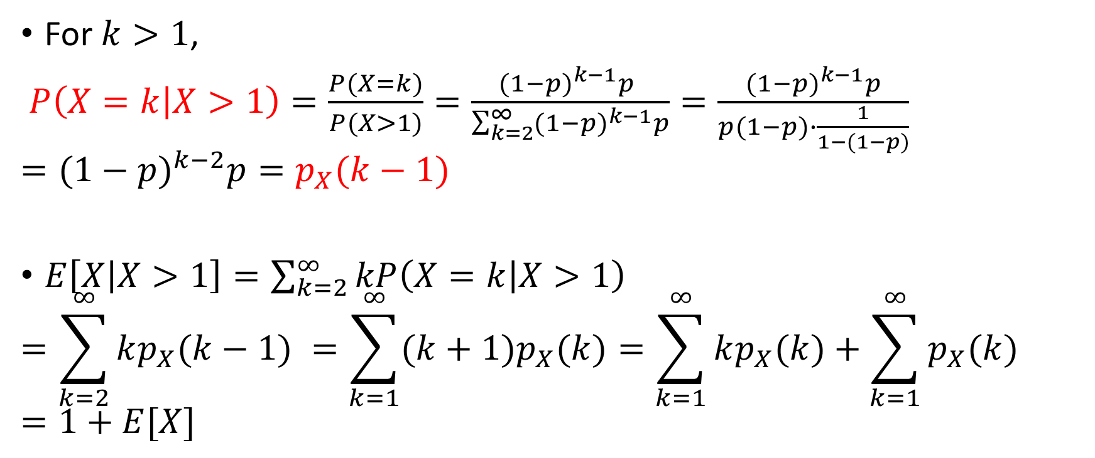
Geometric Random Variables
For $k>1$,
$P\left(X=k | X>1\right)=\frac{P(X=k)}{P(X>1)}=\frac{{(1−p)}^{k−1}p }{\sum_{k=2}^{∞}{{(1−p)}^{k−1}p}}=\frac{{(1−p)}^{k−1}p}{p(1−p)∙\frac{1}{1−(1−p)}}$
$$={(1−p)}^{k−2}p=p_{X}(k−1)$$
$E\left[X | X>1\right]=\sum_{k=2}^{∞}{kP\left(X=k | X>1\right)}$
$$=\sum_{k=2}^{∞}{kp_{X}(k−1) }=\sum_{k=1}^{∞}{(k+1)p_{X}(k)}=\sum_{k=1}^{∞}{kp_{X}(k)}+\sum_{k=1}^{∞}{p_{X}(k)}=1+E[X]$$

Slide 4
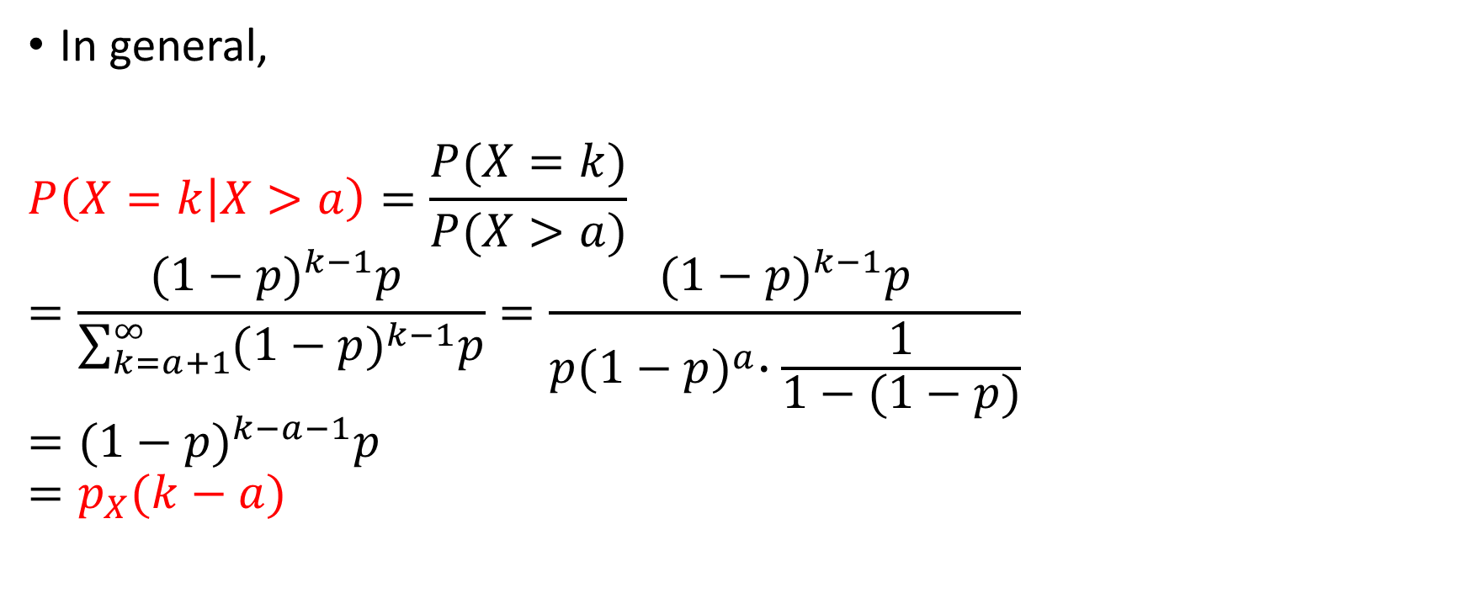
Geometric Random Variables
In general,
$$P\left(X=k | X>a\right)=\frac{P(X=k)}{P(X>a)}$$
$$=\frac{{(1−p)}^{k−1}p }{\sum_{k=a+1}^{∞}{{(1−p)}^{k−1}p}}=\frac{{(1−p)}^{k−1}p}{p{(1−p)}^{a}∙\frac{1}{1−(1−p)}}$$
$$={(1−p)}^{k−a−1}p$$
$$=p_{X}(k−a)$$

Slide 5
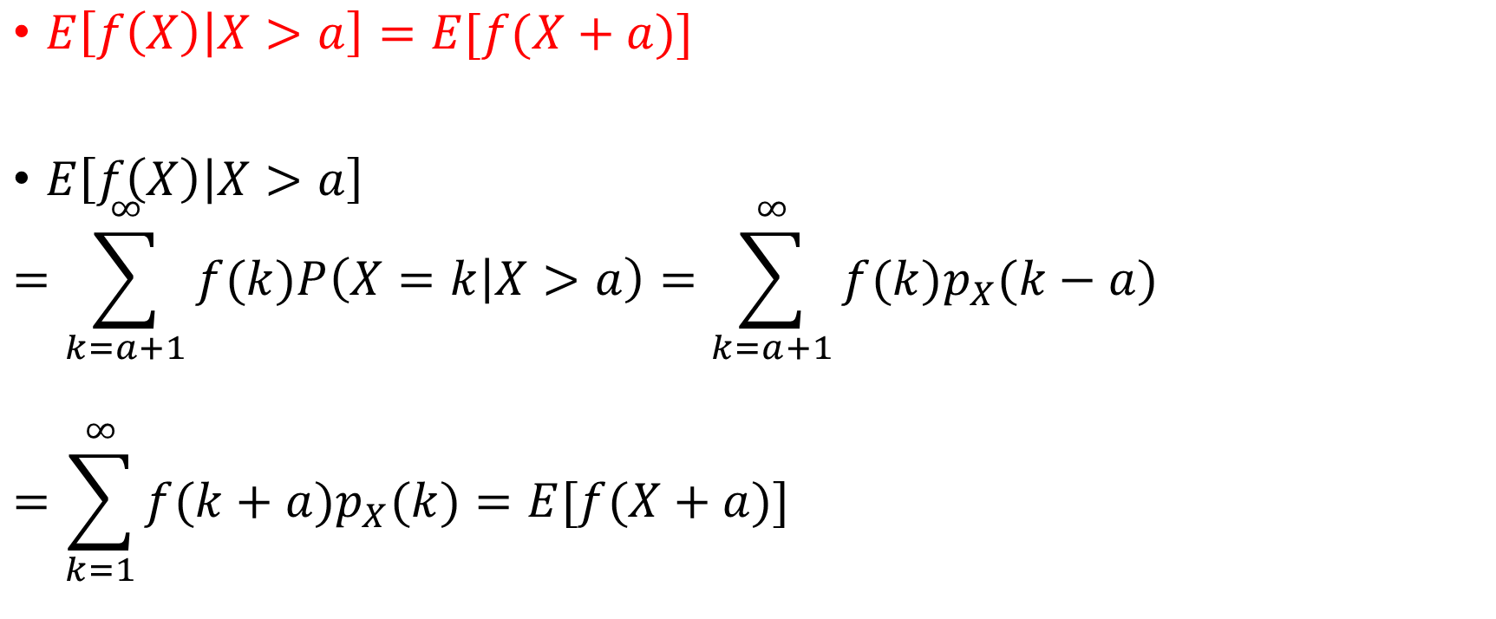
Geometric Random Variables
$E\left[f\left(X\right) | X>a\right]=E[f(X+a)]$
$E\left[f\left(X\right) | X>a\right]$
$$=\sum_{k=a+1}^{∞}{f(k)P\left(X=k | X>a\right)}=\sum_{k=a+1}^{∞}{f(k)p_{X}(k−a)}$$
$$=\sum_{k=1}^{∞}{f(k+a)p_{X}(k)}=E[f(X+a)]$$

Slide 6

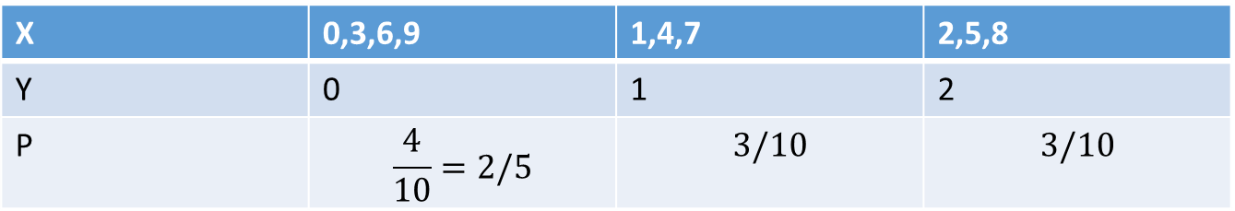
Example 1: Functions of random variables
Let $X$ be a random variable that takes value from $0$ to $9$ with equal probability $1/10$.
(a) Find the PMF of the random variable $Y=X mod(3)$.
X | 0,3,6,9 | 1,4,7 | 2,5,8
Y | 0 | 1 | 2
P | $$\frac{4}{10}=2/5$$ | $$3/10$$ | $$3/10$$

Slide 7

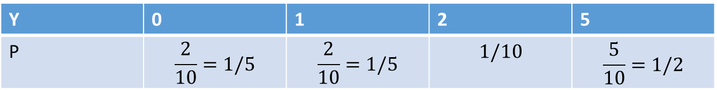
Example 1: Functions of random variables
Let $X$ be a random variable that takes value from $0$ to $9$ with equal probability $1/10$.
(b) Find the PMF of the random variable $Y=5 mod(X+1)$.
X | 0 | 1 | 2 | 3 | 4 | 5 | 6 | 7 | 8 | 9
Y | 0 | 1 | 2 | 1 | 0 | 5 | 5 | 5 | 5 | 5
Y | 0 | 1 | 2 | 5
P | $$\frac{2}{10}=1/5$$ | $$\frac{2}{10}=1/5$$ | $$1/10$$ | $$\frac{5}{10}=1/2$$

Slide 8
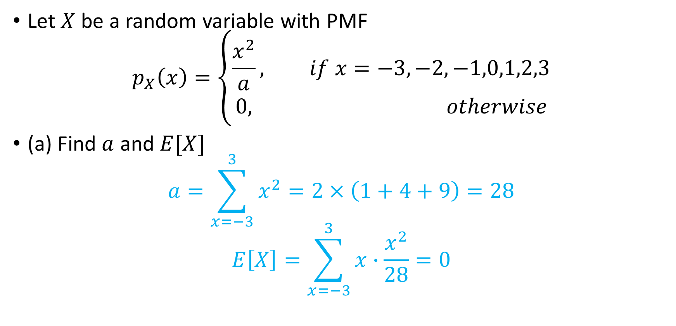
Example 2: Expectation, Mean, and Variance
Let $X$ be a random variable with PMF
$$p_{X}\left(x\right)=\left\{\begin{aligned}\frac{x^{2}}{a}, if x=−3,−2,−1,0,1,2,3 \\ 0, otherwise\end{aligned}\right.$$
(a) Find $a$ and $E[X]$
$$a=\sum_{x=−3}^{3}{x^{2}}=2×\left(1+4+9\right)=28$$
$$E\left[X\right]=\sum_{x=−3}^{3}{x∙\frac{x^{2}}{28}}=0$$

Slide 9
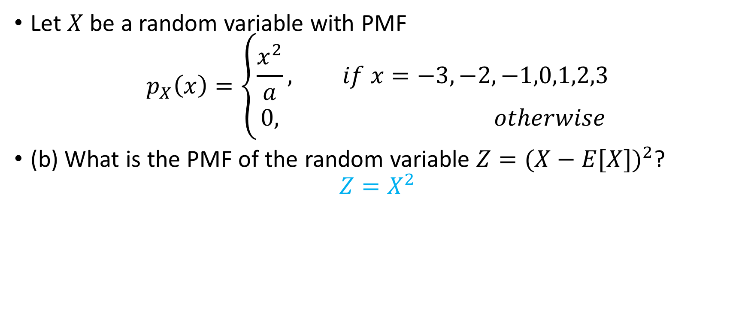
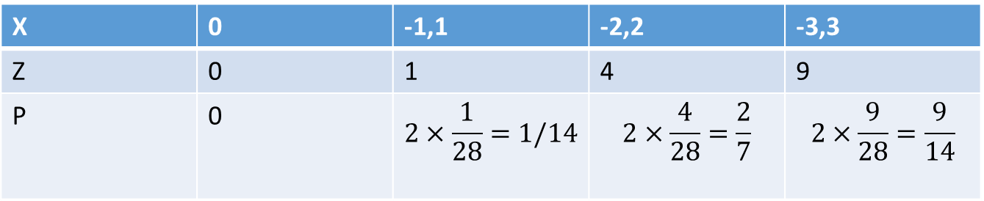
Example 2: Expectation, Mean, and Variance
Let $X$ be a random variable with PMF
$$p_{X}\left(x\right)=\left\{\begin{aligned}\frac{x^{2}}{a}, if x=−3,−2,−1,0,1,2,3 \\ 0, otherwise\end{aligned}\right.$$
(b) What is the PMF of the random variable $Z={(X−E[X])}^{2}$?
$$Z=X^{2}$$
X | 0 | -1,1 | -2,2 | -3,3
Z | 0 | 1 | 4 | 9
P | 0 | $$2×\frac{1}{28}=1/14$$ | $$2×\frac{4}{28}=\frac{2}{7}$$ | $$2×\frac{9}{28}=\frac{9}{14}$$

Slide 10
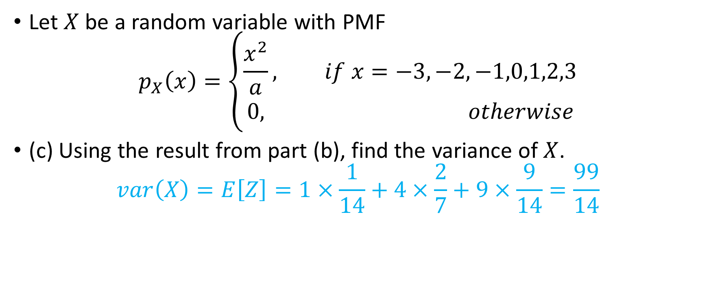
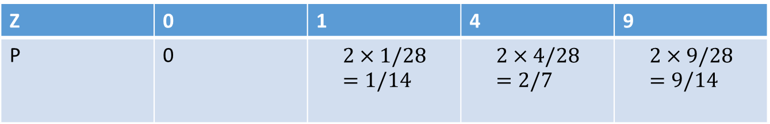
Example 2: Expectation, Mean, and Variance
Let $X$ be a random variable with PMF
$$p_{X}\left(x\right)=\left\{\begin{aligned}\frac{x^{2}}{a}, if x=−3,−2,−1,0,1,2,3 \\ 0, otherwise\end{aligned}\right.$$
(c) Using the result from part (b), find the variance of $X$.
$$var\left(X\right)=E\left[Z\right]=1×\frac{1}{14}+4×\frac{2}{7}+9×\frac{9}{14}=\frac{99}{14}$$
Z | 0 | 1 | 4 | 9
P | 0 | $$2×1/28=1/14$$ | $$2×4/28=2/7$$ | $$2×9/28=9/14$$

Slide 11
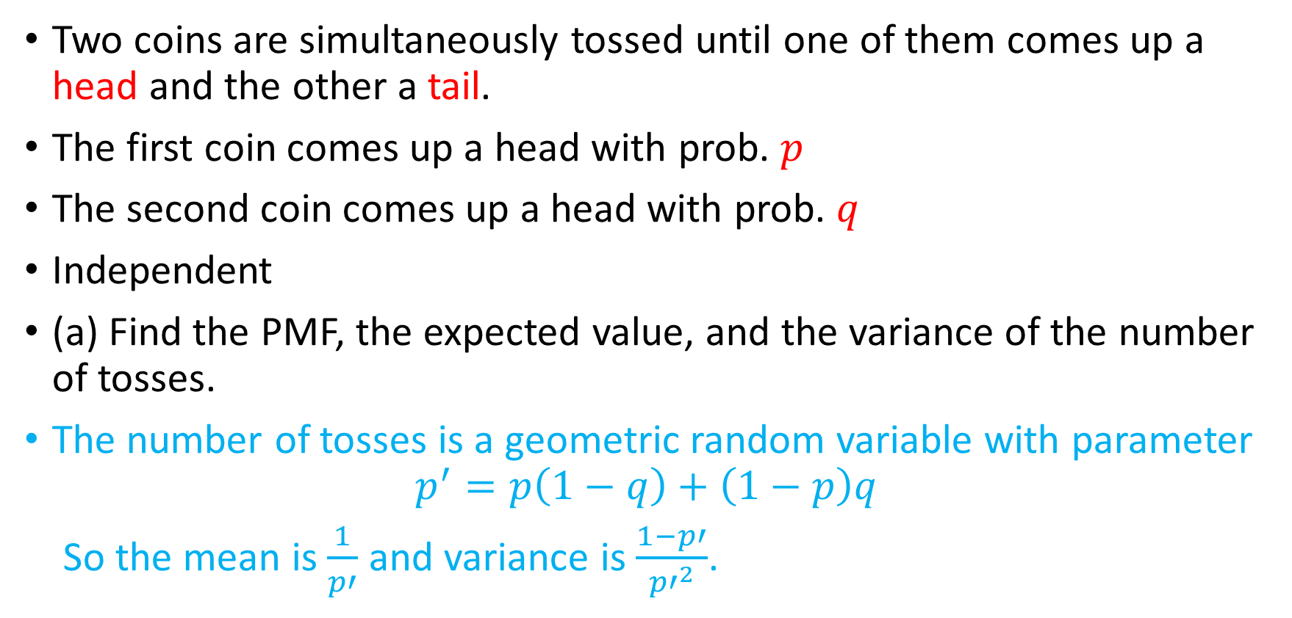
Example 3: Expectation, Mean, and Variance
Two coins are simultaneously tossed until one of them comes up a head and the other a tail.
The first coin comes up a head with prob. $p$
The second coin comes up a head with prob. $q$
Independent
(a) Find the PMF, the expected value, and the variance of the number of tosses.
The number of tosses is a geometric random variable with parameter
$$p^{′}=p\left(1−q\right)+\left(1−p\right)q$$
So the mean is $\frac{1}{p′}$ and variance is $\frac{1−p′}{{p′}^{2}}$.

Slide 12
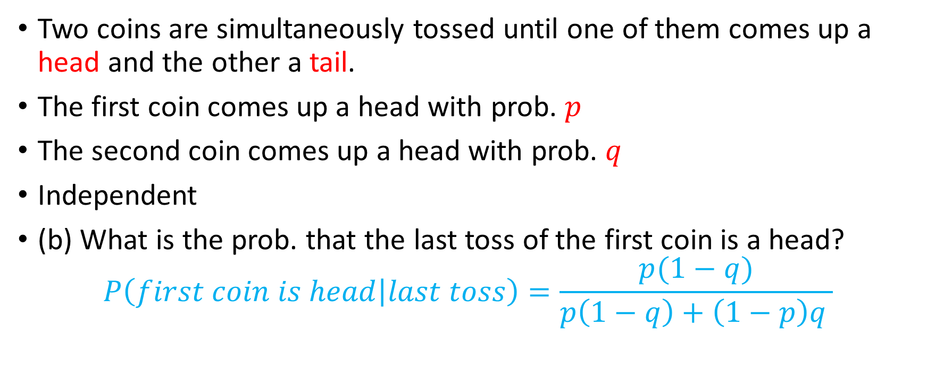
Example 3: Expectation, Mean, and Variance
Two coins are simultaneously tossed until one of them comes up a head and the other a tail.
The first coin comes up a head with prob. $p$
The second coin comes up a head with prob. $q$
Independent
(b) What is the prob. that the last toss of the first coin is a head?
$$P\left(first coin is head | last toss\right)=\frac{p(1−q)}{p\left(1−q\right)+\left(1−p\right)q }$$

Slide 13
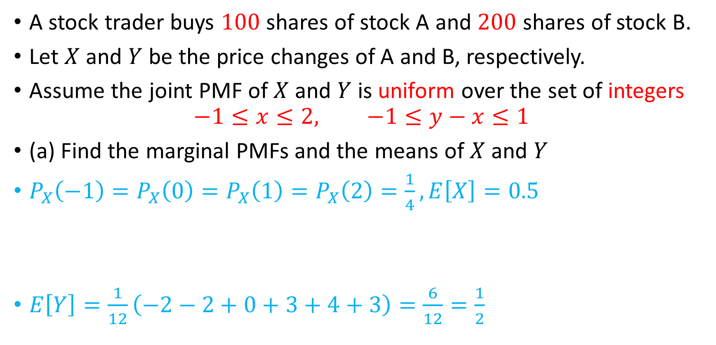
Example 4: Joint PMFs of Multiple Random Variables
A stock trader buys $100$ shares of stock A and $200$ shares of stock B.
Let $X$ and $Y$ be the price changes of A and B, respectively.
Assume the joint PMF of $X$ and $Y$ is uniform over the set of integers
$$−1≤x≤2, −1≤y−x≤1$$
(a) Find the marginal PMFs and the means of $X$ and $Y$
$P_{X}\left(−1\right)=P_{X}\left(0\right)=P_{X}\left(1\right)=P_{X}\left(2\right)=\frac{1}{4}, E\left[X\right]=0.5$
$E\left[Y\right]=\frac{1}{12}\left(−2−2+0+3+4+3\right)=\frac{6}{12}=\frac{1}{2}$
Y | -2 | -1 | 0 | 1 | 2 | 3
P | $$1/12$$ | $$2×\frac{1}{12}=1/6$$ | $$3×\frac{1}{12}=1/4$$ | $$3×\frac{1}{12}=1/4$$ | $$2×\frac{1}{12}=1/6$$ | $$1/12$$

Slide 14
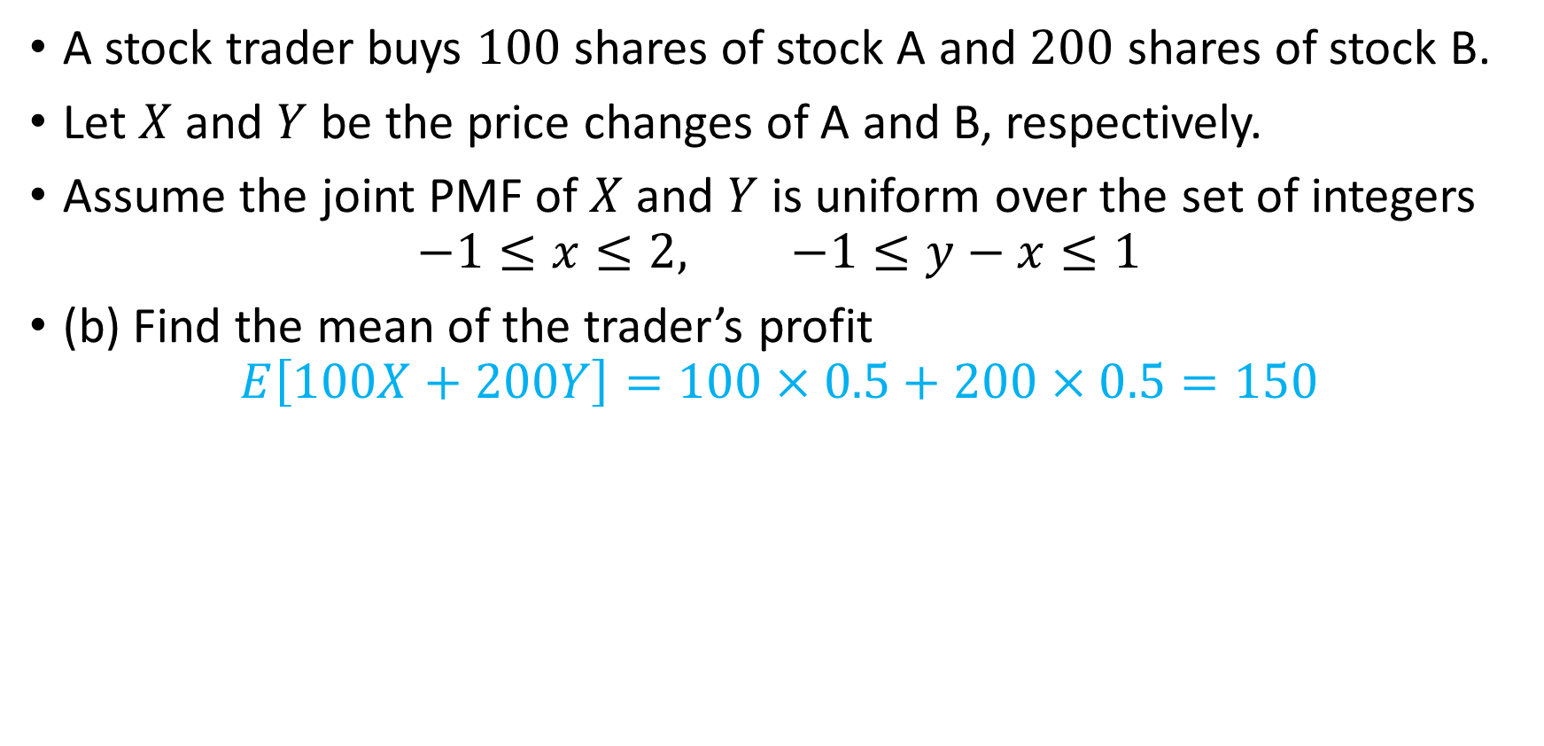
Example 4: Joint PMFs of Multiple Random Variables
A stock trader buys $100$ shares of stock A and $200$ shares of stock B.
Let $X$ and $Y$ be the price changes of A and B, respectively.
Assume the joint PMF of $X$ and $Y$ is uniform over the set of integers
$$−1≤x≤2, −1≤y−x≤1$$
(b) Find the mean of the trader’s profit
$$E\left[100X+200Y\right]=100×0.5+200×0.5=150$$

Slide 15
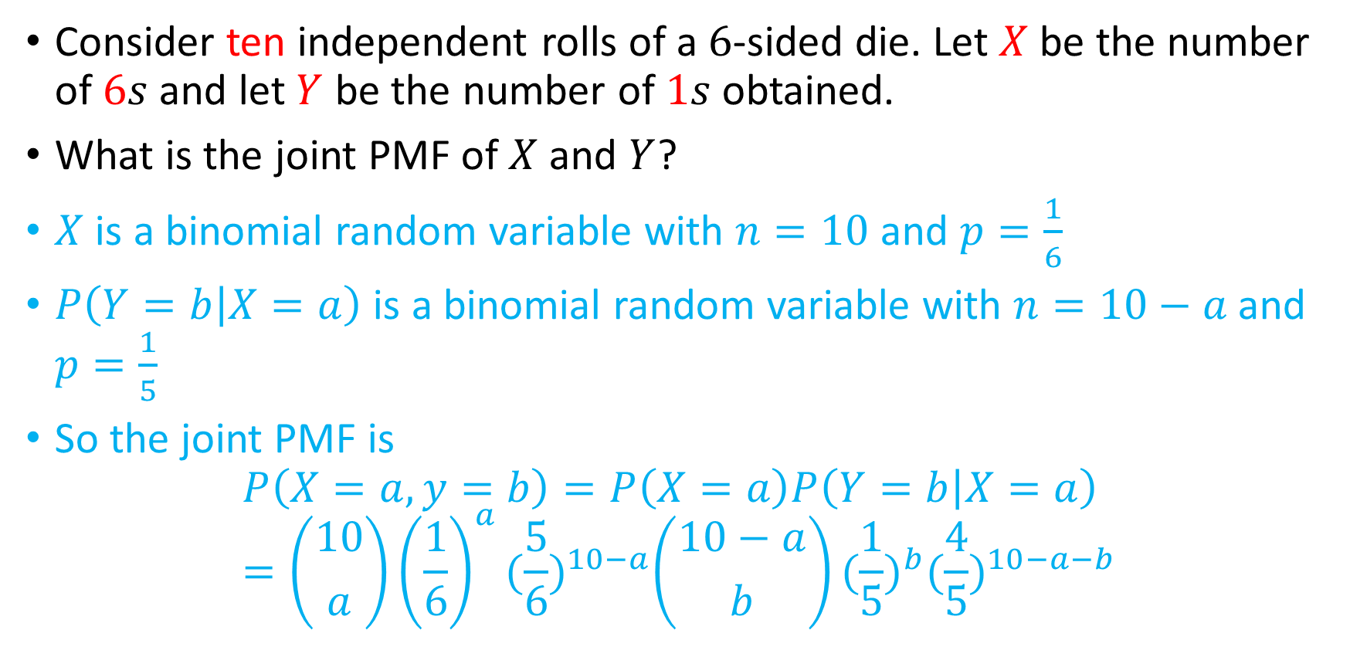
Example 5: Conditioning
Consider ten independent rolls of a $6$-sided die. Let $X$ be the number of $6s$ and let $Y$ be the number of $1s$ obtained.
What is the joint PMF of $X$ and $Y$?
$X$ is a binomial random variable with $n=10$ and $p=\frac{1}{6}$
$P\left(Y=b | X=a\right)$ is a binomial random variable with $n=10−a$ and $p=\frac{1}{5}$
So the joint PMF is
$$P\left(X=a,y=b\right)=P\left(X=a\right)P\left(Y=b | X=a\right)=\left({10 \atop a}\right){\left(\frac{1}{6}\right)}^{a}{(\frac{5}{6})}^{10−a}\left({10−a \atop b}\right){(\frac{1}{5})}^{b}{(\frac{4}{5})}^{10−a−b}$$

Slide 16
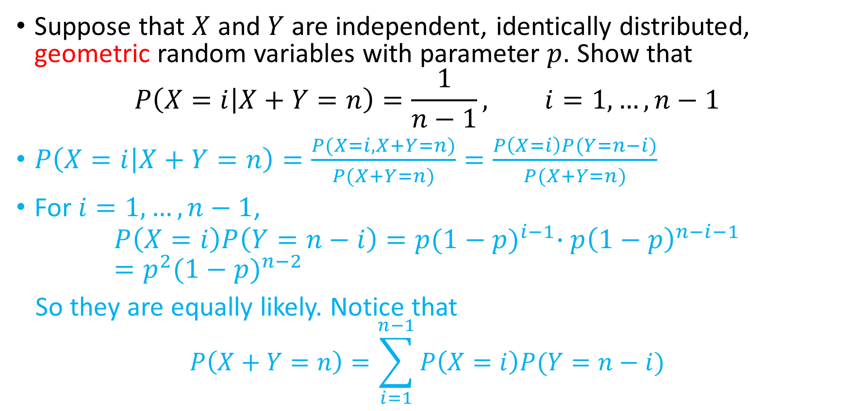
Example 6: Independence
Suppose that $X$ and $Y$ are independent, identically distributed, geometric random variables with parameter $p$. Show that
$$P\left(X=i | X+Y=n\right)=\frac{1}{n−1}, i=1,…,n−1$$
$P\left(X=i | X+Y=n\right)=\frac{P(X=i, X+Y=n)}{P(X+Y=n)}=\frac{P\left(X=i\right)P(Y=n−i)}{P(X+Y=n)}$
For $i=1,…,n−1$,
$$P\left(X=i\right)P\left(Y=n−i\right)=p{(1−p)}^{i−1}∙p{\left(1−p\right)}^{n−i−1}=p^{2}{(1−p)}^{n−2}$$
So they are equally likely. Notice that
$$P\left(X+Y=n\right)=\sum_{i=1}^{n−1}{P\left(X=i\right)P(Y=n−i)}$$

