Slide 1
Tutorial 3: Discrete Random Variables 1
Yihan Zhang and Baoxiang Wang
Spring 2017

Slide 2
Discrete Random Variable
Random Variable $X$
Sample Space
$$Ω$$
$$x$$
Real Number Line
A random variable is discrete if its range is finite or countably infinite.
Each discrete random variable has an associated probability mass function (PMF).
toss a coin | Head | Tail
Probability | $$\frac{1}{2}$$ | $$\frac{1}{2}$$

Slide 3
Example 1: Discrete random variables
Experiment | Random Variable | Possible Values
Making 100 sales call | # sales | 0,1,…,100
Inspect 70 radios | # defective | 0,1,…,70
Answer 20 questions | # correct | 0,1,…,20
Count cars at toll between 11:00-1:00 | # cars arriving | 0,1,2,……

Slide 4
Example 2: Soccer Game
2 games this weekend
$0.4$ probability----not losing the first game
$0.7$ probability----not losing the second game
equally likely to win or tie
independent
$2$ points for a win, $1$ for a tie and $0$ for a loss.
Find the PMF of the number of points that the team earns in this weekend.

Slide 5
Example 2: Soccer Game
 | $$X_{1}$$ | 2 | 1 | 0
$$X_{2}$$ | P | 0.2 | 0.2 | 0.6
2 | 0.35 | 0.07 | 0.07 | 0.21
1 | 0.35 | 0.07 | 0.07 | 0.21
0 | 0.3 | 0.06 | 0.06 | 0.18
$$X=X_{1}+X_{2}$$ | 4 | 3 | 2 | 1 | 0
$$P$$ | 0.07 | 0.14 | 0.34 | 0.27 | 0.18

Slide 6
Compare: Continuous r.v. and PDFs
A random variable 𝑋 is called continuous if there is a function $f_{X}≥0$, called the probability density function of 𝑋, or PDF, s.t. $P(X∈B)=\int_{B}{f_{X}\left(x\right)dx}$ for every subset $B⊆ℝ$.
In particular, when $B=[a,b]$,
$$P(a≤X≤b)=\int_{a}^{b}{f_{X}\left(x\right)dx}$$ is the area under the graph of PDF.

Slide 7
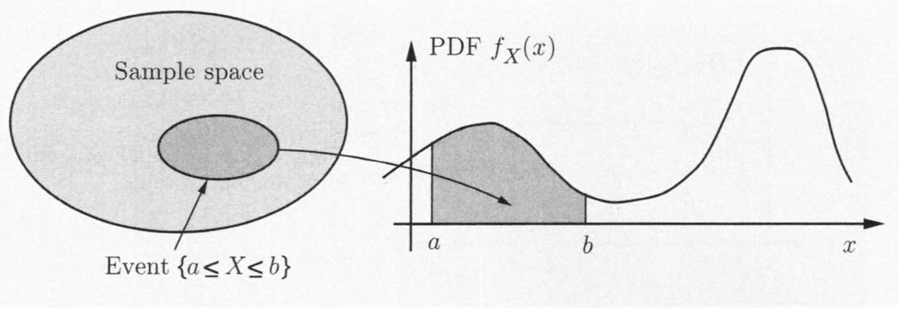
Continuous r.v. and PDFs
A random variable 𝑋 is called continuous if there is a function $f_{X}≥0$, called the probability density function of 𝑋, or PDF, s.t. $P(X∈B)=\int_{B}{f_{X}\left(x\right)dx}$ for every subset $B⊆ℝ$.

Slide 8
Typical Discrete Random Variables
We review typical variables, and understand them using examples
Binomial Random Variable
Poisson Random Variable
Poisson Limit Theorem

Slide 9
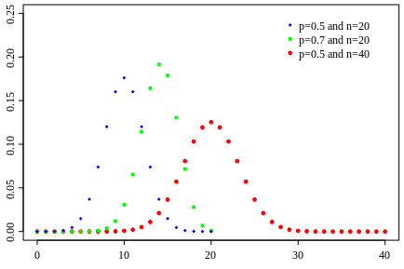
The Binomial Random Variable
We refer to $X$ as a binomial random variable with parameters 𝑛 and 𝑝.
For $k=0,1,…,n$
$p_{X}(k)=\left({n \atop k}\right) p^{k}{\left(1−p\right)}^{n−k}$
Mean: $np$, Mode:$\left[\left(n+1\right)p\right]$, variance:$np(1−p)$
Notice that $\left({n \atop k}\right)=\left({n \atop n−k}\right)$, so $Bin\left(k | n,p\right)=Bin\left(n−k | n,1−p\right).$

Slide 10
Example 3: Thinking Challenge
You are taking a multiple choice test with 20 questions. Each question has 4 choices. The total score is 100 and each question has full score 5.
(a) Clueless on question 1, you decide to guess. What is the chance you will get it right?
$$\frac{1}{4}$$
(b) If you guessed all 20 questions, what is the probability that you get a score of exact 60?
$$\left({20 \atop 12}\right){\left(\frac{1}{4}\right)}^{12}{\left(\frac{3}{4}\right)}^{8}$$

Slide 11
Example 3: Thinking Challenge
You are taking a multiple choice test with 20 questions. Each question has 4 choices. The total score is 100 and each question has full score 5.
(c) If you guessed all 20 questions, what is the probability that you get a score no less than 80?
$$\sum_{k=16}^{20}{\left({20 \atop k}\right){\left(\frac{1}{4}\right)}^{k}{\left(\frac{3}{4}\right)}^{20−k}}$$
What is the result? Estimate?

Slide 12
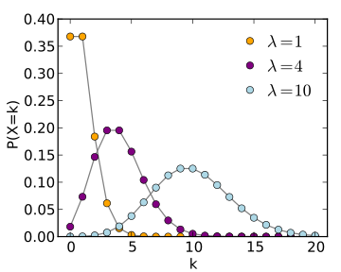
The Poisson Random Variable
A Poisson random variable $X$ takes nonnegative integer values.
The PMF
$p_{X}\left(k\right)=e^{−λ}\frac{λ^{k}}{k!}，k=0, 1, 2, …,$
Mean:$λ$, Mode:$[λ]$, variance:$λ$

Slide 13
Poisson Limit Theorem
If $n→∞, p→0$ such that $np→λ$, then
$$Bin\left(k | n,p\right)=\left({n \atop k}\right)p^{k}{(1−p)}^{n−k} → e^{−λ}\frac{λ^{k}}{k!}=Poi(k|λ)$$
$\sum_{k=16}^{20}{\left({20 \atop k}\right){\left(\frac{1}{4}\right)}^{k}{\left(\frac{3}{4}\right)}^{20−k}}=\sum_{k=0}^{4}{\left({20 \atop k}\right){\left(\frac{3}{4}\right)}^{k}{\left(\frac{1}{4}\right)}^{20−k}}$
$≈\sum_{k=0}^{4}{Poi\left(k | 20×\frac{3}{4}\right)}=\sum_{k=0}^{4}{e^{−15}\frac{{15}^{k}}{k!}}≈8.5664×{10}^{−4}$
very small!!

Slide 14
Example 4: Birthday
You go to a party with other 500 guests.
What is the probability that exactly one other guest has the same birthday as you?
(exclude birthdays on Feb 29.)
$$\left({500 \atop 1}\right){\left(\frac{1}{365}\right)}^{1}{\left(\frac{364}{365}\right)}^{499}$$
By Poisson approximation, $≈Poi(1|\frac{500}{365})=e^{−\frac{500}{365}}\frac{500}{365}≈0.3481.$

Slide 15
Example 5: Phone calls
The number of calls coming per minute is a Poisson random variable with mean 3.
(a) Find the probability that no calls come in a given 1 minute period.
$$P=Poi\left(0 | 3\right)=e^{−3}$$
(b) Find the probability that at least two calls will arrive in a given two minute period. (Assume independency.)
$P\left(X_{1}+X_{2}≥2\right)$
$$=1−P\left(X_{1}+X_{2}<2\right)=1−P\left(X_{1}=X_{2}=0\right)−P\left(X_{1}=0,X_{2}=1\right)−P\left(X_{1}=1,X_{2}=0\right)=1−e^{−3}e^{−3}−e^{−3}e^{−3}3−e^{−3}3e^{−3}=1−7e^{−6}$$

Slide 16
Example 6: Chess match
Alice and Bob play a chess match
the first player to win a game wins the match
0.4, the probability of Alice won
0.3, the probability of Bob won
0.3, the probability of a draw
independent
(a) What is the probability that Alice wins the match?
$$P=0.4+0.3×0.4+{0.3}^{2}×0.4+…=0.4×\frac{1}{1−0.3}=\frac{4}{7}$$

Slide 17
Example 6: Chess match
Alice and Bob play a chess match
the first player to win a game wins the match
0.4, the probability of Alice won
0.3, the probability of Bob won
0.3, the probability of a draw
independent
(b) What is the PMF of the duration of the match?
$$P\left(X=1\right)=0.7, P\left(X=2\right)=0.3×0.7, P\left(X=3\right)={0.3}^{2}×0.7$$
So $X$ follows geometric distribution with $p=0.7$ on positive integers $\{1,2,3,…\}$.

Slide 18
Example 7: Functions of random variables
Let $X$ be a random variable that takes value from $0$ to $9$ with equal probability $1/10$.
(a) Find the PMF of the random variable $Y=X mod(3)$.
X | 0,3,6,9 | 1,4,7 | 2,5,8
Y | 0 | 1 | 2
P | $$\frac{4}{10}=2/5$$ | $$3/10$$ | $$3/10$$

Slide 19
Example 7: Functions of random variables
Let $X$ be a random variable that takes value from $0$ to $9$ with equal probability $1/10$.
(b) Find the PMF of the random variable $Y=5 mod(X+1)$.
X | 0 | 1 | 2 | 3 | 4 | 5 | 6 | 7 | 8 | 9
Y | 0 | 1 | 2 | 1 | 0 | 5 | 5 | 5 | 5 | 5
Y | 0 | 1 | 2 | 5
P | $$\frac{2}{10}=1/5$$ | $$\frac{2}{10}=1/5$$ | $$1/10$$ | $$\frac{5}{10}=1/2$$

