Slide 1
Tutorial 2: Sample Space and Probability 2
Baoxiang WANG bxwang@cse
Spring 2017

Slide 2

Probability models
A probability model is an assignment of probabilities
to every element of the sample space.
Probabilities are nonnegative and add up to one.
Examples
S = { HH, HT, TH, TT }
¼
¼
¼
¼
models a pair of coins with equally likely outcomes

Slide 3
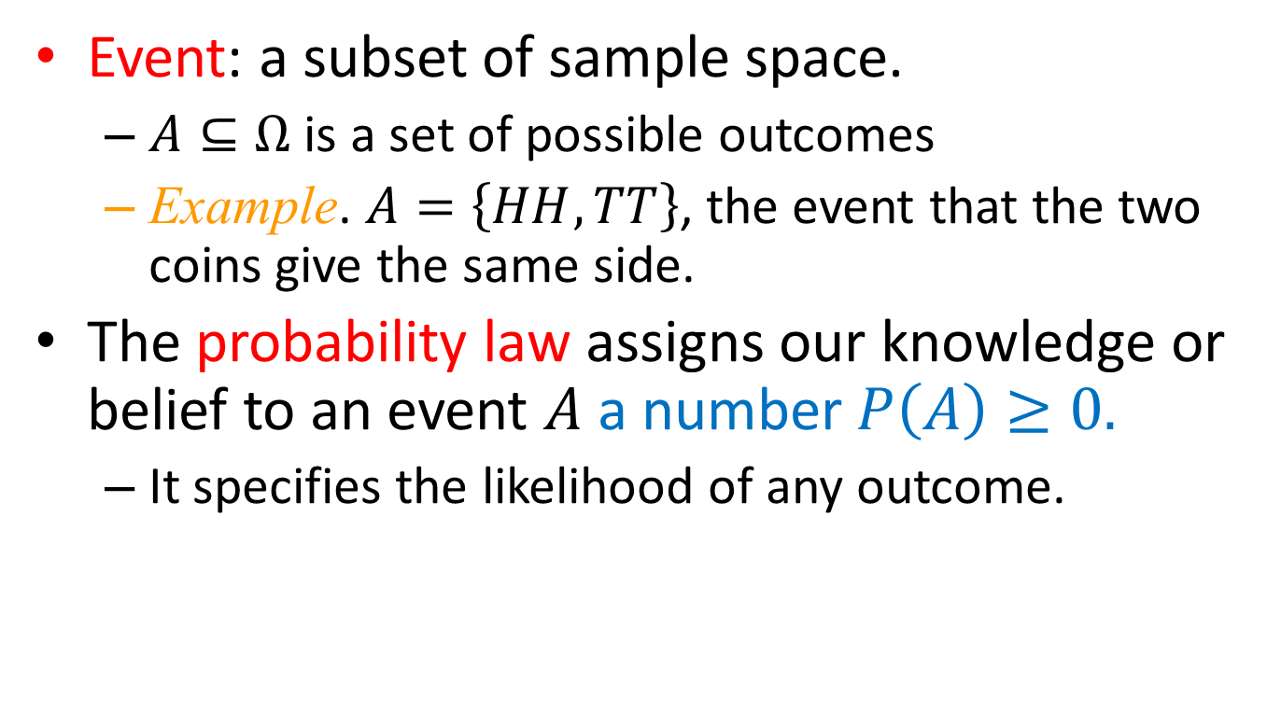
Elements of a Probabilistic Model
Event: a subset of sample space.
  $A⊆Ω$ is a set of possible outcomes
  Example. $A=\left\{HH,TT\right\}$, the event that the two coins give the same side.
The probability law assigns our knowledge or belief to an event $A$ a number $P\left(A\right)≥0.$
  It specifies the likelihood of any outcome.

Slide 4
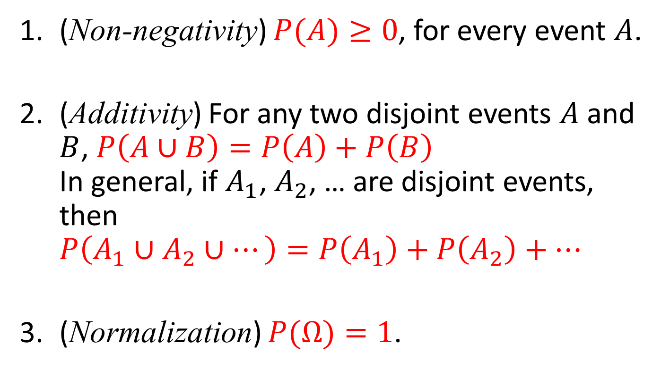
Probability Axioms
(Non-negativity) $P(A)≥0$, for every event $A$.
(Additivity) For any two disjoint events $A$ and $B$, $P\left(A∪B\right)=P\left(A\right)+P\left(B\right)$
In general, if $A_{1}$, $A_{2}$, … are disjoint events, then
$P\left(A_{1}∪A_{2}∪…\right)=P\left(A_{1}\right)+P\left(A_{2}\right)+…$
(Normalization) $P(Ω)=1$.

Slide 5
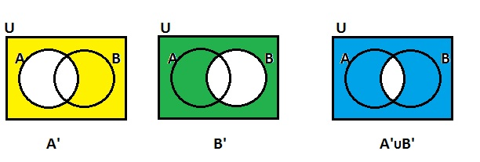
De Morgan’s laws
$${\left(A∪B\right)}^{c}=A^{c}∩B^{c}$$
$${\left(A∩B\right)}^{c}=A^{c}∪B^{c}$$
$${\left(A_{1}∪⋯∪A_{n}\right)}^{c}=A_{1}^{c}∩⋯∩A_{n}^{c}$$
$${\left(A_{1}∩⋯∩A_{n}\right)}^{c}=A_{1}^{c}∪⋯∪A_{n}^{c}$$

Slide 6
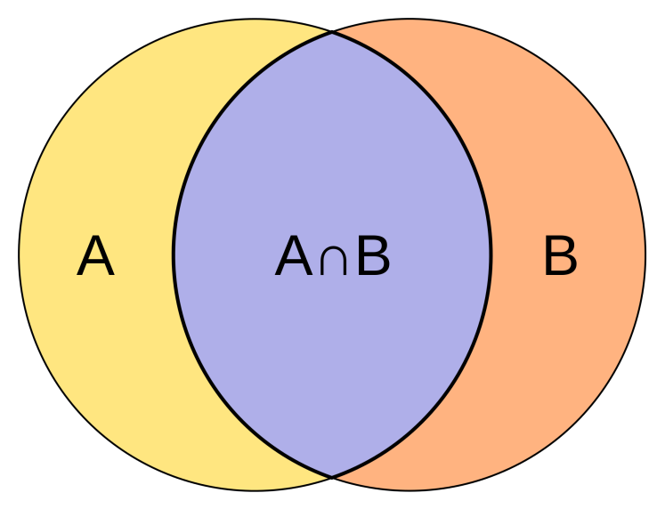
Question
Bonferroni’s inequality.
Prove that for any two events A and B, we have
$$P\left(A∩B\right)≥P\left(A\right)+P\left(B\right)−1$$
$$P\left(A\right)+P\left(B\right)−P\left(A∩B\right)=P(A∪B)$$
$$P(A∪B)≤1$$

Slide 7
Question
Romeo and Juliet have a date.
Each will arrive at the meeting place with a delay between 0 and 1 hour, with all pairs of delays being equally likely.
The first to arrive will wait for 15 minutes and will leave if the other has not yet arrived.
Question: What is the probability that they will meet?

Slide 8
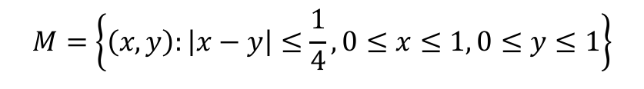
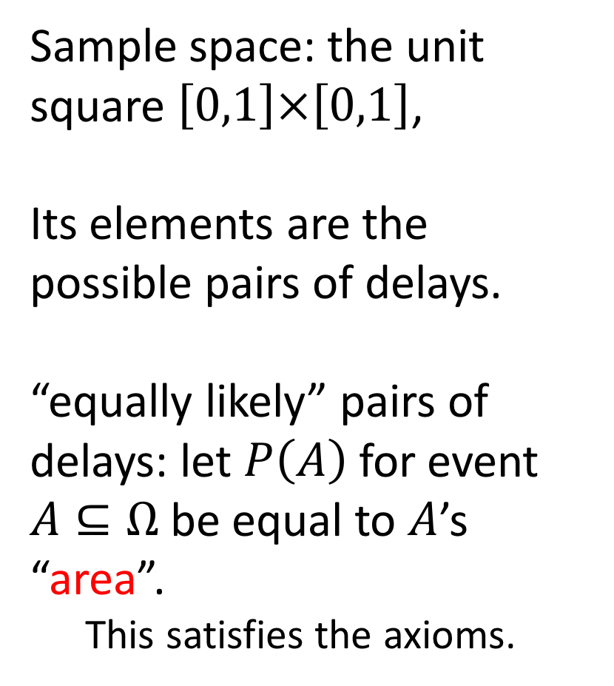
Question
Sample space: the unit square $\left[0,1\right]×\left[0,1\right]$,
Its elements are the possible pairs of delays.
“equally likely” pairs of delays: let $P\left(A\right)$ for event $A⊆Ω$ be equal to $A$’s “area”.
  This satisfies the axioms.
$$M=\left\{\left(x, y\right):\left|x−y\right|≤\frac{1}{4}, 0≤x≤1, 0≤y≤1\right\}$$

Slide 9
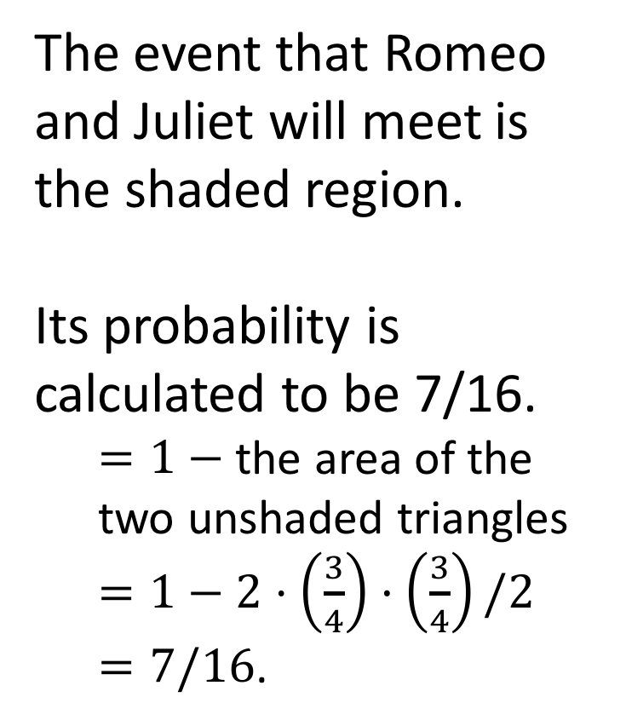
Question
The event that Romeo and Juliet will meet is the shaded region.
Its probability is calculated to be 7/16.
  $=1−$ the area of the two unshaded triangles
  $=1−2⋅\left(\frac{3}{4}\right)·\left(\frac{3}{4}\right)/2$
  $=7/16$.
$$M=\left\{\left(x, y\right):\left|x−y\right|≤\frac{1}{4}, 0≤x≤1, 0≤y≤1\right\}$$

Slide 10
Question
A parking lot contains 100 cars, $k$ of which happen to be lemons. We select $m$ of these cars at random and take them for a test drive. Find the probability that $n$ of the cars tested turn out to be lemons.
The sample space
$Ω=\left\{random choose m cars\right\}$
The size of sample space
$$|Ω|=\left({100 \atop m}\right)$$

Slide 11
Question
A parking lot contains 100 cars, $k$ of which happen to be lemons. We select $m$ of these cars at random and take them for a test drive. Find the probability that $n$ of the cars tested turn out to be lemons.
The event $n$ cars are lemons ($n≤k$ and $n≤m$)
$\left({k \atop n}\right)∙\left({100−k \atop m−n}\right)$
The probability
$$P=\left({k \atop n}\right)∙\left({100−k \atop m−n}\right)/\left({100 \atop m}\right)$$

Slide 12
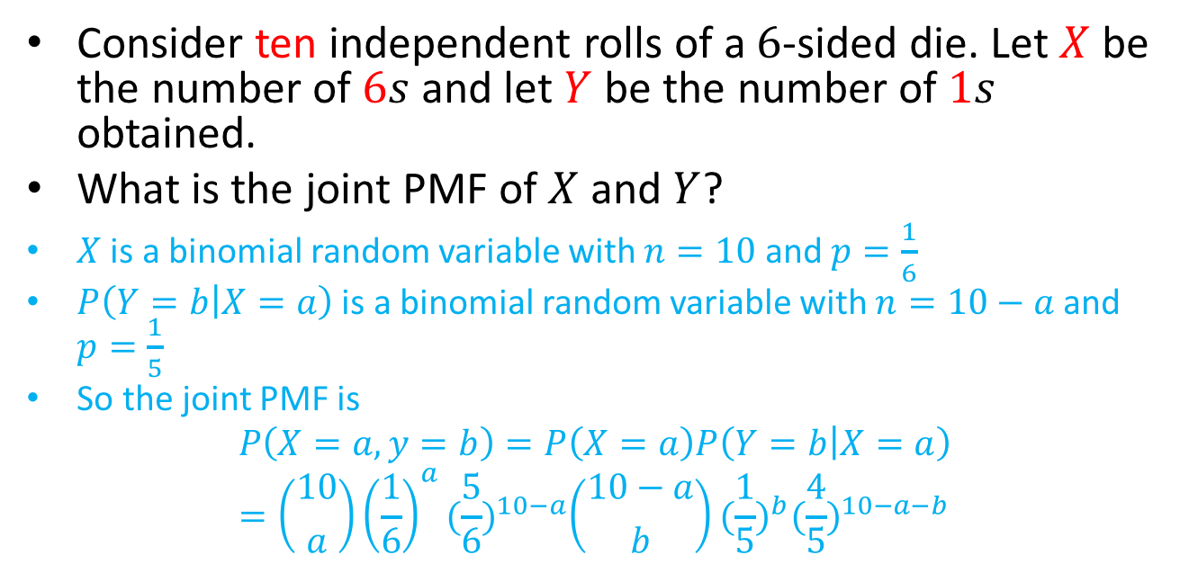
Question: Conditioning
Consider ten independent rolls of a $6$-sided die. Let $X$ be the number of $6s$ and let $Y$ be the number of $1s$ obtained.
What is the joint PMF of $X$ and $Y$?
$X$ is a binomial random variable with $n=10$ and $p=\frac{1}{6}$
$P\left(Y=b | X=a\right)$ is a binomial random variable with $n=10−a$ and $p=\frac{1}{5}$
So the joint PMF is
$$P\left(X=a,y=b\right)=P\left(X=a\right)P\left(Y=b | X=a\right)=\left({10 \atop a}\right){\left(\frac{1}{6}\right)}^{a}{(\frac{5}{6})}^{10−a}\left({10−a \atop b}\right){(\frac{1}{5})}^{b}{(\frac{4}{5})}^{10−a−b}$$

Slide 13
Total Probability Theorem
Let $A_{1},A_{2}, . . . ,A_{n}$be disjoint events that form a partition of the sample space. Assume $P(A_{i})>0$ for all $i$. Then, for any event $B$, we have
$P\left(B\right)= P\left(A_{1}∩B\right)+⋯+P\left(A_{n}∩B\right)$
$= P\left(A_{1}\right)P\left(B | A_{1}\right)+⋯+P\left(A_{n}\right)P\left(B | A_{n}\right)$
Indeed, $B$ is the the disjoint union of $\left(A_{1}∩B\right)$, …, $\left(A_{n}∩B\right)$.
The second equality is given by
$P\left(A_{i}∩B\right)=P\left(A_{i}\right)P\left(B | A_{i}\right).$

Slide 14
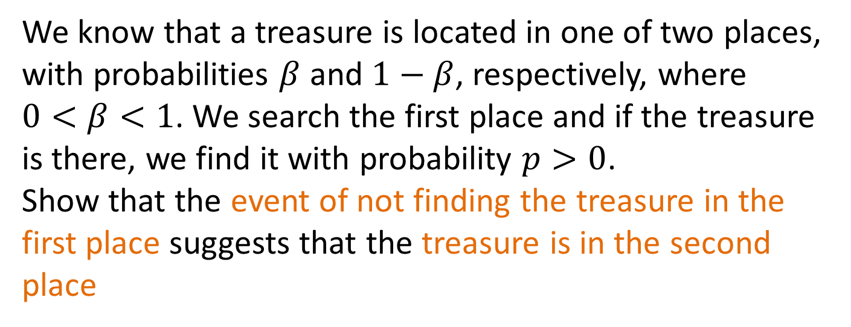
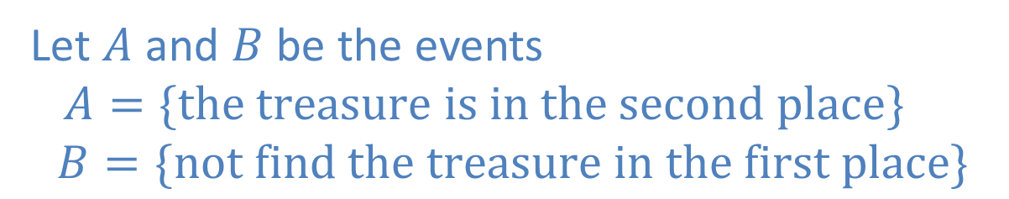
Question
We know that a treasure is located in one of two places, with probabilities $β$ and $1−β$, respectively, where $0<β<1$. We search the first place and if the treasure is there, we find it with probability $p>0$.
Show that the event of not finding the treasure in the first place suggests that the treasure is in the second place
Let $A$ and $B$ be the events
$A=\{the treasure is in the second place\}$
$$B=\{not find the treasure in the first place\}$$

Slide 15
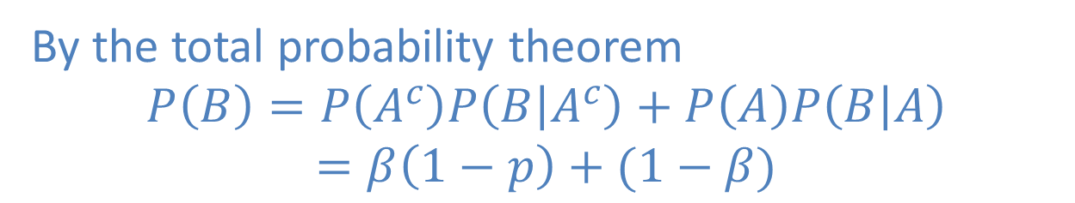
Question
We know that a treasure is located in one of two places, with probabilities $β$ and $1−β$, respectively, where $0<β<1$. We search the first place and if the treasure is there, we find it with probability $p>0$.
Show that the event of not finding the treasure in the first place suggests that the treasure is in the second place
By the total probability theorem
$$P\left(B\right)=P\left(A^{c}\right)P\left(B | A^{c}\right)+P\left(A\right)P\left(B | A\right)$$
$$=β\left(1−p\right)+(1−β)$$

Slide 16
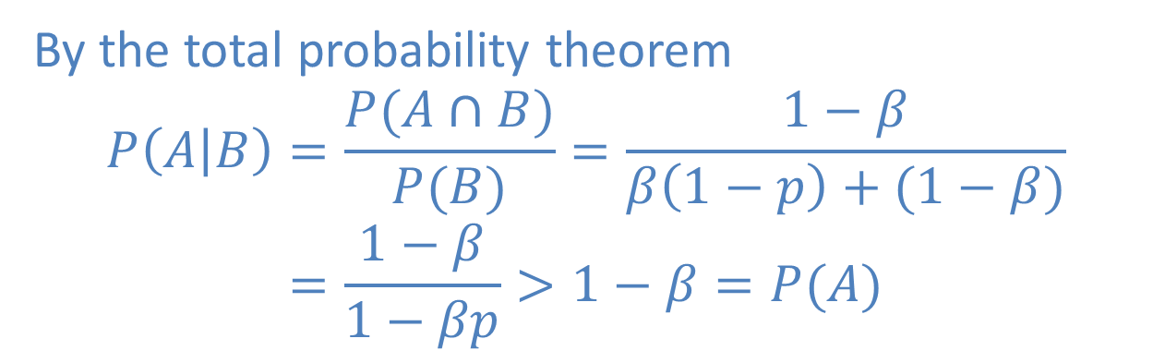
Question
We know that a treasure is located in one of two places, with probabilities $β$ and $1−β$, respectively, where $0<β<1$. We search the first place and if the treasure is there, we find it with probability $p>0$.
Show that the event of not finding the treasure in the first place suggests that the treasure is in the second place
By the total probability theorem
$$P\left(A | B\right)=\frac{P(A∩B)}{P(B)}=\frac{1−β}{β\left(1−p\right)+(1−β)}$$
$$=\frac{1−β}{1−βp}>1−β=P(A)$$

Slide 17
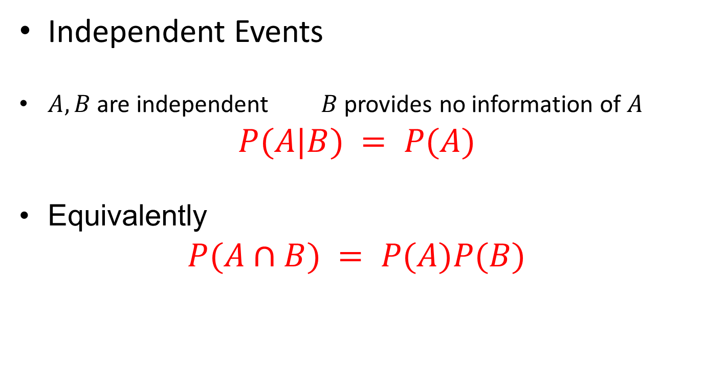
Independence
Independent Events
$A, B$are independent $B$ provides no information of $A$
$$P(A|B) = P(A)$$
Equivalently
$$P(A∩B) = P(A)P(B)$$

Slide 18
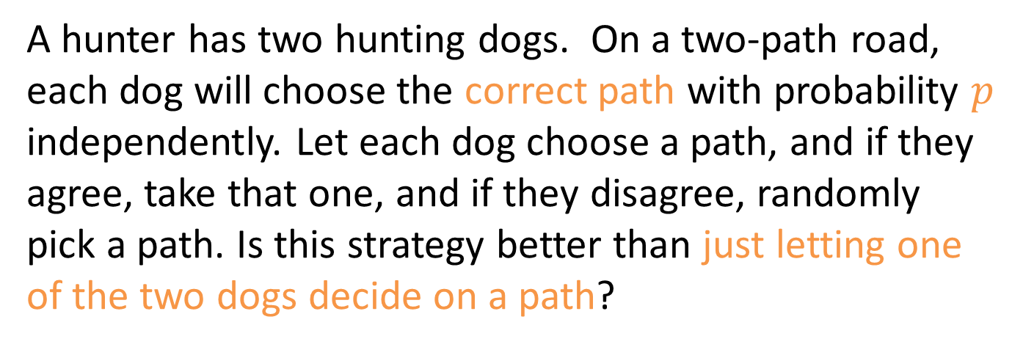

Question
A hunter has two hunting dogs. On a two-path road, each dog will choose the correct path with probability $p$ independently. Let each dog choose a path, and if they agree, take that one, and if they disagree, randomly pick a path. Is this strategy better than just letting one of the two dogs decide on a path?
Both dogs agree on the correct path
$$p⋅p=p^{2}$$
The dogs disagree
$$p\left(1−p\right)⋅2$$

Slide 19
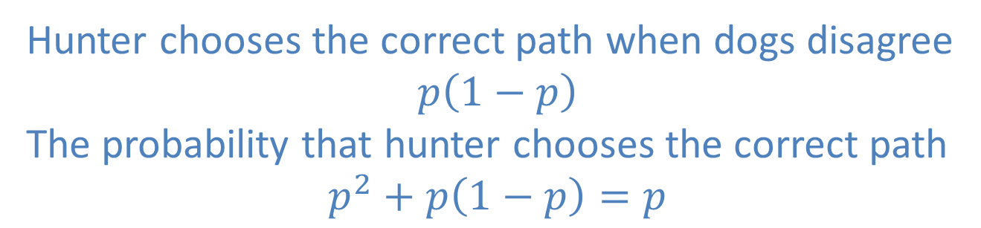
Question
A hunter has two hunting dogs. On a two-path road, each dog will choose the correct path with probability $p$ independently. Let each dog choose a path, and if they agree, take that one, and if they disagree, randomly pick a path. Is this strategy better than just letting one of the two dogs decide on a path?
Hunter chooses the correct path when dogs disagree
$$p\left(1−p\right)$$
The probability that hunter chooses the correct path
$$p^{2}+p\left(1−p\right)=p$$

Slide 20
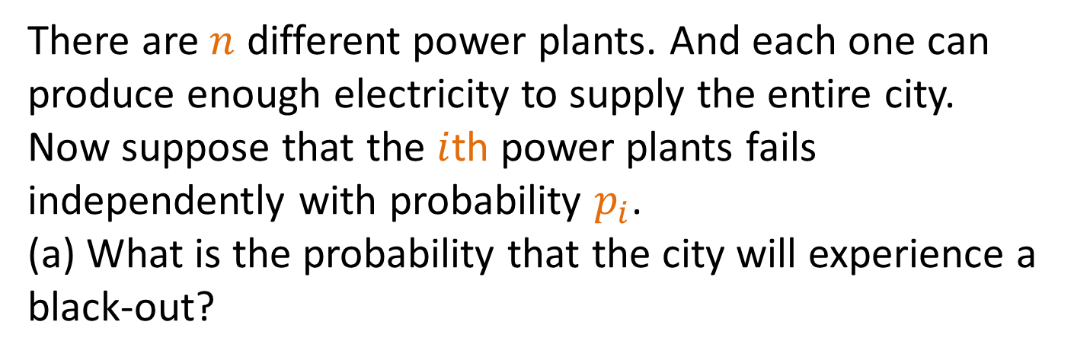

Question
There are $n$ different power plants. And each one can produce enough electricity to supply the entire city. Now suppose that the $i$th power plants fails independently with probability $p_{i}$.
(a) What is the probability that the city will experience a black-out?
Let $A$ denote the event that the city experiences a black-out.
Since the power plants fail independently
$$P\left(A\right)=\prod_{i=1}^{n}{p_{i}}$$

Slide 21
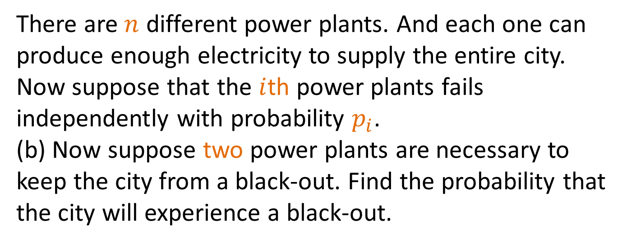
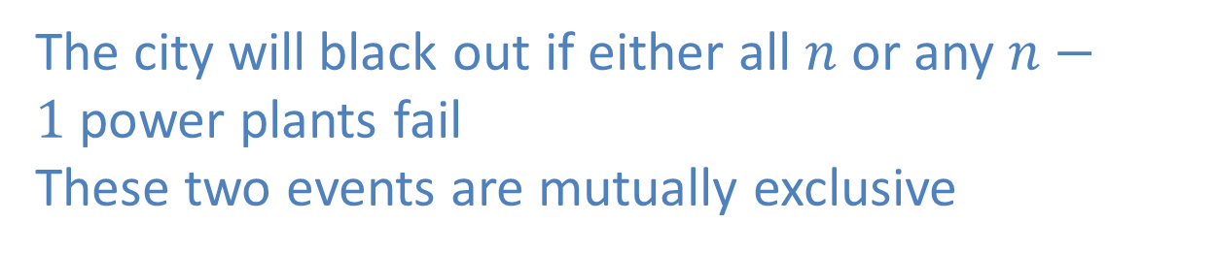
Question
There are $n$ different power plants. And each one can produce enough electricity to supply the entire city. Now suppose that the $i$th power plants fails independently with probability $p_{i}$.
(b) Now suppose two power plants are necessary to keep the city from a black-out. Find the probability that
the city will experience a black-out.
The city will black out if either all $n$ or any $n−1$power plants fail
These two events are mutually exclusive

Slide 22
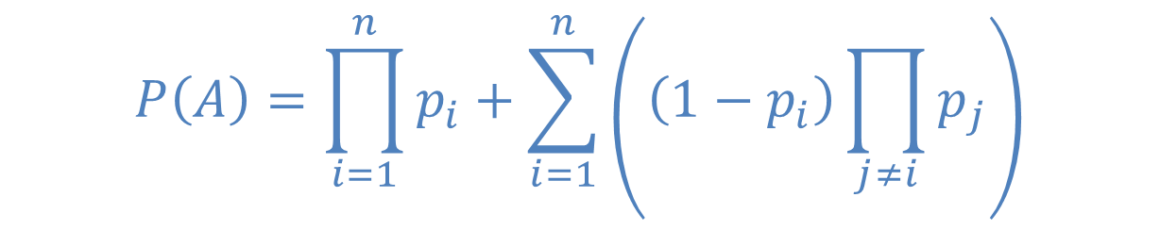
Question
There are $n$ different power plants. And each one can produce enough electricity to supply the entire city. Now suppose that the $i$th power plants fails independently with probability $p_{i}$.
(b) Now suppose two power plants are necessary to keep the city from a black-out. Find the probability that
the city will experience a black-out.
$$P\left(A\right)=\prod_{i=1}^{n}{p_{i}}+\sum_{i=1}^{n}{\left(\left(1−p_{i}\right)\prod_{j≠i}^{ }{p_{j}}\right)}$$

Slide 23
Thanks
Question are welcome.

