Slide 1
Tutorial 11: Limit Theorems
Baoxiang Wang & Yihan Zhang
bxwang, yhzhang@cse.cuhk.edu.hk
April 10, 2017

Slide 2
Outline
The Central Limit Theorem (CLT)
Normal Approximation Based on CLT
De Moivre-Laplace Approximation to the Binomial
Problems and solutions

Slide 3
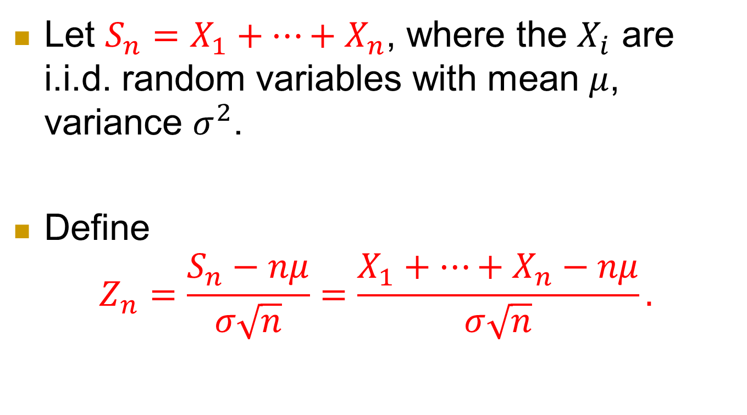
Formally
Let $S_{n}=X_{1}+⋯+X_{n}$, where the $X_{i}$ are i.i.d. random variables with mean $μ$, variance $σ^{2}$.
Define
$Z_{n}=\frac{S_{n}−nμ}{σ\sqrt{n}}=\frac{X_{1}+⋯+X_{n}−nμ}{σ\sqrt{n}}.$

Slide 4
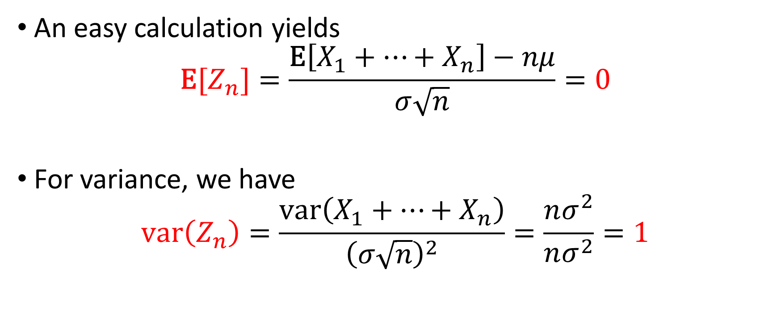
Zero mean and unit variance
An easy calculation yields
$$\text{E}[Z_{n}]=\frac{\text{E}\left[X_{1}+⋯+X_{n}\right]−nμ}{σ\sqrt{n}}=0$$
For variance, we have
$$\text{var}\left(Z_{n}\right)=\frac{\text{var}\left(X_{1}+⋯+X_{n}\right)}{{\left(σ\sqrt{n}\right)}^{2}}=\frac{nσ^{2}}{nσ^{2}}=1$$

Slide 5
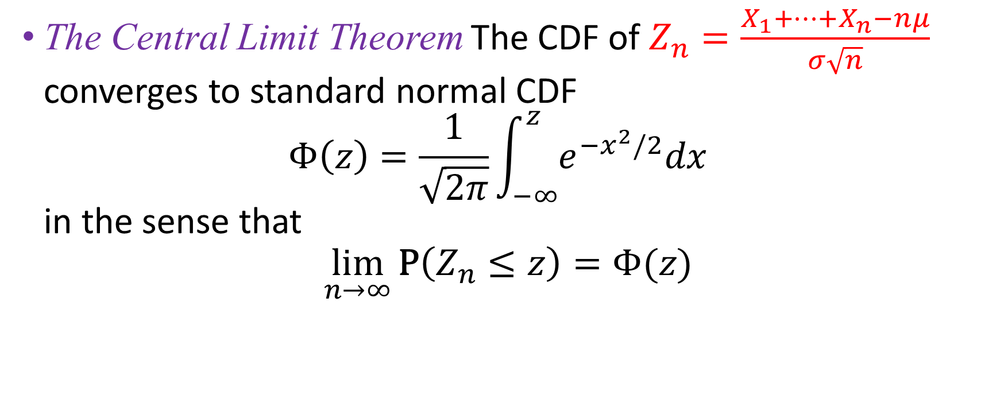
The Central Limit Theorem (CLT)
The Central Limit Theorem The CDF of $Z_{n}=\frac{X_{1}+⋯+X_{n}−nμ}{σ\sqrt{n}}$ converges to standard normal CDF
$Φ\left(z\right)=\frac{1}{\sqrt{2π}}\int_{−∞}^{z}{e^{−x^{2}/2}dx}$
in the sense that
$$\lim_{n→∞}{\text{P}\left(Z_{n}≤z\right)=Φ(z)}$$
The distribution of the r.v.$Z_{n}$approaches a normal distribution.

Slide 6
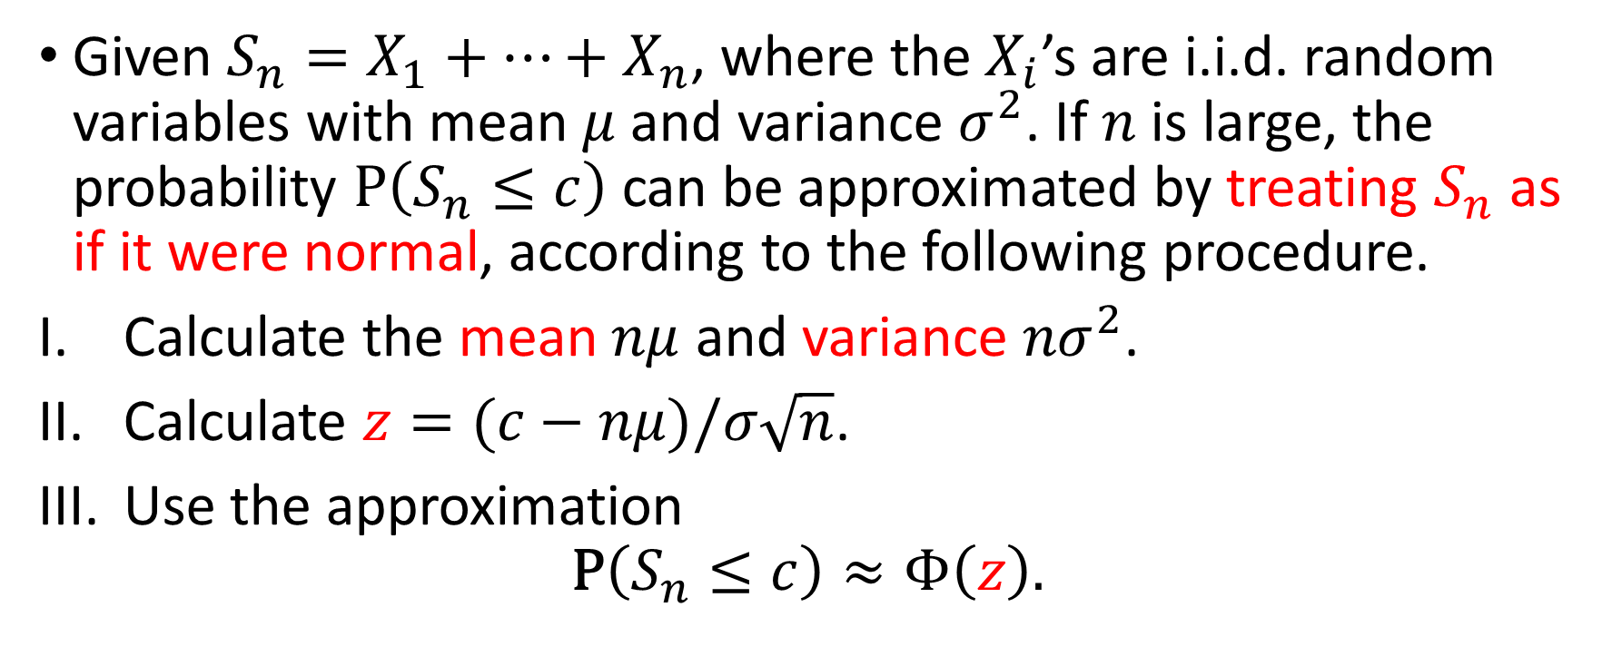
Normal Approximation Based on CLT
Given $S_{n}=X_{1}+⋯+X_{n}$, where the $X_{i}$’s are i.i.d. random variables with mean $μ$ and variance $σ^{2}$. If $n$ is large, the probability $\text{P}\left(S_{n}≤c\right)$ can be approximated by treating $S_{n}$ as if it were normal, according to the following procedure.
Calculate the mean $nμ$ and variance ${nσ}^{2}$.
Calculate $z=(c−nμ)/σ\sqrt{n}$.
Use the approximation
$$\text{P}\left(S_{n}≤c\right)≈Φ\left(z\right).$$

Slide 7
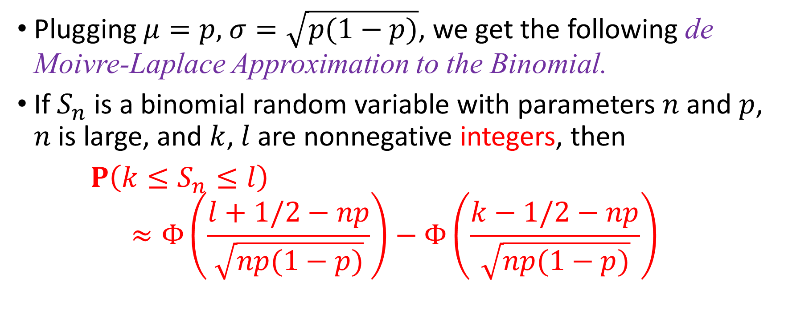
De Moivre-Laplace Approximation to the Binomial
Plugging $μ=p,$ $σ=\sqrt{p(1−p)}$, we get the following de Moivre-Laplace Approximation to the Binomial.
If $S_{n}$ is a binomial random variable with parameters $n$ and $p$, $n$ is large, and $k$, $l$ are nonnegative integers, then
$P\left(k≤S_{n}≤l\right)$
$$≈Φ\left(\frac{l+1/2−np}{\sqrt{np(1−p)}}\right)−Φ\left(\frac{k−1/2−np}{\sqrt{np(1−p)}}\right)$$

Slide 8
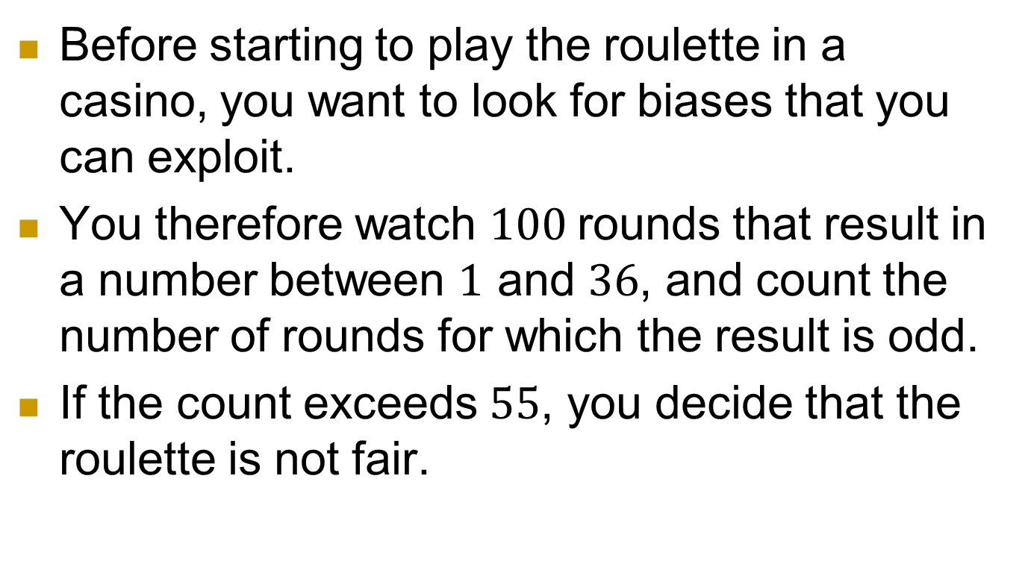
Problem 8.
Before starting to play the roulette in a casino, you want to look for biases that you can exploit.
You therefore watch $100$rounds that result in a number between $1$ and $36$, and count the number of rounds for which the result is odd.
If the count exceeds $55$, you decide that the roulette is not fair.

Slide 9
Question
Assuming that the roulette is fair, find an approximation for the probability that you will make the wrong decision.

Slide 10
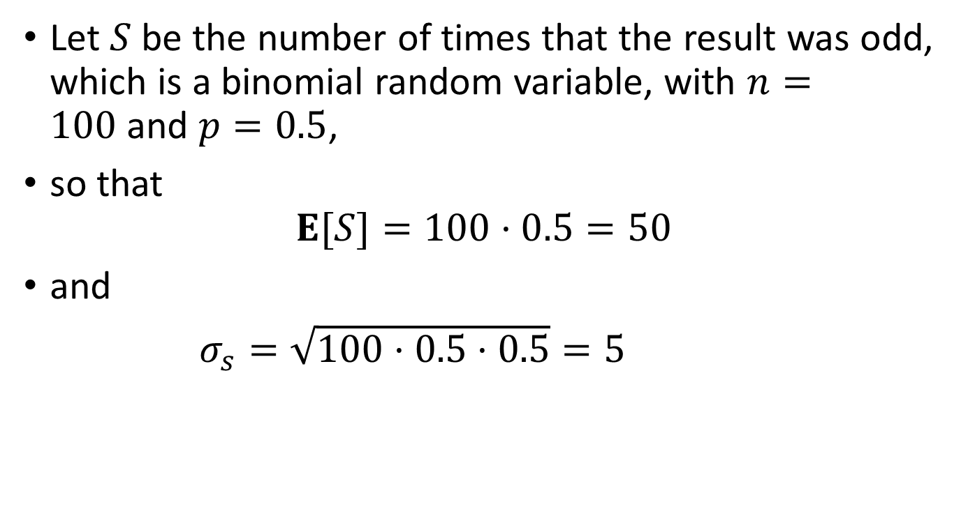
Solution
Let $S$ be the number of times that the result was odd, which is a binomial random variable, with $n=100$and $p=0.5$,
so that
$E[S]=100·0.5=50$
and
$σ_{s}=\sqrt{100·0.5·0.5}=5$

Slide 11

Using the normal approximation to the binomial, we find
$P\left(S>55\right)=P\left(\frac{S−50}{5}>\frac{55−50}{5}\right)$
$=1−P(z≤1)$
$≈1−Φ\left(1\right)$
$=1−0.8413$
$=0.1587$

Slide 12
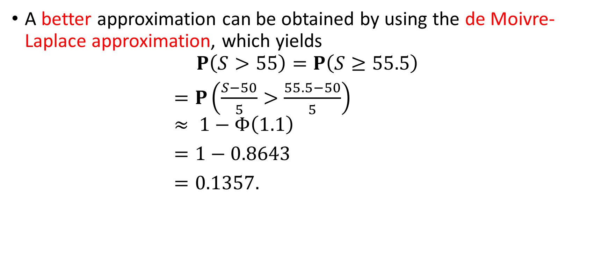
Alternative solution
A better approximation can be obtained by using the de Moivre-Laplace approximation, which yields
$$P\left(S>55\right)=P\left(S≥55.5\right)$$
$=P\left(\frac{S−50}{5}>\frac{55.5−50}{5}\right)$
$≈ 1−Φ\left(1.1\right)$
$=1−0.8643$
$=0.1357.$

Slide 13
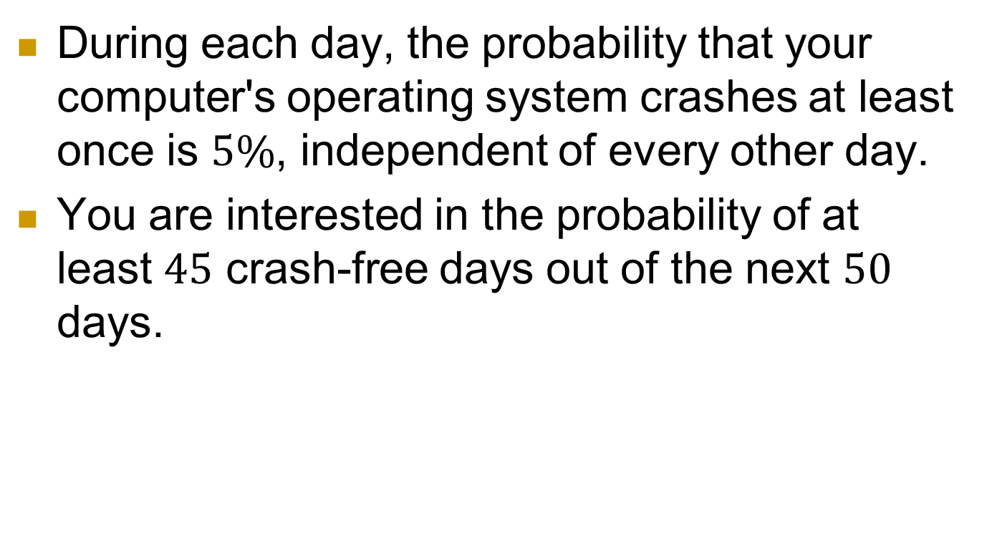
Problem 9
During each day, the probability that your computer's operating system crashes at least once is $5\%$, independent of every other day.
You are interested in the probability of at least $45$ crash-free days out of the next $50$ days.

Slide 14
Question
(a) Find the probability of interest by using the normal approximation to the binomial.
(b) Repeat part (a), this time using the Poisson approximation to the binomial.

Slide 15
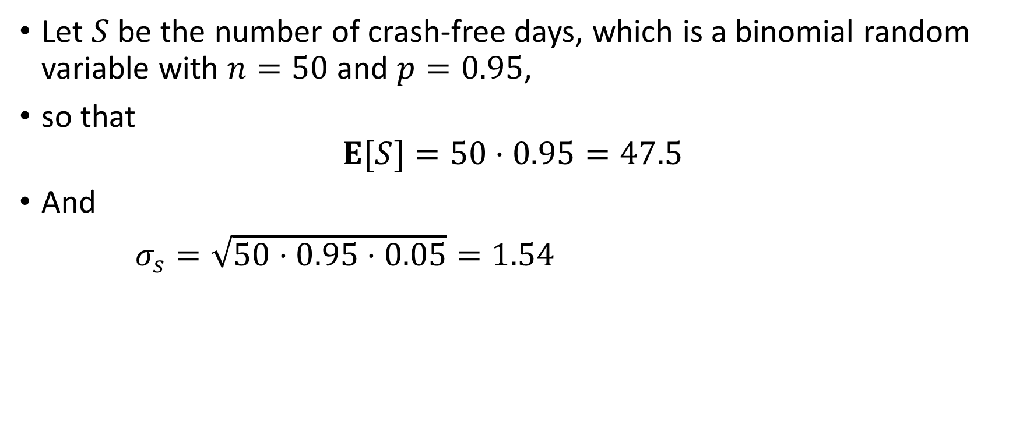
Solution (a)
Let $S$ be the number of crash-free days, which is a binomial random variable with $n=50$and $p=0.95$,
so that
$$E[S]=50·0.95=47.5$$
And
$σ_{s}=\sqrt{50·0.95·0.05}=1.54$

Slide 16
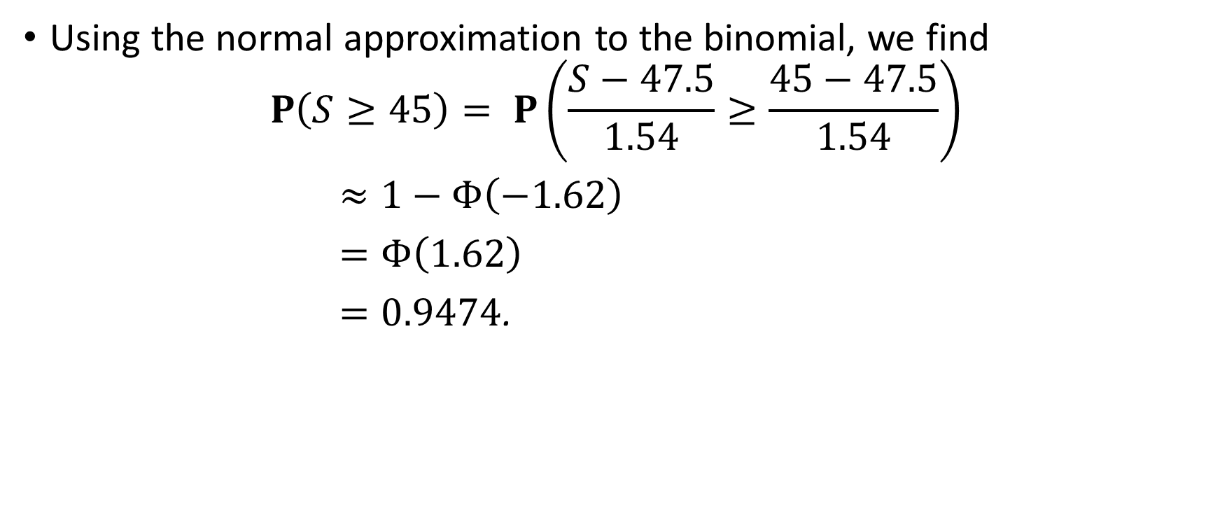
Using the normal approximation to the binomial, we find
$$P\left(S≥45\right)= P\left(\frac{S−47.5}{1.54}≥\frac{45−47.5}{1.54}\right)$$
$≈1−Φ\left(−1.62\right)$
$=Φ\left(1.62\right)$
$=0.9474$.

Slide 17
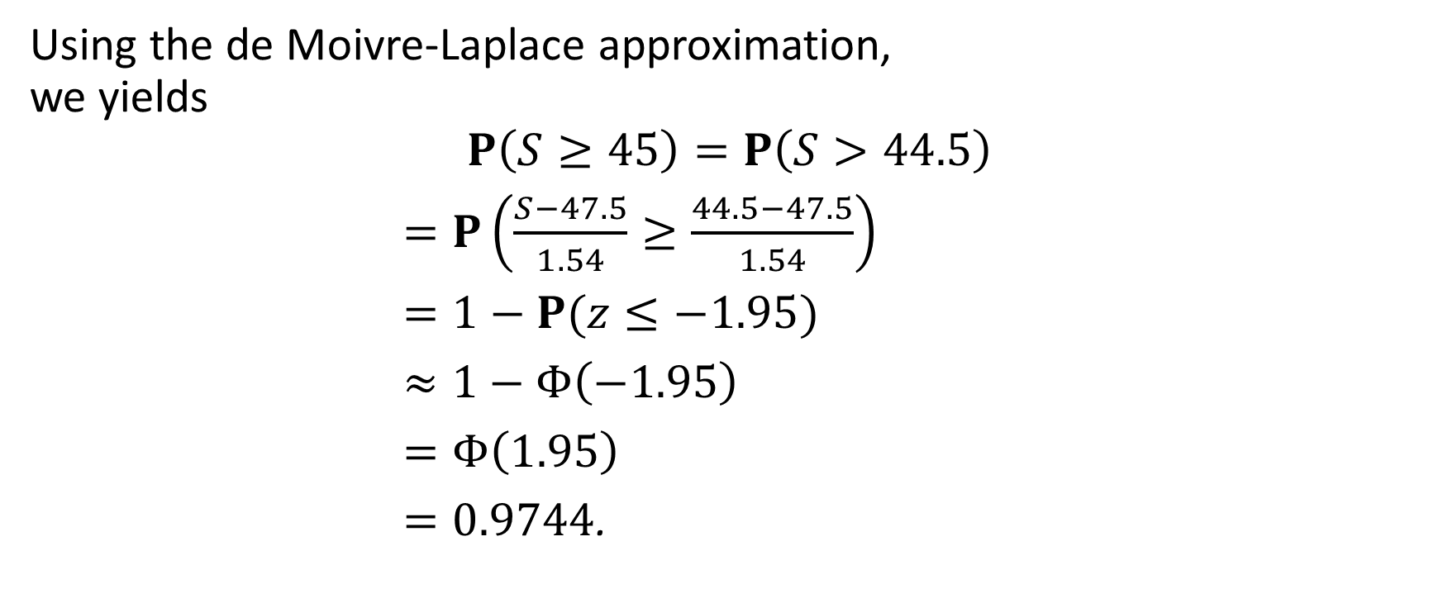
Using the de Moivre-Laplace approximation,
we yields
$$P\left(S≥45\right)=P\left(S>44.5\right)$$
$=P\left(\frac{S−47.5}{1.54}≥\frac{44.5−47.5}{1.54}\right)$
$=1−P(z≤−1.95)$
$≈1−Φ\left(−1.95\right)$
$=Φ\left(1.95\right)$
$=0.9744$.

Slide 18
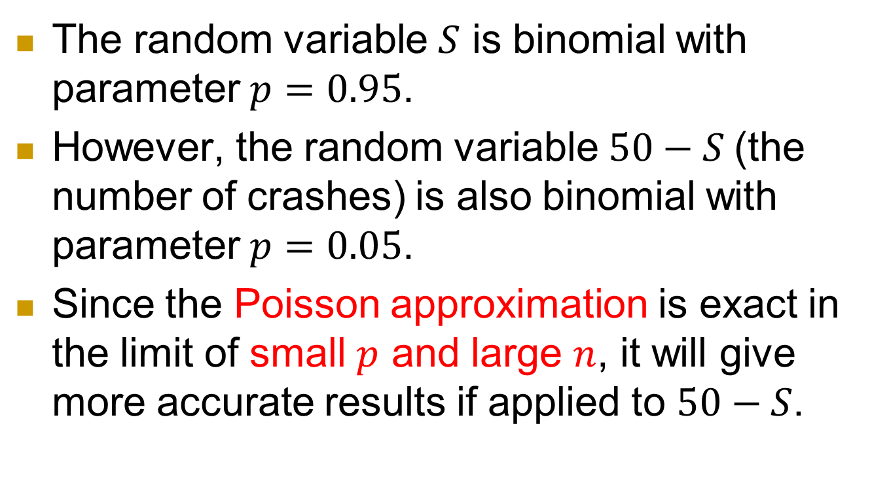
Solution (b)
The random variable $S$ is binomial with parameter $p=0.95$.
However, the random variable $50−S$(the number of crashes) is also binomial with parameter $p=0.05$.
Since the Poisson approximation is exact in the limit of small $p$ and large $n$, it will give more accurate results if applied to $50−S$.

Slide 19
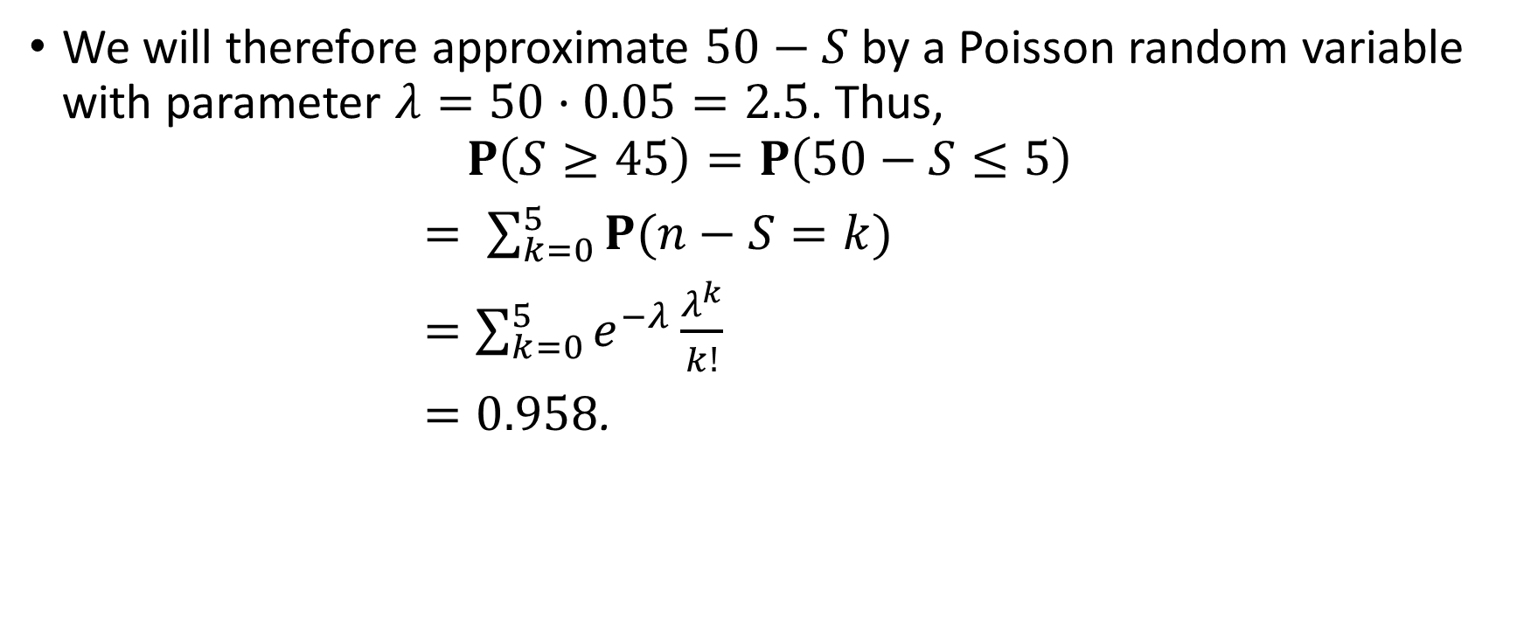
We will therefore approximate $50−S$ by a Poisson random variable with parameter $λ=50·0.05=2.5$. Thus,
$$P\left(S≥45\right)=P\left(50−S≤5\right)$$
$= \sum_{k=0}^{5}{P(n−S=k)}$
$=\sum_{k=0}^{5}{e^{−λ}\frac{λ^{k}}{k!}}$
$=0.958$.

Slide 20
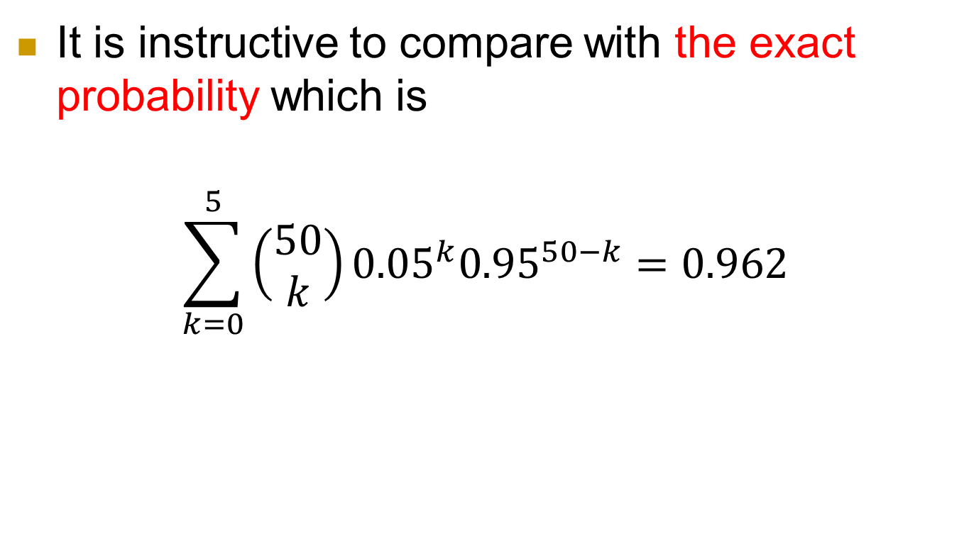
It is instructive to compare with the exact probability which is
$$\sum_{k=0}^{5}{{\left(\begin{aligned}50 \\ k\end{aligned}\right)0.05}^{k}{0.95}^{50−k}}=0.962$$

Slide 21
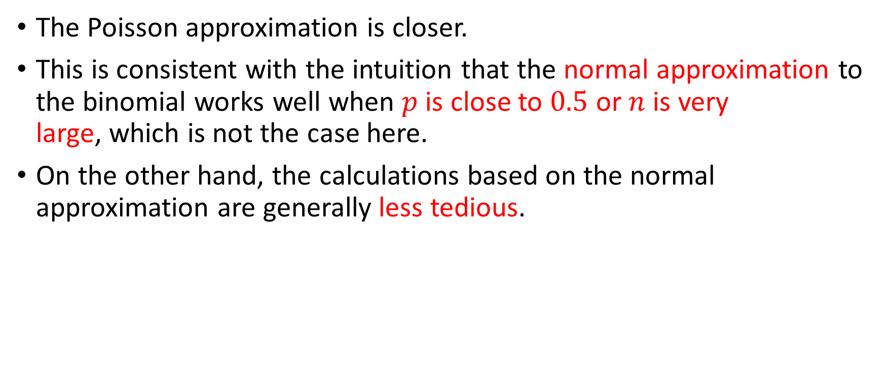
Interpretation
The Poisson approximation is closer.
This is consistent with the intuition that the normal approximation to the binomial works well when $p$ is close to $0.5$ or $n$ is very
large, which is not the case here.
On the other hand, the calculations based on the normal approximation are generally less tedious.

Slide 22

Problem 11
Let $X_{1},Y_{1},X_{2},Y_{2},⋯$ be independent random variables, uniformly distributed in the unit interval $[0, 1]$, and let
$$W=\frac{\left(X_{1}+…+X_{16}\right)−\left(Y_{1}+…+Y_{16}\right)}{16}$$

Slide 23

Question
Find a numerical approximation to the quantity
$$P(|W−E[W]|<0.001)$$

Slide 24
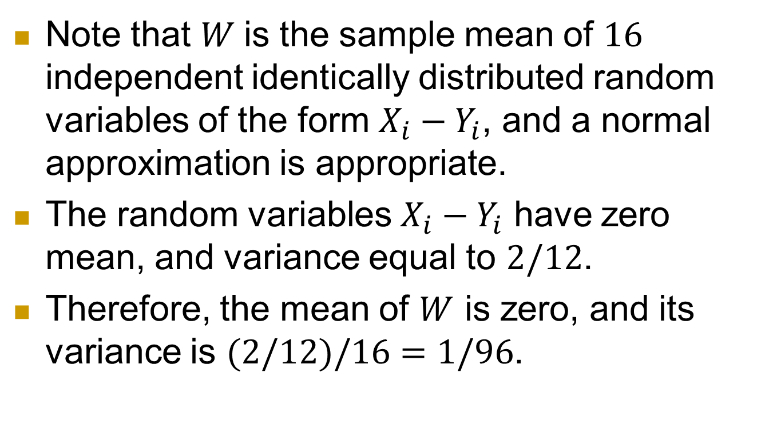
Solution
Note that $W$is the sample mean of $16$ independent identically distributed random variables of the form $X_{i}−Y_{i}$, and a normal approximation is appropriate.
The random variables $X_{i}−Y_{i}$ have zero mean, and variance equal to $2/12$.
Therefore, the mean of $W$ is zero, and its variance is $(2/12)/16=1/96$.

Slide 25
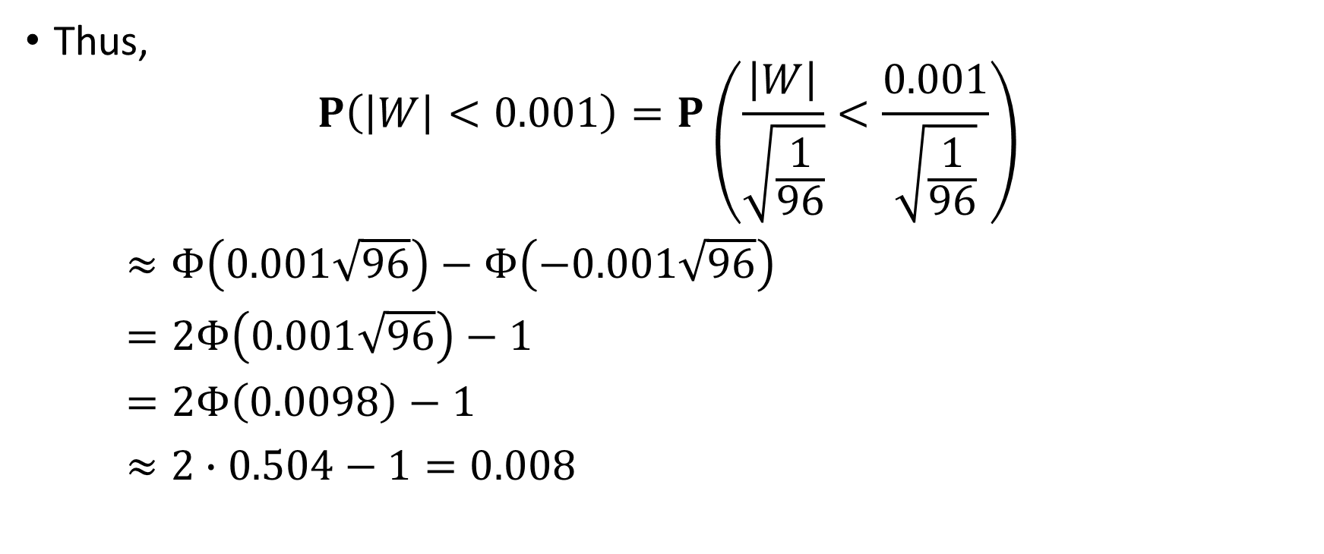
Thus,
$$P\left(\left|W\right|<0.001\right)=P\left(\frac{\left|W\right|}{\sqrt{\frac{1}{96}}}<\frac{0.001}{\sqrt{\frac{1}{96}}}\right)$$
$≈Φ\left(0.001\sqrt{96}\right)−Φ\left(−0.001\sqrt{96}\right)$
$=2Φ\left(0.001\sqrt{96}\right)−1$
$=2Φ\left(0.0098\right)−1$
$≈2∙0.504−1=0.008$

Slide 26
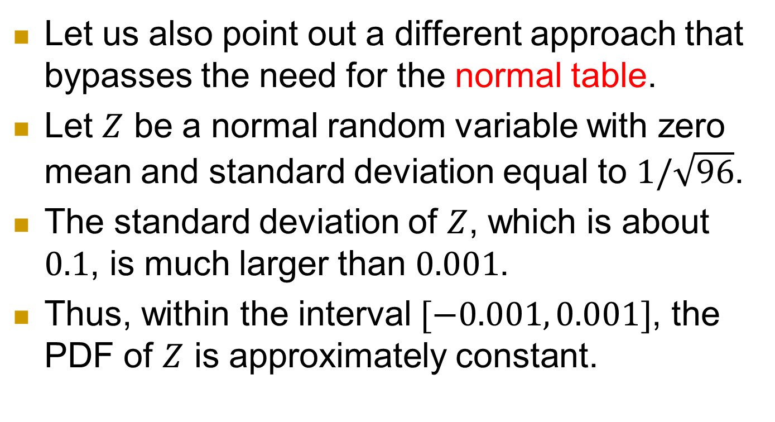
Alternative solution
Let us also point out a different approach that bypasses the need for the normal table.
Let $Z$ be a normal random variable with zero mean and standard deviation equal to $1/\sqrt{96}$.
The standard deviation of $Z$, which is about $0.1$, is much larger than $0.001$.
Thus, within the interval $[−0.001, 0.001]$, the PDF of $Z$ is approximately constant.

Slide 27

$P(z−δ≤Z≤z+δ)≈f_{Z}(z)·2δ$,
$z=0, δ=0.001$,
$$P\left(\left|W\right|<0.001\right)=P(−0.001≤z≤0.001)$$
$≈f_{Z}\left(0\right)·0.002$
$=\frac{0.002}{\sqrt{2π}(\frac{1}{\sqrt{96}})}$
$=0.0078$

