Slide 1
ENGG2430A Probability and Statistics for Engineers
Chapter 9: Classical Statistical Inference
Instructor: Shengyu Zhang

Slide 2
Preceding chapter: Bayesian inference
Preceding chapter: Bayesian approach to inference.
Unknown parameters are modeled as random variables.
Work within a single, fully-specified probabilistic model.
Compute posterior distribution by judicious application of Bayes' rule.

Slide 3
This chapter: classical inference
We view the unknown parameter $θ$ as a deterministic (not random!) but unknown quantity.
The observation $X$ is random and its distribution
$p_{X}\left(x;θ\right)$ if $X$ is discrete
$f_{X}\left(x;θ\right)$ if $X$ is continuous
depends on the value of $θ$.

Slide 4
Classical inference
Deal simultaneously with multiple candidate models, one model for each possible value of $θ$.
A ''good" hypothesis testing or estimation procedure will be one that possesses certain desirable properties under every candidate model.
i.e. for every possible value of $θ$.

Slide 5
Bayesian:
Classical:

Slide 6
Notation
Our notation will generally indicate the dependence of probabilities and expected values on $θ$.
For example, we will denote by $E_{θ}\left[h\left(X\right)\right]$ the expected value of a random variable $h\left(X\right)$ as a function of $θ$.
Similarly, we will use the notation $P_{θ}\left(A\right)$ to denote the probability of an event $A$.

Slide 7
Content
Classical Parameter Estimation
Linear Regression
Binary Hypothesis Testing
Significance Testing

Slide 8
Given observations $X=\left(X_{1},…,X_{n}\right)$, an estimator is a random variable of the form $\hat{Θ}=g\left(X\right)$, for some function $g$.
Note that since the distribution of $X$ depends on $θ$, the same is true for the distribution of $\hat{Θ}$.
We use the term estimate to refer to an actual realized value of $\hat{Θ}$.

Slide 9
Sometimes, particularly when we are interested in the role of the number of observations $n$, we use the notation ${\hat{Θ}}_{n}$ for an estimator.
It is then also appropriate to view ${\hat{Θ}}_{n}$ as a sequence of estimators.
One for each value of $n$.
The mean and variance of ${\hat{Θ}}_{n}$ are denoted $E_{θ}\left[{\hat{Θ}}_{n}\right]$ and ${var}_{θ}\left[{\hat{Θ}}_{n}\right]$, respectively.
We sometimes drop this subscript $θ$ when the context is clear.

Slide 10
Terminology regarding estimators
Estimator: ${\hat{Θ}}_{n}$, a function of $n$ observations for an $\left(X_{1},…,X_{n}\right)$ whose distribution depends on $θ$.
Estimation error: ${\tilde{Θ}}_{n}={\hat{Θ}}_{n}−θ$.
Bias of the estimator: $b_{θ}\left({\hat{Θ}}_{n}\right)=E_{θ}\left[{\hat{Θ}}_{n}\right]−θ$, is the expected value of the estimation error.

Slide 11
bias
${\hat{Θ}}_{n}$ is unbiased if $b_{θ}\left({\hat{Θ}}_{n}\right)=0$.
a desirable property.
${\hat{Θ}}_{n}$ is asymptotically unbiased if $\lim_{n→∞}{E_{θ}\left[{\hat{Θ}}_{n}\right]}=θ$, for every possible value of $θ$.
${\hat{Θ}}_{n}$becomes unbiased as the number $n$ of observations increases,
this is desirable when $n$ is large.

Slide 12
Consistent
${\hat{Θ}}_{n}$ is consistent if the sequence ${\hat{Θ}}_{n}$ converges to the true value $θ$, in probability, for every possible value of $θ$.
Recall:
$X_{n}$ converges to $a$ in probability if
$$∀ε>0, P\left(\left|X_{n}−a\right|≥ε\right)→0\text{, } \text{as} n→∞.$$
$X_{n}$ converges to $a$ with probability­ 1 (or almost surely) if
$$P\left(\lim_{n→∞}X_{n}{=}a\right)=1$$

Slide 13
Mean squared error: $E_{θ}\left[{\tilde{Θ}}_{n}^{2}\right]$.
This is related to the bias and the variance of ${\hat{Θ}}_{n}$: $E_{θ}\left[{\tilde{Θ}}_{n}^{2}\right]=b_{θ}^{2}\left({\hat{Θ}}_{n}\right)+{var}_{θ}\left[{\hat{Θ}}_{n}\right]$.
Reason: $E\left[X^{2}\right]={\left(E\left[X\right]\right)}^{2}+var(X)$, $X={\tilde{Θ}}_{n}={\hat{Θ}}_{n}−θ$.
In many statistical problems, there is a tradeoff between the two terms on the right-hand-side.
Often a reduction in the variance is accompanied by an increase in the bias.
Of course, a good estimator is one that manages to keep both terms small.

Slide 14
Maximum Likelihood Estimation (MLE)
Let the vector of observations $X=\left(X_{1},…,X_{n}\right)$ be described by a joint PMF $p_{X}\left(x;θ\right)$
Note that $p_{X}\left(x;θ\right)$ is PMF for $X$ only, not joint distribution for $X$ and $θ$.
Recall $θ$ is just a fixed parameter, not a random variable.
$p_{X}\left(x;θ\right)$depends on $θ$.
Suppose we observe a particular value $x=\left(x_{1},…,x_{n}\right)$ of $X$.

Slide 15
A maximum likelihood estimate (MLE) is a value of the parameter that maximizes the numerical function $p_{X}\left(x_{1},…,x_{n};θ\right)$ over all $θ$.
$${\hat{θ}}_{n}=\underset{θ}{argmax}{p_{X}\left(x_{1},…,x_{n};θ\right)}$$
The above is for the case of discrete $X$. If $X$ is continuous, then MLE is ${\hat{θ}}_{n}=\underset{θ}{argmax}{f_{X}\left(x_{1},…,x_{n};θ\right)}$

Slide 16
In many applications, the observations $X_{i}$ are assumed to be independent.
Then $p_{X}\left(x_{1},…,x_{n};θ\right)=\prod_{i=1}^{n}{p_{X_{i}}\left(x_{i};θ\right)}$.
It is often analytically or computationally convenient to maximize its logarithm, called the log-likelihood function (over $θ$) $\log{p_{X}\left(x_{1},…,x_{n};θ\right)}=\sum_{i=1}^{n}{\log{p_{X_{i}}\left(x_{i};θ\right)}}$

Slide 17
The term "likelihood" needs to be interpreted properly.
Having observed the value $x$ of $X$, $p_{X}\left(x,θ\right)$ is not the probability that the unknown parameter is equal to $θ$.
It is the probability that the observed value $x$ can arise when the parameter is equal to $θ$.

Slide 18
Thus, in maximizing the likelihood, we are asking the following question:
"What is the value of $θ$ under which the observations we have seen are most likely to arise?"

Slide 19
Comparison with Bayesian MAP
Recall MAP: $\max_{θ}{p_{Θ}\left(θ\right)}p_{X|Θ}\left(x|θ\right)$.
Thus we can interpret MLE as MAP estimation with a flat prior.
i.e., a prior which is the same for all $θ$,
indicating the absence of any useful prior knowledge.
In the case of continuous $θ$ with a bounded range, MLE is MAP with a uniform prior: $f_{Θ}\left(θ\right)=c$ for all $θ$ and some constant $c$.

Slide 20
Estimating parameter of exponential
Customers arrive to a facility, with the $i$th customer arriving at time $Y_{i}$.
We assume that the $i$th interarrival time, $X_{i}=Y_{i}−Y_{i−1}$ is exponentially distributed with parameter $θ$,
with the convention $Y_{0}=0$
Assume that $X_{1},…,X_{n}$ are independent.
We wish to estimate the value of $θ$ (interpreted as the arrival rate), on the basis of the observations $X_{1},…,X_{n}$.

Slide 21
The corresponding likelihood function is $f_{X}\left(x;θ\right)=\prod_{i=1}^{n}{f_{X_{i}}\left(x_{i};θ\right)}=\prod_{i=1}^{n}{θe^{−θx_{i}}}$
Thus the log-likelihood function is $\log{f_{X}\left(x;θ\right)}=\sum_{i}{\log\left(θe^{−θx_{i}}\right)}=n\log{θ}−θy_{n}$ where $y_{n}=\sum_{i=1}^{n}{x_{i}}$.

Slide 22
Setting the derivative (wrt $θ$) to be 0: $\left(n/θ\right)−y_{n}=0$
We get $\hat{θ}=n/y_{n}$.
That is, ${\hat{Θ}}_{n}={\left(\frac{\sum_{i=1}^{n}{x_{i}}}{n}\right)}^{−1}$
It is the inverse of the sample mean of the interarrival times.
Can be interpreted as an empirical arrival rate.

Slide 23
Estimating parameters of normal
Estimating the mean $μ$ and variance $σ$ of a normal distribution using $n$ independent observations $X_{1},…,X_{n}$.
Simple calculation yields that the log likelihood function is $\log{f_{X}(x;μ,σ)}=−\frac{n}{2}\left(\log\left(2πσ\right)+\frac{s_{n}^{2}}{σ}+\frac{{\left(m_{n}−μ\right)}^{2}}{σ}\right)$

Slide 24
$\log{f_{X}(x;μ,σ)}=−\frac{n}{2}\left(\log\left(2πσ\right)+\frac{s_{n}^{2}}{σ}+\frac{{\left(m_{n}−μ\right)}^{2}}{σ}\right)$
Here $m_{n}$ and $s_{n}^{2}$ are the realized values of the random variables $M_{n}=\frac{1}{n}\sum_{i=1}^{n}{X_{i}}$, ${\overline{S}}_{n}^{2}=\frac{1}{n}\sum_{i=1}^{n}{{\left(X_{i}−M_{n}\right)}^{2}}$
The sample mean and sample variance, resp.
The maximizer is $\hat{θ}=\left(m_{n},s_{n}^{2}\right)$.
“The MLE of normal is just sample mean and sample variance.”

Slide 25
Properties of MLE
Invariance principle: if ${\hat{Θ}}_{n}$ is the ML estimate of $θ$, then for any one-to-one function $h$ of $θ$, the MLE of the parameter $ξ= h\left(θ\right)$ is $h\left({\hat{Θ}}_{n}\right)$.
Consistency: MLE is consistent for i.i.d. observations
under some mild assumptions,
Asymptotic normality property: When $θ$ is a scalar, the distribution of $\left({\hat{Θ}}_{n}−θ\right)/σ\left({\hat{Θ}}_{n}\right)$ approaches $N\left(0,1\right)$.
under some mild conditions

Slide 26
Estimation of the Mean
Suppose that the observations $X_{1},…,X_{n}$ are i.i.d., with an unknown common mean $μ$ and common variance $σ^{2}$.
The sample mean $M_{n}=\frac{1}{n}\sum_{i=1}^{n}{X_{i}}$ is unbiased.
Its mean squared error is $E\left[{\left(M_{n}−μ\right)}^{2}\right]=\frac{1}{n^{2}}E\left[{\left(\sum_{i=1}^{n}{(X_{i}−μ)}\right)}^{2}\right]$ $=\frac{1}{n^{2}}\sum_{i=1}^{n}{E\left[{\left(X_{i}−μ\right)}^{2}\right]}=\frac{nσ^{2}}{n^{2}}=\frac{σ^{2}}{n}$.
Doesn’t depend on $μ$.

Slide 27
Estimation of the Variance
Consider the sample variance ${\overline{S}}_{n}^{2}=\frac{1}{n}\sum_{i=1}^{n}{{\left(X_{i}−M_{n}\right)}^{2}}$
Let’s compute its bias.
$E\left[X_{i}^{2}\right]=μ^{2}+σ^{2}$, $E\left[M_{n}^{2}\right]=μ^{2}+\frac{σ^{2}}{n}$.
$E\left[{\overline{S}}_{n}^{2}\right]=\left(1/n\right)E\left[\sum_{i=1}^{n}{X_{i}^{2}}−2M_{n}\sum_{i=1}^{n}{X_{i}^{2}}+nM_{n}^{2}\right]$ $=E\left[\left(1/n\right)\sum_{i=1}^{n}{X_{i}^{2}}−2M_{n}^{2}+M_{n}^{2}\right]$ $=E\left[\left(1/n\right)\sum_{i=1}^{n}{X_{i}^{2}}−M_{n}^{2}\right]$ $=μ^{2}+σ^{2}−\left(μ^{2}+σ^{2}/n\right)$ $=\frac{n−1}{n}σ^{2}$

Slide 28
Last slide: $E\left[{\overline{S}}_{n}^{2}\right]=\frac{n−1}{n}σ^{2}$
The sample variance ${\overline{S}}_{n}^{2}$ is not an unbiased estimator of $σ^{2}$, although it is asymptotically unbiased.
Define ${\hat{S}}_{n}^{2}=\frac{n}{n−1}{\overline{S}}_{n}^{2}=\frac{1}{n−1}\sum_{i=1}^{n}{{\left(X_{i}−M_{n}\right)}^{2}}$, then ${\hat{S}}_{n}^{2}$ is unbiased.
For large $n$, however, ${\hat{S}}_{n}^{2}$ and ${\overline{S}}_{n}^{2}$ are almost the same.

Slide 29
Confidence Intervals
Consider an estimator ${\hat{Θ}}_{n}$ of an unknown parameter $θ$.
Besides the numerical value provided by an estimate, we are often interested in constructing a so-called confidence interval.
Roughly speaking, this is an interval that contains $θ$ with a certain high probability, for every possible value of $θ$.

Slide 30
Let us first fix a desired confidence level, $1−α$, where $α$ is typically a small number.
We then replace the point estimator ${\hat{Θ}}_{n}$ by a lower estimator ${\hat{Θ}}_{n}^{−}$ and an upper estimator ${\hat{Θ}}_{n}^{+}$, s.t. $P\left({\hat{Θ}}_{n}^{−}≤θ≤{\hat{Θ}}_{n}^{+}\right)≥1−α$ for every possible value of $θ$.
We call $\left[{\hat{Θ}}_{n}^{−},{\hat{Θ}}_{n}^{+}\right]$ a $\left(1−α\right)$ confidence interval.

Slide 31
Content
Classical Parameter Estimation
Linear Regression
Binary Hypothesis Testing
Significance Testing

Slide 32
We consider the case of only two variables for illustration.
We wish to model the relation between two variables of interest, $x$ and $y$
e.g., years of education and income.
based on a collection of data pairs $\left(x_{i}, y_{i}\right)$, $i=1,…, n$.
e.g. $x_{i}$ is the years of education, and $y_{i}$ the annual income

Slide 33
Often a two-dimensional plot of these samples indicates a systematic, approximately linear relation between $x_{i}$ and $y_{i}$.
Then, it is natural to attempt to build a linear model of the form $y≈θ_{0}+θ_{1}x$.
$θ_{0}$ and $θ_{1}$ are unknown parameters to be estimated.
Given some estimates ${\hat{θ}}_{0}$ and ${\hat{θ}}_{1}$ of the resulting parameters, the value $y_{i}$ corresponding to $x_{i}$, as predicted by the model, is ${\hat{y}}_{i}={\hat{θ}}_{0}+{\hat{θ}}_{1}x_{i}$.

Slide 34
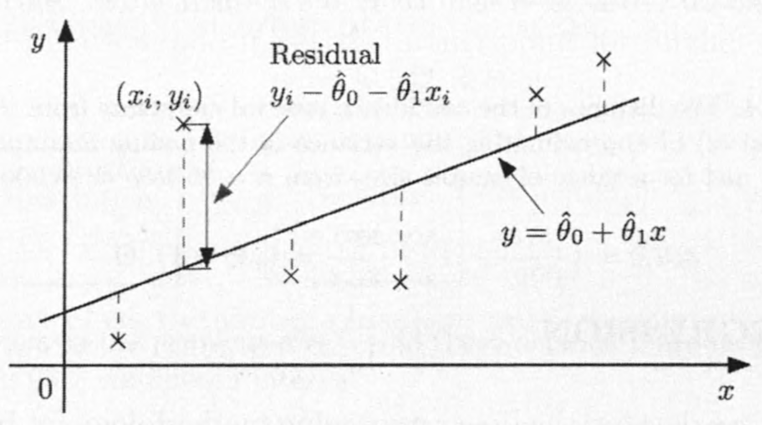
Generally, ${\hat{y}}_{i}$ will be different from the given value $y_{i}$, and the corresponding difference ${\tilde{y}}_{i}={\hat{y}}_{i}−y_{i}$ is called the $i$th residual.
A choice of estimates that results in small residuals is considered to provide a good fit to the data.

Slide 35
The linear regression approach chooses the parameter estimates ${\hat{θ}}_{0}$ and ${\hat{θ}}_{1}$ that minimize the sum of the squared residuals $\sum_{i=1}^{n}{{\left(y_{i}−{\hat{y}}_{i}\right)}^{2}}=\sum_{i=1}^{n}{{\left(y_{i}−θ_{0}−θ_{1}x_{i}\right)}^{2}}$

Slide 36
Note that the postulated linear model may or may not be true.
The true relation between the two variables may be nonlinear.
In practice, there is often an additional phase where we examine whether the hypothesis of a linear model is supported by the data and try to validate the estimated model.

Slide 37
Given $n$ data pairs $\left(x_{i},y_{i}\right)$, the estimates that minimize the sum of the squared residuals are given by ${\hat{θ}}_{1}=\frac{\sum_{i=1}^{n}{\left(x_{i}−\overline{x}\right)\left(y_{i}−\overline{y}\right)}}{\sum_{i=1}^{n}{{\left(x_{i}−\overline{x}\right)}^{2}}}, {\hat{θ}}_{0}=\overline{y}−{\hat{θ}}_{1}\overline{x}.$ where $\overline{x}=\frac{1}{n}\sum_{i=1}^{n}{x_{i}}, \overline{y}=\frac{1}{n}\sum_{i=1}^{n}{y_{i}}$.

Slide 38
Content
Classical Parameter Estimation
Linear Regression
Binary Hypothesis Testing
Significance Testing

Slide 39
We revisit the problem of choosing between two hypotheses.
But unlike the Bayesian formulation, we will assume no prior probabilities.
Two hypotheses: $H_{0}$ and $H_{1}$.
In traditional statistical language, hypothesis $H_{0}$ is often called the null hypothesis and $H_{1}$ the alternative hypothesis.
$H_{0}$ plays the role of a default model, to be proved or disproved on the basis of available data.

Slide 40
The available observation is a vector $X=\left(X_{1},…,X_{n}\right)$ of random variables whose distribution depends on the hypothesis.
Note that consistent with the classical inference framework, these are not conditional probabilities, because the true hypothesis is not treated as a random variable.

Slide 41
Notation: $P\left(X∈A;H_{j}\right)$ is the probability that the observation $X$ belongs to a set $A$ when hypothesis $H_{j}$ is true.
$p_{X}\left(x;H_{j}\right)$ or $f_{X}\left(x;H_{j}\right)$to denote the PMF or PDF, respectively, of the vector $X$, under hypothesis $H_{j}$.

Slide 42
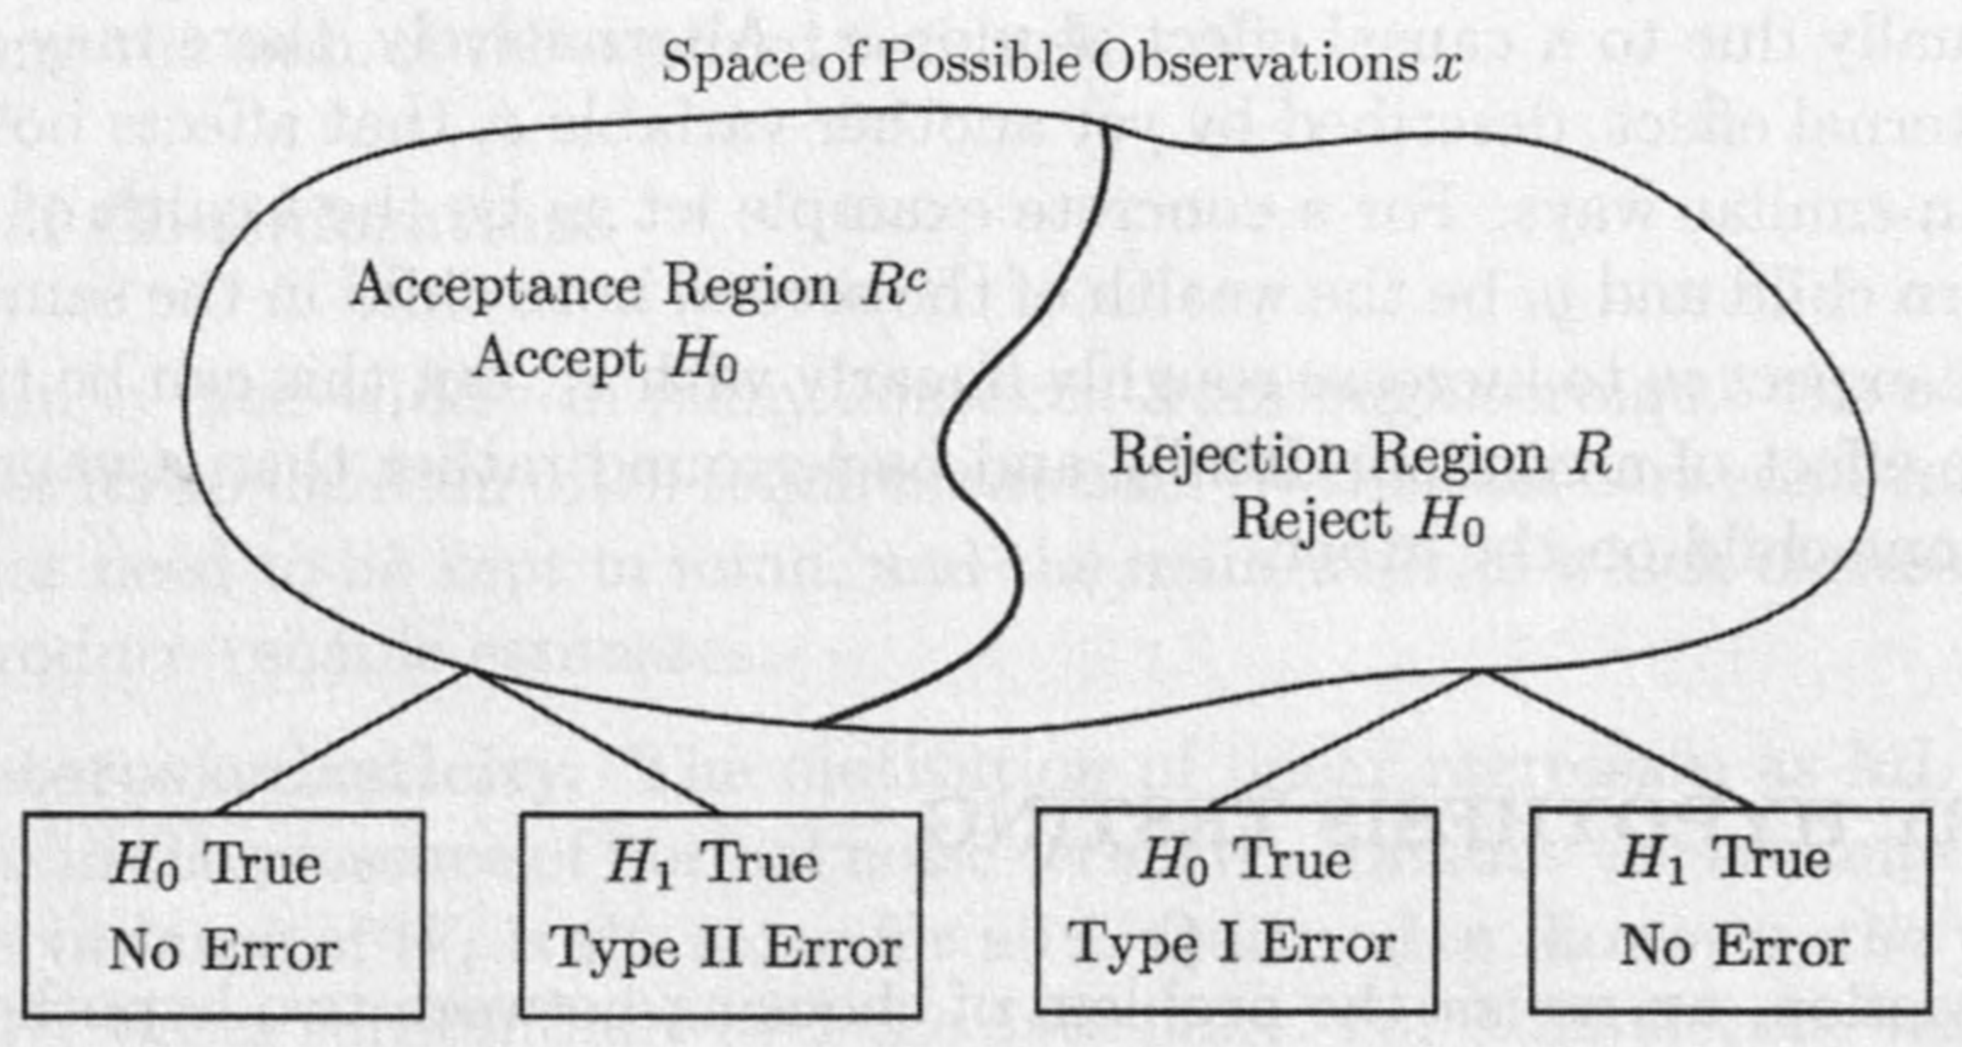
Any decision rule can be represented by a partition of the set of all possible $X=\left(X_{1},…,X_{n}\right)$ into two subsets.
the rejection region $R$,
the acceptance region $R^{c}$.
The choice of a decision rule is equivalent to choosing the rejection region.

Slide 43
For a particular choice of the rejection region $R$, there are two possible types of errors.
Type I error, or a false rejection: Reject $H_{0}$ even though $H_{0}$ is true.
This happens with probability $α\left(R\right)=P\left(X∈R;H_{0}\right)$.
Type II error, or a false acceptance: Accept $H_{0}$ even though $H_{0}$ is false.
This happens with probability $β\left(R\right)=P\left(X∉R;H_{1}\right)$.

Slide 44
To motivate a particular form of rejection region, we draw an analogy with Bayesian hypothesis testing.
Two hypotheses $Θ=θ_{0}$ and $Θ=θ_{1}$ are involved, with respective prior probabilities $p_{Θ}\left(θ_{0}\right)$ and $p_{Θ}\left(θ_{1}\right)$.
The overall probability of error is minimized by using the MAP rule.

Slide 45
Given the observed value $x$ of $X$, declare $Θ=θ_{1}$ be true if $p_{Θ}\left(θ_{0}\right)p_{X|Θ}\left(x|θ_{0}\right)<p_{Θ}\left(θ_{1}\right)p_{X|Θ}\left(x|θ_{1}\right)$
This decision rule can be rewritten as follows.
Define the likelihood ratio $L\left(x\right)$ by $L\left(x\right)=\frac{p_{X|Θ}\left(x|θ_{1}\right)}{p_{X|Θ}\left(x|θ_{0}\right)}$
Declare $Θ=θ_{1}$ to be true if the realized value $x$ of the observation vector $X$ satisfies $L\left(x\right)≥ξ$.

Slide 46
Here $ξ$ is the critical value defined by $ξ=\frac{p_{Θ}\left(θ_{0}\right)}{p_{Θ}\left(θ_{1}\right)}$
If X is continuous, the approach is the same, except that the likelihood ratio is defined as a ratio of PDFs: $L\left(x\right)=\frac{f_{X|Θ}\left(x|θ_{1}\right)}{f_{X|Θ}\left(x|θ_{0}\right)}$.

Slide 47
Motivated by the preceding form of the MAP rule, we are led to consider rejection regions of the form $R=\left\{x | L\left(x\right)>ξ\right\},$ where the likelihood ratio $L\left(x\right)$ is denned similar to the Bayesian case: $L\left(x\right)=\frac{p_{X}\left(x;H_{1}\right)}{p_{X}\left(x;H_{0}\right)}$, or $L\left(x\right)=\frac{f_{X}\left(x;H_{1}\right)}{f_{X}\left(x;H_{0}\right)}$.
The critical value $ξ$ remains free to be chosen on the basis of other considerations.

Slide 48
Likelihood Ratio Test (LRT)
Start with a target value $α$ for the false rejection probability.
Choose a value for $ξ$ such that the false rejection probability is equal to $α$: $P\left(L\left(X\right)>ξ;H_{0}\right)=α$
Once the value $x$ of $X$ is observed, reject $H_{0}$ if $L\left(x\right)>ξ$.
Typical choices for $α$ are $α=0.1$, $α=0.05$, or $α=0.01$, depending on the degree of undesirability of false rejection.

Slide 49
Note that to be able to apply the LRT to a given problem, the following are required.
We must be able to compute $L\left(x\right)$ for any given observation value $x$, so that we can compare it with the critical value $ξ$.
Fortunately, this is the case when the underlying PMFs or PDFs are given in closed form.

Slide 50
We must either have a closed form expression for the distribution of $L\left(X\right)$
or of a related random variable such as $\log{L\left(X\right)}$
or we must be able to approximate it analytically, computationally, or through simulation.
This is needed to determine the critical value $ξ$ that corresponds to a given false rejection probability $α$.

Slide 51
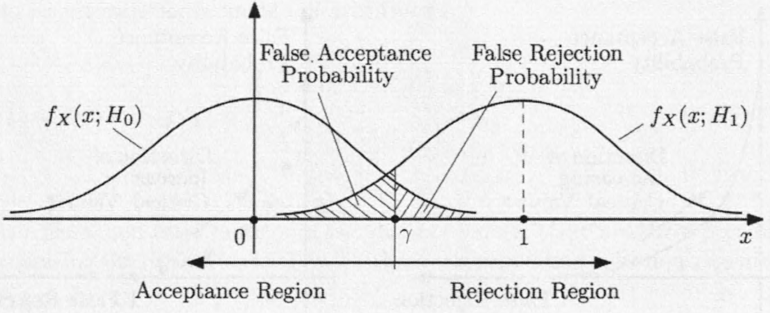

Slide 52
When $L\left(X\right)$ is a continuous random variable, the probability $P\left(L\left(X\right)>ξ;H_{0}\right)$ moves continuously from 1 to 0 as $ξ$ increases.
Thus, we can find a value of $ξ$ for which the requirement $P\left(L\left(X\right)>ξ;H_{0}\right)=α$ is satisfied.
If, however, $L\left(X\right)$ is a discrete random variable, it may be impossible to satisfy the equality $P\left(L\left(X\right)>ξ;H_{0}\right)=α$ exactly, no matter how $ξ$ is chosen.

Slide 53
In such cases, there are several possibilities:
Strive for approximate equality.
Choose the smallest value of $ξ$ that satisfies $P\left(L\left(X\right)>ξ;H_{0}\right)≤α$

Slide 54
We have motivated so far the use of a LRT through an analogy with Bayesian inference.
However, it also has a stronger justification.
For a given false rejection probability, the LRT offers the smallest possible false acceptance probability.

Slide 55
Neyman-Pearson Lemma
Consider a particular choice of $ξ$ in the LRT, which results in error probabilities $P\left(L\left(X\right)>ξ;H_{0}\right)=α$, $P\left(L\left(X\right)≤ξ;H_{1}\right)=β$.
Suppose that some other test, with rejection region $R$, achieves a smaller or equal false rejection probability: $P\left(X∈R;H_{0}\right)≤α (1)$
Then, $P\left(X∉R;H_{1}\right)≥β. (2)$
In addition, if (1) is strict, so is (2).

Slide 56
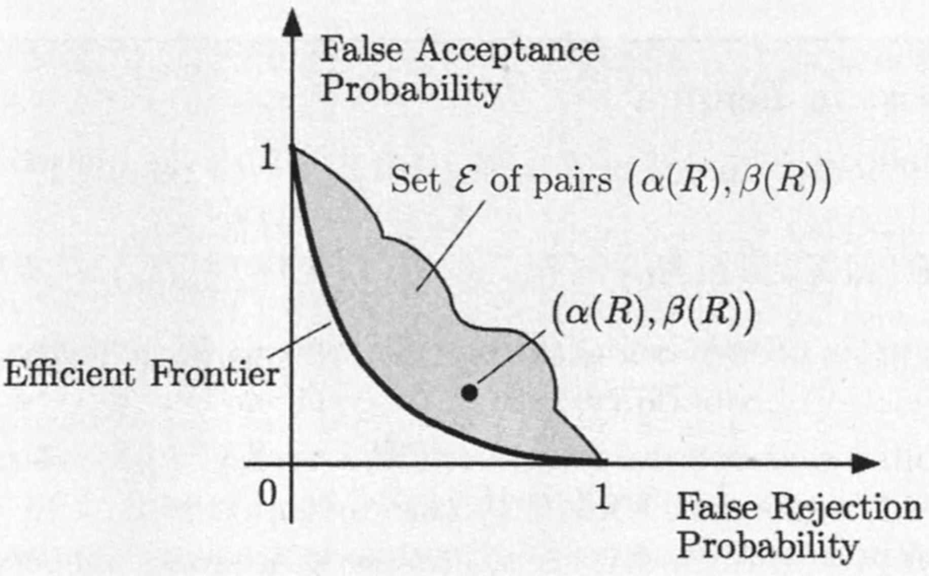

Slide 57
Content
Classical Parameter Estimation
Linear Regression
Binary Hypothesis Testing
Significance Testing

Slide 58
Hypothesis testing problems encountered in realistic settings do not always involve two well-specified alternatives.
So the methodology in the preceding section cannot be applied.
This section introduces an approach to this more general class of problems.
Note: a unique or universal methodology is not available. There is a significant element of judgment and art that comes into play.

Slide 59
Motivation
Consider problems such as the following:
A coin is tossed repeatedly and independently. Is the coin fair?
We observe a sequence of i.i.d. normal random variables $X_{1},…,X_{n}$. Are they standard normal?
Two different drug treatments are delivered to two different groups of patients with the same disease. Is the first treatment more effective than the second?

Slide 60
On the basis of historical data (say, based on the last year), is the daily change of the Dow Jones Industrial Average normally distributed?
On the basis of several sample pairs $\left(x_{i},y_{i}\right)$ of two random variables $X$ and $Y$, can we determine whether the two random variables are independent?
…

Slide 61
In all of the above cases, we are dealing with a phenomenon that involves uncertainty,
presumably governed by a probabilistic model.
We have a default hypothesis, usually called the null hypothesis, denoted by $H_{0}$,
We wish to determine on the basis of the observations $X=\left(X_{1},…,X_{n}\right)$, whether the null hypothesis should be rejected or not.

Slide 62
In order to avoid obscuring the key ideas, we will mostly restrict the scope of our discussion to situations with the following characteristics.
Parametric models: We assume that the observations $X_{1},…,X_{n}$ have a distribution governed by a joint PMF/PDF, which is completely determined by an unknown parameter $θ$ (scalar or vector), belonging to a given set $M$ of possible parameters.

Slide 63
Simple null hypothesis: The null hypothesis asserts that the true value of $θ$ is equal to a given element $θ_{0}$ of $M$.
Alternative hypothesis: The alternative hypothesis, denoted by $H_{1}$, is just the statement that $H_{0}$ is not true, i.e., that $θ≠θ_{0}$.

Slide 64
The General Approach
We introduce the general approach through a concrete example.
We then summarize and comment on the various steps involved.

Slide 65
Example: Is my coin fair?
A coin is tossed independently $n=1000$ times.
Let $θ$ be the unknown probability of heads at each toss.
The set of all possible parameters is $M=\left[0,1\right]$.
The null hypothesis $H_{0}$ ("the coin is fair") is of the form $θ=1/2$. The alternative hypothesis is that $θ≠1/2$.

Slide 66
The observed data is a sequence $X_{1},…,X_{n}$
where $X_{i}$ equals 1 or 0, depending on whether the $i$th toss resulted in heads or tails.
We choose to address the problem by considering the value of $S=X_{1}+…+X_{n}$, the number of heads observed, and using a decision rule of the form: reject $H_{0}$ if $\left|S−\frac{n}{2}\right|>ξ$ where $ξ$ is a suitable critical value, to be determined.

Slide 67
We finally choose the critical value $ξ$ so that the probability of false rejection is equal to a given value $α$: $P\left(reject H_{0};H_{0}\right)=α$
Typically, $α$, called the significance level, is a small number:
In this example, we use $α=0.05$.
Some probabilistic calculations are now needed to determine the critical value $ξ$.

Slide 68
Some probabilistic calculations are now needed to determine the critical value $ξ$.
Under the null hypothesis, the random variable $S$ is binomial with parameters $n=1000$ and $p=1/2$.
Using the normal approximation to the binomial and the normal tables, we find that an appropriate choice is $ξ=31$.

Slide 69
If, for example, the observed value of $S$ turns out to be $s=472$, we have
$$\left|s−500\right|=\left|472−500\right|=28≤31.$$
And the hypothesis $H_{0}$ is not rejected at the 5% significance level.
"not rejected'' (as opposed to "accepted“): We do not have any firm grounds to assert that $θ$ equals ½, as opposed to, say, 0.51.
We can only assert that the observed value of $S$ does not provide strong evidence against hypothesis $H_{0}$.

Slide 70
Significance Testing Methodology
A statistical test of a hypothesis "$H_{0}:θ=θ^{∗}$" is to be performed, based on the observations $X=\left(X_{1},…,X_{n}\right)$.
1. The following steps are carried out before the data are observed.
1.1 Choose a statistic $S$, that is, a scalar random variable that will summarize the data $X$. This involves the choice of a function $h:R^{n}→R$, resulting in the statistic $S=h\left(X\right)$.

Slide 71
1.2 Determine the shape of the rejection region by specifying the set of values of $S$ for which $H_{0}$ will be rejected as a function of a yet undetermined critical value $ξ$.
1.3 Choose the significance level, i.e., the desired probability $α$ of a false rejection of $H_{0}$.
1.4 Choose the critical value $ξ$ so that the probability of false rejection is equal (or approximately equal) to $α$. (At this point, the rejection region is completely determined.)

Slide 72
2. Once the values $x_{1},…,x_{n}$ of $X_{1},…,X_{n}$ are observed:
2.1 Calculate the value $s=h\left(x_{1},…,x_{n}\right)$ of the statistic $S$.
2.2 Reject the hypothesis $H_{0}$ if $s$ belongs to the rejection region.

Slide 73
Comments and interpretation
There is no universal method for choosing the "right'' statistic $S$.
The set of values of $S$ under which $H_{0}$ is not rejected is usually an interval surrounding the peak of the distribution of $S$ under $H_{0}$.
Typical choices for the false rejection probability a range between $α=0.10$ and $α=0.01.$
Step 1.4 is the only place where probabilistic calculations are used.

Slide 74
Given the value of $α$, if the hypothesis $H_{0}$ ends up being rejected, one says that $H_{0}$ is rejected at the a significance level.
Note: It does not mean that the probability of $H_{0}$ being true is less than $α$.
Instead, it means that when this particular methodology is used, we will have false rejections a fraction $α$ of the time.

Slide 75
Quite often, statisticians skip steps 1.3 and 1.4 in the above described methodology.
Instead, once they calculate the realized value $s$ of $S$, they determine and report an associated $p$-value defined by
$$\left\{\min{α| H_{0} would be rejected at the α significance level}\right\}$$

Slide 76
Equivalently, the $p$-value is the value of $α$ for which $s$ would be exactly at the threshold between rejection and non-rejection.
Thus, for example, the null hypothesis would be rejected at the 5% significance level if and only if the $p$-value is smaller than 0.05.

