Slide 1
ENGG2430A Probability and Statistics for Engineers
Chapter 8: Bayesian Statistical Inference
Instructor: Shengyu Zhang

Slide 2
Statistical inference
Statistical inference is the process of extracting information about an unknown variable or an unknown model from available data.
Two main approaches
Bayesian statistical inference
Classical statistical inference

Slide 3
Statistical inference
Main categories of inference problems
parameter estimation
hypothesis testing
significance testing

Slide 4
Statistical inference
Most important methodologies
maximum a posteriori (MAP)
probability rule,
least mean squares estimation,
maximum likelihood,
regression,
likelihood ratio tests

Slide 5
Bayesian versus Classical Statistics
Two prominent schools of thought
Bayesian
Classical/frequentist.
Difference: What’s the nature of the unknown models or variables?
Bayesian: they are treated as random variables with known distributions.
Classical/frequentist: they are treated as deterministic but unknown quantities.

Slide 6
Bayesian
When trying to infer the nature of an unknown model, it views the model as chosen randomly from a given model class.
Introduce a random variable $Θ$ that characterizes the model,
Postulate a prior distribution $p_{Θ}\left(θ\right)$.
Given observed data $x$, one can use Bayes' rule to derive a posterior distribution $p_{Θ|X}\left(θ|x\right)$.
This captures all information that $x$ can provide about $θ$.

Slide 7
Classical/frequentist
View the unknown quantity $θ$ as an unknown constant.
Strives to develop an estimate of $θ$.
We are dealing with multiple candidate probabilistic models, one for each possible value of $θ$.

Slide 8
Model versus Variable Inference
Model inference: the object of study is a real phenomenon or process,…
…for which we wish to construct or validate a model on the basis of available data
e.g., do planets follow elliptical trajectories?
Such a model can then be used to make predictions about the future, or to infer some hidden underlying causes.

Slide 9
Model versus Variable Inference
Variable inference: we wish to estimate the value of one or more unknown variables by using some related, possibly noisy information
e.g., what is my current position, given a few GPS readings?

Slide 10
Statistical Inference Problems
Estimation: a model is fully specified, except for an unknown, possibly multidimensional, parameter $θ$, which we wish to estimate.
This parameter can be viewed as either a random variable …
Bayesian approach
…or as an unknown constant
classical approach.
Objective: to estimate $θ$.

Slide 11
Statistical Inference Problems
Binary hypothesis testing:
start with two hypotheses
use the available data to decide which of the two is true.
$m$-ary hypothesis testing: there is a finite number $m$ of competing hypotheses.
Evaluation: typically by error probability.
Both Bayesian and classical approaches are possible.

Slide 12
Content
Bayesian inference, the posterior distribution
Point estimation, hypothesis testing, MAP
Bayesian least mean squares estimation
Bayesian linear least mean squares estimation

Slide 13
Bayesian inference
In Bayesian inference, the unknown quantity of interest is modeled as a random variable or as a finite collection of random variables.
We usually denote it by $Θ$.
We aim to extract information about $Θ$, based on observing a collection $X=\left(X_{1},…,X_{n}\right)$ of related random variables.
called observations, measurements, or an observation vector.

Slide 14
Bayesian inference
We assume that we know the joint distribution of $Θ$ and $X$.
Equivalently, we assume that we know
A prior distribution $p_{Θ}$ or $f_{Θ}$, depending on whether $Θ$ is discrete or continuous.
A conditional distribution $p_{X|Θ}$ or $f_{X|Θ}$, depending on whether $X$ is discrete or continuous.

Slide 15
Bayesian inference
After a particular value $x$ of $X$ has been observed, a complete answer to the Bayesian inference problem is provided by the posterior distribution $p_{Θ|X}$ or $f_{Θ|X}$.
It encapsulates everything there is to know about $Θ$, given the available information.

Slide 16
Summary of Bayesian Inference
We start with a prior distribution $p_{Θ}$ or $f_{Θ}$ for the unknown random variable $Θ$.
We have a model $p_{X|Θ}$ or $f_{X|Θ}$ of the observation vector $X$.
After observing the value $x$ of $X$, we form the posterior distribution of $Θ$, using the appropriate version of Bayes' rule.

Slide 17
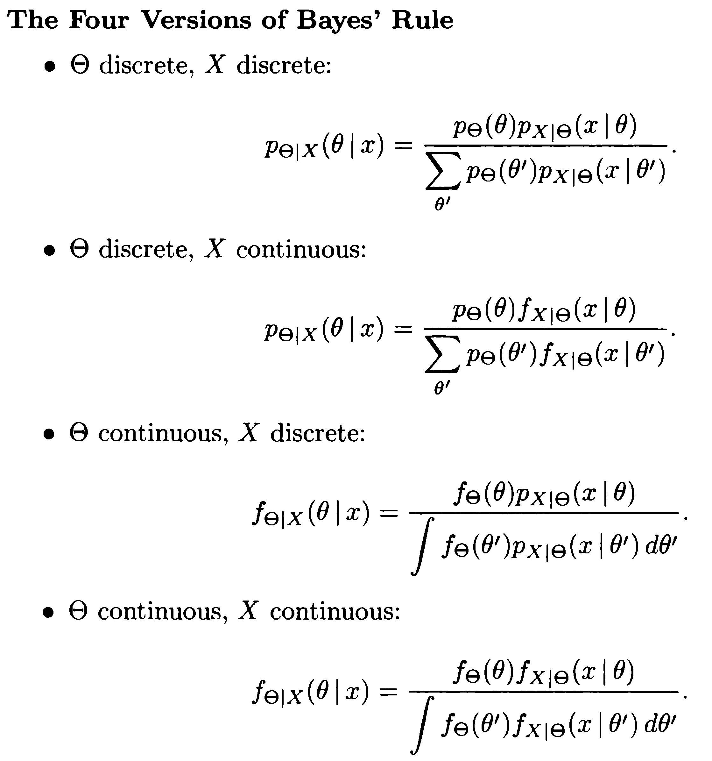
Bayes’ rule: summary
Depending on discrete or continuous $Θ$ and $X$, there are four versions of Bayes' rule.
They are syntactically all similar.

Slide 18
Example: meeting
Romeo and Juliet meeting: Juliet will be late on any date by a random amount $X$, uniformly distributed over the interval $\left[0,θ\right]$.
$θ$ is unknown and is modeled as the value of a random variable uniformly distributed in $\left[0,1\right]$.
Assume that Juliet was late by an amount $x$ on their first date.
Question: How should Romeo use this information to update the distribution of $θ$?

Slide 19
Prior PDF: $f_{Θ}\left(θ\right)=\left\{\begin{matrix}1 & if 0≤θ≤1, \\ 0 & otherwise. \end{matrix}\right.$
Conditional PDF of the observation: $f_{X|Θ}\left(x|θ\right)=\left\{\begin{matrix}1/θ & if 0≤x≤θ, \\ 0 & otherwise. \end{matrix}\right.$

Slide 20
$f_{Θ}\left(θ\right)=1$ if $0≤θ≤1$
$f_{X|Θ}\left(x|θ\right)=1/θ$ if $0≤x≤θ$
Use Bayes' rule: the posterior PDF is $f_{Θ|X}\left(θ|x\right)=\frac{f_{Θ}\left(θ\right)f_{X|Θ}\left(x|θ\right)}{\int_{0}^{1}{f_{Θ}\left(θ^{′}\right)f_{X|Θ}\left(x|θ^{′}\right)dθ^{′}}}$ $=\frac{1/θ}{\int_{x}^{1}{\frac{1}{θ^{′}}dθ^{′}}}=\frac{1}{θ⋅\left|\log{x}\right|}$, $if 0≤x≤θ≤1$
and $f_{Θ|X}\left(θ|x\right)=0$ otherwise.

Slide 21
Example: Inference of common mean of normal
Suppose that $X_{1},…,X_{n}$ are independent normal r.v. with
an unknown common mean,
and known variances $σ_{1}^{2},…,σ_{n}^{2}$.
Suppose that the common mean follows the a normal prior $N\left(x_{0},σ_{0}^{2}\right)$.
Then $X_{i}=Θ+W_{i}$, where
$Θ$, $W_{i}$ are a independent normal r.v.
$Θ$ follows $N\left(x_{0},σ_{0}^{2}\right)$, $W_{i}$ follows $N\left(0,σ_{i}^{2}\right)$.

Slide 22
Last slide: $X_{i}=Θ+W_{i}$.
$Θ$ follows $N\left(x_{0},σ_{0}^{2}\right)$, $W_{i}$ follows $N\left(0,σ_{i}^{2}\right)$.
Prior PDF: $f_{Θ}\left(θ\right)=c_{1}\exp\left\{−\frac{{\left(θ−x_{0}\right)}^{2}}{2σ_{0}^{2}}\right\}$,
Model: $f_{X|Θ}\left(x|θ\right)=c_{2}\exp\left\{−\frac{{\left(x_{1}−θ\right)}^{2}}{2σ_{1}^{2}}\right\}…\exp\left\{−\frac{{\left(x_{n}−θ\right)}^{2}}{2σ_{n}^{2}}\right\}$
$c_{1}$ and $c_{2}$ are constants.
By Bayes’ rule: $f_{Θ|X}\left(θ|x\right)=\frac{f_{Θ}\left(θ\right)f_{X|Θ}\left(x|θ\right)}{\int_{0}^{1}{f_{Θ}\left(θ^{′}\right)f_{X|Θ}\left(x|θ^{′}\right)dθ^{′}}}$
Note: The denominator doesn’t depend on $θ$.

Slide 23
Numerator
$f_{Θ}\left(θ\right)f_{X|Θ}\left(x|θ\right)=c_{1}c_{2}\exp\left\{−\sum_{i=0}^{n}{\frac{{\left(x_{i}−θ\right)}^{2}}{2σ_{i}^{2}}}\right\}.$
The exponent is a quadratic form, thus can be written as $d⋅\exp\left\{−\frac{{\left(θ−m\right)}^{2}}{2v}\right\}$ for some constant $d$, where $m=\left(\sum_{i=0}^{n}{\frac{x_{i}}{σ_{i}^{2}}}\right)/\left(\sum_{i=0}^{n}{\frac{1}{σ_{i}^{2}}}\right)$, $v=1/\left(\sum_{i=0}^{n}{\frac{1}{σ_{i}^{2}}}\right)$ .

Slide 24
Thus $f_{Θ|X}\left(θ|x\right)∝\exp\left\{−\frac{{\left(θ−m\right)}^{2}}{2v}\right\}$
So the posterior PDF $f_{Θ|X}\left(θ|x\right)$is normal with mean $m$ and variance $v$.
Recall prior: $Θ∼N\left(x_{0},σ_{0}^{2}\right)$.
A remarkable property: the posterior distribution of $Θ$ is in the same family as the prior distribution,
the family of normal distributions.

Slide 25
This property opens up the possibility of efficient recursive inference.
Suppose that after $X_{1},…,X_{n}$ are observed, an additional observation $X_{n+1}$ is obtained.
Instead of solving the inference problem from scratch, we can view $f_{Θ|X_{1},…,X_{n}}$ as our prior, and use the new observation to obtain the new posterior $f_{Θ|X_{1},…,X_{n},X_{n+1}}$.

Slide 26
Thus the new posterior is normal distribution with mean $\left(\frac{m}{v}+\frac{x_{n+1 }}{σ_{n+1}^{2}}\right)/\left(\frac{1}{v}+\frac{1}{σ_{n+1}^{2}}\right)$ and variance $1/\left(\frac{1}{v}+\frac{1}{σ_{n+1}^{2}}\right)$.

Slide 27
Content
Bayesian inference, the posterior distribution
Point estimation, hypothesis testing, MAP
Bayesian least mean squares estimation
Bayesian linear least mean squares estimation

Slide 28
MAP
Given the value $x$ of the observation, we select a value of $θ$, denoted $\hat{θ}$, that maximizes the posterior distribution
$p_{Θ|X}\left(θ|x\right)$ if $Θ$ is discrete
$p_{Θ|X}\left(θ|x\right)$ if $Θ$ is continuous
That is, $\hat{θ}=\underset{θ}{argmax}{p_{Θ|X}\left(θ|x\right)}$, if $Θ$ is discrete, $\hat{θ}={argmax}_{θ}{f_{Θ|X}\left(θ|x\right)}$, if $Θ$ is continuous.

Slide 29
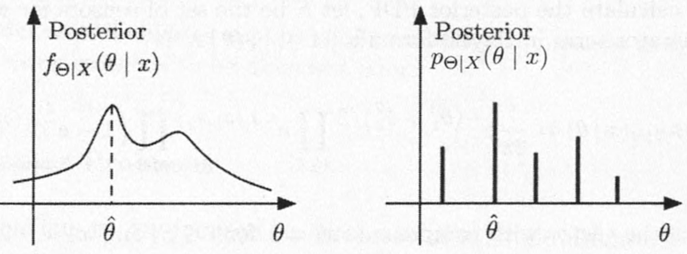
This is called the Maximum a Posteriori probability (MAP) rule.

Slide 30
When $Θ$ is discrete, the MAP rule has an important optimality property.
Since it chooses $θ$ to be the most likely value of $Θ$, it maximizes the probability of correct decision for any given value $x$.
This implies that it also maximizes (over all decision rules) the overall (averaged over all possible values $x$) probability of correct decision.

Slide 31
Computational shortcut
Recall posterior: $p_{Θ|X}\left(θ|x\right)=\frac{p_{Θ}\left(θ\right)p_{X|Θ}\left(x|θ\right)}{\sum_{θ^{′}}{p_{Θ}\left(θ^{′}\right)p_{X|Θ}\left(x|θ^{′}\right)}}$
An important computational shortcut.
The denominator is independent of $θ$.
Thus, to maximize the posterior, we only need to maximize the numerator $p_{Θ}\left(θ\right)p_{X|Θ}\left(x|θ\right)$
or similar expressions if $Θ$ and/or $X$ are continuous.
Calculation of the denominator is unnecessary.

Slide 32
Example
$X_{1},…,X_{n}$ are independent normal r.v. with
an unknown common mean $Θ∼N\left(x_{0},σ_{0}^{2}\right)$,
and known variances $σ_{1}^{2},…,σ_{n}^{2}$.
Posterior: $f_{Θ|X}\left(θ|x\right)∝\exp\left\{−\frac{{\left(θ−m\right)}^{2}}{2v}\right\}$ with $m=\left(\sum_{i=0}^{n}{\frac{x_{i}}{σ_{i}^{2}}}\right)/\left(\sum_{i=0}^{n}{\frac{1}{σ_{i}^{2}}}\right)$, $v=1/\left(\sum_{i=0}^{n}{\frac{1}{σ_{i}^{2}}}\right)$
The MAP estimate: $\hat{θ}=m$.
because the normal PDF is maximized at its mean

Slide 33
Point Estimation
Point estimate: a value that represents our best guess of the value of $Θ$.
Estimate: the numerical value $\hat{θ}$ that we choose on observation $x$.
The value of $\hat{θ}$ is to be determined by applying some function $g$ to the observation $x$, resulting in $\hat{θ}=g\left(x\right)$.
Estimator: the random variable $\hat{Θ}=g\left(X\right)$
its realized value equals $g(x)$ when $X=x$.

Slide 34
Two popular estimators
Two popular estimators:
MAP: $\hat{θ}=\underset{θ}{argmax}{p_{Θ|X}\left(θ|x\right)}$
Conditional Expectation: $\hat{θ}=E\left[Θ|X=x\right]$.
Conditional expectation estimator is also called least mean squares (LMS) estimator.
It minimizes the mean squared error over all estimators.
To be elaborated later.

Slide 35
Example: Romeo and Juliet meeting
Juliet is late on the first date by a random amount $X$.
The distribution of $X$ is uniform over $\left[0,Θ\right]$.
$Θ$ is an unknown random variable with a uniform prior PDF $f_{Θ}$ over the interval $\left[0,1\right]$.
Recall: $f_{Θ|X}\left(θ|x\right)=\frac{1}{θ⋅\left|\log{x}\right|}$, $if 0≤x≤θ≤1$
MAP: $\hat{θ}=x$, because $f_{Θ|X}\left(θ|x\right)$ is decreasing in $θ$ over the range $\left[x,1\right]$.

Slide 36
Last slide: MAP gives $\hat{θ}=x$.
Note that this is an "optimistic" estimate.
If Juliet is late by a small amount on the first date $\left(x≈0\right)$, the estimate of future lateness is also small.
Conditional expectation: less optimistic.
$$E\left[Θ|X=x\right]=\int_{x}^{1}{θ\frac{1}{θ\left|\log{x}\right|}dθ}=\frac{1−x}{\left|\log{x}\right|}.$$

Slide 37
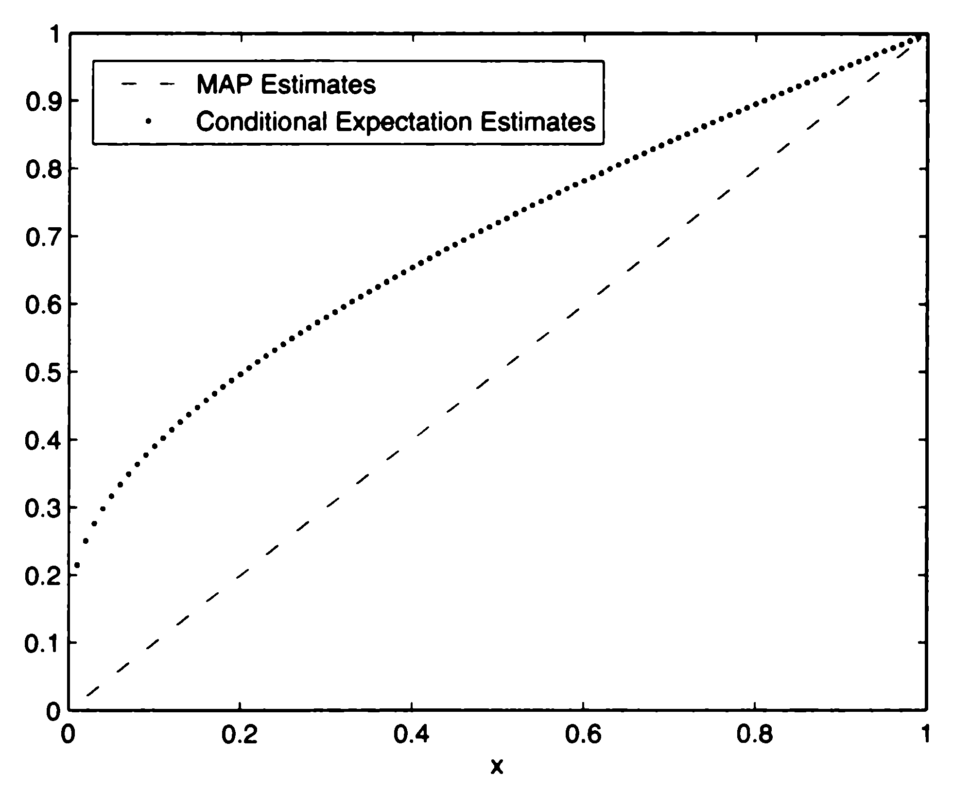
MAP vs. conditional expectation

Slide 38
Hypothesis testing
$Θ$ takes one of $m$ values, $θ_{1},…,θ_{m}$.
$m$ is usually a small integer; often $m=2$.
The $i$th hypothesis: the event $H_{i}≝\left\{Θ=θ_{i}\right\}$.
Once the value $x$ of $X$ is observed, we may use Bayes' rule to calculate the posterior probabilities $P\left(Θ=θ_{i}|X=x\right)=P_{Θ|X}\left(θ_{i}|x\right),$ for each $i$.

Slide 39
MAP: select the hypothesis $H_{i}$ with the largest posterior probability $P\left(Θ=θ_{i}|X=x\right)$.
Equivalently, it selects a hypothesis $H_{i}$ with the largest $P_{Θ}\left(θ_{i}\right)P_{X|Θ}\left(x|θ_{i}\right)$ (if $X$ is discrete) or $P_{Θ}\left(θ_{i}\right)f_{X|Θ}\left(x|θ_{i}\right)$ (if $X$ is continuous).
Computational shortcut

Slide 40
Correct probability
$gMAP\left(x\right)$: the hypothesis selected by the MAP rule when $X=x$,
The probability of correct decision is $P\left(Θ=gMAP\left(x\right)|X=x\right).$
If $S_{i}=\left\{x:gMAP\left(x\right)=H_{i}\right\}$, then the overall probability of correct decision is $P\left(Θ=gMAP\left(X\right)\right)=\sum_{i}{P\left(Θ=θ_{i},X∈S_{i}\right)}$
And the corresponding probability of error is $\sum_{i}{P\left(Θ≠θ_{i},X∈S_{i}\right)}$

Slide 41
Example: binary hypothesis testing
Two biased coins, with probabilities of heads equal to $p_{1}$ and $p_{2}$, respectively.
We choose a coin at random: either coin is equally likely to be chosen.
This gives the prior
We want to infer its identity, based on the outcome of a single toss.

Slide 42
Let $Θ=1$ and $Θ=2$ be the hypotheses that coin 1 or 2, respectively, was chosen.
$X=\left\{\begin{matrix}1 & if head, \\ 0 & if tail. \end{matrix}\right.$
MAP: compare $p_{Θ}\left(1\right)p_{X|Θ}\left(x|1\right)$ and $p_{Θ}\left(2\right)p_{X|Θ}\left(x|2\right)$, and take the larger one.
Since $p_{Θ}\left(1\right)=p_{Θ}\left(2\right)=1/2$, we just need to compare $p_{X|Θ}\left(x|1\right)$ and $p_{X|Θ}\left(x|2\right)$.

Slide 43
For instance, the outcome is tail.
$P\left(tail|Θ=1\right)=1−p_{1}$, $P\left(tail|Θ=2\right)=1−p_{2}$.
So MAP rule selects the $H_{i}$ with smaller $p_{i}$.
We can also toss the selected coin $n$ times.
$X=$ the number of heads obtained.
MAP rule selects the hypothesis under which the observed outcome is most likely.

Slide 44
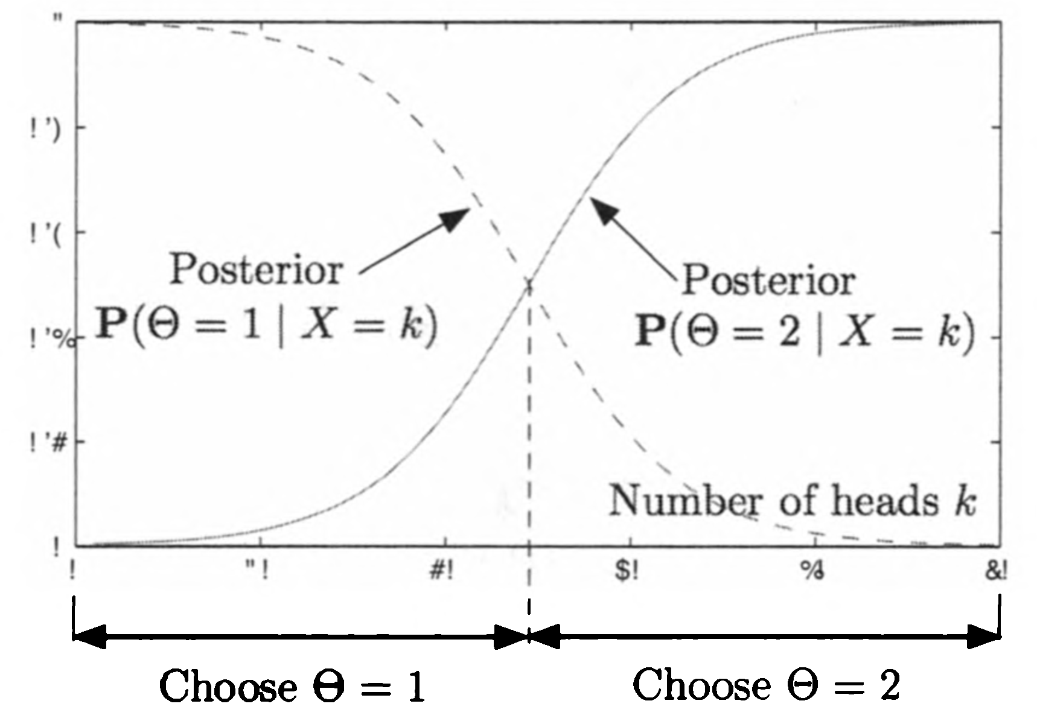
If $X=k$, we should decide $Θ=1$ if $p_{1}^{k}{\left(1−p_{1}\right)}^{n−k}>p_{2}^{k}{\left(1−p_{2}\right)}^{n−k}.$

Slide 45
The character of the MAP rule, as illustrated in the above figure, is typical of decision rules in binary hypothesis testing problems.
It is specified by a partition of the observation space into the two disjoint sets in which each of the two hypotheses is chosen.
In this example, the MAP rule is specified by a single threshold $k^{∗}$:
Accept $Θ=1$ if $k≤k^{∗}$, and accept $Θ=2$ otherwise.

Slide 46
Content
Bayesian inference, the posterior distribution
Point estimation, hypothesis testing, MAP
Bayesian least mean squares estimation
Bayesian linear least mean squares estimation

Slide 47
Estimation without observation
Considering the simpler problem of estimating $Θ$ with a constant $\hat{θ}$, in the absence of an observation $X$.
The estimation error: $\hat{θ}−Θ$
The mean squared error: $E\left[{\left(\hat{θ}−Θ\right)}^{2}\right]$
Question: What’s the minimum $E\left[{\left(\hat{θ}−Θ\right)}^{2}\right]$ (over choices of $\hat{θ}$)?
Answer: $var\left[Θ\right]$, achieved when $\hat{θ}=E\left[Θ\right]$.

Slide 48
proof
$E\left[{\left(\hat{θ}−Θ\right)}^{2}\right]$ $=var\left(Θ−\hat{θ}\right)+{\left(E\left[Θ−\hat{θ}\right]\right)}^{2}$ // def of var() $=var\left(Θ\right)+{\left(E\left[Θ−\hat{θ}\right]\right)}^{2}$ // shifting doesn’t change variance $=var\left(Θ\right)+{\left(E\left[Θ\right]−\hat{θ}\right)}^{2}$ // linearity of expectation $≥var\left(Θ\right)$ // “=” achieved when $\hat{θ}=E\left[Θ\right]$.

Slide 49
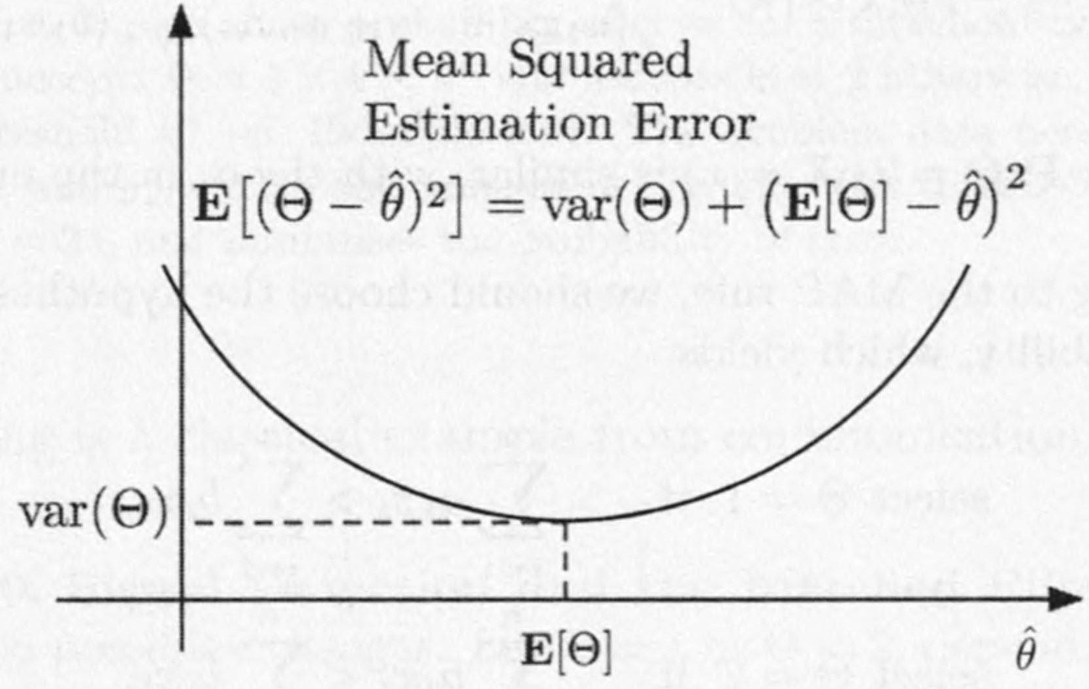

Slide 50
Estimation with observation
Now suppose that we have observation $X$.
We still like to estimate $Θ$ to minimize the mean squared error.
Note that once we know the value $x$ of $X$, the situation is identical to the one considered earlier, …
…except that we are now in a new universe: everything is conditioned on $X=x$.

Slide 51
We can therefore adapt our earlier conclusion.
And assert that the conditional expectation $E\left[Θ|X=x\right]$ minimizes the conditional mean squared error $E\left[{\left(Θ−\hat{θ}\right)}^{2}|X=x\right]$ over all constants $\hat{θ}$.

Slide 52
Generally, the (unconditional) mean squared estimation error associated with an estimator $g\left(X\right)$ is defined as $E\left[{\left(Θ−g\left(X\right)\right)}^{2}\right].$
View $E\left[Θ | X\right]$ as an estimator/function of $X$, the preceding analysis shows that out of all possible estimators.
The mean squared estimation error is minimized when $g\left(X\right)=E\left[Θ|X\right].$

Slide 53
Example
$Θ$: uniform over $\left[4,10\right]$
Independent noise $W$: uniform over $\left[−1,1\right]$
We observe $Θ$ with error $W$: $X=Θ+W$
$f_{Θ}\left(θ\right)=1/6$ if $4≤θ≤10$ (and 0 otherwise).
$X|Θ=θ$ is uniform over $\left[θ−1,θ+1\right]$.
Joint PDF: $f_{Θ,X}\left(θ,x\right)=f_{Θ}\left(θ\right)f_{X|Θ}\left(x|θ\right)=\frac{1}{6}⋅\frac{1}{2}=\frac{1}{12}$
when $θ∈\left[4,10\right]$ and $x∈\left[θ−1,θ+1\right]$.

Slide 54
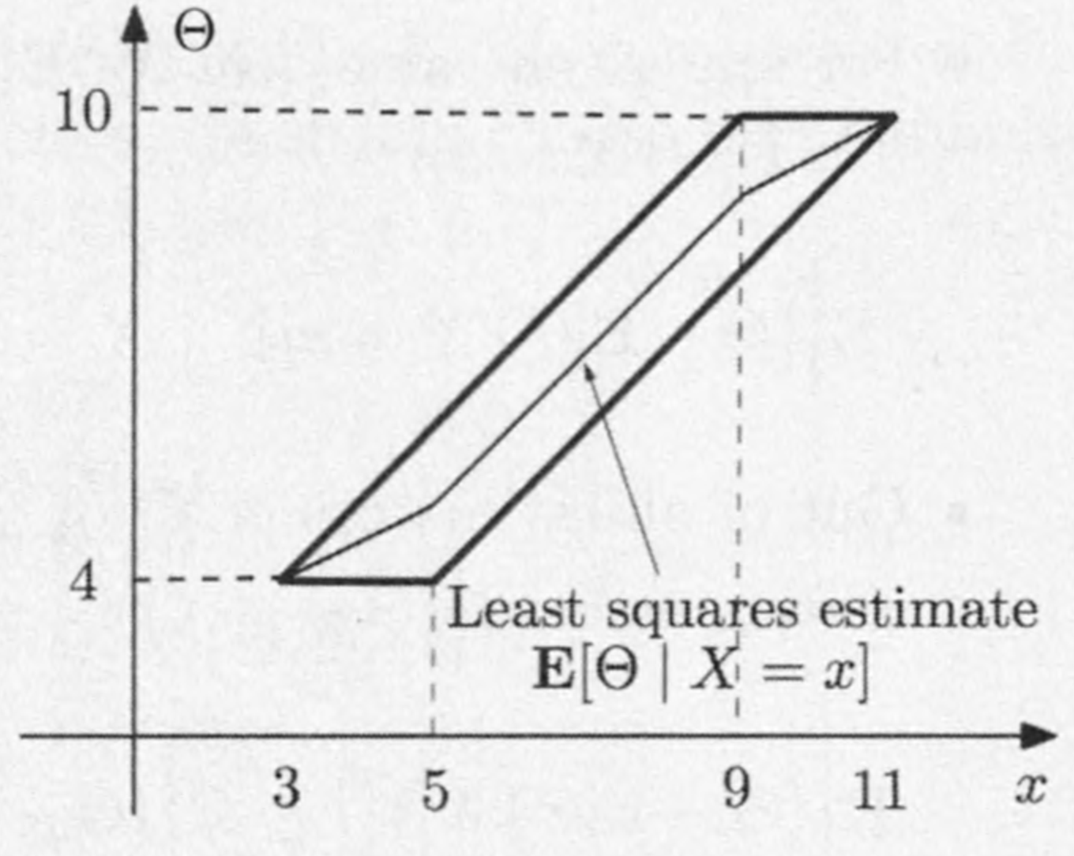
The joint PDF of $Θ$ and $X$ is uniform over the parallelogram.
Given that $X=x$, the posterior PDF $f_{Θ|X}$ is uniform on the corresponding vertical section of the parallelogram.

Slide 55
Thus $E\left[G | X=x\right]$ is the midpoint of that section, which is a piecewise linear function of $x$.
Conditioned on a particular value $x$ of $X$, define the mean squared error as $E\left[{\left(Θ−E\left[Θ | X\right]\right)}^{2}|X=x\right]$,

Slide 56
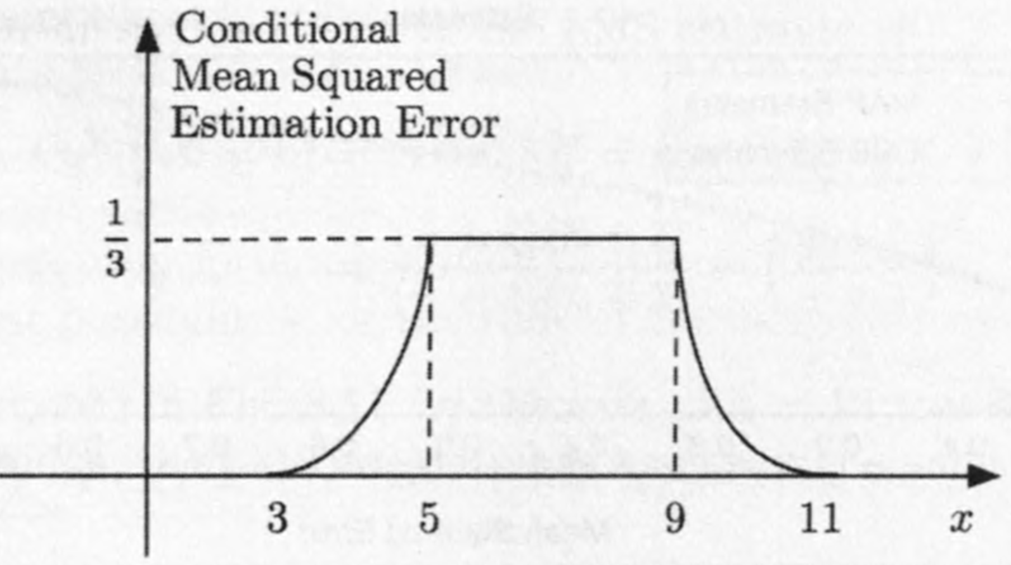
The mean squared error $E\left[{\left(Θ−E\left[Θ | X\right]\right)}^{2}|X=x\right]$, equals the conditional variance of $Θ$.
It is a function of $x$, illustrated in the above figure.

Slide 57
Example: meeting
Juliet is late on the first date by a random amount $X$ that is uniformly distributed over $\left[0,Θ\right]$.
$Θ$: uniform prior over the interval $\left[0,1\right]$.
MAP: $\hat{θ}=x$.
LMS: $\hat{θ}=E\left[Θ|X=x\right]=\int_{x}^{1}{θ\frac{1}{θ\left|\log{x}\right|}dθ}=\frac{1−x}{\left|\log{x}\right|}$
Let’s calculate the conditional mean squared error for the MAP and the LMS estimates.

Slide 58
$E\left[{\left(\hat{θ}−Θ\right)}^{2}|X=x\right]$ $=\int_{x}^{1}{{\left(\hat{θ}−θ\right)}^{2}\frac{1}{θ\left|\log{x}\right|}dθ}$ $=\int_{x}^{1}{\left({\hat{θ}}^{2}−2\hat{θ}θ+θ^{2}\right)\frac{1}{θ\left|\log{x}\right|}dθ}$ $={\hat{θ}}^{2}−\hat{θ}\frac{2\left(1−x\right)}{θ\left|\log{x}\right|}+\frac{1−x^{2}}{2\left|\log{x}\right|}$.

Slide 59
$E\left[{\left(\hat{θ}−Θ\right)}^{2}|X=x\right]={\hat{θ}}^{2}−\hat{θ}\frac{2\left(1−x\right)}{θ\left|\log{x}\right|}+\frac{1−x^{2}}{2\left|\log{x}\right|}.$
MAP: $\hat{θ}=x$. $E\left[{\left(\hat{θ}−Θ\right)}^{2}|X=x\right]=x^{2}+\frac{3x^{2}−4x+1}{2\left|\log{x}\right|}$
LMS: $\hat{θ}=\frac{1−x}{\left|\log{x}\right|}$. $E\left[{\left(\hat{θ}−Θ\right)}^{2}|X=x\right]=\frac{1−x^{2}}{2\left|\log{x}\right|}−{\left(\frac{1−x}{\log{x}}\right)}^{2}$

Slide 60
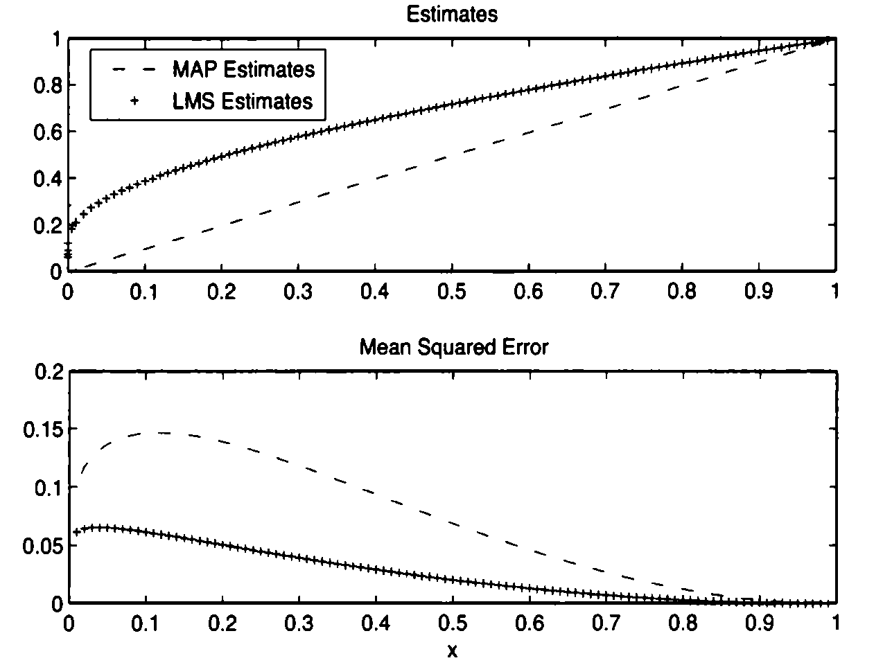
MAP has smaller estimator.
LMS estimator has uniformly smaller mean squared error.

Slide 61
Properties of estimation error
Denote $\hat{Θ}=E\left[Θ|X\right]$, $\tilde{Θ}=\hat{Θ}−Θ$
The LMS estimator and the associated estimation error, respectively.
$E\left[\tilde{Θ}\right]=E\left[\hat{Θ}−Θ\right]=E\left[E\left[Θ|X\right]\right]−E\left[Θ\right]=0$
$E\left[\tilde{Θ}|X=x\right]=E\left[\hat{Θ}−Θ|X=x\right]=E\left[\hat{Θ}|X=x\right]−E\left[Θ|X=x\right]=E\left[Θ|X=x\right]−E\left[Θ|X=x\right]=0.$

Slide 62
$\hat{Θ}=E\left[Θ|X\right]\text{, }\tilde{Θ}=\hat{Θ}−Θ$
$E\left[\hat{Θ}\tilde{Θ}\right]=E\left[E\left[\hat{Θ}\tilde{Θ}|X\right]\right]$ // iterated expectation $=E\left[\hat{Θ}E\left[\tilde{Θ}|X\right]\right]$ // $\hat{Θ}$ depends only on $X$ $=0$ // $E\left[\tilde{Θ}|X=x\right]=0$, $∀x$. So $E\left[\tilde{Θ}|X\right]=0$
$Cov\left(\hat{Θ}\tilde{Θ}\right)=E\left[\hat{Θ}\tilde{Θ}\right]−E\left[\hat{Θ}\right]E\left[\tilde{Θ}\right]=0−0=0$.
Therefore, by considering the variance of both sides in $Θ=\tilde{Θ}+\hat{Θ}$, we have $var\left(Θ\right)=var\left(\hat{Θ}\right)+var\left(\tilde{Θ}\right)$

Slide 63
Content
Bayesian inference, the posterior distribution
Point estimation, hypothesis testing, MAP
Bayesian least mean squares estimation
Bayesian linear least mean squares estimation

Slide 64
LMS estimator is sometimes hard to compute, and we need alternatives.
We derive an estimator that minimizes the mean squared error within a restricted class of estimators: linear functions of the observations.
This estimator may result in higher mean squared error.
But it has a significant computational advantage.
It requires simple calculations, involving only means, variances, and covariances of the parameters and observations.

Slide 65
A linear estimator of a random variable $Θ$, based on observations $X_{1},…,X_{n}$, has the form $\hat{Θ}=a_{1}X_{1}+…+a_{n}X_{n}+b$
Given a particular choice of the scalars $a_{1},…,a_{n},b$, the corresponding mean squared error is $E\left[{\left(\hat{Θ}−a_{1}X_{1}−…−a_{n}X_{n}−b\right)}^{2}\right]$
The linear LMS estimator chooses $a_{1},…,a_{n},b$ to minimize the above expression.

Slide 66
We first develop the solution for the case where $n=1$, and then generalize.
The estimator is $\hat{Θ}=aX+b$ and the mean squared error is $E\left[{\left(\hat{Θ}−aX−b\right)}^{2}\right]$.
We are interested in finding $a$ and $b$ that minimize this error.

Slide 67
If $a$ is chosen, then it’s easy to find the optimal $b$:
Choose a constant $b$ to estimate the random variable $Θ−aX$.
By the discussion in previous section, the best choice is $b=E\left[Θ−aX\right]=E\left[Θ\right]−aE\left[X\right]$.
Thus it remains to minimize $E\left[{\left(Θ−aX−E\left[Θ\right]+aE\left[X\right]\right)}^{2}\right]$ which is $var\left(Θ−aX\right)$.

Slide 68
$var\left(Θ−aX\right)$ $=var\left(Θ\right)+a^{2}var\left(X\right)+2⋅cov\left(Θ,−aX\right)$ $=var\left(Θ\right)+a^{2}var\left(X\right)−2a⋅cov\left(Θ, X\right)$
This is minimized when $a=\frac{cov\left(Θ, X\right)}{var\left(X\right)}=ρ\frac{σ_{Θ}}{σ_{X}}$
$σ_{Θ}$ and $σ_{X}$: standard deviation of $Θ$ and $X$, respectively.
$ρ=\frac{cov\left(Θ, X\right)}{σ_{Θ}σ_{X}}$: the correlation coefficient.

Slide 69
With this choice of $a$, the estimator $\hat{Θ}=aX+b=aX+E\left[Θ\right]−aE\left[X\right]$ $=a\left(X−E\left[X\right]\right)+E\left[Θ\right]$ $=ρ\frac{σ_{Θ}}{σ_{X}}\left(X−E\left[X\right]\right)+E\left[Θ\right]$.
And the mean squared estimation error is $var\left(Θ−\hat{Θ}\right)=\left(1−ρ^{2}\right)var\left(Θ\right)$

Slide 70
Example
Juliet is late by an amount $X$ uniformly distributed over $\left[0, Θ\right]$, and $Θ$ is a random variable with a uniform prior PDF $f_{Θ}\left(θ\right)$ over the interval $\left[0,1\right]$.
Let us derive the linear LMS estimator of $Θ$ based on $X$.
By law of iterated expectation, $E\left[X\right]=E\left[E\left[X|Θ\right]\right]=E\left[Θ/2\right]=\frac{E\left[Θ\right]}{2}=\frac{1}{4}$

Slide 71
By law of total variance, $var\left(X\right)=E\left[var\left(X|Θ\right)\right]+var\left(E\left[X|Θ\right]\right)$ $=E\left[\frac{Θ^{2}}{12}\right]+var\left(\frac{Θ}{2}\right)$ $=\frac{1}{12}\int_{0}^{1}{θ^{2}dθ}+\frac{1}{4}\frac{{\left(1−0\right)}^{2}}{12}=\frac{7}{144}$
Now we compute $cov\left(Θ,X\right)$.
$E\left[ΘX\right]=E\left[E\left[ΘX|Θ\right]\right]=E\left[ΘE\left[X|Θ\right]\right]$ $=E\left[Θ^{2}/2\right]=1/6$

Slide 72
$cov\left(Θ,X\right)=E\left[ΘX\right]−E\left[Θ\right]E\left[X\right]=\frac{1}{6}−\frac{1}{2}⋅\frac{1}{4}=\frac{1}{24}$
The linear LMS estimator is
$\hat{Θ}=E\left[Θ\right]+\frac{cov\left(Θ,X\right)}{var\left(X\right)}\left(X−E\left[X\right]\right)$ $=\frac{1}{2}+\frac{1/24}{7/144}\left(X−\frac{1}{4}\right)=\frac{6}{7}X+\frac{2}{7}$

