Slide 1
ENGG2430A Probability and Statistics for Engineers
Chapter 4: Further Topics on Random Variables
Instructor: Shengyu Zhang

Slide 2
Content
Derived Distributions
Covariance and Correlation
Conditional Expectation and Variance Revisited
Transforms
Sum of a Random Number of Independent Random Variables

Slide 3
more advanced topics
We introduce methods that are useful in:
deriving the distribution of a function of one or multiple random variables;
dealing with the sum of independent random variables, including the case where the number of random variables is itself random;
quantifying the degree of dependence between two random variables.

Slide 4
We’ll introduce a number of tools
transforms
convolutions,
We’ll refine our understanding of the concept of conditional expectation.

Slide 5
Derived distributions
Consider functions $Y=g(X)$ of a continuous random variable $X$.
Question: Given the PDF of $X$, how to calculate the PDF of $Y$?
Also called a derived distribution.
The principal method for doing so is the following two-step approach.

Slide 6
Calculation of PDF of $Y = g(X)$
Calculate the CDF $F_{Y}$ of $Y$ using the formula
$$F_{Y}\left(y\right)=P\left(g\left(X\right)≤y\right)=\int_{\{x|g(x)≤y\}}{f_{X}(x)dx}$$
Differentiate $F_{Y}$to obtain the PDF $f_{Y}$ of $Y$:
$$f_{Y}\left(y\right)=\frac{dF_{Y}}{dy}\left(y\right).$$

Slide 7
Example 1
Let $X$ be uniform on $\left[0,1\right]$, and let $Y=\sqrt{X}$.
Note that for every $y∈\left[0,1\right]$, we have
$$F_{Y}\left(y\right)=P\left(Y≤y\right)$$
$=P\left(\sqrt{X}≤y\right)$
$=P\left(X ≤y^{2}\right)$
$=y^{2}$

Slide 8
Example 1
We then differentiate and obtain the following (for $0≤y≤1$)
$$f_{Y}\left(y\right)=\frac{dF_{Y}}{dy}\left(y\right)=\frac{d(y^{2})}{dy}=2y,$$
Outside the range $\left[0,1\right]$:
The CDF $F_{Y}(y)$ is constant: $F_{Y}(y)=\left\{\begin{matrix}0 & \text{for} y≤0 \\ 1 & \text{for} y≥1\end{matrix}\right.$
Thus by differentiating, $f_{Y}\left(y\right)=0$ for $y∉\left[0,1\right]$.

Slide 9
Example 2
John Slow is driving from Boston to NYC, a distance of 180 miles.
The driving speed is constant, whose value is uniformly distributed between 30 and 60 miles per hour.
Question: What is the PDF of the duration of the trip?

Slide 10
Example 2
Let $X$ be the speed and let $Y=g(X)$ be the trip duration:
$$g\left(X\right)=\frac{180}{X}.$$
To find the CDF of $Y$, we must calculate
$$P\left(Y≤y\right)=P\left(\frac{180}{X}≤y \right)=P\left(\frac{180}{y}≤X\right).$$

Slide 11
Example 2
We use the given uniform PDF of $X$, which is
$$f_{X}\left(x\right)= \left\{\begin{matrix}1/30 & \text{if} 30≤x≤60, \\ 0 & \text{otherwise}\text{.} \end{matrix}\right.$$
and the corresponding CDF, which is
$$F_{X}\left(x\right)=\left\{\begin{matrix}0 & \text{if} x≤30, \\ (x−30)/30, & \text{if} 30≤x≤60, \\ 1 & \text{if} 60≤x. \end{matrix}\right.$$

Slide 12
Example 2
Thus,
$$F_{Y}\left(y\right)=P\left(\frac{180}{y}≤X\right)=1−F_{X}\left(\frac{180}{y}\right)$$
$=\left\{\begin{matrix}0 & \text{if} x ≤\frac{180}{60}, \\ 1−\frac{\frac{180}{y}−30}{30} & \text{if} \frac{180}{60}≤y≤\frac{180}{30}, \\ 1 & \text{if} \frac{180}{30}≤y. \end{matrix}\right.$

Slide 13
Example 2
$=\left\{\begin{matrix}0 & \text{if} y≤3, \\ 2−(6/y) & \text{if} 3≤y≤6, \\ 1 & \text{if} 6≤y. \end{matrix}\right.$
Differentiating this expression, we obtain the PDF of $Y$:
$$f_{Y}\left(y\right)= \left\{\begin{matrix}0 & \text{if} y≤3, \\ 6/y^{2} & \text{if} 3≤y≤6, \\ 0 & \text{if} 6≤y. \end{matrix}\right.$$

Slide 14
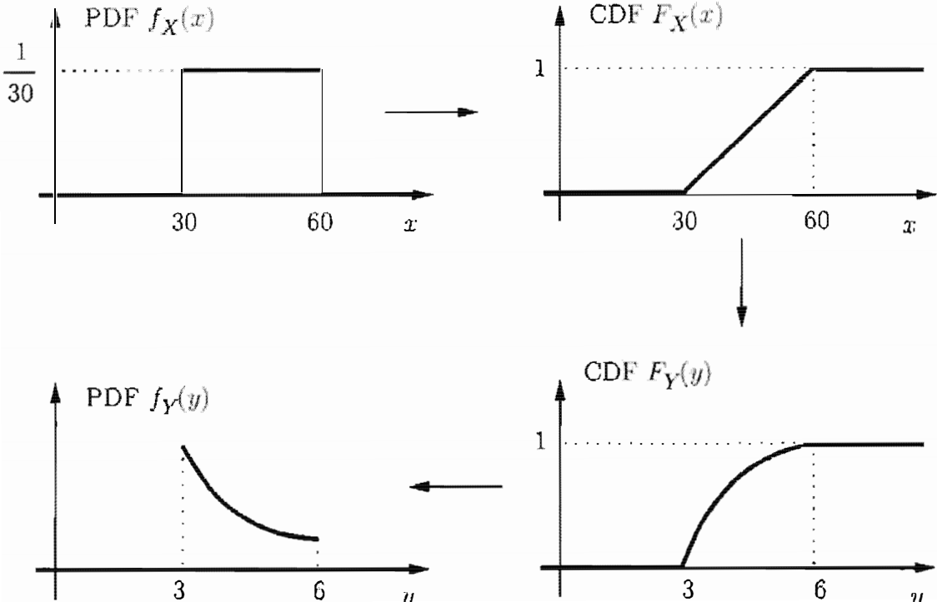
Illustration of the whole process
The arrows indicate the flow of the calculation.

Slide 15
Example 3
Let$Y=g(X)=X^{2}$, where $X$ is a random variable with known PDF.
For any $y≥0$ , we have
$F_{Y}\left(y\right)=P\left(Y≤y\right)$
$=P\left(X^{2}≤y\right)$
$=P\left(−\sqrt{y}≤X≤\sqrt{y}\right)$
$= F_{X}\left(\sqrt{y}\right)−F_{X}\left(−\sqrt{y}\right),$

Slide 16
Example 3
And therefore, by differentiating and using the chain rule,
$$f_{Y}=\frac{1}{2\sqrt{y}}f_{X}\left(\sqrt{y}\right)+\frac{1}{2\sqrt{y}}f_{X}\left(−\sqrt{y}\right), y≥0.$$

Slide 17
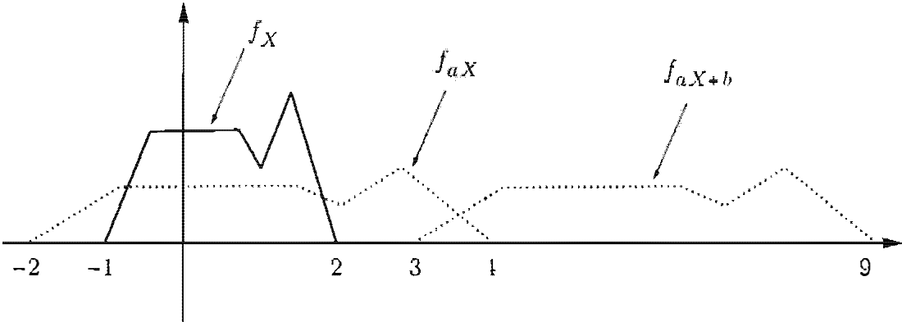
The Linear Case
The PDF of $aX+b$ in terms of the PDF $X$.
In this figure: $a=2$and $b=5$.

Slide 18
Intuition
As a first step, we obtain the PDF of $aX$. The range of $Y$is wider than the range of $X$, by a factor of $a$.
Thus, the PDF must be stretched (scaled horizontally) by the factor.

Slide 19
Intuition
But in order to keep the total area under the PDF (vertically) by the same factor $a$, we need to scale down the PDF (vertically) by the same factor $a$.

Slide 20
Intuition
How about $b$?
The random variable $aX+b$ is the same as $aX$except that its values are shifted by $b$.
Accordingly, we take the PDF of $aX$and shift it (horizontally) by $b$.

Slide 21
Intuition
The end result of these operations is the PDF of $Y=aX+b$ and is given mathematically by
$$f_{Y}\left(y\right)=\frac{1}{\left|a\right|}f_{X}\left(\frac{y−b}{a}\right)$$
Next: formal verification of this formula.

Slide 22
Formal calculation
Let $X$ be a continuous random variable with PDF $f_{X}$, and let
$$Y=aX+b,$$
where $a$ and $b$ are scalars, with $a≠0$.
Then,
$$f_{Y}\left(y\right)=\frac{1}{\left|a\right|}f_{X}\left(\frac{y−b}{a}\right).$$

Slide 23
Formal calculation
First calculate the CDF of $Y$, and differentiate.
(1) Calculate the CDF , we have
$$F_{Y}\left(y\right)$$ | $$=P\left(Y≤y\right)$$
 | $$=P\left(aX+b≤y\right)$$
 | $$=P\left(X≤\frac{y−b}{a}\right)$$
 | $$=F_{X}\left(\frac{y−b}{a}\right)$$

Slide 24
Formal calculation
(2) Differentiate this equality and use the chain rule, to obtain
$$f_{Y}\left(y\right)=\frac{dF_{Y}}{dy}\left(y\right)$$
$$=\frac{1}{a}f_{X}\left(\frac{y−b}{a}\right).$$
We only show the steps for the case where $a>0$; the case $a<0$is similar.

Slide 25
Example 4. Linear of Exponential
Suppose that $X$ is an exponential random variable with PDF
$$f_{X}\left(x\right)=\left\{\begin{aligned}λe^{−λx}, \text{if} x≥0, \\ 0, \text{otherwise},\end{aligned}\right.$$
where $λ$ is a positive parameter.

Slide 26
Example 4. Linear of Exponential
Let $Y = aX+b$. Then,
$$f_{Y}\left(y\right)=\left\{\begin{aligned}\frac{λ}{\left|a\right|}e^{−λ(y−b)/a}, \text{if} (y−b)/a ≥0, \\ 0, \text{otherwise},\end{aligned}\right.$$
If $b=0$ and $a>0$, then $Y$ is an exponential random variable with parameter $λ/a$.

Slide 27
Example 4. Linear of Exponential
Let $Y = aX+b$. Then,
$$f_{Y}\left(y\right)=\left\{\begin{aligned}\frac{λ}{\left|a\right|}e^{−λ(y−b)/a}, \text{if} (y−b)/a ≥0, \\ 0, \text{otherwise},\end{aligned}\right.$$
In general, however, $Y$ need not be exponential.
For example, if $a<0$ and $b=0$, then the range of $Y$ is the negative real axis.
Consider $Y=−X$.

Slide 28
Example 5. Linear of Normal
Suppose that $X$ is a normal random variable with mean $μ$ and variance $σ^{2}$, and let $Y=aX+b$, where $a$ and $b$ are scalars, with $a≠0$.
We have
$$f_{X}\left(x\right)=\frac{1}{\sqrt{2π}σ}e^{−\frac{{(x−μ)}^{2}}{2σ^{2}}}$$

Slide 29
Example 5. Linear of Normal
Therefore,
$f_{Y}\left(y\right)=\frac{1}{\left|a\right|}{ f}_{X }\left(\frac{y−b}{a}\right)$
$=\frac{1}{\left|a\right|}\frac{1}{\sqrt{2π}σ}\exp\left\{−\frac{{\left(\frac{y−b}{a}−μ\right)}^{2}}{2σ^{2}}\right\}$
$= \frac{1}{\sqrt{2π}|a|σ}exp\left\{−\frac{({y−b−aμ)}^{2}}{2a^{2}σ^{2}}\right\}$

Slide 30
Example 5. Linear of Normal
$$f_{Y}\left(y\right)=\frac{1}{\sqrt{2π}|a|σ}exp\left\{−\frac{({y−b−aμ)}^{2}}{2a^{2}σ^{2}}\right\}$$
We recognize this as a normal PDF with mean $aμ+b$ and variance${ a}^{2}σ^{2}$.
In particular, $Y$ is a normal random variable.

Slide 31
The Monotonic Case
The calculation and the formula for the linear case can be generalized to the case where $g$ is a monotonic function.
Let $X$ be a continuous random variable and suppose that its range is contained in a certain interval $I$,
$f_{X}(x)=0, ∀x∈I$.

Slide 32
The Monotonic Case (cont.)
We consider the random variable $Y=g(X),$ and assume that $g$ is strictly monotonic over the interval $I$, so that either
(monotonically increasing case) $g(x)<g(x′)$ for all $x, x′∈I$ satisfying $x<x^{′}$, or
(monotonically decreasing case) $g(x)>g(x′)$ for all $x, x′∈I$ satisfying $x<x′$.

Slide 33
The Monotonic Case (cont.)
Furthermore, we assume that the function $g$ is differentiable.
Its derivative will necessarily be
nonnegative in the increasing case
nonpositive in the decreasing case

Slide 34
The Monotonic Case (cont.)
An important fact is that a strictly monotonic function can be “inverted”.
There is some function $h$, called the inverse of $g$, such that for all $x∈I$, we have
$$y=g\left(x\right) \text{if} \text{and} \text{only} \text{if} x=h(y).$$

Slide 35
The Monotonic Case (cont.)
In Example 2, the inverse of the function $g(x)=180/x$ is$h(y)=180/y$, because we have $y=180/x$ if and only if$x=180/y$.
Other such examples of pairs of inverse functions include
$$g\left(x\right)= ax+b, h\left(y\right)=\frac{y−b}{a}.$$
where $a$ and $b$ are scalars with $a≠0$

Slide 36
The Monotonic Case (cont.)
and
$$g\left(x\right)=e^{ax}, h\left(y\right)=\frac{\ln{y}}{a}.$$
where $a$ is a nonzero scalar.
For strictly monotonic functions $g$, the following is a convenient analytical formula for the PDF of the function $Y=g(X).$

Slide 37
The monotonic case (cont.)
Suppose that $g$ is strictly monotonic and that for some function $h$ and all $x$ in the range of $X$ we have
$$y=g\left(x\right) \text{if} \text{and} \text{only} \text{if} x=h(y).$$
Assume that $h$ is differentiable.
Then, the PDF of $Y$ in the region where $f_{Y}\left(y\right)>0$ is given by
$$f_{Y}\left(y\right)=f_{X}\left(h(y)\right)\left|\frac{dh}{dy}(y)\right|$$

Slide 38
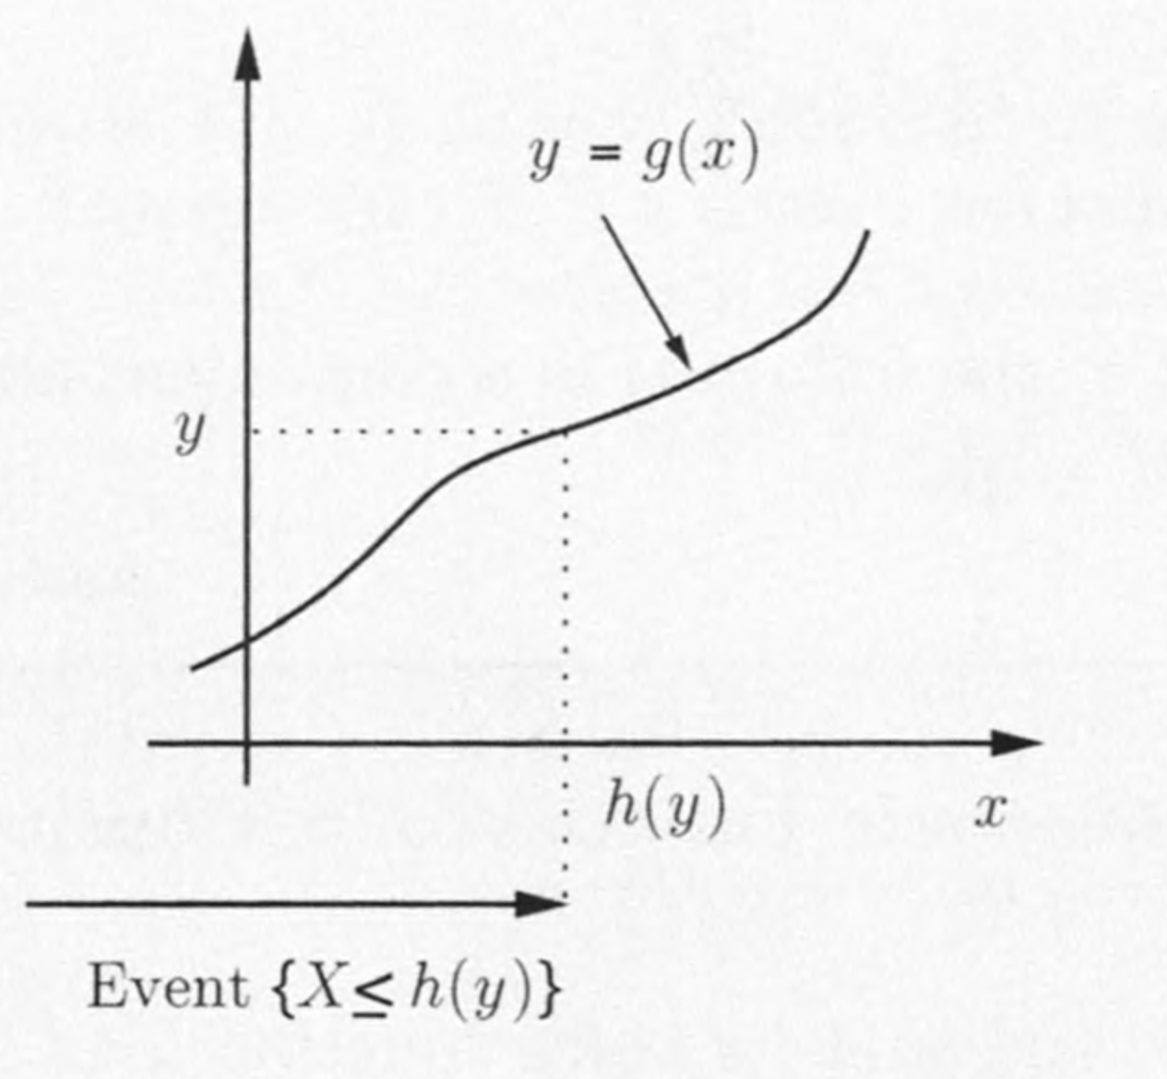
Verification
Assume that $g$ increasing.
We have
$$F_{Y}\left(y\right)=P\left(g(X)≤y\right)$$
$$=P\left(X≤h(y)\right)$$
$$=F_{X}\left(h(y)\right),$$
The second equality can be justified the monotonically increasing property of $g$.

Slide 39
Last slide: $F_{Y}\left(y\right)=F_{X}\left(h(y)\right)$
By differentiating this relation, using also the chain rule, we obtain
$$f_{Y}\left(y\right)=\frac{dF_{Y}}{dy}\left(y\right)$$
$=f_{X }(h(y)) \frac{dh}{dy}\left(y\right)$

Slide 40
Because $g$ is monotonically increasing, $h$ is also monotonically increasing, so its derivative is nonnegative:
$$\frac{dh}{dy}\left(y\right)=\left|\frac{dh}{dy}\left(y\right)\right|$$
This justifies the PDF formula for a monotonically increasing function $g$.

Slide 41
The case of monotonically decreasing function is similar.
We differentiate instead the relation
$$F_{Y}\left(y\right)=P\left(g(X)≤y\right)$$
$=P\left(X≥h(y)\right)$
$={1−F}_{X}\left(h(y)\right),$
When $g$ is decreasing, the event $\left\{g\left(X\right)≤y\right\}$ is the same as the event $\left\{X≥h\left(y\right)\right\}$.

Slide 42
Example: quadratic function revisited
Let$Y=g(X)=X^{2}$, where $X$ is a continuous uniform random variable on $(0, 1].$
$g$ is strictly monotonic within this interval.
Its inverse is $h(y)=\sqrt{y}$.
Thus, for any $y∈\left(0,1\right]$, we have
$$f_{X}\left(\sqrt{y}\right)=1. \left|\frac{dh}{dy}\left(y\right)\right|= \frac{1}{2\sqrt{y}}.$$

Slide 43
Example: quadratic function revisited
$f_{X}\left(\sqrt{y}\right)=1. \left|\frac{dh}{dy}\left(y\right)\right|= \frac{1}{2\sqrt{y}}$
Thus
$$f_{Y}\left(y\right)= \left\{\begin{aligned}\frac{1}{2\sqrt{y}}, \text{if} y∈\left(0,1\right], \\ 0, \text{otherwise}.\end{aligned}\right.$$

Slide 44
Functions of more random variables
Consider now functions of 2 or more r.v.
Recall the two-step procedure for one r.v.
calculates the CDF
differentiates to obtain the PDF.
This applies to the case with $≥2$ r.v. as well.

Slide 45
Example: archer shooting
Two archers shoot at a target.
The distance of each shot from the center of the target is uniformly distributed from $0$ to $1$, independent of the other shot.
Question: What is the PDF of the distance of the losing shot from the center?

Slide 46
Example: archer shooting
Let $X$ and $Y$ be the distances from the center of the first and second shots, respectively.
$Z$: the distance of the losing shot:
$$Z=\max\left\{X, Y\right\}.$$
Since $X$ and $Y$ are uniformly distributed over $\left[0,1\right]$,
we have, for all $z∈\left[0, 1\right]$,
$$P\left(X≤z\right)=P\left(Y≤z\right)=z.$$

Slide 47
Example: archer shooting
Thus, using the independence of $X$ and $Y$, we have for all $z∈\left[0,1\right]$,
$$F_{Z}\left(z\right)=P\left(\max{⁡\{X, Y\}}≤z\right)$$
$= P\left(X≤z, Y≤z\right)$
$=P\left(X≤z\right)P\left(Y≤z\right)$
$=z^{2}.$
Differentiating, we obtain
$$f_{Z}\left(z\right)= \left\{\begin{aligned}2z, \text{if} 0≤z≤1. \\ 0, \text{otherwise}. \end{aligned}\right.$$

Slide 48
Example: $Y/X$
Let $X$ and $Y$ be independent random variables that are uniformly distributed on the interval $[0, 1].$
Question: What is the PDF of the random variable $Z=Y/X$?

Slide 49
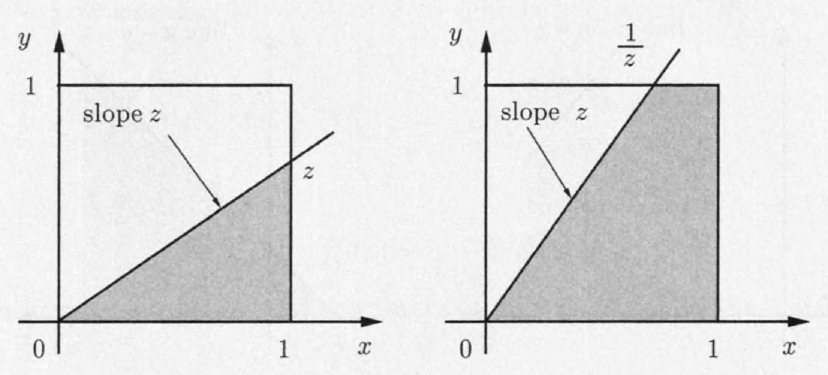
The value $P(Y/X≤z)$ is equal to shaded subarea of unit square.
The figure on the left deals with the case where $0≤z≤1$.
The figure on the right refers to the case where $z>1$.

Slide 50
We will find the PDF of $Z$ by first finding its CDF and then differentiating.
We consider separately the case $0≤z≤1$ and $z>1$.

Slide 51
$F_{z}\left(z\right)=P\left(Y/X≤z\right)$
$$=\left\{\begin{aligned}z/2, \text{if} 0≤z≤1, \\ 1−1/2z, \text{if} z>1, \\ 0, \text{otherwise} \end{aligned}\right.$$

Slide 52
Example: $Y/X$
$F_{z}\left(z\right)=P\left(Y/X≤z\right)$
$$=\left\{\begin{aligned}z/2, \text{if} 0≤z≤1, \\ 1−1/2z, \text{if} z>1, \\ 0, \text{otherwise} \end{aligned}\right.$$
By differentiating, we obtain the pdf of $Z$:
$$f_{z}\left(z\right)= \left\{\begin{aligned}1/2, \text{if} 0≤z≤1, \\ 1/(2z^{2}), \text{if} z>1, \\ 0, \text{otherwise} \end{aligned}\right.$$

Slide 53
Example: Romeo and Juliet
Romeo and Juliet have a date at a given time, and each, independently, will be late by an amount of time that is exponentially distributed with parameter $λ$.
Question: What is the PDF of difference between their times of arrival?

Slide 54
Example: $X−Y$
We denote by $X$ and $Y$ the amounts by which Romeo and Juliet are late, respectively.
We want to find the PDF of $Z=X−Y$, assuming that $X$ and $Y$ are independent and exponentially distributed with parameter $λ$.
We will first calculate the CDF $FZ(z)$ by considering separately the cases $z≥0$ and $z<0$.

Slide 55
For $z≥0$
$F_{Z}\left(z\right)=P\left(X−Y≤z\right)$
$=1−P\left(X−Y>z\right)$
$=1−\int_{0}^{∞}{\left(\int_{z+y}^{∞}{f_{X,Y}\left(x,y\right) dx}\right)dy }$
$=1−\int_{0}^{∞}{λe^{−λy}\left(\int_{z+y}^{∞}{λe^{−λx} dx}\right)dy}$
$=1−\int_{0}^{∞}{λe^{−λy}e^{−λ\left(z+y\right)}dy}$
$=1−e^{−λz}\int_{0}^{∞}{λe^{−2λy}dy}$
$=1−{\frac{1}{2}e}^{−λz}$ // $\int_{0}^{∞}{2λe^{−2λy}dy}=1$.

Slide 56
$$z<0$$
For the case $z<0$, we can use a similar calculation, but we can also argue using symmetry.
Indeed, the symmetry of the situation implies that the random variables $Z=X−Y$ and $–Z=Y−X$have the same distribution.

Slide 57
$$z<0$$
Thus we have $F_{Z}\left(z\right)=1−F_{Z}\left(−z\right)$.
Recall when $z>0$: $F_{Z}\left(z\right)=1−{\frac{1}{2}e}^{−λz}$
Thus for $z<0$: $F_{Z}\left(z\right)=1−F_{Z}\left(−z\right)$
$=1−\left(1−{\frac{1}{2}e}^{−λ\left(−z\right)}\right)$ // $−z>0$
$={\frac{1}{2}e}^{λz}$

Slide 58
together
Combining the two cases $z≥0$ and $z<0$:
$$F_{Z}\left(z\right)= \left\{\begin{aligned}1−\frac{1}{2}e^{−λz}, \text{if} z≥0, \\ \frac{1}{2}e^{λz}, \text{if} z<0.\end{aligned}\right.$$
Differentiating:
$$f_{Z}\left(z\right)= \left\{\begin{aligned}(λ/2)e^{−λz}, \text{if} z≥0, \\ (λ/2)e^{λz}, \text{if} z<0.\end{aligned}\right.$$

Slide 59
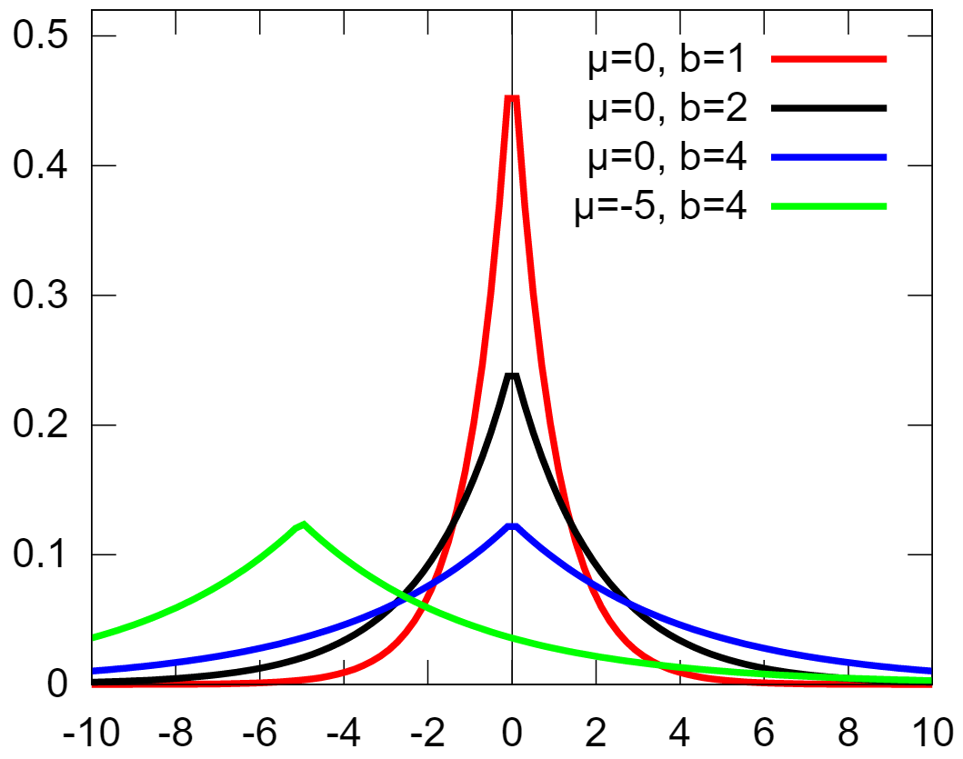
together
This is known as a two-sided exponential PDF,
Also called the Laplace PDF.
$f\left(x | μ,b\right)=\frac{1}{2b}e^{−\frac{\left|x−μ\right|}{b}}$.
(see wiki page)

Slide 60
Convolution
We now consider an important example of a function $Z$ of two random variables, namely, the case where $Z=X+Y$, for independent $X$ and $Y$.
For some initial insight, we start by deriving a PMF formula for the case where $X$ and $Y$ are discrete.

Slide 61
Let $Z=X+Y$, where $X$ and $Y$ are independent integer-valued random variables with PMFs $P_{X}$ and $P_{Y}$, respectively.
Then, for any integer $z$,
$p_{Z}\left(z\right)=P\left(X+Y=z\right)$
$=\sum_{\{(x,y)|x+y=z\}}{P\left(X=x, Y=y\right) }$
$=\sum_{x}{P\left(X=x,Y=z−x\right) }$
$=\sum_{x}{p_{X}\left(x\right)p_{Y}\left(z−x\right)}$

Slide 62
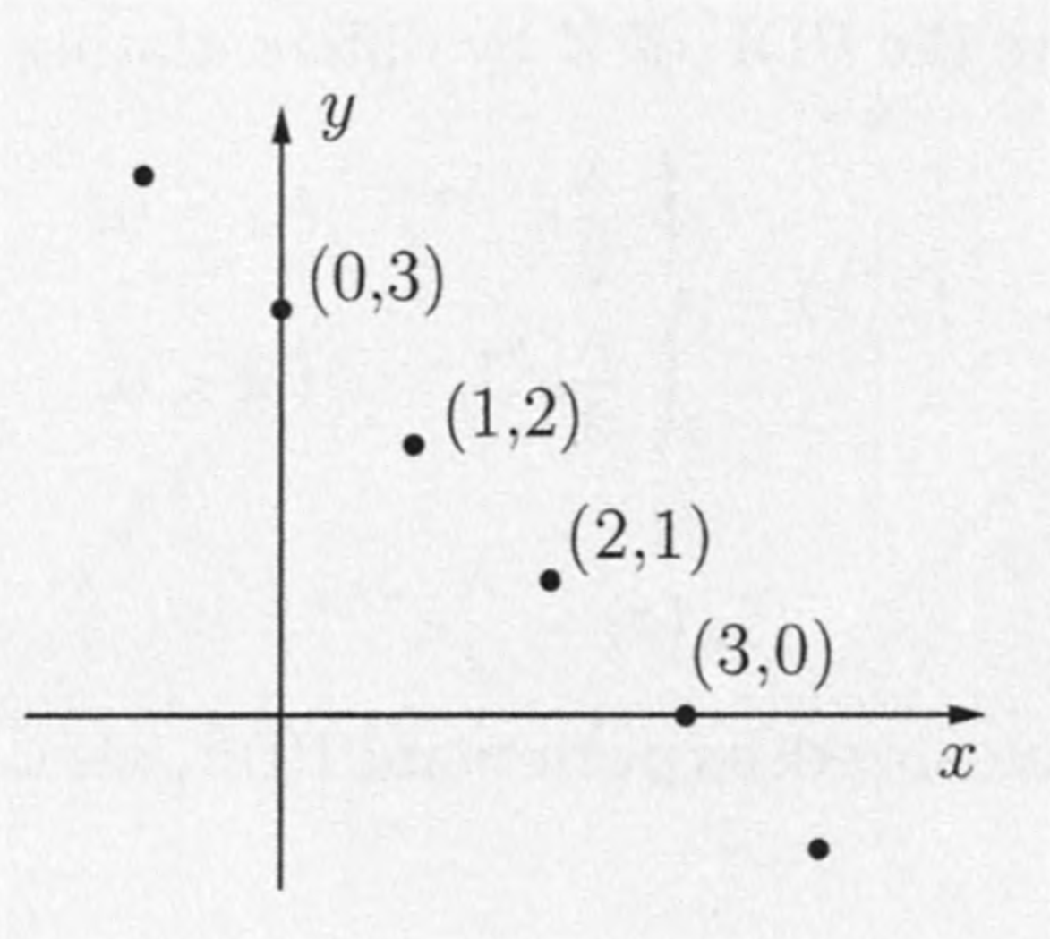
The resulting PMF $p_{z}$ is called the convolution of the PMFs of $X$ and $Y$.

Slide 63
Suppose now that $X$ and $Y$ are independent continuous random variables with PDFs $f_{x}$ and $f_{y}$, respectively.
We wish to find the PDF of $Z=X+Y$.
Two steps:
find the joint PDF of $X$and $Z$
integrate to find the PDF of $Z$.

Slide 64
We first note that
$P\left(Z≤z | X=x\right)=P\left(X+Y≤z | X=x\right)$
$=P\left(x+Y≤z | X=x\right)$
$=$ $P\left(x+Y≤z\right)$
$=$ $P\left(Y≤z−x\right)$
The third equality follows from the independence of $X$ and $Y$.

Slide 65
$P\left(Z≤z | X=x\right)=P(Y≤z−x)$
By differentiating both sides with respect to $z$, we see that $f_{Z|X}\left(z|x\right)=f_{Y}\left(z−x\right)$.
Using the multiplication rule, we have
$$f_{X,Z}\left(x,z\right)=f_{X}\left(x\right)f_{Z|X}\left(z|x\right)$$
$=f_{X}\left(x\right)f_{Y}\left(z−x\right)$

Slide 66
$f_{X,Z}\left(x,z\right)=f_{X}\left(x\right)f_{Y}\left(z−x\right)$
Thus $f_{Z}\left(z\right)=\int_{−∞}^{∞}{f_{X,Z}\left(x,z\right) dx}$
$=\int_{−∞}^{∞}{f_{X}\left(x\right)f_{Y}\left(z−x\right) dx}$
The formula is entirely analogous to the one for the discrete case
$p_{Z}\left(z\right)=\sum_{x}{p_{X}\left(x\right)p_{Y}\left(z−x\right)}$
Except the summation is replaced by an integral and the PMFs are replaced by PDFs.

Slide 67
Example: convolution
The random variables $X$ and $Y$ are independent and uniformly distributed in the interval $\left[0, 1\right].$
The PDF of $Z=X+Y$is
$$f_{Z}\left(z\right)=\int_{−∞}^{∞}{f_{X}\left(x\right)f_{Y}\left(z−x\right) dx}$$

Slide 68
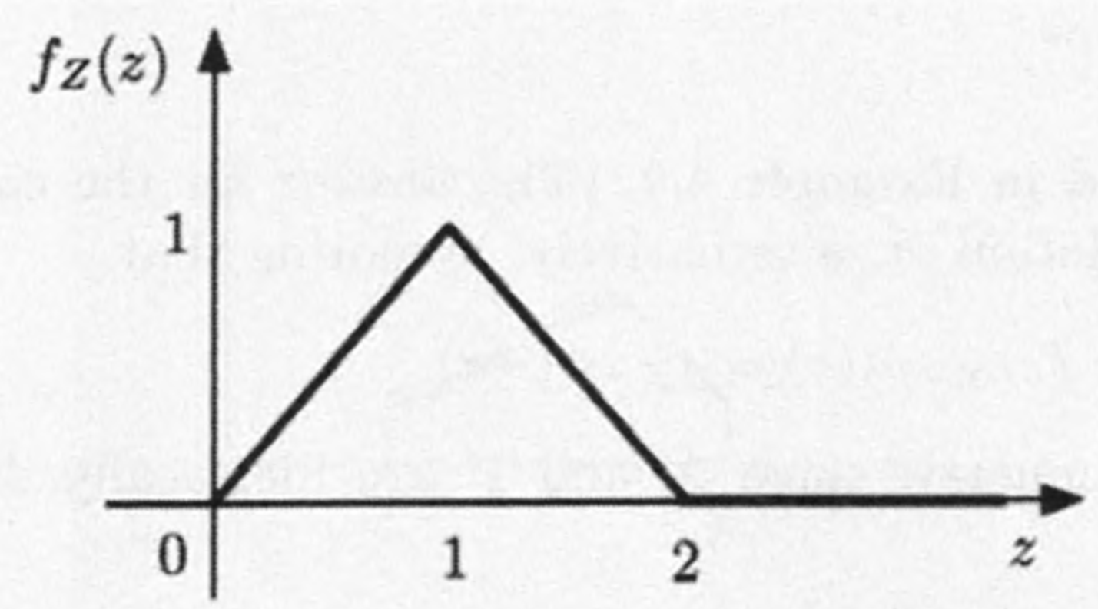
Example: convolution
The integrand $f_{X}\left(x\right)f_{Y}\left(z−x\right)$ is nonzero (and equal to 1) for $0≤x≤1$and $0≤z−x≤1$.
Combining these two inequalities, the integrand is 1 for $max⁡\{0, z−1\}≤x≤min⁡\{1, z\}$
and 0 otherwise.
$f_{Z}\left(z\right)= \left\{\begin{aligned}\min\left\{1,z\right\}−\max\left\{0, z−1\right\}, 0≤z≤2, \\ 0, \text{otherwise},\end{aligned}\right.$

Slide 69
Example: sum of normals
Message: The Sum of Two Independent Normal Random Variables in Normal.
Let $X$ and $Y$ be independent normal random variables with means $μ_{x}$, $μ_{y}$, and variances $σ_{x}^{2}$, $σ_{y}^{2}$, respectively, and let $Z=X+Y$.
$f_{Z}\left(z\right)=\int_{−∞}^{∞}{\frac{1}{\sqrt{2π }σ_{x}}\exp\left\{−\frac{{\left(x−μ_{x}\right)}^{2}}{2σ_{x}^{2}}\right\}}$ $\frac{1}{\sqrt{2π}{ σ}_{y}}\exp\left\{−\frac{{\left(z−x− μ_{y}\right)}^{2}}{2σ_{y}^{2}}\right\}$

Slide 70
Example: sum of normals
This integral can be evaluated in closed form, but the details are tedious and are omitted.
Answer turns out to be
$f_{Z}\left(z\right)=\frac{1}{\sqrt{2π(σ_{x}^{2}+σ_{y}^{2})}}\exp\left\{−\frac{{\left(z−μ_{x}− μ_{y}\right)}^{2}}{2(σ_{x}^{2}+σ_{y}^{2})}\right\}$
It’s a normal PDF with mean${ μ}_{x}+μ_{y}$ and variance $σ_{x}^{2}+σ_{y}^{2}$.

Slide 71
Example: sum of normals
We therefore reach the conclusion that the sum of two independent normal random variables is normal.
Given that scalar multiples of normal random variables are also normal, it follows that $aX+bY$ is also normal, for any nonzero $a$ and $b$.

Slide 72
Example: $X−Y$
The convolution formula can also be used to find the PDF of $X−Y$, when $X$ and $Y$ are independent, by viewing $X−Y$as the sum of $X$ and $−Y$.
Note: the PDF of $−Y$is given by $f_{−Y}\left(y\right)=f_{Y}\left(−y\right)$.
Thus $f_{X−Y}\left(z\right)=\int_{−∞}^{∞}{f_{X}\left(x\right)f_{−Y}\left(z−x\right)dx}$
$=\int_{−∞}^{∞}{f_{X}\left(x\right)f_{Y}\left(x−z\right)dx}$

Slide 73
Example: $X−Y$
When applying the convolution formula, often the most delicate step was to determine the correct limits for the integration.
This is often tedious and error prone, but can be bypassed using a graphical method.

Slide 74
Graphical Calculation of Convolutions
We use a dummy variable $t$ as the argument of the different functions involved in this discussion.
Consider two PDFs $f_{X}\left(t\right)$ and $f_{Y}\left(t\right)$. For a fixed value of $z$, the graphical evaluation of the convolution
$$f_{Z}\left(z\right)=\int_{−∞}^{∞}{f_{X}\left(t\right)f_{Y}\left(z−t\right)dt}$$
consists of the following steps:

Slide 75
We plot $f_{Y}\left(z−t\right)$ as a function of $t$.
This plot has the same shape as the plot of $f_{Y}\left(t\right)$ except that it is first “flipped” and then shifted by an amount $z$.
If $z>0$, this is a shift to the right, if $z<0$, this is a shift to the left.
We place the plots of $f_{X}\left(t\right)$ and $f_{Y}\left(z−t\right)$ on top of each other, and form their product.

Slide 76
Calculate the value of${ f}_{Z}\left(z\right)$ by calculating the integral of the product graph.
By varying the amount $z$ by which we are shifting, we obtain${ f}_{Z}\left(z\right)$ for any $z$.

Slide 77
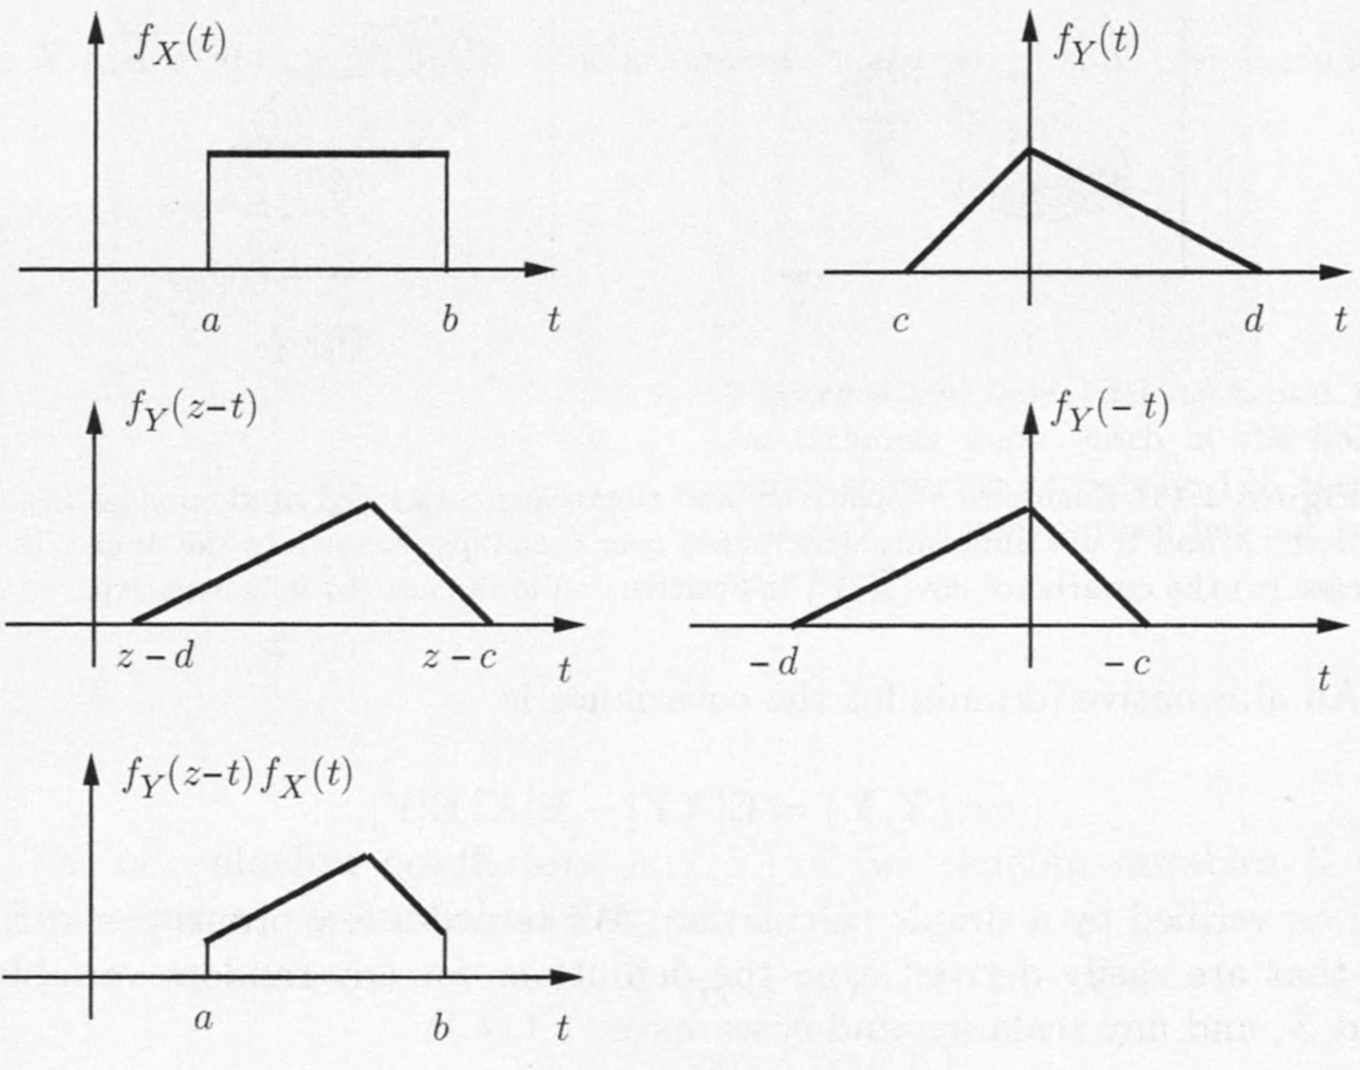
$F(z)=$ integral of function shown in the last plot.

Slide 78
Content
Derived Distributions
Covariance and Correlation
Conditional Expectation and Variance Revisited
Transforms
Sum of a Random Number of Independent Random Variables

Slide 79
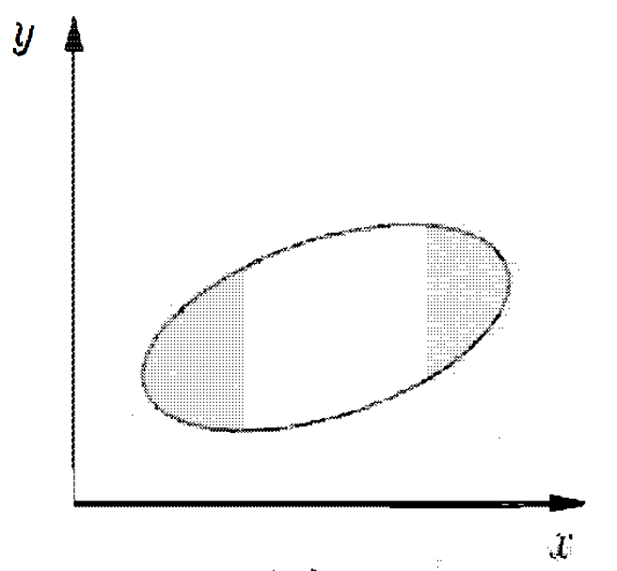
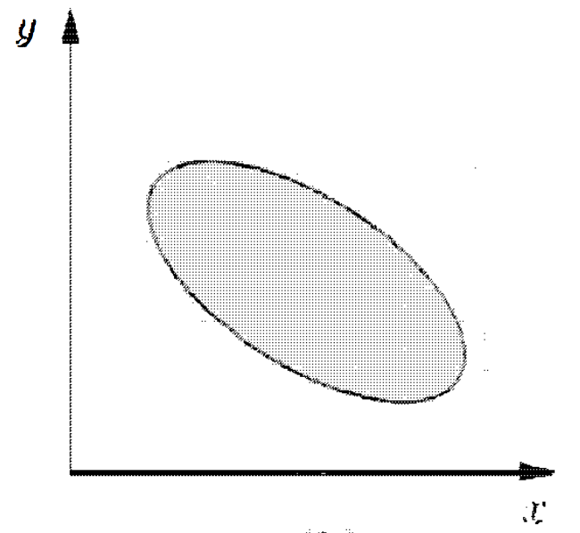
Covariance and Correlation
Covariance and correlation – the measurement of the strength and direction of the relation between 2 random variables.

Slide 80
Covariance
The covariance of two random variables $X$ and $Y$ are defined as
$$c\text{ov}\left(X,Y\right)=\text{E}\left[\left(X−\text{E}\left[X\right]\right)\left(Y−E\left[Y\right]\right)\right].$$
Alternatively
$$c\text{ov}\left(X,Y\right)=\text{E}\left[XY\right]−\text{E}\left[X\right]\text{E}\left[Y\right].$$
Exercise: verify that the two definitions are equivalent.

Slide 81
Covariance - Properties
For any random variable $X$, $Y$, and $Z$, and any scalars $a$ and $b$:
$c\text{ov}\left(X,X\right)=\text{var}\left(X\right),$
$c\text{ov}\left(X,aY+b\right)=a⋅c\text{ov}\left(X,Y\right),$
$c\text{ov}\left(X,Y+Z\right)=c\text{ov}\left(X,Y\right)+c\text{ov}\left(X,Z\right).$
Exercise: verify these.

Slide 82
Covariance - Properties
Independent random variables are uncorrelated. In fact,
$$c\text{ov}\left(X,Y\right)=\text{E}\left[XY\right]−\text{E}\left[X\right]\text{E}\left[Y\right]=0.$$
But not vice versa, as illustrated by the next example.

Slide 83
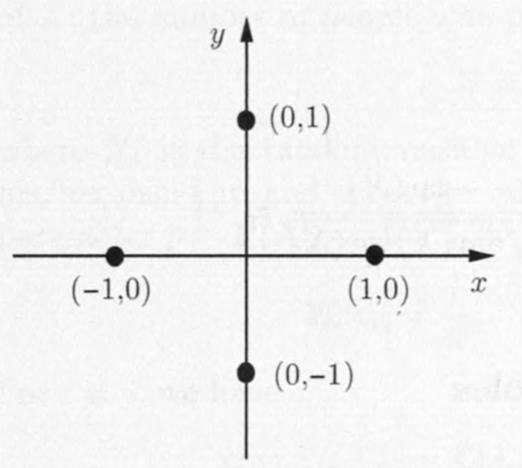
Covariance - Example
$\left(X,Y\right)$ is uniformly distributed over $\left\{\left(1,0\right),\left(0,1\right),\left(−1,0\right),(0,−1)\right\}$, then
$$\text{E}\left[XY\right]=0$$ since either $X$ or $Y$ is $0.$
Also $\text{E}\left[X\right]=\text{E}\left[Y\right]=0$. Thus
$$\text{cov}\left(X,Y\right)=0.$$
But X and Y are not independent. For example, $X≠0⇒Y=0.$

Slide 84
Correlation Coefficient
For any random variable $X$, $Y$ with nonzero variances, the correlation coefficient $ρ\left(X,Y\right)$ of them is defined as
$$ρ(X,Y)=\frac{\text{cov}(X,Y)}{\sqrt{\text{var}\left(X\right)\text{var}(Y)}}.$$
It may be viewed as a normalized version of the covariance $\text{cov}(X,Y)$.
Recall $c\text{ov}\left(X,X\right)=\text{var}\left(X\right)$.
It’s easily verified that
$$−1≤ρ(X,Y)≤1$$

Slide 85
Correlation coefficient: Properties
$ρ\left(X,Y\right)=1$ iff $∃$ a positive number $c$ s.t.
$X−\text{E}\left[X\right]=c\left(Y−\text{E}\left[Y\right]\right).$
If $ρ\left(X,Y\right)>0$, then the values of $X−\text{E}\left[X\right]$ and $Y−\text{E}\left[Y\right]$ “tend” to have the same sign.
$ρ\left(X,Y\right)=−1$ iff $∃$a negative number $c$ s.t.
$$X−\text{E}\left[X\right]=c(Y−\text{E}[Y]).$$
If $ρ\left(X,Y\right)<0$, then the values of $X−\text{E}\left[X\right]$ and $Y−\text{E}\left[Y\right]$ “tend” to have the opposite sign.

Slide 86
Correlation coefficient: Examples
Consider $n$ independent tosses, with head probability $p.$
$X=$ number of heads
$Y=$ number of tails
Then $X+Y=n$, and thus $\text{var}\left(Y\right)=\text{var}\left(X\right)$,
$$\text{E}\left[X\right]+\text{E}\left[Y\right]=\text{E}\left[X+Y\right]=n=X+Y.$$
Hence,
$$X−\text{E}\left[X\right]=−\text{(}Y−\text{E}\left[Y\right])$$

Slide 87
$ρ\left(X,Y\right)$ Examples
Las slide: $X−\text{E}\left[X\right]=−\text{(}Y−\text{E}\left[Y\right])$
Then,
$$\text{cov}\left(X,Y\right)=\text{E}\left[\left(X−\text{E}\left[X\right]\right)\left(Y−\text{E}\left[Y\right]\right)\right]$$
$$=−\text{E}\left[{\left(X−\text{E}\left[X\right]\right)}^{2}\right]$$
$$=−\text{var}\left(X\right).$$
Hence, $ρ\left(X,Y\right)=\frac{\text{cov}\left(X,Y\right)}{\sqrt{\text{var}\left(X\right)\text{var}\left(Y\right)}}=\frac{−\text{var}(X)}{\sqrt{\text{var}\left(X\right)\text{var}\left(X\right)}}=−1.$

Slide 88
Variance of Summations
We know that in general
$$\text{var}\left(X_{1}+X_{2}\right)≠\text{var}\left(X_{1}\right)+\text{var}\left(X_{2}\right)$$
A more precise statement:
$$\text{var}\left(X_{1}+X_{2}\right)=\text{var}\left(X_{1}\right)+\text{var}\left(X_{2}\right)$$ $+2∙\text{cov}\left(X_{1},X_{2}\right)$
In general, let $X_{1},X_{2}{,⋯,X}_{n}$ be random variables with finite variance, then we have
$\text{var}\left(\sum_{i}{X_{i}}\right)=\sum_{i}{\text{var}(X_{i})}+\sum_{i≠j}{\text{cov}(X_{i},X_{j})}$

Slide 89
Variance of Summations
Proof. Let ${\tilde{X}}_{i}=X_{i}−\text{E}\left[X_{i}\right],$
$$\text{var}\left(\sum_{i}{X_{i}}\right)=\text{E}\left[{\left(\sum_{i}{{\tilde{X}}_{i}}\right)}^{2}\right]$$
$$=\sum_{i}{\sum_{j}{\text{E}\left[{\tilde{X}}_{i}{\tilde{X}}_{j}\right]}}$$
$$=\sum_{i}{\text{E}\left[{\tilde{X}}_{i}^{2}\right]}+\sum_{i≠j}{\text{E}\left[{\tilde{X}}_{i}{\tilde{X}}_{j}\right]}$$
$$=\sum_{i}{\text{var}(X_{i})}+\sum_{i≠j}{\text{cov}(X_{i},X_{i})}.$$

Slide 90
Variance of Summations – Example
Consider $n$ people throwing their hats in a box and pick a hat at random.
$X=$ number of people who pick their own hats.
$X_{i}=\left\{\begin{matrix}1 & \text{if} \text{the} i\text{−}\text{th} \text{person} \text{picks} \text{its} \text{own} \text{hat}\text{,} \\ 0 & \text{otherwise}.\end{matrix}\right.$
Then $X=X_{1}+X_{2}+{⋯+X}_{n}$.
And $\text{E}\left[X_{i}\right]=\frac{1}{n}$.

Slide 91
Variance of Summations – Example
For $i≠j$, we have
$$\text{cov}\left(X_{i},X_{j}\right)=\text{E}\left[X_{i}X_{j}\right]−\text{E}\left[X_{i}\right]\text{E}\left[X_{j}\right]$$
$$=\frac{1}{n(n−1)}−\frac{1}{n^{2}}$$
$$=\frac{1}{n^{2}(n−1)}.$$
Also
$$\text{var}\left(X_{i}\right)=\frac{1}{n}\left(1−\frac{1}{n}\right).$$

Slide 92
Variance of Summations – Example
Recall
$$\text{var}\left(\sum_{i}{X_{i}}\right)=\sum_{i}{\text{var}(X_{i})}+\sum_{i≠j}{\text{cov}(X_{i},X_{i})}.$$
We have
$$v\text{ar}\left(X\right)=n\frac{1}{n}\left(1−\frac{1}{n}\right)+\frac{n\left(n−1\right)}{n^{2}\left(n−1\right)}=1.$$

Slide 93
Content
Derived Distributions
Covariance and Correlation
Conditional Expectation and Variance Revisited
Transforms
Sum of a Random Number of Independent Random Variables

Slide 94
We revisit the conditional expectation of a random variable $X$ given another random variable $Y$.
We introduced a random variable, denoted by $E[X|Y]$, that takes value $E\left[X | Y=y\right]$ when $Y$ takes the value $y$.
Since $E\left[X | Y=y\right]$ is a function of $y$, $E\left[X | Y\right]$ is a function of $Y$.

Slide 95
Example: coin
A biased coin.
$Y=$ the probability of heads
$Y$is itself random, with a known distribution over the interval [0,1].
We toss the coin $n$ times.
$X=$ the number of heads obtained.
Then, for any $y∈\left[0,1\right]$, we have $E\left[X|Y=y\right]=ny$
so $E\left[X|Y\right]$ is the random variable $nY$.

Slide 96
Since $E[X|Y]$ is a random variable, it has an expectation $E\left[E\left[X | Y\right]\right]$ of its own,
which can be calculated using the expected value rule: $E\left[E\left[X | Y\right]\right]=\left\{\begin{matrix}\sum_{y}{E\left[X|Y=y\right]p_{Y}(y)} & Y discrete \\ \int_{−∞}^{∞}{E\left[X|Y=y\right]f_{Y}\left(y\right)dy} & Y continuous\end{matrix}\right.$
By total probability theorem, RHS $=E\left[X\right]$.
Law of Iterated Expectations:
$$E\left[E\left[X | Y\right]\right]=E\left[X\right].$$

Slide 97
Example: coin
$Y=$ the probability of heads for our coin
$Y$is uniformly distributed over the interval $\left[0,1\right]$.
Since $E\left[X|Y\right]=nY$ and $E\left[Y\right]=1/2$.
By the law of iterated expectations, we have
$E[X]=E\left[E\left[X | Y\right]\right]=E\left[nY\right]=nE\left[Y\right]=\frac{n}{2}$

Slide 98
Example: stick breaking
We start with a stick of length $ℓ$.
Break it at a point which is chosen randomly and uniformly over its length,
Keep the left piece.
Repeat the same process on this piece.
Question: What is the expected length of the piece that we are left with after breaking twice?

Slide 99
$Y=$ the length of the piece after we break for the first time.
$X=$ the length after we break for the second time.
We have $E\left[X | Y\right]=Y/2$,
since the breakpoint is chosen uniformly over a piece of length $Y$.
For a similar reason, $E\left[Y\right]=ℓ/2$.
$∴E\left[X\right]=E\left[E\left[X | Y\right]\right]=E\left[Y/2\right]=E[Y]/2=ℓ/4$.

Slide 100
Content
Derived Distributions
Covariance and Correlation
Conditional Expectation and Variance Revisited
Transforms
Sum of a Random Number of Independent Random Variables

Slide 101
Transforms
We introduce the transform associated with a random variable.
The transform provides us with an alternative representation of a probability law.
It’s not particularly intuitive, but it is often convenient for certain types of mathematical manipulations.

Slide 102
Transforms
The transform associated with a random variable $X$, also referred to as the associated moment generating function, is a function $M_{X}\left(s\right)$ of a scalar parameter $s$, defined by
$$M_{X}\left(s\right)=\text{E}\left[e^{sX}\right].$$
The simpler notation $M(s)$ can also be used whenever the underlying random variable $X$ is clear from the context.

Slide 103
Transforms
For the defining formula $M_{X}\left(s\right)=\text{E}\left[e^{sX}\right]$
When $X$ is a discrete random variable, the transform is given by
$$M(s)=\sum_{x}{e^{sx}}p_{X}\left(x\right).$$
When $X$ is a continuous random variable:
$$M(s)=\int_{−∞}^{∞}{e^{sx}}f_{X}\left(x\right)dx.$$

Slide 104
Example – a specific discrete r.v.
Let
$$p_{X}\left(x\right)=\left\{\begin{matrix}1/2 & \text{if} x=2, \\ 1/6 & \text{if} x=3, \\ 1/3 & \text{if} x=5.\end{matrix}\right.$$
We have
$$M\left(s\right)=\text{E}\left[e^{sX}\right]=\frac{1}{2}e^{2s}+\frac{1}{6}e^{3s}+\frac{1}{3}e^{5s}.$$

Slide 105
Example - Poisson
Now consider the transform associated with a Poisson random variable.
Let $X$ be a Poisson random variable with parameter $λ$:
$$p_{X}\left(x\right)=\frac{λ^{x}e^{−λ}}{x!}, x=0,1,2,...$$
The transform is
$M\left(s\right)=\text{E}\left[e^{sX}\right]=\sum_{x=0}^{∞}{e^{sx}}\frac{λ^{x}e^{−λ}}{x!}$

Slide 106
Example - Poisson
We can simply this formula
$M\left(s\right)=\sum_{x=0}^{∞}{e^{sx}}\frac{λ^{x}e^{−λ}}{x!}$
Let ${a=e}^{s}λ$,
$M\left(s\right)=e^{−λ}\sum_{x=0}^{∞}{\frac{a^{x}}{x!}}=e^{−λ}e^{a}=e^{λ(e^{s}−1)}.$

Slide 107
Example - Exponential
Let $X$ be an exponential random variable with parameter $λ$
$$f_{X}\left(x\right)=λe^{−λx}, x≥0.$$
Then, for $s<λ$,
$M\left(s\right)=\text{E}\left[e^{sX}\right]=λ\int_{0}^{∞}{e^{sx}e^{−λx}dx}$
$$=\frac{λe^{\left(s−λ\right)x}}{s−λ}{\left.​\right|}_{0}^{∞} \left(if s<λ\right) \\ =\frac{λ}{λ−s}$$

Slide 108
Transforms - Note
It is important to realize that the transform is not a number but rather a function of a parameter $s$.
Thus, we are dealing with a transformation that starts with a function, e.g., a PDF, and results in a new function.
Strictly speaking, $M\left(s\right)$ is only defined for those values of $s$ for which $\text{E}\left[e^{sX}\right]$ is finite.
As in the preceding example.

Slide 109
Example - $aX+b$
We consider the transform associated with a linear function of a random variable.
Let $M_{X}(s)$ be the transform associated with a random variable $X$.
Consider a new random variable
$Y=aX+b$.

Slide 110
Example - $aX+b$
We then have
$M_{Y}\left(s\right)=\text{E}\left[e^{s(aX+b)}\right]$
$$=e^{bs}\text{E}\left[e^{saX}\right]$$
$$=e^{bs}M_{X}\left(sa\right).$$
For example, if $λ=1$, so that $M_{X}\left(s\right)=1/(1−s)$ and if $Y=2X+3$, then
$M_{Y}\left(s\right)=e^{3s}/(1−2s)$

Slide 111
Example - Normal
Consider the transform associated with a normal random variable.
Let $X$ be a normal random variable with mean $μ$ and variance $σ^{2}$.
We first consider the special case of standard normal variable $Y$
$f_{Y}\left(y\right)=\frac{1}{\sqrt{2π}}e^{{−y}^{2}/2}$.

Slide 112
Example - Normal
The associated transform is
$$M_{Y}\left(s\right)=\int_{−∞}^{∞}{\frac{1}{\sqrt{2π}}e^{{−y}^{2}/2}e^{sy}dy}$$
$$=\frac{1}{\sqrt{2π}}\int_{−∞}^{∞}{e^{{−(y}^{2}/2)+sy}dy}$$
$$=e^{s^{2}/2}\frac{1}{\sqrt{2π}}\int_{−∞}^{∞}{e^{{−(y−s)}^{2}/2}dy}$$
$=e^{s^{2}/2}$

Slide 113
Example - Normal
For general normal random variable $X$ with mean $μ$ and variance $σ^{2}$
$$X=σY+μ$$
By applying transform of linear functions, we obtain
$$M_{X}\left(s\right)={e^{sμ}M}_{Y}\left(sσ\right)=e^{\frac{{σ^{2}s}^{2}}{2}+μs}$$

Slide 114
From Transforms to Moments
Why we gave transform an alternative name moment generating function?
The moments of a random variable are easily computed from the associated transform.
Consider the definition
$$M(s)=\int_{−∞}^{∞}{e^{sx}f_{X}\left(x\right)dx}.$$

Slide 115
From Transforms to Moments
Take derivative of both sides of
$$M(s)=\int_{−∞}^{∞}{e^{sx}f_{X}\left(x\right)dx}.$$
We obtain
$$\frac{d}{ds}M\left(s\right)=\frac{d}{ds}\int_{−∞}^{∞}{e^{sx}f_{X}\left(x\right)dx}$$
$$=\int_{−∞}^{∞}{xe^{sx}f_{X}\left(x\right)dx}$$

Slide 116
From Transforms to Moments
Last slide: $\frac{d}{ds}M\left(s\right)=\int_{−∞}^{∞}{xe^{sx}f_{X}\left(x\right)dx}$
Take $s=0$
$${\left.\frac{d}{ds}M\left(s\right)\right|}_{s=0}=\text{E}\left[X\right]$$
Generally, differentiating $n$ times, we get
$${\left.\frac{d^{n}}{{ds}^{n}}M\left(s\right)\right|}_{s=0}=\text{E}\left[X^{n}\right]$$

Slide 117
Moments - Example
Let
$$p_{X}\left(x\right)=\left\{\begin{matrix}1/2 & \text{if} x=2, \\ 1/6 & \text{if} x=3, \\ 1/3 & \text{if} x=5.\end{matrix}\right.$$
Recall that $M\left(s\right)=\frac{1}{2}e^{2s}+\frac{1}{6}e^{3s}+\frac{1}{3}e^{5s}.$

Slide 118
Moments - Example
$M\left(s\right)=\frac{1}{2}e^{2s}+\frac{1}{6}e^{3s}+\frac{1}{3}e^{5s}$.
Then
$$\text{E}\left[X\right]={\left.\frac{d}{ds}M\left(s\right)\right|}_{s=0}=\frac{1}{2}⋅2+\frac{1}{6}⋅3+\frac{1}{3}⋅5=\frac{19}{6}$$
Also
$$\text{E}\left[X^{2}\right]={\left.\frac{d^{2}}{{ds}^{2}}M\left(s\right)\right|}_{s=0}=\frac{1}{2}⋅4+\frac{1}{6}⋅9+\frac{1}{3}⋅25=\frac{71}{6}$$

Slide 119
Moments - Example
For an exponential random variable with PDF
$$f_{X}\left(x\right)=λe^{−λx}, x≥0.$$
We found earlier that
$$M\left(s\right)=\frac{λ}{λ−s}$$
Thus $\frac{d}{ds}M\left(s\right)=\frac{λ}{{\left(λ−s\right)}^{2}}$, $\frac{d^{2}}{ds^{2}}M\left(s\right)=\frac{2λ}{{\left(λ−s\right)}^{3}}$.

Slide 120
Moments - Example
Similarly
$$\text{E}\left[X\right]={\left.\frac{d}{ds}M\left(s\right)\right|}_{s=0}={\left.\frac{λ}{{\left(λ−s\right)}^{2}}\right|}_{s=0}=\frac{1}{λ}$$
Also
$$\text{E}\left[X^{2}\right]={\left.\frac{d^{2}}{{ds}^{2}}M\left(s\right)\right|}_{s=0}={\left.\frac{2λ}{{\left(λ−s\right)}^{3}}\right|}_{s=0}=\frac{2}{λ^{2}}$$

Slide 121
Moments - Example
We note two more useful and generic properties of transforms.
For any random variable $X$, we have
$$M_{X}\left(0\right)=\text{E}\left[e^{0X}\right]=1$$
And if $X$ takes only nonnegative integer values, then
$$\lim_{s→−∞}{M_{X}\left(s\right)}=\text{P}(X=0)$$

Slide 122
Inversion of Transforms
A very important property of the transform $M_{X}\left(s\right)$ is that it can be inverted,
That is, it can be used to determine the probability law of the random variable $X$.
To do this, some appropriate mathematical conditions are required, which are satisfied in all of the following examples.

Slide 123
Inversion of Transforms
Formally, the transform $M_{X}\left(s\right)$ associated with a random variable $X$ uniquely determines the CDF of $X$,
assuming that $M_{X}\left(s\right)$ is finite for all $s$ in some interval $\left[−a,a\right]$, where $a$ is a positive number.

Slide 124
Inversion of Transforms - Example
We are told that the transform associated with a random variable $X$ is
$$M_{X}\left(s\right)=\frac{1}{4}e^{−s}+\frac{1}{2}+\frac{1}{8}e^{4s}+\frac{1}{8}e^{5s}$$
Then we can infer that $X$ is a discrete random variable.
The different values that $X$ can take can be read from the corresponding exponents, and are $−1$, $0$, $4$, and $5$.

Slide 125
Inversion of Transforms - Example
$M_{X}\left(s\right)=\frac{1}{4}e^{−s}+\frac{1}{2}+\frac{1}{8}e^{4s}+\frac{1}{8}e^{5s}$
The probability of each value $x$ is given by the coefficient multiplying the corresponding $e^{sx}$ term:
$$\text{P}\left(X=−1\right)=1/4$$
$$\text{P}\left(X=0\right)=1/2$$
$$\text{P}\left(X=4\right)=1/8$$
$$\text{P}\left(X=5\right)=1/8$$

Slide 126
Inversion of Transforms - Example
We are told that the transform associated with a random variable $X$ is of the form
$$M\left(s\right)=\frac{pe^{s}}{1−(1−p)e^{s}}.$$ where $0<p≤1$.
Recall the formula for the geometric series valid (for $−1<α<1$):
$$\frac{1}{1−α}=1+α+α^{2}+⋯$$

Slide 127
Inversion of Transforms - Example
We use the formula with $α=(1−p)e^{s}$, and for $s$ sufficiently close to zero so that $\left(1−p\right)e^{s}<1$.
We obtain
$M\left(s\right)=pe^{s}(1+\left(1−p\right)e^{s}$
$$+{\left(1−p\right)}^{2}e^{2s}+{\left(1−p\right)}^{3}e^{3s}+⋯)$$
We can infer that
$$P\left(X=k\right)=p{\left(1−p\right)}^{k−1}, k=1, 2, …$$
which is the geometric distribution with parameter $p$.

Slide 128
Inversion of Transforms - Example
We address the transform associated with a mixture of two distributions.
Consider a neighborhood bank has three tellers, two of them fast, one slow.
The time to assist a customer is exponentially distributed with parameter $λ=6$ at the fast tellers, and $λ=4$ at the slow teller.
Alice enters the bank and chooses a teller at random, we try to find the PDF of the time $X$ it takes.

Slide 129
Inversion of Transforms - Example
We have
$$f_{X}\left(x\right)=\frac{2}{3}6e^{−6x}+\frac{1}{3}4e^{−4x}, x≥0$$
Then
$$M\left(s\right)=\int_{0}^{∞}{e^{sx}\left(\frac{2}{3}6e^{−6x}+\frac{1}{3}4e^{−4x}\right)}dx$$
$$=\frac{2}{3}\int_{0}^{∞}{e^{sx}6e^{−6x}dx+}\frac{1}{3}\int_{0}^{∞}{e^{sx}4e^{−4x}dx}$$
$$=\frac{2}{3}\frac{6}{6−s}+\frac{1}{3}\frac{4}{4−s}, \text{for} s<4$$

Slide 130
Sums of Independent Variables
Transform methods are particularly convenient when dealing with a sum of random variables.
An important result is that addition of independent random variables corresponds to multiplication of transforms.

Slide 131
Sums of Independent Variables
We $X$ and $Y$ be independent random variables, and let $Z=X+Y.$ By definition we have
$$M_{Z}\left(s\right)=\text{E}\left[e^{sZ}\right]=\text{E}\left[e^{sX}e^{sY}\right]$$
Since $X$ and $Y$ are independent, $e^{sX}$ and ${ e}^{sY}$ are independent as well. Hence,
$$M_{Z}\left(s\right)=M_{X}\left(s\right)M_{Y}\left(s\right)$$

Slide 132
Sums of Independent Variables
Generally, $X_{1},⋯,X_{n}$ is a collection of independent random variables, and
$$Z=X_{1}+⋯+X_{n}$$
Then,
$$M_{Z}\left(s\right)=M_{X_{1}}\left(s\right)⋯M_{X_{n}}\left(s\right)$$

Slide 133
Sums of Variables - Example
We address the transform associated with the binomial.
Let $X_{1},⋯,X_{n}$ be independent Bernoulli random variables with a common parameter $p$. Then
$$M_{X_{i}}\left(s\right)=\left(1−p\right)e^{0s}+pe^{1s}=1−p+pe^{s}$$
For $Z=X_{1}+⋯+X_{n}$,
$$M_{Z}\left(s\right)={(1−p+pe^{s})}^{n}$$

Slide 134
Sums of Variables - Example
We will show that the sum of independent Poisson random variables is Poisson.
Let $X$ and $Y$ be independent Poisson random variables with means $λ$ and $μ$, respectively.
Let $Z=X+Y$
$$M_{X}\left(s\right)=e^{λ(e^{s}−1)}$$
$$M_{Y}\left(s\right)=e^{μ(e^{s}−1)}$$

Slide 135
Sums of Variables - Example
We have
$$M_{Z}\left(s\right)=M_{X}\left(s\right)M_{Y}\left(s\right)=e^{(λ+μ)(e^{s}−1)}$$
Thus, transform associated with $X$ is the same as the transform associated with a Poisson random variable with mean $λ+μ$.
By the uniqueness property of transforms, $Z$ is Poisson with mean $λ+μ$.

Slide 136
Sums of Variables - Example
We will show that the sum of independent normal random variables is normal.
Let $X$ and $Y$ be independent normal random variables with means $μ_{x}$ and$μ_{y}$, and variances $σ_{x}^{2}$, $σ_{y}^{2}$, respectively.
Let $Z=X+Y$

Slide 137
Sums of Variables - Example
Then
$$M_{X}\left(s\right)=e^{\frac{σ_{x}^{2}s^{2}}{2}+μ_{x}s}$$
$$M_{Y}\left(s\right)=e^{\frac{σ_{y}^{2}s^{2}}{2}+μ_{y}s}$$
and
$$M_{Z}\left(s\right)=e^{\frac{(σ_{x}^{2}+σ_{y}^{2})s^{2}}{2}+(μ_{x}+μ_{y})s}$$
It corresponds to $N\left(μ_{x}+μ_{y},σ_{x}^{2}+σ_{y}^{2}\right).$

Slide 138
Transforms Associated w/ Joint Dist.
Consider random variables $X_{1},⋯,X_{n}$, the associated multivariate transform is a function with $n$ parameters
$$M_{X_{1},⋯,X_{n}}\left(s_{1},⋯,s_{n}\right)=\text{E}[e^{s_{1}X_{1}+⋯+s_{n}X_{n}}]$$
The inversion property of transforms can be extended to the multivariate case.

Slide 139
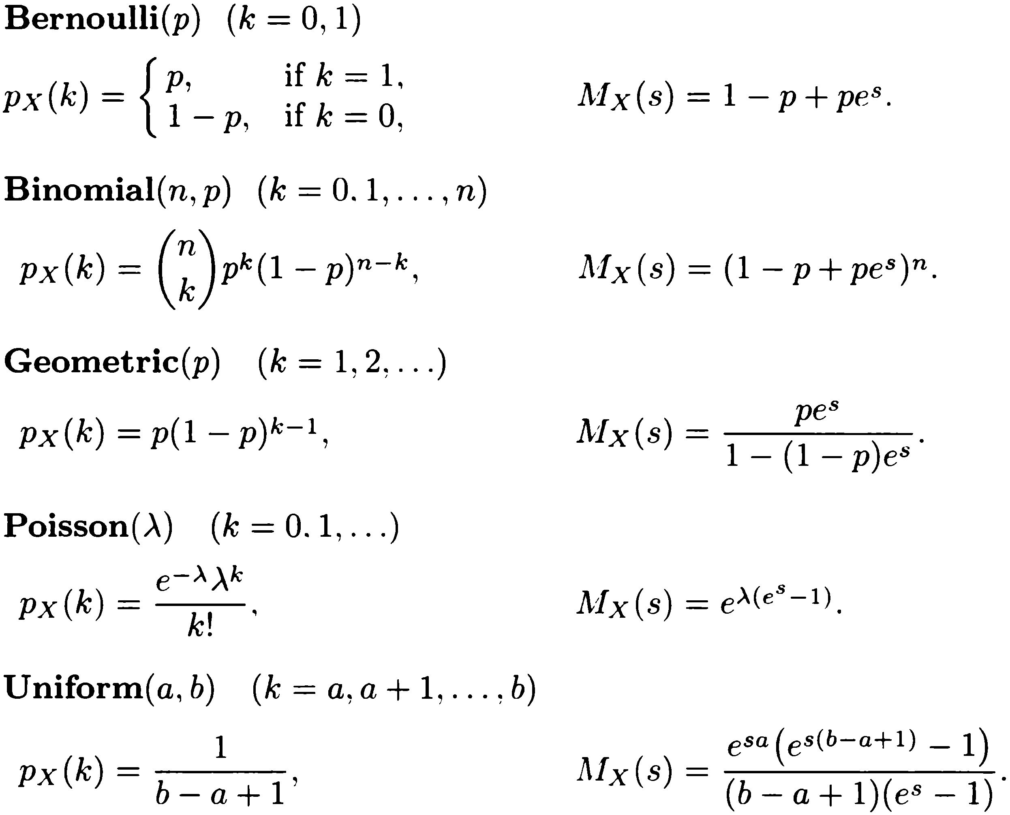
Transforms for Common Discrete r.v.

Slide 140
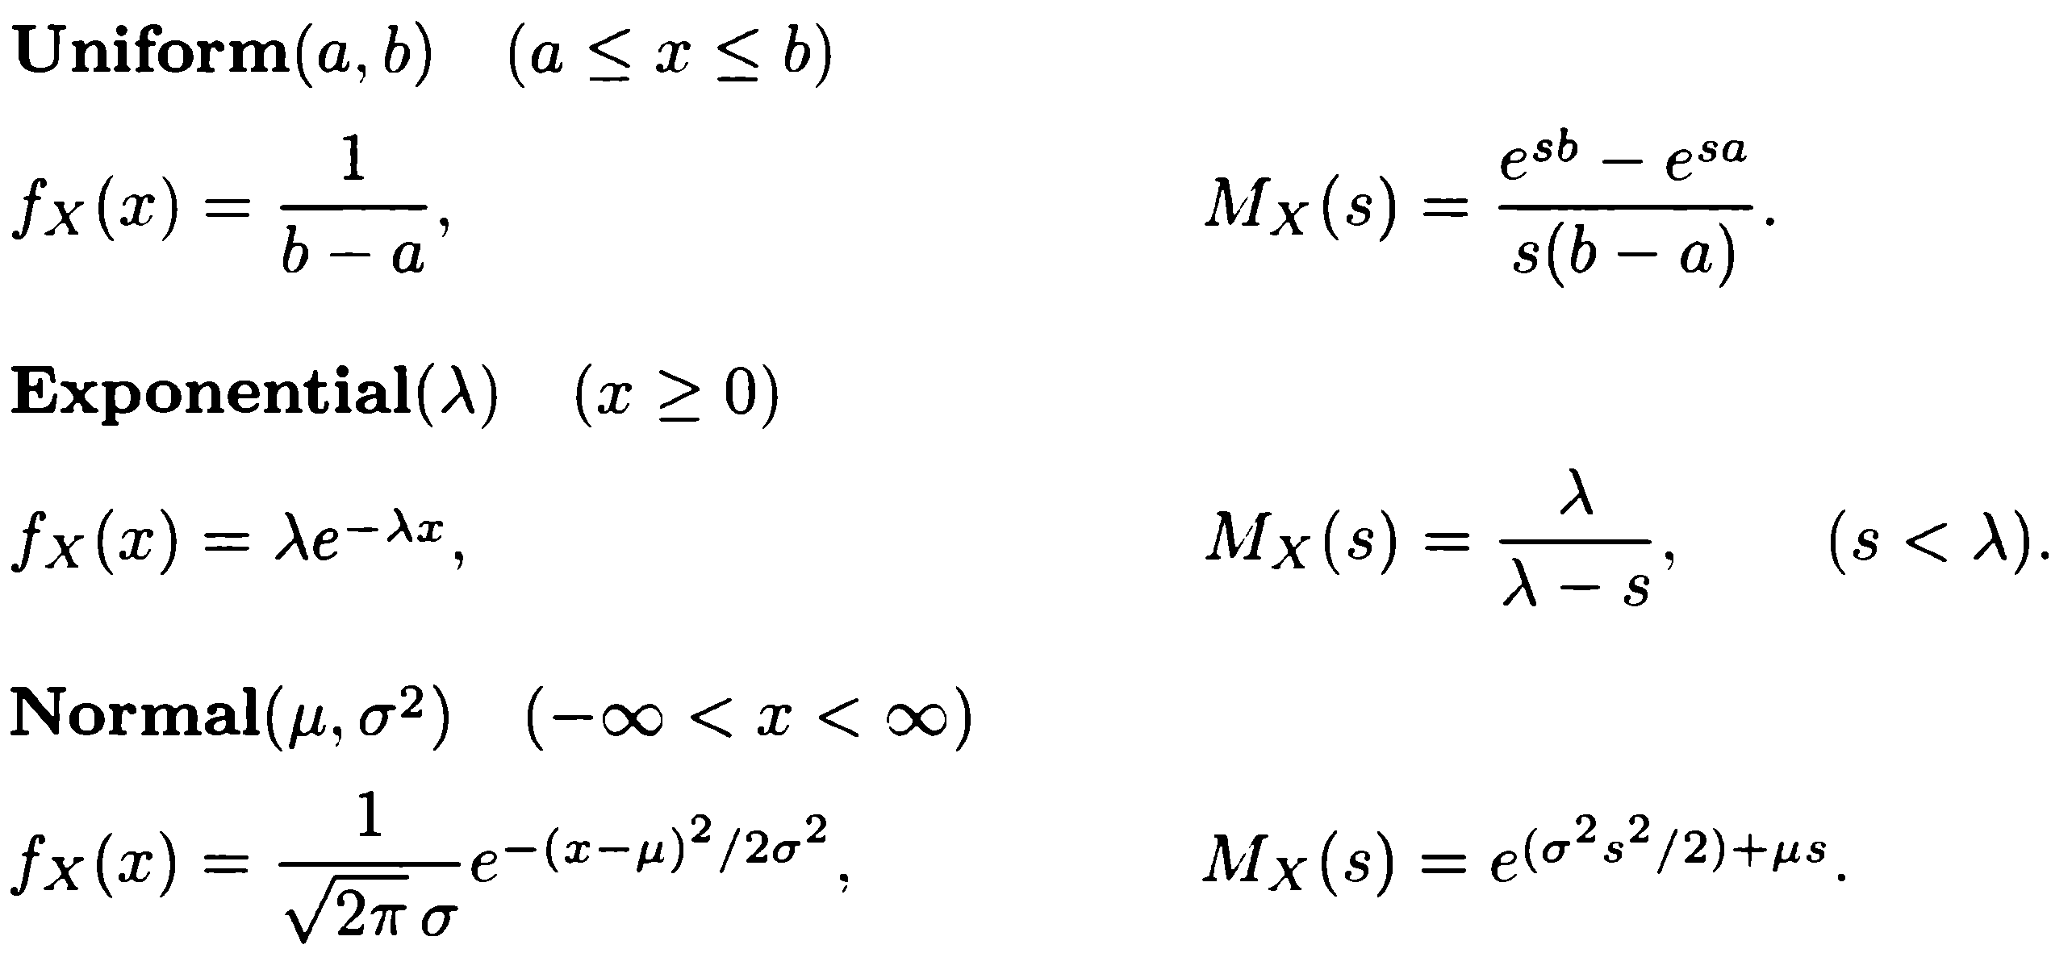
Transforms for Common Continuous Random Variables

Slide 141
Content
Derived Distributions
Covariance and Correlation
Conditional Expectation and Variance Revisited
Transforms
Sum of a Random Number of Independent Random Variables

Slide 142
Sums of A Random Number of Independent Random Variables
So far we have always assumed that the number of variables in the sum is known and fixed.
Now we will consider the case where the number of random variables being added is itself random.

Slide 143
Sums of A Random Number of Independent Random Variables
That is, we consider
$$Y=X_{1}+⋯+X_{N}$$
Where $X_{1},⋯,X_{N}$ are identical and independent random variables.
And $N$ is a random variable that takes nonnegative integer values.
Assume that its PMF is $p_{N}$.

Slide 144
Sums of A Random Number of Independent Random Variables
Denote by $\text{E}[X]$ and $\text{var}(X)$ the common mean and variance, respectively, of the $X_{i}$.
We wish to derive formulas for the mean, variance, and the transform of $Y$.
We address this by first conditioning on event $N=n$.

Slide 145
Sums of A Random Number of Independent Random Variables
Firstly,
$$\text{E}\left[Y | N=n\right]=\text{E}\left[X_{1}+⋯+X_{n}\right]=n\text{E}[X]$$
Hence,
$$\text{E}\left[Y | N\right]=N⋅\text{E}\left[X\right]$$
Recall that $\text{E}\left[Y | N\right]$ is a random variable, which takes value $\text{E}\left[Y | N=n\right]$ when $N=n$.
Then by the law of iterated expectations, we obtain
$$\text{E}\left[Y\right]=\text{E}\left[\text{E}\left[Y | N\right]\right]=\text{E}[N]\text{E}[X]$$

Slide 146
Sums of A Random Number of Independent Random Variables
Similarly,
$$\text{var}\left(Y | N=n\right)=var\left(X_{1}+…+X_{n}\right)=n∙\text{var}\left(X\right).$$
Law of total variance: (proof omitted) $var\left(X\right)=E\left[var\left(X | Y\right)\right]+var\left(E\left[X|Y\right]\right)$.
$\text{var}\left(Y\right)=\text{E}\left[\text{var}\left(Y | N\right)\right]+\text{var}\left(\text{E}\left[Y | N\right]\right)$
$$=\text{E}\left[N∙\text{var}(X)\right]+\text{var}\left(N⋅\text{E}\left[X\right]\right)$$
$$=\text{E}\left[N\right]\text{var}\left(X\right)+{\text{E}[X]}^{2}\text{var}(N)$$

Slide 147
Sums of A Random Number of Independent Random Variables
Similarly, we can compute the transform.
For each $n$, $\text{E}\left[e^{sY} | N=n\right]=\text{E}\left[e^{sX_{1}}⋯e^{sX_{n}}\right]={M_{X}(s)}^{n}$
Then, $M_{Y}\left(s\right)=\text{E}\left[e^{sY}\right]$
$=\text{E}\left[\text{E}\left[e^{sY}|N\right]\right]$ // iterated expectation
$=\text{E}\left[{M_{X}(s)}^{N}\right]$
$=\sum_{n=0}^{∞}{{M_{X}\left(s\right)}^{n}p_{N}(n)}$.

Slide 148
Sums of A Random Number of Independent Random Variables
Observe that ${M_{X}(s)}^{n}=e^{n∙\log{M_{X}(s)}}$
We have,
${ M}_{Y}\left(s\right)=\sum_{n=0}^{∞}{e^{n∙\log{M_{X}(s)}}p_{N}(n)}$.
Recall
${ M}_{N}\left(s\right)=E\left[e^{sN}\right]=\sum_{n=0}^{∞}{e^{sn}p_{N}(n)}$.
Thus $M_{Y}\left(s\right)=M_{N}\left(\log{M_{X}\left(s\right)}\right)$.
$M_{Y}\left(s\right)$ is obtained from the formula for $M_{N}\left(s\right)$, with $s$ replaced with $\log{M_{X}(s)}$.

Slide 149
Summary of A Random Number of Independent Random Variables
Expectation:
$$\text{E}\left[Y | N\right]=N⋅\text{E}\left[X\right]$$
Variance:
$$\text{var}\left(Y\right)=\text{E}\left[N\right]\text{var}\left(X\right)+{\text{E}[X]}^{2}\text{var}(N)$$
Transform:
$$M_{Y}\left(s\right)=M_{N}\left(\log{M_{X}\left(s\right)}\right)$$

Slide 150
Examples
A remote village has three gas stations.
Each gas station is open on any given day with probability 1/2, independently of the others.
The amount of gas $X$for each station is uniformly distributed between 0 and 1000.
Let $N$ be number of open gas stations and $Y$ the total gas available.

Slide 151
Examples
Firstly, $N$ is binomial and
$$M_{N}\left(s\right)={\left(1−p+pe^{s}\right)}^{3}=\frac{1}{8}{\left(1+e^{s}\right)}^{3}$$
The transform $M_{X}\left(s\right)$ for the amount $X$ of gas in one gas station is $M_{X}\left(s\right)=\frac{e^{1000s}−1}{1000s}$.
Recall for uniform$(a,b)$: $M_{Z}\left(s\right)=\frac{e^{sb}−e^{sa}}{s(b−a)}$.
$M_{Y}\left(s\right)=M_{N}\left(\log{M_{X}\left(s\right)}\right)$: Replace $e^{s}$ in $M_{N}\left(s\right)$ with $M_{X}\left(s\right)$ and we get
$${ M}_{Y}\left(s\right)=\frac{1}{8}{\left(1+\frac{e^{1000s}−1}{1000s}\right)}^{3}$$

Slide 152
Examples
Now we discuss the sum of a geometric number of independent exponential random variables.
Suppose Alice visits a number of bookstores for a certain book.
Any store carries the book with probability $p$.
Alice spends an exponentially random amount of time $X_{i}$ at store $i$, with mean $λ$.
Once she find it, she stops.

Slide 153
Examples
Alice will keep visiting bookstores until she buys the book.
The time spent in each is independent of everything else.
We wish to find the mean, variance, and PDF of the total time spent in bookstores.

Slide 154
Examples
$N=$ the total number of stores she visits.
Geometric random variable with parameter $p$.
$Y=$ the total time spent in bookstores.
$Y=X_{1}+X_{2}+…+X_{N}$
Each $X_{i}$: exponential random variable with parameter $λ$.
$\text{E}\left[Y\right]=\text{E}\left[N\right]\text{E}\left[X\right]=\frac{1}{pλ}$
$\text{var}\left(Y\right)=\text{E}\left[N\right]\text{var}\left(X\right)+{\text{E}\left[X\right]}^{2}\text{var}\left(N\right)$
$$=\frac{1}{p}\frac{1}{λ^{2}}+\frac{1}{λ^{2}}\frac{1−p}{p^{2}}=\frac{1}{p^{2}λ^{2}}$$

Slide 155
Examples
Recall
$$M_{X}\left(s\right)=\frac{λ}{λ−s}$$
$$M_{N}\left(s\right)=\frac{pe^{s}}{1−(1−p)e^{s}}$$
We obtain
$$M_{Y}\left(s\right)=\frac{pM_{X}\left(s\right)}{1−(1−p)M_{X}\left(s\right)}=\frac{pλ}{pλ−s}$$

Slide 156
Examples
Last slide: $M_{Y}\left(s\right)=\frac{pλ}{pλ−s}$
We recognize this as the transform associated with an exponentially distributed r.v. with parameter $pλ$, thus
$$f_{Y}\left(y\right)={pλe}^{−pλy}, y≥0$$

