Slide 1
ENGG2430A Probability and Statistics for Engineers
Chapter 3: General Random Variables
Instructor: Shengyu Zhang

Slide 2
Content
Continuous Random Variables and PDFs
Cumulative Distribution Functions
Normal Random Variables
Joint PDFs of Multiple Random Variables
Conditioning
The Continuous Bayes’ Rule

Slide 3
Continuous Random Variables
We’ve learned discrete random variables, which can be used for dice rolling, coin flipping, etc.
Random variables with a continuous range of possible values are quite common.
velocity of a vehicle traveling along the highway
Continuous random variables are useful:
finer-grained than discrete random variables
able to exploit powerful tools from calculus.

Slide 4
Continuous r.v. and PDFs
A random variable $X$ is called continuous if there is a function $f_{X}≥0$, called the probability density function of $X$, or PDF, s.t. $P\left(X∈B\right)=\int_{B}{f_{X}\left(x\right)dx}$ for every subset $B⊆ℝ$.
We assume the integral is well-defined.
Compared to discrete case: replace summation by integral.

Slide 5
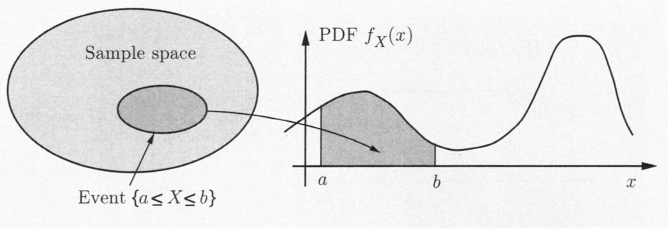
PDF
In particular, when $B=\left[a,b\right]$,
$$P\left(a≤X≤b\right)=\int_{a}^{b}{f_{X}\left(x\right)dx}$$ is the area under the graph of PDF.

Slide 6
PDF
$P\left(a≤X≤a\right)=\int_{a}^{a}{f_{X}\left(x\right)dx}=0$.
$$∴ P\left(a≤X≤b\right)=P\left(a<X≤b\right)$$
$$=P\left(a≤X<b\right)=P\left(a<X<b\right)$$
The entire area under the graph is equal to $1$.
$$\int_{−∞}^{∞}{f_{X}\left(x\right)dx}=P\left(−∞≤X≤∞\right)=1$$

Slide 7
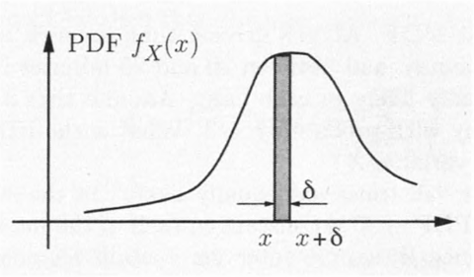
Interpretation of PDF
$f_{X}(x)$: “probability mass per unit length”
$P\left(\left[x,x+δ\right]\right)=\int_{x}^{x+δ}{f_{X}\left(t\right)dt}≈f_{X}(x)∙δ$

Slide 8
Example 1: Uniform
Consider a random variable $X$ takes value in interval $\left[a,b\right]$.
Any subintervals of the same length have the same probability.
It is called uniform random variable.

Slide 9
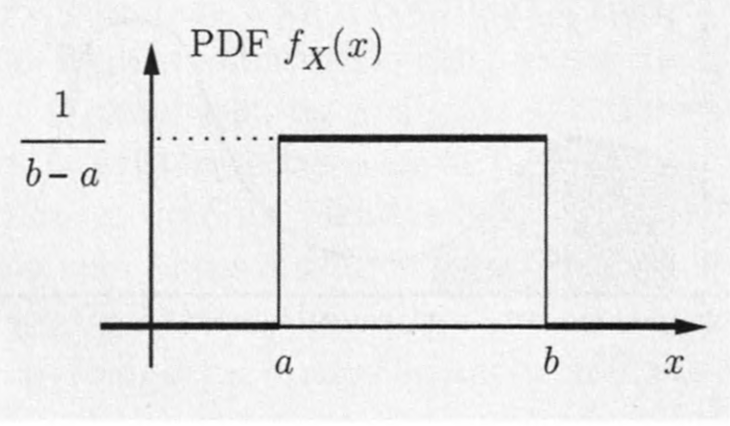
Example 1: Uniform
Its PDF has the form
$$f_{X}\left(x\right)=\left\{\begin{aligned}\frac{1}{b−a}, \text{if} a≤x≤b \\ 0, \text{otherwise} \end{aligned}\right.$$

Slide 10
Example 2: Piecewise Constant
When sunny, driving time is 15-20 minutes.
When rainy, driving time is 20-25 minutes.
With all times equally likely in each case.
Sunny with prob. $2/3$, rainy with prob. $1/3$
The PDF of driving time $X$ is
$$f_{X}\left(x\right)=\left\{\begin{aligned}c_{1, } \text{if} 15≤x≤20 \\ c_{2}, \text{if} 20≤x≤25 \\ 0, \text{otherwise} \end{aligned}\right.$$

Slide 11
Example 2: Piecewise Constant
$f_{X}\left(x\right)=\left\{\begin{aligned}c_{1, } \text{if} 15≤x≤20 \\ c_{2}, \text{if} 20≤x≤25 \\ 0, \text{otherwise} \end{aligned}\right.$
$\frac{2}{3}=P\left(sunny\right)=\int_{15}^{20}{f_{X}\left(x\right)dx}=5c_{1}$
$\frac{1}{3}=P\left(rainy\right)=\int_{20}^{25}{f_{X}\left(x\right)dx}=5c_{2}$
Solving this gives $c_{1}=\frac{2}{15}$, $c_{2}=\frac{1}{15}$.

Slide 12
Example 3: large values
Consider a random variable $X$ with PDF
$$f_{X}\left(x\right)=\left\{\begin{aligned}\frac{1}{2\sqrt{x}}, \text{if} 0<x≤1 \\ 0, \text{otherwise} \end{aligned}\right.$$
Note that $\int_{−∞}^{∞}{f_{X}\left(x\right)dx}=\int_{0}^{1}{\frac{1}{2\sqrt{x}}ⅆx}=\sqrt{x}\left|{1 \atop 0}\right.=1$
So it’s a valid PDF.
But $\lim_{x→0^{+}}{f_{X}(x)}=\lim_{x→0^{+}}{\frac{1}{2\sqrt{x}}}=+∞$.
There, a PDF can take arbitrarily large values.

Slide 13
Expectation
The expectation of a continuous random variable $X$ is defined by
$$E\left[X\right]=\int_{−∞}^{∞}{xf_{X}\left(x\right)dx}$$
As for discrete random variables, the expectation can be interpreted as
"center of gravity'' of the PDF
anticipated average value of $X$ in a large number of independent repetitions of the experiment.

Slide 14
Function of random variable
For any real-valued function $g$, $Y=g(X)$ is also a random variable.
The expectation of $g(X)$ is
$$E\left[g\left(X\right)\right]=\int_{−∞}^{∞}{g(x)f_{X}\left(x\right)dx}.$$

Slide 15
Moments and variance
The $n$th moment of $X$ is defined by $E\left[X^{n}\right]$.
The variance of $X$ is defined by
$Var\left[X\right]=E\left[{\left(X−E\left[X\right]\right)}^{2}\right]$
$=\int_{−∞}^{∞}{{\left(x−E[X]\right)}^{2}f_{X}\left(x\right)dx}$
$0≤Var\left[X\right]=E\left[X^{2}\right]−{\left(E\left[X\right]\right)}^{2}$
Please verify the equality.
If $Y=aX+b$, then
$$E\left[Y\right]=aE\left[X\right]+b, Var\left[Y\right]=a^{2}Var\left[X\right].$$

Slide 16
Example: Uniform
Consider a uniform random variable with PDF
$$f_{X}\left(x\right)=\left\{\begin{aligned}\frac{1}{b−a}, \text{if} a≤x≤b \\ 0, \text{otherwise} \end{aligned}\right.$$
$E\left[X\right]=\int_{a}^{b}{x∙\frac{1}{b−a}dx}=\frac{1}{b−a}∙\frac{1}{2}x^{2}\left|{b \atop a}\right.=\frac{a+b}{2}$.
$E\left[X^{2}\right]=\int_{a}^{b}{\frac{x^{2}}{b−a}dx}=\frac{1}{b−a}∙\frac{1}{3}x^{3}\left|{b \atop a}\right.=\frac{a^{2}+ab+b^{2}}{3}$.
$Var\left[X\right]=E\left[X^{2}\right]−{E\left[X\right]}^{2}=\frac{{(b−a)}^{2}}{12}$.

Slide 17
Example: Exponential
An exponential random variable has PDF
$$f_{X}\left(x\right)=\left\{\begin{aligned}λe^{−λx}, \text{if} x≥0 \\ 0, \text{otherwise}\end{aligned}\right.$$
Note: $f_{X}\left(0\right)=λ$.

Slide 18
Example: Exponential
Note: $\int_{0}^{∞}{λe^{−λx}dx}=−e^{−λx}\left|{∞ \atop 0}\right.=1$.
$d(e^{−λx})/dx=−λe^{−λx}$.
Tail: $P\left(X≥a\right)=\int_{a}^{∞}{λe^{−λx}dx}=−e^{−λx}\left|{∞ \atop a}\right.=e^{−λa}$

Slide 19
Example: Exponential
$E\left[X\right]=\int_{0}^{∞}{xλe^{−λx}dx}=−\int_{0}^{∞}{x de^{−λx}}$
$$=−xe^{−λx}\left|{∞ \atop 0}\right.+\int_{0}^{∞}{e^{−λx}dx}=0−\frac{e^{−λx}}{λ}\left|{∞ \atop 0}\right.=\frac{1}{λ}$$
Recall integral by parts: $\int{udv}=uv−\int{vdu}$.
$E\left[X^{2}\right]=\int_{0}^{∞}{x^{2}λe^{−λx}dx}$
$$=−x^{2}e^{−λx}\left|{∞ \atop 0}\right.+\int_{0}^{∞}{{2xe}^{−λx}dx}=\frac{2}{λ}E\left[X\right]=\frac{2}{λ^{2}}$$
$Var\left[X\right]=E\left[X^{2}\right]−{E\left[X\right]}^{2}=1/λ^{2}$

Slide 20
Example
Time $X$ of a meteorite first lands in Sahara.
An exponential r.v. with mean of 10 days.
Since $E\left[X\right]=1/λ$, we have $λ=1/{10}$.
Question: What’s the probability of it first lands in 6am – 6pm of the first day?
$P\left(\frac{1}{4}≤X≤\frac{3}{4}\right)=P\left(X≥\frac{1}{4}\right)−P\left(X≥\frac{3}{4}\right)$
$=e^{−\frac{1}{40}}−e^{−\frac{3}{40}}=0.0476$.

Slide 21
Content
Continuous Random Variables and PDFs
Cumulative Distribution Functions
Normal Random Variables
Joint PDFs of Multiple Random Variables
Conditioning
The Continuous Bayes’ Rule

Slide 22
Cumulative Distribution Function
The cumulative distribution function, or CDF, of a random variable $X$ is
$F_{X}\left(x\right)=P\left(X≤x\right)$
$=\left\{\begin{matrix}\sum_{k≤x}{p_{X}\left(k\right)}, & \text{discrete} \\ \int_{−∞}^{x}{f_{X}\left(y\right)dy}, & \text{continuous}\end{matrix}\right.$
The CDF $F_{X}\left(x\right)$ “accumulates” probability “up to” the value $x$.

Slide 23
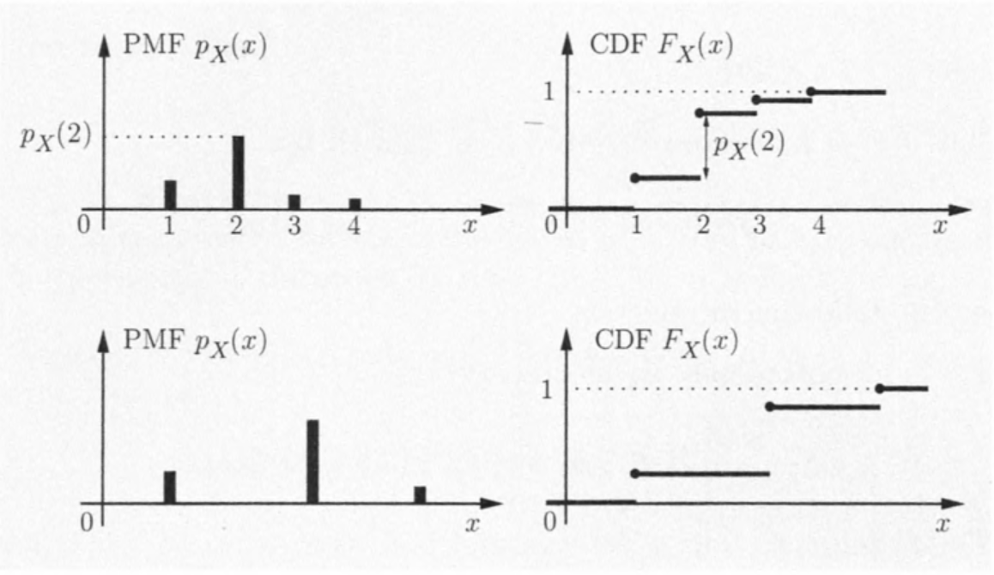
CDF for discrete case

Slide 24
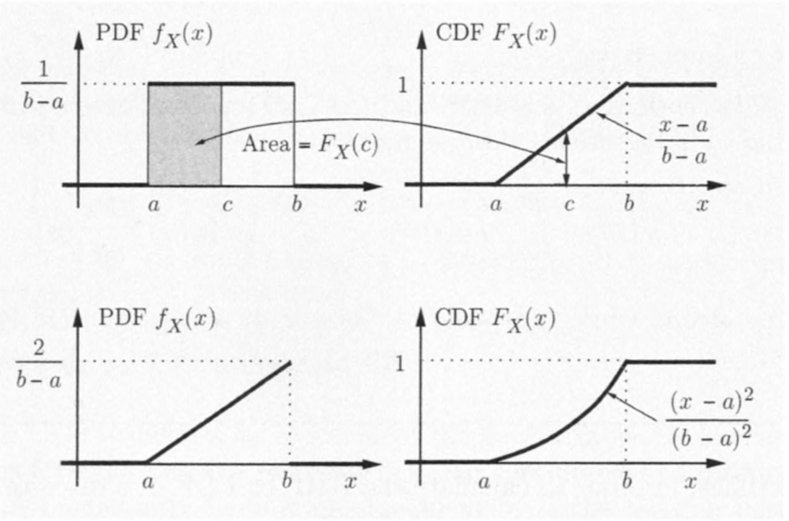
CDF for continuous case

Slide 25
Properties
$F_{X}$ is monotonically increasing:
if $x≤y$, then $F_{X}(x)≤F_{X}(y)$.
$\lim_{x→−∞}{F_{X}(x)}=0, \lim_{x→+∞}{F_{X}(x)}=1$
If $X$ is discrete, $F_{X}$ is piecewise constant.
If $X$ is continuous, $F_{X}$ is continuous and
$$F_{X}\left(x\right)=\int_{−∞}^{x}{f_{X}\left(t\right)dt}, f_{X}\left(x\right)=\frac{dF_{X}}{dx}\left(x\right).$$

Slide 26
Example: maximum of several random variables
Take a test three times with score in $\{1,..,10\}$
The final score is the maximum of the scores
$$X=\max{(X_{1},X_{2},X_{3})}$$
Each $X_{i}$ takes values $\{1,..,10\}$eually likely, and different $X_{i}$’s are independent.
The CDF of the final score $X$ is
$F_{X}\left(k\right)=P\left(X≤k\right)$
$=P\left(X_{1}≤k\right)P\left(X_{2}≤k\right)P\left(X_{3}≤k\right)$
$={(k/10)}^{3}$

Slide 27
Example: maximum of several random variables
Take a test three times with score in $\{1,..,10\}$
The final score is the maximum of the scores
$$X=\max{(X_{1},X_{2},X_{3})}$$
Each $X_{i}$ takes values $\{1,..,10\}$eually likely, and different $X_{i}$’s are independent.
The PDF of the final score $X$ is
$P_{X}\left(k\right)=F_{X}\left(k\right)−F_{X}\left(k−1\right)={\left(\frac{k}{10}\right)}^{3}−{\left(\frac{k−1}{10}\right)}^{3}$

Slide 28
Example: Geometric and Exponential
CDN for geometric random variable:
$F_{geo}\left(n\right)=\sum_{k=1}^{n}{p{(1−p)}^{k}}=p\frac{1−{(1−p)}^{n}}{1−(1−p)}$
$=1−{(1−p)}^{n}$ for $n=1,2,…$
CDN for exponential random variable:
When $x≤0$: $F_{exp}\left(x\right)=P\left(X≤0\right)=0$
When $x≥0$: $F_{exp}\left(x\right)=\int_{0}^{x}{λe^{−λt}dt}$ $=−e^{−λt}\left|{x \atop 0}\right.=1−e^{−λx}$

Slide 29
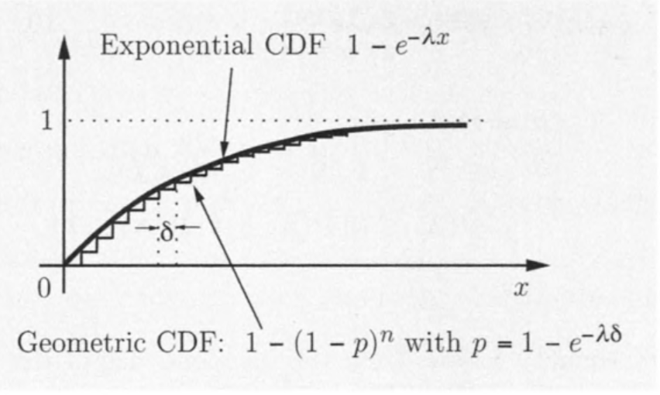
Example: Geometric and Exponential
$F_{geo}\left(n\right)=1−{(1−p)}^{n}$, $F_{exp}\left(x\right)=1−e^{−λx}$.
If $e^{−λδ}=1−p$, then $F_{exp}\left(nδ\right)=F_{geo}\left(n\right)$.

Slide 30
Content
Continuous Random Variables and PDFs
Cumulative Distribution Functions
Normal Random Variables
Joint PDFs of Multiple Random Variables
Conditioning
The Continuous Bayes’ Rule

Slide 31
Normal Random Variable
A continuous random variable $X$ is normal, or Gaussian, if it has a PDF
$$f_{X}\left(x\right)=\frac{1}{\sqrt{2π}σ}e^{−\frac{{(x−μ)}^{2}}{2σ^{2}}}$$ for some $σ>0$.
It can be verified that
$$\int_{−∞}^{∞}{\frac{1}{\sqrt{2π}σ}e^{−\frac{{(x−μ)}^{2}}{2σ^{2}}}dx}=1$$

Slide 32
Example
A normal PDF and CDF with $μ=1, σ^{2}=1$.
The PDF is symmetric around its mean $μ$, and has a characteristic bell shape.

Slide 33
Example
A normal PDF and CDF with $μ=1, σ^{2}=1$.
As $x$ gets further from $μ$. the term $e^{−\frac{{(x−μ)}^{2}}{2σ^{2}}}$ decreases very rapidly. In this figure, the PDF is very close to zero outside the interval $\left[−1,3\right]$.

Slide 34
Mean and variance
The PDF is symmetric around $μ$, so
$$E\left[X\right]=μ$$
It turns out that $Var\left[X\right]=σ^{2}$.

Slide 35
Variance
$Var\left[X\right]$ $=\int_{−∞}^{∞}{\frac{1}{\sqrt{2π}σ}{{(x−μ)}^{2}e}^{−\frac{{(x−μ)}^{2}}{2σ^{2}}}dx}$ $=\frac{σ^{2}}{\sqrt{2π}}\int_{−∞}^{∞}{{y^{2}e}^{−y^{2}/2}dy}$ $\left(∵y=\frac{x−μ}{σ}\right)$ $=\frac{σ^{2}}{\sqrt{2π}}\left(−ye^{−\frac{y^{2}}{2}}\right)\left|{∞ \atop −∞}\right.+\frac{σ^{2}}{\sqrt{2π}}\int_{−∞}^{∞}{e^{−\frac{y^{2}}{2}}dy}$ (integral by parts) $=\frac{σ^{2}}{\sqrt{2π}}\int_{−∞}^{∞}{e^{−y^{2}/2}dy}$ $=σ^{2}$

Slide 36
Standard Normal
The normal random variable with zero mean and unit variance is a standard normal. Its CDF is denoted by $Φ$:
$$Φ\left(y\right)=P\left(Y≤y\right)=\frac{1}{\sqrt{2π}}\int_{−∞}^{y}{e^{−t^{2}/2}dt}$$
By symmetry, it holds
$$Φ\left(−y\right)=1−Φ(y)$$

Slide 37
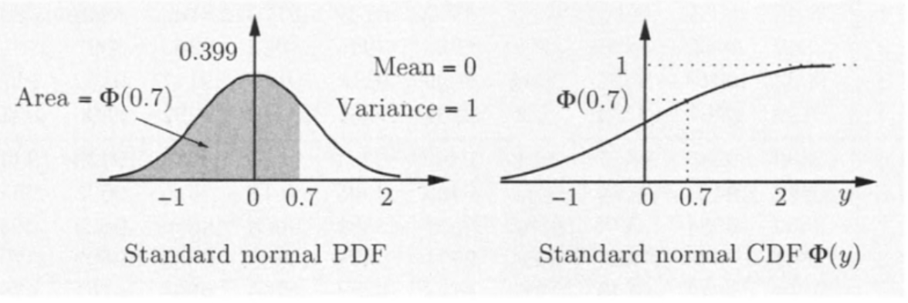
Standard Normal

Slide 38
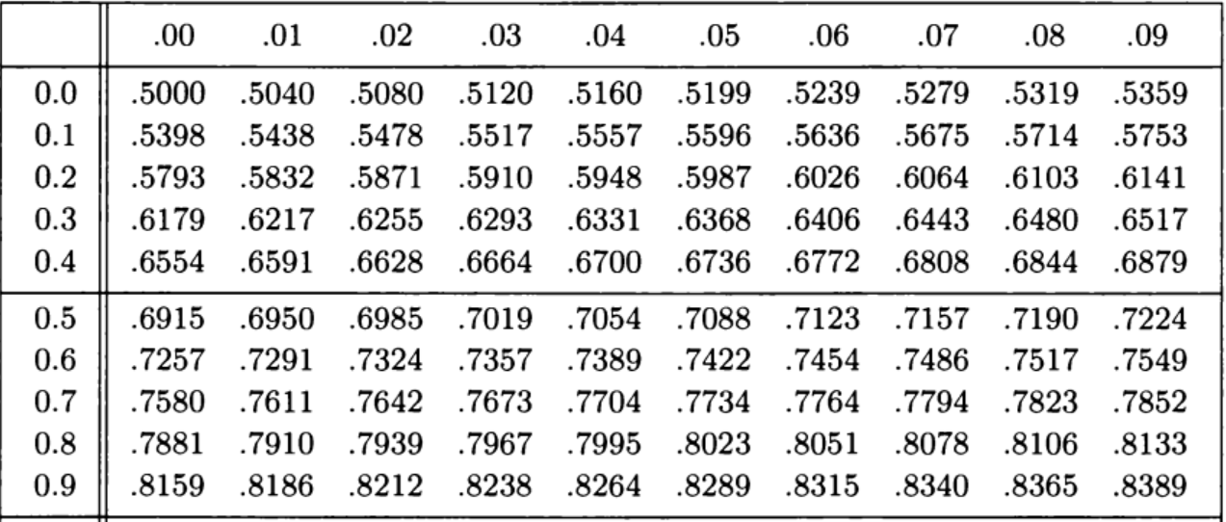
Standard Normal
Table of $Φ(x)$ for positive $x$.
$Φ\left(−0.5\right)=1−Φ\left(0.5\right)=1−.6915=.3085$

Slide 39
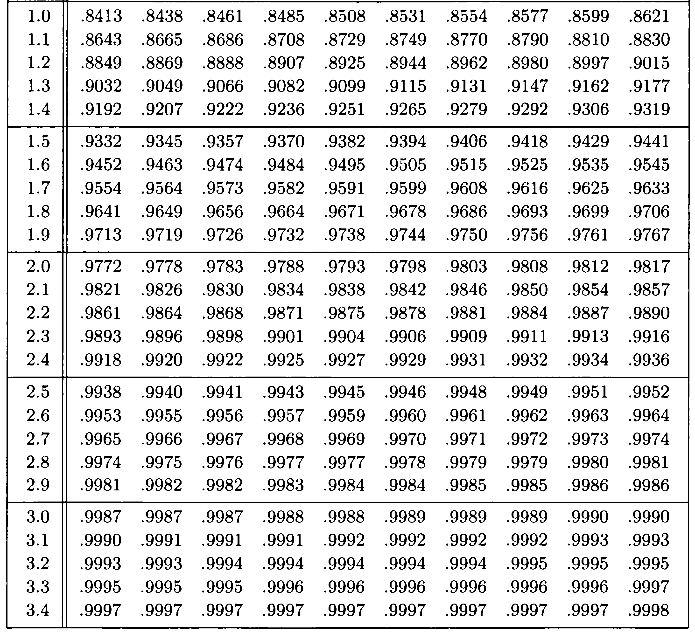

Slide 40
Standard Normal
Let $X$ be a normal random variable with mean $μ$ and variance $σ^{2}$. Then
$$Y=\frac{X−μ}{σ}$$
is normal and
$E\left[Y\right]=\frac{E[X]−μ}{σ}=0, Var\left[Y\right]=\frac{Var[X]}{σ^{2}}=1$
Thus, $Y$ is standard normal.
This fact allows us to calculate the probability of any event defined in terms of $X$: we redefine the event in terms of $y$, and then use the standard normal table.

Slide 41
Example 1: Using the normal table
annual snowfall at a certain place
normal r.v. with mean $μ=60$ and standard deviation $σ=20$.
Question: What is the probability that this year’s snowfall will be at least $80$ inches?
$P\left(X≥80\right)=P\left(\frac{X−60}{20}≥\frac{80−60}{20}\right)=P(Y≥1)$
$$=1−Φ\left(1\right)=1−.8413=.1587$$

Slide 42
Example 1: Using the normal table
In general, we can calculate the CDF for a normal random variable as follows.
For a normal random variable $X$ with mean $μ$ and variance $σ^{2}$, we
first “standardize" $X$, i.e., subtract $μ$ and divide by $σ^{2}$, to obtain a standard normal random variable $Y$
read the CDF value from standard normal table:
$$P\left(X≤x\right)=P\left(\frac{X−μ}{σ}≥\frac{x−μ}{σ}\right)=P\left(Y≤\frac{x−μ}{σ}\right)=Φ\left(\frac{x−μ}{σ}\right)$$

Slide 43
Example 2: Signal detection
A binary message is transmitted as a signal $s$, which is either $+1$ or $−1$.
The communication corrupts the transmission with additional normal noise with mean $μ=0$ and variance $σ^{2}$.
The receiver concludes that the signal $−1$ (or $+1$) was transmitted if the value received is $<0$ (or $≥0$, respectively).

Slide 44
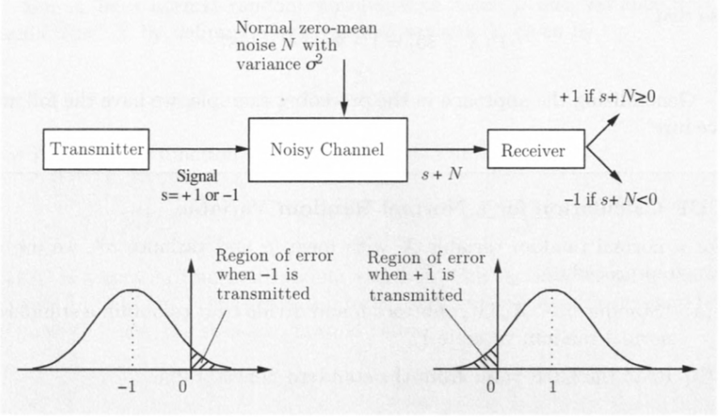
Example 2: Signal detection 2

Slide 45
Example 2: Signal detection 3
Question: What is the probability of error?
The error occurs whenever $−1$ is transmitted and the noise $N$ is at least $1$, or whenever $+1$ is transmitted and the noise is smaller than $−1$.
$P\left(N≥1\right)=1−P\left(N<1\right)$
$=1−P\left(\frac{N−μ}{σ}<\frac{1−μ}{σ}\right)=1−Φ\left(\frac{1−μ}{σ}\right)$ $=1−Φ\left(\frac{1}{σ}\right)$

Slide 46
Normal Random Variable
Normal random variables play an important role in a broad range of probabilistic models.
The main reason is that they model well the additive effect of many independent factors.
The sum of a large number of independent and identically distributed (not necessarily normal) random variables $≈$ normal CDF.
regardless of CDF of individual random variables.
More on this in Chapter 5.

Slide 47
Content
Continuous Random Variables and PDFs
Cumulative Distribution Functions
Normal Random Variables
Joint PDFs of Multiple Random Variables
Conditioning
The Continuous Bayes’ Rule

Slide 48
Joint PDFs
Two continuous random variables associated with the same experiment are jointly continuous and can be described in terms of a joint PDF $f_{X,Y}$ if $f_{X,Y}$ is nonnegative function that satisfies
$$P\left(\left(X,Y\right)∈B\right)=\iint_{\left(x,y\right)∈B}{f_{X,Y}\left(x,y\right)dxdy}$$
for every subset $B$ of the two-dimensional plane.

Slide 49
Joint PDFs
Normalization: $\int_{−∞}^{∞}{\int_{−∞}^{∞}{f_{X,Y}\left(x,y\right)dx}dy}=1$
To interpret the joint PDF, let $δ$ be a small positive number,
$P\left(a≤X≤a+δ,c≤Y≤c+δ\right)$
$$=\int_{c}^{c+δ}{\int_{a}^{a+δ}{f_{X,Y}\left(x,y\right)dx}dy}≈f_{X,Y}(a,c)δ^{2}$$
$f_{X,Y}\left(a,c\right)$: “probability per unit area” in the vicinity of $\left(a,c\right)$.

Slide 50
Marginal Probability
$P\left(X∈A\right)=P\left(X∈A, Y∈\left(−∞,∞\right)\right)$
$$=\int_{A}{\int_{−∞}^{∞}{f_{X,Y}\left(x,y\right)dy}dx}$$
Recall $P\left(X∈A\right)=\int_{x∈A}{f_{X}\left(x\right)dx}$
Thus the marginal PDF of $X$ is given by
$f_{X}\left(x\right)=\int_{−∞}^{∞}{f_{X,Y}\left(x,y\right)dy}$
Similarly, the marginal PDF of $Y$ is
$f_{Y}\left(y\right)=\int_{−∞}^{∞}{f_{X,Y}\left(x,y\right)dx}$

Slide 51
Example: 2D Uniform PDF
Romeo and Juliet have a date at a given time
Each will arrive with a delay between 0 and 1 hour.
Let $X,Y$ denote their delays.
Assume that no pairs in the unit square is more likely than others

Slide 52
Example: 2D Uniform PDF
Then the joint PDF is of the form
$$f_{X,Y}\left(x,y\right)=\left\{\begin{matrix}c & \text{if} 0≤x≤1, 0≤y≤1 \\ 0 & \text{otherwise} \end{matrix}\right.$$
By $\int_{−∞}^{∞}{\int_{−∞}^{∞}{f_{X,Y}\left(x,y\right)dx}dy}=1$, we get
$$c=1$$

Slide 53
2D Uniform PDF
In general, let $S$ be a subset of the two dimensional plane. The corresponding uniform joint PDF on $S$ is defined by
$$f_{X,Y}\left(x,y\right)=\left\{\begin{matrix}\frac{1}{\text{area} \text{of} S} & \text{if} (x,y)∈S \\ 0 & \text{otherwise} \end{matrix}\right.$$

Slide 54
2D Uniform PDF
For any subset $A⊂S$, the probability that $(X, Y)$ lies in $A$ is
$$P\left(\left(X,Y\right)∈A\right)=\iint_{(x,y)∈A}{f_{X,Y}\left(x,y\right)dxdy}$$
$$=\frac{\text{1}}{\text{area} \text{of} S}\iint_{(x,y)∈A}{dxdy}=\frac{\text{area} \text{of} A}{\text{area} \text{of} S}$$

Slide 55
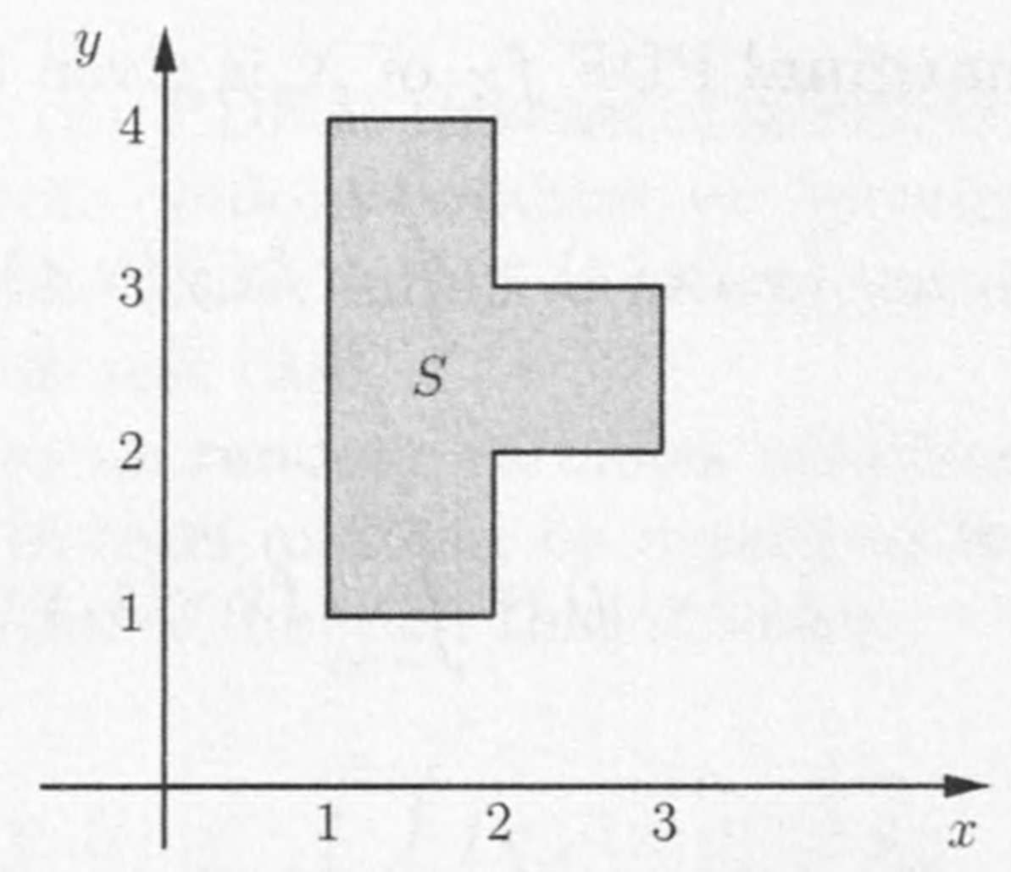
Example 2
Suppose the joint PDF of $X,Y$ is a constant $c$ on $S$ and $0$ outside.
Question: What is $c$?
Question: What are the marginal PDFs of $X$ and $Y$?

Slide 56
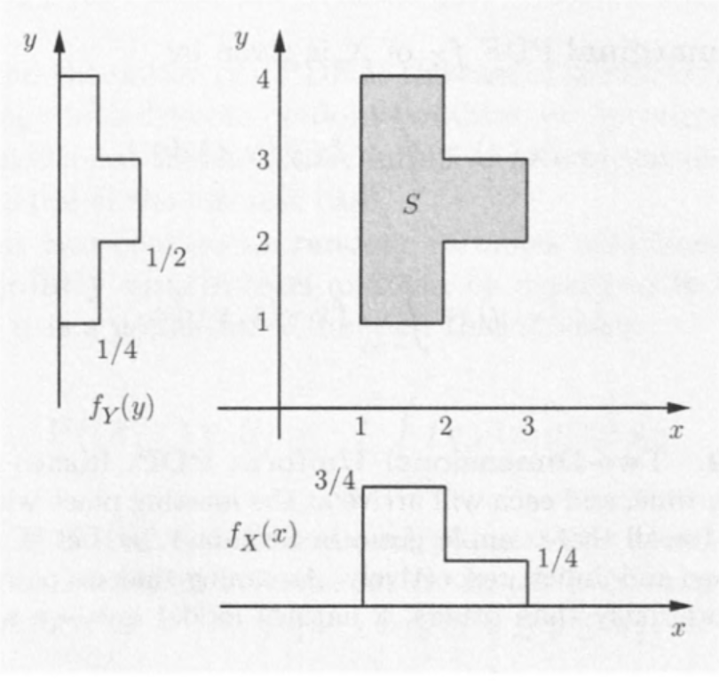
Example 2
Suppose the joint PDF of $X,Y$ is a constant $c$ on $S$ and $0$ outside.
The area of $S$ is $4$, so $c=1/4$.
The marginal PDFs of $X,Y$ are shown in the figure.

Slide 57
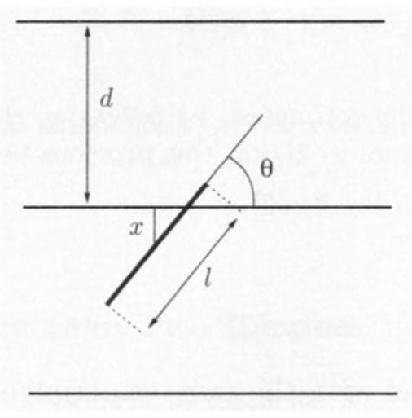
Example: Buffon’s Needle
A surface is ruled with parallel lines, which at distance $d$ from each other.
Suppose we throw a needle of length $l$ randomly.
Question: What is the probability that the needle will intersect one of the lines?
Assume $l<d$ so that the needle cannot intersect two lines simultaneously.

Slide 58
Example: Buffon’s Needle
$X$: the distance from the middle point of the needle and the nearest of the parallel lines
$Θ$: the acute angle formed by the needle and the lines

Slide 59
We model $(X,Θ)$ with a uniform joint PDF:
$$f_{X,Θ}\left(x,θ\right)=\left\{\begin{matrix}\frac{4}{πd} & \text{if} x∈\left[0,\frac{d}{2}\right] \text{and} θ∈\left[0,\frac{π}{2}\right] \\ 0 & \text{otherwise} \end{matrix}\right.$$

Slide 60
The needle will intersect one of the lines if and only if
$$X≤\frac{l}{2}\sin{Θ}$$

Slide 61
Example: Buffon’s Needle
So the probability of intersection is
$$P\left(X≤\frac{l}{2}\sin{Θ}\right)=\iint_{X≤\frac{l}{2}\sin{θ}}{f_{X,Θ}\left(x,θ\right)dxdθ}$$
$$=\frac{4}{πd}\int_{0}^{π/2}{\int_{0}^{\left(\frac{l}{2}\right)\sin{θ}}{dxdθ}}=\frac{4}{πd}\int_{0}^{π/2}{\left(\frac{l}{2}\right)\sin{θ}dθ}$$
$$=\frac{2l}{πd}\left(−\cos{θ}\right)\left|{π/2 \atop 0}\right.=\frac{2l}{πd}$$

Slide 62
Joint CDFs
If $X$ and $Y$ are two random variables associated with the same experiment, we define their joint CDF by
$$F_{X,Y}\left(x,y\right)=P(X≤x,Y≤y)$$

Slide 63
Joint CDFs
If $X$ and $Y$ are described by a joint PDF $f_{X,Y}$, then
$$F_{X,Y}\left(x,y\right)=P\left(X≤x,Y≤y\right)=\int_{−∞}^{x}{\int_{−∞}^{y}{f_{X,Y}\left(s,t\right)dsdt}}$$
and
$$f_{X,Y}(x,y)=\frac{∂^{2}F_{X,Y}}{∂x∂y}(x,y)$$

Slide 64
Example
Let $X$ and $Y$ be described by a uniform PDF on the unit square ${\left[0,1\right]}^{2}$.
The joint CDF is given by
$$F_{X,Y}\left(x,y\right)=P\left(X≤x,Y≤y\right)=xy$$
Then
$$\frac{∂^{2}F_{X,Y}}{∂x∂y}\left(x,y\right)=\frac{∂^{2}\left(xy\right)}{∂x∂y}\left(x,y\right)=1=f_{X,Y}(x,y)$$
for all $\left(x,y\right)$ in the unit square.

Slide 65
Expectation
If $X$ and $Y$ are jointly continuous random variables and $g$ is some function, then
$$Z=g\left(X,Y\right)$$
is also a random variable.
And
$$E\left[g\left(X,Y\right)\right]=\int_{−∞}^{∞}{\int_{−∞}^{∞}{{g(x,y)f}_{X,Y}\left(x,y\right)dxdy}}$$

Slide 66
Expectation
If $g\left(X,Y\right)$ is a linear function: $g\left(X,Y\right)=aX+bY+c$ for some scalars $a,b,c$.
then
$$E\left[aX+bY+c\right]=aE\left[X\right]+bE\left[Y\right]+c$$
“linearity of expectation”

Slide 67
More than two random variables
The joint PDF of $X, Y$ and $Z$ satisfies
$$P\left(\left(X,Y,Z\right)∈B\right)=\iiint_{(x,y,z)∈B}{f_{X,Y,Z}\left(x,y,z\right)dxdydz}$$
for any set $B$.
Marginal:
$f_{X,Y}\left(x,y\right)=\int_{−∞}^{∞}{f_{X,Y,Z}\left(x,y,z\right)dz}$
$f_{X}\left(x\right)=\int_{−∞}^{∞}{\int_{−∞}^{∞}{f_{X,Y,Z}\left(x,y,z\right)dy}dz}$

Slide 68
More than two random variables
$E\left[g\left(X,Y,Z\right)\right]=\int_{−∞}^{∞}{\int_{−∞}^{∞}{\int_{−∞}^{∞}{g\left(x,y,z\right)f_{X,Y,Z}\left(x,y,z\right)dx}dy}dz}$
If $g$ is linear, of the form $aX+bY+cZ$, then
$$E\left[aX+bY+cZ\right]=aE\left[X\right]+bE\left[Y\right]+cE\left[Z\right]$$
In general, $E\left[a_{1}X_{1}+⋯+a_{n}X_{n}\right]=a_{1}E\left[X_{1}\right]+⋯+a_{n}E[X_{n}]$

Slide 69
Content
Continuous Random Variables and PDFs
Cumulative Distribution Functions
Normal Random Variables
Joint PDFs of Multiple Random Variables
Conditioning
The Continuous Bayes’ Rule

Slide 70
Conditioning
Similar to the case of discrete random variables, we can condition a random variable
on an event, or
on another random variable,
and define the concepts of conditional PDF and conditional expectation.

Slide 71
Conditioning a r.v. on an event
The conditional PDF of a continuous random variable $X$, given an event $A$ with $P\left(A\right)>0$, is defined as a nonnegative function $f_{X|A}$ that satisfies
$$P\left(X∈B | A\right)=\int_{B}{f_{X|A}\left(x\right)dx},$$
for any subset $B$ of the real line.

Slide 72
Conditioning a r.v. on an event
In particular, taking $B=ℝ$
$$\int_{−∞}^{∞}{f_{X|A}\left(x\right)dx}=1.$$
So $f_{X|A}$ is a legitimate PDF.

Slide 73
Conditioning on event $\{X∈A\}$
If we condition on event $\{X∈A\}$, with $P\left(X∈A\right)>0$, then
$P\left(X∈B | X∈A\right)$
$$=\frac{P(X∈B,X∈A)}{P(X∈A)}$$
$$=\frac{\int_{A∩B}{f_{X}\left(x\right)dx}}{P(X∈A)}$$

Slide 74
Conditioning on event $\{X∈A\}$
Comparing with the earlier formula gives
$$f_{X|\{X∈A\}}\left(x\right)=\left\{\begin{matrix}\frac{f_{X}\left(x\right)}{P(X∈A)}, & \text{if} X∈A, \\ 0, & \text{otherwise}.\end{matrix}\right.$$
The conditional PDF is zero outside the conditioning set.
Within the conditioning set, the conditional PDF has the same shape as the unconditional one, except that scaled by a factor $1/P(X∈A)$

Slide 75
Conditioning on event $\{X∈A\}$

Slide 76
Example: exp. r.v. is memoryless
The time $T$ until a new light bulb burns out is an exponential random variable with parameter $λ$.
Alice turns the light on, leaves the room, and when she returns, $t$ time units later, finds the light bulb is still on, which corresponds to the event
$$A=\{T>t\}$$

Slide 77
Example: exp. r.v. is memoryless
Let $X$ be the additional time until the light bulb burns out.
Question: What’s the conditional CDF of $X$ given the event $A$?
$P\left(X>x | A\right)=P\left(T>t+x | T>t\right)$
$$=\frac{P(T>t+x \text{and} T>t)}{P(T>t)}=\frac{P(T>t+x)}{P(T>t)}$$
$$=\frac{e^{−λ(t+x)}}{e^{−λt}}=e^{−λx}$$

Slide 78
Example: exp. r.v. is memoryless
Last slide: $P\left(X>x | A\right)=e^{−λx}$.
Recall tail probability of exponential r.v.:
$$P\left(X≥a\right)=e^{−λa}.$$
Observation: The conditional CDF of $X$ is exponential with parameter $A$, regardless of the time $t$ that elapsed between the lighting of the bulb and Alice's arrival.
Thus the exponential random variable is called memoryless.

Slide 79
Conditioning with multiple r.v.
Suppose $X$ and $Y$ are jointly continuous random variables, with joint PDF $f_{X,Y}$.
If we condition on a positive probability event of the form $C=\{(X,Y)∈A\}$, we have
$$f_{X,Y|C}\left(x,y\right)=\left\{\begin{matrix}\frac{f_{X,Y}(x,y)}{P(C)} & \text{if} \left(x,y\right)∈A, \\ 0 & \text{otherwise}.\end{matrix}\right.$$
The conditional PDF of $X$, given event $C$, is
$$f_{X|C}\left(x\right)=\int_{−∞}^{∞}{f_{X,Y|C}\left(x,y\right)dy}$$

Slide 80
Total probability theorem
If the events $A_{1},⋯,A_{n}$ form a partition of the sample space, then
$$f_{X}\left(x\right)=\sum_{i=1}^{n}{P(A_{i})f_{X|A_{i}}(x)}$$
Next we give a proof.

Slide 81
Proof of total probability theorem
By the total probability theorem from Chapter 1, we have
$P\left(X≤x\right)=\sum_{i=1}^{n}{P\left(A_{i}\right)P(X≤x|A_{i})}$
This formula can be written as
$$\int_{−∞}^{x}{f_{X}\left(t\right)dt}=\sum_{i=1}^{n}{P\left(A_{i}\right)\int_{−∞}^{x}{f_{X|A_{i}}\left(t\right)dt}}$$
Then take the derivative with respect to $x$ and get the result.

Slide 82
Example: Taking train
The metro train arrives at the station every quarter hour starting at 6:00 a.m.
You walk into the station between 7:10-7:30 a.m. uniformly.
Question: What’s the PDF of the time you have to wait for the first train to arrive?

Slide 83
Example: Taking train
Denote the time of your arrival by $X$, which is then a uniform random variable on 7:10-7:30
Let $Y$ be the waiting time.
Let $A$ and $B$ be the events
$$A=\left\{7:10≤X≤7:15\right\}=\{board 7:15 train\}$$
$$B=\left\{7:15<X≤7:30\right\}=\{board 7:30 train\}$$

Slide 84
Example: Taking train
Condition on event $A$, $Y$ is uniform on 0-5
Condition on event $B$, $Y$ is uniform on 0-15
Total probability theorem:
$$f_{Y}\left(y\right)=P\left(A\right)f_{Y|A}\left(y\right)+P\left(B\right)f_{Y|B}\left(y\right)$$
For $0≤y≤5$,
$$f_{Y}\left(y\right)=\frac{1}{4}∙\frac{1}{5}+\frac{3}{4}∙\frac{1}{15}=\frac{1}{10}$$
For $5<y≤15$,
$$f_{Y}\left(y\right)=\frac{1}{4}∙0+\frac{3}{4}∙\frac{1}{15}=\frac{1}{20}$$

Slide 85
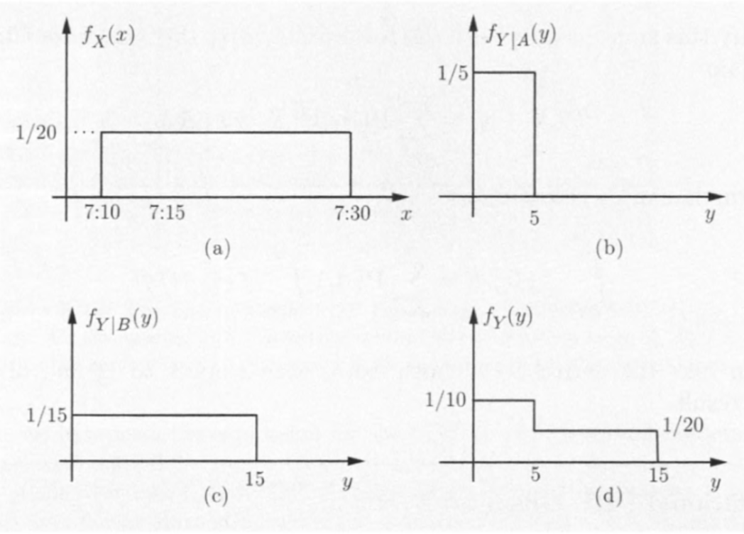
Example: Taking train

Slide 86
Conditioning one r.v. on another
Let $X$ and $Y$ be continuous random variables with joint PDF $f_{X,Y}$.
For any $y$ with $f_{Y}\left(y\right)>0$, the conditional PDF of $X$ given that $Y=y$, is
$$f_{X|Y}\left(x | y\right)=\frac{f_{X,Y}(x,y)}{f_{Y}(y)}.$$
This is analogous to the formula $P_{X|Y}\left(x | y\right)=\frac{P_{X,Y}\left(x,y\right)}{P_{Y}\left(y\right)}$ for the discrete case.

Slide 87
Conditioning one random variable on another
Because
$$f_{Y}\left(y\right)=\int_{−∞}^{∞}{f_{X,Y}\left(x,y\right)dx},$$
then
$$\int_{−∞}^{∞}{f_{X|Y}\left(x | y\right)dx}=1,$$
for any fixed $y$.
Thus $f_{X|Y}\left(x | y\right)$ is a legitimate PDF.

Slide 88
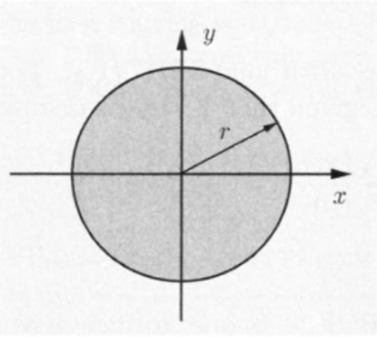
Example: Circular uniform PDF
Bob throws a dart at a circular target of radius $r$.
He always hits the target.
All points of impact $(x,y)$ are equally likely.
Then the joint PDF of the random variables $X,Y$ is uniform.

Slide 89
Example: Circular uniform PDF
Because the area of the circle is $πr^{2}$,
$$f_{X,Y}\left(x,y\right)=\left\{\begin{matrix}\frac{1}{πr^{2}} & \text{if} x^{2}+y^{2}≤r^{2}, \\ 0 & \text{otherwise}\text{.}\end{matrix}\right.$$
To calculate the conditional PDF $f_{X|Y}(x|y)$, let us find the marginal PDF $f_{Y}(y)$.

Slide 90
Example: Circular uniform PDF
For $\left|y\right|>r$, $f_{X|Y}\left(x | y\right)=0$
For $|y|≤r$,
$$f_{Y}\left(y\right)=\int_{−∞}^{∞}{f_{X,Y}\left(x,y\right)dx} \\ =\frac{1}{πr^{2}}\int_{x^{2}+y^{2}≤r^{2}}{dx}=\frac{1}{πr^{2}}\int_{−\sqrt{r^{2}−y^{2}}}^{\sqrt{r^{2}−y^{2}}}{dx}$$
$$=\frac{2\sqrt{r^{2}−y^{2}}}{πr^{2}}$$

Slide 91
Example: Circular uniform PDF
The conditional PDF is
$$f_{X|Y}\left(x | y\right)=\frac{f_{X,Y}(x,y)}{f_{Y}(y)}=\frac{\frac{1}{πr^{2}}}{\frac{2}{πr^{2}}\sqrt{r^{2}−y^{2}}}$$
$$=\frac{1}{2\sqrt{r^{2}−y^{2}}}, if x^{2}+y^{2}≤r^{2}$$
Thus for a fixed value of $y$, the conditional PDF $f_{X|Y}$ is uniform.

Slide 92
Conditional probability on zero event
Let us fix some small positive numbers $δ_{1}$ and $δ_{2}$, and condition on the event
$$B=\left\{y≤Y≤y+δ_{2}\right\}.$$
Then
$$P\left(x≤X≤x+δ_{1} | y≤Y≤y+δ_{2}\right)$$
$$=\frac{P(x≤X≤x+δ_{1} \text{and} y≤Y≤y+δ_{2})}{P(y≤Y≤y+δ_{2})}$$
$$≈\frac{f_{X,Y}\left(x,y\right)δ_{1}δ_{2}}{f_{Y}\left(y\right)δ_{2}}=f_{X|Y}\left(x | y\right)δ_{1},$$ which is independent of $δ_{2}$

Slide 93
Conditional probability on zero event
Let $δ_{2}→0$, we get
$$P\left(x≤X≤x+δ_{1} | Y=y\right)≈f_{X|Y}\left(x | y\right)δ_{1}$$
for $δ_{1}$ small, and more generally
$$P\left(X∈A | Y=y\right)=\int_{A}{f_{X|Y}\left(x | y\right)dx}$$
This gives a conditional probability on the zero event $\{Y=y\}$.

Slide 94
Example: Vehicle speed
The speed of a typical vehicle that drives past a police radar is an exponential random variable $X$ with mean $50$.
The police radar’s measurement $Y$ has an error which is modeled as a normal random variable with zero mean and standard derivation equal to one tenth of the vehicle’s speed.

Slide 95
Example: Vehicle speed
Question: What is the joint PDF of $X$ and $Y$?
First, $f_{X}\left(x\right)=\left(\frac{1}{50}\right)e^{−\frac{x}{50}},$ for $x≥0$
Also, conditioned on $X=x$, the measurement $Y$ has a normal PDF with mean $x$ and variance $x^{2}/100$. Thus
$$f_{Y|X}\left(y | x\right)=\frac{1}{\sqrt{2π}(x/10)}e^{−{\left(y−x\right)}^{2}/(2x^{2}/100)}.$$

Slide 96
Example: Vehicle speed
Thus, for all $x≥0$ and all $y$,
$f_{X,Y}\left(x,y\right)=f_{X}\left(x\right)f_{Y|X}\left(y | x\right)$
$=\frac{1}{50}e^{\frac{x}{50}}\frac{10}{\sqrt{2π}x}e^{−\frac{{50(y−x)}^{2}}{x^{2}}}$

Slide 97
Conditioning for more than two random variables
$f_{X.Y|Z}\left(x,y | z\right)=\frac{f_{X,Y,Z}(x,y,z)}{f_{Z}(z)},$ if $f_{Z}\left(z\right)>0$.
$f_{X|Y,Z}\left(x | y,z\right)=\frac{f_{X,Y,Z}(x,y,z)}{f_{Y,Z}(y,z)},$ if $f_{Y,Z}\left(y,z\right)>0$.
There is an analog of the multiplication rule
$$f_{X,Y,Z}\left(x,y,z\right)=f_{X|Y,Z}\left(x | y,z\right)f_{Y|Z}\left(y | z\right)f_{Z}\left(z\right)$$

Slide 98
Conditional Expectation
For a continuous random variable $X$, its conditional expectation $E[X|A]$ given an event $A$ with $P\left(A\right)>0$ is
$$E\left[X | A\right]=\int_{−∞}^{∞}{xf_{X|A}\left(x\right)dx}$$
The conditional expectation of $X$ given that $Y=y$ is
$$E[X|Y=y]=\int_{−∞}^{∞}{xf_{X|Y}\left(x | y\right)dx}$$

Slide 99
The expected value rule
For a function $g(X)$, we have
$$E\left[g\left(X\right) | A\right]=\int_{−∞}^{∞}{g\left(x\right)f_{X|A}\left(x\right)dx}$$
and
$$E\left[g\left(X\right) | Y=y\right]=\int_{−∞}^{∞}{g\left(x\right)f_{X|Y}\left(x | y\right)dx}$$

Slide 100
Total expectation theorem 1
Let $A_{1},⋯,A_{n}$ be disjoint events that form a partition of the sample space, and assume that $P\left(A_{i}\right)>0$ for all $i$. Then
$$f_{X}\left(x\right)=\sum_{i=1}^{n}{P(A_{i})f_{X|A_{i}}(x)}.$$
From here, we can get
$$E\left[X\right]=\sum_{i=1}^{n}{P\left(A_{i}\right)E[X|A_{i}]}.$$

Slide 101
Total expectation theorem 2
When conditioned on a random variable, we have
$$E\left[X\right]=\int_{−∞}^{∞}{E\left[X | Y=y\right]f_{Y}\left(y\right)dy}$$

Slide 102
Proof
$\int_{−∞}^{∞}{E\left[X | Y=y\right]f_{Y}\left(y\right)dy}$
$$=\int_{−∞}^{∞}{\left[\int_{−∞}^{∞}{xf_{X|Y}\left(x | y\right)dx}\right]f_{Y}\left(y\right)dy}$$
$$=\int_{−∞}^{∞}{\int_{−∞}^{∞}{xf_{X|Y}\left(x | y\right)}f_{Y}\left(y\right)dxdy}$$
$$=\int_{−∞}^{∞}{\int_{−∞}^{∞}{xf_{X,Y}(x,y)}dxdy}$$
$$=\int_{−∞}^{∞}{xf_{X}(x)dx}=E[X]$$

Slide 103
Example: Mean and Variance of a Piecewise Constant PDF
Suppose the random variable $X$ has the PDF
$$f_{X}\left(x\right)=\left\{\begin{matrix}1/3 & \text{if} 0≤x≤1 \\ 2/3 & \text{if} 1<x≤2 \\ 0 & \text{otherwise}\end{matrix}\right.$$
Consider the events
$$A_{1}=\left\{X \text{lies} \text{in} \text{the} \text{first} \text{interval} \left[0,1\right]\right\}$$
$$A_{2}=\{X \text{lies} \text{in} \text{the} \text{second} \text{interval} (1,2]\}$$

Slide 104
Example: Mean and Variance of a Piecewise Constant PDF

Slide 105
Example: Mean and Variance of a Piecewise Constant PDF
Then
$$P\left(A_{1}\right)=1/3, P\left(A_{2}\right)=2/3.$$
And the conditional PDFs $f_{X|A_{1}}$ and $f_{X|A_{2}}$ are uniform.
Recall previous result: Uniform random variable $Y$ on $\left[a,b\right]$ has $E\left[Y^{2}\right]=\frac{a^{2}+ab+b^{2}}{3}$.
Thus $E\left[X | A_{1}\right]=1/2, E\left[X | A_{2}\right]=3/2$
$$E\left[X^{2} | A_{1}\right]=1/3, E\left[X^{2} | A_{2}\right]=7/3$$

Slide 106
Example: Mean and Variance of a Piecewise Constant PDF
And
$E\left[X\right]=P\left(A_{1}\right)E\left[X | A_{1}\right]+P\left(A_{2}\right)E\left[X | A_{2}\right]$
$=\frac{1}{3}∙\frac{1}{2}+\frac{2}{3}∙\frac{3}{2}=\frac{7}{6}.$
$E\left[X^{2}\right]=P\left(A_{1}\right)E\left[X^{2} | A_{1}\right]+P\left(A_{2}\right)E\left[X^{2} | A_{2}\right]$
$=\frac{1}{3}∙\frac{1}{3}+\frac{2}{3}∙\frac{7}{3}=\frac{15}{9}.$
Thus, the variance is
$$Var\left[X\right]=E\left[X^{2}\right]−{\left(E\left[X\right]\right)}^{2}=\frac{15}{9}−\frac{49}{36}=\frac{11}{36}.$$

Slide 107
Independence
Two continuous random variables $X$ and $Y$ are independent if their joint PDF is the product of the marginal PDFs
$$f_{X,Y}\left(x,y\right)=f_{X}(x)f_{Y}(y)$$
for all $x,y$.
It is equivalent to
$$f_{X|Y}\left(x | y\right)=f_{X}(x)$$
for all $y$ with $f_{Y}\left(y\right)>0$ and all $x$.

Slide 108
Independence
Three continuous random variables $X,Y$ and $Z$ are independent if
$$f_{X,Y,Z}\left(x,y,z\right)=f_{X}(x)f_{Y}(y)f_{Z}(z)$$
for all $x,y,z$.

Slide 109
Example: Independent normal random variables
Let $X$ and $Y$ be independent normal random variables with means $μ_{x},μ_{y}$, and variance $σ_{x}^{2},σ_{y}^{2}$, respectively. Their joint PDF is of the form
$f_{X,Y}\left(x,y\right)$
$=f_{X}\left(x\right)f_{Y}\left(y\right)$
$=\frac{1}{2πσ_{x}σ_{y}}\exp\left\{−\frac{{\left(x−μ_{x}\right)}^{2}}{2σ_{x}^{2}}−\frac{{\left(y−μ_{y}\right)}^{2}}{2σ_{y}^{2}}\right\}$

Slide 110
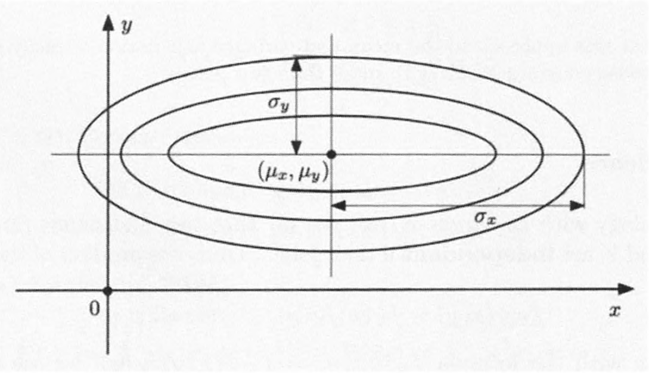
Example: Independent normal random variables
The ellipses are the contours of the PDF: $f_{X,Y}\left(x,y\right)=\frac{1}{2πσ_{x}σ_{y}}\exp\left\{−\frac{{\left(x−μ_{x}\right)}^{2}}{2σ_{x}^{2}}−\frac{{\left(y−μ_{y}\right)}^{2}}{2σ_{y}^{2}}\right\}$

Slide 111
Independence
If $X$ and $Y$ are independent, then any two events of the form $\{X∈A\}$ and $\{Y∈B\}$ are independent.
$P\left(X∈A and Y∈B\right)$ $=\int_{x∈A}{\int_{y∈B}{f_{X,Y}\left(x,y\right)dy}dx}$ $=\int_{x∈A}{\int_{y∈B}{f_{X}\left(x\right)f_{Y}\left(y\right)dy}dx}$ $=\int_{x∈A}{f_{X}\left(x\right)dx}\int_{y∈B}{f_{Y}\left(y\right)dy}$ $=P\left(X∈A\right)P(Y∈B)$

Slide 112
Independence
In particular, when $A=(X≤x)$, $B=(Y≤y)$:
$$P\left(X≤x,Y≤y\right)=P\left(X≤x\right)P\left(Y≤y\right)$$
Thus $F_{X,Y}\left(x,y\right)=F_{X}\left(x\right)F_{Y}\left(y\right)$.

Slide 113
Independence
If $X$ and $Y$ are independent, then
$$E\left[XY\right]=E\left[X\right]E\left[Y\right]$$
More generally, for any two functions $g,h$
$$E\left[g\left(X\right)h\left(Y\right)\right]=E\left[g\left(X\right)\right]E\left[h\left(Y\right)\right]$$
Also, if $X$ and $Y$ are independent, then
$$Var\left(X+Y\right)=Var\left(X\right)+Var\left(Y\right)$$

Slide 114
Content
Continuous Random Variables and PDFs
Cumulative Distribution Functions
Normal Random Variables
Joint PDFs of Multiple Random Variables
Conditioning
The Continuous Bayes’ Rule

Slide 115
The continuous Bayes’ rule
In many situations, we represent an unobserved phenomenon by a random variable $X$ with PDF $f_{X}$.
We make a noisy measurement $Y$, which is modeled in terms of a conditional PDF $f_{Y|X}$
Once the value of $Y$ is measured, what information does it provide on the unknown value of $X$?

Slide 116
The continuous Bayes’ rule
The information is provided by the conditional PDF $f_{X|Y}\left(x | y\right)$. By $f_{X}f_{Y|X}=f_{X,Y}=f_{Y}f_{X|Y}$, it follows that
$$f_{X|Y}\left(x | y\right)=\frac{f_{X}\left(x\right)f_{Y|X}\left(y | x\right)}{f_{Y}\left(y\right)}$$

Slide 117
The continuous Bayes’ rule
Based on the normalization property
$$\int_{−∞}^{∞}{f_{X|Y}\left(x | y\right)dx}=1,$$
an equivalent expression is
$$f_{X|Y}\left(x | y\right)=\frac{f_{X}(x)f_{Y|X}(y|x)}{\int_{−∞}^{∞}{f_{X}\left(x^{′}\right)f_{Y|X}\left(y | x^{′}\right)dx^{′}}}$$
$f_{Y}\left(y\right)=\int_{−∞}^{∞}{f_{X,Y}\left(x^{′},y\right)dx′}$ $=\int_{−∞}^{∞}{f_{X}\left(x^{′}\right)f_{Y|X}\left(y | x^{′}\right)dx^{′}}$

Slide 118
Example: Light bulbs
A light bulb is known to have an exponentially distributed lifetime $Y$.
However, the company has been experiencing quality control problems: On any given day, the parameter $λ$ of the PDF of $Y$ is a uniform random variable $Λ$ on $[1, 3/2]$.
We test a light bulb and record its lifetime.
Question: What can we say about $λ$?
What is $f_{Λ|Y}\left(λ | y\right)$?

Slide 119
Example: Light bulbs
The parameter $λ$ in terms of a uniform random variable $Λ$ with PDF
$$f_{Λ}\left(λ\right)=2, \text{for} 1≤λ≤3/2$$
Then by continuous Bayes’ rule, for $1≤λ≤\frac{3}{2}$
$$f_{Λ|Y}\left(λ | y\right)=\frac{f_{Λ}(λ)f_{Y|Λ}(y|λ)}{\int_{−∞}^{∞}{f_{Λ}\left(t\right)f_{Y|Λ}\left(y | t\right)dt}}$$
$$=\frac{2λe^{−λy}}{\int_{1}^{3/2}{2te^{−ty}dt}}$$
.

Slide 120
Inference about a discrete random variable
In some cases, the unobserved phenomenon is inherently discrete.
Example. Consider a binary signal which is observed in the presence of normally distributed noise.
Example. Consider a medical diagnosis that is made on the basis of continuous measurements, such as temperature and blood counts.

Slide 121
Inference about a discrete random variable
Instead of working with the conditioning event $\{Y=y\}$, which has zero probability, …
… let us first condition on the event $\{y≤Y≤y+δ\}$, then take the limit as $δ→0$.
$$P\left(A | Y=y\right)≈P\left(A | y≤Y≤y+δ\right)$$
$=\frac{P\left(A\right)P\left(y≤Y≤y+δ\right)}{P\left(y≤Y≤y+δ\right)}≈\frac{P\left(A\right)f_{Y|A}\left(y\right)δ}{f_{Y}\left(y\right)δ}$
$=\frac{P\left(A\right)f_{Y|A}\left(y\right)}{f_{Y}\left(y\right)}$

Slide 122
Inference about a discrete random variable
The denominator $f_{Y}\left(y\right)$ can be evaluated by total probability theorem
$$f_{Y}\left(y\right)=P\left(A\right)f_{Y|A}\left(y\right)+P(A^{c})f_{Y|A^{c}}(y)$$
so that
$$P\left(A | Y=y\right)=\frac{P(A)f_{Y|A}\left(y\right)}{P\left(A\right)f_{Y|A}\left(y\right)+P(A^{c})f_{Y|A^{c}}(y) }$$

Slide 123
Inference about a discrete random variable
Consider an event $A=\left\{N=n\right\}$, where $N$ is a discrete random variable with PMF $p_{N}$
Let $Y$ be a continuous random variable with a conditional PDF $f_{Y|N}(y|n)$.
Recall: $P\left(A | Y=y\right)=\frac{P(A)f_{Y|A}\left(y\right)}{P\left(A\right)f_{Y|A}\left(y\right)+P(A^{c})f_{Y|A^{c}}(y) }$
Thus: $P\left(N=n | Y=y\right)=\frac{p_{N}(n)f_{Y|N}(y|n)}{f_{Y}(y)}$
$=\frac{p_{N}(n)f_{Y|N}(y|n)}{\sum_{i}{p_{N}(i)f_{Y|N}(y|i)}}$

Slide 124
Example: Signal Detection
A binary signal $S$ is transmitted with
$$P\left(S=1\right)=p, P\left(S=−1\right)=1−p$$
The received signal is $Y=N+S$, where $N$ is standard normal noise.
Question: What is $P\left(S=1\right)$, as a function of the observed value $y$ of $Y$?
Conditional on $S=s$, the random variable $Y$ has a normal distribution with mean $s$ and variance 1.

Slide 125
Example: Signal Detection
Recall: $P\left(A | Y=y\right)=\frac{P(A)f_{Y|A}\left(y\right)}{P\left(A\right)f_{Y|A}\left(y\right)+P(A^{c})f_{Y|A^{c}}(y) }$
$P\left(S=1 | Y=y\right) =\frac{p_{S}\left(1\right)f_{Y|S}(y|1)}{p_{S}\left(1\right)f_{Y|S}(y|1)+p_{S}\left(−1\right)f_{Y|S}(y|−1)}$
$=\frac{\frac{p}{\sqrt{2π}}e^{−{\left(y−1\right)}^{2}/2}}{\frac{p}{\sqrt{2π}}e^{−{\left(y−1\right)}^{2}/2}+\frac{1−p}{\sqrt{2π}}e^{−{\left(y+1\right)}^{2}/2}}$
$=\frac{pe^{y}}{pe^{y}+(1−p)e^{−y}}$

Slide 126
Example: Signal Detection
$P\left(S=1 | Y=y\right)=\frac{pe^{y}}{pe^{y}+(1−p)e^{−y}}$.
Notice that
$$\lim_{y→−∞}{P(S=1|Y=y)}=0$$
$$\lim_{y→∞}{P(S=1|Y=y)}=1$$
which is consistent with our intuition.

