Slide 1
ENGG2430A Probability and Statistics for Engineers
Chapter 2: Discrete Random Variables
Instructor: Shengyu Zhang

Slide 2
Content
Basic Concepts
Probability Mass Function
Functions of Random Variables
Expectation, Mean, and Variance
Joint PMFs of Multiple Random Variables
Conditioning
Independence

Slide 3
Basic Concepts
In some experiments, the outcomes are numerical.
E.g. stock price.
In some other experiments, the outcomes are not numerical, but they may be associated with some numerical values of interest.
Example. Selection of students from a given population, we may wish to consider their grade point average.
The students are not numerical, but their GPA scores are.

Slide 4
Basic Concepts
When dealing with these numerical values, it is useful to assign probabilities to them.
This is done through the notion of a random variable.
Random Variable $X$
Sample Space
$$Ω$$
$$x$$
Real Number Line

Slide 5
Main Concepts Related to Random Variables
Starting with a probabilistic model of an experiment:
A random variable is a real-valued function of the outcome of the experiment.
A function of a random variable defines another random variable.

Slide 6
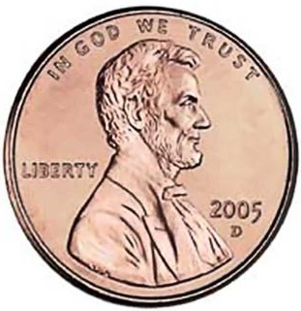
Examples
5 tosses of a coin.
This is a random variable:
The number of heads
This is not:

Slide 7
Main Concepts Related to Random Variables
We can associate with each random variable certain “averages” of interest, such as the mean and the variance.
A random variable can be conditioned on an event or on another random variable.
Notion of independence of a random variable from an event or from another random variable.
We’ll talk about all these in this lecture.

Slide 8
Discrete Random Variable
A random variable is called discrete if its range is either finite or countably infinite.
Example. Two rolls of a die.
The sum of the two rolls.
The number of sixes in the two rolls.
The second roll raised to the fifth power.

Slide 9
Continuous random variable
Example. Pick a real number $a$ and associate to it the numerical value $a^{2}$.
The random variable $a^{2}$ is continuous, not discrete.
We’ll talk about continuous random variables later.
The following random variable is discrete: $sign\left(a\right)=\left\{\begin{matrix}1 & a>0 \\ 0 & a=0 \\ −1 & a<0\end{matrix}\right..$

Slide 10
Discrete Random Variables: Concepts
A discrete random variable is a real-valued function of the outcome of a discrete experiment.
A discrete random variable has an associated probability mass function (PMF), which gives the probability of each numerical value that the random variable can take.
A function of a discrete random variable defines another discrete random variable, whose PMF can be obtained from the PMF of the original random variable.

Slide 11
Content
Basic Concepts
Probability Mass Function
Functions of Random Variables
Expectation, Mean, and Variance
Joint PMFs of Multiple Random Variables
Conditioning
Independence

Slide 12
Probability Mass Function
For a discrete random variable $X$, the probability mass function (PMF) of $X$ captures the probabilities of the values that it can take.
If $x$ is any possible value of $X$, the probability mass of $x$, denoted $p_{X}(x)$, is the probability of the event $\left\{X=x\right\}$ consisting of all outcomes that give rise to a value of $X$ equal to $x$ :
$$p_{X }\left(x\right)=P\left(\left\{X=x\right\}\right)$$

Slide 13
Example
Two independent tosses of a fair coin
$X$: the number of heads obtained
The PMF of $X$ is
$$p_{X}\left(x\right)=\left\{\begin{aligned}1/4 if x=0 \text{or} x=2 \\ 1/2 if x=1 \\ 0 otherwise \end{aligned}\right.$$

Slide 14
Probability Mass Function
Upper case characters to denote random variables
$X, Y, Z, …$
Lower case characters to denote real numbers
$x,y,z,…$
the numerical values of a random variable
We’ll write $P(X=x)$in place of the notation $P(\left\{X=x\right\})$.
Similarly, we’ll write $P\left(X∈S\right)$ for the probability that $X$ takes a value within a set $S$.

Slide 15
Probability Mass Function
Follows from the additivity and normalization axioms
$$\sum_{\begin{aligned}x: all possible \\ values of X\end{aligned}}{p_{X}\left(x\right)=1}$$
The events $\left\{X=x\right\}$ are disjoint, and they form a partition of the sample space
For any set $S$ of real numbers
$$P\left(X∈S\right)=\sum_{x∈S}{p_{X}(x)}$$

Slide 16
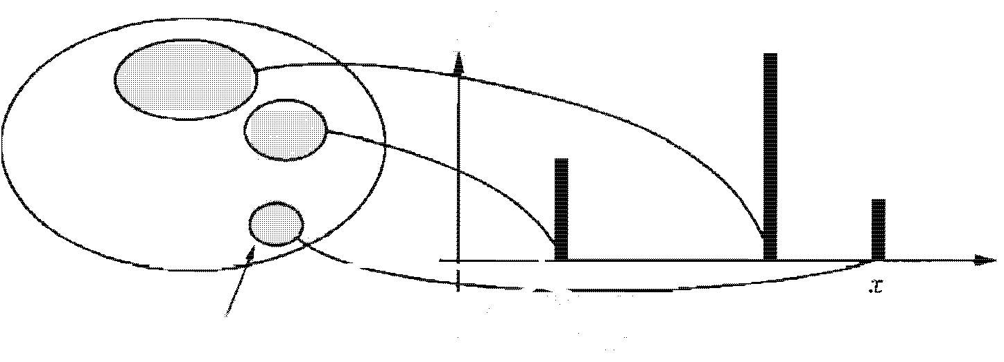
Probability Mass Function
For each possible value $x$ of $X$:
Collect all the possible outcomes that give rise to the event $\left\{X =x\right\}$.
Add their probabilities to obtain $p_{X}(x)$.
$$p_{X}(x)$$
Sample space
$$Ω$$
Event $\left\{X=x\right\}$

Slide 17
Important specific distributions
Binomial random variable
Geometric random variable
Poisson random variable

Slide 18
Bernoulli Random Variable
The Bernoulli random variable takes the two values 1 and 0
$$X∈\left\{0,1\right\}$$
Its PMF is
$$p_{X}\left(x\right)=\left\{\begin{aligned}p \text{if} x=1 \\ 1−p \text{if} x=0\end{aligned}\right.$$

Slide 19
Example of Bernoulli Random Variable
The state of a telephone at a given time that can be either free or busy.
A person who can be either healthy or sick with a certain disease.
The preference of a person who can be either for or against a certain political candidate.

Slide 20
The Binomial Random Variable
A biased coin is tossed $n$ times.
Each toss is independently of prior tosses
Head with probability $p$.
Tail with probability $1−p$.
The number $X$ of heads up is a binomial random variable.

Slide 21
The Binomial Random Variable
We refer to $X$ as a binomial random variable with parameters $n$ and $p$.
For $k=0,1,…,n.$
$$p_{X}\left(k\right)=P\left(X=k\right)=\left({n \atop k}\right)p^{k}{\left(1−p\right)}^{n−k}$$

Slide 22
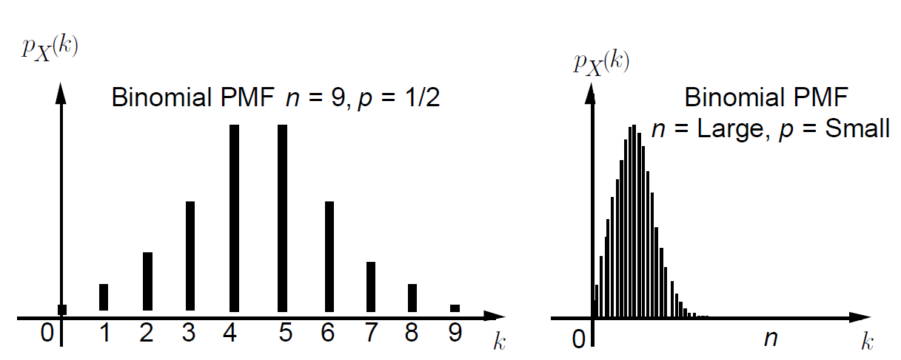
The Binomial Random Variable
Normalization
$$\sum_{k=0}^{n}{\left({n \atop k}\right)p^{k}{\left(1−p\right)}^{n−k}=1}$$

Slide 23
The Geometric Random Variable
Independently and repeatedly toss a biased coin with probability of a head $p$, where $0<p<1$.
The geometric random variable is the number $X$ of tosses needed for a head to come up for the first time.

Slide 24
The Geometric Random Variable
The PMF of a geometric random variable
$$p_{X}\left(k\right)={\left(1−p\right)}^{k−1}p$$
$k−1$ tails followed by a head.
Normalization condition is satisfied:
$$\sum_{k=1}^{∞}{p_{X}\left(k\right)=}\sum_{k=1}^{∞}{{\left(1−p\right)}^{k−1}p}=p\sum_{k=0}^{∞}{{\left(1−p\right)}^{k}}$$
$=p⋅\frac{1}{1−\left(1−p\right)}=1$

Slide 25
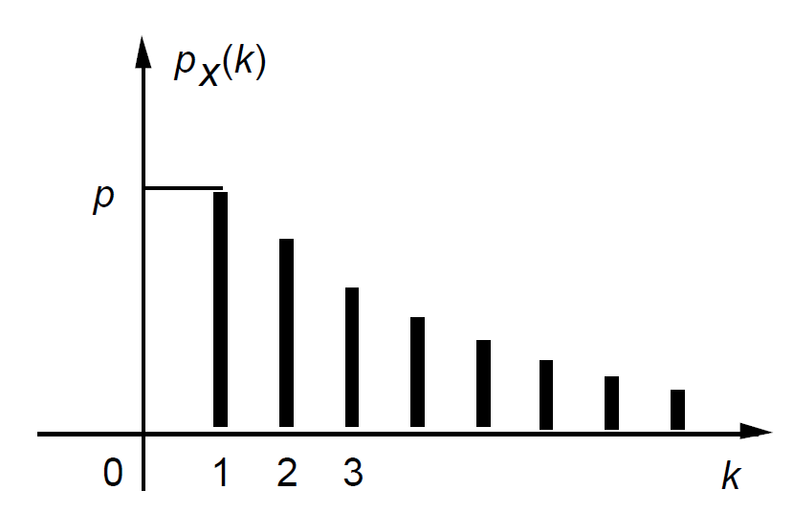
The Geometric Random Variable
The $p_{X}\left(k\right)={\left(1−p\right)}^{k−1}p$ decreases as a geometric progression with parameter $1−p$.

Slide 26
The Poisson Random Variable
A Poisson random variable takes nonnegative integer values.
The PMF
$$p_{X}\left(k\right)=e^{−λ}\frac{λ^{k}}{k!}，k=0, 1, 2, …,$$
Normalization condition
$$\sum_{k=0}^{∞}{e^{−λ}\frac{λ^{k}}{k!}}=e^{−λ}\left(1+λ+\frac{λ^{2}}{2!}+\frac{λ^{3}}{3!}+⋯\right)$$
$=e^{−λ}e^{λ}=1$

Slide 27
Poisson random variable can be viewed as a binomial random variable with very small $p$ and very large $n$.
More precisely, the Poisson PMF with parameter $λ$ is a good approximation for a binomial PMF with parameters $n$ and $p$ where $λ=np$, $n$ is large and $p$ is small.
See the wiki page for a proof.

Slide 28
Examples
Because of the above connection, Poisson random variables are used in many scenarios.
$X$ is the number of typos in a book of $n$ words.
The probability that any one word is misspelled is very small.
$X$is the number of cars involved in accidents in a city on a given day.
The probability that any one car is involved in an accident is very small.

Slide 29
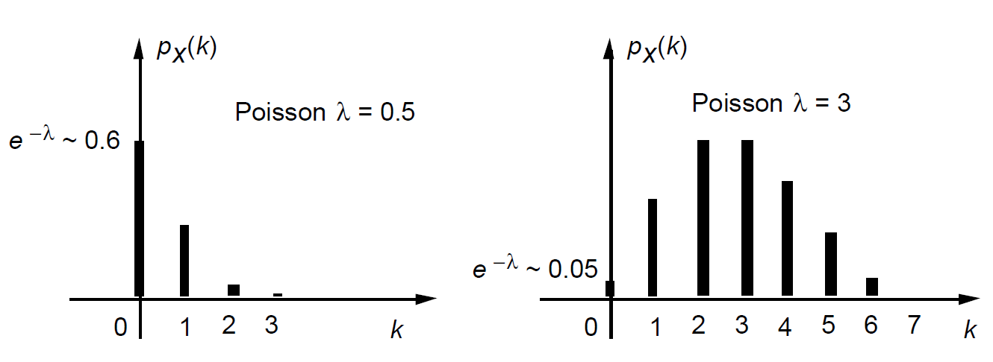
The Poisson Random Variable
For Poisson random variable $p_{X}\left(k\right)=e^{−λ}\frac{λ^{k}}{k!}$
$λ≤1$, monotonically decreasing
$λ>1$, first increases and then decreases

Slide 30
Content
Basic Concepts
Probability Mass Function
Functions of Random Variables
Expectation, Mean, and Variance
Joint PMFs of Multiple Random Variables
Conditioning
Independence

Slide 31
Functions of Random Variables
Consider a probability model of today’s weather
$X=$ the temperature in degrees Celsius
$Y=$ the temperature in degrees Fahrenheit
Their relation is given by
$Y=1.8X+32$
In this example, $Y$ is a linear function of $X$, of the form
$$Y=g\left(X\right)=aX+b$$

Slide 32
Functions of Random Variables
We may also consider nonlinear functions, such as
$$Y=\log\left(X\right)$$
In general, if $Y=g(X)$ is a function of a random variable $X$, then $Y$ is also a random variable.
The PMF $p_{Y}$ of $Y=g(X)$ can be calculated from PMF $p_{X}$ of $X$
$p_{Y}\left(y\right)=\sum_{x:g\left(x\right)=y}{p_{X}\left(x\right)}$

Slide 33
Example
The PMF of $X$ is
$$p_{X}\left(x\right)=\left\{\begin{matrix}1/9 & \text{if} x is an integer and x∈[−4,4] \\ 0 & otherwise \end{matrix}\right.$$
Let $Y=|X|$. Then the PMF of $Y$ is
$$p_{Y}\left(y\right)=\left\{\begin{matrix}2/9 & if y=1,2,3,4 \\ 1/9 & if y=0 \\ 0 & otherwise \end{matrix}\right.$$

Slide 34
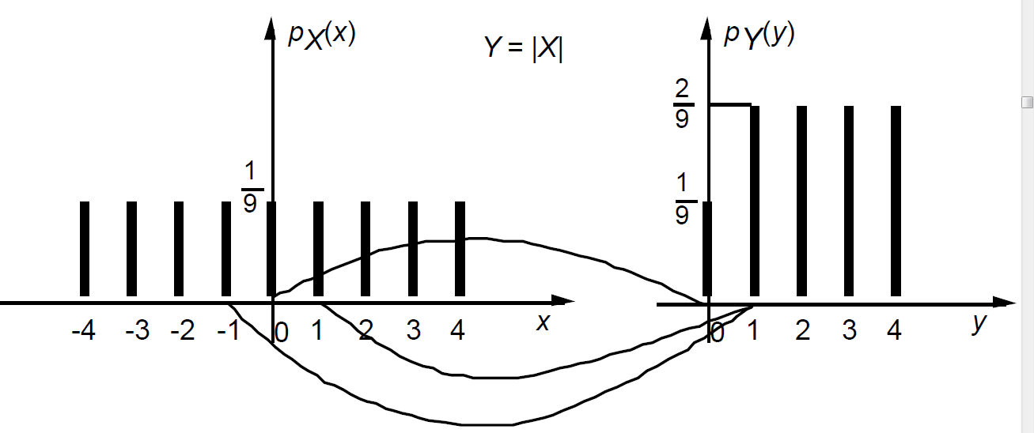
Example
Visualization of the relation between $X$ and $Y$

Slide 35
Example
Let $Z=X^{2}$. Then the PMF of $Z$ is
$$p_{Z}\left(z\right)=\left\{\begin{matrix}2/9 & if z=1, 4, 9, 16 \\ 1/9 & if z=0 \\ 0 & otherwise \end{matrix}\right.$$

Slide 36
Content
Basic Concepts
Probability Mass Function
Functions of Random Variables
Expectation, Mean, and Variance
Joint PMFs of Multiple Random Variables
Conditioning
Independence

Slide 37
Expectation
Sometimes it is desirable to summarize the values and probabilities by one number.
The expectation of $X$ is a weighted average of the possible values of $X$.
Weights: probabilities.
Formally, the expected value of a random variable $X$, with PMF $p_{X}\left(x\right)$, is
$E\left[X\right]=\sum_{x}{xp_{X}(x)}$
Names: expected value, expectation, mean

Slide 38
Example
Two independent coin tosses
$P\left(H\right)=\frac{3}{4}$
$X=$the number of heads
Binomial random variable with parameters $n=2$ and $p=3/4$.

Slide 39
Example
The PMF is
$$p_{X}\left(k\right)=\left\{\begin{aligned}{\left(1/4\right)}^{2} \text{if} k=0 \\ 2⋅\left(1/4\right)⋅\left(3/4\right) \text{if} k=1 \\ {\left(3/4\right)}^{2} \text{if} k=2\end{aligned}\right.$$
The mean is
$$E\left[X\right]=0⋅{\left(\frac{1}{4}\right)}^{2}+1⋅\left(2⋅\frac{1}{4}⋅\frac{3}{4}\right)+2⋅{\left(\frac{3}{4}\right)}^{2}=\frac{3}{2}$$

Slide 40
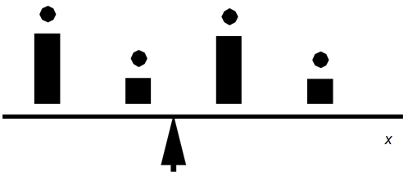
Expectation
Consider the mean as the center of gravity of the PMF
$\sum_{x}{\left(x−c\right)p_{X}\left(x\right)=0}$
$⇒c=\sum_{x}{xp_{X}(x)}$ .
Center of gravity
$$c=\text{mean}=E[X]$$

Slide 41
Variance
Besides the mean, there are several other important quantities.
The $k$th moment is $E\left[X^{k}\right]$
So the first moment is just the mean.
Variance of $X$, denoted by $var(X)$, is
$$var\left(X\right)=E\left[{\left(X−E\left[X\right]\right)}^{2}\right]$$
The second moment of $X−E\left[X\right]$.
The variance is always non-negative:
$$var\left(X\right)≥0$$

Slide 42
Standard deviation
Variance is closely related to another measure.
Standard deviation of $X$, denoted by $σ_{X}$, is
$$σ_{X}=\sqrt{var\left(X\right)}$$

Slide 43
Example
Suppose that the PMF of $X$ is
$$p_{X}\left(x\right)=\left\{\begin{matrix}1/9 & \text{if} x is an integer and x∈[−4,4] \\ 0 & otherwise \end{matrix}\right.$$
The expectation
$$E\left[X\right]=\sum_{x}{xp_{X}\left(x\right)=\frac{1}{9}\sum_{x=−4}^{4}{x}=0}$$
Can also be seen from symmetry.

Slide 44
Example
Let $Z={\left(X−E\left[X\right]\right)}^{2}=X^{2}$. The PMF of $Z$
$$p_{Z}\left(z\right)=\left\{\begin{matrix}2/9 & if z=1, 4, 9, 16 \\ 1/9 & if z=0 \\ 0 & otherwise \end{matrix}\right.$$
The variance of $X$ is then
$var\left(X\right)=E\left[Z\right]=\sum_{z}{zp_{Z}(z)}$
$=0⋅\frac{1}{9}+1⋅\frac{2}{9}+4⋅\frac{2}{9}+9⋅\frac{2}{9}+16⋅\frac{2}{9}=\frac{60}{9}$

Slide 45
Expectation for $g\left(X\right)$
There is a simpler way of computing $var\left(g\left(X\right)\right)$.
Let $X$ be a random variable with PMF $p_{X}(x)$, and let $g(X)$be a real-valued function of $X$.
The expected value of the random variable $Y=g(X)$ is
$$E\left[g\left(X\right)\right]=\sum_{x}{g\left(x\right)p_{X}(x)}$$

Slide 46
Expectation for $g\left(X\right)$
Using the formula $p_{Y}\left(y\right)=\sum_{\{x|g\left(x\right)=y\}}{p_{X}(x)}$:
$E\left[g\left(X\right)\right]=E\left[Y\right]$
$=\sum_{y}{yp_{Y}(y)}$
$=\sum_{y}{y}\sum_{\{x|g\left(x\right)=y\}}{p_{X}(x)}$
$=\sum_{y}{ }\sum_{\{x|g\left(x\right)=y\}}{yp_{X}(x)}$
$=\sum_{y}{ }\sum_{\{x|g\left(x\right)=y\}}{g(x)p_{X}(x)}$
$=\sum_{x}{g\left(x\right)p_{X}(x)}$

Slide 47
Variance example
The PMF of $X$
$$p_{X}\left(x\right)=\left\{\begin{matrix}1/9 & \text{if} x is an integer and x∈[−4,4] \\ 0 & otherwise \end{matrix}\right.$$
The variance
$var\left(X\right)=E\left[{\left(X−E[X]\right)}^{2}\right]$
$=\sum_{x}{{\left(x−E\left[X\right]\right)}^{2}p_{X}(x)}$
$=\frac{1}{9}\sum_{x=−4}^{4}{x^{2}}$ $=\left(16+9+4+1+0+1+9+16\right)$/9
$=\frac{60}{9}$

Slide 48
Mean of $aX+b$
Let $Y$ be a linear function of $X$
$$Y=aX+b$$
The mean of $Y$
$$E\left[Y\right]=\sum_{x}{\left(ax+b\right)p_{X}(x)}=a\sum_{x}{xp_{X}(x)}+b\sum_{x}{p_{X}(x)}=aE\left[X\right]+b$$
The expectation scales linearly.

Slide 49
Variance of $aX+b$
Let $Y$ be a linear function of $X$
$$Y=aX+b$$
The variance of $Y$
$var\left(Y\right)=\sum_{x}{{\left(ax+b−E\left[aX+b\right]\right)}^{2}p_{X}(x)}$
$=\sum_{x}{{\left(ax+b−aE\left[X\right]−b\right)}^{2}p_{X}(x)}$
$=a^{2}\sum_{x}{{\left(x−E\left[X\right]\right)}^{2}p_{X}(x)}$
$=a^{2}var(X)$
The variance scales quadratically.

Slide 50
Variance as moments
Fact. $var\left(X\right)=E\left[X^{2}\right]−{\left(E\left[X\right]\right)}^{2}$.
$var\left(X\right)=E\left[{\left(X−E\left[X\right]\right)}^{2}\right]$
$=E\left[X^{2}−2XE\left[X\right]+{\left(E\left[X\right]\right)}^{2}\right]$
$=E\left[X^{2}\right]−2E\left[XE\left[X\right]\right]+{\left(E\left[X\right]\right)}^{2}$
$=E\left[X^{2}\right]−2E\left[X\right]E\left[X\right]+{\left(E\left[X\right]\right)}^{2}$
$=E\left[X^{2}\right]−{\left(E\left[X\right]\right)}^{2}$

Slide 51
Example: Average time
Distance between class and home is 2 miles
$P\left(weather is good\right)=0.6$
Speed:
$V=5$ miles/hour if weather is good.
$V=30$ miles/hour if weather is bad.
Question: What is the mean of the time $T$ to get to class?

Slide 52
Example: Average time
The PMF of $T$
$$p_{T}\left(t\right)=\left\{\begin{aligned}0.6 if t=\frac{2}{5} hours \\ 0.4 if t=\frac{2}{30} hours\end{aligned}\right.$$
The mean of $T$ $E\left[T\right]=0.6⋅\frac{2}{5}+0.4⋅\frac{2}{30}=\frac{4}{15}$

Slide 53
Example: Average time
Wrong calculation by speed $V$
The mean of speed $V$
$$E\left[V\right]=0.6⋅5+0.4⋅30=15$$
The mean of time $T$
$$\frac{2}{E[V]}=\frac{2}{15}$$
To summarize, in this example we have
$T=\frac{2}{V}$ and $E\left[T\right]=E\left[\frac{2}{V}\right]≠\frac{2}{E[V]}$

Slide 54
Example: Bernoulli
Consider the Bernoulli random variable $X$ with PMF
$$p_{X}\left(x\right)=\left\{\begin{aligned}p \text{if} x=1 \\ 1−p \text{if} x=0\end{aligned}\right.$$
Its mean, second moment, and variance:
$$E\left[X\right]=1⋅p+0⋅\left(1−p\right)=p$$
$$E\left[X^{2}\right]=1^{2}⋅p+0⋅\left(1−p\right)=p$$
$$var\left(X\right)=E\left[X^{2}\right]−{\left(E\left[X\right]\right)}^{2}=p−p^{2}=p(1−p)$$

Slide 55
Example: Uniform
What is the mean and variance of the roll of a fair six-sided die?
$$p_{X}\left(k\right)=\left\{\begin{aligned}1/6 if k=1,2,3,4,5,6 \\ 0 otherwise \end{aligned}\right.$$
The mean $E\left[X\right]=3.5$ and the variance
$var\left(X\right)=E\left[X^{2}\right]−{\left(E\left[X\right]\right)}^{2}$
$=\frac{1}{6}\left(1^{2}+2^{2}+3^{2}+4^{2}+5^{2}+6^{2}\right)−{3.5}^{2}$
$=35/12$

Slide 56
Example: Uniform integers
General, a discrete uniformly distributed random variable
Range: contiguous integer values $a,a+1,…,b$
Probability: equal probability
The PMF is
$$p_{X}\left(k\right)=\left\{\begin{aligned}\frac{1}{b−a+1} if k=a,a+1,…,b \\ 0 otherwise \end{aligned}\right.$$

Slide 57
Example: Uniform integers
The mean
$$E\left[X\right]=\frac{a+b}{2}$$
For variance, first consider $a=1$ and $b=n$
The second moment
$$E\left[X^{2}\right]=\frac{1}{n}\sum_{k=1}^{n}{k^{2}}=\frac{1}{6}(n+1)(2n+1)$$

Slide 58
Example: Uniform integers
The variance for special case
$var\left(X\right)=E\left[X^{2}\right]−{\left(E\left[X\right]\right)}^{2}$
$=\frac{1}{6}\left(n+1\right)\left(2n+1\right)−\frac{1}{4}{\left(n+1\right)}^{2}$
$=\frac{n^{2}−1}{12}$

Slide 59
Example: Uniform integers
For the case of general integers a and b
$X$: discrete uniform over $[a,b]$
$Y$: discrete uniform over $[1,b−a+1]$
Relation between $X$ and $Y$
$$Y=X−a+1$$
Thus
$$var\left(X\right)=var\left(Y\right)=\frac{{\left(b−a+1\right)}^{2}−1}{12}$$

Slide 60
Example: Poisson
Recall Poisson PMF
$$p_{X}\left(k\right)=e^{−λ}\frac{λ^{k}}{k!} k=0,1,2,…,$$
Mean:
$$E\left[X\right]=\sum_{k=0}^{∞}{ke^{−λ}\frac{λ^{k}}{k!}}=\sum_{k=1}^{∞}{ke^{−λ}\frac{λ^{k}}{k!}}$$
$$=λ\sum_{k=1}^{∞}{e^{−λ}\frac{λ^{k−1}}{(k−1)!}}=λ\sum_{m=0}^{∞}{e^{−λ}\frac{λ^{m}}{m!}}$$
$$=λ$$
Variance: $var\left[X\right]=λ$.
Verification left as exercise.

Slide 61
The Quiz Problem
A person is given two questions and must decide which question to answer first.
$P(question 1 correct)=0.8$ Prize=$100
$P(question 2 correct)=0.5$ Prize=$200
If incorrectly answer the first question, then no second question.
How to choose the first question so that maximize the expected prize?

Slide 62
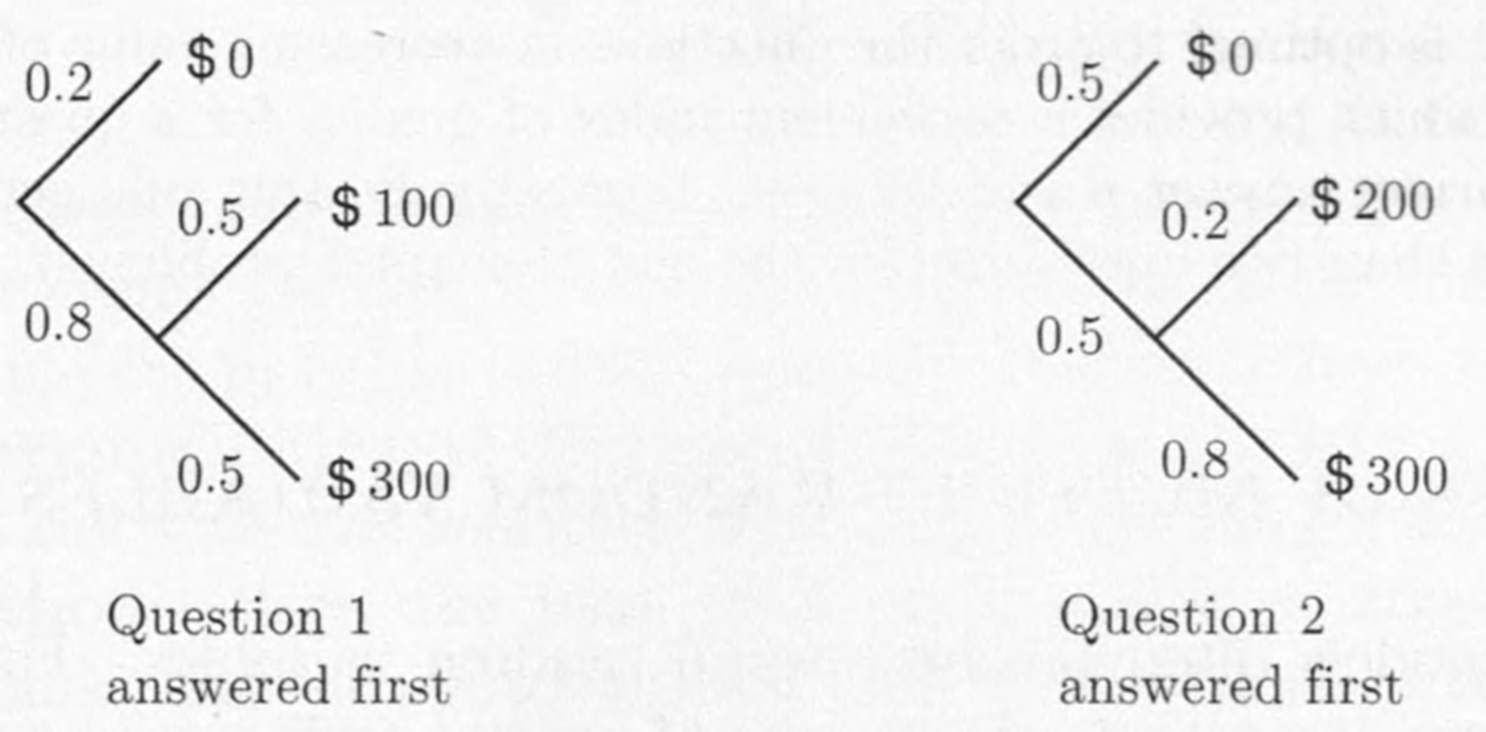
Tree illustration

Slide 63
The Quiz Problem
Answer question 1 first: Then the PMF of $X$ is
$p_{X}\left(0\right)=0.2$
$$p_{X}\left(100\right)=0.8⋅0.5$$
$$p_{X}\left(300\right)=0.8⋅0.5$$
We have
$$E\left[X\right]=0.8⋅0.5⋅100+0.8⋅0.5⋅300=160$$

Slide 64
The Quiz Problem
Answer question 2 first: Then the PMF of $X$ is
$p_{X}\left(0\right)=0.5$
$$p_{X}\left(200\right)=0.5⋅0.2$$
$$p_{X}\left(300\right)=0.5⋅0.8$$
We have
$$E\left[X\right]=0.5⋅0.2⋅200+0.5⋅0.8⋅300=140$$
It is better to answer question 1 first.

Slide 65
The Quiz Problem
Let us now generalize the analysis.
$p_{1}$: $P(correctly answering question 1)$
$p_{2}$: $P(correctly answering question 2)$
$v_{1}$: prize for question 1
$v_{2}$: prize for question 2

Slide 66
The Quiz Problem
Answer question 1 first
$$E\left[X\right]=p_{1}\left(1−p_{2}\right)v_{1}+p_{1}p_{2}\left(v_{1}+v_{2}\right)=p_{1}v_{1}+p_{1}p_{2}v_{2}$$
Answer question 2 first
$$E\left[X\right]=p_{2}\left(1−p_{1}\right)v_{2}+p_{2}p_{1}\left(v_{2}+v_{1}\right)=p_{2}v_{2}+p_{2}p_{1}v_{1}$$

Slide 67
The Quiz Problem
It is optimal to answer question 1 first if and only if
$$p_{1}v_{1}+p_{1}p_{2}v_{2}≥p_{2}v_{2}+p_{2}p_{1}v_{1}$$
Or equivalently
$$\frac{p_{1}v_{1}}{1−p_{1}}≥\frac{p_{2}v_{2}}{1−p_{2}}$$
Rule: Order the questions in decreasing value of the expression $pv/(1−p)$

Slide 68
Content
Basic Concepts
Probability Mass Function
Functions of Random Variables
Expectation, Mean, and Variance
Joint PMFs of Multiple Random Variables
Conditioning
Independence

Slide 69
Multiple Random Variables
Probabilistic models often involve several random variables of interest.
Example: In a medical diagnosis context, the results of several tests may be significant.
Example: In a networking context, the workloads of several gateways may be of interest.

Slide 70
Joint PMFs of Multiple Random Variables
Consider two discrete random variables $X$ and $Y$ associated with the same experiment.
The joint PMF of $X$ and $Y$is denoted by $p_{X,Y}$. It specifies the probability of the values that $X$ and $Y$ can take.
If $\left(x,y\right)$ is a pair of values that $\left(X,Y\right)$ can take, then the probability mass of $\left(x,y\right)$ is the probability of the event $\left\{X=x,Y=y\right\}$:
$$P_{X,Y}\left(x, y\right)=P\left(X=x, Y=y\right).$$

Slide 71
The joint PMF determines the probability of any event that can be specified in terms of the random variables $X$ and $Y$.
For example, if $A$ is the set of all pairs $(x,y)$that have a certain property, then
$$P\left(\left(X,Y\right)∈A\right)=\sum_{\left(x,y\right)∈A}{p_{X,Y}(x,y)}$$

Slide 72
Joint PMFs of Multiple Random Variables
The PMFs of $X$ and $Y$
$p_{X}\left(x\right)=\sum_{y}{p_{X,Y}(x,y)}, p_{Y}\left(y\right)=\sum_{x}{p_{X,Y}(x,y)}$
The formula can be verified by
$${ p}_{X}\left(x\right)=P\left(X=x\right)$$
$=\sum_{y}{P(X=x,Y=y)}$
$=\sum_{y}{p_{X,Y}(x,y)}$
$p_{X}$, $p_{Y}$ are the marginal PMFs.

Slide 73
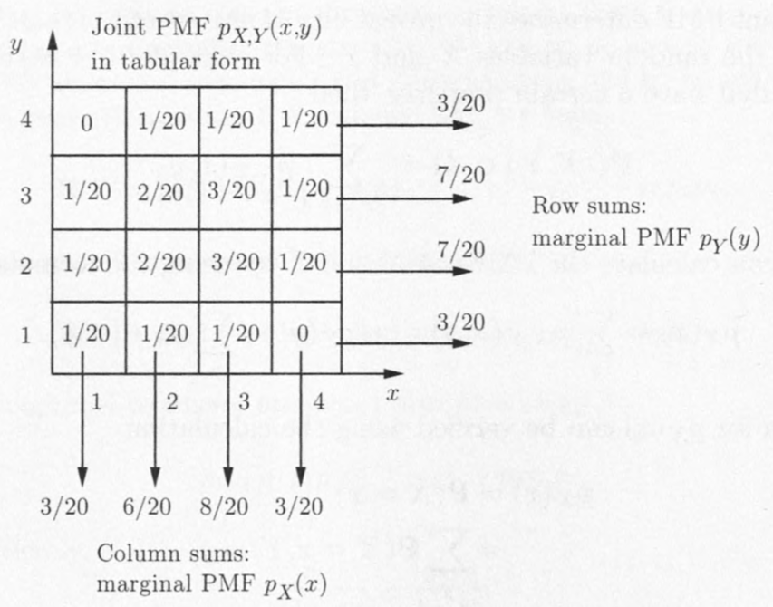
Joint PMFs of Multiple Random Variables
Computing the marginal MPFs $p_{X}$ and $p_{Y}$ of $p_{X,Y}$ from table.
The joint PMF $p_{X,Y}$is arranged in a two-dimensional table.

Slide 74
Joint PMFs of Multiple Random Variables
The marginal PMF of $X$ or $Y$ at a given value is obtained by adding the table entries along a corresponding column or row, respectively.

Slide 75
Functions of Multiple Random Variables
One can generate new random variables by applying functions on several random variables.
Consider $Z=g(X,Y)$.
Its PMF can be calculated from the joint PMF $p_{X,Y}$ according to
$$p_{Z}\left(z\right)=\sum_{\{(x,y)|g\left(x,y\right)=z\}}{p_{X,Y}(x,y)}$$

Slide 76
Functions of Multiple Random Variables
The expected value rule for multiple variables
$$E\left[g\left(X,Y\right)\right]=\sum_{x,y}{g\left(x,y\right)p_{X,Y}(x,y)}$$
For special case, $g$ is linear and of the form $aX+bY+c$, we have
$$E\left[aX+bY+c\right]=aE\left[X\right]+bE\left[Y\right]+c$$
“linearity of expectation” --- regardless of dependence of $X$ and $Y$.

Slide 77
More than Two Random Variables
We can also consider three or more random variables.
The joint PMF of three random variables $X$,$Y$, and $Z$
$$p_{X,Y,Z}\left(x,y,z\right)=P\left(X=x,Y=y,Z=z\right)$$
The marginal PMFs are
$p_{X,Y}\left(x,y\right)=\sum_{z}{p_{X,Y,Z}\left(x,y,z\right)}$
and
$p_{X}\left(x\right)=\sum_{y}{\sum_{z}{p_{X,Y,Z}\left(x,y,z\right)}}$

Slide 78
More than Two Random Variables
The expected value rule for functions
$E\left[g\left(X,Y,Z\right)\right]=\sum_{x,y,z}{g\left(x,y,z\right)p_{X,Y,Z}(x,y,z)}$
If $g$ is linear and of the form $g\left(X,Y,Z\right)=aX+bY+cZ+d$ then
$E\left[aX+bY+cZ+d\right]$
$=aE[X]+bE[Y]+cE[Z]+d$

Slide 79
More than Two Random Variables
Generalization to more than three random variables.
For any random variables $X_{1},X_{2}, . . . ,X_{n}$and any scalars $a_{1}, a_{2}, . . . , a_{n}$, we have
$$E\left[a_{1}X_{1}+a_{2}X_{2}+⋯+a_{n}X_{n}\right]=a_{1}E\left[X_{1}\right]+a_{2}E\left[X_{2}\right]+⋯+a_{n}E[X_{n}]$$

Slide 80
Example: Mean of the Binomial
300 students in probability class
Each student has probability 1/3 of getting an A, independently of any other student.
$X$: the number of students that get an A.
Question: What is the mean of $X$?

Slide 81
Example: Mean of the Binomial
Let $X_{i}$ be the random variable for $i$th student
$$X_{i}=\left\{\begin{aligned}1 if the ith student gets an A \\ 0 otherwise \end{aligned}\right.$$
Each $X_{i}$ is a Bernoulli random variable
$E\left[X_{i}\right]=p=1/3$
$Var\left[X_{i}\right]=p(1−p)=(1/3)(2/3)=2/9$

Slide 82
Example: Mean of the Binomial
The random variable $X$ can be expressed as their sum
$$X=X_{1}+X_{2}+⋯+X_{n}$$
Using the linearity of $X$ as a function of the $X_{i}$
$$E\left[X\right]=\sum_{i=1}^{300}{E\left[X_{i}\right]}=\sum_{i=1}^{300}{\frac{1}{3}}=300⋅\frac{1}{3}=100$$

Slide 83
Example: Mean of the Binomial
If we repeat this calculation for a general number of students $n$ and probability of A equal to $p$, we obtain
$$E\left[X\right]=\sum_{i=1}^{n}{E\left[X_{i}\right]}=np$$

Slide 84
Example: The Hat Problem
Suppose that $n$ people throw their hats in a box.
Each picks up one hat at random.
$X$: the number of people that get back their own hat
Question: What is the expected value of $X$?

Slide 85
Example: The Hat Problem
For the $i$th person, we introduce a random variable $X_{i}$
$$X_{i}=\left\{\begin{aligned}1 if the ith his own \\ 0 otherwise \end{aligned}\right.$$
Since $P\left(X_{i}=1\right)=\frac{1}{n}$ and $P\left(X_{i}=0\right)=1−\frac{1}{n}$
$$E\left[X_{i}\right]=1⋅\frac{1}{n}+0⋅\left(1−\frac{1}{n}\right)=\frac{1}{n}$$

Slide 86
Example: The Hat Problem
We know
$$X=X_{1}+X_{2}+⋯+X_{n}$$
Thus
$$E\left[X\right]=E\left[X_{1}\right]+E\left[X_{2}\right]+⋯+E\left[X_{n}\right]=n⋅\frac{1}{n}=1$$

Slide 87
Summary of Facts About Joint PMFs
The joint PMF of $X$ and $Y$ is defined by
$$p_{X,Y}\left(x,y\right)=P(X=x,Y=y)$$
The marginal PMFs of $X$ and $Y$ can be obtained from the joint PMF, using the formulas
$p_{X}\left(x\right)=\sum_{y}{p_{X,Y}(x,y)}, p_{Y}\left(y\right)=\sum_{x}{p_{X,Y}(x,y)}$

Slide 88
Summary of Facts About Joint PMFs
A function $g(X,Y)$of $X$ and $Y$ defines another random variable
$$E\left[g\left(X,Y\right)\right]=\sum_{x,y}{g\left(x,y\right)p_{X,Y}(x,y)}$$
If $g$ is linear, of the form $aX+bY+c$,
$$E\left[aX+bY+c\right]=aE\left[X\right]+bE\left[Y\right]+c$$
These naturally extend to more than two random variables.

Slide 89
Content
Basic Concepts
Probability Mass Function
Functions of Random Variables
Expectation, Mean, and Variance
Joint PMFs of Multiple Random Variables
Conditioning
Independence

Slide 90
Conditioning
In a probabilistic model, a certain event $A$ has occurred
Conditional probability captures this knowledge.
Conditional probabilities are like ordinary probabilities (satisfy the three axioms) except
refer to a new universe: event $A$ is known to have occurred

Slide 91
Conditioning a Random Variable on an Event
The conditional PMF of a random variable $X$, conditioned on a particular event $A$ with $P(A) > 0$, is defined by
$$p_{X|A}\left(x\right)=P\left(X=x | A\right)$$
$$=\frac{P(\{X=x\}∩A)}{P(A)}$$

Slide 92
Conditioning a Random Variable on an Event
Consider the events $\{X=x\}∩A$:
They are disjoint for different values of $x$.
Their union is $A$.
Thus $P\left(A\right)=\sum_{x}{P(\{X=x\}∩A) }$
Combining this and $p_{X|A}\left(x\right)=P(\{X=x\}∩A)/P\left(A\right)$ (last slide), we can see that
$\sum_{x}{p_{X|A}\left(x\right)=1}$
So $p_{X|A}$ is a legitimate PMF.

Slide 93
Conditioning a Random Variable on an Event
The conditional PMF is calculated similar to its unconditional counterpart.
To obtain $p_{X|A}(x)$
Add the probabilities of the outcomes $X=x$
Conditioning event $A$
Normalize by dividing with $P(A)$

Slide 94
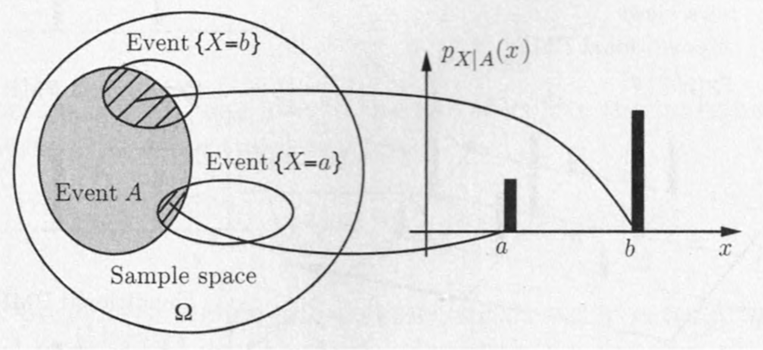
Conditioning a Random Variable on an Event
Visualization and calculation of the conditional PMF $p_{X|A}(x)$

Slide 95
Example: dice
$X$: the roll of a fair 6-sided dice
$A$: the roll is an even number
$p_{X|A}\left(x\right)=P\left(X=x\right|A)$
$$=\frac{P(X=x and A)}{P(A)}$$
$$=\left\{\begin{aligned}\frac{1}{3} if x=2,4,6 \\ 0 otherwise \end{aligned}\right.$$

Slide 96
Conditioning one random variable on another
We have talked about conditioning a random variable $X$ on an event $A$.
Now let’s consider conditioning a random variable $X$ on another random variable $Y$.
Let $X$ and $Y$ be two random variables associated with the same experiment.
The experimental value $Y=y$ ($p_{Y}\left(y\right)>0$) provides partial knowledge about the value of $X$.

Slide 97
Conditioning one random variable on another
The knowledge is captured by the conditional PMF $p_{X|Y}$ of $X$ given $Y$, which is defined as $p_{X|A}$ for $A=\{Y=y\}$:
$$p_{X|Y}\left(x | y\right)=P(X=x|Y=y)$$
Using the definition of conditional probabilities
$$p_{X|Y}\left(x | y\right)=\frac{P(X=x,Y=y)}{P(Y=y)}=\frac{p_{X,Y}(x,y)}{p_{Y}(y)}$$

Slide 98
Conditioning one random variable on another
Fix some $y$, with $p_{Y}\left(y\right)>0$ and consider $p_{X|Y}(x|y)$ as a function of $x$.
This function is a valid PMF for X:
Assigns nonnegative values to each possible x
These values add to 1
Has the same shape as $p_{X,Y}(x,y)$
$\sum_{x}{p_{X|Y}\left(x | y\right)=1}$

Slide 99
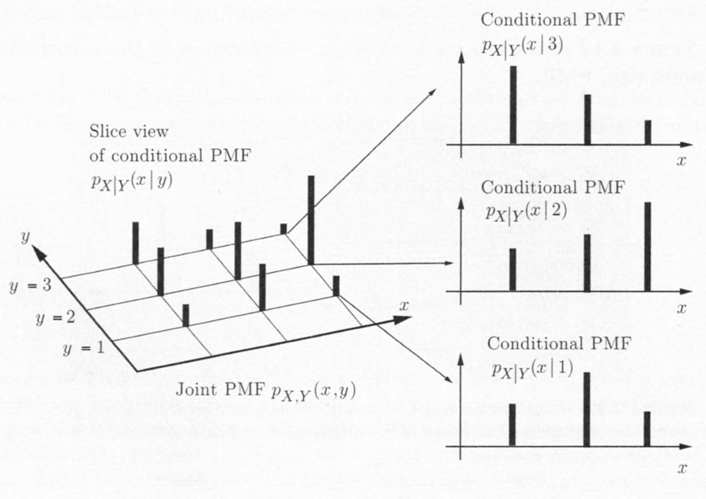
Conditioning one random variable on another
Visualization of the conditional PMF $p_{X|Y}(x|y)$

Slide 100
Conditioning one random variable on another
It is convenient to calculate the joint PMF by a sequential approach and the formula
$p_{X,Y}\left(x,y\right)=p_{Y}\left(y\right)p_{X|Y}(x|y)$,
Or its counterpart
$p_{X,Y}\left(x,y\right)=p_{X}\left(x\right)p_{Y|X}(y|x)$.
This method is entirely similar to the use of the multiplication rule from previous lectures.

Slide 101
Example: Question answering
A professor independently answers each of her students’ questions incorrectly with probability ¼.
In each lecture the professor is asked $0,1,$or $2$ questions with equal probability $1/3$.
$X$: the number of questions professor is asked
$Y$: the number of questions she answers wrong in a given lecture

Slide 102
Example: Question answering
Construct the joint PMF $p_{X,Y}(x,y)$: calcualte all the probabilities $P(X=x,Y=y)$.
Using a sequential description of the experiment and the multiplication rule
$$p_{X,Y}\left(x,y\right)=p_{Y}\left(y\right)p_{X|Y}(x|y)$$

Slide 103
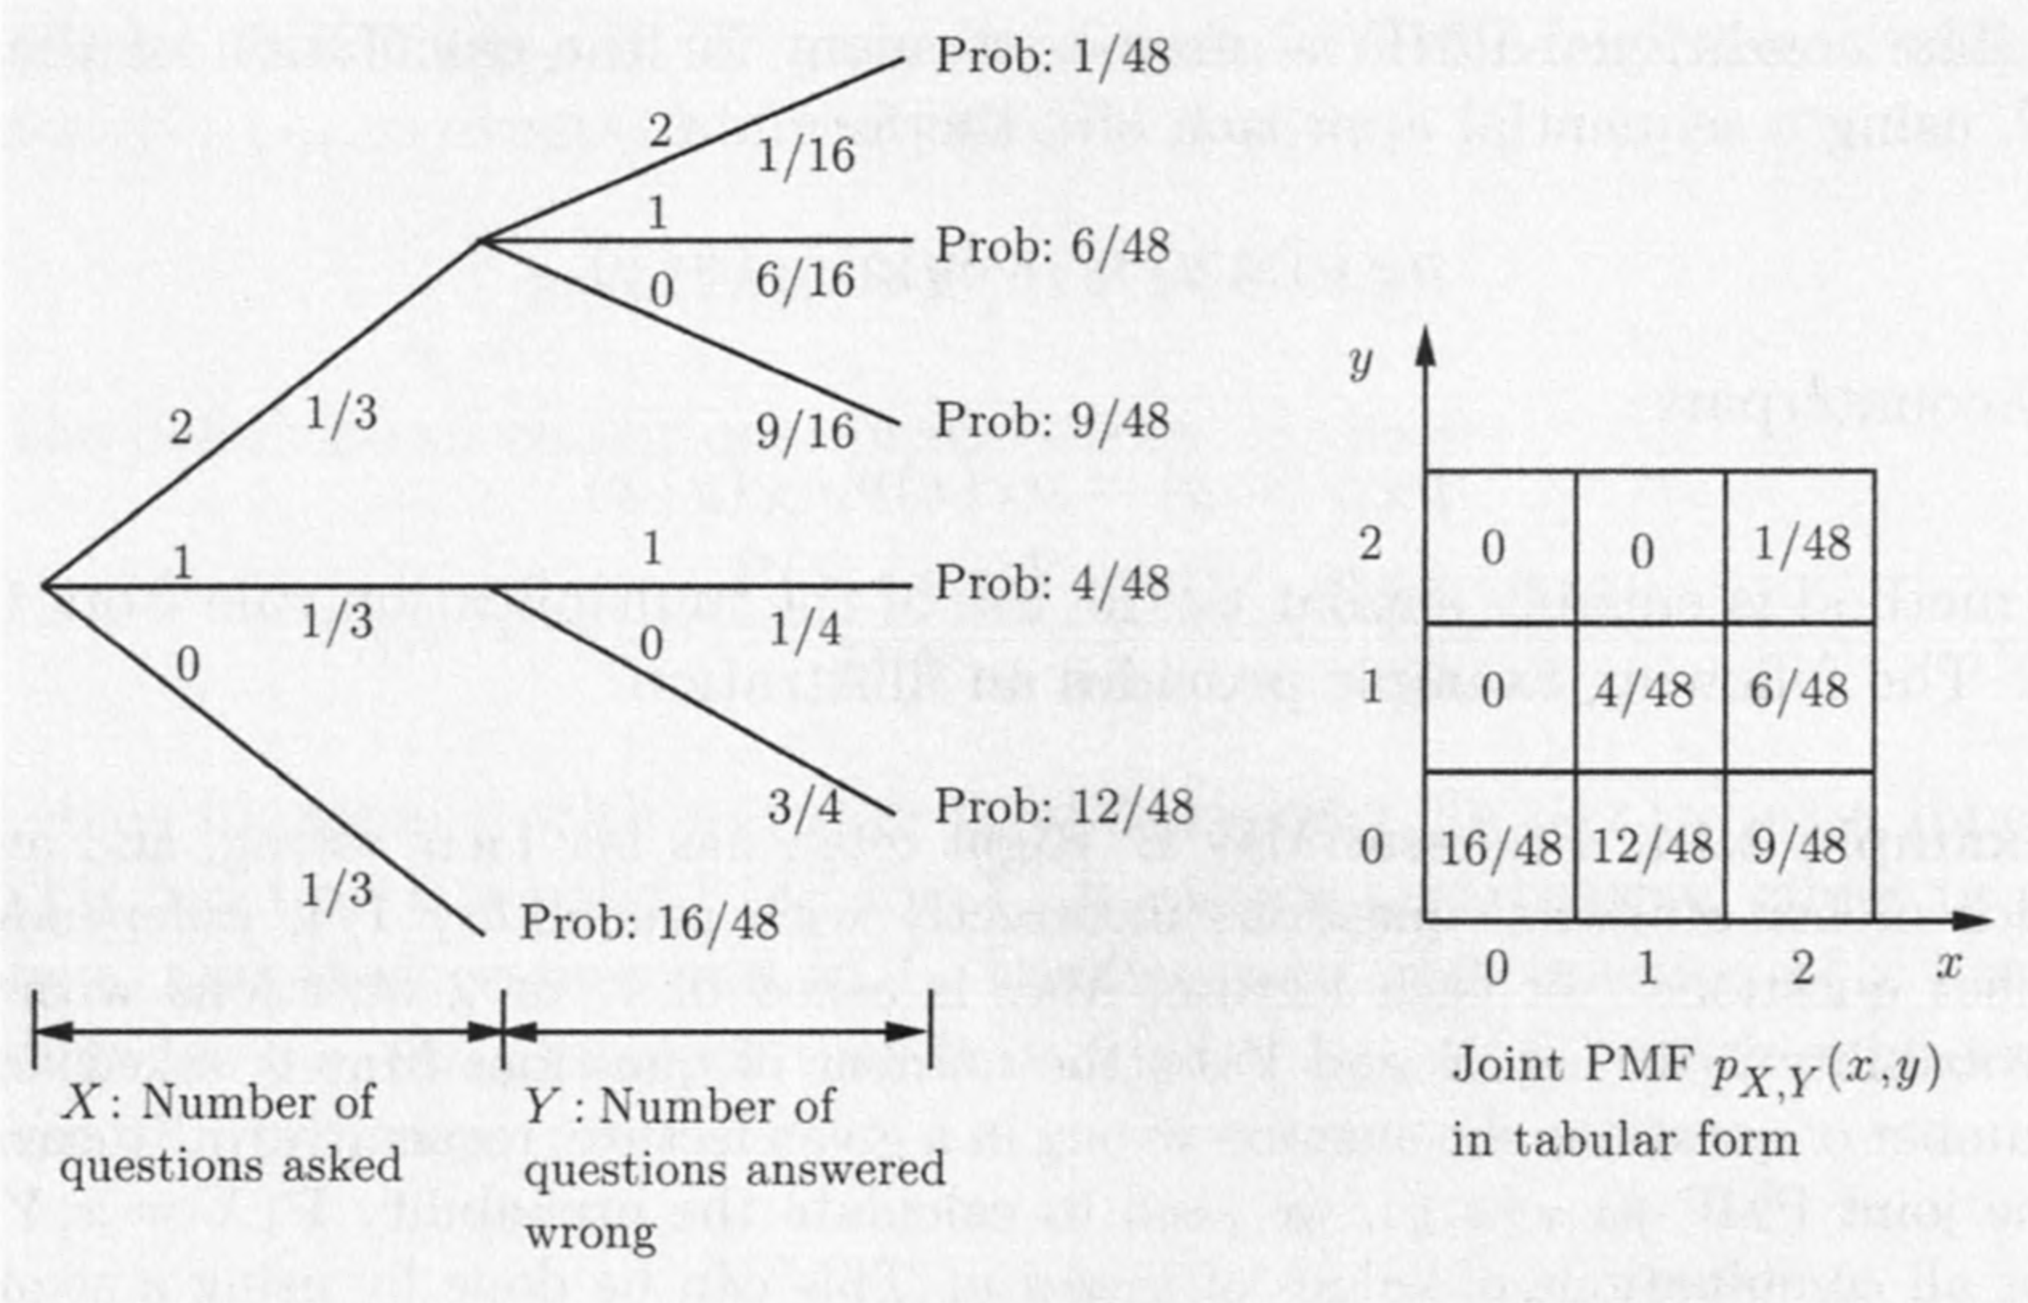
Example: Question answering
For example, $p_{X,Y}\left(1,1\right)=p_{X}\left(x\right)p_{Y|X}\left(y,x\right)=\frac{1}{4}⋅\frac{1}{3}=\frac{1}{12}$

Slide 104
Example: Question answering
We can compute other useful information from two-dimensional table.
For example,
$P\left(at least one wrong answer\right)$
$=p_{X,Y}\left(1,1\right)+p_{X,Y}\left(2,1\right)+p_{X,Y}\left(2,2\right)$
$=\frac{4}{48}+\frac{6}{48}+\frac{1}{48}=\frac{11}{48}$

Slide 105
Conditioning one random variable on another
The conditional PMF can also be used to calculate the marginal PMFs.
$$p_{X}\left(x\right)=\sum_{y}{p_{X,Y}(x,y)}=\sum_{y}{p_{Y}\left(y\right)p_{X|Y}(x|y)}$$
This formula provides a divide-and-conquer method for calculating marginal PMFs.

Slide 106
Summary of Facts About Conditional PMFs
Conditional PMFs are similar to ordinary PMFs, but refer to a universe where the conditioning event is known to have occurred.
The conditional PMF of $X$ given an event $A$ with $P(A)>0$, is defined by
$$p_{X|A}\left(x\right)=P\left(X=x | A\right)$$
and satisfies
$\sum_{x}{p_{X|A}\left(x\right)=1}$

Slide 107
Summary of Facts About Conditional PMFs
The conditional PMF of $X$ given $Y$ can be used to calculate the marginal PMFs with the formula
$$p_{X}\left(x\right)=\sum_{y}{p_{Y}\left(y\right)p_{X|Y}(x|y)}$$
This is analogous to the divide-and-conquer approach for calculating probabilities using the total probability theorem.

Slide 108
Conditional Expectations
The conditional expectation of $X$ given an event $A$ with $P(A)>0$, is defined by
$$E\left[X | A\right]=\sum_{x}{xp_{X|A}(x|A)}$$
For a function $g(X)$, it is given by
$$E\left[g(X) | A\right]=\sum_{x}{g(x)p_{X|A}(x|A)}$$

Slide 109
Conditional Expectations
The conditional expectation of $X$ given a value $y$ of $Y$ is defined by
$$E\left[X | Y=y\right]=\sum_{x}{xp_{X|Y}(x|y)}$$
The total expectation theorem
$$E\left[X\right]=\sum_{y}{p_{Y}(y)}E\left[X | Y=y\right]$$

Slide 110
Conditional Expectations
Let $A_{1},…,A_{n}$ be disjoint events that form a partition of the sample space, and assume that $P(A_{i})>0$for all $i$. Then
$E\left[X\right]=\sum_{i=1}^{n}{P\left(A_{i}\right)E[X|A_{i}]}$
Indeed, $E\left[X\right]=\sum_{x}{xp_{X}\left(x\right)}$ $=\sum_{x}{x\sum_{i=1}^{n}{P\left(A_{i}\right)p_{x|A_{i}}\left(x | A_{i}\right)}}$ $=\sum_{i=1}^{n}{P\left(A_{i}\right)}\sum_{x}{xp_{x|A_{i}}\left(x | A_{i}\right)}$ $=$ $\sum_{i=1}^{n}{P\left(A_{i}\right)}E\left[X|A_{i}\right]$

Slide 111
Conditional Expectation
Messages transmitted by a computer in Boston through a data network are destined
for New York with probability 0.5
for Chicago with probability 0.3
for San Francisco with probability 0.2
The transit time $X$ of a message is random
$E\left[X\right]=0.05$ for New York
$E\left[X\right]=0.1$ for Chicago
$E\left[X\right]=0.3$ for San Francisco

Slide 112
Conditional Expectation
By total expectation theorem
$E\left[X\right] =0.5⋅0.05+0.3⋅0.1+0.2⋅0.3$
$=0.115$

Slide 113
Mean and Variance of the Geometric Random Variable
You write a software program over and over,
probability $p$ that it works correctly
independently from previous attempts
$X$: the number of tries until the program works correctly
Question: What is the mean and variance of $X$?

Slide 114
Mean and Variance of the Geometric Random Variable
$X$ is a geometric random variable with PMF
$$p_{X}\left(k\right)={\left(1−p\right)}^{k−1}p k=1,2,…$$
The mean and variance of $X$
$E\left[X\right]=\sum_{k=1}^{∞}{k{\left(1−p\right)}^{k−1}p}$
$var\left(X\right)=\sum_{k=1}^{∞}{{\left(k−E\left[X\right]\right)}^{2}{\left(1−p\right)}^{k−1}p}$

Slide 115
Mean and Variance of the Geometric Random Variable
Evaluating these infinite sums is somewhat tedious.
As an alternative, we will apply the total expectation theorem.
Let $A_{1}=\left\{X=1\right\}=\{\text{first} \text{try} \text{is} \text{a} \text{success}\}$ and $A_{2}=\left\{X>1\right\}=\{\text{first} \text{try} \text{is} \text{a} \text{failure}\}$

Slide 116
Mean and Variance of the Geometric Random Variable
If the first try is successful, we have $X=1$
$$E\left[X | X=1\right]=1$$
If the first try fails ($X>1$), we have wasted one try, and we are back where we started.
The expected number of remaining tries is $E[X]$
We have
$$E\left[X | X>1\right]=1+E[X]$$

Slide 117
Mean and Variance of the Geometric Random Variable
Thus
$$E\left[X\right] \\ =P\left(X=1\right)E\left[X | X=1\right]+P\left(X>1\right)E\left[X | X>1\right] \\ =p+(1−p)(1+E\left[X\right])$$
Solving this equation gives
$$E[X]=\frac{1}{p}$$

Slide 118
Mean and Variance of the Geometric Random Variable
Similar reasoning
$$E\left[X^{2} | X=1\right]=1$$
and
$E\left[X^{2} | X>1\right]=E\left[{\left(1+X\right)}^{2}\right]$
$=1+2E\left[X\right]+E[X^{2}]$
So
$$E\left[X^{2}\right]=p⋅1+\left(1−p\right)\left(1+2E\left[X\right]+E\left[X^{2}\right]\right)$$

Slide 119
Mean and Variance of the Geometric Random Variable
We obtain
$$E\left[X^{2}\right]=\frac{2}{p^{2}}−\frac{1}{p}$$
and conclude that
$$Var\left(X\right)=E\left[X^{2}\right]−{\left(E\left[X\right]\right)}^{2}$$
$$=\frac{2}{p^{2}}−\frac{1}{p}−\frac{1}{p^{2}}=\frac{1−p}{p^{2}}$$

Slide 120
Content
Basic Concepts
Probability Mass Function
Functions of Random Variables
Expectation, Mean, and Variance
Joint PMFs of Multiple Random Variables
Conditioning
Independence

Slide 121
Independence of a r.v. from an event
Idea is similar to the independence of two events.
Knowing the occurrence of the conditioning event tells us nothing about the value of the random variable.

Slide 122
Independence of a r.v. from an event
Formally, the random variable $X$ is independent of the event $A$ if
$$P\left(X=x and A\right)=P\left(X=x\right)P\left(A\right)=p_{X}\left(x\right)P(A)$$
Same as requiring that the events $\left\{X=x\right\}$ and $A$ are independent, for any choice $x$.

Slide 123
Independence of a r.v. from an event
Consider $P(A)>0$
By the definition of the conditional PMF
$$p_{X|A}\left(x\right)=P(X=x and A)/P(A)$$
Independence is the same as the condition
$$p_{X|A}\left(x\right)=p_{X}\left(x\right) for all x$$

Slide 124
Independence of a r.v. from an event
Consider two independent tosses of a fair coin.
$X$: the number of heads
$A$: the number of heads is even
The PMF of $X$
$$p_{X}\left(x\right)=\left\{\begin{aligned}1/4 \text{if} x=0 \\ 1/2 \text{if} x=1 \\ 1/4 \text{if} x=2\end{aligned}\right.$$

Slide 125
Independence of a r.v. from an event
We know $P\left(A\right)=\frac{1}{2}$
The conditional PMF
$$p_{X|A}\left(x\right)=\left\{\begin{aligned}1/2 \text{if} x=0 \\ 0 \text{if} x=1 \\ 1/2 \text{if} x=2\end{aligned}\right.$$
The PMFs $p_{X}$ and $p_{X|A}$ are different $⇒X$ and $A$ are not independent

Slide 126
Independence of random variables
The notion of independence of two random variables is similar.
Two random variables $X$ and $Y$ are independent if
$$p_{X,Y}\left(x,y\right)=p_{X}\left(x\right)p_{Y}\left(y\right) for all x,y$$
Same as requiring that the two events $\left\{X=x\right\}$ and $\{Y=y\}$be independent for every $x$ and $y$.

Slide 127
Independence of random variables
By the formula
$$p_{X,Y}\left(x,y\right)=p_{X|Y}\left(x | y\right)p_{Y}\left(y\right)$$
Independence is equivalent to the condition
$$p_{X|Y}\left(x | y\right)=p_{X}\left(x\right)$$
for all $y$ with $p_{Y}(y)>0$ and all $x$.
Independence means that the experimental value of $Y$ tells us nothing about the value of $X$.

Slide 128
Independence of random variables
$X$ and$Y$are conditionally independent, if given a positive probability event $A$
$$P\left(X=x,Y=y | A\right)=P\left(X=x | A\right)P(Y=y|A)$$
Using this chapter’s notation
$$p_{X,Y|A}\left(x,y\right)=p_{X|A}\left(x\right)p_{Y|A}(y)$$
Or equivalently,
$$p_{X|Y,A}\left(x | y\right)=p_{X|A}\left(x\right)$$
for all $x,y$such that $p_{Y|A}\left(y\right)>0$.

Slide 129
Independence of random variables
If $X$ and $Y$ are independent random variables, then
$$E\left[XY\right]=E\left[X\right]⋅E[Y]$$
Shown by the following calculation
$E\left[XY\right]=\sum_{x}{\sum_{y}{xy⋅p_{X,Y}(x,y)}}$
$=\sum_{x}{\sum_{y}{xy⋅p_{X}\left(x\right)p_{Y}(y)}}$
$=\sum_{x}{xp_{X}(x) }⋅\sum_{y}{yp_{Y}(y)}$
$=E\left[X\right]⋅E[Y]$

Slide 130
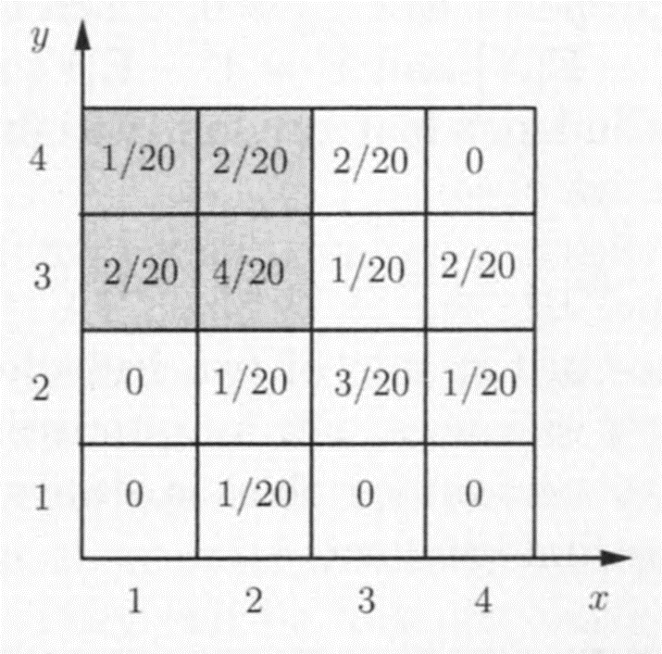
Independence of random variables
Conditional independence may not imply unconditional independence.
$X$ and $Y$ are not independent
$p_{X|Y}\left(1 | 1\right)=P\left(X=1 | Y=1\right)$
$=0≠P\left(X=1\right)=p_{X}(1)$
Condition on
$A=\{X≤2,Y≥3\}$
They are independent

Slide 131
Independence of random variables
A very similar calculation shows that if $X$ and $Y$ are independent, then so are $g(X)$ and $h(Y)$ for any functions $g$ and $h$.
$E\left[g\left(X\right)h(Y)\right]=E\left[g(X)\right]E[h(Y)]$
Next, we consider variance of sum of independent random variables.

Slide 132
Independence of random variables
Consider $Z=X+Y$, where $X$ and $Y$ are independent.
$Var\left(Z\right)=E\left[{\left(X+Y−E\left[X+Y\right]\right)}^{2}\right]$
$=E\left[{\left(X+Y−E\left[X\right]−E\left[Y\right]\right)}^{2}\right]$
$=E\left[{\left(\left(X−E\left[X\right]\right)+\left(Y−E\left[Y\right]\right)\right)}^{2}\right]$
$=E\left[{\left(X−E\left[X\right]\right)}^{2}\right]+E\left[{\left(Y−E\left[Y\right]\right)}^{2}\right]$
$+2E\left[\left(X−E\left[X\right]\right)\left(Y−E\left[Y\right]\right)\right]$

Slide 133
Independence of random variables
Now we compute $E\left[\left(X−E\left[X\right]\right)\left(Y−E\left[Y\right]\right)\right]$.
Since $X$ and $Y$ are independent, so are $X−E\left[X\right]$ and $Y−E\left[Y\right]$.
As they are two functions of $X$ and $Y$, respectively.
Thus $E\left[\left(X−E\left[X\right]\right)\left(Y−E\left[Y\right]\right)\right]$
$=E\left[\left(X−E\left[X\right]\right)\right]⋅E[\left(Y−E\left[Y\right]\right)]$
$=0⋅0=0$
So $Var\left(Z\right)=E\left[{\left(X−E\left[X\right]\right)}^{2}\right]+E\left[{\left(Y−E\left[Y\right]\right)}^{2}\right]$
$=Var\left[X\right]+Var[Y]$

Slide 134
Summary of independent r.v.’s
$X$ is independent of the event $A$ if
$$p_{X|A}\left(x\right)=p_{X}(x)$$
that is, if for all $x$, the events $\{X=x\}$and $A$ are independent.
$X$ and $Y$ are independent if for all possible pairs $(x,y),$the events $\{X=x\}$and $\left\{Y=y\right\}$ are independent
$$p_{X,Y}\left(x,y\right)=p_{X}\left(x\right)p_{Y}(y)$$

Slide 135
Summary of Facts About Independent Random Variables
If $X$ and $Y$ are independent random variables, then
$E\left[XY\right]=E\left[X\right]E\left[Y\right]$
$E\left[g\left(X\right)h(Y)\right]=E\left[g(X)\right]E[h(Y)]$, for any functions $g$ and $h$.
$Var\left[X+Y\right]=Var\left[X\right]+Var[Y]$

Slide 136
Independence of Several Random Variables
All previous results have natural extensions to more than two random variables.
Example: Random variables $X$, $Y$, and $Z$ are independent if
$$p_{X,Y,Z}\left(x,y,z\right)=p_{X}\left(x\right)p_{Y}\left(y\right)p_{Z}(z)$$
Example: If $X_{1},X_{2},…,X_{n}$ are independent random variables, then
$$Var\left(X_{1}+X_{2}+⋯+X_{n}\right)=Var\left(X_{1}\right)+Var\left(X_{2}\right)+⋯+Var(X_{n})$$

Slide 137
Variance of the Binomial
Consider $n$ independent coin tosses
$P\left(H\right)=p$
$X_{i}$: Bernoulli random variable for $i$th toss
Its PMF
$$p_{X_{i}}\left(x\right)=\left\{\begin{aligned}1 i\text{th} \text{toss} \text{comes} \text{up} \text{a} \text{head} \\ 0 otherwise \end{aligned}\right.$$

Slide 138
Variance of the Binomial
Let $X=X_{1}+X_{2}+⋯+X_{n}$be a binomial random variable.
By the independence of the coin tosses
$$Var\left(X\right)=\sum_{i=1}^{n}{Var\left(X_{i}\right)=np(1−p)}$$

Slide 139
Mean and Variance of the Sample Mean
Estimate the approval rating of a president $C$.
Ask $n$ persons randomly from the voters
$X_{i}$ response of the $i$th person
$X_{i}=\left\{\begin{aligned}1 i\text{th} \text{person} \text{approves} C \\ 0 i\text{th} \text{person} \text{dis}\text{approves} C\end{aligned}\right.$

Slide 140
Mean and Variance of the Sample Mean
Model $X_{1},X_{2},…,X_{n}$as independent Bernoulli random variables
mean $p$
variance $p(1−p)$
The sample mean
$$S_{n}=\frac{X_{1}+X_{2}+…+X_{n}}{n}$$

Slide 141
Mean and Variance of the Sample Mean
$S_{n}$ is the approval rating of $C$ within our $n$-person sample.
Using the linearity of $S_{n}$ as a function of the $X_{i}$
$$E\left[S_{n}\right]=\sum_{i=1}^{n}{\frac{1}{n}E\left[X_{i}\right]=\frac{1}{n}\sum_{i=1}^{n}{p}=p}$$
and
$$Var\left(S_{n}\right)=\sum_{i=1}^{n}{\frac{1}{n^{2}}Var\left(X_{i}\right)=\frac{p(1−p)}{n}}$$

