Slide 1
CMSC5706 Topics in Theoretical Computer Science
Week 9: Online Algorithms
Instructor: Shengyu Zhang

Slide 2
Secretary hiring problem

Slide 3
A motivating problem
Secretary problem:
  We want to hire a new office assistant.
  There are a number of candidates.
  We can interview one candidate each day, but we have to decide the acceptance/rejection immediately.

Slide 4
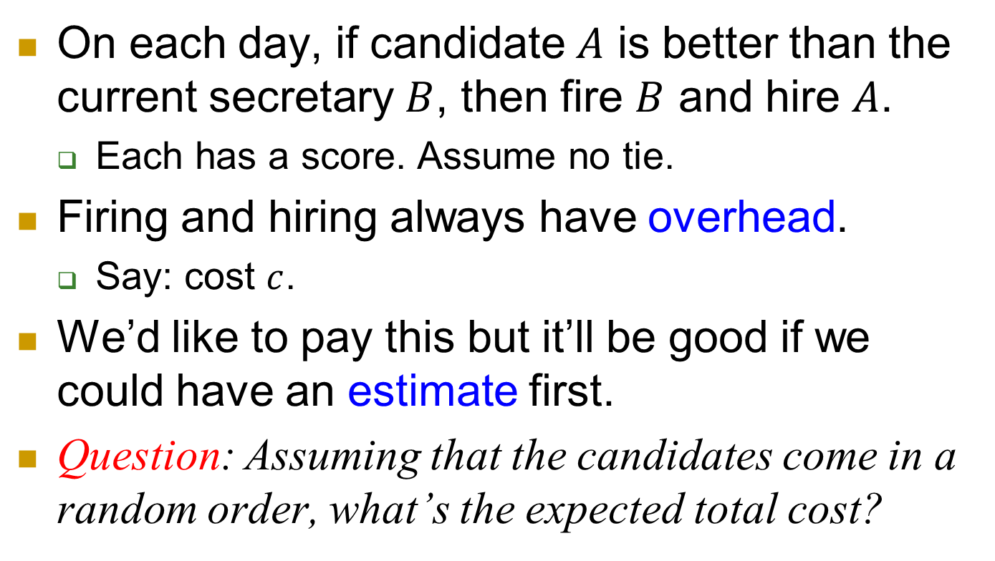
One possible strategy
On each day, if candidate $A$ is better than the current secretary $B$, then fire $B$ and hire $A$.
  Each has a score. Assume no tie.
Firing and hiring always have overhead.
  Say: cost $c$.
We’d like to pay this but it’ll be good if we could have an estimate first.
Question: Assuming that the candidates come in a random order, what’s the expected total cost?

Slide 5
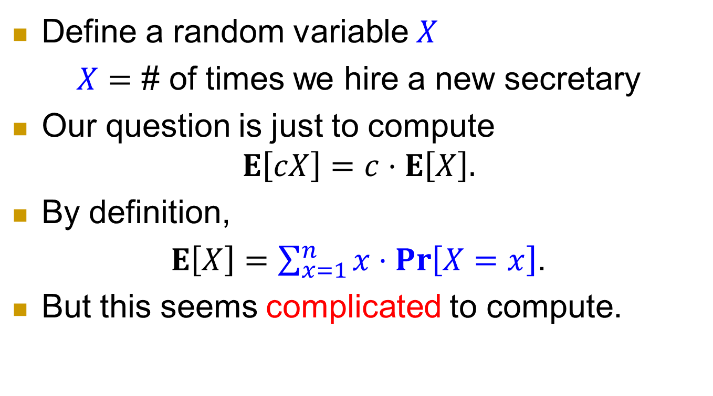
Probability…
Define a random variable $X$
$X=$ # of times we hire a new secretary
Our question is just to compute
$$E\left[cX\right]=c⋅E\left[X\right].$$
By definition,
$E\left[X\right]=\sum_{x=1}^{n}{x⋅\operatorname{Pr}\left[X=x\right]}$.
But this seems complicated to compute.

Slide 6
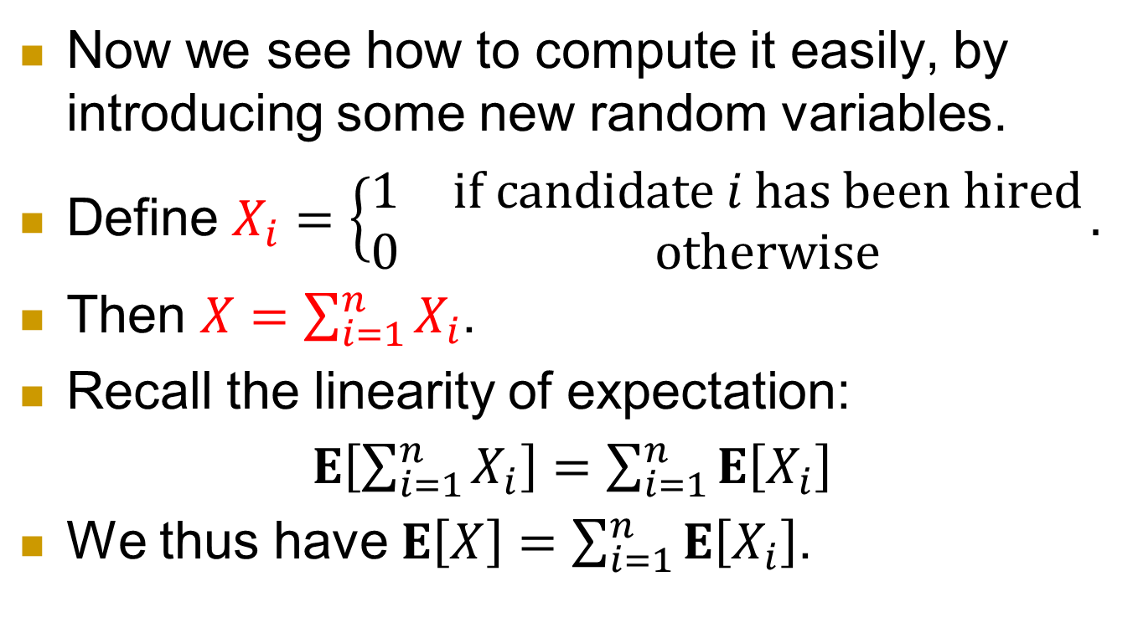
Indicator variables
Now we see how to compute it easily, by introducing some new random variables.
Define $X_{i}=\left\{\begin{matrix}1 & \text{if} \text{candidate} i \text{ha}\text{s} \text{been} \text{hired} \\ 0 & \text{otherwise}\end{matrix}\right..$
Then $X=\sum_{i=1}^{n}{X_{i}}$.
Recall the linearity of expectation:
$E\left[\sum_{i=1}^{n}{X_{i}}\right]=\sum_{i=1}^{n}{E\left[X_{i}\right]}$
We thus have $E\left[X\right]=\sum_{i=1}^{n}{E\left[X_{i}\right]}$.

Slide 7
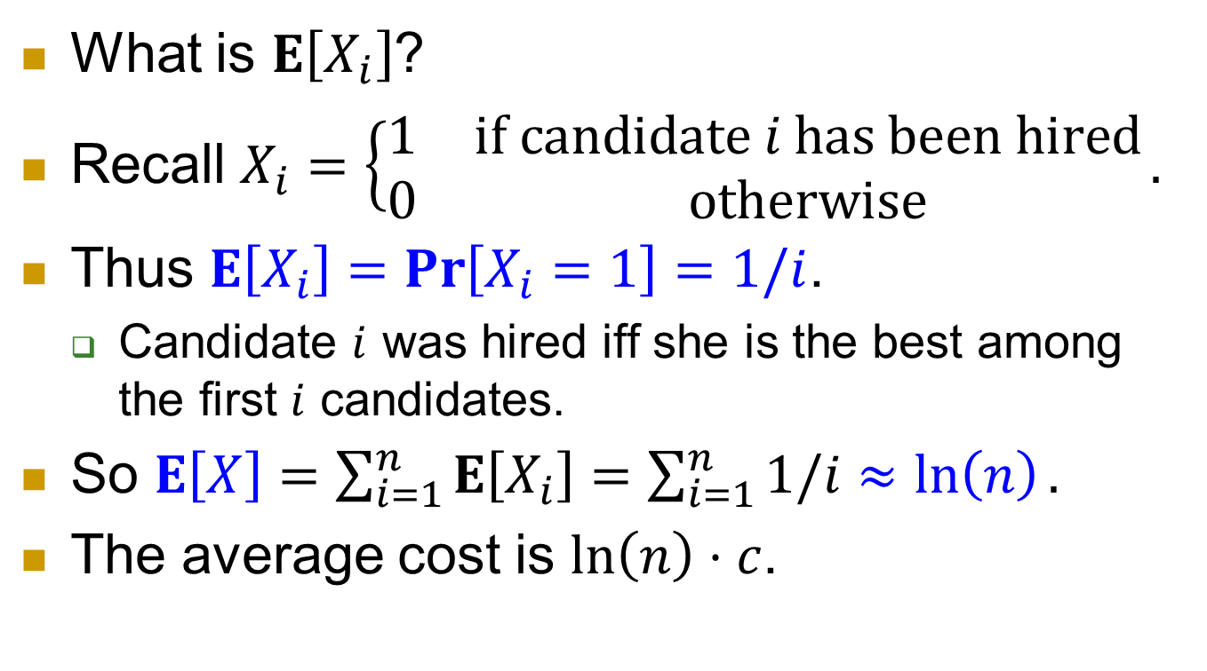
Analysis continued
What is $E\left[X_{i}\right]$?
Recall $X_{i}=\left\{\begin{matrix}1 & \text{if} \text{candidate} i \text{has} \text{been} \text{hired} \\ 0 & \text{otherwise}\end{matrix}\right..$
Thus $E\left[X_{i}\right]=\operatorname{Pr}\left[X_{i}=1\right]=1/i$.
  Candidate $i$ was hired iff she is the best among the first $i$ candidates.
So $E\left[X\right]=\sum_{i=1}^{n}{E\left[X_{i}\right]}=\sum_{i=1}^{n}{1/i}≈\ln\left(n\right).$
The average cost is $\ln\left(n\right)⋅c$.

Slide 8
Another strategy
A more natural scenario is that we only hire once.
And of course, we hope to hire the best one.
But the candidates on the market also get other offers. So we need to issue offer fast.
Interview one candidate each day, and decide acceptance/rejection immediately.
The candidates come in a random order.

Slide 9
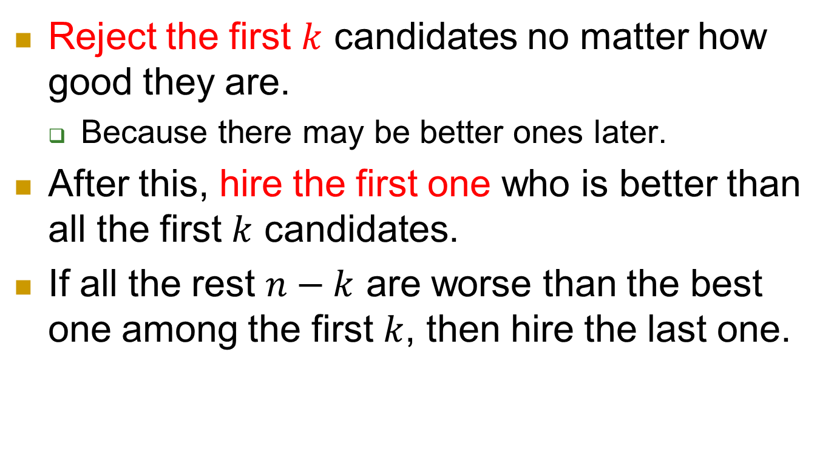
Strategy
Reject the first $k$ candidates no matter how good they are.
  Because there may be better ones later.
After this, hire the first one who is better than all the first $k$ candidates.
If all the rest $n−k$ are worse than the best one among the first $k$, then hire the last one.

Slide 10
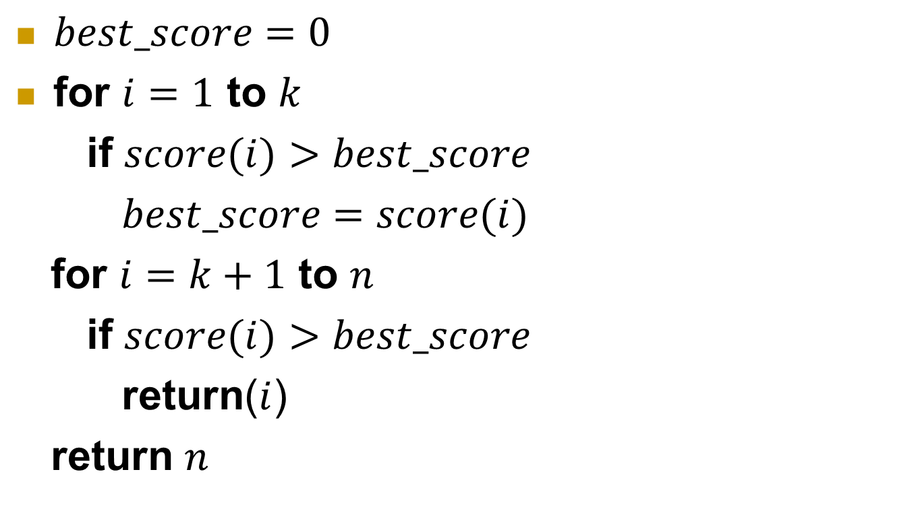
Pseudo-code
$best_score=0$
for $i=1$ to $k$
if $score(i)>best_score$
$best_score=score(i)$
for $i=k+1$ to $n$
if $score(i)>best_score$
return($i$)
return $n$

Slide 11
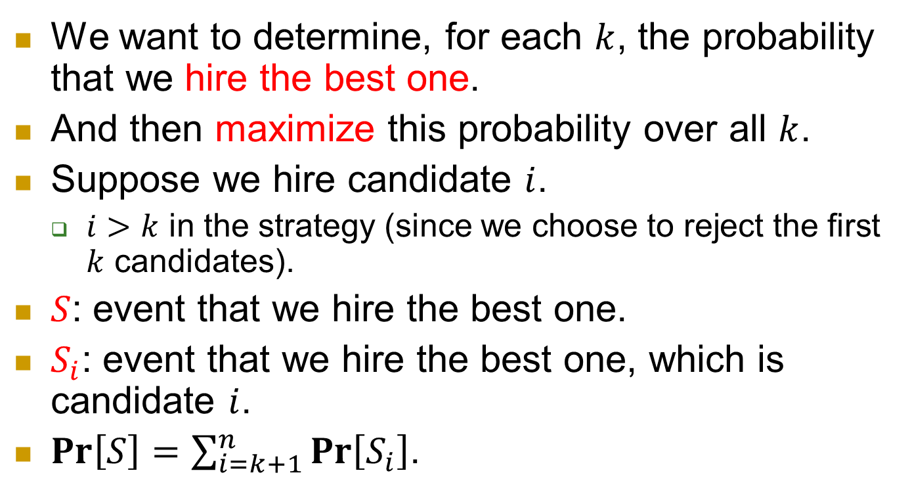
Next
We want to determine, for each $k$, the probability that we hire the best one.
And then maximize this probability over all $k$.
Suppose we hire candidate $i$.
  $i>k$ in the strategy (since we choose to reject the first $k$ candidates).
$S$: event that we hire the best one.
$S_{i}$: event that we hire the best one, which is candidate $i$.
$\operatorname{Pr}\left[S\right]=\sum_{i=k+1}^{n}{\operatorname{Pr}\left[S_{i}\right]}$.

Slide 12
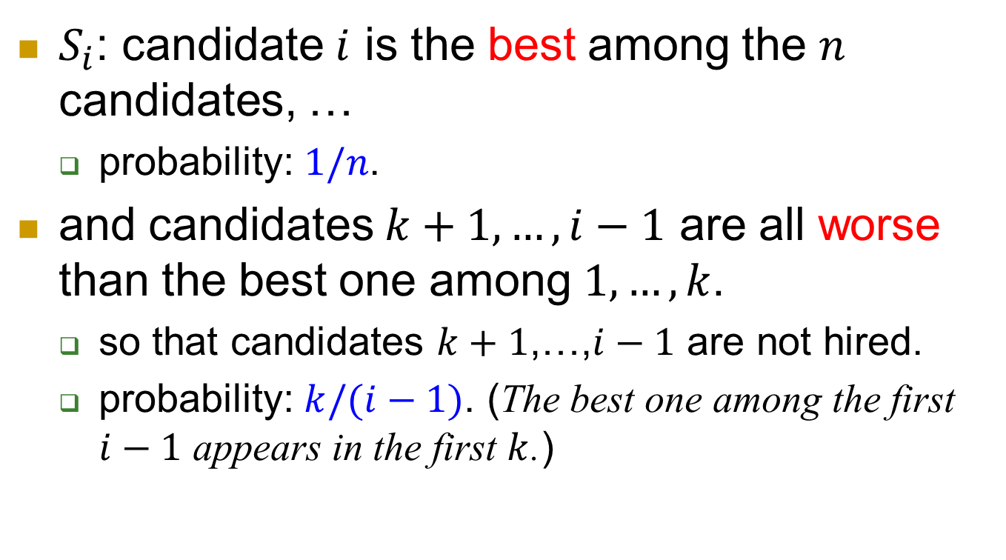
$S_{i}$: candidate $i$ is the best among the $n$ candidates, …
  probability: $1/n$.
and candidates $k+1,…,i−1$ are all worse than the best one among $1,…,k$.
  so that candidates $k+1$,…,$i−1$ are not hired.
  probability: $k/(i−1)$. (The best one among the first $i−1$ appears in the first $k$.)

Slide 13
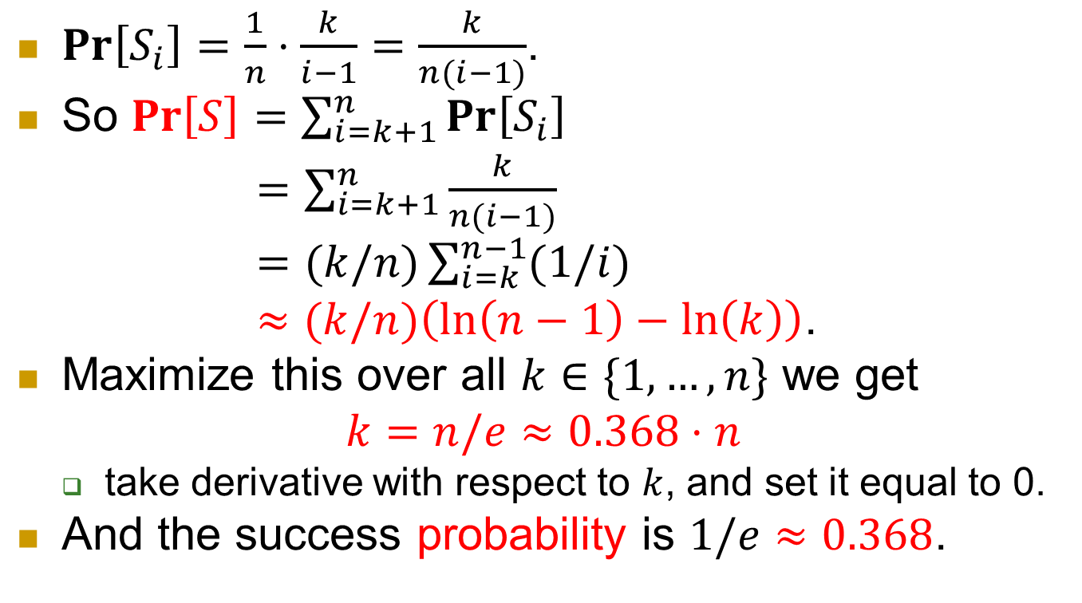
Putting together
$\operatorname{Pr}\left[S_{i}\right]=\frac{1}{n}⋅\frac{k}{i−1}=\frac{k}{n(i−1)}$.
So $\operatorname{Pr}\left[S\right]=\sum_{i=k+1}^{n}{\operatorname{Pr}\left[S_{i}\right]}$
$=\sum_{i=k+1}^{n}{\frac{k}{n(i−1)}}$
$=(k/n)\sum_{i=k}^{n−1}{(1/i)}$
$≈(k/n)\left(\ln\left(n−1\right)−\ln\left(k\right)\right)$.
Maximize this over all $k∈\{1,…,n\}$ we get
$$k=n/e≈0.368⋅n$$
  take derivative with respect to $k$, and set it equal to 0.
And the success probability is $1/e≈0.368$.

Slide 14
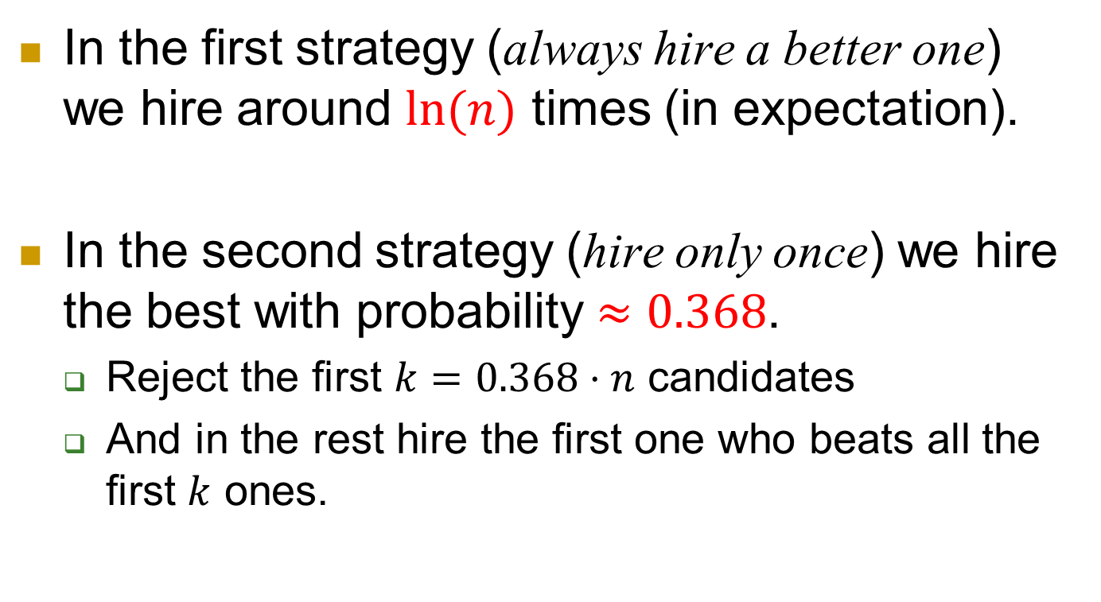
Summary for the Secretary problem
In the first strategy (always hire a better one) we hire around $ln⁡(n)$ times (in expectation).
In the second strategy (hire only once) we hire the best with probability $≈0.368$.
  Reject the first $k=0.368⋅n$ candidates
  And in the rest hire the first one who beats all the first $k$ ones.

Slide 15
Online vs. Offline
Almost all algorithms we encountered in this course assume that the entire input is given all at once.
These are called offline algorithms.
In Secretary problem.
  The input is given gradually.
  We need to respond to each candidate in time.
  We care about our performance compared to the best one in hindsight.
    Namely the best one by an offline algorithm.

Slide 16
Online algorithms
The input is revealed in parts.
An online algorithm needs to respond to each part (of the input) upon its arrival.
The responding actions cannot be canceled/revoked later.
We care about the competitive ratio, which compares the performance of an online algorithm to that of the best offline algorithm.
  Offline: the entire input is given beforehand.

Slide 17
Ski rental problem

Slide 18
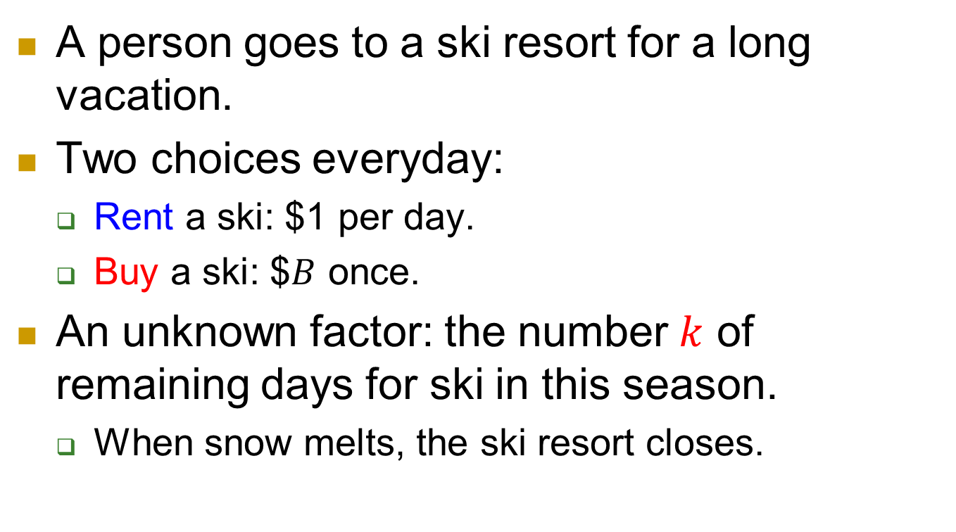
Ski rental
A person goes to a ski resort for a long vacation.
Two choices everyday:
  Rent a ski: $1 per day.
  Buy a ski: $$B$ once.
An unknown factor: the number $k$ of remaining days for ski in this season.
  When snow melts, the ski resort closes.

Slide 19
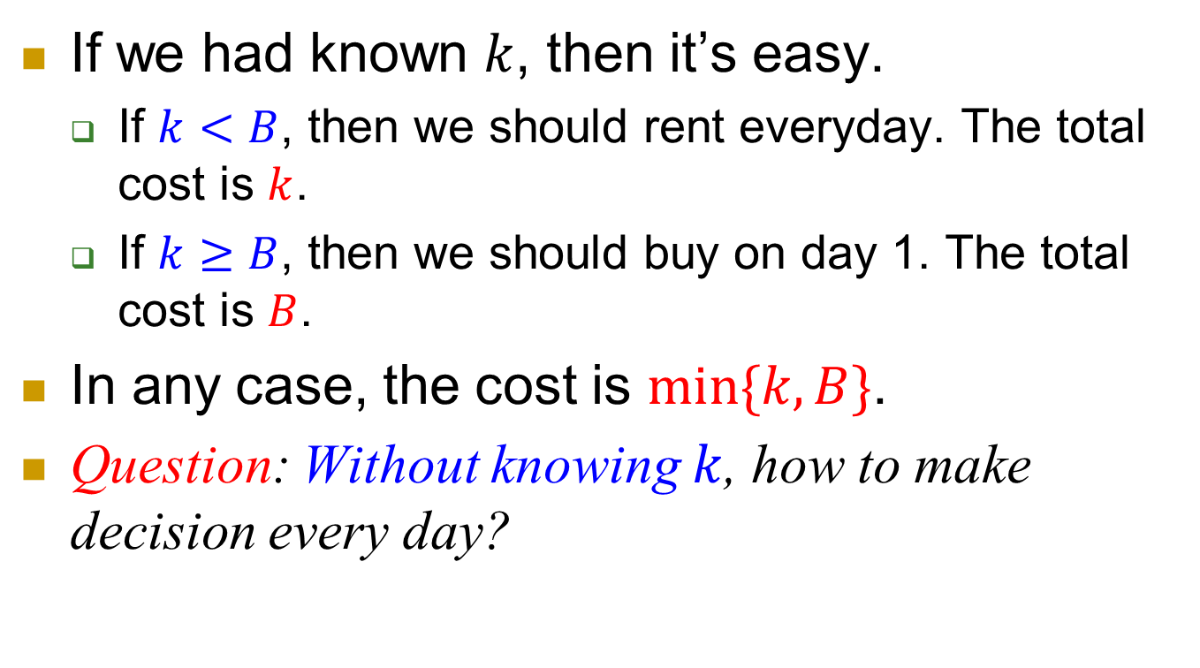
Offline algorithm
If we had known $k$, then it’s easy.
  If $k<B$, then we should rent everyday. The total cost is $k$.
  If $k≥B$, then we should buy on day 1. The total cost is $B$.
In any case, the cost is $\min{\{k,B\}}$.
Question: Without knowing $k$, how to make decision every day?

Slide 20
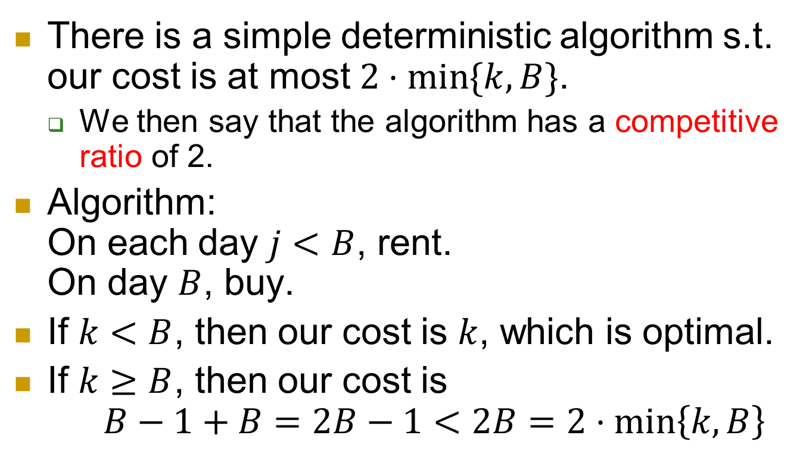
Deterministic algorithm
There is a simple deterministic algorithm s.t. our cost is at most $2⋅\min{\{k,B\}}$.
  We then say that the algorithm has a competitive ratio of 2.
Algorithm:
On each day $j<B$, rent.
On day $B$, buy.
If $k<B$, then our cost is $k$, which is optimal.
If $k≥B$, then our cost is
$B−1+B=2B−1<2B=2⋅\min\left\{k,B\right\}$

Slide 21
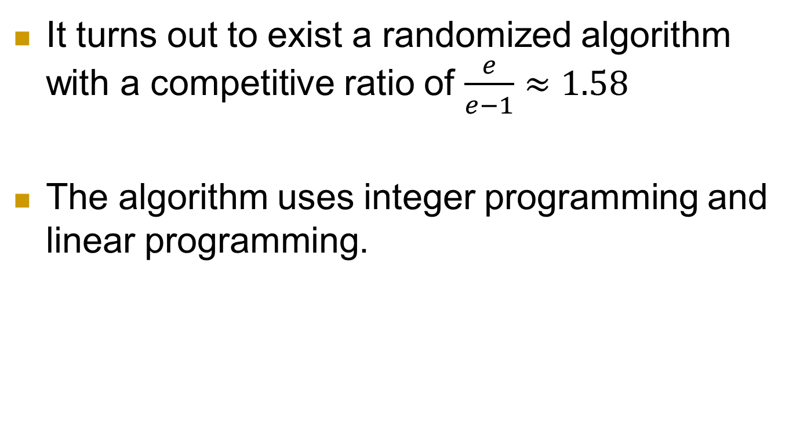
Randomized algorithm
It turns out to exist a randomized algorithm with a competitive ratio of $\frac{e}{e−1}≈1.58$
The algorithm uses integer programming and linear programming.

Slide 22
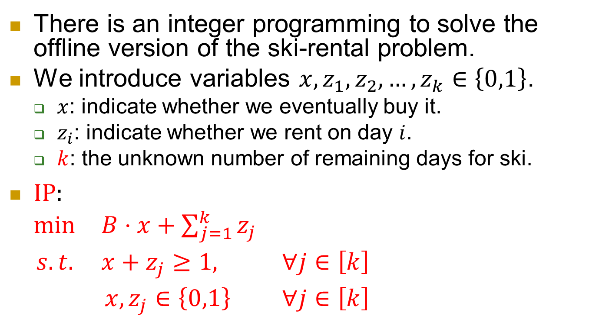
Integer programming
There is an integer programming to solve the offline version of the ski-rental problem.
We introduce variables $x,z_{1},z_{2},…,z_{k}∈\left\{0,1\right\}$.
  $x$: indicate whether we eventually buy it.
  $z_{i}$: indicate whether we rent on day $i$.
  $k$: the unknown number of remaining days for ski.
$IP:$
$\begin{matrix}min & B⋅x+\sum_{j=1}^{k}{z_{j}} & \\ s.t. & x+z_{j}≥1, & ∀j∈\left[k\right] \\ & x,z_{j}∈\left\{0,1\right\} & ∀j∈\left[k\right]\end{matrix}$

Slide 23
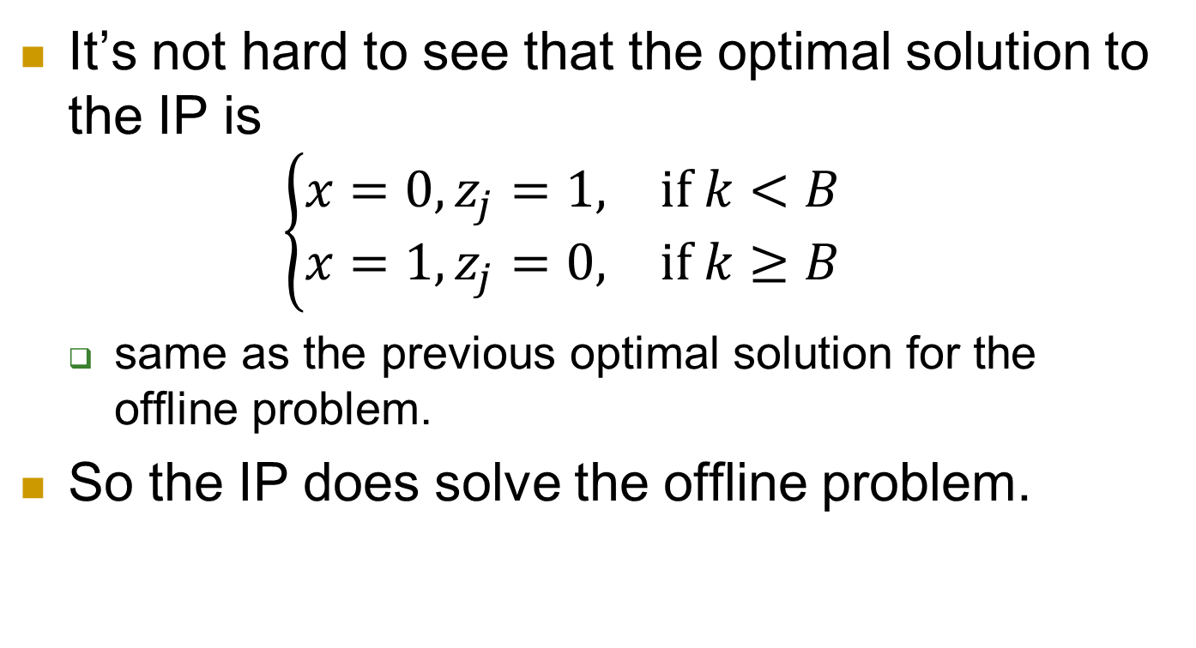
Solution
It’s not hard to see that the optimal solution to the IP is
$\left\{\begin{matrix}x=0,z_{j}=1, & if k<B \\ x=1,z_{j}=0, & if k≥B\end{matrix}\right.$
  same as the previous optimal solution for the offline problem.
So the IP does solve the offline problem.

Slide 24
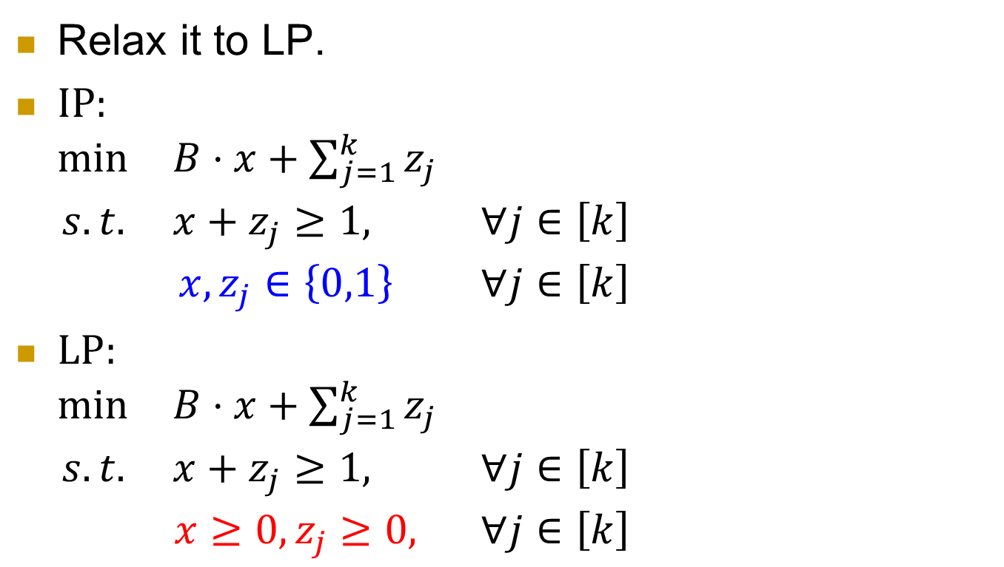
Relaxation
Relax it to LP.
$IP:$
$\begin{matrix}min & B⋅x+\sum_{j=1}^{k}{z_{j}} & \\ s.t. & x+z_{j}≥1, & ∀j∈\left[k\right] \\ & x,z_{j}∈\left\{0,1\right\} & ∀j∈\left[k\right]\end{matrix}$
$LP:$
$\begin{matrix}min & B⋅x+\sum_{j=1}^{k}{z_{j}} & \\ s.t. & x+z_{j}≥1, & ∀j∈\left[k\right] \\ & x≥0,z_{j}≥0, & ∀j∈\left[k\right]\end{matrix}$

Slide 25
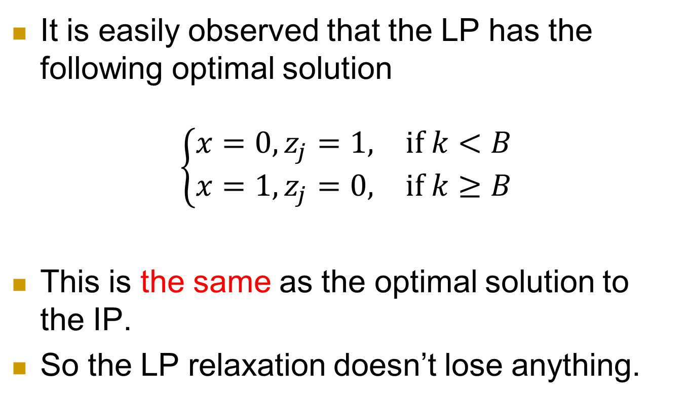
The relaxation doesn’t lose anything
It is easily observed that the LP has the following optimal solution
$$\left\{\begin{matrix}x=0,z_{j}=1, & if k<B \\ x=1,z_{j}=0, & if k≥B\end{matrix}\right.$$
This is the same as the optimal solution to the IP.
So the LP relaxation doesn’t lose anything.

Slide 26

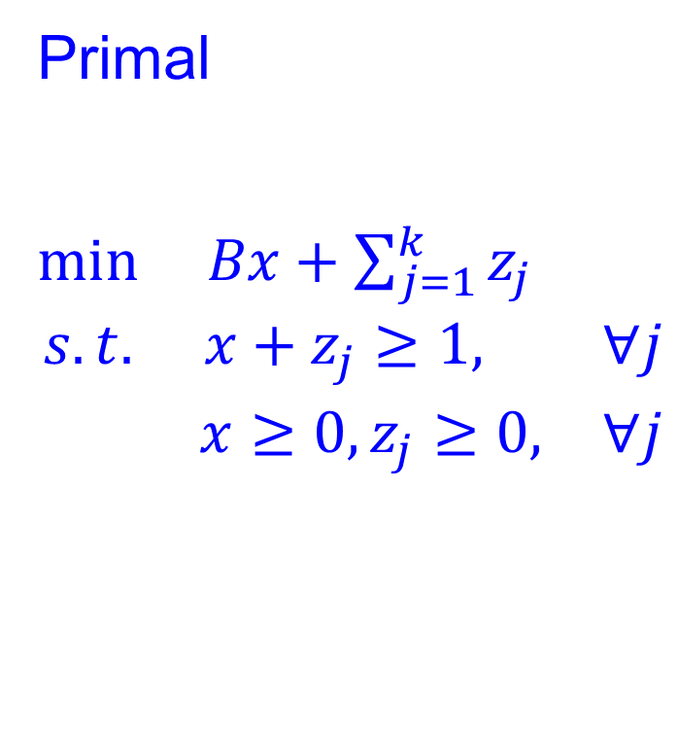


Dual LP
Primal
$\begin{matrix}min & Bx+\sum_{j=1}^{k}{z_{j}} & \\ s.t. & x+z_{j}≥1, & ∀j \\ & x≥0,z_{j}≥0, & ∀j\end{matrix}$
Dual
$\begin{matrix}max & \sum_{j=1}^{k}{y_{j}} & \\ s.t. & \sum_{j=1}^{k}{y_{j}}≤B & ∀j \\ & y_{j}∈[0,1] & ∀j\end{matrix}$
Dual LP
Primal LP
IP
$$OPT_{Dual LP}=OPT_{Primal LP}$$
$$OPT_{IP}$$

Slide 27
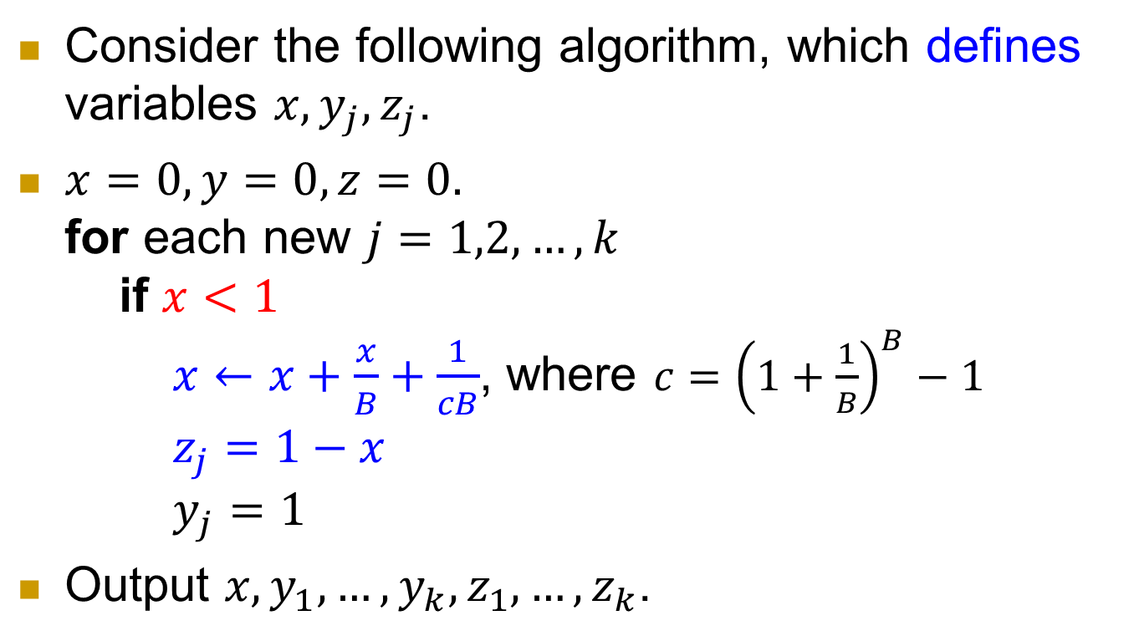
Consider the following algorithm, which defines variables $x,y_{j},z_{j}$.
$x=0, y=0,z=0.$
for each new $j=1,2,…,k$
if $x<1$
$x←x+\frac{x}{B}+\frac{1}{cB}$, where $c={\left(1+\frac{1}{B}\right)}^{B}−1$
$z_{j}=1−x$
$y_{j}=1$
Output $x,y_{1},…,y_{k},z_{1},…,z_{k}$.

Slide 28
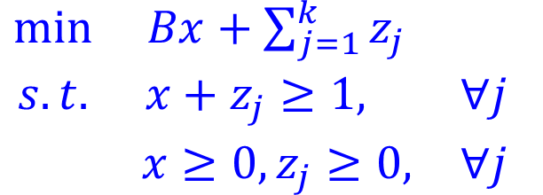
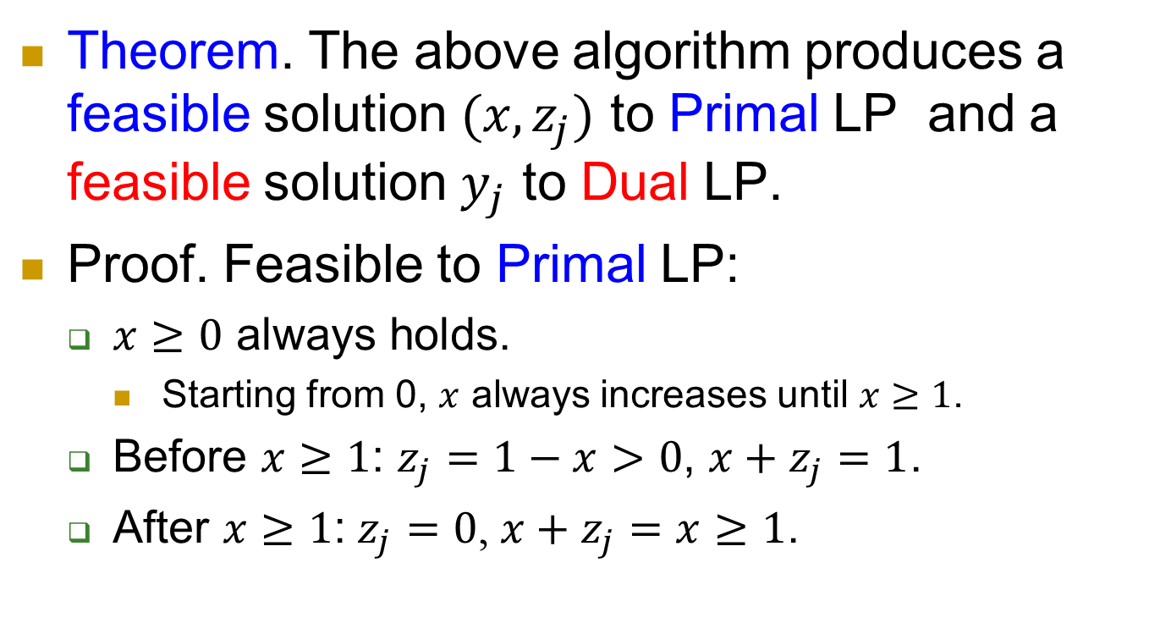
Property 1
$\begin{matrix}min & Bx+\sum_{j=1}^{k}{z_{j}} & \\ s.t. & x+z_{j}≥1, & ∀j \\ & x≥0,z_{j}≥0, & ∀j\end{matrix}$
Theorem. The above algorithm produces a feasible solution $(x,z_{j})$ to Primal LP and a feasible solution $y_{j}$ to Dual LP.
Proof. Feasible to Primal LP:
  $x≥0$ always holds.
    Starting from 0, $x$ always increases until $x≥1$.
  Before $x≥1$: $z_{j}=1−x>0$, $x+z_{j}=1$.
  After $x≥1\text{:}$ $z_{j}=0$, $x+z_{j}=x≥1$.

Slide 29
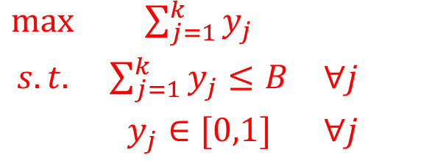
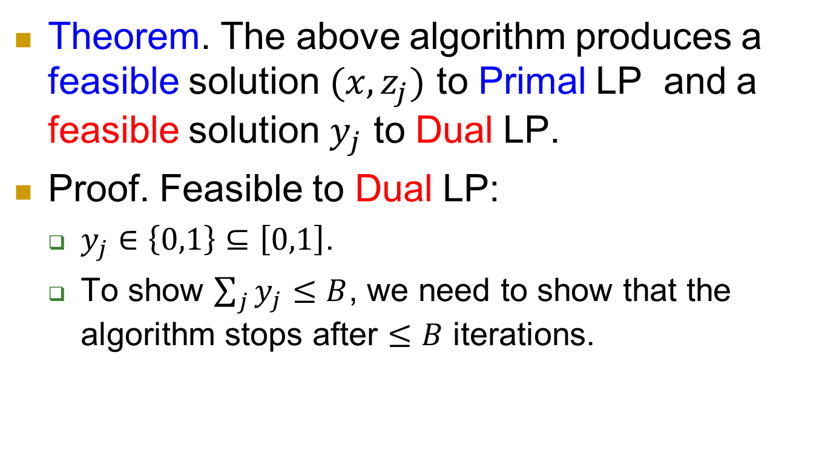
Property 1
$\begin{matrix}max & \sum_{j=1}^{k}{y_{j}} & \\ s.t. & \sum_{j=1}^{k}{y_{j}}≤B & ∀j \\ & y_{j}∈[0,1] & ∀j\end{matrix}$
Theorem. The above algorithm produces a feasible solution $(x,z_{j})$ to Primal LP and a feasible solution $y_{j}$ to Dual LP.
Proof. Feasible to Dual LP:
  $y_{j}∈\left\{0,1\right\}⊆\left[0,1\right]$.
  To show $\sum_{j}{y_{j}}≤B$, we need to show that the algorithm stops after $≤B$ iterations.

Slide 30
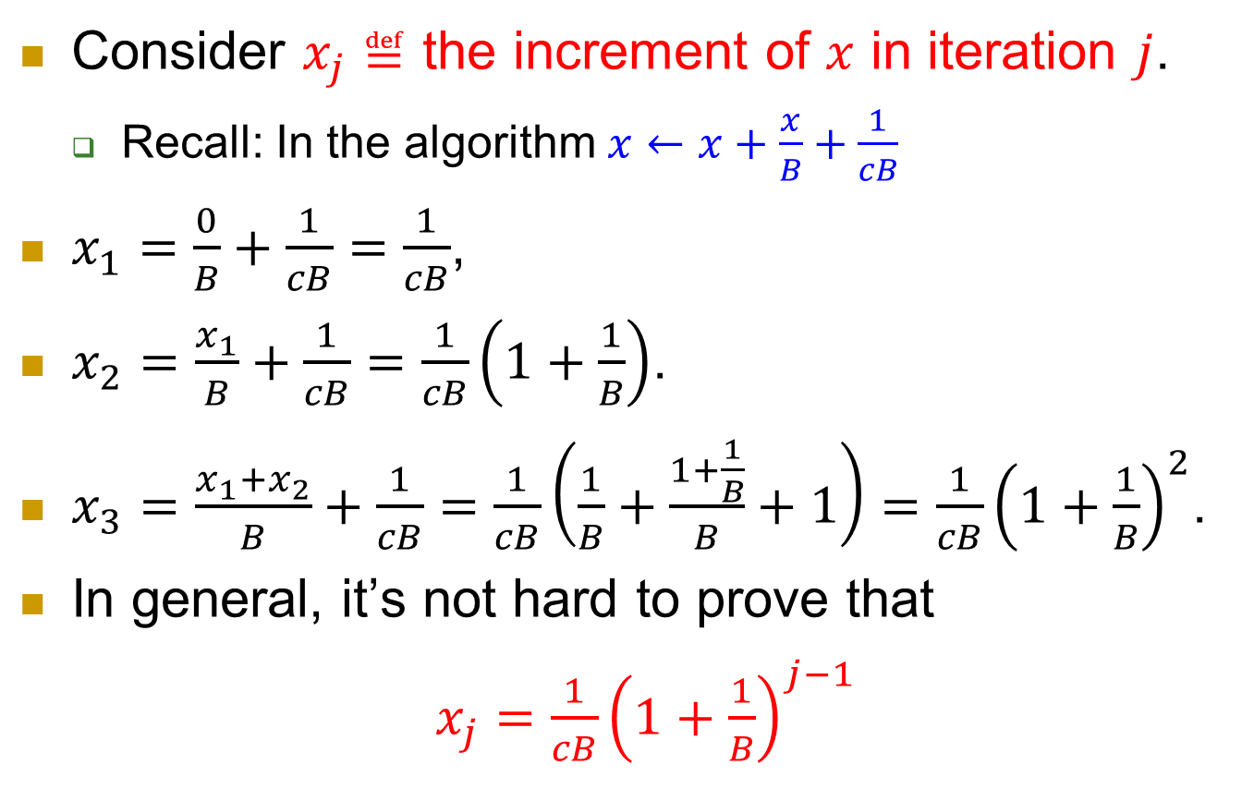
Consider $x_{j}≝$ the increment of $x$ in iteration $j$.
  Recall: In the algorithm $x←x+\frac{x}{B}+\frac{1}{cB}$
$x_{1}=\frac{0}{B}+\frac{1}{cB}=\frac{1}{cB}$,
$x_{2}=\frac{x_{1}}{B}+\frac{1}{cB}=\frac{1}{cB}\left(1+\frac{1}{B}\right)$.
$x_{3}=\frac{x_{1}+x_{2}}{B}+\frac{1}{cB}=\frac{1}{cB}\left(\frac{1}{B}+\frac{1+\frac{1}{B}}{B}+1\right)=\frac{1}{cB}{\left(1+\frac{1}{B}\right)}^{2}$.
In general, it’s not hard to prove that
$x_{j}=\frac{1}{cB}{\left(1+\frac{1}{B}\right)}^{j−1}$

Slide 31
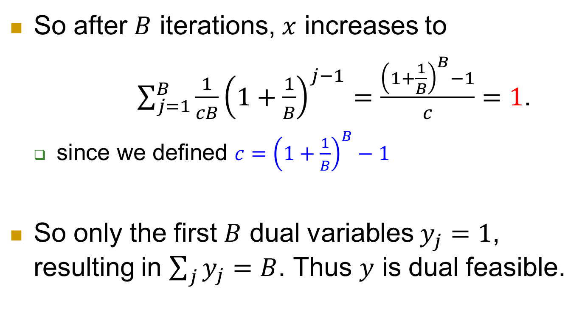
So after $B$ iterations, $x$ increases to
$\sum_{j=1}^{B}{\frac{1}{cB}{\left(1+\frac{1}{B}\right)}^{j−1}}=\frac{{\left(1+\frac{1}{B}\right)}^{B}−1}{c}=1$.
  since we defined $c={\left(1+\frac{1}{B}\right)}^{B}−1$
So only the first $B$ dual variables $y_{j}=1$, resulting in $\sum_{j}{y_{j}}=B$. Thus $y$ is dual feasible.

Slide 32
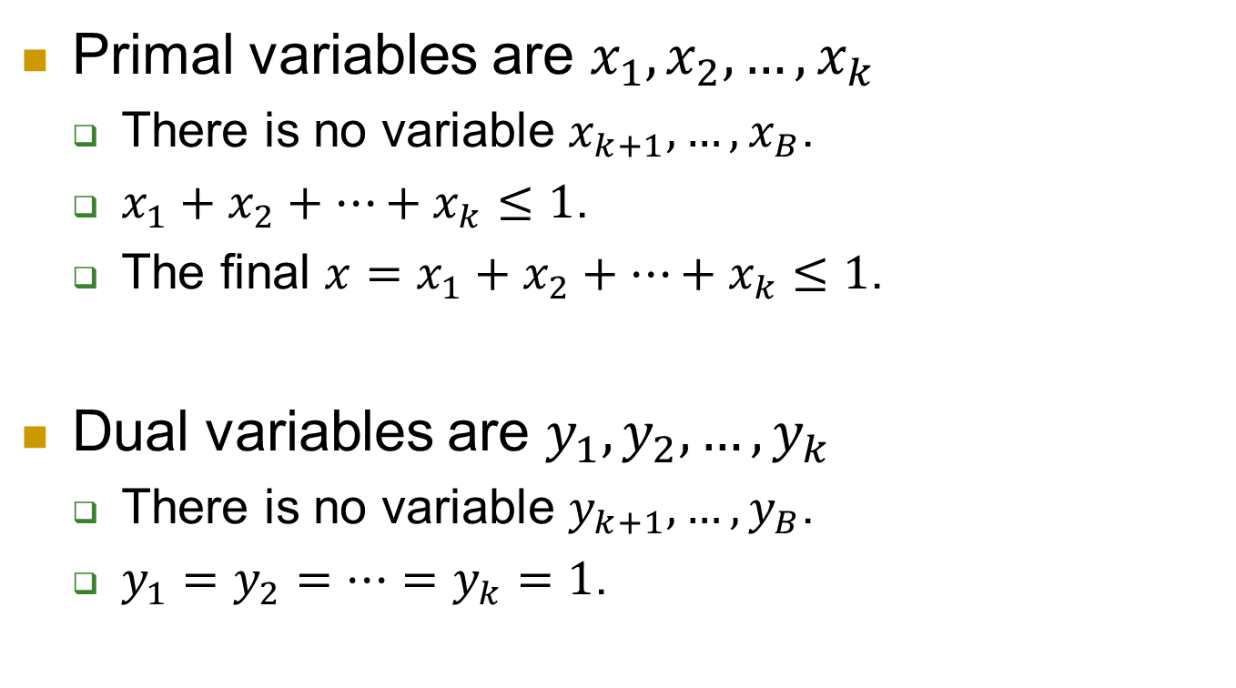

Case 1: $k≤B$
Primal variables are $x_{1},x_{2},…,x_{k}$
  There is no variable $x_{k+1},…,x_{B}$.
  $x_{1}+x_{2}+…+x_{k}≤1$.
  The final $x=x_{1}+x_{2}+…+x_{k}≤1\text{.}$
Dual variables are $y_{1},y_{2},…,y_{k}$
  There is no variable $y_{k+1},…,y_{B}$.
  $y_{1}=y_{2}=…=y_{k}=1$.

Slide 33
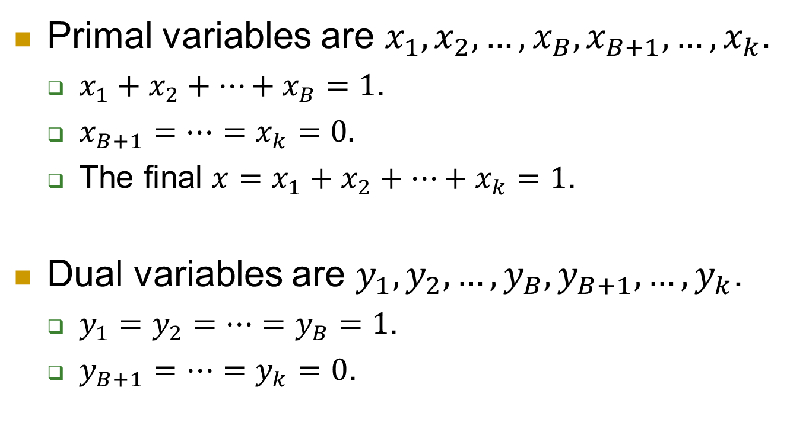

Case 2: $k>B$
Primal variables are $x_{1},x_{2},…,x_{B},x_{B+1},…,x_{k}$.
  $x_{1}+x_{2}+…+x_{B}=1$.
  $x_{B+1}=…=x_{k}=0.$
  The final $x=x_{1}+x_{2}+…+x_{k}=1\text{.}$
Dual variables are $y_{1},y_{2},…,y_{B},y_{B+1},…,y_{k}$.
  $y_{1}=y_{2}=…=y_{B}=1$.
  $y_{B+1}=…=y_{k}=0$.

Slide 34
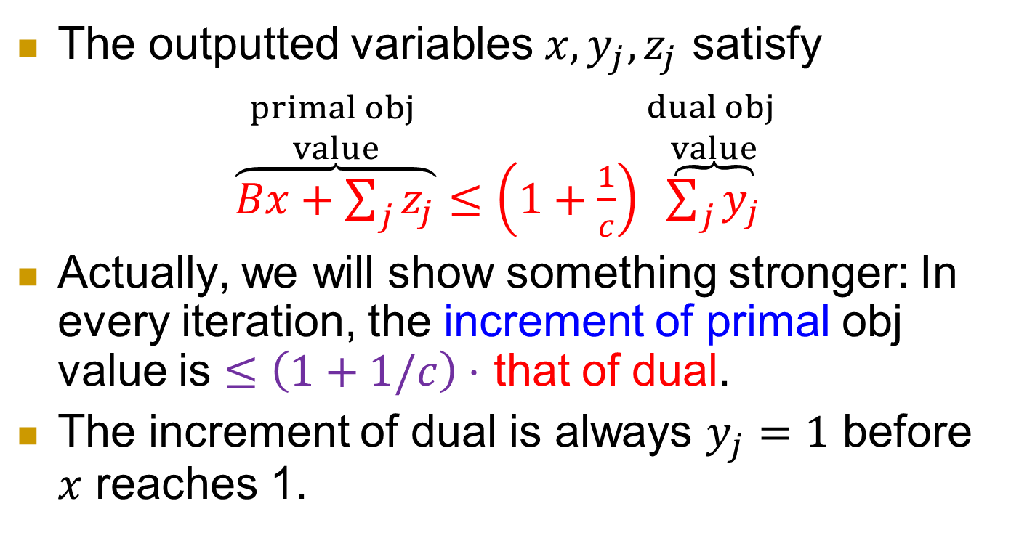
Property 2
The outputted variables $x,y_{j},z_{j}$ satisfy
$\overset{\begin{aligned}primal obj \\ value\end{aligned}}{\overbrace{Bx+\sum_{j}{z_{j}}}}≤\left(1+\frac{1}{c}\right)\overset{\begin{aligned}dual obj \\ value\end{aligned}}{\overbrace{\sum_{j}{y_{j}}}}$
Actually, we will show something stronger: In every iteration, the increment of primal obj value is $≤\left(1+1/c\right)⋅$ that of dual.
The increment of dual is always $y_{j}=1$ before $x$ reaches 1.

Slide 35
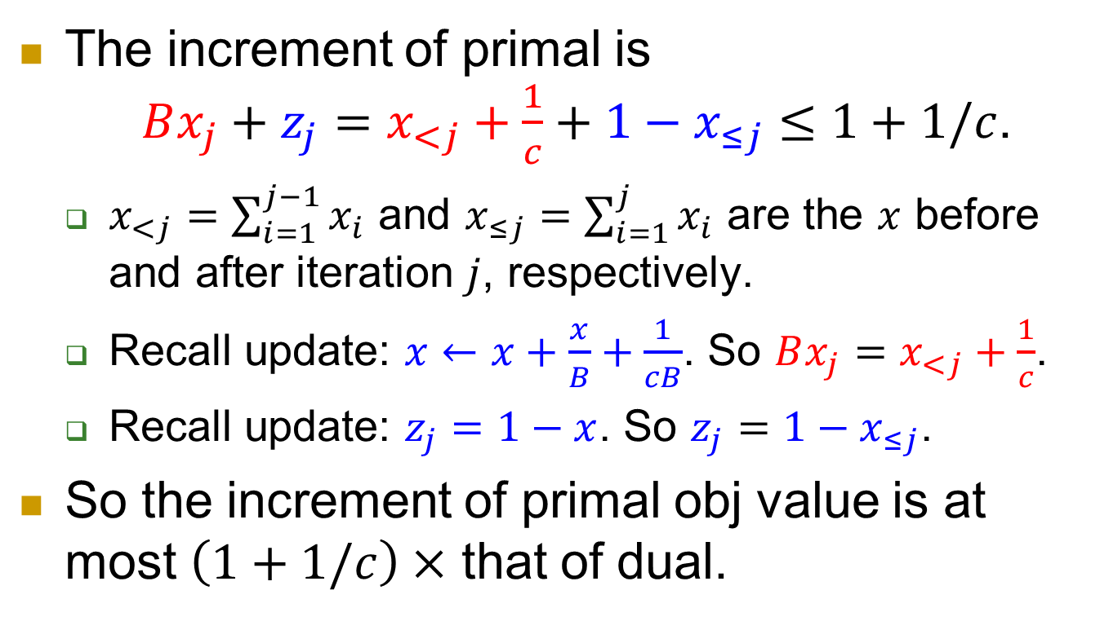
The increment of primal is
$Bx_{j}+z_{j}=x_{<j}+\frac{1}{c}+1−x_{≤j}≤1+1/c$.
  $x_{<j}=\sum_{i=1}^{j−1}{x_{i}}$ and $x_{≤j}=\sum_{i=1}^{j}{x_{i}}$ are the $x$ before and after iteration $j$, respectively.
  Recall update: $x←x+\frac{x}{B}+\frac{1}{cB}$. So $Bx_{j}=x_{<j}+\frac{1}{c}$.
  Recall update: $z_{j}=1−x$. So $z_{j}=1−x_{≤j}$.
So the increment of primal obj value is at most $\left(1+1/c\right)×$ that of dual.

Slide 36



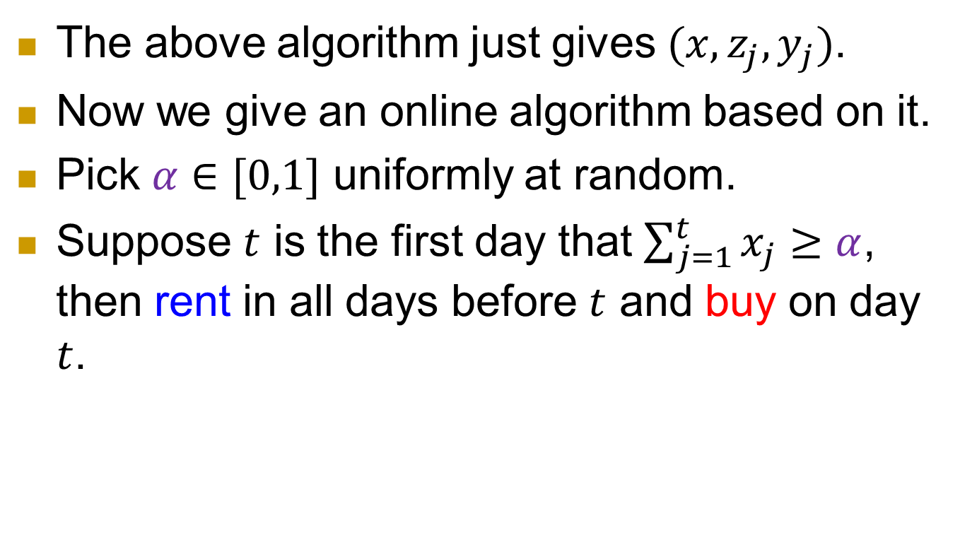




Turning into an online algorithm
The above algorithm just gives $(x,z_{j},y_{j})$.
Now we give an online algorithm based on it.
Pick $α∈[0,1]$ uniformly at random.
Suppose $t$ is the first day that $\sum_{j=1}^{t}{x_{j}}≥α$, then rent in all days before $t$ and buy on day $t$.
$x_{1}$
$x_{2}$
$x_{3}$
…
$x_{t}$
$$0$$
$$α$$
$$1$$
rent
buy

Slide 37
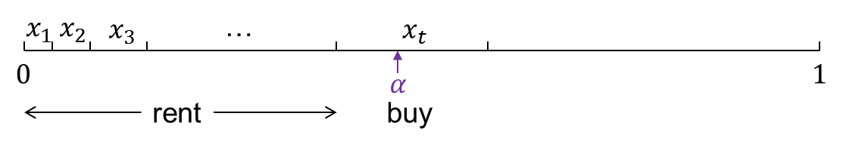
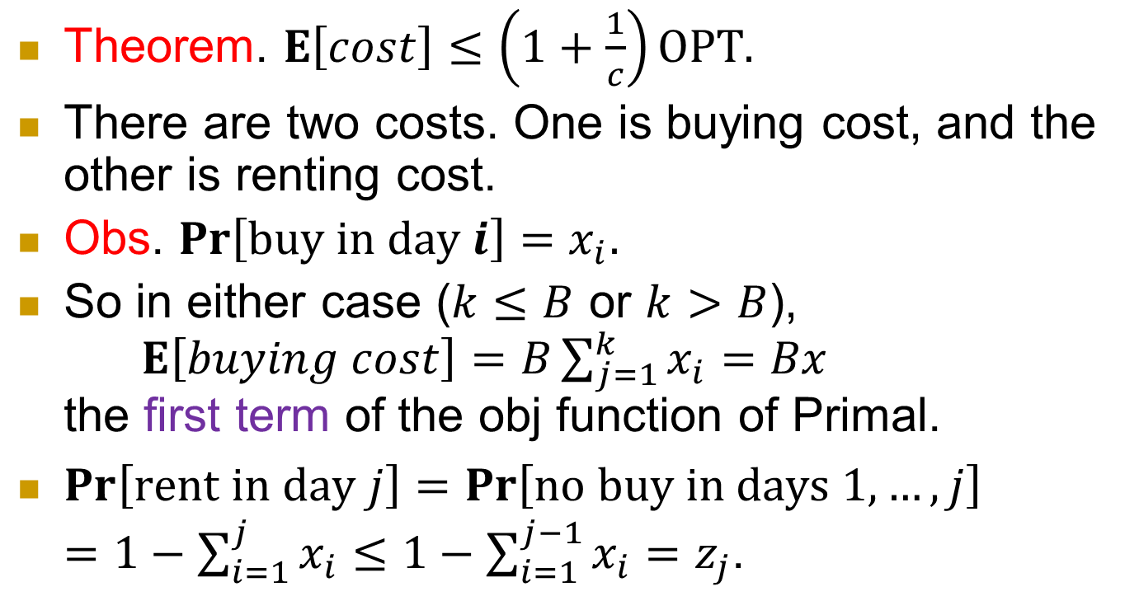
Expected cost
Theorem. $E\left[cost\right]≤\left(1+\frac{1}{c}\right)OPT.$
There are two costs. One is buying cost, and the other is renting cost.
Obs. $Pr\left[buy in day i\right]=x_{i}$.
So in either case ($k≤B$ or $k>B$),
$E\left[buying cost\right]=B\sum_{j=1}^{k}{x_{i}}=Bx$
the first term of the obj function of Primal.
$Pr\left[rent in day j\right]=\operatorname{Pr}\left[no buy in days 1,…,j\right]$
$=1−\sum_{i=1}^{j}{x_{i}}≤1−\sum_{i=1}^{j−1}{x_{i}}=z_{j}$.

Slide 38
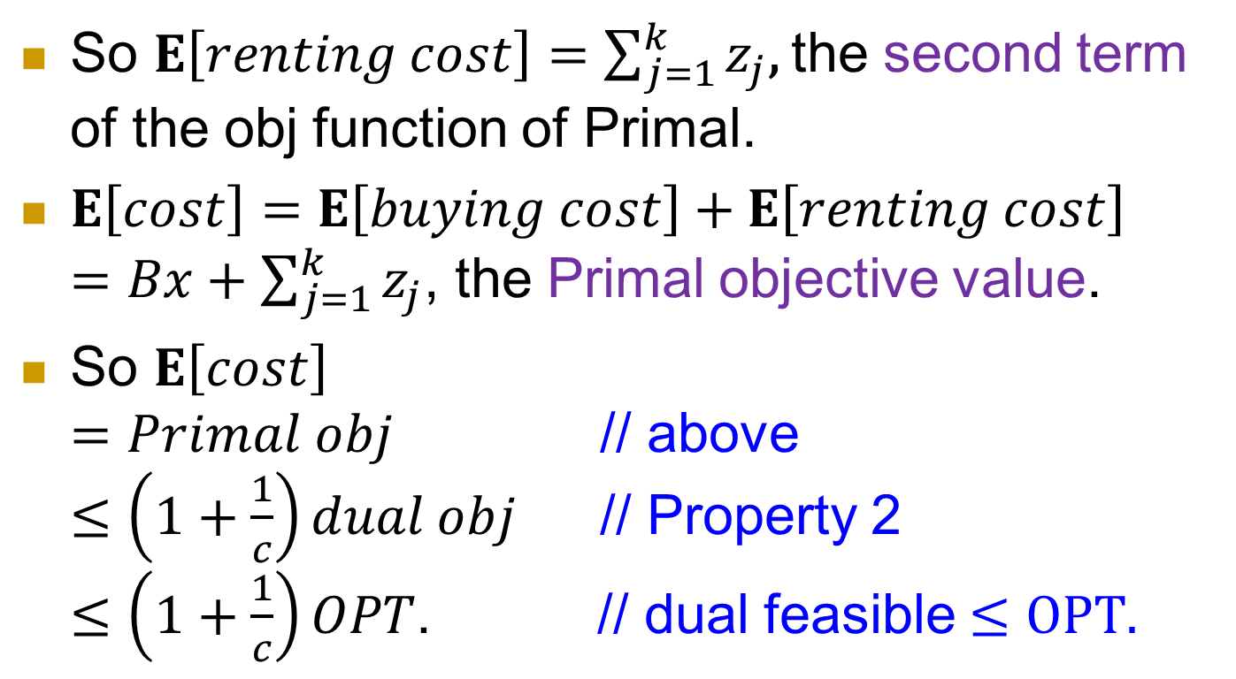
So $E\left[renting cost\right]=\sum_{j=1}^{k}{z_{j}}$, the second term of the obj function of Primal.
$E\left[cost\right]=E\left[buying cost\right]+E\left[renting cost\right]$
$=Bx+\sum_{j=1}^{k}{z_{j}}$, the Primal objective value.
So $E\left[cost\right]$
$=Primal obj$ // above
$≤\left(1+\frac{1}{c}\right)dual obj$ // Property 2
$≤\left(1+\frac{1}{c}\right)OPT$. // dual feasible $≤OPT.$

Slide 39
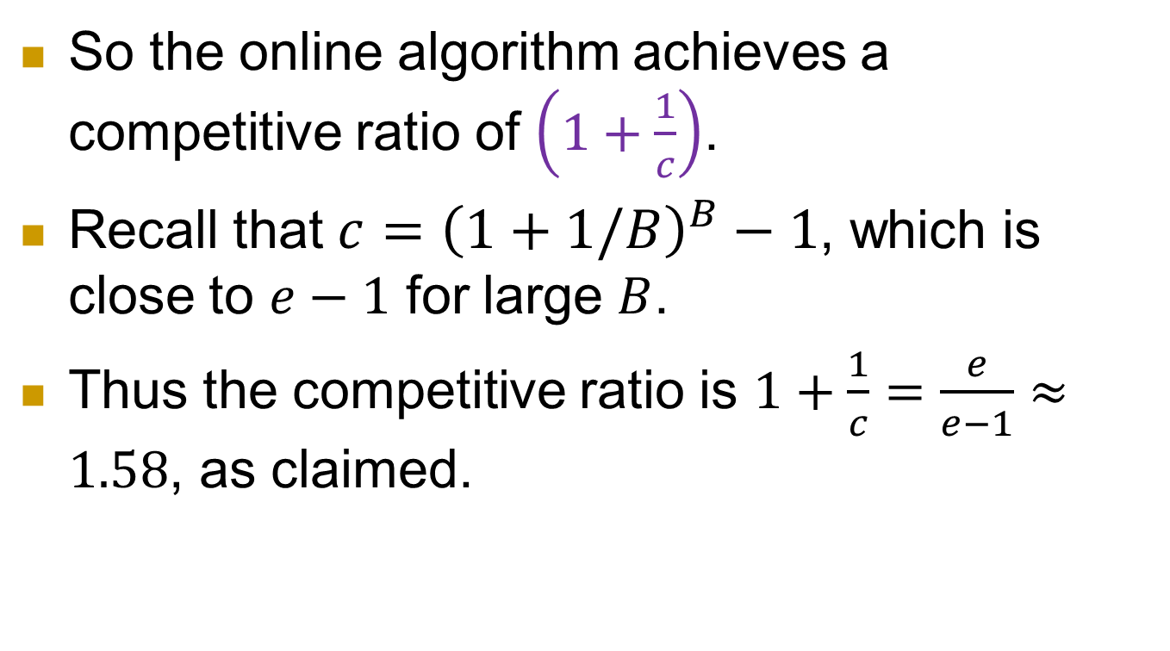
So the online algorithm achieves a competitive ratio of $\left(1+\frac{1}{c}\right)$.
Recall that $c={\left(1+1/B\right)}^{B}−1$, which is close to $e−1$ for large $B$.
Thus the competitive ratio is $1+\frac{1}{c}=\frac{e}{e−1}≈1.58$, as claimed.

Slide 40
Optimality: Both deterministic and randomized algorithms are optimal.
  No better competitive ratio is possible.
Reference: The design of competitive online algorithms via a primal dual approach, Niv Buchbinder and Joseph Naor, Foundations and Trends in Theoretical Computer Science, Vol. 3, pp. 93-263, 2007.

