Slide 1
CMSC5706 Topics in Theoretical Computer Science
Week 6: Algorithms for fair allocation
Instructor: Shengyu Zhang

Slide 2
Resource allocation
General goals:
  Maximize social welfare.
  Fairness.
  Stability.

Slide 3
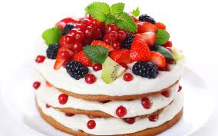
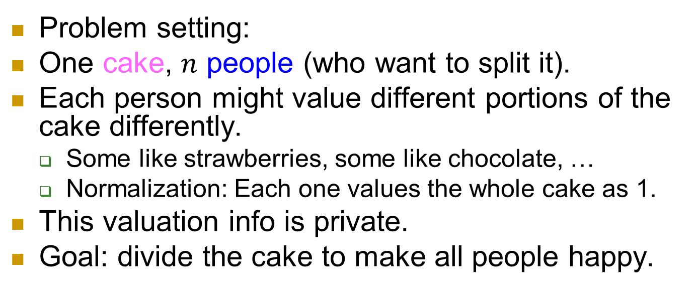
Cake cutting
Problem setting:
One cake, $n$ people (who want to split it).
Each person might value different portions of the cake differently.
  Some like strawberries, some like chocolate, …
  Normalization: Each one values the whole cake as 1.
This valuation info is private.
Goal: divide the cake to make all people happy.

Slide 4
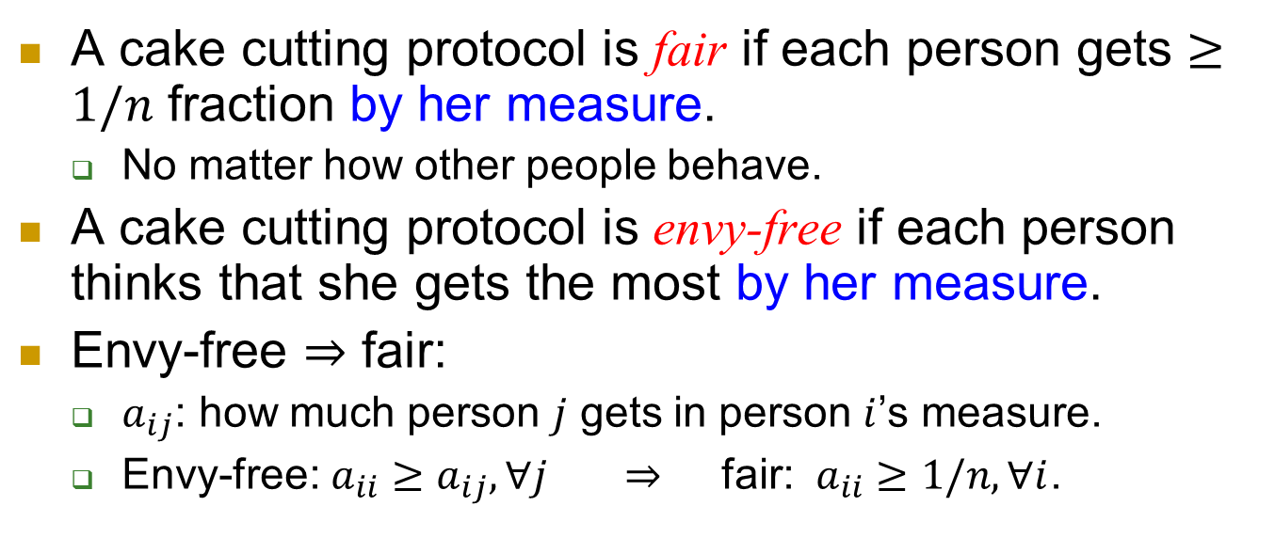
Cake cutting
A cake cutting protocol is fair if each person gets $≥1/n$ fraction by her measure.
  No matter how other people behave.
A cake cutting protocol is envy-free if each person thinks that she gets the most by her measure.
Envy-free $⇒$ fair:
  $a_{ij}$: how much person $j$ gets in person $i$’s measure.
  Envy-free: $a_{ii}≥a_{ij}, ∀j$ $⇒$ fair: $a_{ii}≥1/n, ∀i$.

Slide 5

$$n=2$$
1. Alice cuts the cake into two equal pieces
  by her measure
2. Bob chooses a larger piece
  by his measure
3. Alice takes the other piece

Slide 6



Slide 7
envy-free
Theorem. The outcome is envy-free (and thus fair).
Proof.
  Alice: gets exactly half, no matter which piece Bob chooses.
  Bob: gets at least half, no matter how Alice cuts the cake.

Slide 8

$$n=3$$
Stage 0: Player 1 divides into three equal pieces
  according to his valuation.
Player 2 trims the largest piece s.t. the remaining is the same as the second largest.
The trimmed part is called Cake 2; the other form Cake 1.

Slide 9
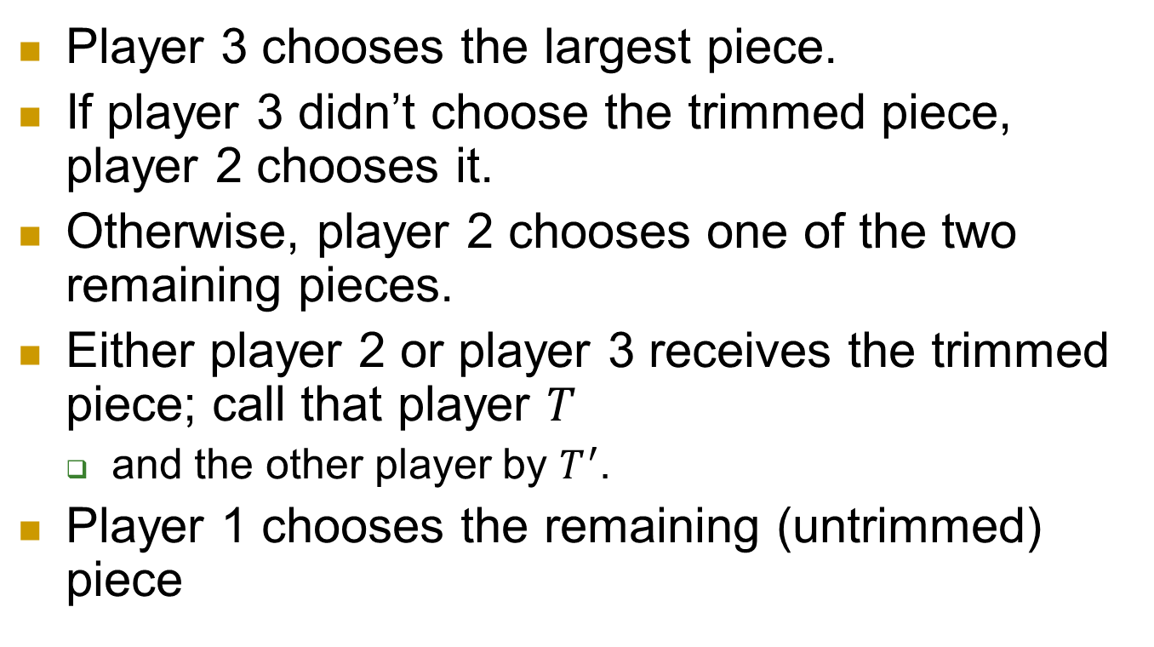
Stage 1: division of Cake 1
Player 3 chooses the largest piece.
If player 3 didn’t choose the trimmed piece, player 2 chooses it.
Otherwise, player 2 chooses one of the two remaining pieces.
Either player 2 or player 3 receives the trimmed piece; call that player $T$
  and the other player by $T^{′}$.
Player 1 chooses the remaining (untrimmed) piece

Slide 10

Stage 2 (division of Cake 2)
$T^{′}$ divides Cake 2 into three equal pieces
  according to his valuation.
Players $T$, 1, and $T^{′}$ choose the pieces of Cake 2, in that order.

Slide 11
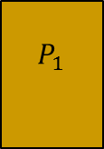


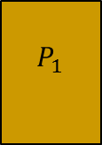

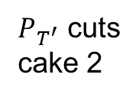

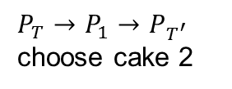

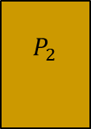
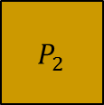

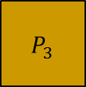
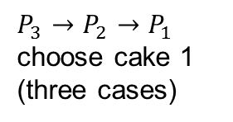


Whole process
$P_{3}→P_{2}→P_{1}$ choose cake 1
(three cases)
$P_{T^{′}}$ cuts
cake 2
$P_{T}→P_{1}→P_{T^{′}}$ choose cake 2
$P_{1}$ cuts
$P_{2}$ trims
Cake 2
$$P_{2}$$
$$P_{2}$$
$$P_{3}$$
$$P_{T}$$
$$P_{T}$$
$$P_{T}$$
$$P_{3}$$
$$P_{1}$$
$$P_{2}$$
$$P_{T^{′}}$$
$$P_{T^{′}}$$
$$P_{1}$$
$$P_{3}$$
$$P_{1}$$
$$P_{T^{′}}$$

Slide 12
Envy-freeness
The division of Cake 1 is envy-free:
Player 3 chooses first so he doesn’t envy others.
Player 2 likes the trimmed piece and another piece equally, both better than the third piece. Player 2 is guaranteed to receive one of these two pieces, thus doesn’t envy others.
Player 1 is indifferent judging the two untrimmed pieces and indeed receives an untrimmed piece.

Slide 13
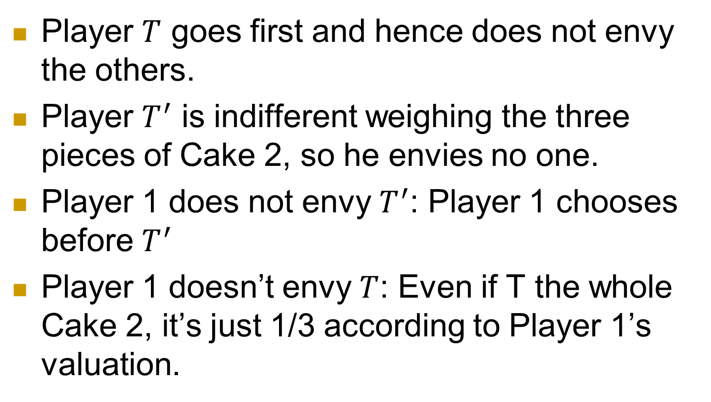
Envy-freeness of Cake 2
Player $T$ goes first and hence does not envy the others.
Player $T^{′}$ is indifferent weighing the three pieces of Cake 2, so he envies no one.
Player 1 does not envy $T^{′}$: Player 1 chooses before $T^{′}$
Player 1 doesn’t envy $T$: Even if T the whole Cake 2, it’s just 1/3 according to Player 1’s valuation.

Slide 14
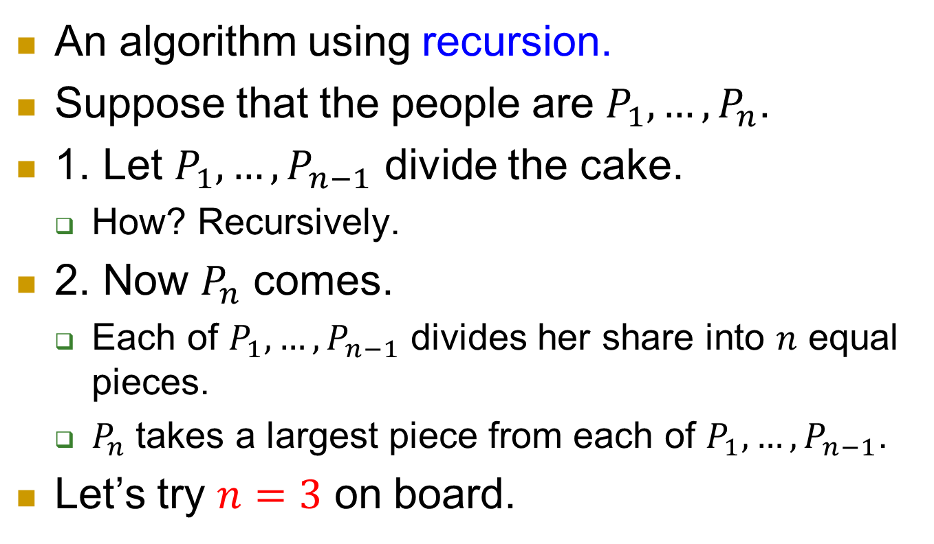

General $n$?
An algorithm using recursion.
Suppose that the people are $P_{1}, …, P_{n}$.
1. Let $P_{1}, …, P_{n−1}$ divide the cake.
  How? Recursively.
2. Now $P_{n}$ comes.
  Each of $P_{1}, …, P_{n−1}$ divides her share into $n$ equal pieces.
  $P_{n}$takes a largest piece from each of $P_{1}, …, P_{n−1}$.
Let’s try $n=3$ on board.

Slide 15
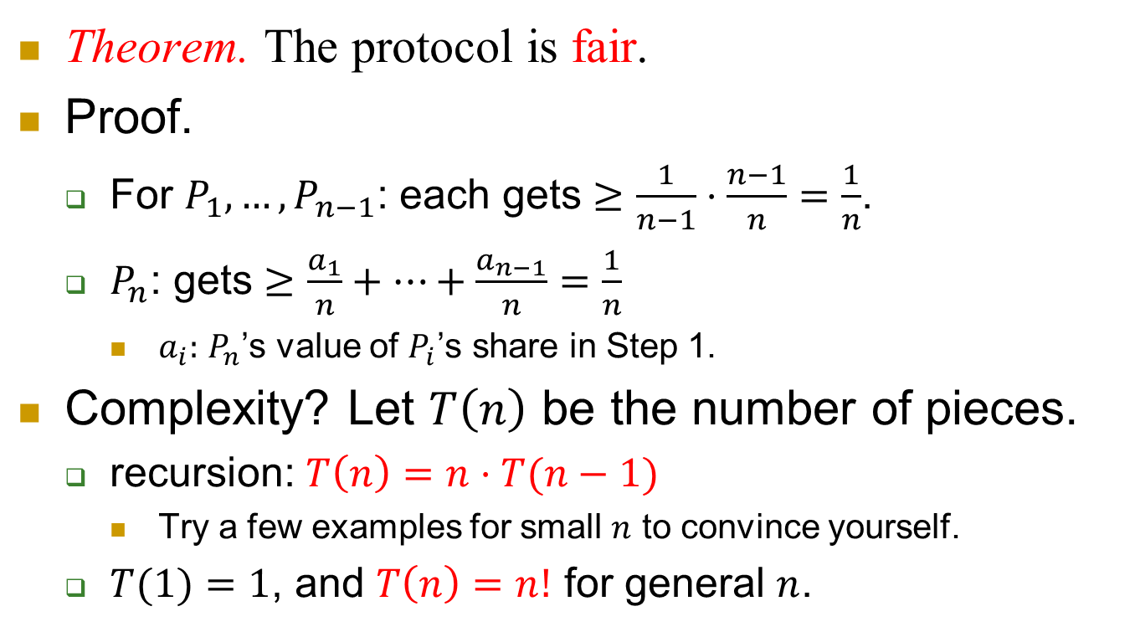
Fairness
Theorem. The protocol is fair.
Proof.
  For $P_{1}, …, P_{n−1}$: each gets $≥\frac{1}{n−1}⋅\frac{n−1}{n}=\frac{1}{n}$.
  $P_{n}$: gets $≥\frac{a_{1}}{n}+⋯+\frac{a_{n−1}}{n}=\frac{1}{n}$
    $a_{i}:$ $P_{n}$’s value of $P_{i}$’s share in Step 1.
Complexity? Let $T\left(n\right)$ be the number of pieces.
  recursion: $T\left(n\right)=n⋅T(n−1)$
    Try a few examples for small $n$ to convince yourself.
  $T(1)=1$, and $T\left(n\right)=n!$ for general $n$.

Slide 16
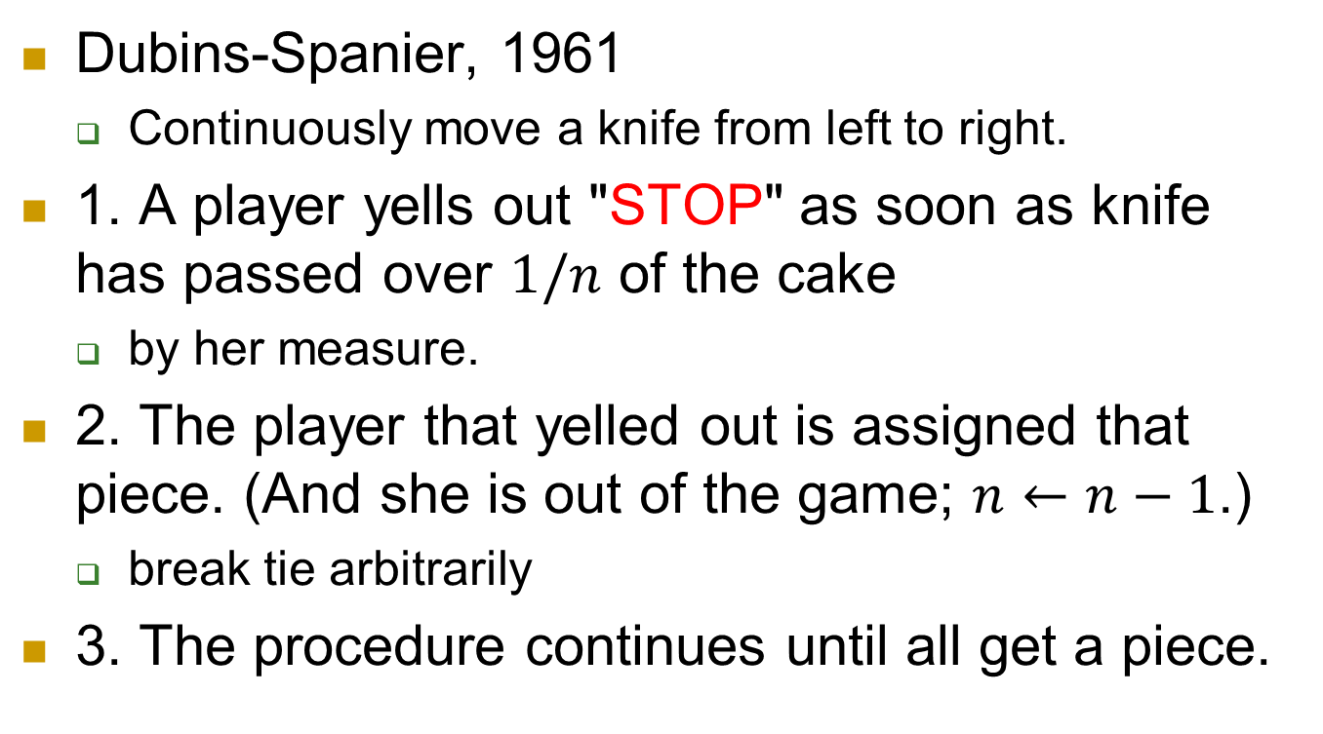
Moving Knife protocols
Dubins-Spanier, 1961
  Continuously move a knife from left to right.
1. A player yells out "STOP" as soon as knife has passed over $1/n$ of the cake
  by her measure.
2. The player that yelled out is assigned that piece. (And she is out of the game; $n←n−1$.)
  break tie arbitrarily
3. The procedure continues until all get a piece.

Slide 17
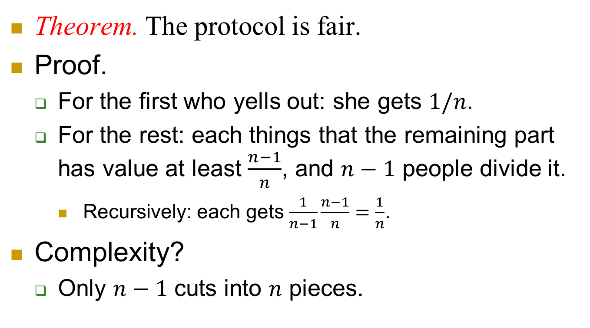
Fairness and complexity
Theorem. The protocol is fair.
Proof.
  For the first who yells out: she gets $1/n$.
  For the rest: each things that the remaining part has value at least $\frac{n−1}{n}$, and $n−1$ people divide it.
    Recursively: each gets $\frac{1}{n−1}\frac{n−1}{n}=\frac{1}{n}$.
Complexity?
  Only $n−1$ cuts into $n$ pieces.

Slide 18
Resource allocation
The previous example of cake cutting is to allocate divisible resource.
Similar examples include time, memory on a computer, etc.
But sometimes resources are indivisible.
  Pictures, cars, … in heritage.
  Baby, house, … in a divorce

Slide 19
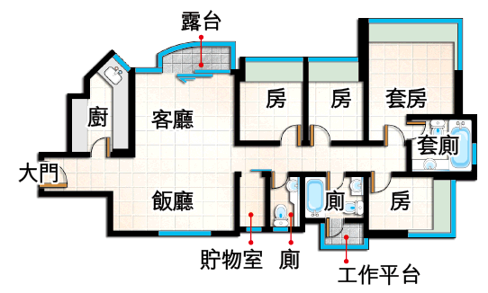
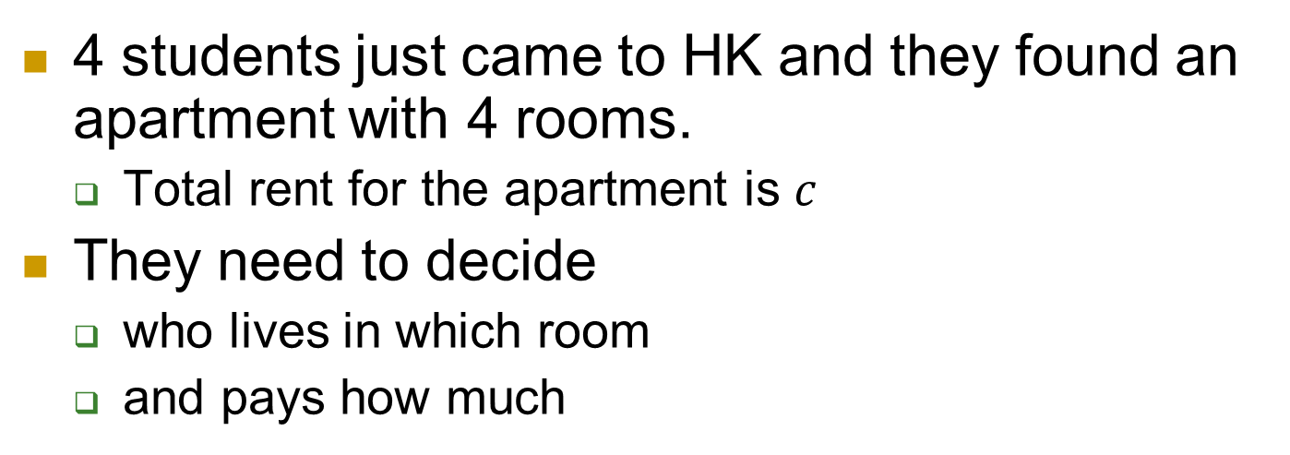
Assignment
4 students just came to HK and they found an apartment with 4 rooms.
  Total rent for the apartment is $c$
They need to decide
  who lives in which room
  and pays how much

Slide 20
Assignment
Note that each person has a different valuation of the four rooms.
  Someone prefers a large room with private bathroom.
  Someone prefers small room with low price.

Slide 21









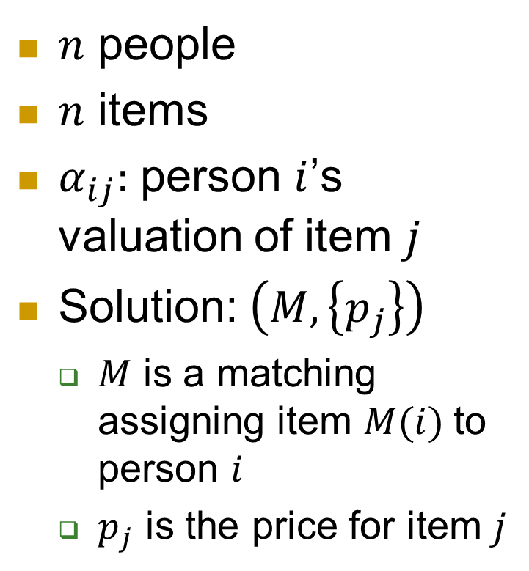

General setup
$$\left\{v_{ij}\right\}$$
$n$ people
$n$ items
$α_{ij}:$ person $i$’s valuation of item $j$
Solution: $\left(M,\left\{p_{j}\right\}\right)$
  $M$ is a matching assigning item $M(i)$to person $i$
  $p_{j}$ is the price for item $j$
$$\left\{p_{j}\right\}$$

Slide 22
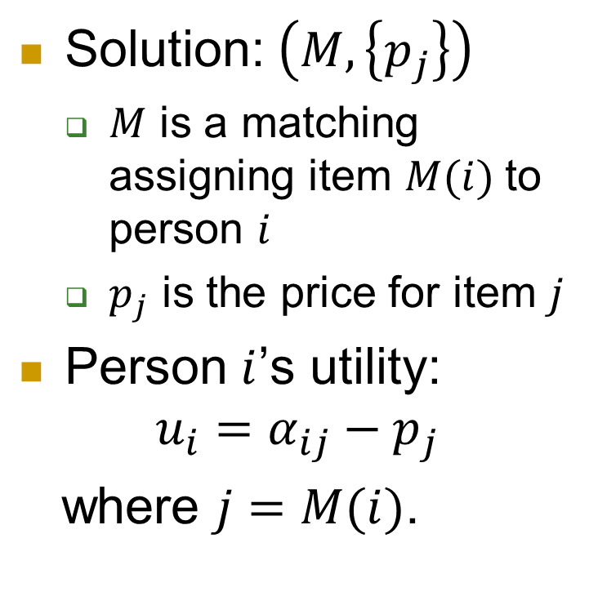

General setup
$$\left\{α_{ij}\right\}$$
Solution: $\left(M,\left\{p_{j}\right\}\right)$
  $M$ is a matching assigning item $M(i)$to person $i$
  $p_{j}$ is the price for item $j$
Person $i$’s utility:
$$u_{i}=α_{ij}−p_{j}$$
where $j=M(i)$.
$$\left\{p_{j}\right\}$$

Slide 23
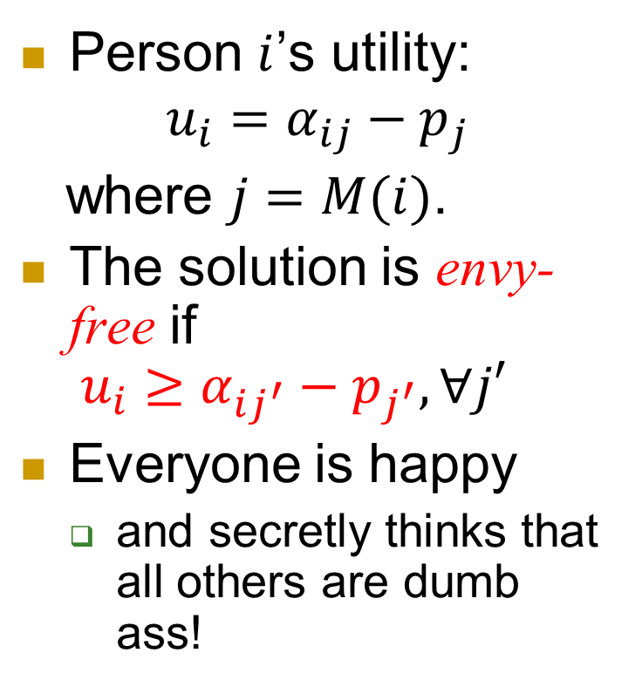
General setup
$$\left\{α_{ij}\right\}$$
Person $i$’s utility:
$$u_{i}=α_{ij}−p_{j}$$
where $j=M(i)$.
The solution is envy-free if
$u_{i}≥α_{ij^{′}}−p_{j^{′}}, ∀j′$
Everyone is happy
  and secretly thinks that all others are dumb ass!
$$\left\{p_{j}\right\}$$

Slide 24
General setup
$$\left\{α_{ij}\right\}$$
Question 1: Does there exist an envy-free solution?
  Sounds too good to be true.
Question 2: If there exists envy-free solutions, can we find one efficiently?
  Seems pretty hard…
$$\left\{p_{j}\right\}$$

Slide 25
General setup
$$\left\{α_{ij}\right\}$$
Question 1: Does there exist an envy-free solution?
  Yes!
Question 2: If there exists envy-free solutions, can we find one efficiently?
  Yes!
$$\left\{p_{j}\right\}$$

Slide 26
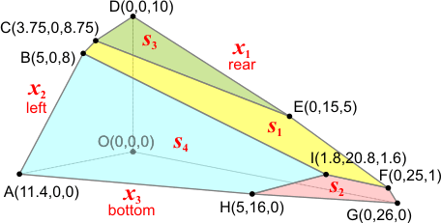

General setup
$$\left\{α_{ij}\right\}$$
Question 1: Does there exist an envy-free solution?
  Yes!
Question 2: If there exists envy-free solutions, can we find one efficiently?
  Yes!
$$\left\{p_{j}\right\}$$
That’s the power of linear program!

Slide 27
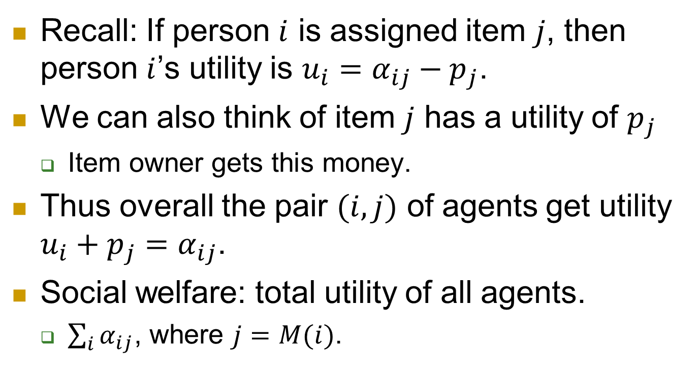
Item owner’s utility
Recall: If person $i$ is assigned item $j$, then person $i$’s utility is $u_{i}=α_{ij}−p_{j}$.
We can also think of item $j$ has a utility of $p_{j}$
  Item owner gets this money.
Thus overall the pair $(i,j)$ of agents get utility $u_{i}+p_{j}=α_{ij}$.
Social welfare: total utility of all agents.
  $\sum_{i}{α_{ij}}$, where $j=M(i)$.

Slide 28
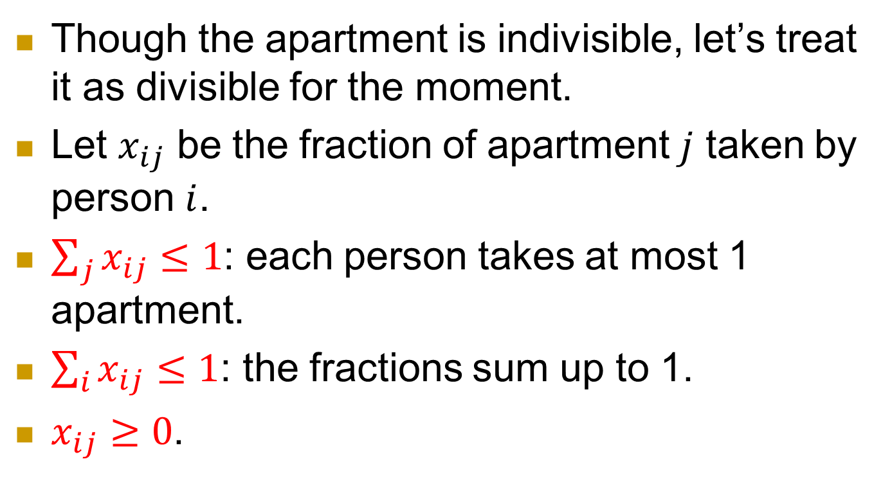
LP
Though the apartment is indivisible, let’s treat it as divisible for the moment.
Let $x_{ij}$ be the fraction of apartment $j$ taken by person $i$.
$\sum_{j}{x_{ij}}≤1$: each person takes at most 1 apartment.
$\sum_{i}{x_{ij}}≤1$: the fractions sum up to 1.
$x_{ij}≥0$.

Slide 29
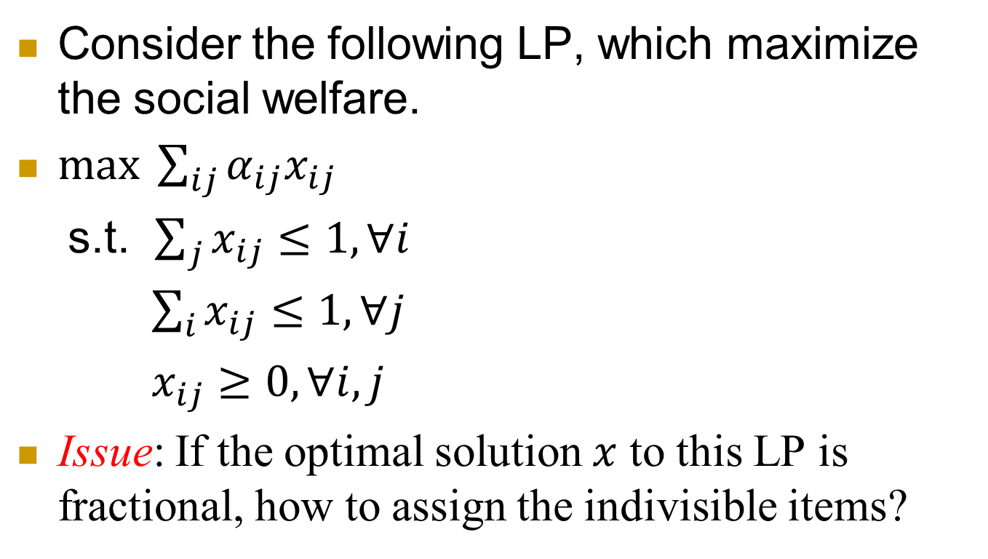
LP
Consider the following LP, which maximize the social welfare.
$\max{ \sum_{ij}{α_{ij}x_{ij}}}$
s.t. $\sum_{j}{x_{ij}}≤1, ∀i$
$\sum_{i}{x_{ij}}≤1, ∀j$
$x_{ij}≥0, ∀i,j$
Issue: If the optimal solution $x$ to this LP is fractional, how to assign the indivisible items?

Slide 30
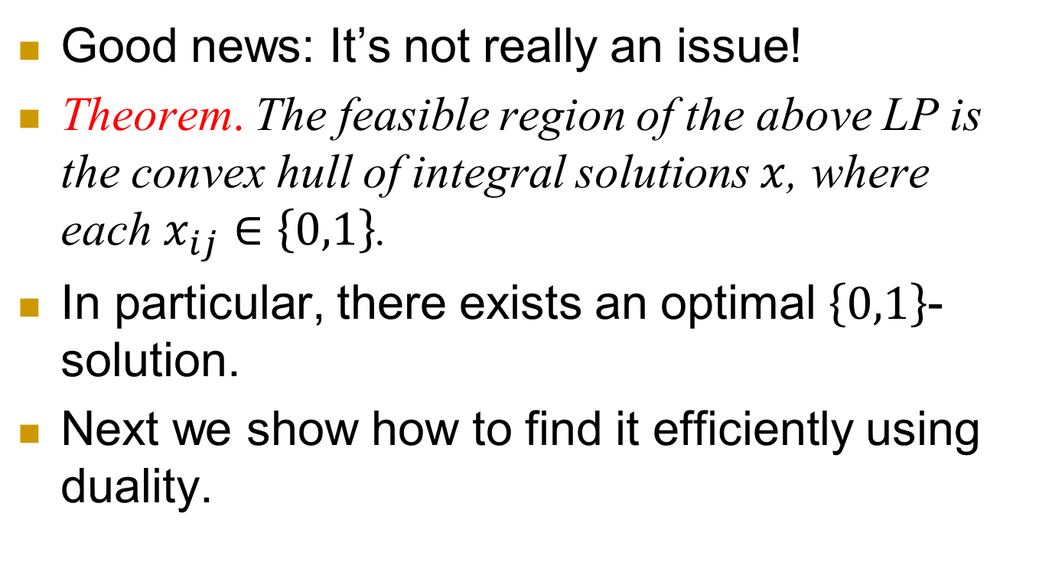
Surprise
Good news: It’s not really an issue!
Theorem. The feasible region of the above LP is the convex hull of integral solutions $x$, where each $x_{ij}∈\left\{0,1\right\}$.
In particular, there exists an optimal $\left\{0,1\right\}$-solution.
Next we show how to find it efficiently using duality.

Slide 31
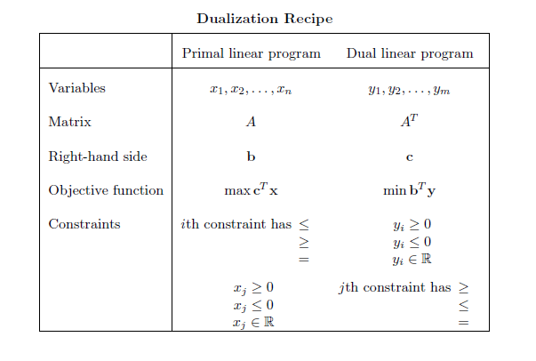
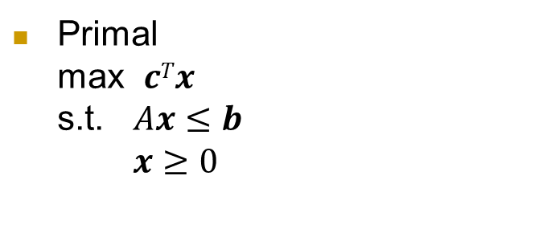

Primal
max $cTx$
s.t. $Ax≤b$
$x≥0$
Dual
min $bTy$
s.t. $ATy≥c$
$y≥0$

Slide 32
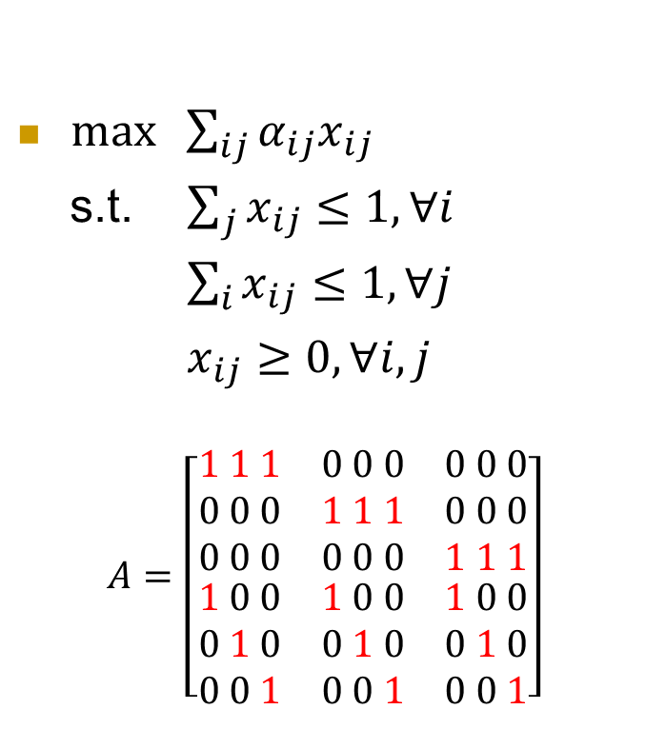
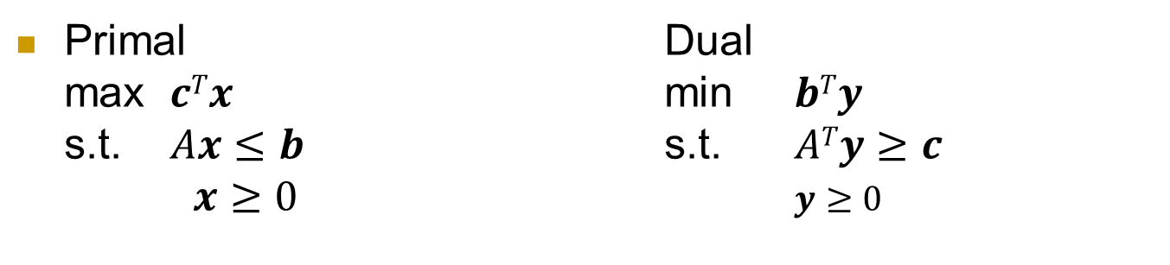
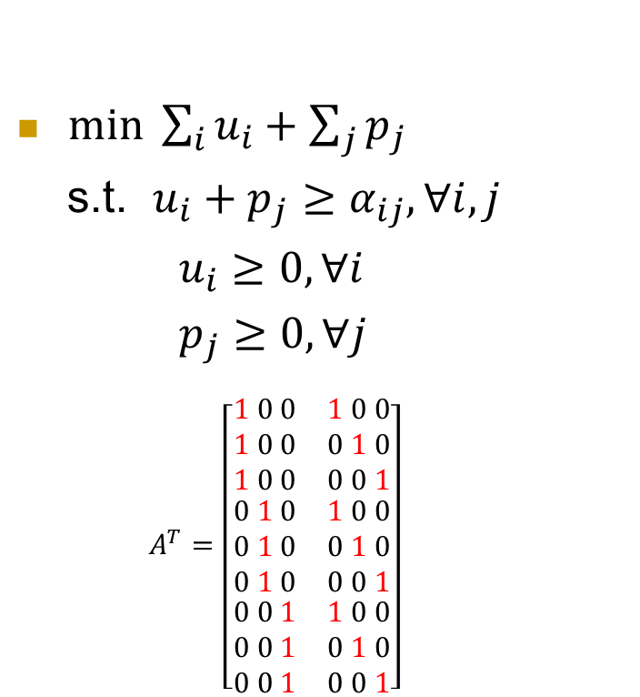
Primal Dual
max $cTx$ min $bTy$
s.t. $Ax≤b$ s.t. $ATy≥c$
$x≥0$ $y≥0$
$\max{ \sum_{ij}{α_{ij}x_{ij}}}$
s.t. $\sum_{j}{x_{ij}}≤1, ∀i$
$\sum_{i}{x_{ij}}≤1, ∀j$
$x_{ij}≥0, ∀i,j$
$$A=\left[\begin{aligned}\begin{matrix}1 1 1 & 0 0 0 & 0 0 0 \\ 0 0 0 & 1 1 1 & 0 0 0 \\ 0 0 0 & 0 0 0 & 1 1 1\end{matrix} \\ \begin{matrix}1 0 0 & 1 0 0 & 1 0 0 \\ 0 1 0 & 0 1 0 & 0 1 0 \\ 0 0 1 & 0 0 1 & 0 0 1\end{matrix}\end{aligned}\right]$$
$\min{ \sum_{i}{u_{i}}+\sum_{j}{p_{j}}}$
s.t. $u_{i}+p_{j}≥α_{ij}, ∀i,j$
$u_{i}≥0, ∀i$
$p_{j}≥0, ∀j$
$$A^{T}=\left[\begin{matrix}\begin{aligned}1 0 0 \\ 1 0 0 \\ 1 0 0\end{aligned} & \begin{aligned}1 0 0 \\ 0 1 0 \\ 0 0 1\end{aligned} \\ \begin{aligned}0 1 0 \\ 0 1 0 \\ 0 1 0\end{aligned} & \begin{aligned}1 0 0 \\ 0 1 0 \\ 0 0 1\end{aligned} \\ \begin{aligned}0 0 1 \\ 0 0 1 \\ 0 0 1\end{aligned} & \begin{aligned}1 0 0 \\ 0 1 0 \\ 0 0 1\end{aligned}\end{matrix}\right]$$

Slide 33
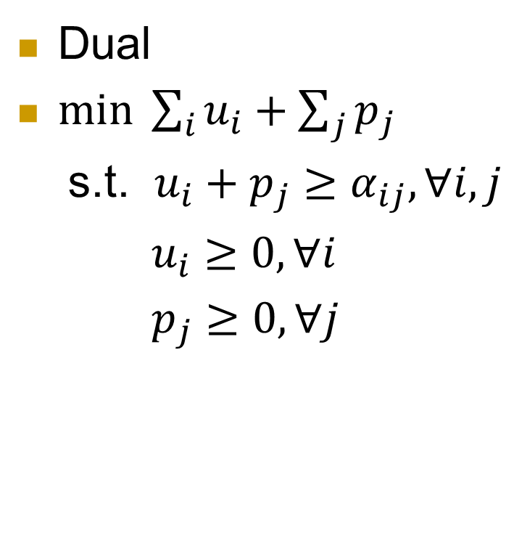

dual
Primal
$\max{ \sum_{ij}{α_{ij}x_{ij}}}$
s.t. $\sum_{j}{x_{ij}}≤1, ∀i$
$\sum_{i}{x_{ij}}≤1, ∀j$
$x_{ij}≥0, ∀i,j$
Dual
$\min{ \sum_{i}{u_{i}}+\sum_{j}{p_{j}}}$
s.t. $u_{i}+p_{j}≥α_{ij}, ∀i,j$
$u_{i}≥0, ∀i$
$p_{j}≥0, ∀j$

Slide 34
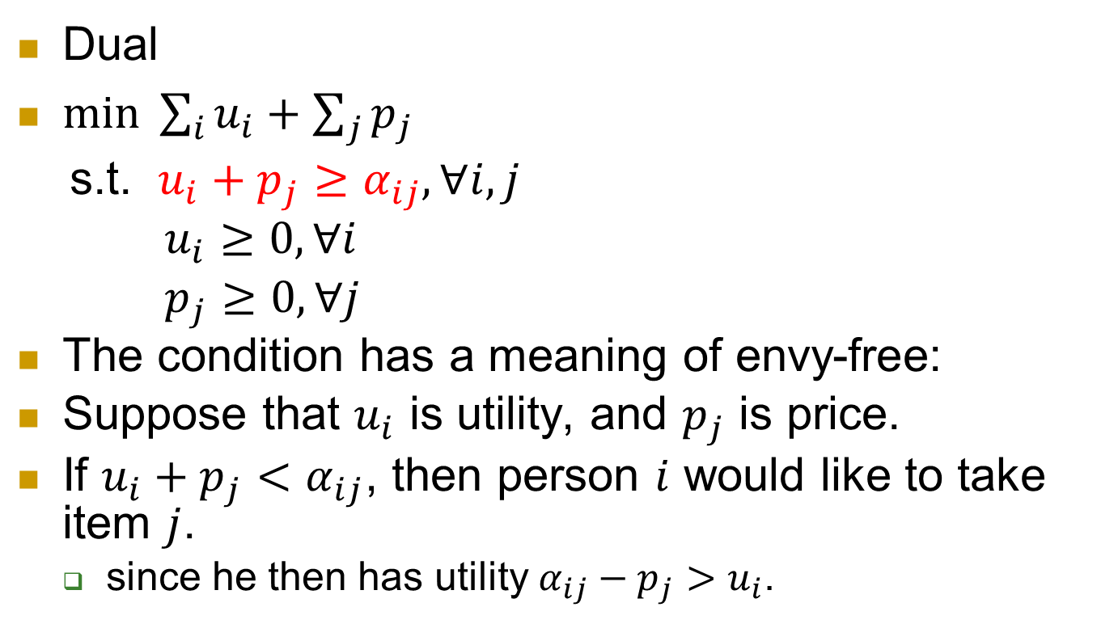
Dual
$\min{ \sum_{i}{u_{i}}+\sum_{j}{p_{j}}}$
s.t. $u_{i}+p_{j}≥α_{ij}, ∀i,j$
$u_{i}≥0, ∀i$
$p_{j}≥0, ∀j$
The condition has a meaning of envy-free:
Suppose that $u_{i}$ is utility, and $p_{j}$ is price.
If $u_{i}+p_{j}<α_{ij}$, then person $i$ would like to take item $j$.
  since he then has utility $α_{ij}−p_{j}>u_{i}$.

Slide 35
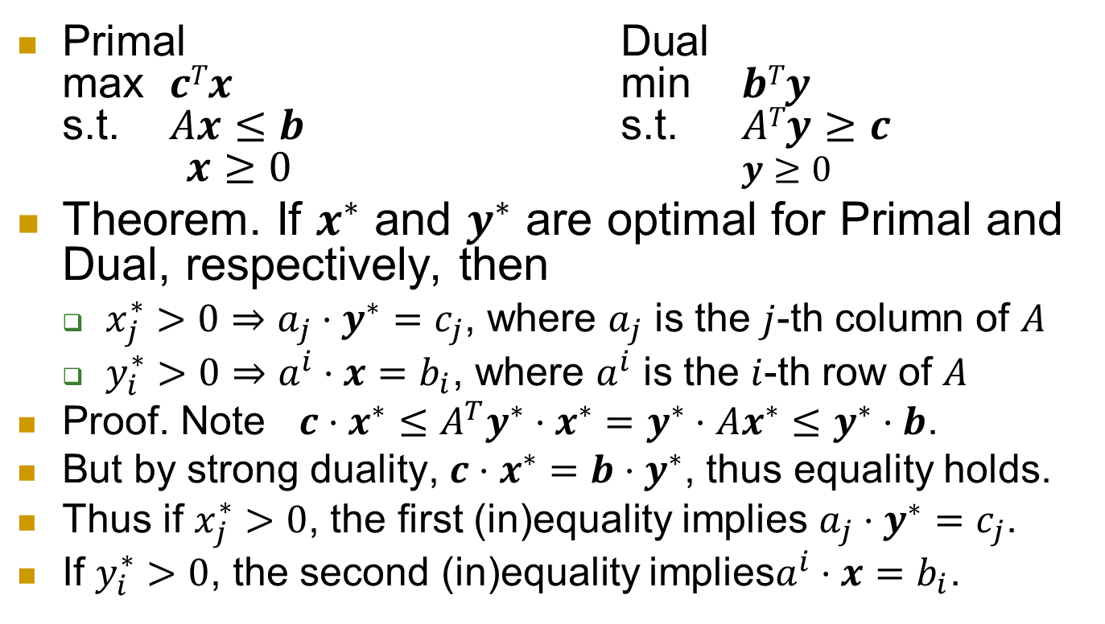
Complementary slackness
Primal Dual
max $cTx$ min $bTy$
s.t. $Ax≤b$ s.t. $ATy≥c$
$x≥0$ $y≥0$
Theorem. If $x^{∗}$ and $y^{∗}$ are optimal for Primal and Dual, respectively, then
  $x_{j}^{∗}>0⇒a_{j}⋅y^{∗}=c_{j}$, where $a_{j}$ is the $j$-th column of $A$
  $y_{i}^{∗}>0⇒a^{i}⋅x=b_{i}$, where $a^{i}$ is the $i$-th row of $A$
  Proof. Note $c⋅x^{∗}≤A^{T}y^{∗}⋅x^{∗}=y^{∗}⋅Ax^{∗}≤y^{∗}⋅b$.
  But by strong duality, $c⋅x^{∗}=b⋅y^{∗}$, thus equality holds.
  Thus if $x_{j}^{∗}>0$, the first (in)equality implies $a_{j}⋅y^{∗}=c_{j}$.
  If $y_{i}^{∗}>0$, the second (in)equality implies$a^{i}⋅x=b_{i}$.

Slide 36
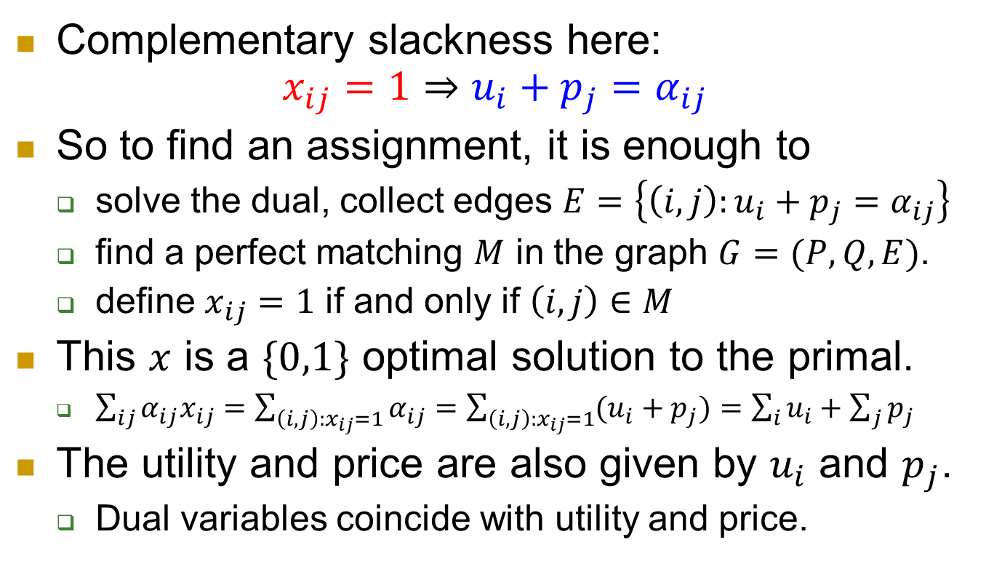
algorithm
Complementary slackness here:
$x_{ij}=1⇒u_{i}+p_{j}=α_{ij}$
So to find an assignment, it is enough to
  solve the dual, collect edges $E=\left\{\left(i,j\right):u_{i}+p_{j}=α_{ij}\right\}$
  find a perfect matching $M$ in the graph $G=(P,Q,E)$.
  define $x_{ij}=1$ if and only if $\left(i,j\right)∈M$
This $x$ is a $\{0,1\}$ optimal solution to the primal.
  $\sum_{ij}{α_{ij}x_{ij}}=\sum_{\left(i,j\right):x_{ij}=1}{α_{ij}}=\sum_{\left(i,j\right):x_{ij}=1}{(u_{i}+p_{j})}=\sum_{i}{u_{i}}+\sum_{j}{p_{j}}$
The utility and price are also given by $u_{i}$ and $p_{j}$.
  Dual variables coincide with utility and price.

Slide 37
Summary
Resource allocation naturally arises in many applications.
Main goal is to achieve high social welfare
as well as fairness.
Examples:
  Divisible: cake cutting
  Indivisible: assignment game

