Slide 1
CMSC5706 Topics in Theoretical Computer Science
Week 5: NP-completeness
Instructor: Shengyu Zhang

Slide 2
Tractable
While we have introduced many problems with polynomial-time algorithms…
…not all problems enjoy fast computation.
Among those “hard” problems, an important class is NP.

Slide 3
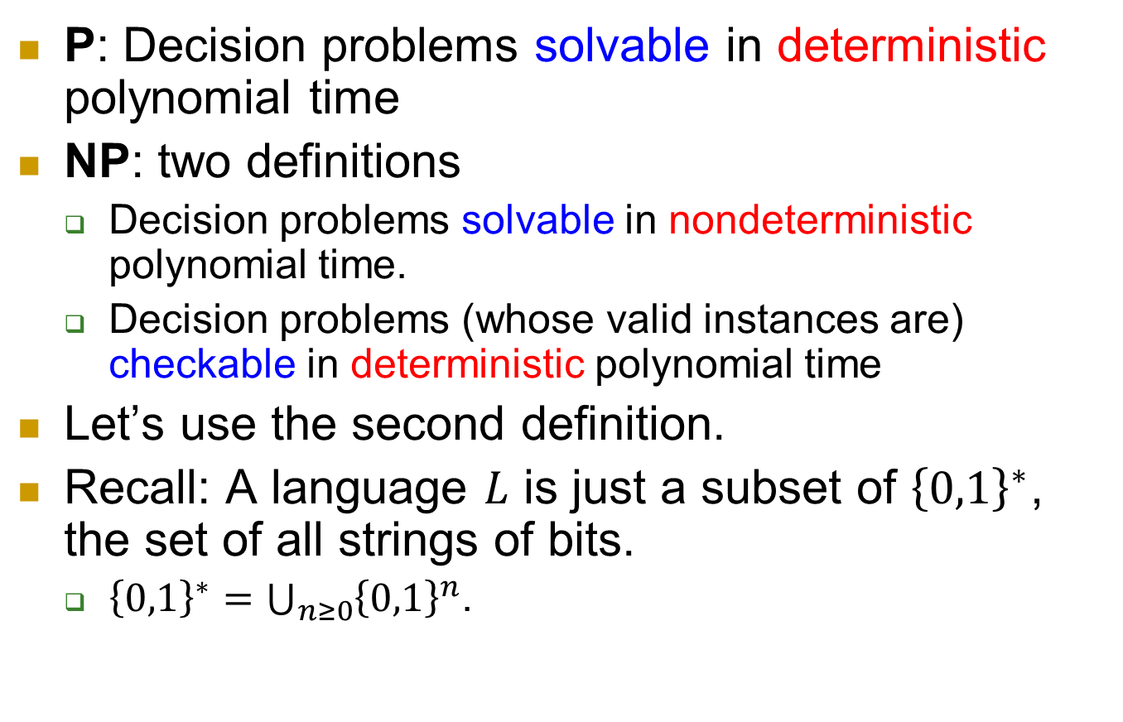
P, NP
P: Decision problems solvable in deterministic polynomial time
NP: two definitions
  Decision problems solvable in nondeterministic polynomial time.
  Decision problems (whose valid instances are) checkable in deterministic polynomial time
Let’s use the second definition.
Recall: A language $L$ is just a subset of ${\left\{0,1\right\}}^{∗}$, the set of all strings of bits.
  ${\left\{0,1\right\}}^{∗}=\bigcup_{n≥0}{{\left\{0,1\right\}}^{n}}$.

Slide 4
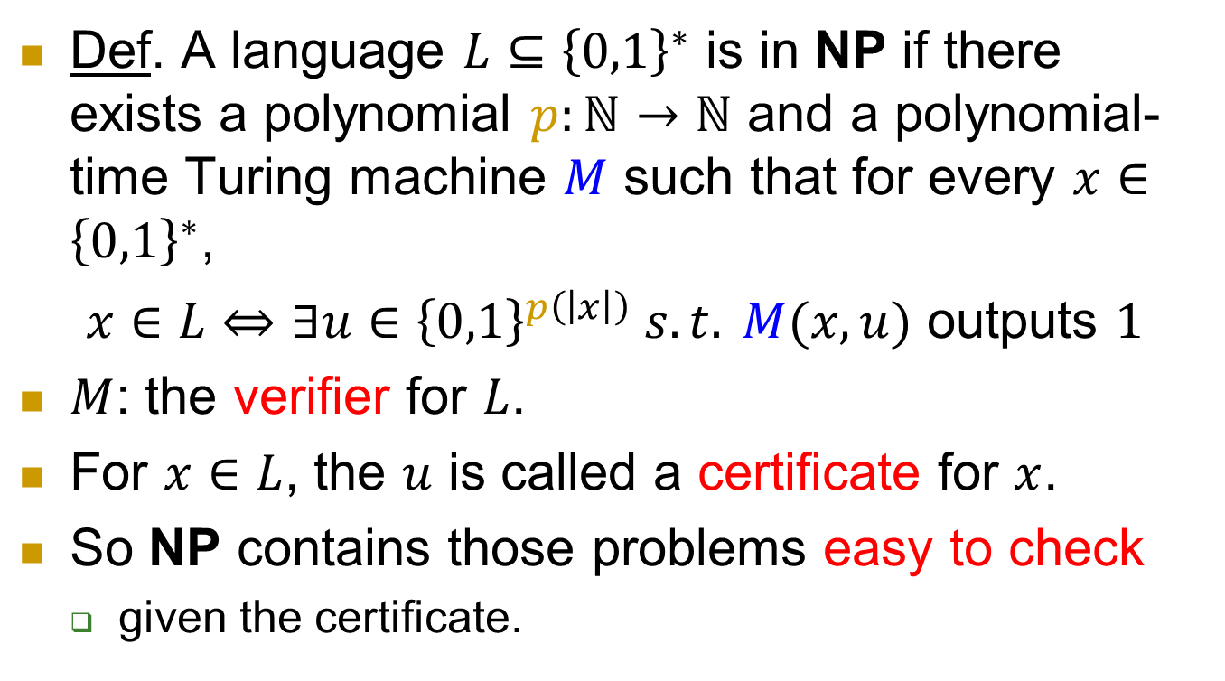
Formal definition of NP
Def. A language $L⊆{\left\{0,1\right\}}^{∗}$ is in NP if there exists a polynomial $p:ℕ→ℕ$ and a polynomial-time Turing machine $M$ such that for every $x∈{\left\{0,1\right\}}^{∗}$,
$x∈L⇔∃u∈{\left\{0,1\right\}}^{p\left(\left|x\right|\right)} s.t. M(x,u)$ outputs $1$
$M$: the verifier for $L$.
For $x∈L$, the $u$ is called a certificate for $x$.
So NP contains those problems easy to check
  given the certificate.

Slide 5
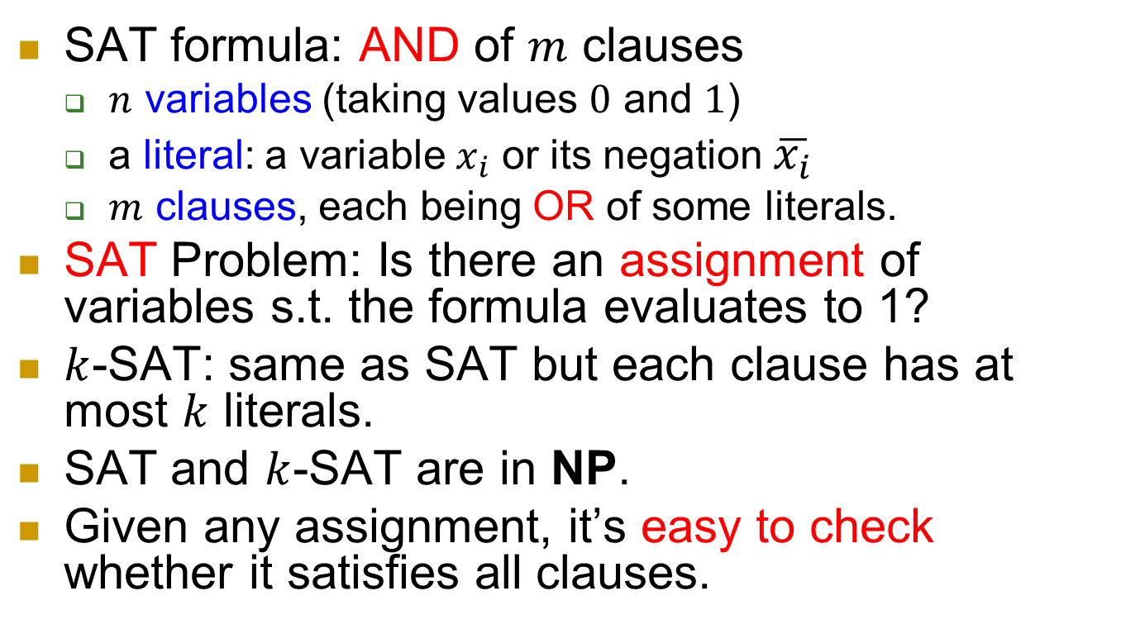

SAT and $k$-SAT
  SAT formula: AND of $m$ clauses
  $n$ variables (taking values $0$ and $1$)
  a literal: a variable $x_{i}$ or its negation $\overline{x_{i}}$
  $m$ clauses, each being OR of some literals.
SAT Problem: Is there an assignment of variables s.t. the formula evaluates to 1?
$k$-SAT: same as SAT but each clause has at most $k$ literals.
SAT and $k$-SAT are in NP.
Given any assignment, it’s easy to check whether it satisfies all clauses.

Slide 6
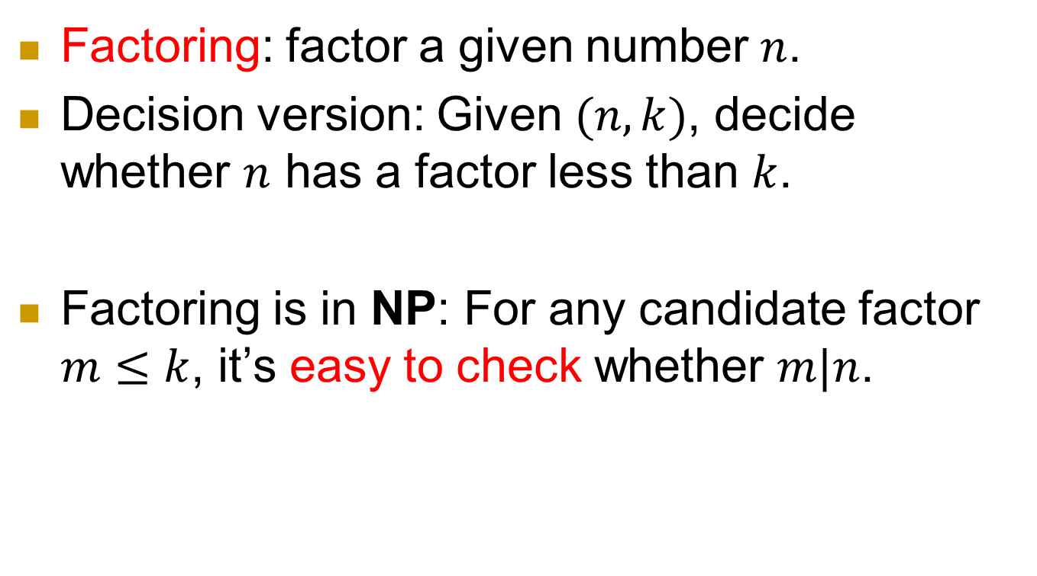
Examples of NP problems
Factoring: factor a given number $n$.
Decision version: Given $(n,k)$, decide whether $n$ has a factor less than $k$.
Factoring is in NP: For any candidate factor $m≤k$, it’s easy to check whether $m|n$.

Slide 7
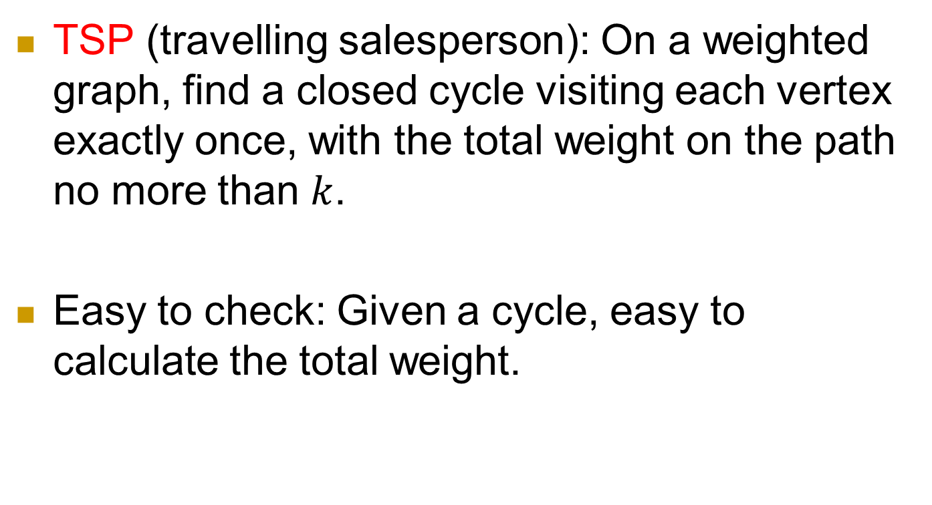
Examples of NP problems
TSP (travelling salesperson): On a weighted graph, find a closed cycle visiting each vertex exactly once, with the total weight on the path no more than $k$.
Easy to check: Given a cycle, easy to calculate the total weight.

Slide 8





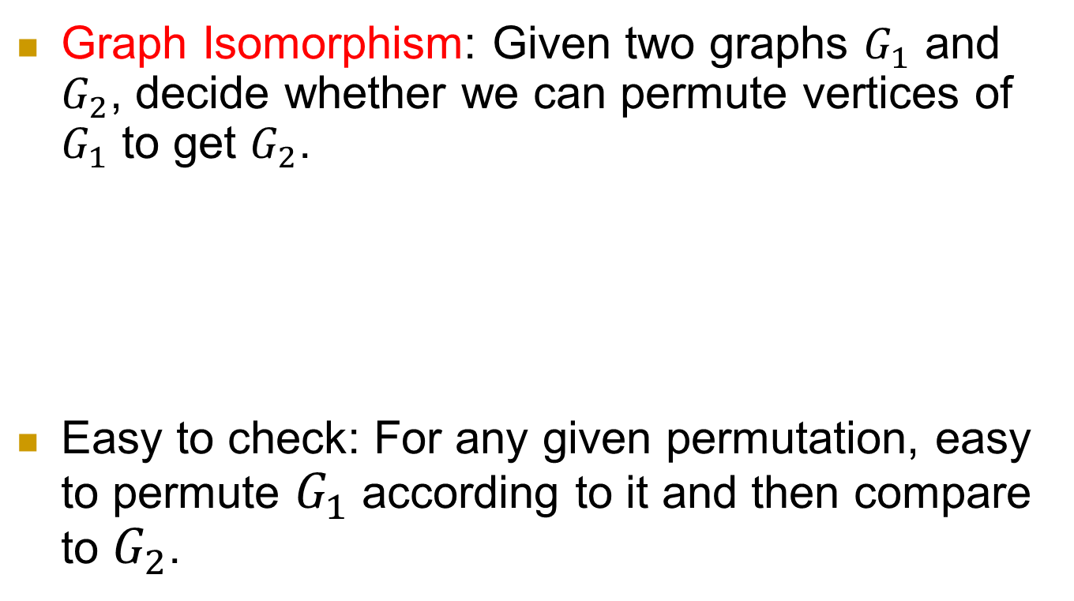






Graph Isomorphism: Given two graphs $G_{1}$ and $G_{2}$, decide whether we can permute vertices of $G_{1}$ to get $G_{2}$.
Easy to check: For any given permutation, easy to permute $G_{1}$ according to it and then compare to $G_{2}$.
$$1$$
$$2$$
$$1$$
$$2$$
$$1→2, 2→1 \\ 3→3, 4→4$$
$$3$$
$$4$$
$$3$$
$$4$$
$$G_{1}$$
$$G_{2}$$

Slide 9
Question of P vs. NP
Is P = NP?
The most famous (and notoriously hard) question in computer science.
  Staggering philosophical and practical implications
  Withstood a great deal of attacks
Clay Mathematics Institute recognized it as one of seven great mathematical challenges of the millennium. US$1M.
  Want to get rich (and famous)? Here is a “simple” way!

Slide 10
The P vs. NP question: intuition
Is producing a solution essentially harder than checking a solution?
  Coming up with a proof vs. verifying a proof.
  Composing a song vs. appreciating a song.
  Cooking good food vs. recognizing good food
  …

Slide 11
What if P = NP?
The world becomes a Utopia.
  Mathematicians are replaced by efficient theorem-discovering machines.
  It becomes easy to come up with the simplest theory to explain known data
  …
But at the same time,
  Many cryptosystems are insecure.

Slide 12
Completeness
NP
[Cook-Levin] There is a class of NP problems,
such that
solve any of them in polynomial time,
⇒ solve all NP problems in polynomial time.
P

Slide 13
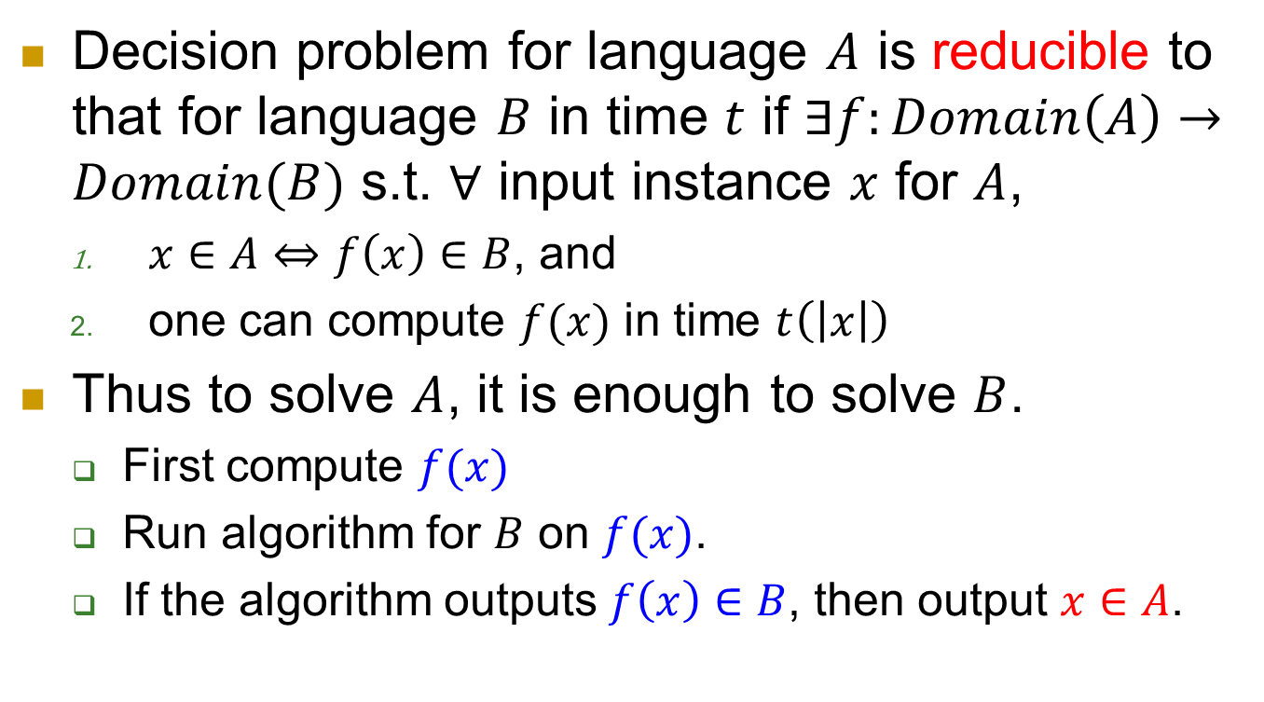
Reduction and completeness
Decision problem for language $A$ is reducible to that for language $B$ in time $t$ if $∃f:Domain\left(A\right)→Domain(B)$ s.t. $∀$ input instance $x$ for $A$,
  $x∈A⇔f\left(x\right)∈B$, and
  one can compute $f(x)$ in time $t\left(\left|x\right|\right)$
Thus to solve $A$, it is enough to solve $B$.
  First compute $f(x)$
  Run algorithm for $B$ on $f(x)$.
  If the algorithm outputs $f\left(x\right)∈B$, then output $x∈A$.

Slide 14
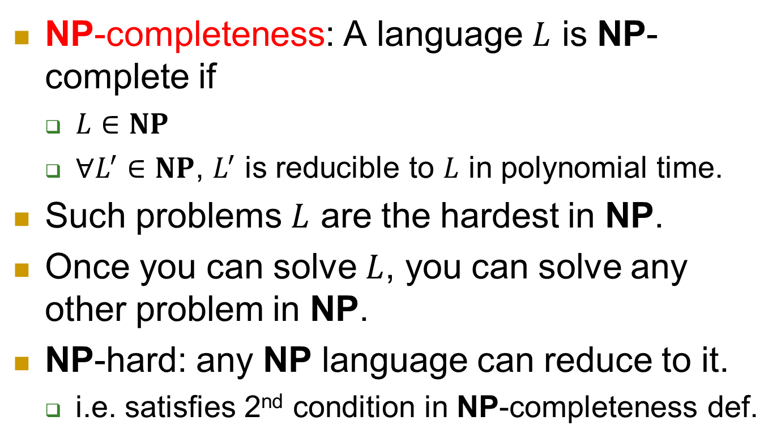
NP-completeness
NP-completeness: A language $L$ is NP-complete if
  $L∈NP$
  $∀L^{′}∈NP$, $L^{′}$ is reducible to $L$ in polynomial time.
Such problems $L$ are the hardest in NP.
Once you can solve $L$, you can solve any other problem in NP.
NP-hard: any NP language can reduce to it.
  i.e. satisfies 2nd condition in NP-completeness def.

Slide 15
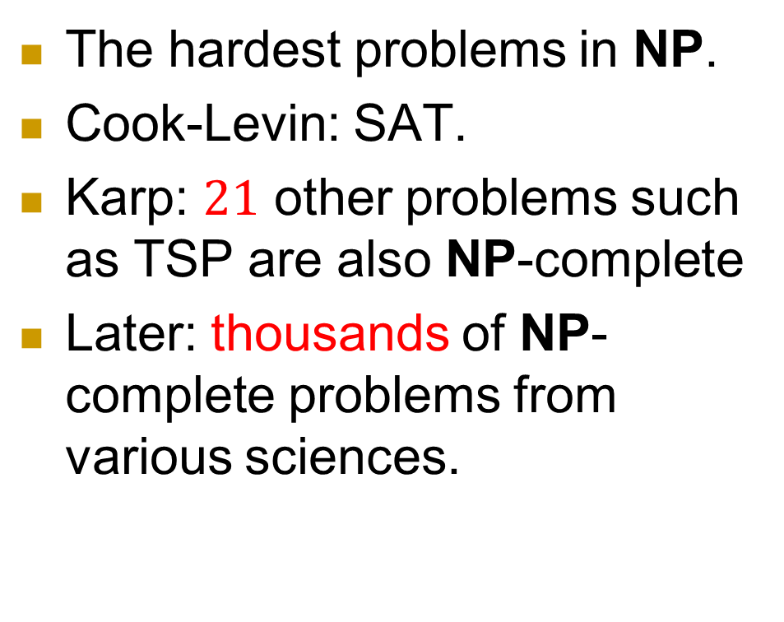
Completeness
NP
NP-
Complete
The hardest problems in NP.
Cook-Levin: SAT.
Karp: $21$ other problems such as TSP are also NP-complete
Later: thousands of NP-complete problems from various sciences.
P

Slide 16
Meanings of NP-completeness
Reduce the number of questions without increasing the number of answers.
Huge impacts on almost all other sciences such as physics, chemistry, biology, …
  Now given a computational problem in NP, the first step is usually to see whether it’s in P or NPC.
“The biggest export of Theoretical Computer Science.”

Slide 17
SAT
Clique
Subset Sum
TSP
Vertex Cover
Integer Programming
NP
NP-
Complete
Not known to be in P or NP-complete:
Factoring
Graph Isomorphism
Nash Equilibrium
Local Search
P
Shortest Path
MST
Maximum Flow
Maximum Matching
PRIMES
Linear Programming

Slide 18
The 1st NP-complete problem: 3-SAT
Any NP problem can be verified in polynomial time, by definition.
Turn the verification algorithm into a formula which checks every step of computation.
Note that in either circuit definition or Turing machine definition, computation is local.
  The change of configuration is only at several adjacent locations.

Slide 19
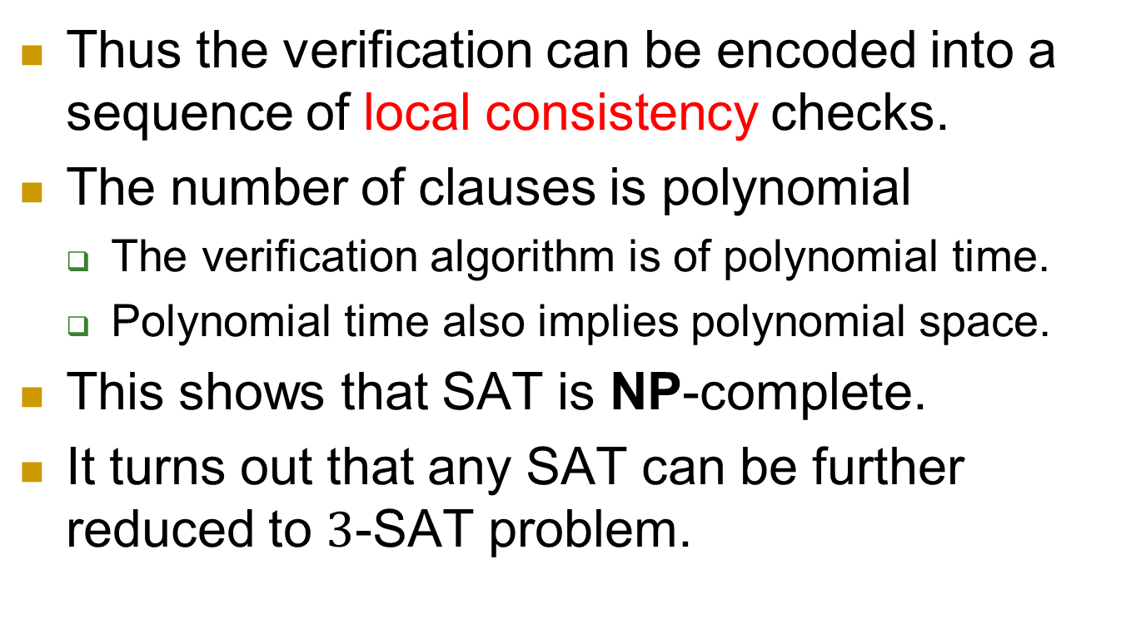
Thus the verification can be encoded into a sequence of local consistency checks.
The number of clauses is polynomial
  The verification algorithm is of polynomial time.
  Polynomial time also implies polynomial space.
This shows that SAT is NP-complete.
It turns out that any SAT can be further reduced to $3$-SAT problem.

Slide 20
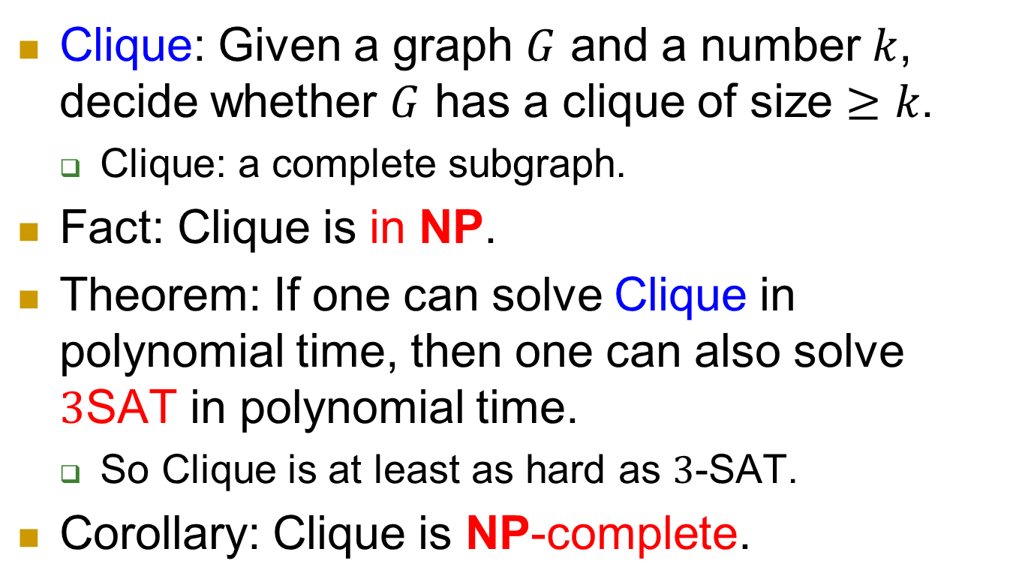
NP-complete problem 1: Clique
Clique: Given a graph $G$ and a number $k$, decide whether $G$ has a clique of size $≥k$.
  Clique: a complete subgraph.
Fact: Clique is in NP.
Theorem: If one can solve Clique in polynomial time, then one can also solve $3$SAT in polynomial time.
  So Clique is at least as hard as $3$-SAT.
Corollary: Clique is NP-complete.

Slide 21
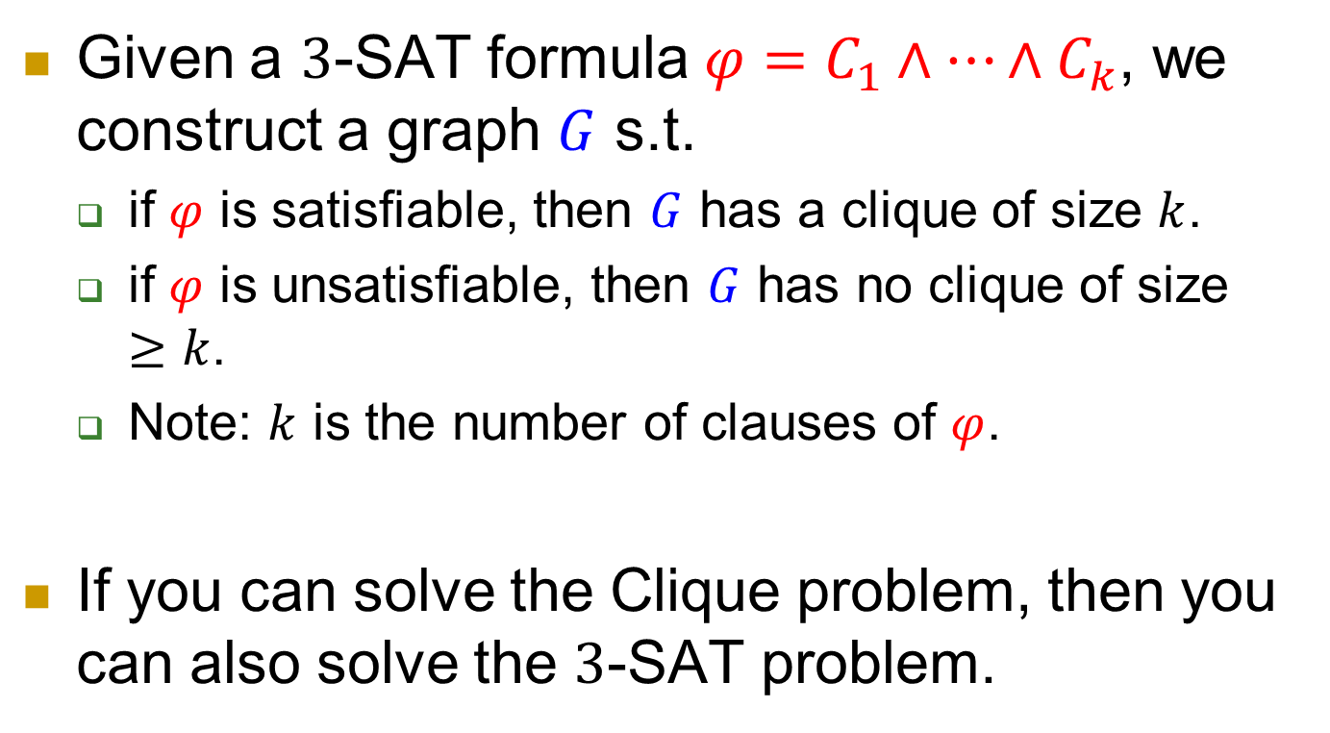
Approach: reduction
Given a $3$-SAT formula $φ=C_{1}∧…∧C_{k}$, we construct a graph $G$ s.t.
  if $φ$ is satisfiable, then $G$ has a clique of size $k$.
  if $φ$ is unsatisfiable, then $G$ has no clique of size $≥k$.
  Note: $k$ is the number of clauses of $φ$.
If you can solve the Clique problem, then you can also solve the $3$-SAT problem.

Slide 22





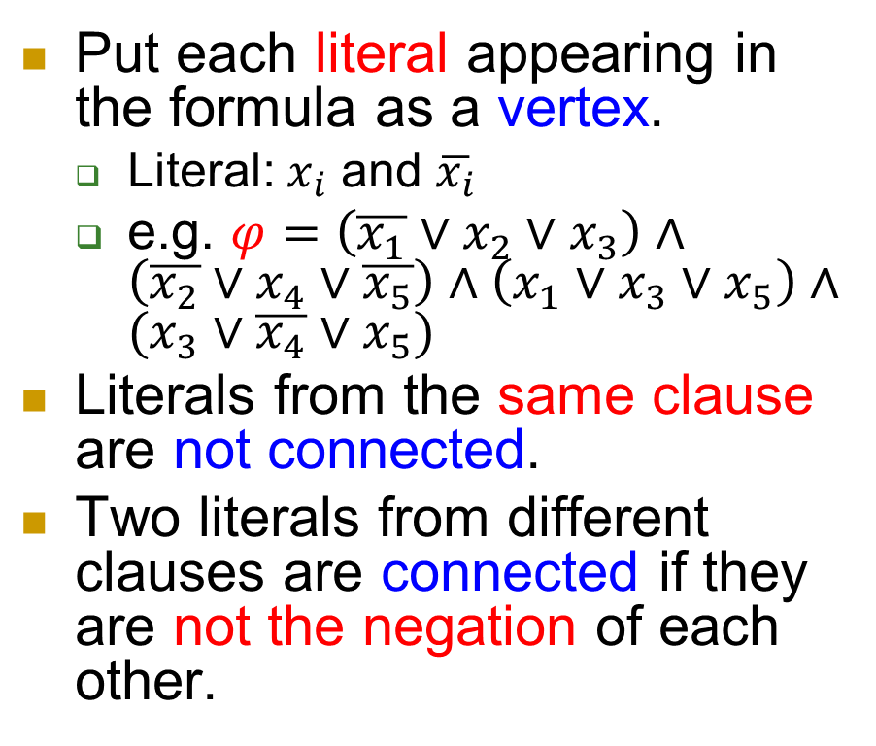







Construction
Put each literal appearing in the formula as a vertex.
  Literal: $x_{i}$ and $\overline{x_{i}}$
  e.g. $φ=\left(\overline{x_{1}}∨x_{2}∨x_{3}\right)∧\left(\overline{x_{2}}∨x_{4}∨\overline{x_{5}}\right)∧\left(x_{1}∨x_{3}∨x_{5}\right)∧(x_{3}∨\overline{x_{4}}∨x_{5})$
Literals from the same clause are not connected.
Two literals from different clauses are connected if they are not the negation of each other.
$$\overline{x_{1}}$$
$$\overline{x_{2}}$$
$$x_{2}$$
$$x_{4}$$
$$x_{3}$$
$$\overline{x_{5}}$$
$$x_{1}$$
$$x_{5}$$
$$x_{3}$$
$$\overline{x_{4}}$$
$$x_{5}$$
$$x_{3}$$

Slide 23
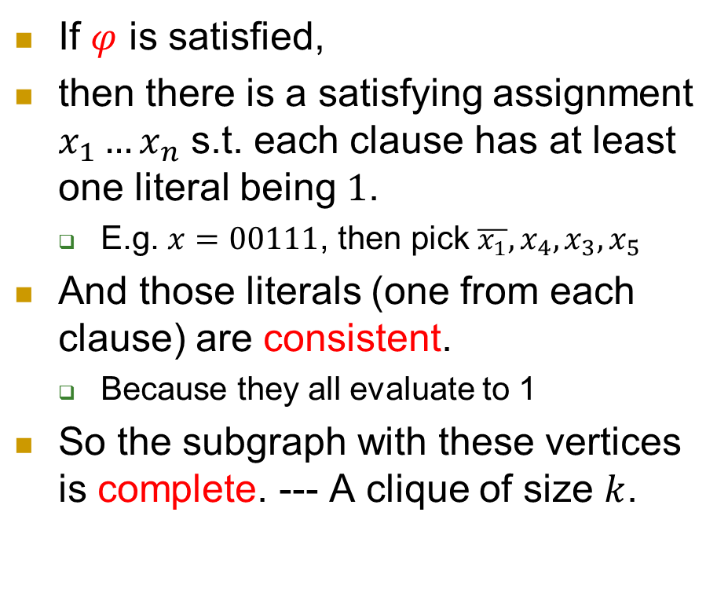

$φ$ is satisfied $⇒G$ has a $k$-clique
If $φ$ is satisfied,
then there is a satisfying assignment $x_{1}…x_{n}$ s.t. each clause has at least one literal being $1$.
  E.g. $x=00111$, then pick $\overline{x_{1}},x_{4},x_{3},x_{5}$
And those literals (one from each clause) are consistent.
  Because they all evaluate to 1
So the subgraph with these vertices is complete. --- A clique of size $k$.
$$\overline{x_{1}}$$
$$\overline{x_{2}}$$
$$x_{2}$$
$$x_{4}$$
$$x_{3}$$
$$\overline{x_{5}}$$
$$x_{1}$$
$$x_{5}$$
$$x_{3}$$
$$\overline{x_{4}}$$
$$x_{5}$$
$$x_{3}$$

Slide 24
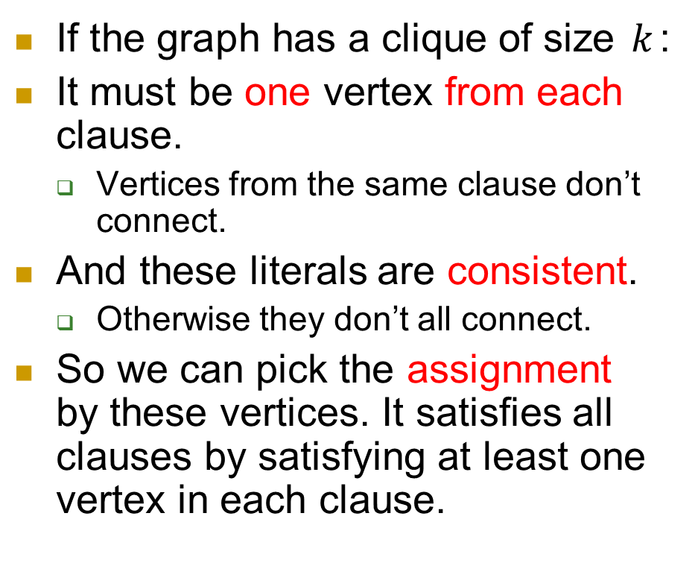

$G$ has a $k$-clique ⇒ $φ$ is satisfied
If the graph has a clique of size $k$:
It must be one vertex from each clause.
  Vertices from the same clause don’t connect.
And these literals are consistent.
  Otherwise they don’t all connect.
So we can pick the assignment by these vertices. It satisfies all clauses by satisfying at least one vertex in each clause.
$$\overline{x_{1}}$$
$$\overline{x_{2}}$$
$$x_{2}$$
$$x_{4}$$
$$x_{3}$$
$$\overline{x_{5}}$$
$$x_{1}$$
$$x_{5}$$
$$x_{3}$$
$$\overline{x_{4}}$$
$$x_{5}$$
$$x_{3}$$

Slide 25
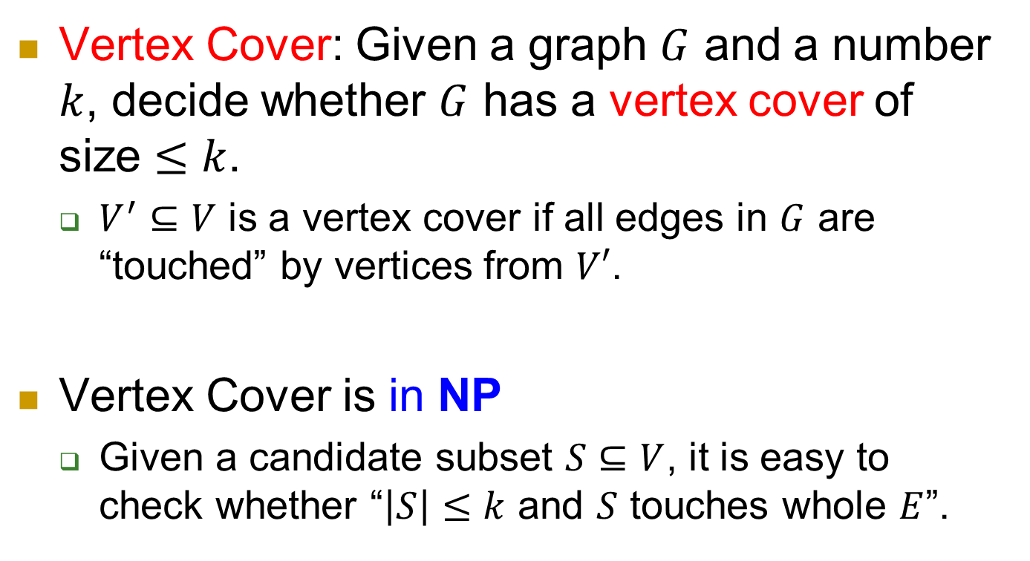
NP-complete problem 2: Vertex Cover
Vertex Cover: Given a graph $G$ and a number $k$, decide whether $G$ has a vertex cover of size $≤k$.
  $V^{′}⊆V$ is a vertex cover if all edges in $G$ are “touched” by vertices from $V′$.
Vertex Cover is in NP
  Given a candidate subset $S⊆V$, it is easy to check whether “$\left|S\right|≤k$ and $S$ touches whole $E$”.

Slide 26
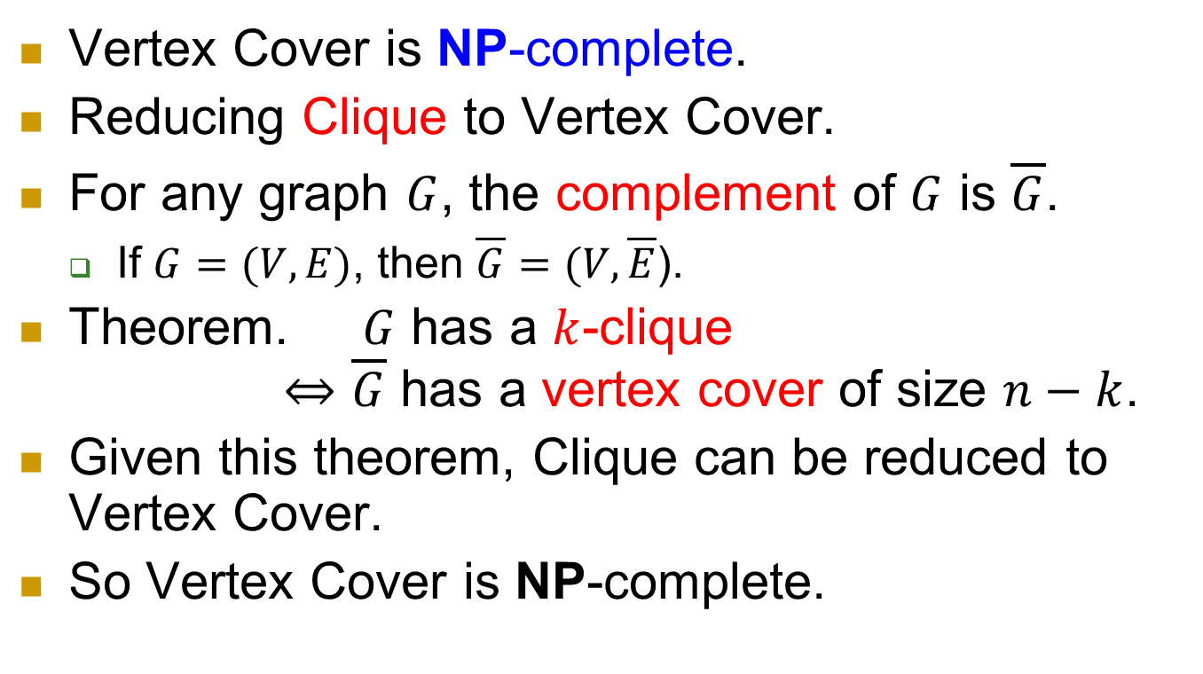
NP-complete
Vertex Cover is NP-complete.
Reducing Clique to Vertex Cover.
For any graph $G$, the complement of $G$ is $\overline{G}$.
  If $G=(V,E)$, then $\overline{G}=(V,\overline{E}$).
Theorem. $G$ has a $k$-clique
$⇔\overline{G}$ has a vertex cover of size $n−k$.
Given this theorem, Clique can be reduced to Vertex Cover.
So Vertex Cover is NP-complete.

Slide 27
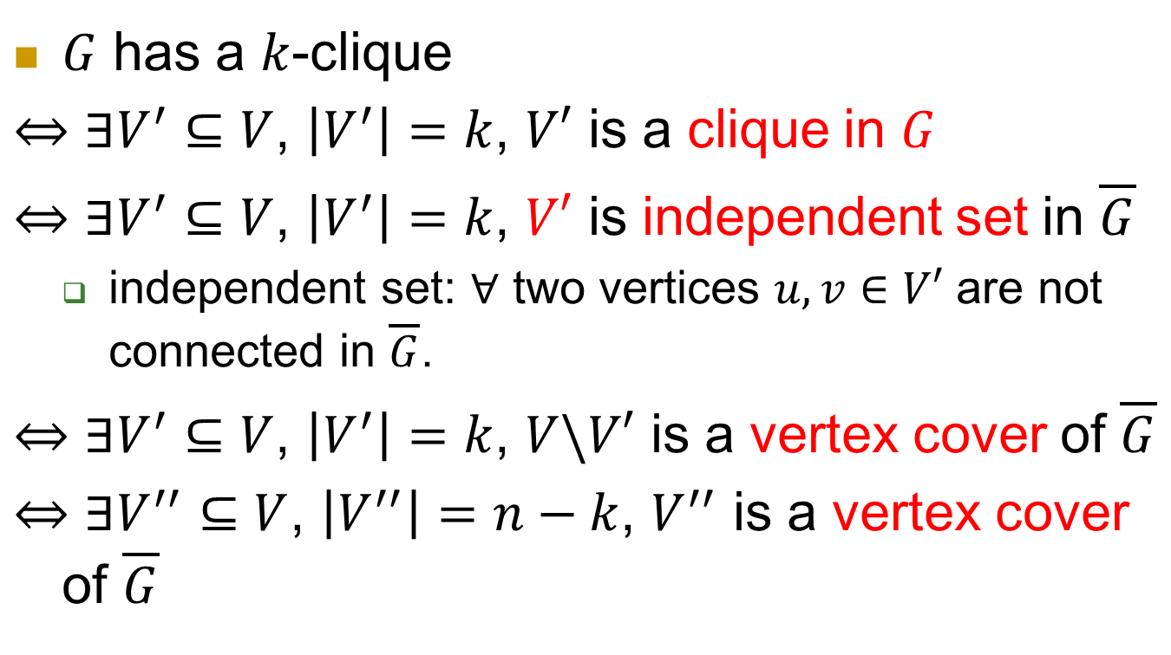
Proof of the theorem
$G$ has a $k$-clique
$⇔$ $∃V^{′}⊆V$, $\left|V^{′}\right|=k$, $V′$ is a clique in $G$
$⇔$ $∃V^{′}⊆V$, $\left|V^{′}\right|=k$, $V′$ is independent set in $\overline{G}$
  independent set: $∀$ two vertices $u, v∈V′$ are not connected in $\overline{G}$.
$⇔$ $∃V^{′}⊆V$, $\left|V^{′}\right|=k$, $V\backslash V′$ is a vertex cover of $\overline{G}$
$⇔$ $∃V^{′′}⊆V$, $\left|V^{′′}\right|=n−k$, $V^{′′}$ is a vertex cover of $\overline{G}$

Slide 28
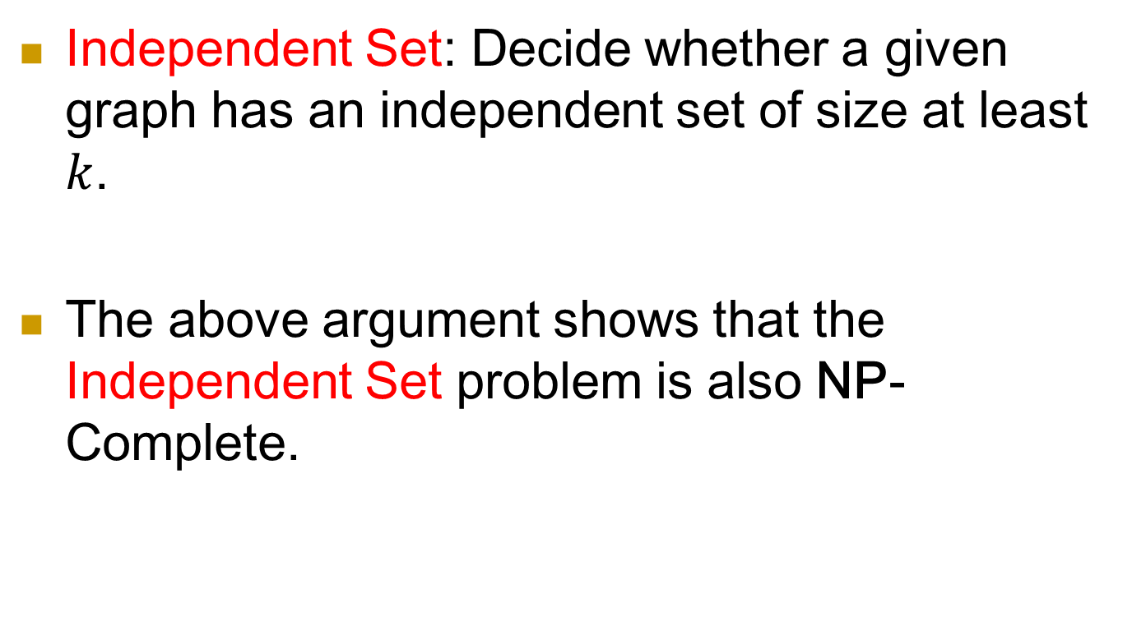
A related problem: Independent Set
Independent Set: Decide whether a given graph has an independent set of size at least $k$.
The above argument shows that the Independent Set problem is also NP-Complete.

Slide 29
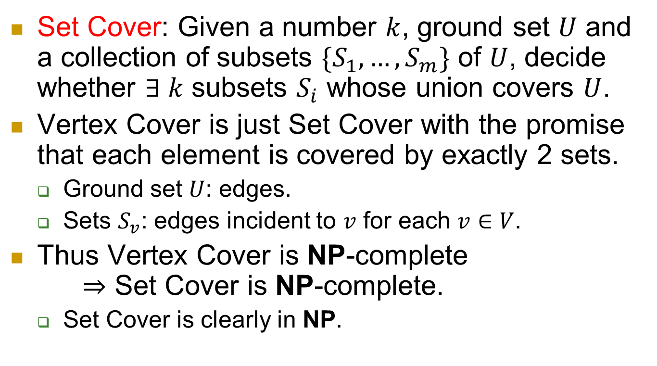
Another bonus: Set Cover
Set Cover: Given a number $k$, ground set $U$ and a collection of subsets $\{S_{1},…,S_{m}\}$ of $U$, decide whether $∃ k$ subsets $S_{i}$ whose union covers $U$.
Vertex Cover is just Set Cover with the promise that each element is covered by exactly 2 sets.
  Ground set $U$: edges.
  Sets $S_{v}$: edges incident to $v$ for each $v∈V$.
Thus Vertex Cover is NP-complete
$⇒$ Set Cover is NP-complete.
  Set Cover is clearly in NP.

Slide 30
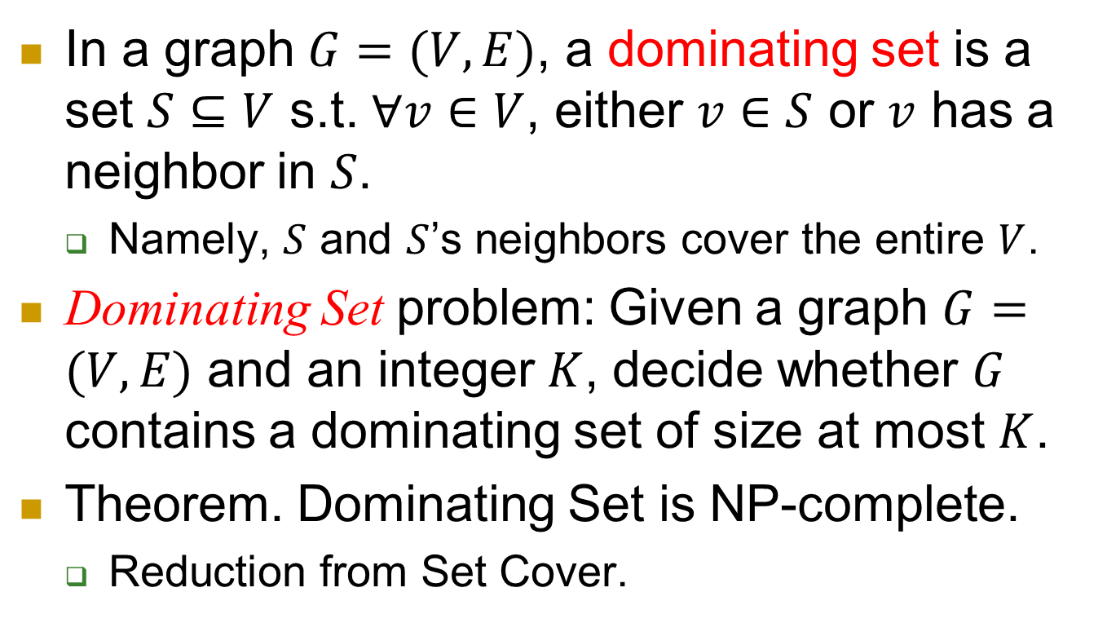
NP-complete problem 3: Dominating Set
In a graph $G=(V,E)$, a dominating set is a set $S⊆V$ s.t. $∀v∈V$, either $v∈S$ or $v$ has a neighbor in $S$.
  Namely, $S$ and $S$’s neighbors cover the entire $V$.
Dominating Set problem: Given a graph $G=(V,E)$ and an integer $K$, decide whether $G$ contains a dominating set of size at most $K$.
Theorem. Dominating Set is NP-complete.
  Reduction from Set Cover.

Slide 31

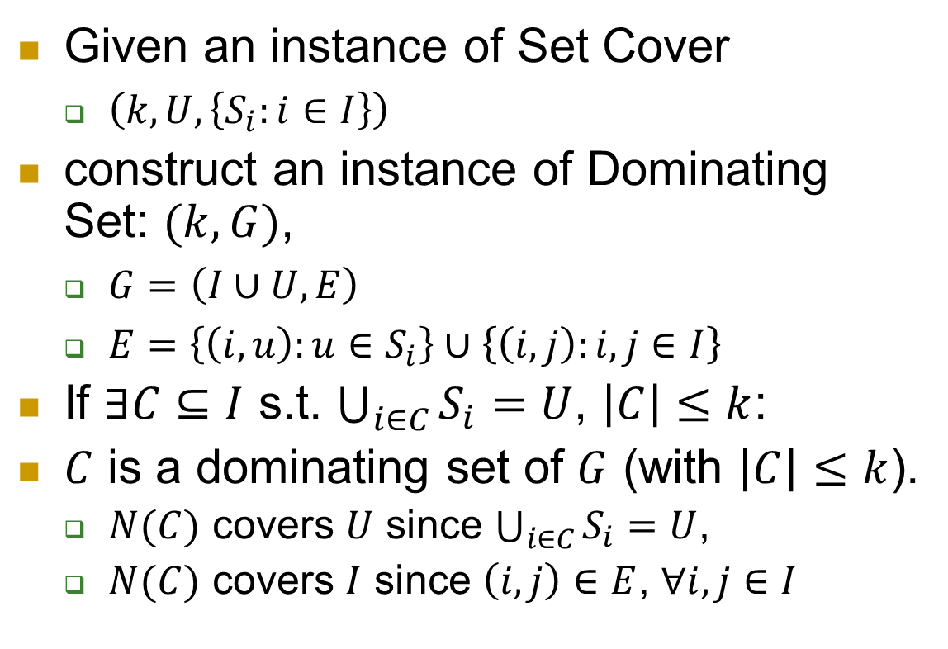

Reduction
Given an instance of Set Cover
  $\left(k,U,\left\{S_{i}:i∈I\right\}\right)$
construct an instance of Dominating Set: $(k,G)$,
  $G=\left(I∪U,E\right)$
  $E=\left\{\left(i,u\right):u∈S_{i}\right\}∪\left\{\left(i,j\right):i,j∈I\right\}$
If $∃C⊆I$ s.t. $\bigcup_{i∈C}{S_{i}}=U$, $\left|C\right|≤k$:
$C$ is a dominating set of $G$ (with $\left|C\right|≤k$).
  $N(C)$ covers $U$ since $\bigcup_{i∈C}{S_{i}}=U$,
  $N(C)$ covers $I$ since $\left(i,j\right)∈E$, $∀i,j∈I$
$$I$$
$$U$$

Slide 32
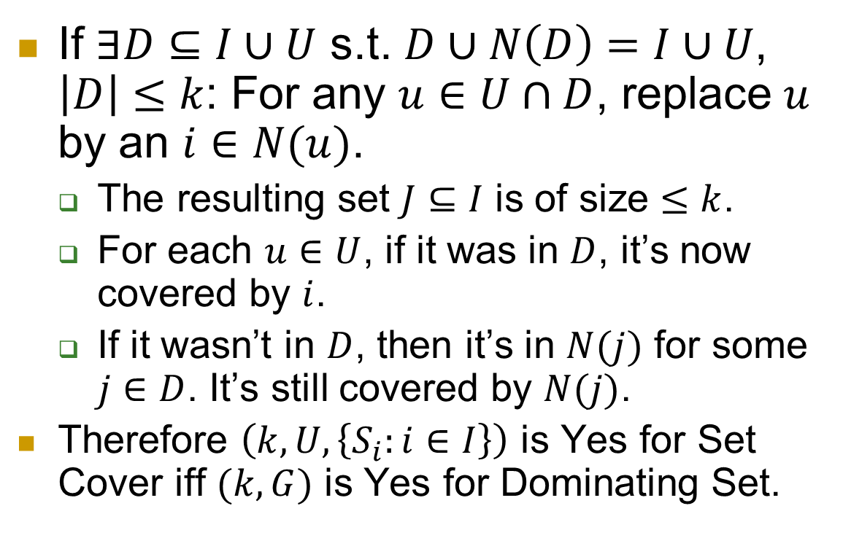
If $∃D⊆I∪U$ s.t. $D∪N\left(D\right)=I∪U$, $\left|D\right|≤k$: For any $u∈U∩D$, replace $u$ by an $i∈N(u)$.
  The resulting set $J⊆I$ is of size $≤k$.
  For each $u∈U$, if it was in $D$, it’s now covered by $i$.
  If it wasn’t in $D$, then it’s in $N(j)$ for some $j∈D$. It’s still covered by $N(j)$.
  Therefore $\left(k,U,\left\{S_{i}:i∈I\right\}\right)$ is Yes for Set Cover iff $(k,G)$ is Yes for Dominating Set.
$$I$$
$$U$$

Slide 33
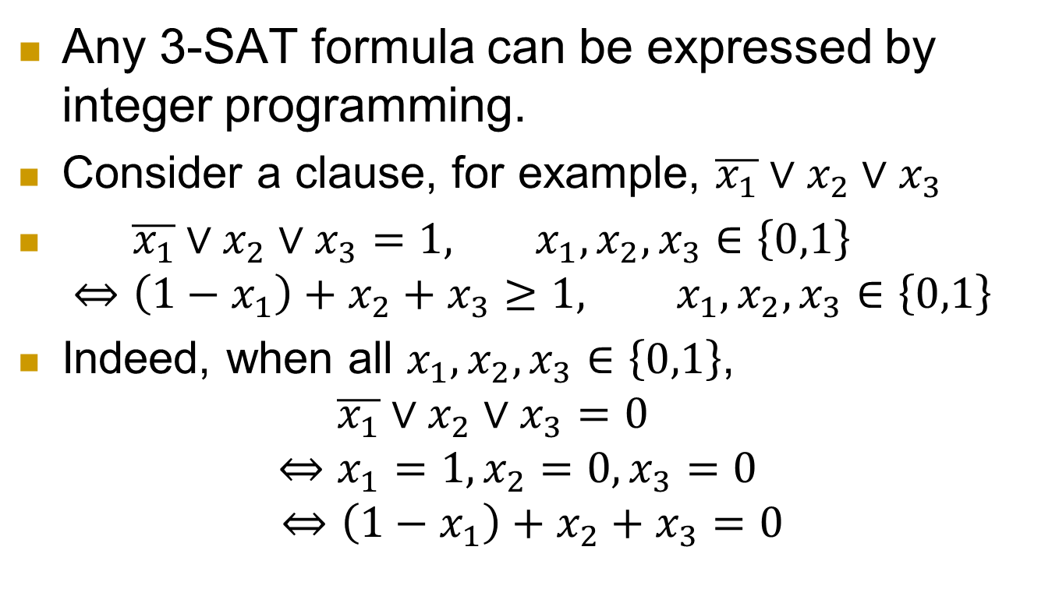
NP-complete problem 4: Integer Programming (IP)
Any 3-SAT formula can be expressed by integer programming.
Consider a clause, for example, $\overline{x_{1}}∨x_{2}∨x_{3}$
$\overline{x_{1}}∨x_{2}∨x_{3}=1, x_{1},x_{2},x_{3}∈\left\{0,1\right\}$
$⇔\left(1−x_{1}\right)+x_{2}+x_{3}≥1, x_{1},x_{2},x_{3}∈\left\{0,1\right\}$
Indeed, when all $x_{1},x_{2},x_{3}∈\left\{0,1\right\}$,
$\overline{x_{1}}∨x_{2}∨x_{3}=0$
$$⇔x_{1}=1,x_{2}=0,x_{3}=0$$
$$⇔\left(1−x_{1}\right)+x_{2}+x_{3}=0$$

Slide 34
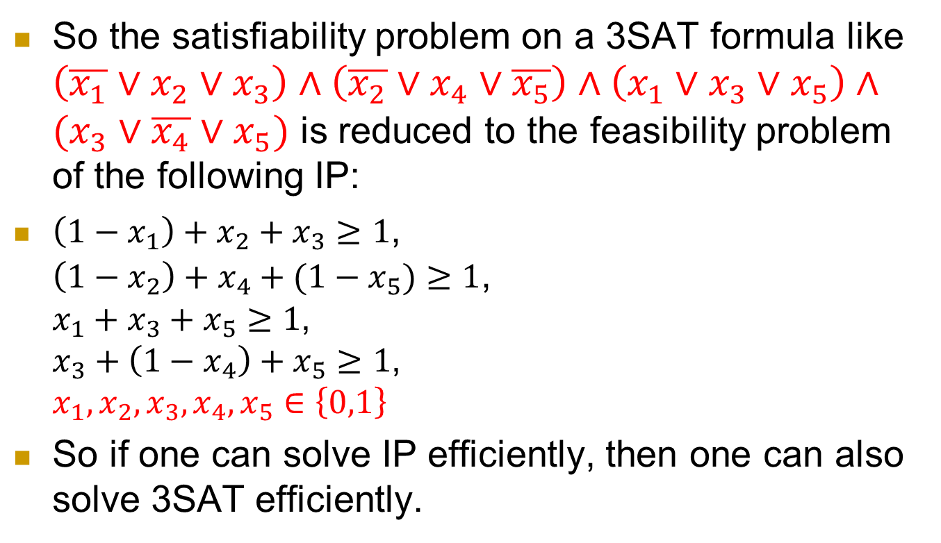
  So the satisfiability problem on a 3SAT formula like $\left(\overline{x_{1}}∨x_{2}∨x_{3}\right)∧\left(\overline{x_{2}}∨x_{4}∨\overline{x_{5}}\right)∧\left(x_{1}∨x_{3}∨x_{5}\right)∧(x_{3}∨\overline{x_{4}}∨x_{5})$ is reduced to the feasibility problem of the following IP:
  $\left(1−x_{1}\right)+x_{2}+x_{3}≥1$,
  $\left(1−x_{2}\right)+x_{4}+(1−x_{5})≥1$,
  $x_{1}+x_{3}+x_{5}≥1$,
  $x_{3}+\left(1−x_{4}\right)+x_{5}≥1$,
  $x_{1},x_{2},x_{3},x_{4},x_{5}∈\left\{0,1\right\}$
So if one can solve IP efficiently, then one can also solve 3SAT efficiently.

Slide 35
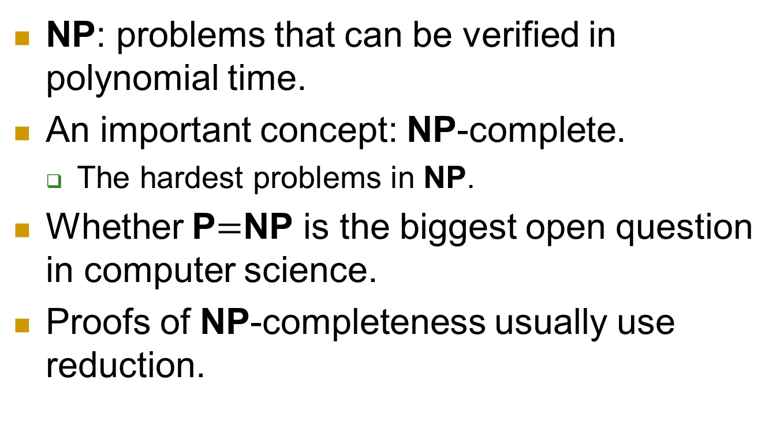
Summary
NP: problems that can be verified in polynomial time.
An important concept: NP-complete.
  The hardest problems in NP.
Whether P$=$NP is the biggest open question in computer science.
Proofs of NP-completeness usually use reduction.

Slide 36

Randomized Algorithms
How to deal with problems harder than P?
One approach: use randomness in our algorithms.

Slide 37
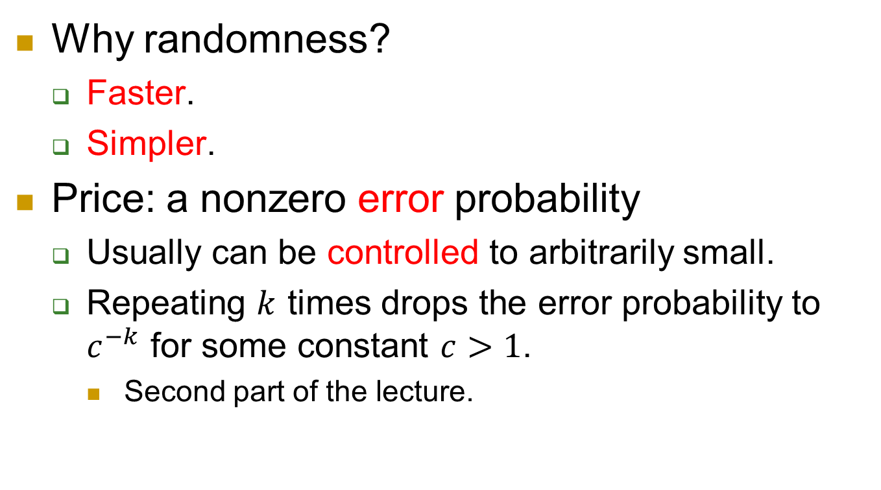
Motivation
Why randomness?
  Faster.
  Simpler.
Price: a nonzero error probability
  Usually can be controlled to arbitrarily small.
  Repeating $k$ times drops the error probability to $c^{−k}$ for some constant $c>1$.
    Second part of the lecture.

Slide 38
Polynomial Identity Testing
Given two polynomials $p_{1}$ and $p_{2}$ (by arithmetic circuit), decide whether they are equal.
Arithmetic circuit:
polynomial computed:
$(x_{1}x_{2}+x_{2}x_{3})((x_{2}+x_{4})−(x_{3}−x_{5}))$
Question: Given two such circuits, do they compute the same polynomial?
×
+
−
×
×
+
−
$$x_{1}$$
$$x_{2}$$
$$x_{3}$$
$$x_{4}$$
$$x_{5}$$

Slide 39
Naïve algorithm?
polynomial computed:
$(x_{1}x_{2}+x_{2}x_{3})((x_{2}+x_{4})−(x_{3}−x_{5}))$
We can expand the two polynomials and compare their coefficients
But it takes too much time.
  Size of the expansion can be exponential in the number of gates.
  Can you give such an example?
×
+
−
×
×
+
−
$$x_{1}$$
$$x_{2}$$
$$x_{3}$$
$$x_{4}$$
$$x_{5}$$
Notes:
Example: $\left(1+x_{1}\right)\left(1+x_{2}\right)⋯(1+x_{n})$

Slide 40
Key idea
Schwartz-Zippel Lemma. If $p(x_{1}, …, x_{n})$ is a polynomial of total degree $d$ over a field $𝔽$, then $∀S⊆𝔽$,
${\text{Pr}}_{a_{i}←_{R}S}\left[p\left(a_{1},…,a_{n}\right)=0\right]≤\frac{d}{\left|S\right|}.$
  total degree of a monomial $x_{1}^{2}x_{2}^{3}x_{5}^{7}:2+3+7=12$
  total degree of a polynomial: the max total degree of its monomials.
  $a_{i}←_{R}S$: pick each $a_{i}$ from $S$ uniformly at random. (Different $a_{i}$’s are picked independently.)

Slide 41
Few other observations
A polynomial is easy to evaluate on any point by following the circuit.
The (formal) degree of an polynomial is easy to obtain.
×
+
−
×
×
+
−
2
3
4
1
6

Slide 42
Randomized Algorithm
On input polynomials $p_{1}$ and $p_{2}$:
$d=max⁡\{deg⁡(p_{1}), deg⁡(p_{2})\}$
$a_{1}, …, a_{n}←_{R}\{1,2,…,100d\}$
Evaluate $p_{1}(a_{1}, …, a_{n})$and $p_{2}(a_{1}, …, a_{n})$by running the circuits on $(a_{1}, …, a_{n})$.
if $p_{1}\left(a_{1}, …, a_{n}\right)=p_{2}(a_{1}, …, a_{n})$,
output “$p_{1}=p_{2}$”.
else
output “$p_{1}≠p_{2}$”.

Slide 43
Correctness
If $p_{1}=p_{2}$, then $p_{1}\left(a_{1}, …, a_{n}\right)=p_{2}(a_{1}, …, a_{n})$ is always true, so the algorithm outputs $p_{1}=p_{2}$.
If $p_{1}≠p_{2}$: Let $p=p_{1}−p_{2}$. Recall that
  we picked $a_{1}, …, a_{n}←_{R}S≝\left\{1,2,…,100d\right\}$,
  Lemma. ${\text{Pr}}_{a_{i}←_{R}S}\left[p\left(a_{1},…,a_{n}\right)=0\right]≤\frac{d}{\left|S\right|}.$
  So $p_{1}\left(a_{1}, …, a_{n}\right)=p_{2}(a_{1}, …, a_{n})$w/ prob. only 0.01.
  The algorithm outputs $p_{1}≠p_{2}$ w/ prob. $≥0.99$.

Slide 44
Catch
One catch is that if the degree $d$ is very large, then the evaluated value can also be huge.
  Thus unaffordable to write down.
Fortunately, a simple trick called “fingerprint” handles this.
  Use a little bit of algebra; omitted here.
Questions for the algorithm?

