Slide 1
CMSC5706 Topics in Theoretical Computer Science
Week 4: Approximation Algorithms
Instructor: Shengyu Zhang

Slide 2
Optimization
Very often we need to solve an optimization problem.
  Maximize the utility/payoff/gain/…
  Minimize the cost/penalty/loss/…
Many optimization problems are NP-complete
  No polynomial algorithms are known, and most likely, they don’t exist.
  Question: Do you want more of this topic?
Approximation: get an approximately good solution.

Slide 3
Example 1: A simple approximation algorithm for 3SAT

Slide 4

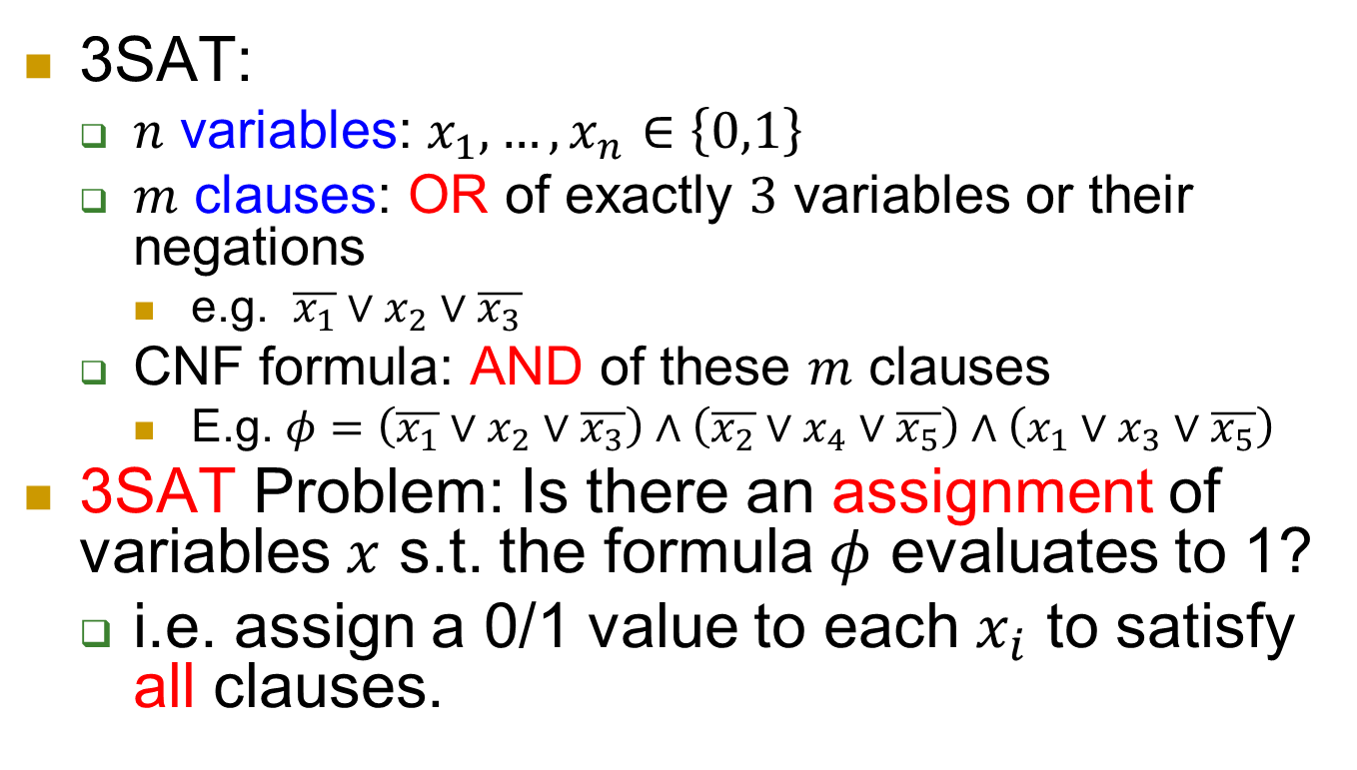
SAT
3SAT:
  $n$ variables: $x_{1},…,x_{n}∈\left\{0,1\right\}$
  $m$ clauses: OR of exactly $3$ variables or their negations
    e.g. $\overline{x_{1}}∨x_{2}∨\overline{x_{3}}$
  CNF formula: AND of these $m$ clauses
    E.g. $φ=\left(\overline{x_{1}}∨x_{2}∨\overline{x_{3}}\right)∧\left(\overline{x_{2}}∨x_{4}∨\overline{x_{5}}\right)∧\left(x_{1}∨x_{3}∨\overline{x_{5}}\right)$
3SAT Problem: Is there an assignment of variables $x$ s.t. the formula $φ$ evaluates to 1?
  i.e. assign a 0/1 value to each $x_{i}$ to satisfy all clauses.
$$x=10010$$

Slide 5
Hard
3SAT is known as an NP-complete problem.
  Very hard: no polynomial algorithm is known.
  Conjecture: no polynomial algorithm exists.
  If a polynomial algorithm exists for 3SAT, then polynomial algorithms exist for all NP problems.
More details in last lecture.

Slide 6
7/8-approximation of 3SAT
Since 3SAT appears too hard in its full generality, let’s aim lower.
3SAT asks whether there is an assignment satisfying all clauses.
Can you find an assignment satisfying half of the clauses?
Let’s run an example where
  you give an input instance
  you give a solution!

Slide 7
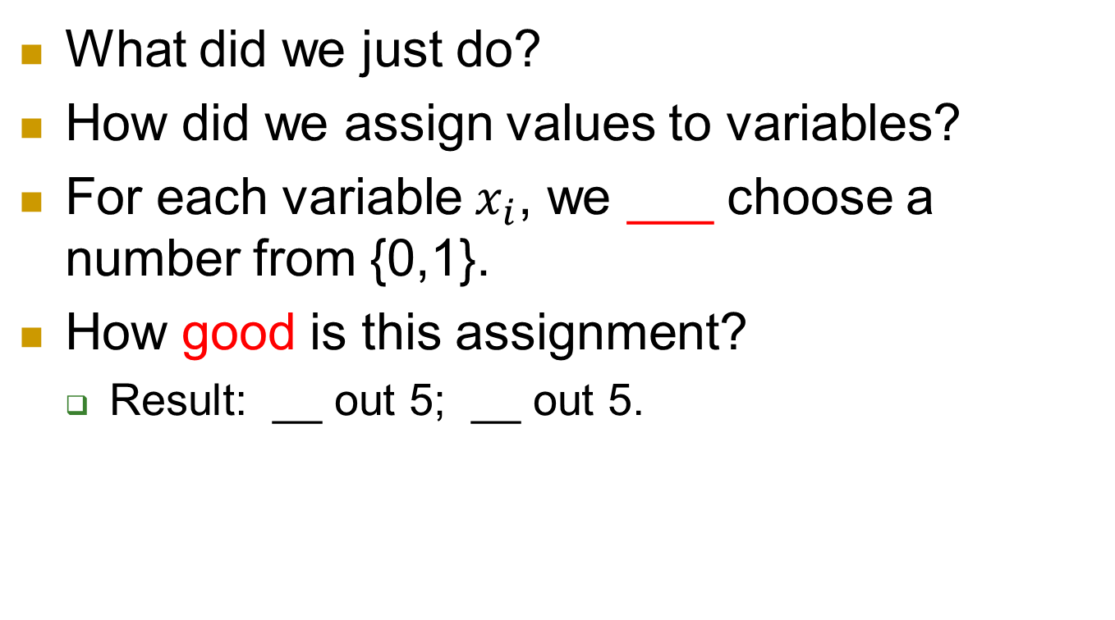
Observation
What did we just do?
How did we assign values to variables?
For each variable $x_{i}$, we ___ choose a number from {0,1}.
How good is this assignment?
  Result: __ out 5; __ out 5.

Slide 8
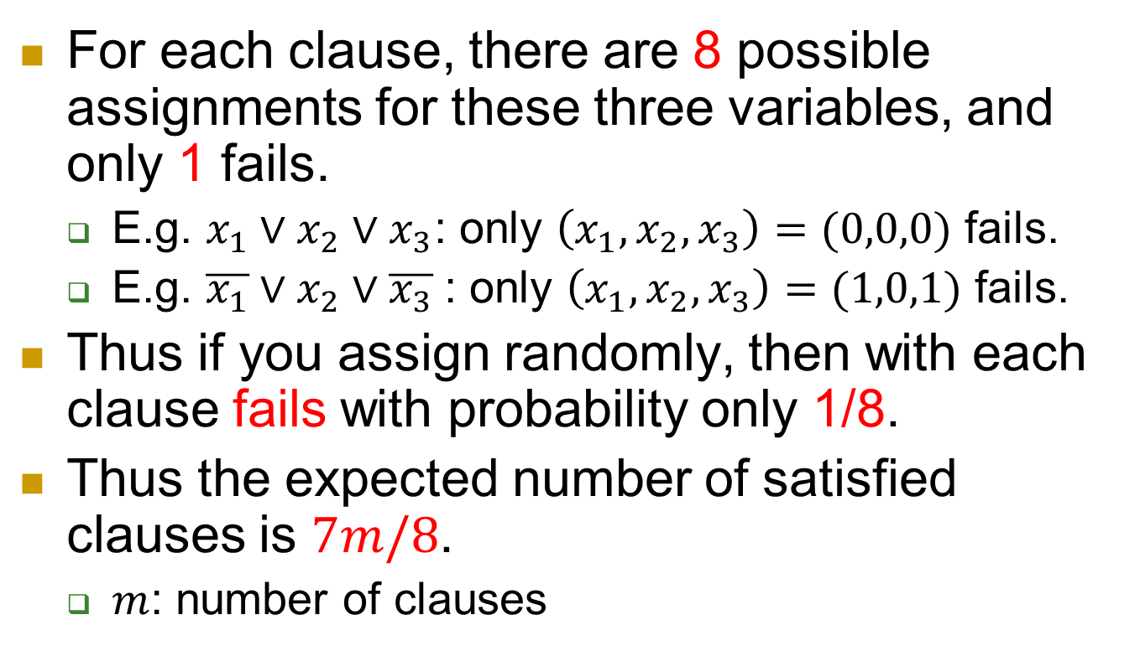
Why?
For each clause, there are 8 possible assignments for these three variables, and only 1 fails.
  E.g. $x_{1}∨x_{2}∨x_{3}$: only $\left(x_{1},x_{2},x_{3}\right)=(0,0,0)$ fails.
  E.g. $\overline{x_{1}}∨x_{2}∨\overline{x_{3}}$: only $\left(x_{1},x_{2},x_{3}\right)=(1,0,1)$ fails.
Thus if you assign randomly, then with each clause fails with probability only 1/8.
Thus the expected number of satisfied clauses is $7m/8$.
  $m$: number of clauses

Slide 9
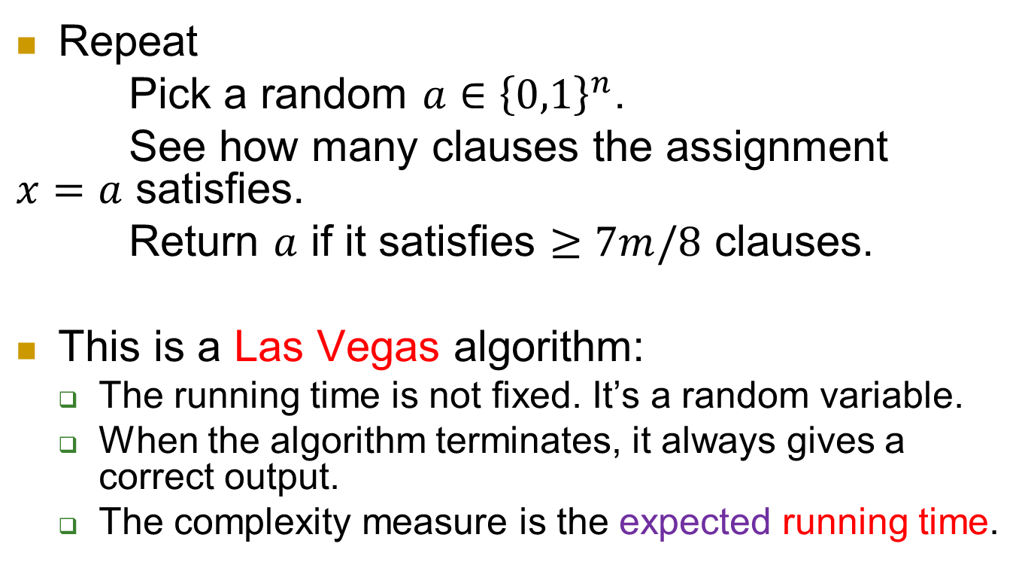
Formally - algorithm
Repeat
Pick a random $a∈{\left\{0,1\right\}}^{n}$.
See how many clauses the assignment $x=a$ satisfies.
Return $a$ if it satisfies $≥7m/8$ clauses.
This is a Las Vegas algorithm:
  The running time is not fixed. It’s a random variable.
  When the algorithm terminates, it always gives a correct output.
  The complexity measure is the expected running time.

Slide 10
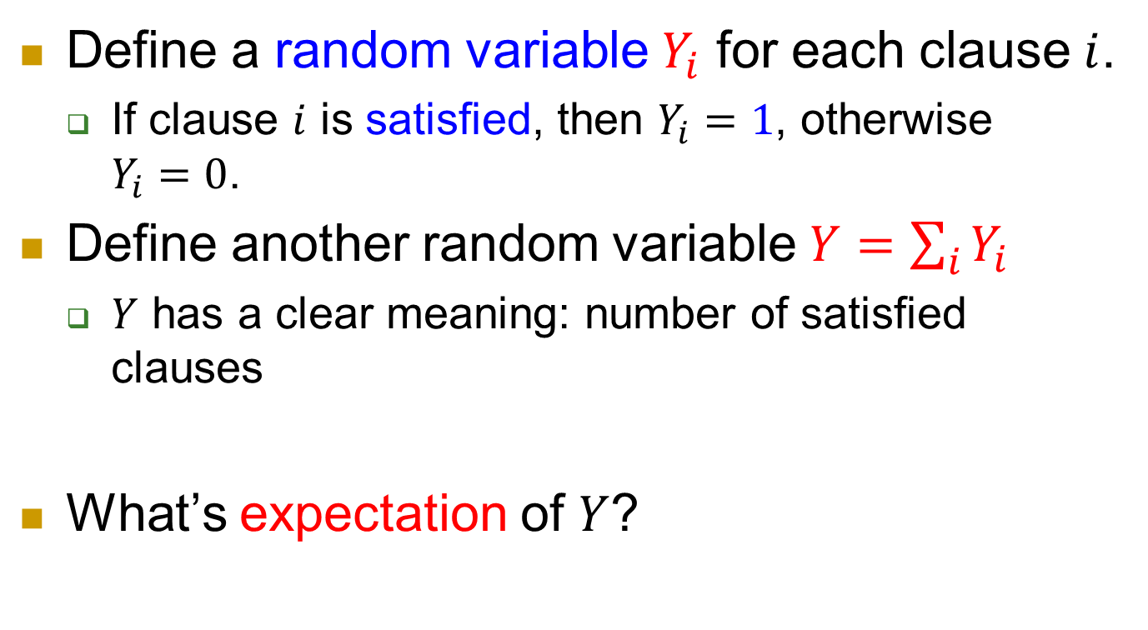
Formally - analysis
Define a random variable $Y_{i}$ for each clause $i$.
  If clause $i$ is satisfied, then $Y_{i}=1$, otherwise $Y_{i}=0$.
Define another random variable $Y=\sum_{i}{Y_{i}}$
  $Y$ has a clear meaning: number of satisfied clauses
What’s expectation of $Y$?

Slide 11


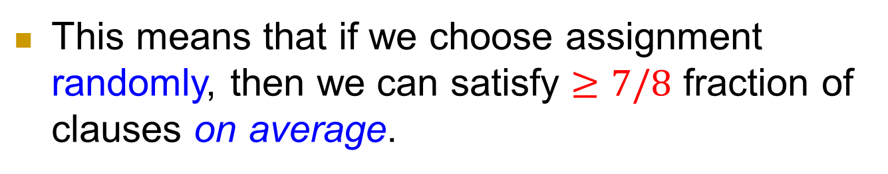

$$E\left[Y\right]$$
$E\left[Y\right]$
$=E\left[\sum_{i}{Y_{i}}\right]$
$=\sum_{i}{E[Y_{i}]}$
$=\sum_{i}{Pr⁡[C_{i} satisfied]}$
$=\sum_{i}{7/8}$
$=\frac{7}{8}m.$
// expected # satisfied clauses
// definition of $Y$: $Y=\sum_{i}{Y_{i}}$
// linearity of expectation
// definition of $Y_{i}$
This means that if we choose assignment randomly, then we can satisfy $≥7/8$ fraction of clauses on average.

Slide 12
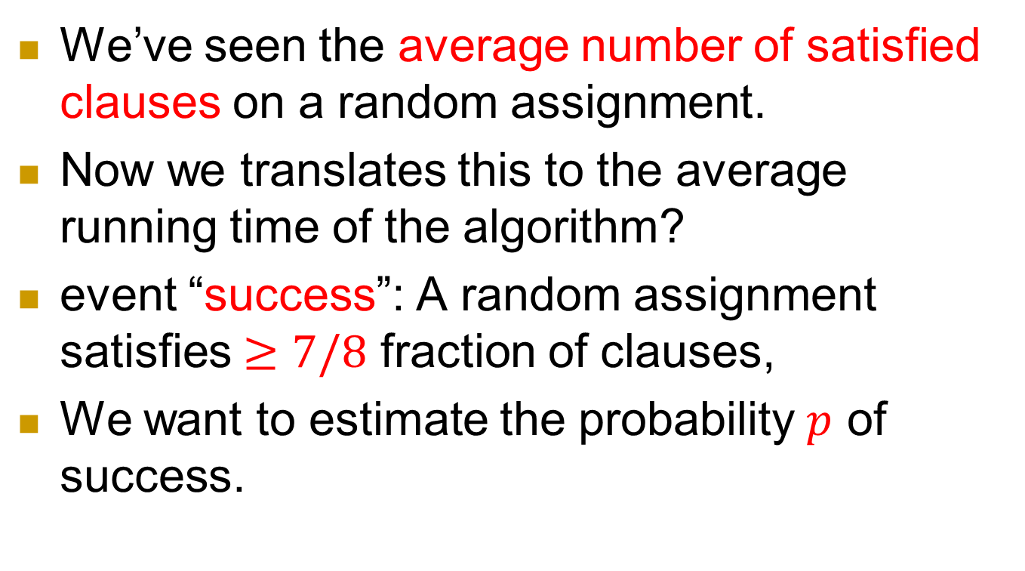
Success probability of one assignment
We’ve seen the average number of satisfied clauses on a random assignment.
Now we translates this to the average running time of the algorithm?
event “success”: A random assignment satisfies $≥7/8$ fraction of clauses,
We want to estimate the probability $p$ of success.

Slide 13
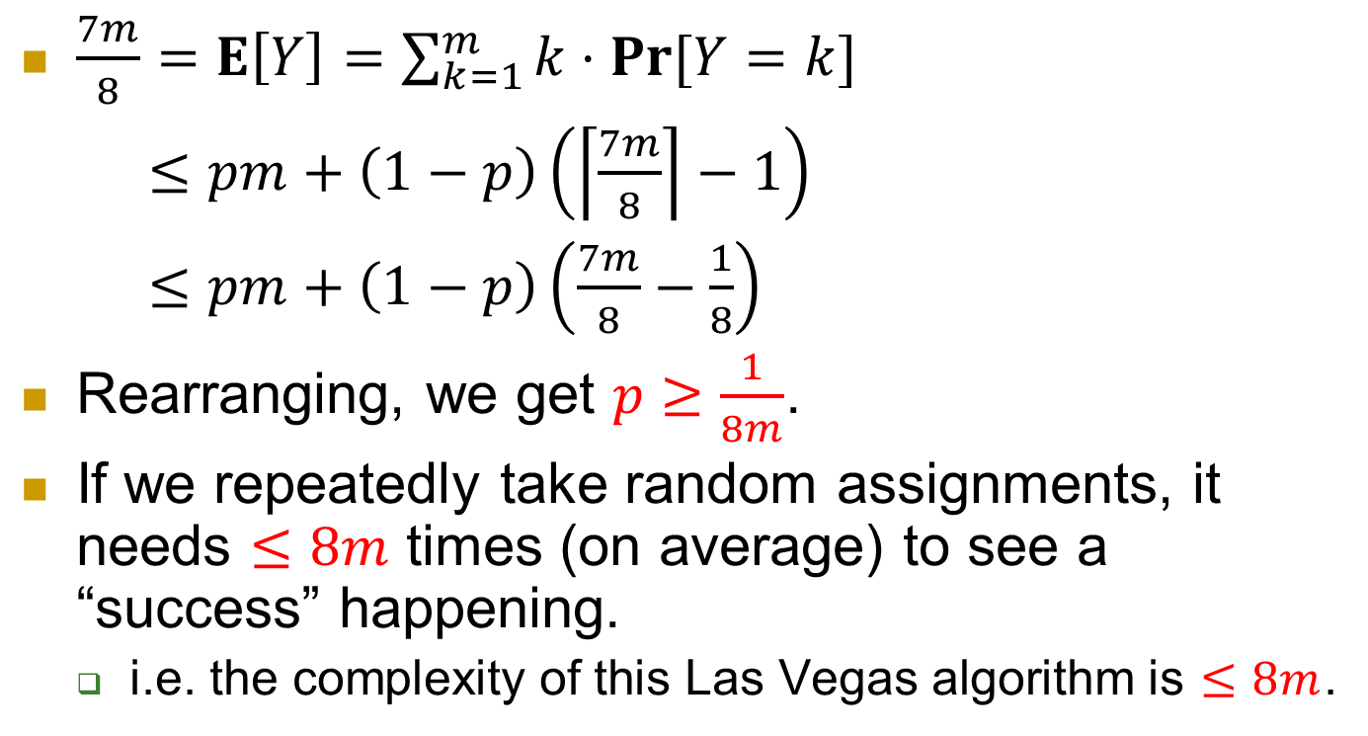
Getting a Las Vegas algorithm
$\frac{7m}{8}=E\left[Y\right]=\sum_{k=1}^{m}{k⋅\operatorname{Pr}{[Y=k]}}$
$≤pm+\left(1−p\right)\left(\left\lceil \frac{7m}{8}\right\rceil −1\right)$
$≤pm+\left(1−p\right)\left(\frac{7m}{8}−\frac{1}{8}\right)$
Rearranging, we get $p≥\frac{1}{8m}$.
If we repeatedly take random assignments, it needs $≤8m$ times (on average) to see a “success” happening.
  i.e. the complexity of this Las Vegas algorithm is $≤8m$.

Slide 14
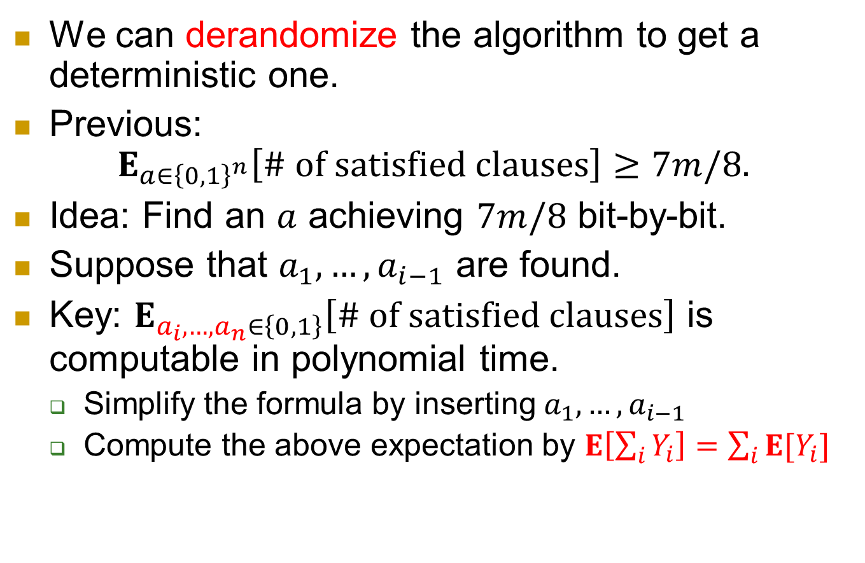
derandomization
We can derandomize the algorithm to get a deterministic one.
Previous:
$E_{a∈{\left\{0,1\right\}}^{n}}\left[\# of satisfied clauses\right]≥7m/8.$
Idea: Find an $a$ achieving $7m/8$ bit-by-bit.
Suppose that $a_{1},…,a_{i−1}$ are found.
Key: $E_{a_{i},…,a_{n}∈\left\{0,1\right\}}\left[\# of satisfied clauses\right]$ is computable in polynomial time.
  Simplify the formula by inserting $a_{1},…,a_{i−1}$
  Compute the above expectation by $E\left[\sum_{i}{Y_{i}}\right]=\sum_{i}{E[Y_{i}]}$

Slide 15
Example 2: Approximation algorithm for Vertex Cover

Slide 16
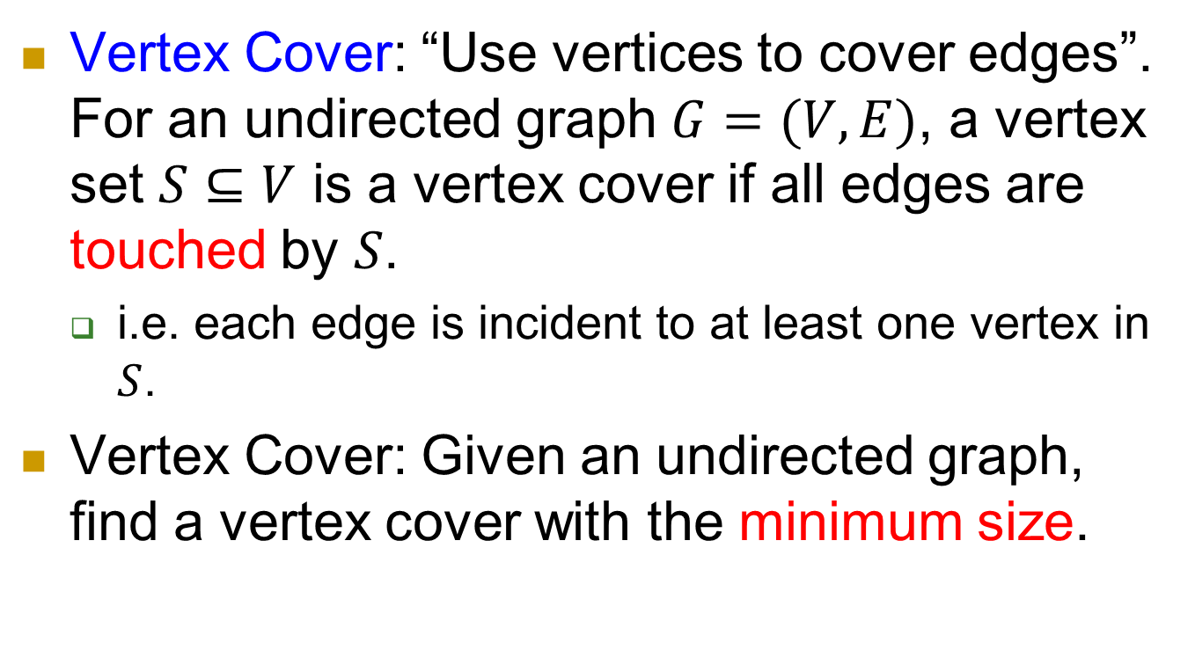
Vertex Cover: Use vertex to cover edges
Vertex Cover: “Use vertices to cover edges”.
For an undirected graph $G=(V,E)$, a vertex set $S⊆V$ is a vertex cover if all edges are touched by $S$.
  i.e. each edge is incident to at least one vertex in $S$.
Vertex Cover: Given an undirected graph, find a vertex cover with the minimum size.

Slide 17
NP-complete
  So it’s (almost) impossible to find the minimum vertex cover in polynomial time.
But there is a polynomial time algorithm that can find a vertex cover of size at most twice of that of minimum vertex cover.

Slide 18
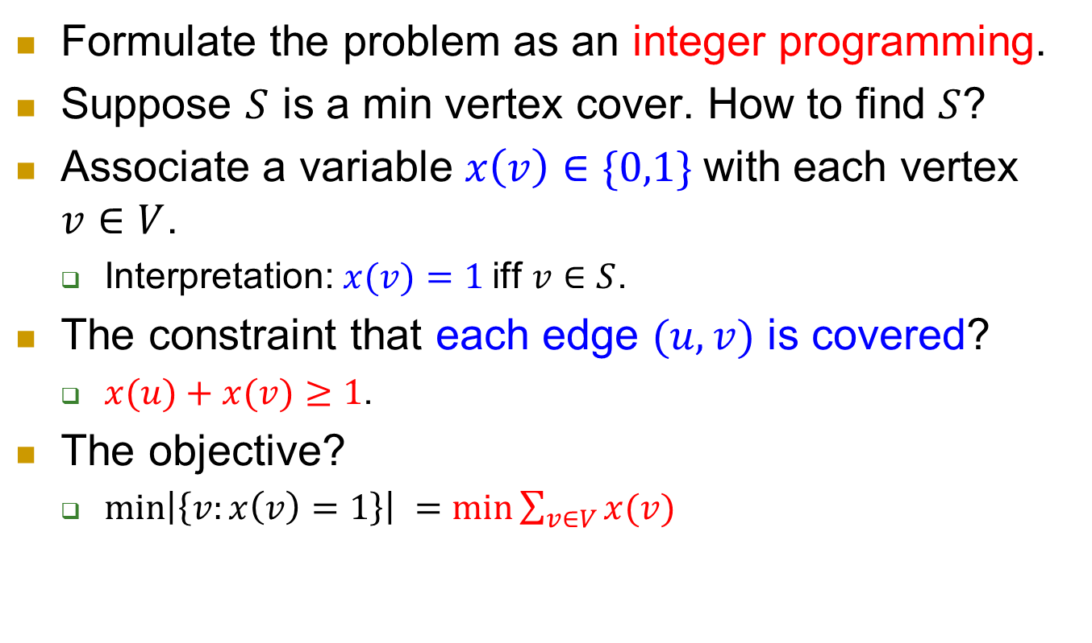
IP formulation
Formulate the problem as an integer programming.
Suppose $S$ is a min vertex cover. How to find $S$?
Associate a variable $x\left(v\right)∈\{0,1\}$with each vertex $v∈V$.
  Interpretation: $x(v)=1$iff $v∈S$.
The constraint that each edge $(u,v)$ is covered?
  $x(u)+x(v)≥1$.
The objective?
  $\min\left|\left\{v:x\left(v\right)=1\right\}\right| =min\sum_{v∈V}{x(v)}$

Slide 19
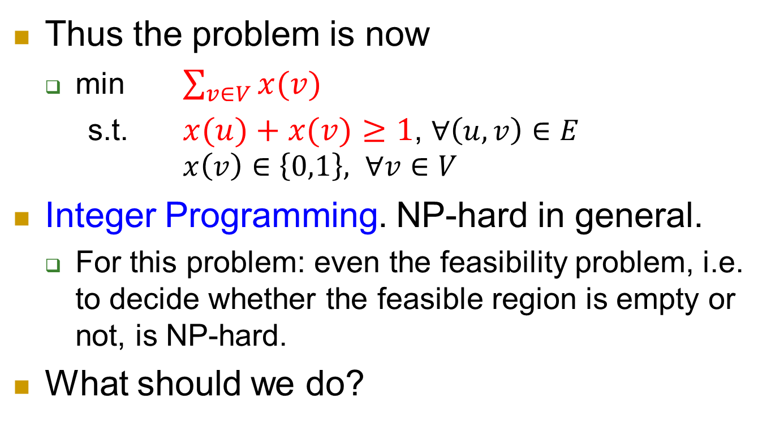
IP formulation, continued.
Thus the problem is now
  min $\sum_{v∈V}{x(v)}$
  s.t. $x(u)+x(v)≥1$, $∀\left(u,v\right)∈E$
  $x\left(v\right)∈\left\{0,1\right\},$ $∀v∈V$
Integer Programming. NP-hard in general.
  For this problem: even the feasibility problem, i.e. to decide whether the feasible region is empty or not, is NP-hard.
What should we do?

Slide 20
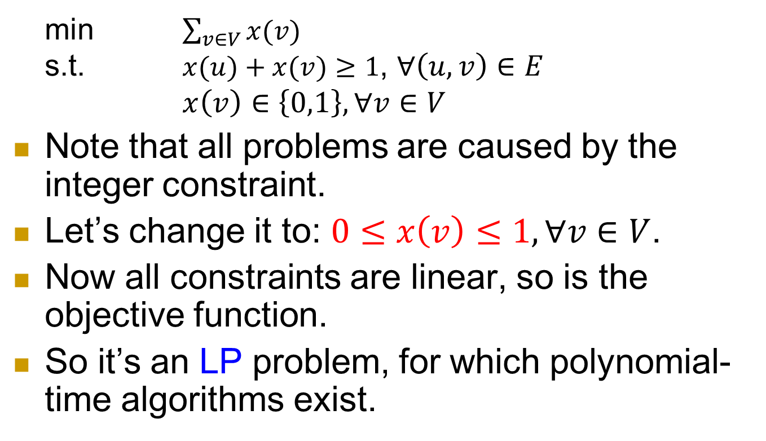
LP relaxation
  min $\sum_{v∈V}{x(v)}$
  s.t. $x(u)+x(v)≥1$, $∀\left(u,v\right)∈E$
  $x\left(v\right)∈\left\{0,1\right\}, ∀v∈V$
Note that all problems are caused by the integer constraint.
Let’s change it to: $0≤x\left(v\right)≤1, ∀v∈V$.
Now all constraints are linear, so is the objective function.
So it’s an LP problem, for which polynomial-time algorithms exist.

Slide 21
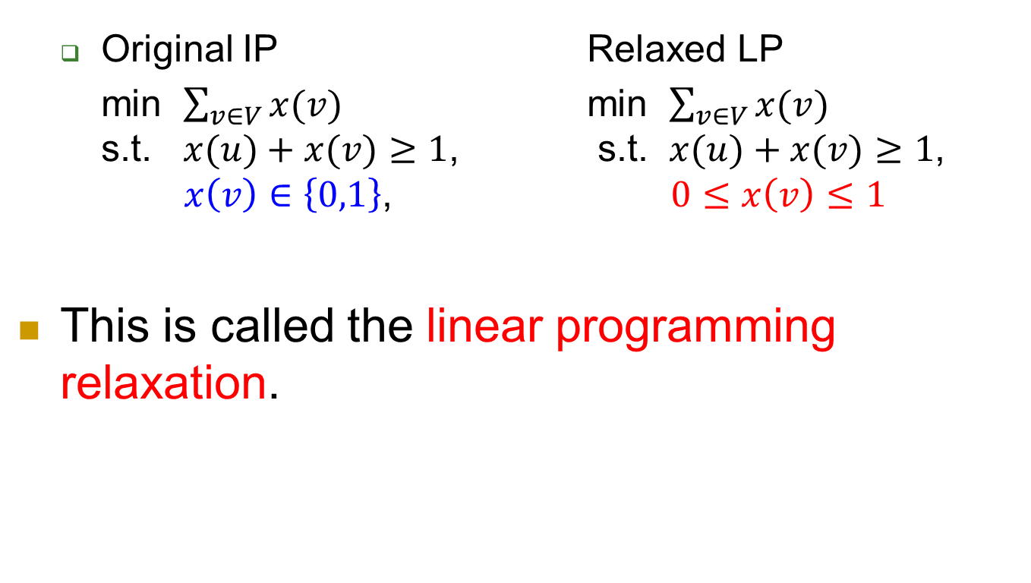
Relaxation
  Original IP Relaxed LP
  min $\sum_{v∈V}{x(v)}$ min $\sum_{v∈V}{x(v)}$
  s.t. $x(u)+x(v)≥1$, s.t. $x(u)+x(v)≥1$,
  $x\left(v\right)∈\left\{0,1\right\}$, $0≤x\left(v\right)≤1$
This is called the linear programming relaxation.

Slide 22
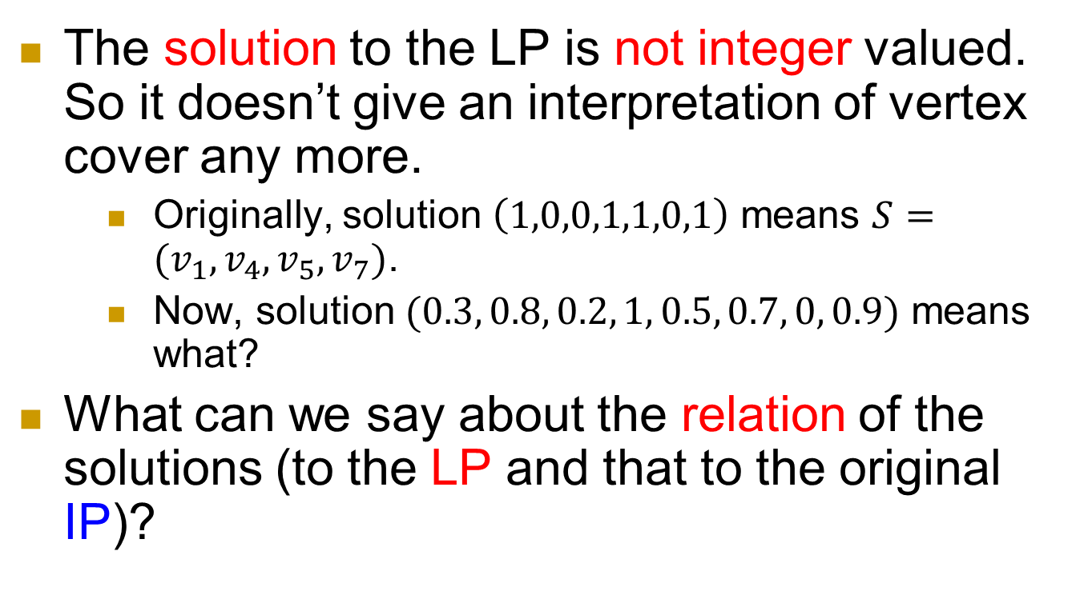
Two key issues
The solution to the LP is not integer valued. So it doesn’t give an interpretation of vertex cover any more.
    Originally, solution $\left(1,0,0,1,1,0,1\right)$ means $S=(v_{1},v_{4},v_{5},v_{7})$.
    Now, solution $(0.3, 0.8, 0.2, 1, 0.5, 0.7, 0, 0.9)$ means what?
What can we say about the relation of the solutions (to the LP and that to the original IP)?

Slide 23
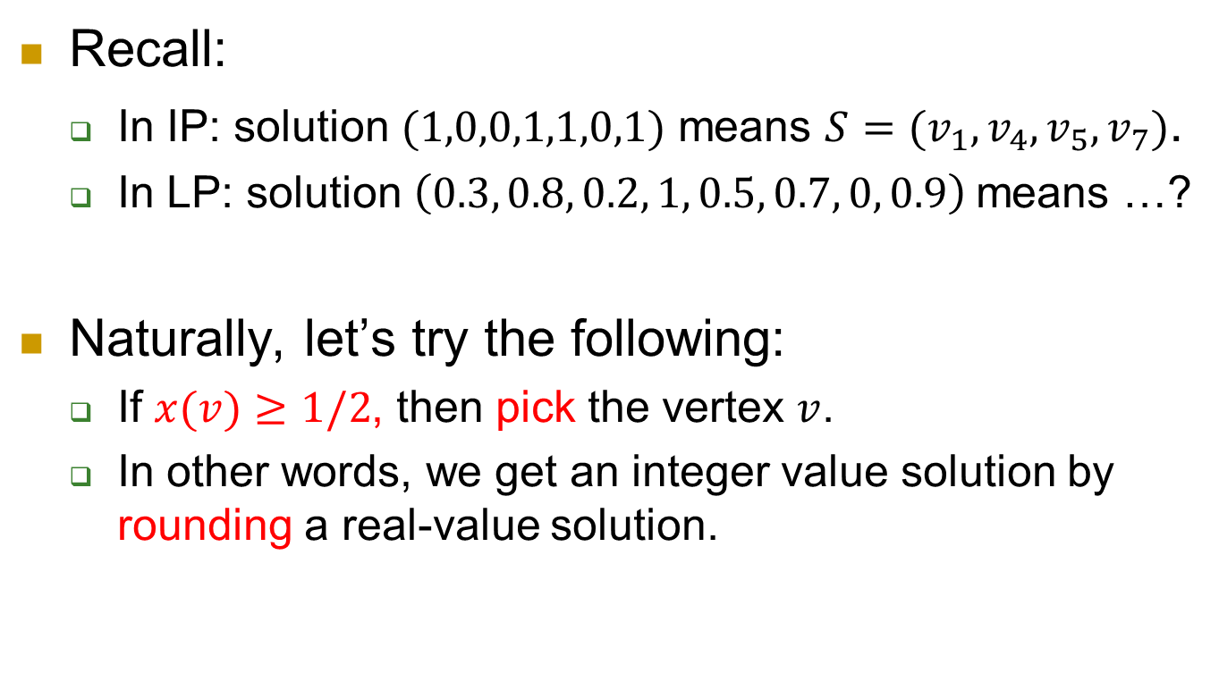
Issue 1: Construct a vertex cover from a solution of LP
Recall:
  In IP: solution $(1,0,0,1,1,0,1)$ means $S=(v_{1},v_{4},v_{5},v_{7})$.
  In LP: solution $\left(0.3, 0.8, 0.2, 1, 0.5, 0.7, 0, 0.9\right)$means …?
Naturally, let’s try the following:
  If $x(v)≥1/2$, then pick the vertex $v$.
  In other words, we get an integer value solution by rounding a real-value solution.

Slide 24
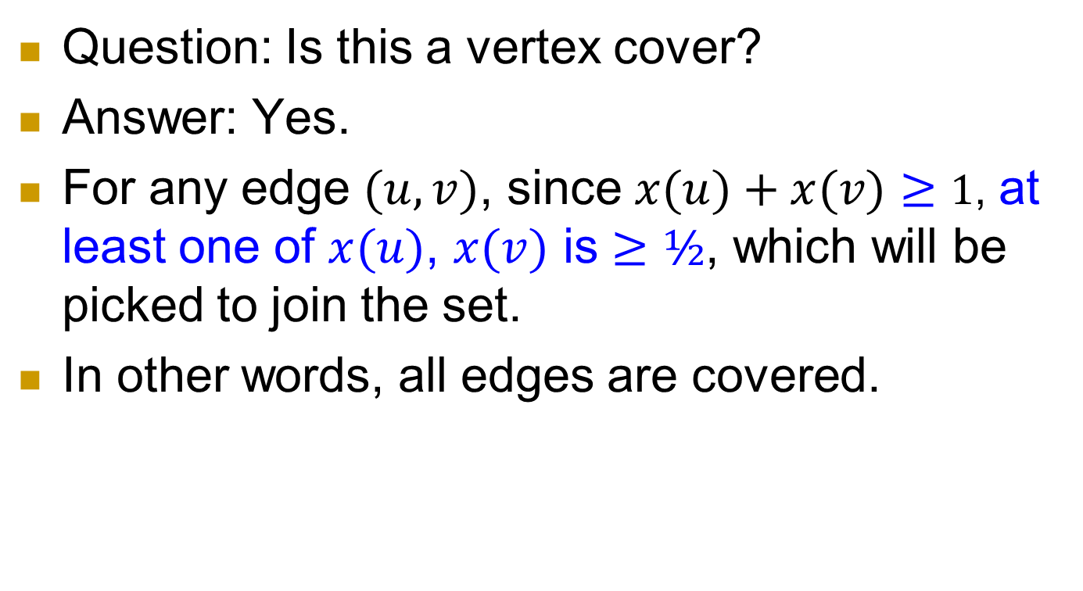
Issue 1, continued
Question: Is this a vertex cover?
Answer: Yes.
For any edge $(u,v)$, since $x(u)+x(v)≥1$, at least one of $x(u)$, $x(v)$ is $≥½$, which will be picked to join the set.
In other words, all edges are covered.

Slide 25
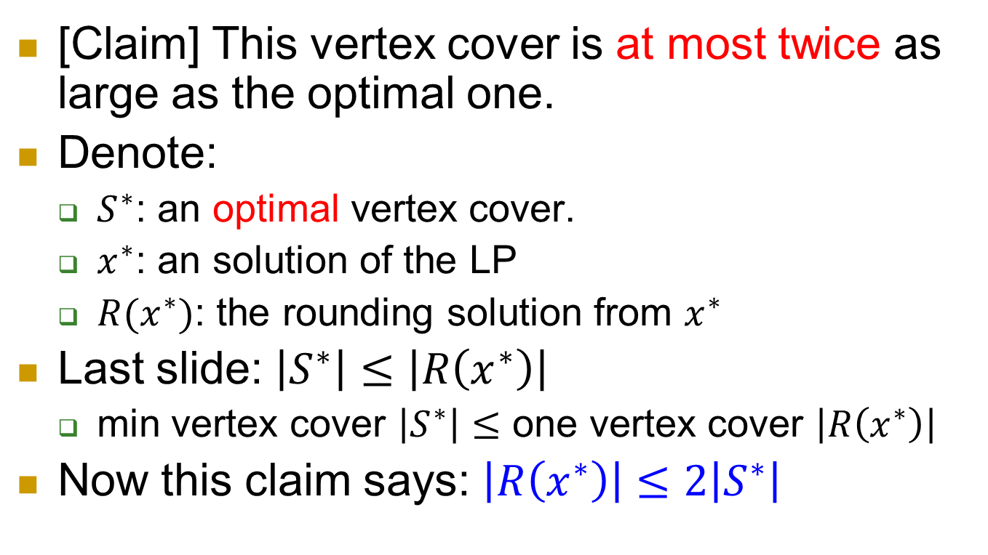
Issue 2: What can we say about the newly constructed vertex cover?
[Claim] This vertex cover is at most twice as large as the optimal one.
Denote:
  $S^{∗}$: an optimal vertex cover.
  $x^{∗}$: an solution of the LP
  $R(x^{∗})$: the rounding solution from $x^{∗}$
Last slide: $\left|S^{∗}\right|≤\left|R\left(x^{∗}\right)\right|$
  min vertex cover $\left|S^{∗}\right|≤$ one vertex cover $\left|R\left(x^{∗}\right)\right|$
Now this claim says: $\left|R\left(x^{∗}\right)\right|≤2\left|S^{∗}\right|$

Slide 26
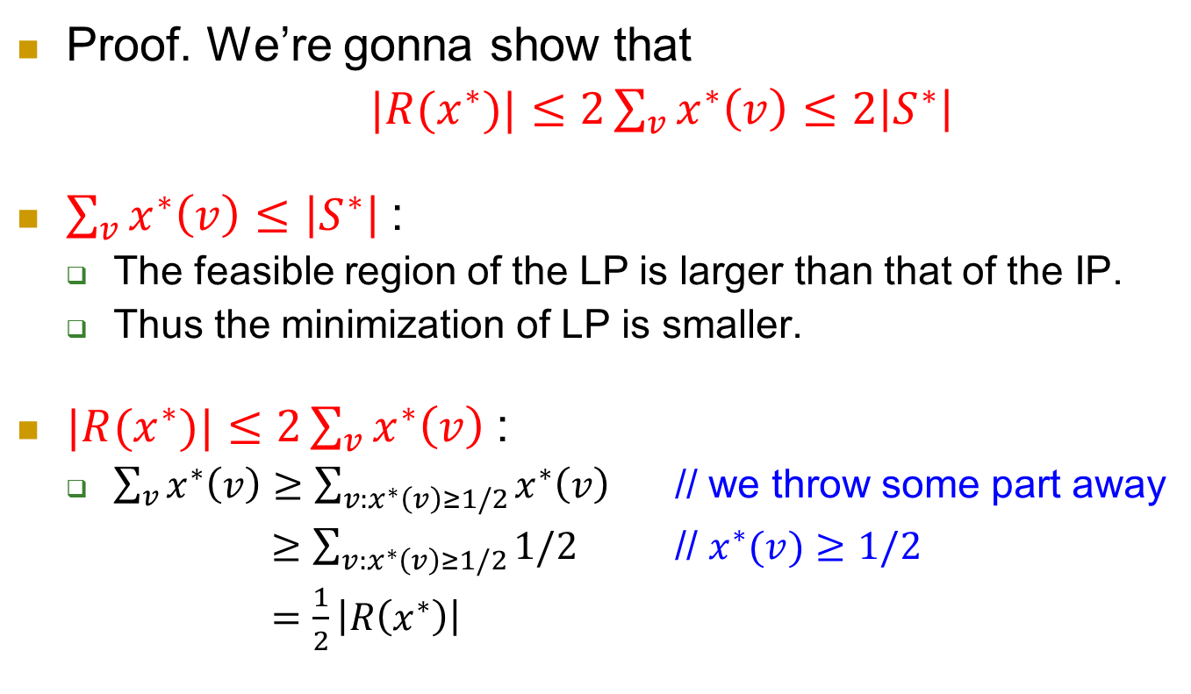

$$\left|R\left(x^{∗}\right)\right|≤2\left|S^{∗}\right|$$
Proof. We’re gonna show that
$|R(x^{∗})|≤2\sum_{v}{x^{∗}\left(v\right)}≤2\left|S^{∗}\right|$
$\sum_{v}{x^{∗}\left(v\right)}≤\left|S^{∗}\right|$:
  The feasible region of the LP is larger than that of the IP.
  Thus the minimization of LP is smaller.
$|R(x^{∗})|≤2\sum_{v}{x^{∗}\left(v\right)}$:
  $\sum_{v}{x^{∗}\left(v\right)}≥\sum_{v:x^{∗}\left(v\right)≥1/2}{x^{∗}\left(v\right)}$ // we throw some part away
  $≥\sum_{v:x^{∗}\left(v\right)≥1/2}{1/2}$ // $x^{∗}(v)≥1/2$
  $=\frac{1}{2}\left|R\left(x^{∗}\right)\right|$

Slide 27
Example 3: Set Cover

Slide 28

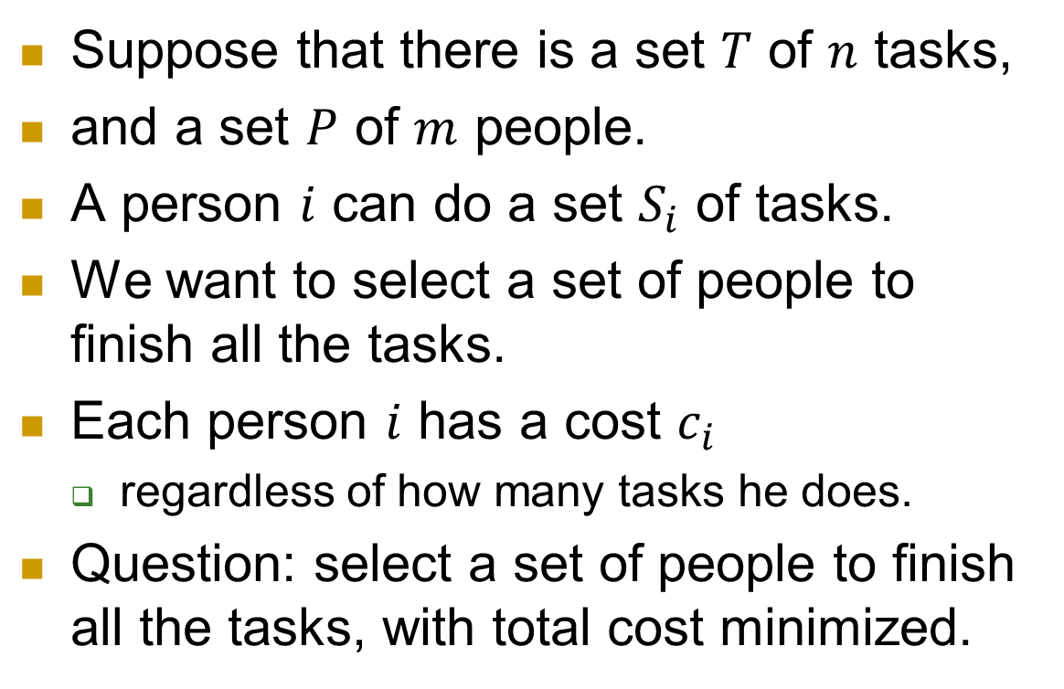



Motivation
Suppose that there is a set $T$ of $n$ tasks,
and a set $P$ of $m$ people.
A person $i$ can do a set $S_{i}$ of tasks.
We want to select a set of people to finish all the tasks.
Each person $i$ has a cost $c_{i}$
  regardless of how many tasks he does.
Question: select a set of people to finish all the tasks, with total cost minimized.
$$i$$
$$S_{i}$$
$$P$$
$$T$$

Slide 29
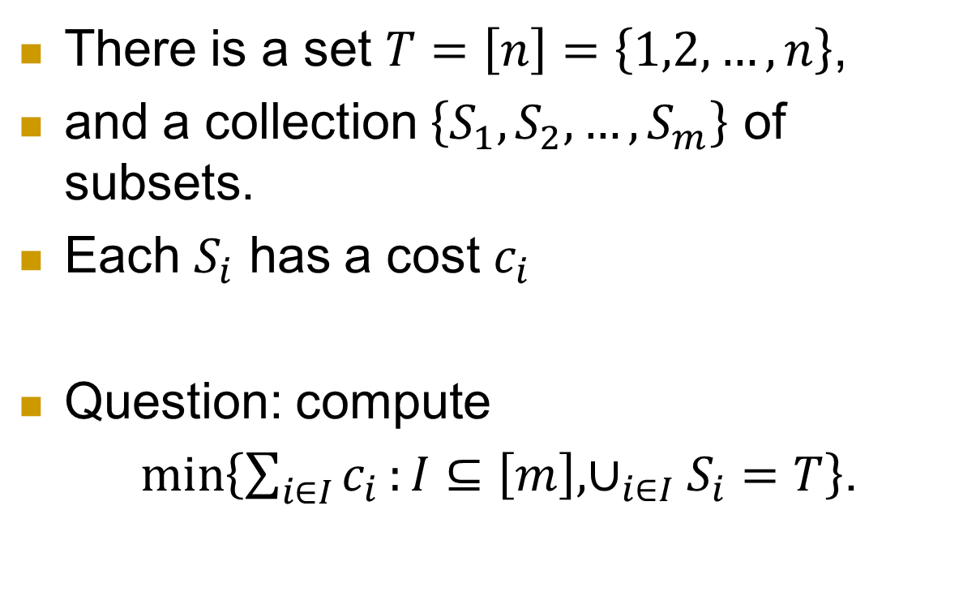
Mathematical formulation
There is a set $T=\left[n\right]=\left\{1,2,…,n\right\}$,
and a collection $\left\{S_{1},S_{2},…,S_{m}\right\}$ of subsets.
Each $S_{i}$ has a cost $c_{i}$
Question: compute
$\min\left\{\sum_{i∈I}{c_{i}}:I⊆\left[m\right],∪_{i∈I}S_{i}=T\right\}$.
$$i$$
$$S_{i}$$
$$P$$
$$T$$

Slide 30
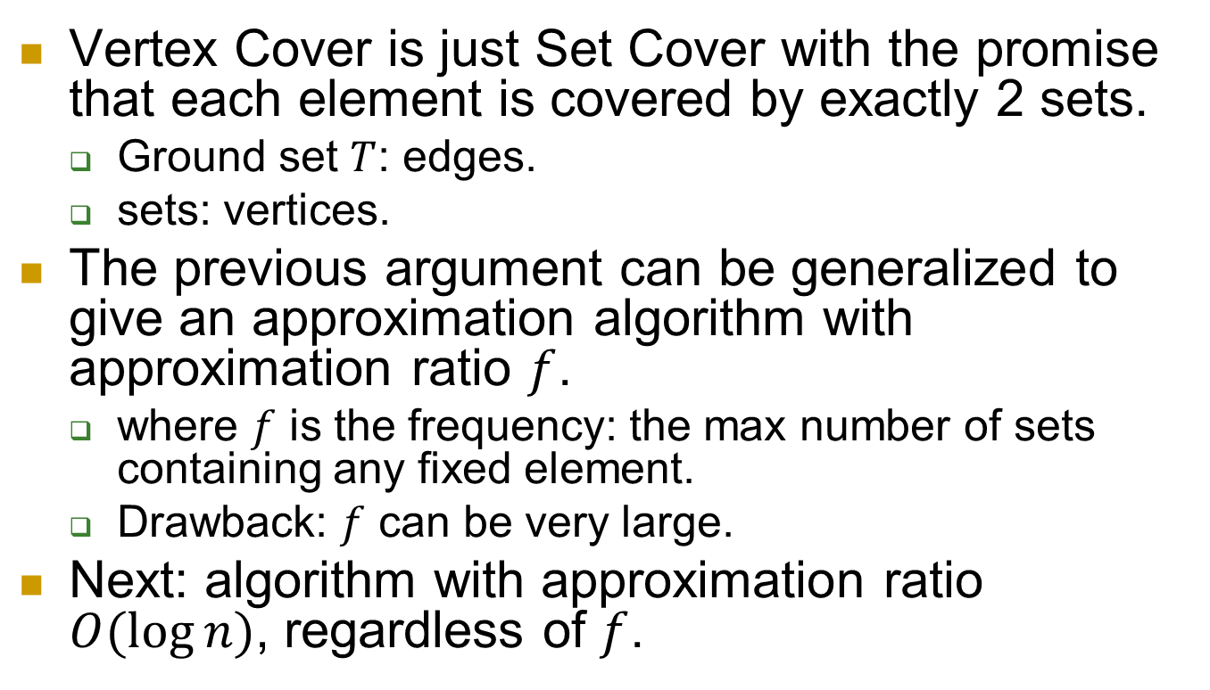
Vertex Cover is just Set Cover with the promise that each element is covered by exactly 2 sets.
  Ground set $T$: edges.
  sets: vertices.
The previous argument can be generalized to give an approximation algorithm with approximation ratio $f$.
  where $f$ is the frequency: the max number of sets containing any fixed element.
  Drawback: $f$ can be very large.
Next: algorithm with approximation ratio $O(\log{n})$, regardless of $f$.

Slide 31
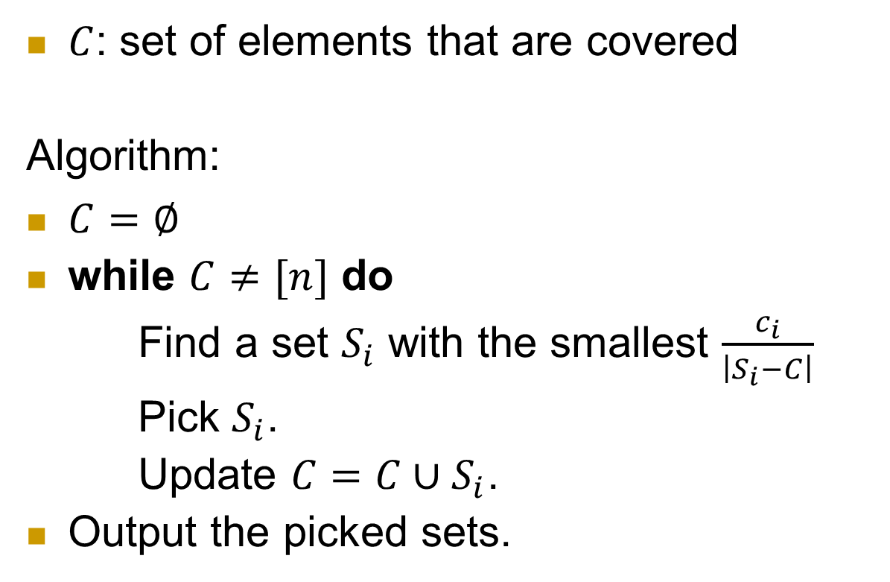
A greedy algorithm
$C$: set of elements that are covered
Algorithm:
$C=∅$
while $C≠[n]$ do
Find a set $S_{i}$ with the smallest $\frac{c_{i}}{\left|S_{i}−C\right|}$
Pick $S_{i}$.
Update $C=C∪S_{i}$.
Output the picked sets.
$$i$$
$$S_{i}$$
$$P$$
$$T$$

Slide 32
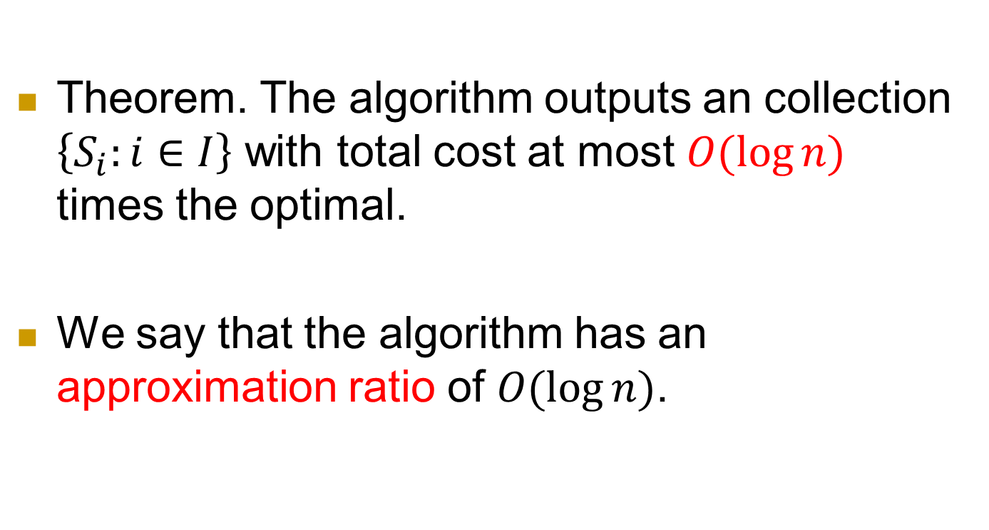
Theorem. The algorithm outputs an collection $\left\{S_{i}:i∈I\right\}$ with total cost at most $O(\log{n})$ times the optimal.
We say that the algorithm has an approximation ratio of $O(\log{n})$.

Slide 33
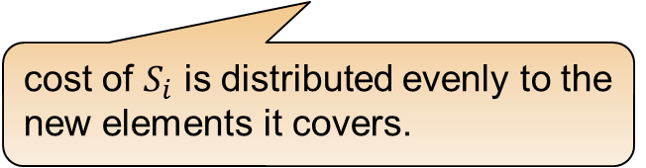
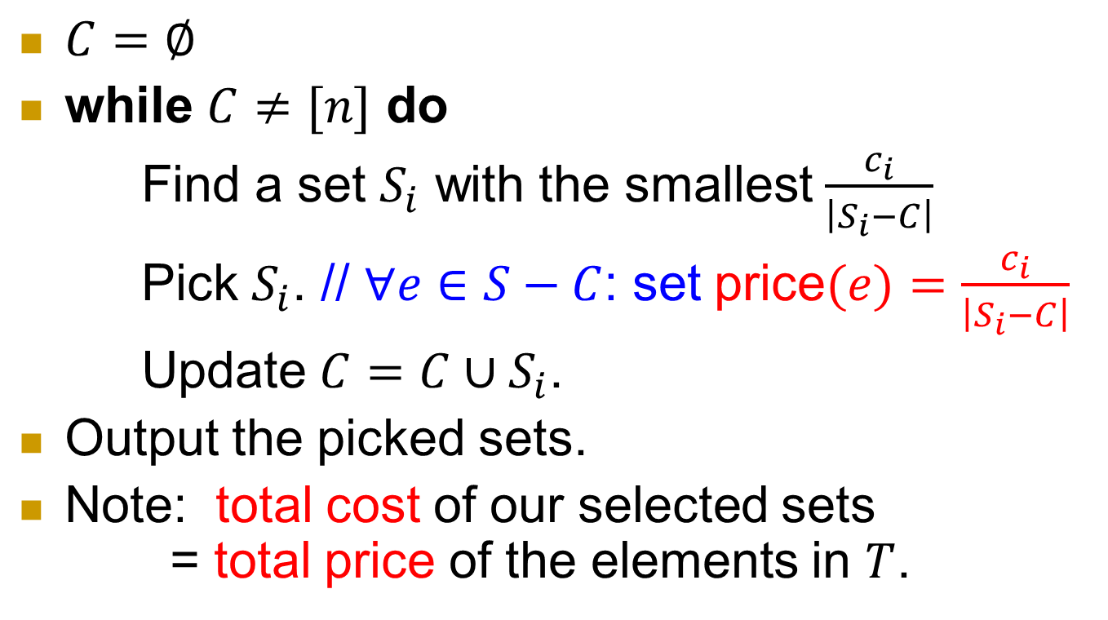
Price
$C=∅$
while $C≠[n]$ do
Find a set $S_{i}$ with the smallest $\frac{c_{i}}{\left|S_{i}−C\right|}$
Pick $S_{i}$. // $∀e∈S−C$: set price$(e)=\frac{c_{i}}{\left|S_{i}−C\right|}$
Update $C=C∪S_{i}$.
Output the picked sets.
Note: total cost of our selected sets
= total price of the elements in $T$.
cost of $S_{i}$ is distributed evenly to the new elements it covers.

Slide 34
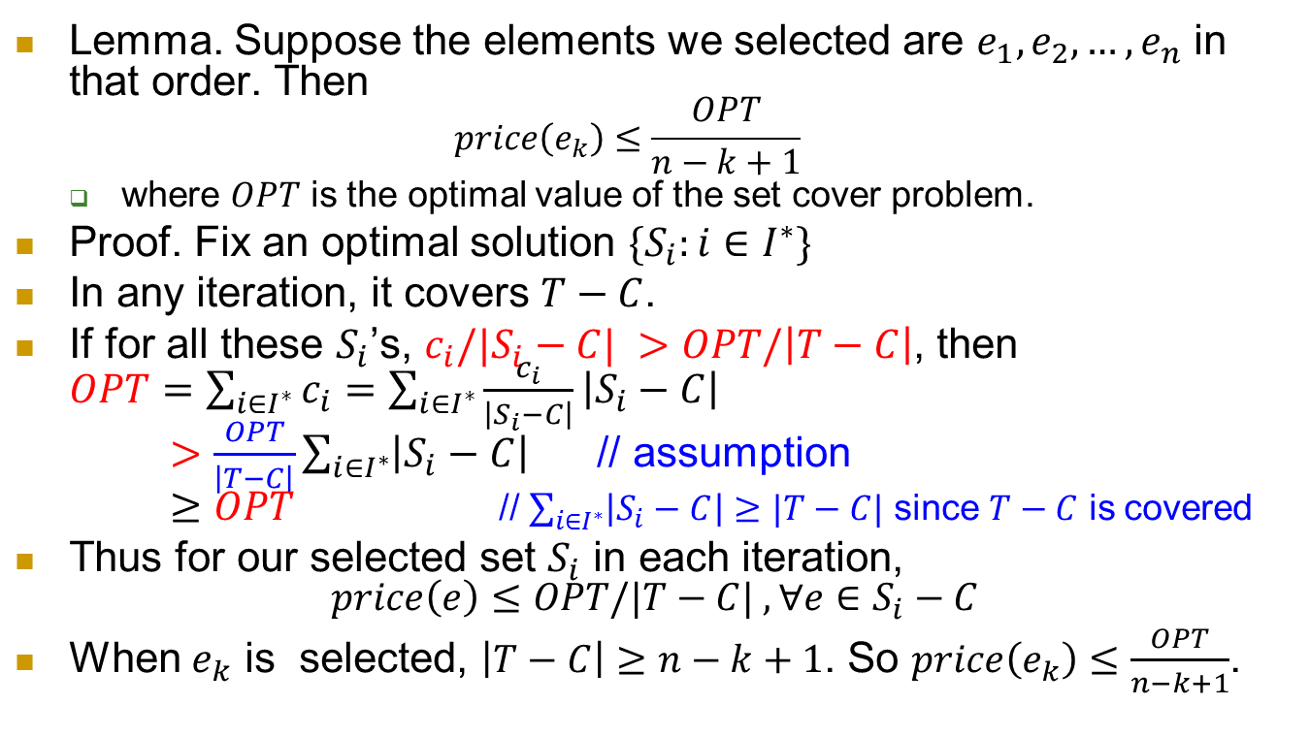
Price is small
Lemma. Suppose the elements we selected are $e_{1},e_{2}, …,e_{n}$ in that order. Then
$price\left(e_{k}\right)≤\frac{OPT}{n−k+1}$
  where $OPT$ is the optimal value of the set cover problem.
Proof. Fix an optimal solution $\{S_{i}:i∈I^{∗}\}$
In any iteration, it covers $T−C$.
If for all these $S_{i}$’s, $c_{i}/|S_{i}−C| >OPT/\left|T−C\right|$, then
$OPT=\sum_{i∈I^{∗}}{c_{i}}=\sum_{i∈I^{∗}}{\frac{c_{i}}{\left|S_{i}−C\right|}\left|S_{i}−C\right|}$
$>\frac{OPT}{\left|T−C\right|}\sum_{i∈I^{∗}}{\left|S_{i}−C\right|}$ // assumption
$≥OPT$ // $\sum_{i∈I^{∗}}{\left|S_{i}−C\right|}≥|T−C|$ since $T−C$ is covered
Thus for our selected set $S_{i}$ in each iteration,
$price\left(e\right)≤OPT/|T−C| , ∀e∈S_{i}−C$
When $e_{k}$ is selected, $\left|T−C\right|≥n−k+1$. So $price\left(e_{k}\right)≤\frac{OPT}{n−k+1}$.

Slide 35
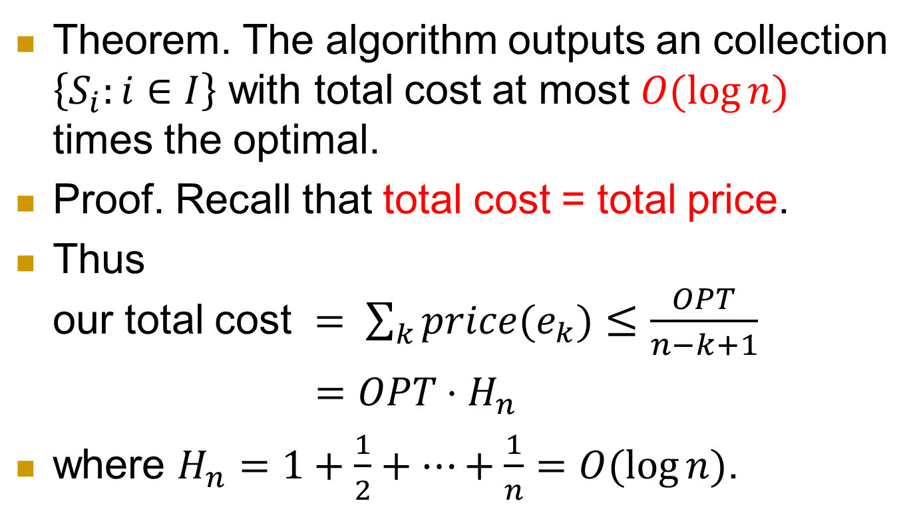
Proof of the theorem
Theorem. The algorithm outputs an collection $\left\{S_{i}:i∈I\right\}$ with total cost at most $O(\log{n})$ times the optimal.
Proof. Recall that total cost = total price.
Thus
our total cost $= \sum_{k}{price(e_{k})}≤\frac{OPT}{n−k+1}$
$=OPT⋅H_{n}$
where $H_{n}=1+\frac{1}{2}+…+\frac{1}{n}=O(\log{n})$.

Slide 36
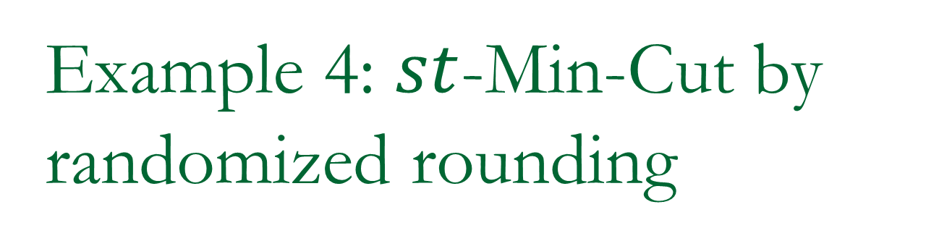
Example 4: $st$-Min-Cut by randomized rounding
Obtaining an exact algorithm!

Slide 37
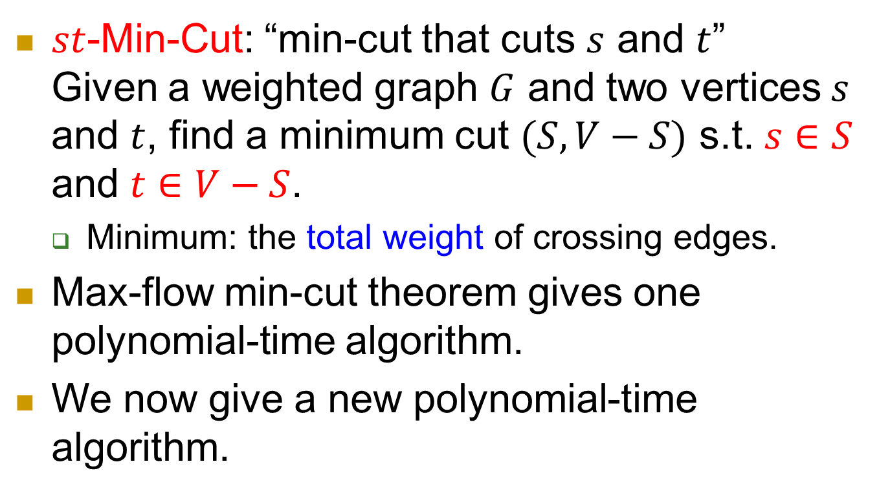
st-Min-Cut
$st$-Min-Cut: “min-cut that cuts $s$ and $t$”
Given a weighted graph $G$ and two vertices $s$ and $t$, find a minimum cut $(S, V−S)$ s.t. $s∈S$ and $t∈V−S$.
  Minimum: the total weight of crossing edges.
Max-flow min-cut theorem gives one polynomial-time algorithm.
We now give a new polynomial-time algorithm.

Slide 38
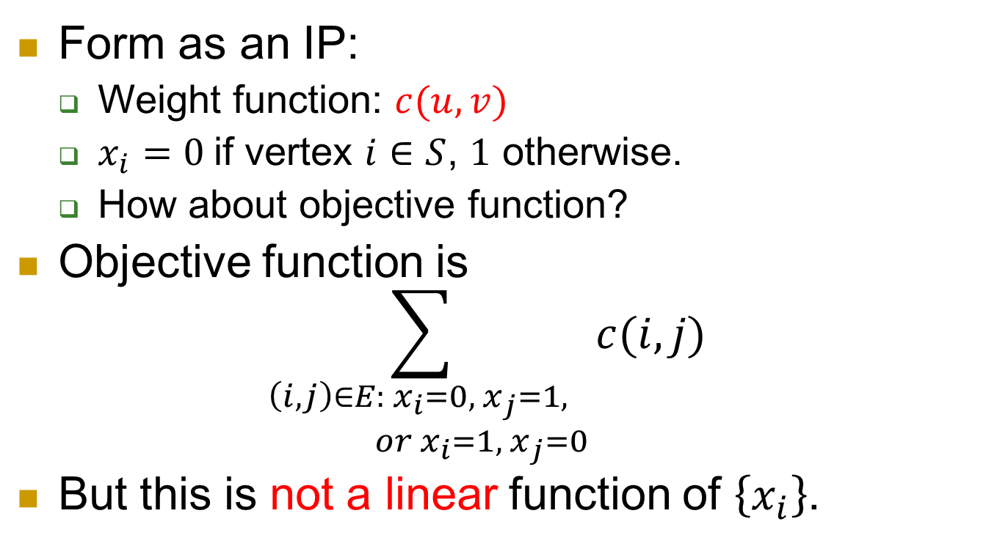
IP formulation
Form as an IP:
  Weight function: $c(u,v)$
  $x_{i}=0$if vertex $i∈S$, $1$ otherwise.
  How about objective function?
Objective function is
$\sum_{\begin{aligned}\left(i,j\right)∈E: x_{i}=0,{ x}_{j}=1, \\ or{ x}_{i}=1,{ x}_{j}=0\end{aligned}}{c(i,j)}$
But this is not a linear function of $\left\{x_{i}\right\}$.

Slide 39
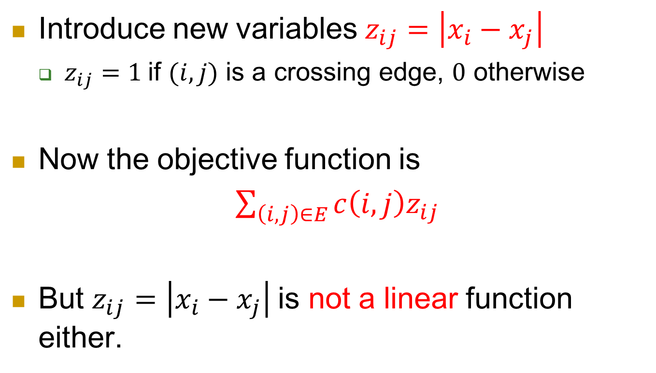
Modification
Introduce new variables $z_{ij}=\left|x_{i}−x_{j}\right|$
  $z_{ij}=1$if $(i,j)$ is a crossing edge, $0$ otherwise
Now the objective function is
$\sum_{\left(i,j\right)∈E}{c\left(i,j\right)z_{ij}}$
But $z_{ij}=\left|x_{i}−x_{j}\right|$is not a linear function either.

Slide 40
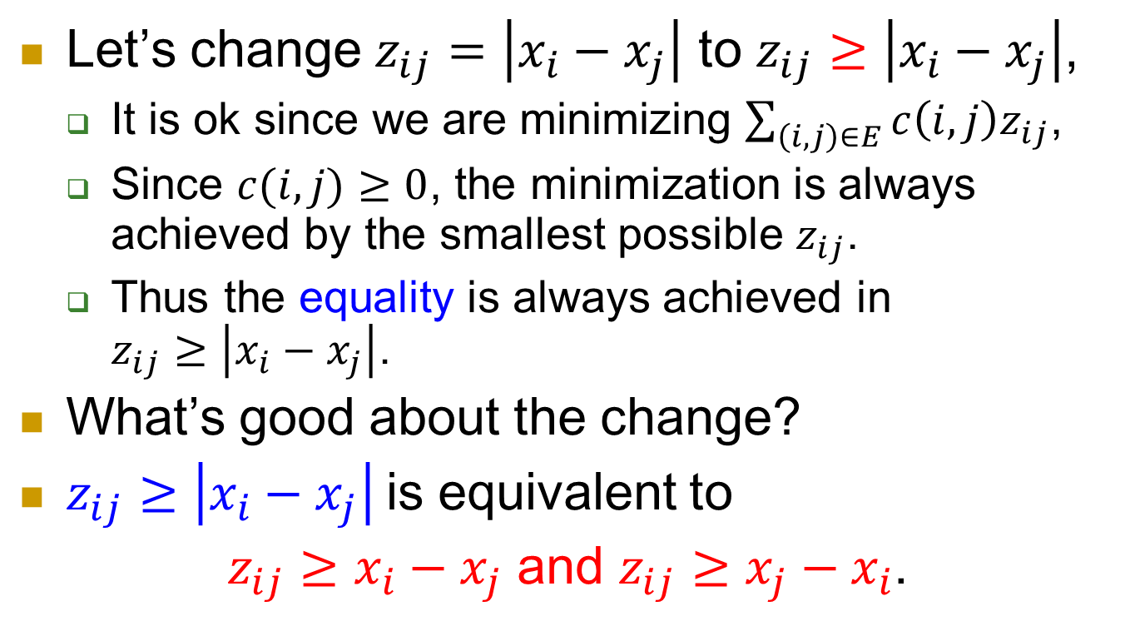
Let’s change $z_{ij}=\left|x_{i}−x_{j}\right|$ to $z_{ij}≥\left|x_{i}−x_{j}\right|$,
  It is ok since we are minimizing $\sum_{\left(i,j\right)∈E}{c\left(i,j\right)z_{ij}}$,
  Since $c(i,j)≥0$, the minimization is always achieved by the smallest possible $z_{ij}$.
  Thus the equality is always achieved in
  $z_{ij}≥\left|x_{i}−x_{j}\right|$.
What’s good about the change?
$z_{ij}≥\left|x_{i}−x_{j}\right|$is equivalent to
$z_{ij}≥x_{i}−x_{j}$ and $z_{ij}≥x_{j}−x_{i}$.

Slide 41
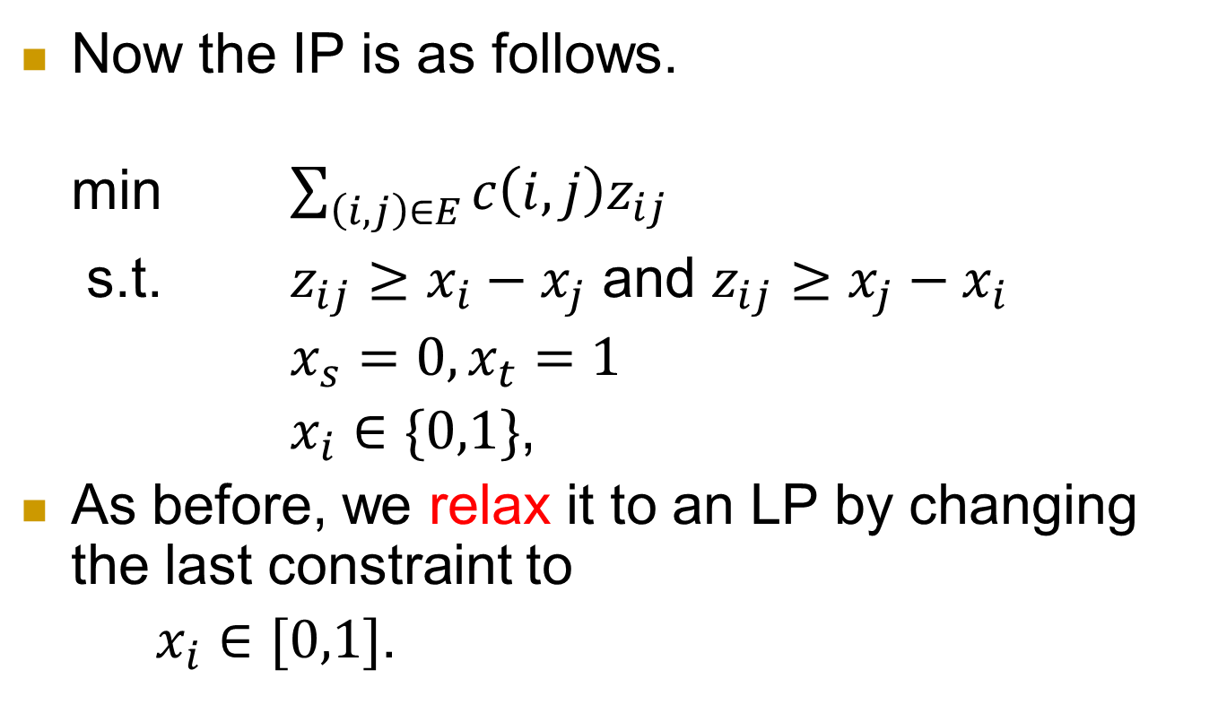
IP
Now the IP is as follows.
min $\sum_{\left(i,j\right)∈E}{c\left(i,j\right)z_{ij}}$
s.t. $z_{ij}≥x_{i}−x_{j}$ and $z_{ij}≥x_{j}−x_{i}$
$x_{s}=0, x_{t}=1$
$x_{i}∈\{0,1\}$,
As before, we relax it to an LP by changing the last constraint to
$x_{i}∈[0,1]$.

Slide 42
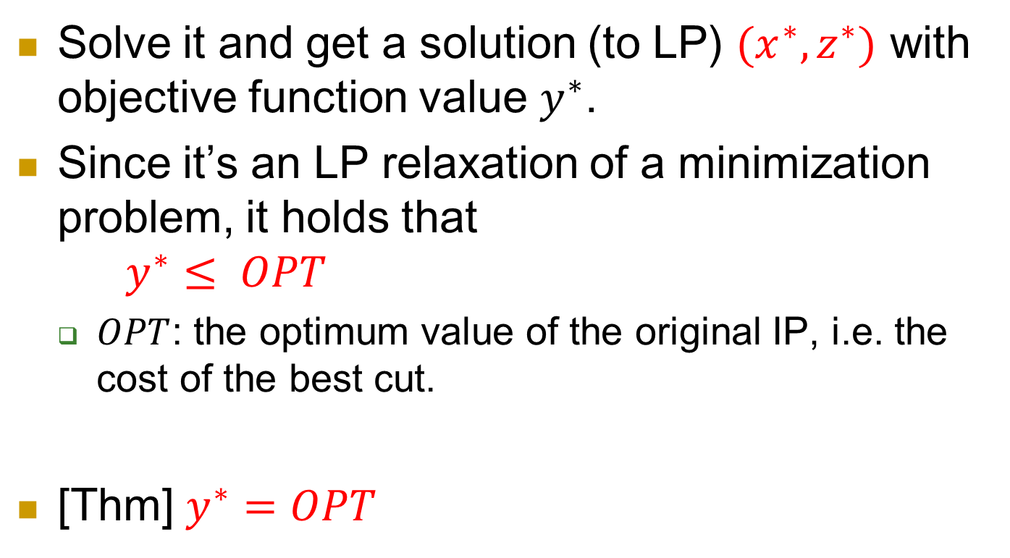
Solve it and get a solution (to LP) $(x^{∗}, z^{∗})$ with objective function value $y^{∗}$.
Since it’s an LP relaxation of a minimization problem, it holds that
$y^{∗}≤ OPT$
  $OPT$: the optimum value of the original IP, i.e. the cost of the best cut.
[Thm] $y^{∗}=OPT$

Slide 43
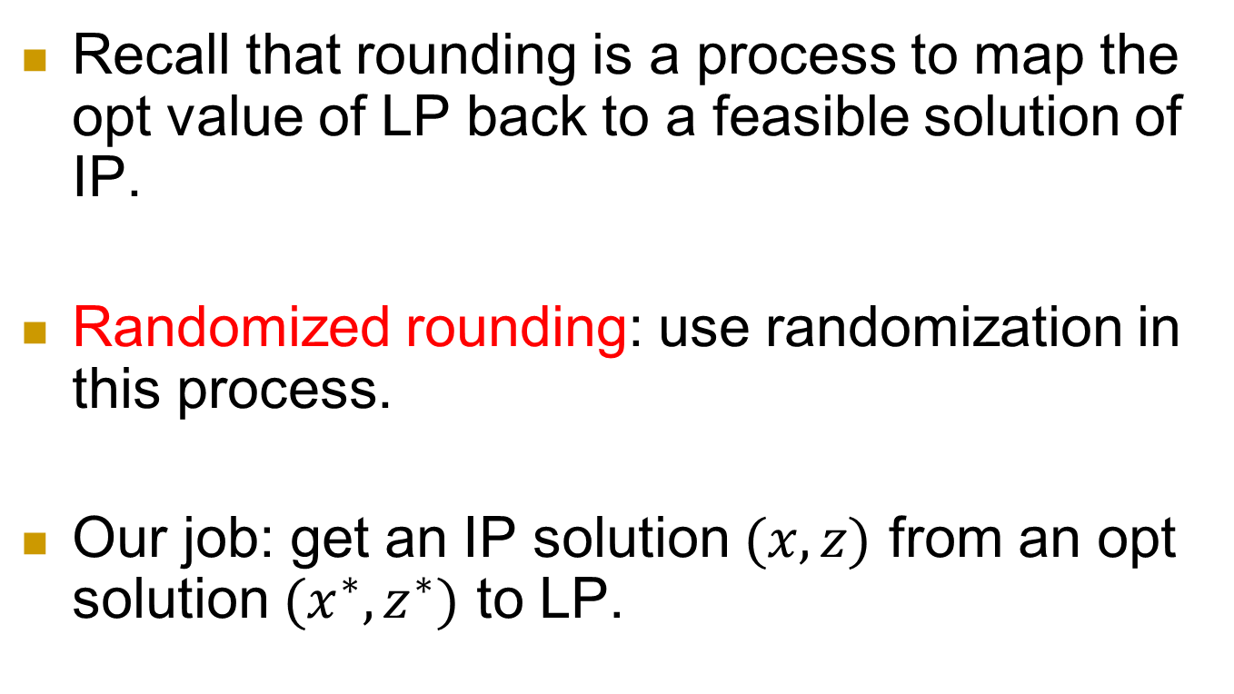
We prove this by randomized rounding
Recall that rounding is a process to map the opt value of LP back to a feasible solution of IP.
Randomized rounding: use randomization in this process.
Our job: get an IP solution $(x,z)$ from an opt solution $(x^{∗},z^{∗})$ to LP.

Slide 44
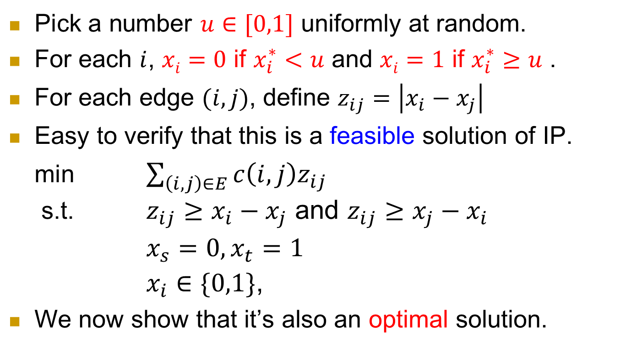
Rounding algorithm
Pick a number $u∈[0,1]$ uniformly at random.
For each $i$, $xi=0$ if $x_{i}^{∗}<u$ and $xi=1$ if $x_{i}^{∗}≥u$ .
For each edge $(i,j)$, define $z_{ij}=\left|x_{i}−x_{j}\right|$
Easy to verify that this is a feasible solution of IP.
min $\sum_{\left(i,j\right)∈E}{c\left(i,j\right)z_{ij}}$
s.t. $z_{ij}≥x_{i}−x_{j}$ and $z_{ij}≥x_{j}−x_{i}$
$x_{s}=0, x_{t}=1$
$x_{i}∈\{0,1\}$,
We now show that it’s also an optimal solution.

Slide 45
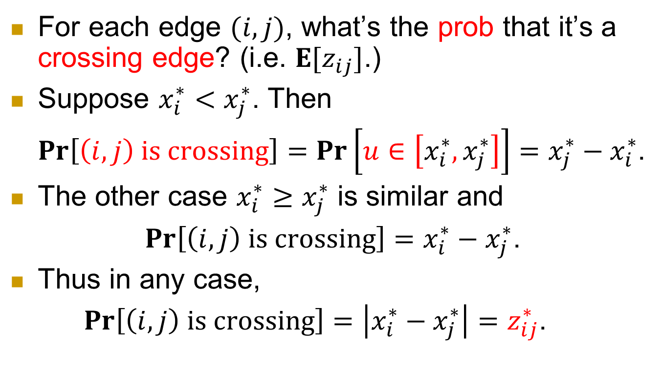
For each edge $(i,j)$, what’s the prob that it’s a crossing edge? (i.e. $E[z_{ij}]$.)
Suppose $x_{i}^{∗}<x_{j}^{∗}$. Then
$\operatorname{Pr}\left[\left(i,j\right) is crossing\right]=\operatorname{Pr}\left[u∈\left[x_{i}^{∗},x_{j}^{∗}\right]\right]=x_{j}^{∗}−x_{i}^{∗}$.
The other case $x_{i}^{∗}≥x_{j}^{∗}$ is similar and
$\operatorname{Pr}\left[\left(i,j\right) is crossing\right]=x_{i}^{∗}−x_{j}^{∗}$.
Thus in any case,
$\operatorname{Pr}\left[\left(i,j\right) is crossing\right]=\left|x_{i}^{∗}−x_{j}^{∗}\right|=z_{ij}^{∗}$.

Slide 46
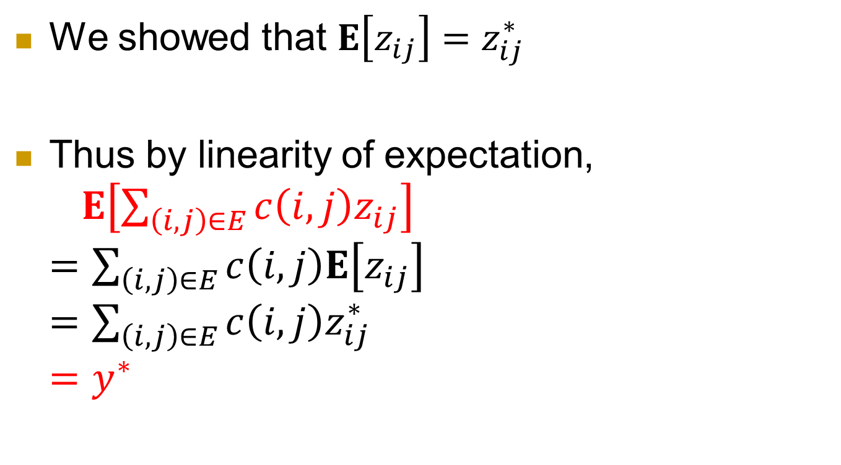
We showed that $E\left[z_{ij}\right]=z_{ij}^{∗}$
Thus by linearity of expectation,
$E\left[\sum_{\left(i,j\right)∈E}{c\left(i,j\right)z_{ij}}\right]$
$=\sum_{\left(i,j\right)∈E}{c\left(i,j\right)E\left[z_{ij}\right]}$
$=\sum_{\left(i,j\right)∈E}{c\left(i,j\right)z_{ij}^{∗}}$
$=y^{∗}$

Slide 47
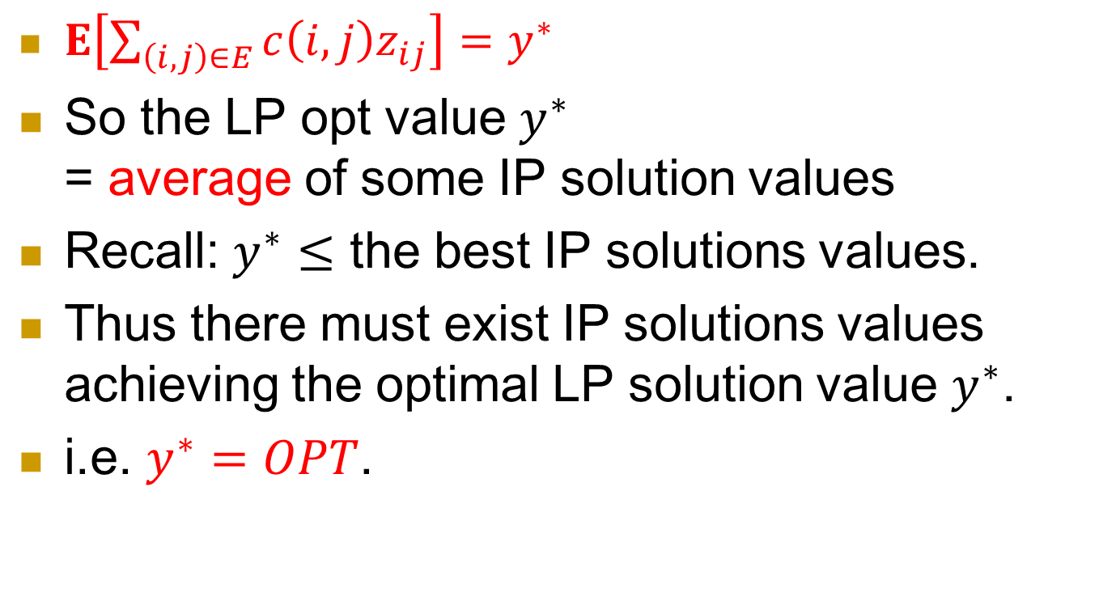
$E\left[\sum_{\left(i,j\right)∈E}{c\left(i,j\right)z_{ij}}\right]=y^{∗}$
So the LP opt value $y^{∗}$
= average of some IP solution values
Recall: $y^{∗}≤$ the best IP solutions values.
Thus there must exist IP solutions values achieving the optimal LP solution value $y^{∗}$.
i.e. $y^{∗}=OPT$.

Slide 48
Summary
Many optimization problems are NP-complete.
Approximation algorithms aim to find almost optimal solution.
An important tool to design approximation algorithms is LP.

