Slide 1
CMSC5706 Topics in Theoretical Computer Science
Week 3: Streaming and Sketching
Instructor: Shengyu Zhang

Slide 2
Map
Motivations and model
Problem 1: Missing numbers
Problem 2: Count-Min sketch
Lower bounds
  Communication complexity

Slide 3

Motivations
Big mass of data.
Data comes as a stream.
  Cannot see future data.
Relatively small space. “sketch”
  Cannot store past data
Need to process each item fast.
  Quick update time.
Examples: Phone calls, Internet packets, satellite pictures, …

Slide 4

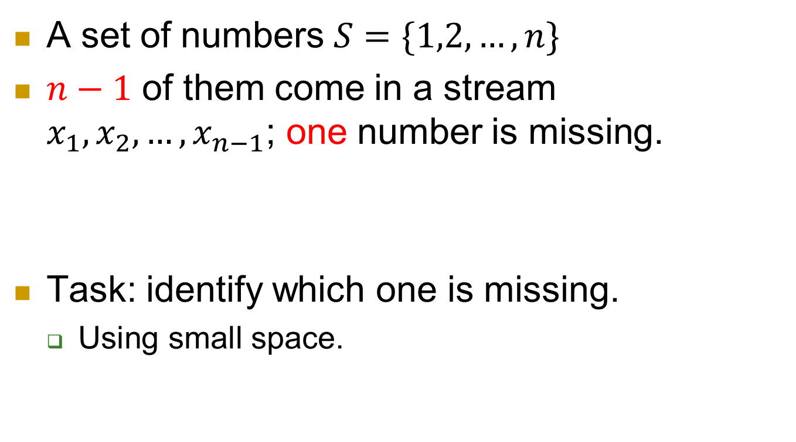
Problem 1: Missing numbers
A set of numbers $S=\{1,2,…,n\}$
$n−1$ of them come in a stream $x_{1}, x_{2}, …, x_{n−1}$; one number is missing.
Task: identify which one is missing.
  Using small space.
$$3, 25, 6, 19, 1, 10, …$$

Slide 5
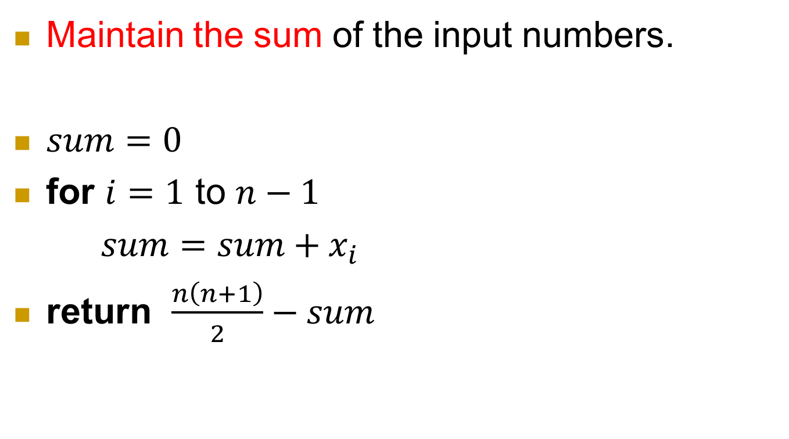
A simple algorithm
Maintain the sum of the input numbers.
$sum=0$
for $i=1$ to $n−1$
$sum=sum+x_{i}$
return $\frac{n\left(n+1\right)}{2}−sum$

Slide 6
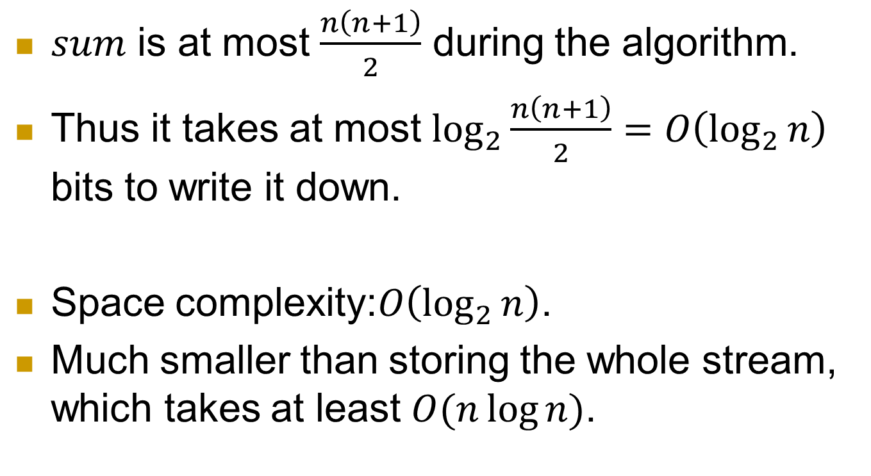
Space complexity
$sum$ is at most $\frac{n\left(n+1\right)}{2}$ during the algorithm.
Thus it takes at most $\log_{2}{\frac{n\left(n+1\right)}{2}}=O\left(\log_{2}{n}\right)$ bits to write it down.
Space complexity:$O\left(\log_{2}{n}\right)$.
Much smaller than storing the whole stream, which takes at least $O(n\log{n})$.

Slide 7
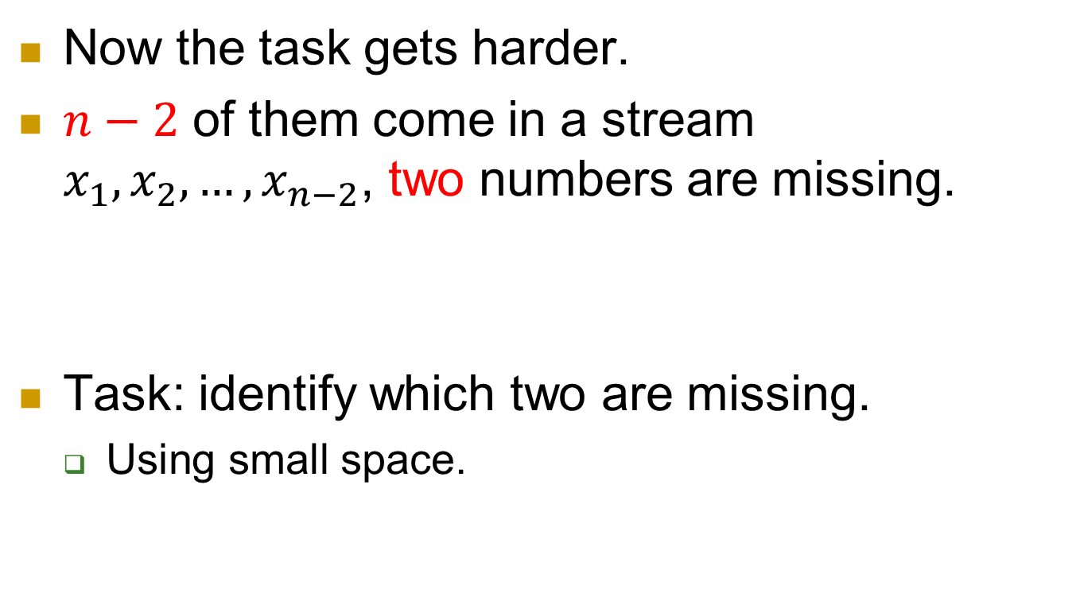
More complicated
Now the task gets harder.
$n−2$ of them come in a stream $x_{1}, x_{2}, …, x_{n−2}$, two numbers are missing.
Task: identify which two are missing.
  Using small space.
$$3, 25, 6, 19, 1, 10, …$$

Slide 8
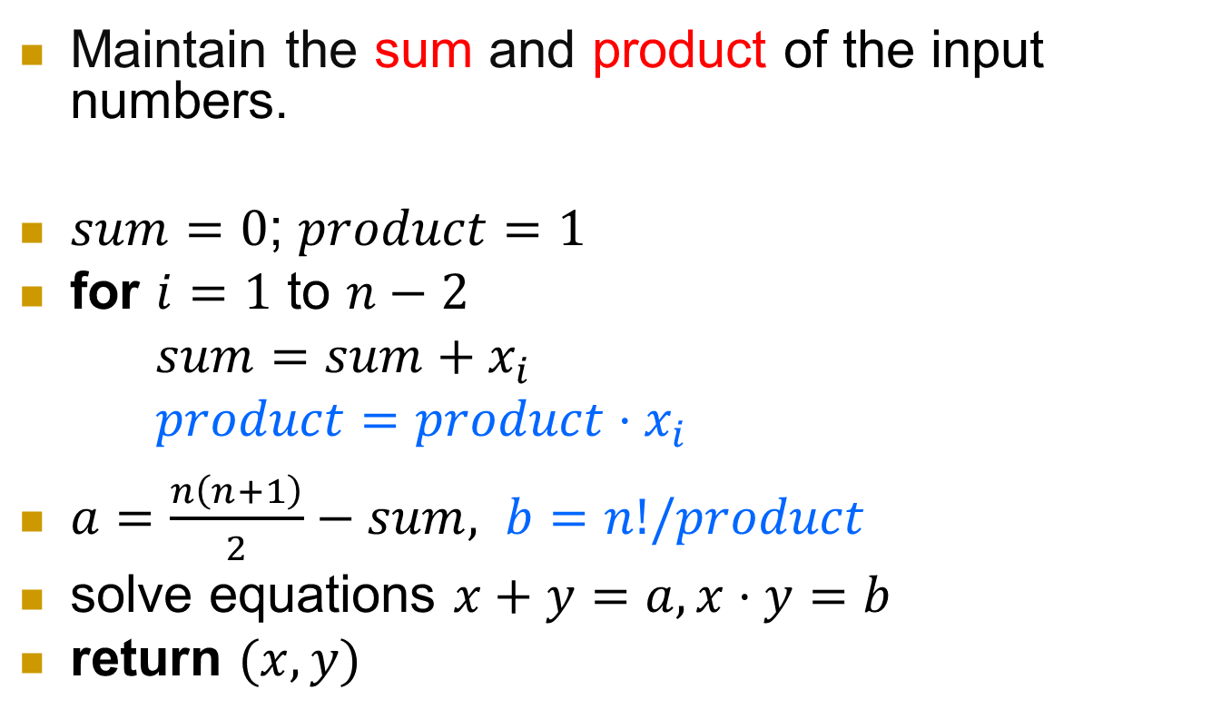
First try
Maintain the sum and product of the input numbers.
$sum=0$; $product=1$
for $i=1$ to $n−2$
$sum=sum+x_{i}$
$product=product⋅x_{i}$
$a=\frac{n\left(n+1\right)}{2}−sum, b=n!/product$
solve equations $x+y=a, x⋅y=b$
return $(x,y)$

Slide 9
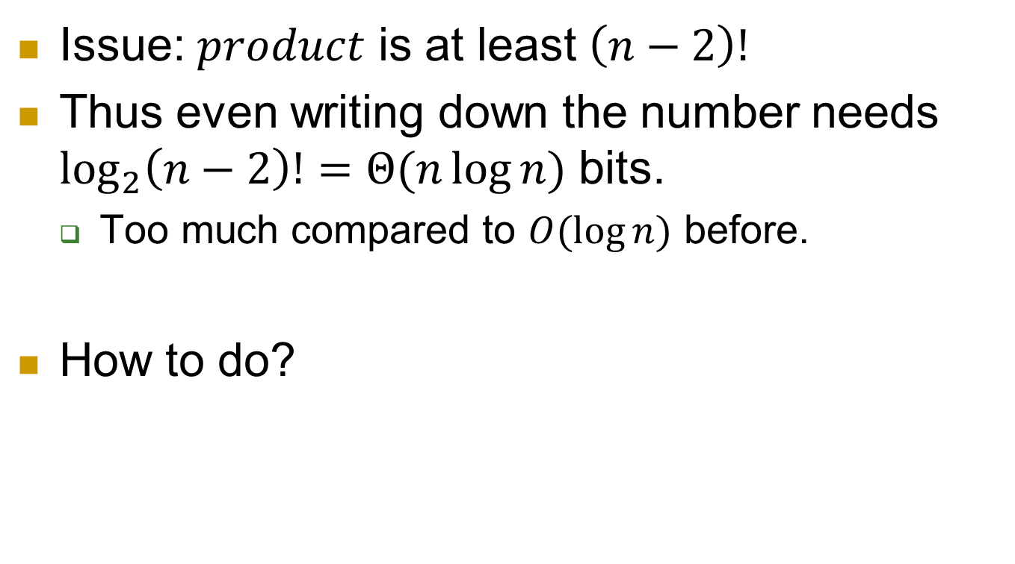
Problem and solution
Issue: $product$ is at least $\left(n−2\right)!$
Thus even writing down the number needs $\log_{2}\left(n−2\right)!=Θ(n\log{n})$ bits.
  Too much compared to $O(\log{n})$ before.
How to do?

Slide 10
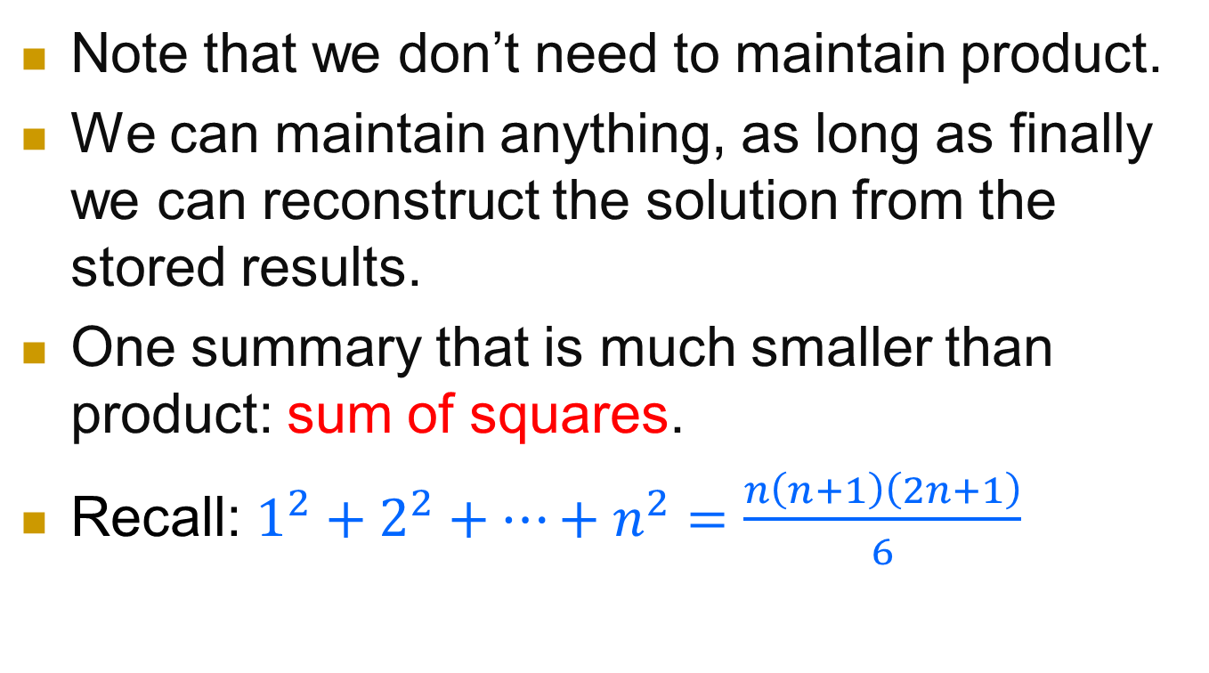
Improvement
Note that we don’t need to maintain product.
We can maintain anything, as long as finally we can reconstruct the solution from the stored results.
One summary that is much smaller than product: sum of squares.
Recall: $1^{2}+2^{2}+…+n^{2}=\frac{n\left(n+1\right)\left(2n+1\right)}{6}$

Slide 11
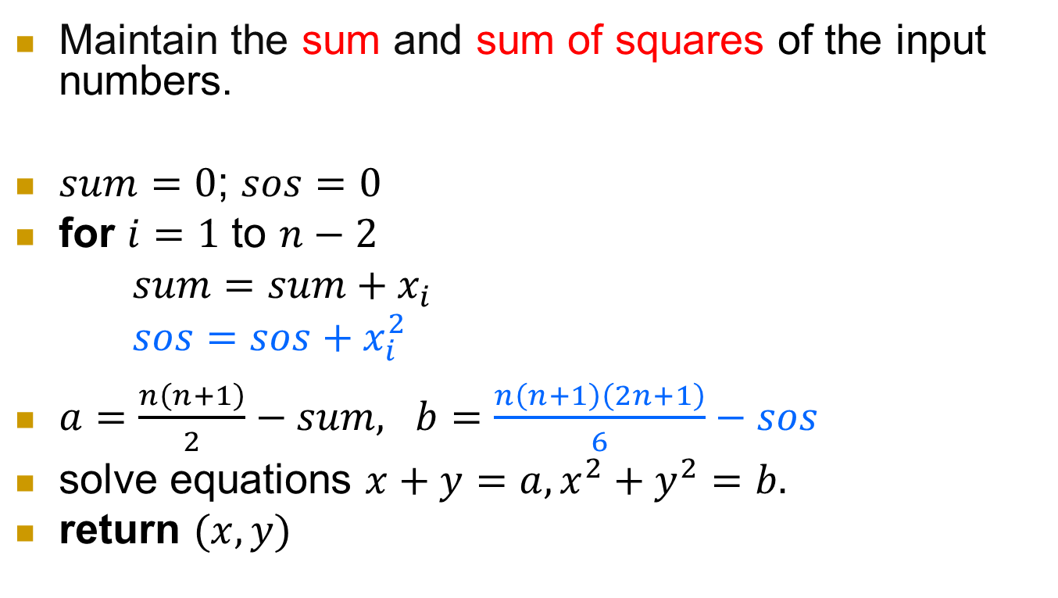
Improvement
Maintain the sum and sum of squares of the input numbers.
$sum=0$; $sos=0$
for $i=1$ to $n−2$
$sum=sum+x_{i}$
$sos=sos+x_{i}^{2}$
$a=\frac{n\left(n+1\right)}{2}−sum, b=\frac{n\left(n+1\right)\left(2n+1\right)}{6}−sos$
solve equations $x+y=a, x^{2}+y^{2}=b.$
return $(x,y)$

Slide 12
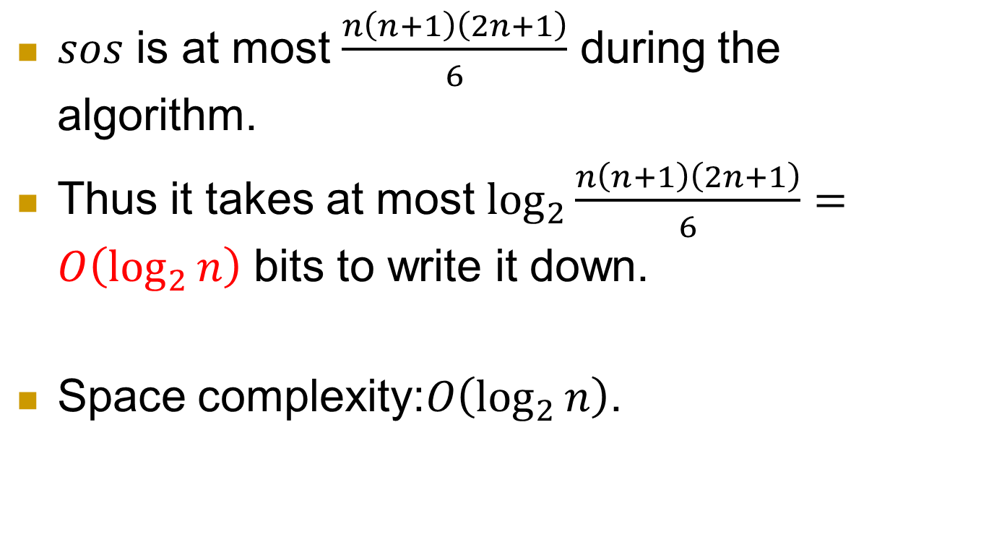
Space complexity
$sos$ is at most $\frac{n\left(n+1\right)\left(2n+1\right)}{6}$ during the algorithm.
Thus it takes at most $\log_{2}{\frac{n\left(n+1\right)\left(2n+1\right)}{6}}=O\left(\log_{2}{n}\right)$ bits to write it down.
Space complexity:$O\left(\log_{2}{n}\right)$.

Slide 13
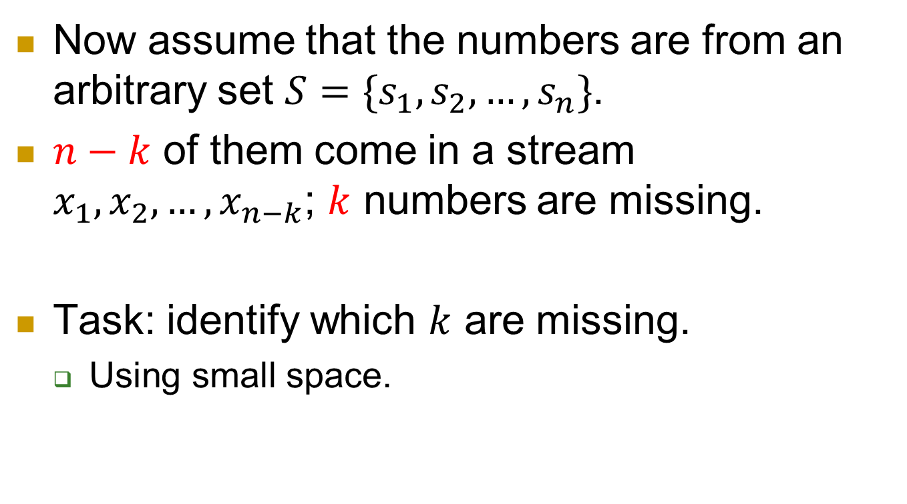
Further question
Now assume that the numbers are from an arbitrary set $S=\{s_{1},s_{2},…, s_{n}\}$.
$n−k$ of them come in a stream $x_{1}, x_{2}, …, x_{n−k}$; $k$ numbers are missing.
Task: identify which $k$ are missing.
  Using small space.

Slide 14
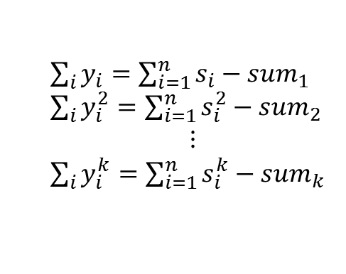
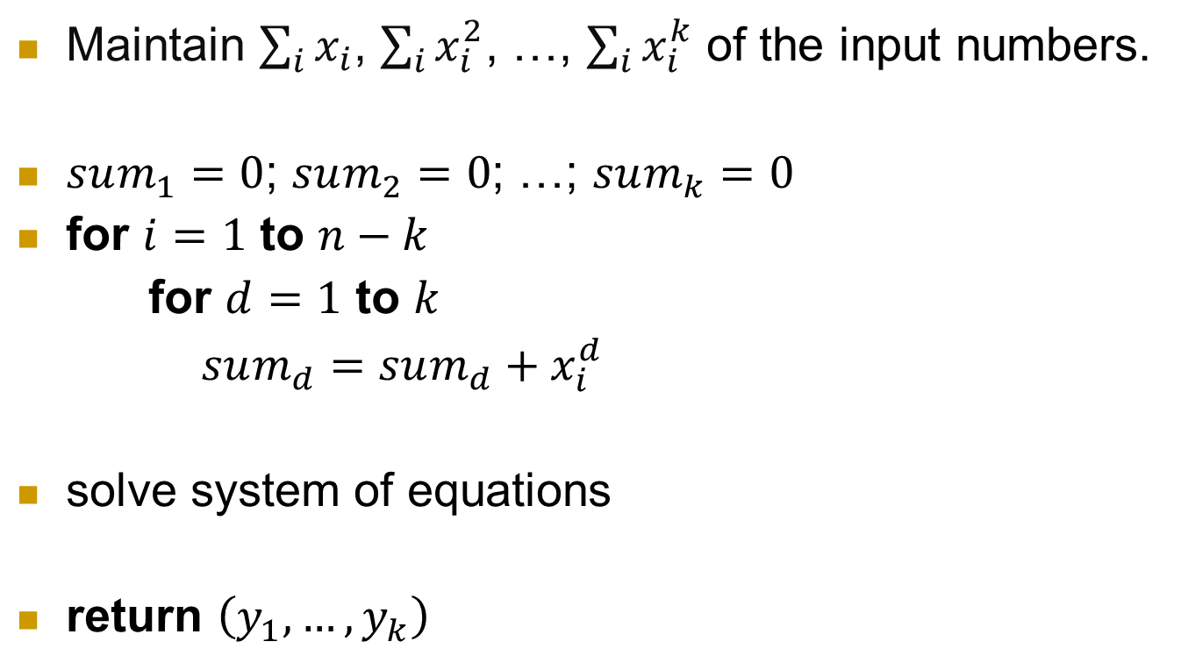
First try
Maintain $\sum_{i}{x_{i}}$, $\sum_{i}{x_{i}^{2}}$, …, $\sum_{i}{x_{i}^{k}}$ of the input numbers.
$sum_{1}=0$; $sum_{2}=0$; …; $sum_{k}=0$
for $i=1$ to $n−k$
for $d=1$ to $k$
$sum_{d}=sum_{d}+x_{i}^{d}$
solve system of equations
return $\left(y_{1},…, y_{k}\right)$
$\sum_{i}{y_{i}}=\sum_{i=1}^{n}{s_{i}}−sum_{1}$
$\sum_{i}{y_{i}^{2}}=\sum_{i=1}^{n}{s_{i}^{2}}−sum_{2}$
$$⋮$$
$\sum_{i}{y_{i}^{k}}=\sum_{i=1}^{n}{s_{i}^{k}}−sum_{k}$

Slide 15
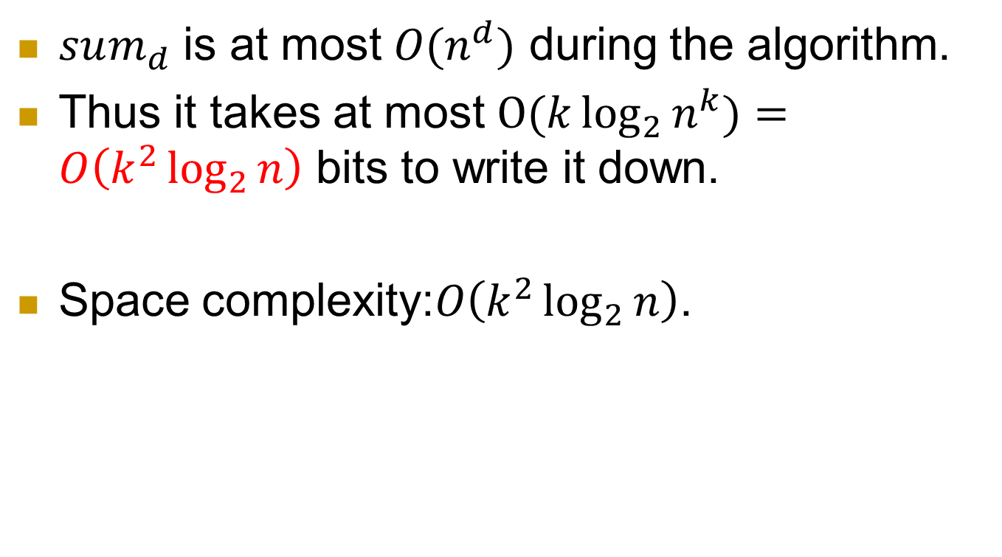
Space complexity
$sum_{d}$ is at most $O(n^{d})$ during the algorithm.
Thus it takes at most $O(k\log_{2}{n^{k}})=O\left(k^{2}\log_{2}{n}\right)$ bits to write it down.
Space complexity:$O\left(k^{2}\log_{2}{n}\right)$.

Slide 16

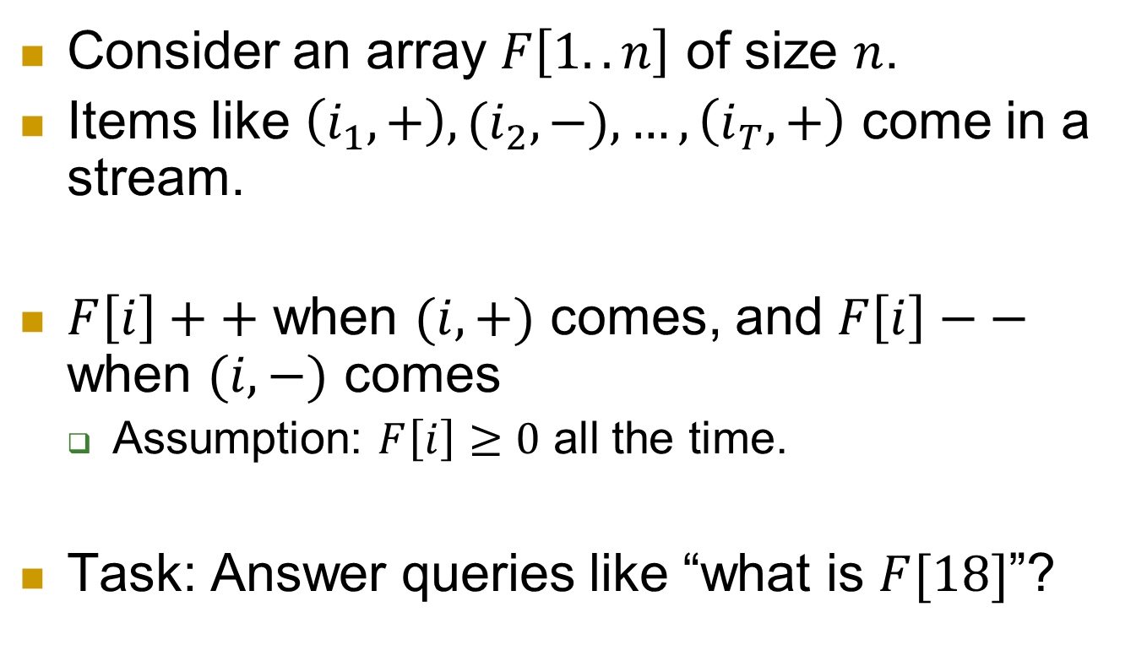
Problem 2: high frequency estimation
Consider an array $F\left[1..n\right]$ of size $n$.
Items like $\left(i_{1},+\right), (i_{2},−), …, \left(i_{T},+\right)$ come in a stream.
$F\left[i\right]++$ when $(i,+)$ comes, and $F\left[i\right]−−$ when $(i,−)$ comes
  Assumption: $F\left[i\right]≥0$ all the time.
Task: Answer queries like “what is $F[18]$”?
$$\left(3,+\right), (3,+),(2,+),(3,−),…$$

Slide 17
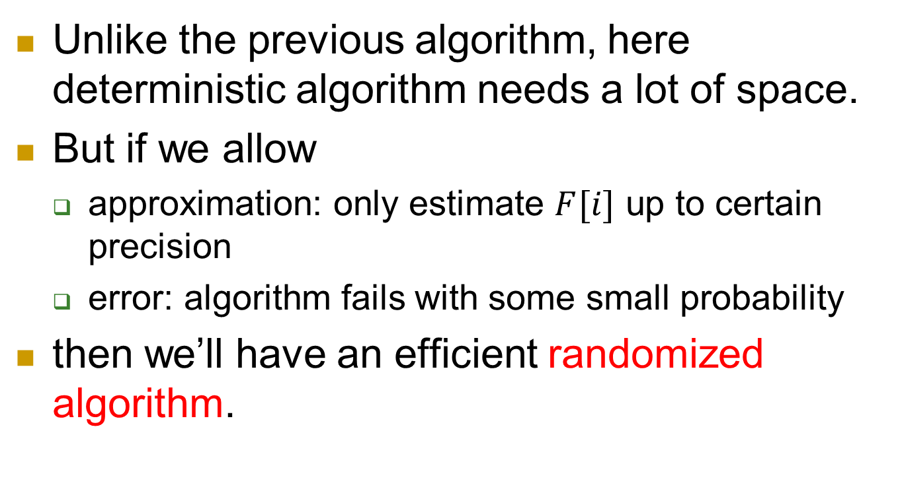
Approximation and error
Unlike the previous algorithm, here deterministic algorithm needs a lot of space.
But if we allow
  approximation: only estimate $F[i]$ up to certain precision
  error: algorithm fails with some small probability
then we’ll have an efficient randomized algorithm.

Slide 18

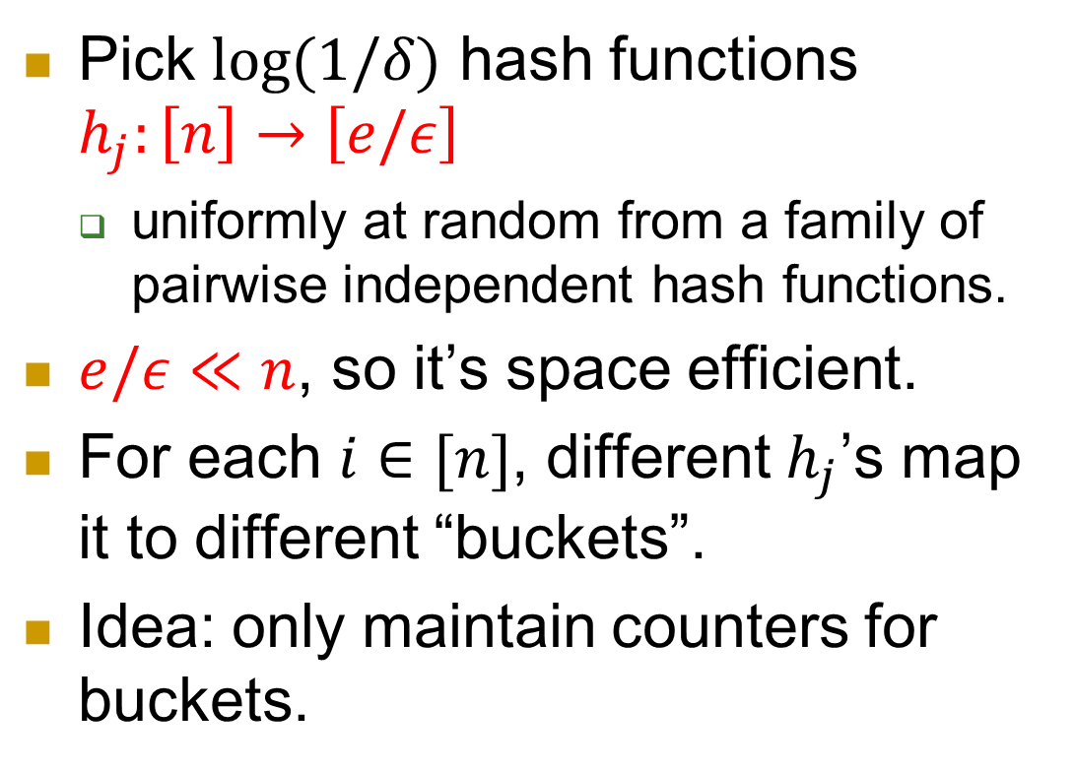


Pick $\log{(1/δ)}$ hash functions $h_{j}:\left[n\right]→\left[e/ε\right]$
  uniformly at random from a family of pairwise independent hash functions.
$e/ε≪n$, so it’s space efficient.
For each $i∈[n]$, different $h_{j}$’s map it to different “buckets”.
Idea: only maintain counters for buckets.
$$h$$
$$e/ε$$
$$n$$

Slide 19
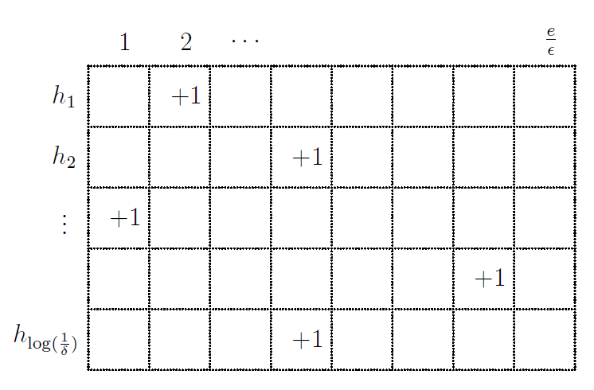
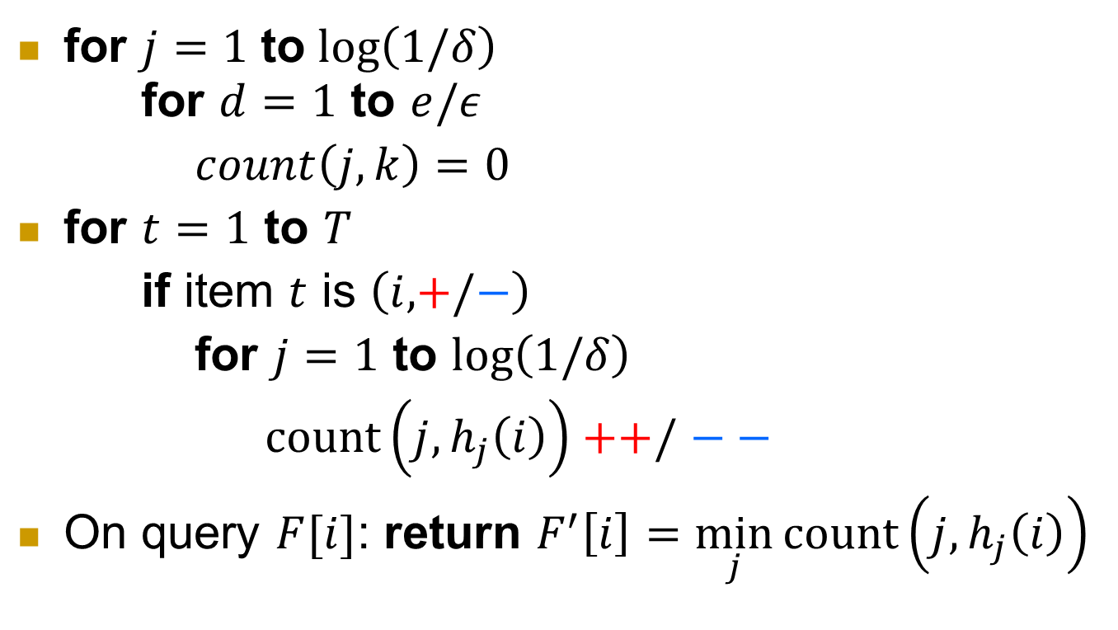
Algorithm
for $j=1$ to $\log\left(1/δ\right)$
for $d=1$ to $e/ε$
$count\left(j,k\right)=0$
for $t=1$ to $T$
if item $t$ is $\left(i,+/−\right)$
for $j=1$ to $\log\left(1/δ\right)$
$count\left(j,h_{j}\left(i\right)\right)++/$ $−−$
On query $F[i]$: return $F^{′}\left[i\right]=\min_{j}{count\left(j,h_{j}\left(i\right)\right)}$

Slide 20
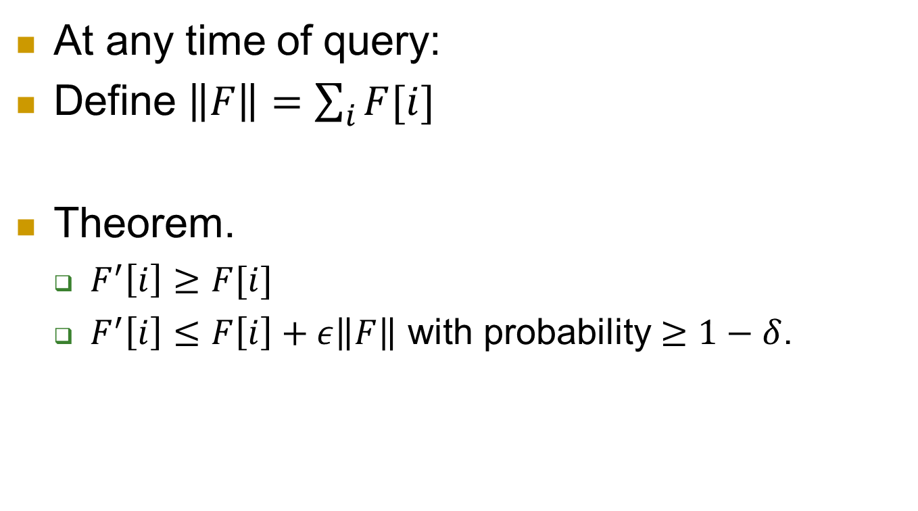
Guarantee
At any time of query:
Define $\left\|F\right\|=\sum_{i}{F[i]}$
Theorem.
  $F^{′}\left[i\right]≥F[i]$
  $F^{′}\left[i\right]≤F\left[i\right]+ε\left\|F\right\|$ with probability $≥1−δ$.

Slide 21
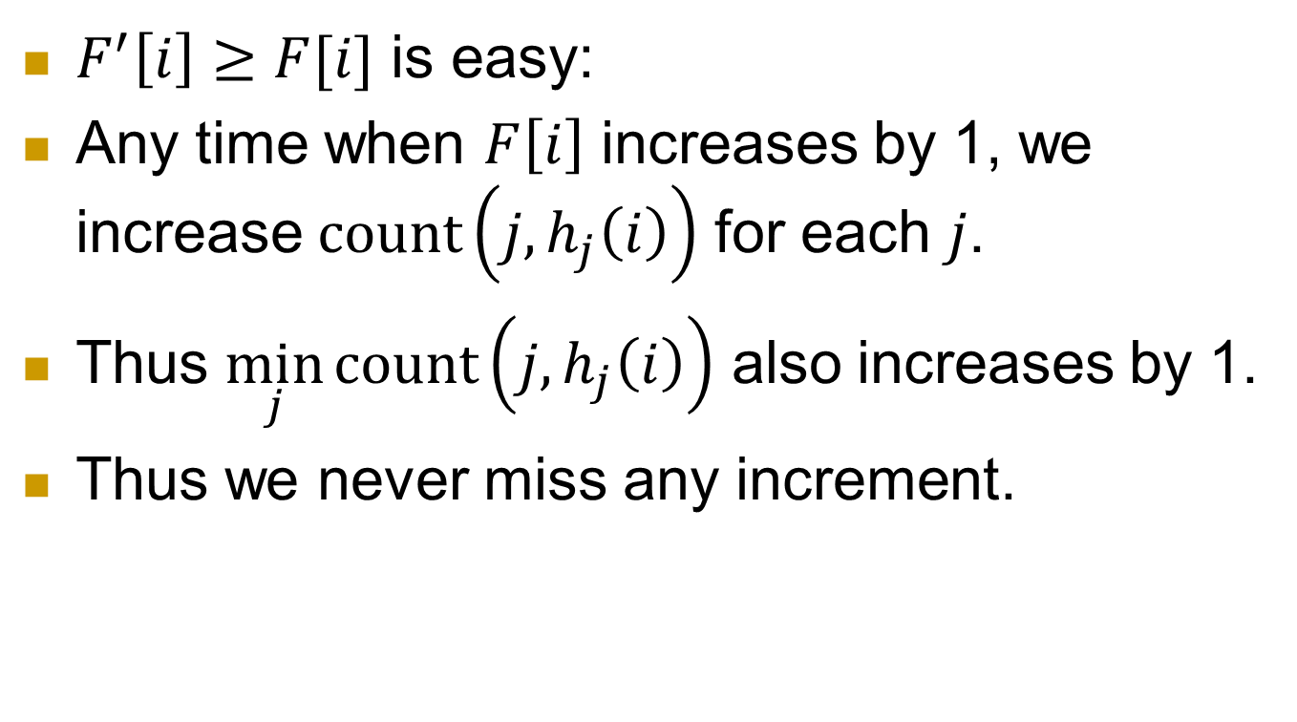
Analysis
  $F^{′}\left[i\right]≥F[i]$ is easy:
  Any time when $F\left[i\right]$ increases by 1, we increase $count\left(j,h_{j}\left(i\right)\right)$ for each $j$.
  Thus $\min_{j}{count\left(j,h_{j}\left(i\right)\right)}$ also increases by 1.
Thus we never miss any increment.

Slide 22
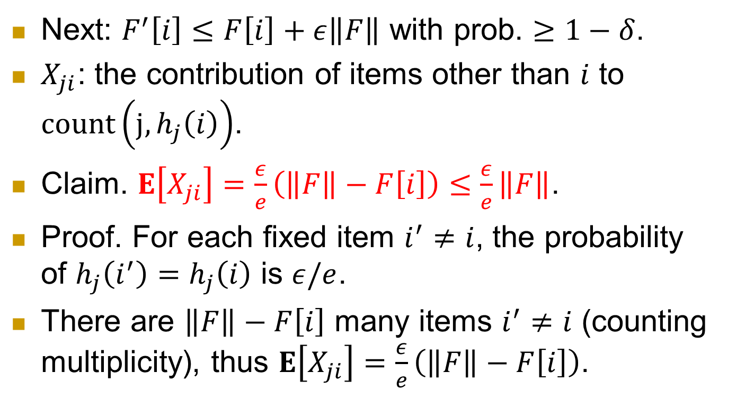
Analysis
  Next: $F^{′}\left[i\right]≤F\left[i\right]+ε\left\|F\right\|$ with prob. $≥1−δ$.
$X_{ji}$: the contribution of items other than $i$ to $count\left(j,h_{j}\left(i\right)\right)$.
Claim. $E\left[X_{ji}\right]=\frac{ε}{e}\left(\left\|F\right\|−F\left[i\right]\right)≤$ $\frac{ε}{e}\left\|F\right\|$.
Proof. For each fixed item $i^{′}≠i$, the probability of $h_{j}\left(i^{′}\right)=h_{j}\left(i\right)$ is $ε/e$.
There are $\left\|F\right\|−F\left[i\right]$ many items $i^{′}≠i$ (counting multiplicity), thus $E\left[X_{ji}\right]=\frac{ε}{e}\left(\left\|F\right\|−F\left[i\right]\right)$.

Slide 23
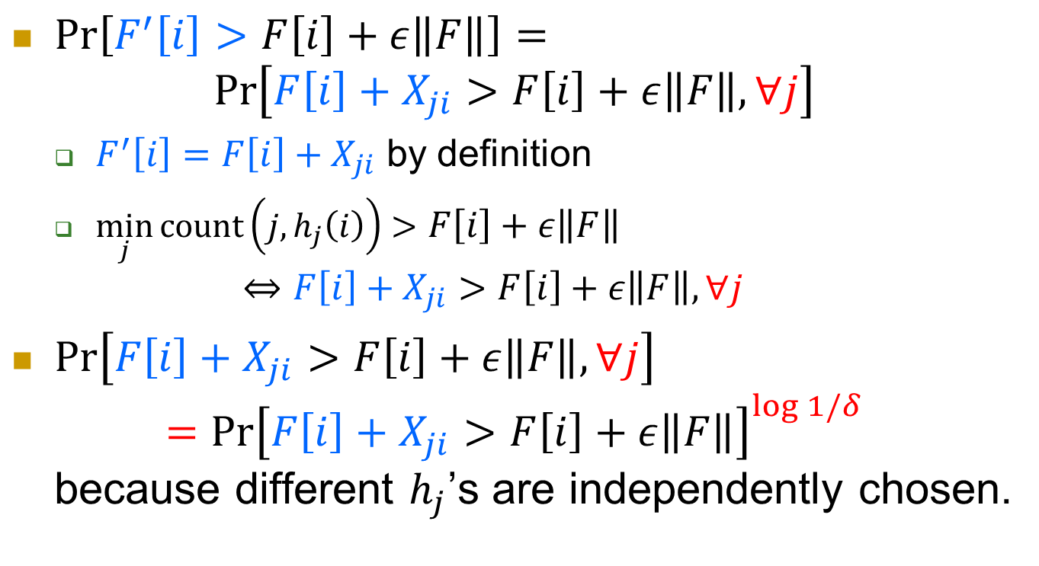
$\operatorname{Pr}\left[F^{′}\left[i\right]>F\left[i\right]+ε\left\|F\right\|\right]=$
$\operatorname{Pr}\left[F\left[i\right]+X_{ji}>F\left[i\right]+ε\left\|F\right\|, ∀j\right]$
  $F^{′}\left[i\right]=F\left[i\right]+X_{ji}$ by definition
  $\min_{j}{count\left(j,h_{j}\left(i\right)\right)}>F\left[i\right]+ε\left\|F\right\|$
  $⇔F\left[i\right]+X_{ji}>F\left[i\right]+ε\left\|F\right\|, ∀j$
$\operatorname{Pr}\left[F\left[i\right]+X_{ji}>F\left[i\right]+ε\left\|F\right\|, ∀j\right]$
$={\operatorname{Pr}\left[F\left[i\right]+X_{ji}>F\left[i\right]+ε\left\|F\right\|\right]}^{\log{1/δ}}$
because different $h_{j}$’s are independently chosen.

Slide 24
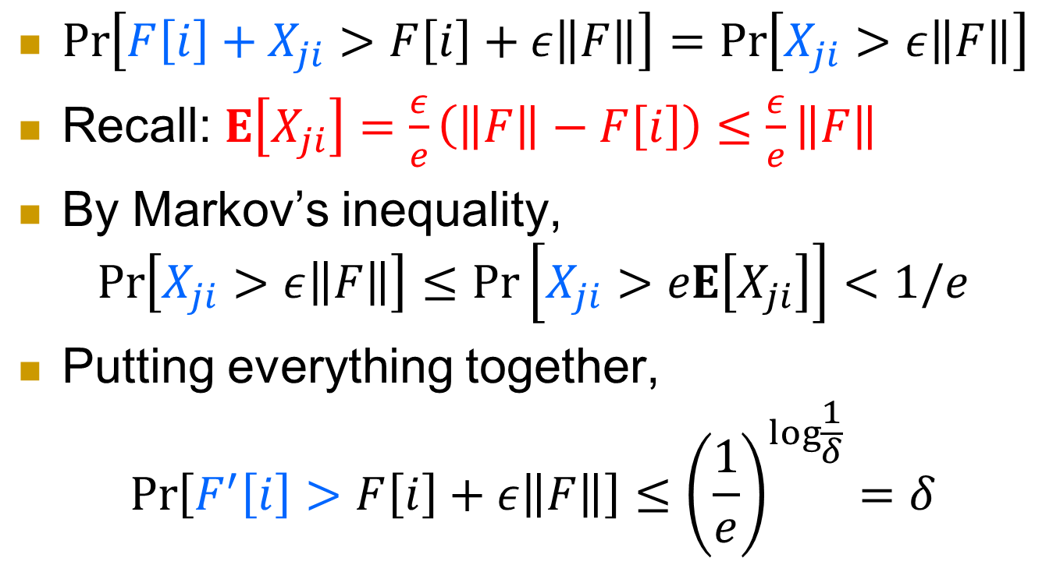
$\operatorname{Pr}\left[F\left[i\right]+X_{ji}>F\left[i\right]+ε\left\|F\right\|\right]=\operatorname{Pr}\left[X_{ji}>ε\left\|F\right\|\right]$
Recall: $E\left[X_{ji}\right]=\frac{ε}{e}\left(\left\|F\right\|−F\left[i\right]\right)≤$ $\frac{ε}{e}\left\|F\right\|$
By Markov’s inequality,
$$\operatorname{Pr}\left[X_{ji}>ε\left\|F\right\|\right]≤\operatorname{Pr}\left[X_{ji}>eE\left[X_{ji}\right]\right]<1/e$$
Putting everything together,
$$\operatorname{Pr}\left[F^{′}\left[i\right]>F\left[i\right]+ε\left\|F\right\|\right]≤{\left(\frac{1}{e}\right)}^{\log{\frac{1}{δ}}}=δ$$

Slide 25
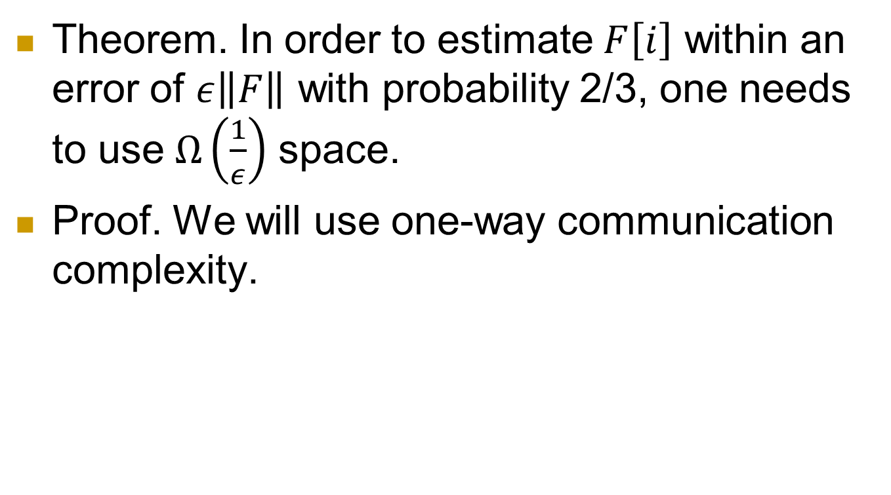
Lower bounds
Theorem. In order to estimate $F\left[i\right]$ within an error of $ε\left\|F\right\|$ with probability 2/3, one needs to use $Ω\left(\frac{1}{ε}\right)$ space.
Proof. We will use one-way communication complexity.

Slide 26



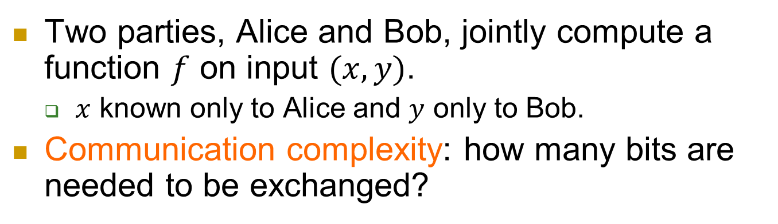


Communication complexity
$$x$$
$$y$$
$f(x,y)$
Two parties, Alice and Bob, jointly compute a function $f$ on input $(x,y)$.
  $x$ known only to Alice and $y$ only to Bob.
Communication complexity: how many bits are needed to be exchanged?

Slide 27

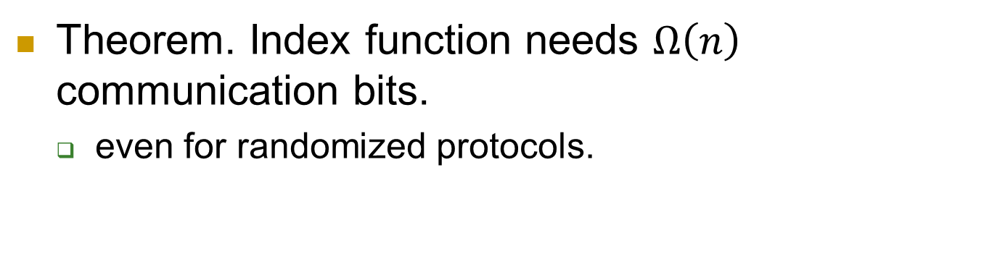


One-way communication complexity
$$x∈{\left\{0,1\right\}}^{n}$$
$$i∈[n]$$
$f\left(x,i\right)=x_{i}$
Theorem. Index function needs $Ω\left(n\right)$ communication bits.
  even for randomized protocols.

Slide 28
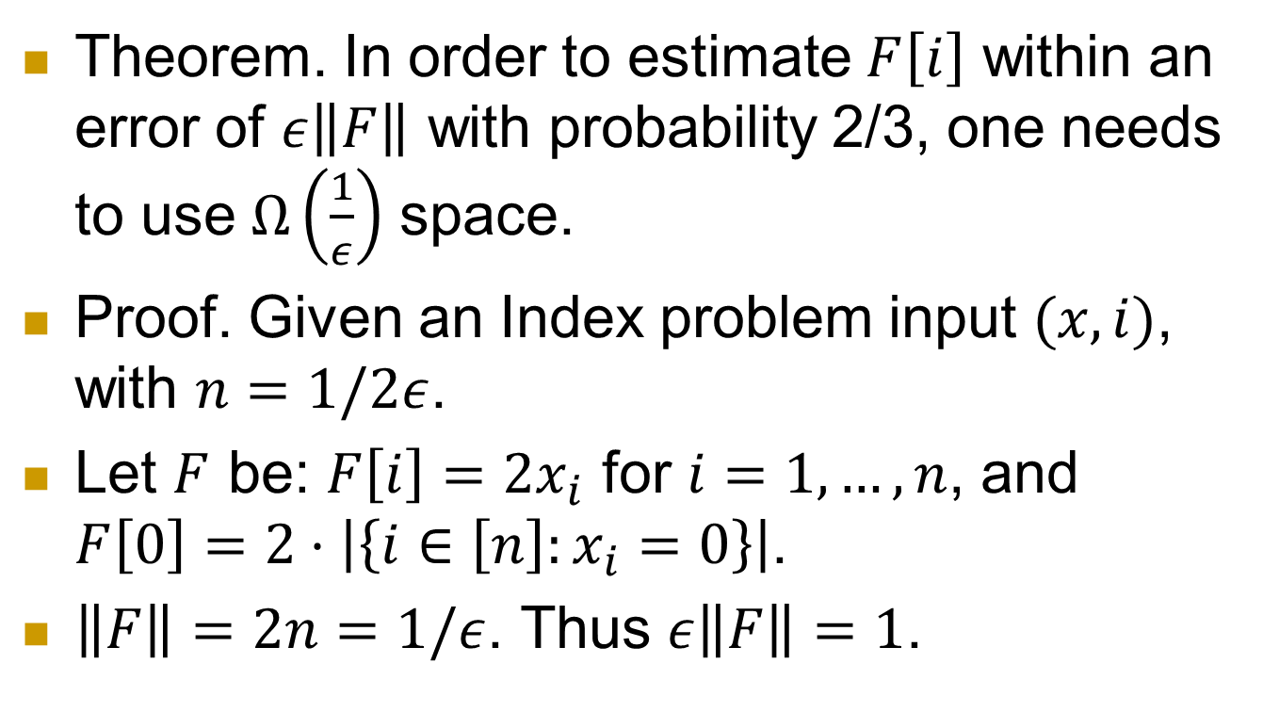
Lower bound
Theorem. In order to estimate $F\left[i\right]$ within an error of $ε\left\|F\right\|$ with probability 2/3, one needs to use $Ω\left(\frac{1}{ε}\right)$ space.
Proof. Given an Index problem input $(x,i)$, with $n=1/2ε$.
Let $F$ be: $F\left[i\right]=2x_{i}$ for $i=1,…,n$, and $F\left[0\right]=2⋅\left|\left\{i∈\left[n\right]:x_{i}=0\right\}\right|$.
$\left\|F\right\|=2n=1/ε$. Thus $ε\left\|F\right\|=1$.

Slide 29
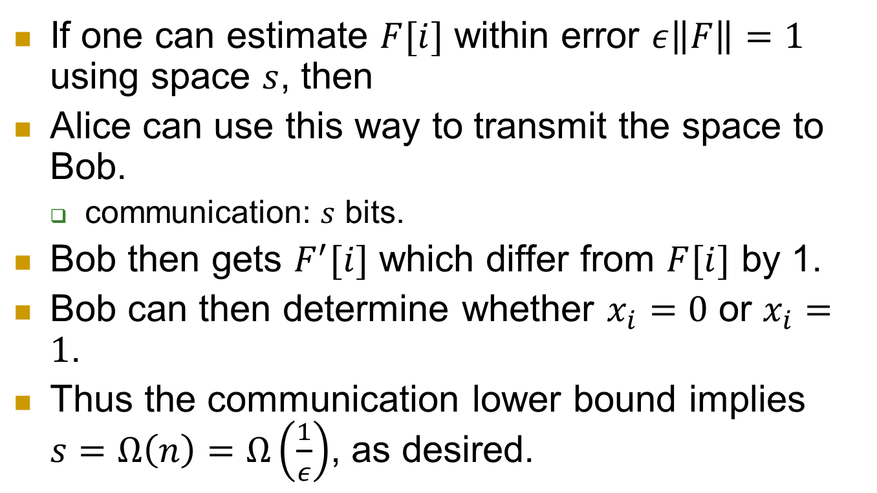
If one can estimate $F[i]$ within error $ε\left\|F\right\|=1$ using space $s$, then
Alice can use this way to transmit the space to Bob.
  communication: $s$ bits.
Bob then gets $F^{′}[i]$ which differ from $F[i]$ by 1.
Bob can then determine whether $x_{i}=0$ or $x_{i}=1$.
Thus the communication lower bound implies $s=Ω\left(n\right)=Ω\left(\frac{1}{ε}\right)$, as desired.

Slide 30
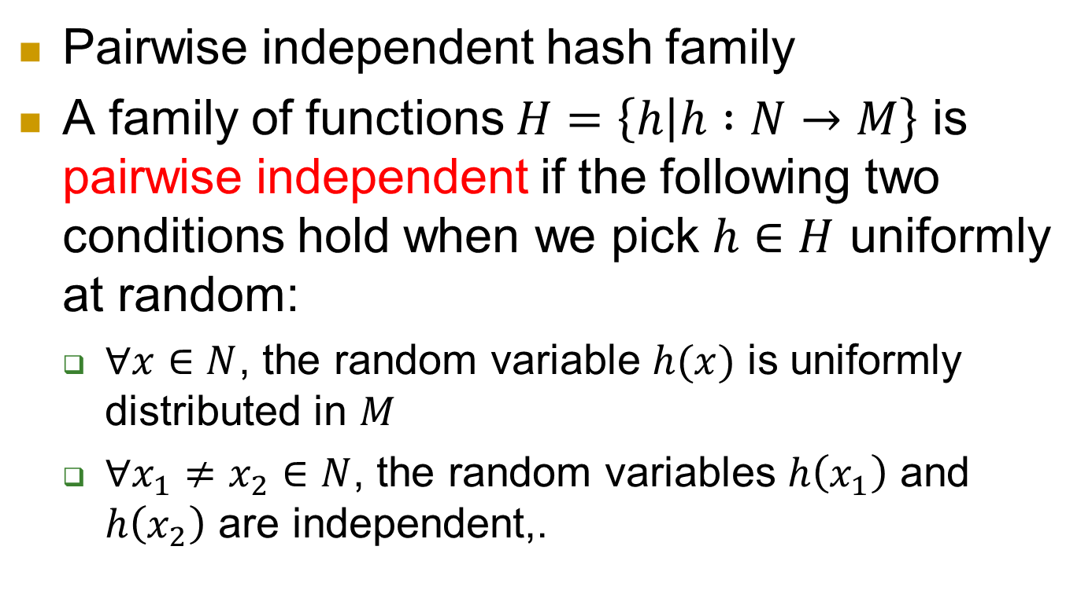
One thing left
Pairwise independent hash family
A family of functions $H=\left\{h | h :N→M\right\}$ is pairwise independent if the following two conditions hold when we pick $h∈H$ uniformly at random:
  $∀x∈N$, the random variable $h(x)$ is uniformly distributed in $M$
  $∀x_{1}≠x_{2}∈N$, the random variables $h\left(x_{1}\right)$ and $h\left(x_{2}\right)$ are independent,.

Slide 31
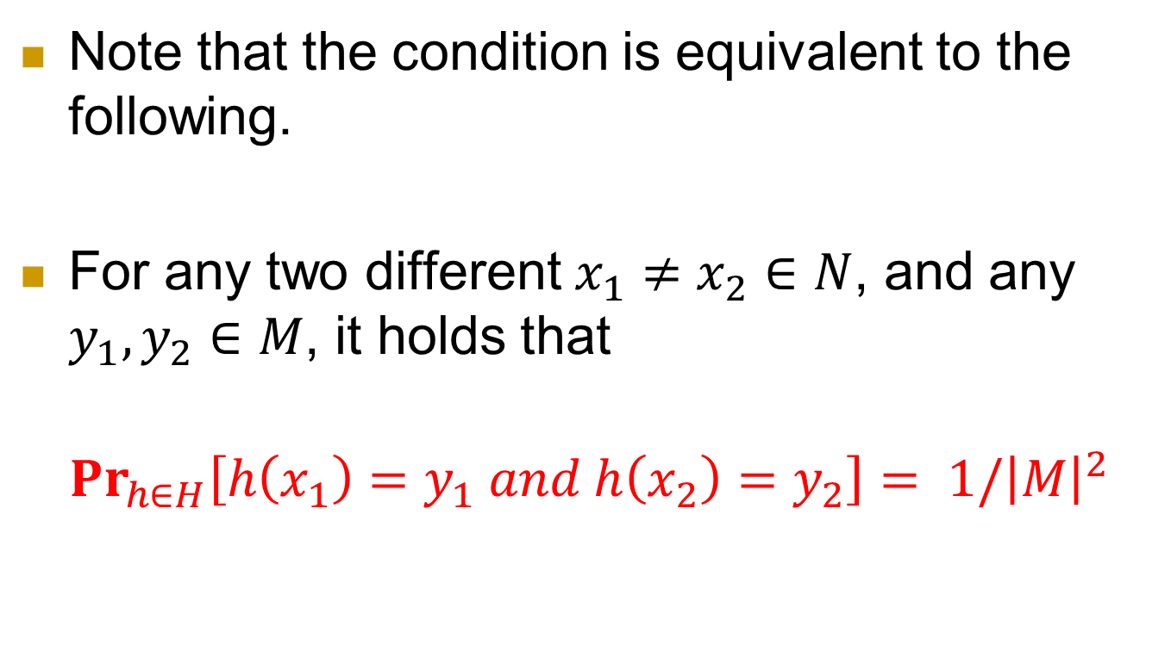
Note that the condition is equivalent to the following.
For any two different $x_{1}≠x_{2}∈N$, and any $y_{1}, y_{2}∈M$, it holds that
$${Pr}_{h∈H}\left[h\left(x_{1}\right)=y_{1} and h\left(x_{2}\right)=y_{2}\right]= 1/{\left|M\right|}^{2}$$

Slide 32
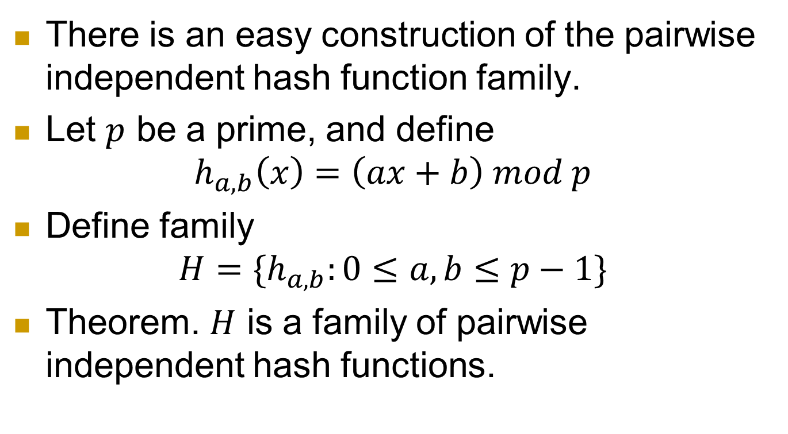
Construction
There is an easy construction of the pairwise independent hash function family.
Let $p$ be a prime, and define
$$h_{a,b}\left(x\right)=\left(ax+b\right) mod p$$
Define family
$H=\{h_{a,b}:0≤a,b≤p−1\}$
Theorem. $H$ is a family of pairwise independent hash functions.

Slide 33
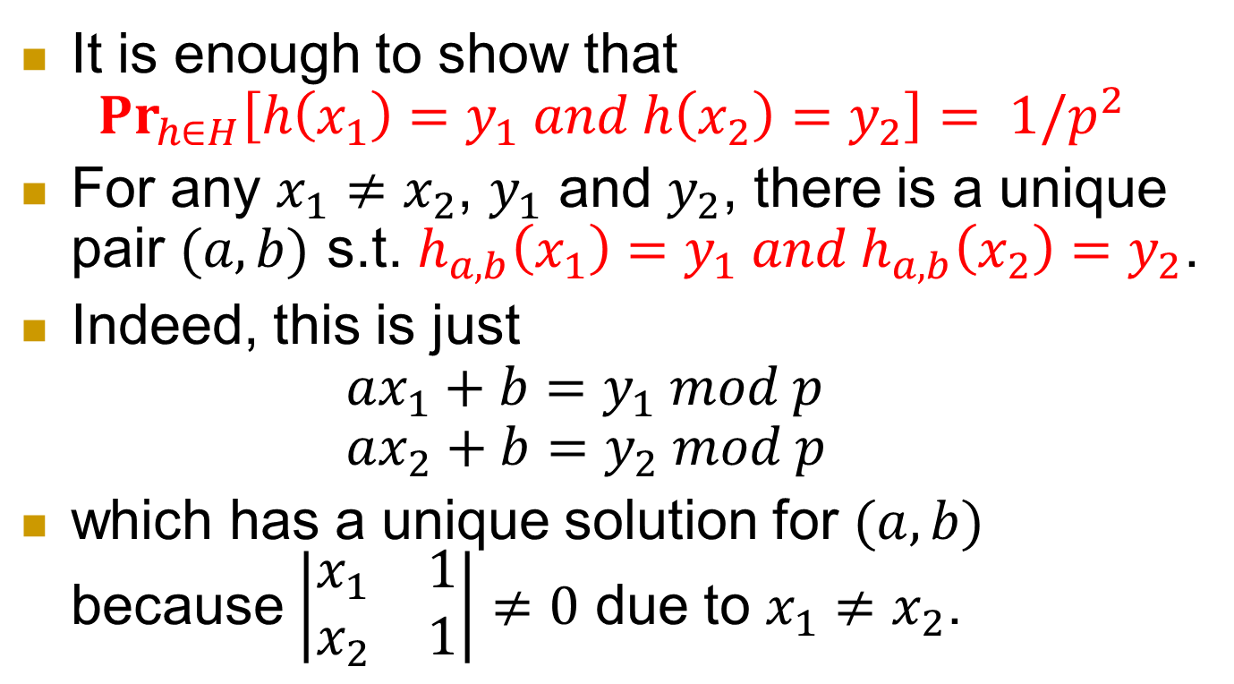
It is enough to show that
${Pr}_{h∈H}\left[h\left(x_{1}\right)=y_{1} and h\left(x_{2}\right)=y_{2}\right]= 1/p^{2}$
For any $x_{1}≠x_{2}$, $y_{1}$ and $y_{2}$, there is a unique pair $(a,b)$ s.t. $h_{a,b}\left(x_{1}\right)=y_{1} and h_{a,b}\left(x_{2}\right)=y_{2}$.
Indeed, this is just
$ax_{1}+b=y_{1} mod p$
$ax_{2}+b=y_{2} mod p$
which has a unique solution for $(a,b)$ because $\left|\begin{matrix}x_{1} & 1 \\ x_{2} & 1\end{matrix}\right|≠0$ due to $x_{1}≠x_{2}$.

