Slide 1
CMSC5706 Topics in Theoretical Computer Science
Week 2: Linear Programming
Instructor: Shengyu Zhang

Slide 2
LP
Motivating examples
Introduction to algorithms
Simplex algorithm
  On a particular example
  General algorithm
Duality
An application to game theory

Slide 3
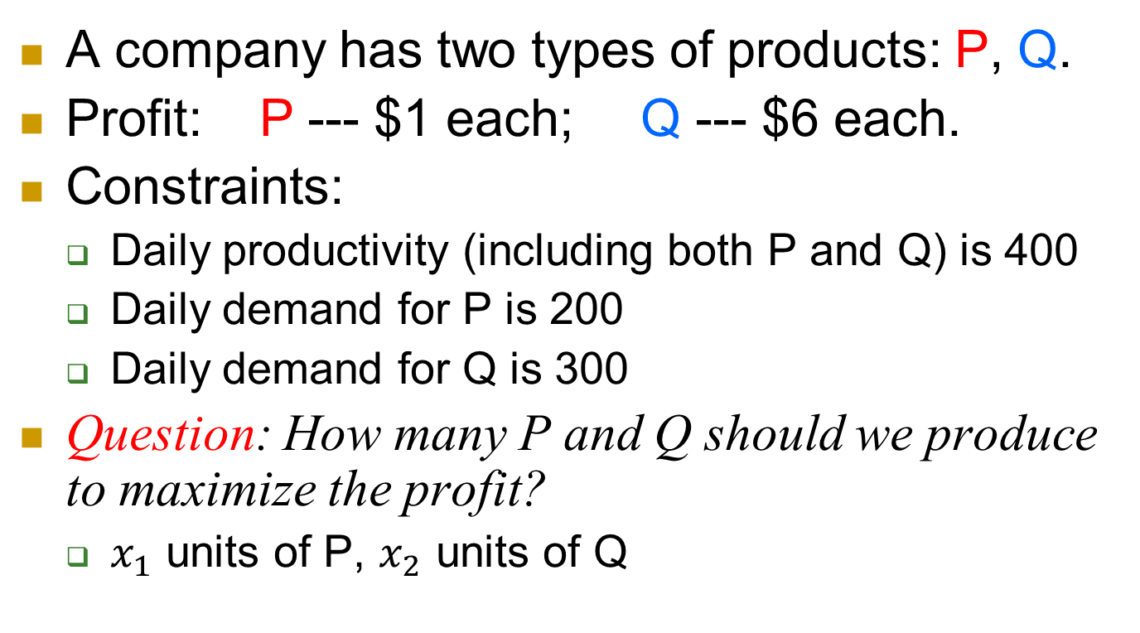
Example 1: profit maximization
A company has two types of products: P, Q.
Profit: P --- $1 each; Q --- $6 each.
Constraints:
  Daily productivity (including both P and Q) is 400
  Daily demand for P is 200
  Daily demand for Q is 300
Question: How many P and Q should we produce to maximize the profit?
  $x_{1}$ units of P, $x_{2}$ units of Q

Slide 4
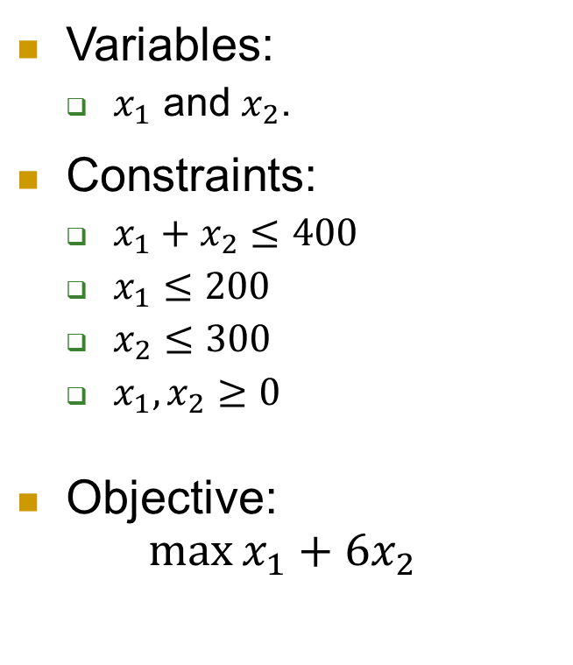
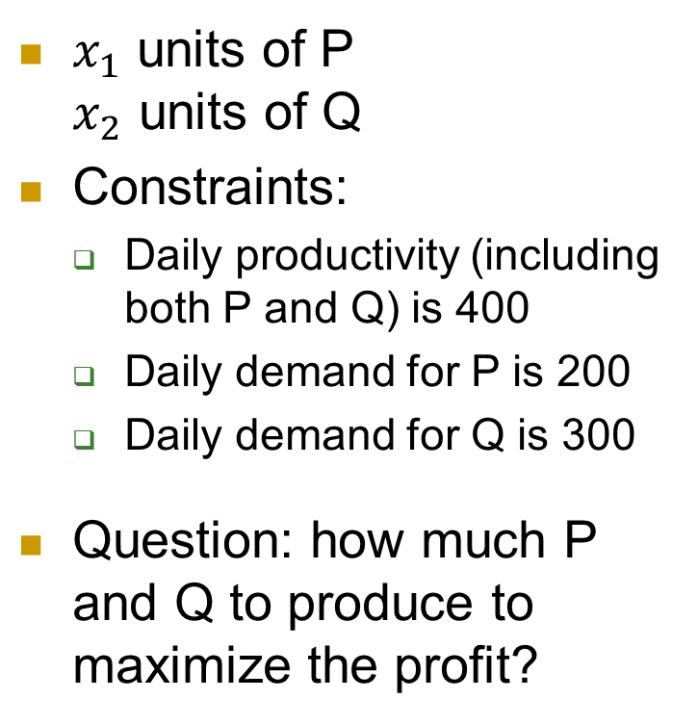
How to solve?
$x_{1}$ units of P
$x_{2}$ units of Q
Constraints:
  Daily productivity (including both P and Q) is 400
  Daily demand for P is 200
  Daily demand for Q is 300
Question: how much P and Q to produce to maximize the profit?
Variables:
  $x_{1}$ and $x_{2}$.
Constraints:
  $x_{1}+x_{2}≤400$
  $x_{1}≤200$
  $x_{2}≤300$
  $x_{1}, x_{2}≥0$
Objective:
$\max{x_{1}+6x_{2}}$

Slide 5
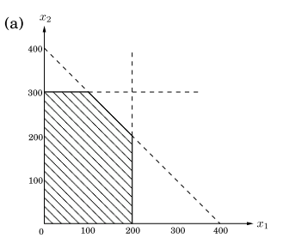
Illustrative figures

Slide 6
Example 2
We are managing a network with bandwidth as shown by numbers on edges.
  Bandwidth: max units of flows
3 connections: AB, BC, CA
  We get $3, $2, $4 for providing them respectively.
  Two routes for each connection: short and long.
Question: How to route the connections to maximize our revenue?

Slide 7
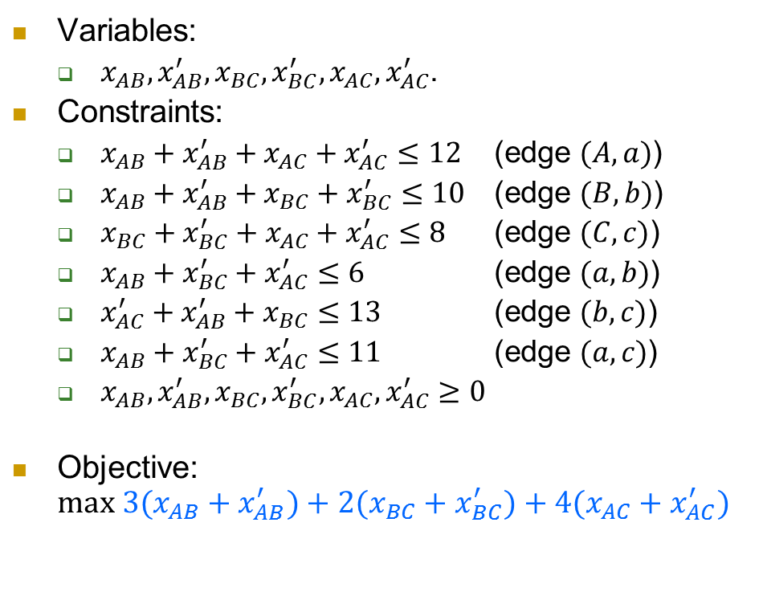
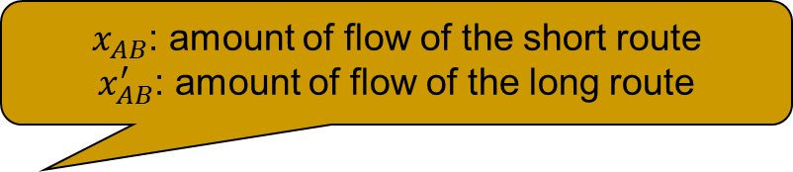
Example 2
$x_{AB}$: amount of flow of the short route
$x_{AB}^{′}$: amount of flow of the long route
Variables:
  $x_{AB}, x_{AB}^{′}, x_{BC}, x_{BC}^{′}, x_{AC}, x_{AC}^{′}$.
Constraints:
  $x_{AB}+x_{AB}^{′}+x_{AC}+x_{AC}^{′}≤12$ (edge $(A,a)$)
  $x_{AB}+x_{AB}^{′}+x_{BC}+x_{BC}^{′}≤10$ (edge $(B,b)$)
  $x_{BC}+x_{BC}^{′}+x_{AC}+x_{AC}^{′}≤8$ (edge $(C,c)$)
  $x_{AB}+x_{BC}^{′}+x_{AC}^{′}≤6$ (edge $(a,b)$)
  $x_{AC}^{′}+x_{AB}^{′}+x_{BC}≤13$ (edge $(b,c)$)
  $x_{AB}+x_{BC}^{′}+x_{AC}^{′}≤11$ (edge $(a,c)$)
  $x_{AB},x_{AB}^{′},x_{BC},x_{BC}^{′},x_{AC},x_{AC}^{′}≥0$
Objective:
$max 3(x_{AB}+x_{AB}^{′})+2(x_{BC}+x_{BC}^{′})+4(x_{AC}+x_{AC}^{′})$

Slide 8
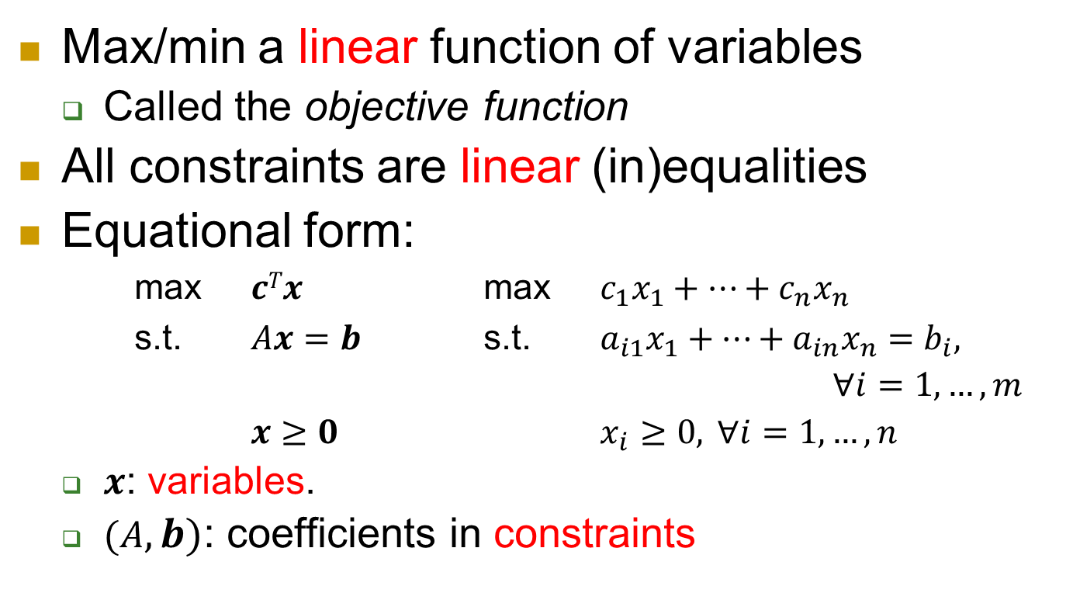
LP in general
Max/min a linear function of variables
  Called the objective function
All constraints are linear (in)equalities
Equational form:
max $cTx$ max $c_{1}x_{1}+…+c_{n}x_{n}$
s.t. $Ax=b$ s.t. $a_{i1}x_{1}+…+a_{in}x_{n}=b_{i},$
$∀i=1,…,m$
$x≥0$ $x_{i}≥0, ∀i=1,…,n$
  $x$: variables.
  $(A, b)$: coefficients in constraints
Superscript ^{T}: transpose of vectors.
Inequality: entry-wise

Slide 9
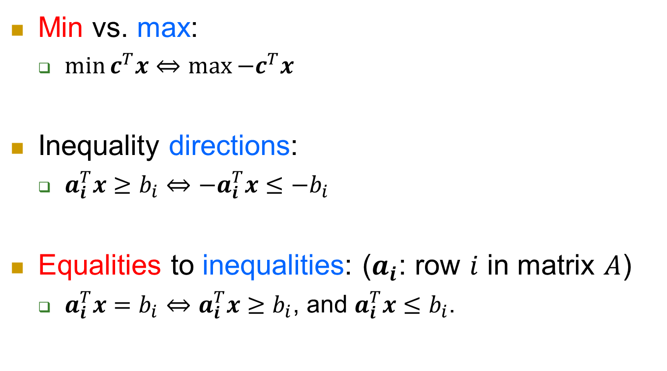
Transformations between forms
Min vs. max:
  $\min{c^{T}x}⇔\max{−c^{T}x}$
Inequality directions:
  $a_{i}^{T}x≥b_{i}⇔−a_{i}^{T}x≤−b_{i}$
Equalities to inequalities: ($a_{i}$: row $i$ in matrix $A$)
  $a_{i}^{T}x=b_{i}⇔a_{i}^{T}x≥b_{i}$, and $a_{i}^{T}x≤b_{i}$.

Slide 10
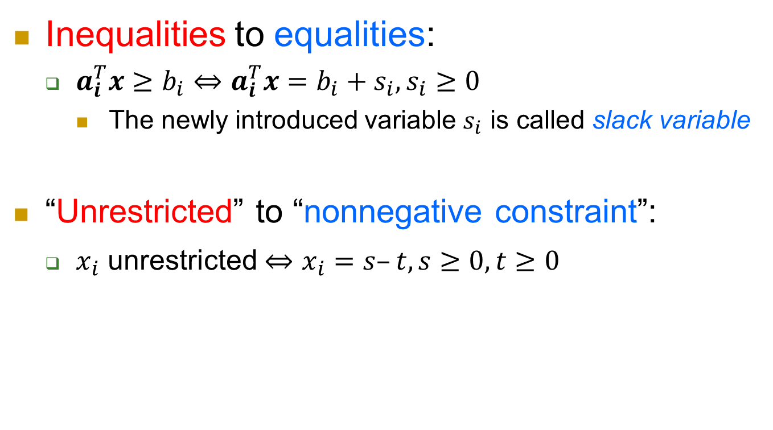
Transformations between forms
Inequalities to equalities:
  $a_{i}^{T}x≥b_{i}⇔$ $a_{i}^{T}x=b_{i}+s_{i}, s_{i}≥0$
    The newly introduced variable $s_{i}$ is called slack variable
“Unrestricted” to “nonnegative constraint”:
  $x_{i}$ unrestricted $⇔x_{i}=s–t, s≥0, t≥0$

Slide 11
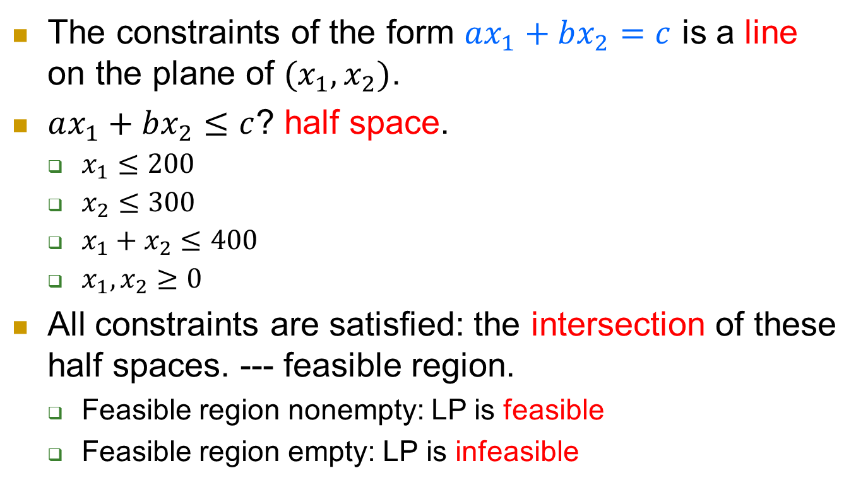
feasibility
The constraints of the form $ax_{1}+bx_{2}=c$ is a line on the plane of $(x_{1}, x_{2})$.
$ax_{1}+bx_{2}≤c$? half space.
  $x_{1}≤200$
  $x_{2}≤300$
  $x_{1}+x_{2}≤400$
  $x_{1}, x_{2}≥0$
All constraints are satisfied: the intersection of these half spaces. --- feasible region.
  Feasible region nonempty: LP is feasible
  Feasible region empty: LP is infeasible

Slide 12
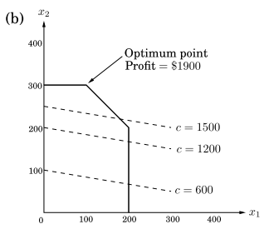
Adding the objective function into the picture
The objective function is also linear
  also a line for a fixed value.
Thus the optimization is:
try to move the line towards the desirable direction s.t. the line still intersects with the feasible region.

Slide 13
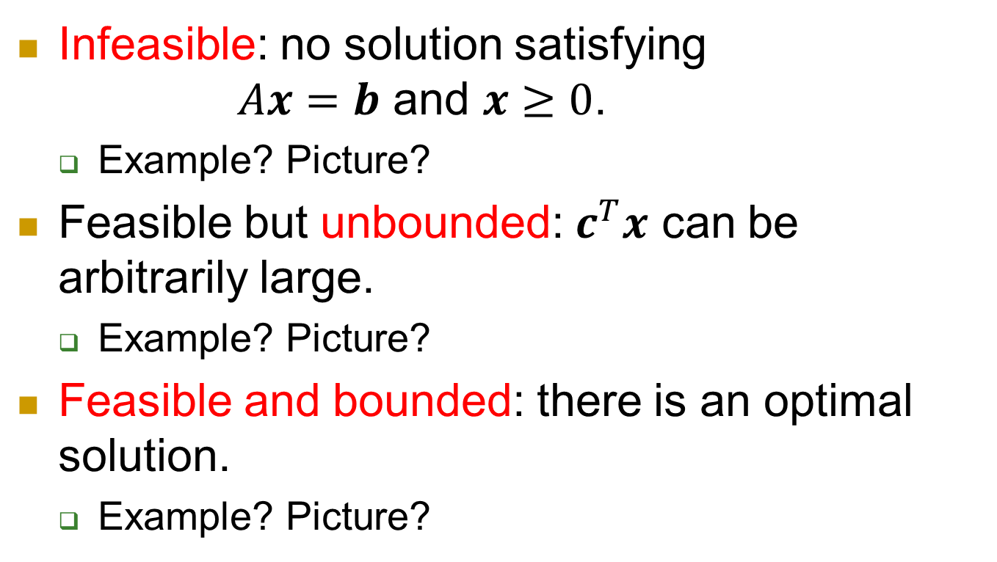
Possibilities of solution
Infeasible: no solution satisfying
$Ax=b$ and $x≥0$.
  Example? Picture?
Feasible but unbounded: $c^{T}x$ can be arbitrarily large.
  Example? Picture?
Feasible and bounded: there is an optimal solution.
  Example? Picture?

Slide 14
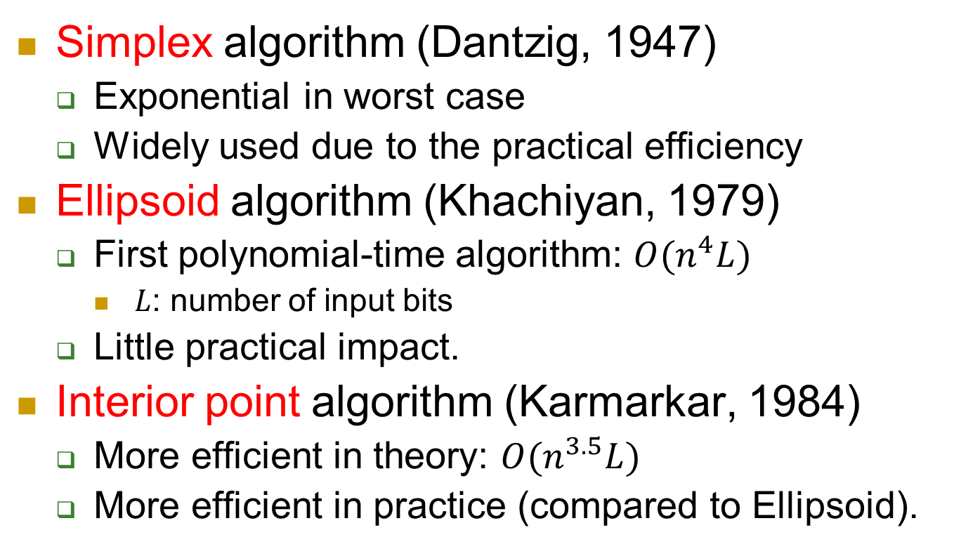
Three Algorithms for LP
Simplex algorithm (Dantzig, 1947)
  Exponential in worst case
  Widely used due to the practical efficiency
Ellipsoid algorithm (Khachiyan, 1979)
  First polynomial-time algorithm: $O(n^{4}L)$
    $L$: number of input bits
  Little practical impact.
Interior point algorithm (Karmarkar, 1984)
  More efficient in theory: $O(n^{3.5}L)$
  More efficient in practice (compared to Ellipsoid).
Weakly polynomial time

Slide 15
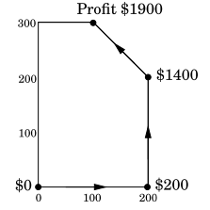
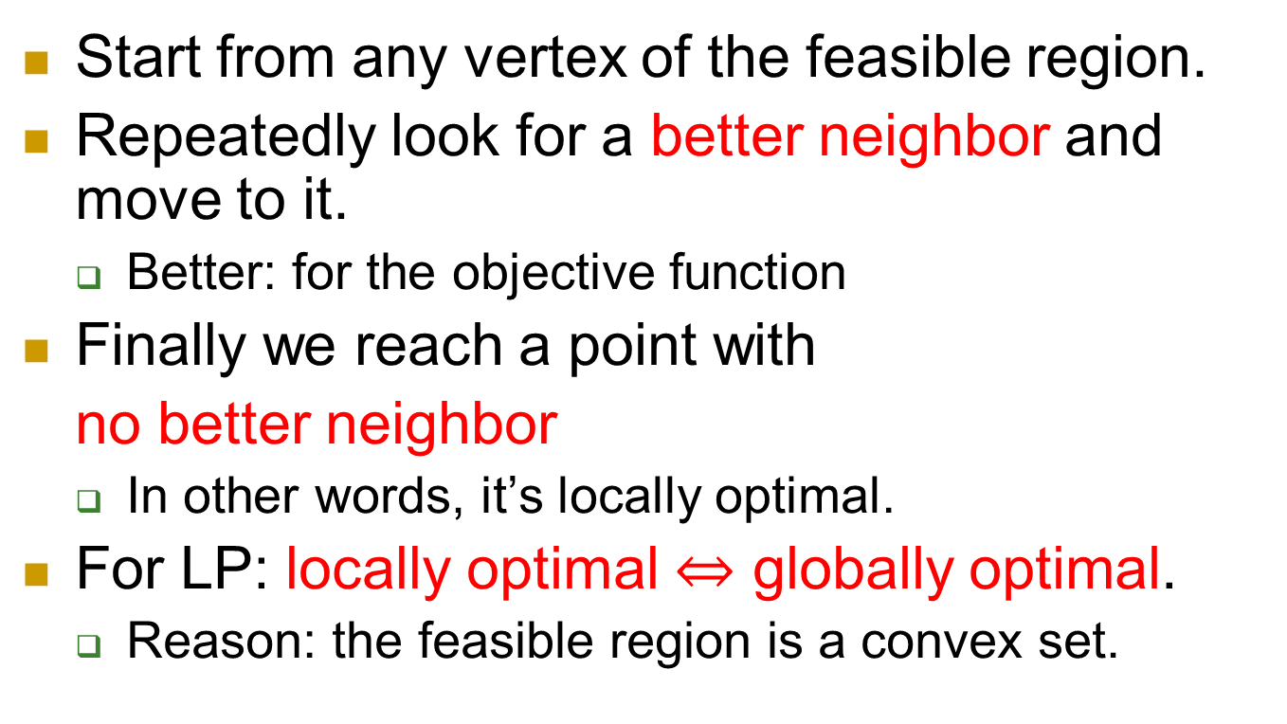
Simplex method: geometric view
Start from any vertex of the feasible region.
Repeatedly look for a better neighbor and move to it.
  Better: for the objective function
Finally we reach a point with
no better neighbor
  In other words, it’s locally optimal.
For LP: locally optimal $⇔$ globally optimal.
  Reason: the feasible region is a convex set.

Slide 16
Simplex algorithm: Framework
A sequence of (simplex) tableaus
Pick an initial tableau
Update the tableau
Terminate
What’s a tableau?
How?
What’s the rule?
When to terminate?
Why optimal?
Complexity?

Slide 17

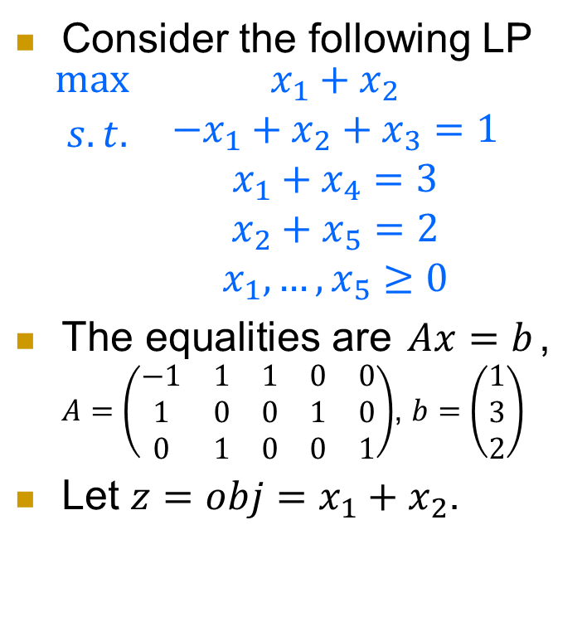
An introductory example
Consider the following LP
$$\begin{matrix}max & x_{1}+x_{2} \\ \begin{aligned} s.t. \\ \\ \\ \end{aligned} & \begin{aligned}−x_{1}+x_{2}+x_{3}=1 \\ x_{1}+x_{4}=3 \\ x_{2}+x_{5}=2 \\ x_{1},…,x_{5}≥0\end{aligned}\end{matrix}$$
The equalities are $Ax=b$, $A=\left(\begin{matrix}−1 & 1 & 1 & 0 & 0 \\ 1 & 0 & 0 & 1 & 0 \\ 0 & 1 & 0 & 0 & 1\end{matrix}\right)$, $b=\left(\begin{matrix}1 \\ 3 \\ 2\end{matrix}\right)$
Let $z=obj=x_{1}+x_{2}$.
Rewrite equalities as follows. (A tableau.)
$\begin{aligned}x_{3}=1+x_{1}−x_{2} \\ x_{4}=3−x_{1} \\ x_{5}=2−x_{2} \\ z=x_{1}+x_{2} \end{aligned}$

Slide 18
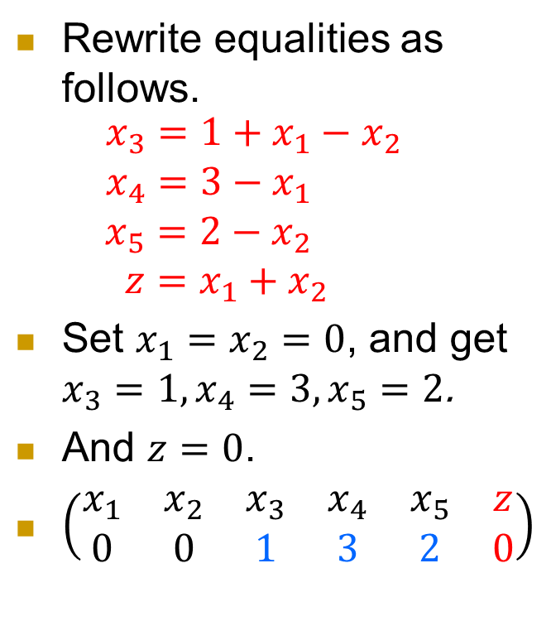
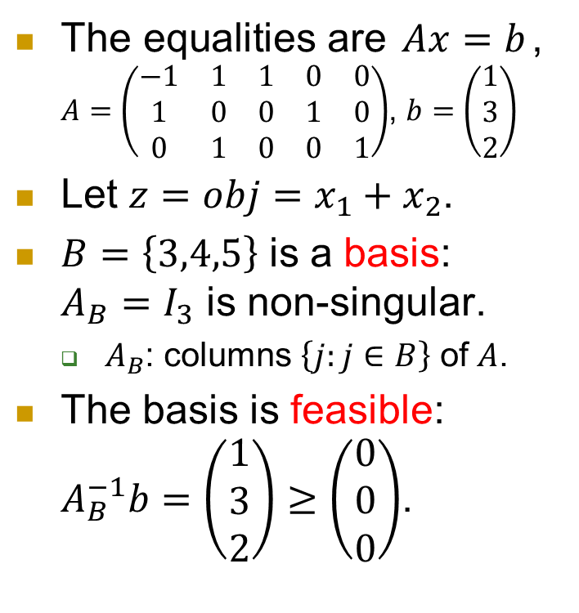
An introductory example
The equalities are $Ax=b$, $A=\left(\begin{matrix}−1 & 1 & 1 & 0 & 0 \\ 1 & 0 & 0 & 1 & 0 \\ 0 & 1 & 0 & 0 & 1\end{matrix}\right)$, $b=\left(\begin{matrix}1 \\ 3 \\ 2\end{matrix}\right)$
Let $z=obj=x_{1}+x_{2}$.
$B=\left\{3,4,5\right\}$ is a basis: $A_{B}=I_{3}$ is non-singular.
  $A_{B}$: columns $\left\{j:j∈B\right\}$ of $A$.
The basis is feasible: $A_{B}^{−1}b=\left(\begin{matrix}1 \\ 3 \\ 2\end{matrix}\right)≥\left(\begin{matrix}0 \\ 0 \\ 0\end{matrix}\right)$.
Rewrite equalities as follows.
$\begin{aligned}x_{3}=1+x_{1}−x_{2} \\ x_{4}=3−x_{1} \\ x_{5}=2−x_{2} \\ z=x_{1}+x_{2} \end{aligned}$
Set $x_{1}=x_{2}=0$, and get $x_{3}=1, x_{4}=3, x_{5}=2$.
And $z=0$.
$\left(\begin{matrix}x_{1} & x_{2} & x_{3} & x_{4} & x_{5} & z \\ 0 & 0 & 1 & 3 & 2 & 0\end{matrix}\right)$

Slide 19
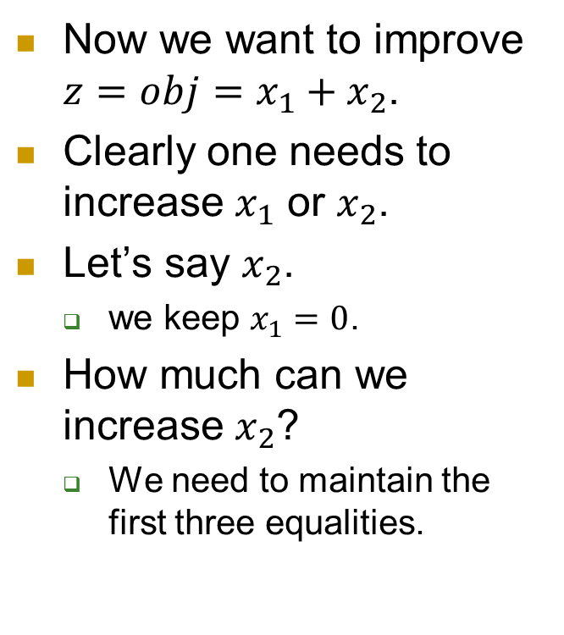
An introductory example
Now we want to improve $z=obj=x_{1}+x_{2}$.
Clearly one needs to increase $x_{1}$ or $x_{2}$.
Let’s say $x_{2}$.
  we keep $x_{1}=0$.
How much can we increase $x_{2}$?
  We need to maintain the first three equalities.
Rewrite equalities as follows.
$\begin{aligned}x_{3}=1+x_{1}−x_{2} \\ x_{4}=3−x_{1} \\ x_{5}=2−x_{2} \\ z=x_{1}+x_{2} \end{aligned}$
Set $x_{1}=x_{2}=0$, and get $x_{3}=1, x_{4}=3, x_{5}=2$.
And $z=0$.
$\left(\begin{matrix}x_{1} & x_{2} & x_{3} & x_{4} & x_{5} & z \\ 0 & 0 & 1 & 3 & 2 & 0\end{matrix}\right)$

Slide 20
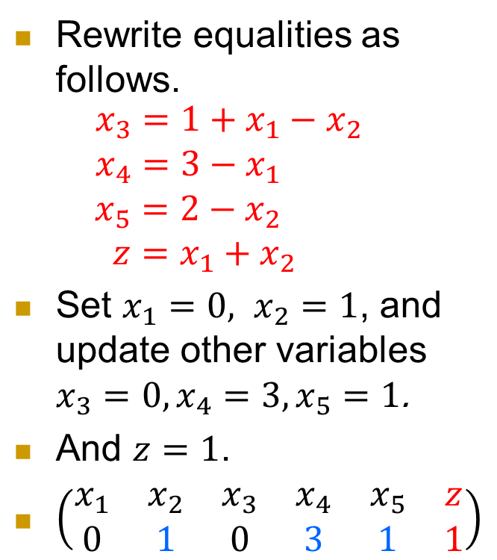
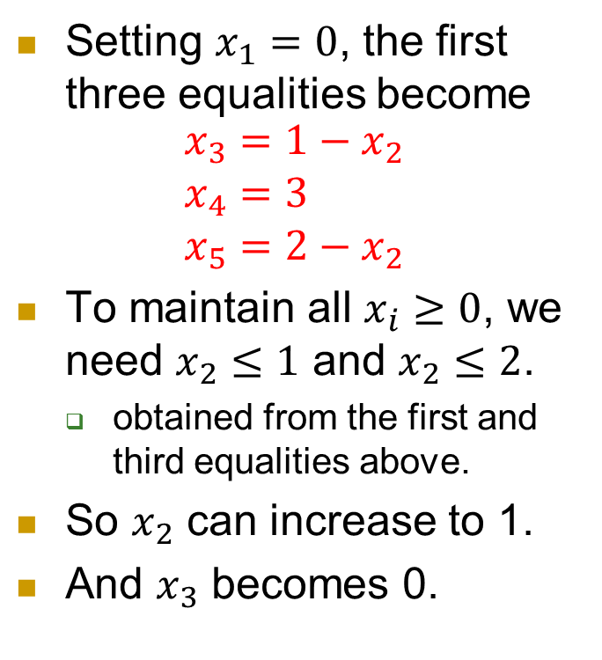
An introductory example
Setting $x_{1}=0$, the first three equalities become
$$\begin{aligned}x_{3}=1−x_{2} \\ x_{4}=3 \\ x_{5}=2−x_{2}\end{aligned}$$
To maintain all $x_{i}≥0$, we need $x_{2}≤1$ and $x_{2}≤2$.
  obtained from the first and third equalities above.
So $x_{2}$ can increase to 1.
And $x_{3}$ becomes 0.
Rewrite equalities as follows.
$\begin{aligned}x_{3}=1+x_{1}−x_{2} \\ x_{4}=3−x_{1} \\ x_{5}=2−x_{2} \\ z=x_{1}+x_{2} \end{aligned}$
Set $x_{1}=0, x_{2}=1$, and update other variables $x_{3}=0, x_{4}=3, x_{5}=1$.
And $z=1$.
$\left(\begin{matrix}x_{1} & x_{2} & x_{3} & x_{4} & x_{5} & z \\ 0 & 1 & 0 & 3 & 1 & 1\end{matrix}\right)$

Slide 21

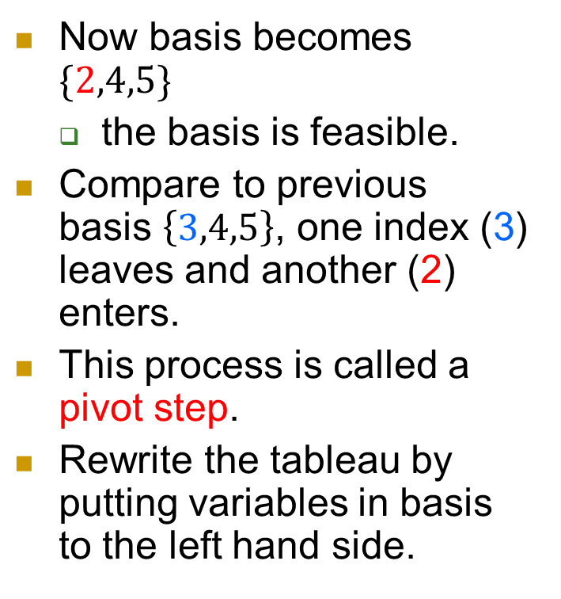
An introductory example
Now basis becomes $\{2,4,5\}$
  the basis is feasible.
Compare to previous basis $\left\{3,4,5\right\}$, one index (3) leaves and another (2) enters.
This process is called a pivot step.
Rewrite the tableau by putting variables in basis to the left hand side.
Rewrite equalities as follows.
$$\begin{aligned}x_{3}=1+x_{1}−x_{2} \\ x_{4}=3−x_{1} \\ x_{5}=2−x_{2} \\ z=x_{1}+x_{2} \end{aligned}$$

Slide 22

An introductory example
Now basis becomes $\{2,4,5\}$
  the basis is feasible.
Compare to previous basis $\left\{3,4,5\right\}$, one index (3) leaves and another (2) enters.
This process is called a pivot step.
Rewrite the tableau by putting variables in basis to the left hand side.
Rewrite equalities as follows.
$\begin{aligned}x_{2}=1+x_{1}−x_{3} \\ x_{4}=3−x_{1} \\ x_{5}=1−x_{1}+x_{3} \\ z=1+2x_{1}−x_{3}\end{aligned}$

Slide 23
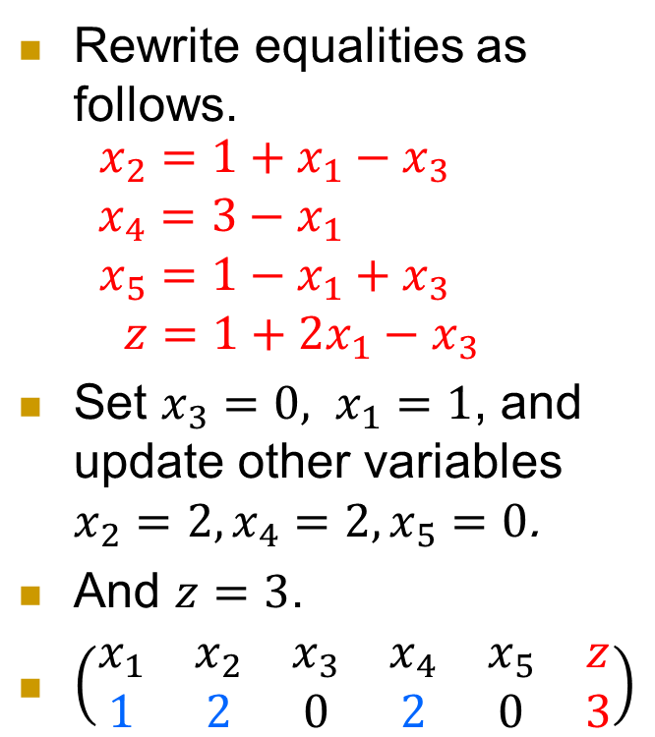
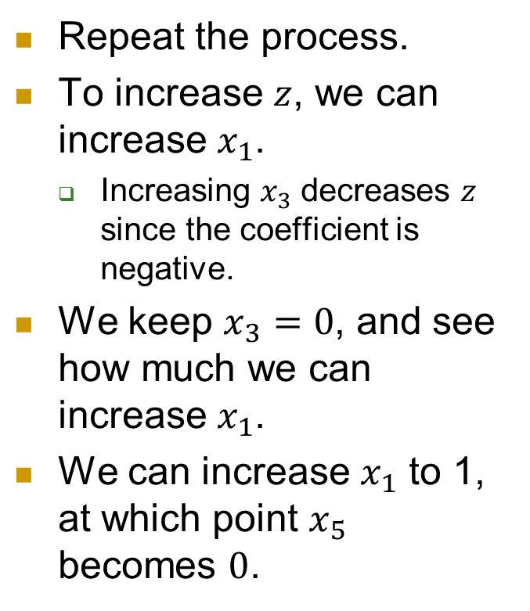
An introductory example
Repeat the process.
To increase $z$, we can increase $x_{1}$.
  Increasing $x_{3}$ decreases $z$ since the coefficient is negative.
We keep $x_{3}=0$, and see how much we can increase $x_{1}$.
We can increase $x_{1}$ to 1, at which point $x_{5}$ becomes $0$.
Rewrite equalities as follows.
$\begin{aligned}x_{2}=1+x_{1}−x_{3} \\ x_{4}=3−x_{1} \\ x_{5}=1−x_{1}+x_{3} \\ z=1+2x_{1}−x_{3}\end{aligned}$
Set $x_{3}=0, x_{1}=1$, and update other variables $x_{2}=2, x_{4}=2, x_{5}=0$.
And $z=3$.
$\left(\begin{matrix}x_{1} & x_{2} & x_{3} & x_{4} & x_{5} & z \\ 1 & 2 & 0 & 2 & 0 & 3\end{matrix}\right)$

Slide 24

An introductory example
The new basis is $\{1,2,4\}$.
Rewrite the tableau.
Rewrite equalities as follows.
$\begin{aligned}x_{2}=1+x_{1}−x_{3} \\ x_{4}=3−x_{1} \\ x_{5}=1−x_{1}+x_{3} \\ z=1+2x_{1}−x_{3}\end{aligned}$
Set $x_{3}=0, x_{1}=1$, and update other variables $x_{2}=2, x_{4}=2, x_{5}=0$.
And $z=3$.
$\left(\begin{matrix}x_{1} & x_{2} & x_{3} & x_{4} & x_{5} & z \\ 1 & 2 & 0 & 2 & 0 & 3\end{matrix}\right)$

Slide 25
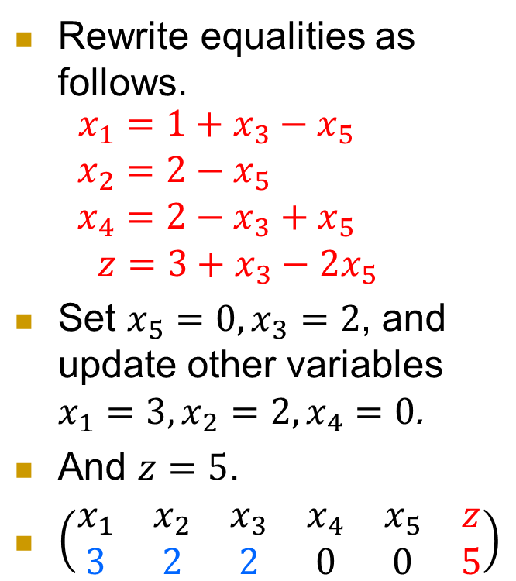
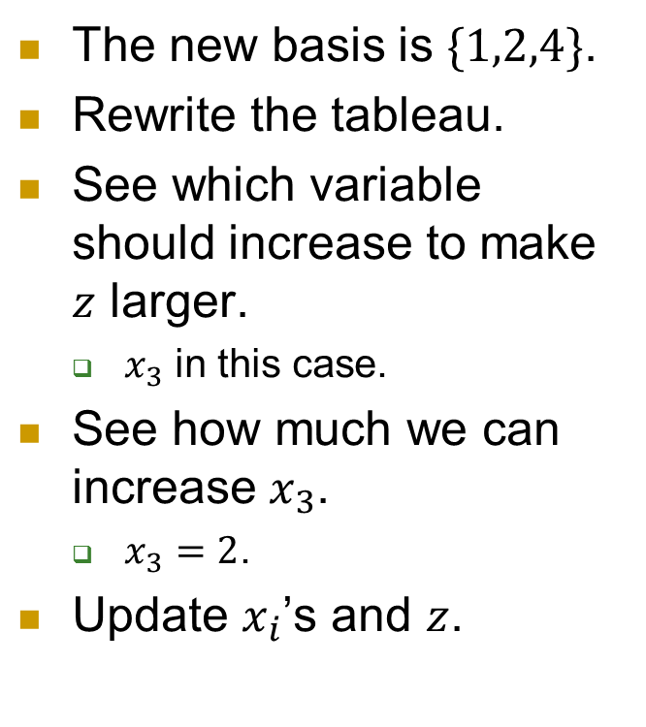
An introductory example
The new basis is $\{1,2,4\}$.
Rewrite the tableau.
See which variable should increase to make $z$ larger.
  $x_{3}$ in this case.
See how much we can increase $x_{3}$.
  $x_{3}=2$.
Update $x_{i}$’s and $z$.
Rewrite equalities as follows.
$\begin{aligned}x_{1}=1+x_{3}−x_{5} \\ x_{2}=2−x_{5} \\ x_{4}=2−x_{3}+x_{5} \\ z=3+x_{3}−2x_{5}\end{aligned}$
Set $x_{5}=0,x_{3}=2$, and update other variables $x_{1}=3, x_{2}=2, x_{4}=0$.
And $z=5$.
$\left(\begin{matrix}x_{1} & x_{2} & x_{3} & x_{4} & x_{5} & z \\ 3 & 2 & 2 & 0 & 0 & 5\end{matrix}\right)$

Slide 26
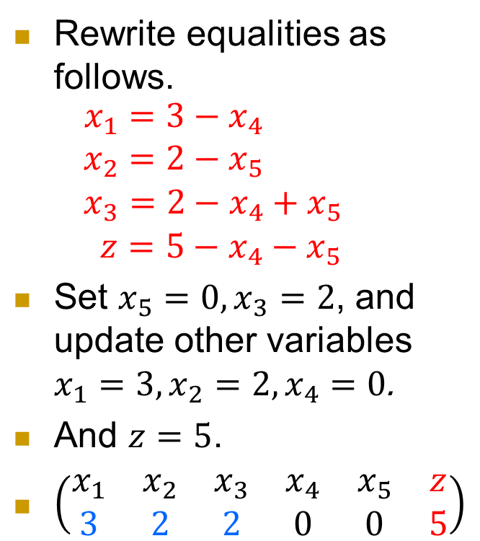
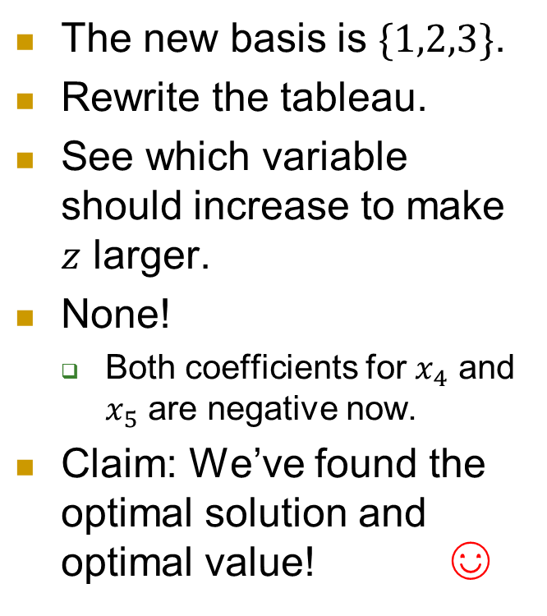
An introductory example
The new basis is $\{1,2,3\}$.
Rewrite the tableau.
See which variable should increase to make $z$ larger.
None!
  Both coefficients for $x_{4}$ and $x_{5}$ are negative now.
Claim: We’ve found the optimal solution and optimal value! ☺
Rewrite equalities as follows.
$\begin{aligned}x_{1}=3−x_{4} \\ x_{2}=2−x_{5} \\ x_{3}=2−x_{4}+x_{5} \\ z=5−x_{4}−x_{5}\end{aligned}$
Set $x_{5}=0,x_{3}=2$, and update other variables $x_{1}=3, x_{2}=2, x_{4}=0$.
And $z=5$.
$\left(\begin{matrix}x_{1} & x_{2} & x_{3} & x_{4} & x_{5} & z \\ 3 & 2 & 2 & 0 & 0 & 5\end{matrix}\right)$

Slide 27
Formal treatment
Now we make the intuitions formal.
We will rigorously define things like basis, feasible basis, tableau, …
discuss the pivot steps,
and formalize the above procedure for general LP.

Slide 28

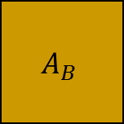

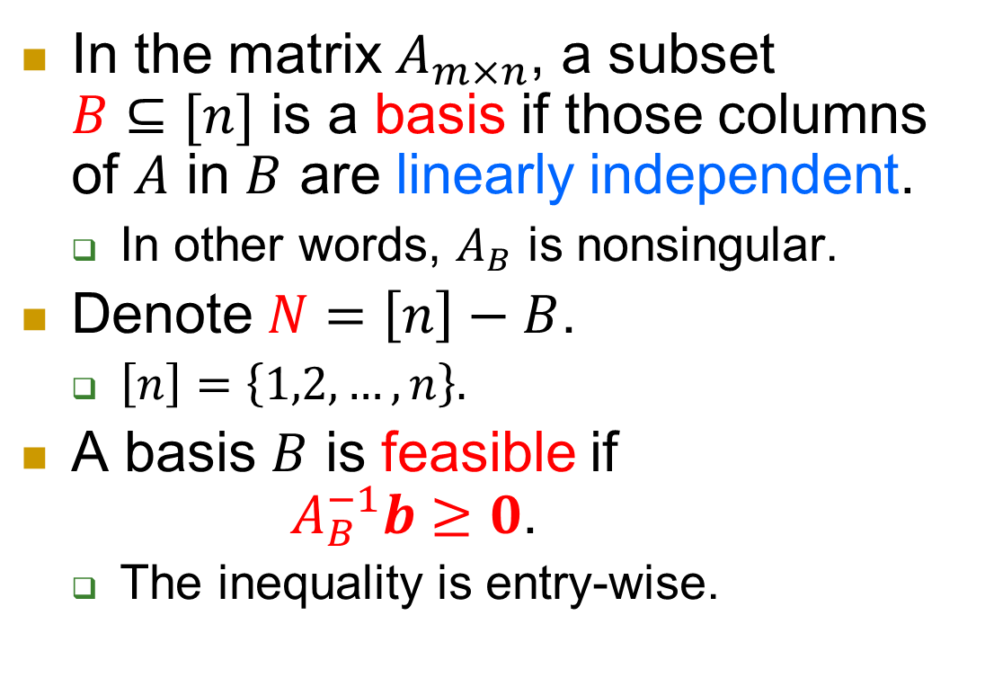
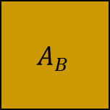





Basis
In the matrix $A_{m×n}$, a subset $B⊆[n]$ is a basis if those columns of $A$ in $B$ are linearly independent.
  In other words, $A_{B}$ is nonsingular.
Denote $N=\left[n\right]−B$.
  $\left[n\right]=\left\{1,2,…,n\right\}.$
A basis $B$ is feasible if
$A_{B}^{−1}b≥0$.
  The inequality is entry-wise.
$$A$$
$$n$$
$$A_{B}$$
$$m$$
$$B$$
$$A$$
$$A_{B}$$
$$A_{N}$$
$$B$$
$$N$$

Slide 29
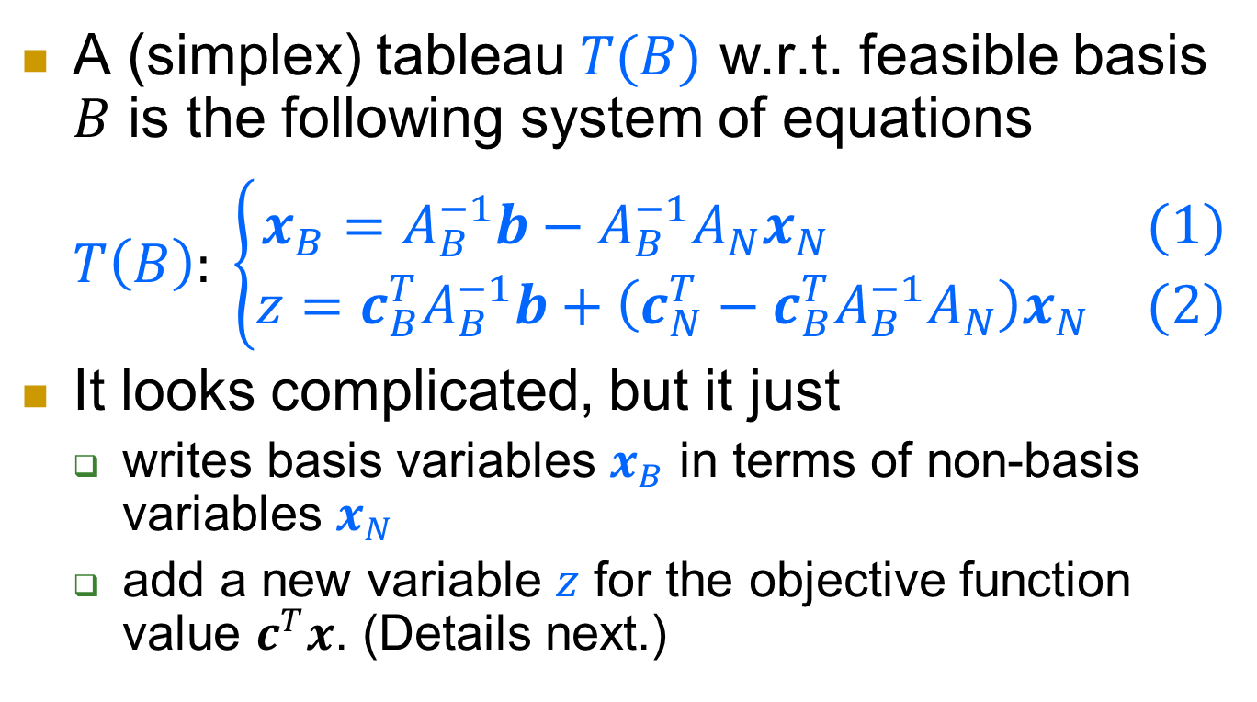
(Simplex) tableau
A (simplex) tableau $T(B)$ w.r.t. feasible basis $B$ is the following system of equations
$T\left(B\right): \left\{\begin{matrix}x_{B}=A_{B}^{−1}b−A_{B}^{−1}A_{N}x_{N} & (1) \\ z=c_{B}^{T}A_{B}^{−1}b+\left(c_{N}^{T}−c_{B}^{T}A_{B}^{−1}A_{N}\right)x_{N} & (2)\end{matrix}\right.$
It looks complicated, but it just
  writes basis variables $x_{B}$ in terms of non-basis variables $x_{N}$
  add a new variable $z$ for the objective function value $c^{T}x$. (Details next.)

Slide 30

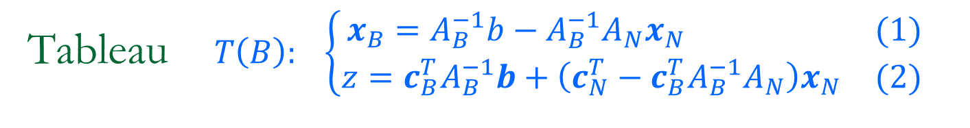

Tableau $T\left(B\right): \left\{\begin{matrix}x_{B}=A_{B}^{−1}b−A_{B}^{−1}A_{N}x_{N} & (1) \\ z=c_{B}^{T}A_{B}^{−1}b+\left(c_{N}^{T}−c_{B}^{T}A_{B}^{−1}A_{N}\right)x_{N} & (2)\end{matrix}\right.$
[Prop 1] If $A_{B}$ is nonsingular, then
$(x,z)$ satisfies $T(B) ⇔ Ax=b, z=c^{T}x$
Proof.
  $⇒:Ax=\left(A_{B},A_{N}\right)\left(\begin{matrix}x_{B} \\ x_{N}\end{matrix}\right)=A_{B}x_{B}+A_{N}x_{N}$
  $=b−A_{N}x_{N}+A_{N}x_{N}=b$
  $c^{T}x=\left(c_{B}^{T},c_{N}^{T}\right)\left(\begin{matrix}x_{B} \\ x_{N}\end{matrix}\right)=c_{B}^{T}x_{B}+c_{N}^{T}x_{N}$
  $=c_{B}^{T}A_{B}^{−1}b−c_{B}^{T}A_{B}^{−1}A_{N}x_{N}+c_{N}^{T}x_{N}$
  $⇐:b=Ax=A_{B}x_{B}+A_{N}x_{N}. ∴A_{B}^{−1}b=x_{B}+A_{B}^{−1}A_{N}x_{N}$.
  $z=c^{T}x=c_{B}^{T}x_{B}+c_{N}^{T}x_{N}$
  $=c_{B}^{T}A_{B}^{−1}b−c_{B}^{T}A_{B}^{−1}A_{N}x_{N}+c_{N}^{T}x_{N}$

Slide 31
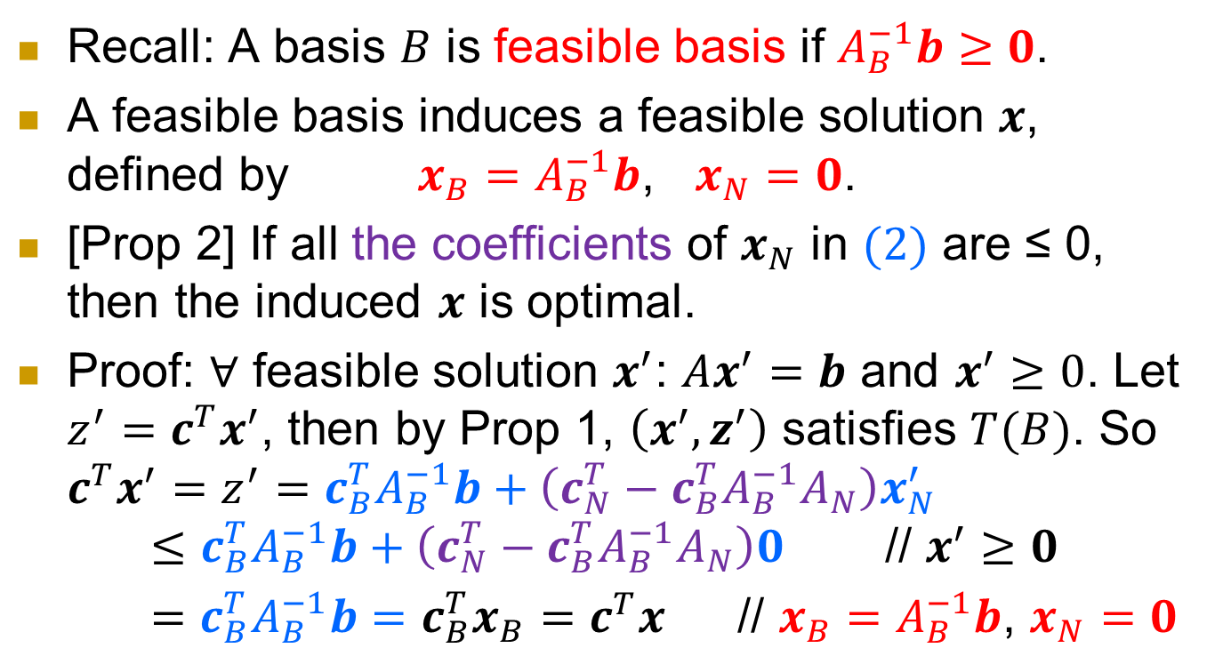
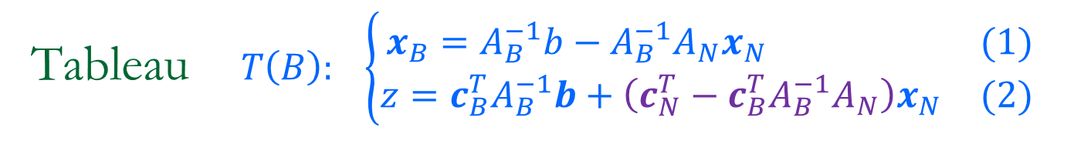
Tableau $T\left(B\right): \left\{\begin{matrix}x_{B}=A_{B}^{−1}b−A_{B}^{−1}A_{N}x_{N} & (1) \\ z=c_{B}^{T}A_{B}^{−1}b+\left(c_{N}^{T}−c_{B}^{T}A_{B}^{−1}A_{N}\right)x_{N} & (2)\end{matrix}\right.$
  Recall: A basis $B$ is feasible basis if $A_{B}^{−1}b≥0$.
  A feasible basis induces a feasible solution $x$, defined by $x_{B}=A_{B}^{−1}b$, $x_{N}=0$.
[Prop 2] If all the coefficients of $x_{N}$ in $(2)$ are ≤ 0, then the induced $x$ is optimal.
Proof: $∀$ feasible solution $x^{′}$: $Ax^{′}=b$ and $x^{′}≥0$. Let $z^{′}=c^{T}x^{′}$, then by Prop 1, $\left(x^{′},z^{′}\right)$ satisfies $T(B)$. So $c^{T}x^{′}=z^{′}=c_{B}^{T}A_{B}^{−1}b+\left(c_{N}^{T}−c_{B}^{T}A_{B}^{−1}A_{N}\right)x_{N}^{′}$
$≤c_{B}^{T}A_{B}^{−1}b+\left(c_{N}^{T}−c_{B}^{T}A_{B}^{−1}A_{N}\right)0$ // $x^{′}≥0$
$=c_{B}^{T}A_{B}^{−1}b=c_{B}^{T}x_{B}=c^{T}x$ // $x_{B}=A_{B}^{−1}b$, $x_{N}=0$
Notes:
It has the objective function value
$c^{T}x=c_{B}^{T}x_{B}=c_{B}^{T}A_{B}^{−1}b$.

Slide 32
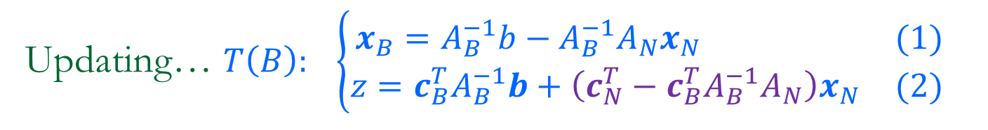
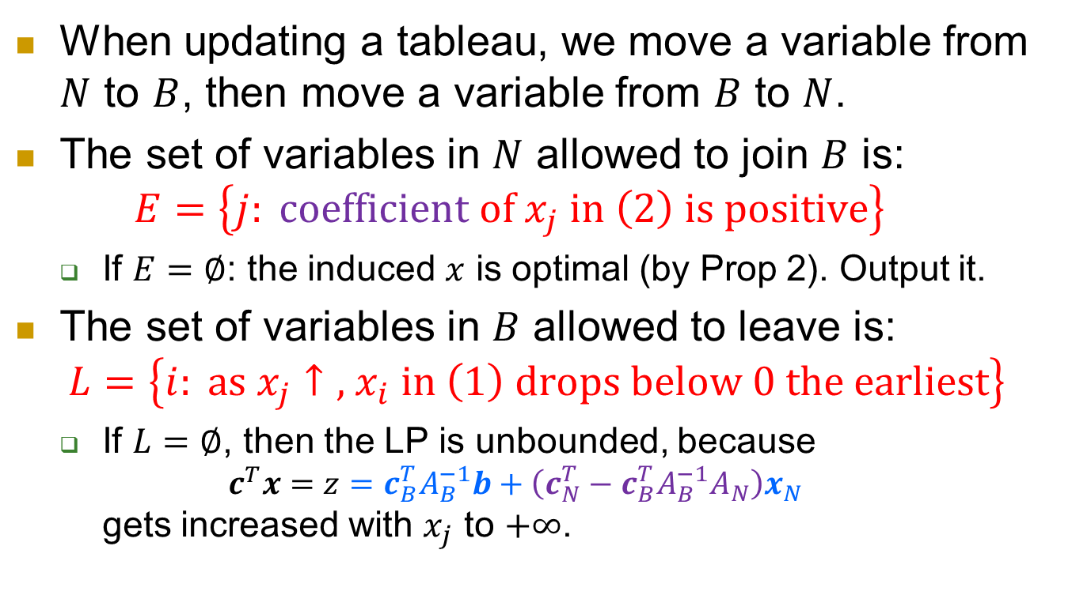
Updating… $T\left(B\right): \left\{\begin{matrix}x_{B}=A_{B}^{−1}b−A_{B}^{−1}A_{N}x_{N} & (1) \\ z=c_{B}^{T}A_{B}^{−1}b+\left(c_{N}^{T}−c_{B}^{T}A_{B}^{−1}A_{N}\right)x_{N} & (2)\end{matrix}\right.$
When updating a tableau, we move a variable from $N$ to $B$, then move a variable from $B$ to $N$.
The set of variables in $N$ allowed to join $B$ is:
$E=\left\{j: \text{coefficient} \text{of} x_{j} \text{in} \left(2\right) \text{is} \text{positive}\right\}$
  If $E=∅$: the induced $x$ is optimal (by Prop 2). Output it.
The set of variables in $B$ allowed to leave is:
$L=\left\{i: \text{as} x_{j}↑\text{,} x_{i} \text{in} \left(1\right) \text{drops} \text{below} 0 \text{the} \text{earliest}\right\}$
  If $L=∅$, then the LP is unbounded, because
  $c^{T}x=z=c_{B}^{T}A_{B}^{−1}b+\left(c_{N}^{T}−c_{B}^{T}A_{B}^{−1}A_{N}\right)x_{N}$
  gets increased with $x_{j}$ to $+∞$.

Slide 33
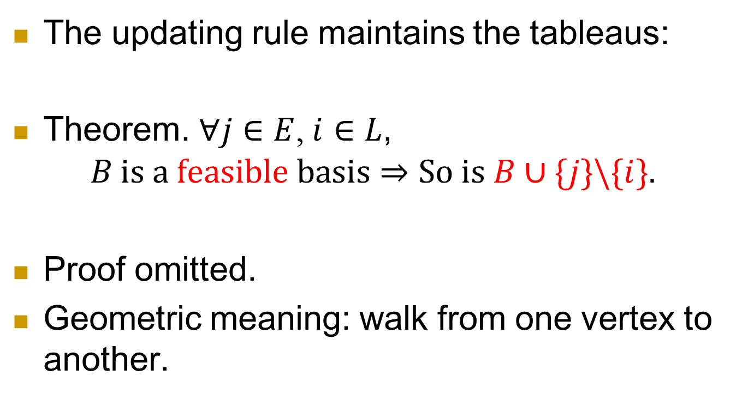
Updating
The updating rule maintains the tableaus:
Theorem. $∀j∈E$, $i∈L$,
$B \text{is} \text{a} \text{feasible} \text{basis}⇒\text{So} \text{is} B∪\{j\}\backslash \{i\}.$
Proof omitted.
Geometric meaning: walk from one vertex to another.

Slide 34
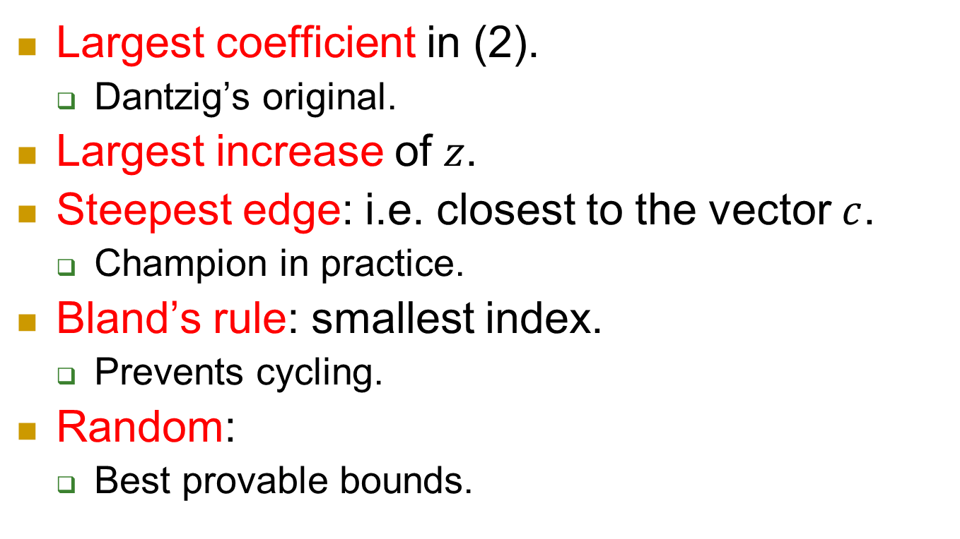
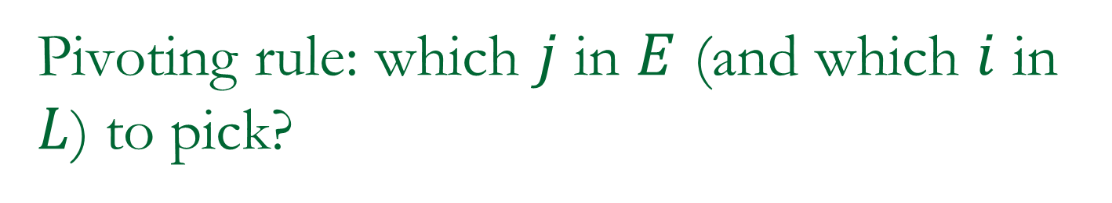
Pivoting rule: which $j$ in $E$ (and which $i$ in $L$) to pick?
Largest coefficient in (2).
  Dantzig’s original.
Largest increase of $z$.
Steepest edge: i.e. closest to the vector $c$.
  Champion in practice.
Bland’s rule: smallest index.
  Prevents cycling.
Random:
  Best provable bounds.

Slide 35
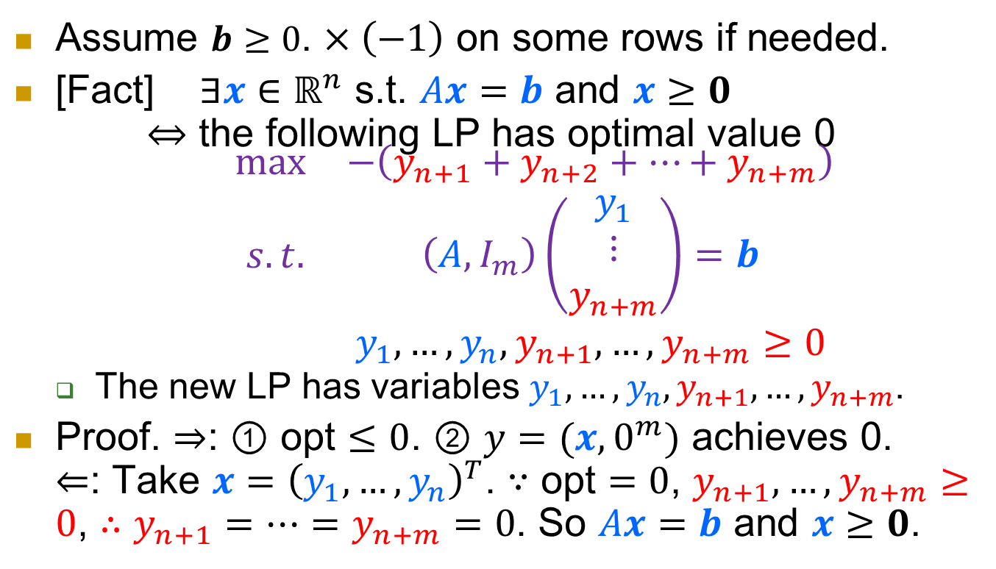
Picking the initial feasible solution
Assume $b≥0$. $×\left(−1\right)$ on some rows if needed.
[Fact] $∃x∈ℝ^{n}$ s.t. $Ax=b$ and $x≥0$
$⇔$ the following LP has optimal value 0
$\begin{matrix}max & −\left(y_{n+1}+y_{n+2}+…+y_{n+m}\right) \\ \begin{aligned} s.t. \\ \end{aligned} & \begin{aligned}\left(A,I_{m}\right)\left(\begin{matrix}y_{1} \\ ⋮ \\ y_{n+m}\end{matrix}\right)=b \\ y_{1},…,y_{n},y_{n+1},…,y_{n+m}≥0\end{aligned}\end{matrix}$
  The new LP has variables $y_{1},…,y_{n},y_{n+1},…,y_{n+m}$.
Proof. $⇒$: $①$ opt $≤0$. $②$ $y=(x,0^{m})$ achieves 0.
$⇐$: Take $x={\left(y_{1},…,y_{n}\right)}^{T}$. $∵$ opt $=0$, $y_{n+1},…,y_{n+m}≥0$, $∴y_{n+1}=…=y_{n+m}=0$. So $Ax=b$ and $x≥0$.

Slide 36
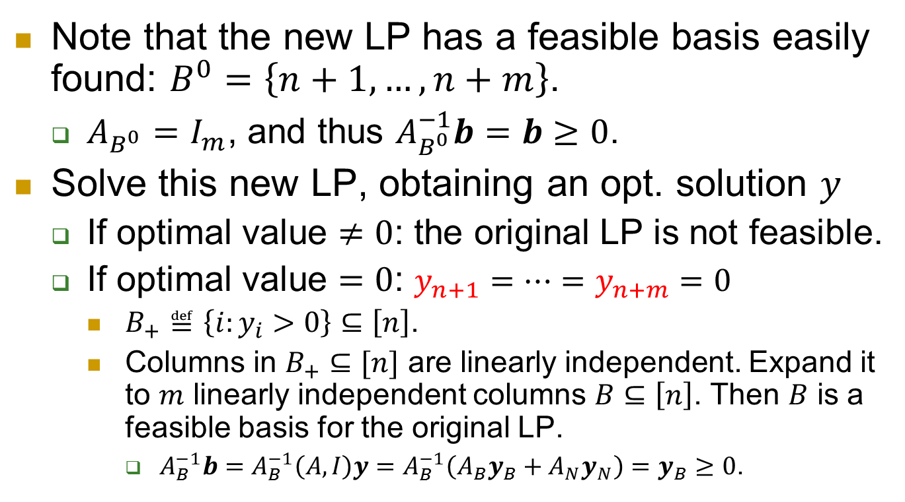
Solve the new LP first
Note that the new LP has a feasible basis easily found: $B^{0}=\left\{n+1, …, n+m\right\}$.
  $A_{B^{0}}=I_{m}$, and thus $A_{B^{0}}^{−1}b=b≥0$.
Solve this new LP, obtaining an opt. solution $y$
  If optimal value $≠0$: the original LP is not feasible.
  If optimal value $=0$: $y_{n+1}=…=y_{n+m}=0$
    $B_{+}≝\left\{i:y_{i}>0\right\}⊆\left[n\right]$.
    Columns in $B_{+}⊆[n]$ are linearly independent. Expand it to $m$ linearly independent columns $B⊆\left[n\right]$. Then $B$ is a feasible basis for the original LP.
      $A_{B}^{−1}b=A_{B}^{−1}\left(A,I\right)y=A_{B}^{−1}\left(A_{B}y_{B}+A_{N}y_{N}\right)=y_{B}≥0$.
Notes:
If $B⊆[n]$: $B$ is also a feasible basis for the original LP.
$A_{B}^{−1}b={\left(A,I\right)}_{B}^{−1}b≥0$.
Else:

Slide 37


Simplex Alg: putting everything together
If no feasible basis is available,
  solve
  If optimal value ≠ 0: original LP is infeasible.
  If optimal value = 0: get a feasible basis $B$ for the original LP.
$$\begin{matrix}max & −\left(y_{n+1}+y_{n+2}+…+y_{n+m}\right) \\ \begin{aligned} s.t. \\ \end{aligned} & \begin{aligned}\left(A,I_{m}\right)\left(\begin{matrix}y_{1} \\ ⋮ \\ y_{n+m}\end{matrix}\right)=b \\ y_{1},…,y_{n},y_{n+1},…,y_{n+m}≥0\end{aligned}\end{matrix}$$

Slide 38

Simplex Algorithm: continued
For the feasible basis $B⊆\left[n\right]$, compute tableau
$T\left(B\right): \left\{\begin{matrix}x_{B}=A_{B}^{−1}b−A_{B}^{−1}A_{N}x_{N} & (1) \\ z=c_{B}^{T}A_{B}^{−1}b+\left(c_{N}^{T}−c_{B}^{T}A_{B}^{−1}A_{N}\right)x_{N} & (2)\end{matrix}\right.$
if all coefficients of $x_{N}$ in $(2)$ are ≤ $0$
  output optimal solution $x=(x_{B},x_{N})$, with $x_{B}$ in $(1)$, and $x_{N}=0$. (opt value: $c^{T}x=z$.)
else
  pick $j∈E$ by some pivoting rule.
  if the column of $j$ in tableau ≥ 0, output “LP is unbounded”.
  else
    Pick $i∈L$ by some pivoting rule
    $B ← B∪\{j\}\backslash \{i\}$ and go to the first step in this slide.
$$E=\left\{j: \text{coefficient} \text{of} x_{j} \text{in} \left(2\right) \text{is} \text{positive}\right\}$$
$$L=\left\{i: \text{as} x_{j}↑\text{,} x_{i} \text{in} \left(1\right) \text{drops} \text{below} 0 \text{the} \text{earliest}\right\}$$

Slide 39

Efficiency
In practice: Very efficient.
  Typical: $2m∼3m$ pivoting steps.
    $m$: number of constraints
In theory:
  Finite: Some pivoting rules prevent cycling.
  Worst case complexity is exponential for most known deterministic pivoting rules.
  No “pivoting rule”, deterministic or randomized, with polynomial worst-case complexity known.
  Best bound: $e^{Θ\left(\sqrt{n log n}\right)}$ with $n$ variables and $n$ constraints

Slide 40

Theory of simplex method
Actually we don’t even know the complexity of best possible pivoting rule.
Hirsch Conj: It’s $O(n)$.
Best upper bound (Kalai-Kleitman): $n^{1+ln⁡(n)}$.
Smoothed complexity: For any LP, perturbing its coefficients by small random amounts makes the simplex method (w/ a certain pivoting rule) polynomial time complexity.
  See here for surveys/papers.

Slide 41


Duality
Recall our problem:
  max $x_{1}+6x_{2}$
  s.t. $x_{1}≤200$ (1)
  $x_{2}≤300$ (2)
  $x_{1}+x_{2}≤400$ (3)
  $x_{1}, x_{2}≥0$ (4)
Let’s see how good the solution could be.
$\left(1\right)+6×(2)$:
  $x_{1}+6x_{2}≤200+6×300= 2000$
It’s an upper bound.
$5×(2)+(3):$
  $5x_{2}+(x_{1}+x_{2})$
  $≤5×300+400=1900$
It’s a better upper bound.
What’s the best upper bound obtained this way?

Slide 42

Duality
Recall our problem:
  max $x_{1}+6x_{2}$
  s.t. $x_{1}≤200$ (1)
  $x_{2}≤300$ (2)
  $x_{1}+x_{2}≤400$ (3)
  $x_{1}, x_{2}≥0$ (4)
In general:
  $y_{1}×\left(1\right)+y_{2}×\left(2\right)+y_{3}×(3):$
  $$\left(y_{1}+y_{3}\right)x_{1}+\left(y_{2}+y_{3}\right)x_{2}≤200y_{1}+300y_{2}+400y_{3}.$$
  If $y_{1}+y_{3}≥1$ and $y_{2}+y_{3}≥6$, we get an upper bound:
  $x_{1}+6x_{2}≤200y_{1}+300y_{2}+400y_{3}$.
The best upper bound?
min $200y_{1}+300y_{2}+400y_{3}$
s.t. $y_{1}+y_{3}≥1$
$y_{2}+y_{3}≥6$
$y_{1}, y_{2}, y_{3}≥0$
This is another linear programming problem.
--- dual of the original LP.

Slide 43


Making it formal
Primal
max $cTx$
s.t. $Ax≤b$
$x≥0$
Dual
min $bTy$
s.t. $ATy≥c$
$y≥0$

Slide 44



Primal
max $cTx$
s.t. $Ax≤b$
$x≥0$
max $c^{T}x$
s.t. $Ax=b$
$x≥0$
Dual
min $bTy$
s.t. $ATy≥c$
$y≥0$
min $b^{T}y$
s.t. $ATy≥c$

Slide 45


Primal
  max $x_{1}+6x_{2}$
  s.t. $x_{1}≤200$ (1)
  $x_{2}≤300$ (2)
  $x_{1}+x_{2}≤400$ (3)
  $x_{1}, x_{2}≥0$
Dual
  min $200y_{1}+300y_{2}+400y_{3}$
  s.t. $y_{1}+y_{3}≥1$ (1)
  $y_{2}+y_{3}≥6$ (2)
  $y_{1},y_{2},y_{3}≥0$

Slide 46

Strong duality
The primal gives lower bounds for the dual
The dual gives upper bounds for the primal
[Strong duality] For linear programming, optimal primal value = optimal dual value
  If both exist, then they are equal
  If one is infinity, then the other is infeasible

Slide 47


A physical interpretation of duality
Consider
Primal Dual
max $cTx$ min $bTy$
s.t. $Ax≤b$ s.t. $ATy≥c$
$y≥0$
Rotate s.t. $c$ points downward.
Each inequality $a_{i}^{T}x≤b_{i}$ gives a half-space, with outer normal $a_{i}$.
  Denote the face by $S_{i}$.

Slide 48

A physical interpretation of duality
Primal Dual
max $cTx$ min $bTy$
s.t. $Ax≤b$ s.t. $ATy≥c$
$y≥0$
Drop a steel ball and let it rolls down to the lowest point $x^{∗}$.
  $x^{∗}$ is an optimal solution.
$x^{∗}$ touches some faces $S_{i}$.
  Let $D=\{i:x^{∗} touches S_{i}\}$.
  Note: $x^{∗}$ touches $S_{i}⇔a_{i}^{T}x^{∗}=b_{i}$.

Slide 49

A physical interpretation of duality
Primal Dual
max $cTx$ min $bTy$
s.t. $Ax≤b$ s.t. $ATy≥c$
$y≥0$
Consider the gravity force $F$.
  It’s decomposed into forces of pressure on the faces $S_{i}$ $\left(i∈D\right):F=\sum_{i∈D}{F_{i}}$.
  $F_{i}$ is directed outward, along the direction $a_{i}$.
  So $\sum_{i∈D}{y_{i}^{∗}a_{i}}=c$ and $y_{i}^{∗}≥0$, $∀i∈D$.

Slide 50

A physical interpretation of duality
Primal Dual
max $cTx$ min $bTy$
s.t. $Ax≤b$ s.t. $ATy≥c$
$y≥0$
Now set $y_{i}^{∗}=0$, $∀i∉D$.
$\sum_{i=1}^{m}{y_{i}^{∗}a_{i}}=\sum_{i∈D}{y_{i}^{∗}a_{i}}=c$.
  That is, $A^{T}y^{∗}=c$.
So this $y^{∗}$ is feasible for Dual.

Slide 51

A physical interpretation of duality
Primal Dual
max $cTx$ min $bTy$
s.t. $Ax≤b$ s.t. $ATy≥c$
$y≥0$
Consider ${\left(y^{∗}\right)}^{T}(Ax^{∗}−b)$.
  For $i∈D$: $a_{i}^{T}x^{∗}=b_{i}$, so $a_{i}^{T}x^{∗}−b_{i}=0$.
  For $i∉D$: $y_{i}^{∗}=0$
Thus ${\left(y^{∗}\right)}^{T}\left(Ax^{∗}−b\right)=0$.
Therefore,
$${\left(y^{∗}\right)}^{T}b={\left(y^{∗}\right)}^{T}Ax^{∗}={\left(A^{T}y^{∗}\right)}^{T}x^{∗}=c^{T}x^{∗}$$
We just “proved” strong duality by physics!

Slide 52





Application: Zero-sum game
Two players: Row and Column
Payoff matrix
  $(i,j)$: Row pays to Column when Row takes strategy $i$ and Column takes strategy $j$
Row wants to minimize; Column wants to maximize.
Game: You don’t know others’ strategy.
 | 0 | 1 | -1
 | -1 | 0 | 1
 | 1 | -1 | 0

Slide 53

Who moves first?
They both want to minimize their loss in the worst case (of the other’s strategy).
  Row: ${\text{min}}_{i}{\text{max}}_{j}a_{ij}$
  Column: ${\text{max}}_{j}{\text{min}}_{i}a_{ij}$
Fact: ${\text{min}}_{i}{\text{max}}_{j}a_{ij}≥{\text{max}}_{j}{\text{min}}_{i}a_{ij}$
Game theoretical interpretation:
The player making the first move has disadvantage.
  Consider the Rock-Paper-Scissors game: If you move first, then you’ll lose for sure.

Slide 54

Mixed strategy
Mixed strategy: a randomized choice.
  Row: strategy $i$ with prob. $p_{i}$.
  Column: strategy $j$ with prob. $q_{j}$.
Now the tasks are:
  Row: ${\text{min}}_{{\{p}_{i}\}}{\text{max}}_{\left\{q_{j}\right\}}\sum_{i}{p_{i}q_{j}a_{ij}}$
  Column: ${\text{max}}_{{\{q}_{j}\}}{\text{min}}_{\left\{p_{i}\right\}}\sum_{j}{p_{i}q_{j}a_{ij}}$
Fact: the inner opt can be achieved by a deterministic strategy.
So the tasks become:
  Row: ${\text{min}}_{{\{p}_{i}\}}{\text{max}}_{j}\sum_{i}{p_{i}a_{ij}}$
  Column: ${\text{max}}_{{\{q}_{j}\}}{\text{min}}_{i}\sum_{j}{q_{j}a_{ij}}$

Slide 55

Minimax
Minimax theorem:
${\text{min}}_{{\{p}_{i}\}}{\text{max}}_{j}\sum_{i}{p_{i}a_{ij}}$= ${\text{max}}_{{\{q}_{j}\}}{\text{min}}_{i}\sum_{j}{q_{j}a_{ij}}$
The player who moves first doesn’t have disadvantage any more!
  Consider the Rock-Paper-Scissors game again: Each player wants to use $\left(\frac{1}{3},\frac{1}{3},\frac{1}{3}\right)$ distribution on her choices.

Slide 56


Proof by LP duality
Row:
${\text{min}}_{{\{p}_{i}\}}{\text{max}}_{j}\sum_{i}{p_{i}a_{ij}}$
  min $z$
  s.t. $\sum_{i}{p_{i}a_{ij}}≤z, ∀j$
  $0≤p_{i}≤1$
  $\sum_{i}{p_{i}}=1$
Column:
${\text{max}}_{{\{q}_{j}\}}{\text{min}}_{i}\sum_{j}{q_{j}a_{ij}}$
  max $w$
  s.t. $\sum_{j}{q_{j}a_{ij}}≥w, ∀ i$
  $0≤q_{j}≤1$
  $\sum_{j}{q_{j}}=1$
Observation: These two LP’s are dual to each other.
Thus they have the same optimal value.

Slide 57
Summary
Linear program: a very useful framework
Algorithms:
  Simplex: exponential in worst-case, efficient in practice.
  Ellipsoid: polynomial in worst-case but usually not efficient enough for practical data.
  Interior point: polynomial in worst-case and efficient in practice.
Duality: Each LP has a dual LP, which has the same optimal value as the primal LP if both are feasible.

Slide 58


References
Our introduction to LP largely follows the book
Understanding and Using Linear Programming, Jiři Matoušek and Bernd Gärtner, Springer, 2006.
Many references on LP or other optimization theories.
Convex Optimization, Boyd and Vandenberghe, Cambridge University Press, 2004.

