Slide 1
CMSC5706 Topics in Theoretical Computer Science
Week 11: Influence Maximization
on Social Networks
Instructor: Shengyu Zhang

Slide 2
Location change for the final 2 classes
Nov 17: YIA 404 (Yasumoto International Academic Park 康本國際學術園)
Nov 24: No class.
  Conference leave.
Dec 1: YIA 508 (Yasumoto International Academic Park 康本國際學術園)

Slide 3
Social network
Extensively studied by social scientists for decades.
  Usually small datasets.
Social networks on Internet are gigantic
  Facebook, Twitter, LinkedIn, WeChat, Weibo, …
A large class of tasks/studies are about the influence and information propagation.
A typical task: select some seed customers and let them influence others.

Slide 4
Motivating examples
Adoption of smart phones.
  Good: easy access to Internet, many cool apps, etc.
  Bad: expensive, absorbing too much time, …
Once you start to use smart phones, it’s hard to go back.
  There are not even many choices of traditional phones.
Similar adoption: Religion, new idea, virus, …
This lecture focuses on progressive models: once a node becomes active, it stays active.
  There are also non-progressive models.

Slide 5
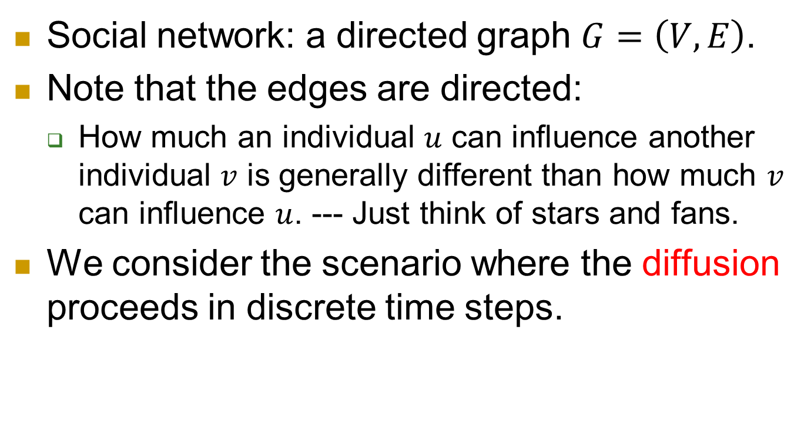
Popular models
Social network: a directed graph $G=\left(V,E\right)$.
Note that the edges are directed:
  How much an individual $u$ can influence another individual $v$ is generally different than how much $v$ can influence $u$. --- Just think of stars and fans.
We consider the scenario where the diffusion proceeds in discrete time steps.

Slide 6
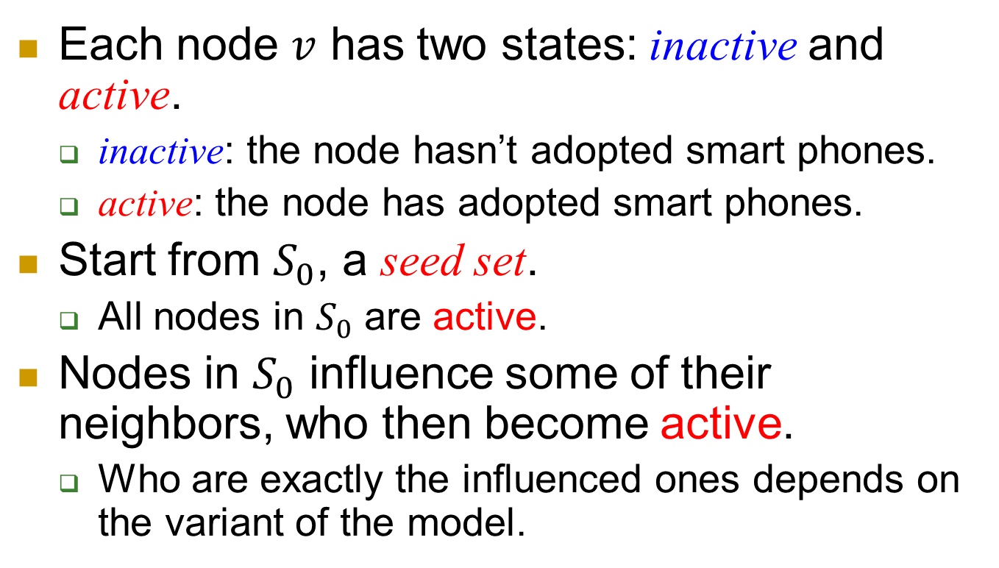
Each node $v$ has two states: inactive and active.
  inactive: the node hasn’t adopted smart phones.
  active: the node has adopted smart phones.
Start from $S_{0}$, a seed set.
  All nodes in $S_{0}$ are active.
Nodes in $S_{0}$ influence some of their neighbors, who then become active.
  Who are exactly the influenced ones depends on the variant of the model.

Slide 7
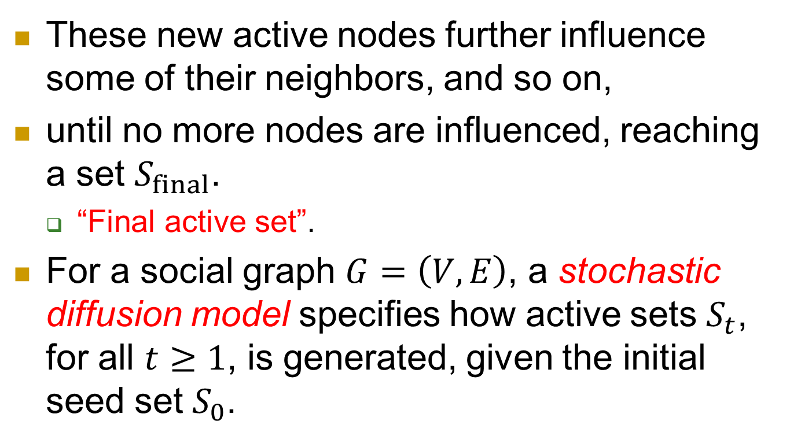
model
These new active nodes further influence some of their neighbors, and so on,
until no more nodes are influenced, reaching a set $S_{final}$.
  “Final active set”.
For a social graph $G=\left(V,E\right)$, a stochastic diffusion model specifies how active sets $S_{t}$, for all $t≥1$, is generated, given the initial seed set $S_{0}$.

Slide 8
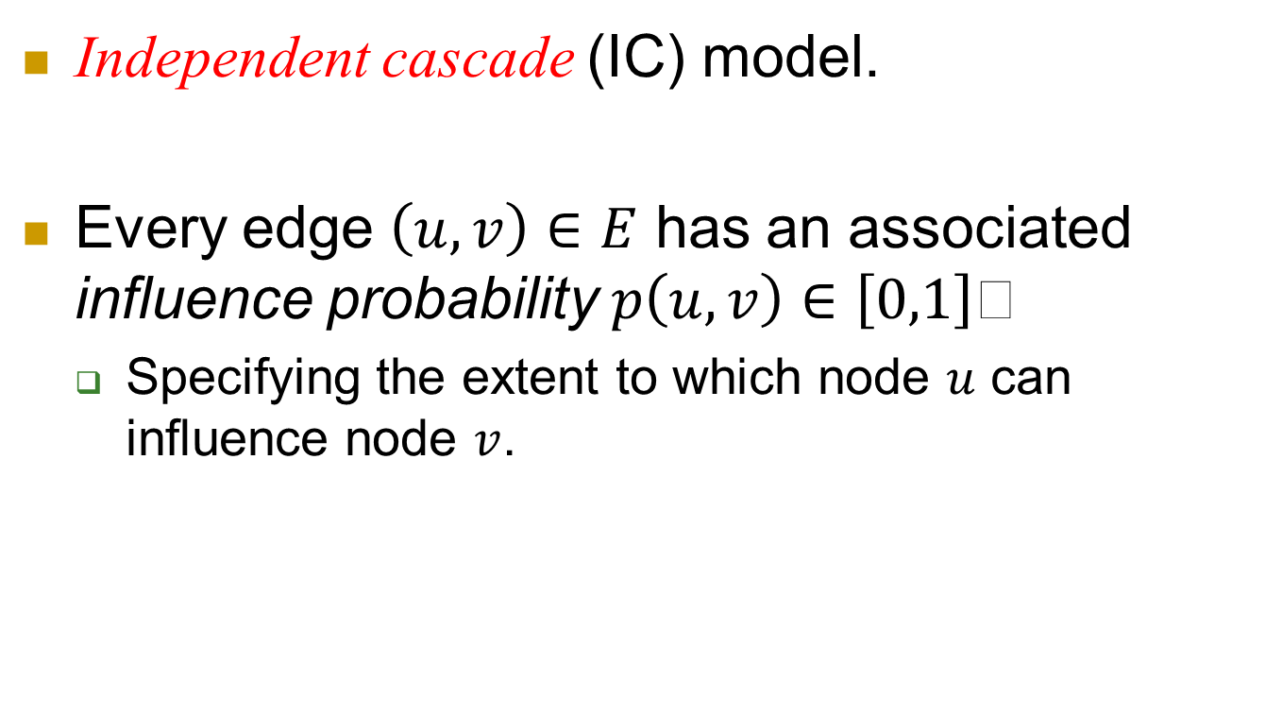
Model 1: IC
Independent cascade (IC) model.
Every edge $\left(u,v\right)∈E$ has an associated influence probability $p\left(u,v\right)∈\left[0,1\right]$
  Specifying the extent to which node $u$ can influence node $v$.

Slide 9
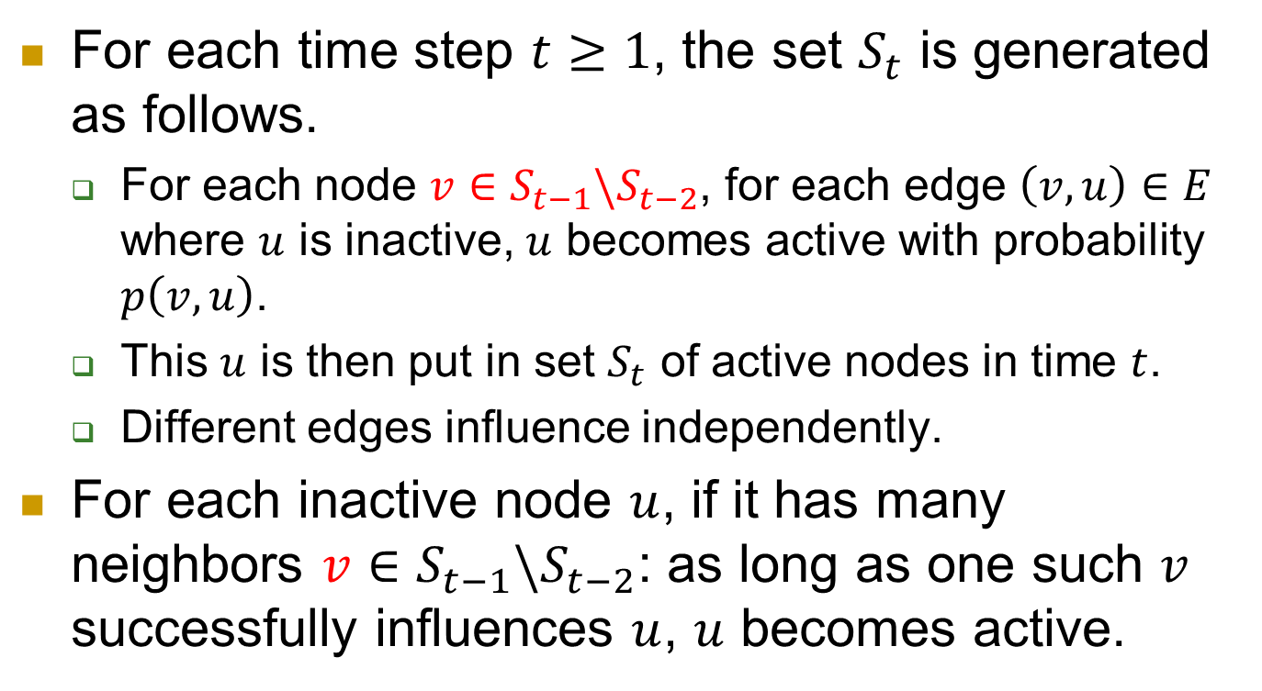
For each time step $t≥1$, the set $S_{t}$ is generated as follows.
  For each node $v∈S_{t−1}\backslash S_{t−2}$, for each edge $\left(v,u\right)∈E$ where $u$ is inactive, $u$ becomes active with probability $p\left(v,u\right)$.
  This $u$ is then put in set $S_{t}$ of active nodes in time $t$.
  Different edges influence independently.
For each inactive node $u$, if it has many neighbors $v∈S_{t−1}\backslash S_{t−2}$: as long as one such $v$ successfully influences $u$, $u$ becomes active.

Slide 10
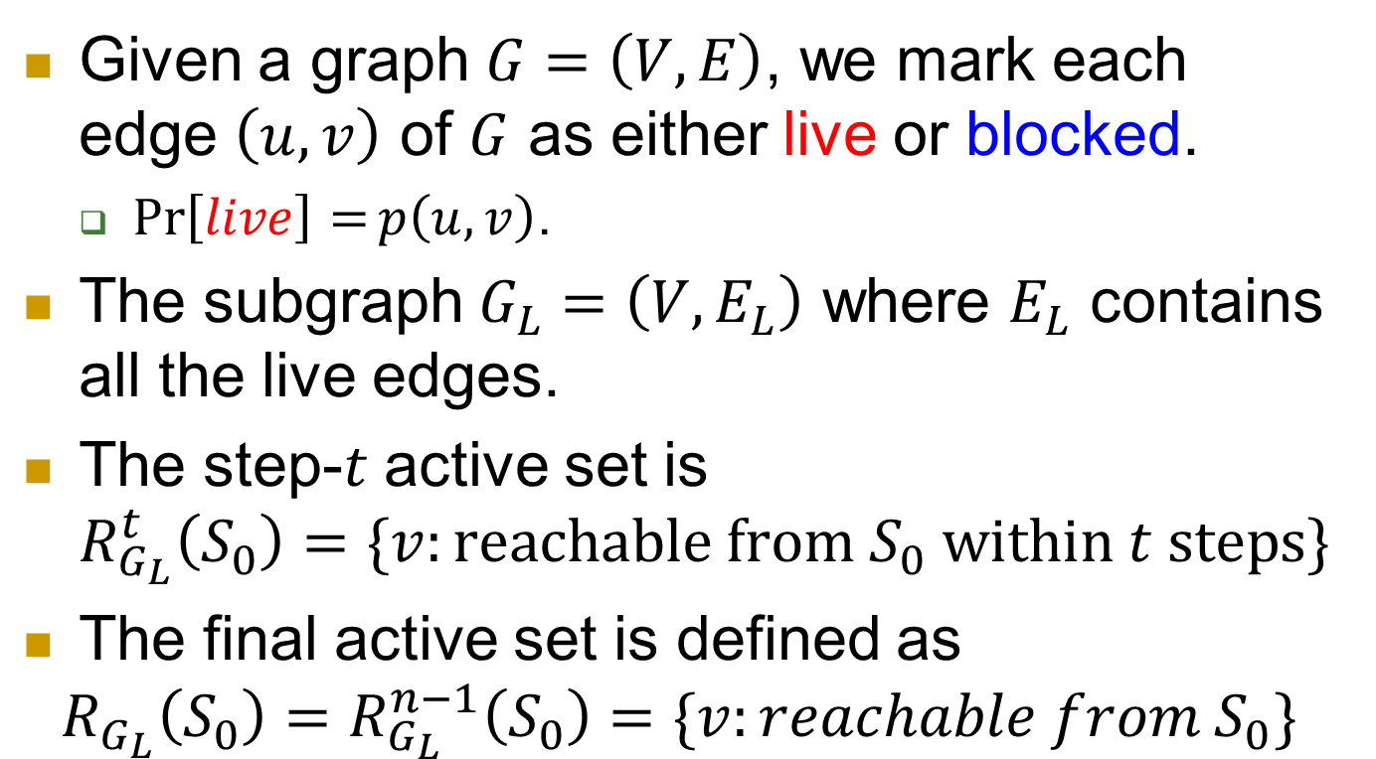
An equivalent model
Given a graph $G=\left(V,E\right)$, we mark each edge $\left(u,v\right)$ of $G$ as either live or blocked.
  $\operatorname{Pr}\left[live\right]=p\left(u,v\right)$.
The subgraph $G_{L}=\left(V,E_{L}\right)$ where $E_{L}$ contains all the live edges.
The step-$t$ active set is
$R_{G_{L}}^{t}\left(S_{0}\right)=\{v:reachable from S_{0} within t steps\}$
The final active set is defined as
$$R_{G_{L}}\left(S_{0}\right)=R_{G_{L}}^{n−1}\left(S_{0}\right)=\{v:reachable from S_{0}\}$$

Slide 11
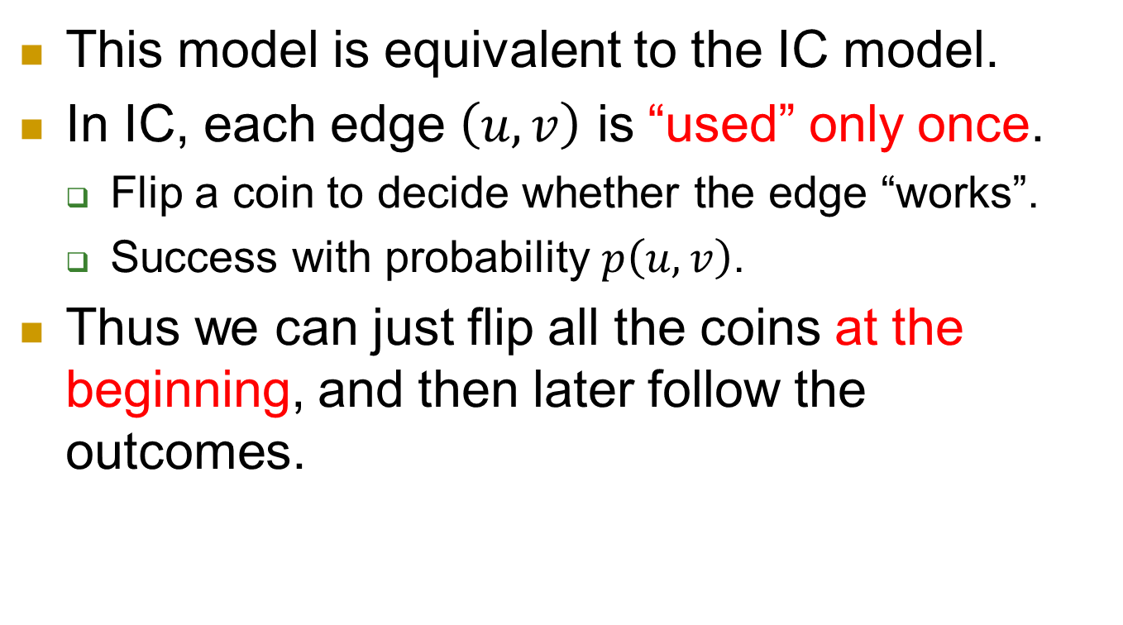
This model is equivalent to the IC model.
In IC, each edge $\left(u,v\right)$ is “used” only once.
  Flip a coin to decide whether the edge “works”.
  Success with probability $p\left(u,v\right)$.
Thus we can just flip all the coins at the beginning, and then later follow the outcomes.

Slide 12
Model 2: LT
Linear threshold (LT) model.
In many situations, multiple and independent sources are needed for an individual to be convinced to adopt some idea.
E.g. Seeing 1/3 of your friends using smart phone, you made the decision.

Slide 13
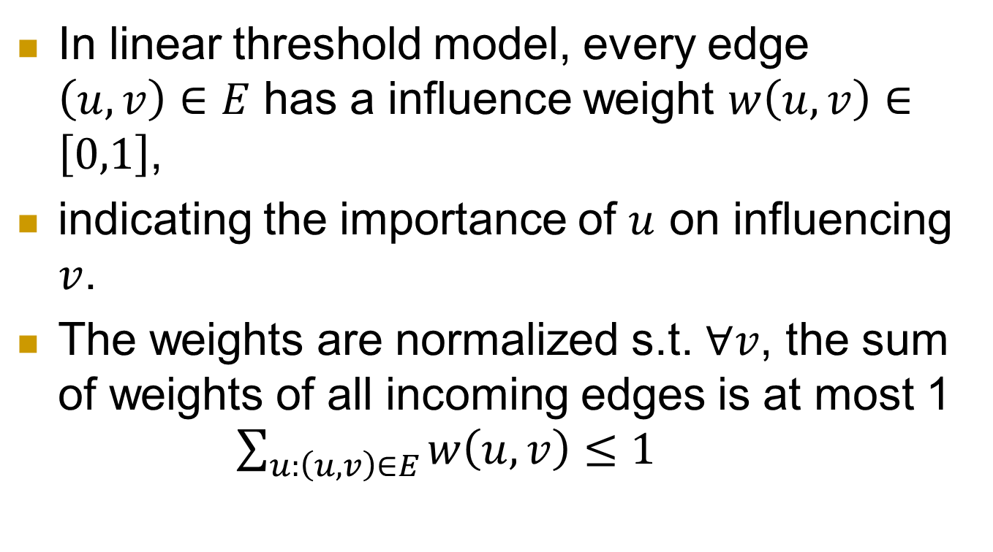
In linear threshold model, every edge $\left(u,v\right)∈E$ has a influence weight $w\left(u,v\right)∈\left[0,1\right]$,
indicating the importance of $u$ on influencing $v$.
The weights are normalized s.t. $∀v$, the sum of weights of all incoming edges is at most 1
$\sum_{u:\left(u,v\right)∈E}{w\left(u,v\right)}≤1$

Slide 14
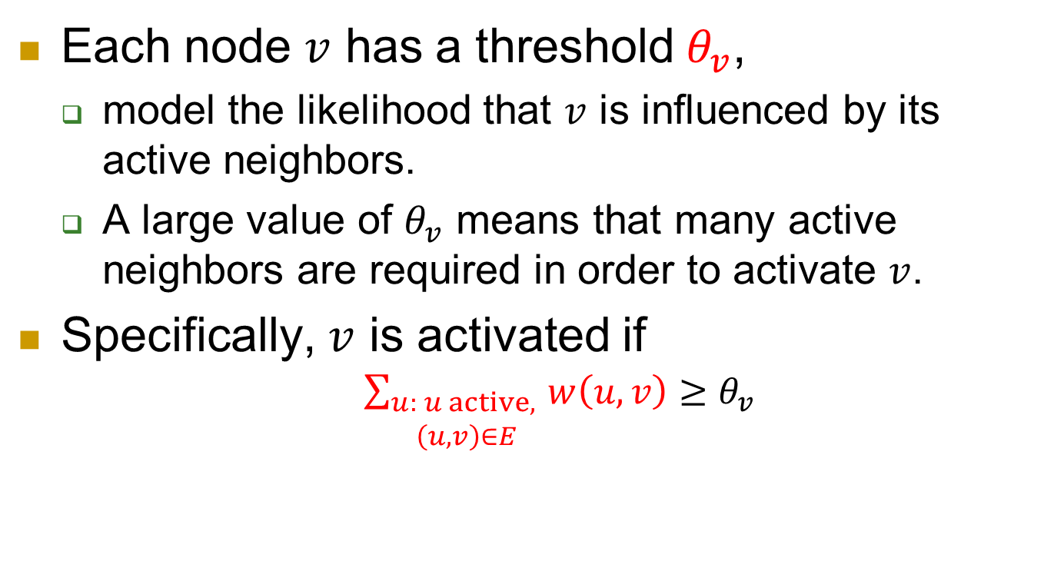
Each node $v$ has a threshold $θ_{v}$,
  model the likelihood that $v$ is influenced by its active neighbors.
  A large value of $θ_{v}$ means that many active neighbors are required in order to activate $v$.
Specifically, $v$ is activated if
$\sum_{\begin{aligned}u: u active, \\ \left(u,v\right)∈E\end{aligned}}{w\left(u,v\right)}≥θ_{v}$

Slide 15
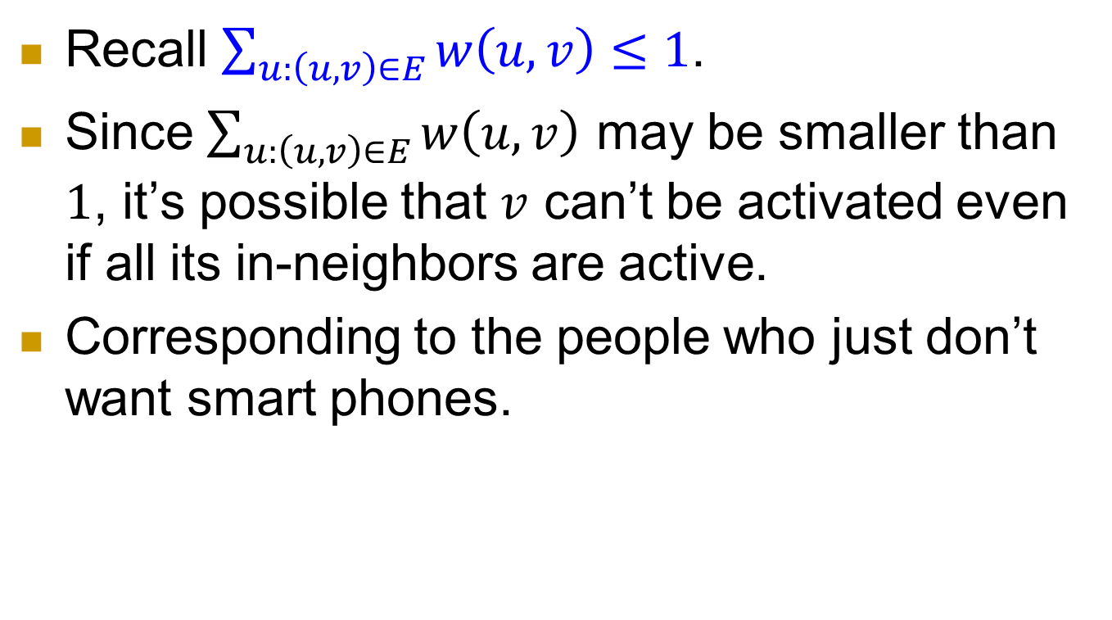
Recall $\sum_{u:\left(u,v\right)∈E}{w\left(u,v\right)}≤1$.
Since $\sum_{u:\left(u,v\right)∈E}{w\left(u,v\right)}$ may be smaller than $1$, it’s possible that $v$ can’t be activated even if all its in-neighbors are active.
Corresponding to the people who just don’t want smart phones.

Slide 16
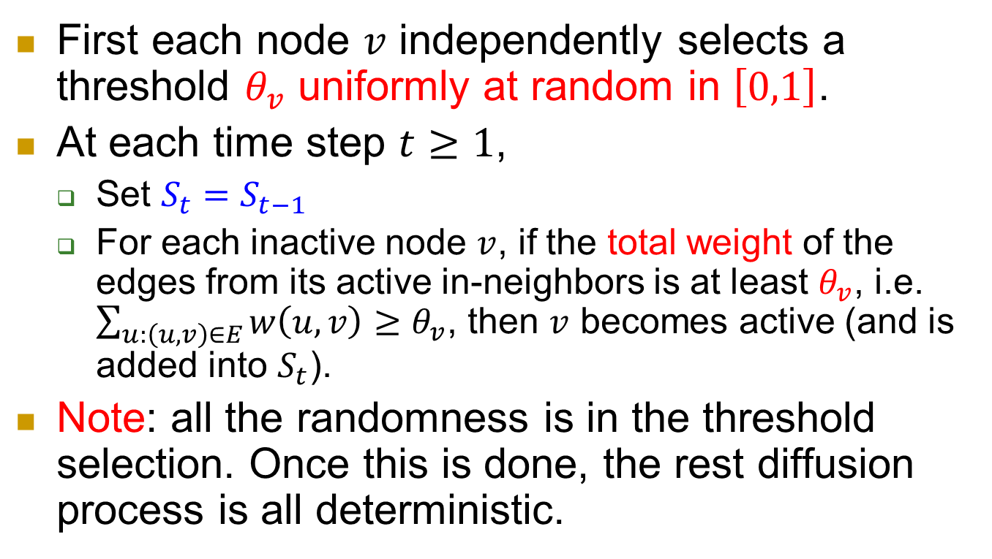
Diffusion process in LT model
First each node $v$ independently selects a threshold $θ_{v}$ uniformly at random in $\left[0,1\right]$.
At each time step $t≥1$,
  Set $S_{t}=S_{t−1}$
  For each inactive node $v$, if the total weight of the edges from its active in-neighbors is at least $θ_{v}$, i.e. $\sum_{u:\left(u,v\right)∈E}{w\left(u,v\right)}≥θ_{v}$, then $v$ becomes active (and is added into $S_{t}$).
Note: all the randomness is in the threshold selection. Once this is done, the rest diffusion process is all deterministic.

Slide 17
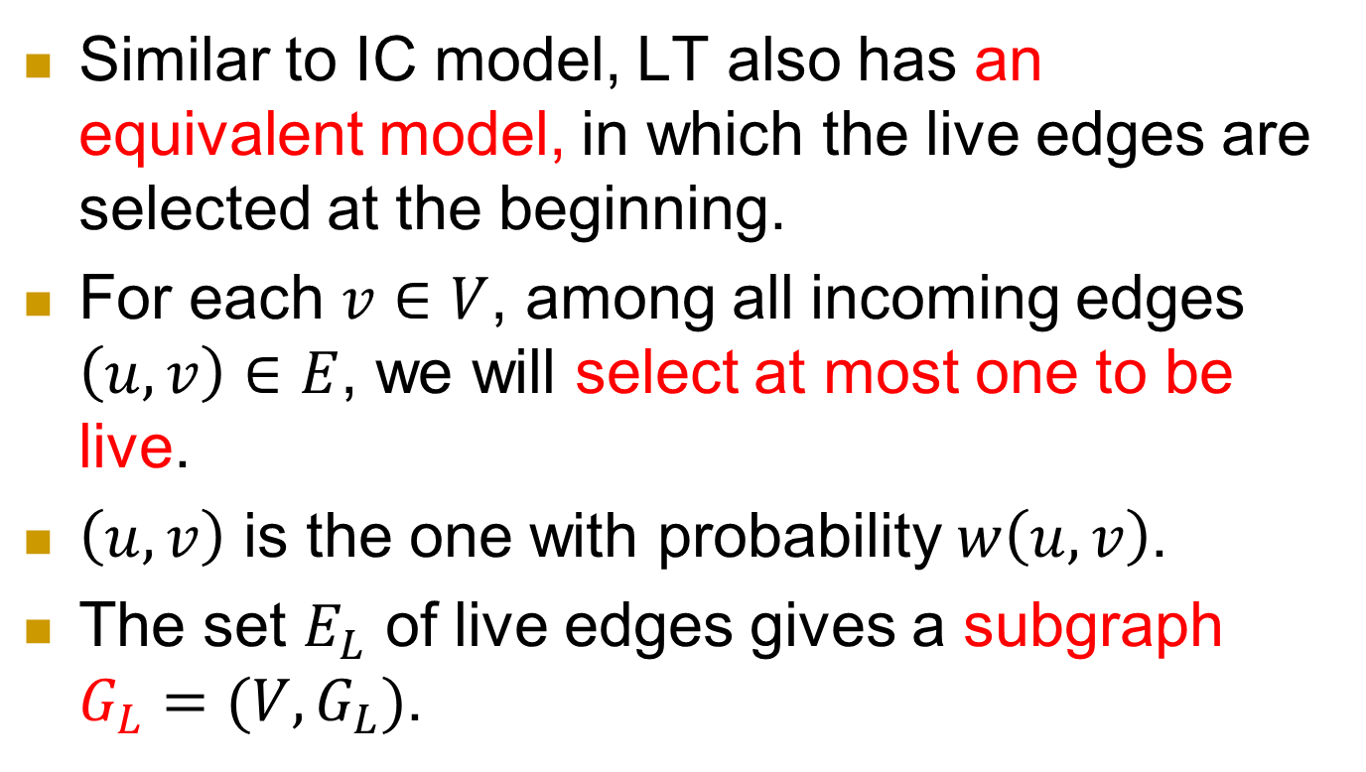
An equivalent model: LT’
Similar to IC model, LT also has an equivalent model, in which the live edges are selected at the beginning.
For each $v∈V$, among all incoming edges $\left(u,v\right)∈E$, we will select at most one to be live.
$\left(u,v\right)$ is the one with probability $w\left(u,v\right)$.
The set $E_{L}$ of live edges gives a subgraph $G_{L}=(V,G_{L})$.

Slide 18
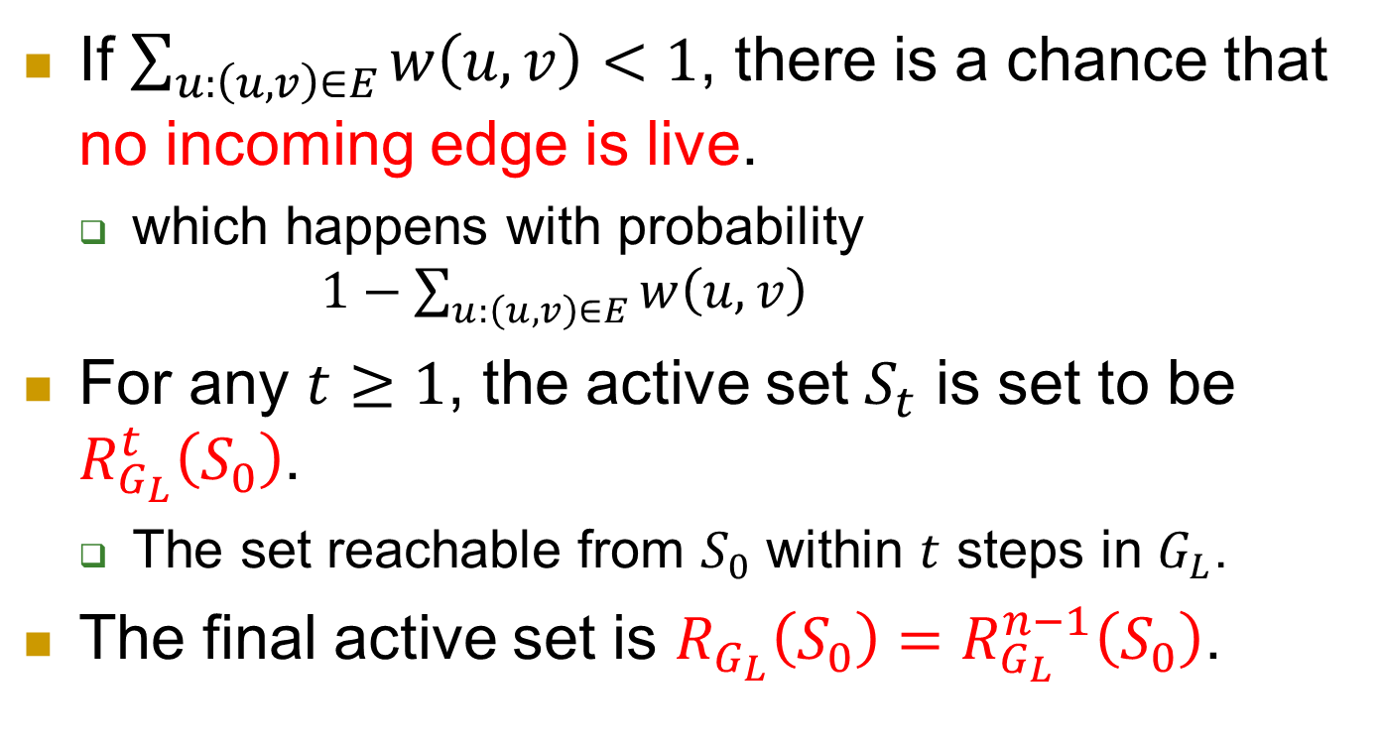
If $\sum_{u:\left(u,v\right)∈E}{w\left(u,v\right)}<1$, there is a chance that no incoming edge is live.
  which happens with probability
  $1−\sum_{u:\left(u,v\right)∈E}{w\left(u,v\right)}$
For any $t≥1$, the active set $S_{t}$ is set to be $R_{G_{L}}^{t}\left(S_{0}\right)$.
  The set reachable from $S_{0}$ within $t$ steps in $G_{L}$.
The final active set is $R_{G_{L}}\left(S_{0}\right)=R_{G_{L}}^{n−1}\left(S_{0}\right)$.

Slide 19
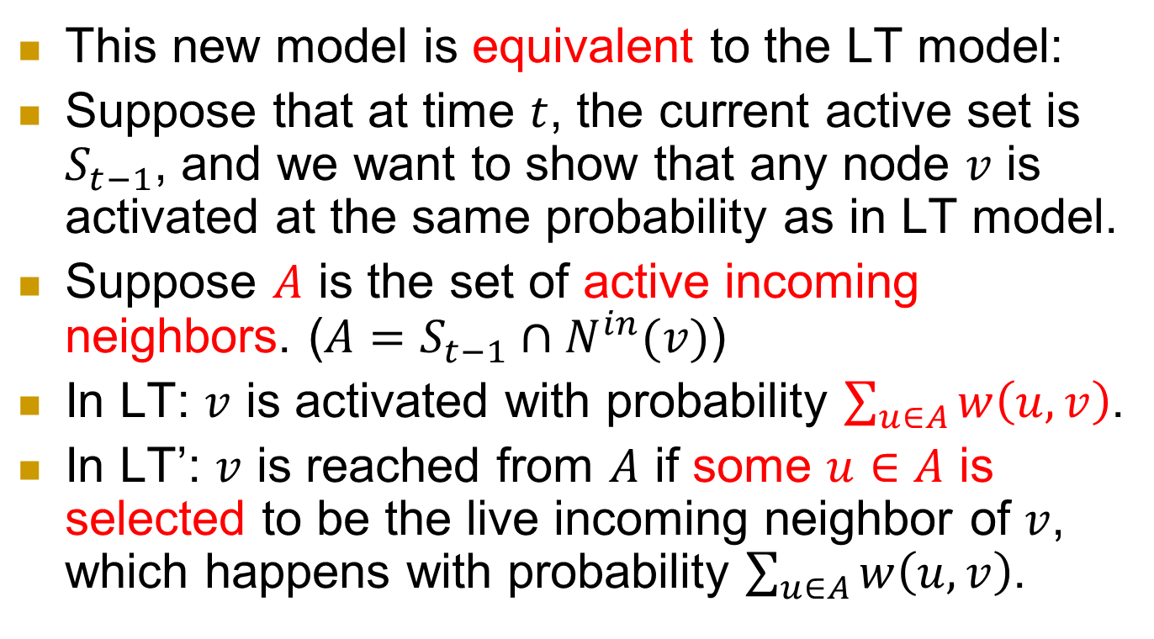
This new model is equivalent to the LT model:
Suppose that at time $t$, the current active set is $S_{t−1}$, and we want to show that any node $v$ is activated at the same probability as in LT model.
Suppose $A$ is the set of active incoming neighbors. ($A=S_{t−1}∩N^{in}(v)$)
In LT: $v$ is activated with probability $\sum_{u∈A}{w\left(u,v\right)}$.
In LT’: $v$ is reached from $A$ if some $u∈A$ is selected to be the live incoming neighbor of $v$, which happens with probability $\sum_{u∈A}{w\left(u,v\right)}$.

Slide 20
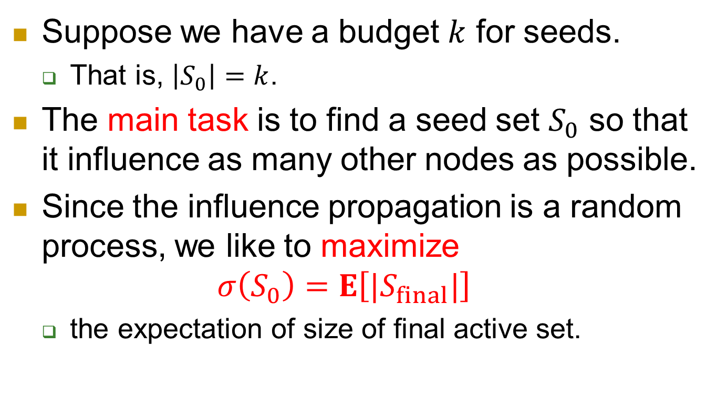
task
Suppose we have a budget $k$ for seeds.
  That is, $\left|S_{0}\right|=k$.
The main task is to find a seed set $S_{0}$ so that it influence as many other nodes as possible.
Since the influence propagation is a random process, we like to maximize
$σ\left(S_{0}\right)=E\left[|S_{final}|\right]$
  the expectation of size of final active set.

Slide 21
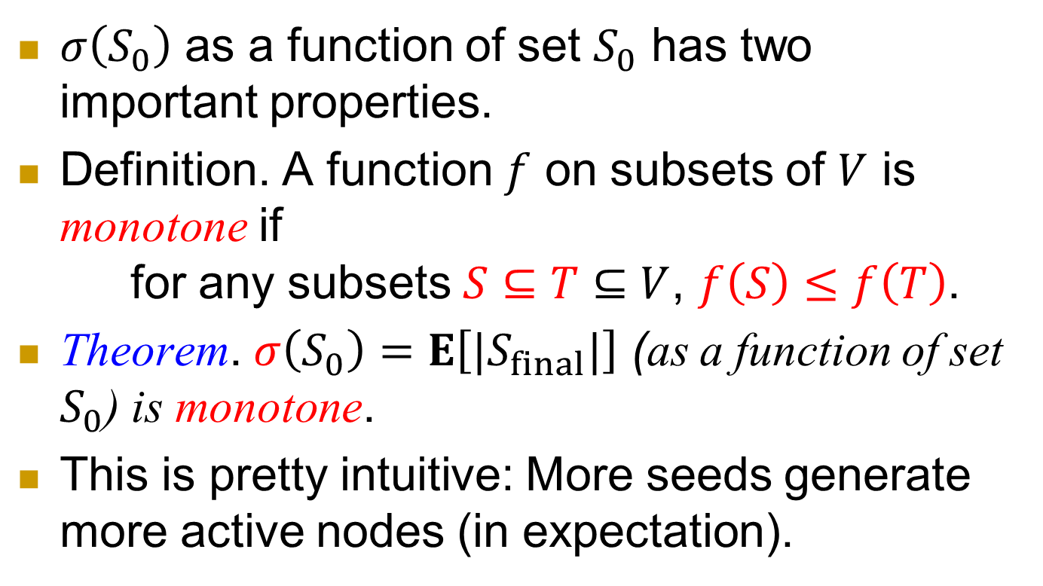
Monotonicity
$σ\left(S_{0}\right)$ as a function of set $S_{0}$ has two important properties.
Definition. A function $f$ on subsets of $V$ is monotone if
for any subsets $S⊆T⊆V$, $f\left(S\right)≤f\left(T\right)$.
Theorem. $σ\left(S_{0}\right)=E\left[|S_{final}|\right]$ (as a function of set $S_{0}$) is monotone.
This is pretty intuitive: More seeds generate more active nodes (in expectation).

Slide 22
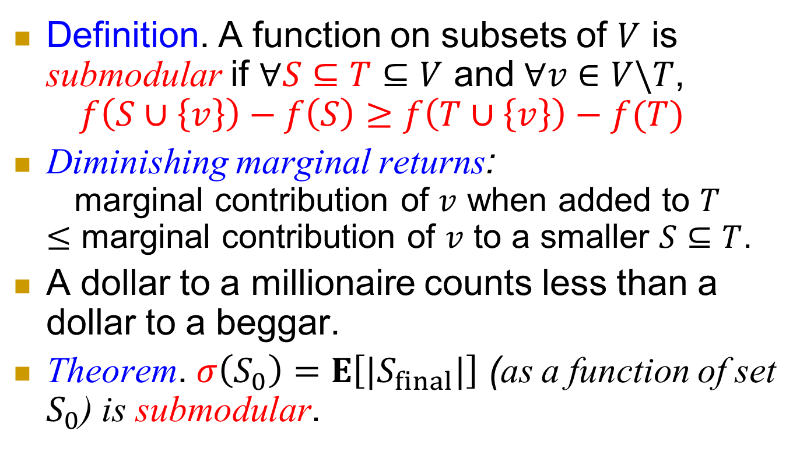
Submodularity
Definition. A function on subsets of $V$ is submodular if $∀S⊆T⊆V$ and $∀v∈V\backslash T$,
$f\left(S∪\left\{v\right\}\right)−f\left(S\right)≥f\left(T∪\left\{v\right\}\right)−f(T)$
Diminishing marginal returns:
marginal contribution of $v$ when added to $T$
$≤$ marginal contribution of $v$ to a smaller $S⊆T$.
A dollar to a millionaire counts less than a dollar to a beggar.
Theorem. $σ\left(S_{0}\right)=E\left[|S_{final}|\right]$ (as a function of set $S_{0}$) is submodular.

Slide 23
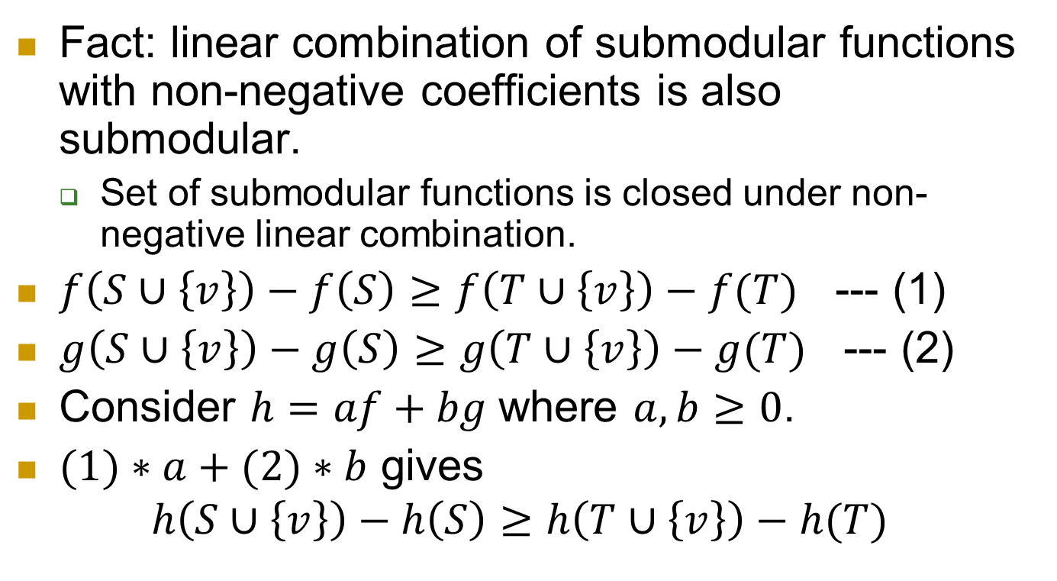
Fact: linear combination of submodular functions with non-negative coefficients is also submodular.
  Set of submodular functions is closed under non-negative linear combination.
$f\left(S∪\left\{v\right\}\right)−f\left(S\right)≥f\left(T∪\left\{v\right\}\right)−f(T)$ --- (1)
$g\left(S∪\left\{v\right\}\right)−g\left(S\right)≥g\left(T∪\left\{v\right\}\right)−g(T)$ --- (2)
Consider $h=af+bg$ where $a,b≥0$.
$(1)∗a+(2)∗b$ gives
$$h\left(S∪\left\{v\right\}\right)−h\left(S\right)≥h\left(T∪\left\{v\right\}\right)−h(T)$$

Slide 24
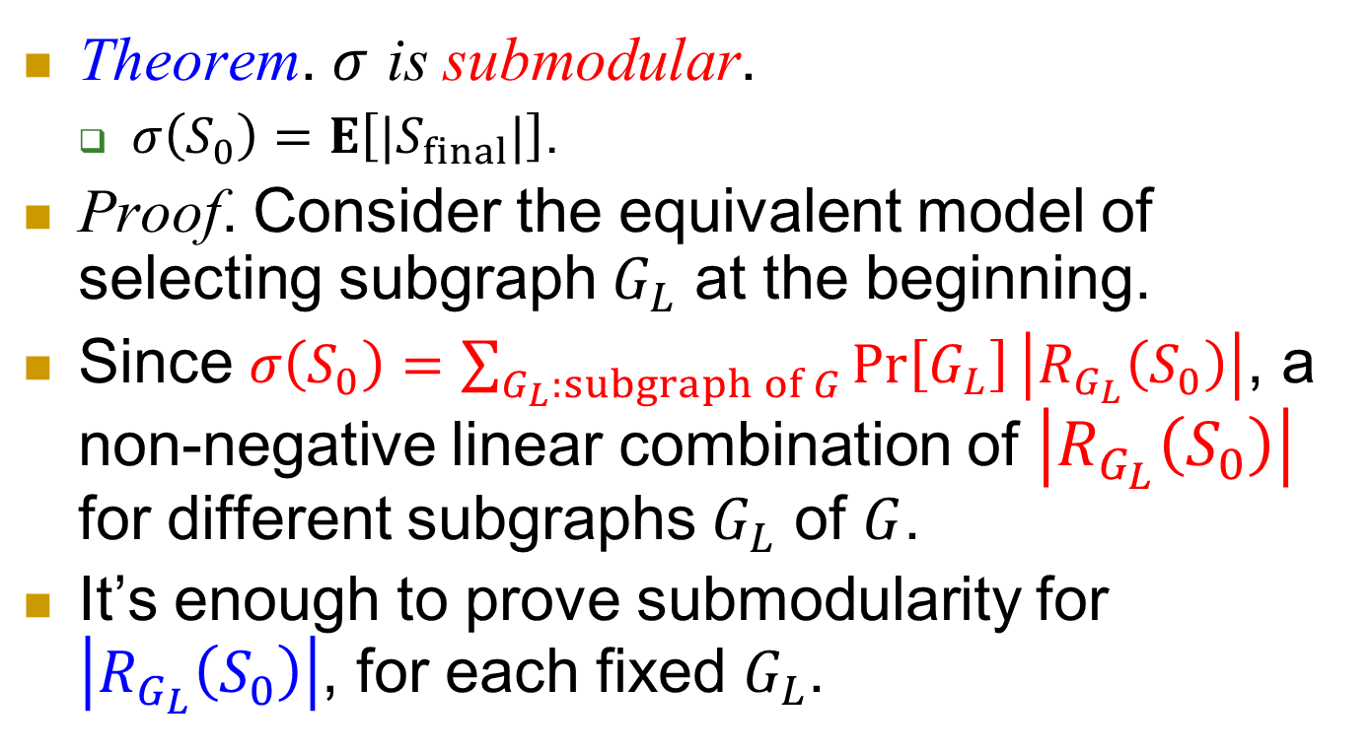
Theorem. $σ$ is submodular.
  $σ\left(S_{0}\right)=E\left[|S_{final}|\right]$.
Proof. Consider the equivalent model of selecting subgraph $G_{L}$ at the beginning.
Since $σ\left(S_{0}\right)=\sum_{G_{L}:subgraph of G}{\operatorname{Pr}\left[G_{L}\right]\left|R_{G_{L}}\left(S_{0}\right)\right|}$, a non-negative linear combination of $\left|R_{G_{L}}\left(S_{0}\right)\right|$ for different subgraphs $G_{L}$ of $G$.
It’s enough to prove submodularity for $\left|R_{G_{L}}\left(S_{0}\right)\right|$, for each fixed $G_{L}$.

Slide 25
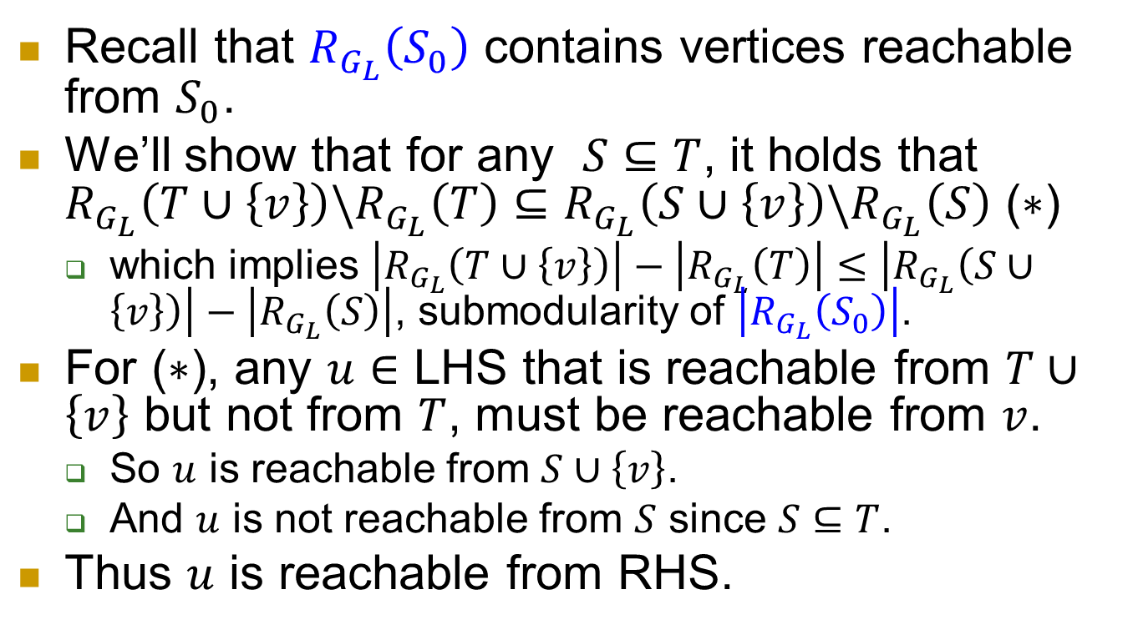
Recall that $R_{G_{L}}\left(S_{0}\right)$ contains vertices reachable from $S_{0}$.
We’ll show that for any $S⊆T$, it holds that $R_{G_{L}}\left(T∪\left\{v\right\}\right)\backslash R_{G_{L}}\left(T\right)⊆R_{G_{L}}\left(S∪\left\{v\right\}\right)\backslash R_{G_{L}}\left(S\right)$ ($∗$)
  which implies $\left|R_{G_{L}}\left(T∪\left\{v\right\}\right)\right|−\left|R_{G_{L}}\left(T\right)\right|≤\left|R_{G_{L}}\left(S∪\left\{v\right\}\right)\right|−\left|R_{G_{L}}\left(S\right)\right|$, submodularity of $\left|R_{G_{L}}\left(S_{0}\right)\right|$.
For ($∗$), any $u∈$ LHS that is reachable from $T∪\left\{v\right\}$ but not from $T$, must be reachable from $v$.
  So $u$ is reachable from $S∪\left\{v\right\}$.
  And $u$ is not reachable from $S$ since $S⊆T$.
Thus $u$ is reachable from RHS.

Slide 26
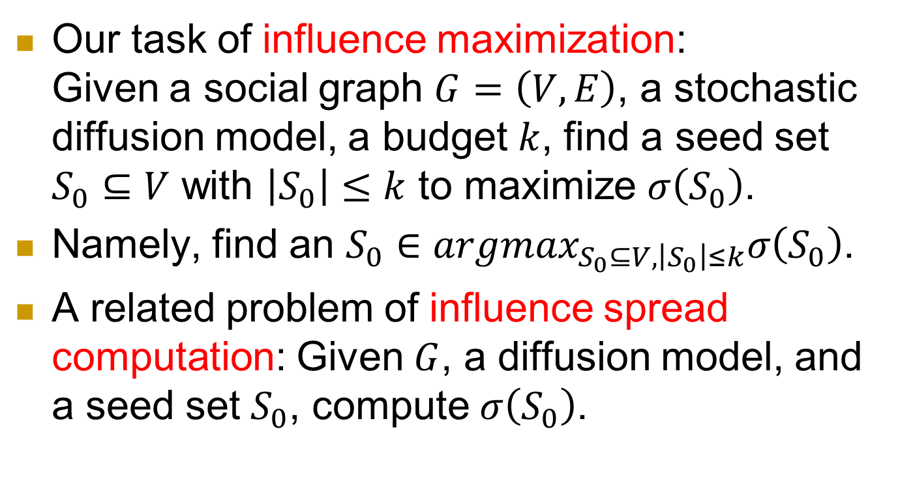
Influence maximization
Our task of influence maximization:
Given a social graph $G=\left(V,E\right)$, a stochastic diffusion model, a budget $k$, find a seed set $S_{0}⊆V$ with $\left|S_{0}\right|≤k$ to maximize $σ\left(S_{0}\right)$.
Namely, find an $S_{0}∈argmax_{S_{0}⊆V,\left|S_{0}\right|≤k}σ\left(S_{0}\right)$.
A related problem of influence spread computation: Given $G$, a diffusion model, and a seed set $S_{0}$, compute $σ\left(S_{0}\right)$.

Slide 27
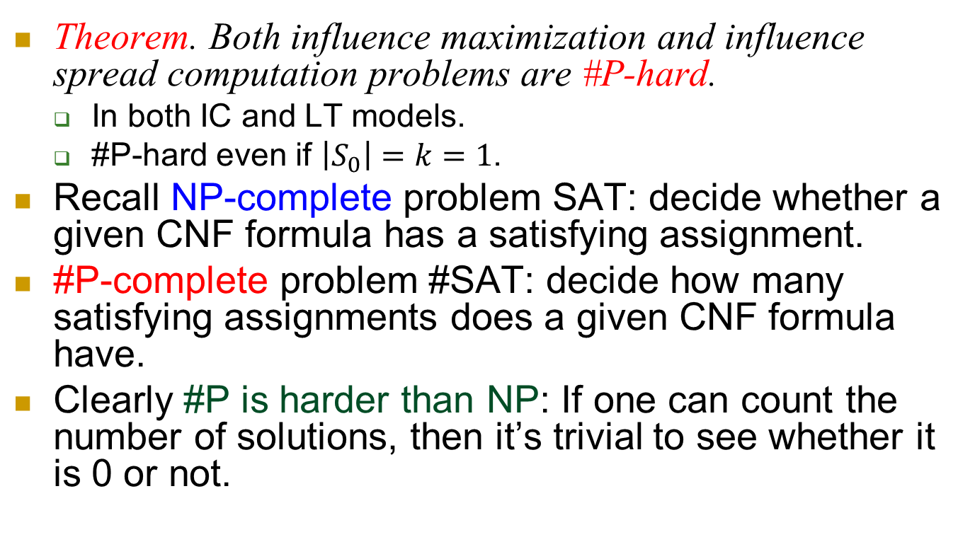
Bad news: #P-hard
Theorem. Both influence maximization and influence spread computation problems are #P-hard.
  In both IC and LT models.
  #P-hard even if $\left|S_{0}\right|=k=1$.
Recall NP-complete problem SAT: decide whether a given CNF formula has a satisfying assignment.
#P-complete problem #SAT: decide how many satisfying assignments does a given CNF formula have.
Clearly #P is harder than NP: If one can count the number of solutions, then it’s trivial to see whether it is 0 or not.

Slide 28
Good news
The hardness comes from two sources
  Combinatorial nature.
  Influence computation.
The first can be partly overcome by a greedy approximation algorithm.
The second can be overcome by Monte Carlo simulation.

Slide 29
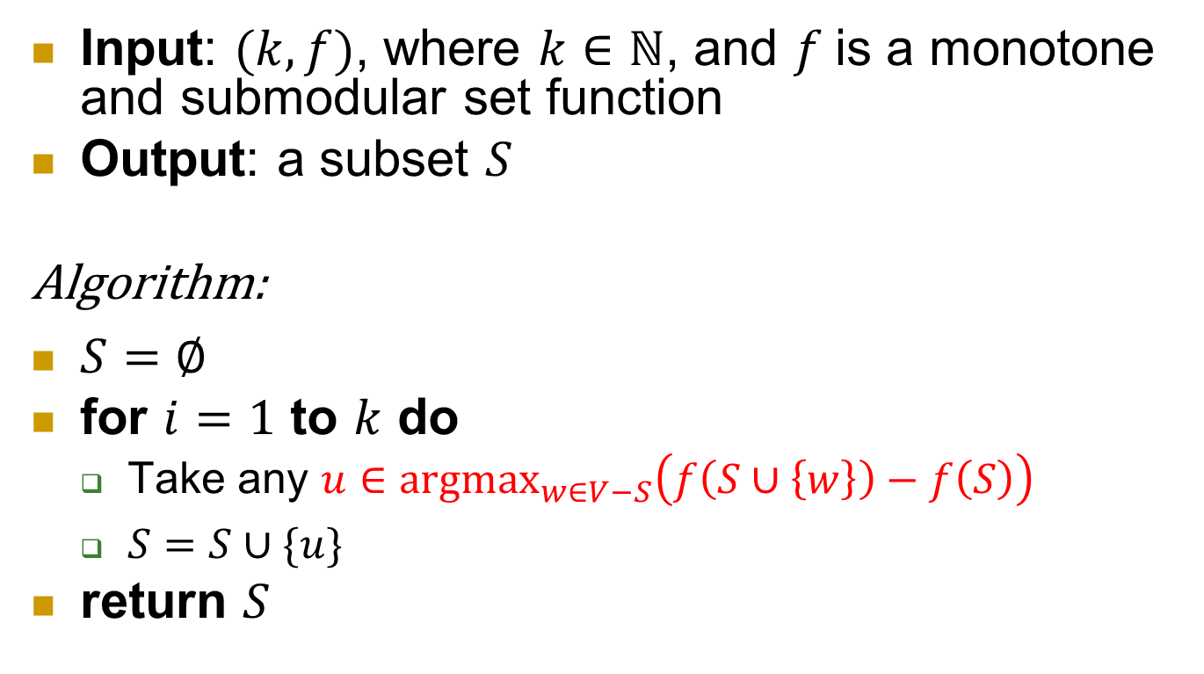
Greedy algorithm
Input: $(k,f)$, where $k∈ℕ$, and $f$is a monotone and submodular set function
Output: a subset $S$
Algorithm:
$S=∅$
for $i=1$ to $k$ do
  Take any $u∈{argmax}_{w∈V−S}\left(f\left(S∪\left\{w\right\}\right)−f\left(S\right)\right)$
  $S=S∪\{u\}$
return $S$

Slide 30
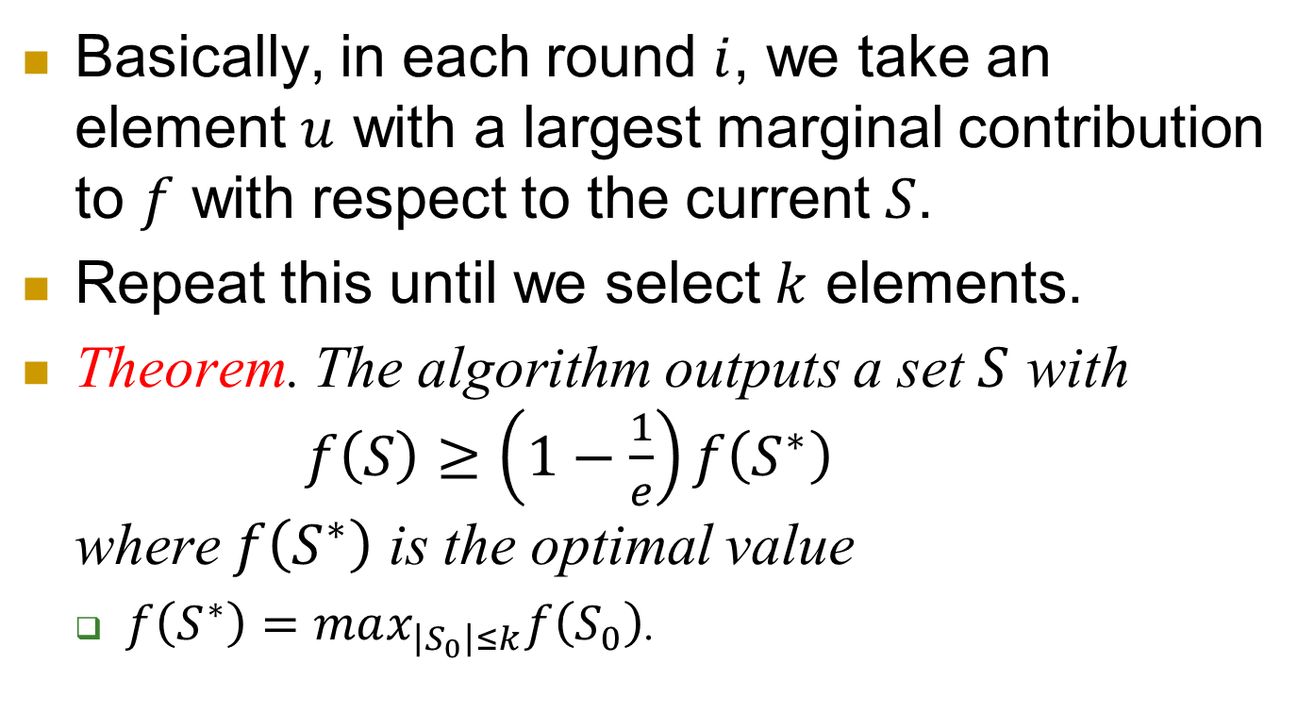
Basically, in each round $i$, we take an element $u$ with a largest marginal contribution to $f$ with respect to the current $S$.
Repeat this until we select $k$ elements.
Theorem. The algorithm outputs a set $S$ with
$f\left(S\right)≥\left(1−\frac{1}{e}\right)f\left(S^{∗}\right)$
where $f\left(S^{∗}\right)$ is the optimal value
  $f\left(S^{∗}\right)=max_{\left|S_{0}\right|≤k}f\left(S_{0}\right)$.

Slide 31
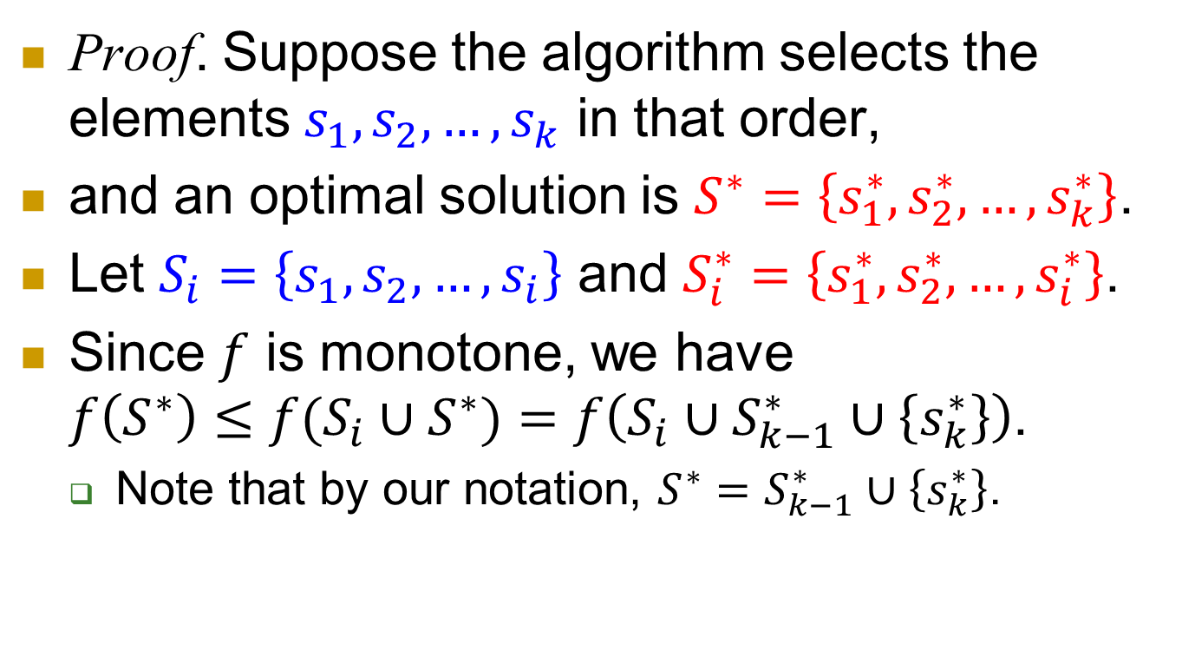
Proof. Suppose the algorithm selects the elements $s_{1},s_{2},…,s_{k}$ in that order,
and an optimal solution is $S^{∗}=\left\{s_{1}^{∗},s_{2}^{∗},…,s_{k}^{∗}\right\}$.
Let $S_{i}=\left\{s_{1},s_{2},…,s_{i}\right\}$ and $S_{i}^{∗}=\left\{s_{1}^{∗},s_{2}^{∗},…,s_{i}^{∗}\right\}$.
Since $f$ is monotone, we have
$f\left(S^{∗}\right)≤f(S_{i}∪S^{∗})=f\left(S_{i}∪S_{k−1}^{∗}∪\left\{s_{k}^{∗}\right\}\right)$.
  Note that by our notation, $S^{∗}=S_{k−1}^{∗}∪\left\{s_{k}^{∗}\right\}$.

Slide 32
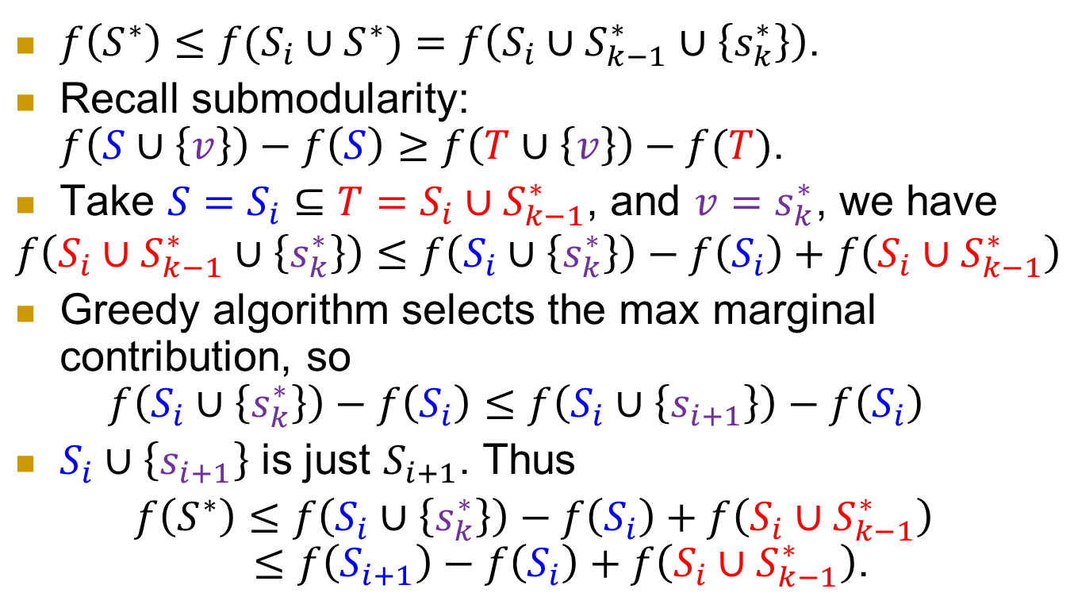
$f\left(S^{∗}\right)≤f(S_{i}∪S^{∗})=f\left(S_{i}∪S_{k−1}^{∗}∪\left\{s_{k}^{∗}\right\}\right)$.
Recall submodularity:
$f\left(S∪\left\{v\right\}\right)−f\left(S\right)≥f\left(T∪\left\{v\right\}\right)−f(T)$.
Take $S=S_{i}⊆T=S_{i}∪S_{k−1}^{∗}$, and $v=s_{k}^{∗}$, we have
$$f\left(S_{i}∪S_{k−1}^{∗}∪\left\{s_{k}^{∗}\right\}\right)≤f\left(S_{i}∪\left\{s_{k}^{∗}\right\}\right)−f\left(S_{i}\right)+f\left(S_{i}∪S_{k−1}^{∗}\right)$$
Greedy algorithm selects the max marginal contribution, so
$f\left(S_{i}∪\left\{s_{k}^{∗}\right\}\right)−f\left(S_{i}\right)≤f\left(S_{i}∪\left\{s_{i+1}\right\}\right)−f\left(S_{i}\right)$
$S_{i}∪\left\{s_{i+1}\right\}$ is just $S_{i+1}$. Thus
$f\left(S^{∗}\right)≤f\left(S_{i}∪\left\{s_{k}^{∗}\right\}\right)−f\left(S_{i}\right)+f\left(S_{i}∪S_{k−1}^{∗}\right)$
$≤f\left(S_{i+1}\right)−f\left(S_{i}\right)+f\left(S_{i}∪S_{k−1}^{∗}\right)$.

Slide 33
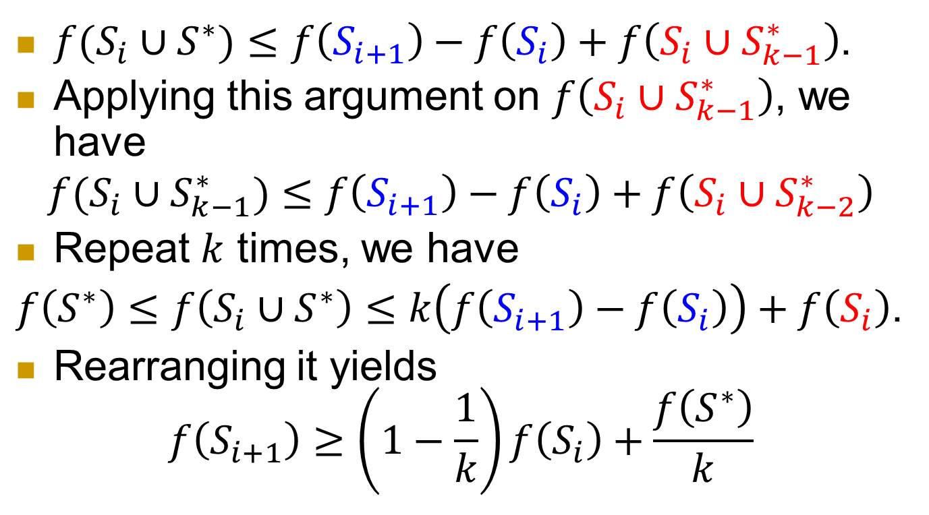
$f(S_{i}∪S^{∗})≤f\left(S_{i+1}\right)−f\left(S_{i}\right)+f\left(S_{i}∪S_{k−1}^{∗}\right)$.
Applying this argument on $f\left(S_{i}∪S_{k−1}^{∗}\right)$, we have
$$f(S_{i}∪S_{k−1}^{∗})≤f\left(S_{i+1}\right)−f\left(S_{i}\right)+f\left(S_{i}∪S_{k−2}^{∗}\right)$$
Repeat $k$ times, we have
$f\left(S^{∗}\right)≤f\left(S_{i}∪S^{∗}\right)≤k\left(f\left(S_{i+1}\right)−f\left(S_{i}\right)\right)+f\left(S_{i}\right)$.
Rearranging it yields
$f\left(S_{i+1}\right)≥\left(1−\frac{1}{k}\right)f\left(S_{i}\right)+\frac{f\left(S^{∗}\right)}{k}$

Slide 34
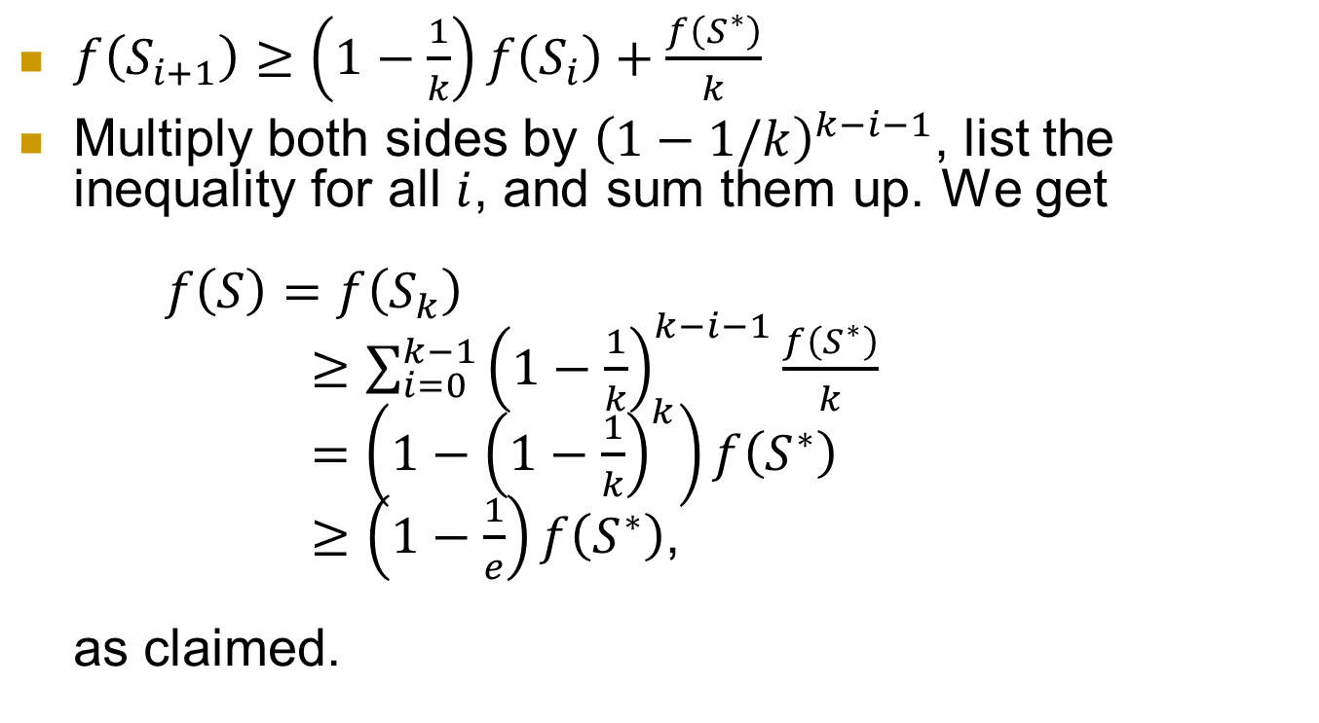
$f\left(S_{i+1}\right)≥\left(1−\frac{1}{k}\right)f\left(S_{i}\right)+\frac{f\left(S^{∗}\right)}{k}$
Multiply both sides by ${\left(1−1/k\right)}^{k−i−1}$, list the inequality for all $i$, and sum them up. We get
$f\left(S\right)=f\left(S_{k}\right)$
$≥\sum_{i=0}^{k−1}{{\left(1−\frac{1}{k}\right)}^{k−i−1}}\frac{f\left(S^{∗}\right)}{k}$
$=\left(1−{\left(1−\frac{1}{k}\right)}^{k}\right)f\left(S^{∗}\right)$
$≥\left(1−\frac{1}{e}\right)f\left(S^{∗}\right)$,
as claimed.

Slide 35
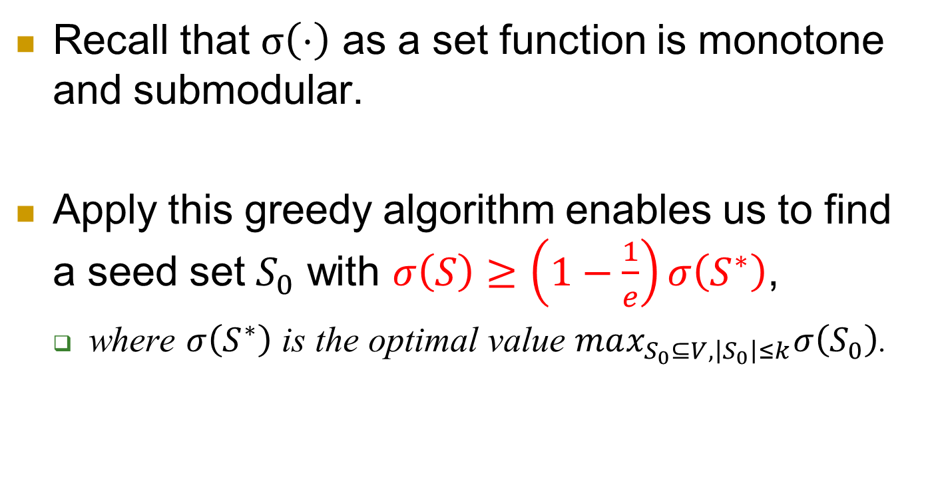
Recall that $σ\left(⋅\right)$ as a set function is monotone and submodular.
Apply this greedy algorithm enables us to find a seed set $S_{0}$ with $σ\left(S\right)≥\left(1−\frac{1}{e}\right)σ\left(S^{∗}\right)$,
  where $σ\left(S^{∗}\right)$ is the optimal value $max_{S_{0}⊆V,\left|S_{0}\right|≤k}σ\left(S_{0}\right)$.

Slide 36
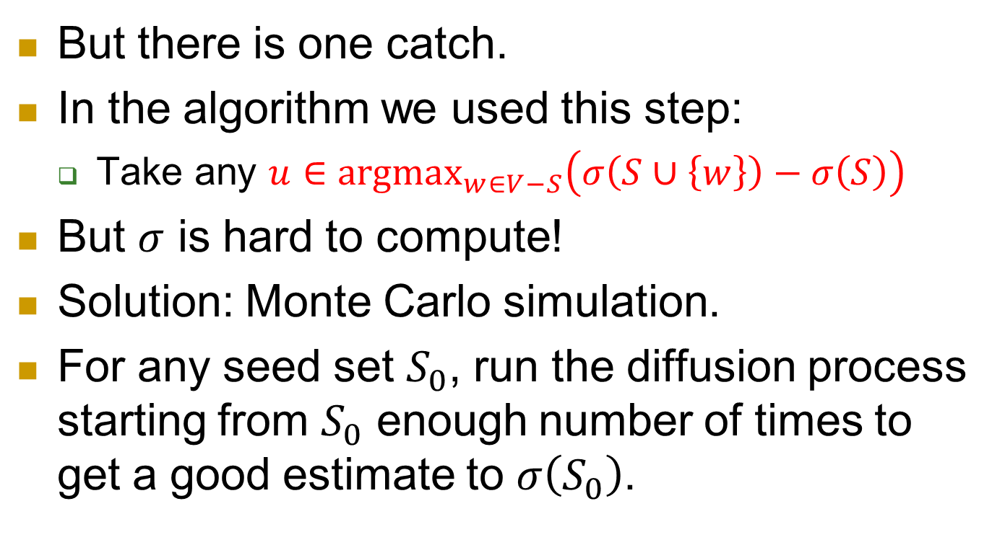
But there is one catch.
In the algorithm we used this step:
  Take any $u∈{argmax}_{w∈V−S}\left(σ\left(S∪\left\{w\right\}\right)−σ\left(S\right)\right)$
But $σ$ is hard to compute!
Solution: Monte Carlo simulation.
For any seed set $S_{0}$, run the diffusion process starting from $S_{0}$ enough number of times to get a good estimate to $σ\left(S_{0}\right)$.

Slide 37
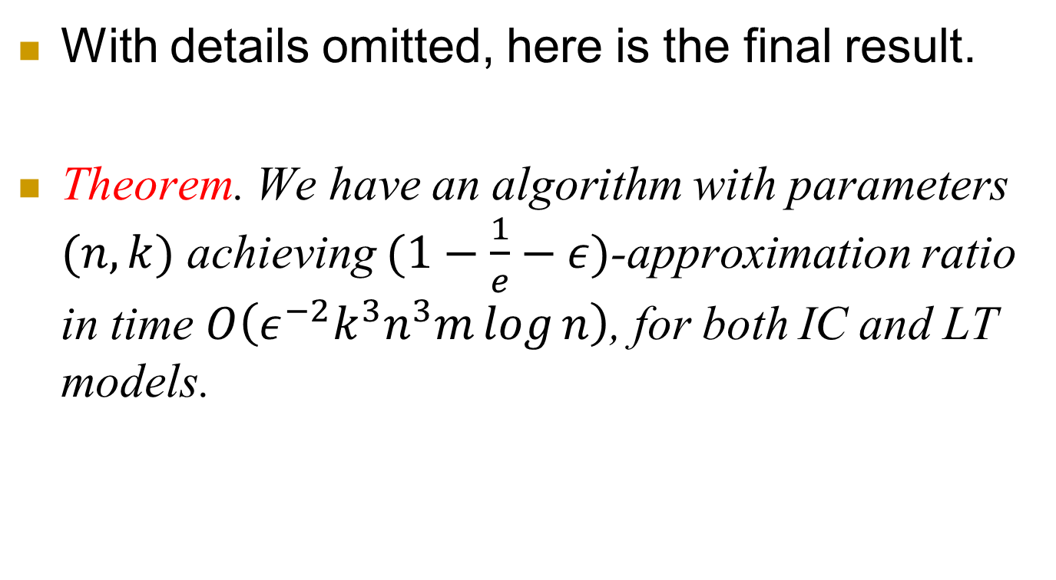
Putting everything together
With details omitted, here is the final result.
Theorem. We have an algorithm with parameters $(n,k)$ achieving $(1−\frac{1}{e}−ε)$-approximation ratio in time $O\left(ε^{−2}k^{3}n^{3}m\log{n}\right)$, for both IC and LT models.

Slide 38
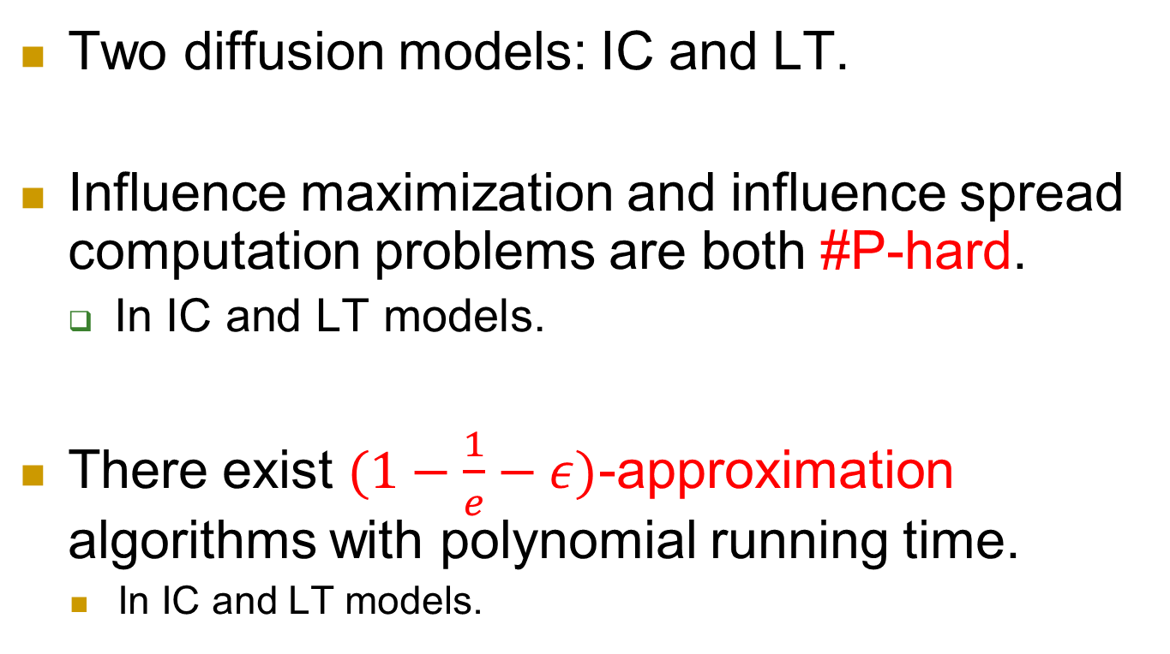
Summary
Two diffusion models: IC and LT.
Influence maximization and influence spread computation problems are both #P-hard.
  In IC and LT models.
There exist $(1−\frac{1}{e}−ε)$-approximation algorithms with polynomial running time.
    In IC and LT models.

