Slide 1
CMSC5706 Topics in Theoretical Computer Science
Week 10: Online Learning
Instructor: Shengyu Zhang

Slide 2
Location change for the final 2 classes
Nov 17: YIA 404 (Yasumoto International Academic Park 康本國際學術園)
Nov 24: No class.
  Conference leave.
Dec 1: YIA 508 (Yasumoto International Academic Park 康本國際學術園)

Slide 3
Problem 1: Experts problem

Slide 4
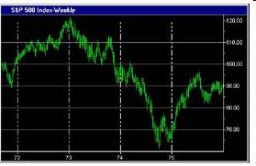
Stock market
Simplification: Only consider up or down.

Slide 5


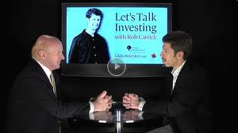
Which expert to follow?
Each day, stock market goes up or down.
Each morning, $n$ “experts” predict the market.
How should we do? Whom to listen to? Or combine their advice in some way?

Slide 6
Which expert to follow?
Each day, stock market goes up or down.
At the end of the day, we’ll see whether the market actually goes up or down.
We lose 1 if our prediction was wrong.

Slide 7
After a year, we’ll see with hindsight that one expert is the best.
  But, of course, we don’t know who in advance.
We’ll think “If we had followed his advice…”
Theorem: We have a method to perform close to the best expert!
  We don’t assume anything about the experts.
    They may not know what they are talking about.
    They may even collaborate in any bad manner.

Slide 8
Method and intuition
Algorithm: Randomized Weighted Majority
Use random choice: following expert $i$ with probability $p_{i}$
If an expert predicts wrongly: punish him by decreasing the probability of choosing him/her in next round.
  If someone gives you wrong info, then you tend to trust him less in future.

Slide 9
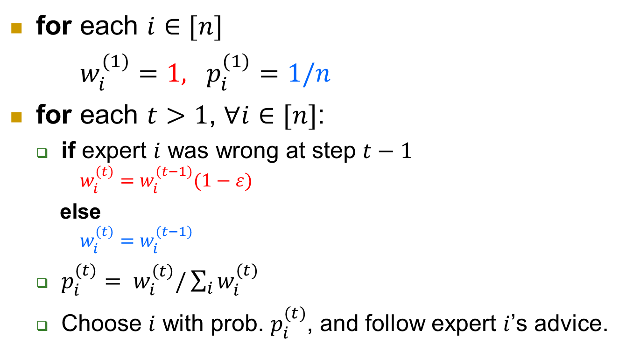
Randomized Weighted Majority
$w_{i}^{(t)}$: weight of expert $i$ at time $t$
$p_{i}^{(t)}$: probability of choosing expert $i$ at time $t$
for each $i∈[n]$
$w_{i}^{(1)}=1, p_{i}^{(1)}=1/n$
for each $t>1$, $∀i∈[n]$:
  if expert $i$ was wrong at step $t−1$
  $w_{i}^{(t)}=w_{i}^{(t−1)}(1−ε)$
  else
  $w_{i}^{(t)}=w_{i}^{(t−1)}$
  $p_{i}^{(t)}= w_{i}^{\left(t\right)}/\sum_{i}{w_{i}^{(t)}}$
  Choose $i$ with prob. $p_{i}^{(t)}$, and follow expert $i$’s advice.
Decrease your weight!
Probability is proportional to weight

Slide 10
Example (n=5, T=6, ε = 1/4)
 | 1 | 2 | 3 | 4 | 5 | our | real
1 | 1, ↑ | 1, ↑ | 1, ↓ | 1, ↑ | 1, ↓ | ↑ | ↑
2 | 1, ↑ | 1, ↓ | 0.75, ↑ | 1, ↑ | 0.75, ↑ | ↑ | ↑
3 | 1, ↑ | 0.75, ↑ | 0.75, ↓ | 1, ↓ | 0.75, ↑ | ↓ | ↓
4 | 0.75, ↑ | 0.5625, ↑ | 0.75, ↓ | 0.75, ↓ | 0.5625, ↑ | ↑ | ↓
5 | 0.5625, ↓ | 0.4219, ↑ | 0.75, ↑ | 0.75, ↓ | 0.4219, ↓ | ↓ | ↑
6 | 0.4219, ↑ | 0.4219, ↑ | 0.75, ↓ | 0.5625, ↑ | 0.3164, ↑ | ↓ | ↓
loss | 4 | 4 | 1 | 2 | 5 | 2
Numbers: weight
Arrows: predications. Red: wrong.

Slide 11
$LRWM$: expected loss of our algorithm
$Lmin$: loss of the best expert
Theorem. For $ε<1/2$, the loss on any sequence of $\left\{0,1\right\}$ in time $T$ satisfies
$L_{RWM}≤\left(1+ε\right)L_{min}+ ln⁡(n)/ε$.
  $n$: number of experts. (The more experts, the harder to catch the best one.)

Slide 12
Proof
Key: Consider the total weight $W^{(t)}$ at time $t$.
Fact: Any time our algorithm has significant expected loss, the total weight drops substantially.
$l_{i}^{(t)}$: $1$ if expert $i$ is wrong at step $t$ (and $0$ otherwise)
Let $F^{(t)}=(\sum_{i:l_{i}^{(t)}=1}{w_{i}^{(t)}})/W^{(t)}$. Two meanings:
  The fraction of the weight on wrong experts
  The expected loss of our algorithm at step $t$
Note:$W^{(t+1)}=F^{(t)}W^{\left(t\right)}(1−ε)+(1−F^{(t)})W^{(t)}$
$=W^{(t)}(1–εF^{(t)})$

Slide 13
Last slide: $W^{(t+1)}=W^{\left(t\right)}\left(1–εF^{\left(t\right)}\right)$
So $W^{(T+1)}=W^{(T)}(1–εF^{\left(T\right)})$
$=W^{\left(T−1\right)}\left(1–εF^{\left(T−1\right)}\right)\left(1–εF^{\left(T\right)}\right)$
$= …$
$=W^{(1)}(1–εF^{\left(1\right)}) …(1–εF^{\left(T\right)})$
On the other hand,
$W^{(T+1)}≥\max_{i}{w_{i}^{\left(T+1\right)}}={\left(1−ε\right)}^{L_{min}^{(T)}}$
So ${\left(1−ε\right)}^{L_{min}^{(T)}}≤W^{\left(1\right)}(1−εF^{(1)})…(1−εF^{(T)})$
Note: $L_{min}^{(T)}$ is the loss of the best expert.

Slide 14
$${\left(1−ε\right)}^{L_{min}^{(T)}}≤W^{\left(1\right)}(1−εF^{(1)})…(1−εF^{(T)})$$
Note that $W^{(1)}=n$since $w_{i}^{(1)}= 1$, $∀i$
Take log:
$L_{min}^{\left(T\right)}ln\left(1−ε\right)≤ln\left(n\right)+\sum_{t=1,…,T}{ln⁡(1−εF^{(t)})}$
$≤\ln\left(n\right)−\sum_{t=1,…,T}{εF^{\left(t\right)}} ∵\ln\left(1−z\right)≤ −z$
$=\ln\left(n\right)−εL_{RWM}^{\left(T\right)} ∵L_{RWM}^{\left(T\right)}=\sum_{t=1,…,T}{F^{\left(t\right)}}$
  $L_{RWM}^{\left(T\right)}$ is the loss of our algorithm.
Rearranging the inequality and using
$$–\ln\left(1−z\right)≤z+z^{2}, 0≤z≤1/2$$
we get the inequality in the theorem.
$L_{RWM}≤\left(1+ε\right)L_{min}+ ln⁡(n)/ε$.

Slide 15
Extensions
The case that $T$ is unknown.
The case that loss is in $[0,1]$instead of $\{0,1\}$
References:
  The Multiplicative Weights Update Method: a Meta-Algorithm and Applications, Sanjeev Arora, Elad Hazan, and Satyen Kale, Theory of Computing, Volume 8, Article 6 pp. 121-164, 2012.
  Chapter 4 of Algorithmic Game Theory, available at http://www.cs.cmu.edu/~avrim/Papers/regret-chapter.pdf

Slide 16
Problem 2: Multi-armed Bandit

Slide 17

One-armed bandit
Bandit: a robber or outlaw belonging to a gang and typically operating in an isolated or lawless area.
One-armed bandit:

Slide 18
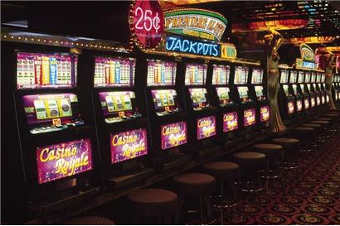
Multi-armed bandit
Question: Which machine to play?

Slide 19
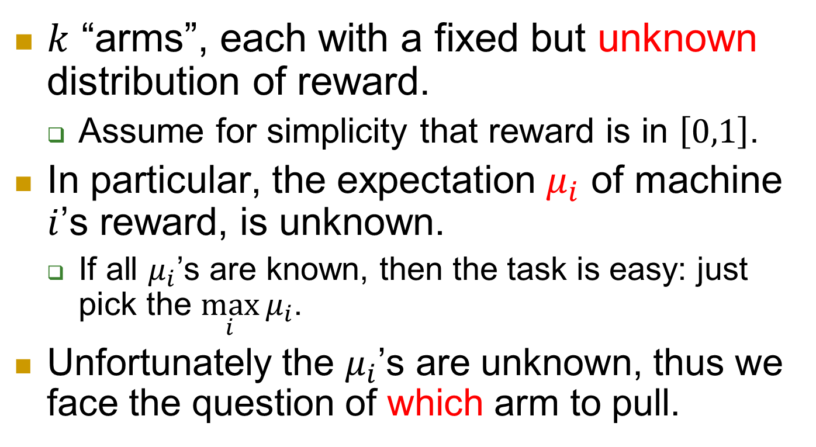
Formal model
$k$ “arms”, each with a fixed but unknown distribution of reward.
  Assume for simplicity that reward is in $\left[0,1\right]$.
In particular, the expectation $μ_{i}$ of machine $i$’s reward, is unknown.
  If all $μ_{i}$’s are known, then the task is easy: just pick the $\max_{i}{μ_{i}}$.
Unfortunately the $μ_{i}$’s are unknown, thus we face the question of which arm to pull.

Slide 20
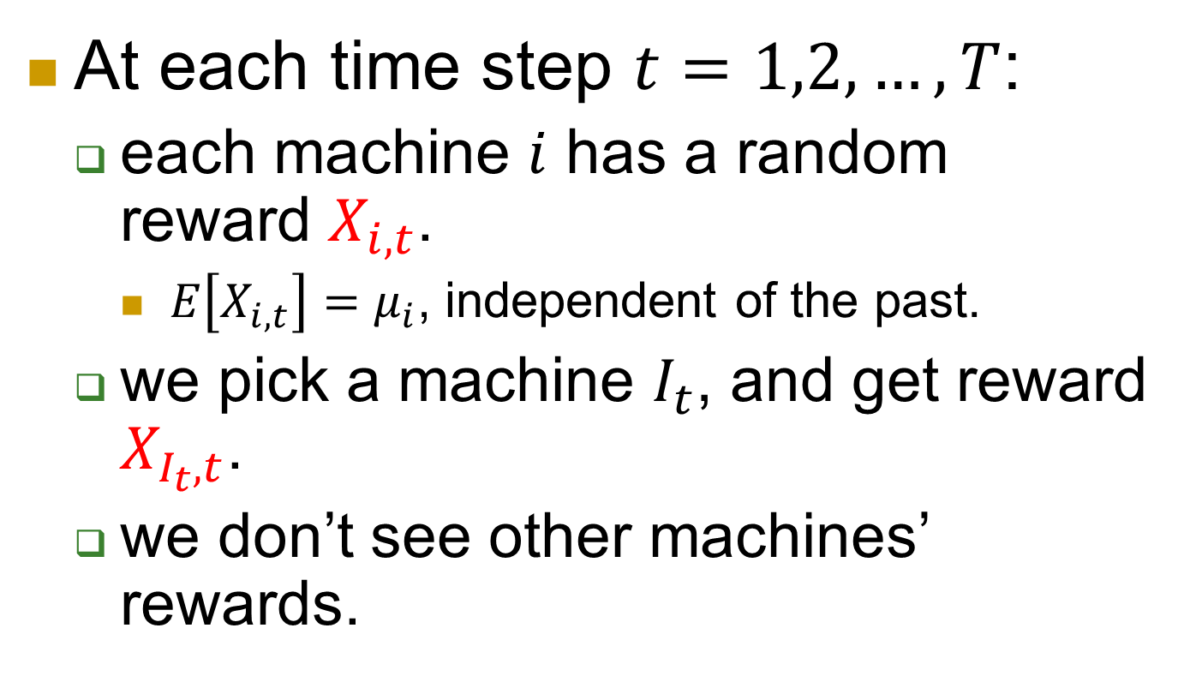
Operation, feedback and reward
At each time step $t=1,2,…,T$:
  each machine $i$ has a random reward $X_{i,t}$.
    $E\left[X_{i,t}\right]=μ_{i}$, independent of the past.
  we pick a machine $I_{t}$, and get reward $X_{I_{t},t}$.
  we don’t see other machines’ rewards.

Slide 21
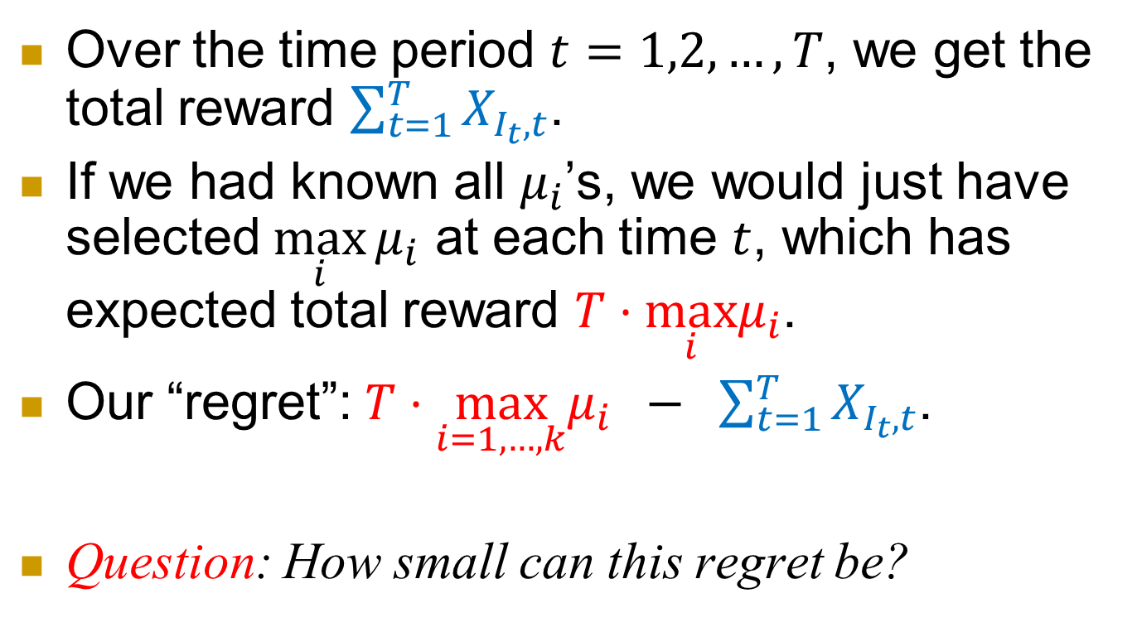
Formal model
Over the time period $t=1,2,…,T$, we get the total reward $\sum_{t=1}^{T}{X_{I_{t},t}}$.
If we had known all $μ_{i}$’s, we would just have selected $\max_{i}{μ_{i}}$ at each time $t$, which has expected total reward $T⋅\max_{i}μ_{i}$.
Our “regret”: $T⋅\max_{i=1,…,k}μ_{i} − \sum_{t=1}^{T}{X_{I_{t},t}}$.
Question: How small can this regret be?
best machine’s reward
(in expectation)
our reward

Slide 22
Exploration vs. exploitation dilemma
Exploration: to find the best.
  Overhead: big loss when trying the bad arms.
Exploitation: to exploit what we’ve discovered
  weakness: there may be better ones that we haven’t explored and identified.
Question: With the fixed budget, how to balance the exploration and exploitation, so that the total loss is small?

Slide 23
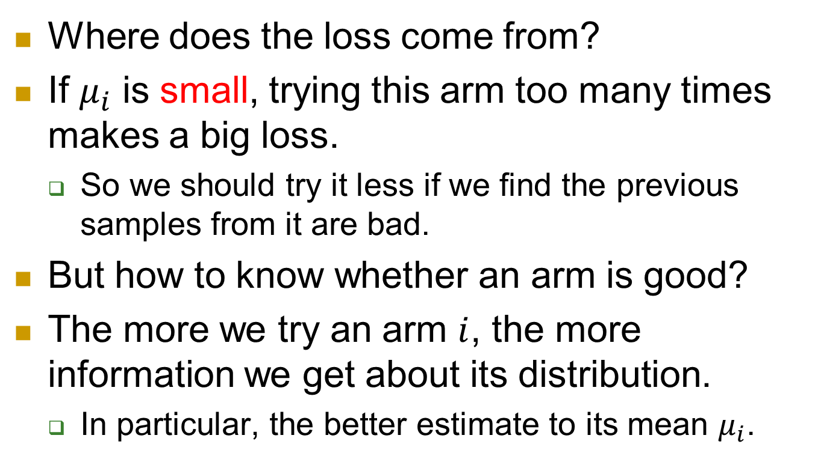
Observations and ideas
Where does the loss come from?
If $μ_{i}$ is small, trying this arm too many times makes a big loss.
  So we should try it less if we find the previous samples from it are bad.
But how to know whether an arm is good?
The more we try an arm $i$, the more information we get about its distribution.
  In particular, the better estimate to its mean $μ_{i}$.

Slide 24
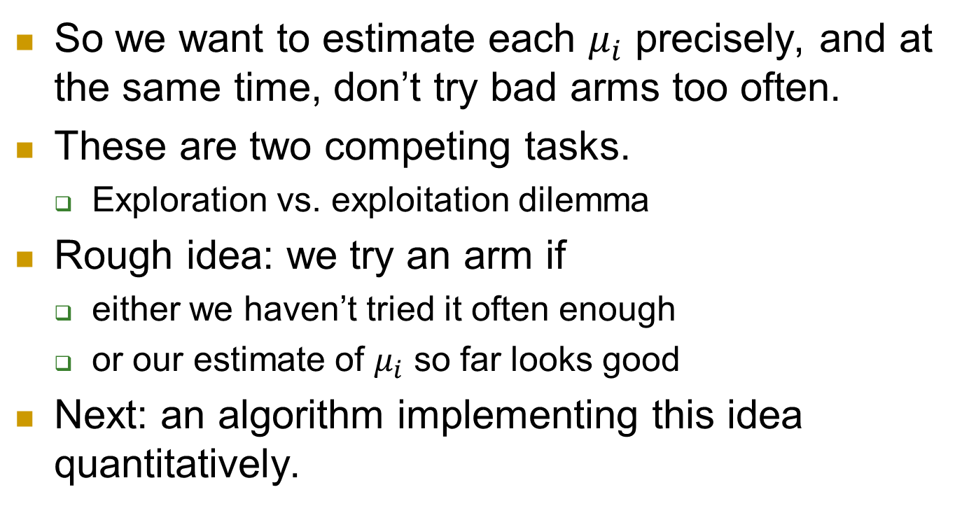
Observations and ideas
So we want to estimate each $μ_{i}$ precisely, and at the same time, don’t try bad arms too often.
These are two competing tasks.
  Exploration vs. exploitation dilemma
Rough idea: we try an arm if
  either we haven’t tried it often enough
  or our estimate of $μ_{i}$ so far looks good
Next: an algorithm implementing this idea quantitatively.

Slide 25

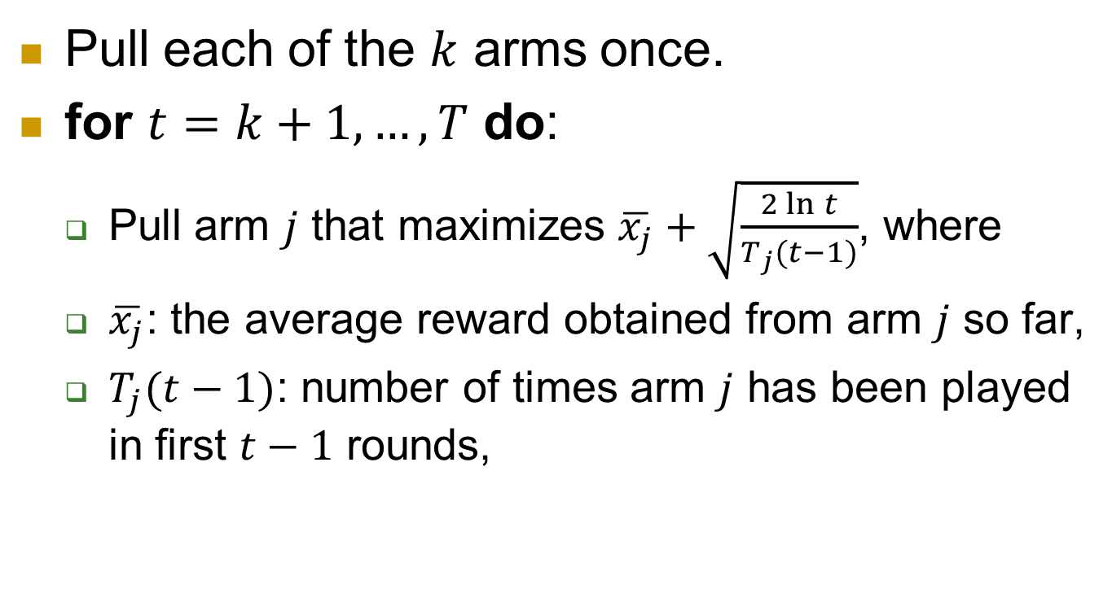

Upper Confidence Bound (UCB)
Pull each of the $k$ arms once.
for $t=k+1,…,T$ do:
  Pull arm $j$ that maximizes $\overline{x_{j}}+\sqrt{\frac{2\ln{t}}{T_{j}(t−1)}}$, where
  $\overline{x_{j}}$: the average reward obtained from arm $j$ so far,
  $T_{j}(t−1)$: number of times arm $j$ has been played in first $t−1$ rounds,
( )
$$\overline{x_{j}}+\sqrt{\frac{2\ln{t}}{t_{j}}}$$
$$\overline{x_{j}}$$

Slide 26
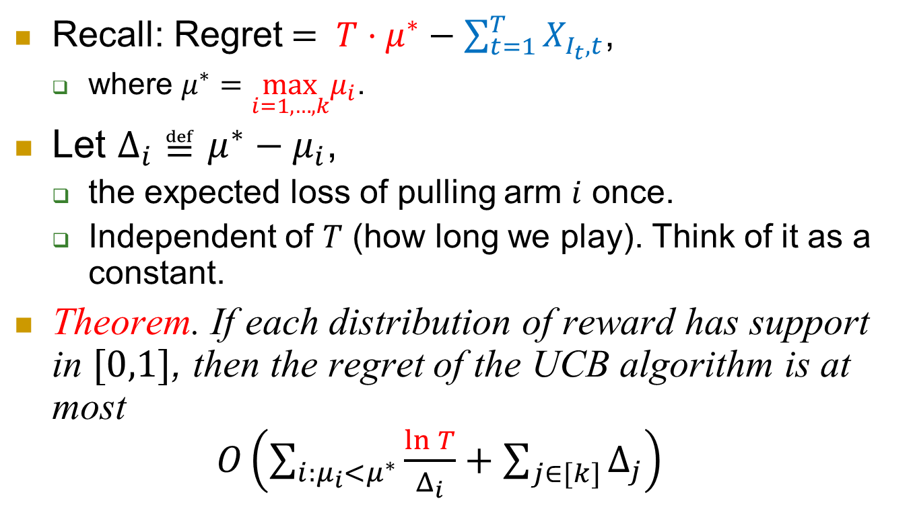
Performance
Recall: Regret$= T⋅μ^{∗}−\sum_{t=1}^{T}{X_{I_{t},t}}$,
  where $μ^{∗}=\max_{i=1,…,k}μ_{i}$.
Let $Δ_{i}≝μ^{∗}−μ_{i}$,
  the expected loss of pulling arm $i$ once.
  Independent of $T$ (how long we play). Think of it as a constant.
Theorem. If each distribution of reward has support in $[0,1]$, then the regret of the UCB algorithm is at most
$O\left(\sum_{i:μ_{i}<μ^{∗}}{\frac{\ln{T}}{Δ_{i}}}+\sum_{j∈[k]}{Δ_{j}}\right)$

Slide 27
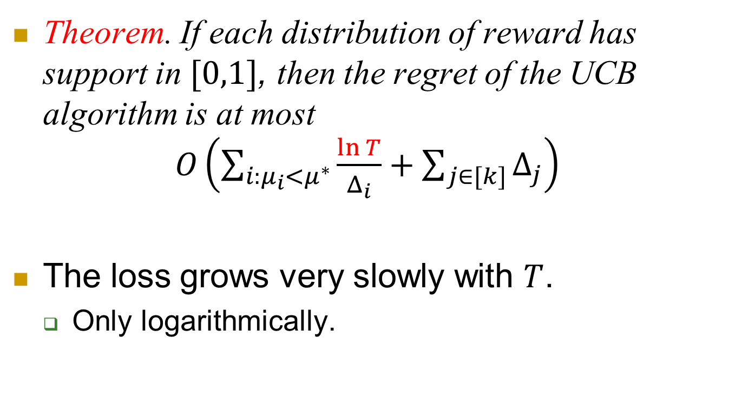
Performance
Theorem. If each distribution of reward has support in $[0,1]$, then the regret of the UCB algorithm is at most
$O\left(\sum_{i:μ_{i}<μ^{∗}}{\frac{\ln{T}}{Δ_{i}}}+\sum_{j∈[k]}{Δ_{j}}\right)$
The loss grows very slowly with $T$.
  Only logarithmically.

Slide 28
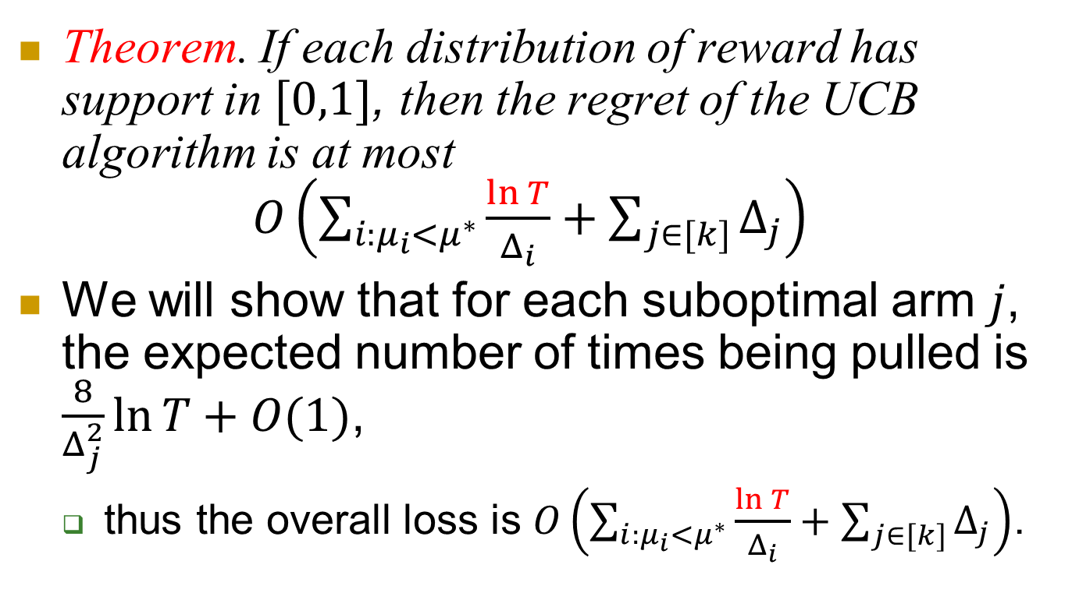
Performance
Theorem. If each distribution of reward has support in $[0,1]$, then the regret of the UCB algorithm is at most
$O\left(\sum_{i:μ_{i}<μ^{∗}}{\frac{\ln{T}}{Δ_{i}}}+\sum_{j∈[k]}{Δ_{j}}\right)$
We will show that for each suboptimal arm $j$, the expected number of times being pulled is $\frac{8}{Δ_{j}^{2}}\ln{T}+O(1)$,
  thus the overall loss is $O\left(\sum_{i:μ_{i}<μ^{∗}}{\frac{\ln{T}}{Δ_{i}}}+\sum_{j∈[k]}{Δ_{j}}\right)$.

Slide 29
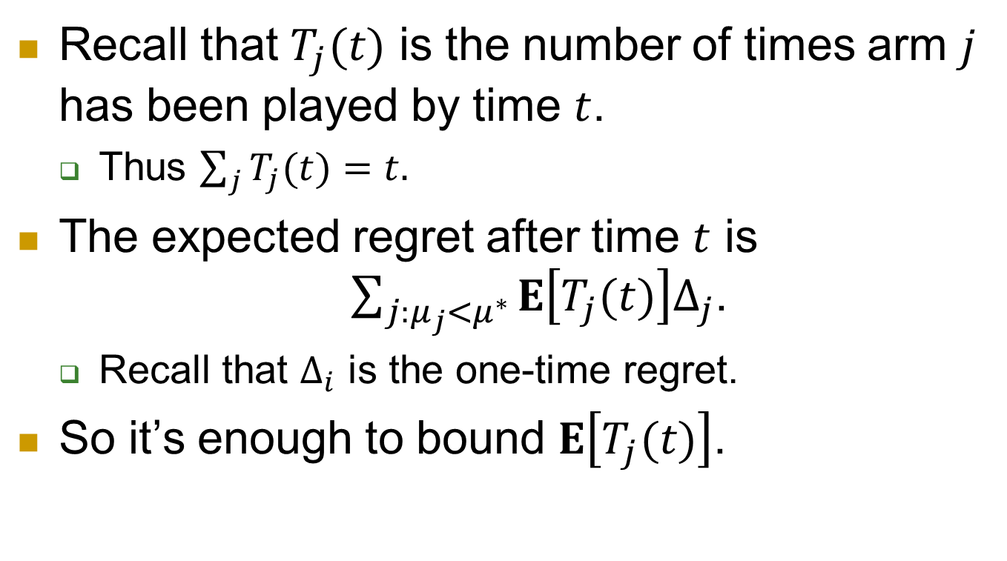
Recall that $T_{j}(t)$ is the number of times arm $j$ has been played by time $t$.
  Thus $\sum_{j}{T_{j}(t)}=t.$
The expected regret after time $t$ is $\sum_{j:μ_{j}<μ^{∗}}{E\left[T_{j}(t)\right]Δ_{j}}$.
  Recall that $Δ_{i}$ is the one-time regret.
So it’s enough to bound $E\left[T_{j}(t)\right]$.

Slide 30
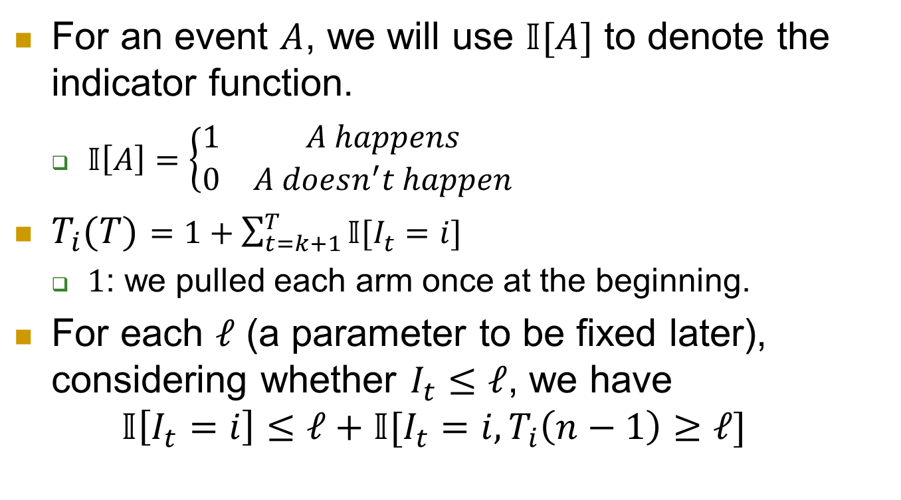
For an event $A$, we will use $𝕀[A]$ to denote the indicator function.
  $𝕀\left[A\right]=\left\{\begin{matrix}1 & A happens \\ 0 & A doesn^{′}t happen\end{matrix}\right.$
$T_{i}(T)=1+\sum_{t=k+1}^{T}{𝕀[I_{t}=i]}$
  $1$: we pulled each arm once at the beginning.
For each $ℓ$ (a parameter to be fixed later), considering whether $I_{t}≤ℓ$, we have
$𝕀\left[I_{t}=i\right]≤ℓ+𝕀[I_{t}=i,T_{i}\left(n−1\right)≥ℓ]$

Slide 31
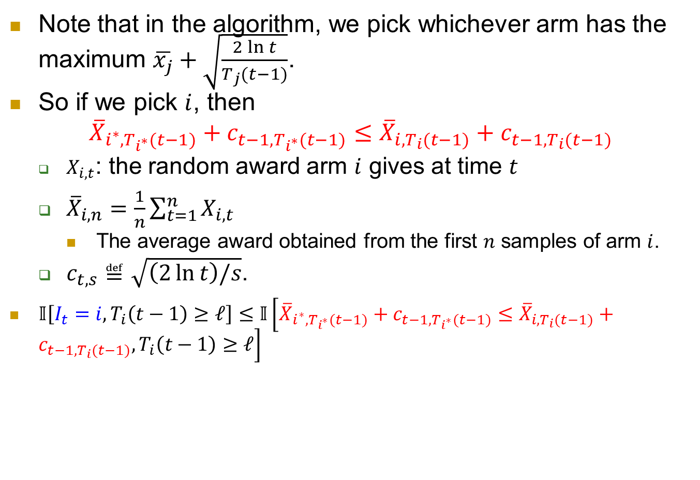
Note that in the algorithm, we pick whichever arm has the maximum $\overline{x_{j}}+\sqrt{\frac{2\ln{t}}{T_{j}(t−1)}}$.
So if we pick $i$, then
$${\overline{X}}_{i^{∗},T_{i^{∗}}(t−1)}+c_{t−1,T_{i^{∗}}(t−1)}≤{\overline{X}}_{i,T_{i}(t−1)}+c_{t−1,T_{i}(t−1)}$$
  $X_{i,t}$: the random award arm $i$ gives at time $t$
  ${\overline{X}}_{i,n}=\frac{1}{n}\sum_{t=1}^{n}{X_{i,t}}$
    The average award obtained from the first $n$ samples of arm $i$.
  $c_{t,s}≝\sqrt{\left(2\ln{t}\right)/s}$.
$𝕀\left[I_{t}=i,T_{i}\left(t−1\right)≥ℓ\right]≤𝕀\left[{\overline{X}}_{i^{∗},T_{i^{∗}}(t−1)}+c_{t−1,T_{i^{∗}}(t−1)}≤{\overline{X}}_{i,T_{i}(t−1)}+c_{t−1,T_{i}(t−1)},T_{i}\left(t−1\right)≥ℓ\right]$

Slide 32
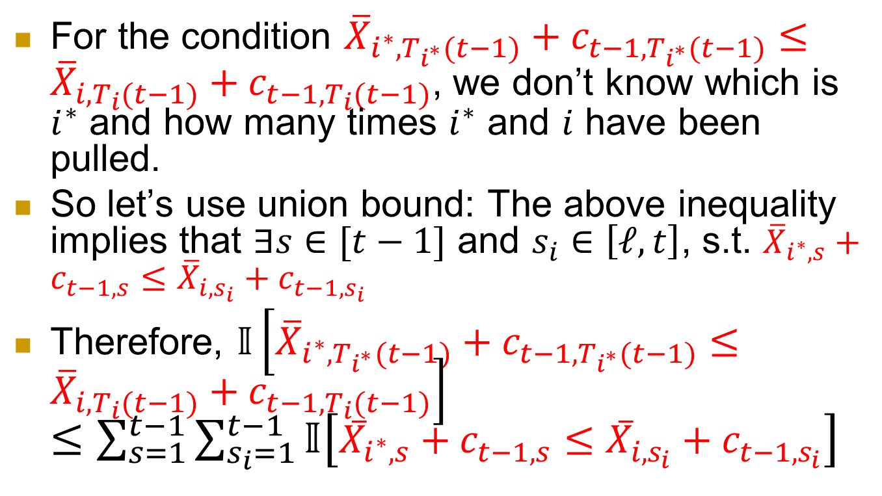
For the condition ${\overline{X}}_{i^{∗},T_{i^{∗}}(t−1)}+c_{t−1,T_{i^{∗}}(t−1)}≤{\overline{X}}_{i,T_{i}(t−1)}+c_{t−1,T_{i}(t−1)}$, we don’t know which is $i^{∗}$ and how many times $i^{∗}$ and $i$ have been pulled.
So let’s use union bound: The above inequality implies that $∃s∈[t−1]$ and $s_{i}∈\left[ℓ,t\right]$, s.t. ${\overline{X}}_{i^{∗},s}+c_{t−1,s}≤{\overline{X}}_{i,s_{i}}+c_{t−1,s_{i}}$
Therefore, $𝕀\left[{\overline{X}}_{i^{∗},T_{i^{∗}}(t−1)}+c_{t−1,T_{i^{∗}}(t−1)}≤{\overline{X}}_{i,T_{i}(t−1)}+c_{t−1,T_{i}(t−1)}\right]$
$≤\sum_{s=1}^{t−1}{\sum_{s_{i}=1}^{t−1}{𝕀\left[{\overline{X}}_{i^{∗},s}+c_{t−1,s}≤{\overline{X}}_{i,s_{i}}+c_{t−1,s_{i}}\right]}}$

Slide 33
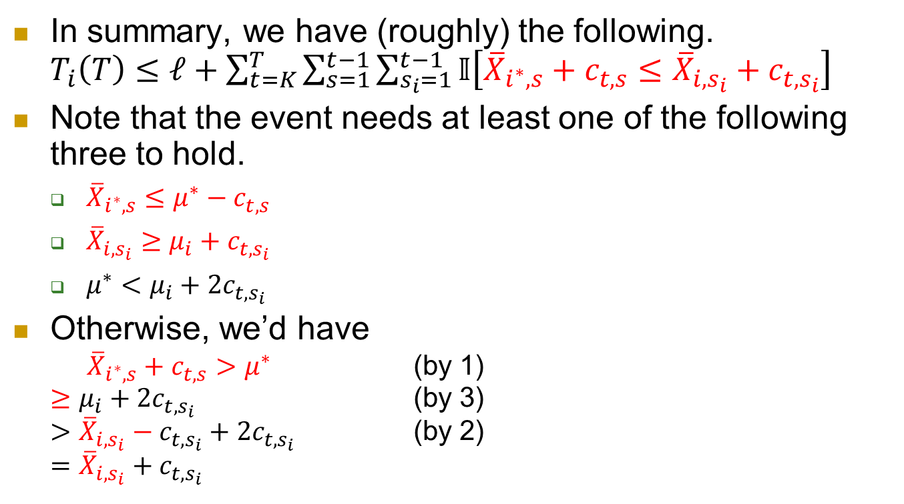
In summary, we have (roughly) the following.
$T_{i}\left(T\right)≤ℓ+\sum_{t=K}^{T}{\sum_{s=1}^{t−1}{\sum_{s_{i}=1}^{t−1}{𝕀\left[{\overline{X}}_{i^{∗},s}+c_{t,s}≤{\overline{X}}_{i,s_{i}}+c_{t,s_{i}}\right]}}}$
Note that the event needs at least one of the following three to hold.
  ${\overline{X}}_{i^{∗},s}≤μ^{∗}−c_{t,s}$
  ${\overline{X}}_{i,s_{i}}≥μ_{i}+c_{t,s_{i}}$
  $μ^{∗}<μ_{i}+2c_{t,s_{i}}$
Otherwise, we’d have
${\overline{X}}_{i^{∗},s}+c_{t,s}>μ^{∗}$ (by 1)
$≥μ_{i}+2c_{t,s_{i}}$ (by 3)
$>{\overline{X}}_{i,s_{i}}−c_{t,s_{i}}+2c_{t,s_{i}}$ (by 2)
$={\overline{X}}_{i,s_{i}}+c_{t,s_{i}}$

Slide 34
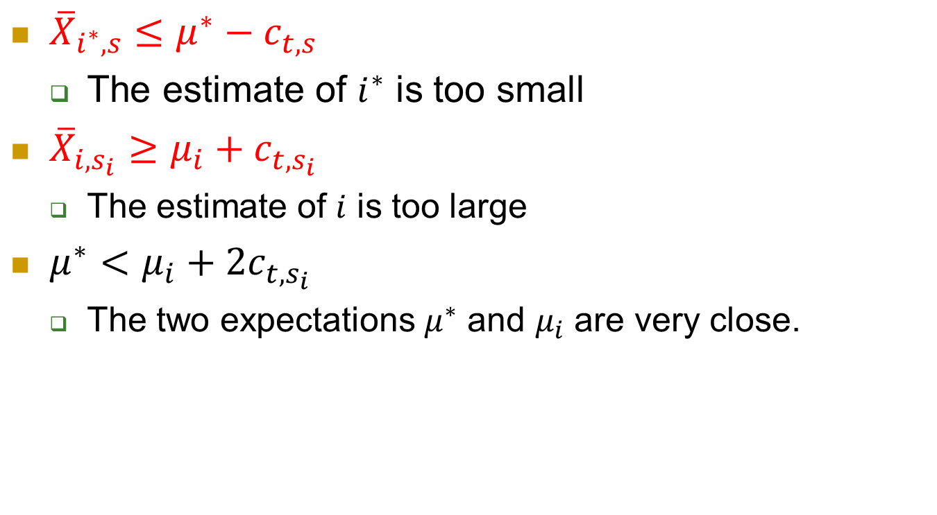
The three conditions
${\overline{X}}_{i^{∗},s}≤μ^{∗}−c_{t,s}$
  The estimate of $i^{∗}$ is too small
${\overline{X}}_{i,s_{i}}≥μ_{i}+c_{t,s_{i}}$
  The estimate of $i$ is too large
$μ^{∗}<μ_{i}+2c_{t,s_{i}}$
  The two expectations $μ^{∗}$ and $μ_{i}$ are very close.

Slide 35
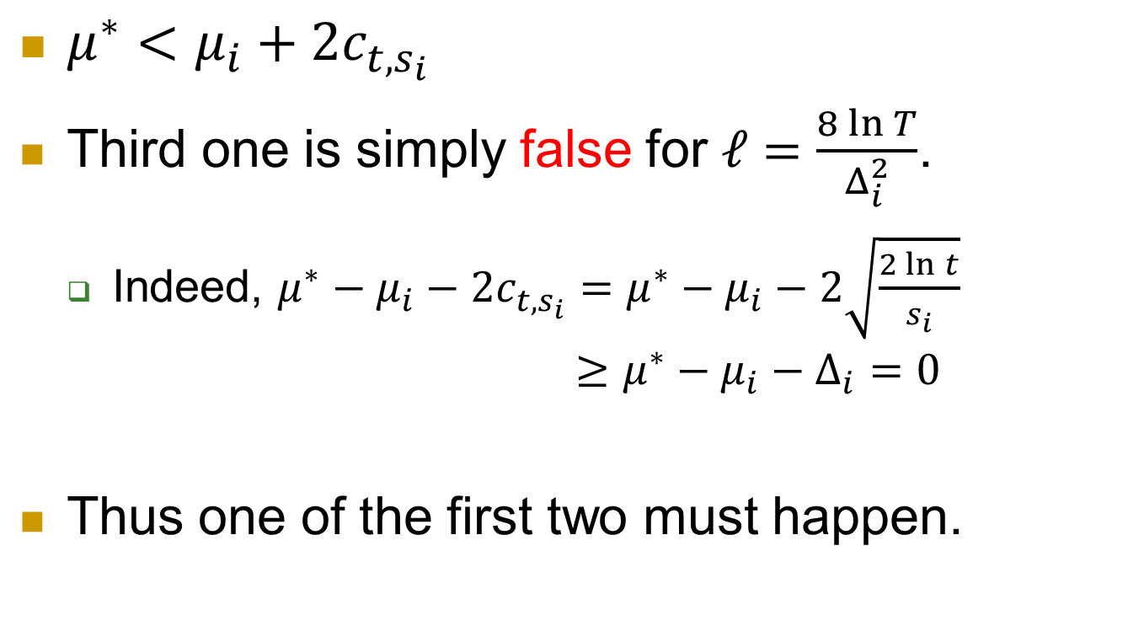
The third one
$μ^{∗}<μ_{i}+2c_{t,s_{i}}$
Third one is simply false for $ℓ=\frac{8\ln{T}}{Δ_{i}^{2}}$.
  Indeed, $μ^{∗}−μ_{i}−2c_{t,s_{i}}=μ^{∗}−μ_{i}−2\sqrt{\frac{2\ln{t}}{s_{i}}}$
  $≥μ^{∗}−μ_{i}−Δ_{i}=0$
Thus one of the first two must happen.

Slide 36
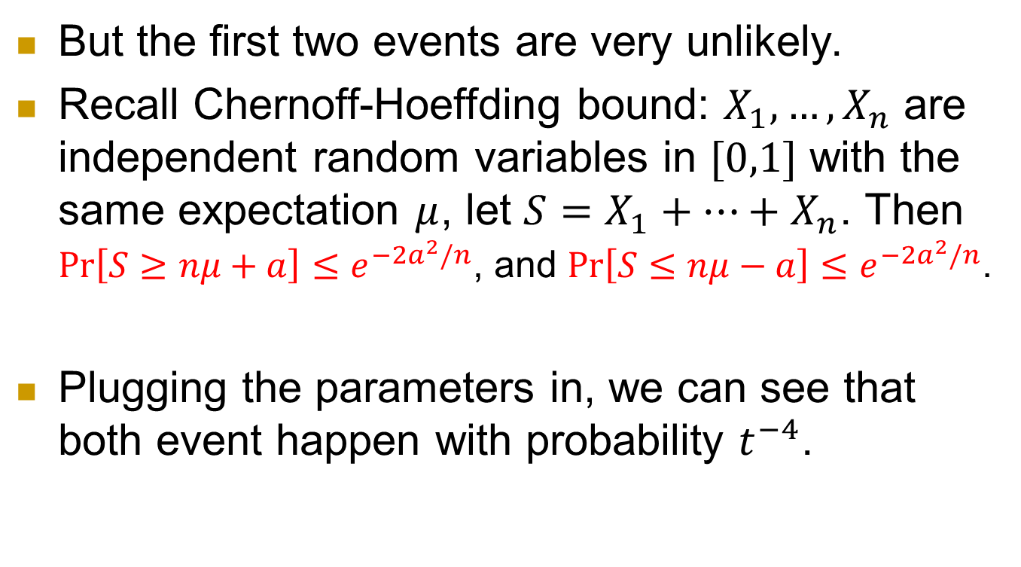
But the first two events are very unlikely.
Recall Chernoff-Hoeffding bound: $X_{1},…,X_{n}$ are independent random variables in $[0,1]$ with the same expectation $μ$, let $S=X_{1}+…+X_{n}$. Then
$\operatorname{Pr}\left[S≥nμ+a\right]≤e^{−2a^{2}/n}$, and $\operatorname{Pr}\left[S≤nμ−a\right]≤e^{−2a^{2}/n}$.
Plugging the parameters in, we can see that both event happen with probability $t^{−4}$.

Slide 37
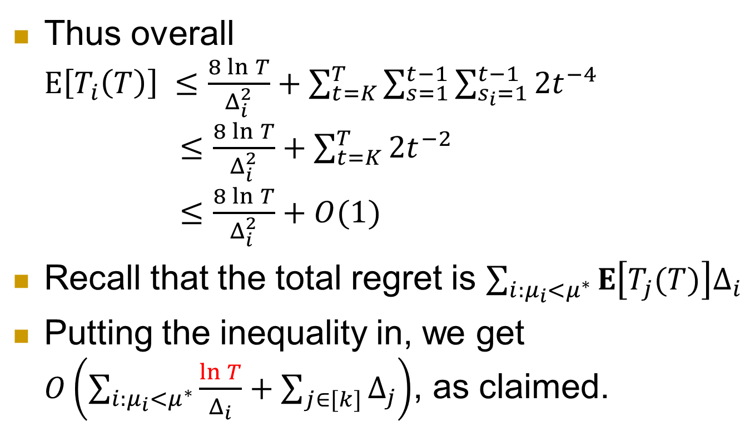
Thus overall
$E\left[T_{i}\left(T\right)\right] ≤\frac{8\ln{T}}{Δ_{i}^{2}}+\sum_{t=K}^{T}{\sum_{s=1}^{t−1}{\sum_{s_{i}=1}^{t−1}{{2t}^{−4}}}}$
$≤\frac{8\ln{T}}{Δ_{i}^{2}}+\sum_{t=K}^{T}{2t^{−2}}$
$≤\frac{8\ln{T}}{Δ_{i}^{2}}+O(1)$
Recall that the total regret is $\sum_{i:μ_{i}<μ^{∗}}{E\left[T_{j}(T)\right]Δ_{i}}$
Putting the inequality in, we get $O\left(\sum_{i:μ_{i}<μ^{∗}}{\frac{\ln{T}}{Δ_{i}}}+\sum_{j∈[k]}{Δ_{j}}\right)$, as claimed.

Slide 38
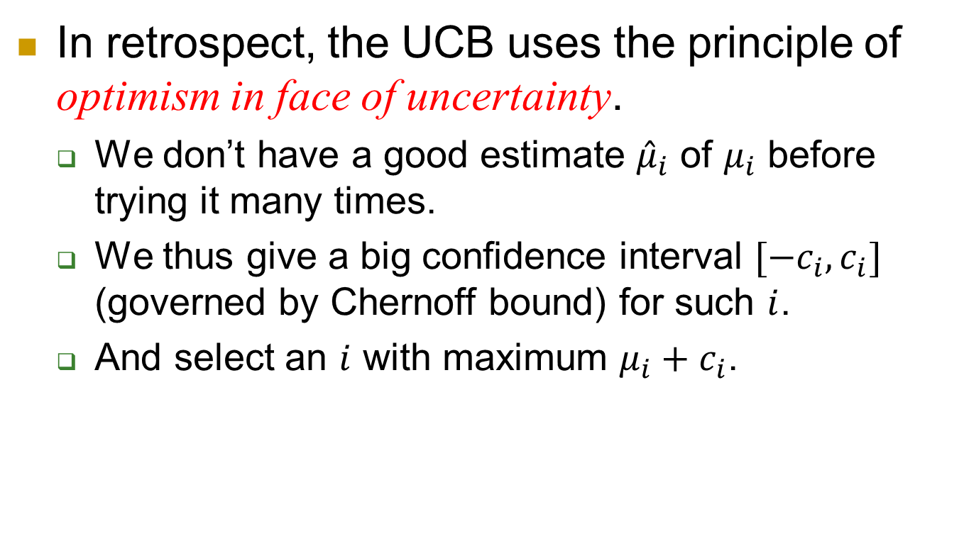
In retrospect, the UCB uses the principle of optimism in face of uncertainty.
  We don’t have a good estimate ${\hat{μ}}_{i}$ of $μ_{i}$ before trying it many times.
  We thus give a big confidence interval $[−c_{i},c_{i}]$ (governed by Chernoff bound) for such $i$.
  And select an $i$ with maximum $μ_{i}+c_{i}$.

Slide 39
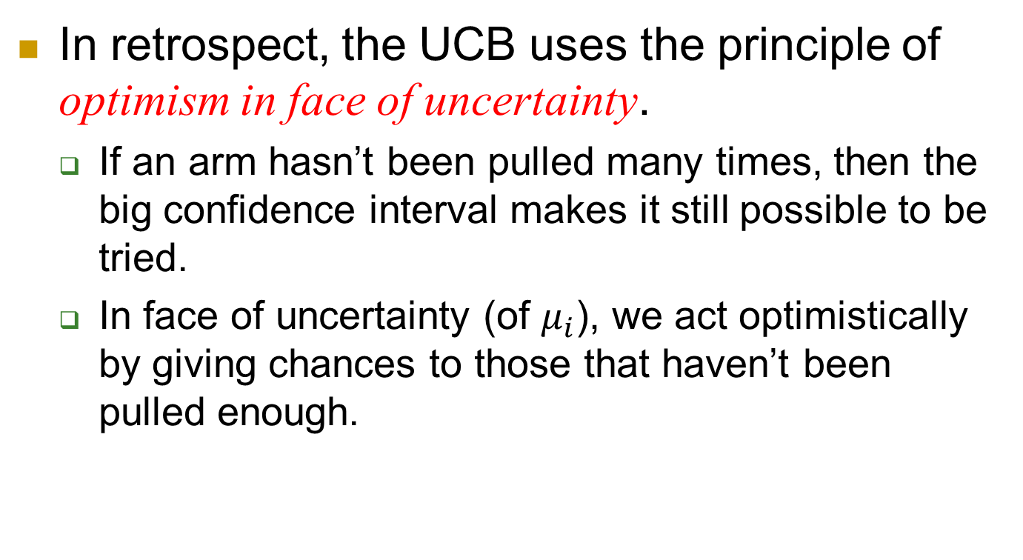
In retrospect, the UCB uses the principle of optimism in face of uncertainty.
  If an arm hasn’t been pulled many times, then the big confidence interval makes it still possible to be tried.
  In face of uncertainty (of $μ_{i}$), we act optimistically by giving chances to those that haven’t been pulled enough.

Slide 40
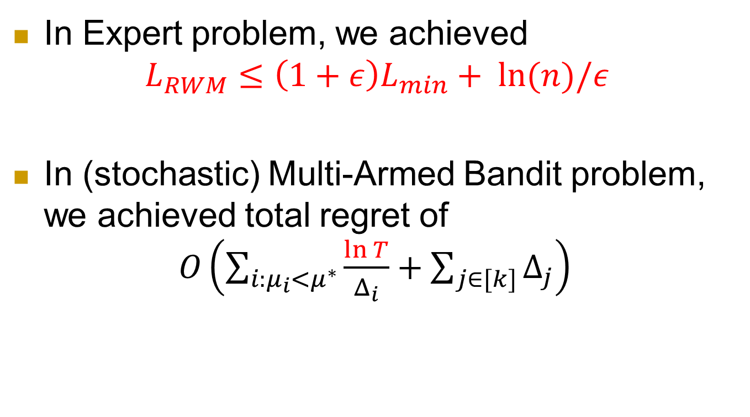
Summary
In Expert problem, we achieved
$$L_{RWM}≤\left(1+ε\right)L_{min}+ ln⁡(n)/ε$$
In (stochastic) Multi-Armed Bandit problem, we achieved total regret of
$O\left(\sum_{i:μ_{i}<μ^{∗}}{\frac{\ln{T}}{Δ_{i}}}+\sum_{j∈[k]}{Δ_{j}}\right)$

