Slide 1
CMSC5706 Topics in Theoretical Computer Science
Week 1: Review of
Algorithms and Probability
Instructor: Shengyu Zhang

Slide 2
First week
Part I: About the course
Part II: About algorithms and complexity
  What are algorithms?
  Growth of functions
  What is the complexity of an algorithm / a problem
Part III: Review of probability
  Tail bounds

Slide 3
Part I: About the course

Slide 4
Info
Webpage: http://www.cse.cuhk.edu.hk/~syzhang/course/MScAlg15
  Information (time and venue, TA, textbook, etc.)
  Lecture slides
  Homework
  Announcements
Flavor:
  More math than programming.

Slide 5
Homework
Homework assignments (100%).
  No exam.
12 homework.
You only need to complete 10.
  If you do more than 10, the 10 with the highest scores count.

Slide 6
textbook
No textbook.
Lecture notes available before classes.
Some general references are listed in the course website as well.

Slide 7
Part II: About algorithms and complexity

Slide 8
A good example: driving directions
Suppose we want to drive from CUHK to Central. How to route?
Let’s ask Google.

Slide 9
What’s good here:
  Step by step.
  Each step is either turn left/right, or go straight for … meters.
  An estimated time is also given.
An algorithm is a computational procedure that has step-by-step instructions.
It’ll be good if an estimated time is given.

Slide 10
More on complexity
Why time matters?
  Time is money!
  Being late means 0 value
    Weather forecast.
    Homework.
Running time: the number of elementary steps
  Assuming that each step only costs a small (or fixed) amount of time.

Slide 11
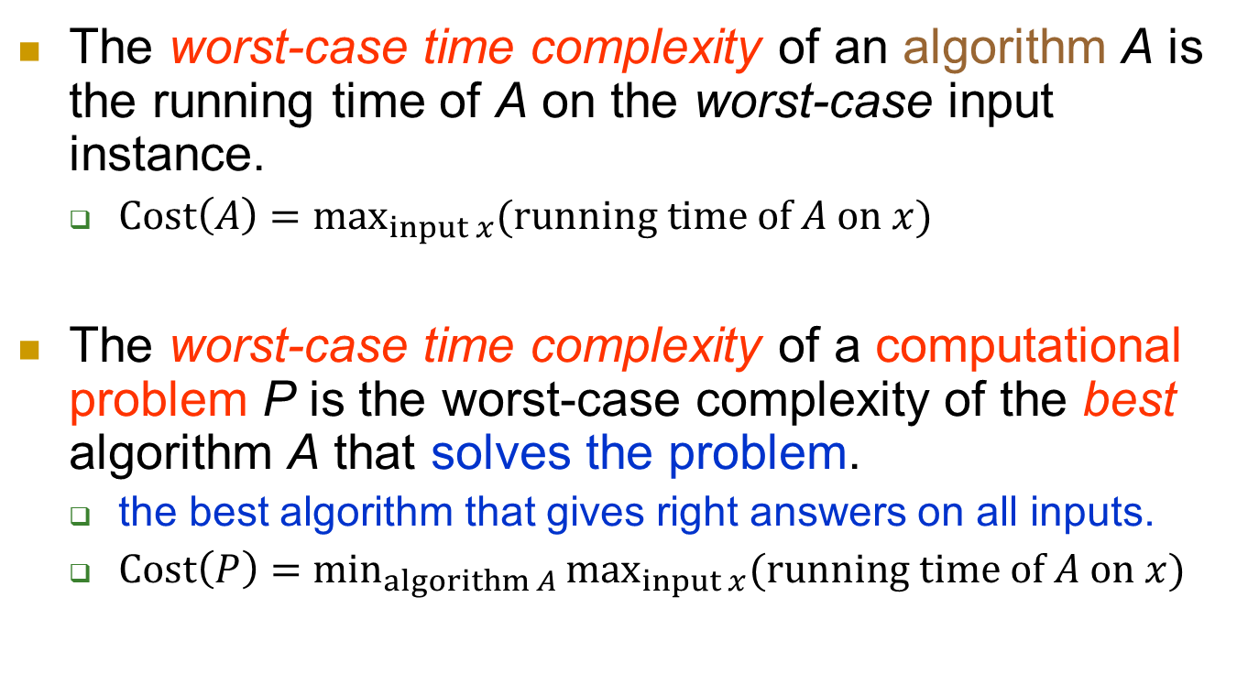
complexity
The worst-case time complexity of an algorithm A is the running time of A on the worst-case input instance.
  $Cost\left(A\right)=\max_{input x}{(running time of A on x)}$
The worst-case time complexity of a computational problem P is the worst-case complexity of the best algorithm A that solves the problem.
  the best algorithm that gives right answers on all inputs.
  $Cost\left(P\right)=\min_{algorithm A}{\max_{input x}{(running time of A on x)}}$

Slide 12
Hardness of problems can vary a lot
Multiplication:
  1234 * 5678 = ?
    7006652
  2749274929483758 * 4827593028759302 = ?
    Can you finish it in 10 minutes?
Do you think you can handle multiplication easily?

Slide 13
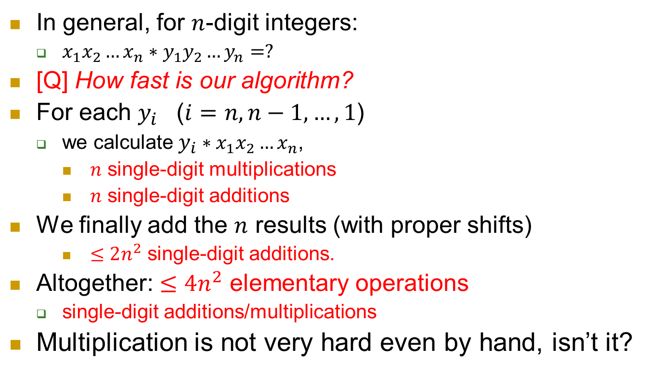

Complexity of integer multiplication
$x_{1}x_{2}…x_{n}$
$∗$ $y_{1}y_{2}…y_{n}$
---------------------------
* * * ∙∙∙ *
* * * ∙∙∙ *
∙∙∙ ∙∙∙
+ * * * ∙∙∙ *
---------------------------------
* * * * * * ∙∙∙ ∙∙∙ *
In general, for $n$-digit integers:
  $x_{1}x_{2}…x_{n}∗y_{1}y_{2}…y_{n}=?$
[Q] How fast is our algorithm?
For each $y_{i}$ ($i=n, n−1, …, 1$)
  we calculate $y_{i}∗x_{1}x_{2}…x_{n}$,
    $n$ single-digit multiplications
    $n$ single-digit additions
We finally add the $n$ results (with proper shifts)
    $≤2n^{2}$ single-digit additions.
Altogether: $≤4n^{2}$ elementary operations
  single-digit additions/multiplications
Multiplication is not very hard even by hand, isn’t it?
Notes:
Divide and Conquer: [Karatsuba and Ofman, 1962] O(n^{log_2} ³) ≈ O(n^{1.59})
FFT based: [Strassen-Schonhage, 1971] O( n∙log(n)∙loglog(n) )
Current record: [Furer, 2007] n∙log(n)∙2^{O(log*(n))}

Slide 14
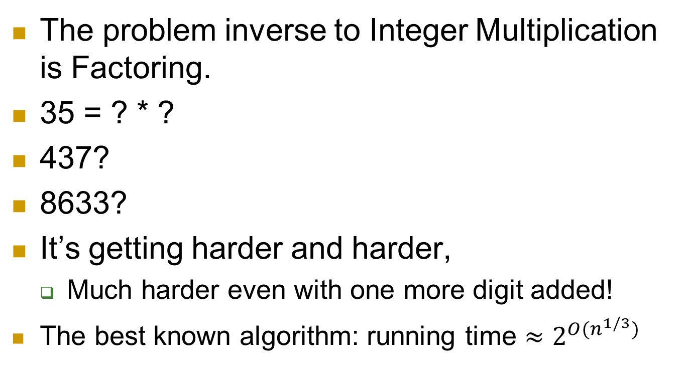
Inverse problem
The problem inverse to Integer Multiplication is Factoring.
35 = ? * ?
437?
8633?
It’s getting harder and harder,
  Much harder even with one more digit added!
  The best known algorithm: running time $≈2^{O(n^{1/3})}$

Slide 15
The bright side
Hard problems can be used for cryptography!
RSA [Rivest, Shamir, Adleman]:
  widely-used today,
  broken if one can factor quickly!
One-line message: Quantum computers can factor quickly!
Notes:
For more introduction of RSA, see http://en.wikipedia.org/wiki/RSA

Slide 16
Messages
Message 1: We care about the speed of the increase, especially when the size is very large.
Many interesting instances in both theory and practice are of huge (and growing!) sizes.

Slide 17
Message 2: We care about the big picture first.
Is the problem as easy as multiplication, or as hard as factoring?

Slide 18
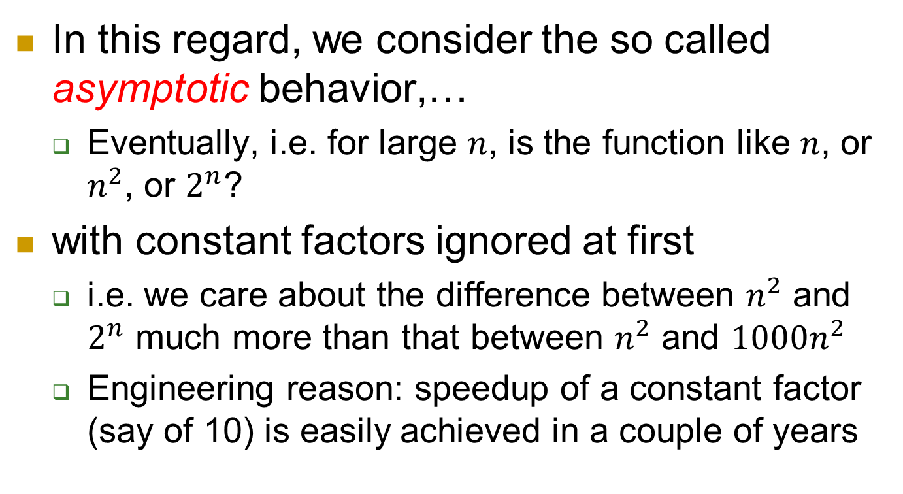
In this regard, we consider the so called asymptotic behavior,…
  Eventually, i.e. for large $n$, is the function like $n$, or $n^{2}$, or $2^{n}$?
with constant factors ignored at first
  i.e. we care about the difference between $n^{2}$ and $2^{n}$ much more than that between $n^{2}$ and $1000n^{2}$
  Engineering reason: speedup of a constant factor (say of 10) is easily achieved in a couple of years

Slide 19

Some examples
Which increases faster?
  $(100n^{2}, 0.01∗2^{n})$
  $(0.1∗\log{n}, 10n)$
  $({10}^{10}n, {10}^{−10}n^{2})$

Slide 20
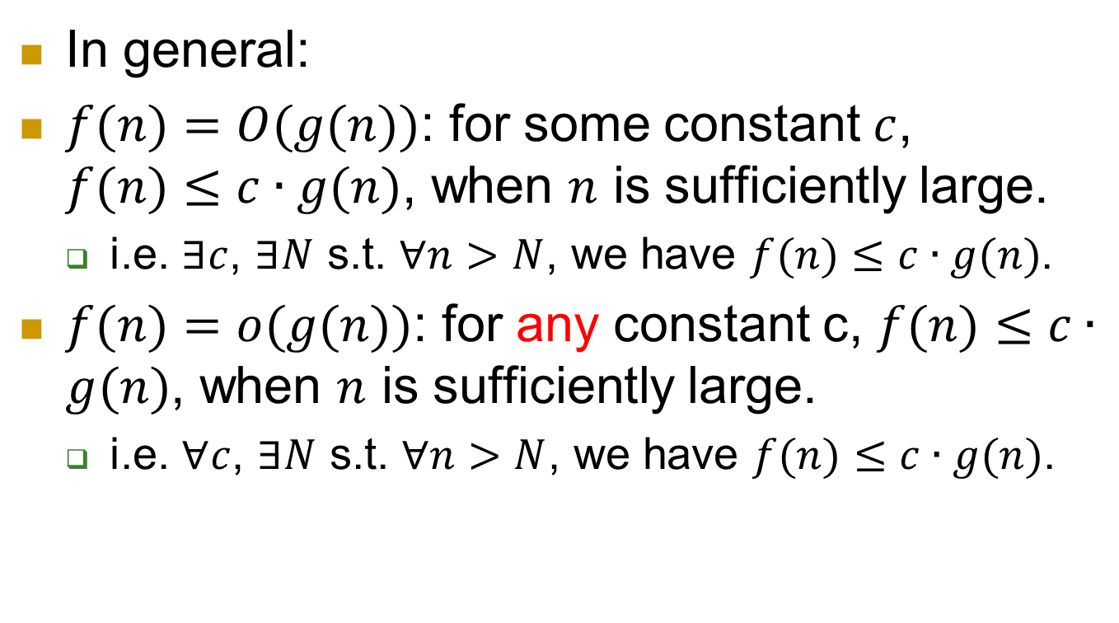
Big-O and small-o
In general:
$f(n)=O(g(n))$: for some constant $c$, $f(n)≤c∙g(n)$, when $n$ is sufficiently large.
  i.e. $∃c$, $∃N$ s.t. $∀n>N$, we have $f(n)≤c∙g(n)$.
$f(n)=o(g(n))$: for any constant c, $f(n)≤c∙g(n)$, when $n$ is sufficiently large.
  i.e. $∀c$, $∃N$ s.t. $∀n>N$, we have $f(n)≤c∙g(n)$.

Slide 21
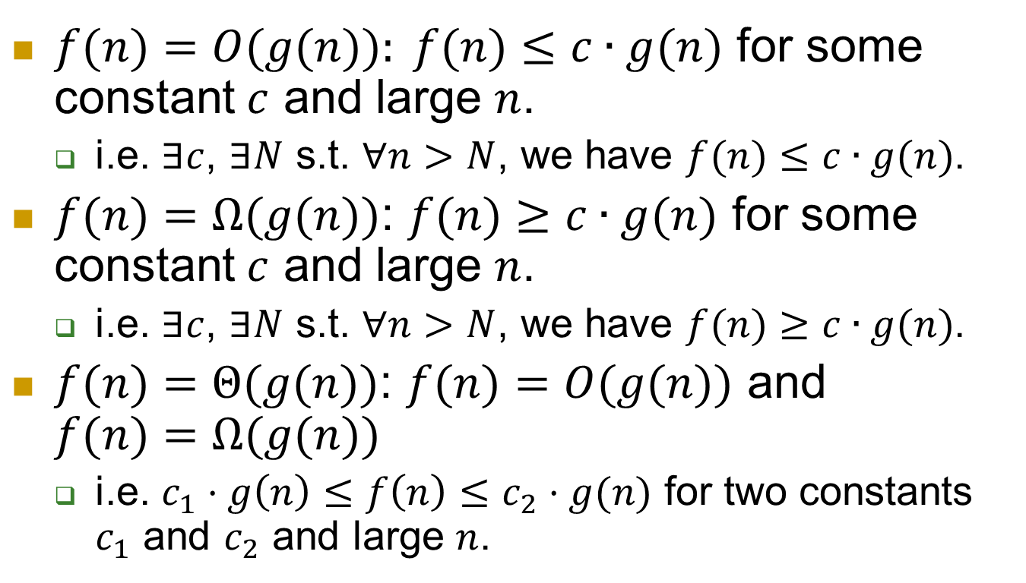
The other direction
$f(n)=O(g(n)): f(n)≤c∙g(n)$ for some constant $c$ and large $n$.
  i.e. $∃c$, $∃N$ s.t. $∀n>N$, we have $f(n)≤c∙g(n)$.
$f(n)=Ω(g(n))$: $f(n)≥c∙g(n)$ for some constant $c$ and large $n$.
  i.e. $∃c$, $∃N$ s.t. $∀n>N$, we have $f(n)≥c∙g(n)$.
$f(n)=Θ(g(n))$: $f(n)=O(g(n))$ and $f(n)=Ω(g(n))$
  i.e. $c_{1}⋅g\left(n\right)≤f\left(n\right)≤c_{2}⋅g(n)$ for two constants $c_{1}$ and $c_{2}$ and large $n$.

Slide 22
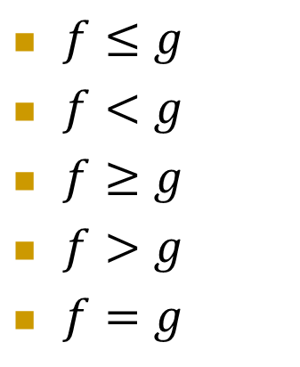
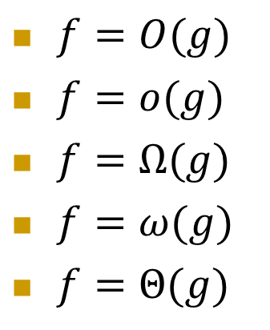
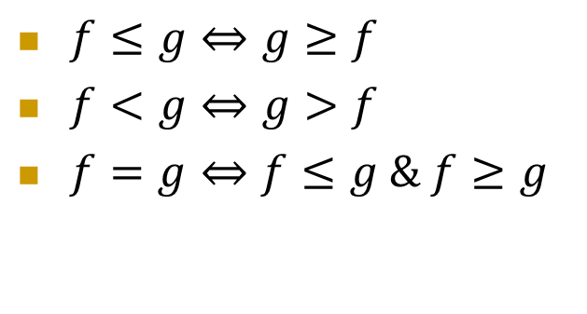
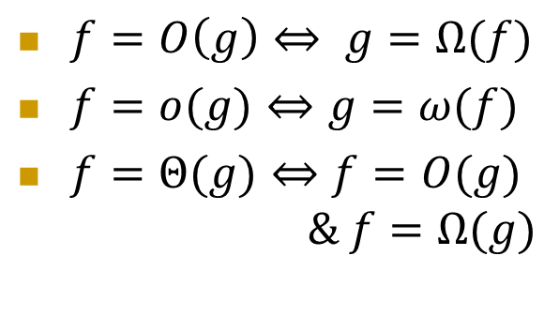
Intuition
$f=O(g)$
$f=o(g)$
$f=Ω(g)$
$f=ω(g)$
$f=Θ(g)$
$f≤g$
$f<g$
$f≥g$
$f>g$
$f=g$
$f=O\left(g\right)⇔ g=Ω(f)$
$f=o(g)⇔g=ω(f)$
$f=Θ(g)⇔f=O(g)$
$\& f=Ω(g)$
$f≤g⇔g≥f$
$f<g⇔g>f$
$f=g⇔f≤g \& f≥g$

Slide 23
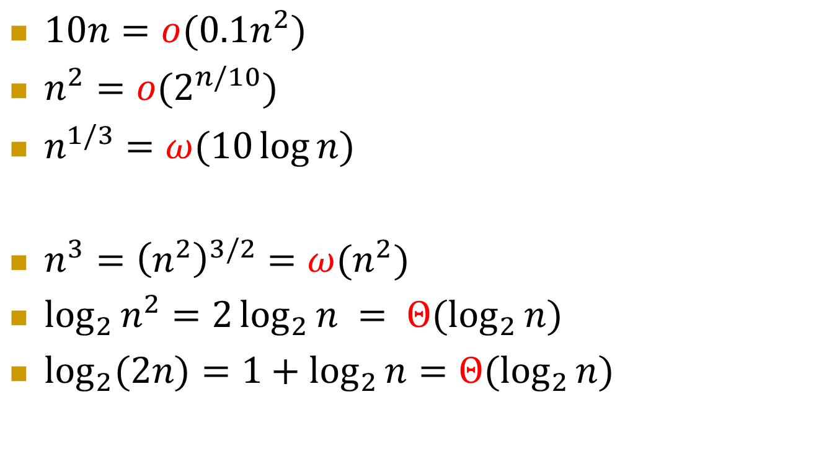
Examples
$10n=o(0.1n^{2})$
$n^{2}=o(2^{n/10})$
$n^{1/3}=ω(10\log{n})$
$n^{3}={\left(n^{2}\right)}^{3/2}=ω(n^{2})$
$\log_{2}{n^{2}}=2\log_{2}{n} = Θ(\log_{2}{n})$
$\log_{2}{(2n)}=1+\log_{2}{n}=Θ(\log_{2}{n})$

Slide 24
Part III: Probability and tail bounds

Slide 25
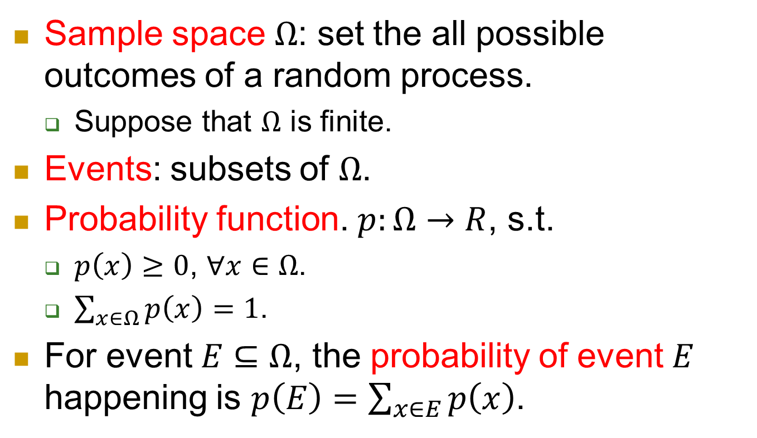
Finite sample space
Sample space $Ω$: set the all possible outcomes of a random process.
  Suppose that $Ω$ is finite.
Events: subsets of $Ω$.
Probability function. $p:Ω→R$, s.t.
  $p\left(x\right)≥0$, $∀x∈Ω$.
  $\sum_{x∈Ω}{p\left(x\right)}=1$.
For event $E⊆Ω$, the probability of event $E$ happening is $p\left(E\right)=\sum_{x∈E}{p\left(x\right)}$.

Slide 26
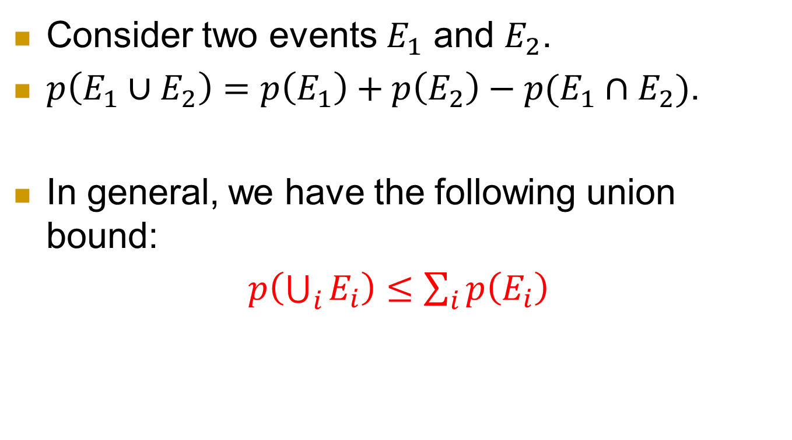
Union of events
Consider two events $E_{1}$ and $E_{2}$.
$p\left(E_{1}∪E_{2}\right)=p\left(E_{1}\right)+p\left(E_{2}\right)−p(E_{1}∩E_{2})$.
In general, we have the following union bound:
$p\left(\bigcup_{i}{E_{i}}\right)≤\sum_{i}{p\left(E_{i}\right)}$

Slide 27
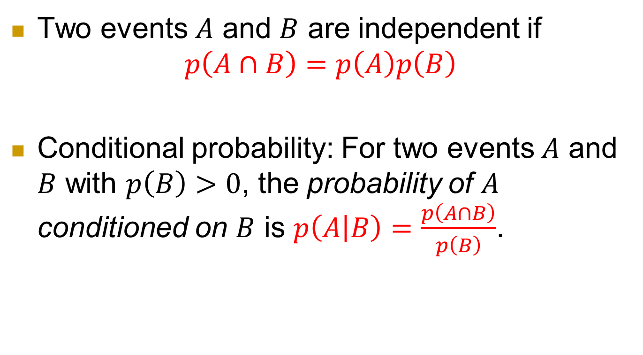
Independence of events
Two events $A$ and $B$ are independent if
$$p\left(A∩B\right)=p\left(A\right)p\left(B\right)$$
Conditional probability: For two events $A$ and $B$ with $p\left(B\right)>0$, the probability of $A$ conditioned on $B$ is $p\left(A | B\right)=\frac{p\left(A∩B\right)}{p\left(B\right)}$.

Slide 28
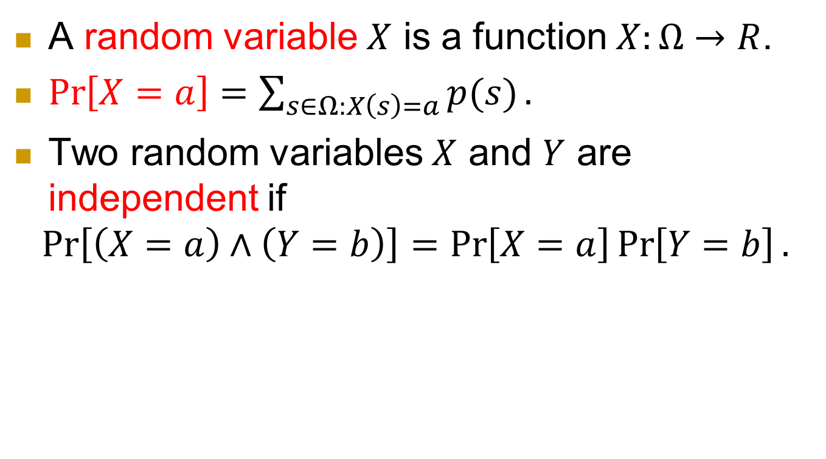
Random variable
A random variable $X$ is a function $X:Ω→R$.
$\operatorname{Pr}\left[X=a\right]=\sum_{s∈Ω:X\left(s\right)=a}{p(s)}.$
Two random variables $X$ and $Y$ are independent if
$$\operatorname{Pr}\left[\left(X=a\right)∧\left(Y=b\right)\right]=\operatorname{Pr}\left[X=a\right]\operatorname{Pr}\left[Y=b\right].$$

Slide 29
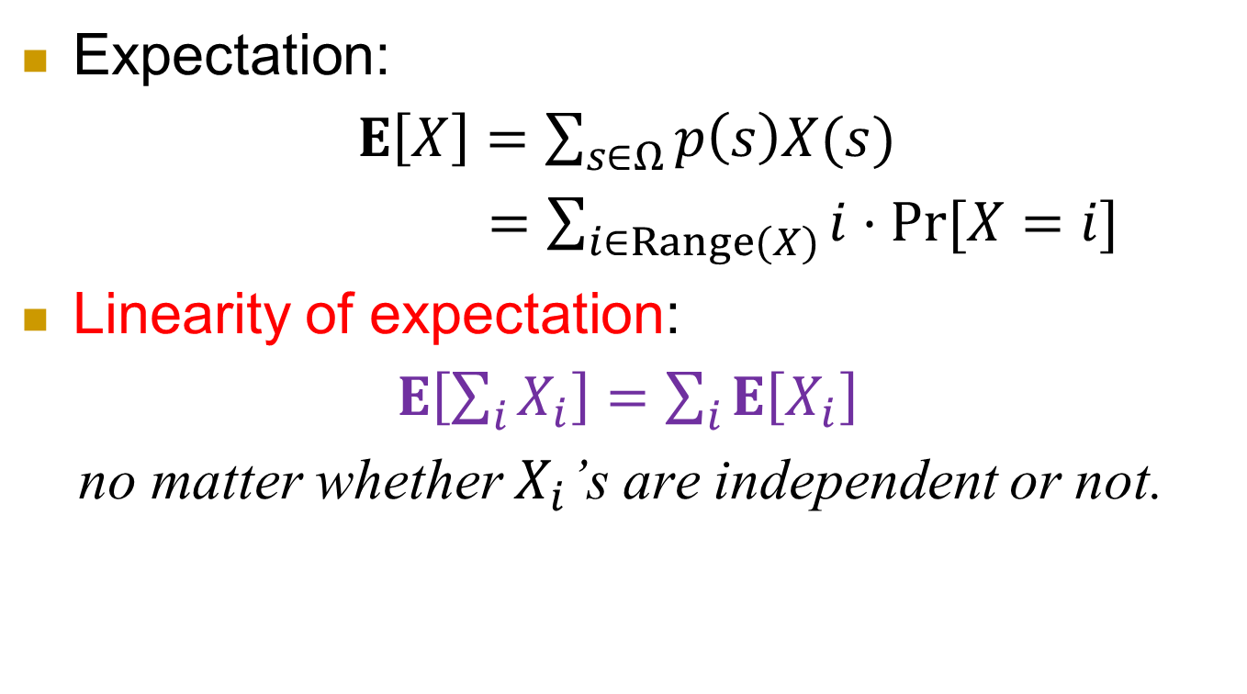
Expectation
Expectation:
$E\left[X\right]=\sum_{s∈Ω}{p\left(s\right)X(s)}$
$=\sum_{i∈Range(X)}{i⋅\operatorname{Pr}{[X=i]}}$
Linearity of expectation:
$E\left[\sum_{i}{X_{i}}\right]=\sum_{i}{E\left[X_{i}\right]}$
no matter whether $X_{i}$’s are independent or not.

Slide 30
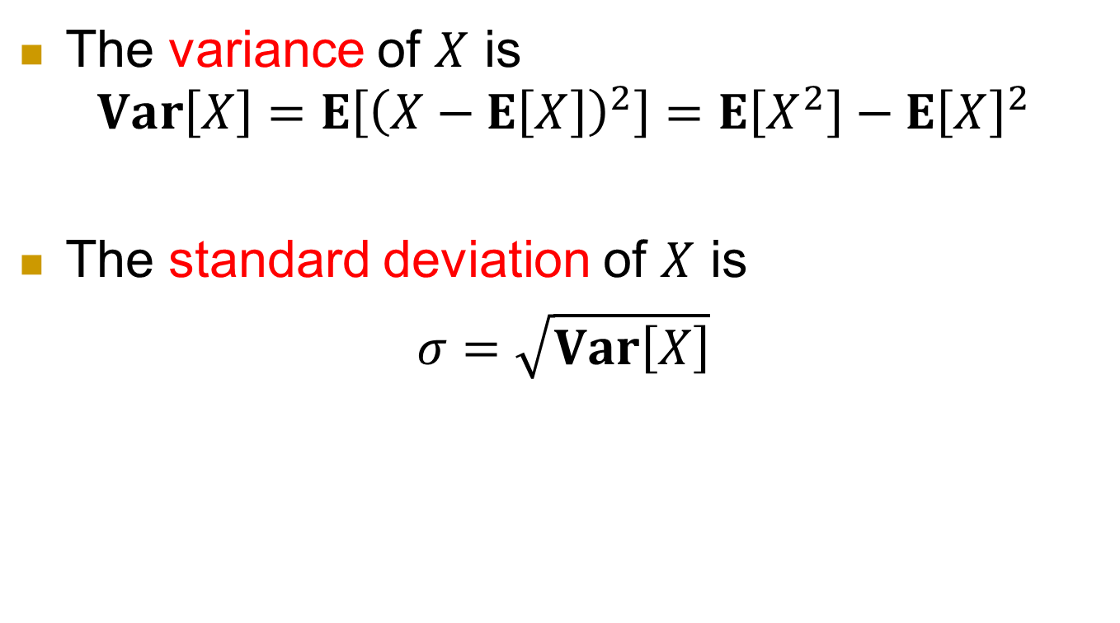
variance
The variance of $X$ is
$$Var\left[X\right]=E\left[{\left(X−E\left[X\right]\right)}^{2}\right]=E\left[X^{2}\right]−E{\left[X\right]}^{2}$$
The standard deviation of $X$ is
$σ=\sqrt{Var\left[X\right]}$

Slide 31
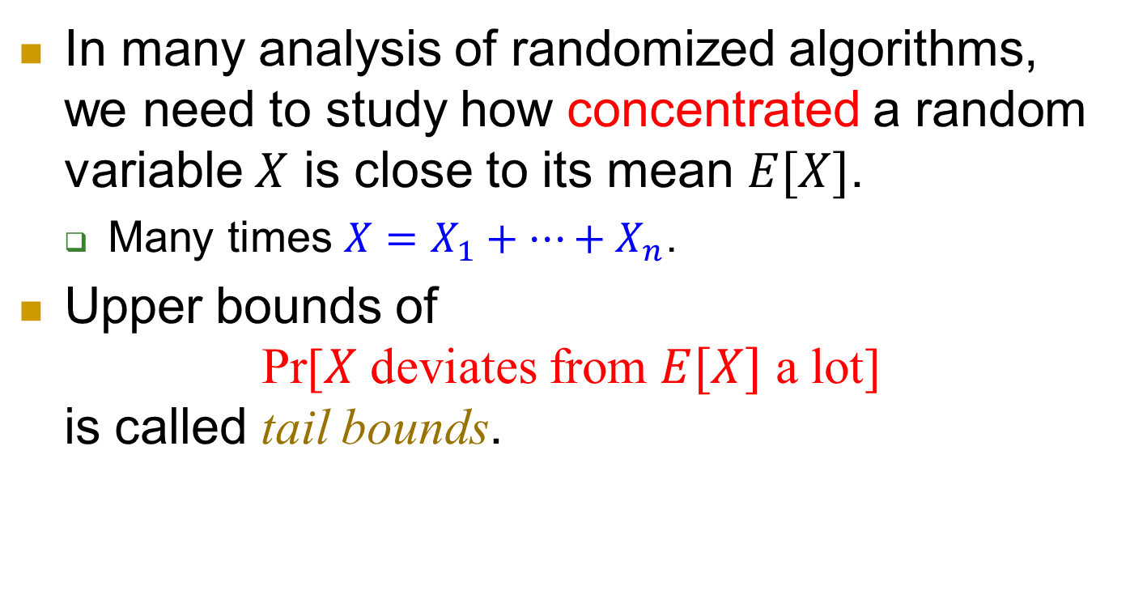
Concentration and tail bounds
In many analysis of randomized algorithms, we need to study how concentrated a random variable $X$ is close to its mean $E[X]$.
  Many times $X=X_{1}+…+X_{n}$.
Upper bounds of
Pr[$X$ deviates from $E[X]$ a lot]
is called tail bounds.

Slide 32
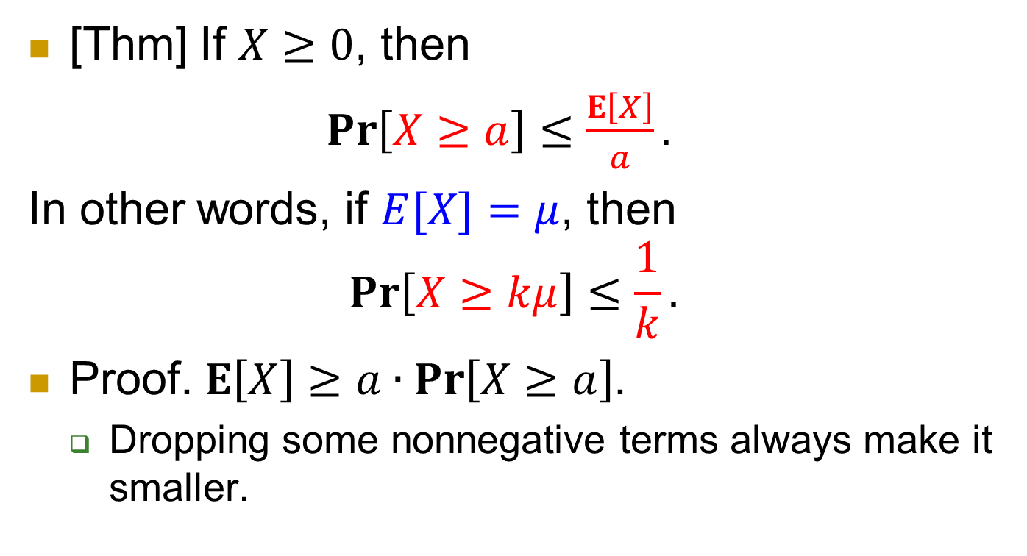
Markov’s Inequality: when you only know expectation
[Thm] If $X≥0$, then
$\operatorname{Pr}\left[X≥a\right]≤\frac{E\left[X\right]}{a}.$
In other words, if $E[X]=μ$, then
$$\operatorname{Pr}\left[X≥kμ\right]≤\frac{1}{k}.$$
Proof. $E\left[X\right]≥a∙\operatorname{Pr}\left[X≥a\right]$.
  Dropping some nonnegative terms always make it smaller.

Slide 33
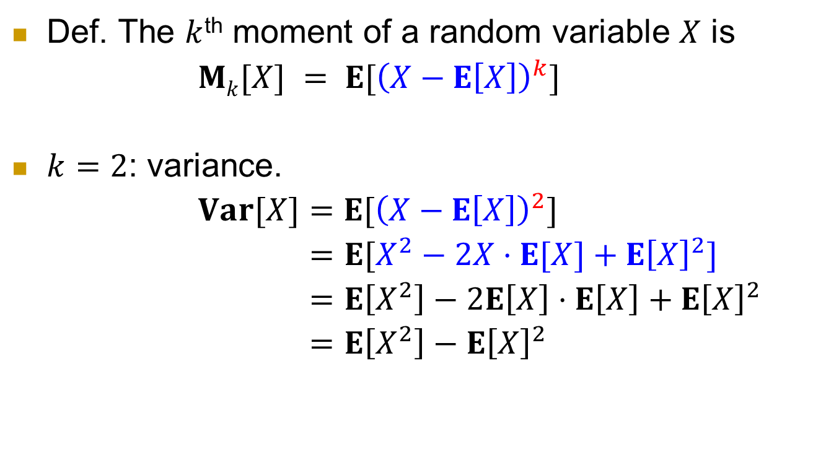
Moments
Def. The $k$^{th} moment of a random variable $X$ is
$Mk[X] = E[{\left(X−E\left[X\right]\right)}^{k}]$
$k=2$: variance.
$Var[X]=E[{\left(X−E\left[X\right]\right)}^{2}]$
$=E[X^{2}−2X⋅E[X]+E{\left[X\right]}^{2}]$
$=E\left[X^{2}\right]−2E\left[X\right]⋅E\left[X\right]+E{\left[X\right]}^{2}$
$=E\left[X^{2}\right]−E{\left[X\right]}^{2}$

Slide 34
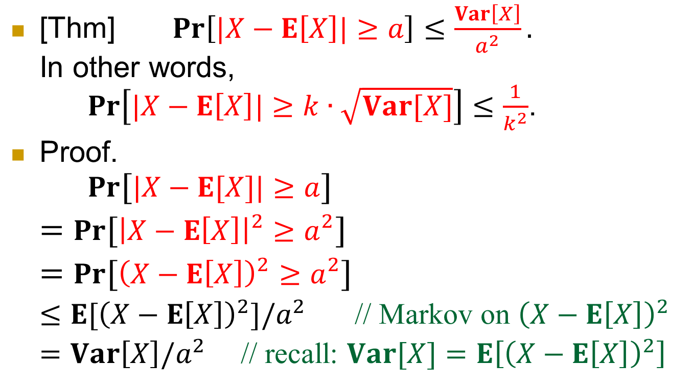
Chebyshev’s Inequality: when you also know variance
[Thm] $\operatorname{Pr}\left[|X−E\left[X\right]|≥a\right]≤\frac{Var\left[X\right]}{a^{2}}.$
In other words,
$\operatorname{Pr}\left[|X−E\left[X\right]|≥k∙\sqrt{Var[X]}\right]≤\frac{1}{k^{2}}$.
Proof.
$Pr⁡[|X−E[X]|≥a]$
$=Pr⁡[{\left|X−E\left[X\right]\right|}^{2}≥a^{2}]$
$=Pr⁡[{\left(X−E\left[X\right]\right)}^{2}≥a^{2}]$
$≤E[{\left(X−E\left[X\right]\right)}^{2}]/a^{2}$ // Markov on ${\left(X−E\left[X\right]\right)}^{2}$
$=Var\left[X\right]/a^{2}$ // recall: $Var[X]=E\left[{\left(X−E\left[X\right]\right)}^{2}\right]$

Slide 35
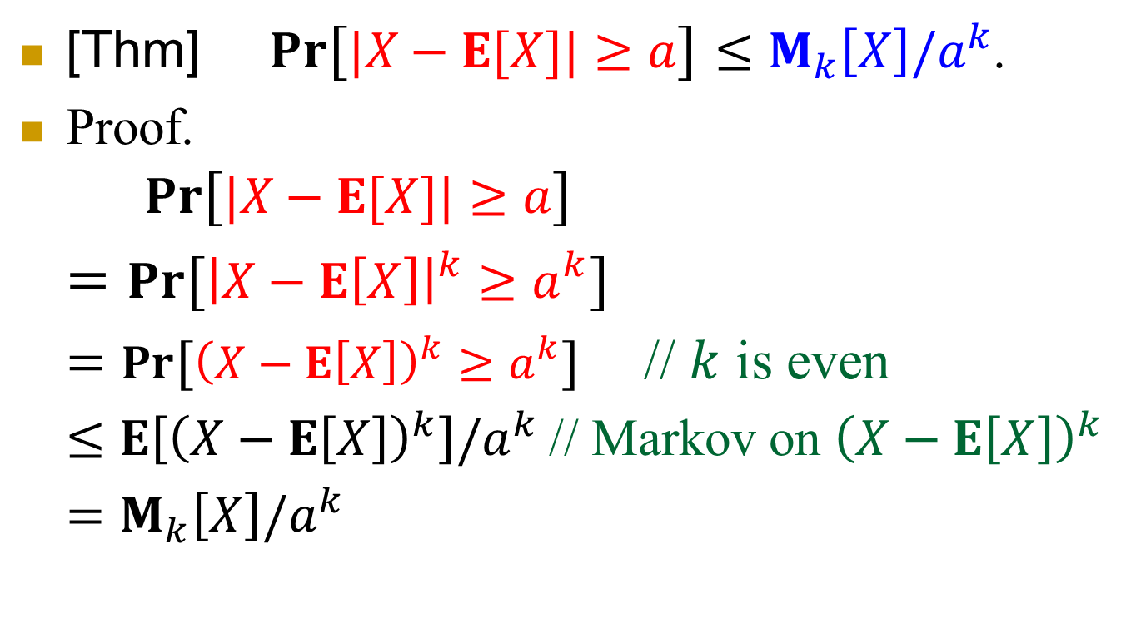
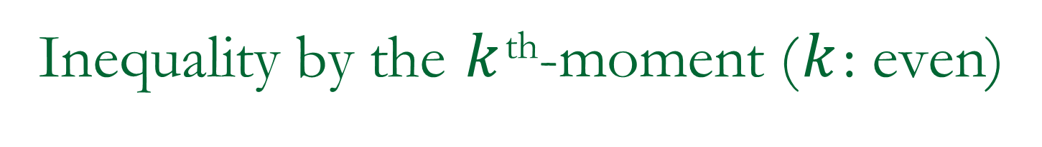
Inequality by the $k$^{th}-moment ($k$: even)
[Thm] $Pr⁡[|X−E[X]|≥a]≤M_{k}\left[X\right]/a^{k}$.
Proof.
$Pr⁡[|X−E[X]|≥a]$
$=Pr⁡[{\left|X−E\left[X\right]\right|}^{k}≥a^{k}]$
$=Pr⁡[{\left(X−E\left[X\right]\right)}^{k}≥a^{k}]$ // $k$ is even
$≤E\left[{\left(X−E\left[X\right]\right)}^{k}\right]/a^{k}$// Markov on ${\left(X−E\left[X\right]\right)}^{k}$
$=M_{k}\left[X\right]/a^{k}$

Slide 36
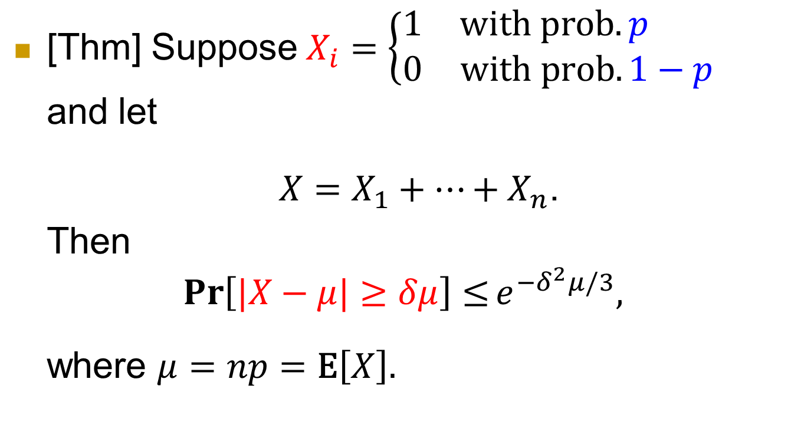
Chernoff’s Bound
[Thm] Suppose$X_{i}=\left\{\begin{matrix}1 & \text{with} \text{prob}. p \\ 0 & \text{with} \text{prob}. 1−p\end{matrix}\right.$
and let
$X=X_{1}+⋯+X_{n}$.
Then
$${\operatorname{Pr}\left[|X−μ|≥δμ\right]≤e}^{−δ^{2}μ/3},$$
where $μ=np=\text{E}\left[X\right].$

Slide 37
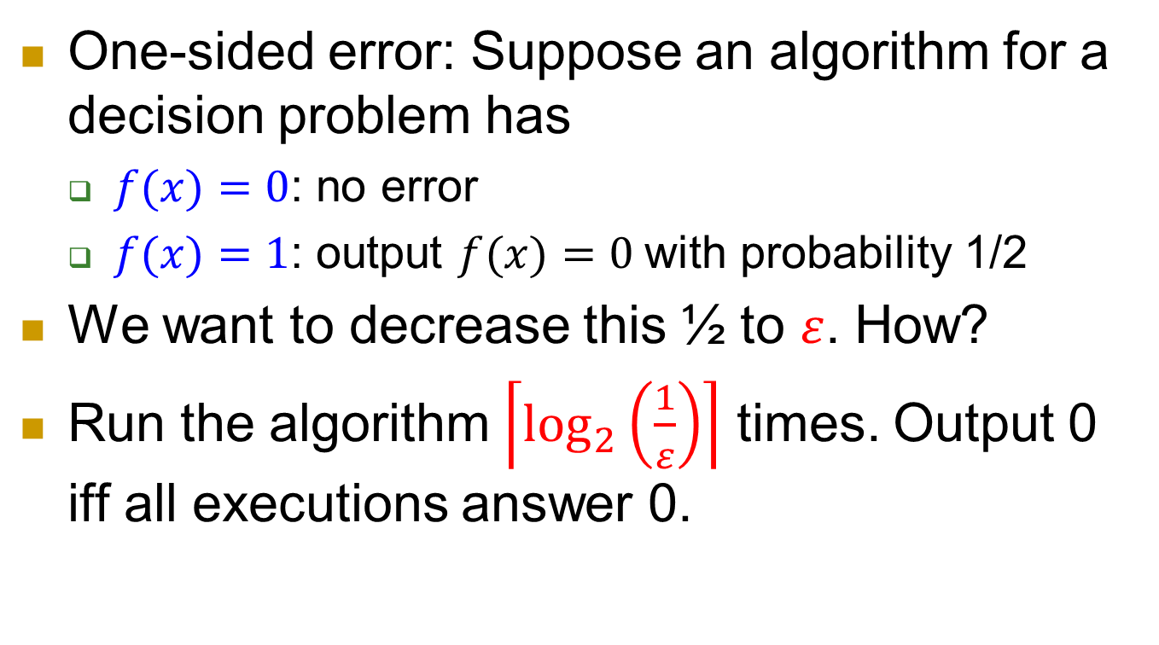
Some basic applications
One-sided error: Suppose an algorithm for a decision problem has
  $f(x)=0$: no error
  $f(x)=1$: output $f(x)=0$with probability 1/2
We want to decrease this ½ to $ε$. How?
Run the algorithm $\left\lceil \log_{2}\left(\frac{1}{ε}\right)\right\rceil$ times. Output 0 iff all executions answer 0.

Slide 38
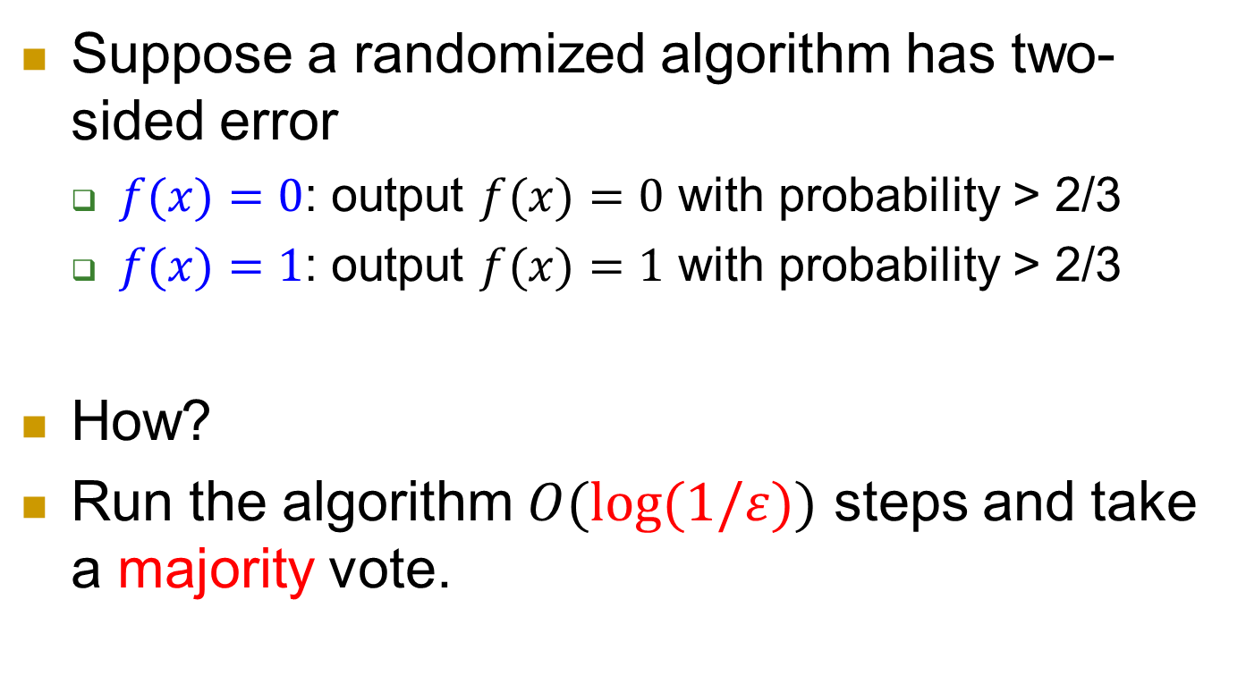
Two-sided error
Suppose a randomized algorithm has two-sided error
  $f(x)=0$: output $f(x)=0$ with probability > 2/3
  $f(x)=1$: output $f(x)=1$ with probability > 2/3
How?
Run the algorithm $O(log⁡(1/ε))$ steps and take a majority vote.

Slide 39
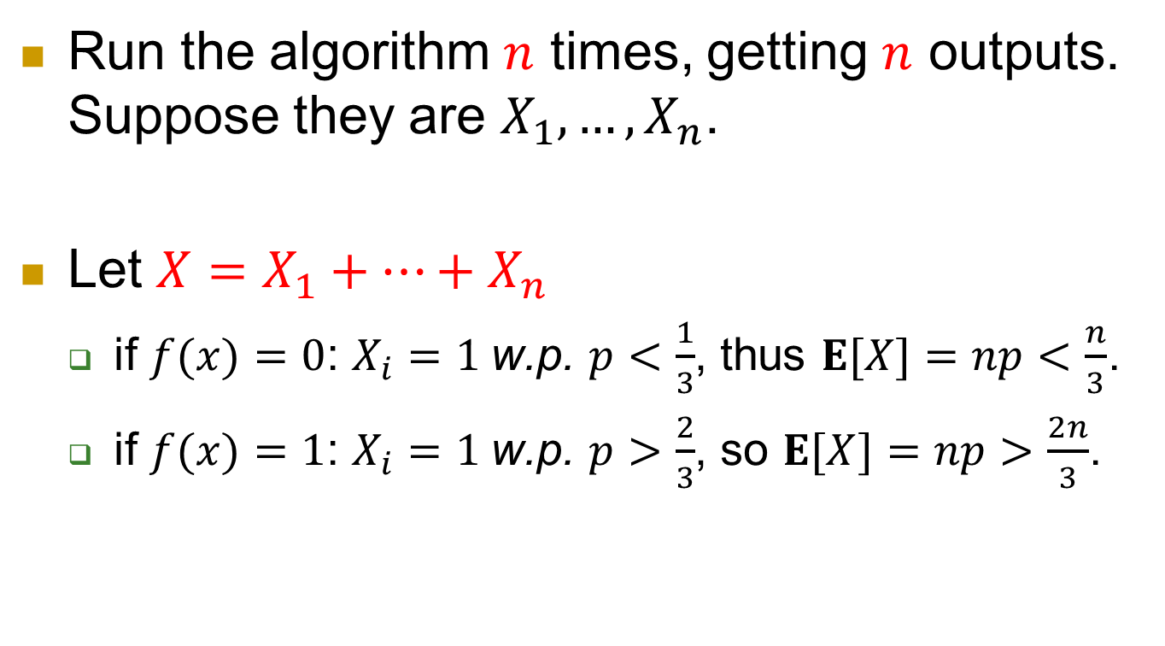
Using Chernoff’s bound
Run the algorithm $n$ times, getting $n$ outputs. Suppose they are $X_{1}, …, X_{n}$.
Let $X=X_{1}+…+X_{n}$
  if $f(x)=0$: $X_{i}=1$w.p. $p<\frac{1}{3}$, thus $E[X]=np<\frac{n}{3}$.
  if $f(x)=1$: $X_{i}=1$w.p. $p>\frac{2}{3}$, so $E[X]=np>\frac{2n}{3}$.

Slide 40
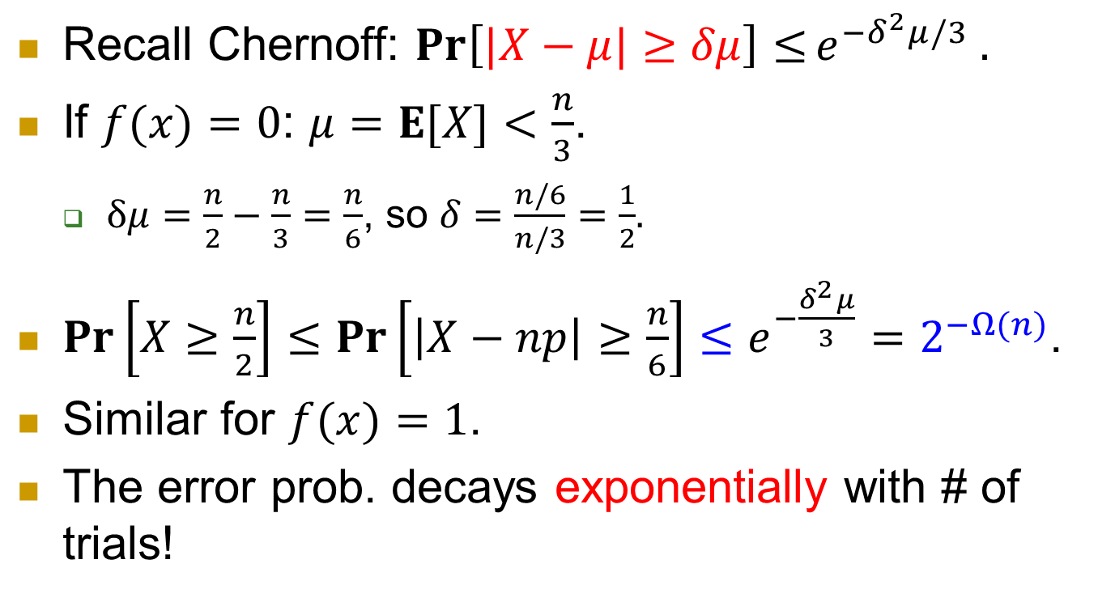
Recall Chernoff: ${\operatorname{Pr}\left[|X−μ|≥δμ\right]≤e}^{−δ^{2}μ/3} .$
If $f(x)=0$: $μ=E[X]<\frac{n}{3}$.
  $δμ=\frac{n}{2}−\frac{n}{3}=\frac{n}{6}$, so $δ=\frac{n/6}{n/3}=\frac{1}{2}$.
$\operatorname{Pr}\left[X≥\frac{n}{2}\right]≤\operatorname{Pr}\left[\left|X−np\right|≥\frac{n}{6}\right]≤e^{−\frac{δ^{2}μ}{3}}=2^{−Ω(n)}$.
Similar for $f(x)=1$.
The error prob. decays exponentially with # of trials!

