Slide 1
CRYPTOGRAPHY WHAT IS IT GOOD FOR?
Andrej Bogdanov
Chinese University of Hong Kong
CMSC 5719 | 6 Feb 2012

Slide 2
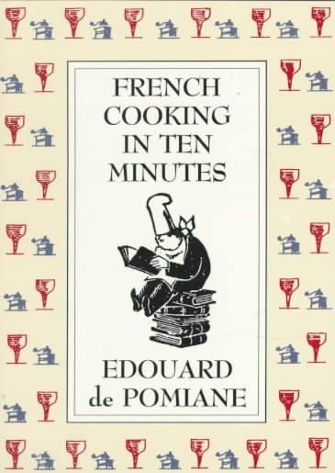
cryptography

Slide 3
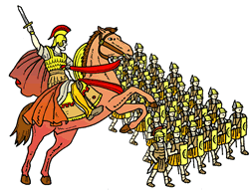
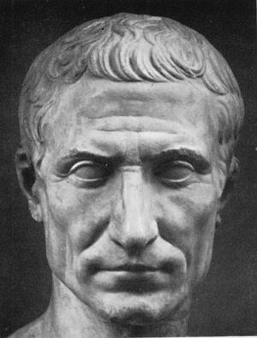
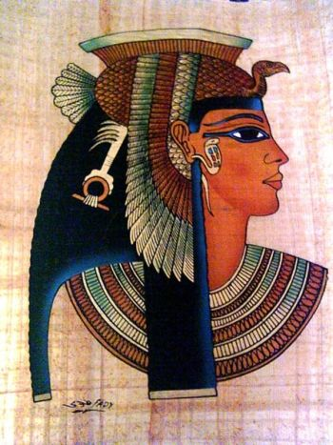
phhw ph dw wjh uxelfrq
I know what he is up to!

Slide 4
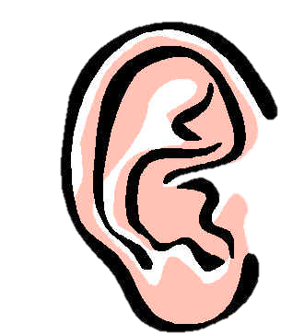
A model for encryption
saopgpwnhx
Alice
nizpfkel3c
Bob
OK!
??!
Eve
Alice and Bob want to exchange messages
but remain private to eavesdroppers

Slide 5
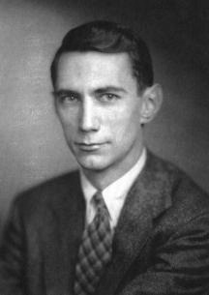
Bad news
saopgpwnhx
Alice
nizpfkel3c
Bob
OK!
??!
Eve
impossible!
Eve can simulate the states of Alice & Bob
and learn everything they know

Slide 6
The one-time pad
Alice
Bob
want to say
10111001
10111001
hello
= 01101001
⊕ 10111001
11010000
Alice and Bob share a secret key
Bob can recover the message,
but to Eve it looks totally random!

Slide 7
Secret-key cryptography
saopgpwnhx
Alice
nizpfkel3c
Bob
OK!
10111001
10111001
Easy if they share
a secret key
… but the key must be as long as all the
messages they will ever exchange!

Slide 8
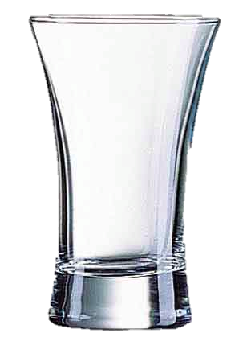
Enter computation
easy
hard
953081
× 603749
easy
hard?
575421700669

Slide 9
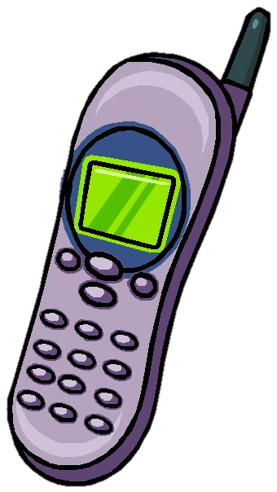
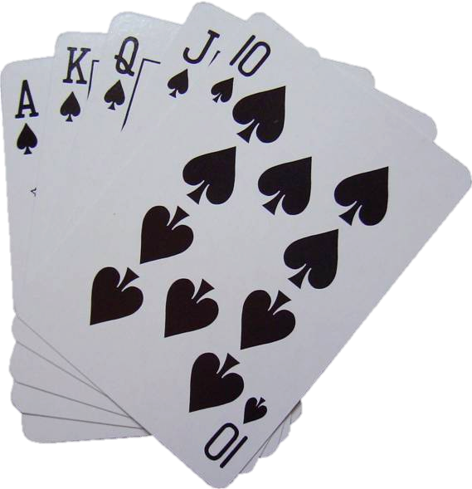
The cryptographic revolution
Assuming there exist digital tasks that are hard to reverse-engineer* we can do
saopgpwnhx
Alice
nizpfkel3c
Bob
OK!
??!
Eve
public key encryption
mental poker
secure multiparty computation
[Diffie-Hellman, Rivest-Shamir-Adleman]
[Yao, Blum, Goldreich-Micali-Wigderson]

Slide 10
The foundations of cryptography
953081
× 603749
Is it really that hard?
575421700669
We can’t say for sure,
but many have tried and failed.

Slide 11
The foundations of cryptography
Cryptography is based on digital tasks that are easy to do forward, but hard to do backwards
We are not 100% sure such tasks exist at all, but there are several viable candidates
953081
0
1
1
0
× 603749
575421700669
0
1
1
1
0
0

Slide 12
Goldreich’s function
0
1
1
0
input bits
very easy
?
1
0
1
1
1
0
0
1
output bits
output = majority(input₁, input₂, input₃)
Input and output are typically large, e.g. 500 bits input,
10,000 bits output

Slide 13
Two measures of hardness
0
1
1
0
1
0
1
1
1
0
0
1
One-wayness: Given an output, can you recover the input that led to it?
Pseudorandomness: Can you distinguish the output from a random string of the same length?

Slide 14
Encryption from pseudorandomness
Alice
Bob
want to say
0110
0110
hello
= 01101001
⊕ 10111001
11010000
0
1
1
0
1
0
1
1
1
0
0
1
To Eve it looks the same as when
Alice and Bob used a one-time pad

Slide 15
Can this be broken?
small local dependencies
allow reverse-engineering
does not look random
Fortunately, most graphs are expanding: they have no local dependencies

Slide 16
Public-key encryption
Alice
Bob
private-key
bla
bla
Alice
Bob
public-key
bla
bla
Alice and Bob can communicate securely,
although they have never met before!

Slide 17
Public-key encryption
Alice
Bob
bla
bla
➊
Bob: generate (Public Key, Secret Key) pair
public key is broadcast, secret key is hidden
➋
Alice: encrypt message using public key
➌
Bob: decrypt using secret key

Slide 18
One-bit encryption
?
Alice
0
Bob
Alice
1
Bob
Eve
one-bit encryption
a simplified setting
A proposed one-bit scheme by Applebaum, Barak, and Wigderson

Slide 19
One-bit encryption
➊
Bob:
generate (Public Key, Secret Key) pair
public key:
the graph G
secret key:
a hidden subgraph with k outputs
connecting to k − 1 inputs
send Public Key to Alice

Slide 20
One-bit encryption
➋
Alice encrypts:
0
1
1
0
to encrypt 0:
XOR (+)
1
0
1
0
0
1
1
1
0
1
to encrypt 1:
XOR (+)
0
1
1
0
1
0
reverse
1
0
0
1
0
1

Slide 21
One-bit encryption
➌
Bob decrypts:
fewer inputs than outputs,
so outputs must satisfy a linear constraint
y₁
y₂
y₃
y₁ + y₂ + y₃ = 0
Enc(0)
1
0
1
0
0
1
y₁ + y₂ + y₃ = 0
Enc(1) = NOT Enc(0)
1
0
0
1
0
1
y₁ + y₂ + y₃ = 1

Slide 22
Security?
Eve cannot tell which is the right linear constraint to check because subgraph is hidden
To argue security, we must make an assumption*
1
0
1
0
0
1
Finding a hidden subgraph in a graph is computationally hard

Slide 23
Insecurity
This assumption is not enough as the message can be recovered by solving linear equations
x₁
x₂
x₃
x₄
indeterminates
1
0
1
0
0
1
x₁ + x₂ = 1
x₁ = 0
x₂ = 1
x₁ + x₂ + x₃ = 0
x₁ + x₂ + x₃ + x₄ = 0
x₁ + x₃ + x₄ = 1
101001 is an
encryption of 0
if
has a solution.

Slide 24
One-bit encryption
➋
Alice encrypts:
0
1
1
0
to encrypt 0:
XOR (+)
1
0
1
0
0
1
add random noise
1
0
1
1
0
0
If the noise stays outside the secret key,
decryption will still work

Slide 25
Security of one-bit encryption?
x₁
x₂
x₃
x₄
x₁ + x₂ = 1
x₁ = 0
x₂ = 1
x₁ + x₂ + x₃ = 1
x₁ + x₂ + x₃ + x₄ = 0
x₁ + x₃ + x₄ = 1
1
0
1
0
0
1
1
0
1
1
0
0
Now some equations are incorrect, so they are unlikely to have a solution

Slide 26
Is public-key cryptography secure?
We never now for sure!
So we make plausible (studied) assumptions
0
1
1
0
1
1
0
1
XOR (+)
XOR (+)
1
0
1
0
0
1
0
1
1
0
1
0
1
0
0
1
0
1
1
0
1
0
1
1
1
0
0
0
0
0
Enc(0)
is indistinguishable from
Enc(1)

Slide 27
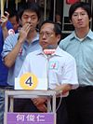
Elections
✗
Alice
✗
Bob
✓
Eve
24%
11%
35%

Slide 28
Elections
Elections should be free and fair
integrity
Every vote cast should be counted
properly
anonymity
People cannot find out who you
voted for
… other features?

Slide 29
Electronic voting
How to run elections online?
Solution using public key cryptography:
✗
Alice
0
Enc_{Public} _{Key}(0)
✗
Bob
0
Enc_{Public} _{Key}(0)
✓
Eve
1
Enc_{Public} _{Key}(1)

Slide 30
Anonymity
assumptions
The Public Key is known to everyone
The Secret Key is kept secret (by the trustworthy electoral commission)
voter
votes for
Alice
Enc_{Public} _{Key}(0)
Enc_{Public} _{Key}(0)
Enc_{Public} _{Key}(0)
Bob
Enc_{Public} _{Key}(0)
Enc_{Public} _{Key}(0)
Enc_{Public} _{Key}(1)
Eve
Enc_{Public} _{Key}(1)
Enc_{Public} _{Key}(1)
Enc_{Public} _{Key}(0)

Slide 31
Anonymity
voter
votes for
Alice
Enc_{Public} _{Key}(0)
Enc_{Public} _{Key}(0)
Enc_{Public} _{Key}(0)
Bob
Enc_{Public} _{Key}(0)
Enc_{Public} _{Key}(0)
Enc_{Public} _{Key}(1)
Eve
Enc_{Public} _{Key}(1)
Enc_{Public} _{Key}(1)
Enc_{Public} _{Key}(0)
If Enc is secure, this collection of votes
looks indistinguishable from e.g.
Alice
Enc_{Public} _{Key}(0)
Enc_{Public} _{Key}(1)
Enc_{Public} _{Key}(0)
Bob
Enc_{Public} _{Key}(1)
Enc_{Public} _{Key}(0)
Enc_{Public} _{Key}(1)
Eve
Enc_{Public} _{Key}(0)
Enc_{Public} _{Key}(0)
Enc_{Public} _{Key}(0)

Slide 32
Counting the votes
votes for Bob
Enc_{Public} _{Key}(1)
Enc_{Public} _{Key}(0)
Enc_{Public} _{Key}(1)
If we reveal the individual votes to the commission,
anonymity will be violated
votes for Bob
Enc_{Public} _{Key}(0)
Enc_{Public} _{Key}(1)
Enc_{Public} _{Key}(1)
solution 1: mixnet
randomly permute the votes

Slide 33
Counting the votes
Enc_{Public} _{Key}(1)
+
Enc_{Public} _{Key}(0)
+
Enc_{Public} _{Key}(1)
=
Enc_{Public} _{Key}(1+0+1)
=
Enc_{Public} _{Key}(2)
solution 2: additively homomorphic encryption
The encryption we described is additively homomorphic* mod 2 (homework)
If we work with larger numbers instead of bits, we can make it additively homomorphic over integers

Slide 34
Some other issues
How do we prevent a person from voting for several candidates or voting multiple times?
✗
Alice
0
Enc_{Public} _{Key}(0)
✓
✓
Bob
2
Enc_{Public} _{Key}(2)
✓
Eve
1
Enc_{Public} _{Key}(1)
In a mixnet, we may detect and invalidate such patterns
With homomorphic encryption, the voter needs to prove that
his votes are valid (but without revealing the votes)
there is a cryptographic technology called zero-knowledge

Slide 35
Some other issues
In a real election, I cannot prove who I voted for
✗
Alice
✗
Bob
✓
Eve
this prevents coercing votes.
What happens in electronic voting?

Slide 36
Electronic voting
In applications like electronic voting, even understanding the requirements is not easy
We start with an ideal list of requirements and see if they can be implemented using cryptography
Sometimes we succeed; other times we can prove that all the requirements are impossible to meet

