Slide 1
Game theory in computer science
Shengyu Zhang
The Chinese University of Hong Kong

Slide 2
Map
Intro to strategic-form games
Two forms
Examples
NE and CE
Algorithmic questions in games
Hardness of finding an NE and CE
Congestion games
Game theory applied to computer science

Slide 3
Part I. strategic-form games

Slide 4
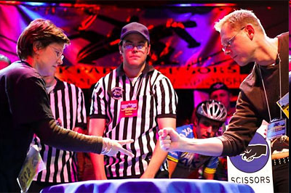
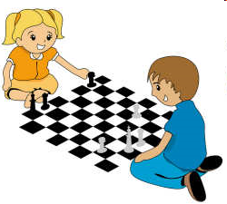
Game: Two basic forms
strategic (normal) form
extensive form

Slide 5
First example: Prisoner’s dilemma
Two prisoners are on trial for a crime, each can either confess or remain silent.
If both silent: both serve 2 years.
If only one confesses: he serves 1 year and the other serves 5 years.
If both confess: both serve 4 years.
What would you do if you are Prisoner Blue? Red?
 | Confess | Silent
Confess | 4 4 | 5 1
Silent | 1 5 | 2 2

Slide 6
Example 1: Prisoners’ dilemma
By a case-by-case analysis, we found that both Prisoners would confess, regardless of what the other chooses.
Embarrassingly, they could have both chosen “Silent” to serve less years.
But people are selfish: They only care about their own payoff.
Resulting a dilemma: You pay two more years for being selfish.
 | Confess | Silent
Confess | 4 4 | 5 1
Silent | 1 5 | 2 2

Slide 7
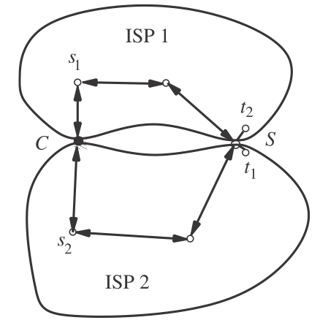
Example 2: ISP routing game
 | C | S
C | 4 4 | 5 1
S | 1 5 | 2 2
Two ISPs.
The two networks can exchange traffic via points C and S.
Two flows from s_{i} to t_{i}.
Each edge costs 1.
Each ISP has choice to going via C or S.

Slide 8
Example 3: Pollution game
N countries
Each country faces the choice of either controlling pollution or not.
Pollution control costs 3 for each country.
Each country that pollutes adds 1 to the cost of all countries.
What would you do if you are one of those countries?
Suppose k countries don’t control.
For them: cost = k
For others: cost = 3+k
So all countries don’t control!

Slide 9
Example 4: Battle of the sexes
A boy and a girl want to decide whether to go to watch a baseball or a softball game.
The boy prefers baseball and the girl prefers softball.
But they both like to spend the time together rather than separately.
What would you do?
 | B | S
B | 6 5 | 1 1
S | 2 2 | 5 6

Slide 10
Formal definition
In all previous games:
There are a number of players
Each has a set of strategies to choose from
Each aims to maximize his/her payoff, or minimize his/her loss.
Formally,
n-players.
Each player i has a set S_{i} of strategies.
Let S = S₁ × ⋯ × S_{n}. A joint strategy is an s = s₁…s_{n}.
Each player i has a payoff function u_{i}(s) depending on a joint strategy s.

Slide 11
A notion of being stable: equilibrium
Some combination of strategies is stable: No player wants to change his/her current strategy, provided that others don’t change. --- Nash Equilibrium.
(Pure) Nash Equilibrium: A joint strategy s s.t. u_{i}(s) ≥ u_{i}(s_{i}’s_{-i}), ∀i.
In other words, s_{i} achieves max_{s_i’}u_{i}(s_{i}’s_{-i})

Slide 12
Prisoners’ dilemma
ISP routing
 | Confess | Silent
Confess | 4 4 | 5 1
Silent | 1 5 | 2 2

Slide 13
Prisoners’ dilemma
ISP routing
Pollution game: All countries don’t control the pollution.
Battle of sexes: both are stable.
 | B | S
B | 6 5 | 1 1
S | 2 2 | 5 6

Slide 14
Example 5: Penny matching.
Two players, each can exhibit one bit.
If the two bits match, then red player wins and gets payoff 1.
Otherwise, the blue player wins and get payoff 1.
Find a pure NE?
Conclusion: There may not exist Nash Equilibrium in a game.
 | 0 | 1
0 | 1 0 | 0 1
1 | 0 1 | 1 0

Slide 15
Mixed strategies
Consider the case that players pick their strategies randomly.
Player i picks s_{i} according to a distribution p_{i}.
Let p = p₁ × ⋯ × p_{n}.
s←p: draw s from p.
Care about: the expected payoff E_{s←p}[u_{i}(s)]
Mixed Nash Equilibrium: A distribution p s.t. E_{s←p}[u_{i}(s)] ≥ E_{s←p’}[u_{i}(s)], ∀ p’ different from p only at p_{i} (and same at other distributions p_{-i}).

Slide 16
Existence of mixed NE: Penny Matching
A mixed NE: Both players take uniform distribution.
What’s the expected payoff for each player?
½.
 | 0 | 1
0 | 1 0 | 0 1
1 | 0 1 | 1 0

Slide 17
Existence of mixed NE
Nash, 1951: All games (with finite players and finite strategies for each player) have mixed NE.

Slide 18
3 strategies
How about Rock-Paper-Scissors?
Winner gets payoff 1 and loser gets -1.
Both get 0 in case of tie.
Write down the payoff matrices?
Does it have a pure NE?
Find a mixed NE.

Slide 19
Example 6: Traffic light
Two cars are at an interaction at the same time.
If both cross, then a bad traffic accident. So -100 payoff for each.
If only one crosses, (s)he gets payoff 1; the other gets 0.
If both stop, both get 0.
 | Cross | Stop
Cross | -100 -100 | 0 1
Stop | 1 0 | 0 0

Slide 20
Example 6: Traffic light
2 pure NE: one crosses and one stops.
Good: Payoff (0,1) or (1,0)
Bad: not fair
1 (more) mixed NE: both cross w.p. 1/101.
Good: Fair
Bad: Low payoff: ≃0.0001
Worse: Positive chance of crash
Stop light: randomly pick one and suggest to cross, the other one to stop.
 | Cross | Stop
Cross | -100 -100 | 0 1
Stop | 1 0 | 0 0

Slide 21
Correlated Equilibrium
Recall that a mixed NE is a probability distribution p = p₁ × ⋯ × p_{n}.
A general distribution may not be decomposed into such product form.
A general distribution p on S is a correlated equilibrium (CE) if for any given s drawn from p, each player i won’t change strategy based on his/her information s_{i}.

Slide 22
Correlated Equilibrium
You can think of it as an extra party samples s from p and recommend player i take strategy s_{i}. Then player i doesn’t want to change s_{i} to any other s_{i}’.
Formal: E_{s←p}[u_{i}(s)|s_{i}] ≥ E_{s←p}[u_{i}(s_{i}’s_{-i})|s_{i}],∀i,s_{i},s_{i}’
Conditional expectation
Or equivalently, ∑_{s_{-i}}p(s)u_{i}(s) ≥ ∑_{s_{-i}}p(s)u_{i}(s_{i}’s_{-i}), ∀ i, s_{i}, s_{i}’.

Slide 23
Summary
n players: P₁, …, P_{n}
P_{i} has a set S_{i} of strategies
P_{i} has a utility function u_{i}: S→ℝ
S = S₁ × S₂ × ⋯ × S_{n}
strategic (normal) form

Slide 24
Nash equilibrium
Pure Nash equilibrium: a joint strategy s = (s₁, …, s_{n}) s.t. ∀i, u_{i}(s_{i},s_{-i}) ≥ u_{i}(s_{i}’,s_{-i})
(Mixed) Nash equilibrium (NE): a product distribution p = p₁ × … × p_{n} s.t. ∀i, ∀ s_{i} with p_{i}(s_{i})>0, ∀s_{i}’ E_{s←p}[u_{i}(s_{i},s_{-i})] ≥ E_{s←p}[u_{i}(s_{i}’,s_{-i})]
Correlated equilibrium (CE): a joint distribution p s.t. ∀i, ∀ s_{i} with p_{i}(s_{i})>0, ∀s_{i}’ E_{s←p}[u_{i}(s)|s_{i}] ≥ E_{s←p}[u_{i}(s_{i}’s_{-i})|s_{i}]

Slide 25
Part II. Algorithmic questions in games

Slide 26
Complexity of finding a NE and CE

Slide 27
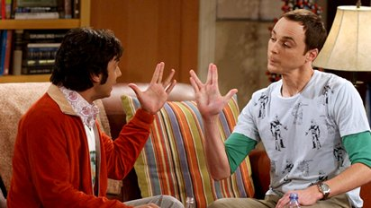
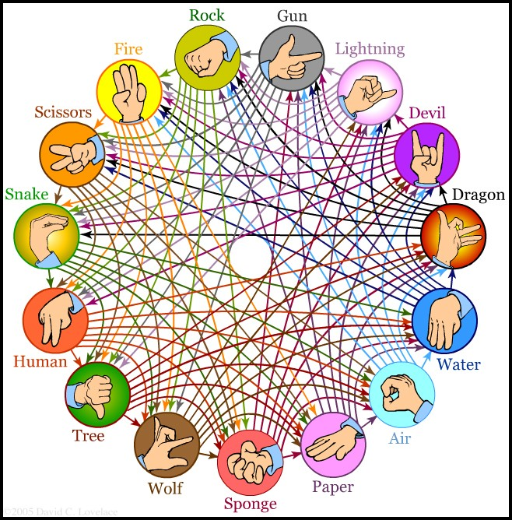
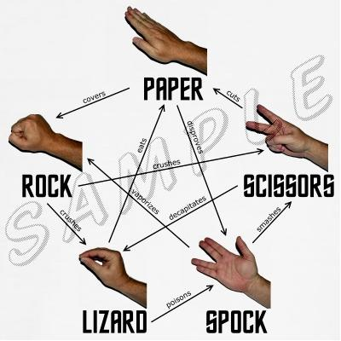
Why algorithmic issues?
What if we have a large number of strategies?
Or large number of players?

Slide 28
Complexity of finding a NE and CE
Given the utility functions, how hard is it to find one NE?
No polynomial time algorithm is known to find a NE.
But, there is polynomial-time algorithms for finding a correlated equilibrium.

Slide 29
{p(s): s∊S} are unknowns.
Constraints: ∀ i, s_{i}, s_{i}’, ∑_{s_{-i}}p(s)u_{i}(s) ≥ ∑_{s_{-i}}p(s)u_{i}(s_{i}’s_{-i})
Note that each u_{i}(s) is given.
Thus all constraints are linear!
So we just want to find a feasible solution to a set of linear constraints.
We’ve known how to do it by linear programming.

Slide 30
We can actually find a solution to maximize a linear function of p(s)’s, such as the expected total payoff.
Max ∑_{i} ∑_{s} p(s)u_{i}(s)
s.t. ∑_{s_{-i}}p(s)u_{i}(s) ≥ ∑_{s_{-i}}p(s)u_{i}(s_{i}’s_{-i}), ∀ i, s_{i}, s_{i}’.

Slide 31
Congestion games

Slide 32
Pigou’s example
1 unit of flow go from s to t
k players, each has 1/k amount of flow
Strategies for each player: 2 paths
Best cost?
Suppose m uses the lower path:
Total cost: m·(1/k)·(m/k) + (k-m)·(1/k) = (m/k)²-(m/k)+1 ≥ ¾. (“=” iff m=k/2)
Equilibrium: all players use the lower. Total cost = 1.
c(x) = 1
s
t
c(x) = x

Slide 33
Price of Anarchy
So the m players have total cost 1, while they could have ¾.
Punishment of selfish routings.
Price of Anarchy:
cost of a worst equilibrium
minimal total cost
In the above example: 1 / ¾ = 4/3.
c(x) = 1
s
t
c(x) = x

Slide 34
Braess’s Paradox
c(x) = x
v
c(x) = 1
c(x) = x
v
c(x) = 1
s
t
s
c=0
t
c(x) = 1
w
c(x) = x
c(x) = 1
w
c(x) = x
1 unit of flow.
Suppose p-fraction uses the upper path.
Total cost: p(p+1)+(1-p)(1+(1-p)) ≥ 3/2.
“=” iff p=1/2.
p = ½ is also the unique equilibrium.
PoA = 1.
1 unit of flow.
We can ignore the new added edge and
But now selfish routing would all take the path
s→v→w→t.
Total cost: 1.
PoA = 4/3.

Slide 35
Braess’s Paradox
c(x) = x
v
c(x) = 1
c(x) = x
v
c(x) = 1
s
t
s
c=0
t
c(x) = 1
w
c(x) = x
c(x) = 1
w
c(x) = x
1 unit of flow.
equilibrium = global opt
PoA = 1.
1 unit of flow.
equilibrium = 4/3 global opt
PoA = 4/3.
Adding one more edge (which is also free) causes more congestion!

Slide 36
General setting
A directed graph G = (V,E).
Commodities (s₁,t₁), …, (s_{k},t_{k}).
A feasible solution: a flow f = ∑_{i}f_{i}, where f_{i} routes r_{i}-amount of commodity i from s_{i} to t_{i}.
Cost:
Edge: cost function c_{e}(f(e)).
Total cost: ∑_{e}c_{e}(f(e))

Slide 37
Game side
Think of each data as being decomposed into small pieces, and each piece routes itself selfishly.
Equilibrium: ∀i, ∀paths P and P’ from s_{i} to t_{i} with f_{i}(P)>0, ∑_{e∈P} c_{e}(f(e)) ≤ ∑_{e∈P’} c_{e}(f(e)).
If not, a small piece can shift from P to P’, getting smaller cost.

Slide 38
Largest PoA
[Thm] At least one equilibrium exists.
[Thm] All equilibrium flows have the same cost.
[Thm] For any instance, (∀G,{s_{i},t_{i};r_{i}},c) Price of Anarchy ≤ 4/3.
So the previous example is optimal.

Slide 39
Part III. Game theory applied to computer science

Slide 40
Zero-sum game
Two players: Row and Column
Payoff matrix
(i,j): Row pays to Column when Row takes strategy i and Column takes strategy j
Row wants to minimize; Column wants to maximize.
 | 0 | 1 | -1
 | -1 | 0 | 1
 | 1 | -1 | 0

Slide 41
Minimax theorem
 | 0 | 1 | -1
 | -1 | 0 | 1
 | 1 | -1 | 0
$\min_{x}{\max_{y}{f(x,y)}}≥\max_{y}{\min_{x}{f(x,y)}}$
Game interpretation.
If the players use mixed strategies:
$\min_{p}{\max_{y}{\underset{x←p}{E}{[f(x,y)]}}}=\max_{q}{\min_{x}{\underset{y←q}{E}{[f(x,y)]}}}$

Slide 42
Query (decision tree) models
f(x₁,x₂,x₃)=x₁∧(x₂∨x₃)
Task: compute f(x)
The input x can be accessed by querying x_{i}’s
We only care about the number of queries made
Query (decision tree) complexity D(f): min # queries needed.
x₁ = ?
0
1
f(x₁,x₂,x₃)=0
x₂ = ?
0
1
x₃ = ?
f(x₁,x₂,x₃)=1
0
1
f(x₁,x₂,x₃)=0
f(x₁,x₂,x₃)=1

Slide 43
Randomized/Quantum query models
Randomized query model:
We can toss a coin to decide the next query.
R(f): randomized query complexity.
While D(f) is relatively easy to lower bound, R(f) is much harder.
Yao: Let algorithms and adversaries play a game!

Slide 44
Minimax on algorithms
inputs
Row: algorithms. Column: inputs.
f(x,y): # queries
Recall: $\min_{p}{\max_{y}{\underset{x←p}{E}{[f(x,y)]}}}=\max_{q}{\min_{x}{\underset{y←q}{E}{[f(x,y)]}}}$
i.e. $\min_{\begin{aligned}rand. \\ alg. A\end{aligned}}{\max_{input y}{\underset{\begin{aligned}A^{′}s \\ rand.\end{aligned}}{E}{[\# queries of A on y]}}}$
$$=\max_{\begin{aligned}input \\ distri. q\end{aligned}}{\min_{\begin{aligned}deter. \\ alg B\end{aligned}}{\underset{y←q}{E}{[\# queries of B on y]}}}$$
algorithms

Slide 45
Recipe
So to show a lower bound on R(f), it’s enough to
define an input distribution q, and
argue that any deterministic algorithm needs many queries on a random input y←q.
Example: OR_{n}.
q: e_{i} with prob. 1/n.
Any deter. alg. detect the unique 1 using n/2 queries on average.
This shows a n/2 lower bound on R(OR_{n}).

Slide 46
Thanks

