Slide 1
An Introduction to Bioinformatics and its application in Protein-DNA/Protein Interactions Research and Drug Discovery
CMSC5719
Dr. Leung, Kwong Sak
Professor of Computer Science and Engineering
Mar 26, 2012

Slide 2
Outline
I. Introduction to Bioinformatics
II. Protein-DNA Interactions
III. Drug Discovery
IV. Discussion and Conclusion

Slide 3
I. Introduction to Bioinformatics
Bioinformatics
Research Areas
Biological Basics

Slide 4
Introduction
Bioinformatics
More and more crucial in life sciences and biomedical applications for analysis and new discoveries
Huge noisy data
Curated and well-organized
Costly annotations
Bioinformatics
Effective and efficient analysis
Individual & specific
Bridging
Generalized knowledge
Biology
Informatics
(e.g. Computer Science)

Slide 5
Bioinformatics Research Areas
Many (crossing) areas:
(Genome-scale) Sequence Analysis
Sequence alignments, motif discovery, genome-wide association (to study diseases such as cancers)
Computational Evolutionary Biology
Phylogenetics, evolution modeling
Analysis of Gene Regulation
Gene expression analysis, alternative splicing, protein-DNA interactions, gene regulatory networks
Structural Biology
Drug discovery, protein folding, protein-protein interactions
Synthetic Biology
High throughput Imaging Analysis
…
Notes:
Phylogenetics : evolutionary relatedness amongst groups organisms;

Slide 6
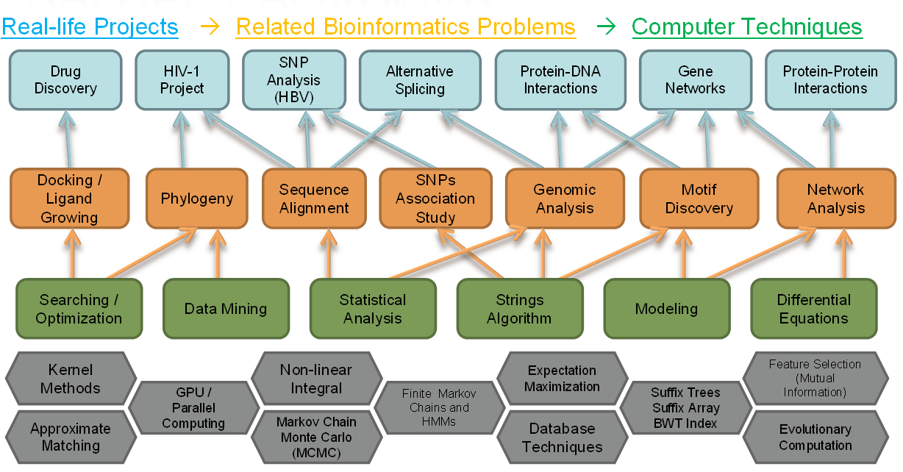
Our Research Roadmap
Notes:
Single nucleotide polymorphism;

Slide 7
Genome-wide Association
Human DNA sequences
!
Normal
Targets: SNPs that are associated with genetic diseases; Diagnosis and healthcare for high-risk patent
Methods: Feature selection; mutual information; non-linear integrals; Support Vector Machine (SVM);
…
Disease!
SNPs (single nucleotide polymorphism; >5% variations)
KS Leung, KH Lee, (JF Wang), (Eddie YT Ng), Henry LY Chan, Stephen KW Tsui, Tony SK Mok, Chi-Hang Tse, Joseph JY Sung, “Data Mining on DNA Sequences of Hepatitis B Virus”. IEEE/ACM Transactions on Computational Biology and Bioinformatics. 2011

Slide 8
HBV Project (Example)
Feature Selection
HBV sequences
Hepatitis B (Hep B)
→Normal
Non-linear Integral
(Problem Modeling)
…
Hep B → Cancer!
Optimization and
Classification
?
?
?
SNPs are not known and to be discovered by alignments
Explicit Diagnosis Rules
(if sites XX & YY are A & T, then …)

Slide 9
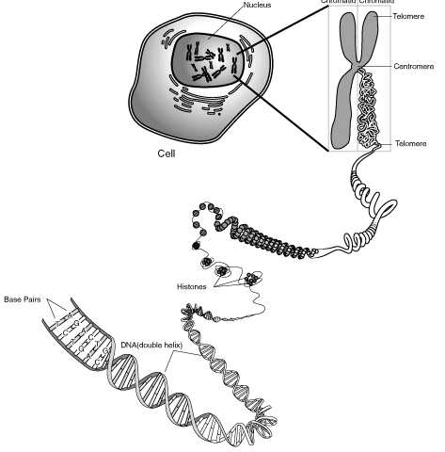
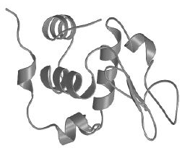
Biological Basics
A string of amino acids
Chromosome
Genome
Cell
Other functions:
Protein-protein
Protein-ligand
Gene
RNA
Protein
Transcription
Translation
Base Pairs
A-T
C-G
Regulatory functions
DNA
Sequence
5’...AGACTGCGGA...3’
...AGACTGCGGA...
3’...TCTGACGCCT...5’
A string with alphabet
http://www.jeffdonofrio.net/DNA/DNA%20graphics/chromosome.gif
http://upload.wikimedia.org/wikipedia/commons/7/7a/Protein_conformation.jpg

Slide 10
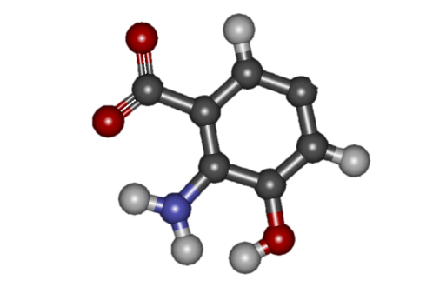
Protein-ligand Interactions
Protein structures
Computational power
Simulation over wet lab
Drug Discovery
Protein-ligand Interactions
Other functions:
Protein-protein
Protein
Detailed in III. drug discovery

Slide 11
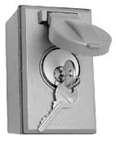
Transcriptional Regulation
Binding for Transcriptional Regulation
Transcription Factor (TF):
TF Binding Site (TFBS):
Transcription rate (gene expression):
the protein as the key
the DNA segment as the key switch
the production rate
Protein
Transcription Factor
(TF)
Translation
Transcription
RNA
DNA
Sequence
Gene
TATAAA
TFBS
ATGCTGCAACTG…
The binding domain (core) of TF
Detailed in II. protein-DNA interactions

Slide 12
II. Protein-DNA Interactions
Introduction
Approximate TF-TFBS rule discovery
Results and Analysis
Discussion
Tak-Ming Chan, Ka-Chun Wong, Kin-Hong Lee, Man-Hon Wong, Chi-Kong Lau, Stephen Kwok-Wing Tsui, Kwong-Sak Leung, Discovering Approximate Associated Sequence Patterns for Protein-DNA Interactions. Bioinformatics, 2011, 27(4), pp. 471-478
12

Slide 13
Introduction
3D: limited, expensive
Sequences: widely available
We focus on TF-TFBS bindings which are primary protein-DNA interactions
Discover TF-TFBS binding relationship to understand gene regulation
Experimental data: 3D structures of TF-TFBS bindings are limited and expensive (Protein Data Bank PDB); TF-TFBS binding sequences are widely available (Transfac DB)
Further bioengineering or biomedical applications to manipulate or predict TFBS and/or TF (esp. cancer targets) given either side
Existing Methods
Motif discovery: either on protein (TF) or DNA (TFBS) side. No linkage for direct TF-TFBS relationship
One-one binding codes: R-A, E-C, K-G, Y-T? No universal codes!
Machine learning: training limitation (limited 3D data) and not trivial to interpret or apply

Slide 14
Conservation
TFBSs, Genes → merely A,C,G,Ts;
The binding domains of TFs → merely amino acids (AAs)
What distinguish them from the others?
Functional sequences are less likely to change through evolution
Association rule mining
Exploit the overrepresented and conserved sequence patterns (motifs) from large-scale protein-DNA interactions (TF-TFBS bindings) sequence data
Biological mutations and experimental noises exist!—Approximate rules
Conservation
→ similar Patterns across genes/species
→ Bioinformatics!
Notes:
Overrepresentation: frequency more than random (expectation as the background);

Slide 15
Motivations
Problem Introduction
Input: given a set of TF-TFBS binding sequences (TF: hundreds of AAs; TFBS: tens of bps depending on experiment resolution), discover the associated patterns of width w (potential interaction cores within binding distance)
Associated TF-TFBS binding sequence patterns (TF-TFBS rules)
—given binding sequence data (Transfac) ONLY, predict short TF-TFBS pairs verifiable in real 3D structures of protein-DNA interactions (PDB)!
Previous method: exact Association Rule Mining based on exact counts (supports)
Prohibited for sequence variations common in reality
Simple counts can happen by chance (no elaborate modeling)
Motivations: Approximation is critical!
Small errors should be allowed!
Model “overrepresented” biologically (probabilistic model VS counts/supports)!
Kwong-Sak Leung, Ka-ChunWong, Tak-Ming Chan, Man-Hon Wong, Kin-Hong Lee, Chi-Kong Lau, Stephen Kwok-Wing Tsui, Discovering Protein-DNA Binding Sequence Patterns Using Association Rule Mining. Nucleic Acids Research. 2010, 38(19), pp. 6324-6337

Slide 16
Overall Methodology
A progressive approach:
Use the available TFBS motifs C from Transfac DB—already approximate with ambiguity code representation—TFBS side done!
Group TF sequences with different motif C similarity thresholds TY=0.0, 0.1, 0.3
Approximate TF Core Motif Discovery for T (instance set {t_{i,j}}) give W and E—TF side done
Customized Algorithm
Associating T ({t_{i,j}}) with C
Notes:
TFBS: consensus from TRANSFAC (existing data); TF list corresponds to the same or similar TFBS consensus grouping; Then TF list => core motif discovery

Slide 17
TF Side: Core TF Motif Discovery
The customized algorithm
Input: width W and (substitution) error E, TF Sequences S
Find W-patterns (at least 1 hydrophilic amino acid) and their E approximate matches
Iteratively find the optimal match set {t_{i,j}} based on the Bayesian scoring function f for motif discovery:
Top K=10 motifs are output, each with its instance set {t_{i,j}}
17
Notes:
First part of eqn: conservation; 2nd part is overrepresentation (reflect the frequency of the pattern);

Slide 18
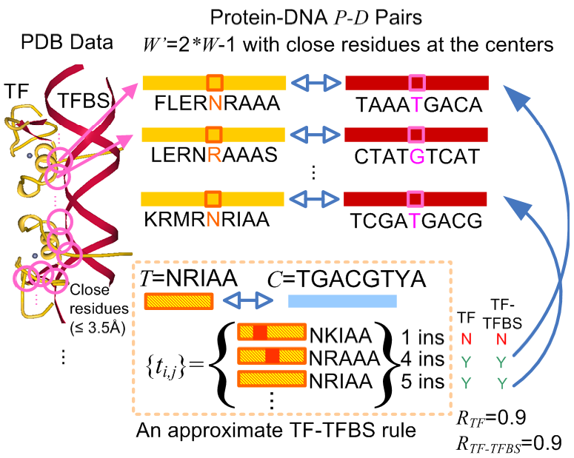
Results and Analysis
Verification
on Protein Data Bank
(PDB)
Check the approximate TF-TFBS rules T({t_{i,j}})-C
Approximate appearance in binding pairs from PDB 3D structure data : width W bounded by E
TF side (R_{TF}): instance oriented—{t_{i,j}} evaluated
TFBS side (R_{TF-TFBS}): pattern oriented—C evaluated
Most representative database of experimentally determined protein-DNA 3D structure data
* expensive and time consuming
* most accurate evidence for verification
[0,1] higher the better
18
Notes:
R: verification ratio (0 - 1.0);

Slide 19
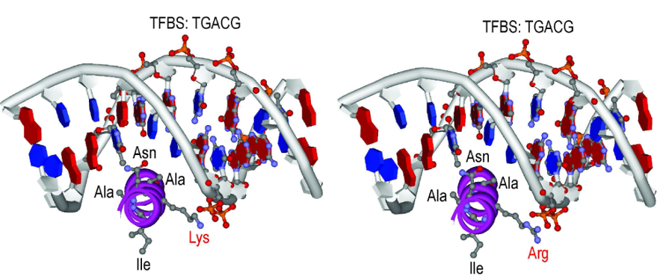
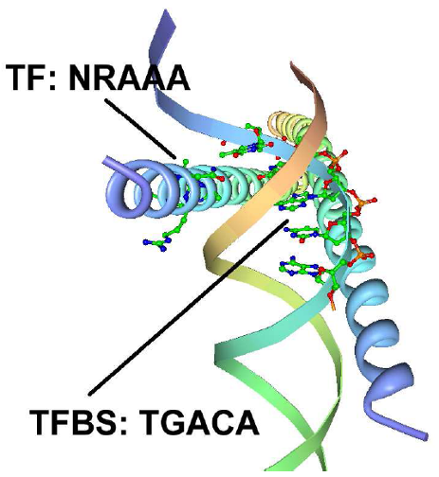
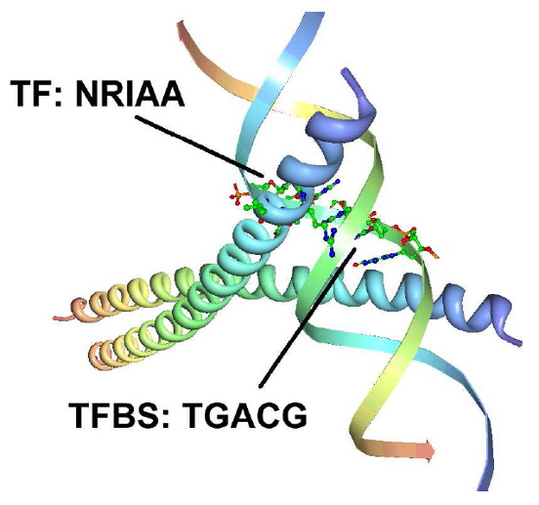
Biological verification
Recall the challenge
Given sequence datasets of tens of TF sequences, each hundreds of AA in length, grouped by TFBS consensus C (5~20bp),
Predict W(=5,6) substrings ({t_{i,j}}) associated with C
NRIAA
NKIAA
Which can be verified in actual 3D TF-TFBS binding structures as well as homology modeling (by bio experts)!
PDB Verified examples in Rule NRIAA(NKIAA; NRAAA; NREAA; NRIAA)-TGACGTYA

Slide 20
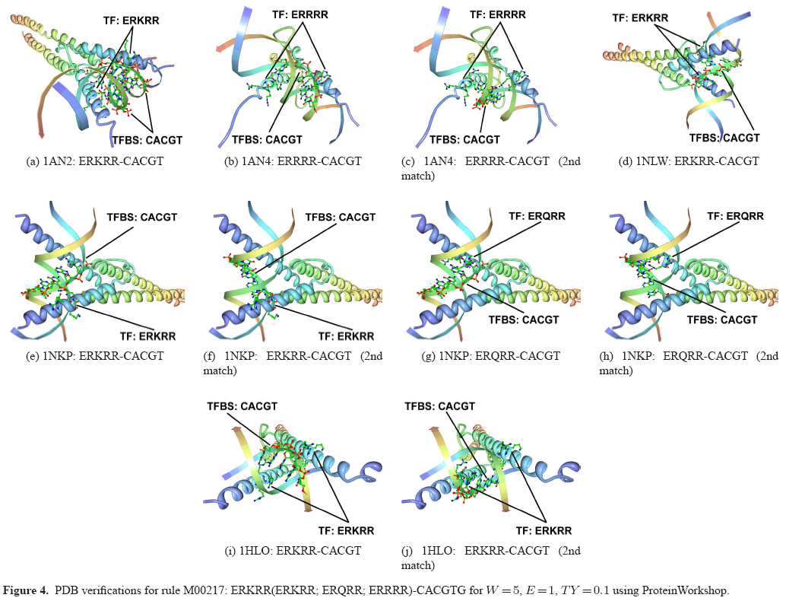
Results and Analysis
One more verified example
1NKP:
M00217: ERKRR(ERKRR; ERQRR; ERRRR)-CACGTG
20
Notes:
From PDB;

Slide 21
Results and Analysis
Quantitative Comparisons with Exact Rules
More informative (verified) rules (110 VS 76 W=5; 88 VS 6 W=6)
Improvement on exact ones (AVG R* 29%, 46% W=5)
21
Notes:
R: verifiable rules ratio;

Slide 22
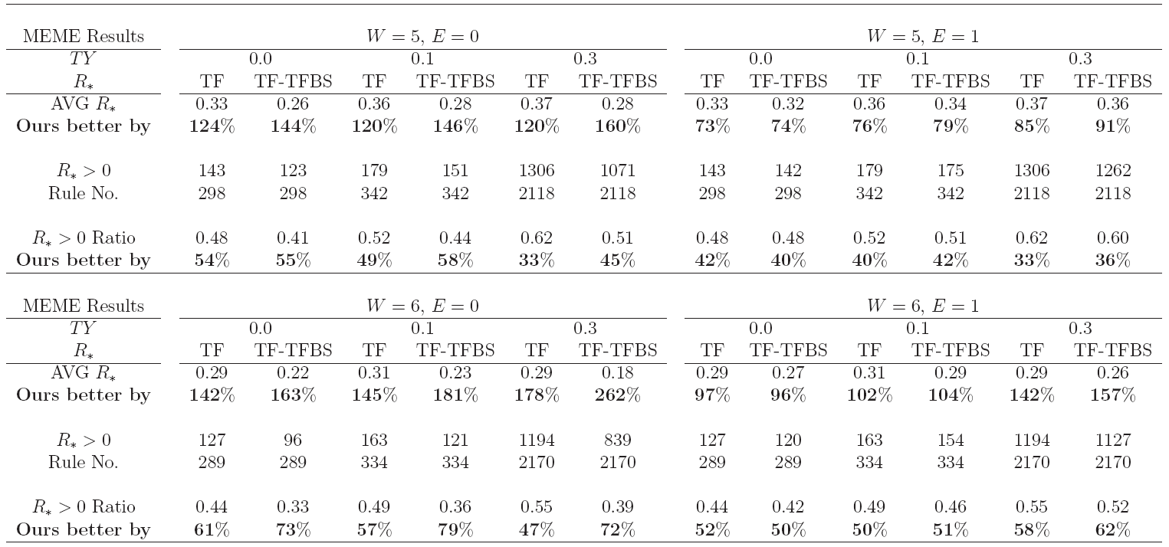
Results and Analysis
73%-262% improvement on AVG R*
33%-84% improvement on R*>0 Ratio
Customized TF core motif discovery is necessary
Comparisons with MEME as TF side discovery tool
22
Notes:
R: verifiable rule ratio;

Slide 23
Discussion
For the first time we generalize the exact TF-TFBS associated sequence patterns to approximate ones
The discovered approximate TF-TFBS rules
Competitive performance with respect to verification ratios (R∗) on both TF and TF-TFBS aspects
Strong edge over exact rules and MEME results
Demonstration of the flexibility of specific positions TF-TFBS binding (further biological verification with NCBI independent protein records!)
23

Slide 24
Discussion
Great and promising direction for further discovering protein-DNA interactions
Future Work
Formal models for whole associated TF-TFBS rules
Advanced Search algorithms for motifs
Associating multiple short TF-TFBS rules
Handling uncertainty such as widths
24

Slide 25
III. Drug Discovery
Background: Docking VS Synthesis
SmartGrow
Experimental Results
Discussion
25

Slide 26
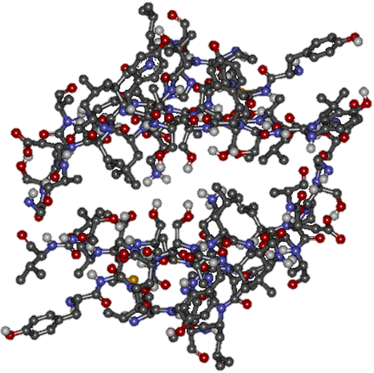
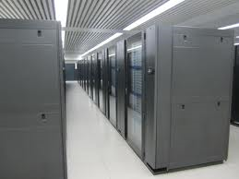
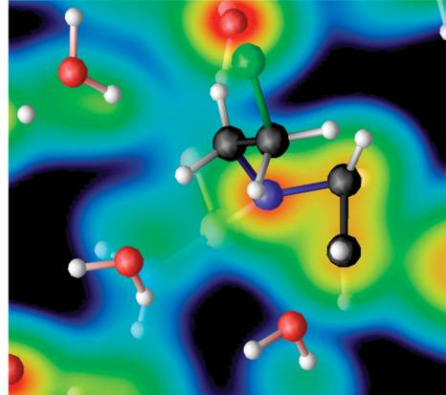
Background
Drug discovery by computational docking
Protein structures
Computational power
Simulation over wet lab
Notes:
Drug discovery is a very huge field. Computational docking is part of the entire drug discovery project.
According to a nature paper, computational docking accounts for 10% of the entire drug discovery project. In the coming decade, this ratio will increase to 20% because of two major reasons: more and more protein structures are being revealed and the computational power is evolving dramatically. Therefore, scientists prefer computer simulations over wet lab experiments.
26

Slide 27
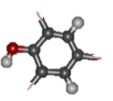
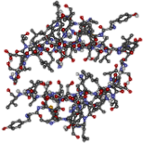
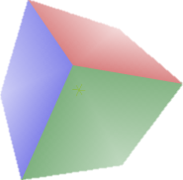
Computational Docking
Rank | Conformation | Free energy (kcal/mol)
1 |  | -7.0
2 |  | -6.1
3 |  | -6.0
4 |  | -5.9
5 |  | -5.9
6 |  | -5.8
7 |  | -5.8
8 |  | -5.7
9 |  | -5.6
Docking
Translate and rotate the ligand
Predict binding affinity
AutoDock Vina
Docking

Slide 28
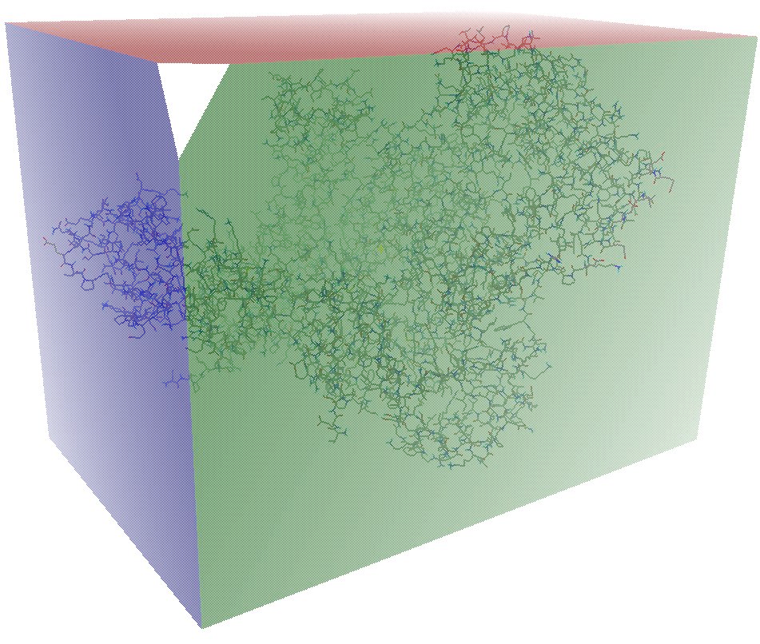
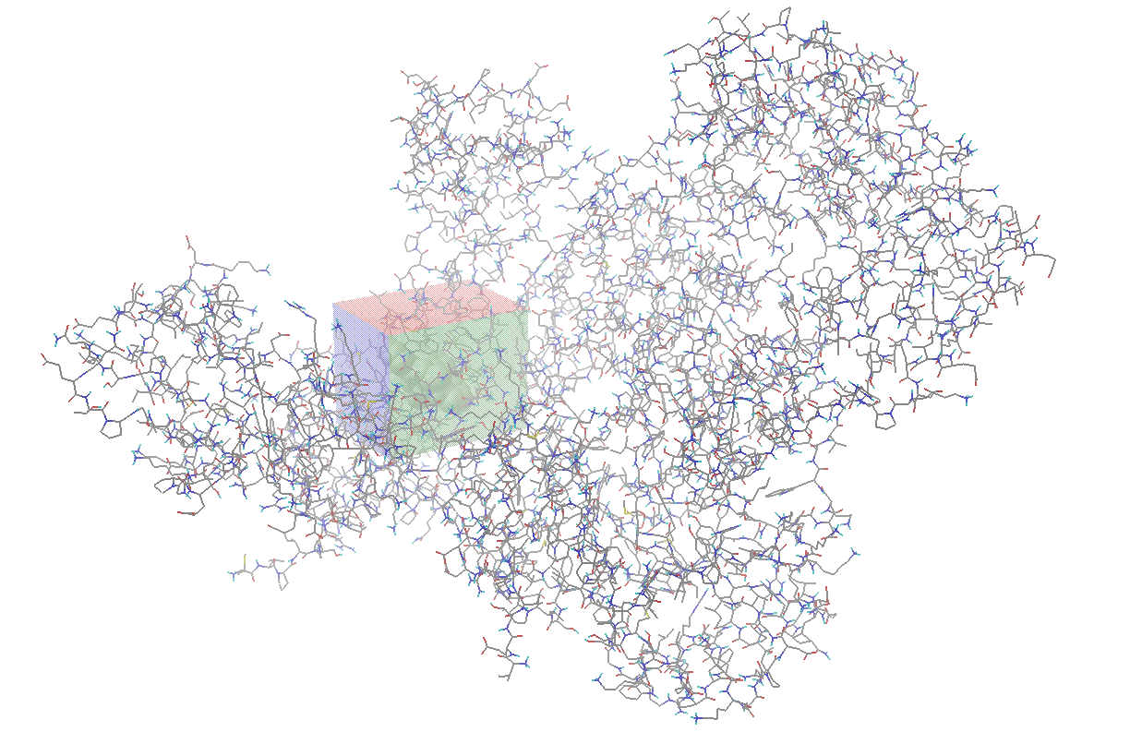
Computational Docking
Search space
Catalytic site or
allosteric site
Blind docking
Notes:
We may define the search space to cover the entire protein. This approach is regarded as blind docking because we try to dock the ligand to every possible position blindly. However, in most cases, we restrict the search space to a particular domain, which is usually a catalytic site or allosteric site of the protein.
28

Slide 29
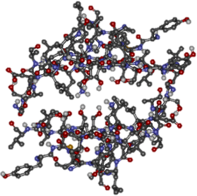
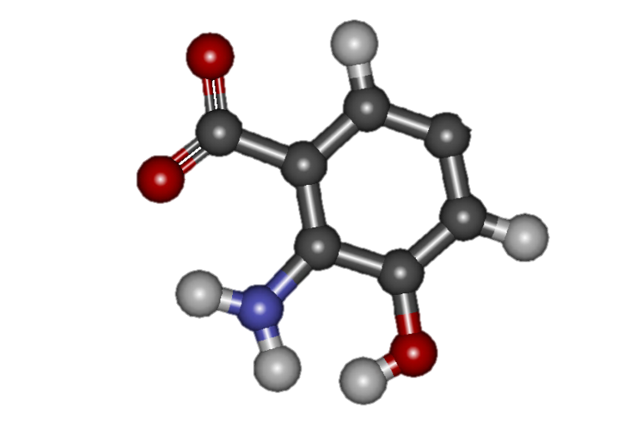
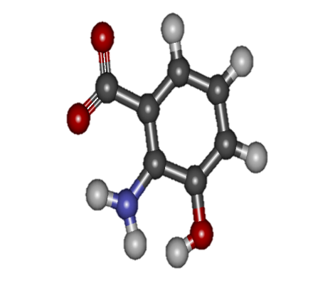
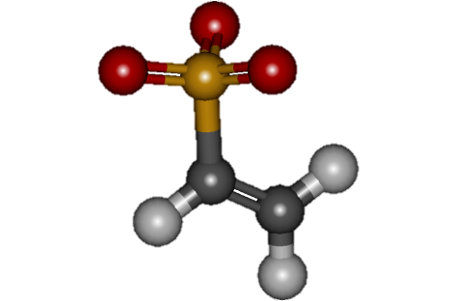
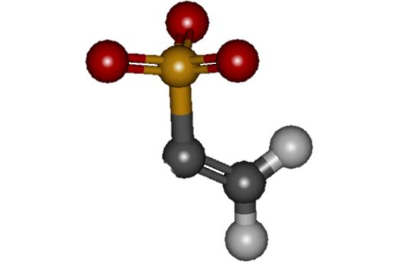
Computational Synthesis
Virtual screening Synthesis strategy
10⁶⁰ – 10¹⁰⁰ drug-like molecules.
Grows an initial scaffold by adding fragments.
Selection of linker hydrogen atoms
Placement of fragment in 3D space
Selection of fragments out of dozens
Combinatorial optimization problem
Single bond length
C-C: 1.530 Å
N-N: 1.425 Å
C-N: 1.469 Å
O-O: 1.469 Å
Synthesize ligands that have higher binding affinities.
Genetic Algorithm
(GA)
Notes:
Given a protein, we try to dock more than one ligand to the protein, and find out which ligand has the highest binding affinity. The number of ligands to dock is usually in the magnitude of millions. This kind of massive docking is known as virtual screening.
According to a nature paper, …, it is totally impossible to dock all the available ligands.
Therefore, a new strategy called synthesis was born, which basically grows …
29

Slide 30
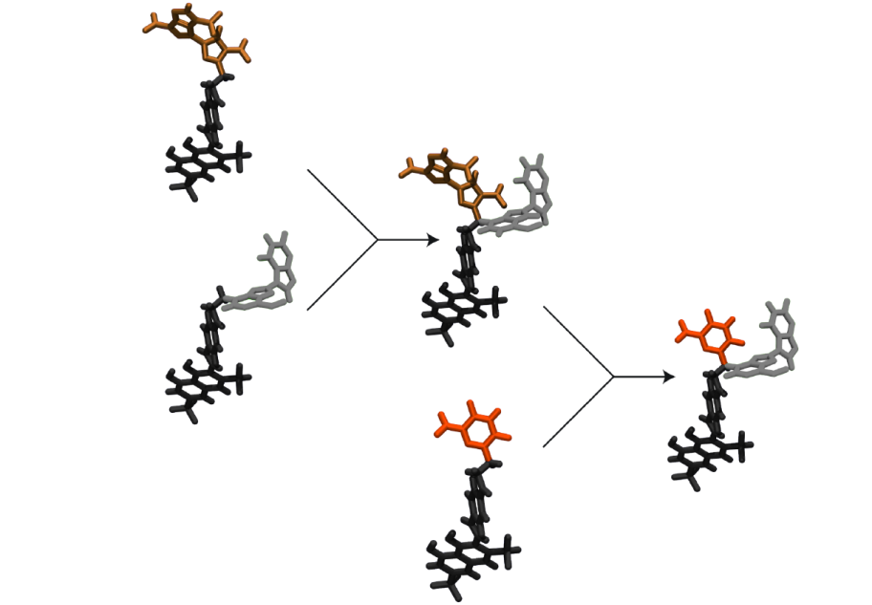
Computational Synthesis
AutoGrow (GA based)
Mutation
Crossover

Slide 31
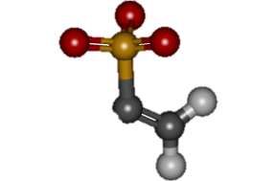
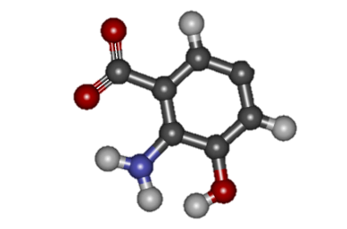
Motivations
Disadvantages of AutoGrow
Functionally
Can only form single bond
No way for double bond, ring joining
No support for P and 2-letter elements, e.g. Cl, Br
ATP, Etravirine
Drug-like properties ignored
Excessively large
Not absorbable
Computationally
Extremely slow, > 3h for one run on an 8-core PC
Fail to run under Windows
Notes:
ATP…: existing drugs;

Slide 32
Objectives
Development of SmartGrow
Functionally
Ligand diversity
Split, merging, ring joining
Support for P and Cl, Br
Druggability testing
Lipinski’s rule of five
Computationally
> 20% faster
C++ over Java
Cross platform
Linux and Windows

Slide 33
Flowchart
Rank | Energy
1 | -7.0
2 | -6.1
3 | -6.0
4 | -5.9
5 | -5.9
6 | -5.8
7 | -5.8
8 | -5.7
9 | -5.6
Computational docking
or scoring only
Number of generations
Weighted sum of molecular weights
Excessively large
Yes

Slide 34
Genetic Operators
Mutation
Crossover
A
A
I
C
C
I
D
B
I
B

Slide 35
Genetic Operators
Split
Merging
A
A
I
C
I
I
C
C
B
I
B
I
C

Slide 36
Experimental Results
Data Preparation
Experiment Settings
Results and Comparisons

Slide 37
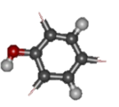
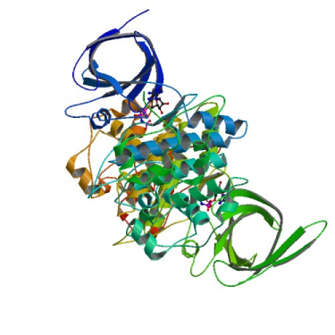
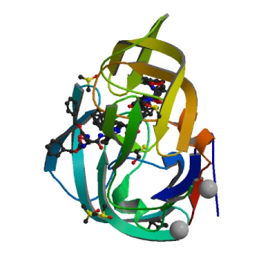
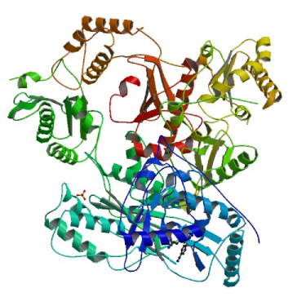
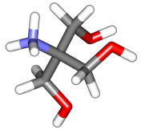
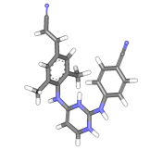
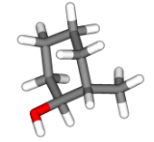
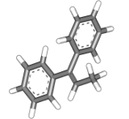
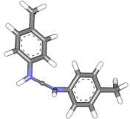
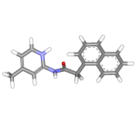
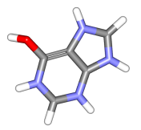
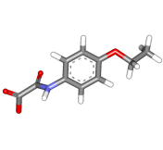
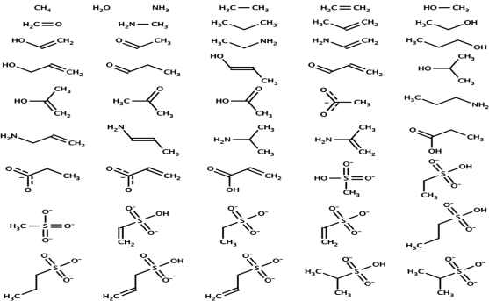
Data Preparation
Fragment library
Proteins
Initial ligands
3 proteins from PDB
8 unique initial ligands
3 from PDB complexes
5 from ZINC
Fragment library
Small-fragment library
Provided by AutoGrow
AD
AIDS
AIDS
Notes:
We aimed to select receptors that are of real-life importance.
37

Slide 38
18 Test Cases
Initial Ligand | Free Energy (kcal/mol) | Molecular Weight (Da)
TRS | -3.8 | 122
ZINC01019824 | -6.9 | 194
ZINC08442219 | -6.5 | 224
ZINC09365179 | -8.3 | 278
ZINC18153302 | -4.2 | 142
ZINC20030231 | -5.6 | 209
T27 | -13.9 | 373
ZINC01019824 | -9.6 | 194
ZINC08442219 | -9.1 | 224
ZINC09365179 | -11.0 | 278
ZINC18153302 | -5.8 | 142
ZINC20030231 | -7.1 | 209
4DX | -4.0 | 114
ZINC01019824 | -5.9 | 194
ZINC08442219 | -5.6 | 224
ZINC09365179 | -6.4 | 278
ZINC18153302 | -4.1 | 142
ZINC20030231 | -4.9 | 209
Notes:
38

Slide 39
Fragment Library
Small-fragment library
Provided by AutoGrow
46 fragments
3 to 15 atoms
Average 9.6 atoms
Standard deviation 2.8

Slide 40
Parameter Settings
Parameters | AutoGrow | SmartGrow
Number of elitists | 10 | 10
Number of children | 20 | 20
Number of mutants | 20 | 20
Number of generations | 8 | 24
Docking frequency | 1 | 3
Max number of atoms | 80 | 80
Dual Xeon Quad Core 2.4GHz, 32GB RAM, Ubuntu
AutoGrow: 18 testcases × 9 runs × 3.0 h = 486 h
SmartGrow: 18 testcases × 9 runs × 2.4 h = 388 h
Run time for one testcase
3.0 h
2.4 h

Slide 41
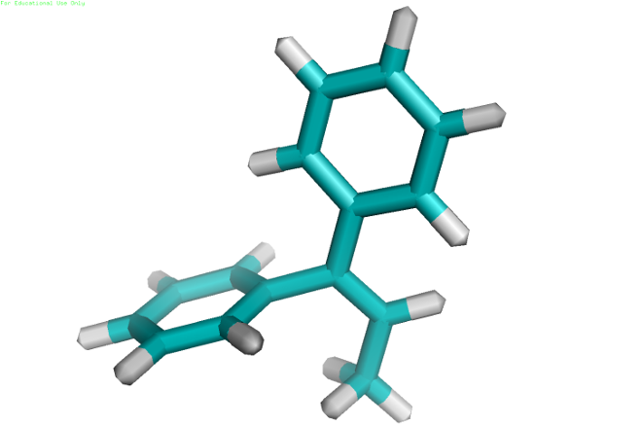
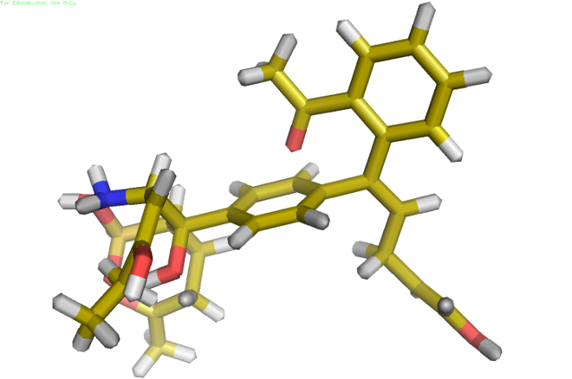
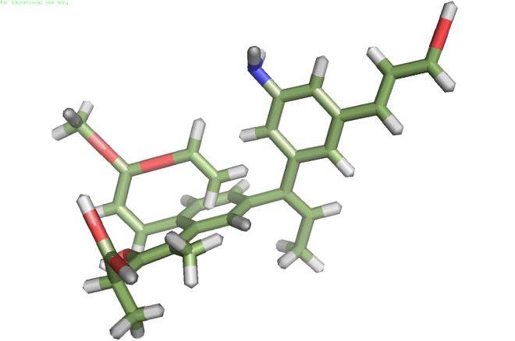
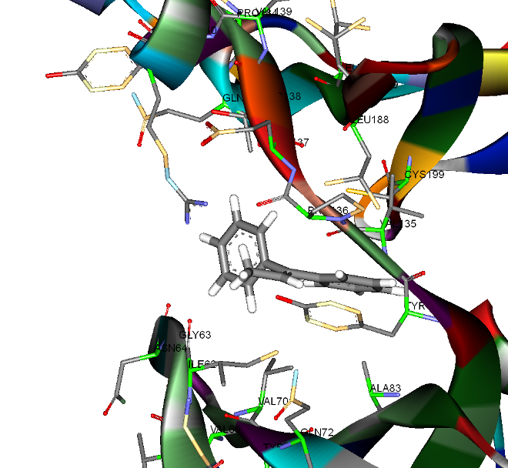
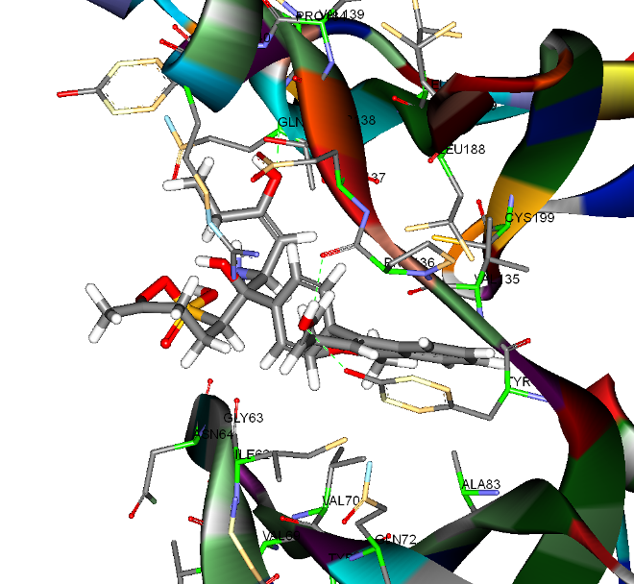
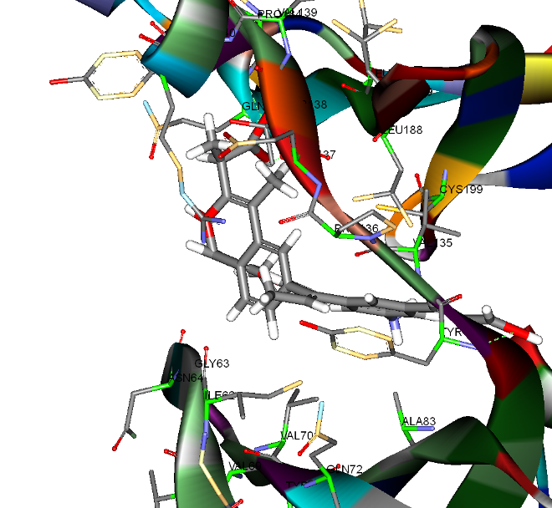
Results: GSK3β-ZINC01019824
Initial ligand
-6.9, 194
AutoGrow
-11.9, 572
SmartGrow
-11.2, 505

Slide 42
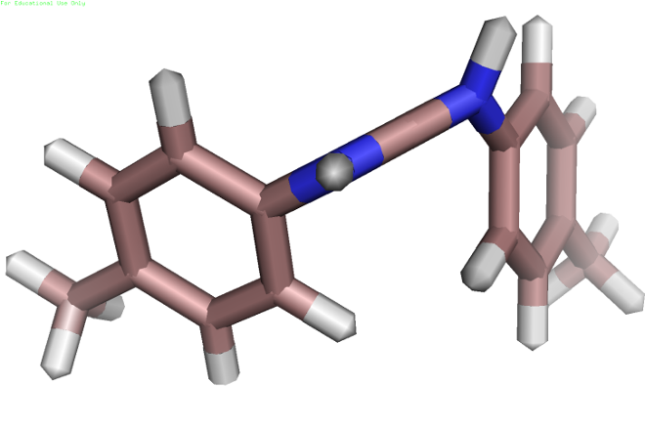
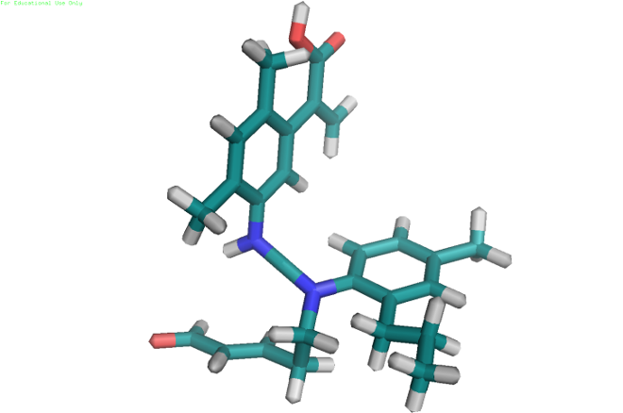
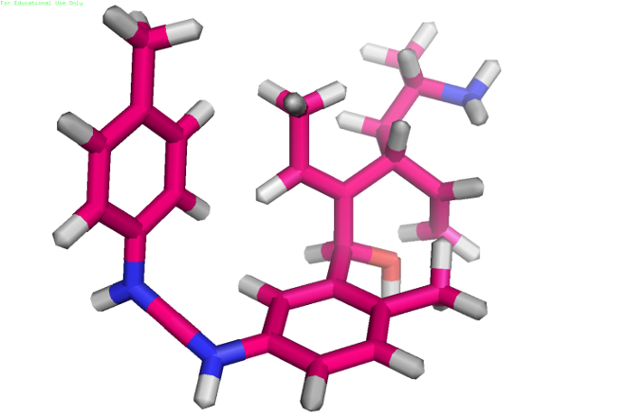
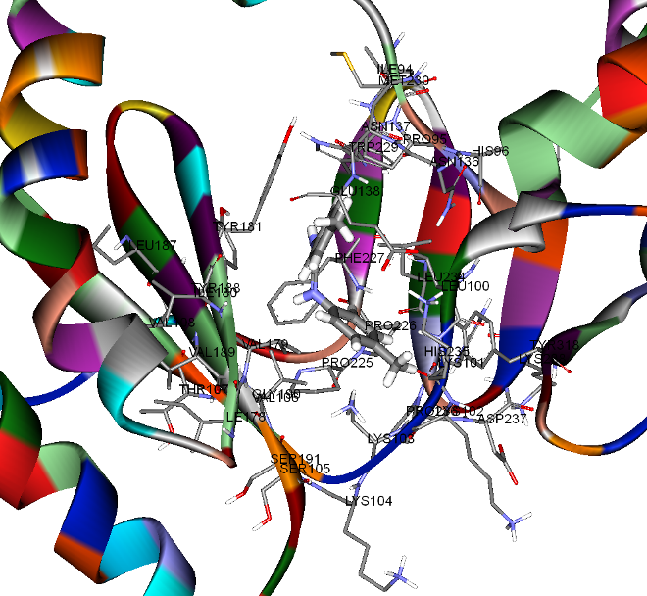
Results: HIV RT-ZINC08442219
Initial ligand
-9.1, 224
AutoGrow
-11.3, 433
SmartGrow
-11.8, 392

Slide 43
Results: HIV PR-ZINC20030231
Initial ligand
-4.9, 209
AutoGrow
-7.3, 683
SmartGrow
-7.5, 489

Slide 44
Results: GSK3β

Slide 45
Results: HIV RT

Slide 46
Results: HIV PR

Slide 47
Results: Execution Time
30%

Slide 48
Results: Handling Phosphorus(P)
Synthesized ligand
by SmartGrow
Initial ligand

Slide 49
Discussion
SmartGrow
Functionally
An efficient tool for computational synthesis of potent ligands for drug discovery
Enriched ligand diversity
Split, merging, ring joining
Support for P and Cl, Br
Druggability testing
Low molecular weight, < 500 Da
Computationally
20% ~ 30% faster, avg. 2.4 h for one run
Cross platform
Linux and Windows
Notes:
BR: Bromine; Cl: chlorine; P: Phosphorus;

Slide 50
Future Improvements
Integrate SmartGrow into AutoDock Vina
Receptor structure
Uniform interface
File I/O reduced
ADMET
Adsorption, Distribution, Metabolism, Excretion, and Toxicity
Parallelization by GPU hardware
Web interface
Real life applications
Alzheimer’s Disease, HIV/AIDS, HBV (liver cancer)

Slide 51
IV. Discussion and Conclusion
Summary
Discussion

Slide 52
Summary
In this lecture
A brief introduction to Bioinformatics research problems
Discovering approximate protein-DNA interaction sequence patterns for better understanding gene regulation (the essential control mechanisms of life)
Drug synthesis based on synthesizing drug candidates and optimizing the conformations of 3D protein-ligand interactions effectively and efficiently with computers
Encouraging results have been achieved and promising direction has been pointed out

Slide 53
Discussion
Bioinformatics becomes more and more important in life sciences and biomedical applications
Most computational fields (ranging from string algorithms to graphics) have applications in Bioinformatics
Still long way to go (strong potentials to explore)
Massive data are available but annotations are still limited
Lack of full knowledge in many biological mechanisms
Biological systems are very complicated and stochastic

Slide 54
The End
Thank you!
Q&A

Slide 55
Appendix
II: Results and Analysis: Statistical Significance
III: The details for the 3 proteins and the 8 ligands used in the experiments

Slide 56
II: Results and Analysis
Statistical Significance (W=5)
Simulated on over 100,000 rules for each setting
The majority (64%-79%) for R_{TF-TFBS} are statistically significant
For E=0, although the 0.05<p(R_{TF}≥1)<0.07, the majority (74%-82%) achieve the best possible p-values
56

Slide 57
III: 3 proteins
Glycogen synthase kinase 3 beta (GSK3β)
Alzheimer's disease (AD), Type-2 diabetes
Source: Protein Data Bank
Notes:
Glycogen synthase kinase 3 beta (GSK3) is a theoretically promising pharmacotherapeutic target for the treatment of several human diseases, including type-2 diabetes [20] and Alzheimer's disease (AD) [13].
57

Slide 58
3 proteins
HIV reverse transcriptase (HIV RT)
AIDS
Source: Protein Data Bank

Slide 59
3 proteins
HIV protease (HIV PR)
AIDS
Source: Protein Data Bank

Slide 60
8 unique initial ligands
TRS
122 Da
T27
373 Da
4DX
114 Da
ZINC01019824
194 Da
ZINC08442219
224 Da
ZINC09365179
278 Da
ZINC18153302
142 Da
ZINC20030231
209 Da
Notes:
60

