Slide 1
CSC3160: Design and Analysis of Algorithms
Week 10: Stable Matching and Secretary Problem
Instructor: Shengyu Zhang

Slide 2

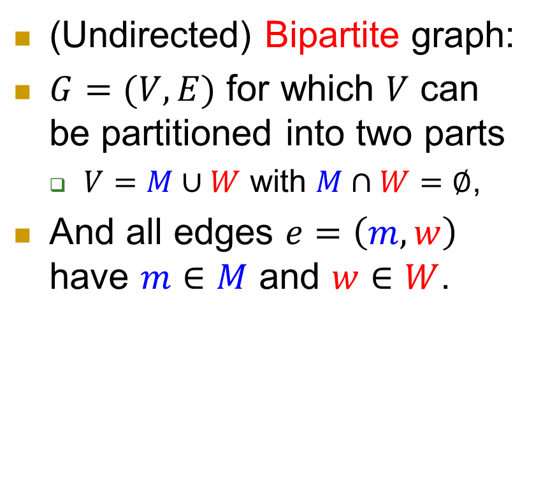

Bipartite graph
(Undirected) Bipartite graph:
$G=(V,E)$ for which $V$ can be partitioned into two parts
  $V=M∪W$ with $M∩W=∅$,
And all edges $e=\left(m,w\right)$ have $m∈M$ and $w∈W$.
$$M$$
$$W$$

Slide 3
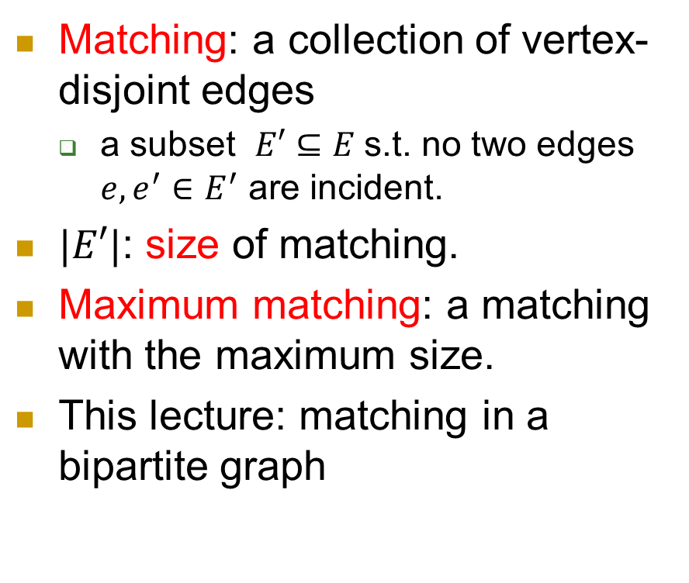
Matching, maximum matching
Matching: a collection of vertex-disjoint edges
  a subset $E′⊆E$s.t. no two edges $e,e^{′}∈E^{′}$ are incident.
$|E′|$: size of matching.
Maximum matching: a matching with the maximum size.
This lecture: matching in a bipartite graph
$$M$$
$$W$$

Slide 4
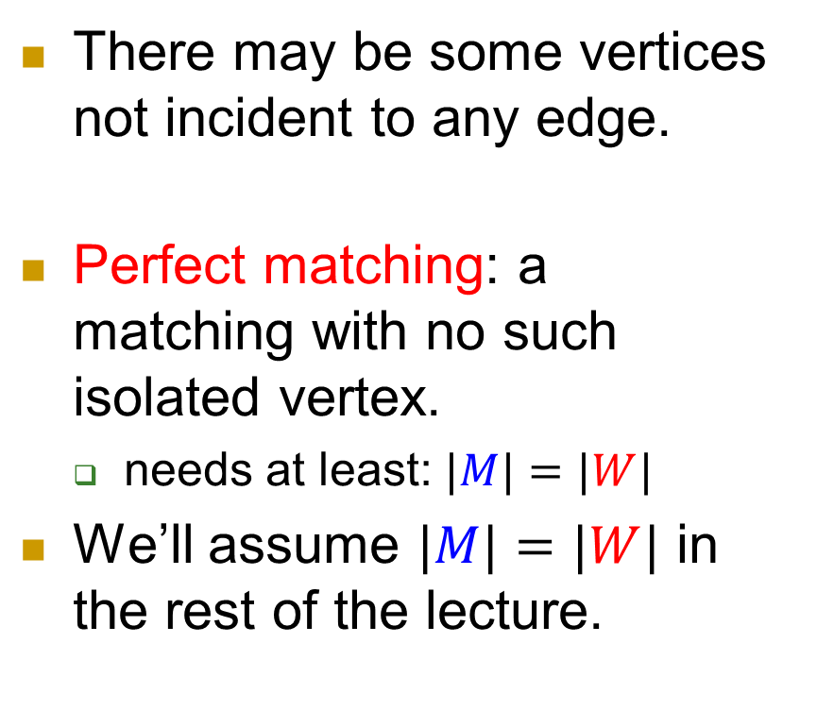
Perfect matching
There may be some vertices not incident to any edge.
Perfect matching: a matching with no such isolated vertex.
  needs at least: $|M|=|W|$
We’ll assume $|M|=|W|$ in the rest of the lecture.
$$M$$
$$W$$

Slide 5




Men’s Preference
Suppose a man sees these women.
He has a preference among them.
  What’s your preference list?
Different men may have different lists.

Slide 6

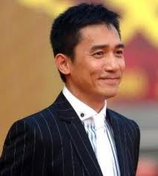


Women’s preference
Women also have their preference lists.
Assume no tie.
  The general case can be handled similarly.

Slide 7



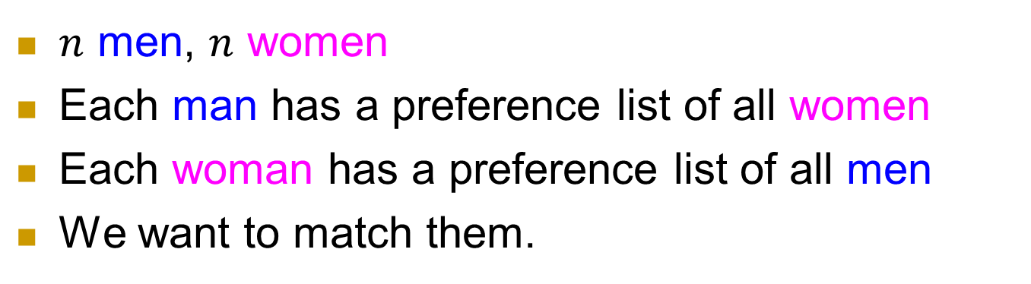












Setting
$n$ men, $n$ women
Each man has a preference list of all women
Each woman has a preference list of all men
We want to match them.
$$w_{1}>w_{2}>w_{3}>w_{4}$$
$m_{1}$
$w_{1}$
$$m_{3}>m_{1}>m_{2}>m_{4}$$
$$w_{1}>w_{2}>w_{3}>w_{4}$$
$m_{2}$
$w_{2}$
$$m_{3}>m_{4}>m_{1}>m_{2}$$
$$w_{2}>w_{1}>w_{3}>w_{4}$$
$m_{3}$
$w_{3}$
$$m_{1}>m_{4}>m_{2}>m_{3}$$
$$w_{3}>w_{2}>w_{4}>w_{1}$$
$m_{4}$
$w_{4}$
$$m_{4}>m_{1}>m_{3}>m_{2}$$
Notes:
7

Slide 8

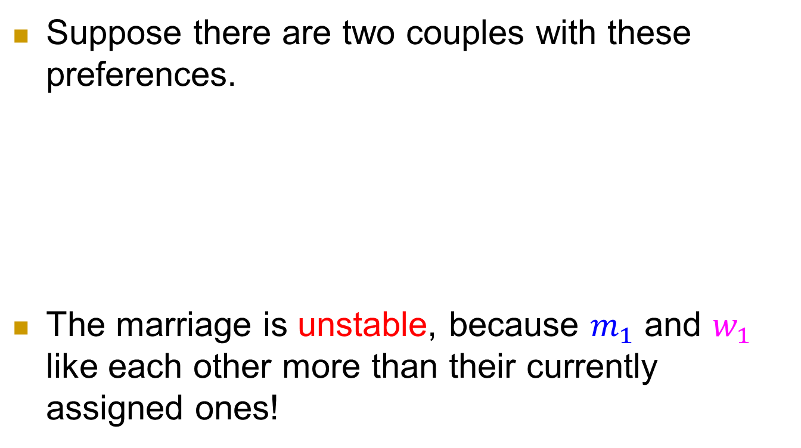







A stability property
Suppose there are two couples with these preferences.
The marriage is unstable, because $m_{1}$ and $w_{1}$ like each other more than their currently assigned ones!
$$w_{1}>w_{2}$$
$$m_{1}$$
$$w_{1}$$
$$m_{1}>m_{2}$$
$$w_{1}>w_{2}$$
$$m_{2}$$
$$w_{2}$$
$$m_{1}>m_{2}$$
Notes:
Line color

Slide 9
Stability
Such a pair is called a blocking pair.
Question: Can we have a matching without any blocking pair?
  Such a matching is then called a stable matching.
$$w_{1}>w_{2}$$
$$m_{1}$$
$$w_{1}$$
$$m_{1}>m_{2}$$
$$w_{1}>w_{2}$$
$$m_{2}$$
$$w_{2}$$
$$m_{1}>m_{2}$$
Notes:
Line color

Slide 10
Real applications
If you think marriage is a bit artificial since there is no centralized arranger, here is a real application.
Medical students work as interns at hospitals.
  In the US more than 20,000 medical students and 4,000 hospitals are matched through a clearinghouse, called NRMP
  (National Resident Matching Program).

Slide 11
Real applications
Students and hospitals submit preference rankings to the clearinghouse, who uses a specified rule to decide who works where.
Question: What is a good way to match students and hospitals?

Slide 12
More than one question
Question: Does a stable matching always exist?
Question: If yes, how to find one?
Question: What mathematical / economic properties it has?

Slide 13
Good news: Stable matchings always exist.
Theorem (Gale-Shapley) For any given preference lists, there always exists a stable matching.
They actually gave an algorithm, which bears some resemblance to real marriages.

Slide 14
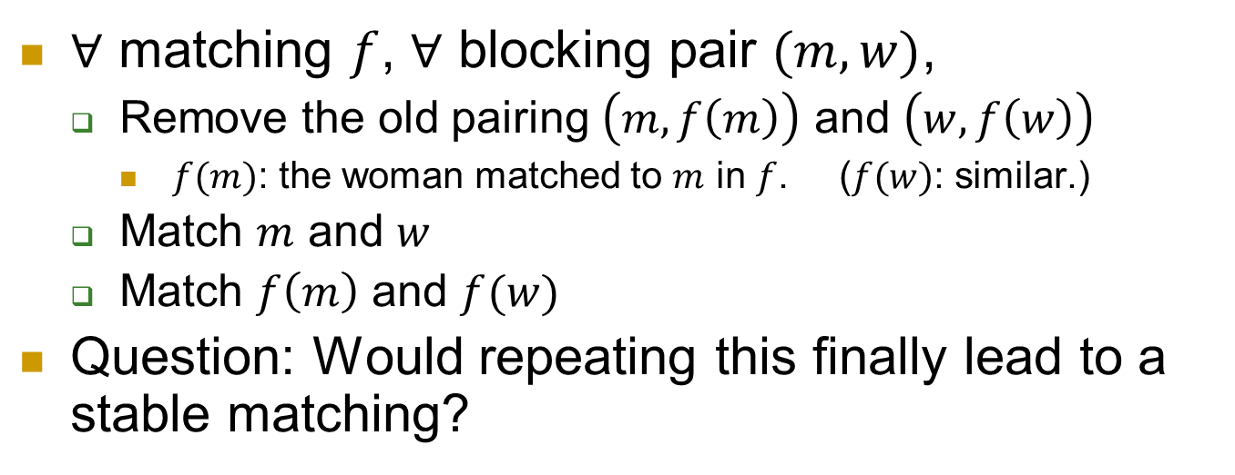
Consider a simple dynamics
$∀$ matching $f$, $∀$ blocking pair $(m,w)$,
  Remove the old pairing $\left(m,f\left(m\right)\right)$ and $\left(w,f\left(w\right)\right)$
    $f(m)$: the woman matched to $m$ in $f$. ($f(w)$: similar.)
  Match $m$ and $w$
  Match $f\left(m\right)$ and $f(w)$
Question: Would repeating this finally lead to a stable matching?
$$w_{1}>w_{2}$$
$$m_{1}$$
$$w_{1}$$
$$m_{1}>m_{2}$$
$$w_{1}>w_{2}$$
$$m_{2}$$
$$w_{2}$$
$$m_{1}>m_{2}$$

Slide 15
Example
Can you find an counterexample?
Next we’ll give an algorithm that actually works.
Let’s first run the algorithm on an example.
Notes:
Check out an example.

Slide 16
















Algorithm by an example
$$w_{1}>w_{2}>w_{3}>w_{4}$$
$m_{1}$
$w_{1}$
$$m_{3}>m_{1}>m_{2}>m_{4}$$
$$w_{1}>w_{2}>w_{3}>w_{4}$$
$m_{2}$
$w_{2}$
$$m_{3}>m_{4}>m_{1}>m_{2}$$
$$w_{2}>w_{1}>w_{3}>w_{4}$$
$m_{3}$
$w_{3}$
$$m_{1}>m_{4}>m_{2}>m_{3}$$
$$w_{3}>w_{2}>w_{4}>w_{1}$$
$m_{4}$
$w_{4}$
$$m_{4}>m_{1}>m_{3}>m_{2}$$
Notes:
16

Slide 17
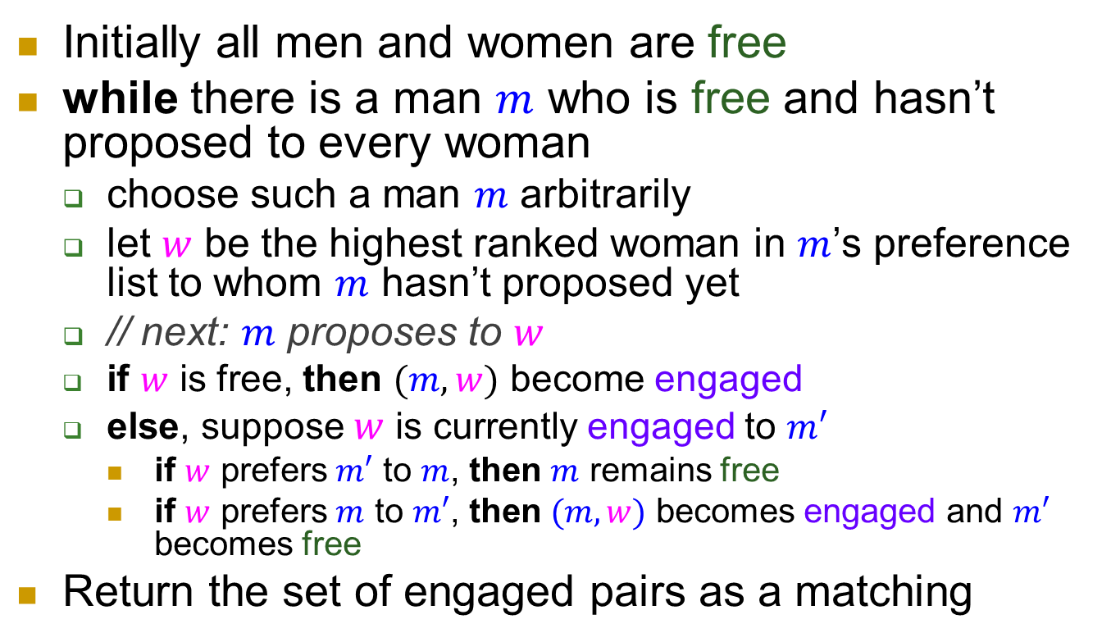
Gale-Shapley (Deferred-Acceptance) Algorithm
Initially all men and women are free
while there is a man $m$ who is free and hasn’t proposed to every woman
  choose such a man $m$ arbitrarily
  let $w$ be the highest ranked woman in $m$’s preference list to whom $m$ hasn’t proposed yet
  // next: $m$ proposes to $w$
  if $w$ is free, then $(m,w)$ become engaged
  else, suppose $w$ is currently engaged to $m′$
    if $w$ prefers $m′$ to $m$, then $m$ remains free
    if $w$ prefers $m$ to $m′$, then $(m,w)$ becomes engaged and $m′$ becomes free
Return the set of engaged pairs as a matching

Slide 18
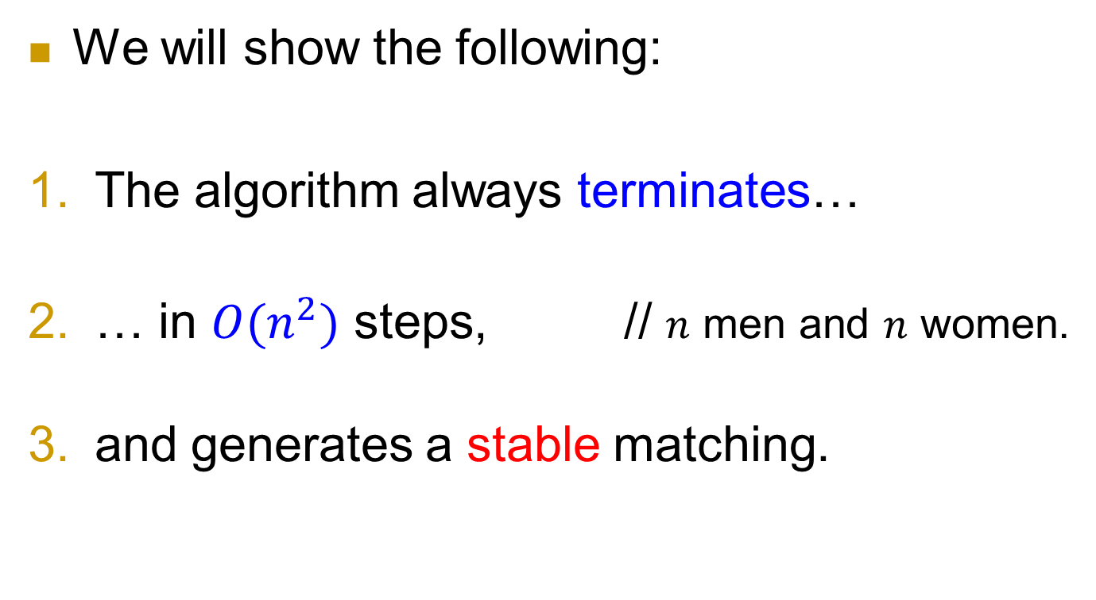
Analysis of the algorithm
We will show the following:
The algorithm always terminates…
… in $O(n^{2})$ steps, // $n$ men and $n$ women.
and generates a stable matching.

Slide 19
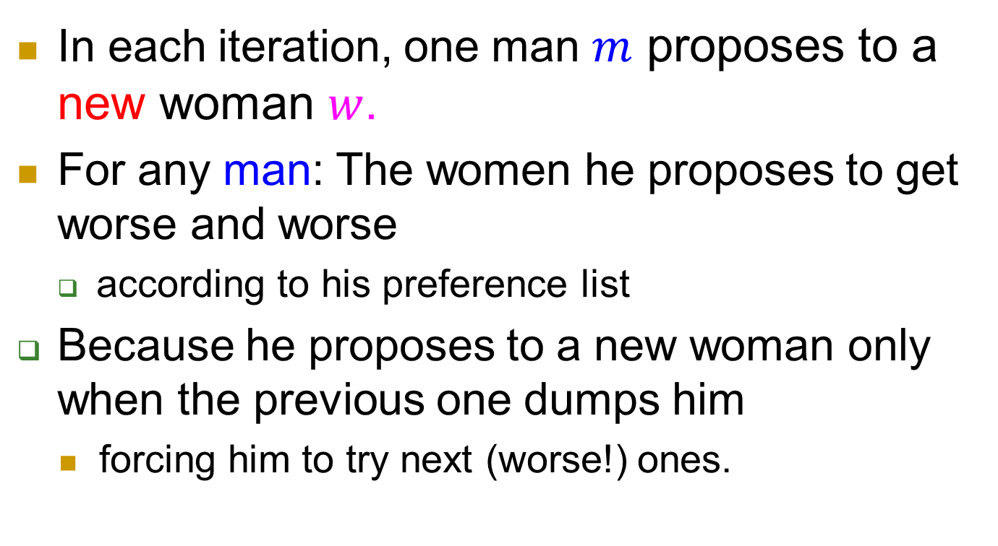
Some observations
In each iteration, one man $m$ proposes to a new woman $w$.
For any man: The women he proposes to get worse and worse
  according to his preference list
  Because he proposes to a new woman only when the previous one dumps him
    forcing him to try next (worse!) ones.

Slide 20
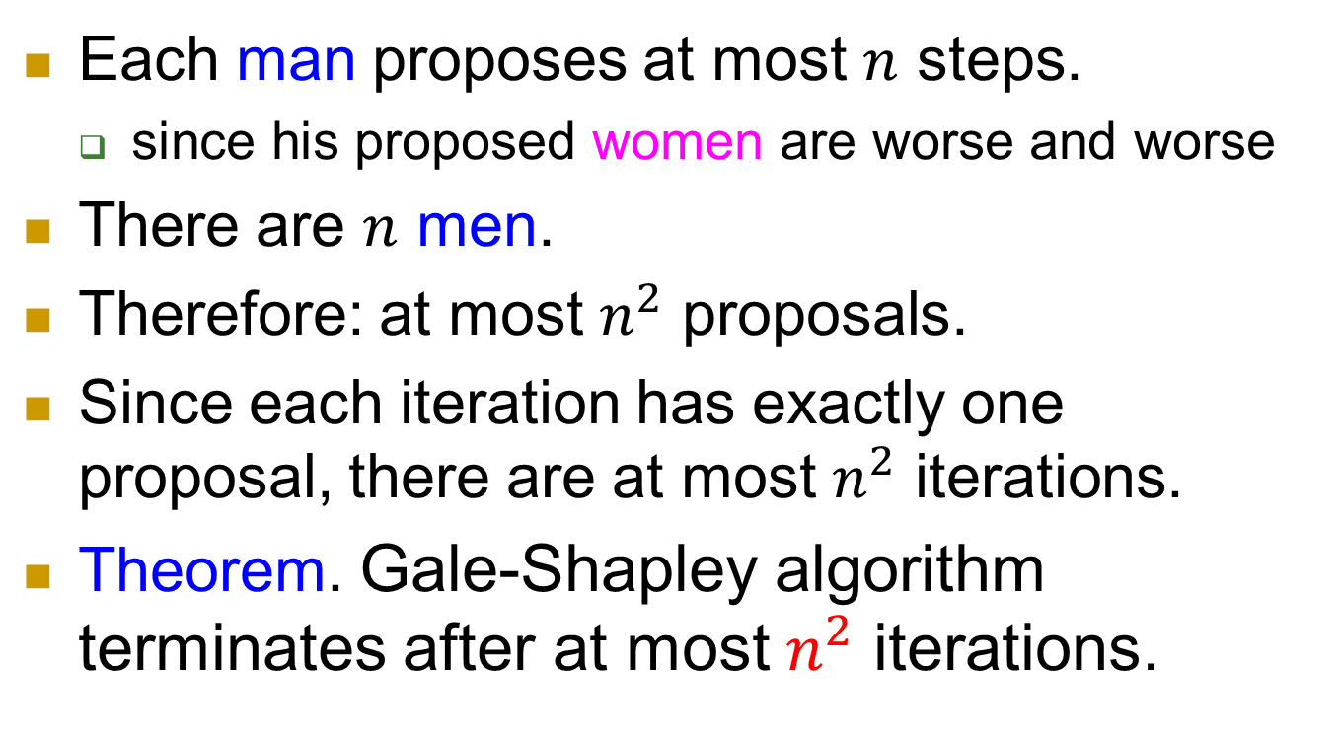
Time bound
Each man proposes at most $n$ steps.
  since his proposed women are worse and worse
There are $n$ men.
Therefore: at most $n^{2}$ proposals.
Since each iteration has exactly one proposal, there are at most $n^{2}$ iterations.
Theorem. Gale-Shapley algorithm terminates after at most $n^{2}$ iterations.

Slide 21

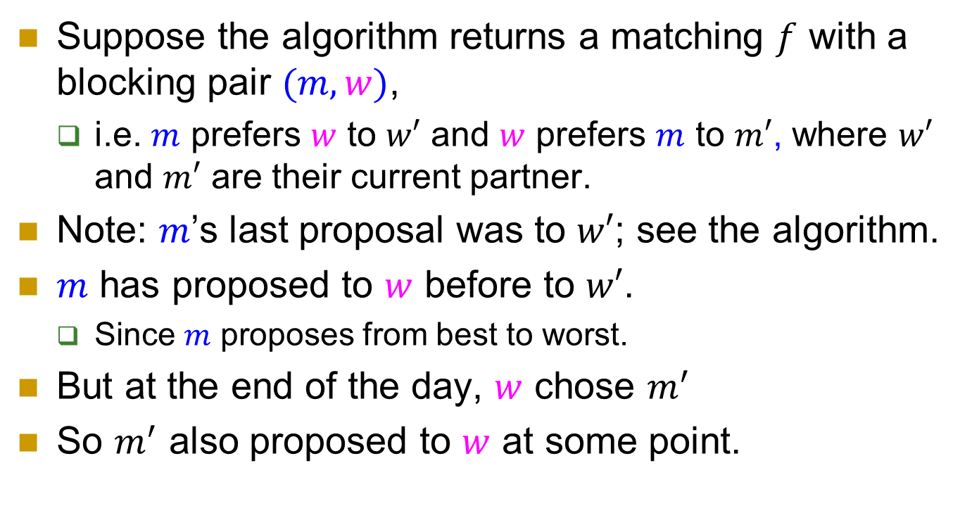





Correctness
$$w>w′$$
$$m$$
$w′$
$m′$
$$w$$
$$m>m′$$
Suppose the algorithm returns a matching $f$ with a blocking pair $(m,w)$,
  i.e. $m$ prefers $w$ to $w′$ and $w$ prefers $m$ to $m′$, where $w′$ and $m′$ are their current partner.
Note: $m$’s last proposal was to $w′$; see the algorithm.
$m$ has proposed to $w$ before to $w′$.
  Since $m$ proposes from best to worst.
But at the end of the day, $w$ chose $m^{′}$
So $m^{′}$ also proposed to $w$ at some point.
21
Notes:
21

Slide 22
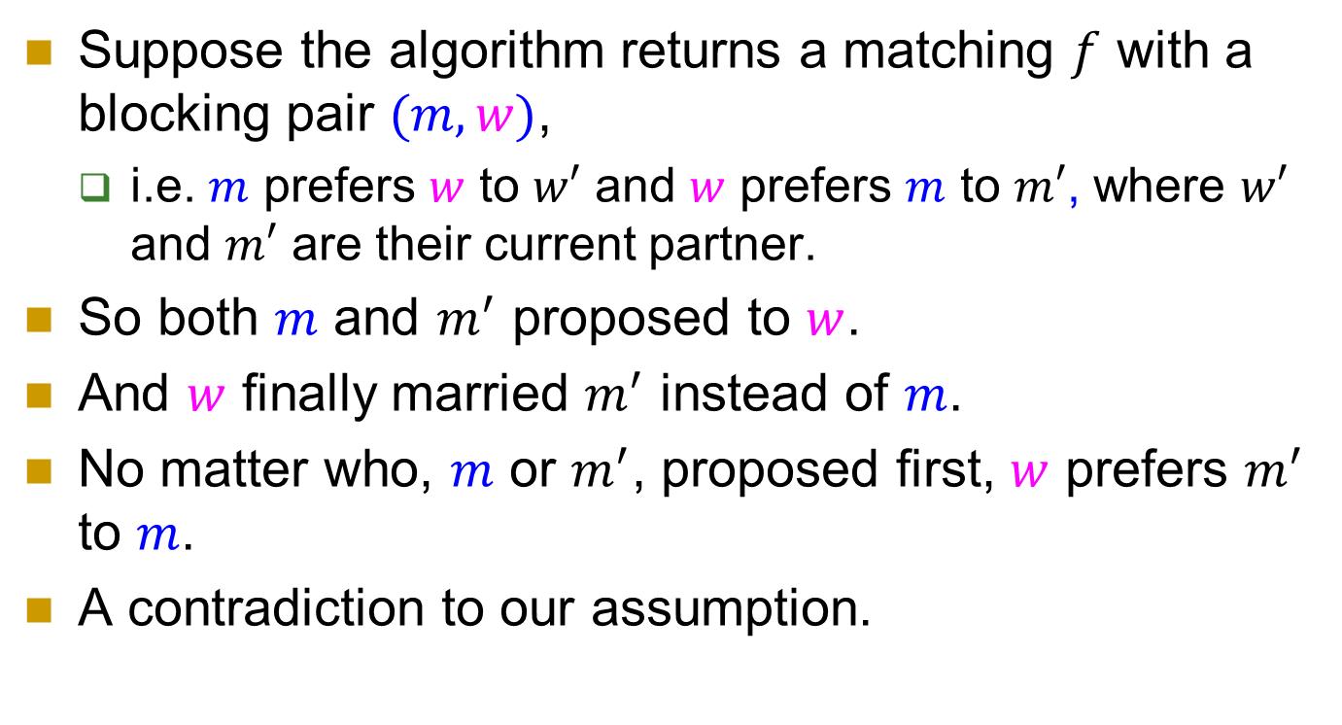
Correctness
$$w>w′$$
$$m$$
$w′$
$m′$
$$w$$
$$m>m′$$
Suppose the algorithm returns a matching $f$ with a blocking pair $(m,w)$,
  i.e. $m$ prefers $w$ to $w′$ and $w$ prefers $m$ to $m′$, where $w′$ and $m′$ are their current partner.
So both $m$ and $m^{′}$ proposed to $w$.
And $w$ finally married $m^{′}$ instead of $m$.
No matter who, $m$ or $m^{′}$, proposed first, $w$ prefers $m^{′}$ to $m$.
A contradiction to our assumption.
22
Notes:
22

Slide 23


Some observations
For any man: His fiancé gets worse and worse (according to his preference list)
    because he changes fiancé only when the previous one dumps him, forcing him to try next (worse!) ones.
For any woman: Her fiancé gets better and better (according to her preference list)
  because she changes fiancé only when a better man proposes to her.

Slide 24












Women propose?
What if women propose?
$$w_{1}>w_{2}>w_{3}$$
\
$m_{1}$
$w_{1}$
$$m_{1}>m_{2}>m_{3}$$
$$w_{1}>w_{2}>w_{3}$$
$m_{2}$
$w_{2}$
\
\
$$m_{1}>m_{3}>m_{2}$$
$$w_{1}>w_{3}>w_{2}$$
$m_{3}$
$w_{3}$
\
\
$$m_{1}>m_{2}>m_{3}$$

Slide 25



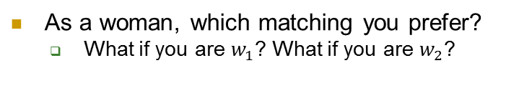



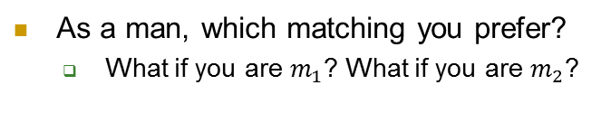










Which stable matching is better?
$$w_{1}>w_{2}$$
$m_{1}$
$w_{1}$
$$m_{2}>m_{1}$$
$$w_{2}>w_{1}$$
$m_{2}$
$w_{2}$
$$m_{1}>m_{2}$$
GS algorithm: men propose
GS algorithm: women propose
$m_{1}$
$w_{1}$
$m_{1}$
$w_{1}$
$m_{2}$
$w_{2}$
$m_{2}$
$w_{2}$
As a man, which matching you prefer?
  What if you are $m_{1}$? What if you are $m_{2}$?
As a woman, which matching you prefer?
  What if you are $w_{1}$? What if you are $w_{2}$?

Slide 26
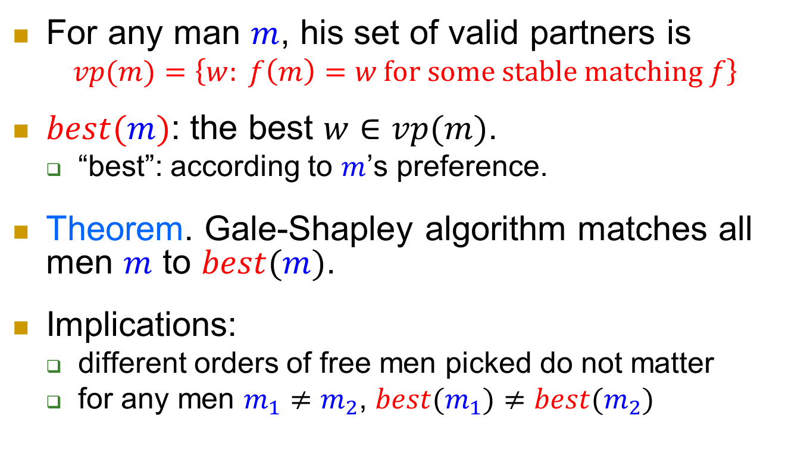
Stable Matching by G-S, men propose
For any man $m$, his set of valid partners is
$$vp(m)=\left\{w: f\left(m\right)=w \text{for} \text{some} \text{stable} \text{matching} f\right\}$$
$best(m)$: the best $w∈vp(m)$.
  “best”: according to $m$’s preference.
Theorem. Gale-Shapley algorithm matches all men $m$ to $best(m)$.
Implications:
  different orders of free men picked do not matter
  for any men $m_{1}≠m_{2}$, $best(m_{1})≠best(m_{2})$

Slide 27
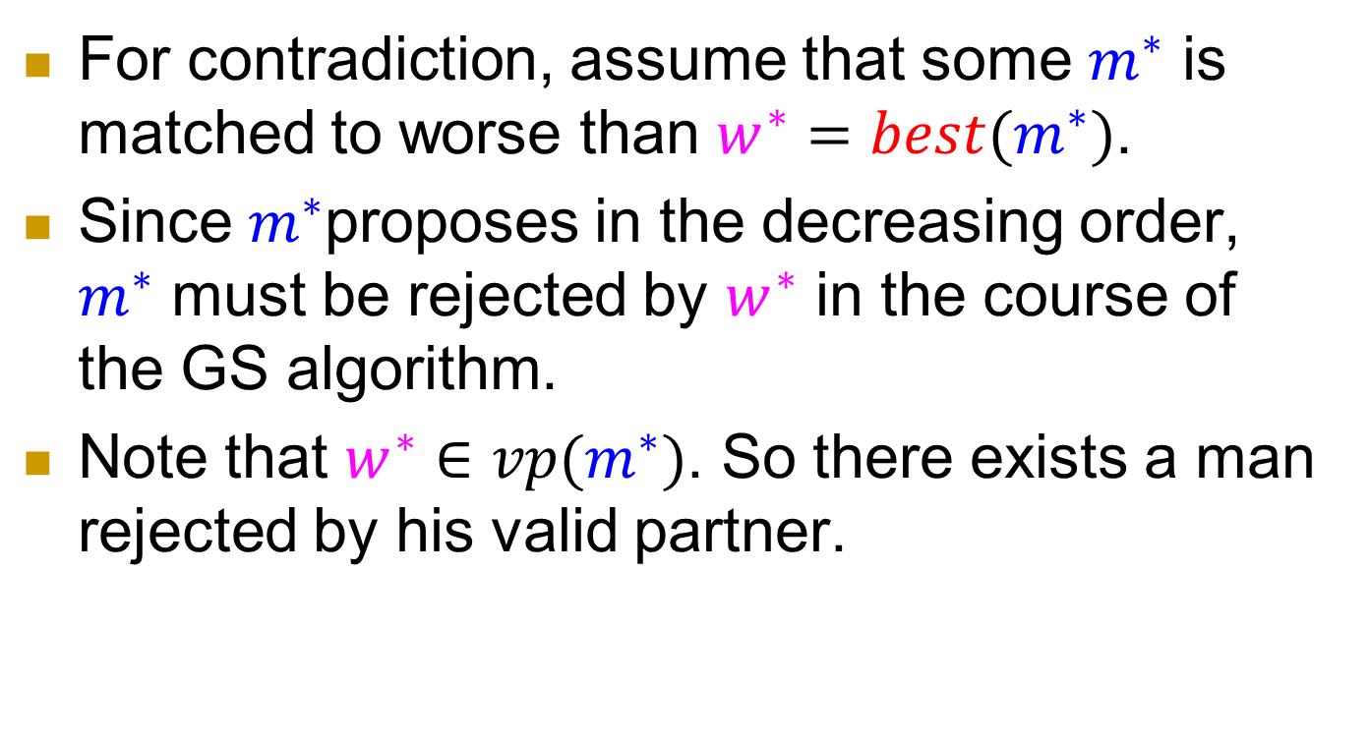
Proof
For contradiction, assume that some $m^{∗}$ is matched to worse than $w^{∗}=best(m^{∗})$.
Since $m^{∗}$proposes in the decreasing order, $m^{∗}$ must be rejected by $w^{∗}$ in the course of the GS algorithm.
Note that $w^{∗}∈vp(m^{∗})$. So there exists a man rejected by his valid partner.

Slide 28

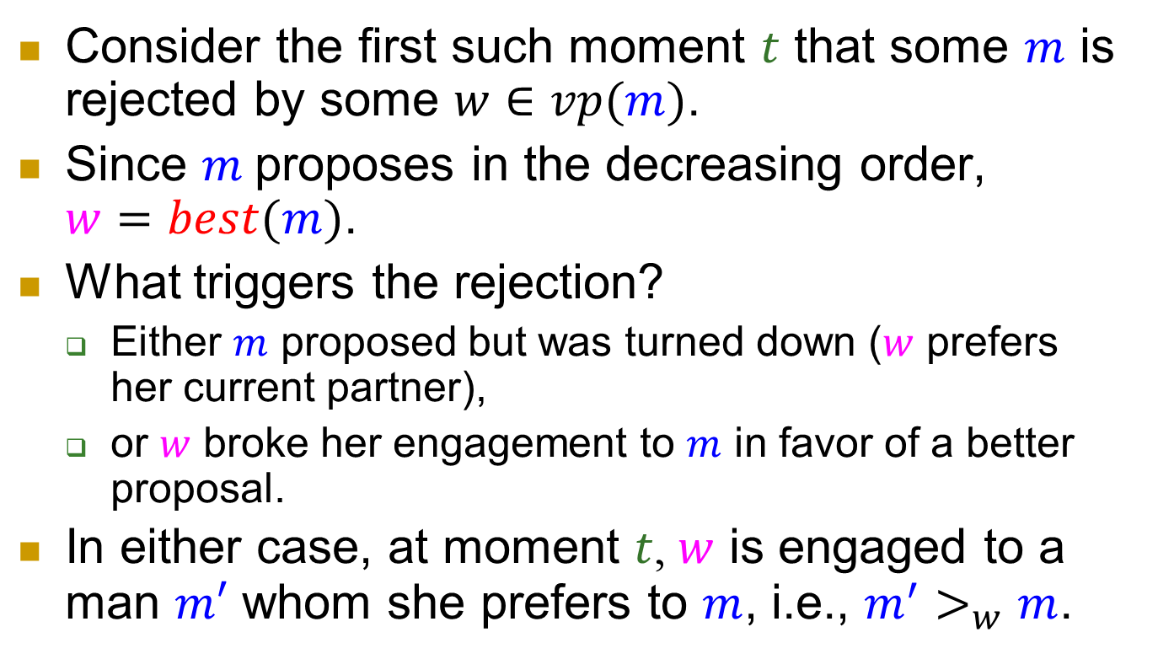



Proof
$$m$$
$$w$$
$$m^{′}>_{w}m$$
$m′$
Consider the first such moment $t$ that some $m$ is rejected by some $w∈vp(m)$.
Since $m$proposes in the decreasing order, $w=best(m)$.
What triggers the rejection?
  Either $m$ proposed but was turned down ($w$ prefers her current partner),
  or $w$ broke her engagement to $m$ in favor of a better proposal.
In either case, at moment $t$, $w$ is engaged to a man $m′$ whom she prefers to $m$, i.e., $m^{′}>_{w}m$.

Slide 29
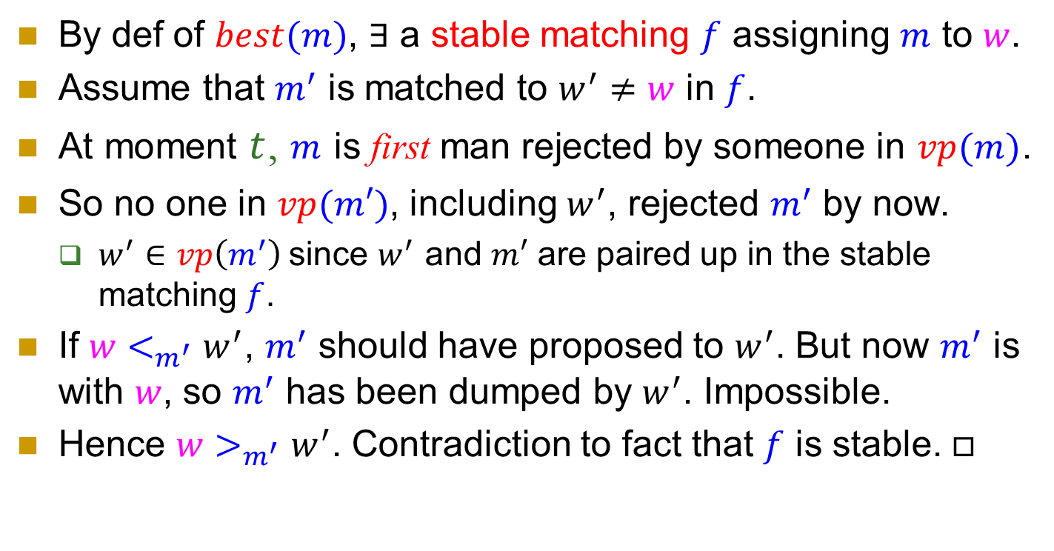




Proof
$$f$$
$$m$$
$$w$$
$$m^{′}>_{w}m$$
$$w>_{m^{′}}w′$$
$m′$
$$w′$$
$$f$$
By def of $best(m)$, $∃$ a stable matching $f$ assigning $m$ to $w$.
Assume that $m^{′}$ is matched to $w^{′}≠w$ in $f$.
At moment $t$, $m$ is first man rejected by someone in $vp(m)$.
So no one in $vp(m′)$, including $w^{′}$, rejected $m^{′}$ by now.
  $w^{′}∈vp\left(m^{′}\right)$since $w^{′}$ and $m′$ are paired up in the stable matching $f$.
If $w<_{m^{′}}w^{′}$, $m^{′}$ should have proposed to $w^{′}$. But now $m^{′}$ is with $w$, so $m^{′}$ has been dumped by $w^{′}$. Impossible.
Hence $w>_{m^{′}}w^{′}$. Contradiction to fact that $f$ is stable. $□$

Slide 30
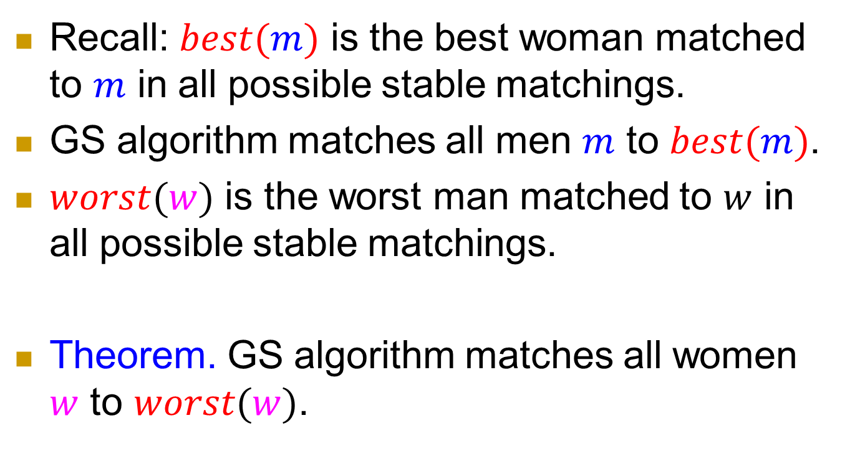
How about women?
Recall: $best(m)$ is the best woman matched to $m$ in all possible stable matchings.
GS algorithm matches all men $m$ to $best(m)$.
$worst(w)$ is the worst man matched to $w$ in all possible stable matchings.
Theorem. GS algorithm matches all women $w$ to $worst(w)$.

Slide 31



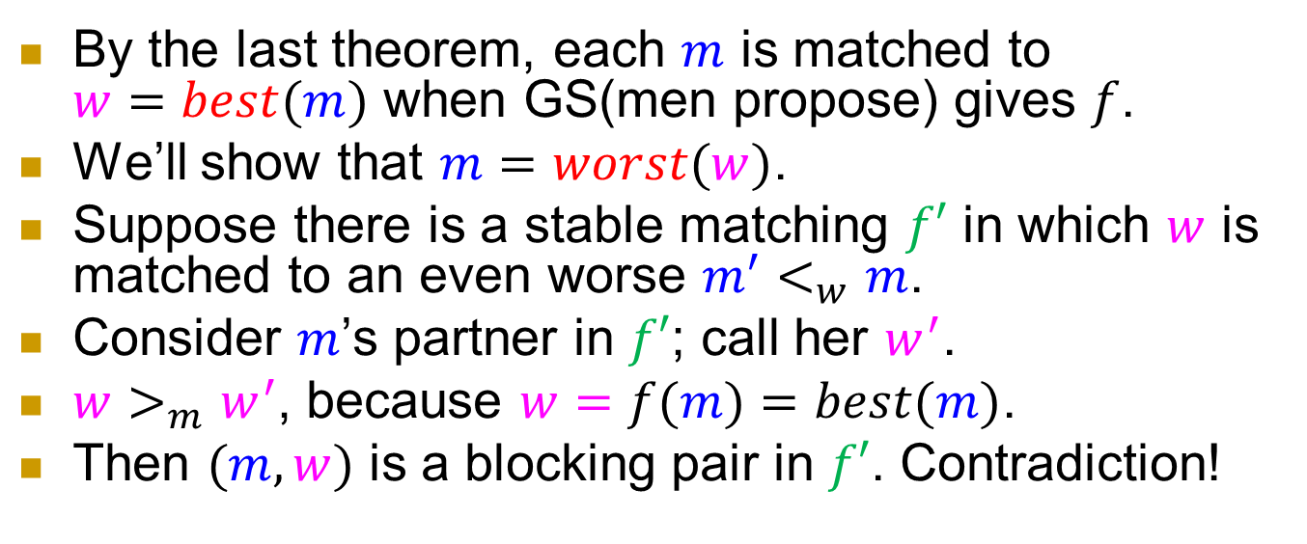





Proof
By the last theorem, each $m$ is matched to $w=best(m)$ when GS(men propose) gives $f$.
We’ll show that $m=worst(w)$.
Suppose there is a stable matching $f′$ in which $w$ is matched to an even worse $m^{′}<_{w}m$.
Consider $m$’s partner in $f′$; call her $w^{′}$.
$w>_{m}w^{′}$, because $w=f(m)=best(m)$.
Then $(m,w)$ is a blocking pair in $f′$. Contradiction!
$$m$$
$$f$$
$$w$$
$$w>_{m}w^{′}$$
$$m>_{w}m′$$
$m′$
$$f′$$
$$w′$$

Slide 32


Who should propose?
Thus if men propose, then
in each man’s eyes:
  His engaged women get worse and worse.
  But finally he gets the best possible. (The best that avoids a later divorce.)
in each woman’s eyes:
  Her engaged men get better and better.
  But finally she gets the worst possible.
  (The worst that avoids a later divorce.)

Slide 33
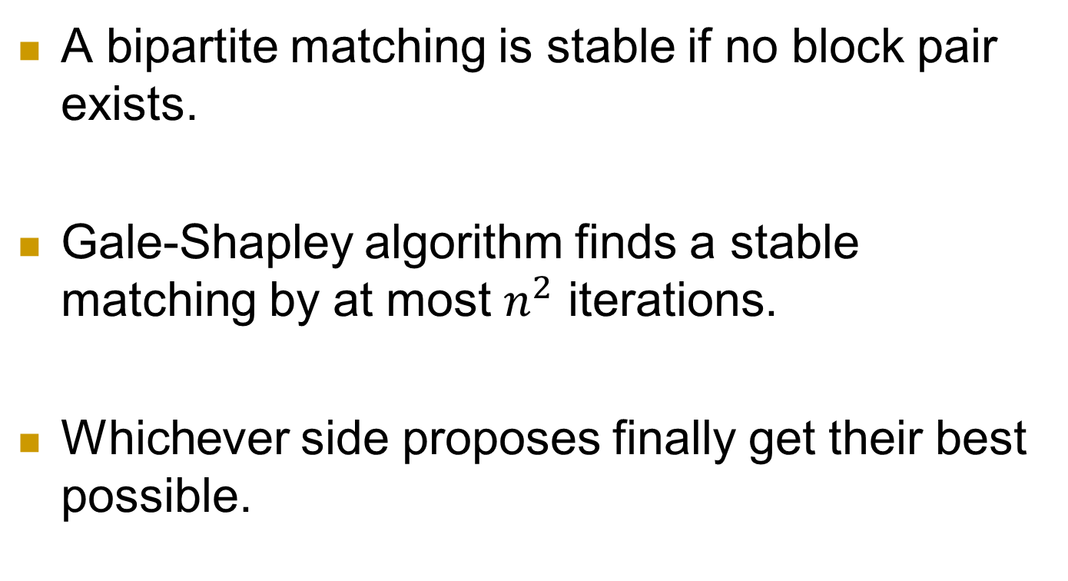
Summary for Stable Matching
A bipartite matching is stable if no block pair exists.
Gale-Shapley algorithm finds a stable matching by at most $n^{2}$ iterations.
Whichever side proposes finally get their best possible.

Slide 34
Secretary hiring problem

Slide 35
When to settle down?
Continuing the discussion about “marriage”, a related problem is:
When to settle down?
Secretary problem:
  We want to hire a new office assistant.
  There are a number of candidates.
  We can interview one candidate each day, but we have to decide the acceptance/rejection immediately.

Slide 36
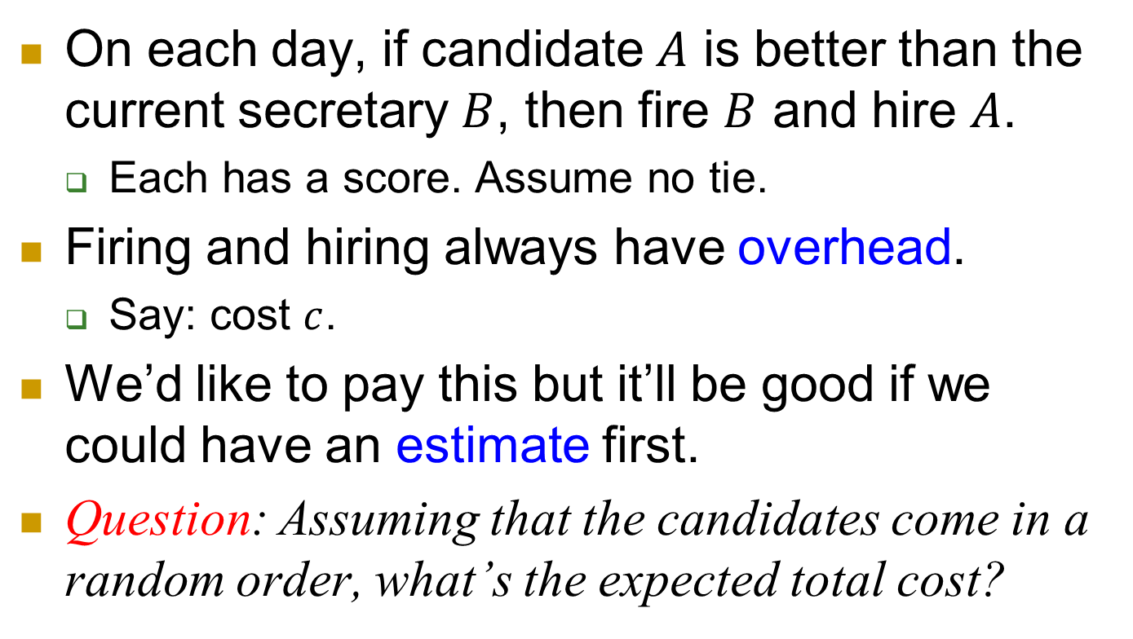
One possible strategy
On each day, if candidate $A$ is better than the current secretary $B$, then fire $B$ and hire $A$.
  Each has a score. Assume no tie.
Firing and hiring always have overhead.
  Say: cost $c$.
We’d like to pay this but it’ll be good if we could have an estimate first.
Question: Assuming that the candidates come in a random order, what’s the expected total cost?

Slide 37
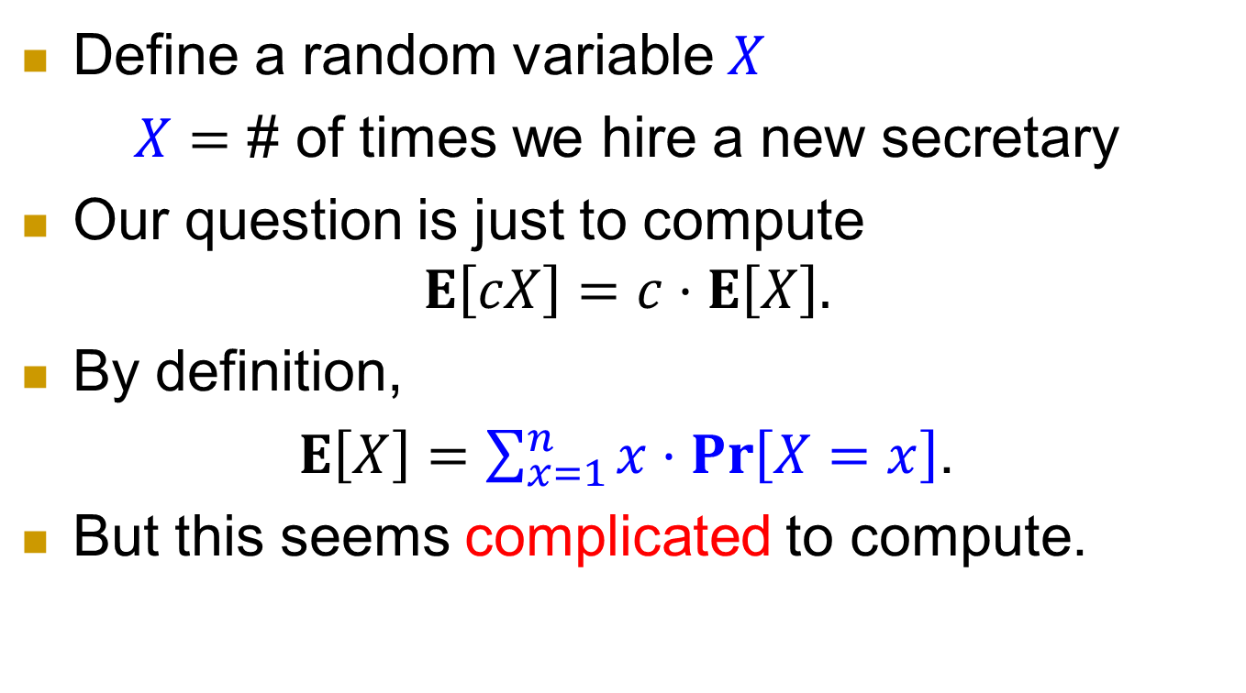
Probability…
Define a random variable $X$
$X=$ # of times we hire a new secretary
Our question is just to compute
$$E\left[cX\right]=c⋅E\left[X\right].$$
By definition,
$E\left[X\right]=\sum_{x=1}^{n}{x⋅\operatorname{Pr}\left[X=x\right]}$.
But this seems complicated to compute.

Slide 38
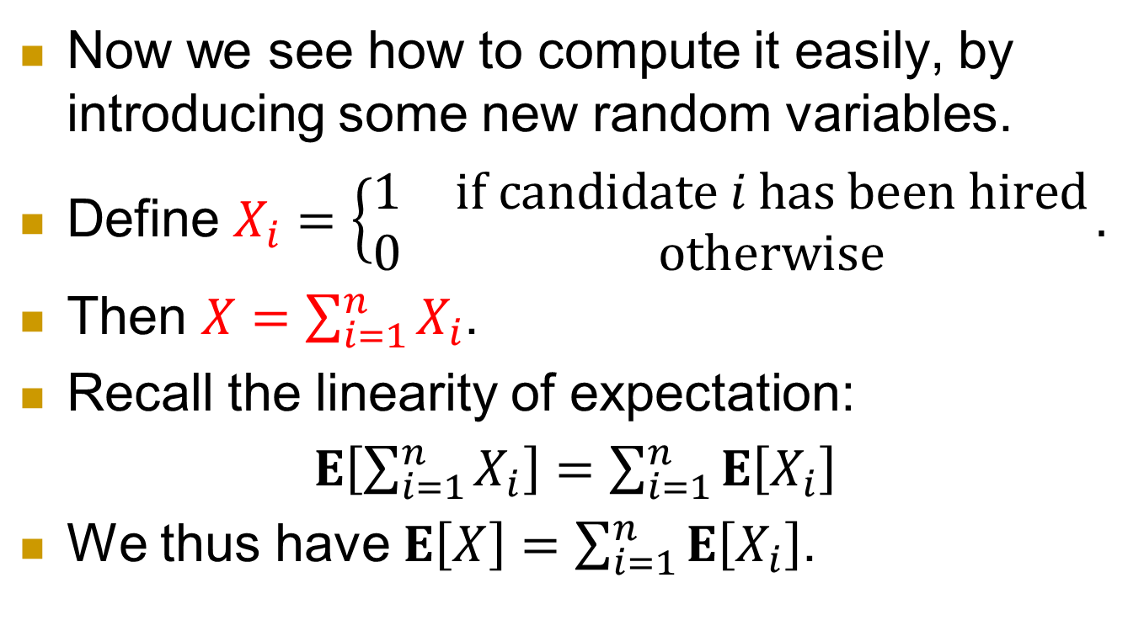
Indicator variables
Now we see how to compute it easily, by introducing some new random variables.
Define $X_{i}=\left\{\begin{matrix}1 & \text{if} \text{candidate} i \text{ha}\text{s} \text{been} \text{hired} \\ 0 & \text{otherwise}\end{matrix}\right..$
Then $X=\sum_{i=1}^{n}{X_{i}}$.
Recall the linearity of expectation:
$E\left[\sum_{i=1}^{n}{X_{i}}\right]=\sum_{i=1}^{n}{E\left[X_{i}\right]}$
We thus have $E\left[X\right]=\sum_{i=1}^{n}{E\left[X_{i}\right]}$.

Slide 39
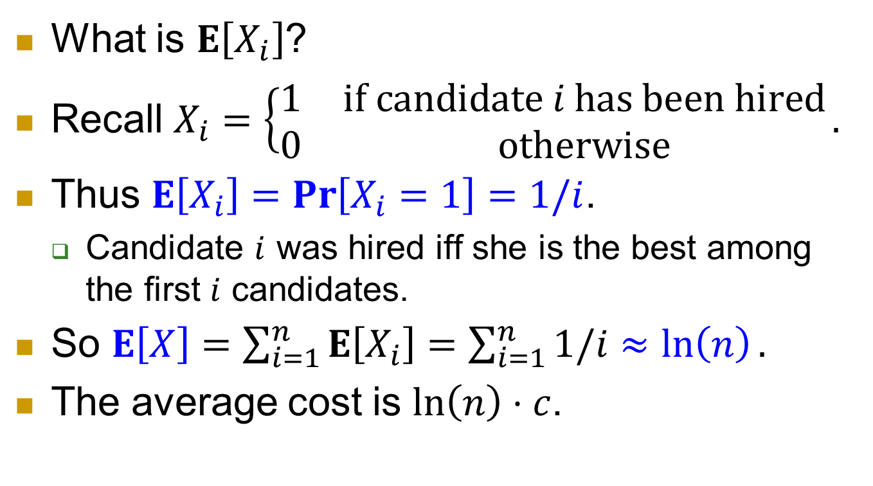
Analysis continued
What is $E\left[X_{i}\right]$?
Recall $X_{i}=\left\{\begin{matrix}1 & \text{if} \text{candidate} i \text{has} \text{been} \text{hired} \\ 0 & \text{otherwise}\end{matrix}\right..$
Thus $E\left[X_{i}\right]=\operatorname{Pr}\left[X_{i}=1\right]=1/i$.
  Candidate $i$ was hired iff she is the best among the first $i$ candidates.
So $E\left[X\right]=\sum_{i=1}^{n}{E\left[X_{i}\right]}=\sum_{i=1}^{n}{1/i}≈\ln\left(n\right).$
The average cost is $\ln\left(n\right)⋅c$.

Slide 40
Another strategy
A more natural scenario is that we only hire once.
And of course, we hope to hire the best one.
But the candidates on the market also get other offers. So we need to issue offer fast.
Interview one candidate each day, and decide acceptance/rejection immediately.
The candidates come in a random order.

Slide 41
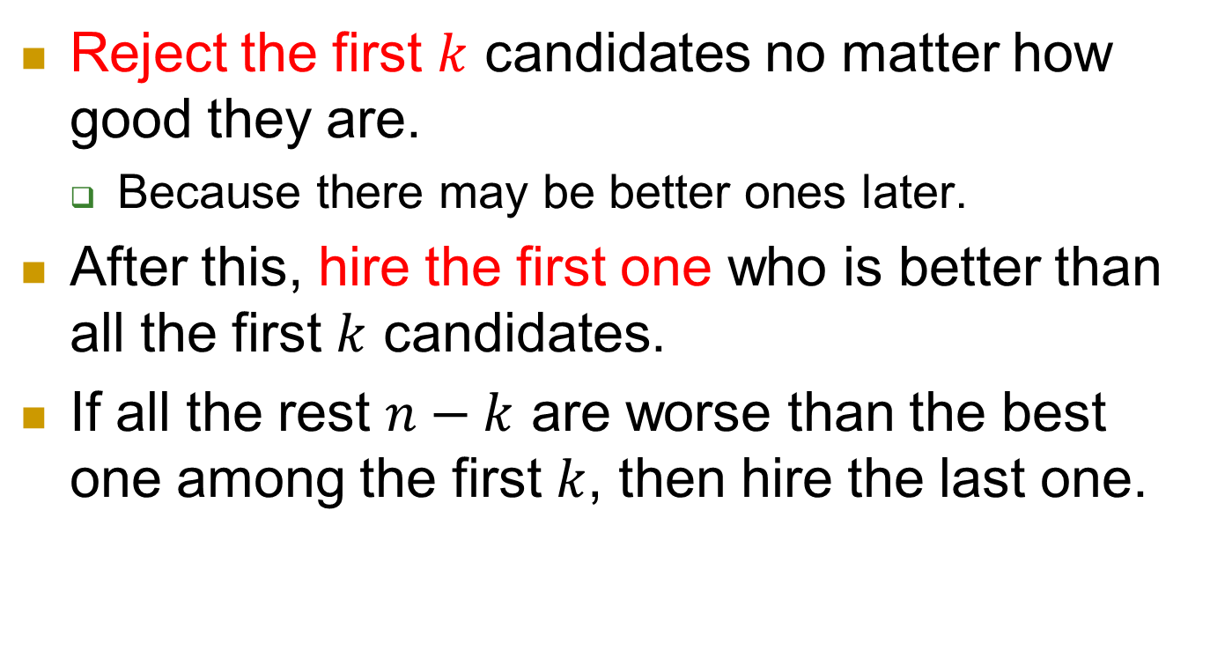
Strategy
Reject the first $k$ candidates no matter how good they are.
  Because there may be better ones later.
After this, hire the first one who is better than all the first $k$ candidates.
If all the rest $n−k$ are worse than the best one among the first $k$, then hire the last one.

Slide 42
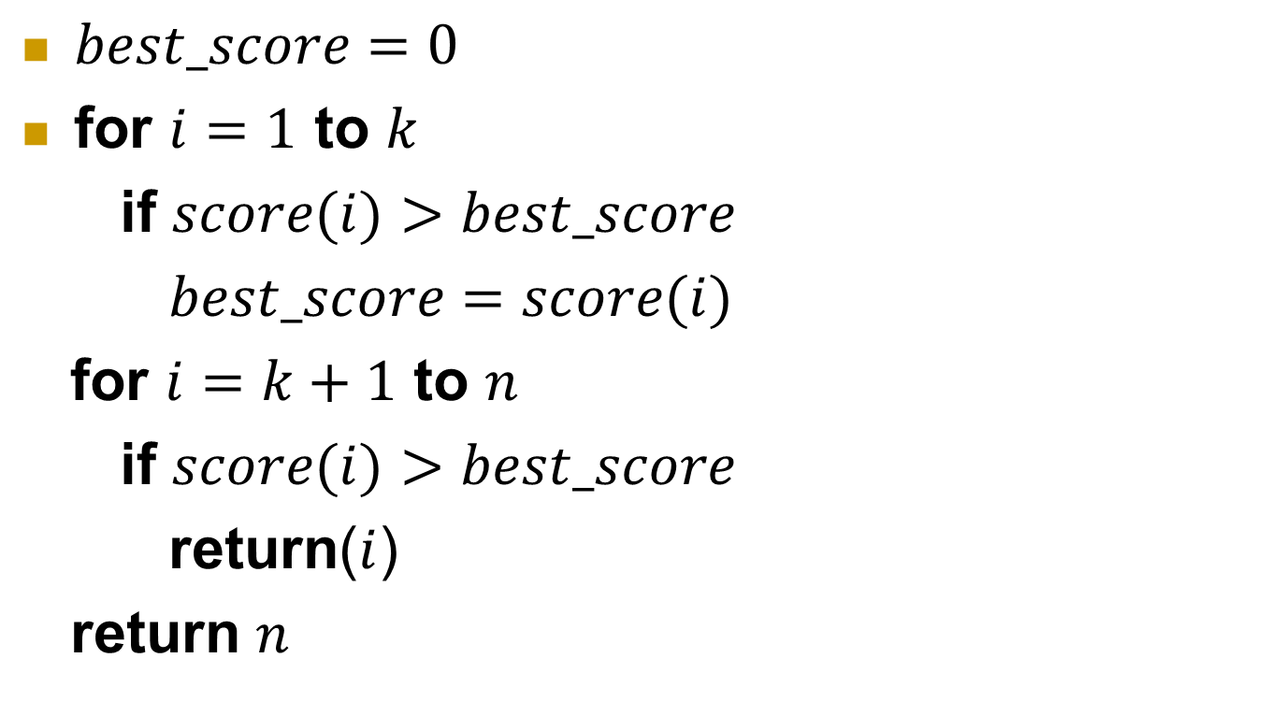
Pseudo-code
$best_score=0$
for $i=1$ to $k$
if $score(i)>best_score$
$best_score=score(i)$
for $i=k+1$ to $n$
if $score(i)>best_score$
return($i$)
return $n$

Slide 43
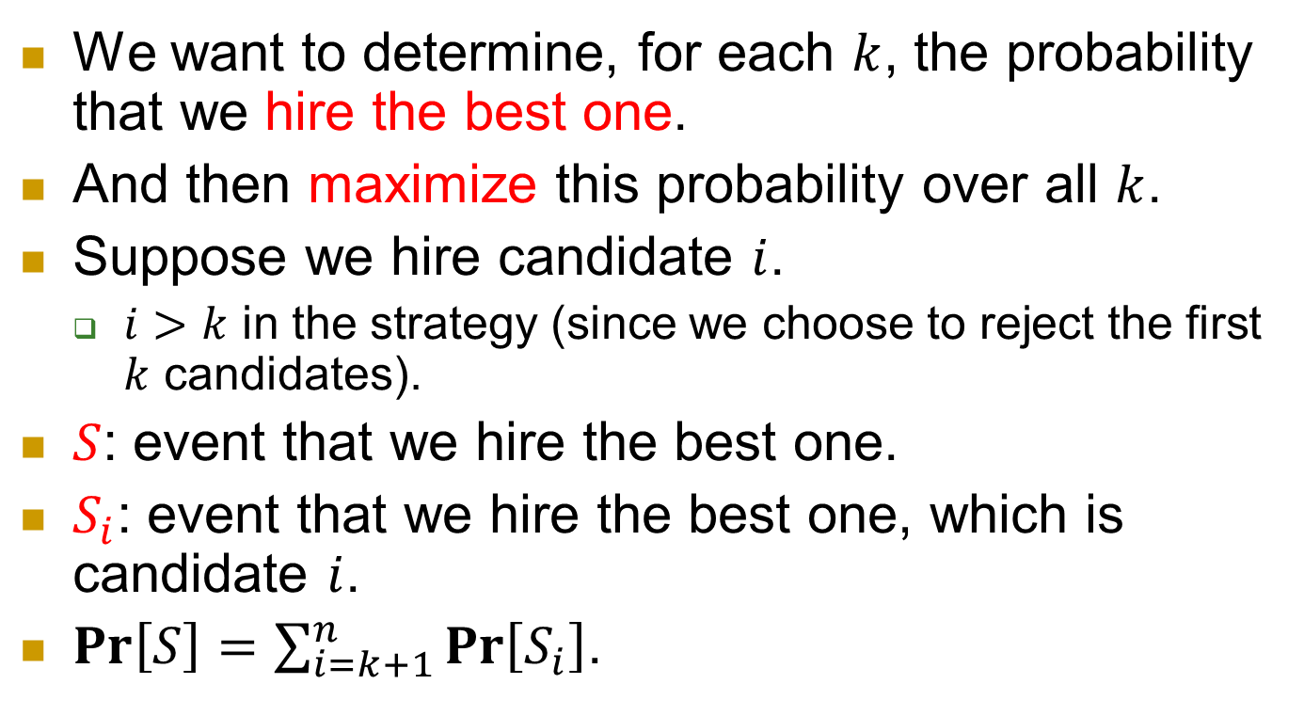
Next
We want to determine, for each $k$, the probability that we hire the best one.
And then maximize this probability over all $k$.
Suppose we hire candidate $i$.
  $i>k$ in the strategy (since we choose to reject the first $k$ candidates).
$S$: event that we hire the best one.
$S_{i}$: event that we hire the best one, which is candidate $i$.
$\operatorname{Pr}\left[S\right]=\sum_{i=k+1}^{n}{\operatorname{Pr}\left[S_{i}\right]}$.

Slide 44
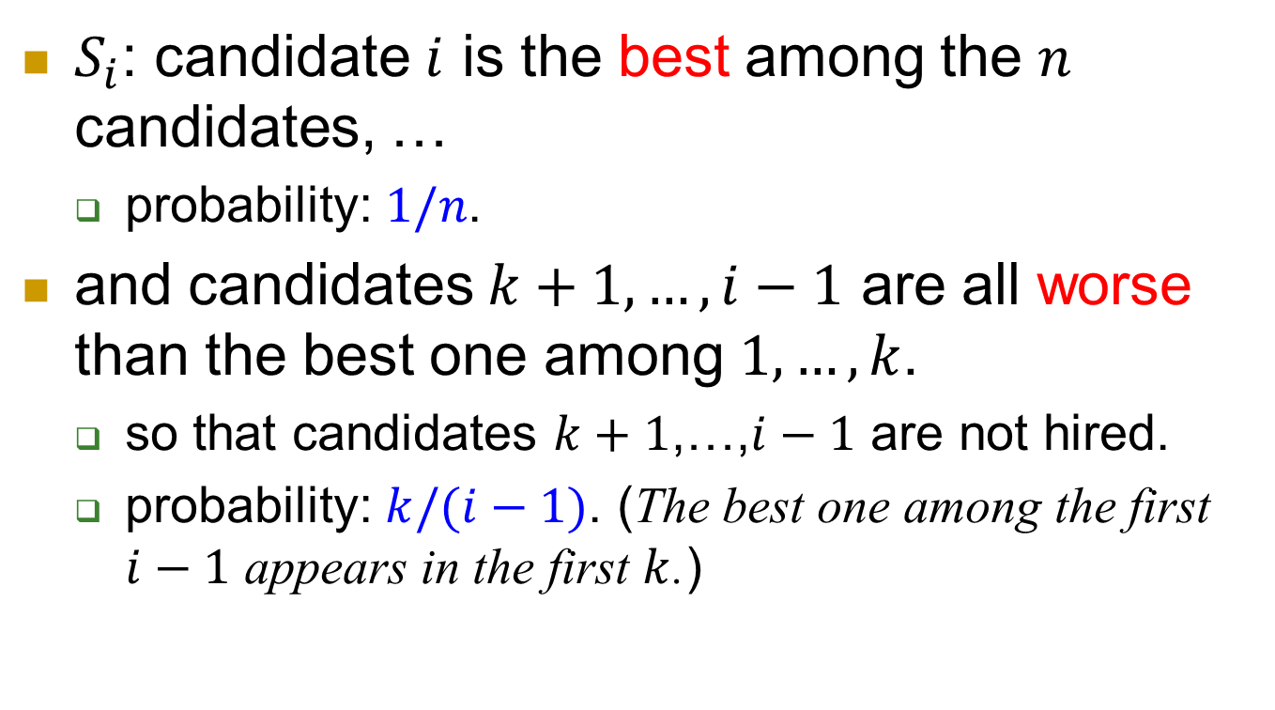
$S_{i}$: candidate $i$ is the best among the $n$ candidates, …
  probability: $1/n$.
and candidates $k+1,…,i−1$ are all worse than the best one among $1,…,k$.
  so that candidates $k+1$,…,$i−1$ are not hired.
  probability: $k/(i−1)$. (The best one among the first $i−1$ appears in the first $k$.)

Slide 45
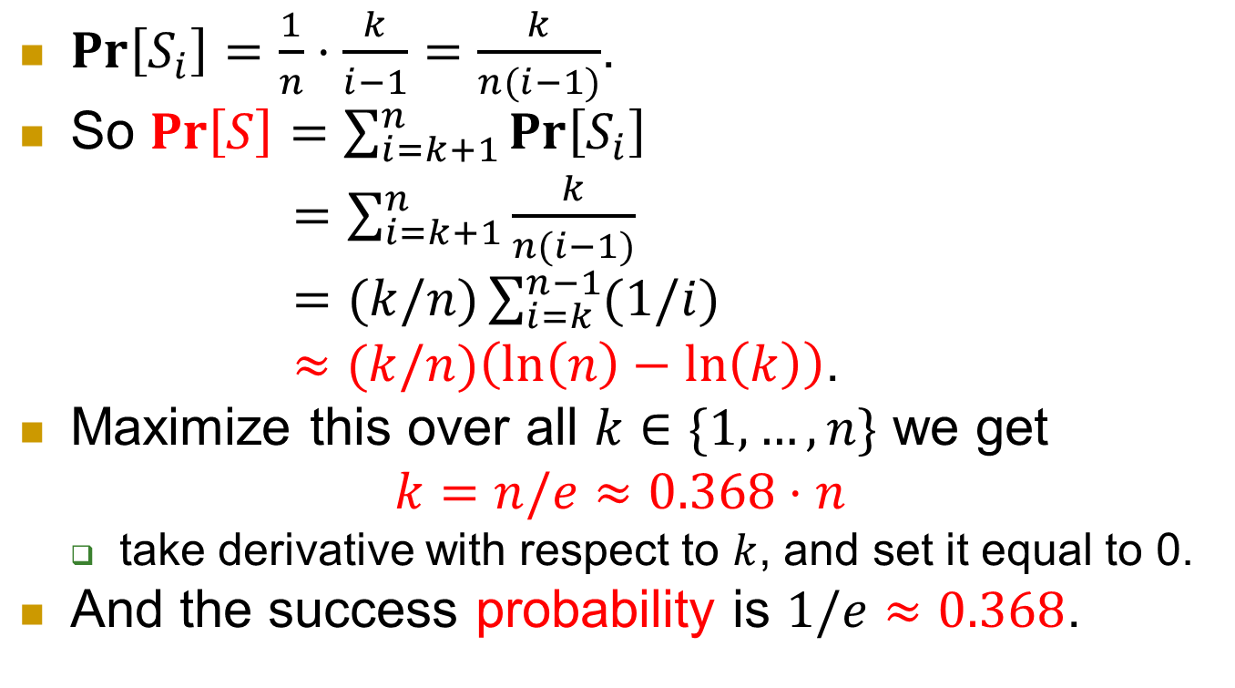
Putting together
$\operatorname{Pr}\left[S_{i}\right]=\frac{1}{n}⋅\frac{k}{i−1}=\frac{k}{n(i−1)}$.
So $\operatorname{Pr}\left[S\right]=\sum_{i=k+1}^{n}{\operatorname{Pr}\left[S_{i}\right]}$
$=\sum_{i=k+1}^{n}{\frac{k}{n(i−1)}}$
$=(k/n)\sum_{i=k}^{n−1}{(1/i)}$
$≈(k/n)\left(\ln\left(n\right)−\ln\left(k\right)\right)$.
Maximize this over all $k∈\{1,…,n\}$ we get
$$k=n/e≈0.368⋅n$$
  take derivative with respect to $k$, and set it equal to 0.
And the success probability is $1/e≈0.368$.

Slide 46
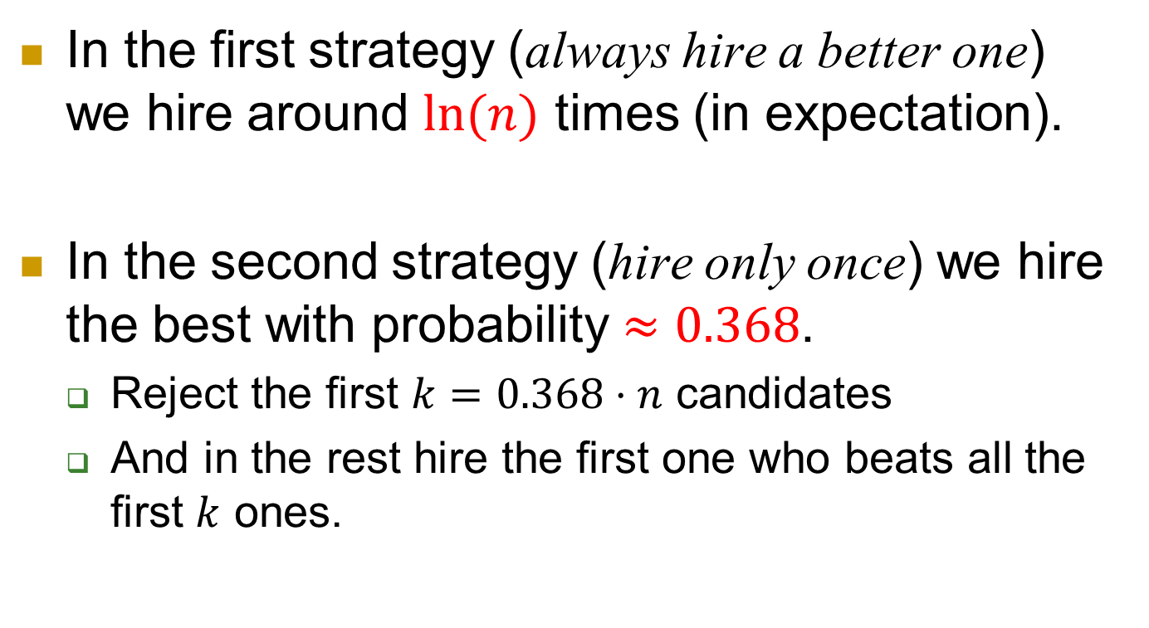
Summary for the Secretary problem
In the first strategy (always hire a better one) we hire around $ln⁡(n)$ times (in expectation).
In the second strategy (hire only once) we hire the best with probability $≈0.368$.
  Reject the first $k=0.368⋅n$ candidates
  And in the rest hire the first one who beats all the first $k$ ones.

