Slide 1
CSC3160: Design and Analysis of Algorithms
Week 8: Maximum Network Flow
Instructor: Shengyu Zhang

Slide 2
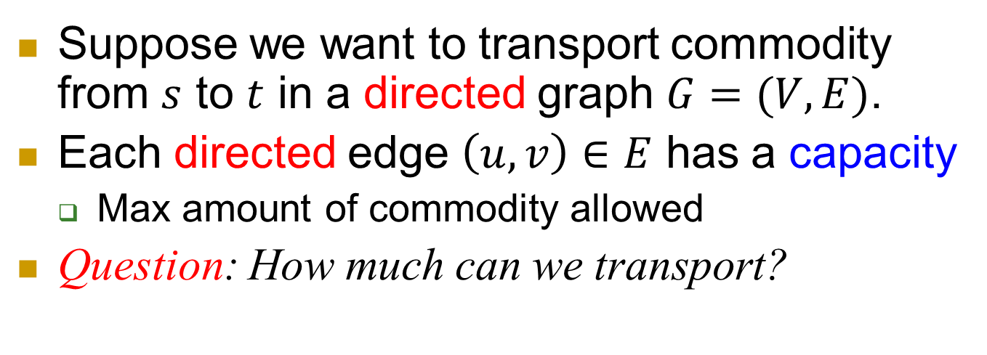
Transportation
Total Flow: 16
0
flow
a
4
c
capacity
6
8
8
10
2
0
8
6
6
10
8
8
10
s
10
b
9
d
10
t
Suppose we want to transport commodity from $s$ to $t$ in a directed graph $G=(V,E)$.
Each directed edge $\left(u,v\right)∈E$ has a capacity
  Max amount of commodity allowed
Question: How much can we transport?

Slide 3
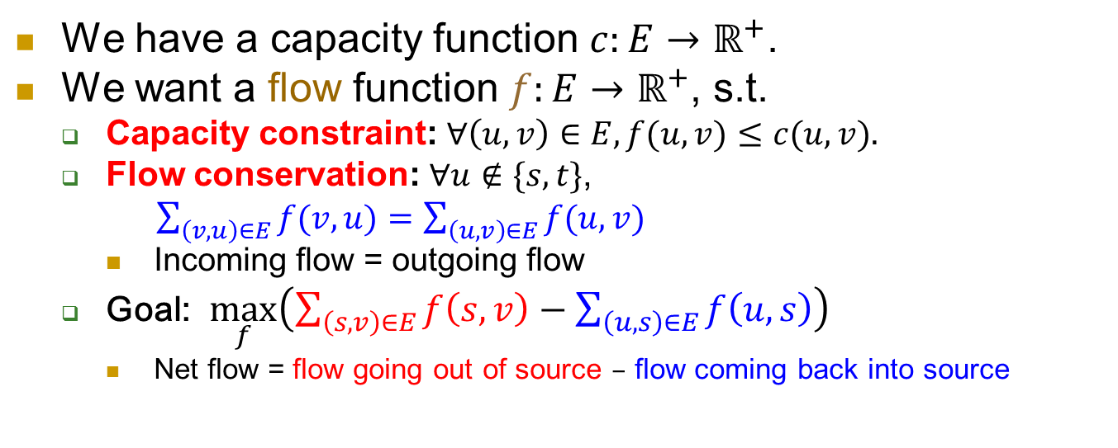
Technically
Total Flow: 16
0
flow
a
4
c
capacity
6
8
8
10
2
0
8
6
6
10
8
8
10
s
10
b
9
d
10
t
We have a capacity function $c:E→ℝ^{+}$.
We want a flow function $f:E→ℝ^{+}$, s.t.
  Capacity constraint: $∀\left(u,v\right)∈E, f(u,v)≤c(u,v).$
  Flow conservation: $∀u∉\{s,t\}$,
  $\sum_{\left(v,u\right)∈E}{f(v,u)}=\sum_{\left(u,v\right)∈E}{f(u,v)}$
    Incoming flow = outgoing flow
  Goal: $\max_{f}\left(\sum_{\left(s,v\right)∈E}{f\left(s,v\right)}−\sum_{\left(u,s\right)∈E}{f\left(u,s\right)}\right)$
    Net flow = flow going out of source $–$ flow coming back into source

Slide 4
Improve it ☺
Total Flow: 16
19
0
3
flow
a
4
c
capacity
10
6
9
8
8
7
10
2
0
8
6
6
10
8
9
8
9
10
s
10
b
9
d
10
t
Can we improve this?
  For some edges: we gave too much.
  For some other edges: we didn’t give enough.
Can we further improve this?

Slide 5
Network Flow
Can you give a good algorithm?
Methodology 5: Approach to the optimum by a sequence of improvements.

Slide 6
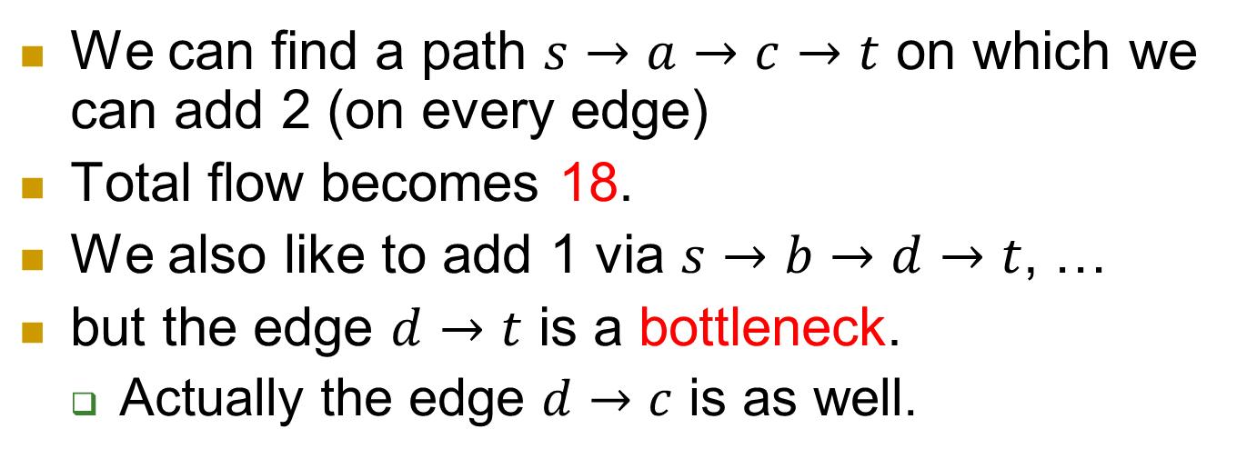
Improve it little by little
Total Flow: 16
18
0
+2=2
flow
a
4
c
capacity
+2=10
6
+2=8
8
8
10
2
0
8
6
6
10
8
+1
8
+1
10
s
10
b
9
d
10
t
We can find a path $s→a→c→t$ on which we can add 2 (on every edge)
Total flow becomes 18.
We also like to add 1 via $s→b→d→t$, …
but the edge $d→t$ is a bottleneck.
  Actually the edge $d→c$ is as well.

Slide 7
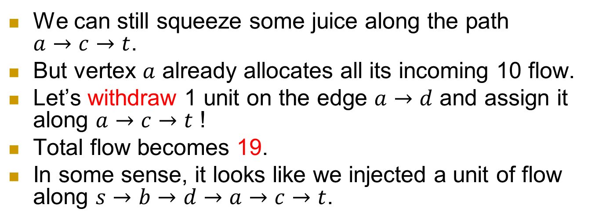
Improve it little by little
Total Flow: 16
18
19
0
+2=2
flow
a
4
+1=3
c
capacity
+2=10
6
+2=8
8
-1=7
8
10
2
0
8
6
6
10
+1=9
8
+1
8
+1
10
s
10
b
9
d
10
t
We can still squeeze some juice along the path $a→c→t$.
But vertex $a$ already allocates all its incoming 10 flow.
Let’s withdraw 1 unit on the edge $a→d$ and assign it along $a→c→t$ !
Total flow becomes 19.
In some sense, it looks like we injected a unit of flow along $s→b→d→a→c→t$.

Slide 8
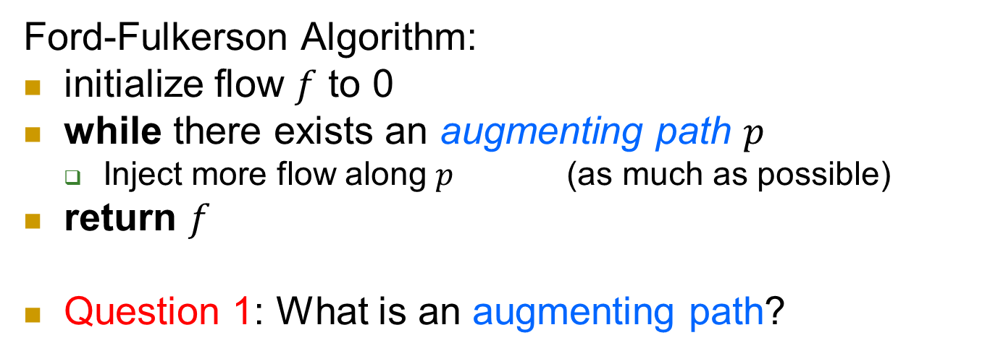
Improve it little by little
Total Flow: 16
18
19
0
+2=2
flow
a
4
+1=3
c
capacity
+2=10
6
+2=8
8
-1=7
8
10
2
0
8
6
6
10
+1=9
8
+1
8
+1
10
s
10
b
9
d
10
t
Ford-Fulkerson Algorithm:
initialize flow $f$ to 0
while there exists an augmenting path $p$
  Inject more flow along $p$ (as much as possible)
return $f$
Question 1: What is an augmenting path?

Slide 9
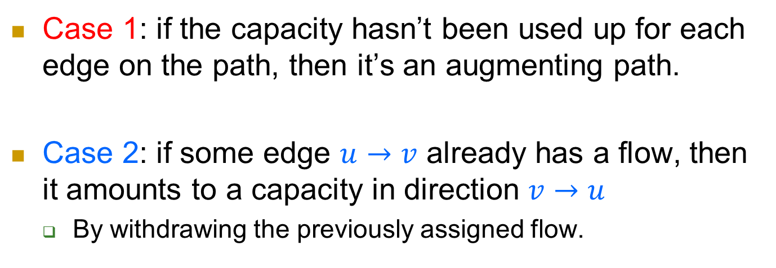
Improve it little by little
Total Flow: 16
18
19
0
+2=2
flow
a
4
+1=3
c
capacity
+2=10
6
+2=8
8
-1=7
8
10
2
0
8
6
6
10
+1=9
8
+1
8
+1
10
s
10
b
9
d
10
t
Case 1: if the capacity hasn’t been used up for each edge on the path, then it’s an augmenting path.
Case 2: if some edge $u→v$ already has a flow, then it amounts to a capacity in direction $v→u$
  By withdrawing the previously assigned flow.

Slide 10
Improve it little by little
Total Flow: 16
18
19
0
+2=2
flow
a
4
+1=3
c
capacity
+2=10
6
+2=8
8
-1=7
8
10
2
0
8
6
6
10
+1=9
8
+1
8
+1
10
s
10
b
9
d
10
t
Question 2: How to find an augmenting path?
By residual networks.

Slide 11




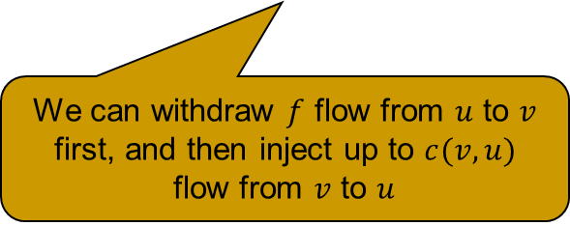
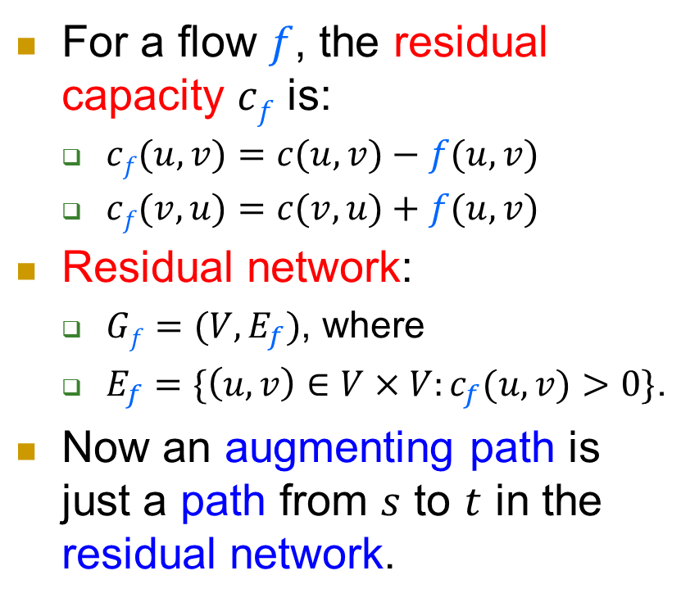

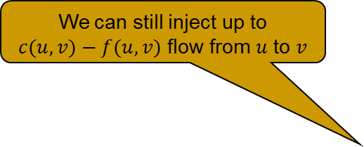




Residual networks
For a flow $f$, the residual capacity $cf$ is:
  $cf(u,v)=c(u,v)−f(u,v)$
  $cf(v,u)=c(v,u)+f(u,v)$
Residual network:
  $Gf=(V,E_{f})$, where
  $E_{f}=\{\left(u,v\right)∈V×V:c_{f}(u,v)>0\}$.
Now an augmenting path is just a path from $s$ to $t$ in the residual network.
$$f(u,v)$$
We can still inject up to $c(u,v)−f(u,v)$ flow from $u$ to $v$
$$c(u,v)$$
$$u$$
$$v$$
$$c(v,u)$$
$$c(u,v)−f(u,v)$$
$$v$$
$$u$$
$$c(v,u)+f(u,v)$$
We can withdraw $f$ flow from $u$ to $v$ first, and then inject up to $c(v,u)$ flow from $v$ to $u$

Slide 12
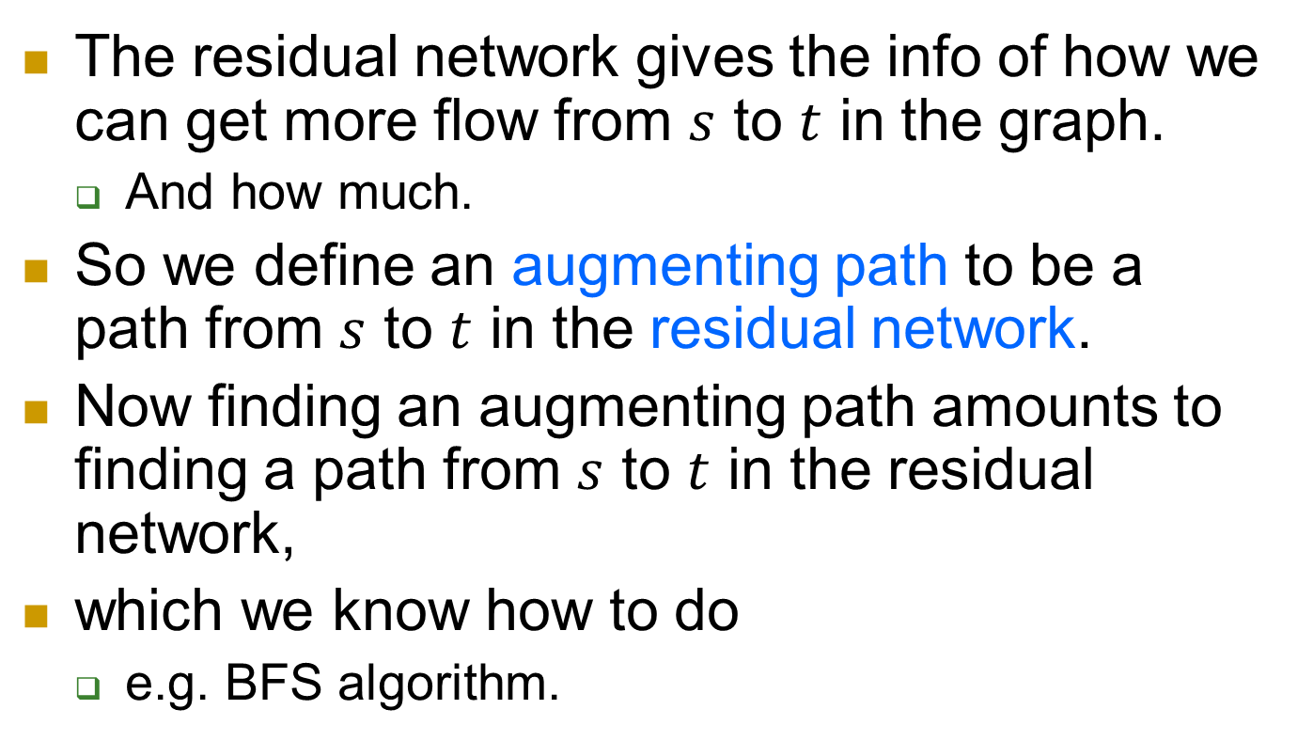
Residual networks
The residual network gives the info of how we can get more flow from $s$ to $t$ in the graph.
  And how much.
So we define an augmenting path to be a path from $s$ to $t$ in the residual network.
Now finding an augmenting path amounts to finding a path from $s$ to $t$ in the residual network,
which we know how to do
  e.g. BFS algorithm.

Slide 13
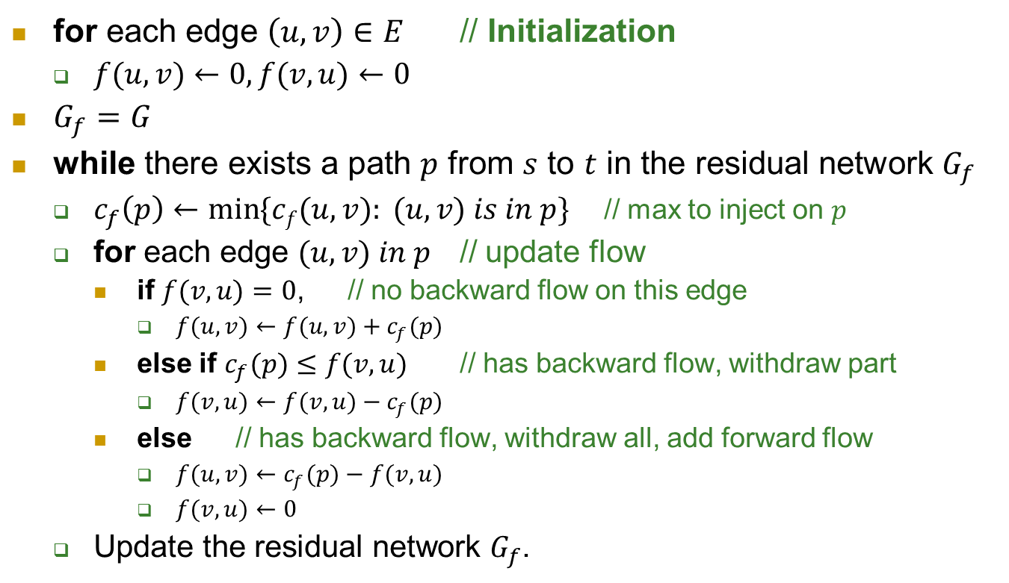

FORD-FULKERSON$(G, s, t)$
for each edge $\left(u,v\right)∈E$ // Initialization
  $f(u,v)←0, f(v,u)←0$
$G_{f}=G$
while there exists a path $p$ from $s$ to $t$ in the residual network $G_{f}$
  $c_{f}\left(p\right)←\min{\{cf(u,v): (u,v) is in p\}}$ // max to inject on $p$
  for each edge $(u,v) in p$ // update flow
    if $f(v,u)=0$, // no backward flow on this edge
      $f(u,v)←f(u,v)+c_{f}(p)$
    else if $c_{f}(p)≤f(v,u)$ // has backward flow, withdraw part
      $f(v,u)←f(v,u)−c_{f}(p)$
    else // has backward flow, withdraw all, add forward flow
      $f(u,v)←c_{f}(p)−f(v,u)$
      $f(v,u)←0$
  Update the residual network $G_{f}$.

Slide 14
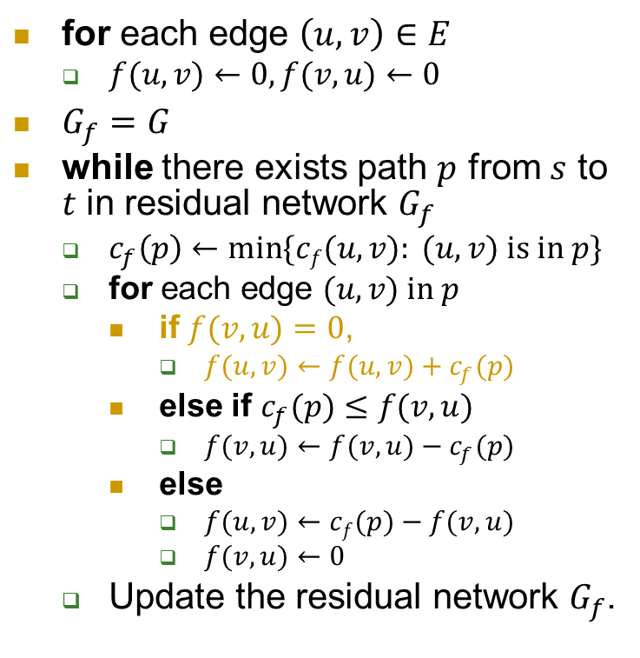



FORD-FULKERSON$(G, s, t)$
for each edge $\left(u,v\right)∈E$
  $f(u,v)←0, f(v,u)←0$
$G_{f}=G$
while there exists path $p$ from $s$ to $t$ in residual network $G_{f}$
  $c_{f}\left(p\right)←\min{\{cf(u,v): (u,v) \text{is} \text{in} p\}}$
  for each edge $(u,v) \text{in} p$
    if $f(v,u)=0$,
      $f(u,v)←f(u,v)+c_{f}(p)$
    else if $c_{f}(p)≤f(v,u)$
      $f(v,u)←f(v,u)−c_{f}(p)$
    else
      $f(u,v)←cf(p)−f(v,u)$
      $f(v,u)←0$
  Update the residual network $G_{f}$.
$$G$$
0
a
4
c
0
8
0
8
0
10
2
0
8
6
0
10
0
0
0
8
s
10
b
9
d
10
t
$$G_{f}$$
a
4
c
10
2
8
6
10
s
10
b
9
d
10
t
$$c_{f}(p)=8, \text{flow}=8$$

Slide 15


FORD-FULKERSON$(G, s, t)$
for each edge $\left(u,v\right)∈E$
  $f(u,v)←0, f(v,u)←0$
$G_{f}=G$
while there exists path $p$ from $s$ to $t$ in residual network $G_{f}$
  $c_{f}\left(p\right)←\min{\{cf(u,v): (u,v) \text{is} \text{in} p\}}$
  for each edge $(u,v) \text{in} p$
    if $f(v,u)=0$,
      $f(u,v)←f(u,v)+c_{f}(p)$
    else if $c_{f}(p)≤f(v,u)$
      $f(v,u)←f(v,u)−c_{f}(p)$
    else
      $f(u,v)←cf(p)−f(v,u)$
      $f(v,u)←0$
  Update the residual network $G_{f}$.
$$G$$
0
a
4
c
8
8
0
10
2
0
8
6
0
10
0
0
8
s
10
b
9
d
10
t
$$G_{f}$$
8
a
4
c
8
2
2
0
6
10
s
10
b
9
d
2
t
$$c_{f}\left(p\right)=8, flow=8$$
8
New $c_{f}(p)$? New flow? New $G_{f}$?

Slide 16
Questions left
How to find an augmenting path?
What if, at some step, there is no augmenting path in the residual network?
  Can we conclude that we’ve found the maximum flow?

Slide 17
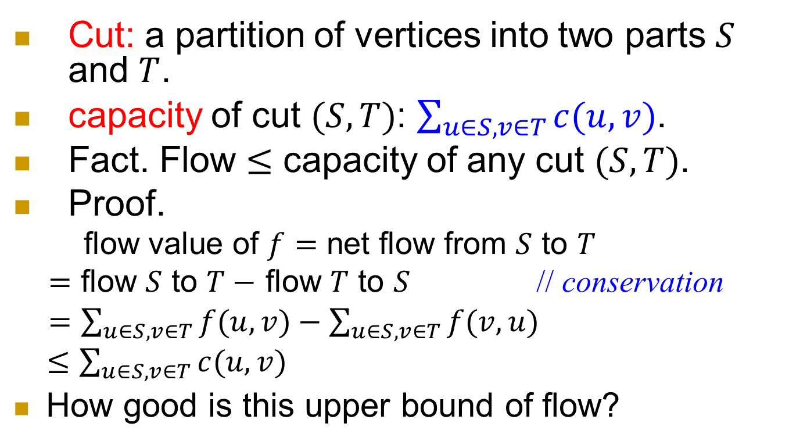
Cut
Cut: a partition of vertices into two parts $S$ and $T$.
capacity of cut $(S,T)$: $\sum_{u∈S,v∈T}{c(u,v)}$.
Fact. Flow $≤$ capacity of any cut $(S,T)$.
Proof.
flow value of $f$ $=$ net flow from $S$ to $T$
$=$ flow $S$ to $T−$ flow $T$ to $S$ // conservation
$=$ $\sum_{u∈S,v∈T}{f(u,v)}−\sum_{u∈S,v∈T}{f(v,u)}$
$≤\sum_{u∈S,v∈T}{c(u,v)}$
How good is this upper bound of flow?

Slide 18
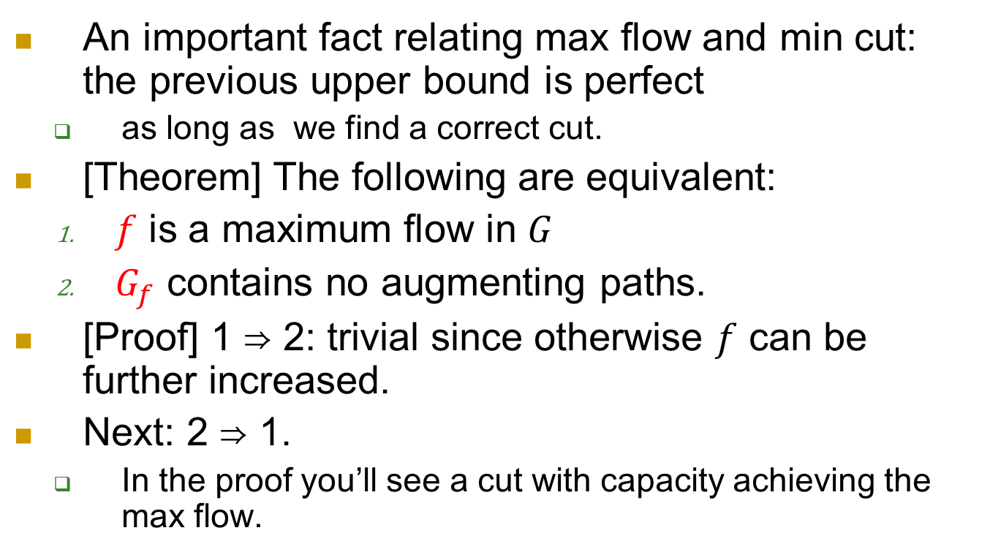
Max-flow min-cut Theorem.
An important fact relating max flow and min cut: the previous upper bound is perfect
  as long as we find a correct cut.
[Theorem] The following are equivalent:
  $f$ is a maximum flow in $G$
  $G_{f}$ contains no augmenting paths.
[Proof] 1 ⇒ 2: trivial since otherwise $f$ can be further increased.
Next: 2 ⇒ 1.
  In the proof you’ll see a cut with capacity achieving the max flow.

Slide 19

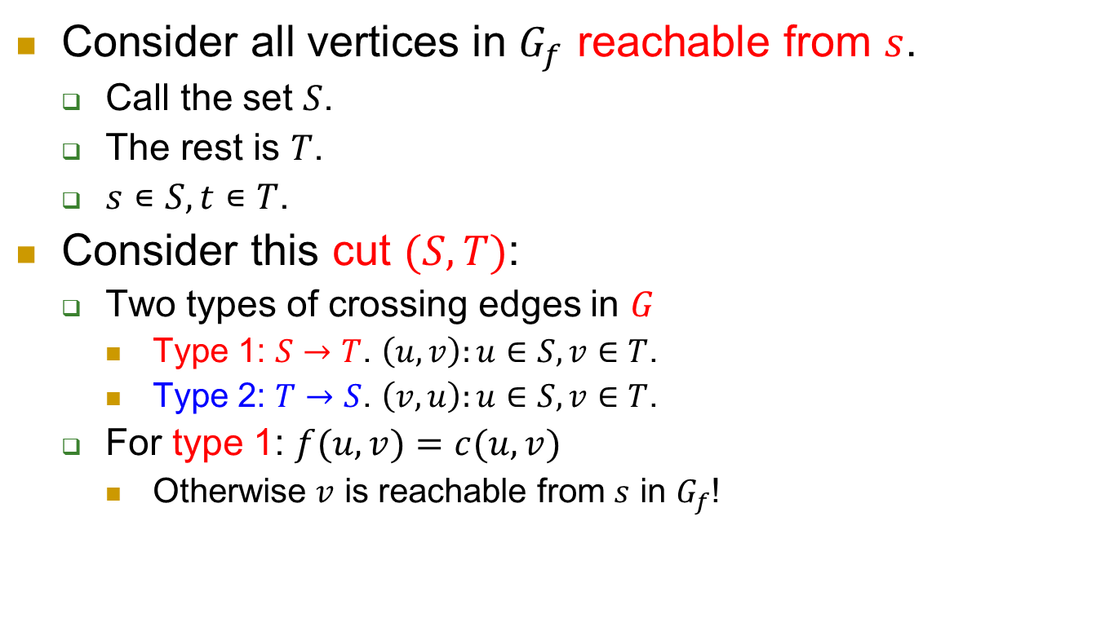

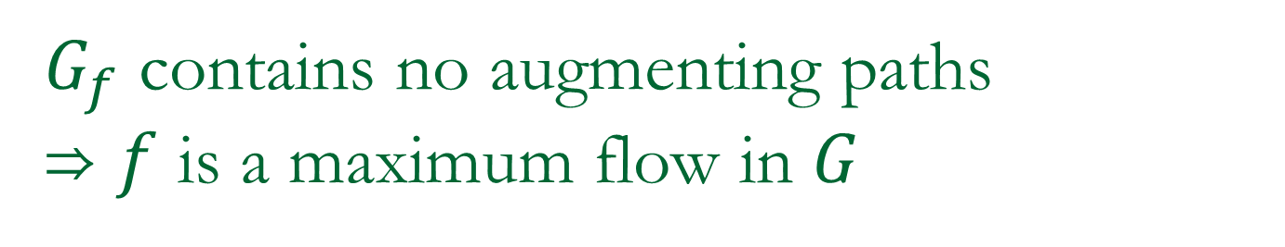




$G_{f}$ contains no augmenting paths
⇒ $f$ is a maximum flow in $G$
Consider all vertices in $G_{f}$ reachable from $s$.
  Call the set $S$.
  The rest is $T$.
  $s∊S, t∊T$.
Consider this cut $(S,T)$:
  Two types of crossing edges in $G$
    Type 1: $S→T$. $\left(u,v\right):u∈S,v∈T$.
    Type 2: $T→S$. $\left(v,u\right):u∈S,v∈T$.
  For type 1: $f(u,v)=c(u,v)$
    Otherwise $v$ is reachable from $s$ in $G_{f}$!
$$s$$
$$u$$
$$t$$
$$v$$
$$S$$
$$T$$

Slide 20
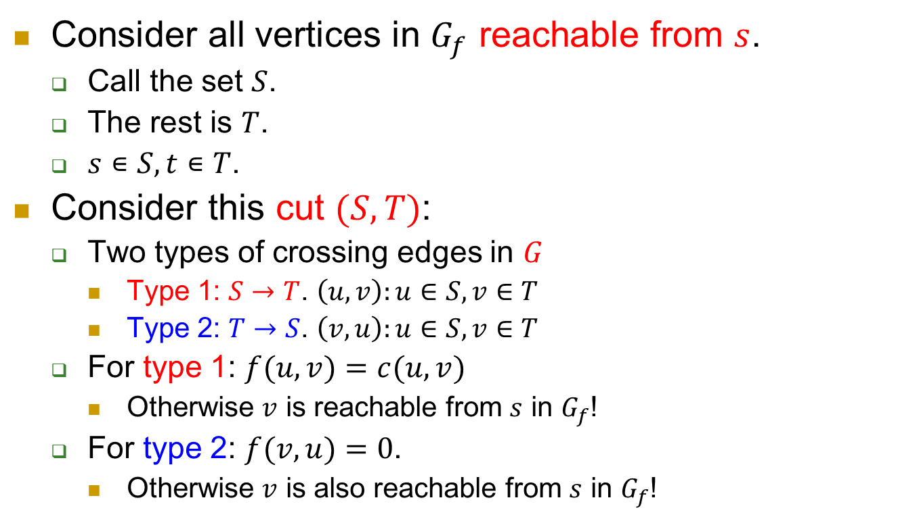

$G_{f}$ contains no augmenting paths
⇒ $f$ is a maximum flow in $G$
Consider all vertices in $G_{f}$ reachable from $s$.
  Call the set $S$.
  The rest is $T$.
  $s∊S, t∊T$.
Consider this cut $(S,T)$:
  Two types of crossing edges in $G$
    Type 1: $S→T$. $\left(u,v\right):u∈S,v∈T$
    Type 2: $T→S$. $\left(v,u\right):u∈S,v∈T$
  For type 1: $f(u,v)=c(u,v)$
    Otherwise $v$ is reachable from $s$ in $G_{f}$!
  For type 2: $f(v,u)=0$.
    Otherwise $v$ is also reachable from $s$ in $G_{f}$!
$$v$$
$$s$$
$$u$$
$$t$$
$$S$$
$$T$$
Done!
Why?

Slide 21

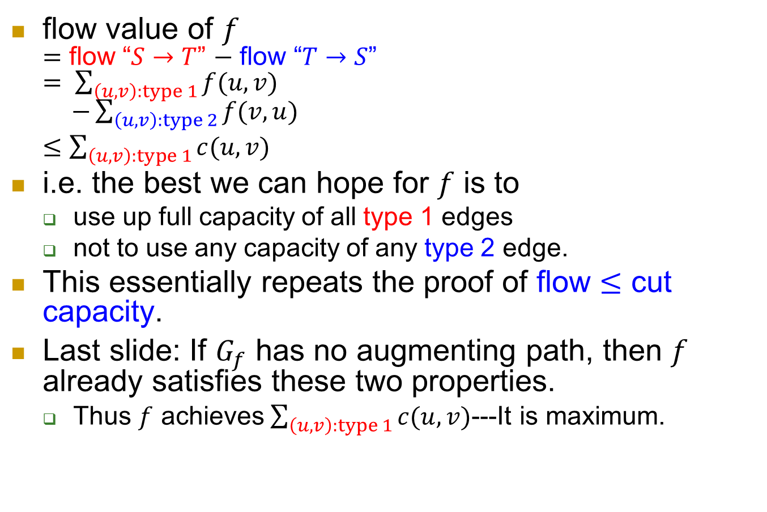



Any cut gives an upper bound!
flow value of $f$
$=$ flow “$S→T$” $−$ flow “$T→S$”
$= \sum_{\left(u,v\right):type 1}{f(u,v)}$
$−\sum_{\left(u,v\right):type 2}{f(v,u)}$
$≤\sum_{\left(u,v\right):type 1}{c(u,v)}$
i.e. the best we can hope for $f$ is to
  use up full capacity of all type 1 edges
  not to use any capacity of any type 2 edge.
This essentially repeats the proof of flow $≤$ cut capacity.
Last slide: If $G_{f}$ has no augmenting path, then $f$ already satisfies these two properties.
  Thus $f$ achieves $\sum_{\left(u,v\right):type 1}{c(u,v)}$---It is maximum.
$$s$$
$$t$$
$$S$$
$$T$$

Slide 22
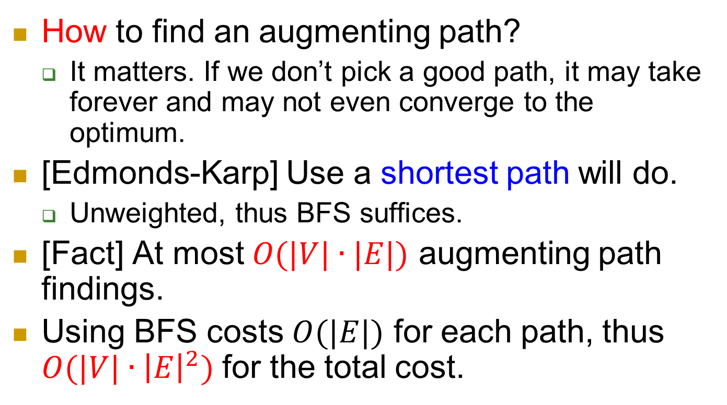
Next
How to find an augmenting path?
  It matters. If we don’t pick a good path, it may take forever and may not even converge to the optimum.
[Edmonds-Karp] Use a shortest path will do.
  Unweighted, thus BFS suffices.
[Fact] At most $O(|V|∙|E|)$ augmenting path findings.
Using BFS costs $O(|E|)$ for each path, thus $O(|V|∙{\left|E\right|}^{2})$ for the total cost.

Slide 23
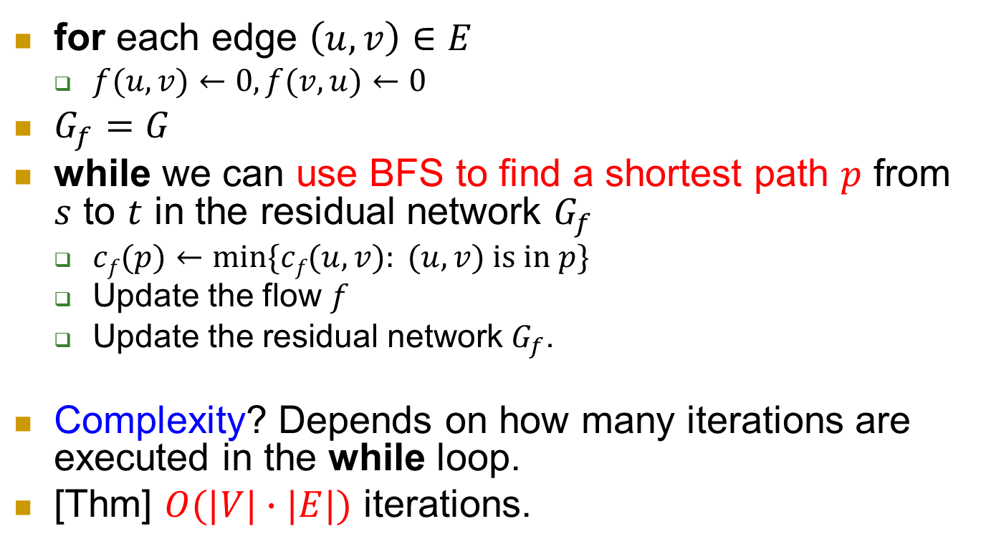
Edmonds-Karp Algorithm
for each edge $\left(u,v\right)∈E$
  $f(u,v)←0, f(v,u)←0$
$G_{f}=G$
while we can use BFS to find a shortest path $p$ from $s$ to $t$ in the residual network $G_{f}$
  $cf(p)←min⁡\{cf(u,v): (u,v) \text{is} \text{in} p\}$
  Update the flow $f$
  Update the residual network $G_{f}$.
Complexity? Depends on how many iterations are executed in the while loop.
[Thm] $O(|V|∙|E|)$ iterations.

Slide 24
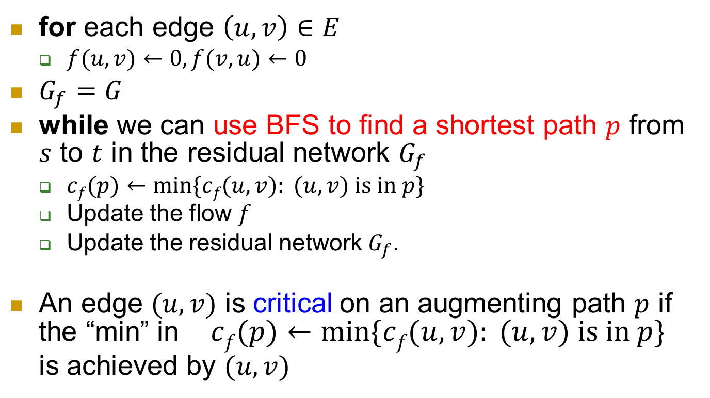
Edmonds-Karp Algorithm
for each edge $\left(u,v\right)∈E$
  $f(u,v)←0, f(v,u)←0$
$G_{f}=G$
while we can use BFS to find a shortest path $p$ from $s$ to $t$ in the residual network $G_{f}$
  $cf(p)←min⁡\{cf(u,v): (u,v) \text{is} \text{in} p\}$
  Update the flow $f$
  Update the residual network $G_{f}$.
An edge $(u,v)$ is critical on an augmenting path $p$ if the “min” in $cf(p)←min⁡\{cf(u,v): (u,v) \text{is} \text{in} p\}$
is achieved by $(u,v)$

Slide 25
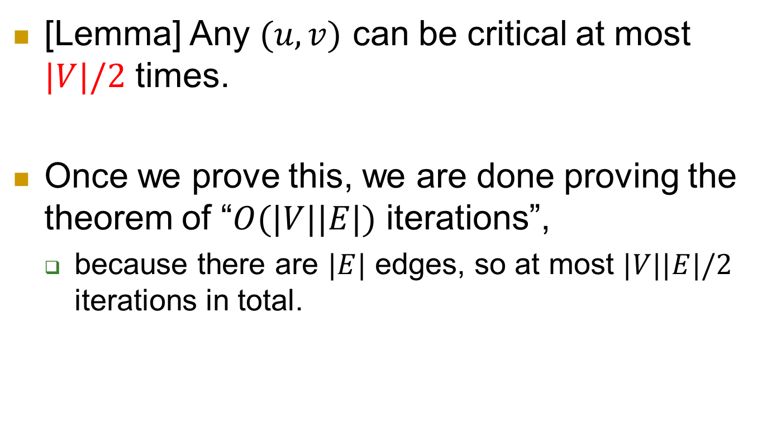
Analysis
[Lemma] Any $(u,v)$ can be critical at most $|V|/2$ times.
Once we prove this, we are done proving the theorem of “$O(|V||E|)$ iterations”,
  because there are $|E|$ edges, so at most $|V||E|/2$ iterations in total.

Slide 26
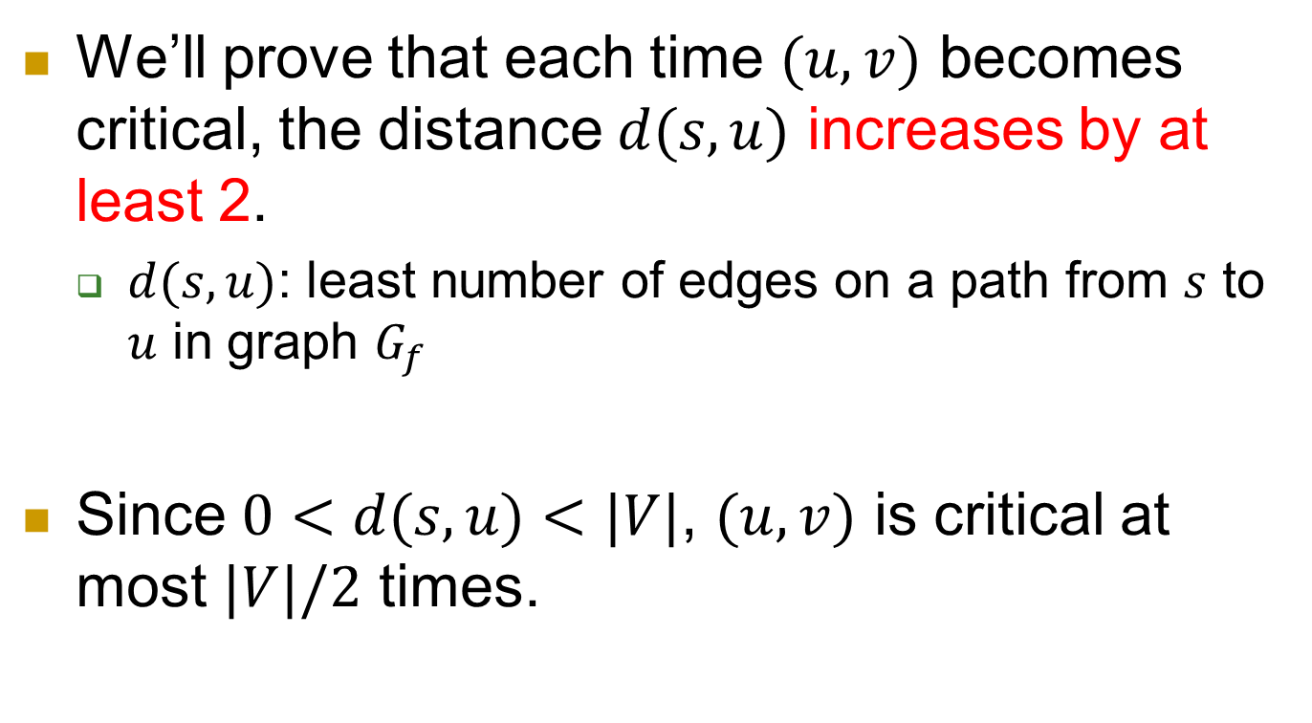
Proof of the lemma
We’ll prove that each time $(u,v)$ becomes critical, the distance $d(s,u)$ increases by at least 2.
  $d(s,u)$: least number of edges on a path from $s$ to $u$ in graph $G_{f}$
Since $0<d(s,u)<|V|$, $(u,v)$ is critical at most $|V|/2$ times.

Slide 27
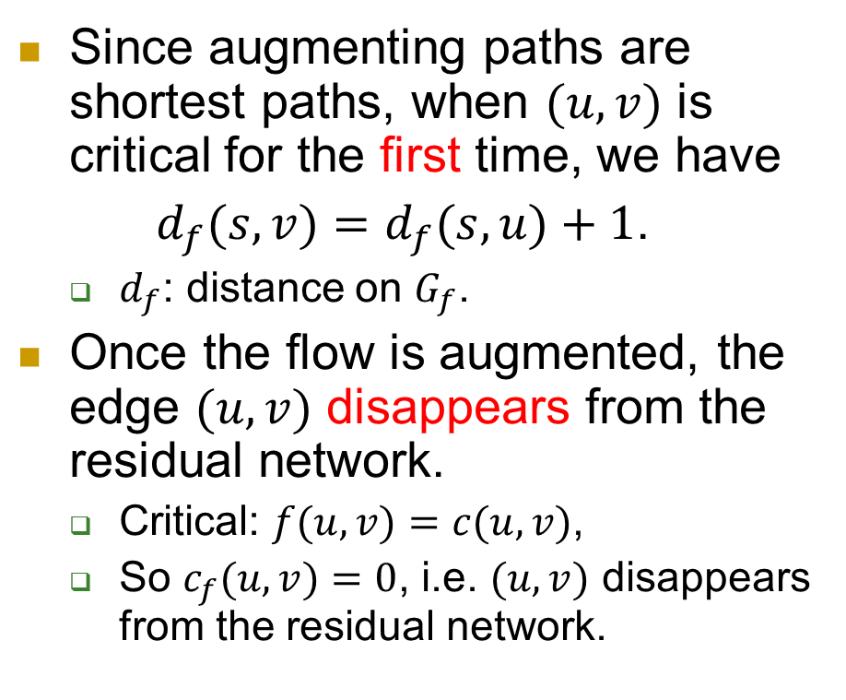
Proof (continued)
Since augmenting paths are shortest paths, when $(u,v)$ is critical for the first time, we have
$d_{f}(s,v)=d_{f}(s,u)+1$.
  $d_{f}$: distance on $G_{f}$.
Once the flow is augmented, the edge $(u,v)$ disappears from the residual network.
  Critical: $f(u,v)=c(u,v)$,
  So $c_{f}(u,v)=0$, i.e. $(u,v)$ disappears from the residual network.
t
s
u
v

Slide 28
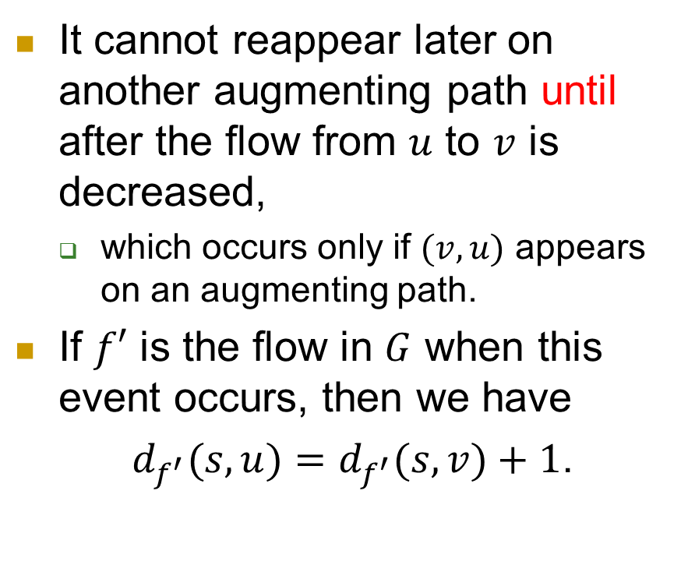
Proof (continued)
It cannot reappear later on another augmenting path until after the flow from $u$ to $v$ is decreased,
  which occurs only if $(v,u)$ appears on an augmenting path.
If $f′$ is the flow in $G$ when this event occurs, then we have
$d_{f^{′}}(s,u)=d_{f^{′}}(s,v)+1$.
t
s
u
v

Slide 29
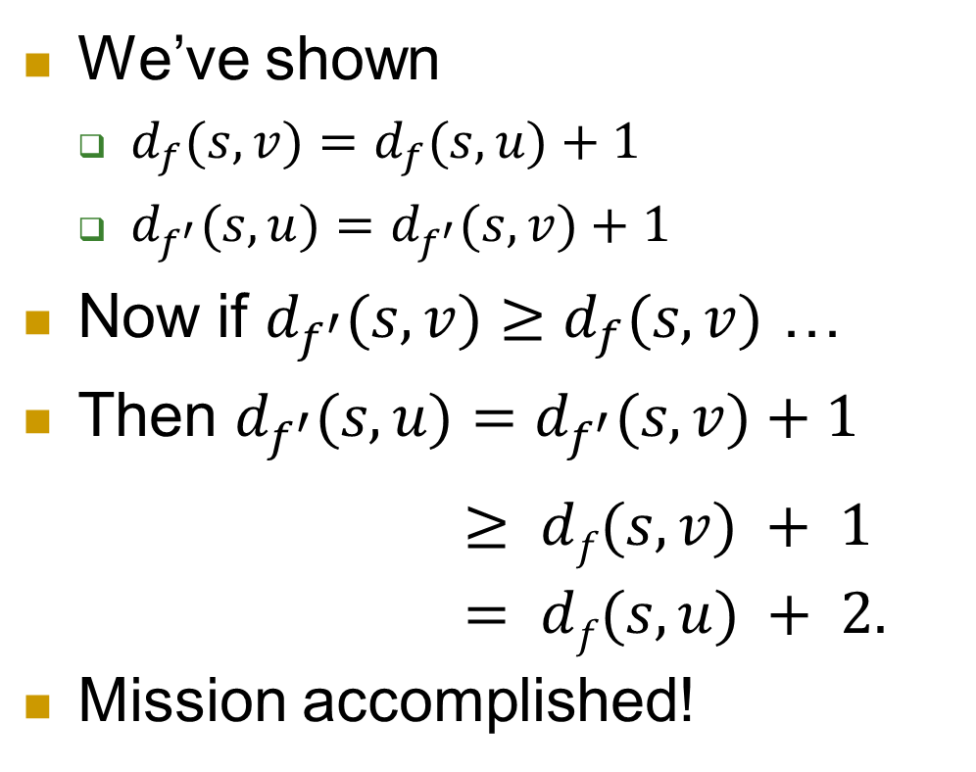
Proof (continued)
We’ve shown
  $d_{f}(s,v)=d_{f}(s,u)+1$
  $d_{f^{′}}(s,u)=d_{f^{′}}(s,v)+1$
Now if $d_{f^{′}}(s,v)≥d_{f}(s,v)$ …
Then $d_{f^{′}}(s,u)=d_{f^{′}}(s,v)+1$
$≥ df(s,v) + 1$
$= df(s,u) + 2.$
Mission accomplished!
Exercise!

Slide 30
Application: Max bipartite matching
We’ve learned maximum flow problem and algorithms.
Next we apply it to solve the maximum bipartite matching problem.

Slide 31

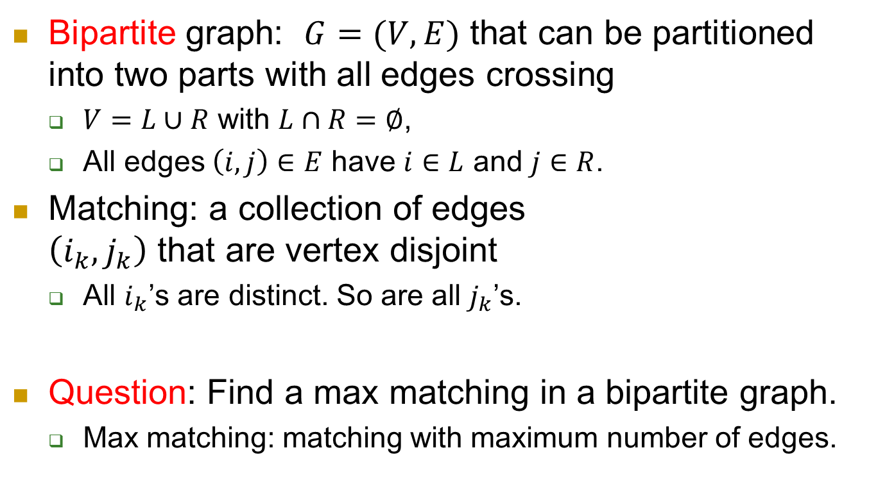

Maximum bipartite matching
Bipartite graph: $G=(V,E)$ that can be partitioned into two parts with all edges crossing
  $V=L∪R$ with $L∩R=∅$,
  All edges $\left(i,j\right)∈E$ have $i∈L$ and $j∈R$.
Matching: a collection of edges
$\left(i_{k},j_{k}\right)$ that are vertex disjoint
  All $i_{k}$’s are distinct. So are all $j_{k}$’s.
Question: Find a max matching in a bipartite graph.
  Max matching: matching with maximum number of edges.
$$L$$
$$R$$

Slide 32
Methodology 0: See whether the problem can be reduced to another one whose answer is known.
Very often, the problem that you are facing appeared to other people before.
  Solutions are known.
Also very often, the problem is probably new, but it’s very similar to, or essentially the same as an old one.
Then a simple transformation or reduction works.

Slide 33



Orient existing edges from $L$ to $R$.
$$L$$
$$R$$

Slide 34

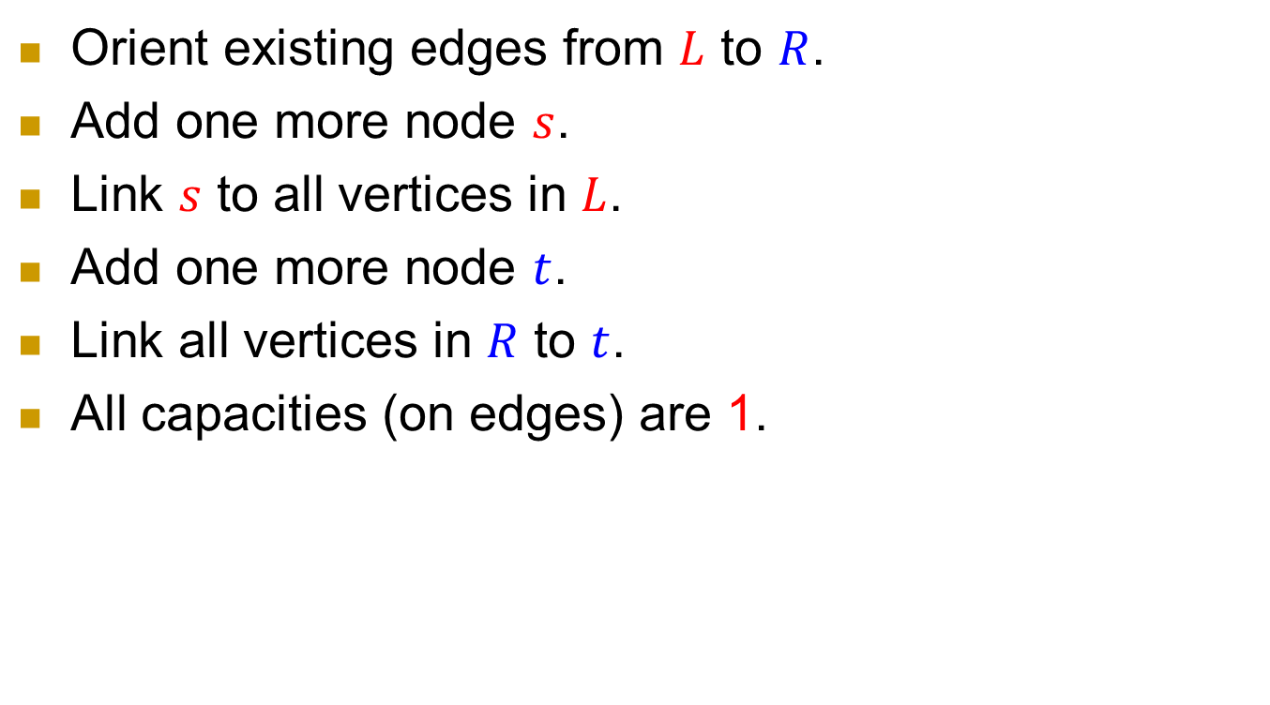

Orient existing edges from $L$ to $R$.
Add one more node $s$.
Link $s$ to all vertices in $L$.
Add one more node $t$.
Link all vertices in $R$ to $t$.
All capacities (on edges) are 1.
$$L$$
$$R$$
$$s$$
$$t$$

Slide 35

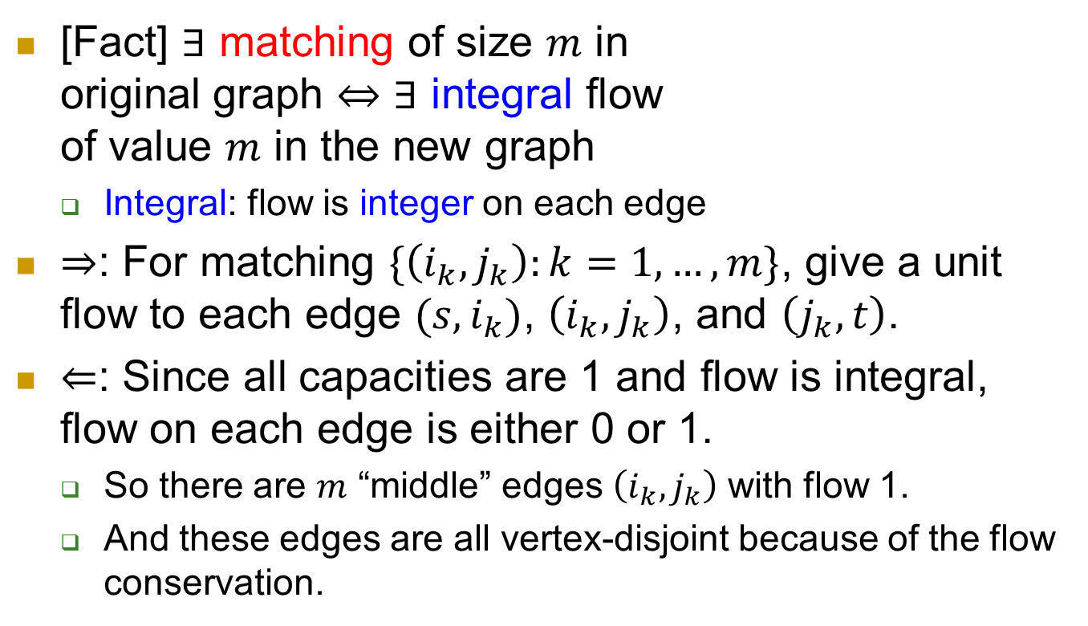



Equivalence
$$L$$
$$R$$
[Fact] $∃$ matching of size $m$ in
original graph $⇔$ $∃$ integral flow
of value $m$ in the new graph
  Integral: flow is integer on each edge
$⇒$: For matching $\{\left(i_{k},j_{k}\right):k=1,…,m\}$, give a unit flow to each edge $(s,i_{k})$, $\left(i_{k},j_{k}\right)$, and $\left(j_{k},t\right)$.
$⇐$: Since all capacities are 1 and flow is integral, flow on each edge is either 0 or 1.
  So there are $m$ “middle” edges $\left(i_{k},j_{k}\right)$ with flow 1.
  And these edges are all vertex-disjoint because of the flow conservation.
$$s$$
$$t$$

Slide 36
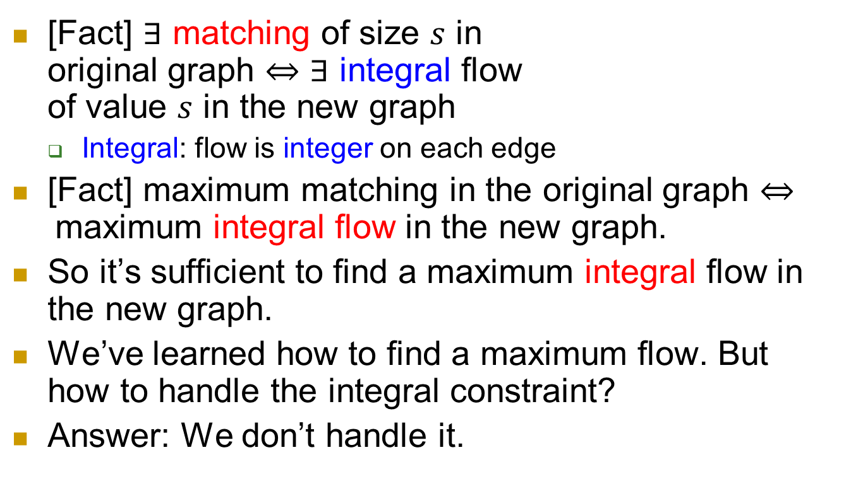
$$L$$
$$R$$
[Fact] $∃$ matching of size $s$ in
original graph $⇔$ $∃$ integral flow
of value $s$ in the new graph
  Integral: flow is integer on each edge
[Fact] maximum matching in the original graph $⇔$maximum integral flow in the new graph.
So it’s sufficient to find a maximum integral flow in the new graph.
We’ve learned how to find a maximum flow. But how to handle the integral constraint?
Answer: We don’t handle it.
$$s$$
$$t$$

Slide 37
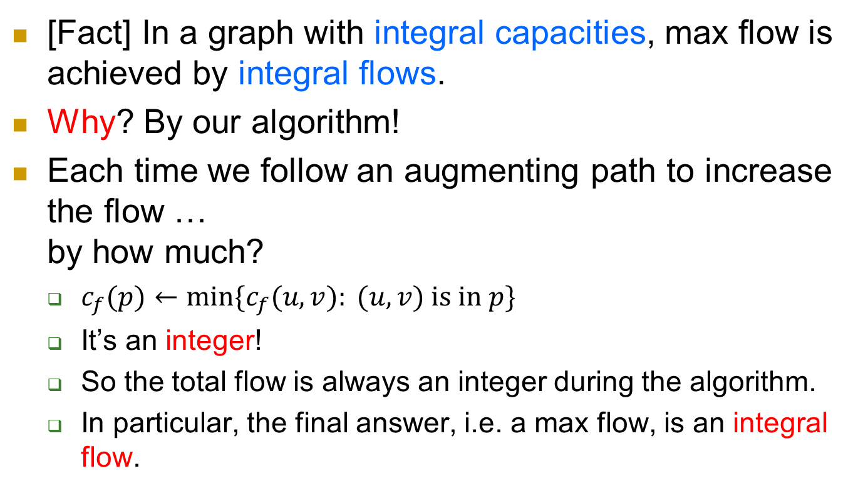
Integral constraint: automatic
[Fact] In a graph with integral capacities, max flow is achieved by integral flows.
Why? By our algorithm!
Each time we follow an augmenting path to increase the flow …
by how much?
  $c_{f}(p)←min⁡\{c_{f}(u,v): (u,v) \text{is} \text{in} p\}$
  It’s an integer!
  So the total flow is always an integer during the algorithm.
  In particular, the final answer, i.e. a max flow, is an integral flow.

Slide 38

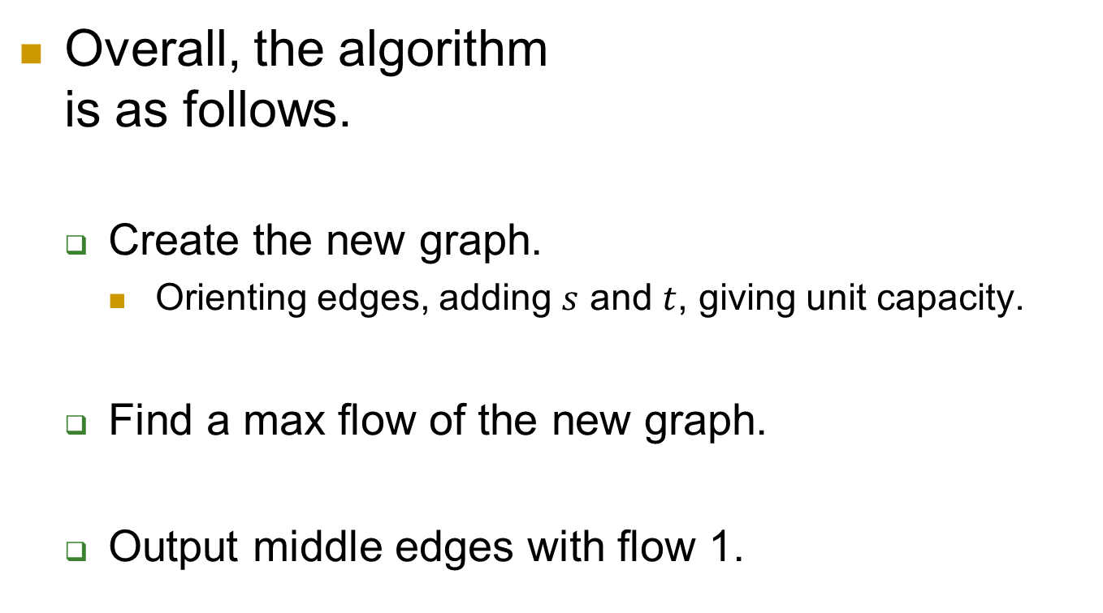



algorithm
$$L$$
$$R$$
Overall, the algorithm
is as follows.
  Create the new graph.
    Orienting edges, adding $s$ and $t$, giving unit capacity.
  Find a max flow of the new graph.
  Output middle edges with flow 1.
$$s$$
$$t$$

Slide 39
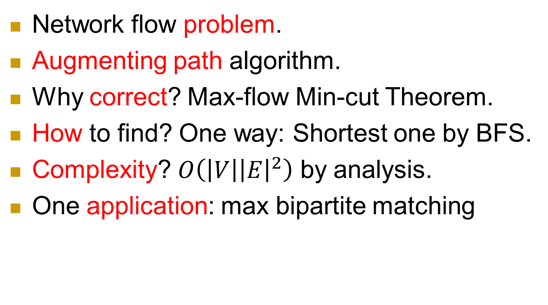
Summary
Network flow problem.
Augmenting path algorithm.
Why correct? Max-flow Min-cut Theorem.
How to find? One way: Shortest one by BFS.
Complexity? $O\left(\left|V\right|{\left|E\right|}^{2}\right)$ by analysis.
One application: max bipartite matching

