Slide 1
CSC3160: Design and Analysis of Algorithms
Week 5: Dynamic Programming
Instructor: Shengyu Zhang

Slide 2
About midterm
Time: Mar 3, 2:50pm – 4:50pm.
Place: This lecture room.
Open book, open lecture notes.
  But no Internet allowed.
Scope: First 6 lectures

Slide 3
Dynamic Programming
A simple but non-trivial method for designing algorithms
Achieve much better efficiency than naïve ones.
A couple of examples will be exhibited and analyzed.

Slide 4
Problem 1: Chain matrix multiplication

Slide 5
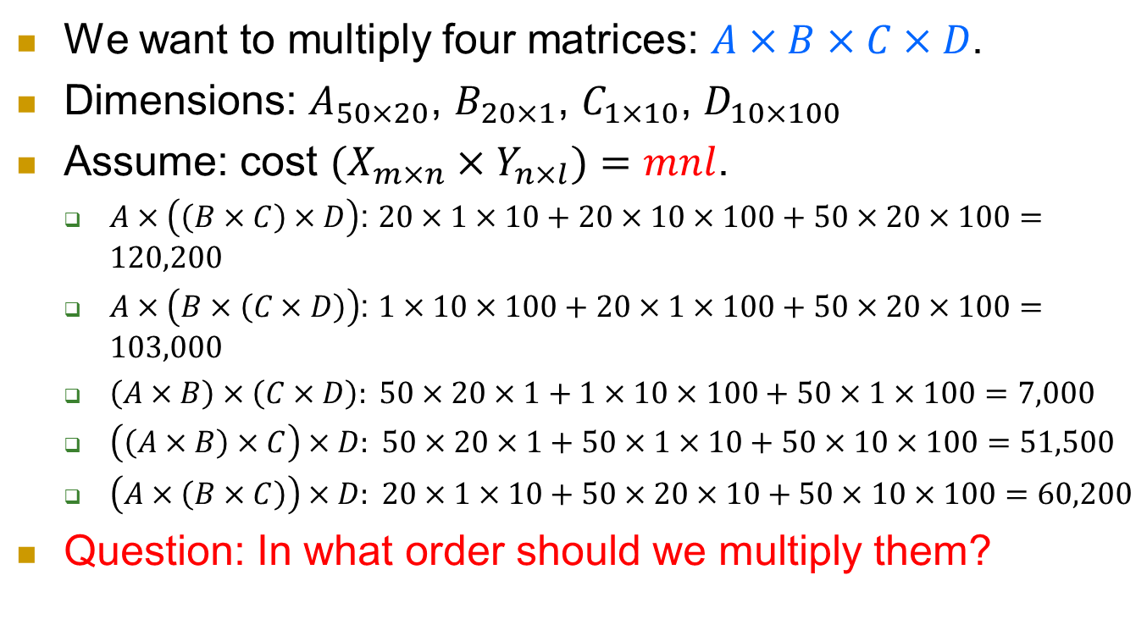
Suppose we want to multiply four matrices
We want to multiply four matrices: $A×B×C×D$.
Dimensions: $A_{50×20}$, $B_{20×1}$, $C_{1×10}$, $D_{10×100}$
Assume: cost $(X_{m×n}×Y_{n×l})=mnl$.
  $A×\left(\left(B×C\right)×D\right)$: $20×1×10+20×10×100+50×20×100=120,200$
  $A×\left(B×\left(C×D\right)\right)$: $1×10×100+20×1×100+50×20×100=103,000$
  $\left(A×B\right)×\left(C×D\right): 50×20×1+1×10×100+50×1×100=7,000$
  $\left(\left(A×B\right)×C\right)×D: 50×20×1+50×1×10+50×10×100=51,500$
  $\left(A×\left(B×C\right)\right)×D: 20×1×10+50×20×10+50×10×100=60,200$
Question: In what order should we multiply them?
The order matters!

Slide 6
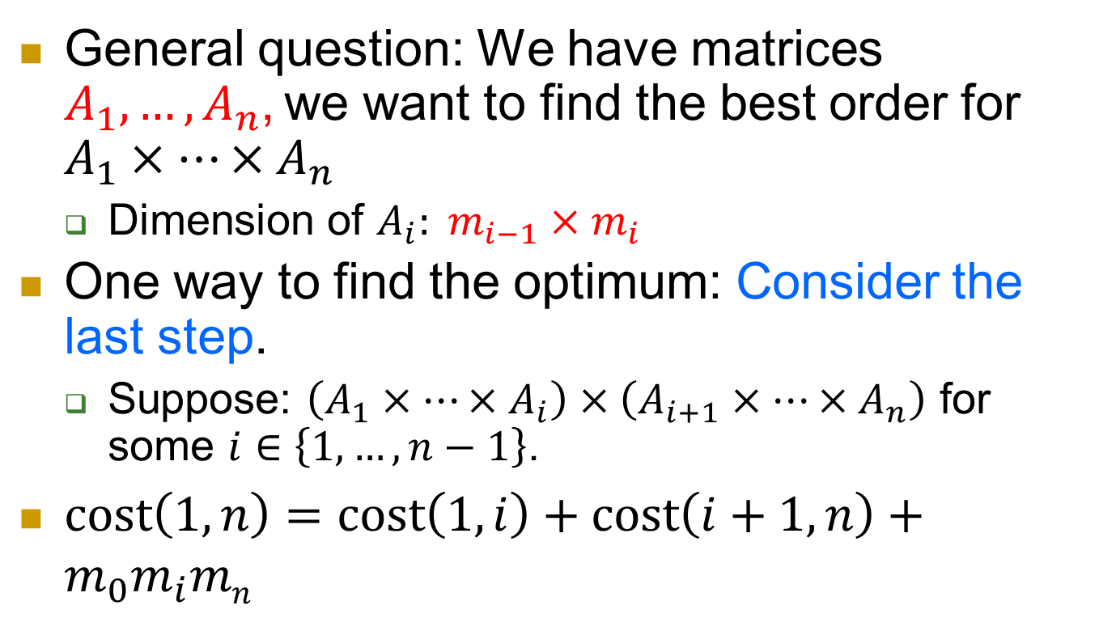
Key property
General question: We have matrices $A_{1}, …, A_{n}$, we want to find the best order for $A_{1}×…×A_{n}$
  Dimension of $A_{i}: m_{i−1}×m_{i}$
One way to find the optimum: Consider the last step.
  Suppose: $\left(A_{1}×…×A_{i}\right)×\left(A_{i+1}×…×A_{n}\right)$ for some $i∈\left\{1,…,n−1\right\}$.
$cost\left(1,n\right)=cost\left(1,i\right)+cost\left(i+1,n\right)+m_{0}m_{i}mn$

Slide 7
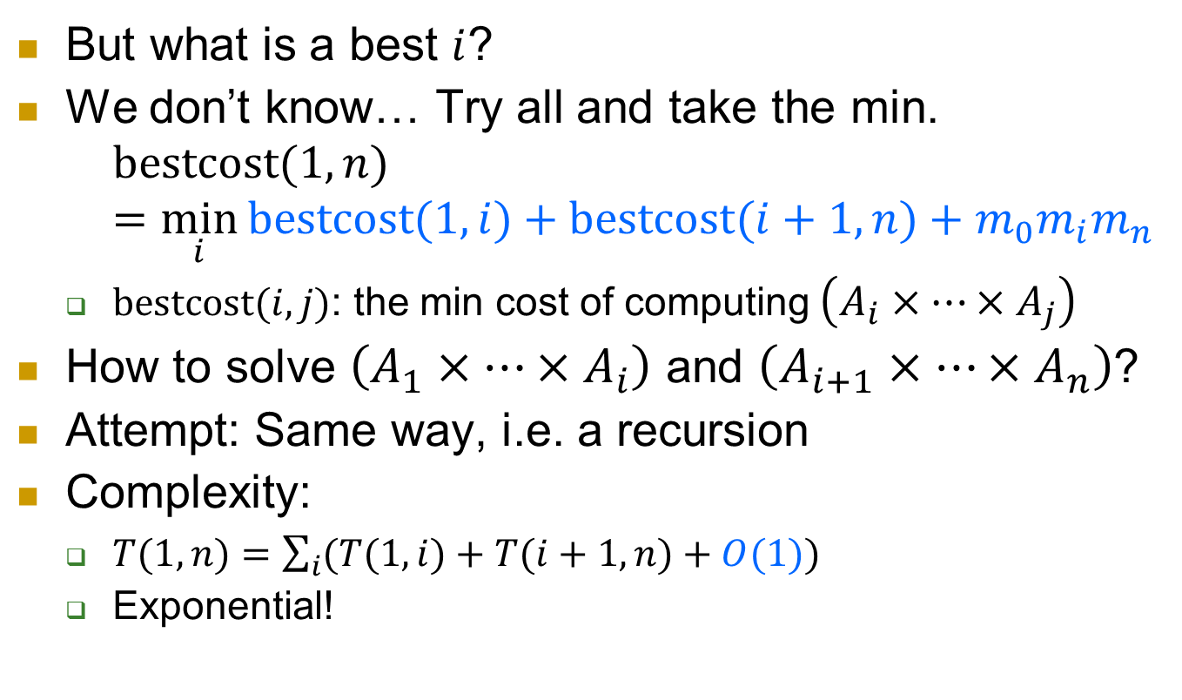
Algorithm
But what is a best $i$?
We don’t know… Try all and take the min.
  $$bestcost(1,n)=\min_{i}{bestcost(1,i)+bestcost(i+1,n)+m_{0}m_{i}m_{n}}$$
  $bestcost(i,j)$: the min cost of computing $\left(A_{i}×…×A_{j}\right)$
How to solve $\left(A_{1}×…×A_{i}\right)$ and $\left(A_{i+1}×…×A_{n}\right)$?
Attempt: Same way, i.e. a recursion
Complexity:
  $T(1,n)=\sum_{i}{(T(1,i)+T(i+1,n)+O(1))}$
  Exponential!

Slide 8

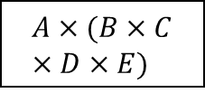

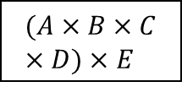
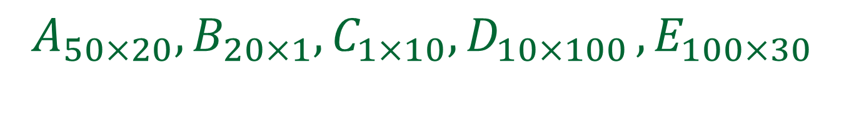
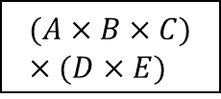

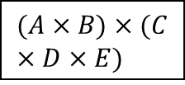



$$A_{50×20}, B_{20×1}, C_{1×10}, D_{10×100} , E_{100×30}$$
$$A×B×C×D×E$$
min
$$A×(B×C×D×E)$$
$$(A×B)×(C×D×E)$$
$$(A×B×C)×(D×E)$$
$$(A×B×C×D)×E$$
$$B×C×D$$
$$C×D×E$$
$$C×D×E$$
$$A×B×C$$
$$A×B×C$$
$$B×C×D$$
Observation: small subproblems are calculated many times!

Slide 9
What did we observe?
Why not just do it once and store the result for later reference?
  When needed later: simply look up the stored result.
That’s dynamic programming.
  First compute the small problems and store the answers
  Then compute the large problems using the stored results of smaller subproblems.

Slide 10


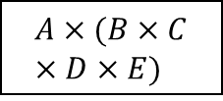


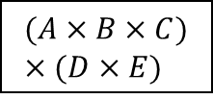

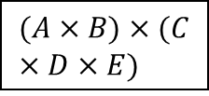
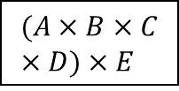



$$A_{50×20}, B_{20×1}, C_{1×10}, D_{10×100} , E_{100×30}$$
$$A×B×C×D×E$$
min
$$A×(B×C×D×E)$$
$$(A×B)×(C×D×E)$$
$$(A×B×C)×(D×E)$$
$$(A×B×C×D)×E$$
$$A×B×C$$
$$B×C×D$$
$$C×D×E$$
$$A×B$$
$$B×C$$
$$C×D$$
$$D×E$$
Now solve the problem this way.

Slide 11
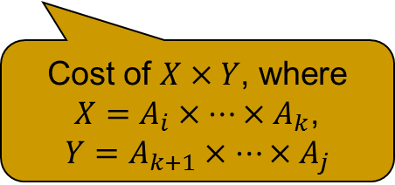

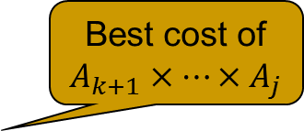
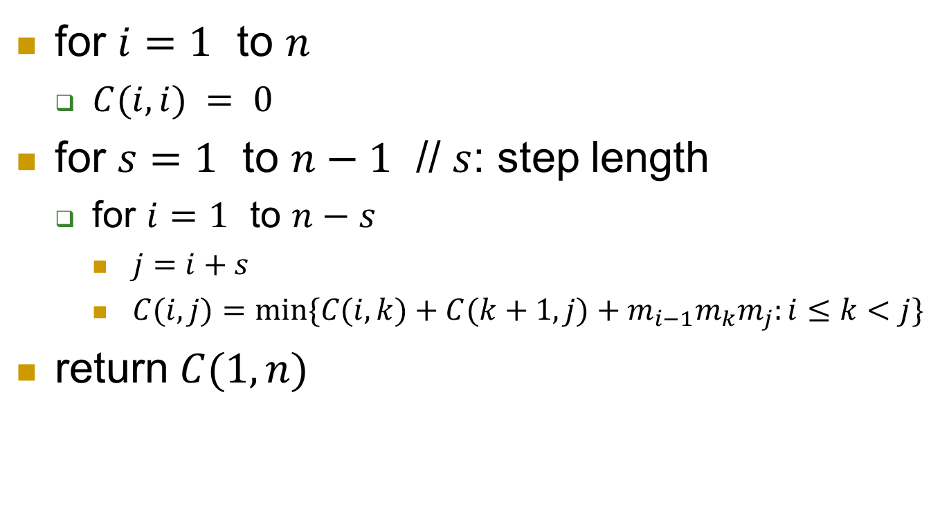
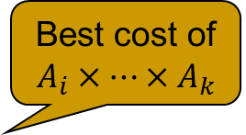



Algorithm
For the first example:
$s=1$: {bestcost($A_{1}×A_{2}$), bestcost($A_{2}×A_{3}$), bestcost($A_{3}×A_{4}$)}
$s=2$: {bestcost($A_{1}×A_{2}×A_{3}$), bestcost($A_{2}×A_{3}×A_{4}$)}
$s=3$: {bestcost($A_{1}×A_{2}×A_{3}×A_{4}$)}.
for $i=1$ to $n$
  $C(i, i) = 0$
for $s=1$ to $n−1$ // $s$: step length
  for $i=1$ to $n−s$
    $j=i+s$
    $C(i,j)=min⁡\{C(i,k)+C(k+1,j)+m_{i−1}m_{k}m_{j}:i≤k<j\}$
return $C(1,n)$
Best cost of $A_{i}×…×A_{k}$
Best cost of $A_{k+1}×…×A_{j}$
Cost of $X×Y$, where
$X=A_{i}×…×A_{k}$,
$$Y=A_{k+1}×…×A_{j}$$
$$s$$
$$i$$
$$j=i+s$$

Slide 12

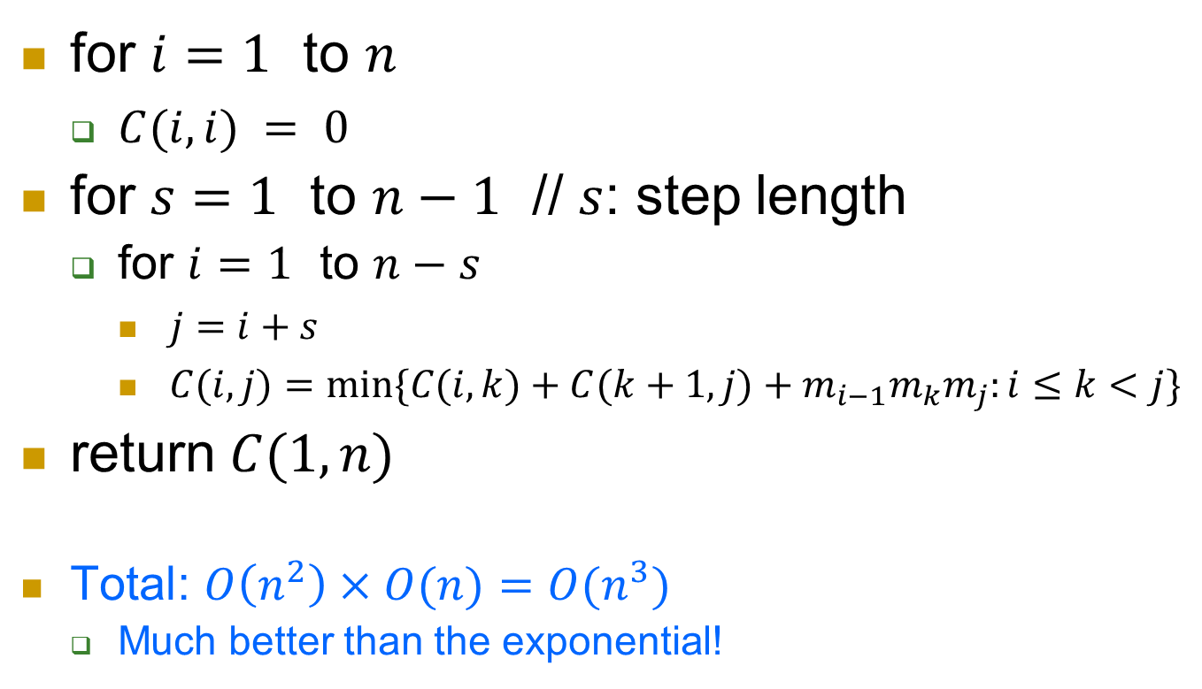


Complexity
for $i=1$ to $n$
  $C(i, i) = 0$
for $s=1$ to $n−1$ // $s$: step length
  for $i=1$ to $n−s$
    $j=i+s$
    $C(i,j)=min⁡\{C(i,k)+C(k+1,j)+m_{i−1}m_{k}m_{j}:i≤k<j\}$
return $C(1,n)$
Total: $O\left(n^{2}\right)×O(n)=O(n^{3})$
  Much better than the exponential!
$Θ(n^{2})$ iterations
$$–O(1)$$
$$–O(n)$$

Slide 13
Optimal value vs. optimal solution
We’ve seen how to compute the optimal value using dynamic programming.
What if we want an optimal solution?
  The order of matrix multiplication.

Slide 14
Problem 2: longest increasing subsequence

Slide 15
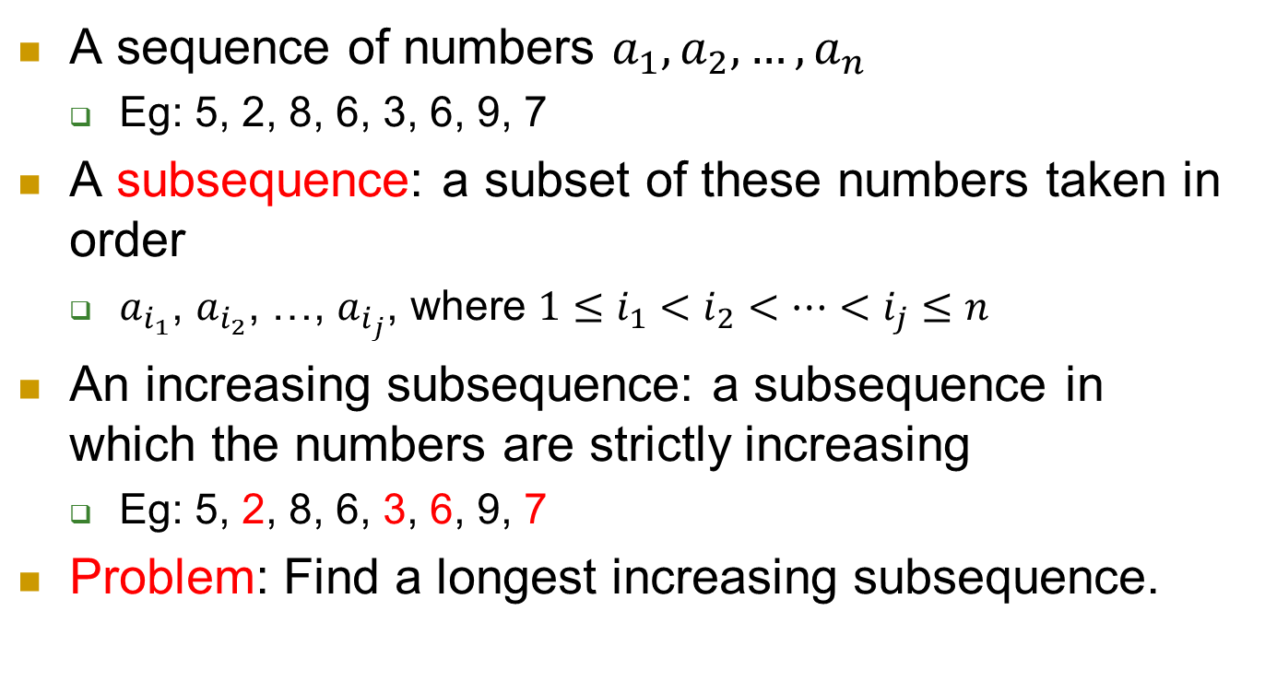
Problem 2: longest increasing subsequence
A sequence of numbers $a_{1}, a_{2}, …, a_{n}$
  Eg: 5, 2, 8, 6, 3, 6, 9, 7
A subsequence: a subset of these numbers taken in order
  $a_{i_{1}}$, $a_{i_{2}}$, …, $a_{i_{j}}$, where $1≤i_{1}<i_{2}<…<i_{j}≤n$
An increasing subsequence: a subsequence in which the numbers are strictly increasing
  Eg: 5, 2, 8, 6, 3, 6, 9, 7
Problem: Find a longest increasing subsequence.

Slide 16
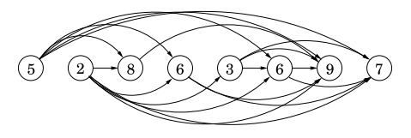

A good algorithm
Consider the following graph where
  $V=\{a_{1}, …, a_{n}\}$
  $E=\{(a_{i},a_{j}): i<j and a_{i}<a_{j}\}$
  longest increasing subsequence ↔ longest path

Slide 17
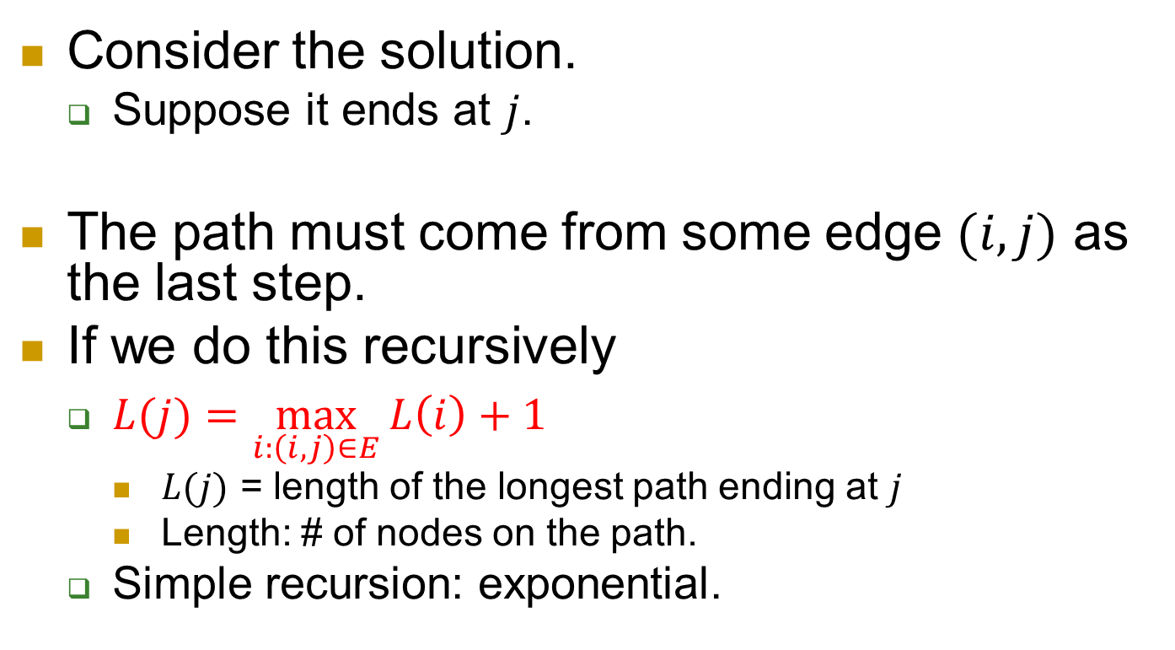
Attempt
Consider the solution.
  Suppose it ends at $j$.
The path must come from some edge $(i,j)$ as the last step.
If we do this recursively
  $L(j)=\max_{i:\left(i,j\right)∈E}{L\left(i\right)+1}$
    $L(j)$ = length of the longest path ending at $j$
    Length: # of nodes on the path.
  Simple recursion: exponential.

Slide 18
Again…
We observe that subproblems are calculated over and over again.
So we record the answers to them.
And use them for later computation.

Slide 19
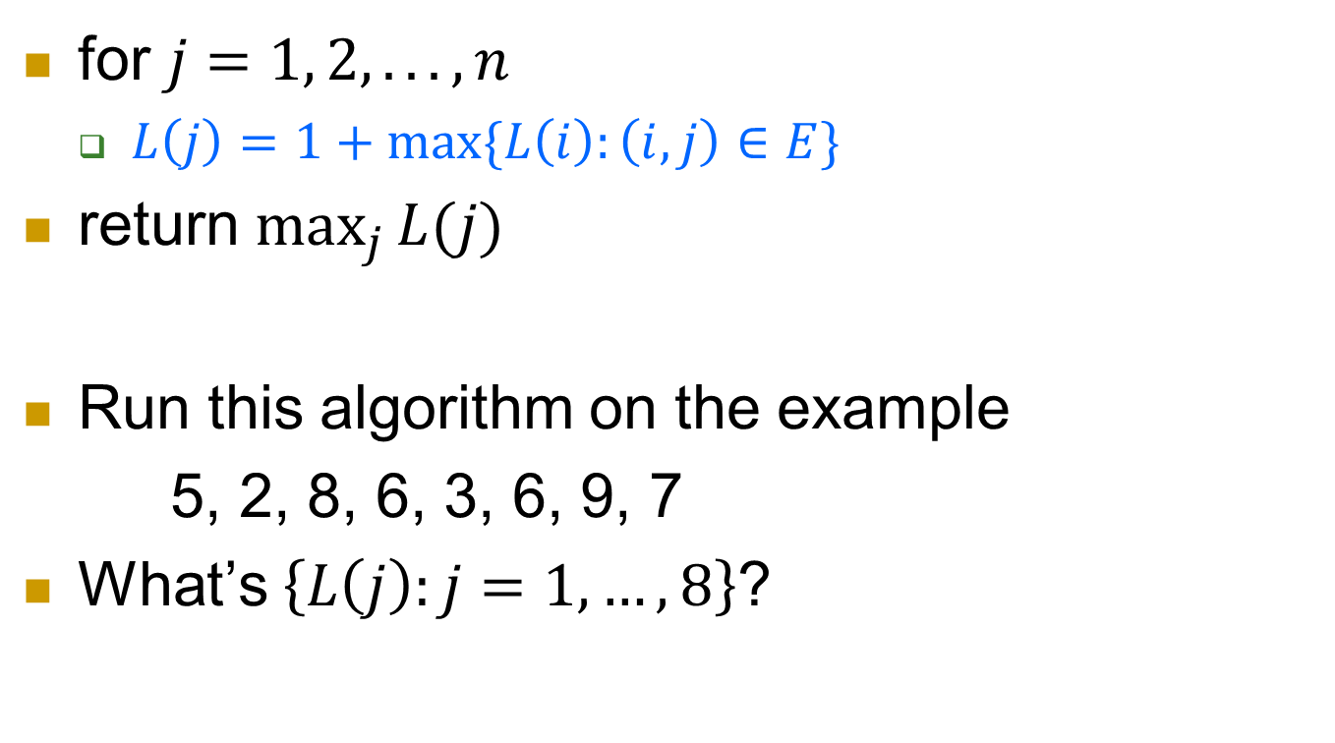
Algorithm
for $j=1, 2, . . . , n$
  $L\left(j\right)=1+\max{⁡\{L\left(i\right):\left(i, j\right)∈E\}}$
return $\max_{j}{L(j)}$
Run this algorithm on the example
5, 2, 8, 6, 3, 6, 9, 7
What’s $\left\{L\left(j\right):j=1, …, 8\right\}$?
Notes:
1 1 2 2 2 3 4 4

Slide 20
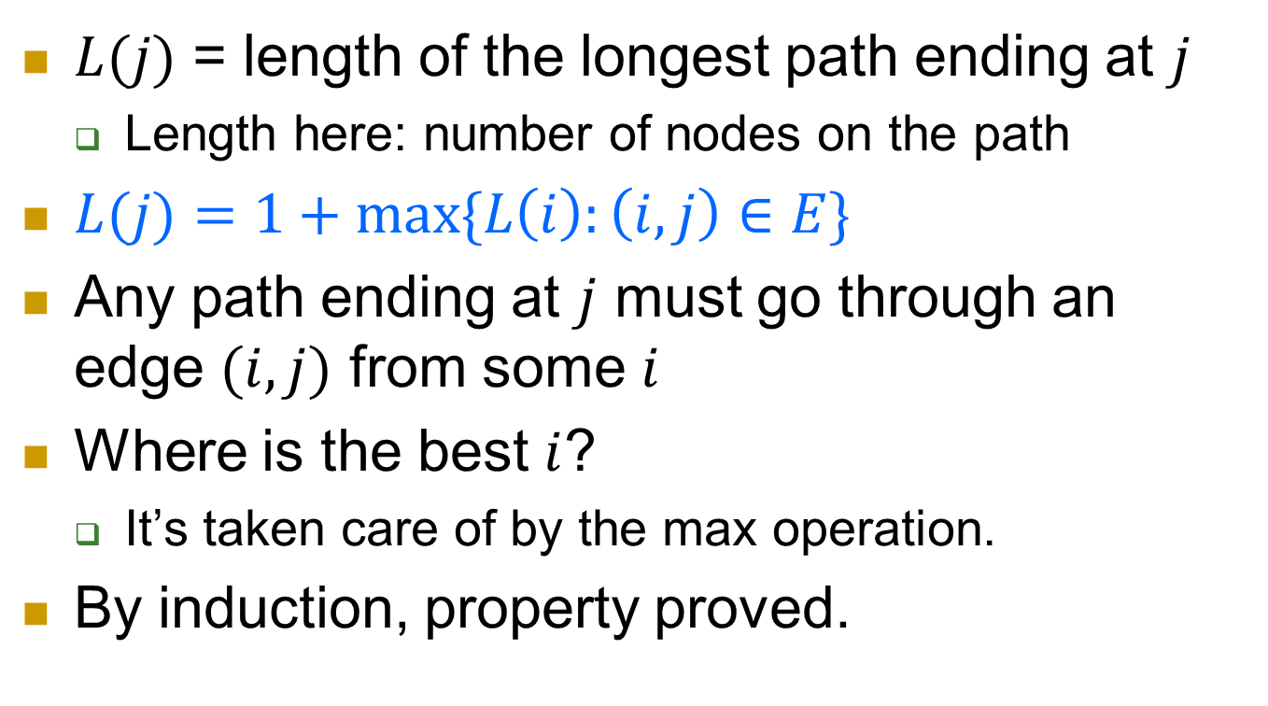
Correctness
$L(j)$ = length of the longest path ending at $j$
  Length here: number of nodes on the path
$L(j)=1+\max{\{L\left(i\right):\left(i, j\right)∈E\}}⁡$
Any path ending at $j$ must go through an edge $(i,j)$ from some $i$
Where is the best $i$?
  It’s taken care of by the max operation.
By induction, property proved.

Slide 21
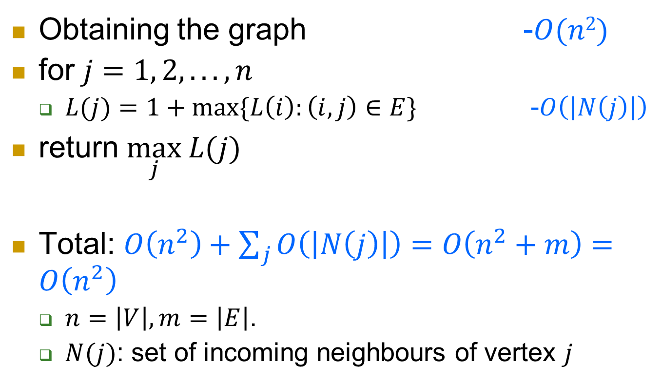
Complexity
Obtaining the graph -$O(n2)$
for $j=1, 2, . . . , n$
  $L(j)=1+\max{\{L\left(i\right):\left(i,j\right)∈E\}}$ -$O\left(\left|N\left(j\right)\right|\right)$
return $\max_{j} L(j)$
Total: $O\left(n^{2}\right)+\sum_{j}{O\left(\left|N\left(j\right)\right|\right)}=O\left(n^{2}+m\right)=O\left(n^{2}\right)$
  $n=\left|V\right|, m=\left|E\right|$.
  $N(j)$: set of incoming neighbours of vertex $j$

Slide 22
What’s the strategy used?
We break the problem into smaller ones.
We find an order of the problems s.t. easy problems appear ahead of hard ones.
We solve the problems in the order of their difficulty, and write down answers along the way.
When we need to compute a hard problem, we use the previously stored answers (to the easy problems) to help.

Slide 23
Optimal value vs. optimal solution
We’ve seen how to compute the optimal value using dynamic programming.
  The length of the longest increasing subsequence.
What if we want an optimal solution?
  A longest increasing subsequence.

Slide 24
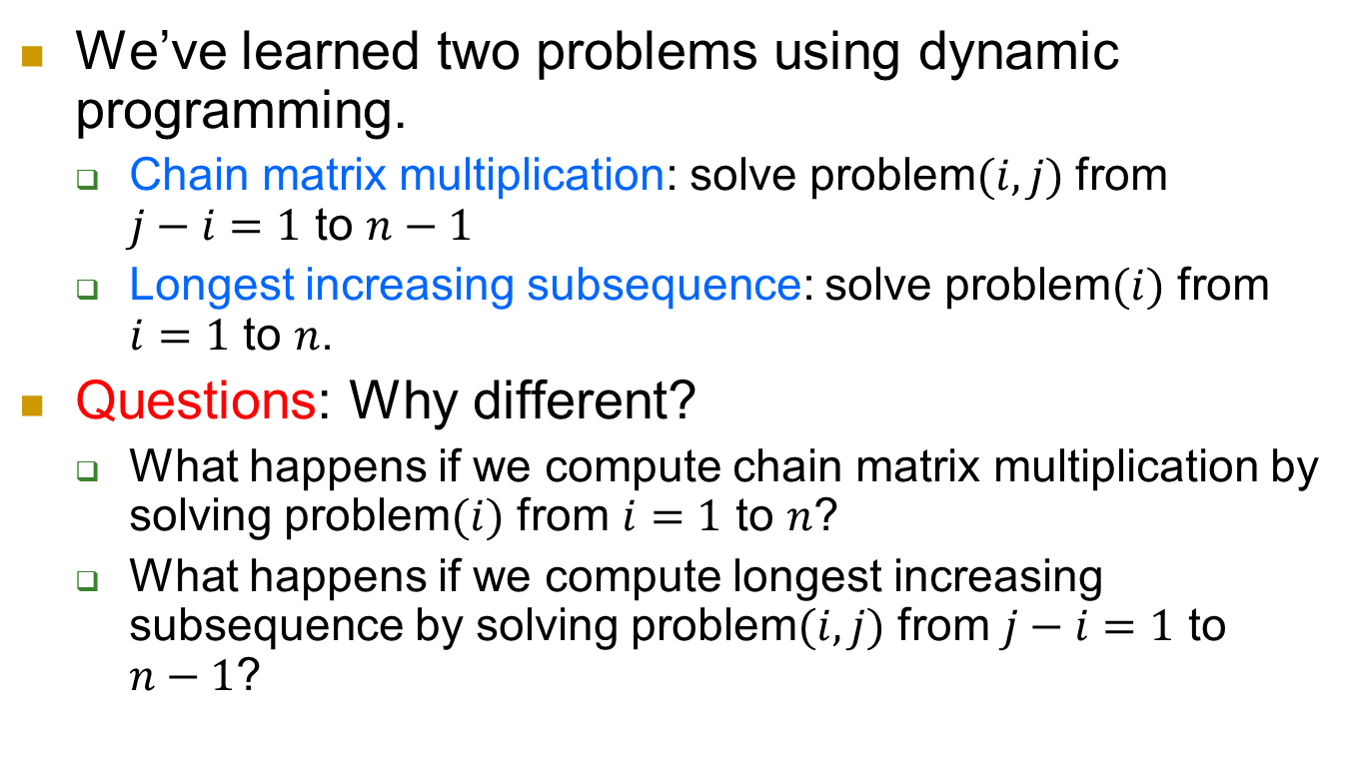
More questions to think about
We’ve learned two problems using dynamic programming.
  Chain matrix multiplication: solve problem$(i,j)$ from $j−i=1$ to $n−1$
  Longest increasing subsequence: solve problem$(i)$ from $i=1$ to $n$.
Questions: Why different?
  What happens if we compute chain matrix multiplication by solving problem$(i)$ from $i=1$ to $n$?
  What happens if we compute longest increasing subsequence by solving problem$(i,j)$ from $j−i=1$ to $n−1$?

Slide 25
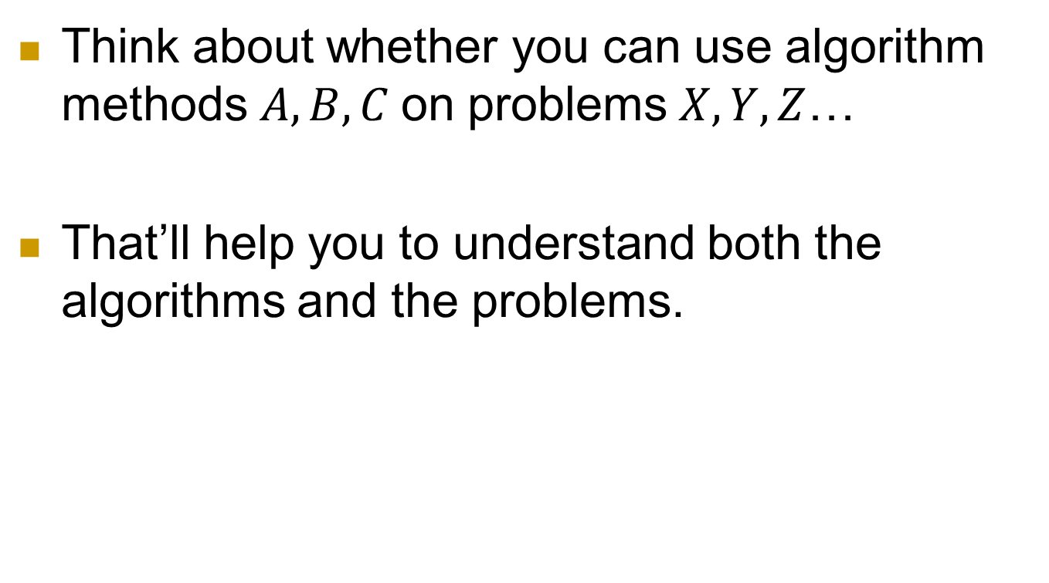
In general
Think about whether you can use algorithm methods $A,B,C$on problems $X,Y,Z$…
That’ll help you to understand both the algorithms and the problems.

Slide 26
Problem 3: All-pairs Shortest Path

Slide 27
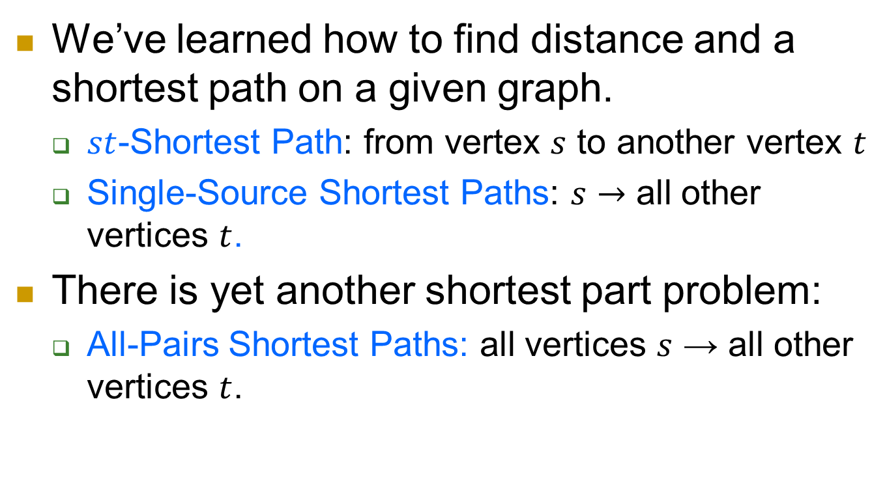
Recap of shortest path problems
We’ve learned how to find distance and a shortest path on a given graph.
  $st$-Shortest Path: from vertex $s$ to another vertex $t$
  Single-Source Shortest Paths: $s→$ all other vertices $t$.
There is yet another shortest part problem:
  All-Pairs Shortest Paths: all vertices $s$ → all other vertices $t$.

Slide 28
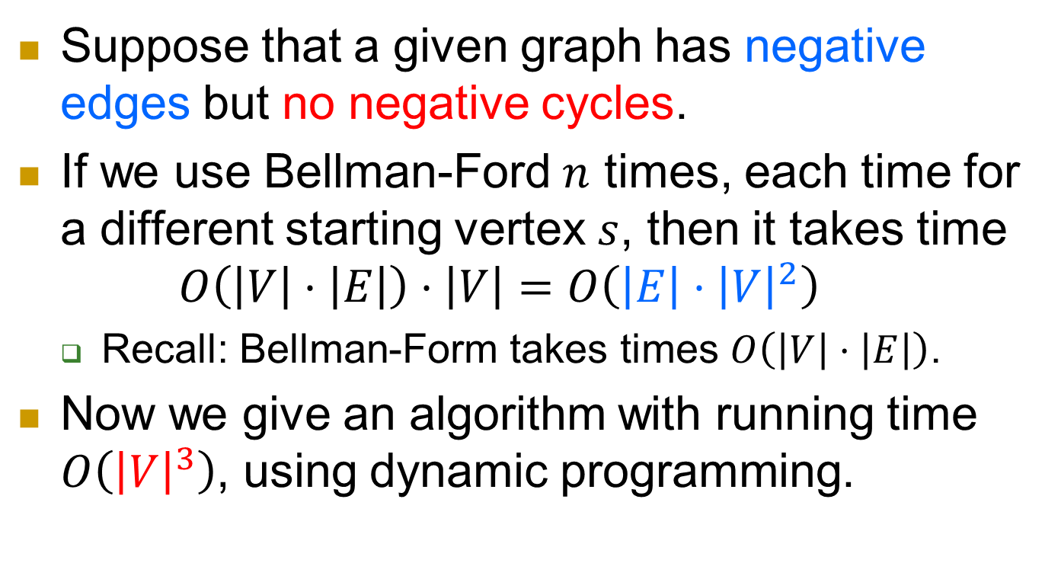
Naive algorithms and a new one
Suppose that a given graph has negative edges but no negative cycles.
If we use Bellman-Ford $n$ times, each time for a different starting vertex $s$, then it takes time
$O\left(\left|V\right|⋅\left|E\right|\right)⋅\left|V\right|=O\left(\left|E\right|⋅{\left|V\right|}^{2}\right)$
  Recall: Bellman-Form takes times $O\left(\left|V\right|⋅\left|E\right|\right)$.
Now we give an algorithm with running time $O\left({\left|V\right|}^{3}\right)$, using dynamic programming.

Slide 29
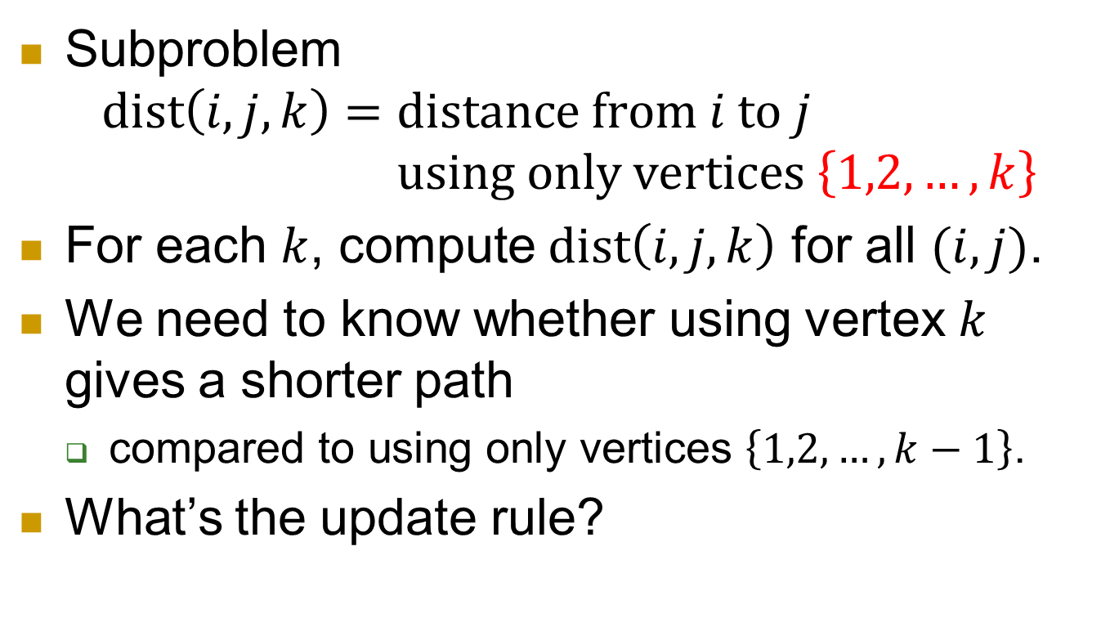
subproblems
Subproblem
$$dist\left(i,j,k\right)=\text{distance} \text{from} i \text{to} j$$
$$\text{using} \text{only} \text{vertices} \left\{1,2,…,k\right\}$$
For each $k$, compute $dist\left(i,j,k\right)$ for all $(i,j)$.
We need to know whether using vertex $k$ gives a shorter path
  compared to using only vertices $\left\{1,2,…,k−1\right\}$.
What’s the update rule?

Slide 30


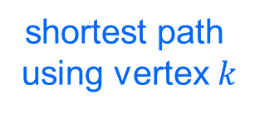
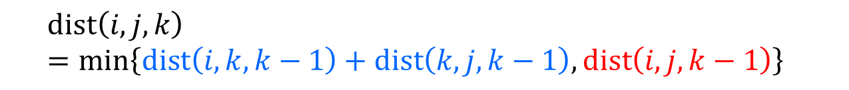
Updating rule
Observation. If vertex $k$ is used in a shortest path, it’s used only once.
  We assumed that there is no negative cycle.
Comparison:
  $$dist\left(i,j,k\right)=\min\left\{dist\left(i,k,k−1\right)+dist\left(k,j,k−1\right), dist\left(i,j,k−1\right)\right\}$$
shortest path
using vertex $k$
shortest path
without using vertex $k$

Slide 31
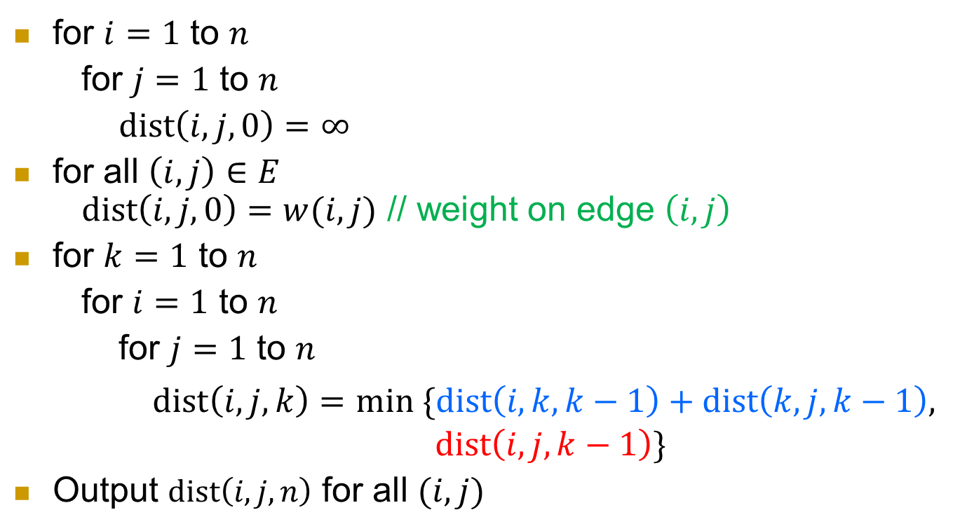
Floyd-Warshall Algorithm
for $i=1$ to $n$
for $j=1$ to $n$
$\text{dist}\left(i,j,0\right)=∞$
for all $\left(i,j\right)∈E$
$\text{dist}\left(i,j,0\right)=w(i,j)$ // weight on edge $\left(i,j\right)$
for $k=1$ to $n$
for $i=1$ to $n$
for $j=1$ to $n$
  $dist\left(i,j,k\right)=min \{dist\left(i,k,k−1\right)+dist\left(k,j,k−1\right),$
  $$dist\left(i,j,k−1\right)\}$$
Output $dist\left(i,j,n\right)$ for all $(i,j)$

Slide 32

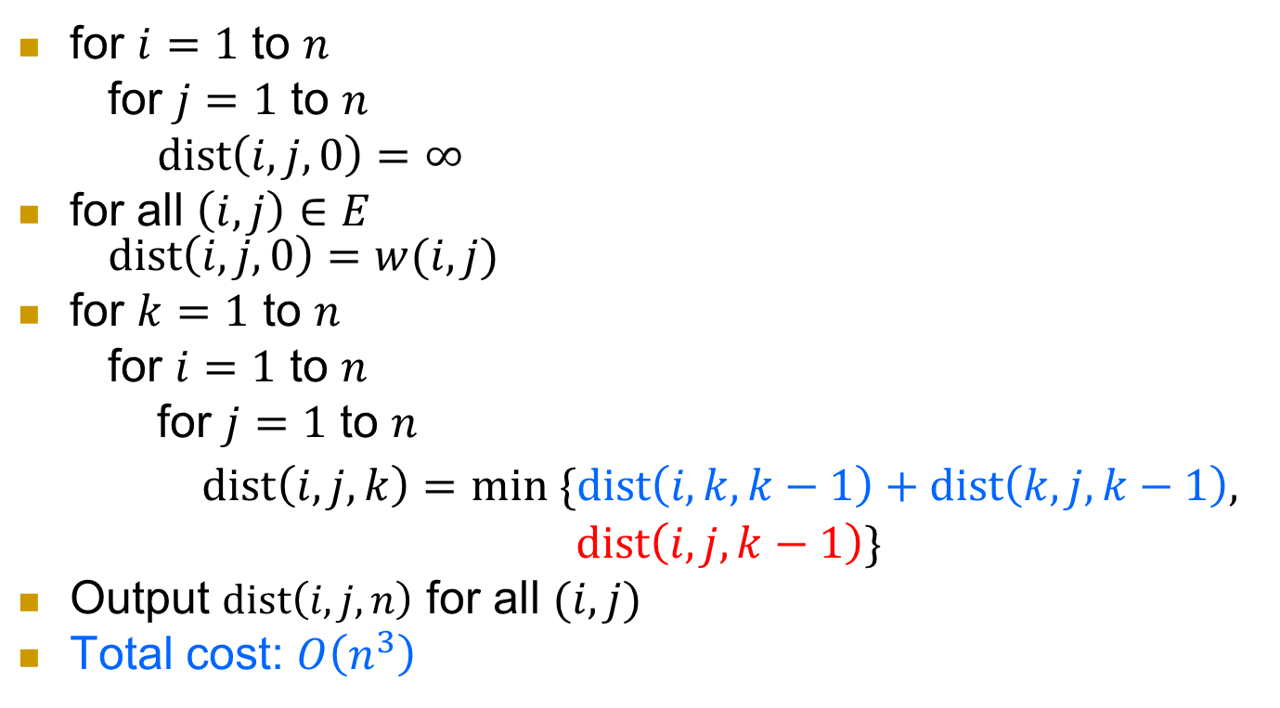



Complexity
for $i=1$ to $n$
for $j=1$ to $n$
$\text{dist}\left(i,j,0\right)=∞$
for all $\left(i,j\right)∈E$
$\text{dist}\left(i,j,0\right)=w(i,j)$
for $k=1$ to $n$
for $i=1$ to $n$
for $j=1$ to $n$
  $dist\left(i,j,k\right)=min \{dist\left(i,k,k−1\right)+dist\left(k,j,k−1\right),$
  $$dist\left(i,j,k−1\right)\}$$
Output $dist\left(i,j,n\right)$ for all $(i,j)$
Total cost: $O\left(n^{3}\right)$
$$O\left(n^{2}\right)$$
$$O\left(m\right)$$
$$O\left(n^{3}\right)$$
$$O\left(n^{2}\right)$$

Slide 33
Problem 4: Edut dstamnce

Slide 34
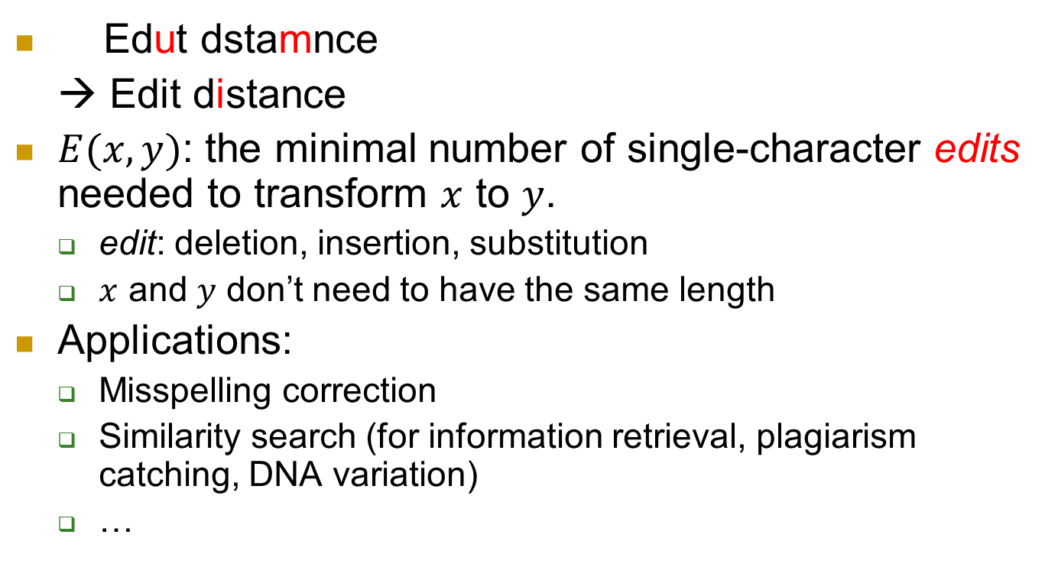
Definition and applications
Edut dstamnce
→ Edit distance
$E(x,y)$: the minimal number of single-character edits needed to transform $x$ to $y$.
  edit: deletion, insertion, substitution
  $x$ and $y$ don’t need to have the same length
Applications:
  Misspelling correction
  Similarity search (for information retrieval, plagiarism catching, DNA variation)
  …

Slide 35
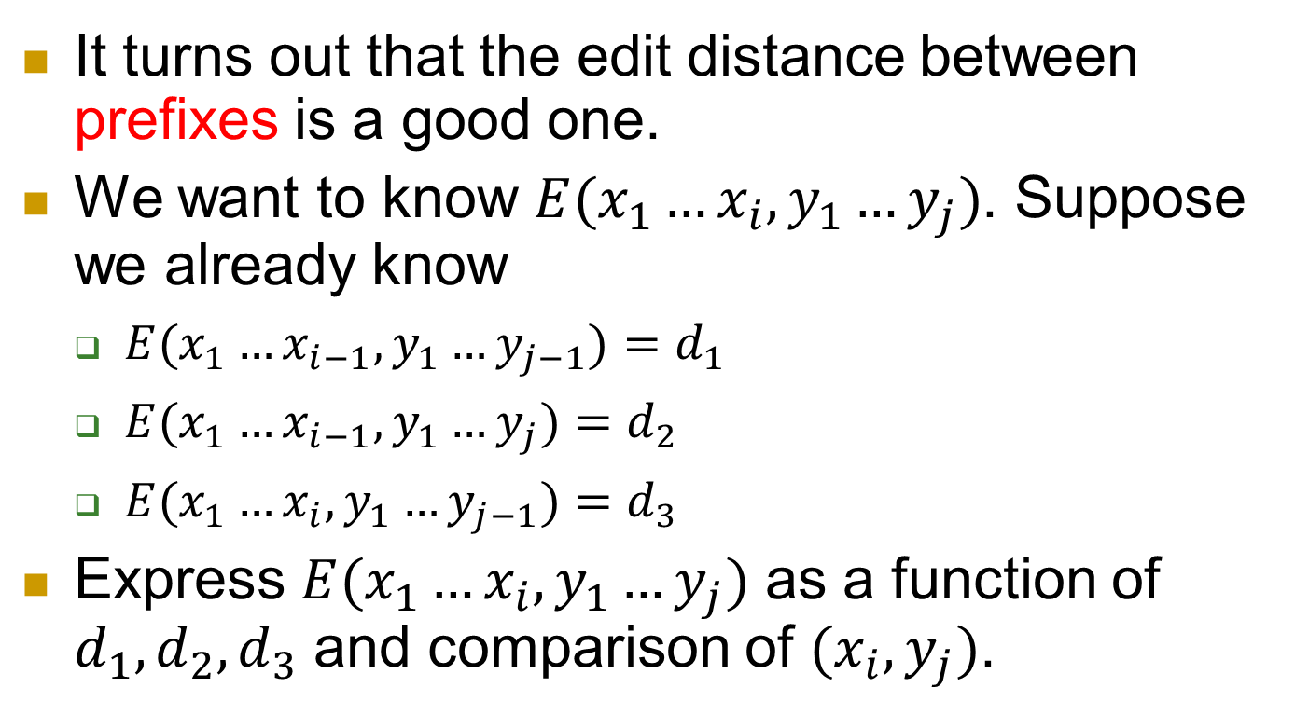
What are subproblems now?
It turns out that the edit distance between prefixes is a good one.
We want to know $E(x_{1}…x_{i}, y_{1}…y_{j})$. Suppose we already know
  $E(x_{1}…x_{i−1}, y_{1}…y_{j−1})=d_{1}$
  $E(x_{1}…x_{i−1}, y_{1}…y_{j})=d_{2}$
  $E(x_{1}…x_{i}, y_{1}…y_{j−1})=d_{3}$
Express $E(x_{1}…x_{i}, y_{1}…y_{j})$ as a function of $d_{1}, d_{2}, d_{3}$ and comparison of $(x_{i},y_{j})$.

Slide 36
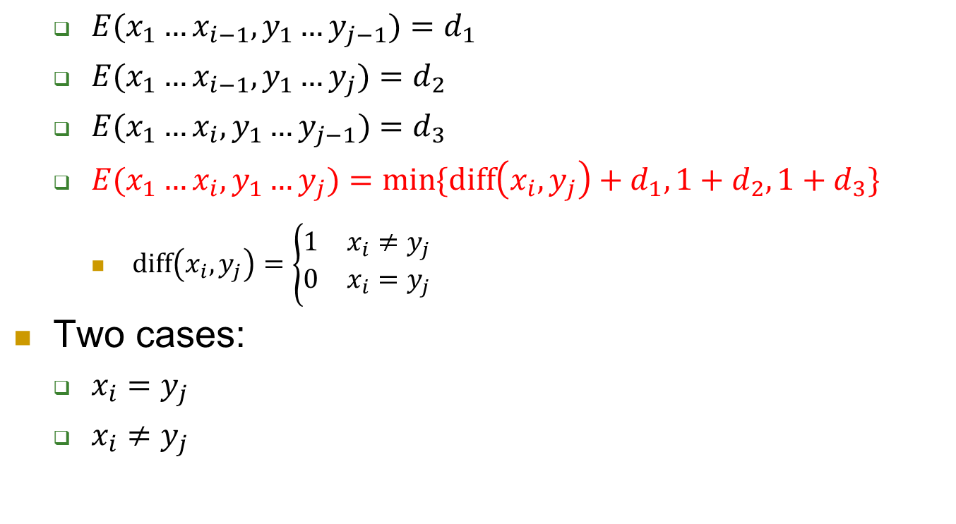
Answer
  $E(x_{1}…x_{i−1}, y_{1}…y_{j−1})=d_{1}$
  $E(x_{1}…x_{i−1}, y_{1}…y_{j})=d_{2}$
  $E(x_{1}…x_{i}, y_{1}…y_{j−1})=d_{3}$
  $E(x_{1}…x_{i}, y_{1}…y_{j})=\min{\{diff\left(x_{i},y_{j}\right)+d_{1},1+d_{2},1+d_{3}\}}$
    $\text{diff}\left(x_{i},y_{j}\right)=\left\{\begin{matrix}1 & x_{i}≠y_{j} \\ 0 & x_{i}=y_{j}\end{matrix}\right.$
Two cases:
  $x_{i}=y_{j}$
  $x_{i}≠y_{j}$

Slide 37
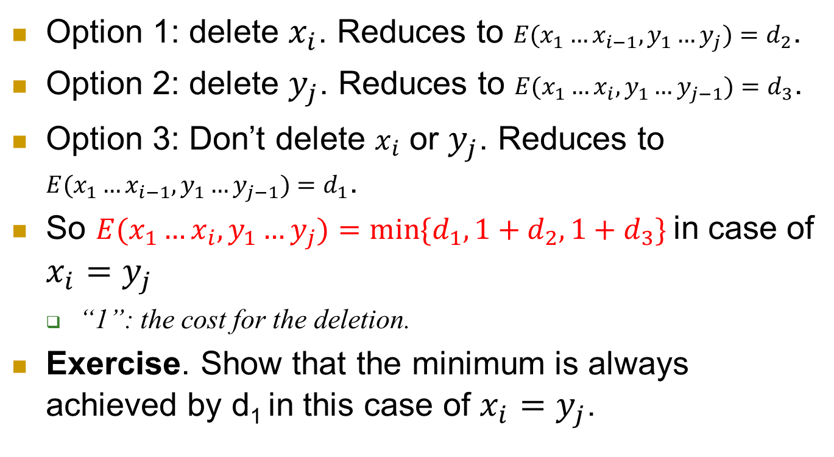
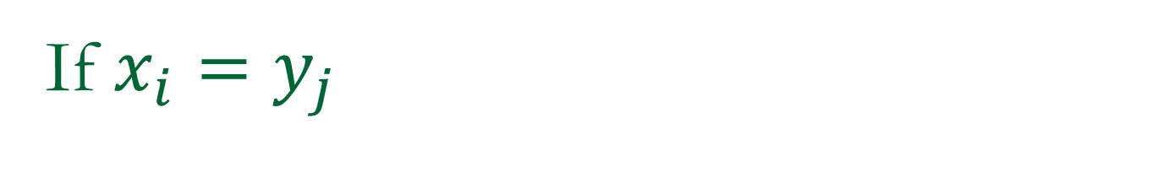
If $x_{i}=y_{j}$
Option 1: delete $x_{i}$. Reduces to $E(x_{1}…x_{i−1}, y_{1}…y_{j})=d_{2}$.
Option 2: delete $y_{j}$. Reduces to $E(x_{1}…x_{i}, y_{1}…y_{j−1})=d_{3}$.
Option 3: Don’t delete $x_{i}$ or $y_{j}$. Reduces to $E(x_{1}…x_{i−1}, y_{1}…y_{j−1})=d_{1}$.
So $E(x_{1}…x_{i}, y_{1}…y_{j})=\min{\{d_{1},1+d_{2},1+d_{3}\}}$in case of $x_{i}=y_{j}$
  “1”: the cost for the deletion.
Exercise. Show that the minimum is always achieved by d₁ in this case of $x_{i}=y_{j}$.

Slide 38
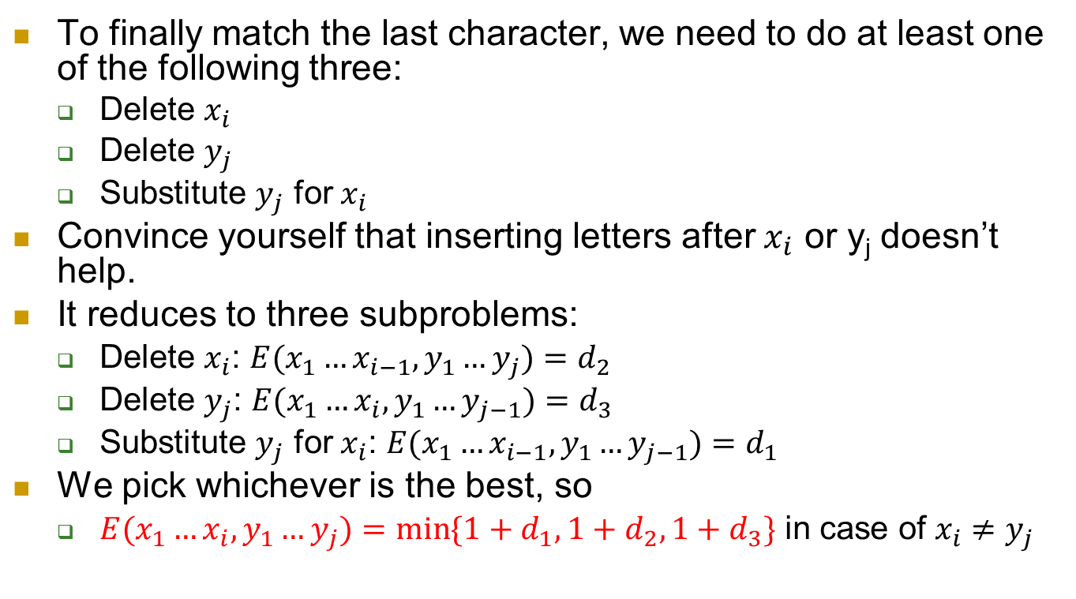
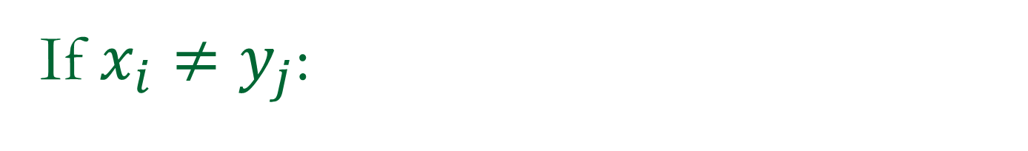
If $x_{i}≠y_{j}$:
To finally match the last character, we need to do at least one of the following three:
  Delete $x_{i}$
  Delete $y_{j}$
  Substitute $y_{j}$ for $x_{i}$
Convince yourself that inserting letters after $x_{i}$ or y_{j} doesn’t help.
It reduces to three subproblems:
  Delete $x_{i}$: $E(x_{1}…x_{i−1}, y_{1}…y_{j})=d_{2}$
  Delete $y_{j}$: $E(x_{1}…x_{i}, y_{1}…y_{j−1})=d_{3}$
  Substitute $y_{j}$ for $x_{i}$: $E(x_{1}…x_{i−1}, y_{1}…y_{j−1})=d_{1}$
We pick whichever is the best, so
  $E(x_{1}…x_{i}, y_{1}…y_{j})=\min{\{1+d_{1},1+d_{2},1+d_{3}\}}$ in case of $x_{i}≠y_{j}$
Each costs 1.

Slide 39
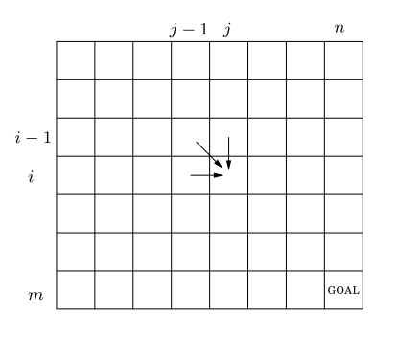
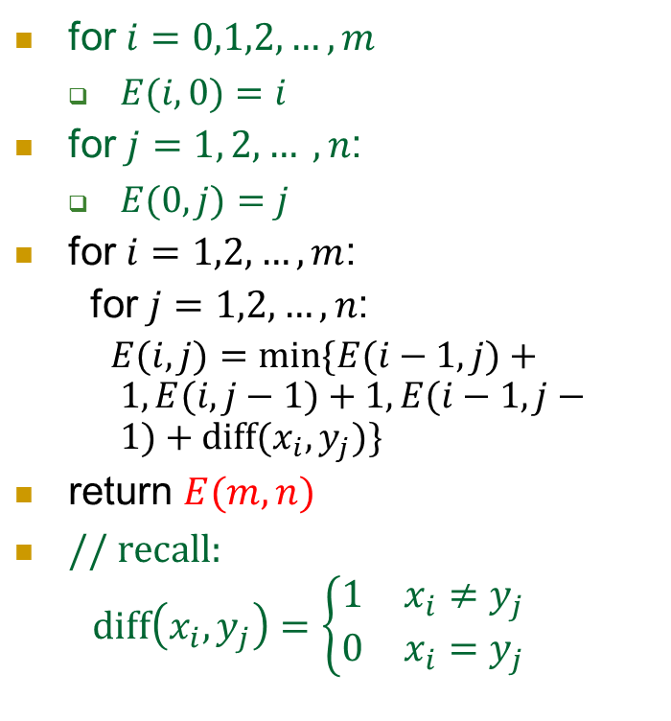
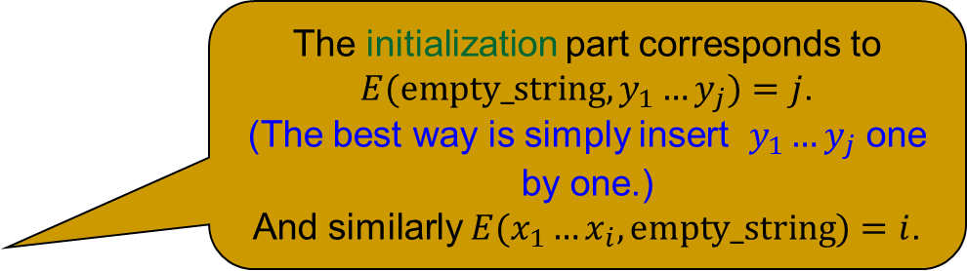
Now the algorithm
The initialization part corresponds to $E(empty_string, y_{1}…y_{j})=j$.
(The best way is simply insert $y_{1}…y_{j}$ one by one.)
And similarly $E(x_{1}…x_{i}, empty_string)=i$.
for $i=0,1,2,…,m$
  $E(i,0)=i$
for $j=1, 2, … , n$:
  $E(0,j)=j$
for $i=1,2,…,m$:
for $j=1,2,…,n$:
  $E(i,j)=min⁡\{E(i−1,j)+1,E(i,j−1)+1,E(i−1,j−1)+diff(x_{i},y_{j})\}$
return $E(m, n)$
$\text{/}\text{/ }\text{recall}\text{:}$
$\text{diff}\left(x_{i},y_{j}\right)=\left\{\begin{matrix}1 & x_{i}≠y_{j} \\ 0 & x_{i}=y_{j}\end{matrix}\right.$

Slide 40
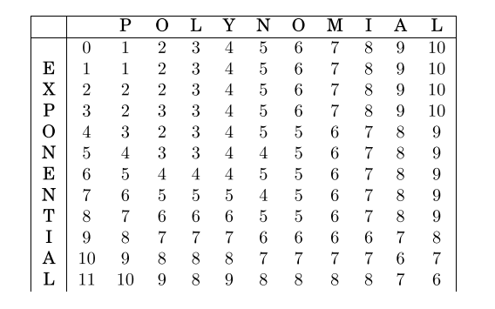
Running it on (polynomial, exponential)
  $$E(i, j)=\min\left\{E\left(i−1, j\right)+1, E\left(i, j−1\right)+1, E\left(i−1,j−1\right)+diff\left(x_{i},y_{j}\right)\right\}$$

Slide 41
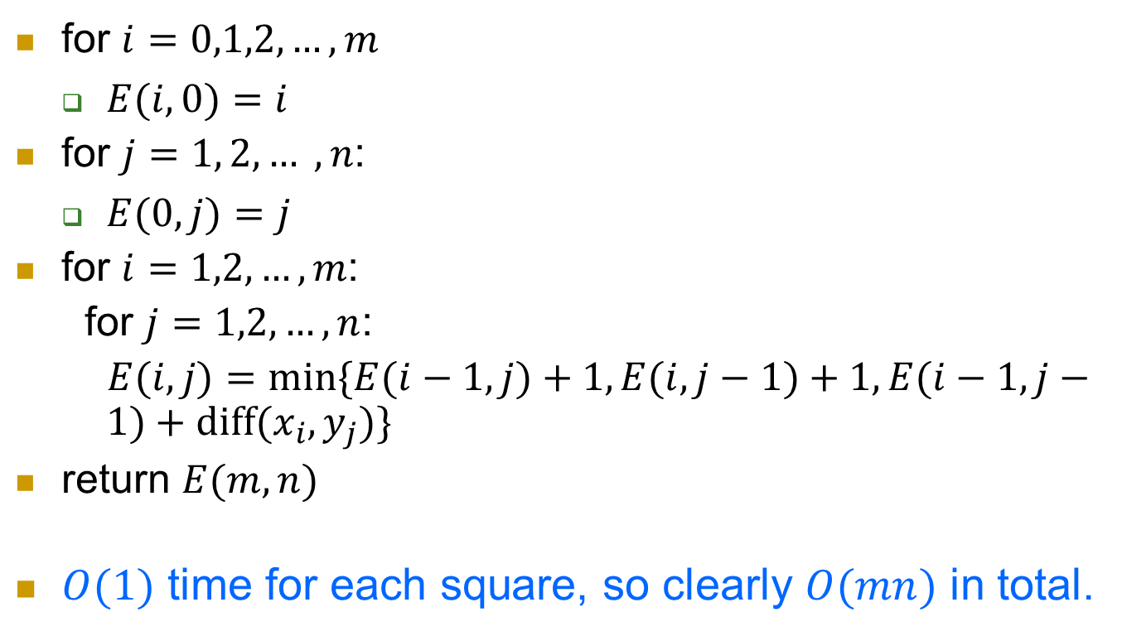
Complexity
for $i=0,1,2,…,m$
  $E(i,0)=i$
for $j=1, 2, … , n$:
  $E(0,j)=j$
for $i=1,2,…,m$:
for $j=1,2,…,n$:
  $E(i,j)=min⁡\{E(i−1,j)+1,E(i,j−1)+1,E(i−1,j−1)+diff(x_{i},y_{j})\}$
return $E(m, n)$
$O(1)$ time for each square, so clearly $O(mn)$ in total.

Slide 42
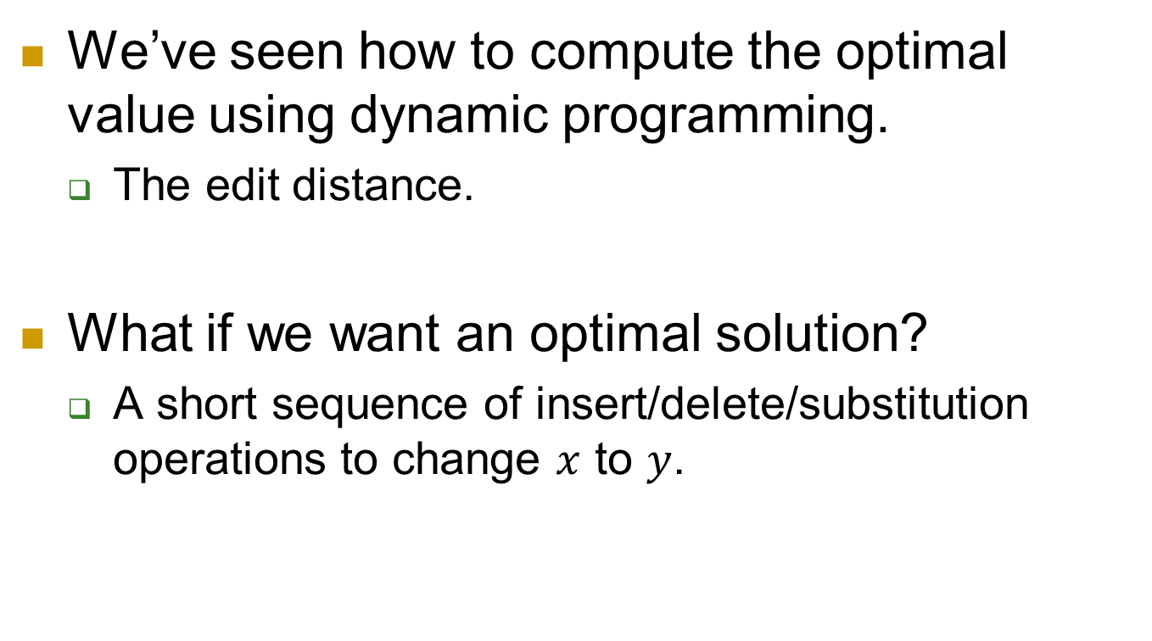
Optimal value vs. optimal solution
We’ve seen how to compute the optimal value using dynamic programming.
  The edit distance.
What if we want an optimal solution?
  A short sequence of insert/delete/substitution operations to change $x$ to $y$.

Slide 43
Summary of dynamic programming
Break the problem into smaller subproblems.
Subproblems overlap
  Some subproblems appear many times in different branches.
Compute subproblems and store the answers.
When later needed to solve these subproblems, just look up the stored answers.

