Slide 1
CSC3160: Design and Analysis of Algorithms
Week 3: Greedy Algorithms
Instructor: Shengyu Zhang

Slide 2
Content
Two problems
  Minimum Spanning Tree
  Huffman encoding
One approach: greedy algorithms

Slide 3
Example 1: Minimum Spanning Tree

Slide 4
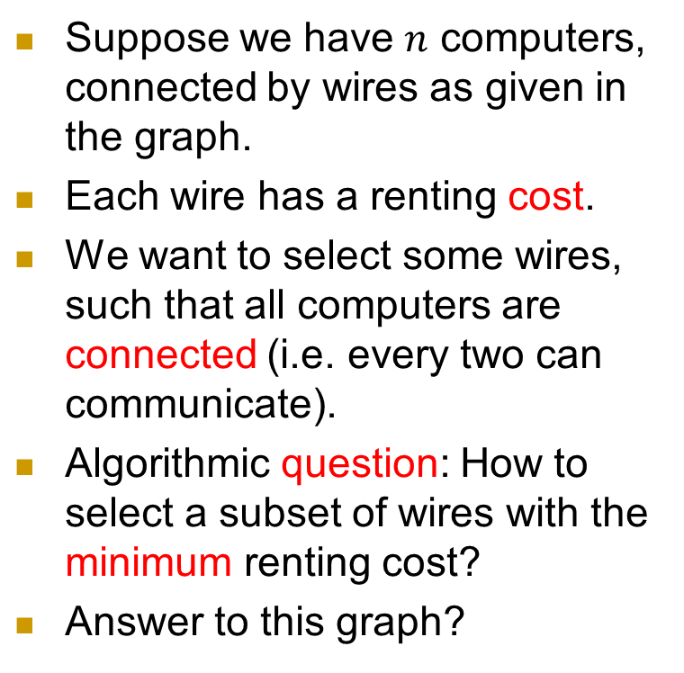
MST: Problem and Motivation
Suppose we have $n$ computers, connected by wires as given in the graph.
Each wire has a renting cost.
We want to select some wires, such that all computers are connected (i.e. every two can communicate).
Algorithmic question: How to select a subset of wires with the minimum renting cost?
Answer to this graph?
4
1
4
6
3
2
2
4
5
2
3
3
2

Slide 5
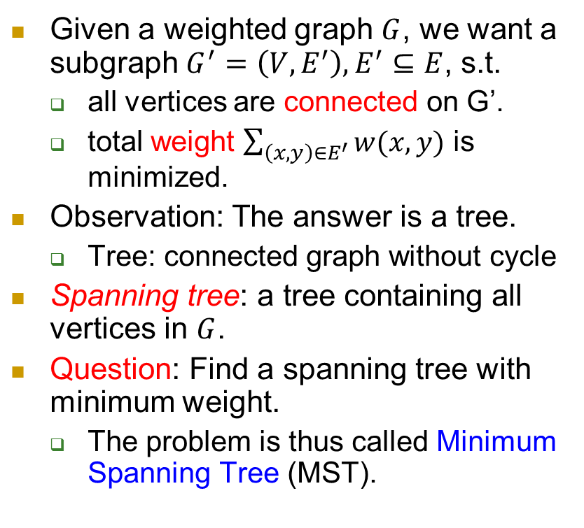
More precisely
Given a weighted graph $G$, we want a subgraph $G^{′}=\left(V,E^{′}\right), E^{′}⊆E$, s.t.
  all vertices are connected on G’.
  total weight $\sum_{\left(x,y\right)∈E^{′}}{w(x,y)}$ is minimized.
Observation: The answer is a tree.
  Tree: connected graph without cycle
Spanning tree: a tree containing all vertices in $G$.
Question: Find a spanning tree with minimum weight.
  The problem is thus called Minimum Spanning Tree (MST).
4
1
4
6
3
2
2
4
5
2
3
3
2

Slide 6
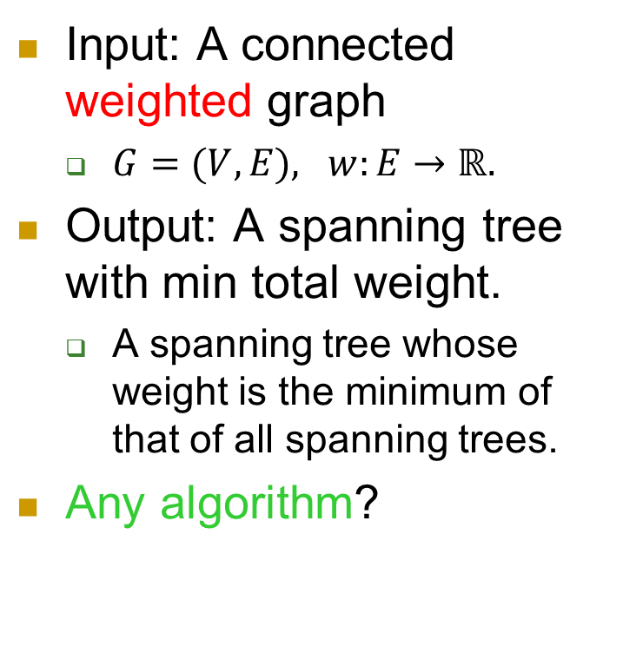
MST: The abstract problem
Input: A connected weighted graph
  $G=(V,E), w:E→ℝ.$
Output: A spanning tree with min total weight.
  A spanning tree whose weight is the minimum of that of all spanning trees.
Any algorithm?
4
1
4
6
3
2
2
4
5
2
3
3
2

Slide 7
Methodology 4: Starting from a naïve solution
  See whether it works well enough
  If not, try to improve it.
A first attempt may not be correct
But that’s fine. The key is that it’ll give you a chance to understand the problem.

Slide 8
What if I’m really stingy?
I’ll first pick the cheapest edge.
I’ll then again pick the cheapest one in the remaining edges
I’ll just keep doing like this …
  as long as no cycle caused
… until a cycle is unavoidable. Then I’ve got a spanning tree!
  No cycle.
  Connected: Otherwise I can still pick something without causing a cycle.
Concern: Is there a better spanning tree?
6
1
5
6
3
4
2
5
6
4
4
4
2

Slide 9
Kruskal's Algorithm
What we did just now is Kruskal’s algorithm.
  Repeatedly add the next lightest edge that doesn't produce a cycle…
    in case of a tie, break it arbitrarily.
  …until finally reaching a tree --- that’s the answer!

Slide 10
Illustrate an execution of the algorithm
At first all vertices are all separated.
Little by little, they merge into groups.
Groups merge into larger groups.
Finally, all groups merge into one.
That’s the spanning tree outputted by the algorithm.
6
1
5
6
3
4
2
5
6
4
4
4
2

Slide 11

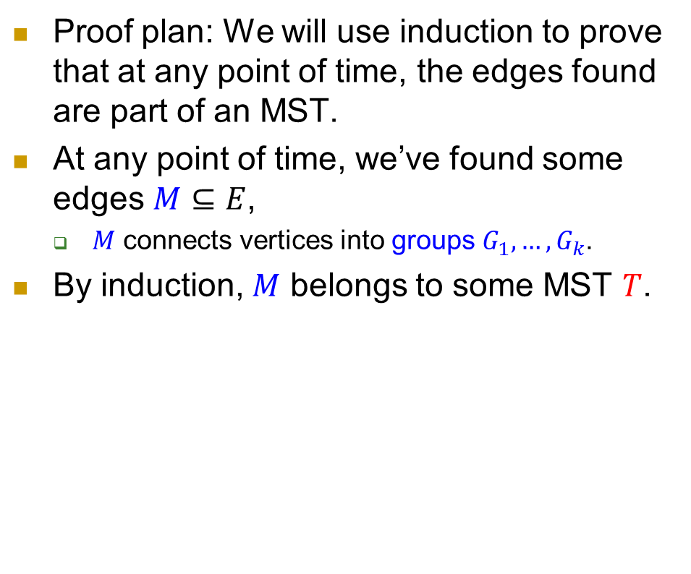
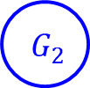
Correctness: prove by induction
Proof plan: We will use induction to prove that at any point of time, the edges found are part of an MST.
At any point of time, we’ve found some edges $M⊆E$,
  $M$ connects vertices into groups $G_{1},…,G_{k}$.
By induction, $M$ belongs to some MST $T$.
$${ G}_{1}$$
$${ G}_{2}$$

Slide 12

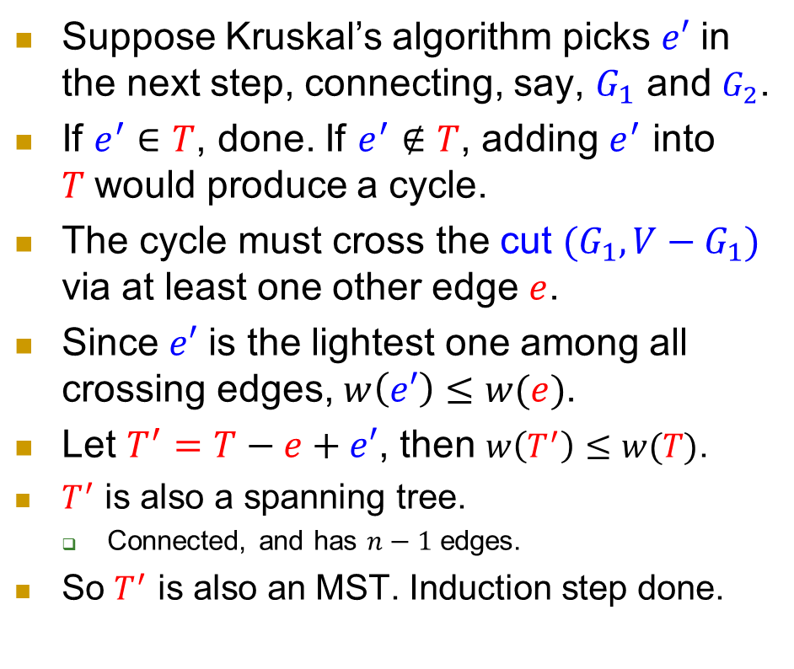

Correctness: prove by induction
Suppose Kruskal’s algorithm picks $e′$ in the next step, connecting, say, $G_{1}$ and $G_{2}$.
If $e^{′}∈T$, done. If $e^{′}∉T$, adding $e^{′}$ into $T$would produce a cycle.
The cycle must cross the cut $(G_{1},V−G_{1})$ via at least one other edge $e$.
Since $e′$ is the lightest one among all crossing edges, $w\left(e′\right)≤w(e)$.
Let $T^{′}=T−e+e′$, then $w\left(T^{′}\right)≤w(T)$.
$T^{′}$ is also a spanning tree.
  Connected, and has $n−1$ edges.
So $T^{′}$ is also an MST. Induction step done.
$${ G}_{1}$$
$$e′$$
$${ G}_{2}$$
$$e$$
5

Slide 13
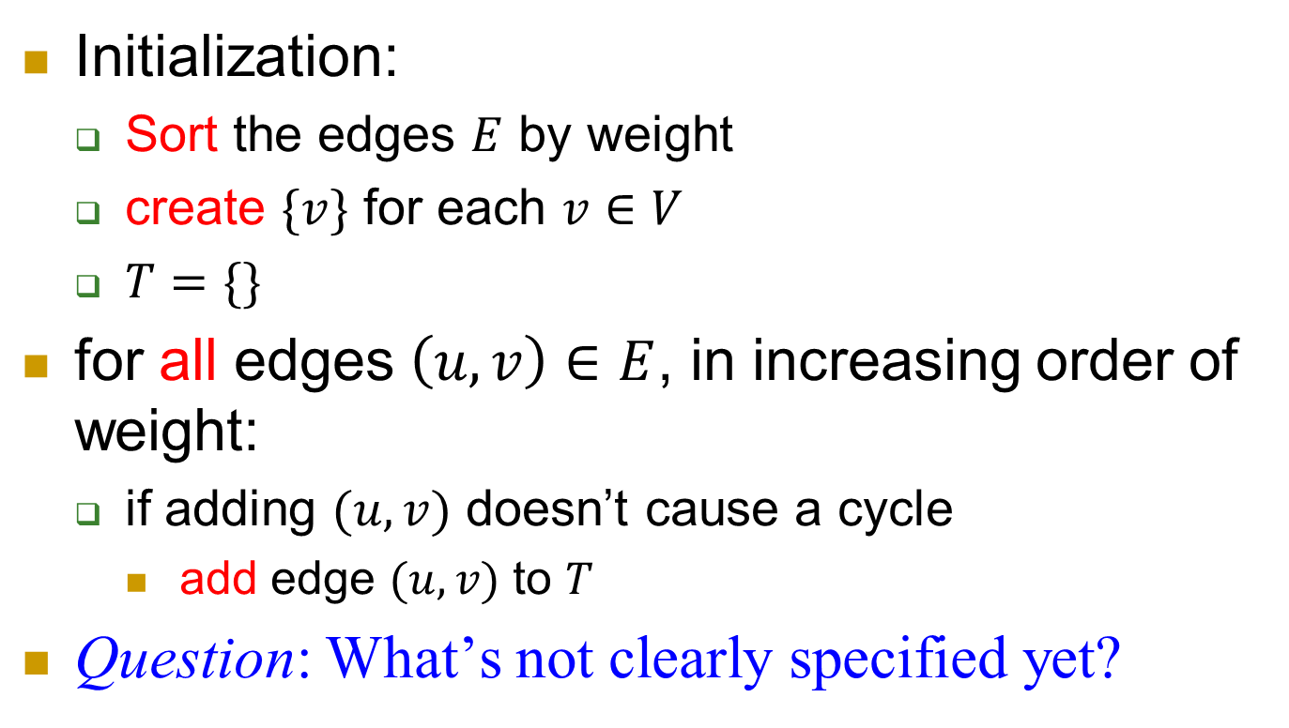
Implementing Kruskal's Algorithm:
Initialization:
  Sort the edges $E$ by weight
  create $\{v\}$ for each $v∈V$
  $T=\{\}$
for all edges $\left(u,v\right)∈E$, in increasing order of weight:
  if adding $(u,v)$ doesn’t cause a cycle
    add edge $(u,v)$ to $T$
Question: What’s not clearly specified yet?

Slide 14
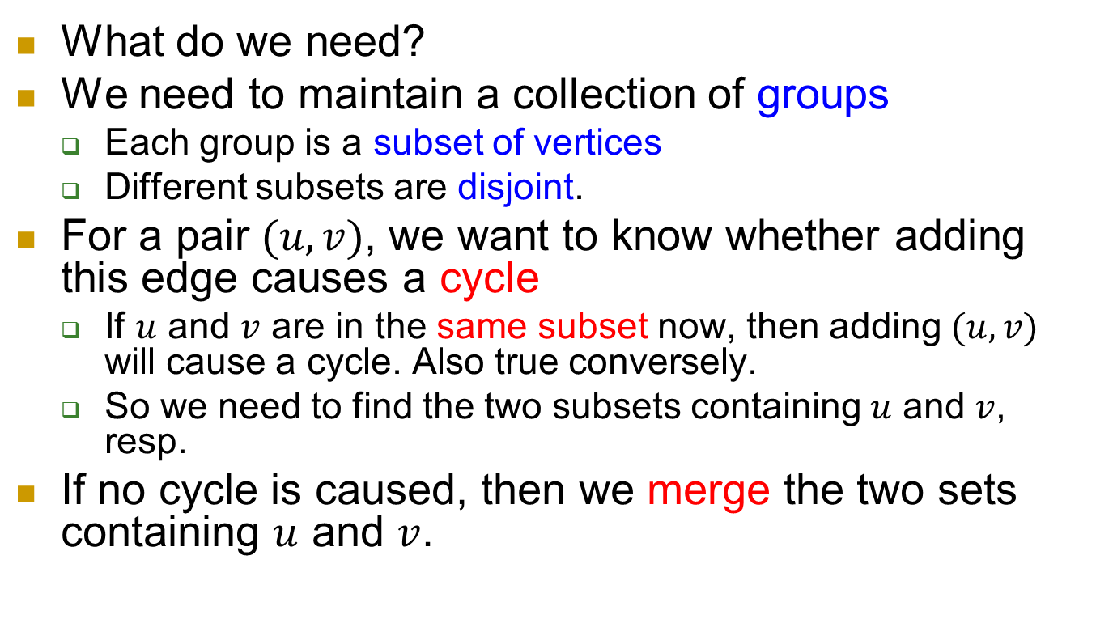
Implementation
What do we need?
We need to maintain a collection of groups
  Each group is a subset of vertices
  Different subsets are disjoint.
For a pair $(u,v)$, we want to know whether adding this edge causes a cycle
  If $u$ and $v$ are in the same subset now, then adding $(u,v)$ will cause a cycle. Also true conversely.
  So we need to find the two subsets containing $u$ and $v$, resp.
If no cycle is caused, then we merge the two sets containing $u$ and $v$.

Slide 15
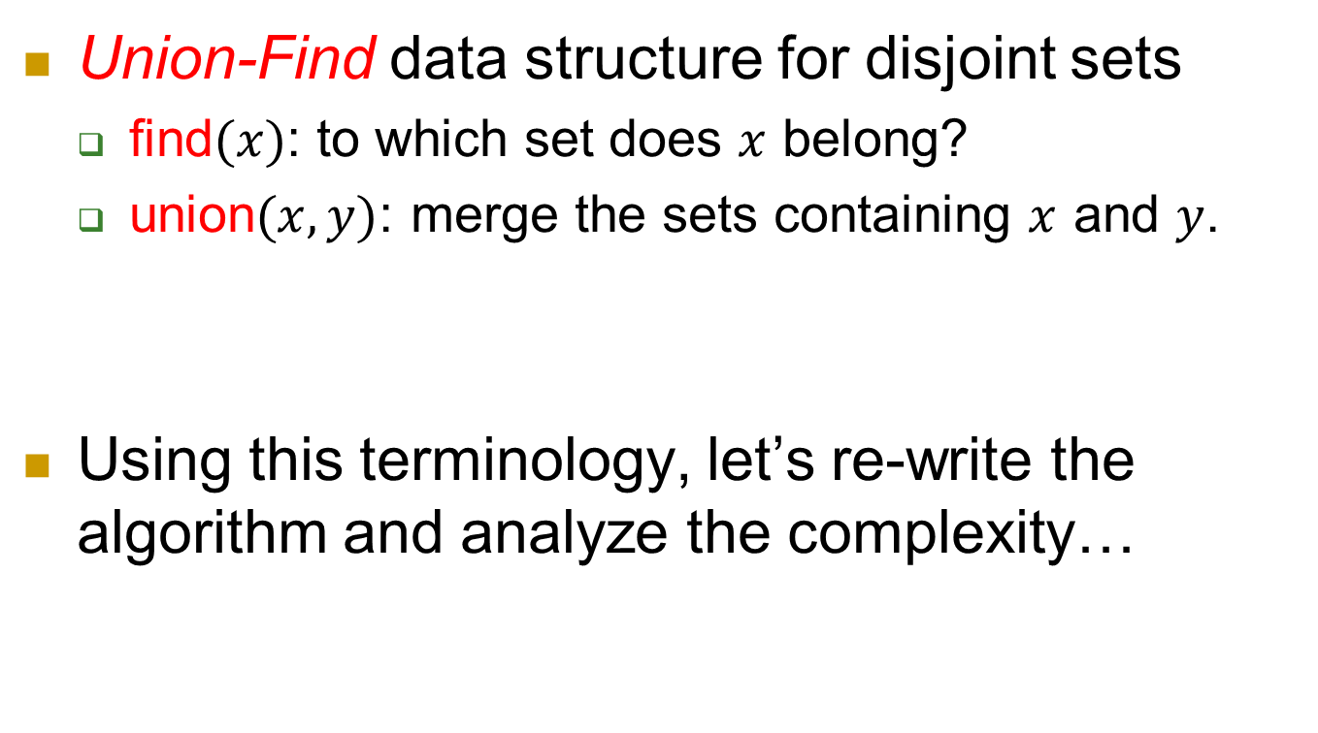
Data structure
Union-Find data structure for disjoint sets
  find$(x)$: to which set does $x$ belong?
  union$(x,y)$: merge the sets containing $x$ and $y$.
Using this terminology, let’s re-write the algorithm and analyze the complexity…

Slide 16
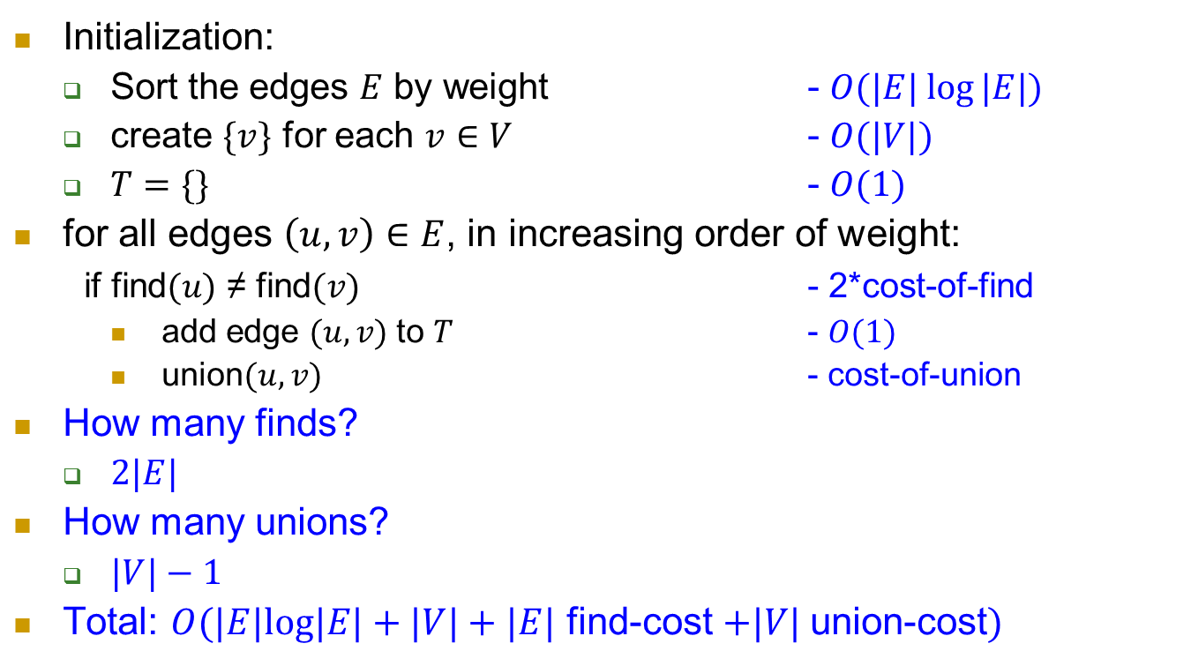
Kruskal's Algorithm: rewritten, complexity
Initialization:
  Sort the edges $E$ by weight - $O(|E| log⁡|E|)$
  create $\{v\}$ for each $v∈V$ - $O(|V|)$
  $T=\{\}$ - $O(1)$
for all edges $\left(u,v\right)∈E$, in increasing order of weight:
if find$(u)$ ≠ find$(v)$ - 2*cost-of-find
    add edge $(u,v)$ to $T$ - $O(1)$
    union$(u,v)$ - cost-of-union
How many finds?
  $2|E|$
How many unions?
  $|V|−1$
Total: $O(|E|log|E|+|V|+|E|$ find-cost $+|V|$union-cost$)$

Slide 17
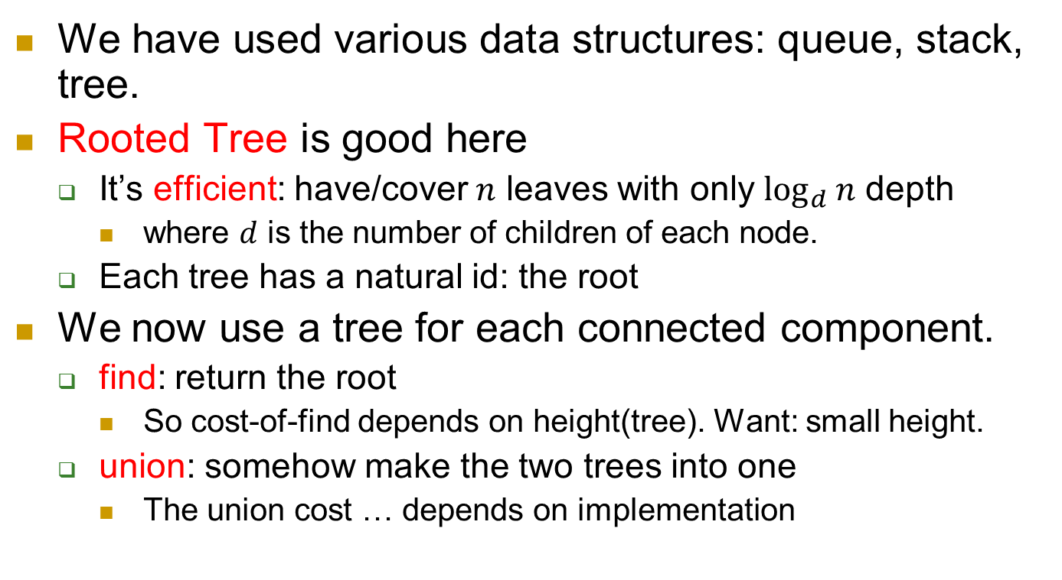
data structure for union-find
We have used various data structures: queue, stack, tree.
Rooted Tree is good here
  It’s efficient: have/cover $n$ leaves with only $\log_{d}{n}$ depth
    where $d$ is the number of children of each node.
  Each tree has a natural id: the root
We now use a tree for each connected component.
  find: return the root
    So cost-of-find depends on height(tree). Want: small height.
  union: somehow make the two trees into one
    The union cost … depends on implementation

Slide 18
union
Recall: a tree is constructed by a sequence of union operations.
So we want to design a union algorithm s.t.
  the resulting tree is short
  the cost of union itself is not large either.
A natural idea: let the shorter tree be part of the higher tree
  Actually right under the root of the higher tree
To this end, we need to maintain the height information of a tree, which is pretty easy.

Slide 19
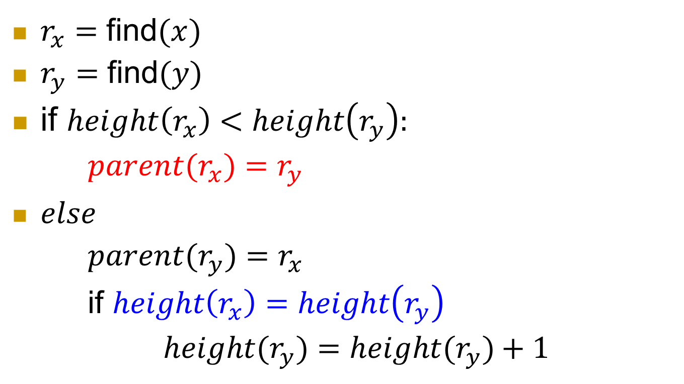

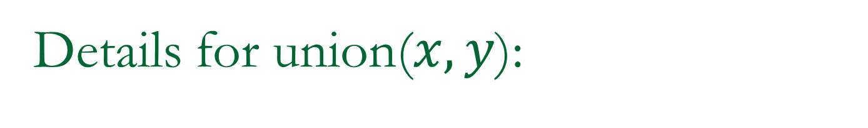



Details for union($x,y$):
$r_{x}=$ find$(x)$
$r_{y}=$ find$(y)$
if $height\left(r_{x}\right)<height\left(r_{y}\right):$
$parent(r_{x})=r_{y}$
$else$
$parent(r_{y})=r_{x}$
if $height\left(r_{x}\right)=height\left(r_{y}\right)$
$height(r_{y})=height(r_{y})+1$
$$r_{y}$$
$$r_{x}$$
$$x$$
$$y$$

Slide 20
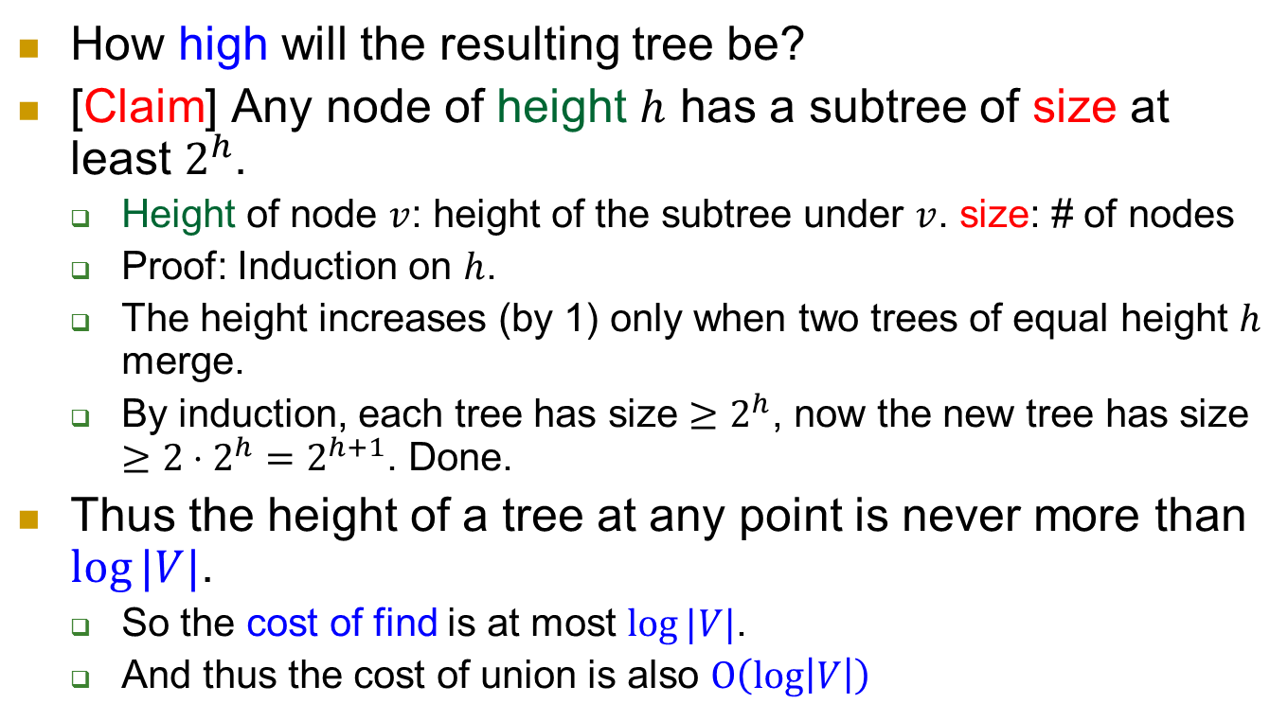
How good is this?
How high will the resulting tree be?
[Claim] Any node of height $h$ has a subtree of size at least $2^{h}$.
  Height of node $v$: height of the subtree under $v$. size: # of nodes
  Proof: Induction on $h$.
  The height increases (by 1) only when two trees of equal height $h$ merge.
  By induction, each tree has size $≥2^{h}$, now the new tree has size $≥2⋅2^{h}=2^{h+1}$. Done.
Thus the height of a tree at any point is never more than $log⁡|V|$.
  So the cost of find is at most $log⁡|V|$.
  And thus the cost of union is also $O\left(\log\left|V\right|\right)$

Slide 21
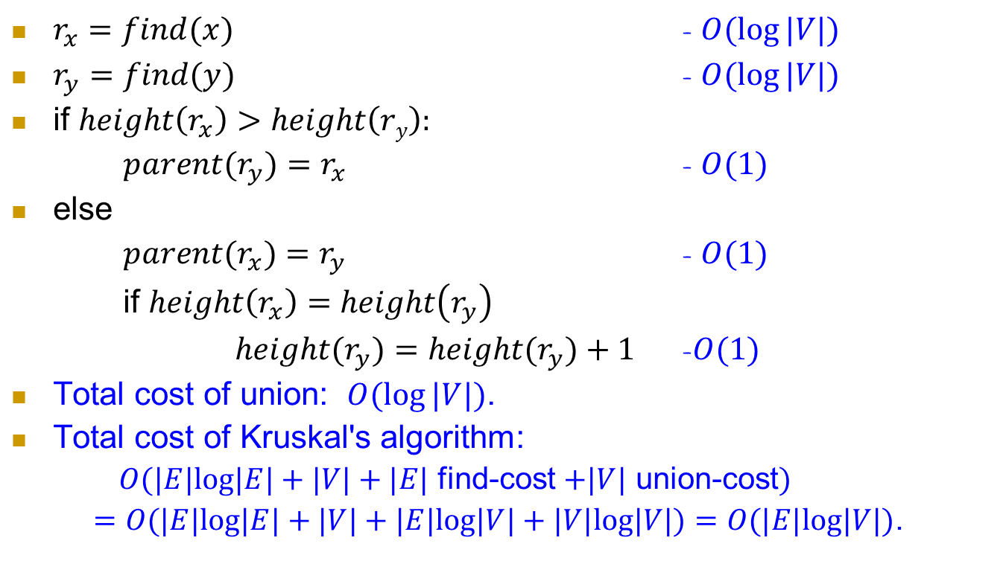
Cost of union?
$r_{x}=find(x)$ - $O(log⁡|V|)$
$r_{y}=find(y)$ - $O(log⁡|V|)$
if $height\left(r_{x}\right)>height\left(ry\right):$
$parent(r_{y})=r_{x}$ - $O(1)$
else
$parent(r_{x})=r_{y}$ - $O(1)$
if $height\left(r_{x}\right)=height\left(r_{y}\right)$
$height(r_{y})=height(r_{y})+1$ -$O(1)$
Total cost of union: $O(log⁡|V|)$.
Total cost of Kruskal's algorithm:
  $O(|E|log|E|+|V|+|E|$ find-cost $+|V|$ union-cost$)$
  $=O(|E|log|E|+|V|+|E|log|V|+|V|log|V|)=O(|E|log|V|)$.

Slide 22
Don’t confuse the two types of trees
Type 1: (parts of) the spanning tree
  Red edges
Type 2: the tree data structure used for implementing union-find operations
  Blue edges
6
1
5
6
3
4
2
5
6
4
4
4
2

Slide 23
Question?
Next: another MST algorithm.

Slide 24
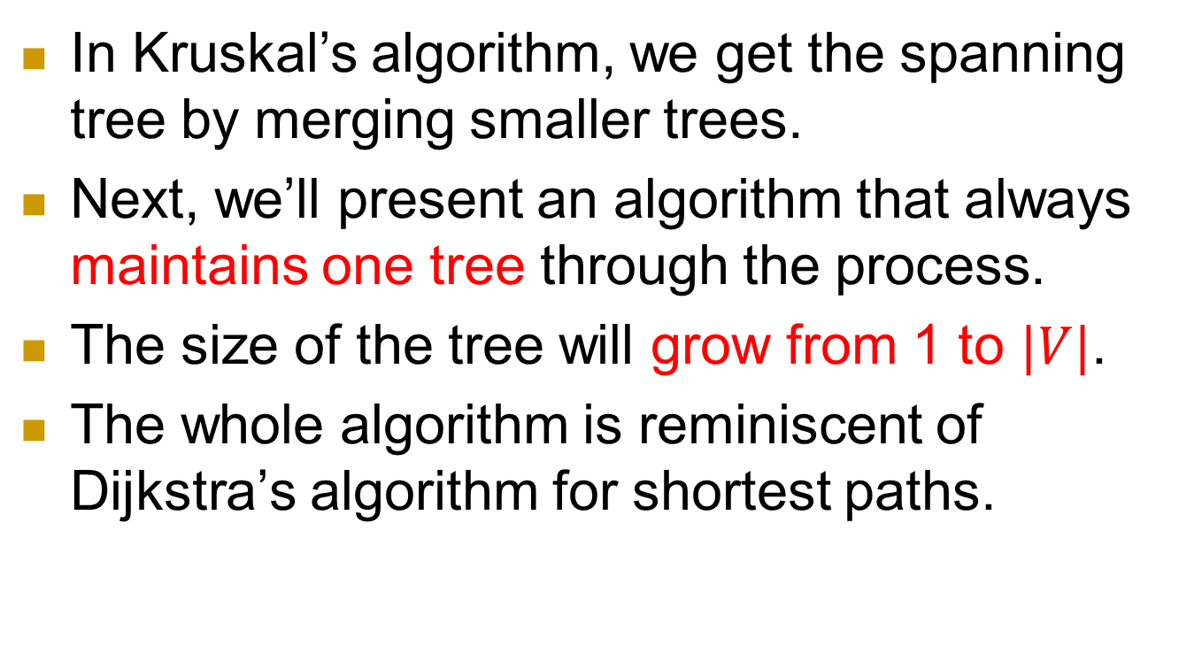
Next: another MST algorithm
In Kruskal’s algorithm, we get the spanning tree by merging smaller trees.
Next, we’ll present an algorithm that always maintains one tree through the process.
The size of the tree will grow from 1 to $|V|$.
The whole algorithm is reminiscent of Dijkstra’s algorithm for shortest paths.

Slide 25
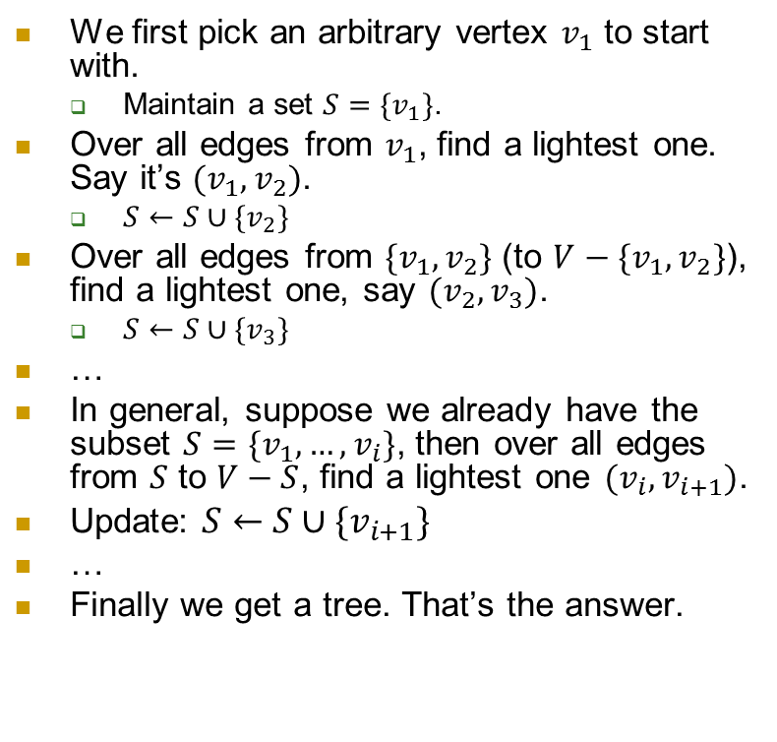
Execution on the same example
We first pick an arbitrary vertex $v_{1}$ to start with.
  Maintain a set $S=\{v_{1}\}$.
Over all edges from $v_{1}$, find a lightest one. Say it’s $(v_{1},v_{2})$.
  $S←S∪\{v_{2}\}$
Over all edges from $\{v_{1},v_{2}\}$ (to $V−\{v_{1},v_{2}\}$), find a lightest one, say $(v_{2},v_{3})$.
  $S←S∪\{v_{3}\}$
…
In general, suppose we already have the subset $S=\{v_{1}, …,v_{i}\}$, then over all edges from $S$ to $V−S$, find a lightest one $(v_{i}, v_{i+1})$.
Update: $S←S∪\{v_{i+1}\}$
…
Finally we get a tree. That’s the answer.
v₉
v₁
6
1
v₂
5
6
3
4
2
v₈
v₃
v₆
5
6
4
4
4
v₅
2
v₄
v₇

Slide 26

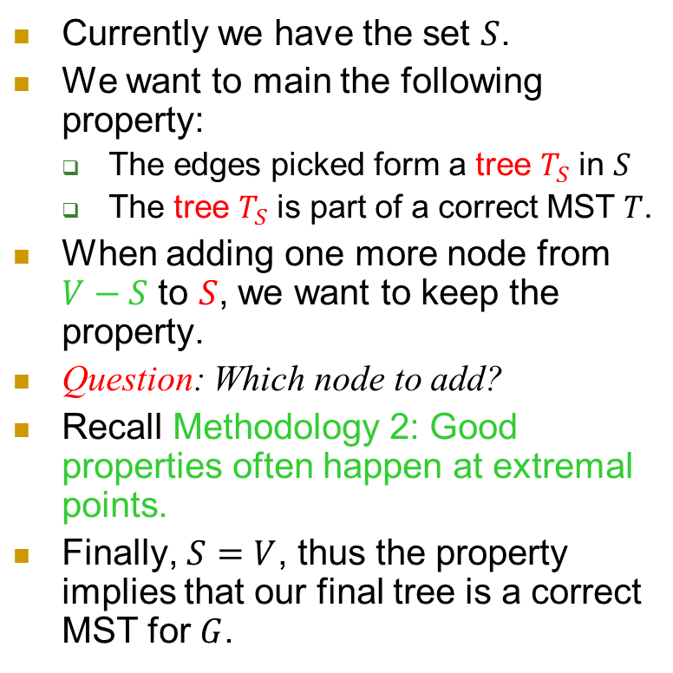

Key property
Currently we have the set $S$.
We want to main the following property:
  The edges picked form a tree $T_{S}$ in $S$
  The tree $T_{S}$ is part of a correct MST $T$.
When adding one more node from $V−S$ to $S$, we want to keep the property.
Question: Which node to add?
Recall Methodology 2: Good properties often happen at extremal points.
Finally, $S=V$, thus the property implies that our final tree is a correct MST for $G$.
v₁
6
v₂
6
4
v₃
6
v₅
v₄
$$V−S$$
$$S$$

Slide 27
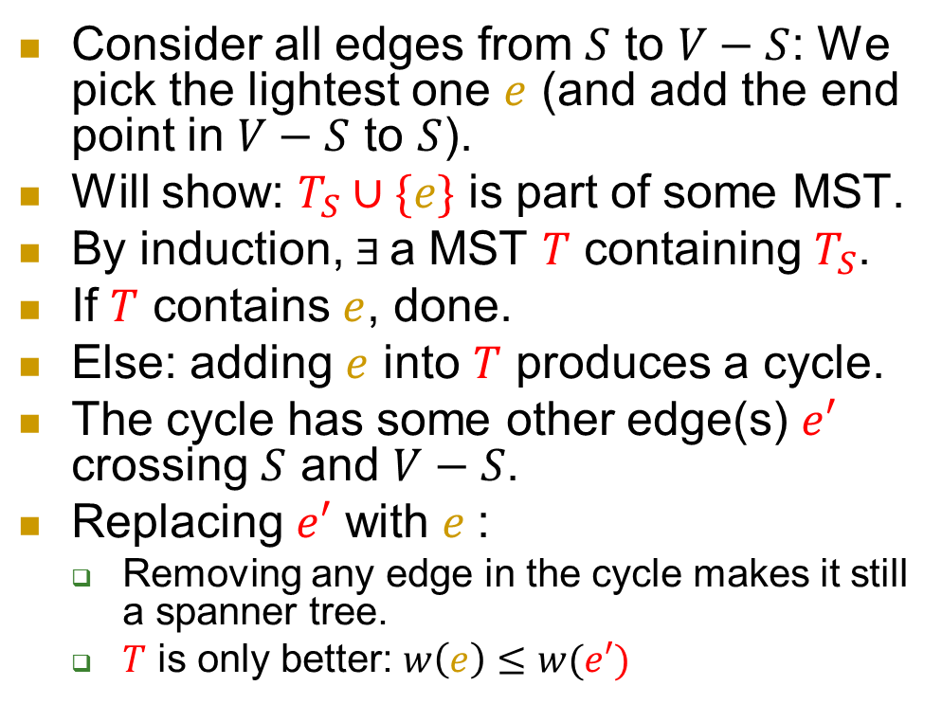





Key property: $T_{S}$ is part of a MST $T$.
Consider all edges from $S$ to $V−S$: We pick the lightest one $e$ (and add the end point in $V−S$ to $S$).
Will show: $T_{S}∪\{e\}$ is part of some MST.
By induction, Ǝ a MST $T$ containing $T_{S}$.
If $T$ contains $e$, done.
Else: adding $e$ into $T$ produces a cycle.
The cycle has some other edge(s) $e′$ crossing $S$ and $V−S$.
Replacing $e′$ with $e$:
  Removing any edge in the cycle makes it still a spanner tree.
  $T$ is only better: $w\left(e\right)≤w(e′)$
6
$$e′$$
6
$$e$$
4
6
$$V−S$$
$$S$$

Slide 28
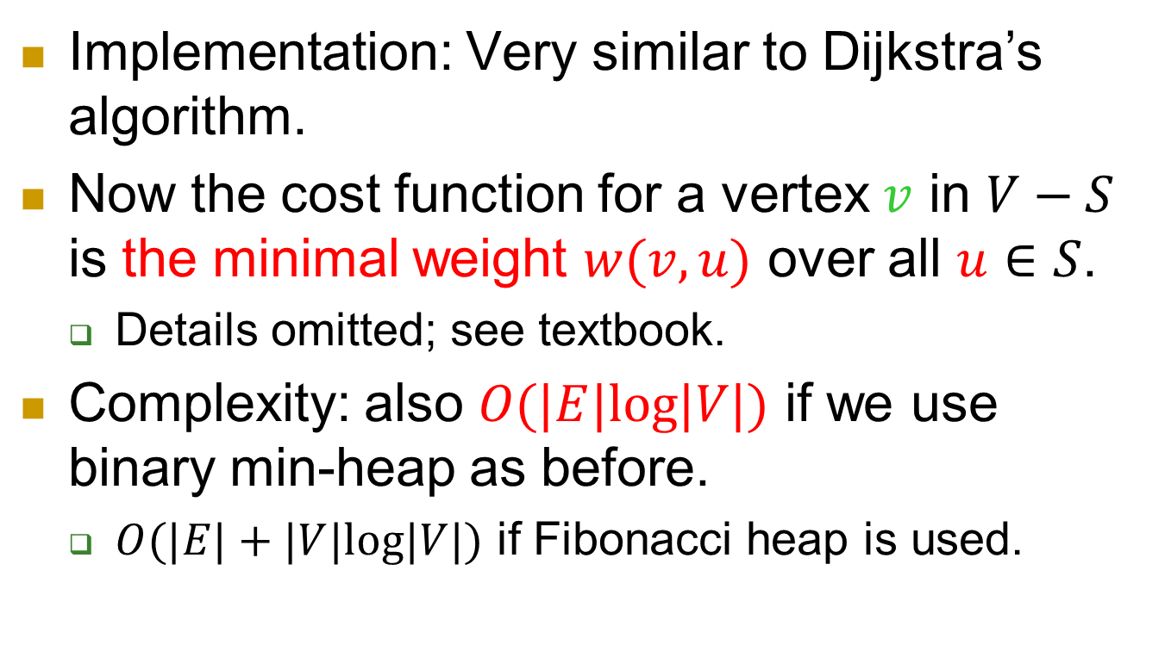
Prim’s algorithm
Implementation: Very similar to Dijkstra’s algorithm.
Now the cost function for a vertex $v$ in $V−S$ is the minimal weight $w(v,u)$ over all $u∈S$.
  Details omitted; see textbook.
Complexity: also $O(|E|log|V|)$ if we use binary min-heap as before.
  $O(|E|+|V|log|V|)$ if Fibonacci heap is used.

Slide 29

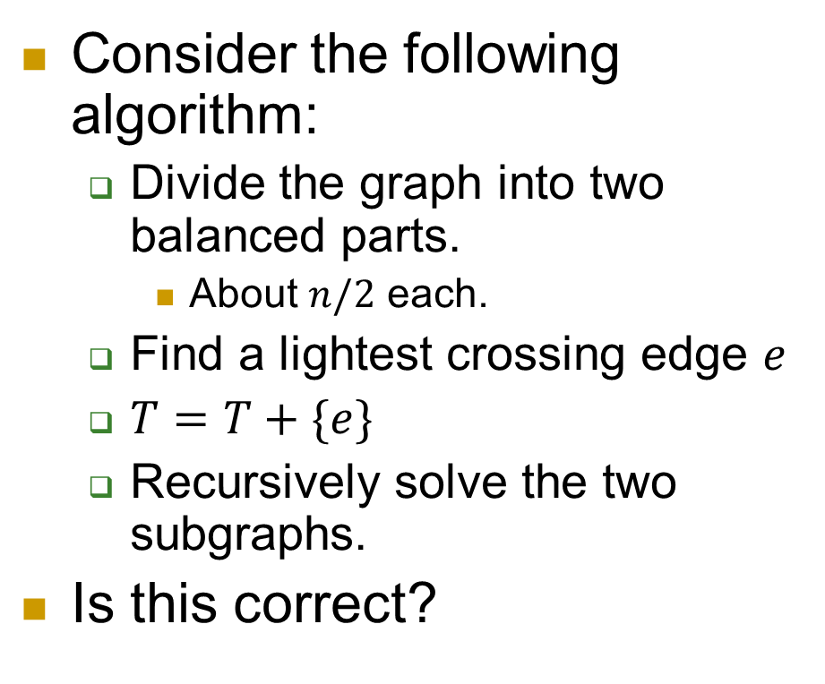

Extra: Divide and Conquer?
Consider the following algorithm:
  Divide the graph into two balanced parts.
    About $n/2$ each.
  Find a lightest crossing edge $e$
  $T=T+\{e\}$
  Recursively solve the two subgraphs.
Is this correct?
6
6
4
6
$$V−S$$
$$S$$

Slide 30
Example 2: Huffman code

Slide 31
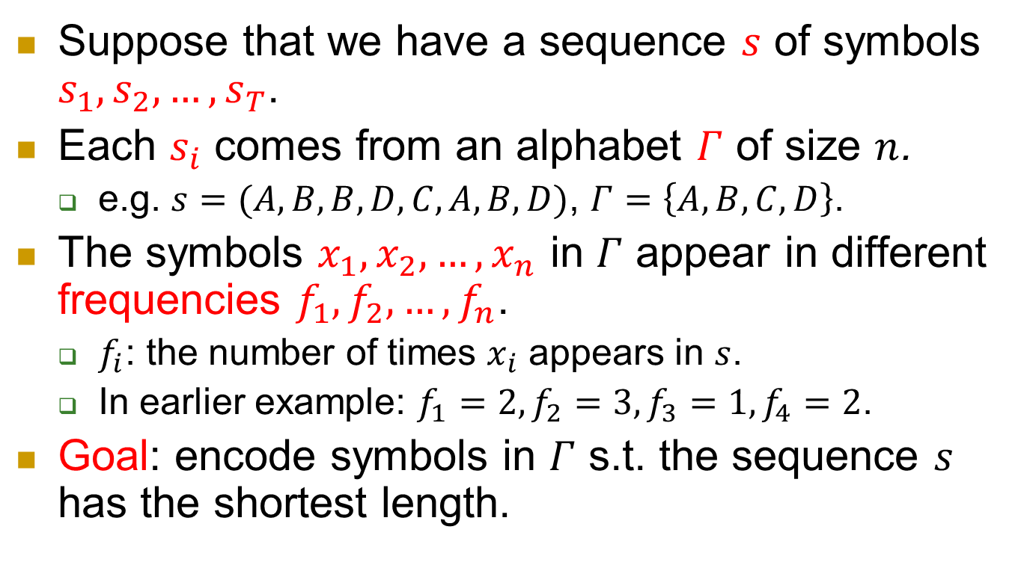
Huffman encoding
Suppose that we have a sequence $s$ of symbols $s_{1}, s_{2},…, s_{T}$.
Each $s_{i}$ comes from an alphabet $Γ$ of size $n$.
  e.g. $s=(A,B,B,D,C,A,B,D)$, $Γ=\left\{A,B,C,D\right\}$.
The symbols $x_{1}, x_{2},…, x_{n}$ in $Γ$ appear in different frequencies $f_{1},f_{2},…,f_{n}$.
  $f_{i}$: the number of times $x_{i}$ appears in $s$.
  In earlier example: $f_{1}=2,f_{2}=3,f_{3}=1,f_{4}=2$.
Goal: encode symbols in $Γ$ s.t. the sequence $s$ has the shortest length.

Slide 32
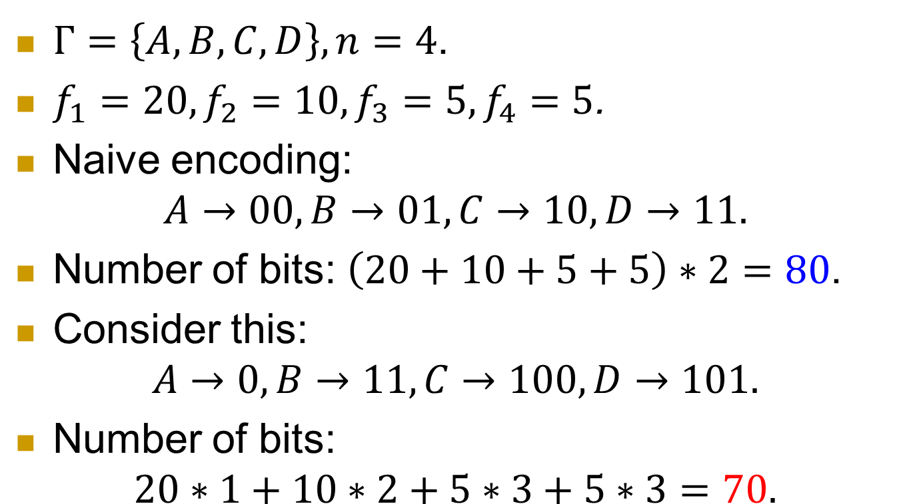
Example
$Γ=\left\{A,B,C,D\right\}, n=4$.
$f_{1}=20, f_{2}=10, f_{3}=5, f_{4}=5$.
Naive encoding:
$$A→00,B→01,C→10, D→11.$$
Number of bits: $\left(20+10+5+5\right)∗2=80$.
Consider this:
$$A→0,B→11,C→100, D→101.$$
Number of bits:
$20∗1+10∗2+5∗3+5∗3=70.$

Slide 33
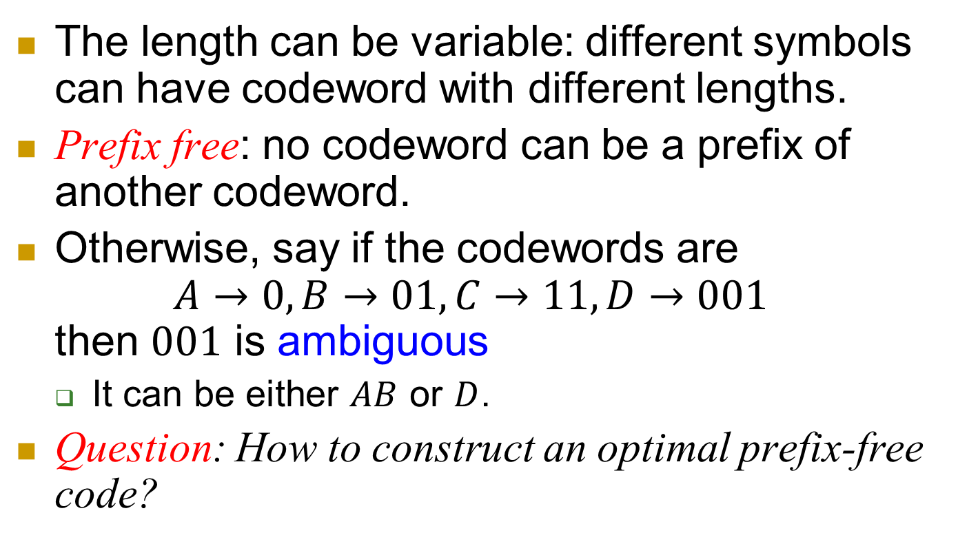
Requirement for the code
The length can be variable: different symbols can have codeword with different lengths.
Prefix free: no codeword can be a prefix of another codeword.
Otherwise, say if the codewords are
$A→0,B→01,C→11, D→001$
then $001$ is ambiguous
  It can be either $AB$ or $D$.
Question: How to construct an optimal prefix-free code?

Slide 34

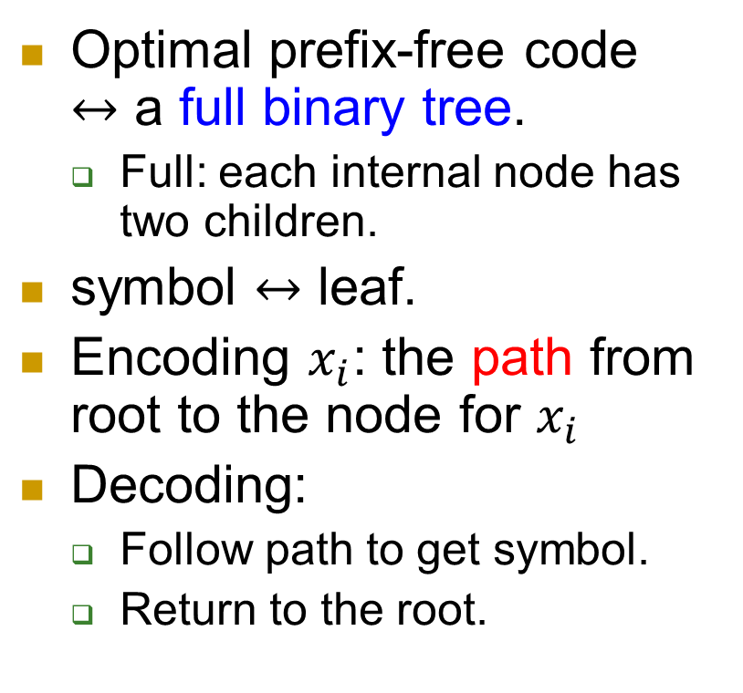
Prefix-free code and binary tree
$$A→0,B→11,C→100, D→101$$
Optimal prefix-free code $↔$ a full binary tree.
  Full: each internal node has two children.
symbol $↔$ leaf.
Encoding $x_{i}$: the path from root to the node for $x_{i}$
Decoding:
  Follow path to get symbol.
  Return to the root.
0
1
A
0
1
0
1
B
C
D
  Path: represented by sequence of 0’s and 1’s.
  0: left branch. 1: right branch

Slide 35
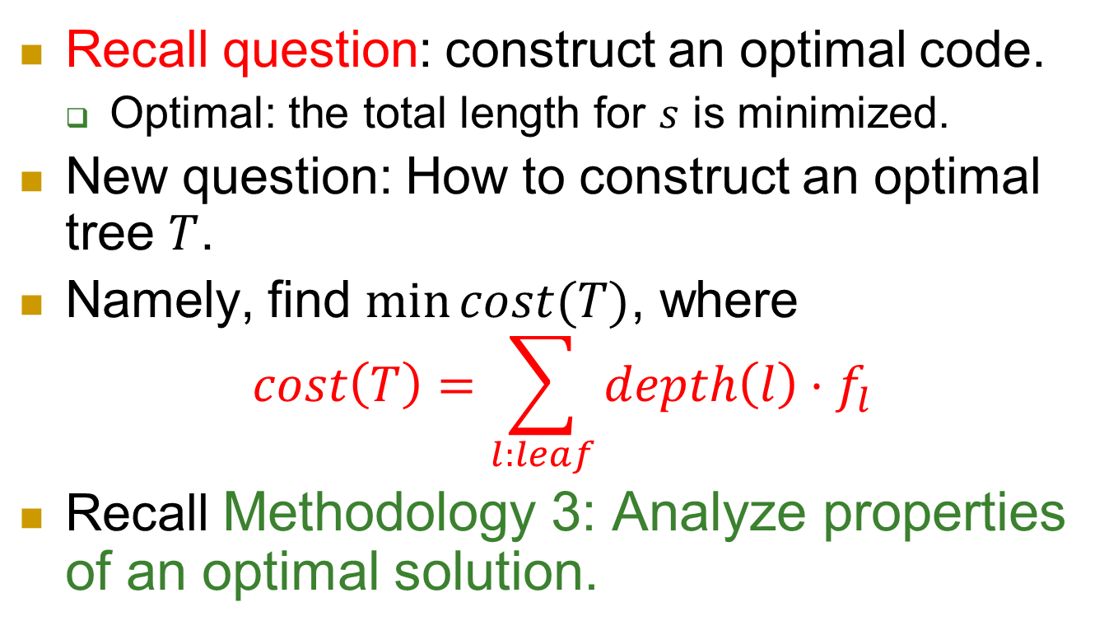
Optimal tree?
Recall question: construct an optimal code.
  Optimal: the total length for $s$ is minimized.
New question: How to construct an optimal tree $T$.
Namely, find $\min{cost(T)}$, where
$cost\left(T\right)=\sum_{l:leaf}{depth\left(l\right)⋅f_{l}}$
Recall Methodology 3: Analyze properties of an optimal solution.

Slide 36
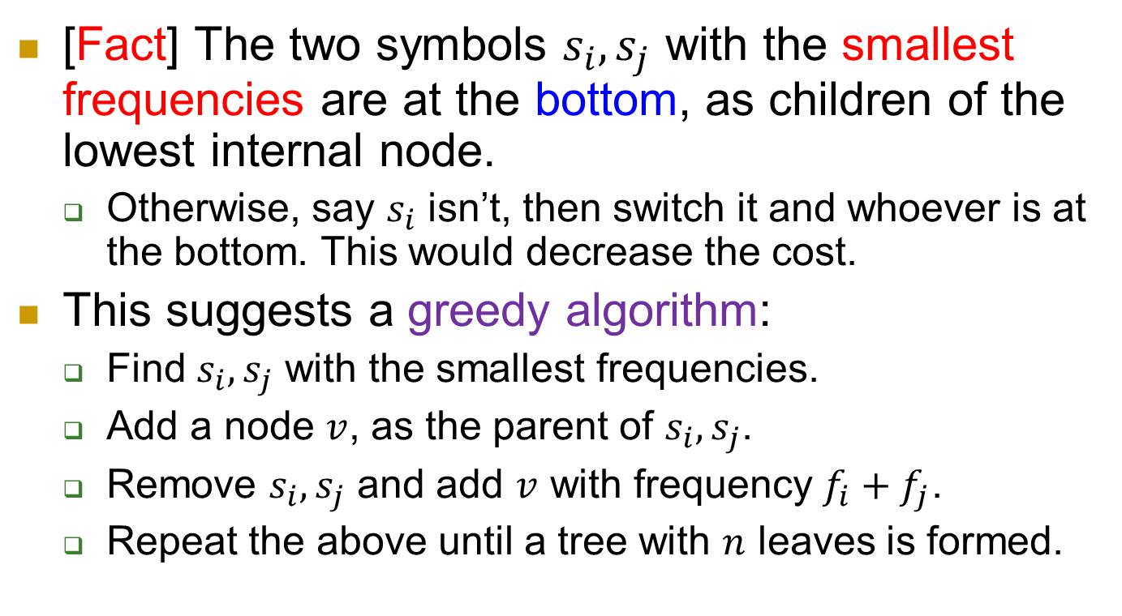
In an optimal tree
[Fact] The two symbols $s_{i},s_{j}$ with the smallest frequencies are at the bottom, as children of the lowest internal node.
  Otherwise, say $s_{i}$ isn’t, then switch it and whoever is at the bottom. This would decrease the cost.
This suggests a greedy algorithm:
  Find $s_{i},s_{j}$ with the smallest frequencies.
  Add a node $v$, as the parent of $s_{i},s_{j}$.
  Remove $s_{i},s_{j}$ and add $v$ with frequency $f_{i}+f_{j}$.
  Repeat the above until a tree with $n$ leaves is formed.

Slide 37
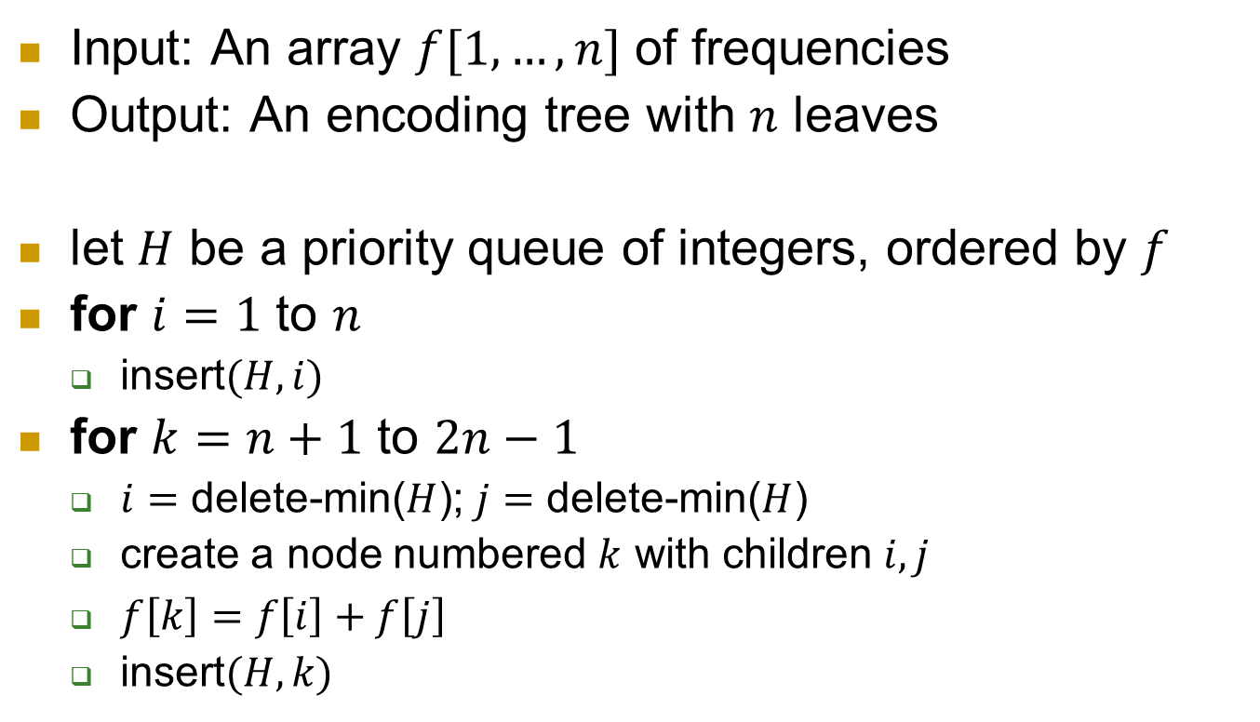
Algorithm, formal description
Input: An array $f[1, …,n]$ of frequencies
Output: An encoding tree with $n$ leaves
let $H$ be a priority queue of integers, ordered by $f$
for $i=1$ to $n$
  insert$(H,i)$
for $k=n+1$ to $2n−1$
  $i=$ delete-min($H$); $j=$ delete-min($H$)
  create a node numbered $k$ with children $i, j$
  $f\left[k\right]=f\left[i\right]+f\left[j\right]$
  insert$(H,k)$

Slide 38
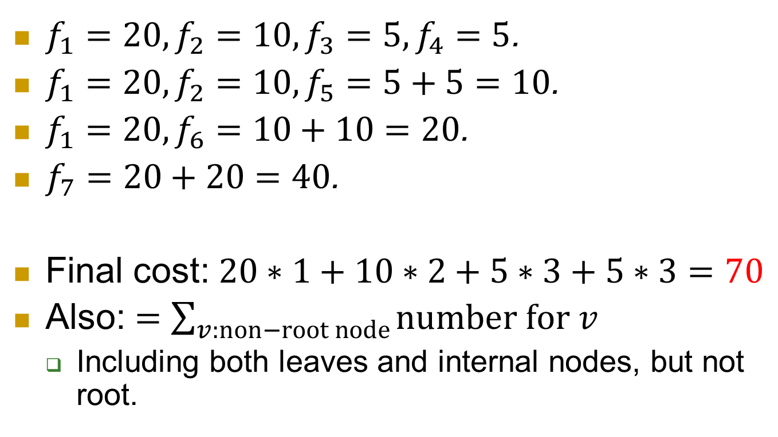
On the running example…
$f_{1}=20, f_{2}=10, f_{3}=5, f_{4}=5$.
$f_{1}=20, f_{2}=10, f_{5}=5+5=10$.
$f_{1}=20, f_{6}=10+10=20$.
$f_{7}=20+20=40$.
Final cost: $20∗1+10∗2+5∗3+5∗3=70$
Also: $=\sum_{v:non−root node}{number for v}$
  Including both leaves and internal nodes, but not root.
0
1
40
A:20
0
1
20
0
10
1
B:10
C:5
D:5

Slide 39
Summary
We give two examples for greedy algorithms.
  MST, Huffman code
General idea: Make choice which is the best at the moment only.
  without worrying about long-term consequences.
An intriguing question: When greedy algorithms work?
  Namely, when there is no need to think ahead?
Matroid theory provides one explanation.
  See CLRS book (Chapter 16.4) for a gentle intro.

