Slide 1
CSC3160: Design and Analysis of Algorithms
Week 2: Single Source Shortest Paths
Instructor: Shengyu Zhang

Slide 2
Content
Graphs: model, size, distance.
Problem: shortest path.
Algorithms:
  BFS: unweighted
  Dijkstra: non-negative weights
  Bellman-Ford: negative weights

Slide 3

Abstract model
Graph: $G=(V,E)$
  $V$: set of nodes/vertices/points
  $E⊆V×V$: set of edges
3
3
2
2
1
1
4
4
undirected graph:
  Edges have no directions
directed graph:
  Edges have directions

Slide 4
Graph, graph, graph…
Why graph? There are lots of graph examples in our lives.
Name one.
  Information: WWW, citation
  Social: co-actor, dating, messenger, communities
  Technological: Internet, power grids, airline routes
  Biological: Neural networks, food web, blood vessels
  …

Slide 5
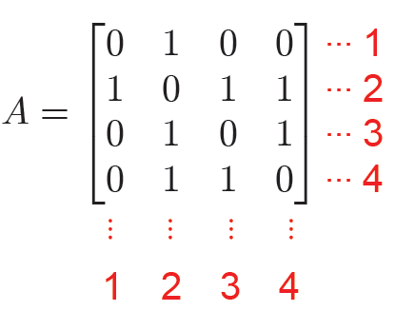

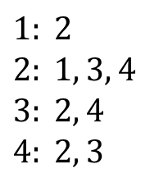
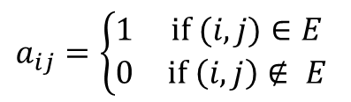
Representations of graphs
3
Adjacency list
  for sparse graphs
Adjacency matrix:
  $A = [aij]$, where
  for general graphs
2
1
$$a_{ij}=\left\{\begin{matrix}1 & \text{if} (i,j)∈E \\ 0 & \text{if} \left(i,j\right)∉ E\end{matrix}\right.$$
4
$$1: 2$$
$$2: 1, 3, 4$$
$$3: 2, 4$$
$$4: 2, 3$$

Slide 6
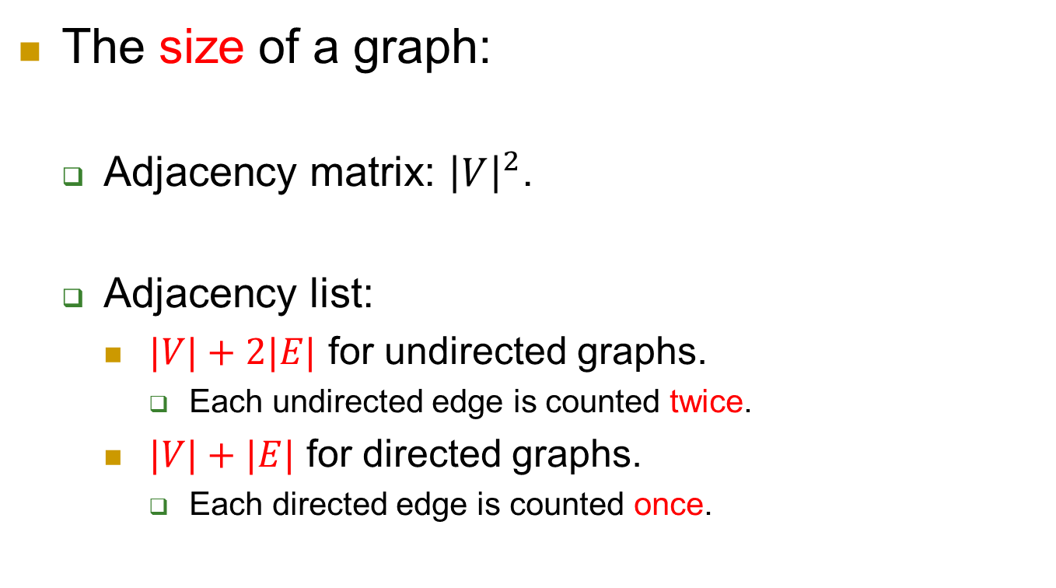

Size of graph
The size of a graph:
  Adjacency matrix: ${\left|V\right|}^{2}$.
  Adjacency list:
    $|V|+2|E|$ for undirected graphs.
      Each undirected edge is counted twice.
    $|V|+|E|$ for directed graphs.
      Each directed edge is counted once.
$$1: 2$$
$$2: 1, 3, 4$$
$$3: 2, 4$$
$$4: 2, 3$$

Slide 7
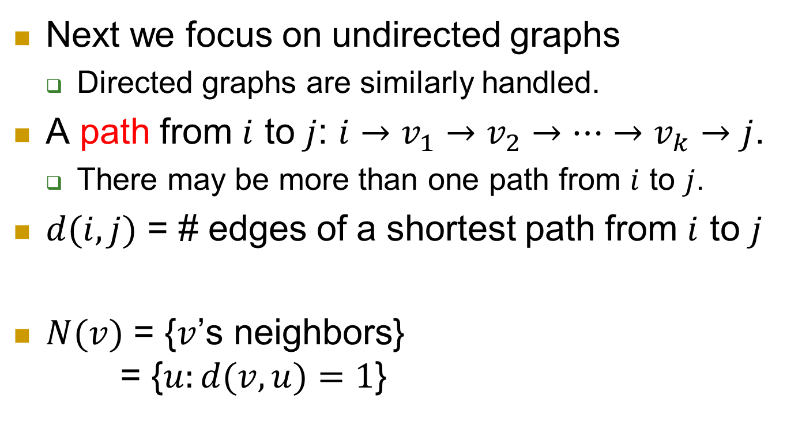
Distance
Next we focus on undirected graphs
  Directed graphs are similarly handled.
A path from $i$ to $j$: $i→v_{1}→v_{2}→…→v_{k}→j$.
  There may be more than one path from $i$ to $j$.
$d(i,j)$ = # edges of a shortest path from $i$ to $j$
$N(v)$ = {$v$’s neighbors}
= {$u:d(v,u)=1$}
3
2
1
4

Slide 8
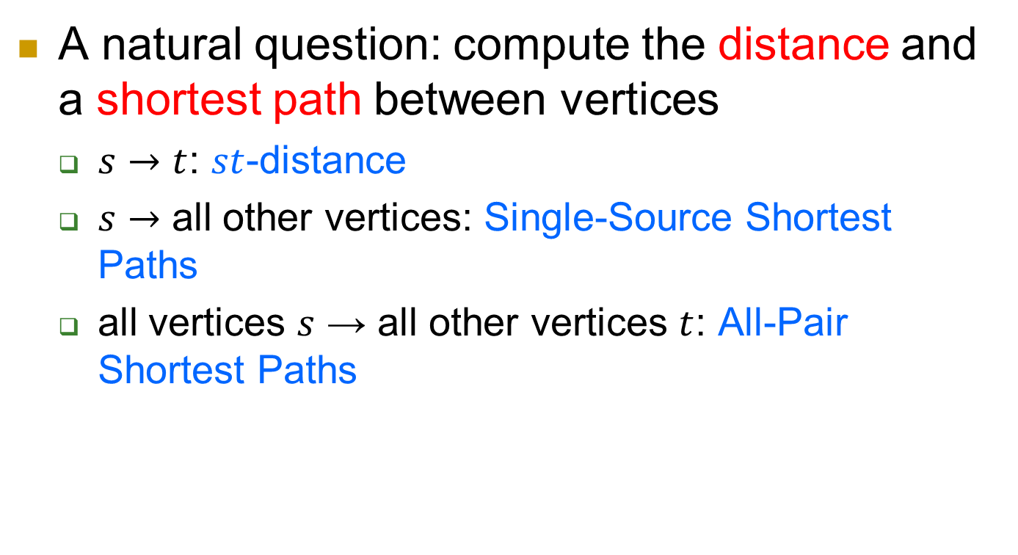
A natural question: compute the distance and a shortest path between vertices
  $s→t$: $st$-distance
  $s→$ all other vertices: Single-Source Shortest Paths
  all vertices $s$ → all other vertices $t$: All-Pair Shortest Paths

Slide 9
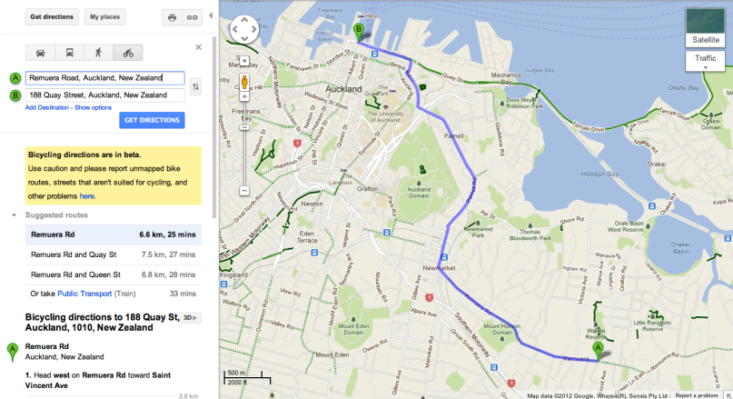

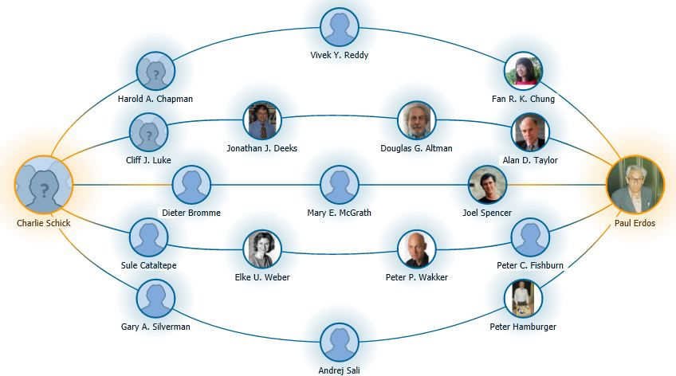
Why shortest paths?
Google map for directions
Optimal solution of Rubik’s cube.
  Guess what’s the number?
Erdős number

Slide 10
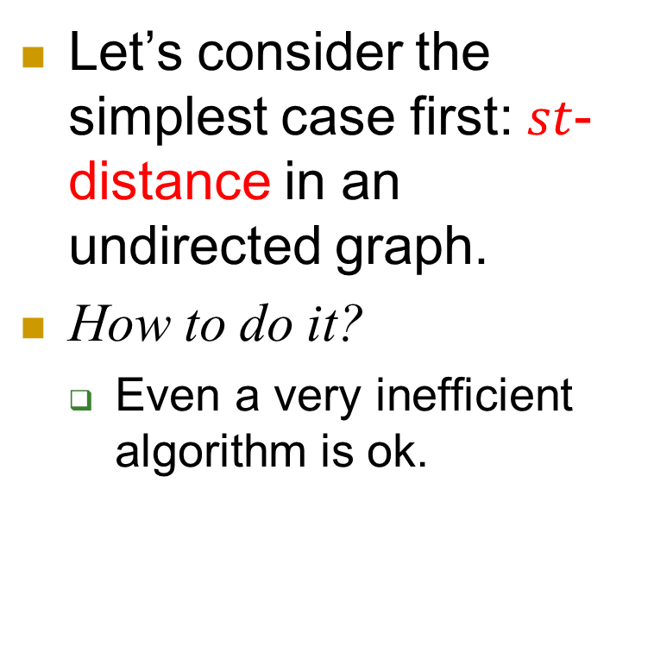

$st$-distance
Let’s consider the simplest case first: $st$-distance in an undirected graph.
How to do it?
  Even a very inefficient algorithm is ok.
t
s

Slide 11
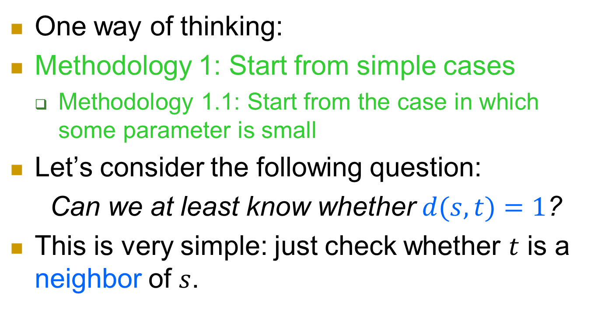
BFS
t
One way of thinking:
Methodology 1: Start from simple cases
  Methodology 1.1: Start from the case in which some parameter is small
Let’s consider the following question:
Can we at least know whether $d(s,t)=1$?
This is very simple: just check whether $t$ is a neighbor of $s$.
s

Slide 12
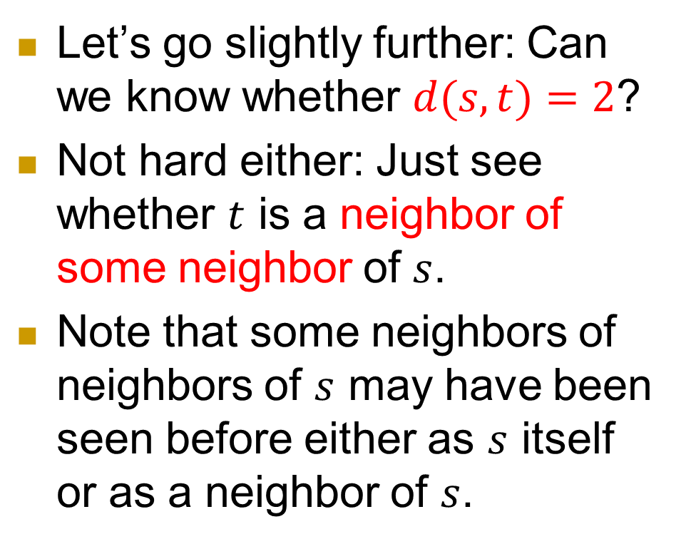
Little by little…
Let’s go slightly further: Can we know whether $d(s,t)=2$?
Not hard either: Just see whether $t$ is a neighbor of some neighbor of $s$.
Note that some neighbors of neighbors of $s$ may have been seen before either as $s$ itself or as a neighbor of $s$.
t
s

Slide 13
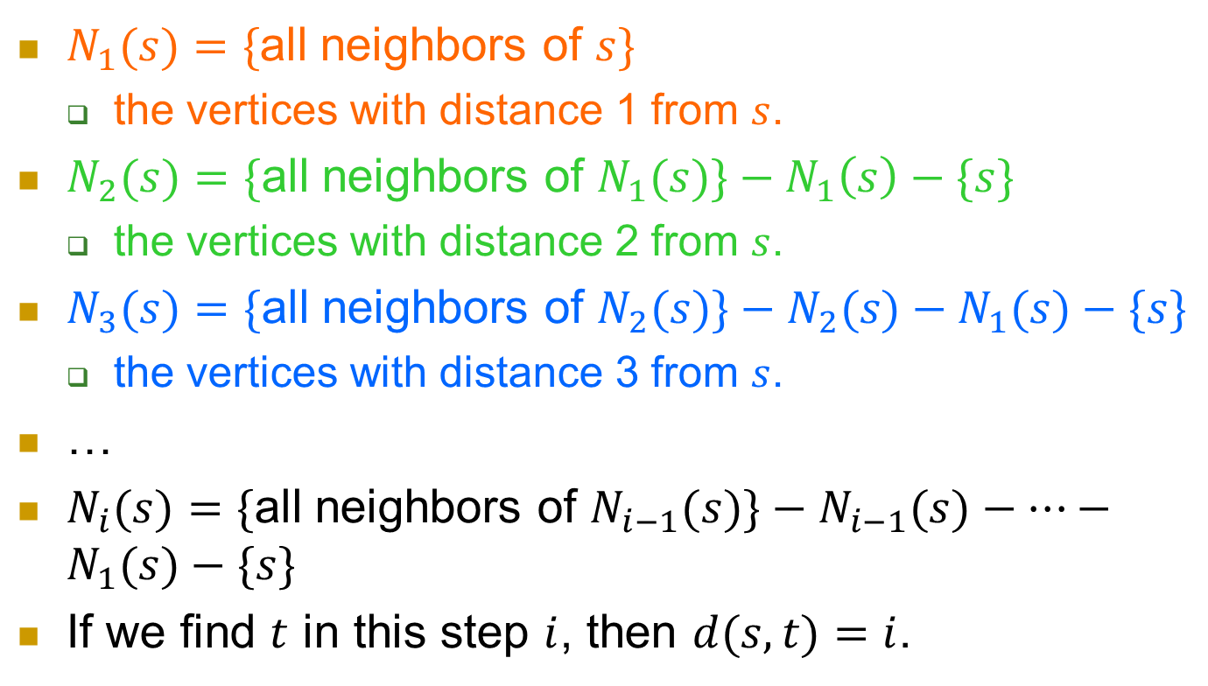
In general?
t
$N_{1}(s)=\{$all neighbors of $s\}$
  the vertices with distance 1 from $s$.
$N_{2}(s)=\{$all neighbors of $N_{1}(s)\}−N_{1}\left(s\right)−\{s\}$
  the vertices with distance 2 from $s$.
$N_{3}(s)=\{$all neighbors of $N_{2}(s)\}−N_{2}(s)−N_{1}(s)−\{s\}$
  the vertices with distance 3 from $s$.
…
$N_{i}(s)=\{$all neighbors of $N_{i−1}(s)\}−N_{i−1}(s)−⋯−N_{1}(s)−\{s\}$
If we find $t$ in this step $i$, then $d(s,t)=i$.
s

Slide 14
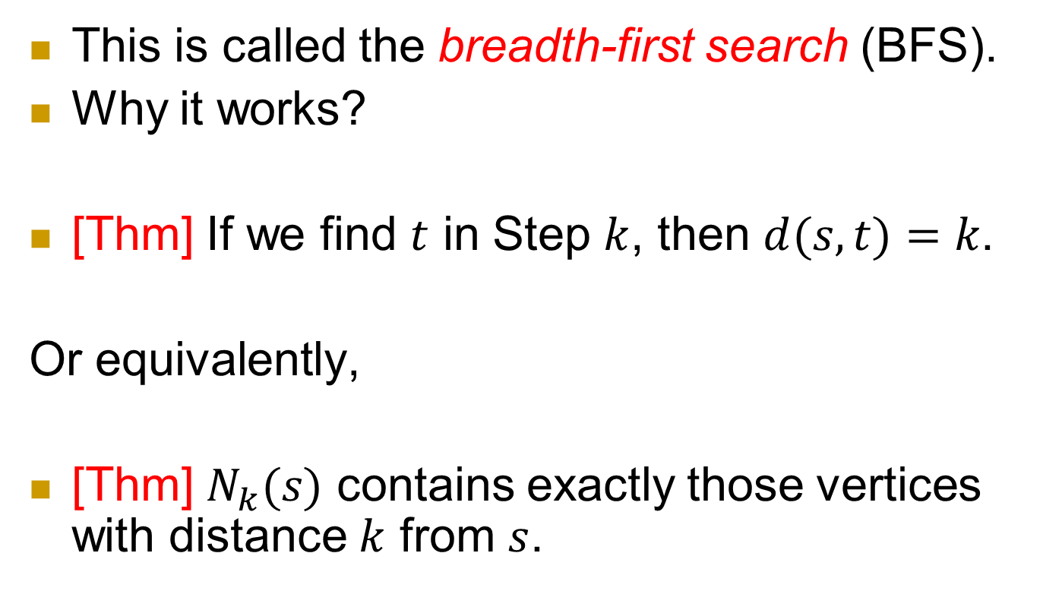
BFS
This is called the breadth-first search (BFS).
Why it works?
[Thm] If we find $t$ in Step $k$, then $d(s,t)=k$.
Or equivalently,
[Thm] $N_{k}(s)$ contains exactly those vertices with distance $k$ from $s$.

Slide 15
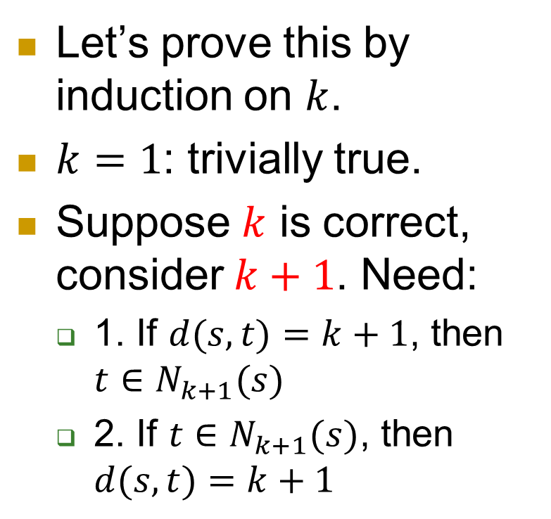

Proof of $N_{k}(s)=\{v:d(v,s)=k\}$
Let’s prove this by induction on $k$.
$k=1$: trivially true.
Suppose $k$ is correct, consider $k+1$. Need:
  1. If $d(s,t)=k+1$, then $t∈N_{k+1}(s)$
  2. If $t∈N_{k+1}(s)$, then $d(s,t)=k+1$
k
2
1
t
s

Slide 16
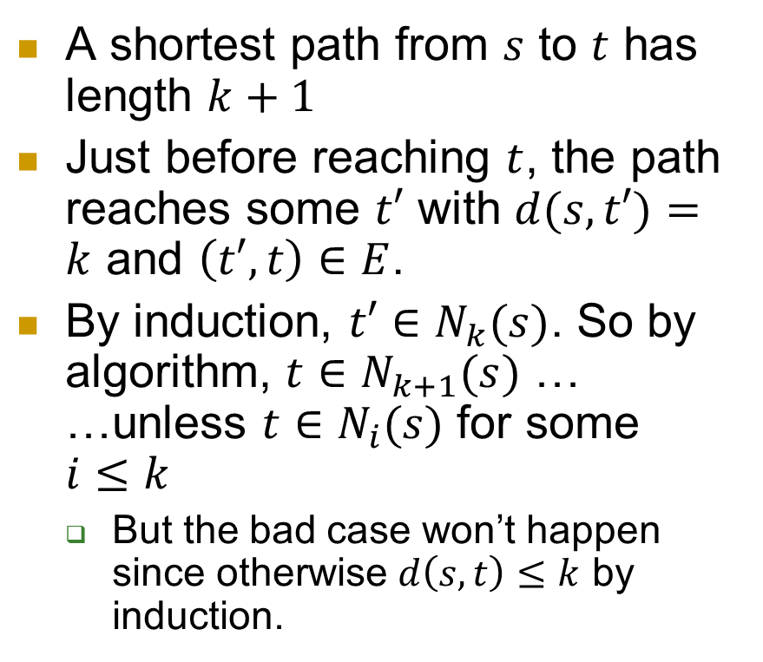
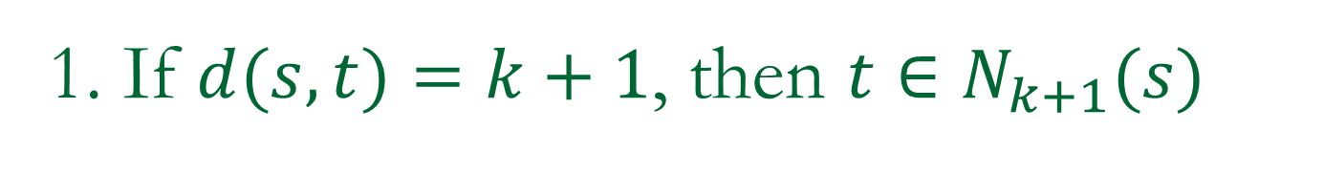
1. If $d(s,t)=k+1$, then $t∈N_{k+1}(s)$
Recall:$N_{i}(s)=\{$all neighbors of $N_{i−1}(s)\}−N_{i−1}(s)−⋯−N_{1}(s)−\{s\}$
A shortest path from $s$ to $t$ has length $k+1$
Just before reaching $t$, the path reaches some $t′$ with $d(s,t′)=k$ and $\left(t′,t\right)∈E$.
By induction, $t′∈N_{k}(s)$. So by algorithm, $t∈N_{k+1}(s)$ …
…unless $t∈N_{i}(s)$ for some $i≤k$
  But the bad case won’t happen since otherwise $d\left(s,t\right)≤k$ by induction.
k
2
1
t
s
t’

Slide 17
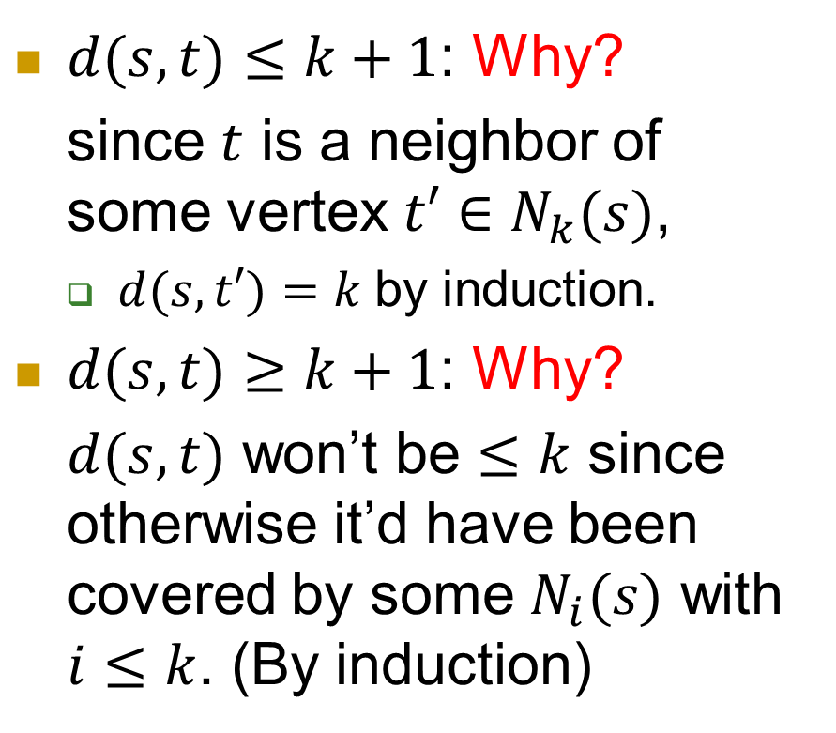
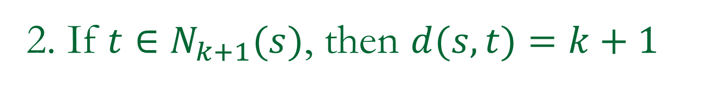
2. If $t∈N_{k+1}(s)$, then $d(s,t)=k+1$
Recall:$N_{i}(s)=\{$all neighbors of $N_{i−1}(s)\}−N_{i−1}(s)−⋯−N_{1}(s)−\{s\}$
$d(s,t)≤k+1$: Why?
since $t$ is a neighbor of some vertex $t′∈N_{k}(s)$,
  $d(s,t′)=k$by induction.
$d(s,t)≥k+1$: Why?
$d(s,t)$ won’t be $≤k$ since otherwise it’d have been covered by some $N_{i}(s)$ with $i≤k$. (By induction)
k
2
1
t
s
t’

Slide 18
Implementation of the algorithm
Queue: first in first out.
Basic operations:
  enqueue
  dequeue
enqueue
dequeue

Slide 19
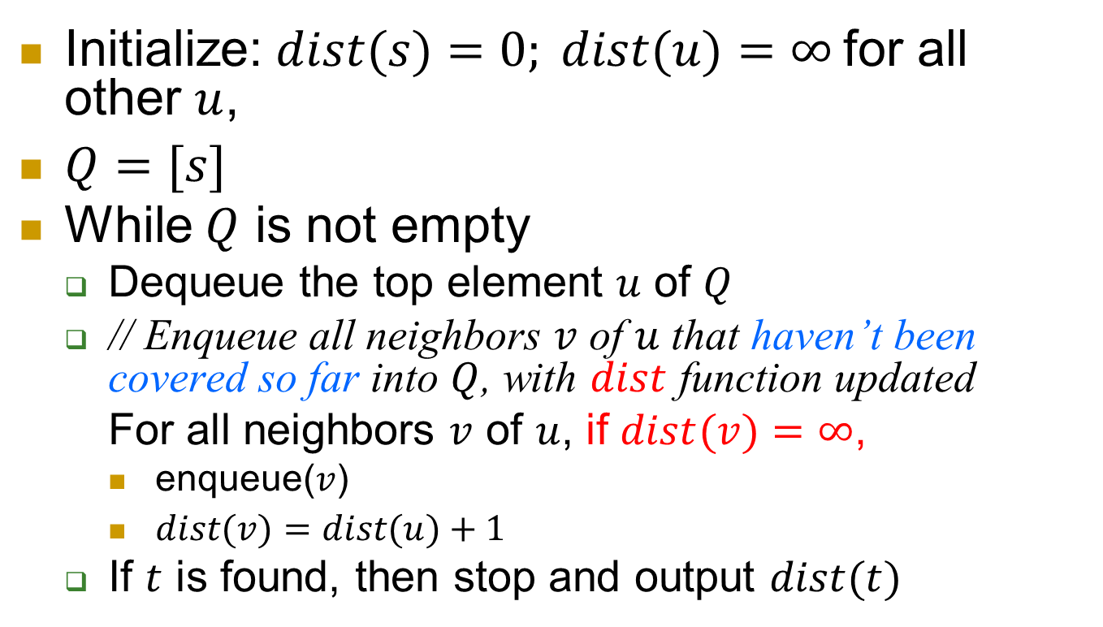

Algorithm for $st$-distance
Initialize: $dist(s)=0; dist(u)=∞$for all other $u$,
$Q=[s]$
While $Q$ is not empty
  Dequeue the top element $u$ of $Q$
  // Enqueue all neighbors $v$ of $u$ that haven’t been covered so far into $Q$, with $dist$ function updated
  For all neighbors $v$ of $u$, if $dist(v)=∞$,
    enqueue($v$)
    $dist(v)=dist(u)+1$
  If $t$ is found, then stop and output $dist(t)$

Slide 20
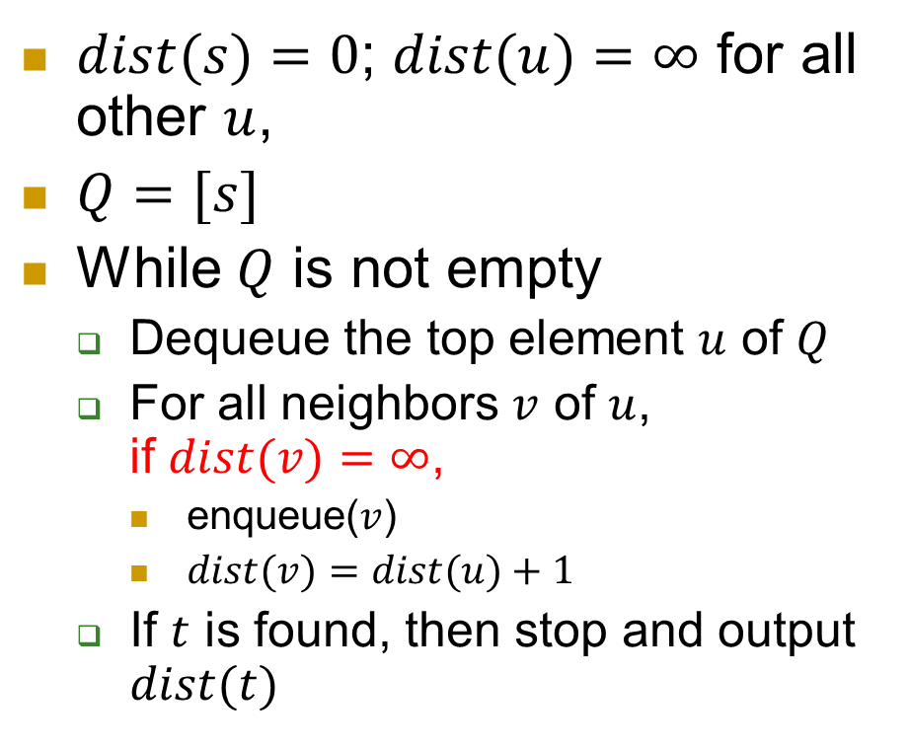
Let’s run it step by step together on the board!
$dist(s)=0$; $dist(u)=∞$ for all other $u$,
$Q=[s]$
While $Q$ is not empty
  Dequeue the top element $u$ of $Q$
  For all neighbors $v$ of $u$,
  if $dist(v)=∞$,
    enqueue($v$)
    $dist(v)=dist(u)+1$
  If $t$ is found, then stop and output $dist(t)$
t
s

Slide 21
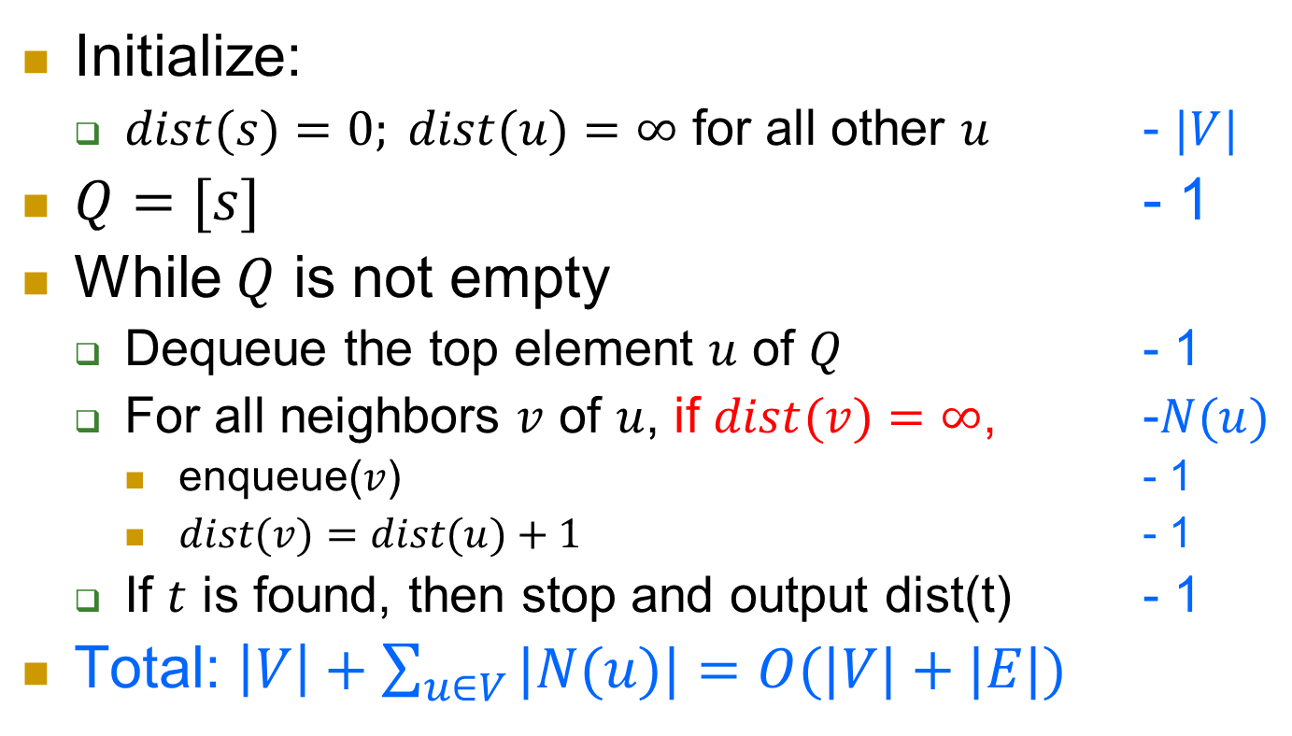
Complexity
Initialize:
  $dist(s)=0; dist(u)=∞$ for all other $u$ - $|V|$
$Q=[s]$ - 1
While $Q$ is not empty
  Dequeue the top element $u$ of $Q$ - 1
  For all neighbors $v$ of $u$, if $dist(v)=∞$, -$N(u)$
    enqueue($v$) - 1
    $dist(v)=dist(u)+1$ - 1
  If $t$ is found, then stop and output dist(t) - 1
Total: $\left|V\right|+\sum_{u∈V}{|N(u)|}=O(|V|+|E|)$

Slide 22
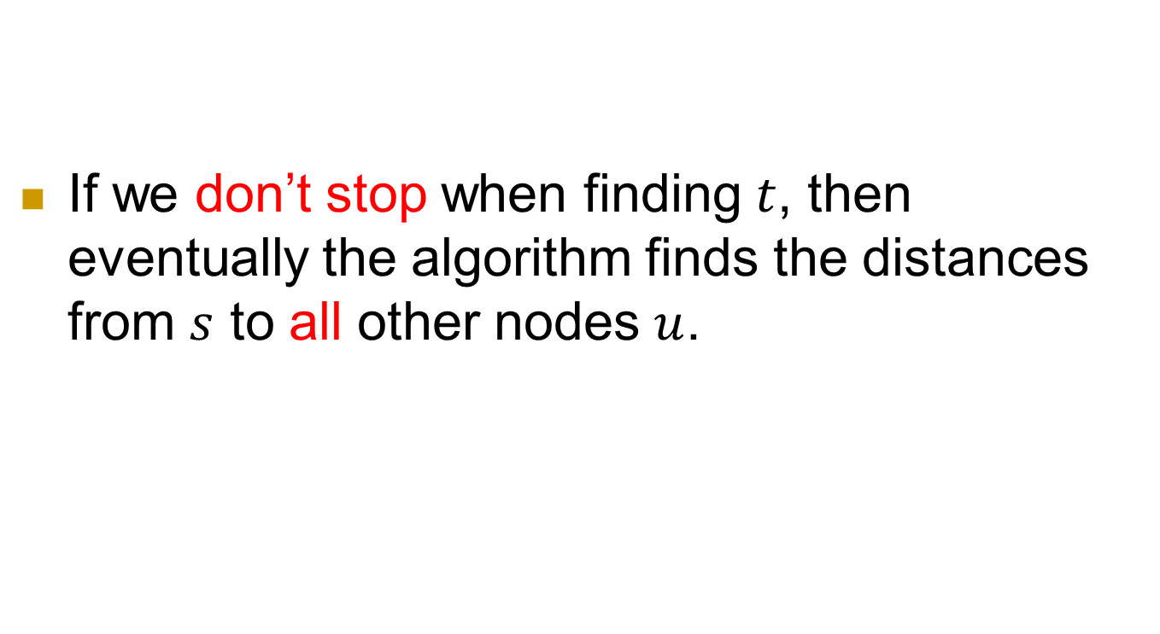
One observation
If we don’t stop when finding $t$, then eventually the algorithm finds the distances from $s$ to all other nodes $u$.

Slide 23
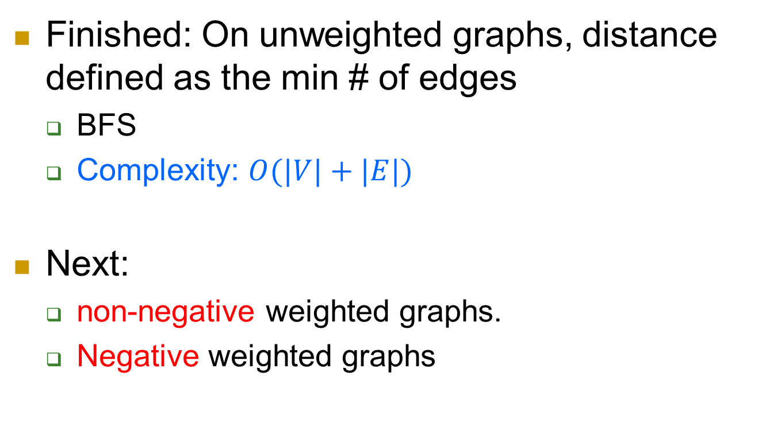
Map
Finished: On unweighted graphs, distance defined as the min # of edges
  BFS
  Complexity: $O(|V|+|E|)$
Next:
  non-negative weighted graphs.
  Negative weighted graphs

Slide 24
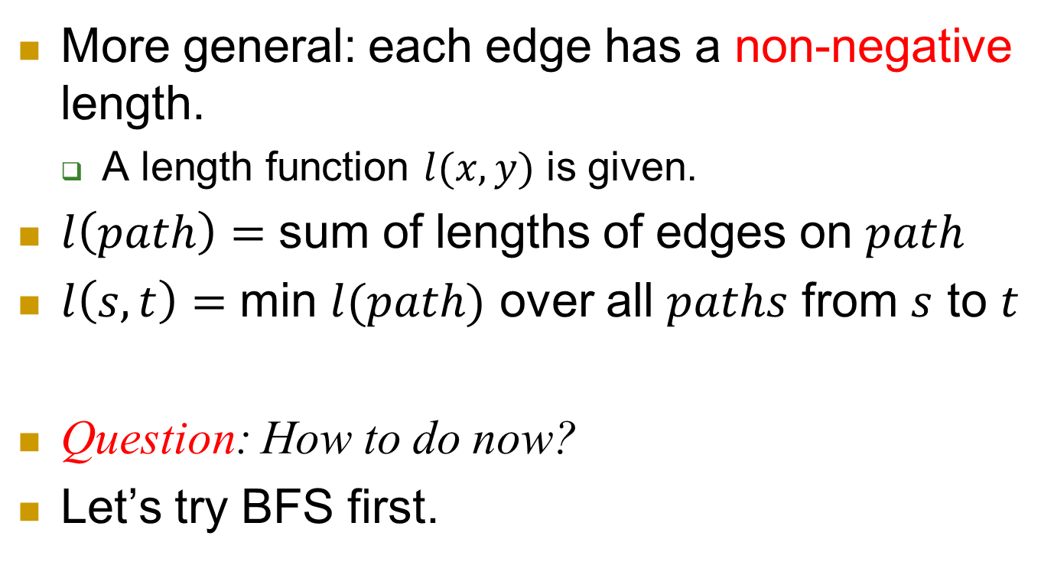
Weighted edges
More general: each edge has a non-negative length.
  A length function $l(x,y)$ is given.
$l\left(path\right)=$ sum of lengths of edges on $path$
$l\left(s,t\right)=$ min $l(path)$ over all $paths$ from $s$ to $t$
Question: How to do now?
Let’s try BFS first.
Notes:
Starting from a simple example: integral length.
Add dummy nodes.
Problem of this.
Solution: Dijkstra’s algorithm.

Slide 25
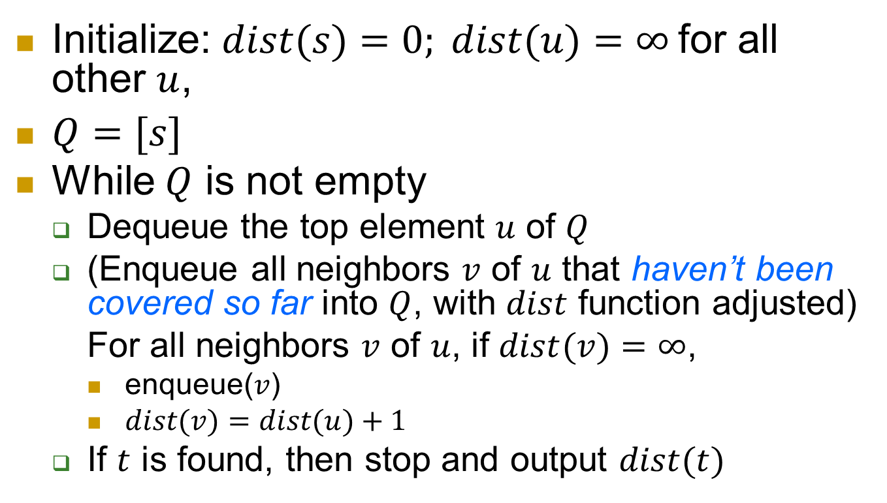

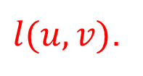
BFS Algorithm for $st$-distance
Initialize: $dist(s)=0; dist(u)=∞$for all other $u$,
$Q=[s]$
While $Q$ is not empty
  Dequeue the top element $u$ of $Q$
  (Enqueue all neighbors $v$ of $u$ that haven’t been covered so far into $Q$, with $dist$ function adjusted)
  For all neighbors $v$ of $u$, if $dist(v)=∞$,
    enqueue($v$)
    $dist(v)=dist(u)+1$
  If $t$ is found, then stop and output $dist(t)$
Is this correct?
$l(u,v)$.

Slide 26
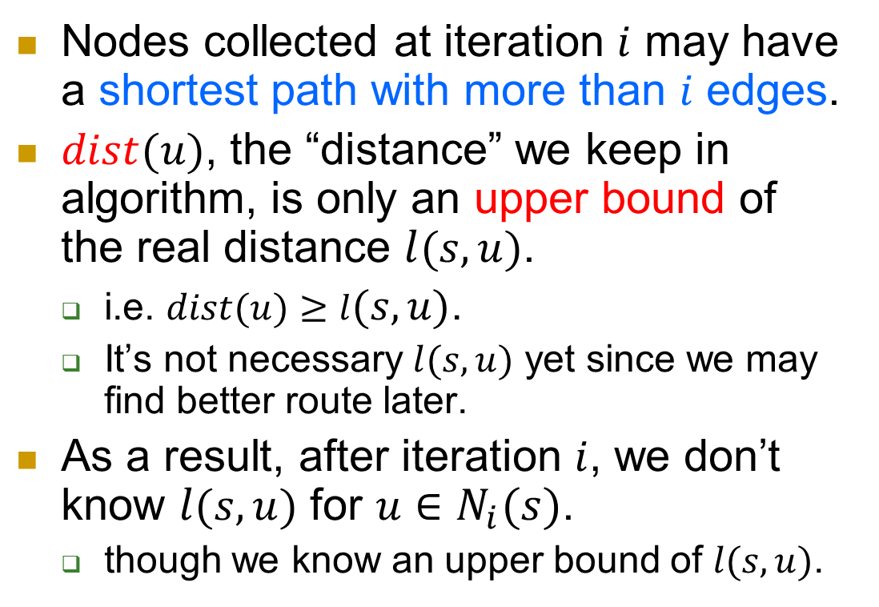
Problem of BFS
Nodes collected at iteration $i$ may have a shortest path with more than $i$ edges.
$dist(u)$, the “distance” we keep in algorithm, is only an upper bound of the real distance $l(s,u)$.
  i.e. $dist(u)≥l(s,u)$.
  It’s not necessary $l(s,u)$ yet since we may find better route later.
As a result, after iteration $i$, we don’t know $l(s,u)$ for $u∈N_{i}(s)$.
  though we know an upper bound of $l(s,u)$.
1
1
1
1
s
10
u

Slide 27


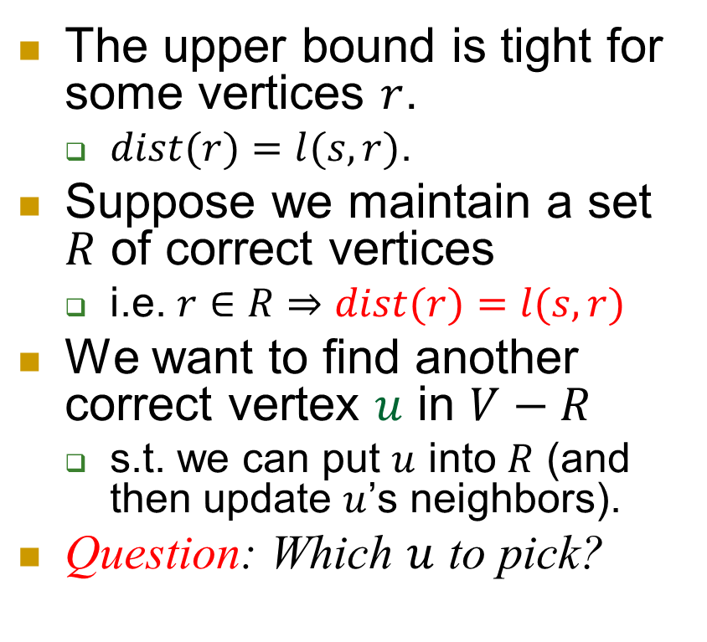



Interesting things coming…
The upper bound is tight for some vertices $r$.
  $dist(r)=l(s,r)$.
Suppose we maintain a set $R$ of correct vertices
  i.e. $r∈R⇒dist(r)=l(s,r)$
We want to find another correct vertex $u$ in $V−R$
  s.t. we can put $u$ into $R$ (and then update $u$’s neighbors).
Question: Which $u$ to pick?
$$Q=V−R$$
$$R$$
$$u$$
$$s$$
$$r$$

Slide 28
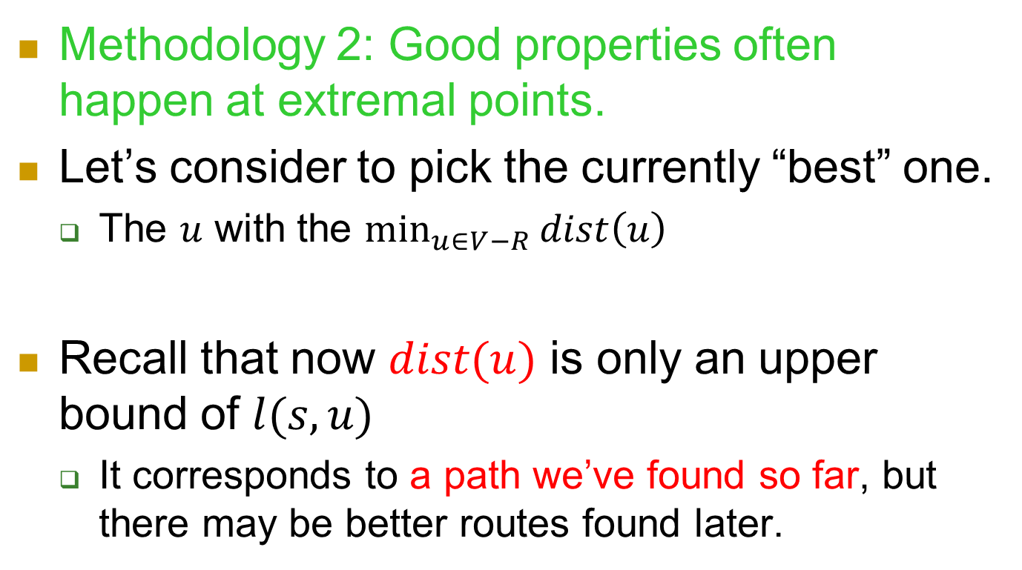
When you want to pick something…
Methodology 2: Good properties often happen at extremal points.
Let’s consider to pick the currently “best” one.
  The $u$ with the $\min_{u∈V−R}{dist\left(u\right)}$
Recall that now $dist(u)$ is only an upper bound of $l(s,u)$
  It corresponds to a path we’ve found so far, but there may be better routes found later.

Slide 29

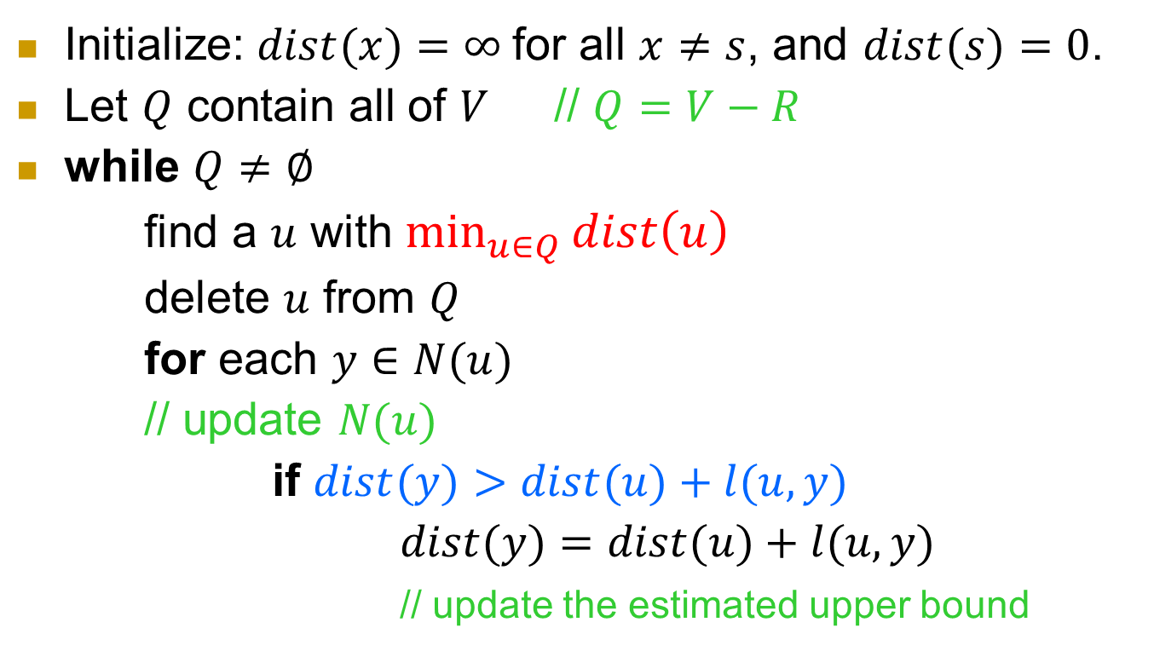


Dijkstra’s algorithm
Initialize: $dist(x)=∞$for all $x≠s$, and $dist(s)=0$.
Let $Q$ contain all of $V$ // $Q=V−R$
while $Q≠∅$
find a $u$ with $\min_{u∈Q}{dist\left(u\right)}$
delete $u$ from $Q$
for each $y∈N(u)$
// update $N(u)$
if $dist(y)>dist(u)+l(u,y)$
$dist(y)=dist(u)+l(u,y)$
// update the estimated upper bound
$$Q=V−R$$
$$R$$
$$u$$
$$s$$

Slide 30
Running on an example

Slide 31
Running on an example (continued)

Slide 32

Running on an example (continued)

Slide 33
Running on an example (continued)

Slide 34
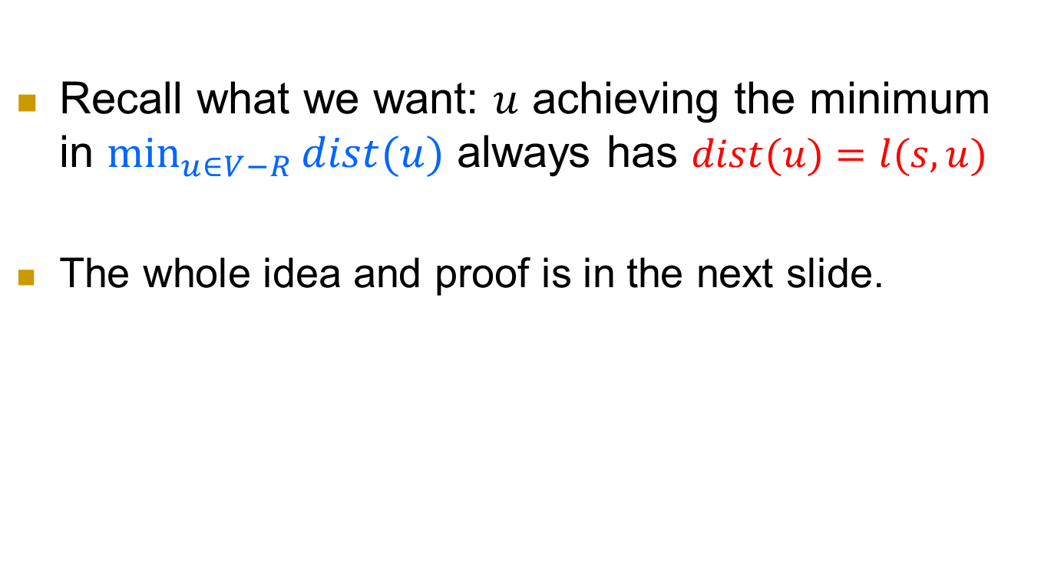
Key property in the proof
Recall what we want: $u$ achieving the minimum in $\min_{u∈V−R}{dist(u)}$ always has $dist(u)=l(s,u)$
The whole idea and proof is in the next slide.

Slide 35
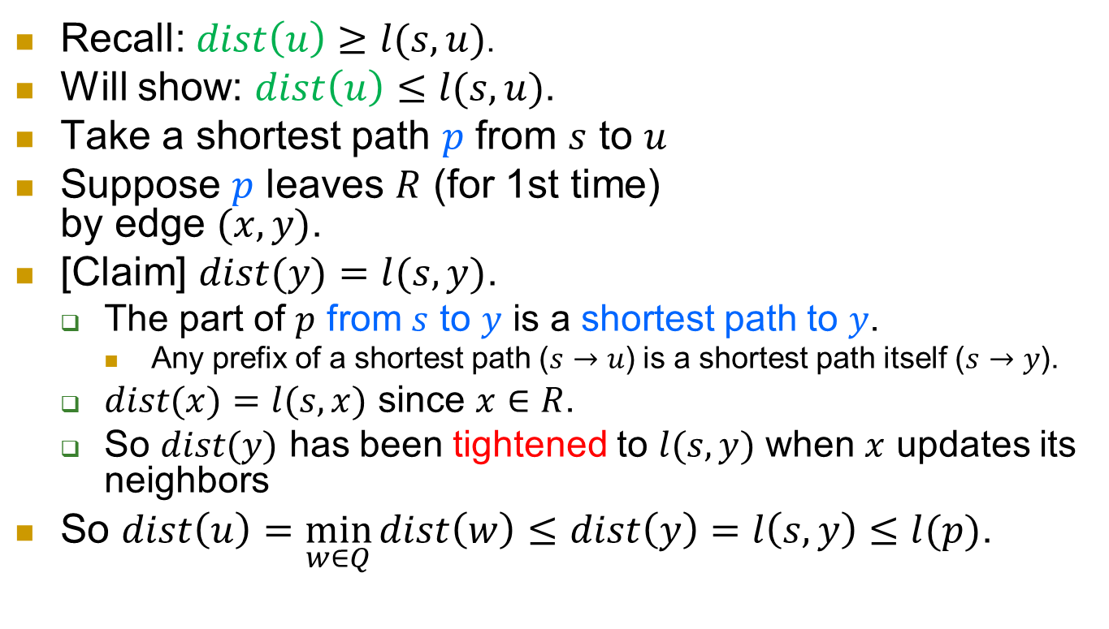


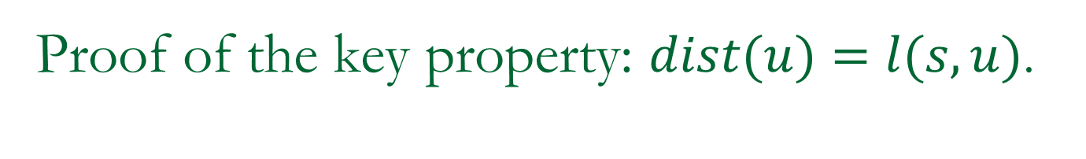





Proof of the key property: $dist(u)=l(s,u)$.
$$Q$$
Recall: $dist\left(u\right)≥l(s,u)$.
Will show: $dist\left(u\right)≤l(s,u)$.
Take a shortest path $p$ from $s$ to $u$
Suppose $p$ leaves $R$ (for 1st time)
by edge $(x,y)$.
[Claim] $dist(y)=l(s,y)$.
  The part of $p$ from $s$ to $y$ is a shortest path to $y$.
    Any prefix of a shortest path ($s→u$) is a shortest path itself ($s→y$).
  $dist(x)=l(s,x)$ since $x∈R$.
  So $dist(y)$ has been tightened to $l(s,y)$ when $x$ updates its neighbors
So $dist\left(u\right)=\min_{w∈Q}{dist\left(w\right)≤dist\left(y\right)=l\left(s,y\right)≤l(p)}$.
$$R$$
$$u$$
$$p$$
$$s$$
$$x$$
$$y$$
$$yQ$$
Claim
part $≤$ whole

Slide 36
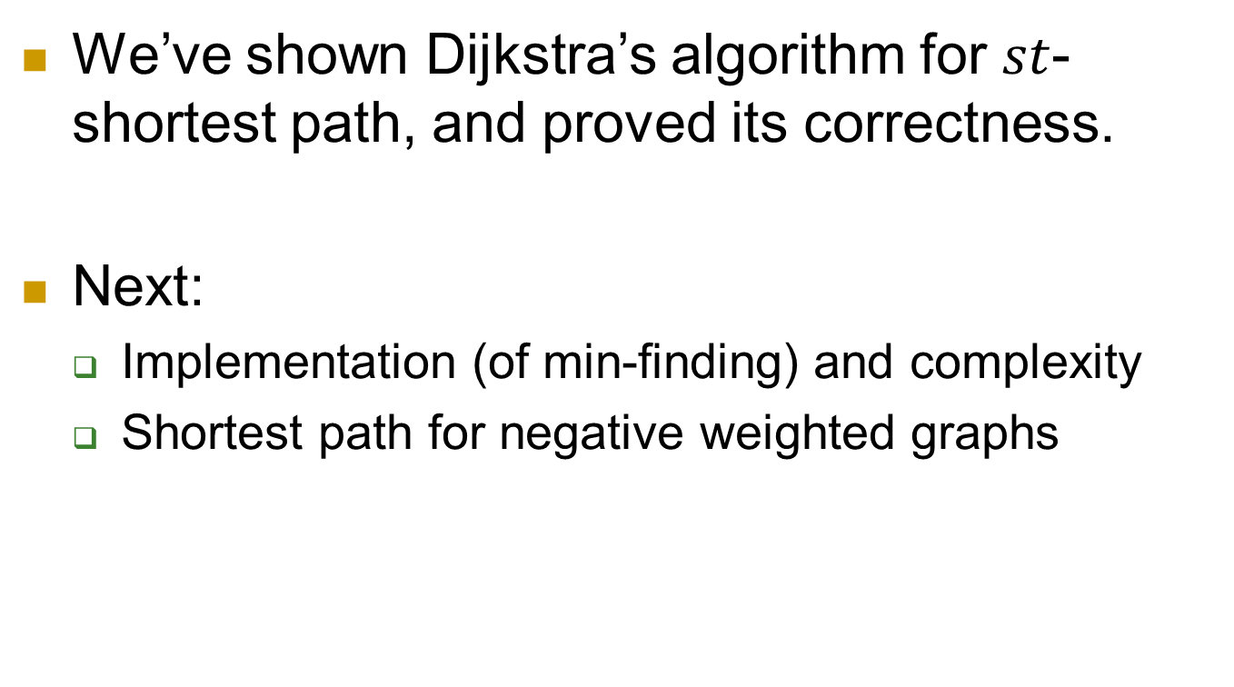
Map
We’ve shown Dijkstra’s algorithm for $st$-shortest path, and proved its correctness.
Next:
  Implementation (of min-finding) and complexity
  Shortest path for negative weighted graphs

Slide 37
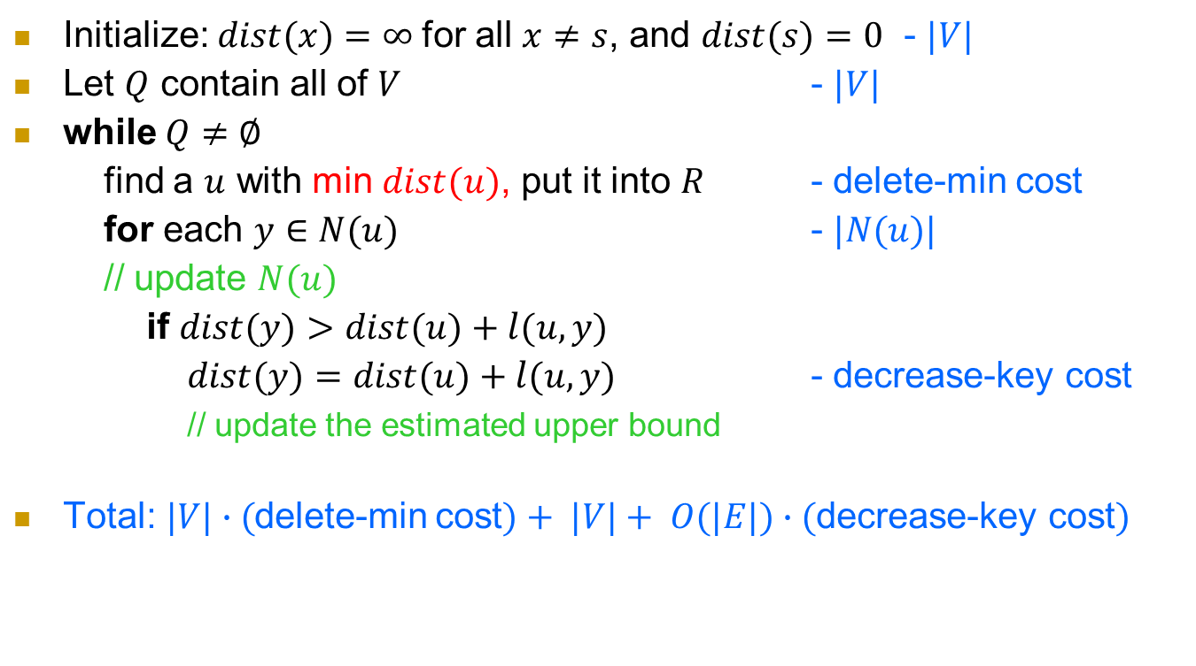
Complexity
Initialize: $dist(x)=∞$for all $x≠s$, and $dist(s)=0$ - $|V|$
Let $Q$ contain all of $V$ - $|V|$
while $Q≠∅$
find a $u$ with min $dist(u)$, put it into $R$ - delete-min cost
for each $y∈N(u)$ - $|N(u)|$
// update $N(u)$
if $dist(y)>dist(u)+l(u,y)$
$dist(y)=dist(u)+l(u,y)$ - decrease-key cost
// update the estimated upper bound
Total:$|V|∙($delete-min cost$)+ |V|+ O(|E|)∙($decrease-key cost$)$

Slide 38

Implement of the queue
We want a queue good for delete-min
priority queue
delete-min cost and decrease-key cost depend on the implementation of priority queue.
  Array:
    delete-min cost: length of $Q$, which is $≤|V|$ in general.
    decrease-key cost: $O(1)$
    Total cost: $O({\left|V\right|}^{2})$.
Recall: Total cost $=|V|∙($delete-min cost$)+ |V|+ O(|E|)∙($decrease-key cost$)$

Slide 39
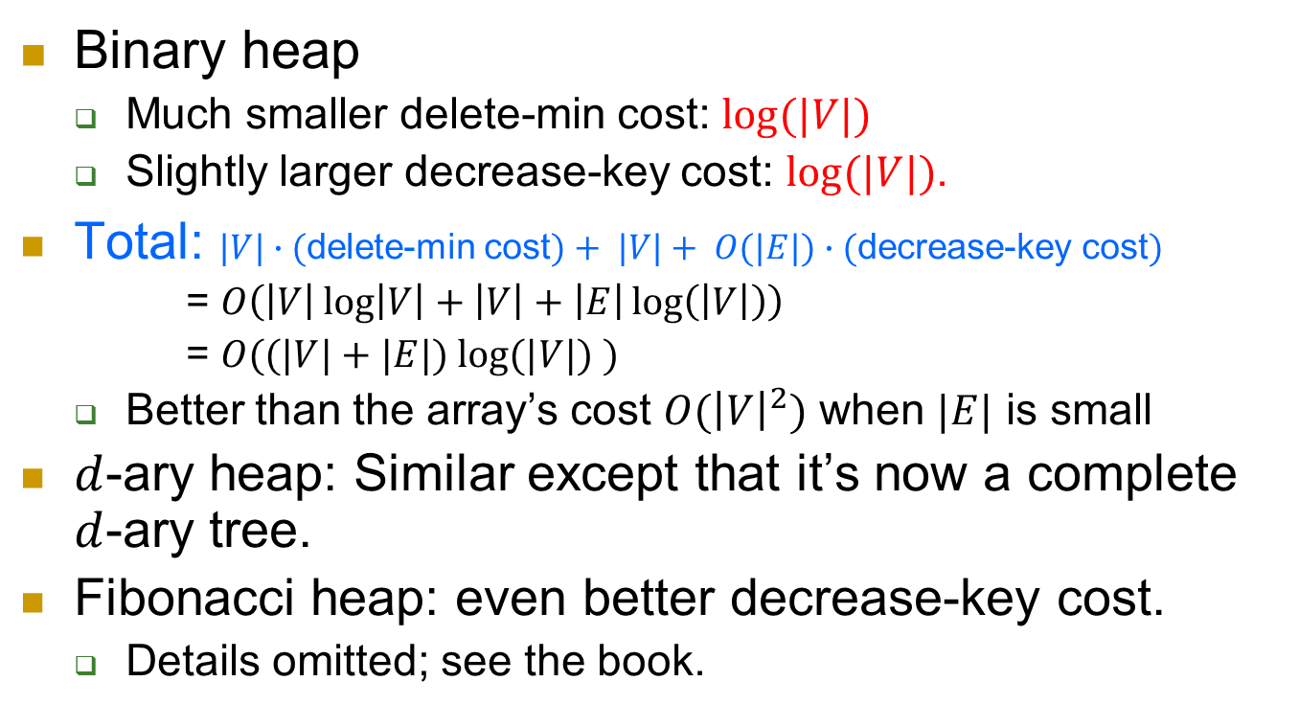
Other choices
Binary heap
  Much smaller delete-min cost: $log⁡(|V|)$
  Slightly larger decrease-key cost: $log⁡(|V|)$.
Total: $|V|∙($delete-min cost$)+ |V|+ O(|E|)∙($decrease-key cost$)$
= $O\left(\left|V\right|\log\left|V\right|+\left|V\right|+\left|E\right|\log\left(\left|V\right|\right)\right)$
= $O((|V|+|E|) log⁡(|V|) )$
  Better than the array’s cost $O({\left|V\right|}^{2})$ when $|E|$ is small
$d$-ary heap: Similar except that it’s now a complete $d$-ary tree.
Fibonacci heap: even better decrease-key cost.
  Details omitted; see the book.

Slide 40
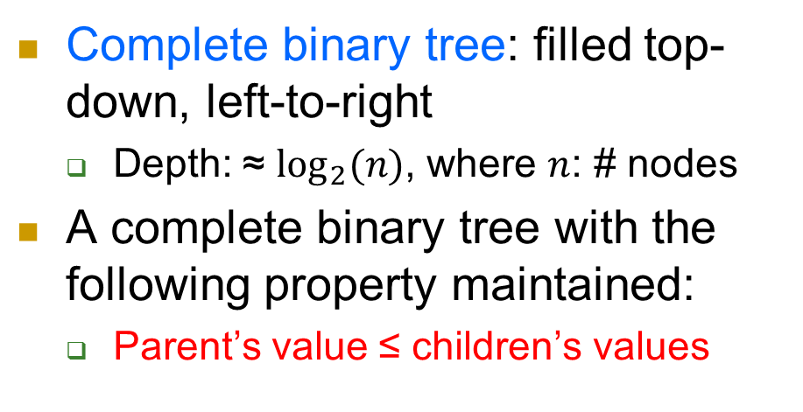
Binary heap
Complete binary tree: filled top-down, left-to-right
  Depth: ≈ $\log_{2}(n)$, where $n$: # nodes
A complete binary tree with the following property maintained:
  Parent’s value ≤ children’s values
The property implies that the root has the min value
Good: really easy to find min.
Bad: deleting the root makes it not a tree any more.

Slide 41
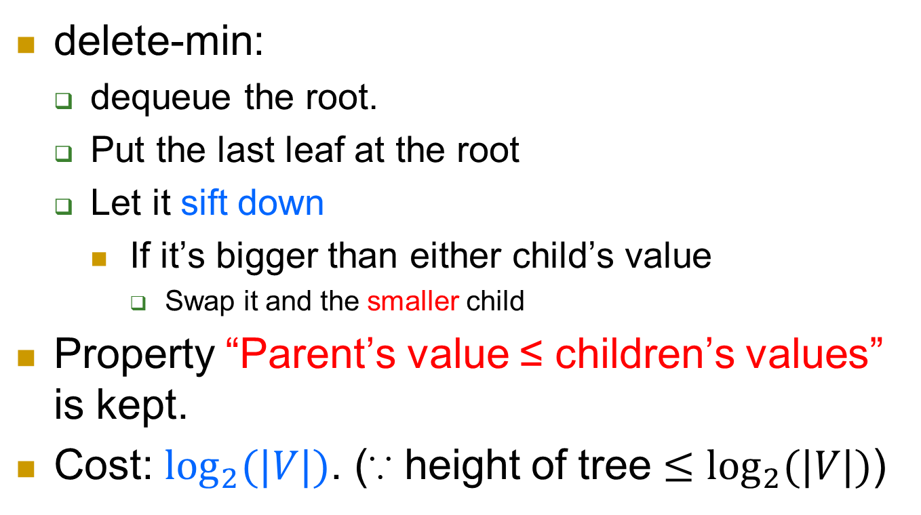
delete-min
5
delete-min:
  dequeue the root.
  Put the last leaf at the root
  Let it sift down
    If it’s bigger than either child’s value
      Swap it and the smaller child
Property “Parent’s value ≤ children’s values” is kept.
Cost: $\log_{2}(|V|)$. (∵ height of tree $≤\log_{2}(|V|)$)
2
3

Slide 42
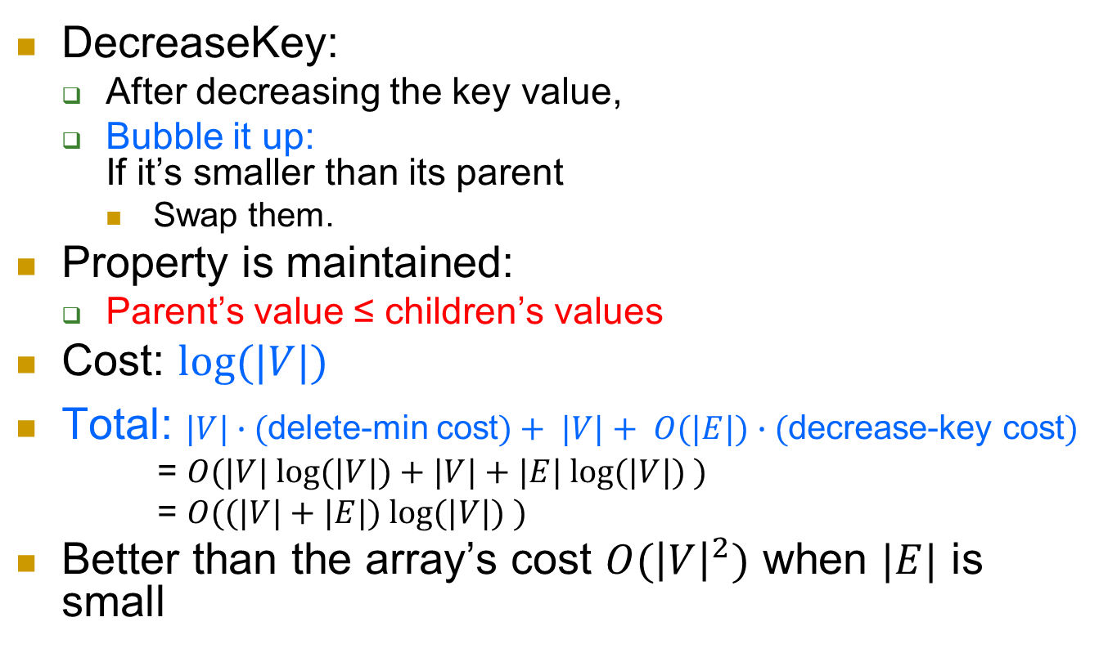
DecreaseKey
Recall:
if $dist(y)>dist(u)+l(u,y)$
$dist(y)=dist(u)+l(u,y)$
- cost decrease-key
DecreaseKey:
  After decreasing the key value,
  Bubble it up:
  If it’s smaller than its parent
    Swap them.
Property is maintained:
  Parent’s value ≤ children’s values
Cost: $log⁡(|V|)$
Total: $|V|∙($delete-min cost$)+ |V|+ O(|E|)∙($decrease-key cost$)$
= $O(|V| log⁡(|V|)+|V|+|E| log⁡(|V|) )$
= $O((|V|+|E|) log⁡(|V|) )$
Better than the array’s cost $O({\left|V\right|}^{2})$ when $|E|$ is small
5
3
6

Slide 43
Map
We talked about Single Source Shortest Paths problem
  On unweighted graphs, distance defined as the # of edges
    BFS
  On weighted graphs, distance defined as the sum of lengths of edges
    Dijkstra’s algorithm
Next: on graphs with negative weights
  Bellman-Ford

Slide 44
Further generalization
Allow negative weights on edges?
How to define the length of a path?
  For $p=v_{1}→v_{2}→…→v_{t}$,
  Naturally as before,
  $w(p)=\sum_{i=1,…,t−1}{w(v_{i},v_{i+1})}$
  Only difference is that now some $w()$ may be < 0.
Problem?

Slide 45
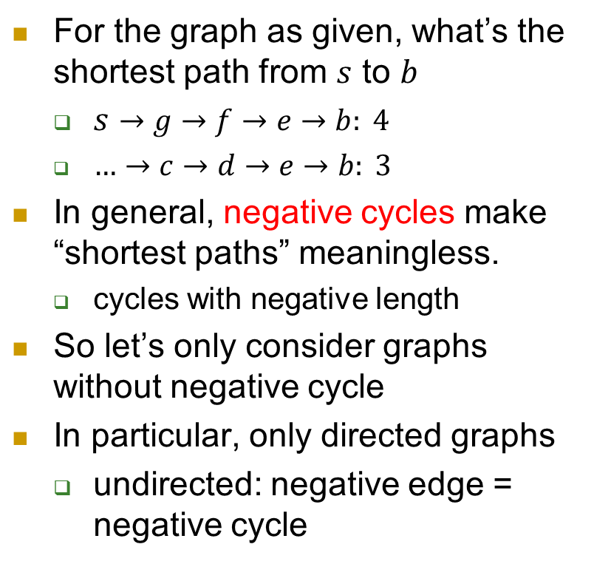
negative cycle
For the graph as given, what’s the shortest path from $s$ to $b$
  $s→g→f→e→b: 4$
  $…→c→d→e→b: 3$
In general, negative cycles make “shortest paths” meaningless.
  cycles with negative length
So let’s only consider graphs without negative cycle
In particular, only directed graphs
  undirected: negative edge = negative cycle
s
10
a
8
1
g
b
-4
1
2
1
-4
c
f
-1
3
e
-1
d

Slide 46
Requirements
For a general graph, we thus desire an algorithm that
  1) tells whether the graph contains a negative cycle, and
  2) if not, computes the shortest paths
Bellman-Ford’s algorithm: achieve both!
Let’s first assume no negative cycle, and come back to this case later.

Slide 47
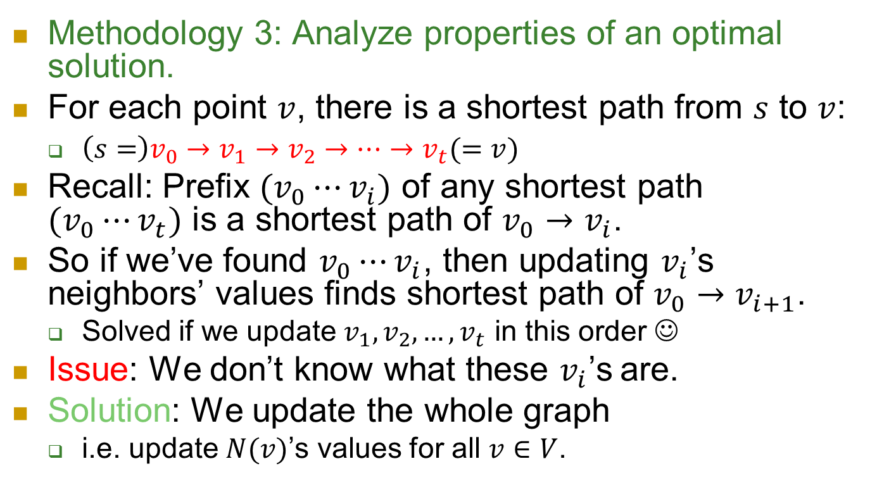
Idea of Bellman-Ford
Methodology 3: Analyze properties of an optimal solution.
For each point $v$, there is a shortest path from $s$ to $v$:
  $\left(s=\right)v_{0}→v_{1}→v_{2}→…→v_{t}(=v)$
Recall: Prefix $(v_{0}⋯v_{i})$ of any shortest path $(v_{0}⋯v_{t})$ is a shortest path of $v_{0}→v_{i}$.
So if we’ve found $v_{0}⋯v_{i}$, then updating $v_{i}$’s neighbors’ values finds shortest path of $v_{0}→v_{i+1}$.
  Solved if we update $v_{1}, v_{2}, …, v_{t}$ in this order ☺
Issue: We don’t know what these $v_{i}$’s are.
Solution: We update the whole graph
  i.e. update $N(v)$’s values for all $v∈V$.

Slide 48
Bellman-Ford’s algorithm
$dist(s)=0$and $dist(u)=∞$ for all $u≠s$
for $|V|−1$ times
for each $\left(x,y\right)∈E$,
if $dist(y)>dist(x)+w(x,y)$ (1)
$dist(y)=dist(x)+w(x,y)$ (2)

Slide 49
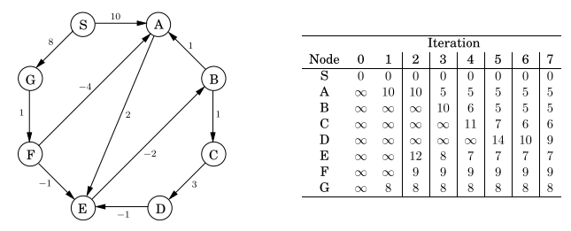
Execution on an example

Slide 50
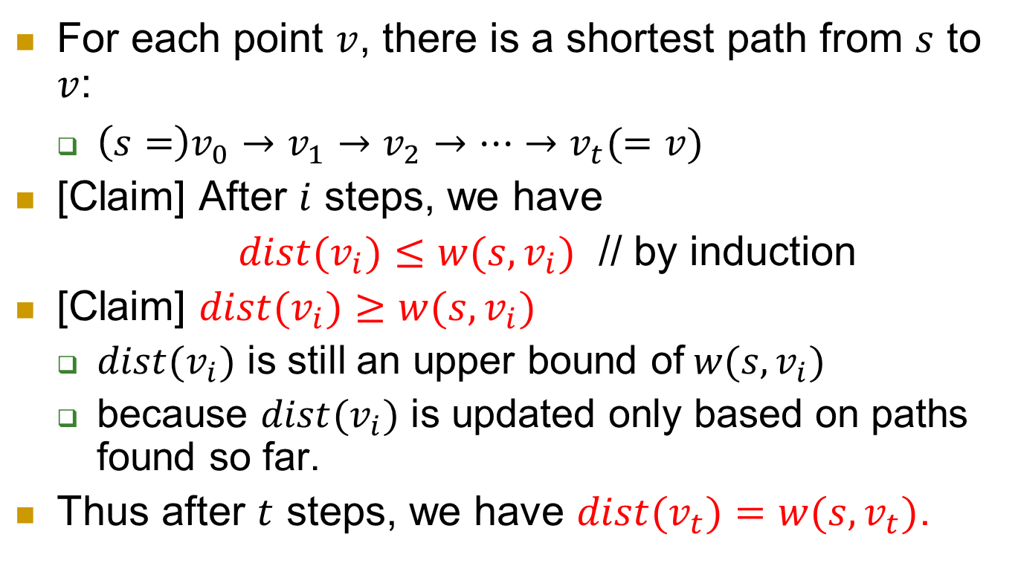
Correctness: suppose no negative cycle
For each point $v$, there is a shortest path from $s$ to $v$:
  $\left(s=\right)v_{0}→v_{1}→v_{2}→…→v_{t}(=v)$
[Claim] After $i$ steps, we have
$dist(v_{i})≤w(s,v_{i})$ // by induction
[Claim] $dist(v_{i})≥w(s,v_{i})$
  $dist(v_{i})$ is still an upper bound of$w(s,v_{i})$
  because $dist(v_{i})$ is updated only based on paths found so far.
Thus after $t$ steps, we have $dist(v_{t})=w(s,v_{t})$.

Slide 51
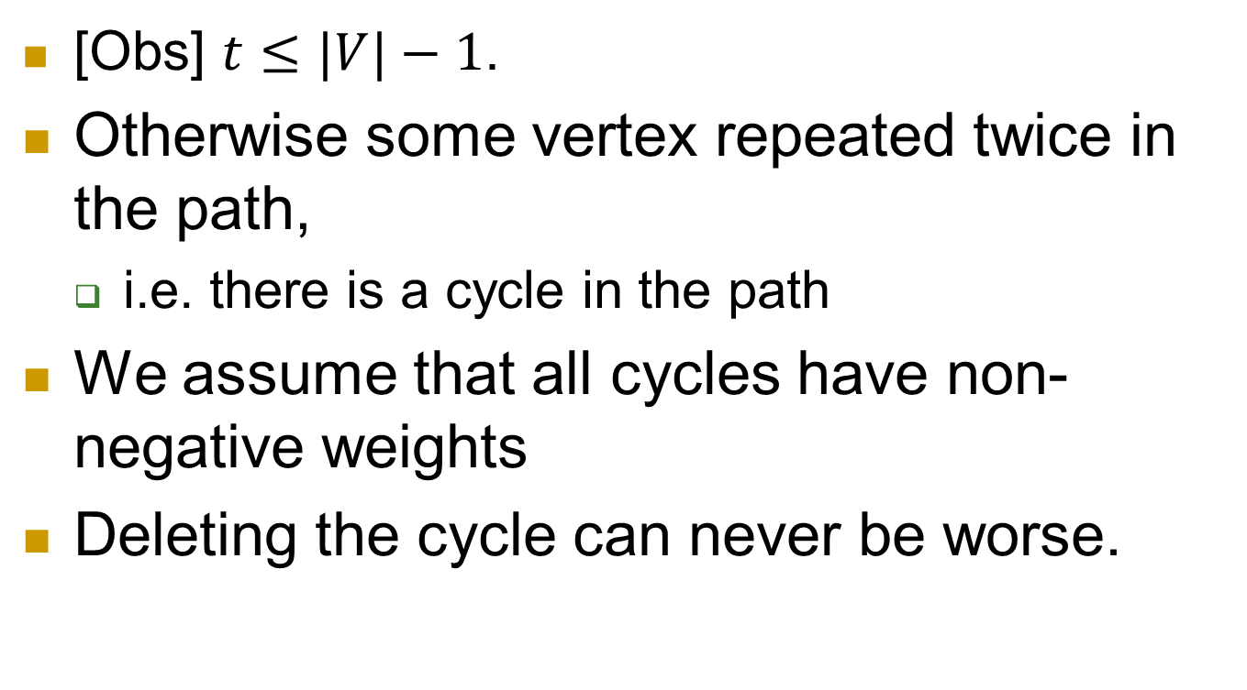
How large could t be?
[Obs] $t≤|V|−1$.
Otherwise some vertex repeated twice in the path,
  i.e. there is a cycle in the path
We assume that all cycles have non-negative weights
Deleting the cycle can never be worse.

Slide 52
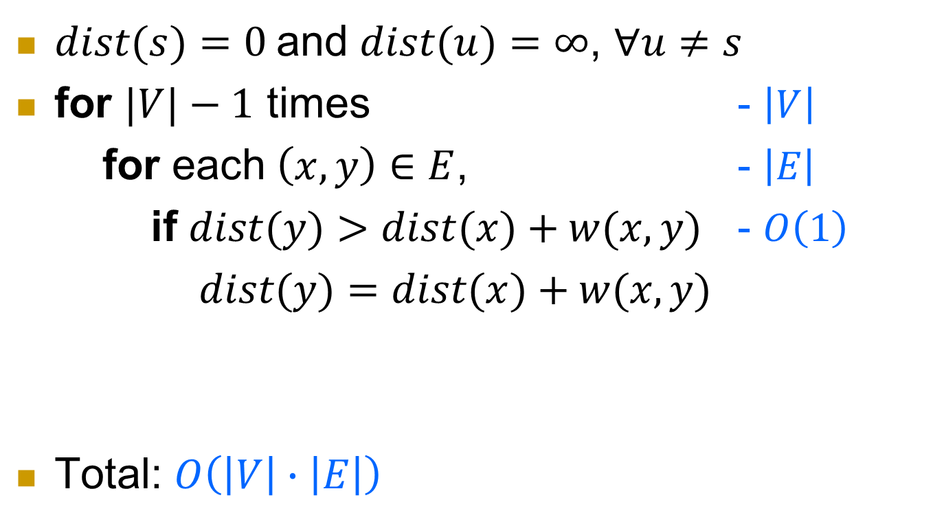
Complexity
$dist(s)=0$and $dist(u)=∞$, $∀u≠s$
for $|V|−1$ times - $\left|V\right|$
for each $\left(x,y\right)∈E$, - $\left|E\right|$
if $dist(y)>dist(x)+w(x,y)$ - $O\left(1\right)$
$dist(y)=dist(x)+w(x,y)$
Total: $O\left(\left|V\right|∙\left|E\right|\right)$

Slide 53
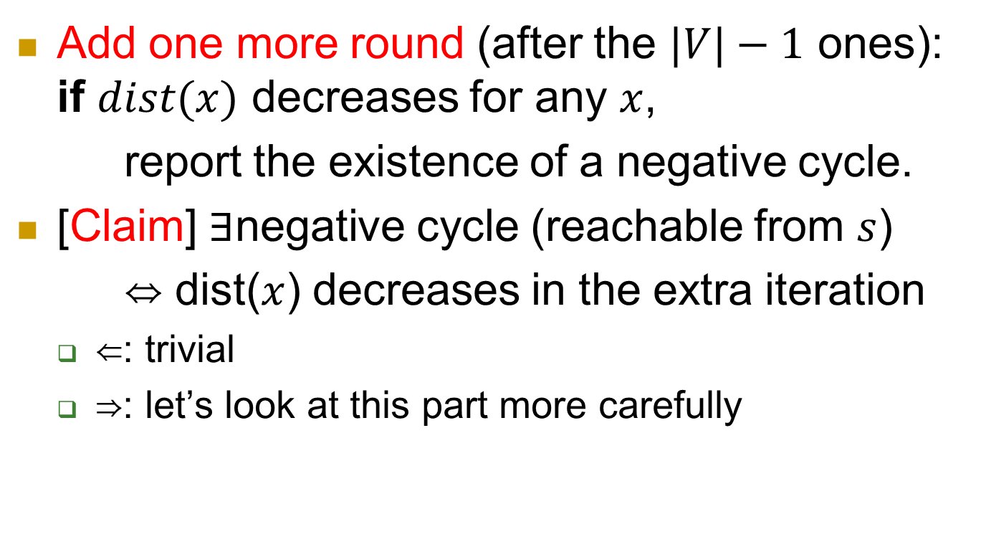
Handling negative cycles
Add one more round (after the $|V|−1$ ones): if $dist(x)$ decreases for any $x$,
report the existence of a negative cycle.
[Claim] ∃negative cycle (reachable from $s$)
⇔ dist($x$) decreases in the extra iteration
  ⇐: trivial
  ⇒: let’s look at this part more carefully

Slide 54
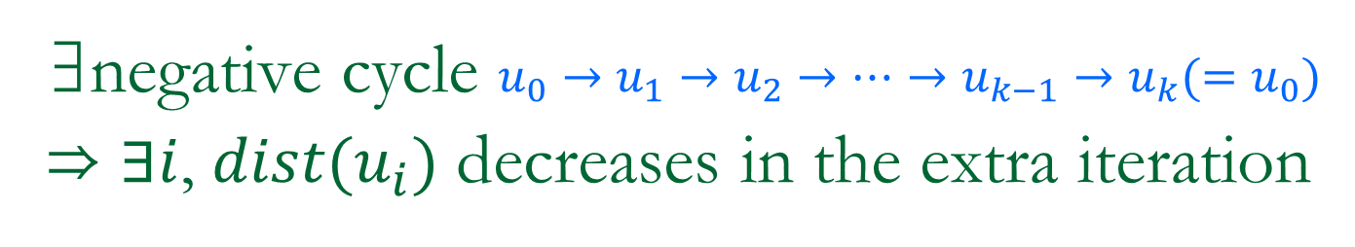
∃negative cycle $u_{0}→u_{1}→u_{2}→⋯→u_{k−1}→u_{k}(=u_{0})$
⇒ $∃i$, $dist(u_{i})$ decreases in the extra iteration
all $dist(u_{i})$ don’t decrease
  ⇒ $dist(u_{i})≤dist(u_{i−1})+w(u_{i−1},u_{i}), ∀i$
Sum up all these inequalities:
  $dist(u_{1})+…+dist(u_{k})$
  $≤dist\left(u_{0}\right)+…+dist\left(u_{k−1}\right)$
  $+ w(u_{0},u_{1})+…+w(u_{k−1},u_{k})$
  Note that $u_{k}=u_{0}$, thus the $dist()$ values cancel
So $0≤w(u_{0},u_{1})+…+w(u_{k−1},u_{k})$, contradictory to our assumption of negative cycle.
u_{k-1}
u₀ (=u_{k})
u_{k-2}
u₁
u₂
…
…
u_{i}
u_{i-1}

Slide 55

In summary
On unweighted graphs, distance defined as the min # of edges
  BFS
  Complexity: $O(|V|+|E|)$
On non-negative weighted graphs, distance defined as the min sum of lengths of edges
  Dijkstra’s algorithm
  Complexity: $O\left(\left(\left|V\right|+\left|E\right|\right)\log\left|V\right|\right)$
On general weighted graphs:
  Bellman-Ford algorithm
  Complexity: $O(|V|∙|E|)$

Slide 56
More algorithms (negative weight)?
[Gabow and Tarjan] $O(\sqrt{|V|}|E|log⁡(VW))$
  $W=\max_{\left(u,v\right)∈E}⁡\{|w(u,v)|\}$.
  H. Gabow and R. Tarjan. Faster scaling algorithms for network problems. SIAM Journal on Computing, 18(5): 1013–1036, 1989.
[Goldberg] $O(\sqrt{|V|}|E|log⁡(W))$
  A. Goldberg. Scaling algorithms for the shortest paths problem. SIAM Journal on Computing, 24(3): 494–504, 1995.
An extensive overview of shortest path algorithms, in both theory and experiment.
  B. Cherkassky, A. Goldberg, and T. Radzik. Shortest paths algorithms: Theory and experimental evaluation. Mathematical Programming, 73(2): 129–174, 1996.

