Slide 1
CSC3160: Design and Analysis of Algorithms
Week 11: Approximation Algorithms
Instructor: Shengyu Zhang

Slide 2
Optimization
Very often we need to solve an optimization problem.
  Maximize the utility/payoff/gain/…
  Minimize the cost/penalty/loss/…
Many optimization problems are NP-complete
  No polynomial algorithms are known, and most likely, they don’t exist.
  More details in the previous lecture.
Approximation: get an approximately good solution.

Slide 3
Example 1: A simple approximation algorithm for 3SAT

Slide 4

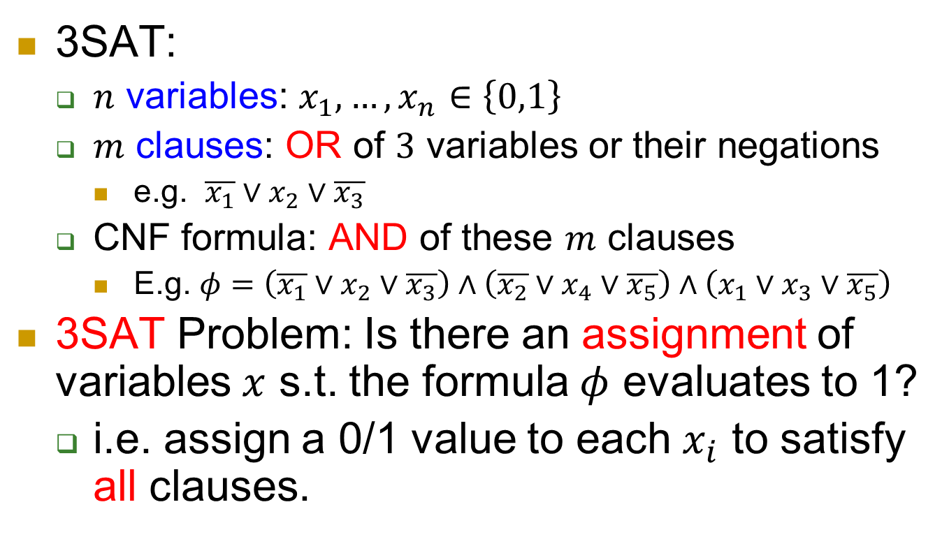
SAT
3SAT:
  $n$ variables: $x_{1},…,x_{n}∈\left\{0,1\right\}$
  $m$ clauses: OR of $3$ variables or their negations
    e.g. $\overline{x_{1}}∨x_{2}∨\overline{x_{3}}$
  CNF formula: AND of these $m$ clauses
    E.g. $φ=\left(\overline{x_{1}}∨x_{2}∨\overline{x_{3}}\right)∧\left(\overline{x_{2}}∨x_{4}∨\overline{x_{5}}\right)∧\left(x_{1}∨x_{3}∨\overline{x_{5}}\right)$
3SAT Problem: Is there an assignment of variables $x$ s.t. the formula $φ$ evaluates to 1?
  i.e. assign a 0/1 value to each $x_{i}$ to satisfy all clauses.
$$x=10010$$

Slide 5
Hard
3SAT is known as an NP-complete problem.
  Very hard: no polynomial algorithm is known.
  Conjecture: no polynomial algorithm exists.
  If a polynomial algorithm exists for 3SAT, then polynomial algorithms exist for all NP problems.
More details in last lecture.

Slide 6
7/8-approximation of 3SAT
Since 3SAT appears too hard in its full generality, let’s aim lower.
3SAT asks whether there is an assignment satisfying all clauses.
Can you find an assignment satisfying half of the clauses?
Let’s run an example where
  you give an input instance
  you give a solution!

Slide 7
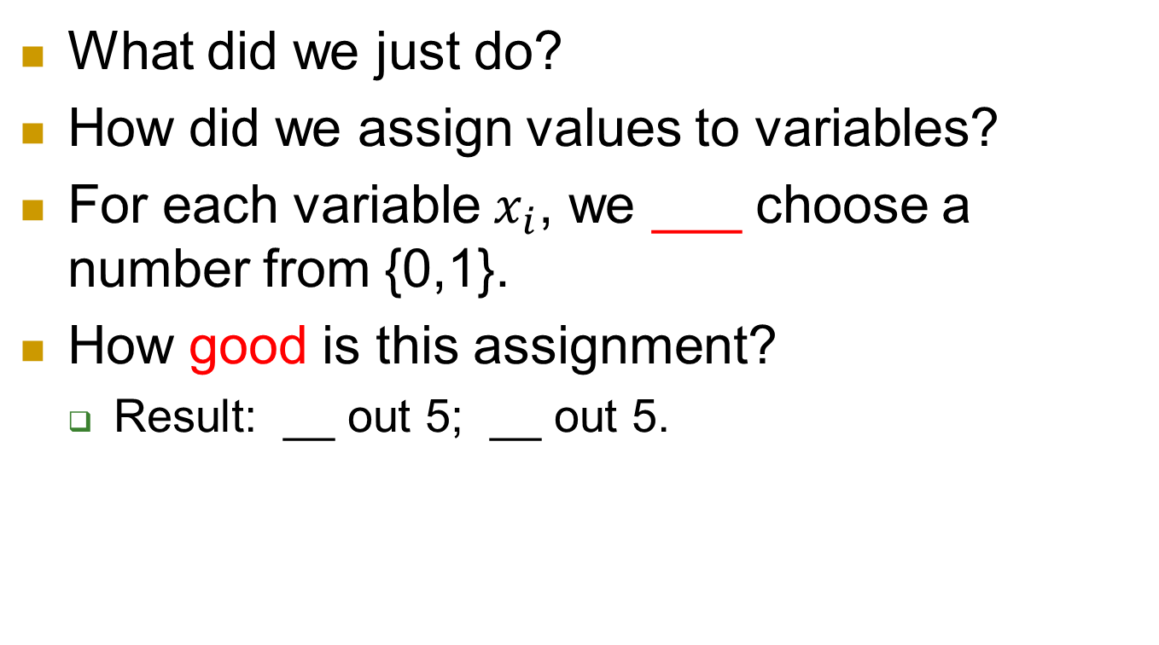
Observation
What did we just do?
How did we assign values to variables?
For each variable $x_{i}$, we ___ choose a number from {0,1}.
How good is this assignment?
  Result: __ out 5; __ out 5.

Slide 8
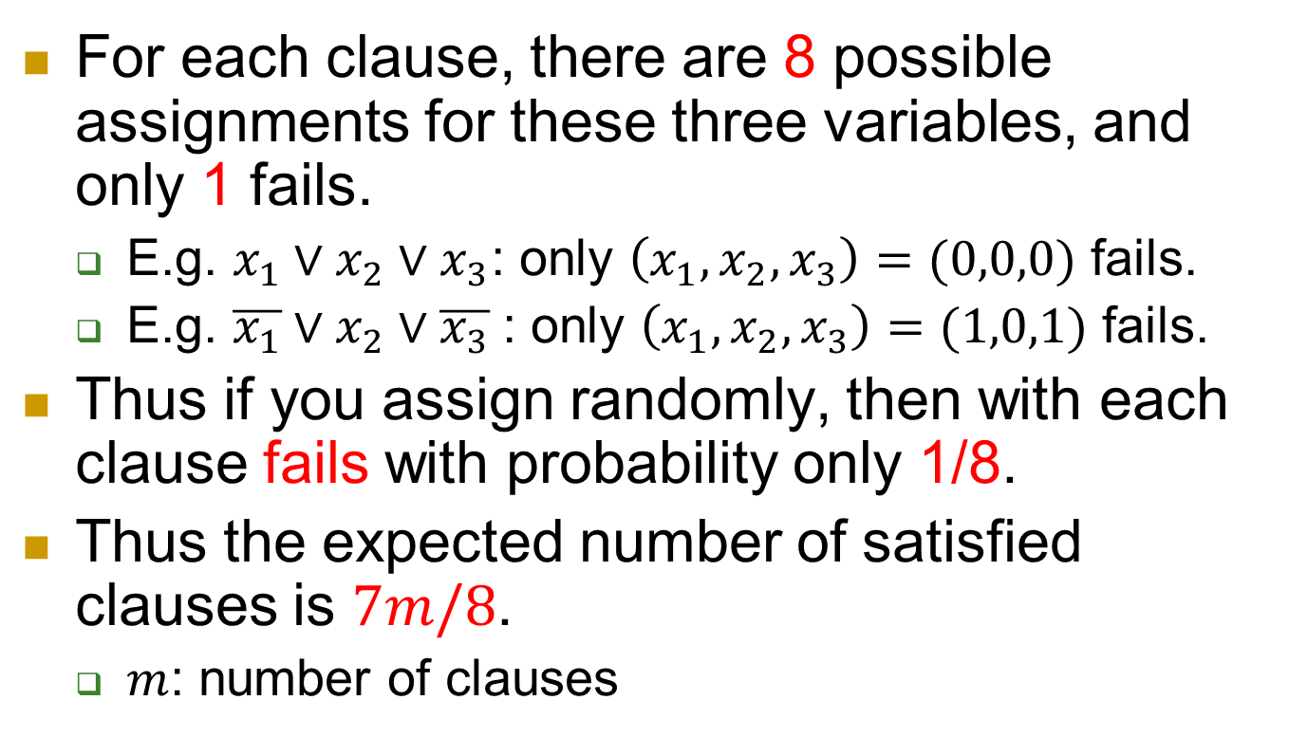
Why?
For each clause, there are 8 possible assignments for these three variables, and only 1 fails.
  E.g. $x_{1}∨x_{2}∨x_{3}$: only $\left(x_{1},x_{2},x_{3}\right)=(0,0,0)$ fails.
  E.g. $\overline{x_{1}}∨x_{2}∨\overline{x_{3}}$: only $\left(x_{1},x_{2},x_{3}\right)=(1,0,1)$ fails.
Thus if you assign randomly, then with each clause fails with probability only 1/8.
Thus the expected number of satisfied clauses is $7m/8$.
  $m$: number of clauses

Slide 9
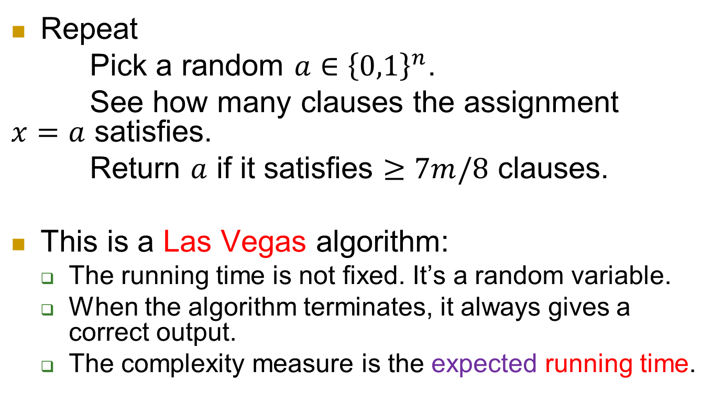
Formally - algorithm
Repeat
Pick a random $a∈{\left\{0,1\right\}}^{n}$.
See how many clauses the assignment $x=a$ satisfies.
Return $a$ if it satisfies $≥7m/8$ clauses.
This is a Las Vegas algorithm:
  The running time is not fixed. It’s a random variable.
  When the algorithm terminates, it always gives a correct output.
  The complexity measure is the expected running time.

Slide 10
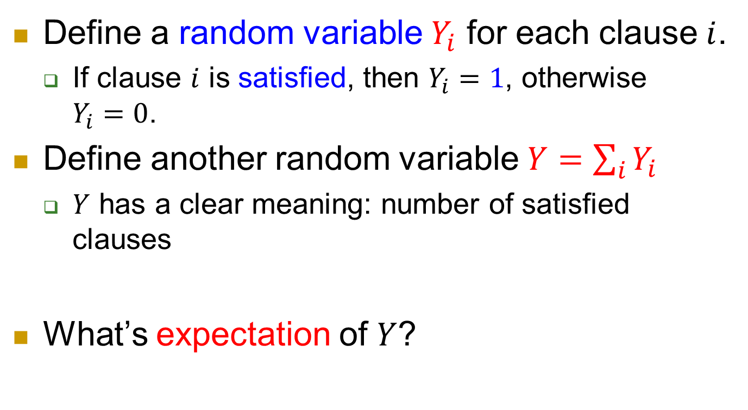
Formally - analysis
Define a random variable $Y_{i}$ for each clause $i$.
  If clause $i$ is satisfied, then $Y_{i}=1$, otherwise $Y_{i}=0$.
Define another random variable $Y=\sum_{i}{Y_{i}}$
  $Y$ has a clear meaning: number of satisfied clauses
What’s expectation of $Y$?

Slide 11

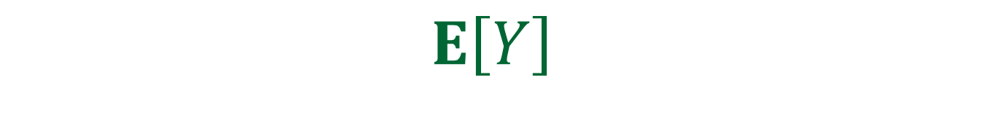
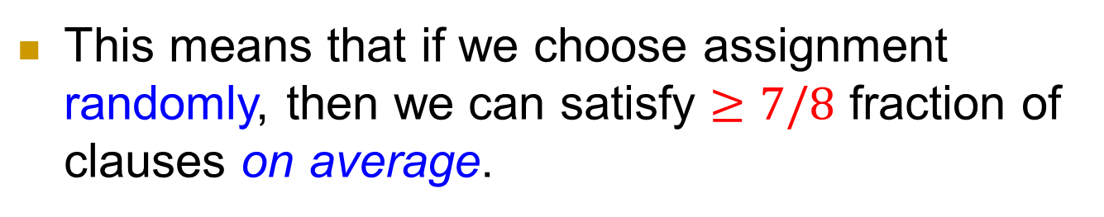

$$E\left[Y\right]$$
$E\left[Y\right]$
$=E\left[\sum_{i}{Y_{i}}\right]$
$=\sum_{i}{E[Y_{i}]}$
$=\sum_{i}{Pr⁡[C_{i} satisfied]}$
$=\sum_{i}{7/8}$
$=\frac{7}{8}m.$
// expected # satisfied clauses
// definition of $Y$: $Y=\sum_{i}{Y_{i}}$
// linearity of expectation
// definition of $Y_{i}$
This means that if we choose assignment randomly, then we can satisfy $≥7/8$ fraction of clauses on average.

Slide 12
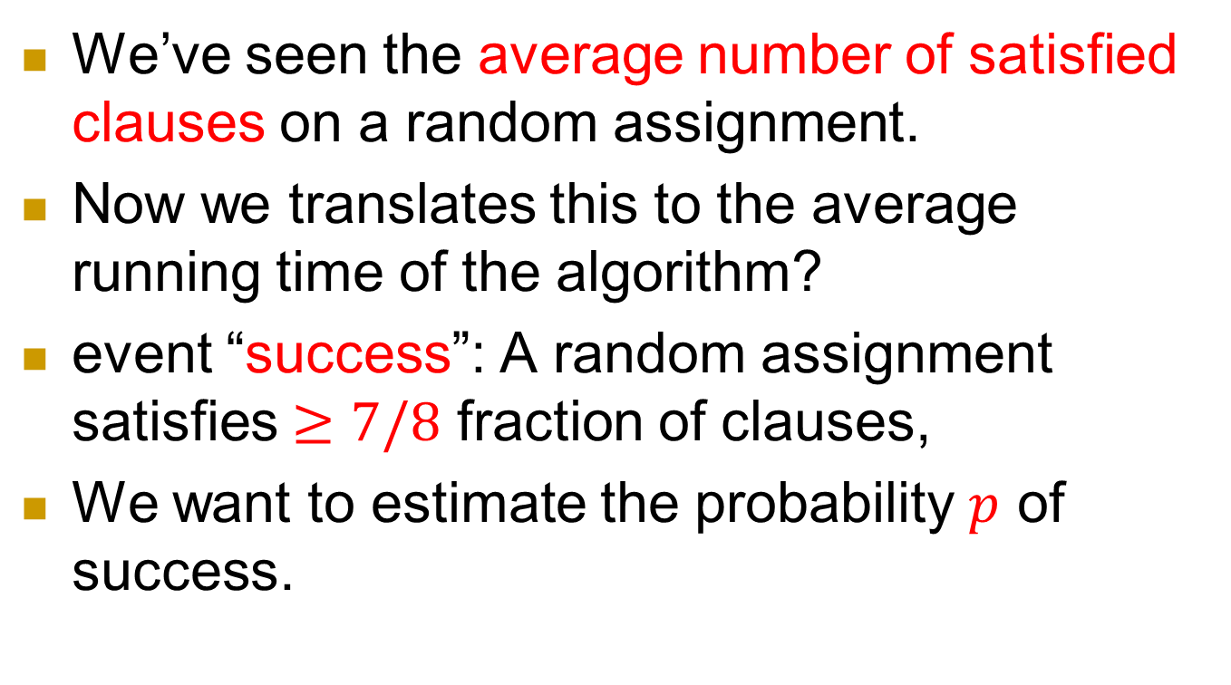
Success probability of one assignment
We’ve seen the average number of satisfied clauses on a random assignment.
Now we translates this to the average running time of the algorithm?
event “success”: A random assignment satisfies $≥7/8$ fraction of clauses,
We want to estimate the probability $p$ of success.

Slide 13
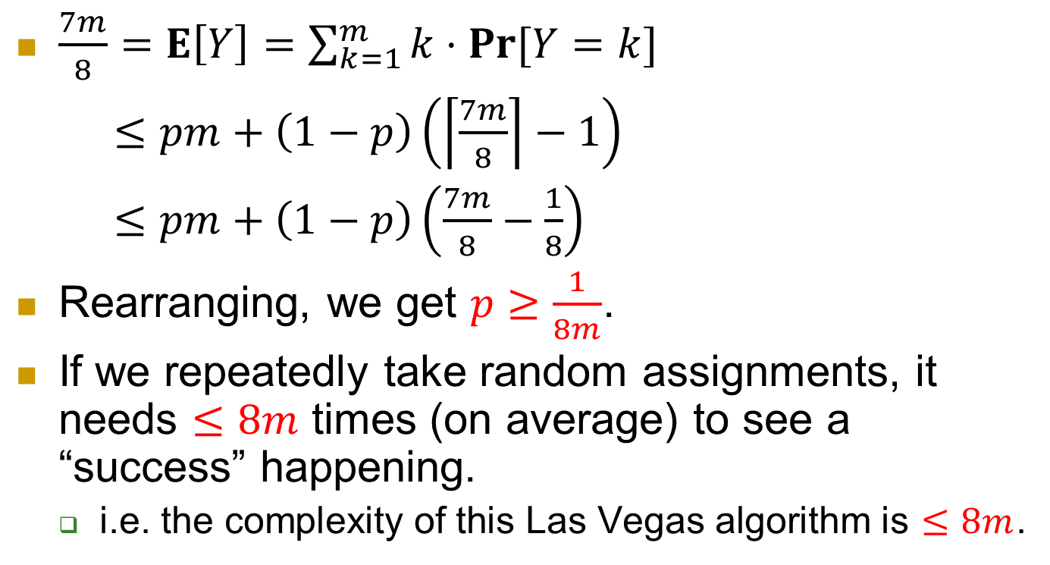
Getting a Las Vegas algorithm
$\frac{7m}{8}=E\left[Y\right]=\sum_{k=1}^{m}{k⋅\operatorname{Pr}{[Y=k]}}$
$≤pm+\left(1−p\right)\left(\left\lceil \frac{7m}{8}\right\rceil −1\right)$
$≤pm+\left(1−p\right)\left(\frac{7m}{8}−\frac{1}{8}\right)$
Rearranging, we get $p≥\frac{1}{8m}$.
If we repeatedly take random assignments, it needs $≤8m$ times (on average) to see a “success” happening.
  i.e. the complexity of this Las Vegas algorithm is $≤8m$.

Slide 14
Example 2: Approximation algorithm for Vertex Cover

Slide 15
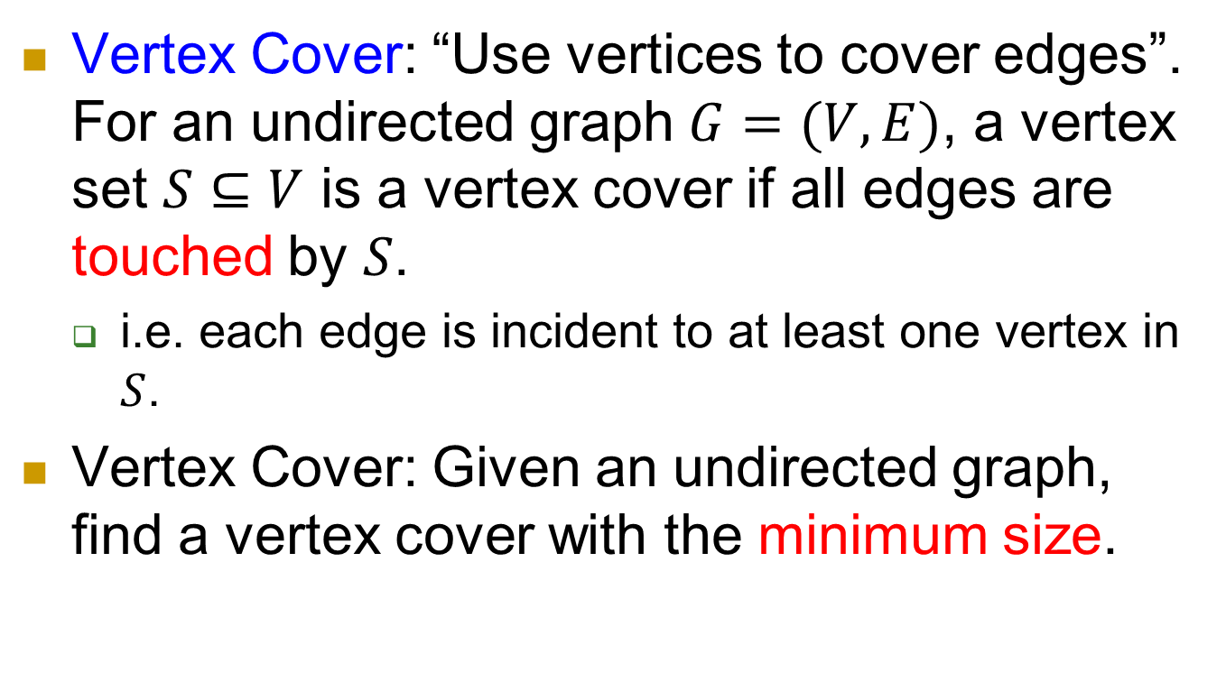
Vertex Cover: Use vertex to cover edges
Vertex Cover: “Use vertices to cover edges”.
For an undirected graph $G=(V,E)$, a vertex set $S⊆V$ is a vertex cover if all edges are touched by $S$.
  i.e. each edge is incident to at least one vertex in $S$.
Vertex Cover: Given an undirected graph, find a vertex cover with the minimum size.

Slide 16
NP-complete
  So it’s (almost) impossible to find the minimum vertex cover in polynomial time.
But there is a polynomial time algorithm that can find a vertex cover of size at most twice of that of minimum vertex cover.

Slide 17
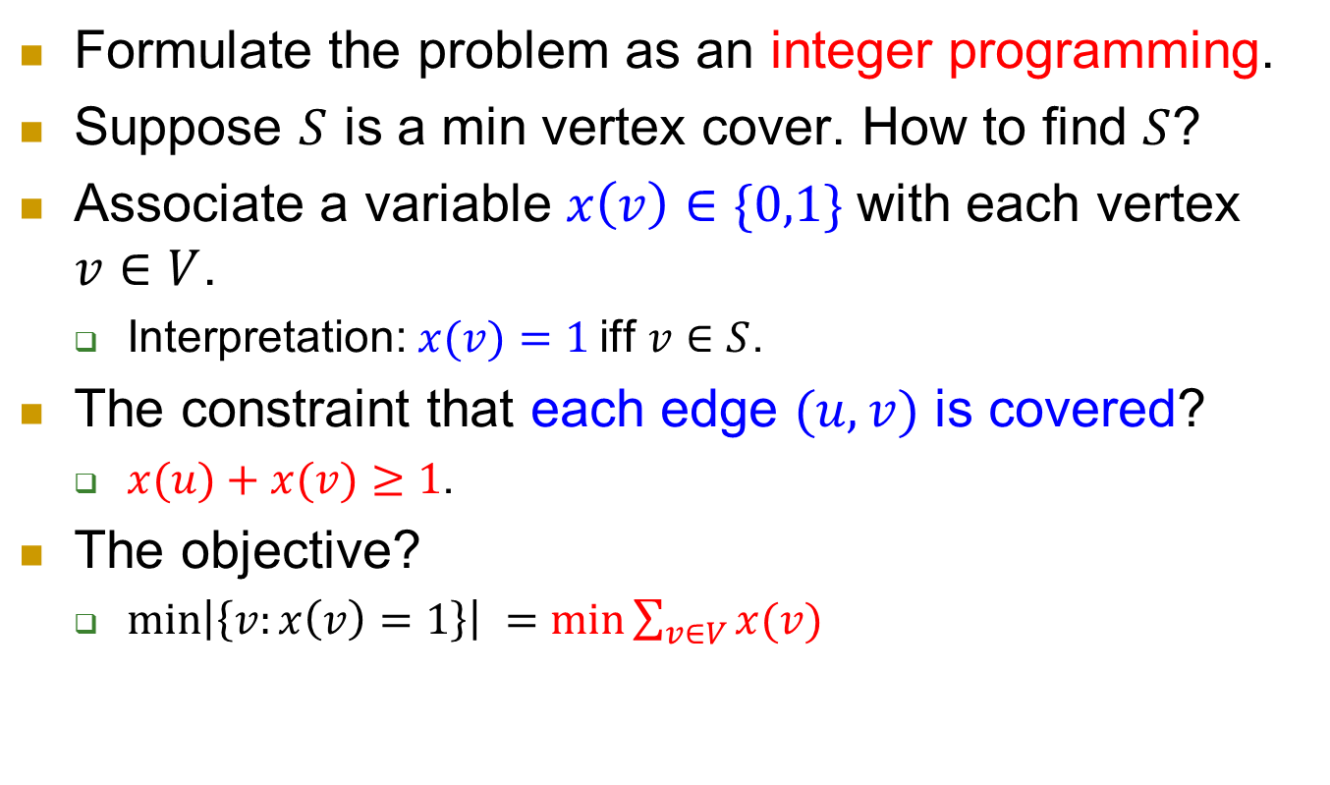
IP formulation
Formulate the problem as an integer programming.
Suppose $S$ is a min vertex cover. How to find $S$?
Associate a variable $x\left(v\right)∈\{0,1\}$with each vertex $v∈V$.
  Interpretation: $x(v)=1$iff $v∈S$.
The constraint that each edge $(u,v)$ is covered?
  $x(u)+x(v)≥1$.
The objective?
  $\min\left|\left\{v:x\left(v\right)=1\right\}\right| =min\sum_{v∈V}{x(v)}$

Slide 18
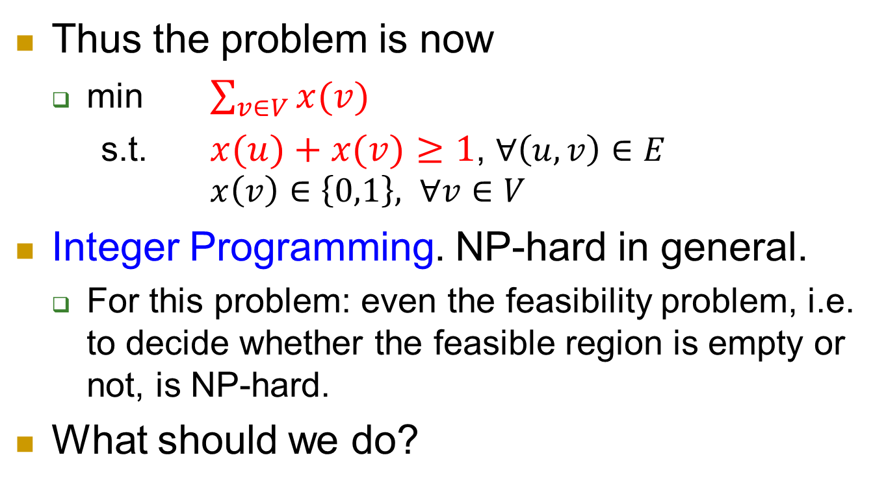
IP formulation, continued.
Thus the problem is now
  min $\sum_{v∈V}{x(v)}$
  s.t. $x(u)+x(v)≥1$, $∀\left(u,v\right)∈E$
  $x\left(v\right)∈\left\{0,1\right\},$ $∀v∈V$
Integer Programming. NP-hard in general.
  For this problem: even the feasibility problem, i.e. to decide whether the feasible region is empty or not, is NP-hard.
What should we do?

Slide 19
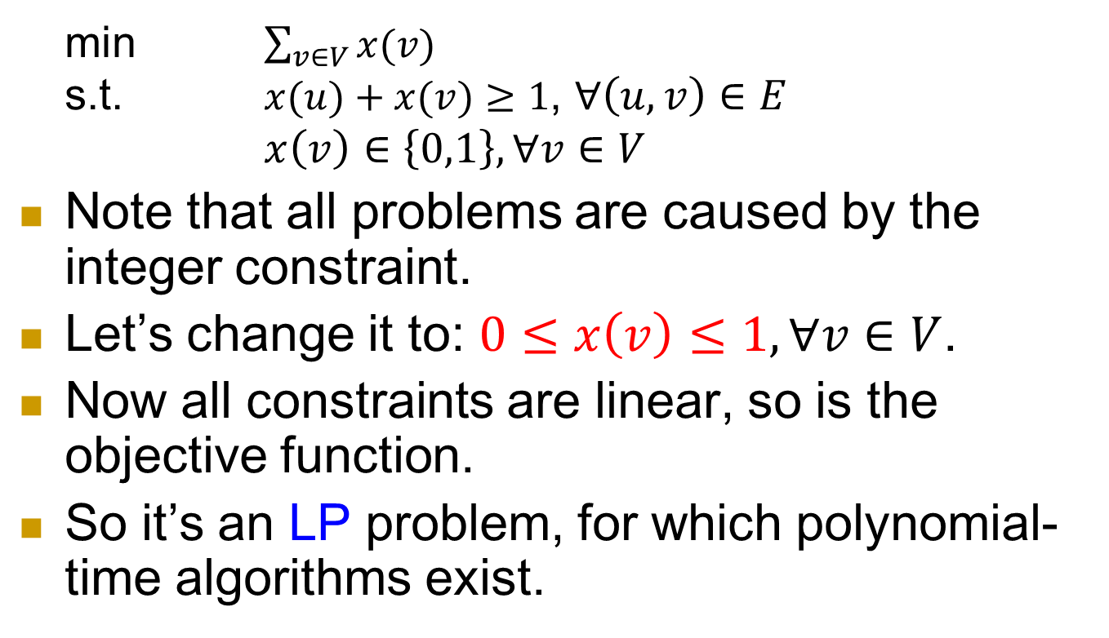
LP relaxation
  min $\sum_{v∈V}{x(v)}$
  s.t. $x(u)+x(v)≥1$, $∀\left(u,v\right)∈E$
  $x\left(v\right)∈\left\{0,1\right\}, ∀v∈V$
Note that all problems are caused by the integer constraint.
Let’s change it to: $0≤x\left(v\right)≤1, ∀v∈V$.
Now all constraints are linear, so is the objective function.
So it’s an LP problem, for which polynomial-time algorithms exist.

Slide 20
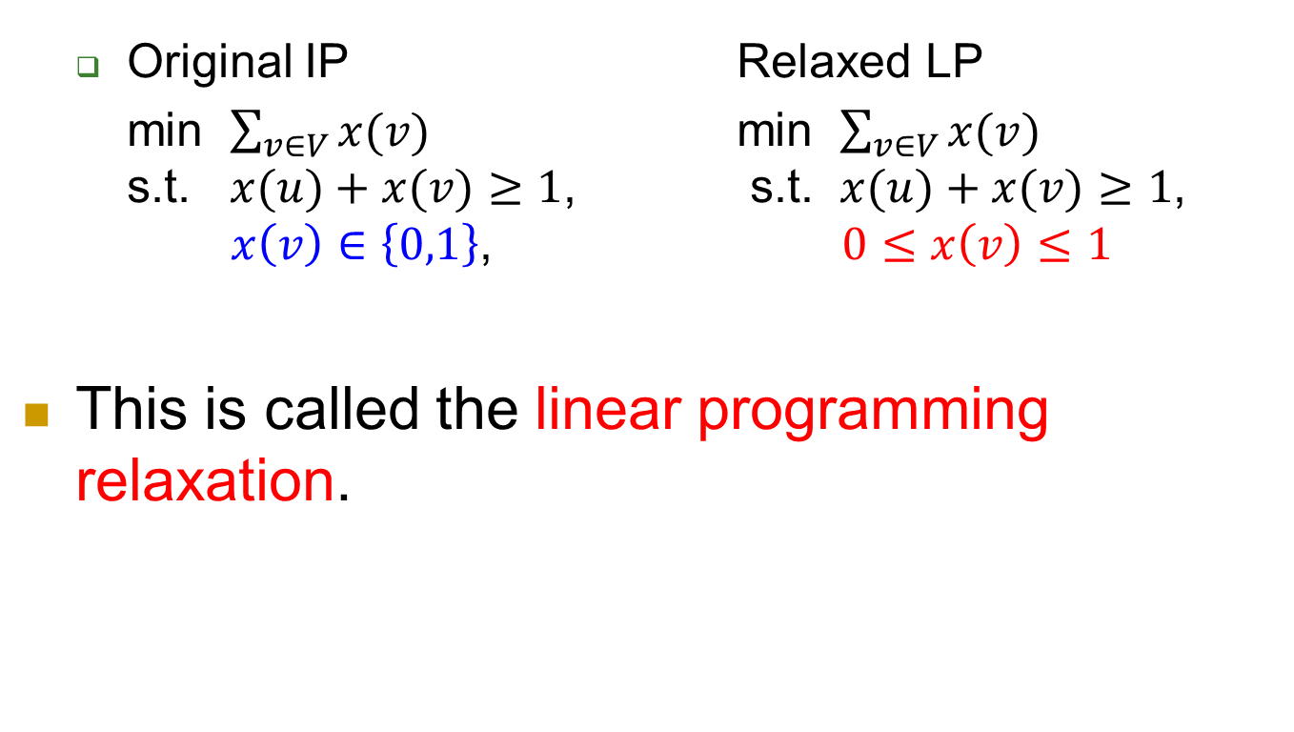
Relaxation
  Original IP Relaxed LP
  min $\sum_{v∈V}{x(v)}$ min $\sum_{v∈V}{x(v)}$
  s.t. $x(u)+x(v)≥1$, s.t. $x(u)+x(v)≥1$,
  $x\left(v\right)∈\left\{0,1\right\}$, $0≤x\left(v\right)≤1$
This is called the linear programming relaxation.

Slide 21
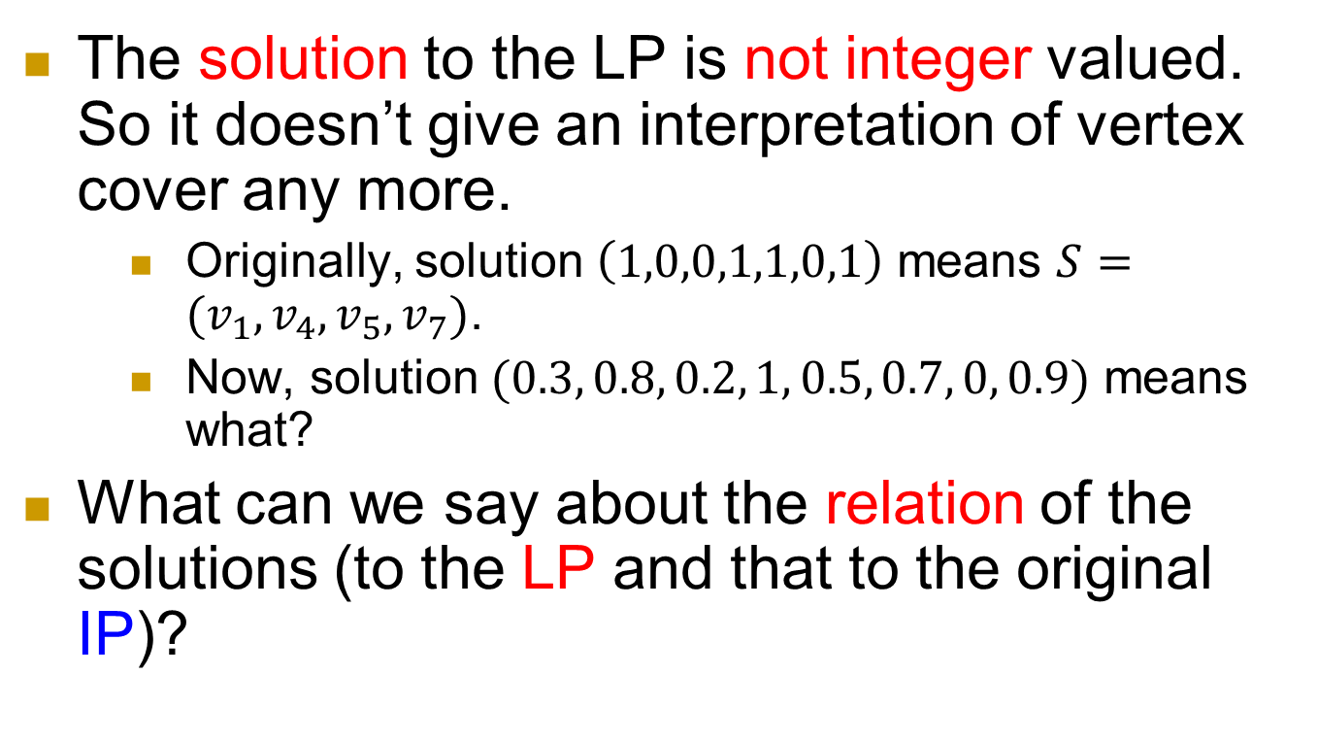
Two key issues
The solution to the LP is not integer valued. So it doesn’t give an interpretation of vertex cover any more.
    Originally, solution $\left(1,0,0,1,1,0,1\right)$ means $S=(v_{1},v_{4},v_{5},v_{7})$.
    Now, solution $(0.3, 0.8, 0.2, 1, 0.5, 0.7, 0, 0.9)$ means what?
What can we say about the relation of the solutions (to the LP and that to the original IP)?

Slide 22
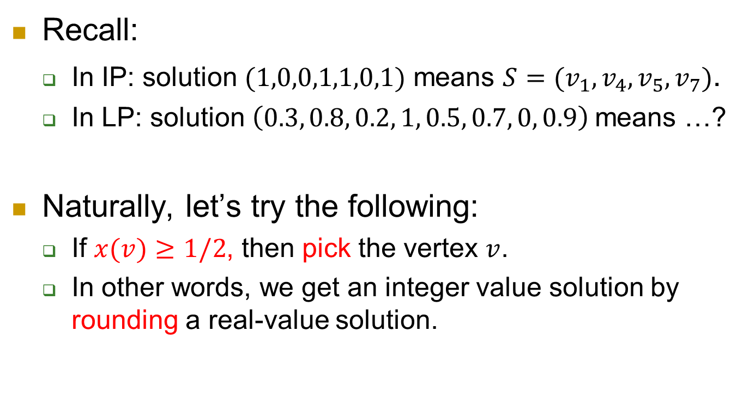
Issue 1: Construct a vertex cover from a solution of LP
Recall:
  In IP: solution $(1,0,0,1,1,0,1)$ means $S=(v_{1},v_{4},v_{5},v_{7})$.
  In LP: solution $\left(0.3, 0.8, 0.2, 1, 0.5, 0.7, 0, 0.9\right)$means …?
Naturally, let’s try the following:
  If $x(v)≥1/2$, then pick the vertex $v$.
  In other words, we get an integer value solution by rounding a real-value solution.

Slide 23
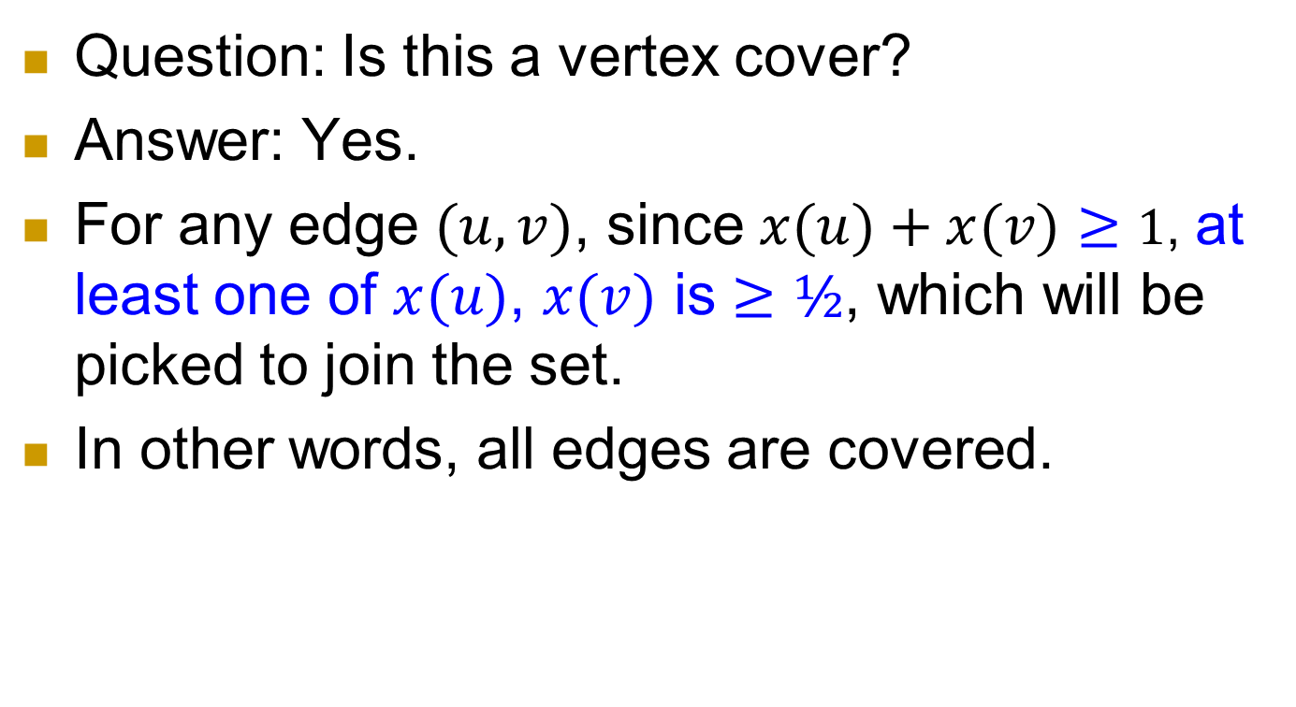
Issue 1, continued
Question: Is this a vertex cover?
Answer: Yes.
For any edge $(u,v)$, since $x(u)+x(v)≥1$, at least one of $x(u)$, $x(v)$ is $≥½$, which will be picked to join the set.
In other words, all edges are covered.

Slide 24
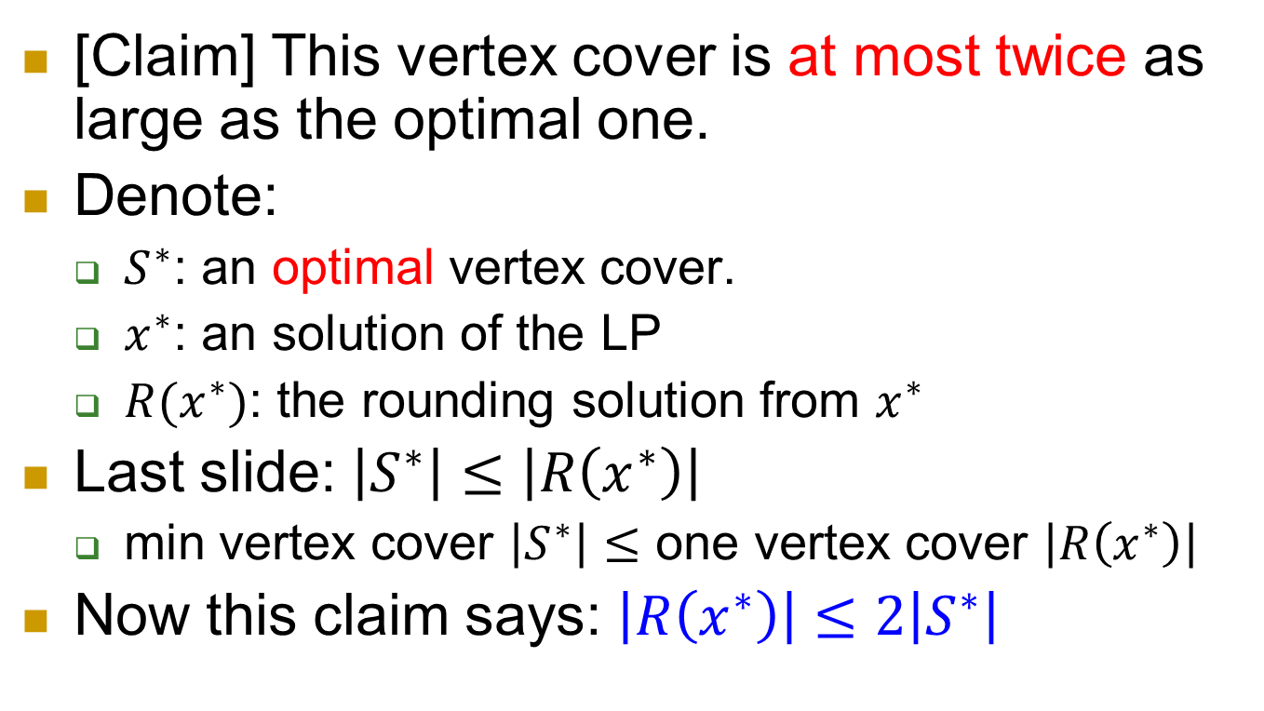
Issue 2: What can we say about the newly constructed vertex cover?
[Claim] This vertex cover is at most twice as large as the optimal one.
Denote:
  $S^{∗}$: an optimal vertex cover.
  $x^{∗}$: an solution of the LP
  $R(x^{∗})$: the rounding solution from $x^{∗}$
Last slide: $\left|S^{∗}\right|≤\left|R\left(x^{∗}\right)\right|$
  min vertex cover $\left|S^{∗}\right|≤$ one vertex cover $\left|R\left(x^{∗}\right)\right|$
Now this claim says: $\left|R\left(x^{∗}\right)\right|≤2\left|S^{∗}\right|$

Slide 25
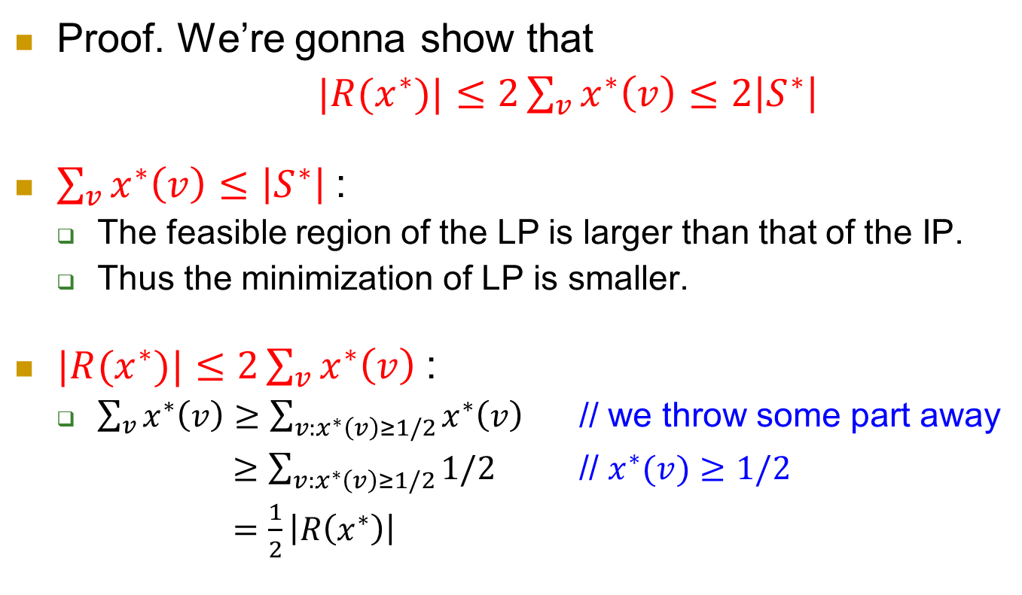
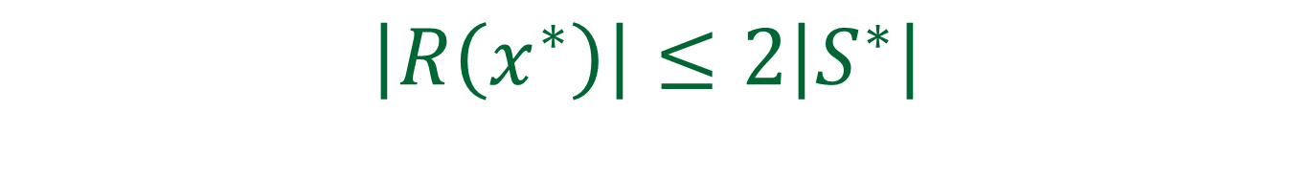
$$\left|R\left(x^{∗}\right)\right|≤2\left|S^{∗}\right|$$
Proof. We’re gonna show that
$|R(x^{∗})|≤2\sum_{v}{x^{∗}\left(v\right)}≤2\left|S^{∗}\right|$
$\sum_{v}{x^{∗}\left(v\right)}≤\left|S^{∗}\right|$:
  The feasible region of the LP is larger than that of the IP.
  Thus the minimization of LP is smaller.
$|R(x^{∗})|≤2\sum_{v}{x^{∗}\left(v\right)}$:
  $\sum_{v}{x^{∗}\left(v\right)}≥\sum_{v:x^{∗}\left(v\right)≥1/2}{x^{∗}\left(v\right)}$ // we throw some part away
  $≥\sum_{v:x^{∗}\left(v\right)≥1/2}{1/2}$ // $x^{∗}(v)≥1/2$
  $=\frac{1}{2}\left|R\left(x^{∗}\right)\right|$

Slide 26
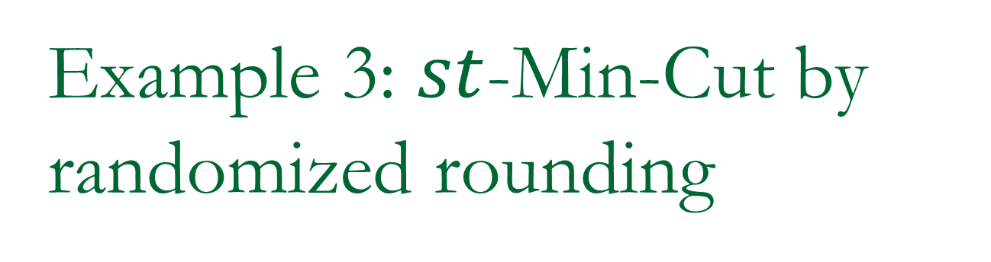
Example 3: $st$-Min-Cut by randomized rounding
Obtaining an exact algorithm!

Slide 27
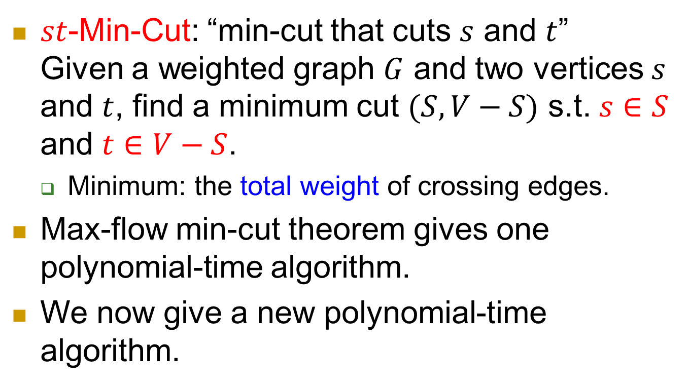
st-Min-Cut
$st$-Min-Cut: “min-cut that cuts $s$ and $t$”
Given a weighted graph $G$ and two vertices $s$ and $t$, find a minimum cut $(S, V−S)$ s.t. $s∈S$ and $t∈V−S$.
  Minimum: the total weight of crossing edges.
Max-flow min-cut theorem gives one polynomial-time algorithm.
We now give a new polynomial-time algorithm.

Slide 28
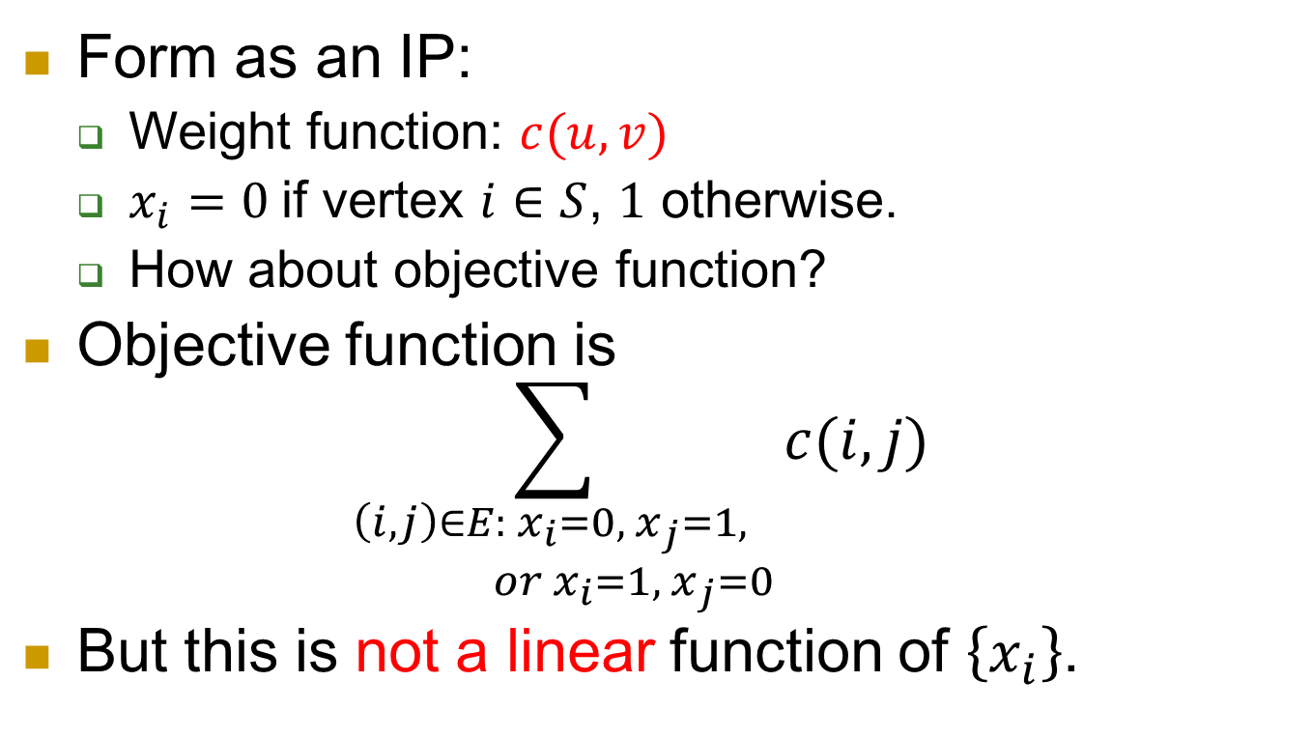
IP formulation
Form as an IP:
  Weight function: $c(u,v)$
  $x_{i}=0$if vertex $i∈S$, $1$ otherwise.
  How about objective function?
Objective function is
$\sum_{\begin{aligned}\left(i,j\right)∈E: x_{i}=0,{ x}_{j}=1, \\ or{ x}_{i}=1,{ x}_{j}=0\end{aligned}}{c(i,j)}$
But this is not a linear function of $\left\{x_{i}\right\}$.

Slide 29
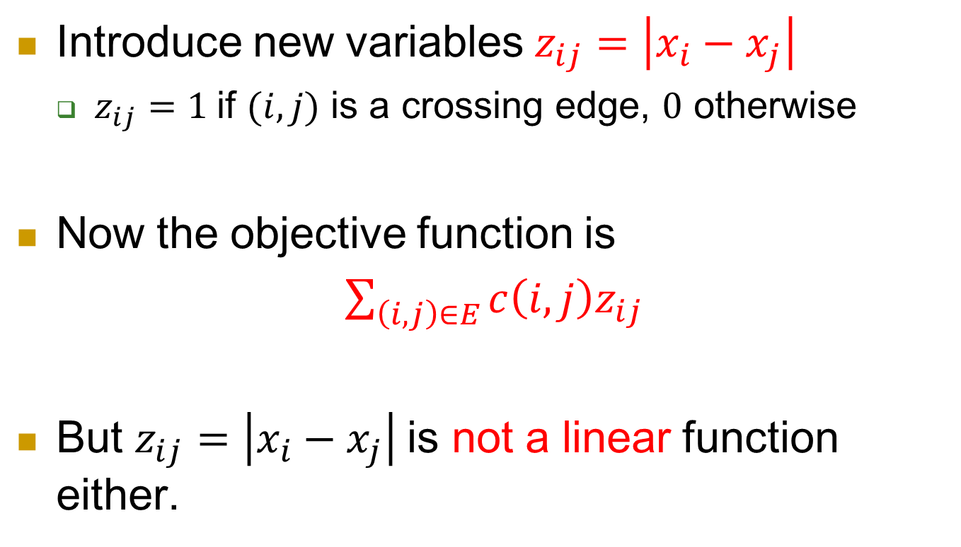
Modification
Introduce new variables $z_{ij}=\left|x_{i}−x_{j}\right|$
  $z_{ij}=1$if $(i,j)$ is a crossing edge, $0$ otherwise
Now the objective function is
$\sum_{\left(i,j\right)∈E}{c\left(i,j\right)z_{ij}}$
But $z_{ij}=\left|x_{i}−x_{j}\right|$is not a linear function either.

Slide 30
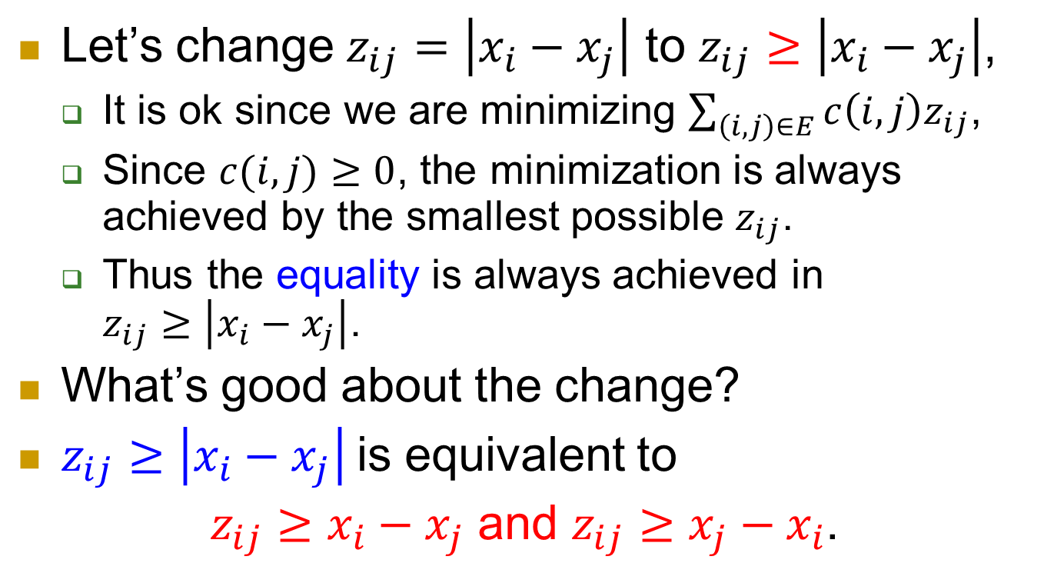
Let’s change $z_{ij}=\left|x_{i}−x_{j}\right|$ to $z_{ij}≥\left|x_{i}−x_{j}\right|$,
  It is ok since we are minimizing $\sum_{\left(i,j\right)∈E}{c\left(i,j\right)z_{ij}}$,
  Since $c(i,j)≥0$, the minimization is always achieved by the smallest possible $z_{ij}$.
  Thus the equality is always achieved in
  $z_{ij}≥\left|x_{i}−x_{j}\right|$.
What’s good about the change?
$z_{ij}≥\left|x_{i}−x_{j}\right|$is equivalent to
$z_{ij}≥x_{i}−x_{j}$ and $z_{ij}≥x_{j}−x_{i}$.

Slide 31
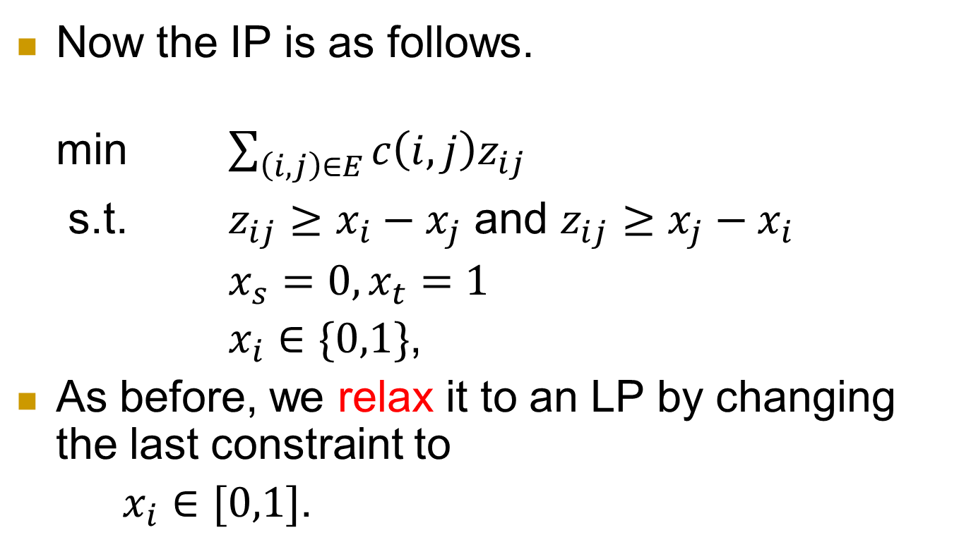
IP
Now the IP is as follows.
min $\sum_{\left(i,j\right)∈E}{c\left(i,j\right)z_{ij}}$
s.t. $z_{ij}≥x_{i}−x_{j}$ and $z_{ij}≥x_{j}−x_{i}$
$x_{s}=0, x_{t}=1$
$x_{i}∈\{0,1\}$,
As before, we relax it to an LP by changing the last constraint to
$x_{i}∈[0,1]$.

Slide 32
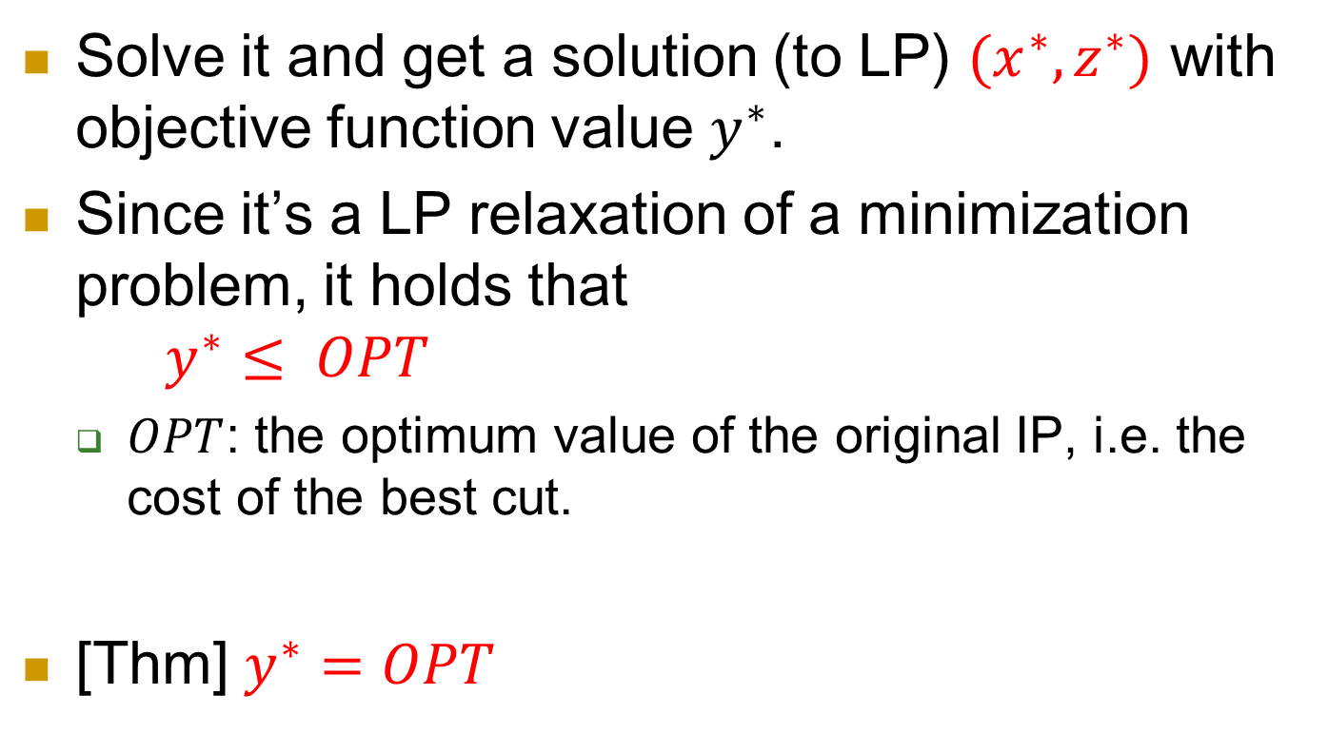
Solve it and get a solution (to LP) $(x^{∗}, z^{∗})$ with objective function value $y^{∗}$.
Since it’s a LP relaxation of a minimization problem, it holds that
$y^{∗}≤ OPT$
  $OPT$: the optimum value of the original IP, i.e. the cost of the best cut.
[Thm] $y^{∗}=OPT$

Slide 33
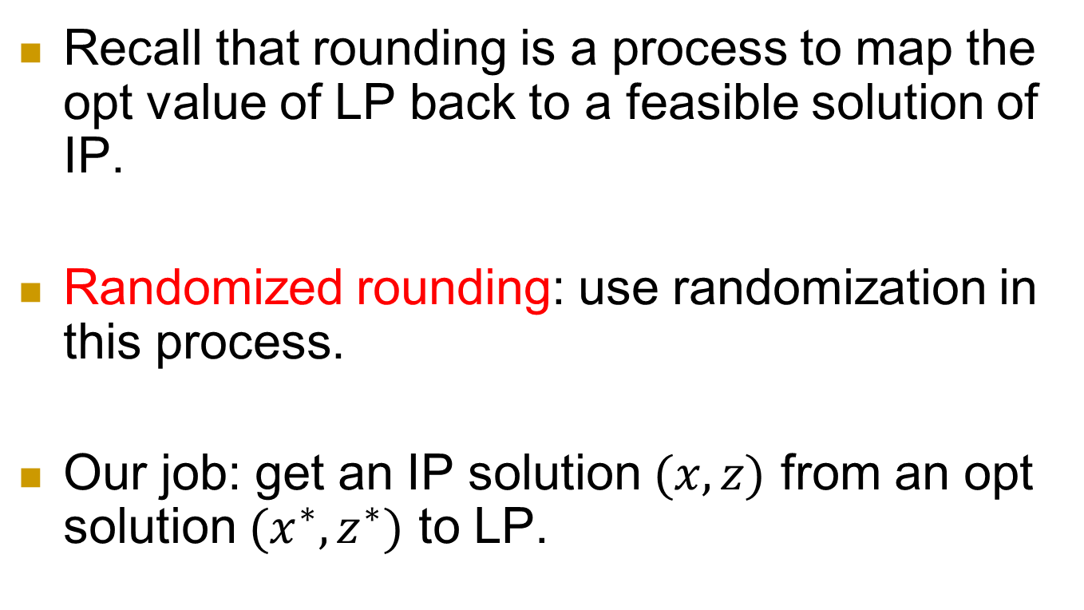
We prove this by randomized rounding
Recall that rounding is a process to map the opt value of LP back to a feasible solution of IP.
Randomized rounding: use randomization in this process.
Our job: get an IP solution $(x,z)$ from an opt solution $(x^{∗},z^{∗})$ to LP.

Slide 34
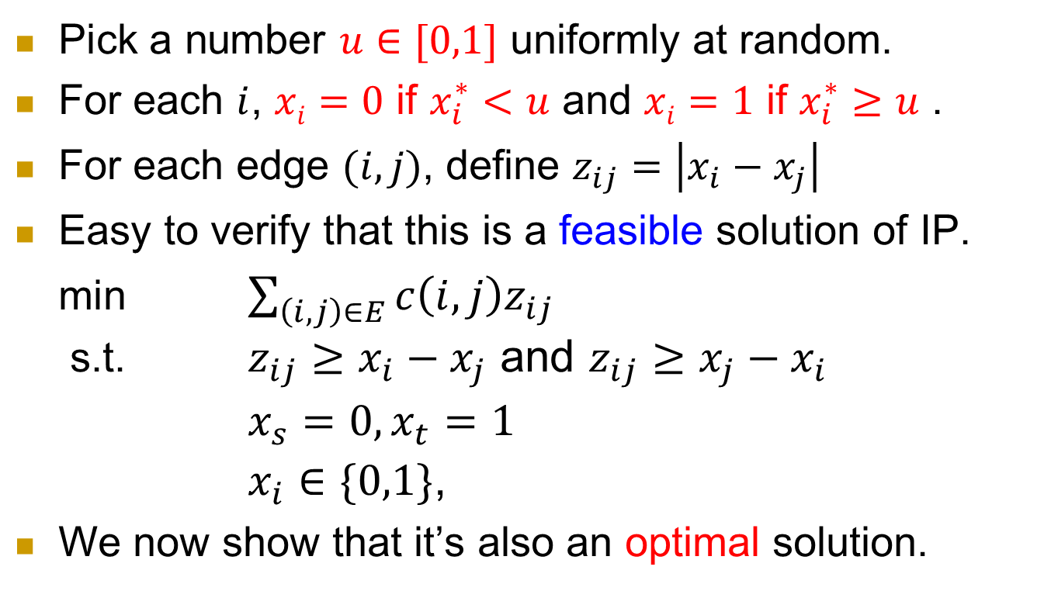
Rounding algorithm
Pick a number $u∈[0,1]$ uniformly at random.
For each $i$, $xi=0$ if $x_{i}^{∗}<u$ and $xi=1$ if $x_{i}^{∗}≥u$ .
For each edge $(i,j)$, define $z_{ij}=\left|x_{i}−x_{j}\right|$
Easy to verify that this is a feasible solution of IP.
min $\sum_{\left(i,j\right)∈E}{c\left(i,j\right)z_{ij}}$
s.t. $z_{ij}≥x_{i}−x_{j}$ and $z_{ij}≥x_{j}−x_{i}$
$x_{s}=0, x_{t}=1$
$x_{i}∈\{0,1\}$,
We now show that it’s also an optimal solution.

Slide 35
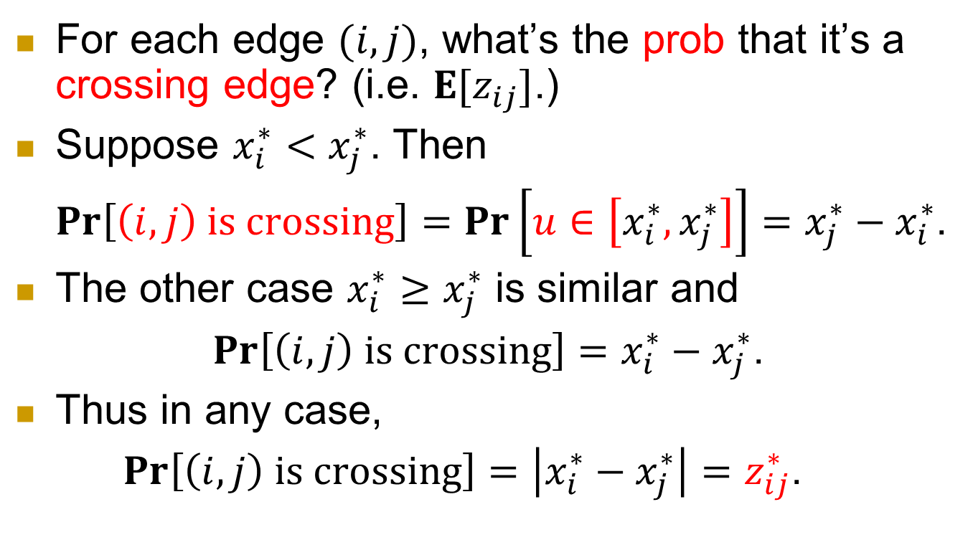
For each edge $(i,j)$, what’s the prob that it’s a crossing edge? (i.e. $E[z_{ij}]$.)
Suppose $x_{i}^{∗}<x_{j}^{∗}$. Then
$\operatorname{Pr}\left[\left(i,j\right) is crossing\right]=\operatorname{Pr}\left[u∈\left[x_{i}^{∗},x_{j}^{∗}\right]\right]=x_{j}^{∗}−x_{i}^{∗}$.
The other case $x_{i}^{∗}≥x_{j}^{∗}$ is similar and
$\operatorname{Pr}\left[\left(i,j\right) is crossing\right]=x_{i}^{∗}−x_{j}^{∗}$.
Thus in any case,
$\operatorname{Pr}\left[\left(i,j\right) is crossing\right]=\left|x_{i}^{∗}−x_{j}^{∗}\right|=z_{ij}^{∗}$.

Slide 36
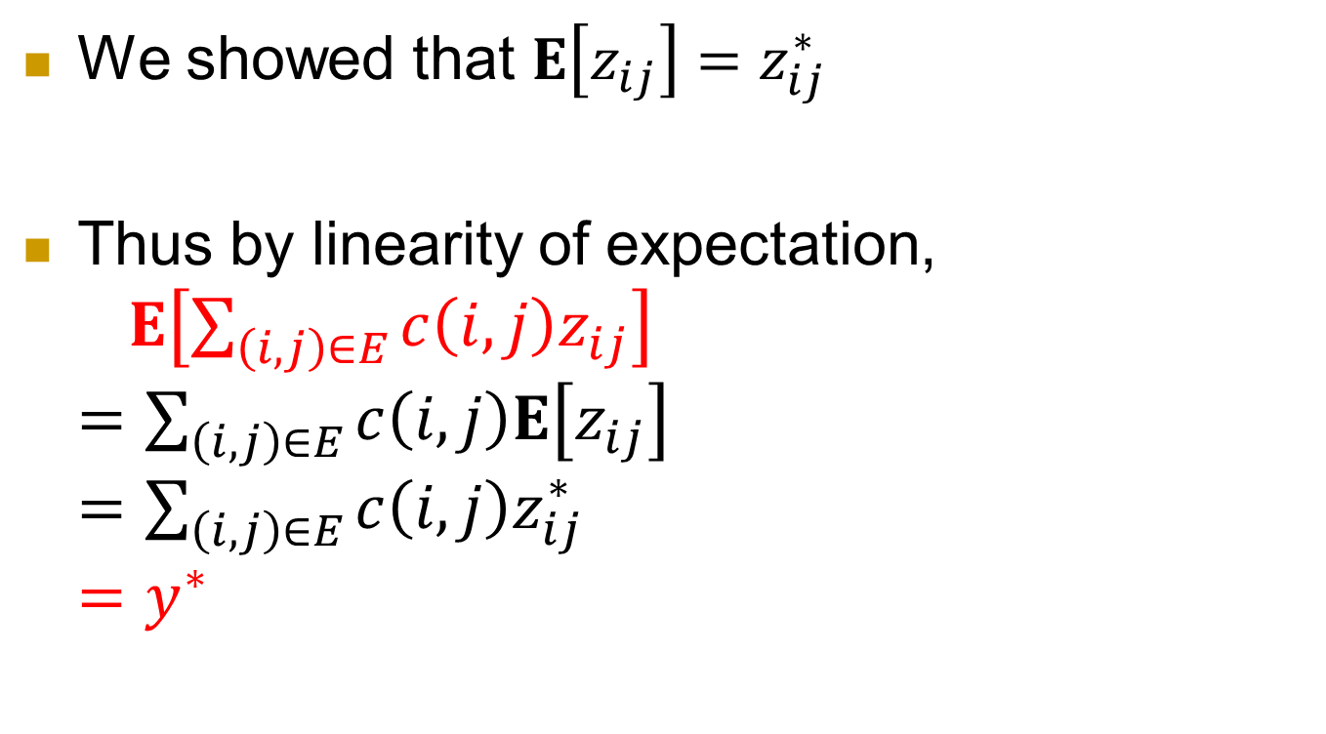
We showed that $E\left[z_{ij}\right]=z_{ij}^{∗}$
Thus by linearity of expectation,
$E\left[\sum_{\left(i,j\right)∈E}{c\left(i,j\right)z_{ij}}\right]$
$=\sum_{\left(i,j\right)∈E}{c\left(i,j\right)E\left[z_{ij}\right]}$
$=\sum_{\left(i,j\right)∈E}{c\left(i,j\right)z_{ij}^{∗}}$
$=y^{∗}$

Slide 37
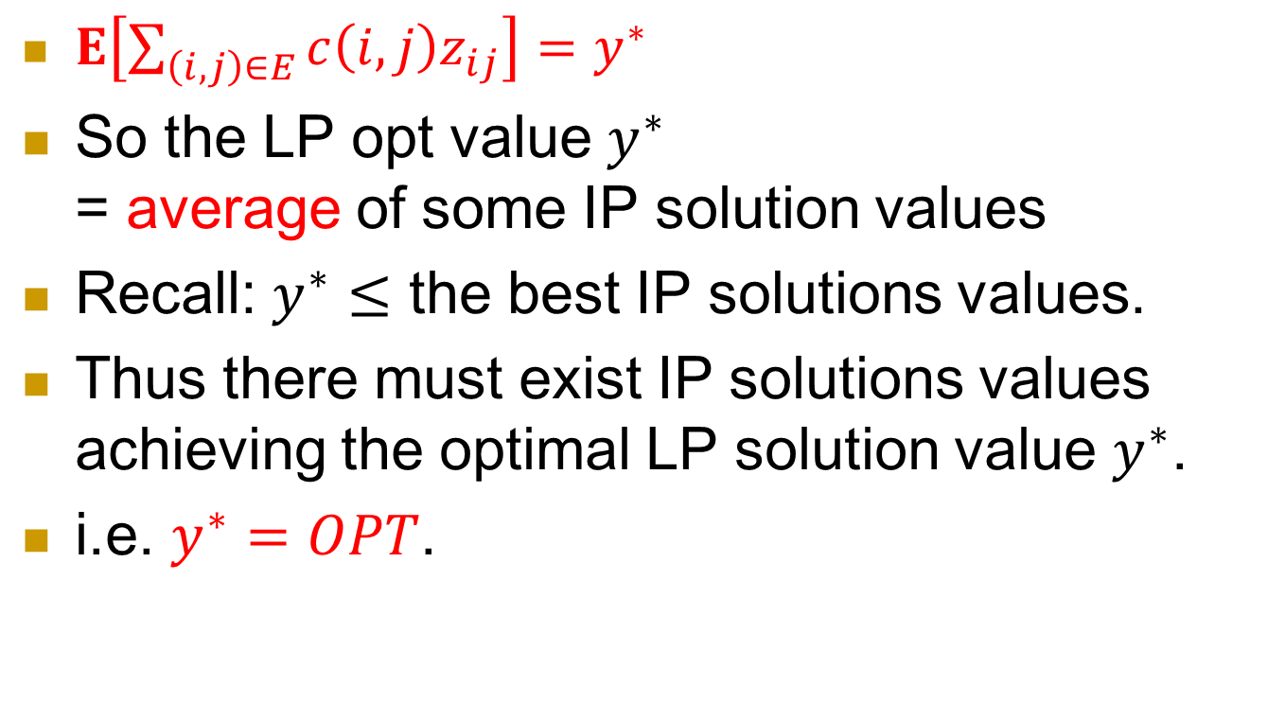
$E\left[\sum_{\left(i,j\right)∈E}{c\left(i,j\right)z_{ij}}\right]=y^{∗}$
So the LP opt value $y^{∗}$
= average of some IP solution values
Recall: $y^{∗}≤$ the best IP solutions values.
Thus there must exist IP solutions values achieving the optimal LP solution value $y^{∗}$.
i.e. $y^{∗}=OPT$.

Slide 38
Summary
Many optimization problems are NP-complete.
Approximation algorithms aim to find almost optimal solution.
An important tool to design approximation algorithms is LP.

Slide 39
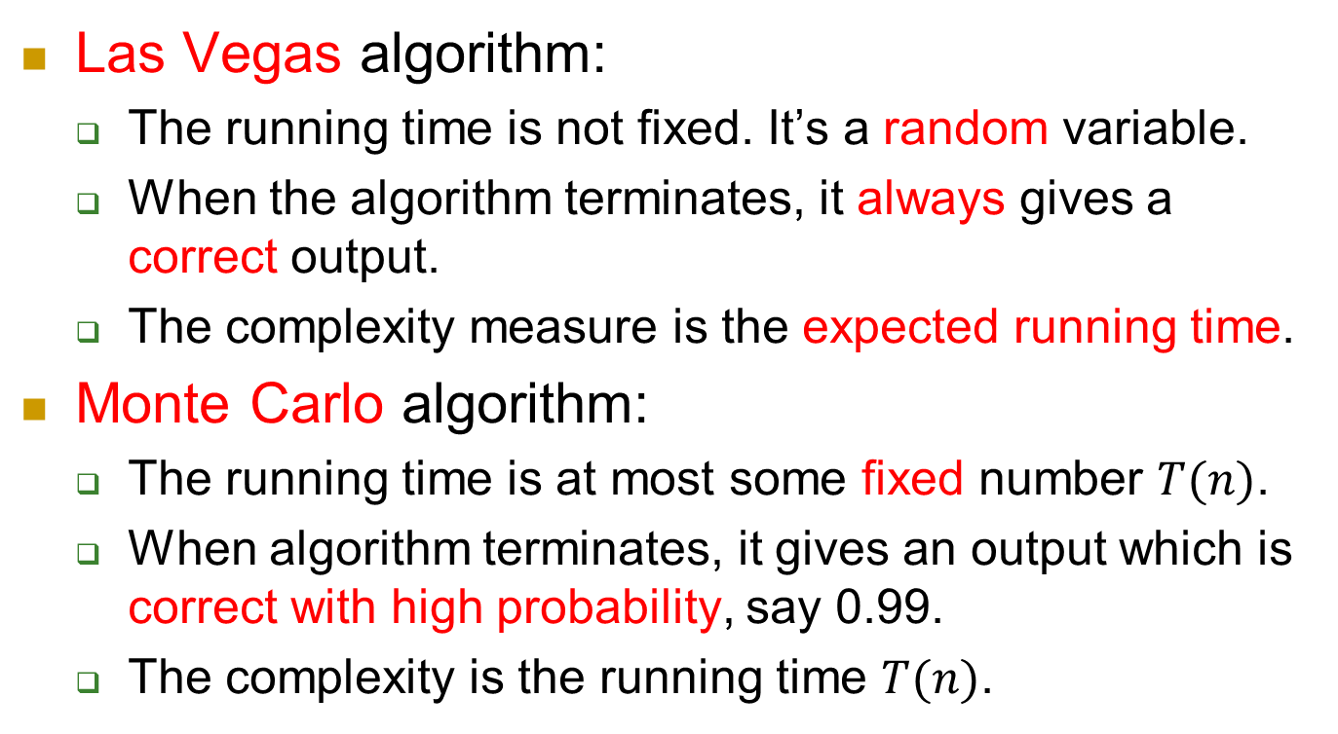
Appendix: Las Vegas → Monte Carlo
Las Vegas algorithm:
  The running time is not fixed. It’s a random variable.
  When the algorithm terminates, it always gives a correct output.
  The complexity measure is the expected running time.
Monte Carlo algorithm:
  The running time is at most some fixed number $T(n)$.
  When algorithm terminates, it gives an output which is correct with high probability, say 0.99.
  The complexity is the running time $T(n)$.

Slide 40
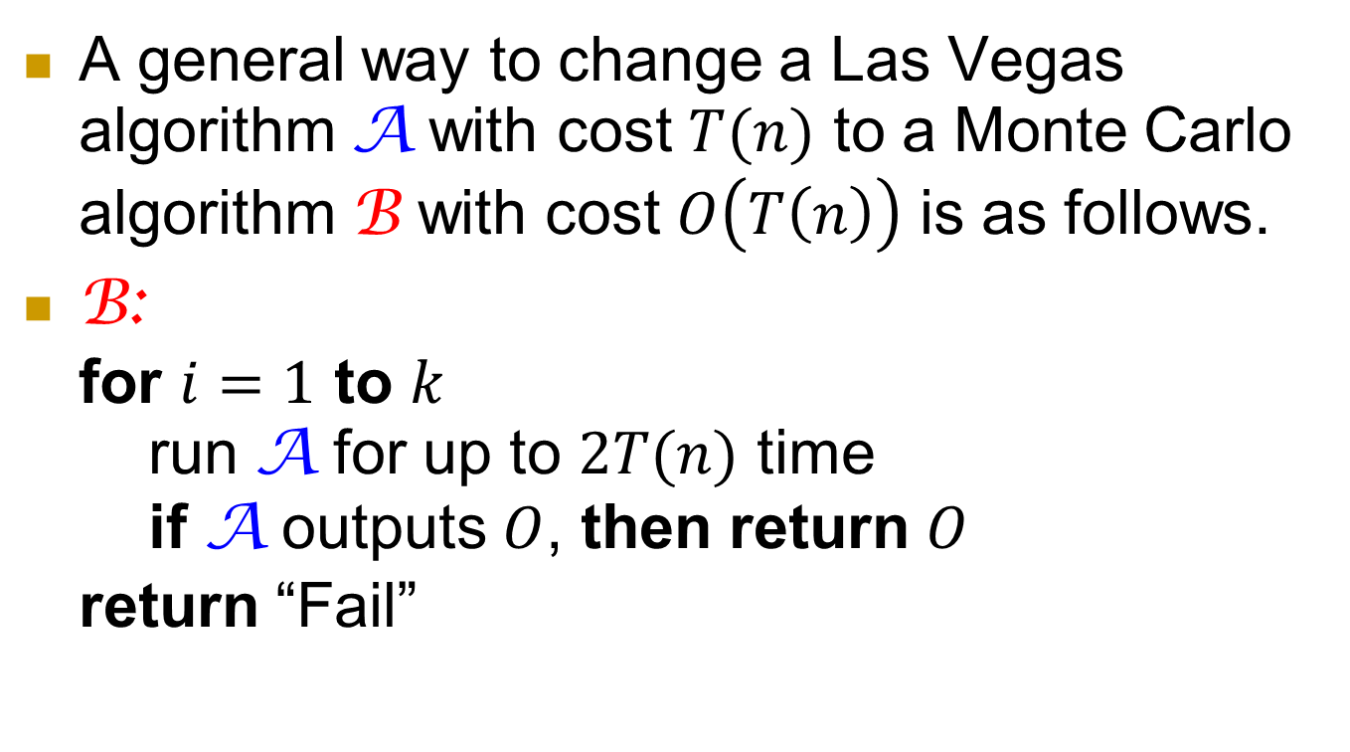
Las Vegas → Monte Carlo
A general way to change a Las Vegas algorithm A with cost $T(n)$ to a Monte Carlo algorithm B with cost $O\left(T\left(n\right)\right)$ is as follows.
B:
for $i=1$ to $k$
run A for up to $2T(n)$ time
if A outputs $O$, then return $O$
return “Fail”

Slide 41
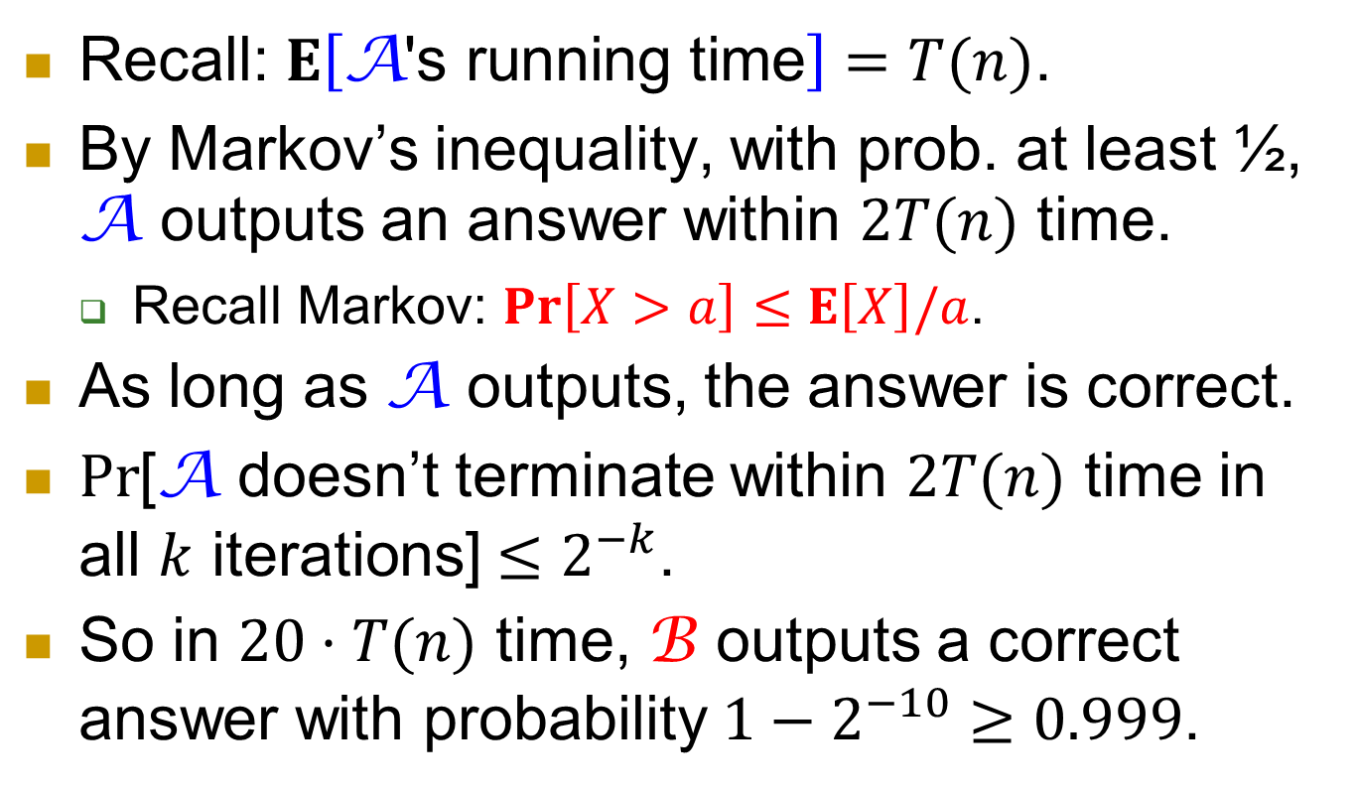
Recall: $E\left[\text{A}\text{′}\text{s} \text{running} \text{time}\right]=T(n)$.
By Markov’s inequality, with prob. at least ½, A outputs an answer within $2T(n)$ time.
  Recall Markov: $\operatorname{Pr}\left[X>a\right]≤E\left[X\right]/a$.
As long as A outputs, the answer is correct.
$Pr$[A doesn’t terminate within $2T(n)$ time in all $k$ iterations] $≤2^{−k}$.
So in $20⋅T(n)$ time, B outputs a correct answer with probability $1−2^{−10}≥0.999$.

Slide 42
Make-up class
Topic: online algorithms.
  The input is given as a sequence.
Venue: ERB 713.
Time: 2:30-5:15pm, April 17 (this Friday).
Tutorial follows at 5:30pm, same classroom.
Not required in exam.

