Slide 1
CSC3160: Design and Analysis of Algorithms
Week 10: NP-completeness
Instructor: Shengyu Zhang

Slide 2
Tractable
While we have introduced many problems with polynomial-time algorithms…
…not all problems enjoy fast computation.
Among those “hard” problems, an important class is NP.

Slide 3
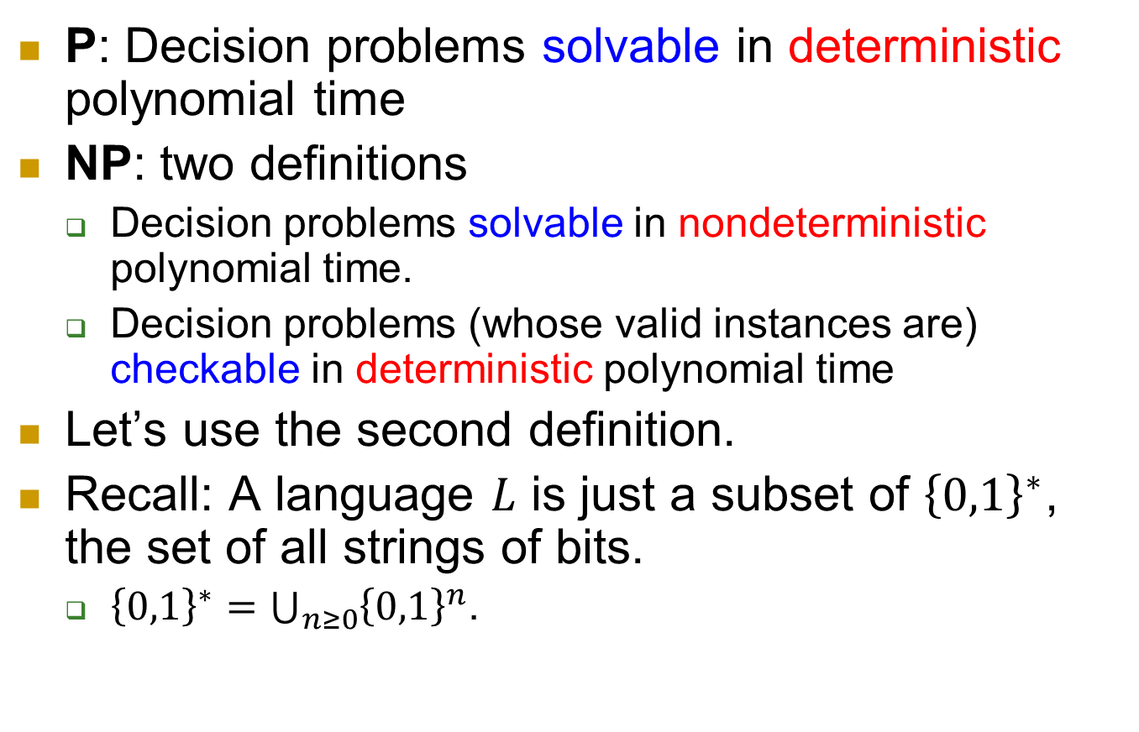
P, NP
P: Decision problems solvable in deterministic polynomial time
NP: two definitions
  Decision problems solvable in nondeterministic polynomial time.
  Decision problems (whose valid instances are) checkable in deterministic polynomial time
Let’s use the second definition.
Recall: A language $L$ is just a subset of ${\left\{0,1\right\}}^{∗}$, the set of all strings of bits.
  ${\left\{0,1\right\}}^{∗}=\bigcup_{n≥0}{{\left\{0,1\right\}}^{n}}$.

Slide 4
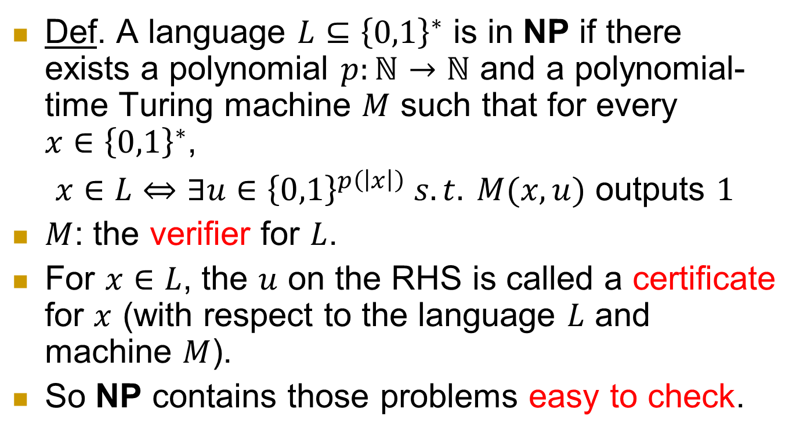
Formal definition of NP
Def. A language $L⊆{\left\{0,1\right\}}^{∗}$ is in NP if there exists a polynomial $p:ℕ→ℕ$ and a polynomial-time Turing machine $M$ such that for every $x∈{\left\{0,1\right\}}^{∗}$,
$x∈L⇔∃u∈{\left\{0,1\right\}}^{p\left(\left|x\right|\right)} s.t. M(x,u)$ outputs $1$
$M$: the verifier for $L$.
For $x∈L$, the $u$ on the RHS is called a certificate for $x$ (with respect to the language $L$ and machine $M$).
So NP contains those problems easy to check.

Slide 5
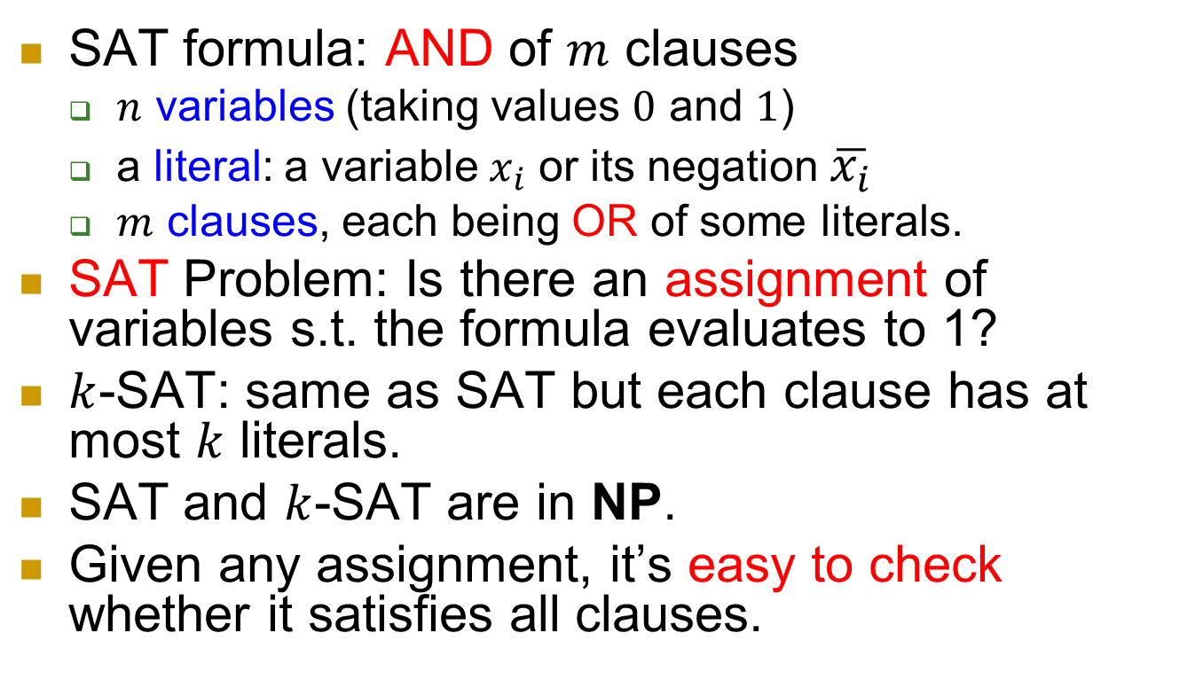

SAT and $k$-SAT
  SAT formula: AND of $m$ clauses
  $n$ variables (taking values $0$ and $1$)
  a literal: a variable $x_{i}$ or its negation $\overline{x_{i}}$
  $m$ clauses, each being OR of some literals.
SAT Problem: Is there an assignment of variables s.t. the formula evaluates to 1?
$k$-SAT: same as SAT but each clause has at most $k$ literals.
SAT and $k$-SAT are in NP.
Given any assignment, it’s easy to check whether it satisfies all clauses.

Slide 6
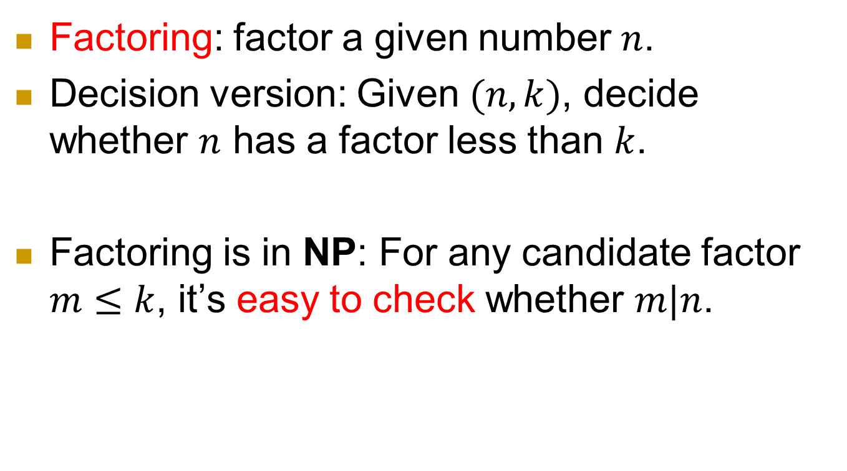
Examples of NP problems
Factoring: factor a given number $n$.
Decision version: Given $(n,k)$, decide whether $n$ has a factor less than $k$.
Factoring is in NP: For any candidate factor $m≤k$, it’s easy to check whether $m|n$.

Slide 7
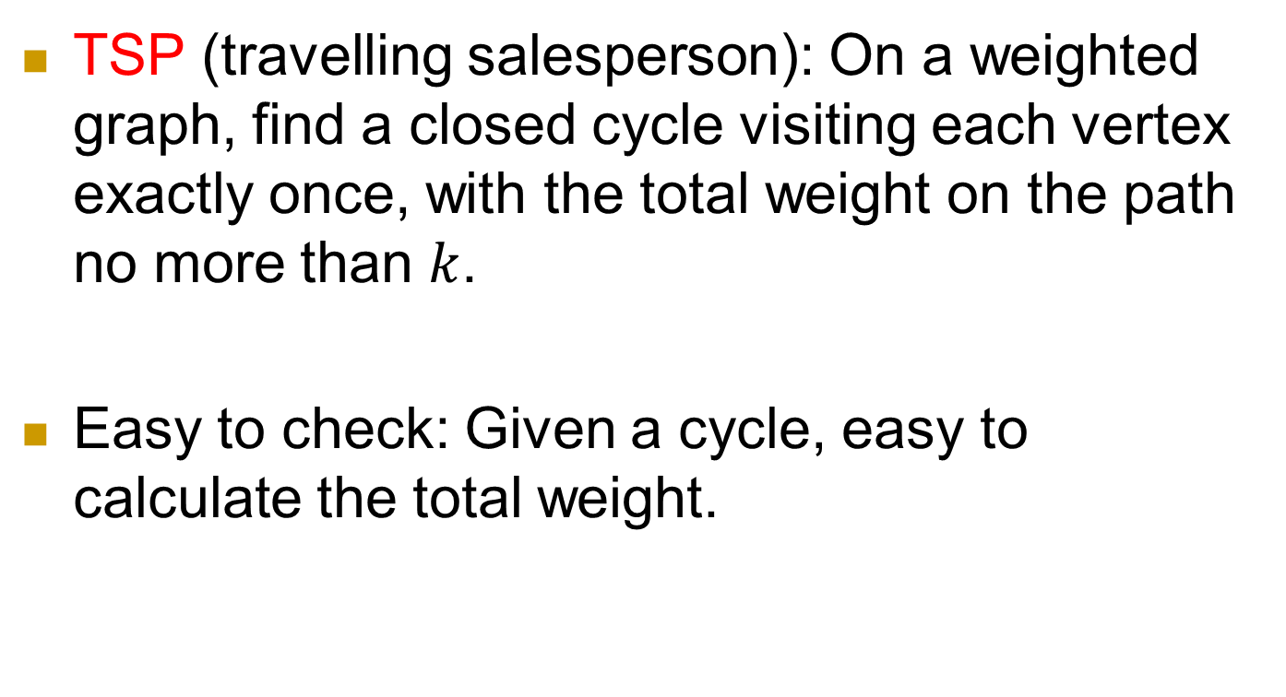
Examples of NP problems
TSP (travelling salesperson): On a weighted graph, find a closed cycle visiting each vertex exactly once, with the total weight on the path no more than $k$.
Easy to check: Given a cycle, easy to calculate the total weight.

Slide 8





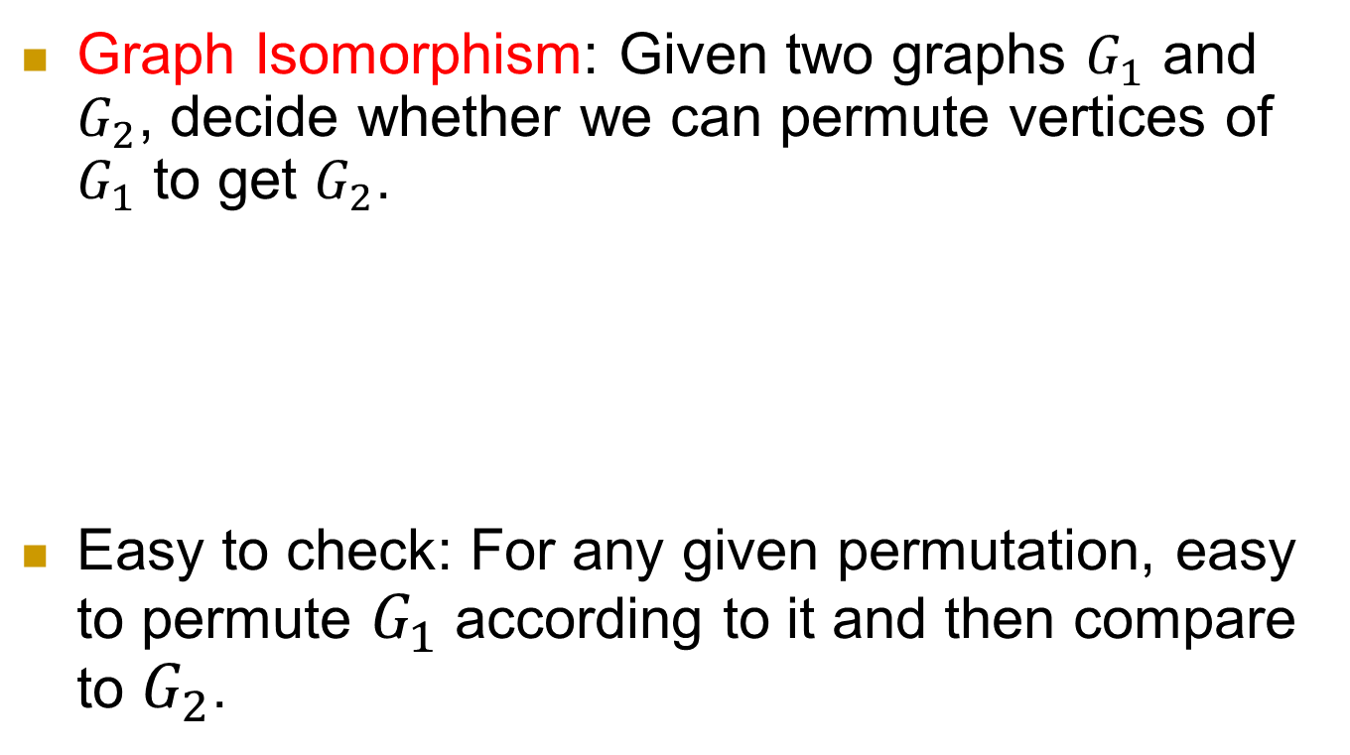






Graph Isomorphism: Given two graphs $G_{1}$ and $G_{2}$, decide whether we can permute vertices of $G_{1}$ to get $G_{2}$.
Easy to check: For any given permutation, easy to permute $G_{1}$ according to it and then compare to $G_{2}$.
$$1$$
$$2$$
$$1$$
$$2$$
$$1→2, 2→1 \\ 3→3, 4→4$$
$$3$$
$$4$$
$$3$$
$$4$$
$$G_{1}$$
$$G_{2}$$

Slide 9
Question of P vs. NP
Is P = NP?
The most famous (and notoriously hard) question in computer science.
  Staggering philosophical and practical implications
  Withstood a great deal of attacks
Clay Mathematics Institute recognized it as one of seven great mathematical challenges of the millennium. US$1M.
  Want to get rich (and famous)? Here is a “simple” way!

Slide 10
The P vs. NP question: intuition
Is producing a solution essentially harder than checking a solution?
  Coming up with a proof vs. verifying a proof.
  Composing a song vs. appreciating a song.
  Cooking good food vs. recognizing good food
  …

Slide 11
What if P = NP?
The world becomes a Utopia.
  Mathematicians are replaced by efficient theorem-discovering machines.
  It becomes easy to come up with the simplest theory to explain known data
  …
But at the same time,
  Many cryptosystems are insecure.

Slide 12
Completeness
NP
[Cook-Levin] There is a class of NP problems,
such that
solve any of them in polynomial time,
⇒ solve all NP problems in polynomial time.
P

Slide 13
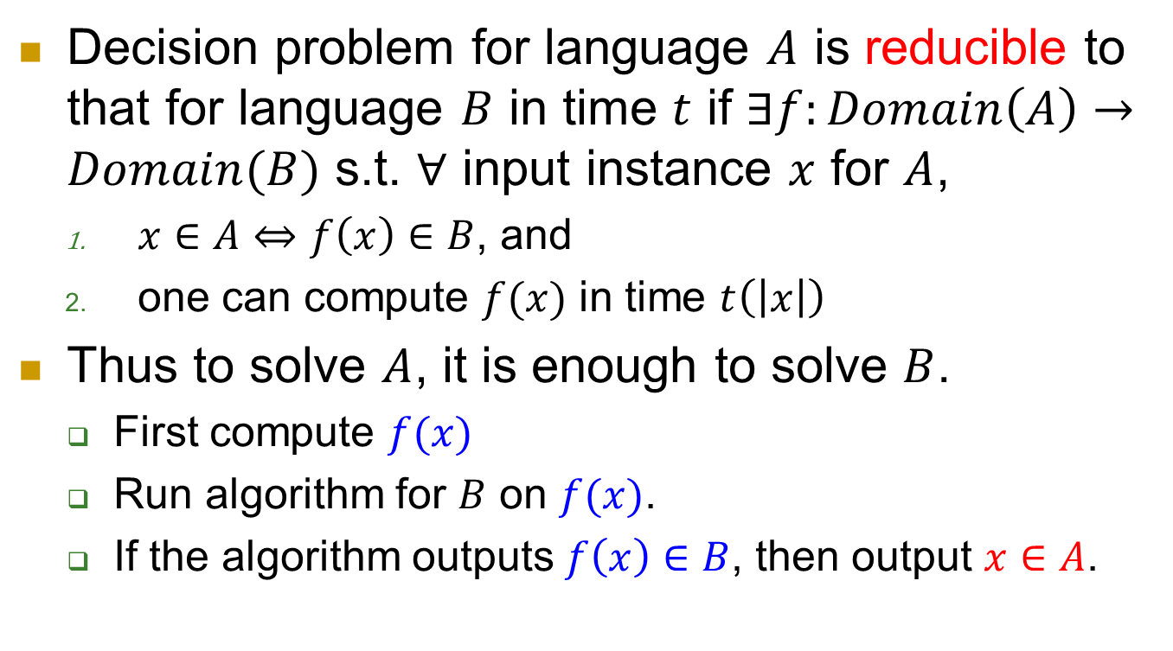
Reduction and completeness
Decision problem for language $A$ is reducible to that for language $B$ in time $t$ if $∃f:Domain\left(A\right)→Domain(B)$ s.t. $∀$ input instance $x$ for $A$,
  $x∈A⇔f\left(x\right)∈B$, and
  one can compute $f(x)$ in time $t\left(\left|x\right|\right)$
Thus to solve $A$, it is enough to solve $B$.
  First compute $f(x)$
  Run algorithm for $B$ on $f(x)$.
  If the algorithm outputs $f\left(x\right)∈B$, then output $x∈A$.

Slide 14
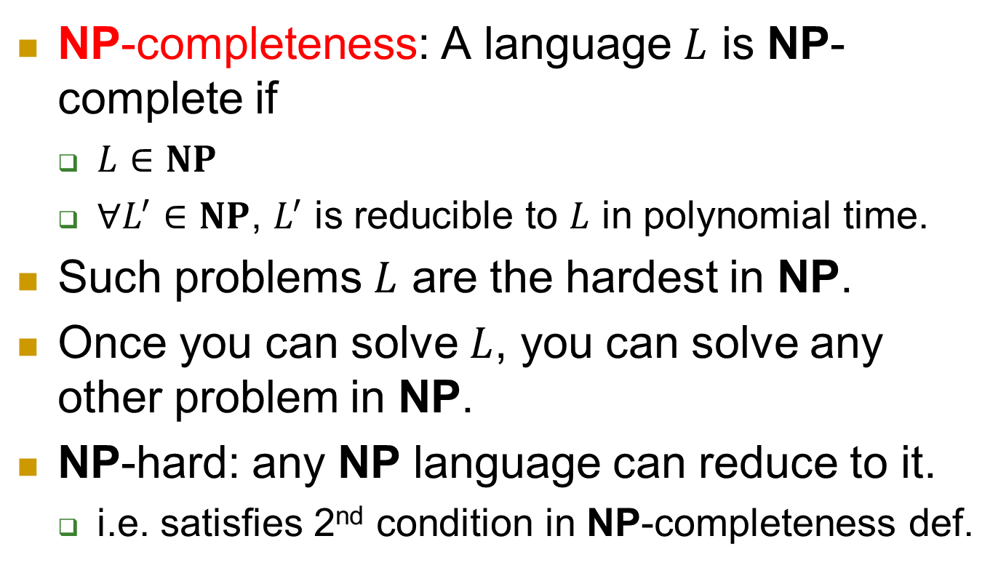
NP-completeness
NP-completeness: A language $L$ is NP-complete if
  $L∈NP$
  $∀L^{′}∈NP$, $L^{′}$ is reducible to $L$ in polynomial time.
Such problems $L$ are the hardest in NP.
Once you can solve $L$, you can solve any other problem in NP.
NP-hard: any NP language can reduce to it.
  i.e. satisfies 2nd condition in NP-completeness def.

Slide 15
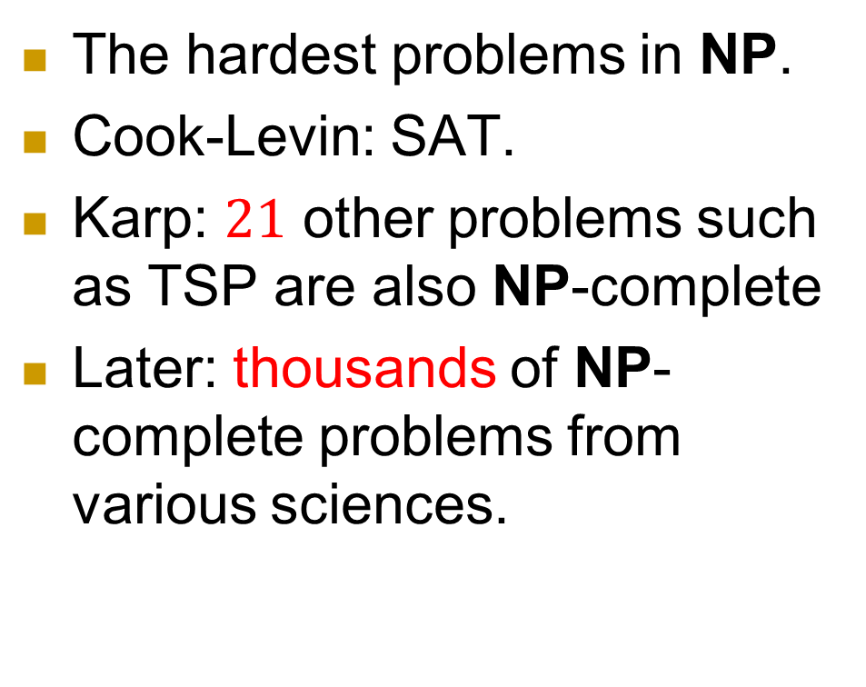
Completeness
NP
NP-
Complete
The hardest problems in NP.
Cook-Levin: SAT.
Karp: $21$ other problems such as TSP are also NP-complete
Later: thousands of NP-complete problems from various sciences.
P

Slide 16
Meanings of NP-completeness
Reduce the number of questions without increasing the number of answers.
Huge impacts on almost all other sciences such as physics, chemistry, biology, …
  Now given a computational problem in NP, the first step is usually to see whether it’s in P or NPC.
“The biggest export of Theoretical Computer Science.”

Slide 17
SAT
Clique
Subset Sum
TSP
Vertex Cover
Integer Programming
NP
NP-
Complete
Not known to be in P or NP-complete:
Factoring
Graph Isomorphism
Nash Equilibrium
Local Search
P
Shortest Path
MST
Maximum Flow
Maximum Matching
PRIMES
Linear Programming

Slide 18
The 1st NP-complete problem: 3-SAT
Any NP problem can be verified in polynomial time, by definition.
Turn the verification algorithm into a formula which checks every step of computation.
Note that in either circuit definition or Turing machine definition, computation is local.
  The change of configuration is only at several adjacent locations.

Slide 19
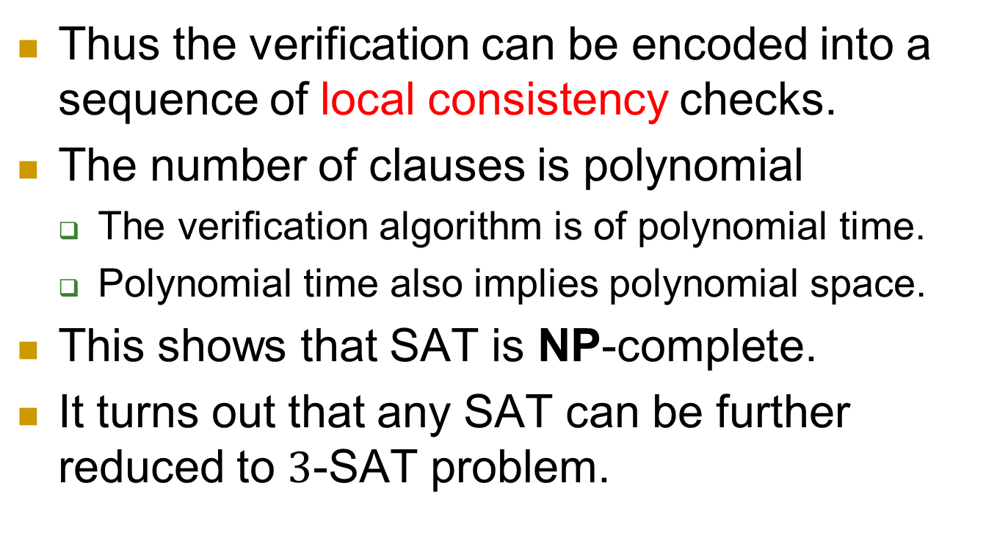
Thus the verification can be encoded into a sequence of local consistency checks.
The number of clauses is polynomial
  The verification algorithm is of polynomial time.
  Polynomial time also implies polynomial space.
This shows that SAT is NP-complete.
It turns out that any SAT can be further reduced to $3$-SAT problem.

Slide 20
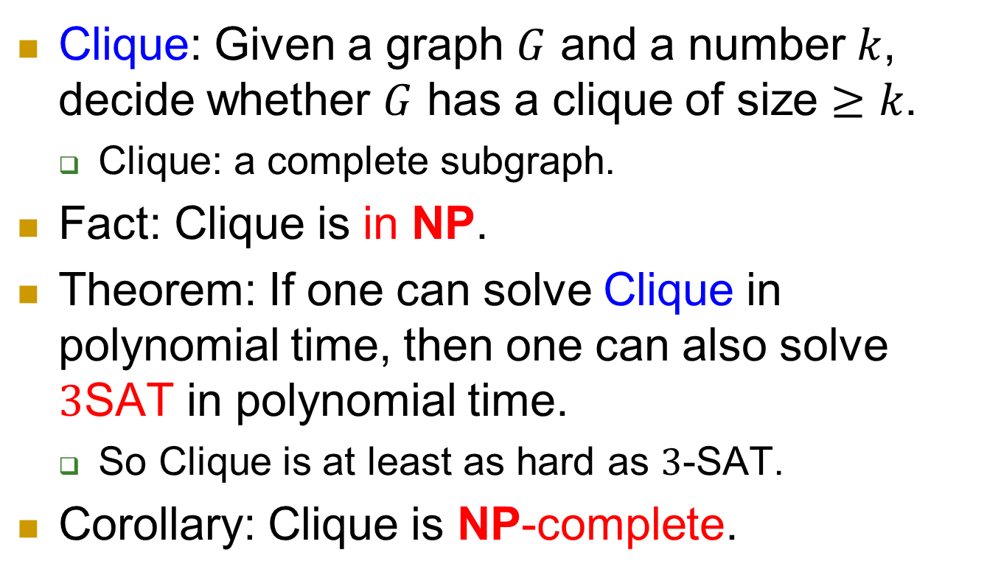
NP-complete problem 1: Clique
Clique: Given a graph $G$ and a number $k$, decide whether $G$ has a clique of size $≥k$.
  Clique: a complete subgraph.
Fact: Clique is in NP.
Theorem: If one can solve Clique in polynomial time, then one can also solve $3$SAT in polynomial time.
  So Clique is at least as hard as $3$-SAT.
Corollary: Clique is NP-complete.

Slide 21
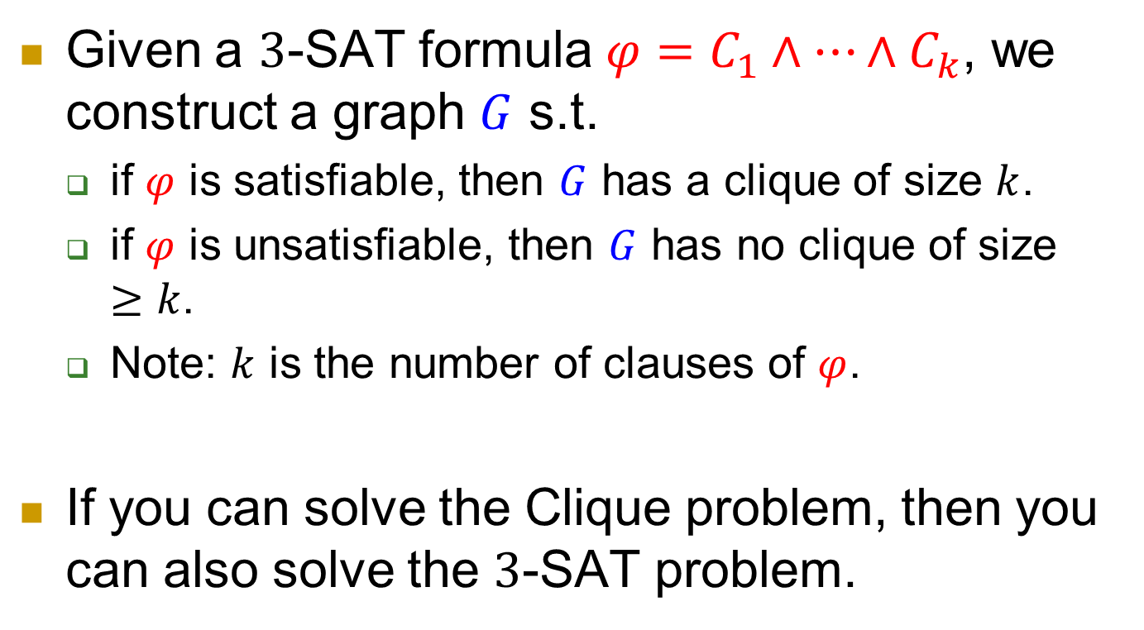
Approach: reduction
Given a $3$-SAT formula $φ=C_{1}∧…∧C_{k}$, we construct a graph $G$ s.t.
  if $φ$ is satisfiable, then $G$ has a clique of size $k$.
  if $φ$ is unsatisfiable, then $G$ has no clique of size $≥k$.
  Note: $k$ is the number of clauses of $φ$.
If you can solve the Clique problem, then you can also solve the $3$-SAT problem.

Slide 22





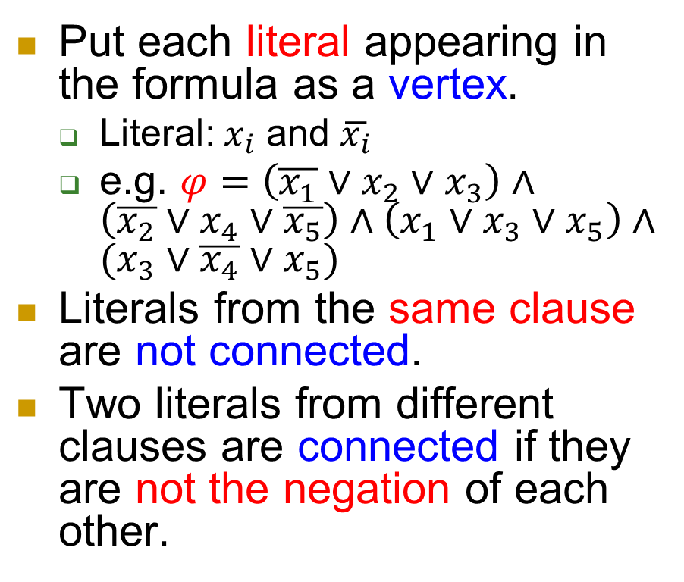







Construction
Put each literal appearing in the formula as a vertex.
  Literal: $x_{i}$ and $\overline{x_{i}}$
  e.g. $φ=\left(\overline{x_{1}}∨x_{2}∨x_{3}\right)∧\left(\overline{x_{2}}∨x_{4}∨\overline{x_{5}}\right)∧\left(x_{1}∨x_{3}∨x_{5}\right)∧(x_{3}∨\overline{x_{4}}∨x_{5})$
Literals from the same clause are not connected.
Two literals from different clauses are connected if they are not the negation of each other.
$$\overline{x_{1}}$$
$$\overline{x_{2}}$$
$$x_{2}$$
$$x_{4}$$
$$x_{3}$$
$$\overline{x_{5}}$$
$$x_{1}$$
$$x_{5}$$
$$x_{3}$$
$$\overline{x_{4}}$$
$$x_{5}$$
$$x_{3}$$

Slide 23
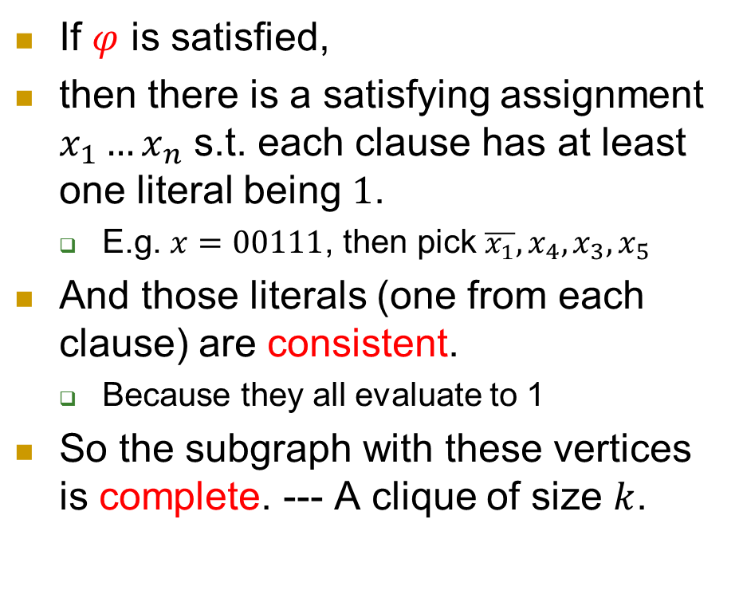

$φ$ is satisfied $⇒G$ has a $k$-clique
If $φ$ is satisfied,
then there is a satisfying assignment $x_{1}…x_{n}$ s.t. each clause has at least one literal being $1$.
  E.g. $x=00111$, then pick $\overline{x_{1}},x_{4},x_{3},x_{5}$
And those literals (one from each clause) are consistent.
  Because they all evaluate to 1
So the subgraph with these vertices is complete. --- A clique of size $k$.
$$\overline{x_{1}}$$
$$\overline{x_{2}}$$
$$x_{2}$$
$$x_{4}$$
$$x_{3}$$
$$\overline{x_{5}}$$
$$x_{1}$$
$$x_{5}$$
$$x_{3}$$
$$\overline{x_{4}}$$
$$x_{5}$$
$$x_{3}$$

Slide 24
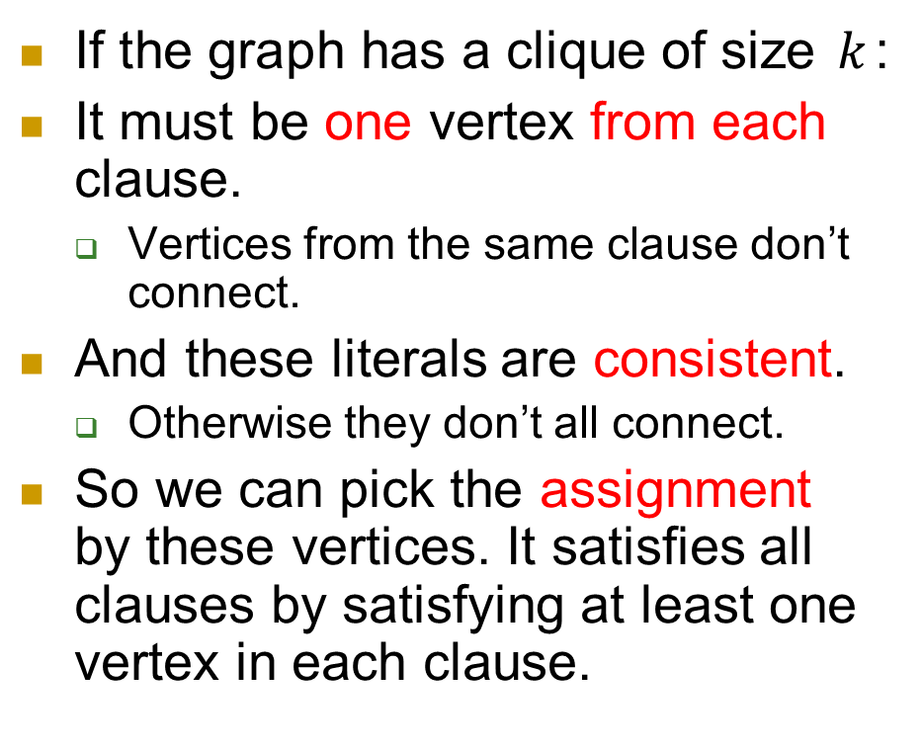
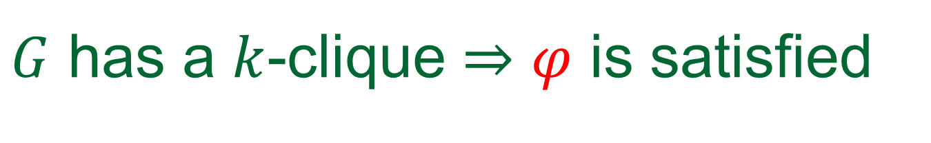
$G$ has a $k$-clique ⇒ $φ$ is satisfied
If the graph has a clique of size $k$:
It must be one vertex from each clause.
  Vertices from the same clause don’t connect.
And these literals are consistent.
  Otherwise they don’t all connect.
So we can pick the assignment by these vertices. It satisfies all clauses by satisfying at least one vertex in each clause.
$$\overline{x_{1}}$$
$$\overline{x_{2}}$$
$$x_{2}$$
$$x_{4}$$
$$x_{3}$$
$$\overline{x_{5}}$$
$$x_{1}$$
$$x_{5}$$
$$x_{3}$$
$$\overline{x_{4}}$$
$$x_{5}$$
$$x_{3}$$

Slide 25
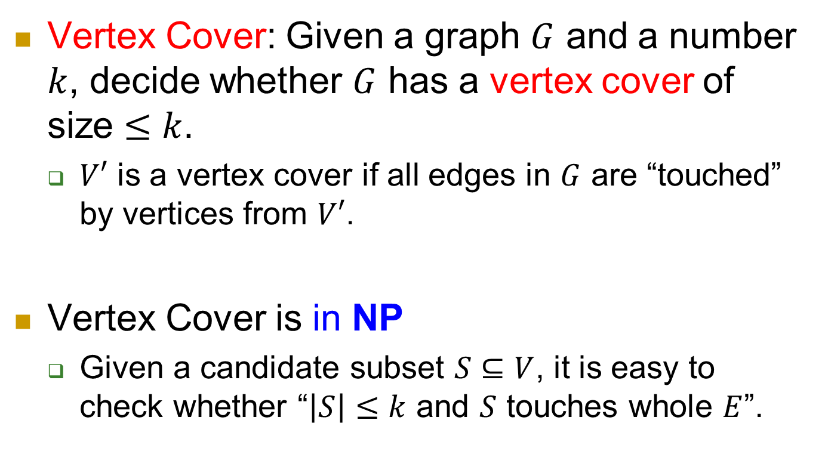
NP-complete problem 2: Vertex Cover
Vertex Cover: Given a graph $G$ and a number $k$, decide whether $G$ has a vertex cover of size $≤k$.
  $V′$ is a vertex cover if all edges in $G$ are “touched” by vertices from $V′$.
Vertex Cover is in NP
  Given a candidate subset $S⊆V$, it is easy to check whether “$\left|S\right|≤k$ and $S$ touches whole $E$”.

Slide 26
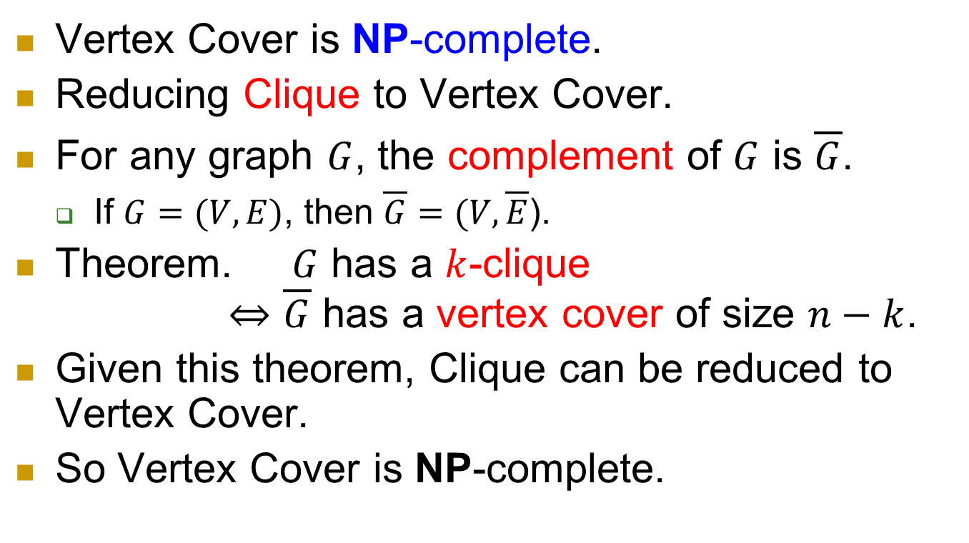
NP-complete
Vertex Cover is NP-complete.
Reducing Clique to Vertex Cover.
For any graph $G$, the complement of $G$ is $\overline{G}$.
  If $G=(V,E)$, then $\overline{G}=(V,\overline{E}$).
Theorem. $G$ has a $k$-clique
$⇔\overline{G}$ has a vertex cover of size $n−k$.
Given this theorem, Clique can be reduced to Vertex Cover.
So Vertex Cover is NP-complete.

Slide 27
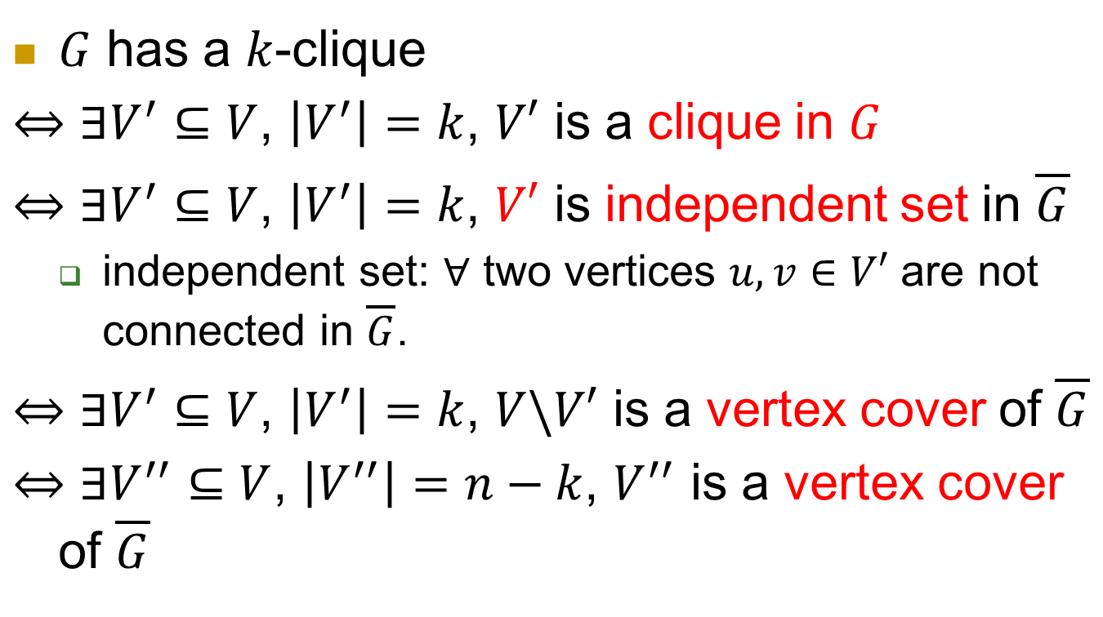
Proof of the theorem
$G$ has a $k$-clique
$⇔$ $∃V^{′}⊆V$, $\left|V^{′}\right|=k$, $V′$ is a clique in $G$
$⇔$ $∃V^{′}⊆V$, $\left|V^{′}\right|=k$, $V′$ is independent set in $\overline{G}$
  independent set: $∀$ two vertices $u, v∈V′$ are not connected in $\overline{G}$.
$⇔$ $∃V^{′}⊆V$, $\left|V^{′}\right|=k$, $V\backslash V′$ is a vertex cover of $\overline{G}$
$⇔$ $∃V^{′′}⊆V$, $\left|V^{′′}\right|=n−k$, $V^{′′}$ is a vertex cover of $\overline{G}$

Slide 28
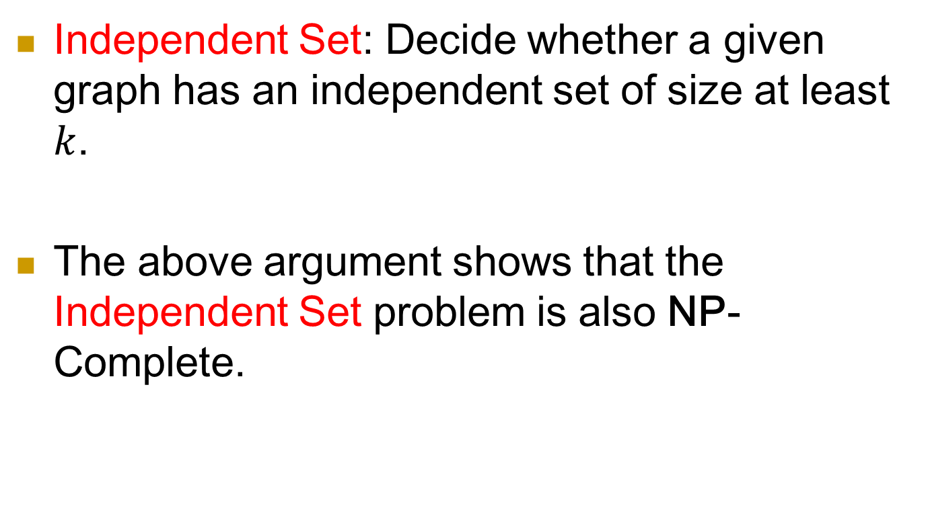
A related problem: Independent Set
Independent Set: Decide whether a given graph has an independent set of size at least $k$.
The above argument shows that the Independent Set problem is also NP-Complete.

Slide 29
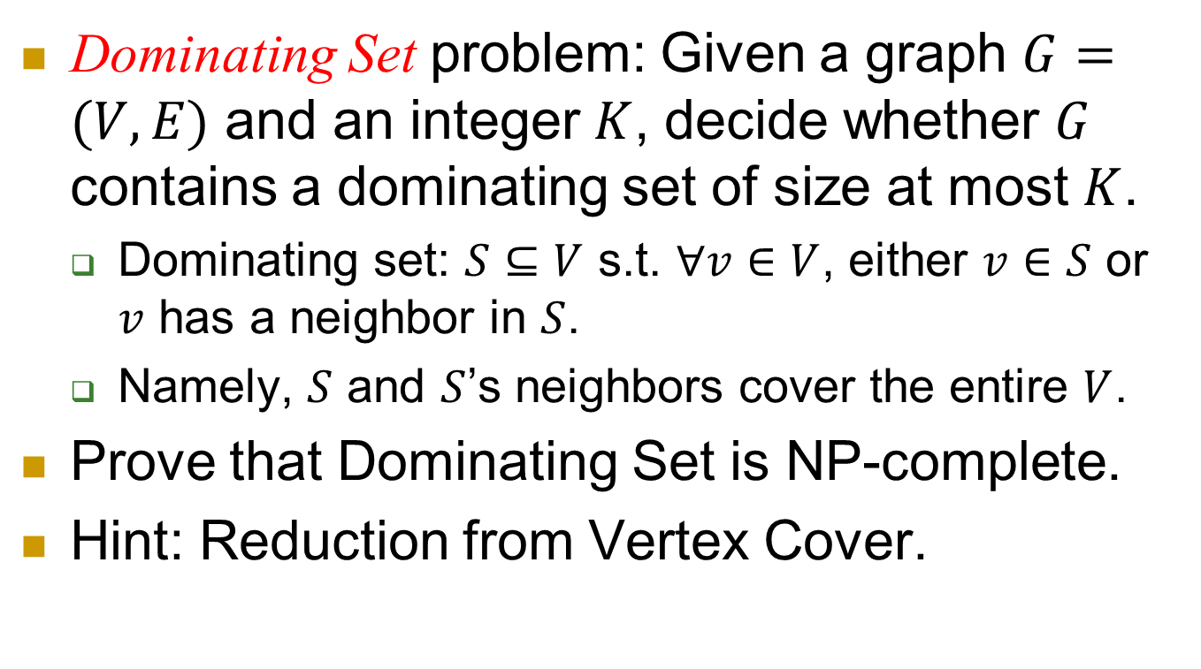
Exercise
Dominating Set problem: Given a graph $G=(V,E)$ and an integer $K$, decide whether $G$ contains a dominating set of size at most $K$.
  Dominating set: $S⊆V$ s.t. $∀v∈V$, either $v∈S$ or $v$ has a neighbor in $S$.
  Namely, $S$ and $S$’s neighbors cover the entire $V$.
Prove that Dominating Set is NP-complete.
Hint: Reduction from Vertex Cover.

Slide 30
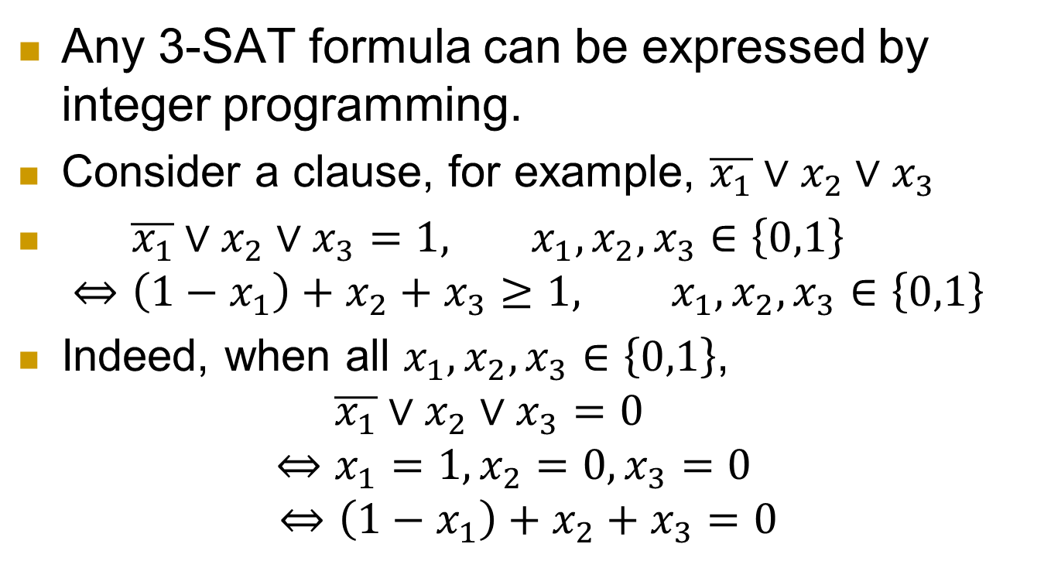
NP-complete problem 3: Integer Programming (IP)
Any 3-SAT formula can be expressed by integer programming.
Consider a clause, for example, $\overline{x_{1}}∨x_{2}∨x_{3}$
$\overline{x_{1}}∨x_{2}∨x_{3}=1, x_{1},x_{2},x_{3}∈\left\{0,1\right\}$
$⇔\left(1−x_{1}\right)+x_{2}+x_{3}≥1, x_{1},x_{2},x_{3}∈\left\{0,1\right\}$
Indeed, when all $x_{1},x_{2},x_{3}∈\left\{0,1\right\}$,
$\overline{x_{1}}∨x_{2}∨x_{3}=0$
$$⇔x_{1}=1,x_{2}=0,x_{3}=0$$
$$⇔\left(1−x_{1}\right)+x_{2}+x_{3}=0$$

Slide 31
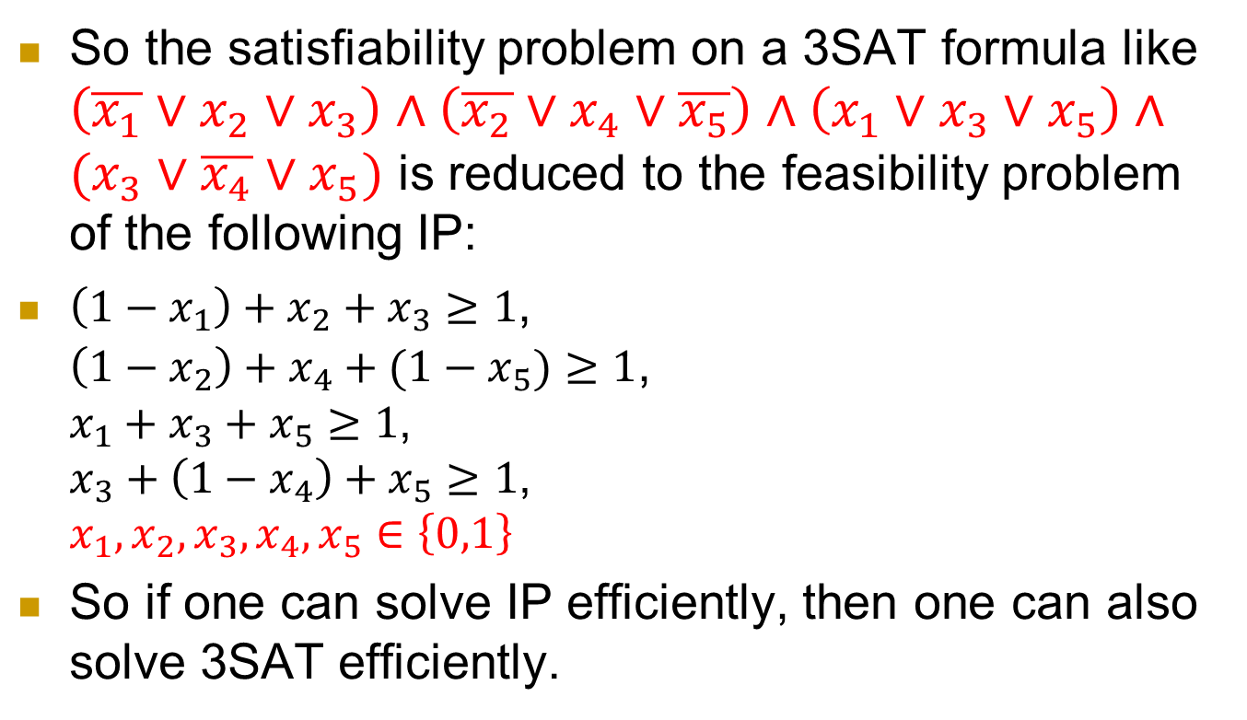
  So the satisfiability problem on a 3SAT formula like $\left(\overline{x_{1}}∨x_{2}∨x_{3}\right)∧\left(\overline{x_{2}}∨x_{4}∨\overline{x_{5}}\right)∧\left(x_{1}∨x_{3}∨x_{5}\right)∧(x_{3}∨\overline{x_{4}}∨x_{5})$ is reduced to the feasibility problem of the following IP:
  $\left(1−x_{1}\right)+x_{2}+x_{3}≥1$,
  $\left(1−x_{2}\right)+x_{4}+(1−x_{5})≥1$,
  $x_{1}+x_{3}+x_{5}≥1$,
  $x_{3}+\left(1−x_{4}\right)+x_{5}≥1$,
  $x_{1},x_{2},x_{3},x_{4},x_{5}∈\left\{0,1\right\}$
So if one can solve IP efficiently, then one can also solve 3SAT efficiently.

Slide 32
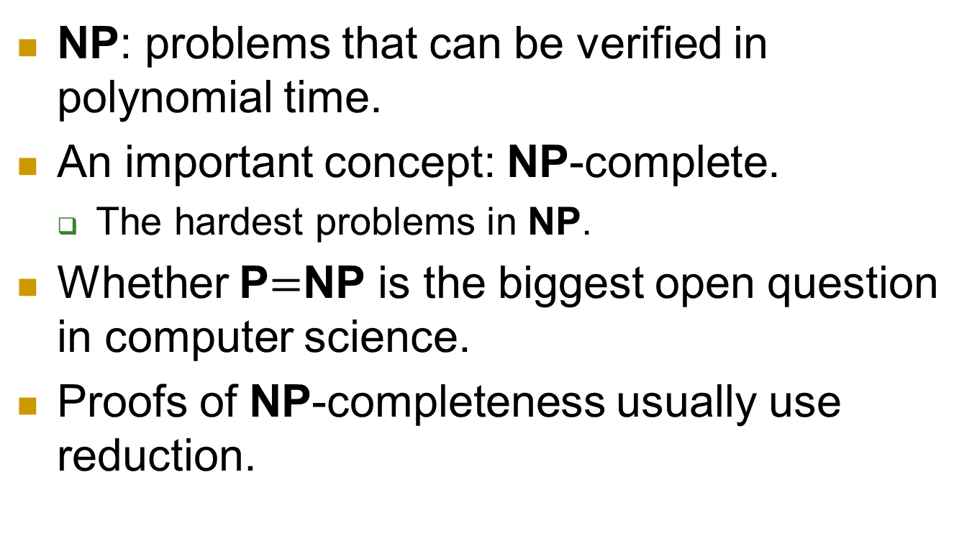
Summary
NP: problems that can be verified in polynomial time.
An important concept: NP-complete.
  The hardest problems in NP.
Whether P$=$NP is the biggest open question in computer science.
Proofs of NP-completeness usually use reduction.

Slide 33
Next
Next class: April 14th.
Make-up Class:
  To be decided.
Either class: Nothing about final exam.
Final: Open book and lecture notes.
  Again, no ipad/iphone/Internet…

