Slide 1
CSCI 3160
Design and Analysis of Algorithms
Tutorial 9
Chengyu Lin

Slide 2
Outline
Stable Matching
Secretary Problem

Slide 3
Stable Matching
Figures borrowed from Lecture Notes of CSCI2110

Slide 4
Perfect Matching in Bipartite Graph
Given a bipartite graph G(V, W, E) with |V| = |W|,
  Matching: a collection of vertex-disjoint edges
  Perfect matching: every vertex gets matched
Men
Women

Slide 5
Preference
Each man has a preference list of all women
Each woman has a preference list of all men
Assume there is no tie
Men Women
1: CBEAD A : 35214
2 : ABECD B : 52143
3 : DCBAE C : 43512
4 : ACDBE D : 12345
5 : ABDEC E : 23415

Slide 6
Blocking Pairs
A Blocking Pair is a pair of man and woman that prefer each other to their current partners.
Man 4 prefer Woman C to current partner Woman B
Woman C prefer Man 4 to current partner Man 1
Men Women
1: CBEAD A : 35214
2 : ABECD B : 52143
3 : DCBAE C : 43512
4 : ACDBE D : 12345
5 : ABDEC E : 23415

Slide 7
Stable Matching
Stable Matching: a matching without any blocking pair
Given a matching, you can verify whether it’s a stable matching in O(n²) time, but
  Dose stable matching always exist?
  How to find a stable matching?
Men Women
1: CBEAD A : 35214
2 : ABECD B : 52143
3 : DCBAE C : 43512
4 : ACDBE D : 12345
5 : ABDEC E : 23415

Slide 8
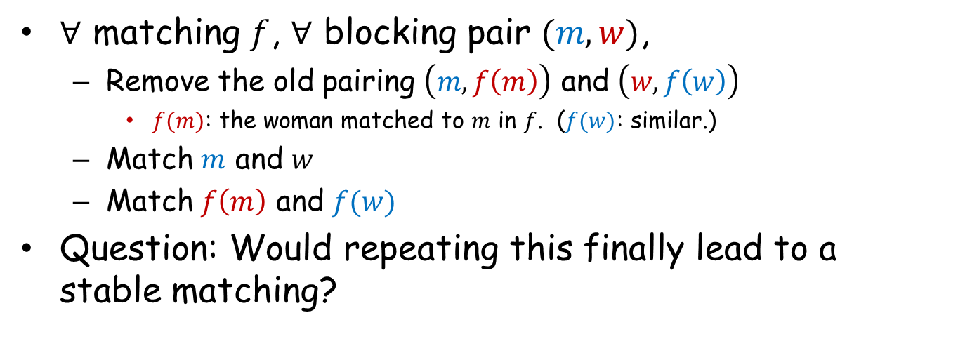
Consider a Simple Dynamics
$∀$ matching $f$, $∀$ blocking pair $(m,w)$,
  Remove the old pairing $\left(m,f\left(m\right)\right)$ and $\left(w,f\left(w\right)\right)$
    $f(m)$: the woman matched to $m$ in $f$. ($f(w)$: similar.)
  Match $m$ and $w$
  Match $f\left(m\right)$ and $f(w)$
Question: Would repeating this finally lead to a stable matching?
Men
Women
A:12
1:AB
B:12
2:AB

Slide 9
Counterexample with 2 Men and 2 Women?
Men
Women
A
1
B
2
Man A and Woman 1 have no incentive to breakup
Counterexample with 2 Men and 2 Women is IMPOSSIBLE !

Slide 10
Counterexample with 3 Men and 3 Women?
Men
Women
A:???
1:???
B:???
2:???
C:???
3:???

Slide 11
Counterexample (Step 1)
Men
Women
A:321
1:xxx
B:231
2:ABC
C:xxx
3:BAC

Slide 12
Counterexample (Step 2)
Men
Women
A:321
1:xxx
B:231
2:ABC
C:xxx
3:BAC

Slide 13
Counterexample (Step 3)
Men
Women
A:321
1:xxx
B:231
2:ABC
C:xxx
3:BAC

Slide 14
Counterexample (Step 4)
Men
Women
A:321
1:xxx
B:231
2:ABC
C:xxx
3:BAC

Slide 15
Counterexample (Back to Initial Matching)
Men
Women
A:321
1:xxx
B:231
2:ABC
C:xxx
3:BAC

Slide 16
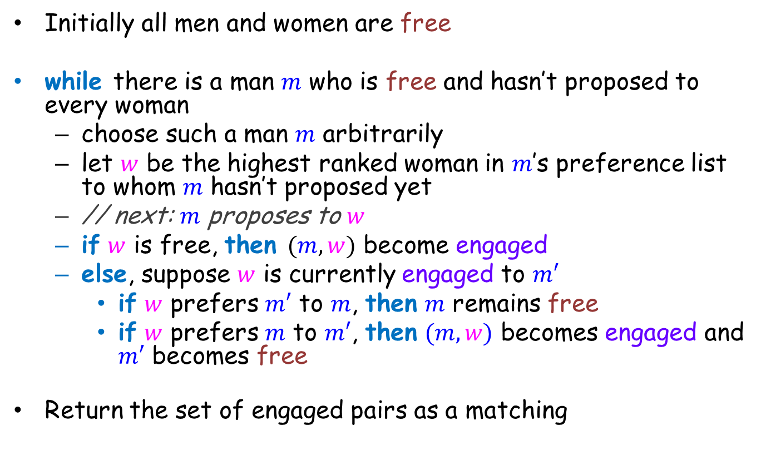
Gale-Shapley (Deferred-Acceptance) Algorithm
Initially all men and women are free
while there is a man $m$ who is free and hasn’t proposed to every woman
  choose such a man $m$ arbitrarily
  let $w$ be the highest ranked woman in $m$’s preference list to whom $m$ hasn’t proposed yet
  // next: $m$ proposes to $w$
  if $w$ is free, then $(m,w)$ become engaged
  else, suppose $w$ is currently engaged to $m′$
    if $w$ prefers $m′$ to $m$, then $m$ remains free
    if $w$ prefers $m$ to $m′$, then $(m,w)$ becomes engaged and $m′$ becomes free
Return the set of engaged pairs as a matching

Slide 17
Run By an Example (from lecture notes)
Men Women
1: ABCD A : 3124
2 : ABCD B : 3412
3 : BACD C : 1423
4 : CBDA D : 4132

Slide 18
Men Optimal & Women Pessimal Algorithm
All Men get the best partner simultaneously!
All Women get the worst partner simultaneously!
That is, among all possible stable matching,
men get the best possible partners simultaneously.
Can a woman do better by lying?
YES!

Slide 19
Women with True Preference
Men
Women
A:213
1:ABC
Done! Woman 2 gets her second best choice
B:123
2:BAC
C:231
3:CBA

Slide 20
Woman 2 Tells a Lie
Men
Women
A:213
1:ABC
Done! Woman 2 gets her best choice
B:123
2:BCA
BAC (true preference)
C:231
3:CBA

Slide 21


Secretary Problem
We have a single secretary position
There are n candidates
We will hold interviews and hire one of them

Slide 22
Assumptions
All candidates can be totally ordered without tie
The candidates arrive at a sequentially random order
We can only determine the relative ranks of the candidates (among all interviewed candidates)
We only aim at the best candidate, no one less will do
Irrevocable decision is made immediately after the interview
The value of n is known to us

Slide 23
The Strategy
Reject the first k candidates no matter how good they are
  Because there may be better ones later
After this, hire the first one who is better than all candidates interviewed so far
If all the rest n-k are worse than the best one among the first k, then hire the last one

Slide 24
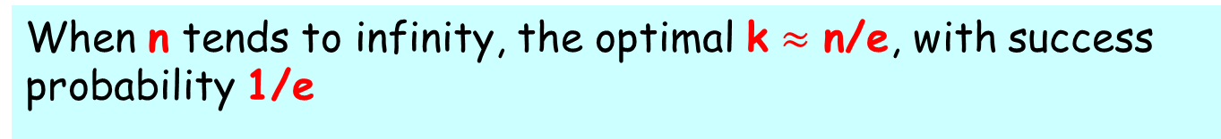
Optimal k
Our strategy is in the form of
“reject the first k and then choose the next best one”
We would like to maximize the probability of hiring the best candidate, i.e. choose an optimal k
When n tends to infinity, the optimal k $≈$ n/e, with success probability 1/e

Slide 25
Optimal Strategy (Optional)
Is an optimal strategy always in the form of
“reject the first k and then choose the next best one”?
The answer is YES !
Let’s try to prove it !
What is a strategy?
A stopping rule specifies whether to move on (interview) or to stop upon the arrival of a new candidate
The proof idea comes from math.stackexchange.com:
http://math.stackexchange.com/questions/45266/secretary-problem-why-is-the-optimal-solution-optimal

Slide 26
Prerequisite: Current Best Candidate
When the r-th candidate arrives, if he is not the best among candidates 1,…,r, obviously, an optimal strategy will never choose him
So, an optimal strategy must be in the following form
At each time r, if candidate r is the best one so far and [some additional conditions], choose him and stop.

Slide 27
[some additional conditions]
What are the additional conditions?
By the assumption, “[some additional conditions]” can only depend on the value of r and relative order of candidates 1 to r
We only care about whether we pick the best candidate or not, the only relevant factor of relative order is who is the best candidate so far
But we already know candidate r is the best one so far
So “[some additional conditions]” must be some predicate P(r) depends only on r

Slide 28
Properties of P(r)
If we pick the candidate r, the best one so far, then the success probability is the conditional probability
p(r-th one is global best | r-th one is local best) = r/n
which is just the probability that the global best one is among 1 to r (check it!)
r/n is an increasing function of r, which implies if P(r) is true then P(r+1) also should be true in an optimal strategy (be careful, we need some more discussions here)
Therefore, P(r) is monotone and in the following form
if r > k then true, else false

Slide 29
Conclusion
Combine together, an optimal strategy must be in the following form
At each time r, if candidate r is the best one so far and r > k, choose him and stop
It’s just the same as
“reject the first k and then choose the next best one”
To argue by dynamic programming, please see the following paper (if you are interested):
Lindley, D. V. 1961. Dynamic Programming and Decision Theory. Applied Statistics 10, 39-51.

Slide 30
Thank You!
Q & A ?

