Slide 1
CSCI 3160 Design and Analysis of Algorithms Tutorial 8
Chengyu Lin

Slide 2
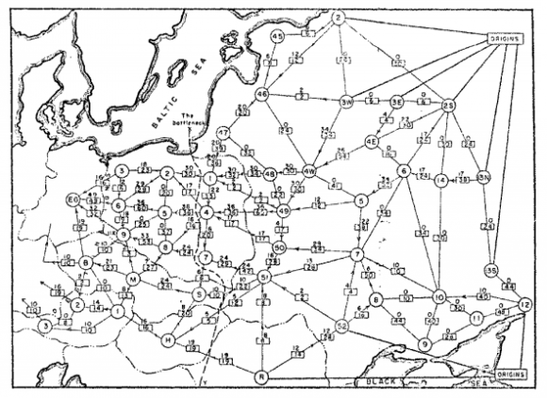
Maximum Network Flow
Maximize the flow from the source to the sink
Disclaimer: Most of the slides are taken from last year’s tutorial of this course.

Slide 3
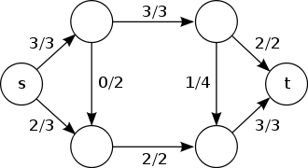
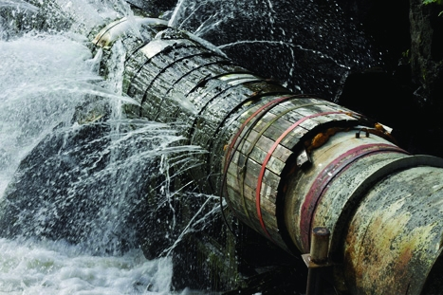
Network Flow
Capacity constraint
Flow value (nonnegative) on an edge (u,v) cannot exceed c(u,v)
Flow conservation
Incoming = Outgoing
No leakage
5/30
20/40
15/30

Slide 4
Residual Network
Residual network
Residual capacity
The amount of flow you can push or undo
20/20
0/40
40
20
s
20/30
t
s
20
10
t
20
0/40
20/40
40
20

Slide 5
Augmenting path
A path from source to sink in the residual network
Different ways of finding augmenting path yield different performances
Method |  | Complexity
Ford-Fulkerson | DFS | O(|E| max|f|)
Edmonds-Karp | BFS | O(|V||E|²)

Slide 6
How slow can Ford-Fulkerson be?
0/9999
0/9999
s
0/1
t
0/9999
0/9999

Slide 7
How slow can Ford-Fulkerson be?
*These are residual networks
9999
9999
9998
9999
s
1
t
s
1
t
1
1
9999
9999
9999
9998
9998
9999
9998
9998
1
s
1
t
s
1
t
1
1
1
1
1
9999
9998
9998
9998

Slide 8
How slow can Ford-Fulkerson be?
*These are residual networks
9998
9998
9997
9998
1
1
s
1
t
s
2
1
t
1
1
1
1
2
9998
9998
9998
9997
9997
9998
9997
9997
1
2
s
2
1
t
s
2
t
1
1
2
2
2
9998
9997
9997
9997

Slide 9
What about Edmonds-Karp?
0/9999
0/9999
s
0/1
t
0/9999
0/9999

Slide 10
What about Edmonds-Karp?
*These are residual networks
9999
9999
9999
9999
s
1
t
s
1
t
9999
9999
9999
9999
9999
9999
9999
9999
s
1
t
s
1
t
9999
9999
9999
9998

Slide 11
Applications
What if there are multiple sources and multiple sinks?
Goal: maximize the flow from sources to sinks
s₁
s₂
s₃
s₄
t₁
t₂
t₃
t₄

Slide 12
Multi-source Multi-sink max flow
Add a super source and a super sink
s
0/∞
0/∞
0/∞
0/∞
s₁
s₂
s₃
s₄
t₁
t₂
t₃
t₄
0/∞
0/∞
0/∞
0/∞
t

Slide 13
Applications
What if capacity constraint also applies to node?
0/40
0/30
0/40
20/40

Slide 14
Node Splitting
Split the node into two
0/40
0/30
0/40
20/40

Slide 15
Applications
Given an undirected graph.
What is the maximum number of edge disjoint paths from one node to another?
Two paths are edge disjoint if they do not share any edges

Slide 16
All pairs edge disjoint paths
Split each edge into two edges with different directions
Set the capacity of each edge to be 1
Find the maximum of max flow between every pair of nodes
0/1
0/1
0/1
0/1
1/1
1/1
1/1
0/1
0/1
0/1
0/1
1/1
0/1
1/1
1/1
1/1
0/1
0/1
1/1
0/1

Slide 17
All pairs edge disjoint paths
Can you solve the all pairs edge disjoint path problem without using max flow algorithm?
0/1
0/1
0/1
0/1
1/1
1/1
1/1
0/1
0/1
0/1
0/1
1/1
0/1
1/1
1/1
1/1
0/1
0/1
1/1
0/1

Slide 18
Edge disjoint paths
By max-flow min-cut theorem
Find the min-cut instead
Karger’s Algorithm: the randomized min-cut algorithm seen in week 4

Slide 19
Max-flow min-cut theorem
Max-flow min-cut theorem
The maximum value of an s-t flow is equal to the minimum capacity of an s-t cut.
Strong duality theorem
optimal primal value = optimal dual value
This also proves the max-flow min-cut theorem

Slide 20
Max-flow min-cut theorem
Max-flow = min-cut = 7
Given a max-flow, how do you find the cut set?
4/4
3/4
s
1/3
t
3/3
4/5

Slide 21
End
Questions?

