Slide 1
CSCI 3160
Design and Analysis of Algorithms
Tutorial 6
Fei Chen

Slide 2
Outline
Linear Programming
  Standard form
  Problem modeling
  Algorithm
Duality
Application

Slide 3
Linear Programming
Constraint Optimization
  Linear constraints
  Linear objective function
Example
max
x₁ + 2x₂ + 3x₃
subject to
80x₁ + 60x₂ ≤ 7173
75x₂ + 50x₃ ≤ 2131
80x₃ ≤ 9366
x₁+x₂+x₃ ≤ 200
x₁ , x₂ , x₃ ≥ 0

Slide 4
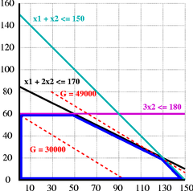
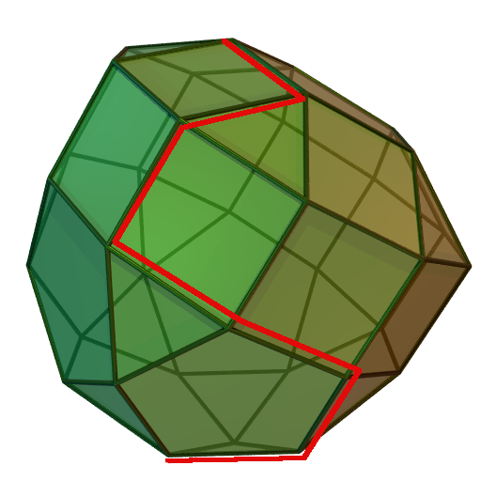
Linear Programming
In LP, the feasible region is a convex polytope bounded by many half planes (constraints)
By linearity, the optimal solution must locate at the extreme points
  There are finite number of points to try

Slide 5
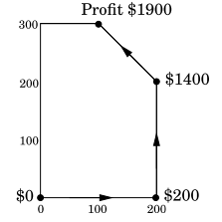
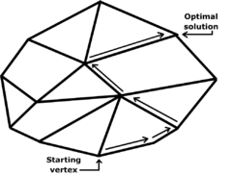
Simplex method
Start from any vertex of the polytope
look for a better neighbor and move to it.
Until the current vertex is better than all of its neighbors
For LP local optimal ⇔ global optimal
  because the feasible region is convex

Slide 6



Example
Want to build the strongest army for the 3160 Empires.
Resources we have: 9366 wood, 7173 food, 2131 gold
Soldiers we can produce:
How to maximize the power of our army?
80 food
Power: 1
60 food
75 gold
Power: 2
80 wood
50 gold
Power: 3
Notes:
6

Slide 7
Linear Program
Variables:
  x₁ units
  x₂ units
  x₃ units
Constraints
  Food supply is 7173
  Wood supply is 9366
  Gold supply is 2131
  Max population is 200
Objective
  Maximize the power of the army
80 food
Power: 1
60 food
75 gold
Power: 2
80 wood
50 gold
Power: 3
max
x₁ + 2x₂ + 3x₃
subject to
80x₁ + 60x₂ ≤ 7173
75x₂ + 50x₃ ≤ 2131
80x₃ ≤ 9366
x₁+x₂+x₃ ≤ 200
x₁ , x₂ , x₃ ≥ 0
Notes:
7

Slide 8
Standard form
max
c^{T}x
subject to
Ax ≤ b
c₁x₁ + … + c_{n}x_{n}
x ≥ 0
a₁₁ x₁ + … + a_{1n}x_{n} ≤ b₁
a₂₁ x₁ + … + a_{2n}x_{n} ≤ b₂
…
a_{m1} x₁ + … + a_{mn}x_{n} ≤ b_{m}
x₁, x₂, …, x_{n} ≥ 0

Slide 9
Converting into standard form
Constraints
  a₁₁ x₁ + … + a_{1n}x_{n} ≥ b₁
  is equivalent to
  -a₁₁ x₁ - … - a_{1n}x_{n} ≤ -b₁
  a₁₁ x₁ + … + a_{1n}x_{n} = b₁
  is equivalent to
  -a₁₁ x₁ - … - a_{1n}x_{n} ≤ -b₁ and a₁₁ x₁ + … + a_{1n}x_{n} ≤ b₁

Slide 10
Converting into standard form
Constraints
  x free (free variables)
  is equivalent to
  x = x⁺ - x⁻ and x⁺, x⁻ ≥ 0

Slide 11
Converting into standard form
Objective function
  min z
  is equivalent to
  max -z

Slide 12
Objective function
Non-linear objective function
  Can sometimes be converted into linear objective function with extra linear constraints
  e.g. max min_{i} x_{i}
  is equivalent to
max
z
subject to
x_{i} ≥ z

Slide 13
Objective function
Non-linear objective function
  Can sometimes be converted into linear objective function with extra linear constraints
  e.g. max c|x_{i} – x_{j}|
  is equivalent to
max
cy - cz
subject to
x_{i} – x_{j} = y - z
y, z ≥ 0

Slide 14
Duality
Primal Program
Dual Program
max
c^{T}x
min
b^{T}y
subject to
Ax ≤ b
subject to
A^{T}y ≥ c
x ≥ 0
y ≥ 0
Primal Program
Dual Program
max
c^{T}x
min
b^{T}y
subject to
Ax = b
subject to
A^{T}y ≥ c
x ≥ 0
y is free
The dual of a dual program is the primal program!

Slide 15
Example
Primal Program
Dual Program
max
40x₁ + 20x₂ + 2x₃
min
50y₁ + 10y₂ + 2y₃
subject to
3x₁ - 3x₂ + 5x₃ ≤ 50
subject to
3y₁ + y₂ + y₃ ≥ 40
x₁ + x₃ ≤ 10
-3y₁ - y₃ ≥ 20
x₁ - x₂ + 4x₃ ≤ 2
5y₁ + y₂ + 4y₃ = 2
x₁ , x₂ ≥ 0, x₃ is free
y₁ , y₂, y₃ ≥ 0

Slide 16
Duality
Weak duality theorem
  The primal gives lower bounds for the dual
  The dual gives upper bounds for the primal
Let x and y be feasible solutions of the primal and dual respectively, then c^{T}x ≤ b^{T}y.

Slide 17
Duality
Strong duality theorem
  optimal primal value = optimal dual value
  If both exist, then they are equal
  If one is infinity, then the other is infeasible

Slide 18
Application of duality theorem
Max-flow min-cut theorem
  A special case of duality theorem
  you will see this in the future!

Slide 19
End
Questions?

