Slide 1
CSCI 3160
Design and Analysis of Algorithms
Tutorial 12
Chengyu Lin

Slide 2
Outline
Online Algorithm
Competitive Analysis
Primal-Dual Method

Slide 3
Online vs. Offline
Each round part of the input is revealed
Make irrevocable decision each round
Example: Secretary Problem

Slide 4
Applications
Real-world problems (secretary problem)
Streaming Algorithm (memory limited computation, big data)
Online Machine Learning

Slide 5
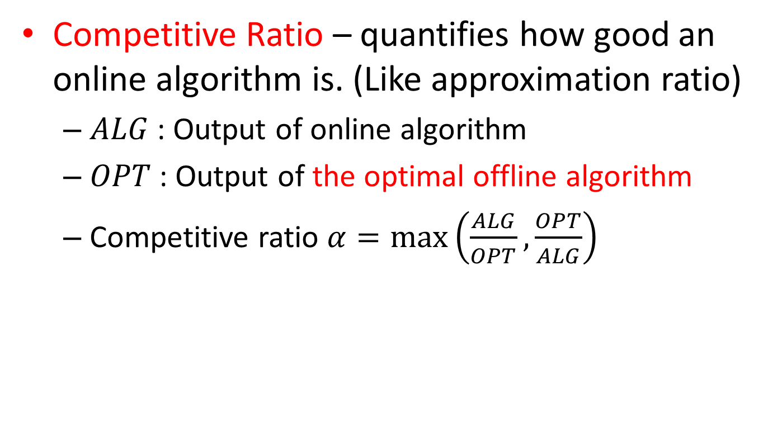
Competitive Analysis
Competitive Ratio – quantifies how good an online algorithm is. (Like approximation ratio)
  $ALG$ : Output of online algorithm
  $OPT$ : Output of the optimal offline algorithm
  Competitive ratio $α=max\left(\frac{ALG}{OPT},\frac{OPT}{ALG}\right)$

Slide 6
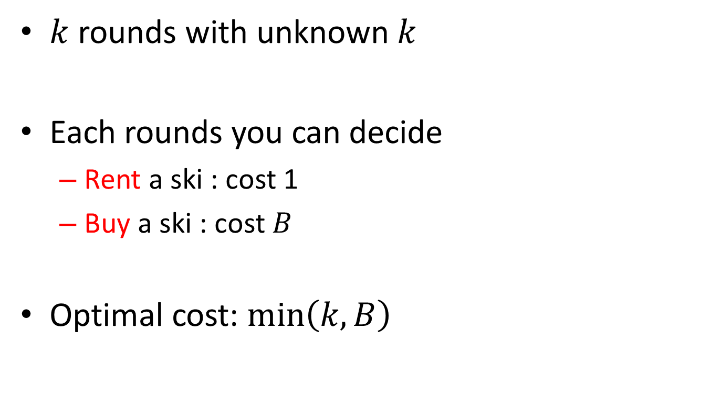
Ski rental problem
$k$ rounds with unknown $k$
Each rounds you can decide
  Rent a ski : cost 1
  Buy a ski : cost $B$
Optimal cost: $min\left(k, B\right)$

Slide 7

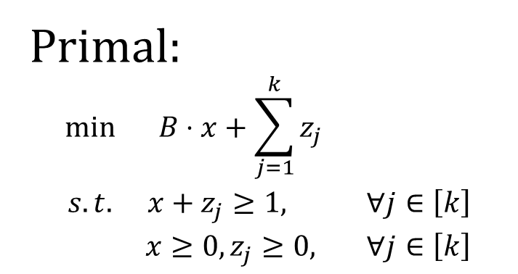
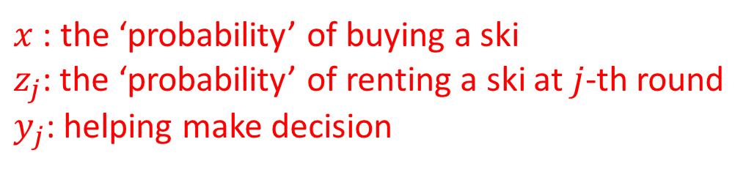
Primal-Dual Method
Primal:
$$\begin{matrix}min & B⋅x+\sum_{j=1}^{k}{z_{j}} & \\ s.t. & x+z_{j}≥1, & ∀j∈\left[k\right] \\ & x≥0,z_{j}≥0, & ∀j∈\left[k\right]\end{matrix}$$
Dual:
$$\begin{matrix}max & \sum_{j=1}^{k}{y_{j}} & \\ s.t. & \sum_{j=1}^{k}{y_{j}}≤B & ∀j \\ & y_{j}∈[0,1] & ∀j\end{matrix}$$
$x$ : the ‘probability’ of buying a ski
$z_{j}$: the ‘probability’ of renting a ski at $j$-th round
$y_{j}$: helping make decision

Slide 8
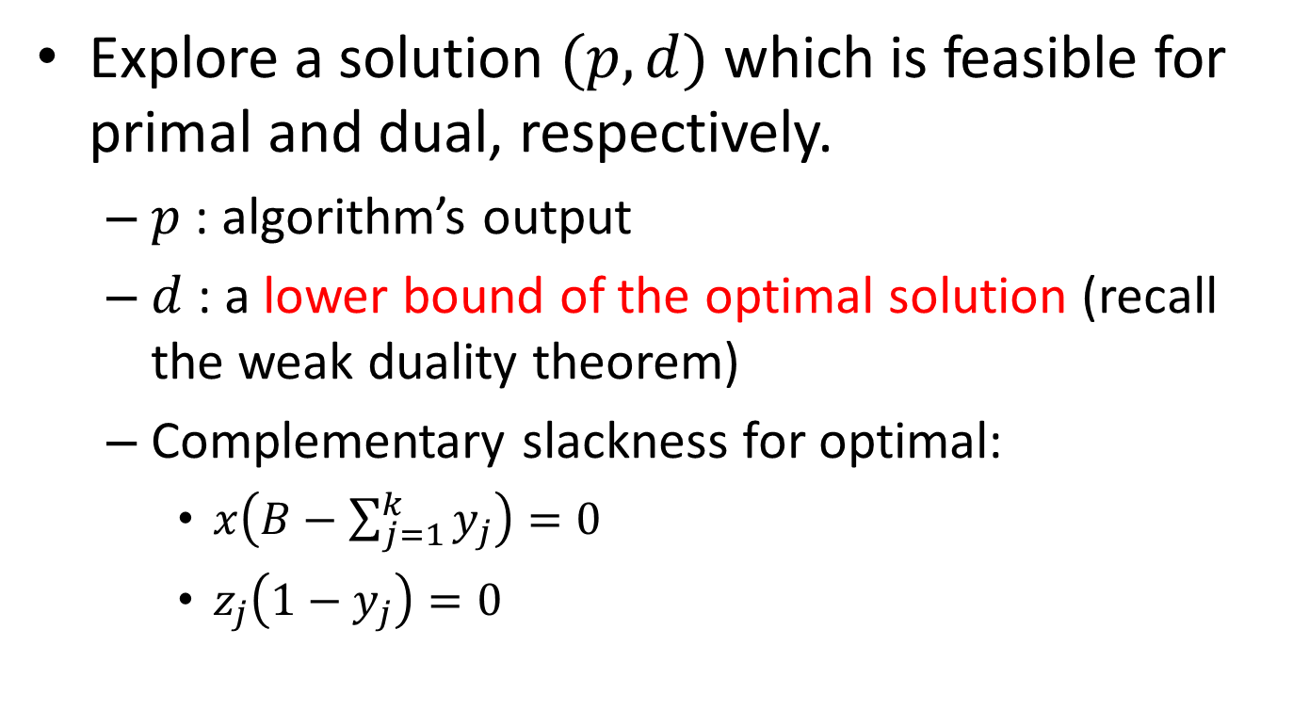
Primal-Dual Method
Explore a solution $(p,d)$ which is feasible for primal and dual, respectively.
  $p$ : algorithm’s output
  $d$ : a lower bound of the optimal solution (recall the weak duality theorem)
  Complementary slackness for optimal:
    $x\left(B−\sum_{j=1}^{k}{y_{j}}\right)=0$
    $z_{j}\left(1−y_{j}\right)=0$

Slide 9
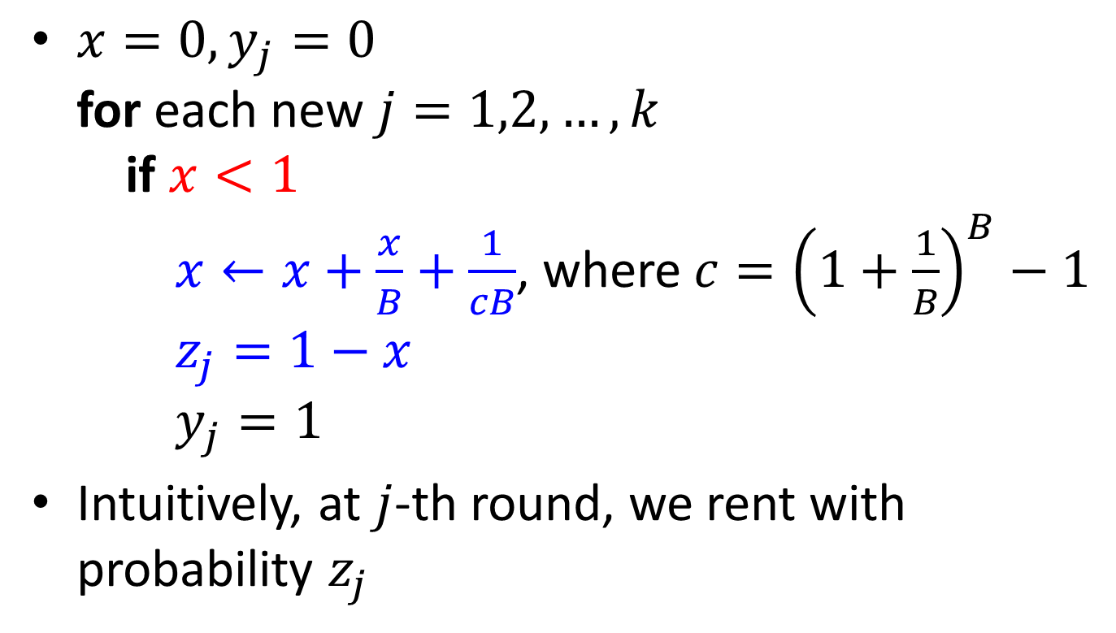
Primal-Dual Algorithm
$x=0, y_{j}=0$
for each new $j=1,2,…,k$
if $x<1$
$x←x+\frac{x}{B}+\frac{1}{cB}$, where $c={\left(1+\frac{1}{B}\right)}^{B}−1$
$z_{j}=1−x$
$y_{j}=1$
Intuitively, at $j$-th round, we rent with probability $z_{j}$

Slide 10
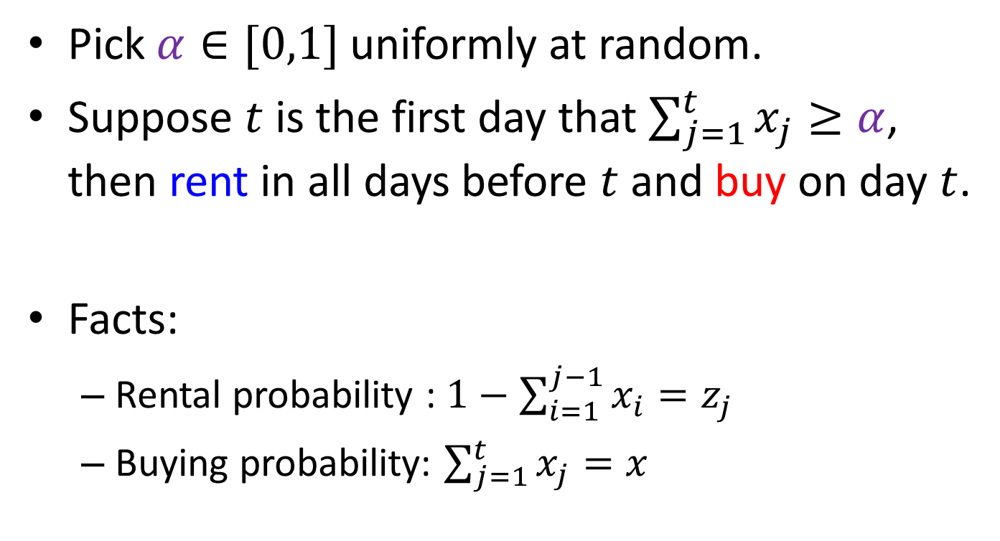
Primal-Dual Algorithm
Pick $α∈[0,1]$ uniformly at random.
Suppose $t$ is the first day that $\sum_{j=1}^{t}{x_{j}}≥α$, then rent in all days before $t$ and buy on day $t$.
Facts:
  Rental probability : $1−\sum_{i=1}^{j−1}{x_{i}}=z_{j}$
  Buying probability: $\sum_{j=1}^{t}{x_{j}}=x$

Slide 11
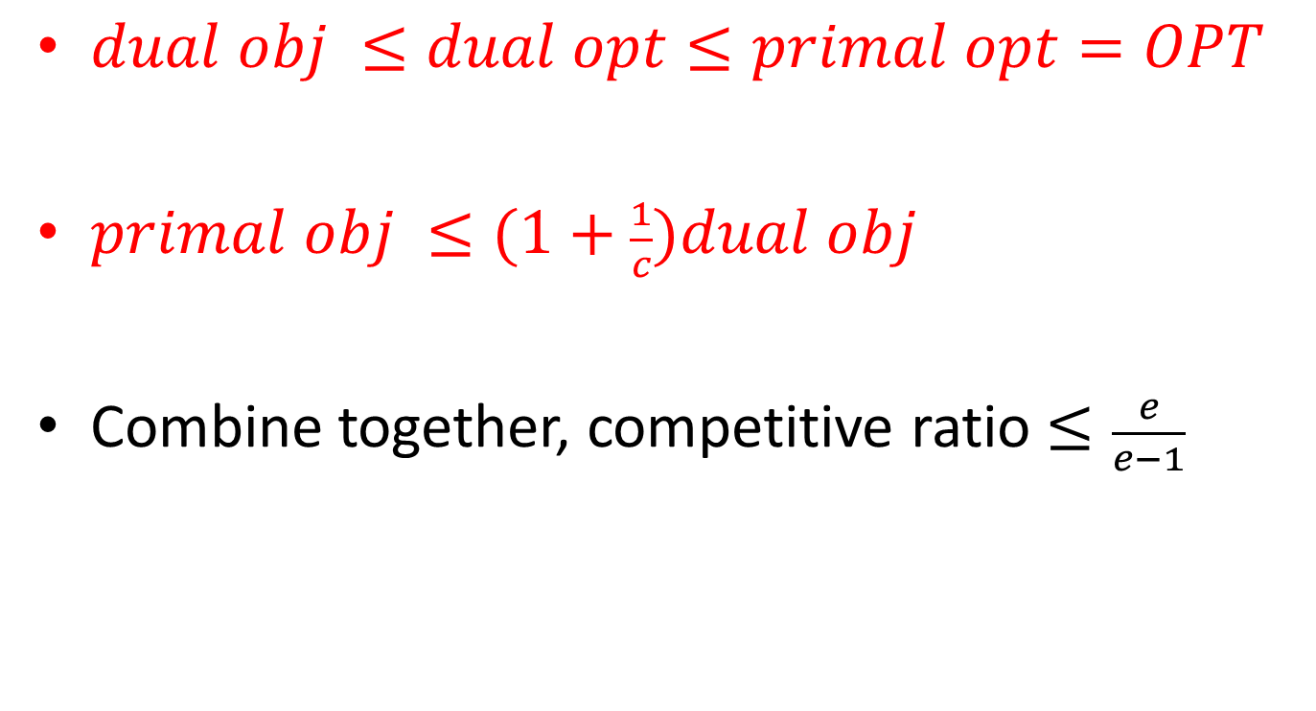
Competitive ratio
$dual obj ≤dual opt≤primal opt=OPT$
$primal obj ≤(1+\frac{1}{c})dual obj$
Combine together, competitive ratio $≤\frac{e}{e−1}$

Slide 12
End
Questions?

