Slide 1
CSCI 3160 Design and Analysis of Algorithms Tutorial 1
Chengyu Lin

Slide 2
About me
Name: Chengyu Lin
Email: cylin@cse.cuhk.edu.hk
Office: SHB 117
Office hour: Friday 14:00 – 16:00
You can always send me emails to make appointments

Slide 3
Asymptotic Notations
O(g(n))
Big O
Asymptotic upper bound
Ω(g(n))
Big Omega
Asymptotic lower bound
Θ(g(n))
Big Theta
Asymptotic tight bound

Slide 4
Asymptotic Notations
The time (space) complexity of an algorithm usually depends on the input size, where the input could be
vertices/edges of a graph
a sequence of integers
Usually the running time of algorithm grows with the input size
Usually the running time is written as a function t(n), where n is the input size

Slide 5
Asymptotic Notations
Suppose we want to analyze the running time of a program, e.g.
This takes t(n) = n(n+1)/2 · n(n+1)/2 = n²(n+1)²/4 steps.
Calculating the exact running time is tedious.
for (int i = 1; i <= n; ++i) {
for (int j = i; j <= n; ++j) {
for (int r = 1; r <= n; ++r) {
for (int s = r; s <= n; ++s) {
puts(“hello”);
}
}
} }

Slide 6
Asymptotic Notations
Asymptotic notation simplifies the calculations
This takes t(n) = O(n²) · O(n²) = O(n⁴) steps.
and yet it still captures the behavior of t(n) very well when the n is “large” enough
for (int i = 1; i <= n; ++i) {
for (int j = i; j <= n; ++j) {
for (int r = 1; r <= n; ++r) {
for (int s = r; s <= n; ++s) {
puts(“hello”);
}
}
} }

Slide 7
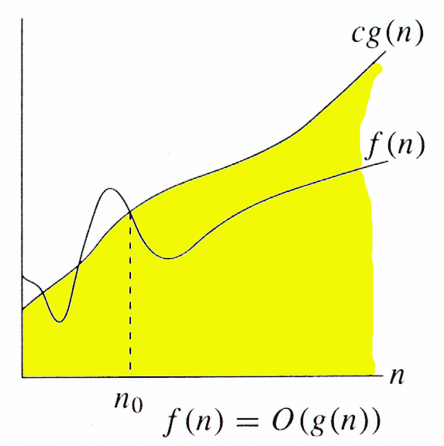
Big O notation
We say that
t(n) = O(g(n)) if
there exists a constant c > 0 such that
t(n) ≤ c · g(n) for every sufficiently large n
Intuitively, if t(n) is the running time, it tells us
the running time cannot be worse than g(n) by a constant multiplicative factor
Usually, g(n) looks simpler than t(n) (e.g. g(n) = n², n!, log n, …)

Slide 8
Big O notation
We say that t(n) = O(g(n)) if
there exists a constant c > 0 such that
t(n) ≤ c · g(n) for every sufficiently large n
The inequality only needs to hold for large n
e.g. n² = O(2^{n})
3n² ≤ 2^{n} is not true when n = 3
It holds for every n ≥ 4, so it’s okay

Slide 9
Big O notation
We say that
t(n) = O(g(n)) if
there exists a constant c > 0 such that
t(n) ≤ c · g(n) for every sufficiently large n
We can multiply g(n) by a positive constant
e.g. 4n² = O(n²)
4n² ≤ n² is not true for any n
But 4n² ≤ 4n² holds, so it’s okay

Slide 10
Big O notation
We say that
t(n) = O(g(n)) if
there exists a constant c > 0 such that
t(n) ≤ c · g(n) for every sufficiently large n
g(n) can be any upper bound
e.g. n² = O(n²)
It is also true to say n² = O(n¹⁰⁰) or n² = O(2^{n})

Slide 11
Convention
Actually, O(g(n)) is a set
O(g(n)) = {t | ∃c > 0 such that t(n) ≤ c · g(n) for every large n}
it contains all the functions that are upper bounded by g(n)
When we say t(n) = O(g(n))
Actually we mean t(n) ∈ O(g(n))
When we say O(f(n)) = O(g(n))
Actually we mean O(f(n)) ⊆ O(g(n))
meaning if t(n) = O(f(n)) then t(n) = O(g(n))

Slide 12
Comparing functions
|←exp→|
tower
O(1) , …, log* n, … loglog n, … log n, log² n, …
… n^{1/3} n^{1/2} n n² n³ … … 2^{n} 2^{n^2} … 2^{2^n} … 2^2^…^2
|← polynomial →|
double exp
…
The functions above increases from left to right asymptotically
i.e. O(1) < O(loglog n) < O(log n) < log² n = (log n)² < O(n^{1/3}) < O(n) < O(n²) < O(2^{n}) < O(n!) < O(n^{n})
Logarithm is a lot smaller than polynomial
e.g. 2^{k log n} = n^{k}
Polynomial is a lot smaller than exponential
e.g. log 2^{n} = n

Slide 13
Comparing functions
|←exp→|
tower
O(1) , …, log* n, … loglog n, … log n, log² n, …
… n^{1/3} n^{1/2} n n² n³ … … 2^{n} 2^{n^2} … 2^{2^n} … 2^2^…^2
|← polynomial →|
double exp
…
The functions above increases from left to right asymptotically
When we compare two functions asymptotically, compare the dominating terms on both sides first
If they are of the same order, compare the next dominating terms, and so on…
e.g. O(2^{n} n² log n) < O(2.1^{n} n³ log² n), since 2^{n} < 2.1^{n}
the rest contributes very little when n is large

Slide 14
Examples
1 = O(log n)?
n³ = O(n²)?
log¹⁰⁰⁰n = O(n)?
n³ = O(1.001n)?
1.002^{n} = O(1.001^{n} n²)?
O((log n)¹⁹⁹⁹⁾ = O(n^{0.001})?
O(loglog n) = O(log³ n)?
O(2^{n} n⁴ log n) = O(2^{n} n⁴ log⁴ n)?
Yes
No
Yes
No
No
Yes (see slide 12)
Yes
Yes

Slide 15
Properties
O(f(n)) + O(g(n)) = O(f(n) + g(n))
O(max(f(n), g(n))) = O(f(n) + g(n))
t(n) = O(n²) + O(n) = O(n² + n) (by property 1)
t(n) = O(n² + n) = O(n²) (by property 2)
for (int i = 1; i <= n; ++i) {
for (int j = i; j <= n; ++j) {
puts(“CSCI3160);
} }
for (int i = 1; i <= n; ++i) {
puts(“CSCI3160”);
}

Slide 16
Properties
O(f(n)) × O(g(n)) = O(f(n) × g(n))
e.g.
O(n) × O(n) × O(n) = O(n³) (by property 3)
for (int i = 1; i <= n; ++i) {
for (int j = i; j <= n; ++j) {
for (int k = j; k <= n; ++k) {
puts(“hello”);
}
} }

Slide 17
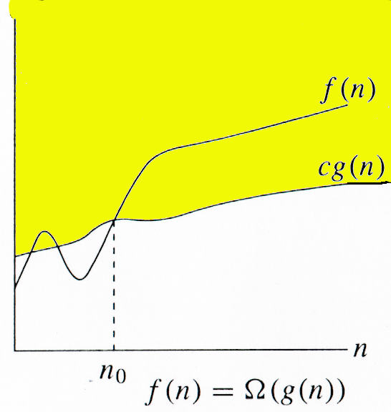
Big Omega notation
We say that
t(n) = Ω(g(n)) if
there exists a constant c > 0 such that
t(n) ≥ c · g(n) for every sufficiently large n
Intuitively, if t(n) is the running time, it tells us
the running time cannot be better than g(n) by a constant multiplicative factor
e.g. All comparison sort algorithms run in Ω(n log n) time
Again, g(n) usually looks simple

Slide 18
Big Omega notation
We say that
t(n) = Ω(g(n)) if
there exists a constant c > 0 such that
t(n) ≥ c · g(n) for every sufficiently large n
The inequality only needs to hold for large n
e.g. 2^{n} = Ω(n²)
2^{n} ≥ n² is not true when n = 3
It holds for every n ≥ 4, so it’s okay

Slide 19
Big Omega notation
We say that
t(n) = Ω(g(n)) if
there exists a constant c > 0 such that
t(n) ≥ c · g(n) for every sufficiently large n
We can multiply g(n) by a positive constant
e.g. 0.1 n² = Ω(n²)
0.1n² ≥ n² is not true for any n
But 0.1n² ≥ 0.1n² holds, so it’s okay

Slide 20
Big Omega notation
We say that
t(n) = Ω(g(n)) if
there exists a constant c > 0 such that
t(n) ≥ c · g(n) for every sufficiently large n
g(n) can be any lower bound
e.g. n² = Ω(n²)
It is also true to say n² = Ω(n) or n² = Ω(log n)

Slide 21
Properties
Ω(f(n)) + Ω(g(n)) = Ω(f(n) + g(n))
Ω(max(f(n), g(n))) = Ω(f(n) + g(n))
Ω(f(n)) × Ω(g(n)) = Ω(f(n) × g(n))

Slide 22
Examples
1 = Ω(log n)? No
n³ = Ω(n²)? Yes
log¹⁰⁰⁰n = Ω(n)? No
n³ = Ω(1.001n)? Yes
1.002^{n} = Ω(1.001^{n} n²)? Yes
1 = O(log n)? Yes
n³ = O(n²)? No
log¹⁰⁰⁰n = O(n)? Yes
n³ = O(1.001n)? No
1.002^{n} = O(1.001^{n} n²)? No
If t(n) = O(g(n)) then t(n) ≠ Ω(g(n))?
If t(n) = Ω(g(n)) then t(n) ≠ O(g(n))?
No!
e.g. n³ = O(n³) = Ω(n³)

Slide 23
Big Theta notation
Big O gives an asymptotical upper bound to t(n)
Big Omega gives an asymptotical lower bound to t(n)
There could be a gap between both bounds
The upper and lower bounds could be very loose
e.g. n² = O(2^{n}), n² = Ω(1)
When the upper bound matches the lower bound, we say this bound is tight (asymptotically)

Slide 24
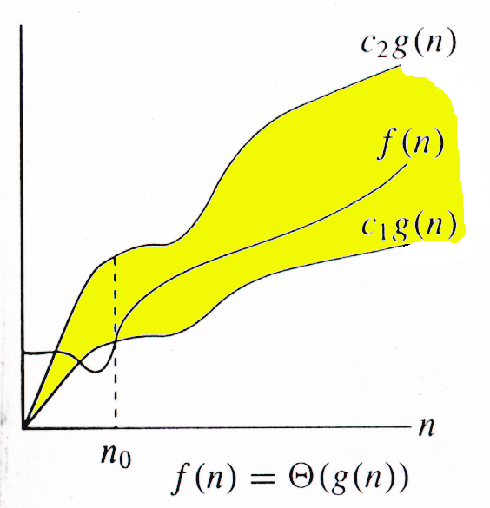
Big Theta notation
We say that
t(n) = Θ(g(n)) if
t(n) = O(g(n)) and t(n) = Ω(g(n))
Combining the definitions of O(g(n)) and Ω(g(n)),
t(n) = Θ(g(n)) if
there exists a constant c₁, c₂ > 0 such that
c₁ · g(n) ≤ t(n) ≤ c₂ · g(n) for every sufficiently large n
Intuitively, if t(n) is the running time, it tells us
the running time grows at about the same rate as g(n)

Slide 25
Examples
t(n) = n³ - 4n² + log n + 1
t(n) = O(n³)
t(n) = Ω(n³)
t(n) = Θ(n³)

Slide 26
Examples
1 = Ω(log n)? No
n³ = Ω(n²)? Yes
log¹⁰⁰⁰n = Ω(n)? No
n³ = Ω(1.001n)? Yes
1.002^{n} = Ω(1.001^{n} n²)? Yes
1 = O(log n)? Yes
n³ = O(n²)? No
log¹⁰⁰⁰n = O(n)? Yes
n³ = O(1.001n)? No
1.002^{n} = O(1.001^{n} n²)? No
If t(n) = O(g(n)) then t(n) ≠ Ω(g(n))?
If t(n) = Ω(g(n)) then t(n) ≠ O(g(n))?
No!
e.g. n³ = O(n³) = Ω(n³)

Slide 27
Properties
But we have
t(n) = O(g(n)) if and only if g(n) = Ω(t(n))
For Big Theta, we have
t(n) = Θ(g(n)) if and only if g(n) = Θ(t(n))
Θ(f(n)) + Θ(g(n)) = Θ(f(n) + g(n))
Θ(max(f(n), g(n))) = Θ(f(n) + g(n))
Θ(f(n)) × Θ(g(n)) = Θ(f(n) × g(n))

Slide 28
Examples
Θ((log n)¹⁹⁹⁹) = Θ(n^{0.001})?
Θ(loglog n) = Θ(log³ n)?
Θ(2^{n} + n⁴ + log n) = Θ(2^{n} + n⁴ + log⁴ n)?
No
No
Yes
Θ(2^{n} + n⁴ + log n) = Θ(max{2^{n}, n⁴, log n}) = Θ(2^{n})
Similarly, Θ(2^{n} + n⁴ + log⁴ n) = Θ(2^{n})
t(n) = Θ(g(n)) if and only if g(n) = Θ(t(n))
So Θ(2^{n} + n⁴ + log n) = Θ(2^{n}) = Θ(2^{n} + n⁴ + log⁴ n)

Slide 29
Asymptotic Notations
O(g(n)), big O
Ω(g(n)), big Omega
Θ(g(n)), big theta
In this course, we will use Big O notation a lot
It is important to get familiar with it
There are two other asymptotic notations
o(g(n)) (small o)
ω(g(n)) (small omega)

Slide 30
End
Questions

