Slide 1
Erasure Coding for Small Objects in In-Memory Key-Value Storage
Matt M. T. Yiu, Helen H. W. Chan, Patrick P. C. Lee
The Chinese University of Hong Kong
SYSTOR 2017

Slide 2
Introduction
In-memory key-value (KV) stores are widely deployed for scalable, low-latency access
Examples: Memcached, Redis, VoltDB, RAMCloud
Failures are prevalent in distributed storage systems
Replication in DRAM?
High storage overheads
Replication in secondary storage (e.g., HDDs)?
High latency to replicas (especially for random I/Os)
Erasure coding
Minimum data redundancy
Redundant information is stored entirely in memory for low-latency accesses → fast recovery under stragglers and failures
Notes:
Memory-centric storage systems have been proposed to keep primary data in memory to enable scalable, low-latency data access
Such systems are often deployed as in-memory key-value stores, which organize data in memory as key-value pairs (called objects) to form structured storage
In-memory storage is even more susceptible to data loss due to the volatile nature of memory
Two standard approaches
Replication: Redis, RAMCloud
Erasure coding
Erasure coding works by transforming data into fixed-size encoded chunks, such that the original data can be reconstructed from a subset of encoded chunks
Achieve higher fault tolerance while incurring lower redundancy

Slide 3
Erasure Coding
Divide data to k data chunks
Encode data chunks to additional n-k parity chunks
Each collection of n data/parity chunks is called a stripe
Distribute each stripe to n different nodes
Many stripes are stored in large-scale systems
Fault tolerance: any k out of n nodes can recover file data
Redundancy: $\frac{n}{k}$

Slide 4
Challenges
Erasure coding is expensive in data updates and failure recovery
Many solutions in the literature
Real-life in-memory storage workloads are dominated by small-size objects
Keys and values can be as small as few bytes (e.g., 2-3 bytes of values) [Atikoglu, Sigmetrics’12]
Erasure coding is often used for large objects
In-memory KV stores issue decentralized requests without centralized metadata lookup
Need to maintain data consistency when failures happen
Notes:
To achieve low-latency data access, in-memory KV stores issue decentralized requests without centralized metadata lookups
When failures happen, ongoing requests may need to be reverted or replayed to avoid inconsistency
In erasure coding, we also need to maintain consistency across encoded chunks that are dependent on each other
Non-trivial task

Slide 5
Our Contributions
Build MemEC, a high-availability, erasure-coding-based in-memory KV store that aims for
Low-latency access
Fast recovery (under stragglers/failures)
Storage-efficient
Propose a new all-encoding data model
Ensure graceful transitions between normal mode and degraded mode
Evaluate MemEC prototype with YCSB workloads
Notes:
All-encoding data model encodes objects in entirety, including keys, values, and metadata, so as to highly suppress storage redundancy for fault tolerance

Slide 6
Existing Data Models
All-replication
Store multiple replicas for each object in memory
Used by many KV stores (e.g., Redis)
Node #1
Node #2
Node #i
Key
Value
Metadata
Reference
Key
Value
Metadata
Reference
Key
Value
Metadata
Reference
...
Notes:
Most key-value stores directly store replicas in memory → high storage cost
RAMCloud reduces memory footprints by storing replicas in secondary storage
RAMCloud incurs expensive I/Os when there are intensive random reads to failed objects

Slide 7
Existing Data Models
Hybrid-encoding
Assumption: Value size is sufficiently large
Erasure coding to values only
Replication for key, metadata, and reference to the object
Used by LH*RS [TODS‘05], Cocytus [FAST‘16]
Node #1
Node #2
Node #k
Node #(k+1)
Node #n
Erasure coding
Value
Value
Value
Parity
Parity
Key
Metadata
Reference
Key
Metadata
Reference
Key
Metadata
Reference
Key
Metadata
Reference
Key
Metadata
Reference
...
...
Replication
Notes:
Hybrid-encoding combines erasure coding and replication
Introduce two parameters n and k: Values are stored in k data chunks (the servers storing the data chunks are called data servers); the parity or coded information is stored in (n – k) parity chunks (the servers storing the parity chunks are called parity servers) – n servers are needed in total
The n chunks are collectively called “a stripe”
The major drawback of hybrid-encoding is that if the value size is significantly small, it still incurs significant storage overhead due to the replication of keys and metadata

Slide 8
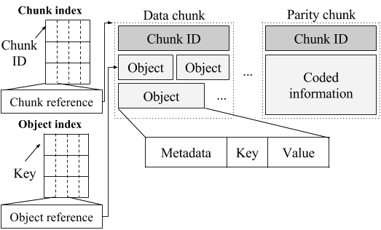
Our data model: All-encoding
Apply erasure coding to objects in entirety
Design specific index structures to limit storage
Notes:
Two main features…

Slide 9
All-encoding: Data Organization
Divide storage into fixed-size chunks (4 KB) as units of erasure coding
A unique fixed-size chunk ID (8 bytes) for chunk identification in a server
Notes:
A larger chunk size provides better storage efficiency by mitigating the storage overhead due to indexing, yet it also incurs higher computational overhead in encoding/decoding
Our current implementation chooses 4 KB as the chunk size to balance the trade-off

Slide 10
All-encoding: Data Organization
Each data chunk contains multiple objects
Each object starts with fixed-size metadata, followed by variable-size key and value

Slide 11
All-encoding: Data Organization
Append new objects to a data chunk until the chunk size limit is reached, and seal the data chunk
Sealed data chunks are encoded to form parity chunks belonging to same stripe

Slide 12
All-encoding: Data Organization
Chunk index maps a chunk ID to a chunk reference
Object index maps a key to an object reference
Use cuckoo hashing
No need to keep redundancy for both indexes in memory
Key-to-chunk mappings are needed for failure recovery, but can be stored in secondary storage
Notes:
When a server fails, we can reconstruct the failed chunks from other working servers by erasure coding, and rebuild both indexes by reinserting the references of the reconstructed objects and chunks into the object and chunk indexes, respectively

Slide 13
All-encoding: Chunk ID
Main Memory
Chunk ID has three fields:
Stripe list ID: identifying the set of n data and parity servers for the stripe
Determined by hashing a key
Stripe ID: identifying the stripe
Each server increments a local counter when a data chunk is sealed
Chunk position: from 0 to n – 1
Chunks of the same stripe has the same stripe list ID and same stripe ID
Chunk ID
O₁
O₂
O₃
8 bytes + 4 KB
O₄
O₅
O₆
Chunk ID
O₁
O₂
O₃
8 bytes + 4 KB
O₄
O₅
O₆
Chunk ID
O₁
O₂
O₃
8 bytes + 4 KB
O₄
O₅
O₆
...
Notes:
To support updates and recovery, we need to locate the data and parity chunks of the same stripe
We leverage the chunk ID for this purpose
To form a stripe ID, each server maintains a local counter (initialized to be zero) for each stripe list
Each time when a chunk is sealed, the data server sets the stripe ID as the current counter value and increments the counter value by one
Each parity server encodes the data chunks of the same stripe ID into a parity chunk (which is also associated with the same stripe list ID and same stripe ID)
We use the chunk ID and both object and chunk indexes to locate an object to be updated
To update an object, we locate the object in the data server via the object index, and then obtain the corresponding chunk ID that is stored at the head of the chunk
Using the chunk ID, we identify each corresponding parity server, in which we can locate the parity chunk of the same stripe via the chunk index

Slide 14
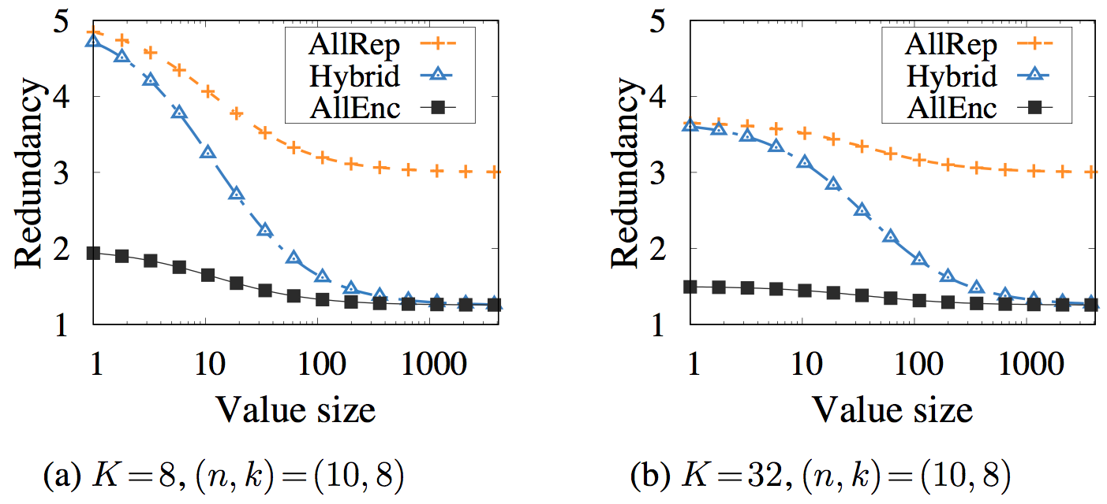
Analysis
All-encoding achieves much lower redundancy
Notes:
M: 1-byte key size and 3-byte value size
R: Pointer size for a 64-bit system
I: Size of chunk ID
O: Space utilization achieved by 4-way set-associative cuckoo hashing

Slide 15
MemEC Architecture
Client
Object
Coordinator
Coordinator on I/O path
only in degraded mode
SET / GET / UPDATE / DELETE
Unified memory
Proxy
...
Client
Server
...
Server
Proxy
Server
Notes:
MemEC realizes four basic requests of practical KV stores
We focus on normal mode first

Slide 16
MemEC SET
Coordinator
Data Server
Request:
Key
Value
Proxy
SET request
Key
Value
Data Server
Data Server
Parallel
Data Server
Parity Server
Parity Server
Notes:
A proxy sends the object to these servers in parallel, each of which returns an acknowledgement upon receiving the object
The data server appends the object to a data chunk that is not yet full, while each parity server keeps the object in a temporary buffer as a replica
The data server also adds the object’s reference to its own object index
When the data chunk is full, it is sealed, and the data server sends the keys of the objects in the sealed data chunk to all parity servers
Upon receiving the keys, each parity server rebuilds the data chunk from the objects in its temporary buffer, computes the data delta and updates its parity chunk, and finally discards the objects from its temporary buffer

Slide 17
MemEC GET
Data Server
Proxy
GET request
Key
Request:
Key
Data Server
Data Server
Data Server
Parity Server
Parity Server
Notes:
A proxy uses the key to determine the data server that stores the object, and requests the data server for the object’s value

Slide 18
MemEC UPDATE/DELETE
UPDATE request:
Key
Modified range
Modified data
DELETE request:
Key
Data Server
Proxy
UPDATE_CHUNK request
Chunk identifier
Data delta
Data Server
Data Server
Parallel
Data Server
Parity Server
Parity Server

Slide 19
Fault Tolerance
In normal mode, requests are decentralized
Coordinator is not on I/O path
When a server fails, proxies move from decentralized requests to degraded requests managed by coordinator
Ensure data consistency by reverting any inconsistent changes or replaying incomplete requests
Coordinator redirects degraded requests from a failed server to another working server
Requests that do not involve the failed server remain decentralized
Rationale: normal mode is common case; coordinator is only involved in degraded mode
Notes:
Our goal is to ensure…
In particular, …
To this end, …

Slide 20
Server States
Coordinator maintains a state for each server and instructs all proxies how to communicate with a server
Intermediate
Server failed
Inconsistency resolved
Normal
Degraded
Migration completed
Coordinated Normal
Server restored

Slide 21
Server States
All proxies and working servers share the same view of server states
Two-phase protocol:
When coordinator detects a server failure, it notifies all proxies to finish all decentralized requests (intermediate state)
Each proxy notifies coordinator when finished
Coordinator notifies all proxies to issues degraded requests via coordinator (degraded state)
Implemented via atomic broadcast

Slide 22
Evaluation
Testbed under commodity settings:
16 servers
4 proxies
1 coordinator
1 Gbps Ethernet
YCSB benchmarking (4 instances, 64 threads each)
Key size: 24 bytes
Value size: 8 bytes and 32 bytes (large values also considered)
Do not consider range queries

Slide 23
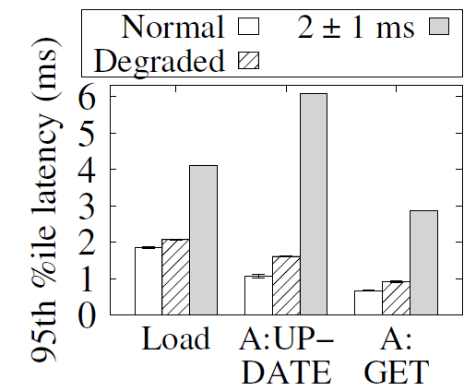
Impact of Transient Failures
Failures occur before load phase:
Latency of SET in load phase increases by 11.5% with degraded request handing
For Workload A, latencies of UPDATE and GET increase by 53.3% and 38.2%, resp.
Notes:
We evaluate the degraded requests of MemEC in the presence of transient failures.
We only consider a single-server failure, while the results are similar for a double-server failure.
Before writes: A transient failure happens before MemEC stores any data. All SET, GET, and UPDATE requests are degraded
With degraded request handling disabled, the latencies are much higher – more than 3 times of the latencies over normal mode

Slide 24
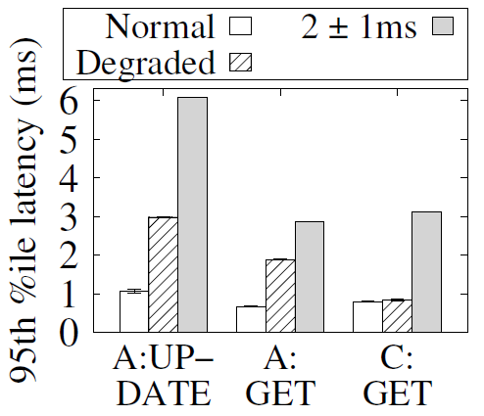
Impact of Transient Failures
Failures occur after load phase:
Latencies of GET and UPDATE increase by 180.3% and 177.5%, resp.
Latency of GET in Workload C only increase by 6.69%
Notes:
After writes: We run the load phase and trigger a transient failure
The latencies of degraded GET in Workloads A and C are different
If a redirected server receives an UPDATE before GET, it reconstructs all failed chunks of the same stripe before modifying the chunks in order to ensure consistency
The following GET requests to the failed data chunks are blocked until the reconstructed chunks are available on the redirected server

Slide 25
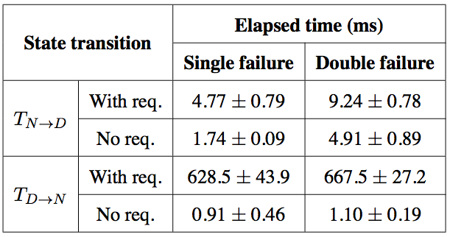
State Transition Overhead
Difference between two elapsed times is mainly caused by reverting parity updates of incomplete requests
Elapsed time includes data migration from the redirected server to the restored server, so increases a lot
Average elapsed times of state transitions with 95% confidence

Slide 26
Conclusion
A case of applying erasure coding to build a high-available in-memory KV store: MemEC
Enable fast recovery by keeping redundancy entirely in memory
Two key designs:
Support of small objects
Graceful transition between decentralized requests in normal mode and coordinated degraded requests in degraded mode
Prototype and experiments
Source code: https://github.com/mtyiu/memec

