Slide 1
Enabling Low-Redundancy Proactive Fault Tolerance for Stream Machine Learning via Erasure Coding
Zhinan Cheng¹, Lu Tang¹, Qun Huang², and Patrick P. C. Lee¹
¹The Chinese University of Hong Kong (CUHK)
²Peking University
Notes:
Hi, I am Zhinan Cheng from The Chinese University of Hong Kong.
I am going to present the work “Enabling Low-Redundancy Proactive
Fault Tolerance for Stream Machine Learning via Erasure Coding”.
This is a joint work with Lu Tang, Patrick Lee from CUHK and Qun
Huang from Peking University.

Slide 2
Stream Machine Learning
Stream machine learning
Use of machine learning for continuous streams of data items
Special case of stream processing
Critical for online advertising and real-time recommendation
Large-scale deployment of stream machine learning
Distributed stream processing systems (DSPS)
Across different operators that are executed by multiple workers
Notes:
Stream machine learning refers to the use of machine learning, for example
model training and prediction, for continuous streams of data items,
and can be viewed as a special use case of stream processing.
The demands for stream machine learning are significant in various domains,
such as online advertising and real-time recommendation.
To handle massive amounts of data, large-scale stream machine learning should be
deployed in a distributed manner as in current distributed stream processing systems,
in which data streams are processed in parallel across different operators
that are executed by multiple workers

Slide 3
Fault Tolerance
Fault tolerance is critical for stream machine learning
Failures are prevalent in distributed environments
Workers unexpectedly crash and lose all states
Unique aspects of fault tolerance of stream processing
Infeasible to track and replay all dependent items for failure recovery
Main memory supports fast processing but is vulnerable to data loss
Fast failure recovery for real-time responses
Notes:
Failures are prevalent in distributed environments, as any worker unexpectedly stops
working and its operators lose all their states (for example, model parameters) and the items
being processed. Thus, fault tolerance is a critical requirement for stream machine learning.
Providing fault tolerance for stream machine learning, or stream processing in general,
must deal with the following unique aspects:
First, the system needs to process numerous items that arrive as a continuous data stream,
It is infeasible to track and replay all dependent items for failure recovery.
Second, operators often keep states in main memory for fast processing,
but main memory is volatile and subject to data loss in failures;
Finally, fast failure recovery is critical for real-time responses.

Slide 4
Fault Tolerance
Existing approaches for fault tolerance in DSPS
Reactive fault tolerance
Triggers failure recovery upon the detection of failures
Issues periodic backups for both states and items to persistent storage
Restores the latest backup and replays items in new workers
Significant disk I/O, disturbing normal performance
Non-zero recovery latency
Proactive replication
Issues multiple replicas of each item to different workers for concurrent execution
Prohibitively expensive
Notes:
Most current stream processing systems supporting stream machine learning
adopt reactive fault tolerance, by triggering failure recovery upon the detection of failures
A common approach is to periodically issue backups for both states and items to persistent storage.
If a worker fails, a new worker can restore the latest backup state of any operator of the failed worker
and replay the items since the latest backup state. However, issuing backups too frequently not only
incurs significant disk I/O that disturbs normal performance, but also incurs a non-zero recovery latency
for retrieving backups from external storage.
Some stream processing systems adopt replication, which provides proactive fault tolerance
by issuing multiple replicas of each item to different workers for concurrent execution.
However, replication is prohibitively expensive, as it multiplies the resource consumption by the number of replicas.

Slide 5
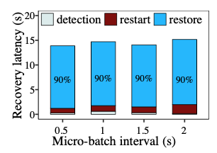
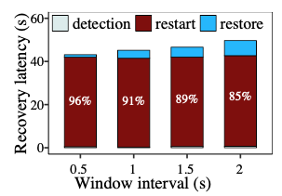
Recovery Overhead
Recovery overhead of DSPS: Spark Streaming and Flink
Spark Streaming incurs high recovery latency due to high restore time
Flink incurs high recovery overhead due to high restart time
Spark Streaming
Flink
Notes:
To justify our claim, we evaluate the recovery latencies of Spark Streaming and
Flink under failures by varying their micro-batch intervals.
For Spark Streaming the recovery latency is above 13 s in all settings
We find that the high recovery latency is mainly attributed to the high restore time,
as Spark Streaming writes streaming items to HDFS and reads them back after restarting the failed tasks.
For Flink the recovery latency is larger than 42 s in all settings.
The reason is that when a worker fails, Flink needs to stop and restart the
processing of all operators to roll back to a consistent condition.

Slide 6
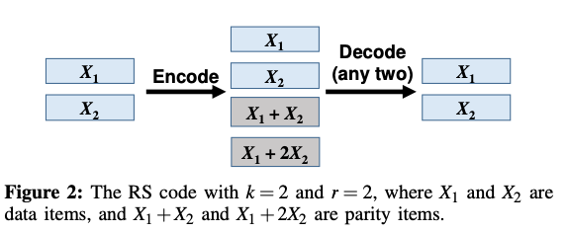
Erasure Coding
Erasure coding for low-redundancy proactive fault tolerance
For (k,r) Reed-Solomon (RS) codes
Encode k uncoded streaming data item into r parity items
Can reconstruct original k data items using any k out of k + r data/parity items
Can tolerate any r failures
Example
(2,2) RS code for tolerating 2 failures
2X overhead for RS code
3X overhead for replication
Notes:
Erasure coding has been traditionally used to provide fault tolerance in the
areas of communication and distributed storage
In this work, we construct the erasure code based on the classical
Reed-Solomon (RS) codes, which have been widely used in production storage systems.
RS codes are associated with two configurable integer parameters k and r.
Specifically, for every k uncoded data item RS codes encode them into r coded parity items,
such that any k out of the k + r data/parity items can reconstruct the original k data items.
This implies that RS codes provide fault tolerance against the failures of any r items.
For example, the figures show a (2,2) RS code where the overhead is 2X to tolerate two failures.
On the other hand, replication needs 3X overhead to tolerate two failures.

Slide 7
Coded Computation
Coded computation
A special case of applying erasure coding for fault tolerance in distributed computations
Applicable for linear operations
Apply linear operations to all k + r data and parity items
Operation outputs of k data items can be reconstructed from any k out of the k + r operation outputs of data/parity items
Cannot support non-linear operations
Notes:
Recent studies also explore coded computation as a special case of applying
erasure coding for fault tolerance in distributed computation.
Coded computation applies to linear operations, such that the
operation outputs of the k data items can be reconstructed from any k out of
the k+r operation outputs of the data/parity items.
However, coded computation cannot directly support non-linear operations,
which are commonly found in stream machine learning algorithms.

Slide 8
Challenges
Challenges for applying erasure coding to stream machine learning:
Practical erasure coding constructions mainly build on linear operations on data units, but non-linear operations are common in stream machine learning
Continuous real-time nature of stream machine learning requires highly efficient coding operations for low-latency responses
Notes:
Making erasure coding effective for stream machine learning is non-trivial.
First, practical erasure coding constructions mainly build on the linear operations on data units.
However, non-linear operations are common in stream machine learning,
implying that any erasure coding solution for stream machine learning
must support both linear and non-linear operations for practical concerns.
Second, while the computational overhead of erasure coding is of less concern
in storage deployment compared to the more dominant bandwidth and I/O constraints,
the continuous real-time nature of stream machine learning requires highly efficient coding
operations for low-latency responses.

Slide 9
Contributions
StreamLEC: a stream machine learning system with erasure coding to provide low-redundancy proactive fault tolerance and immediate failure recovery
A streaming workflow with an extensible programming model
Erasure-coded fault tolerance
Supports general stream machine learning applications
Incremental encoding and hybrid coded computation
Effectively mitigate computational and communicational overhead of erasure coding
Extensive evaluation on both a local cluster and Amazon EC2
Notes:
Our contribution is StreamLEC, a stream machine learning system with erasure coding
to provide low-redundancy proactive fault tolerance for immediate failure recovery.
We first design an extensible programming model and a streaming workflow for StreamLEC,
so as to integrate erasure coding into general stream machine learning applications.
We also propose two techniques for StreamLEC to mitigate erasure coding overhead:
We design incremental encoding, to mitigate the computational overhead of erasure coding
and hybrid coded computation to mitigate the communication overhead.
Finally We prototype and extensively evaluate StreamLEC on both a local cluster and Amazon EC2.

Slide 10
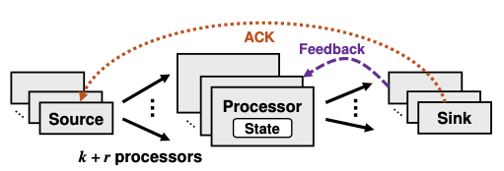
StreamLEC Architecture
Source:
Splits data streams into micro-batches
Encodes and distributes items to processors
Processor:
Receives data or parity items from one or multiple sources
Executes user-defined operators on each received data item
Emits outputs to one or multiple sinks
Sink:
Reconstructs processing results of k data items from any k out of k+r processor outputs
Returns feedbacks to processors and ACKs to the source
Notes:
StreamLEC’s architecture comprises different types of workers as shown in the figure:
Specifically, StreamLEC is composed of three stages of workers, namely sources, processors, and sinks:
Each source splits the data stream into different micro-batches,
and it encodes and distributes data items on each micro-batch to multiple processors.
• Each processor receives data or parity items from one or multiple sources.
It executes user-defined operators on each received data item and emits outputs to one or multiple sinks.
• Each sink aggregates the outputs from any k out of k+r processors and reconstructs the processing results of the k data items.
The aggregated results may be later stored in persistent storage.
To support iterative processing (e.g., model training), a sink can send a feedback to each of the processors.
Finally, the sink will also send a acknowledgement to the source to indicate the finish of the whole micro-batch data.

Slide 11
Programming Model
StreamLEC’s programming model provides two types of interfaces:
Communication interfaces:
Construct the message workflow among different workers
User-defined interfaces
Extensible and allow programmers to add implementation details for specific machine learning applications
The streaming workflow ensures that any application implemented with user-defined interfaces achieves erasure-coded fault tolerance
Notes:
StreamLEC’s programming models provide two types of interfaces, namely communication and user-defined interfaces.
The communication interfaces construct the message workflow among different workers.
On the other hand, StreamLEC further defines a set of user-defined interfaces, which are extensible and allow programmers
to add implementation details for specific machine learning applications.
The streaming workflow of StreamLEC guarantee that any applications implemented with these
user-defined interfaces can enable erasure-coded fault tolerances.

Slide 12
Streaming Workflow
Encoding workflow executed by a source:
Encodes and sends both data and parity items to k + r processors
Processing workflow executed by a processor:
For data items, generates results with user-defined operators, emits the results to the sink, and attaches input data items to the emitted output
For parity items, directly sends them to a sink
Decoding workflow executed by a sink:
Receives processing results, also data/parity items
If any result unavailable, decodes the corresponding data items and recomputes results
Notes:
The streaming workflow of StreamLEC guarantees the erasure-coded fault tolerance.
Specifically, the streaming workflows include three parts.
First, the encoding workflow executed by a source.
The source simply split a stream of data items into different micro-batches,
And for each micro-batch, the source encodes and send both data and parity items to
k+r processors.
Second, the processing workflow for a processor.
Each processor may receive a data or parity item from a source.
If the processor receives a data item, it generates the processing result on the data item.
In addition to emitting the processing result to a sink, the processor also attaches
the input data item into the emitted outputs. If the processor receives a parity item,
it directly emits the parity item to the sink.
For a sink, due to the processor workflow, the sink now receives not only the processing result,
but also the data/parity items of each stripe for reconstructing any unavailable data items.
Thus, if any results are unavailable due to failures, the sink can decode corresponding
data items and recompute the these results.

Slide 13
Incremental encoding
Main ideas:
Per-data-item basis rather than per-micro-batch basis
Pipelines encoding operations and transmissions of data items to mitigate computational overhead of erasure coding
Insights
A parity item is a linear combination of k data item, e.g., parity item $Y=a_{0}X_{0}+a_{1}X_{1}+a_{2}X_{2}$, where $X_{0}$ $X_{1}$ $X_{2}$ are data item, $a_{0}$ $a_{1}$ $a_{2}$ are encoding parameters
When $X_{0}$ available, compute $Y^{′}=a_{0}X_{0}$ and send $X_{0}$
When $X_{1}$ available, compute $Y^{′′}={Y^{′}+a}_{1}X_{1}$ and send $X_{1}$
When $X_{2}$ available, compute $Y={Y^{′′}+a}_{2}X_{2}$ and send $X_{2}$ and $Y$
Notes:
To achieve low-latency encoding, StreamLEC performs incremental encoding,
which computes a parity item on a per-data-item basis.
Specifically, consider a parity item Y = a0X0 +a1X1 +a2X2,
where k = 3, X0, X1, and X2 are the data items generated in order by the source,
and a0, a1, and a2 are the corresponding encoding coefficients.
When X0 is available, the source first updates the parity item as Y′ = a0X0;
when X1 is available, the source updates the parity item as Y ′′ = Y ′ + a1 X1 ;
finally, when X2 is available, the source computes the final parity item Y = Y ′′ + a2 X2 .
After the source updates the parity item with a data item, it can send the data item to one of the processors.
Thus, it pipelines the encoding operations and the transmissions of data items.

Slide 14
Hybrid Coded Computation
Main ideas:
Performs coded computation on linear components and normal (uncoded) computation on the non-linear components to mitigate communication overhead
Workflow:
Decompose computation into linear and non-linear components
Assume linear component runs before non-linear components
For data item, compute and send results, attach output of linear component
For parity item, compute and send the output of linear component
The sink can reconstruct any non-linear results using any k out of k + r linear results
Recall that originally a processor attaches input data items (vector) to the emitted outputs. We now only attach the linear results (scalar)
Notes:
StreamLEC can incorporate coded computation into linear operations,
such that each processor sends only its processing result on a data/parity item
to a sink without attaching the data item, and thus mitigate the communication overhead.
Specifically, StreamLEC decompose the computation into linear and non-linear components,
For linear data item , the processor compute both the linear and non-linear results,
it sends the required non-linear results to the sink and attached the linear results to the output.
While for a parity item, it only computes and send the linear results.
In this way, the sink can reconstruct any non-linear results using any k out of k + r linear results;
Therefore, now we only attach linear result instead of the input item to the output, and thus, reduce the communication overhead.

Slide 15
Evaluation
Prototype StreamLEC in C++, with 19000 LOC
Two real-world dataset:
KDD12 Cup and HIGGS
Algorithms
Linear regression, Logistic regression, SVM, K-Means
Schemes
Rep-2X and Rep-3X, Reactive (Checkpointing), and SteramLEC with EC (5,1) and EC(4,2)
Notes:
We prototype the StreamLEC in C++ with 19 thousands LOC.
We further evaluate StreamLEC using two real-world dataset, KDD12 and HIGGS.
We also implemented four algorithms for evaluation and compared StreamLEC with three different scheme3s eactive checkpointing and replications.

Slide 16
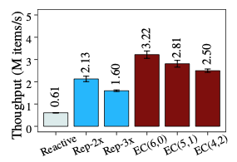
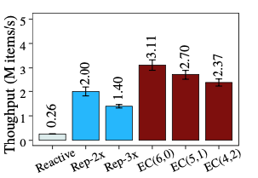
Evaluation
Throughput in normal mode
StreamLEC significantly outperforms Reactive and Replication
EC(4,2) achieves 5.17X and 1.55X throughput over Reactive and Rep-3x, respectively
Logistic regression, KDD12
K-Means, HIGGS
Notes:
We first compare the throughputs in normal modes.
We show the result for logistic regression with KDD12 and K-Means with HIGGS.
However, we also observe similar cases for other algorithms on both datasets.
Our result shows that StreamLEC significantly outperforms both reactive and replication.
Considering the average over the different applications, StreamLEC with EC(4,2) achieves 5.17× and 1.55× throughput compared to Reactive and Rep-3x, respectively.

Slide 17
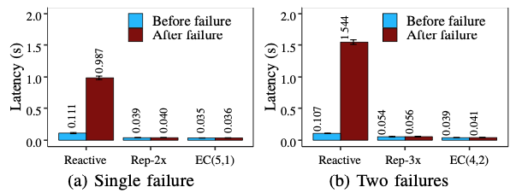
Evaluation
Failure recovery
StreamLEC (i.e., EC(5,1) and EC(4,2)) have negligible latency differences before and after failure recovery.
Reactive incurs 8.9× and 14× increases of processing latency after single-fault recovery and double-fault recovery, respectively
Notes:
We next study the performance impact of both single-fault and double-fault recovery cases.
We stop one or two of the processors in the midst of processing a micro- batch,
and restart the failed processors in the same machines.
We measure the processing latencies of the two micro-batches right before and after failure recovery.
Figures show the result. Both StreamLEC (i.e., EC(5,1) and EC(4,2)) and replication (i.e., Rep-2x and Rep-3x) have
negligible latency differences before and after failure recovery.
However he processing latency of Reactive incurs 8.9× and 14× increases after single-fault recovery and double-fault recovery, respectively.

Slide 18
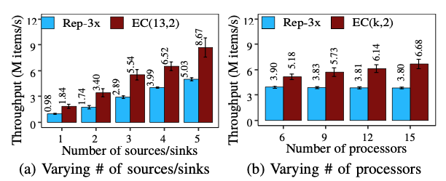
Evaluation
Scalability on Amazon EC2
Both StreamLEC and Rep-3x scale linearly with number of source/sink pairs
StreamLEC’s throughput increases with the number of processors while Replication cannot
Notes:
We finally study StreamLEC’s scalability on Amazon EC2 in two aspects: (i) varying the number of source/sink pairs
from one to five and fixing k=13 and r=2; and (ii) varying k from 4 to 13, while fixing r = 2 and four source/sink pairs.
Figure 9 shows the throughput results in normal mode.
Both StreamLEC and Rep-3x scale linearly with the number of source/sink pairs (Figure (a)),
while StreamLEC achieves an average throughput gain of 1.82× over Rep-3x.
However, Rep-3x cannot scale its throughput even if the number of processors increases (Figure (b)),
since its high redundancy incurs high communication overhead in the source/sink pairs.
In contrast, StreamLEC’s throughput increases with the number of processors.

Slide 19
Conclusion
StreamLEC:
Providing low-redundancy proactive fault tolerance and immediate failure recovery via erasure coding
Supporting general stream machine learning applications
Evaluation on both local clusters and Amazon EC2
StreamLEC significantly outperforms both reactive and replication-based fault tolerance approaches with negligible failure recovery overhead
Source code:
http://adslab.cse.cuhk.edu.hk/software/streamlec/
Notes:
To conclude, we propose StreamLEC, a stream machine learning system
with erasure coding to provide low-redundancy proactive fault tolerance and
Immediate failure recovery.
Our evaluation results show that StreamLEC outperforms both reactive and
replication-based fault tolerance approaches with negligible failure recovery overhead.
Our project is now open-sourced for further research

Slide 20
Thank You! Q & A
Notes:
Thank you. I’d like to take your questions and comments.

