Slide 1
Automated Intelligent Healing in Cloud-Scale Data Centers
Rui Li¹, Zhinan Cheng², Patrick P. C. Lee² ,Pinghui Wang³, Yi Qiang¹,
Lin Lan³, Cheng He¹, Jinlong Lu¹, Mian Wang¹, and Xinquan Ding¹
¹Alibaba Group ²The Chinese University of Hong Kong
³Xi’an Jiaotong University
Notes:
Hi, I am Zhinan Cheng from The Chinese University of Hong Kong.
I am going to present the work “Automated Intelligent Healing in Cloud-Scale
Data Centers”.
This is a joint work with Alibaba Group and Xian JiaoTong University.

Slide 2
Self-healing
Production cloud-scale data centers are susceptible to various types of component failures, e.g., hardware crashes, network disconnection
To maintain high availability of commercial cloud services, modern cloud-scale data centers support self-healing
  automation of the detection and repair of component failures with limited human intervention.
Notes:
Cloud-scale data centers in production are susceptible to various types of
component failures such as hardware crashes, software bugs, network.
To maintain high availability of commercial cloud services at scale,
modern cloud-scale data centers often support self- healing,
which refers to the automation of the detection and repair of component failures
with limited human intervention.

Slide 3
Cloud Infrastructure
Cloud infrastructure in this paper
  22 data centers, 5100 clusters, with a total 1.1 million servers
Monitoring systems
  Monitors all servers in real time and collects raw monitoring logs
  The raw monitoring logs covers 165 attributes, which describe the operational status and error information of a server.
  Each attributes is associated with one of six levels of failure severity
    Info, good, warning, error, critical, and fatal
    For error, critical, and fatal, the server is considered to be failed
Repair actions
  NOP, MSR, ER, RB, RI, RMA
Notes:
The cloud infrastructure mentioned in this paper comprises 22 data centers,
includes 5,100 clusters with a total of 1.1 million servers.
Our cloud infrastructure also includes a monitoring system that
centrally monitors all servers in real time and collects raw monitoring logs from each server.
The raw monitoring logs covers 165 attributes, which describe the operational status and error information of a server.
Each attributes is associated with one of six levels of failure severity, namely Info, good, warning, error, critical, and fatal
Our cloud infrastructure supports six different repair actions to fix a failed server.
These repair action are also commonly used for self-healing in other production data centers

Slide 4
Motivation
Challenges of choosing right repair actions
  Infeasible to traverse and try each repair action
  Wrong repair action adds extra overhead and increase server downtime
Limitation of our existing policy-based self-healing
  ineffective, due to the huge number of attributes and different severity levels of each attribute
  cannot cover any emerging failure that we have not observed
  infeasible to manually examine each failure and specify the corresponding repair action
This motivates us to explore machine-learning-based solutions to automate the entire self-healing workflow.
Notes:
Given the limited number of repair actions, one might ask It is infeasible to traverse
and try each repair action to fix a failure?
Unfortunately, the answer is no, as executing a wrong repair action adds extra overhead and increase the server downtime.
Therefore, we need to find the most suitable repair action for each failures to minimize the
downtime of each failed servers.
Our cloud infrastructure has adopted a policy-based self-healing solution.
However, our deployment experience is that policy-based self-healing is ineffective,
due to the huge number of attributes and different severity levels of each attribute.
Our policies currently can only cover a small fraction of failures for some
combinations of severity levels, but cannot cover any emerging failure that we have not observed.
This motivates us to explore machine-learning-based solutions to automate the entire self-healing workflow.

Slide 5
Motivation
Some studies^{[8,15]} reportedly adopt machine learning to predict repair actions based on historical data.
Limited analysis of machine-learning-based self-healing solutions in real-world cloud-scale data centers.
  How a complete machine-learning-based self-healing pipeline should be deployed?
  How the prediction accuracy of self-healing varies across different machine learning models?
  How different stages of machine-learning-based self-healing pipeline affect the overall prediction accuracy of self-healing?
Notes:
Existing studies reportedly adopt machine learning to predict repair actions based on historical data
While machine learning is widely believed as an effective tool for data- driven prediction,
there remains limited analysis of machine- learning-based self-healing solutions in
real-world cloud-scale data center deployment. In particular, some key deployment questions
are unexplored, such as:
how a complete machine- learning-based self-healing pipeline should be deployed;
how the prediction accuracy of self-healing varies across different machine learning models;
how different stages of a machine-learning-based self-healing pipeline affect the overall prediction accuracy of self-healing.

Slide 6
Our Contributions
AIHS: an Automated Intelligent Healing System that applies machine learning to self-healing in cloud-scale data centers.
  Provides a full-fledged, general pipeline that supports various machine learning models
  Predicts a repair action for a given failure based on the learning of raw monitoring logs and historical repair actions
  Deployed in cloud-scale data centers with 600K servers at Alibaba
Extensive trace-driven and production experiments validate the effectiveness of AIHS
Lessons learned from the design and deployment of AIHS
Notes:
We answer the above questions in this paper.
Our contribution is AIHS, an Automated Intelligent Healing System
that applies machine learning to self-healing in cloud-scale data centers.
AIHS provides a full-fledged, general pipeline that supports various machine
learning models, and predicts a repair action for a given failure based on
the learning of raw monitoring logs and historical repair actions.
AIHS is currently deployed in production cloud-scale data centers with about 600 K servers at Alibaba.
To validate the effectiveness of AIHS, we conduct extensive evaluation
via both trace-driven and production experiments.

Slide 7
Trace for AIHS Design
The monitoring system collects a repair record of each triggered repair action.
The trace is used for model training, each record includes
  The server ID
  The raw monitoring logs
  The trigger repair actions
  The repair results
    Marked as successful if the repair action recovers the swerver to work more than 20 minutes
    Otherwise marked as unsuccessful
Notes:
To motivate the AIHS design, the monitoring system collects a repair record of each triggered repair action.
Each repair record contains the following fields: (i) the server ID,
(ii) the raw monitoring logs, (iii) the triggered repair action, and (iv) the repair result.
The repair result is marked as either successful if the repair action successfully recovers the server

Slide 8
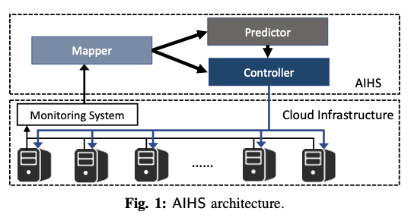
AIHS architecture
AIHS comprises three components
  Mapper
    Transforms the raw monitoring logs into numerical features.
    Formulate as an embedding problem in natural language processing
    Supports different supervised embedding methods: TF-IDF, LDA, BERT
  Predictor
    Formulate as a multi-class classification problem
    Predict a repair action for each monitoring log
    Support LR, SVM, RF, GBDT, Bayes network
  Controller
    Receive results from the Mapper and Predictor
    to decide the final repair action
Notes:
Figure 1 shows the architecture of AIHS, which comprises three components, namely Mapper, Predictor, and Controller .
As machine learning require numerical features for training prediction.
We first design the Mapper that transforms the raw monitoring logs into numerical features.
The Mapper formulates the transformation as an embedding problem in natural language processing,
where the raw text is processed by unsupervised learning models and converted into numerical vectors.
We further design the Predictor to recommend one of the repair actions for each detected failure.
Specifically, it receives the numerical features of a failure from the Mapper as input.
It then predicts a repair action, which is sent to the Controller as a recommendation.
The Predictor formulates a multi-class classification problem, in which each class corresponds to a repair action.
Finally, we design the Controller to take the numerical features of a failure from the
Mapper and the recommended repair action from the Predictor as input,
and determines the final repair action to fix the failure.

Slide 9
Design of Controller
Main ideas of Controller
  Assess if a repair action is likely to fix the failure
  Employs six trained binary classifiers, one for each repair action, that learned the relation between monitoring logs and repair results
Workflows
  If the repair action from the Predictor is assessed to be successful, trigger the repair action.
  Otherwise, assess the repair action that has the lowest repair cost, if the result is to be successful, tigger repair, otherwise, repeats assessment on other action with higher costs.
  Calls the administrator to manually diagnose the failure if no repair action is assessed to be successful
Notes:
To find a repair action that is likely to fix the failure, we design the Controller to assess
the recommended repair action on the failure to see how likely the repair action can fix the failure.
To assess a repair action on a failure, the Controller employs six trained binary classifiers, one for each of the six repair actions.
Each binary classifiers learns the relation between the monitoring logs and the repair results for a specific repair action.
The controller executes a three-step workflow
Step 1: It feeds the numerical features of the failure to the corresponding classifier of the recommended
repair action made by the Predictor, and predicts the repair outcome (i.e., successful or unsuccessful).
If the repair outcome is successful, the Controller directly triggers the recommended repair action and quits.
• Step 2: If the repair outcome is predicted to be unsuccessful, the Controller assesses other repair actions.
It first assesses the repair action that has the lowest repair cost (Section II). If the repair outcome is predicted
to be successful, the Controller triggers the repair action and quits; otherwise, it repeats the assessment on
the next repair action with a higher repair cost.
• Step 3: If the Controller finds no repair action that returns a successful outcome,
it calls the administrator to manually diagnose the failure.

Slide 10
Production Deployment
Model training and update
  Offline training
    Train the multiclass classifier of the Predictor using successful repair records
    Train each binary classifier in Controller using both successful and unsuccessful repair records
  Model update
    Update the model if the newly collected traces can improve the accuracy
    In a monthly basis
Deployment
  Deployed AIHS on 2200 clusters.
  Divide the clusters into five groups based on business, run one AIHS instance for each group independently
Notes:
We train the machine learning models offline for AIHS before its deployment.
For the Predictor, we train its multi- class classifier using successful repair records (Section III-B).
For the Controller, we train each binary classifier using both successful and unsuccessful repair records
Also, we periodically update the models of AIHS in deployment.
We now check whether the model accuracy can be improved with the new repair records on a monthly basis.
If the new models show improved accuracies than the old ones, we update the deployed AIHS with the updated models
For deployment, we have deployed AIHS on 2,200 out of 5,100 clusters.
We divide the 2,200 clusters into five groups based on the services hosted by the clusters.
Each group runs an AIHS instance independently

Slide 11
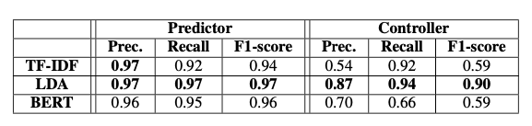
Evaluation
Trace-driven experiments for comparisons of unsupervised models in the Mapper
  Fix GBDT in the Predictor and Controller
  LDA is the most suitable model for the Mapper and provides high prediction accuracies in both the Predictor and the Controller.
Notes:
We evaluate AIHS via extensive trace-driven and production experiments.
We first compare the unsupervised learning models in the Mapper
by studying how they affect the prediction accuracies in the Predictor and the Controller.
Specifically, we fix GBDT as the multi-class classifier in the Predictor and the binary classifier for each repair action in the Controller.
Our result show thatLDA is the most suitable model for the Mapper and provides high prediction accuracies in both the Predictor and the Controller.

Slide 12
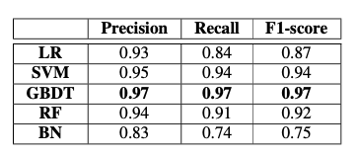
Evaluation
Trace-driven experiments for comparisons of multi-class classifiers in the Predictor
  Fix GBDT in the Mapper
  GBDT achieves the highest precision, recall, and F1-score in all cases.
Notes:
We next compare different multi-class classifiers in the Predictor.
We fix LDA in the Mapper and compare the accuracy of different classification models in the Predictor.
Our result show that GBDT achieves the highest precision, recall, and F1-score in all cases.
One major reason is that GBDT can better solve the sample imbalance problem of our collected traces

Slide 13
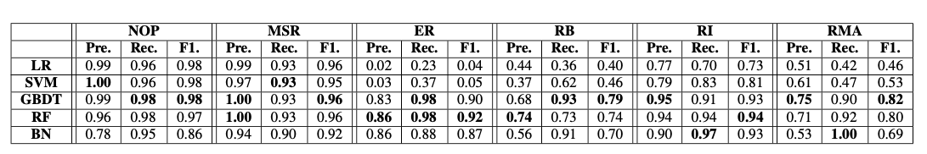
Evaluation
Trace-driven experiments for comparisons of binary classifiers in the Controller
  Fix GBDT in the Mapper
  GBDT performs the best for most repair actions.
  Choose the GBDT for all repair actions for the sake of simplicity and ease of maintenance
Notes:
We compare different binary classifiers in the Controller.
We again use LDA in the Mapper. For each repair action,
we train the corresponding binary classifier using all the related repair records.
Both GBDT and RF generally achieve the highest accuracy.
Nevertheless, for the sake of simplicity and ease of maintenance,
we tend to choose a single model for all repair actions.
We find that GBDT performs the best for most repair actions.
Thus, we also choose GBDT for the Controller in our deployment.

Slide 14
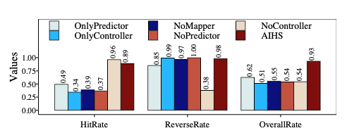
Evaluation
Micro-benchmarking AIHS
  Define HitRate, ReverseRate, and OverallRate for evaluating the accuracy of AIHS, which is similar as precision, recall, and F1-score.
  AIHS achieves high HitRate, ReverseRate, and OverallRate by combining all components to learn both successful and unsuccessful repair records.
Notes:
We next benchmarking different components of AIHS.
Before that, we define the metrics for evaluating accuracy of AIHS, namely hitrate, reverserate and overall rate,
Where the metrics is similar as precison, recall and F1-score.
Here, we use LDA in the Mapper and GBDT in Predictor and Controller.
Our result shows that if any component is disabled in AIHS, AIHS cannot work perfectly.
In contrast, combining all components to learn both successful and unsuccessful
repair records allows AIHS to achieves high HitRate, ReverseRate, and OverallRate

Slide 15
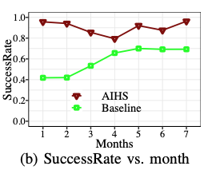
Evaluation
Production accuracy
  Baseline: Policy-based self-healing
  SuccessRate: Fraction of failures that are successfully fixed
  AIHS significantly outperforms the policy-based solution all the time, successfully fix 92.4% productions failures over 7 months
  AIHS also reduce 51% of unavailable time of each failed server
Notes:
We then study the production accuracy, compared with the policy-based self-healing.
The Figure here compare the successrate of both approach, where the success rate
is defined as the fraction of production failures that are successfully fixed.
We observe that AIHS significantly outperforms the policy-based solution all the time,
Consider 7 months, AIHS successfully fix 92.4% productions failures over 7 months
Furthermore, AIHS also reduces 51% of unavailable time of each failed server compared to baseline.

Slide 16
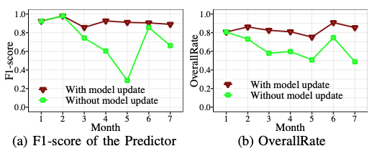
Evaluation
Effectiveness of monthly model update
  Disabling monthly model update significantly reduces the F1-score of Predictor and the OverallRate of AIHS
  AIHS effectively mitigates the impact of emerging failures and maintains high prediction accuracy via monthly model updates.
Notes:
We also study how monthly model updates improve the accuracy of AIHS.
Figures compare the accuracy when we enable or disable the monthly model update.
We find that disabling monthly model update significantly reduces the F1-score of
Predictor and the OverallRate of AIHS
On the other hand, enabling monthly model update allows AIHS effectively mitigates
the impact of emerging failures and maintains high prediction accuracy

Slide 17
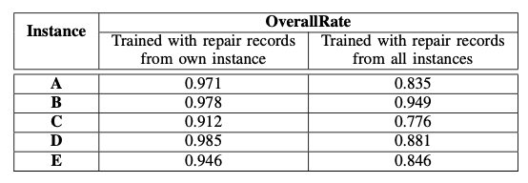
Evaluation
AIHS instance accuracy
  each instance achieves a higher OverallRate when only using the repair records collected from itself to re-train the models
  Aggregating repair records from all five instances to re-train the models actually reduces the OverallRate of each instance due to different statistical properties.
Notes:
Finally, Our current deployment treats each AIHS instance independently, such that the model training of
each instance is independent of the other instances. We justify this deployment strategy by studying
how the repair records collected from different AIHS instances affect the accuracy of each AIHS instance.
Table VI shows the results. We observe that each instance achieves a higher OverallRate when
only using the repair records collected from itself to re-train the models. Aggregating repair records from all
five instances to re-train the models actually reduces the OverallRate of each instance (e.g., by 0.1 on average),
since the repair records collected from different AIHS have different statistical properties.

Slide 18
Lessons Learned
Lessons learned from design and deployment of AIHS
  Designing AIHS as a general framework allows us to find the appropriate machine learning models for self-healing for different deployment environments in our business.
  LDA can better interpret the correlation among different attributes and thus achieve best accuracy in Mapper while GBDT achieves high accuracy in Predictor and Controller as it can solve sample imbalance.
  Performing incremental deployment of AIHS on our business and monthly model update for AIHS allows us to observe if AIHS works as expected and make correct decision on AIHS deployment.
Notes:
We now pose some lessons we learned from the design and deployment of AIHS.
First, Designing AIHS as a general framework allows us to find the appropriate machine
learning models for self-healing for different deployment environments in our business.
Second, in our cases, LDA can better interpret the correlation among different attributes
and thus achieve best accuracy in Mapper
while GBDT achieves high accuracy in Predictor and Controller as it can solve sample imbalance.
Finally, performing incremental deployment of AIHS on our business and monthly model update for AIHS, which allows us to observer if AIHS works as expected.

Slide 19
Conclusion
AIHS:
  A machine-learning-based automated intelligent healing system for cloud-scale data centers.
  Support various machine learning for self-healing
  Extensive trace-driven experiments and production experiments validate the effectiveness of AIHS.
Source code:
  https://github.com/alibaba-edu/dcbrain/master/AIHS_prototype
Notes:
To conclude, we propose AIHS, a machine-learning-based
automated intelligent healing system for cloud-scale data centers.
Our project is now open-sourced for further research.

Slide 20
Thank You!
Q & A
Notes:
Thank you. I’d like to take your questions and comments.

