Slide 1
Correlation-Aware Stripe Organization for Efficient Writes in Erasure-Coded Storage Systems
Zhirong Shen⁺, Patrick Lee⁺, Jiwu Shu$, and Wenzhong Guo*
⁺The Chinese University of Hong Kong
$Tsinghua University
*Fuzhou University
Presented at IEEE SRDS’17
Notes:
Good evening, everyone. Tonight I will give a presentation about our paper which is accepted to IEEE SRDS’17.
The paper is entitled “Correlation ... ”

Slide 2
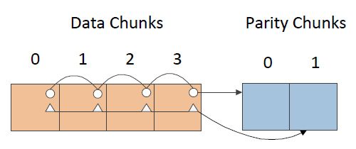
Background
Failures become commonplace in distributed storage systems
Different levels: sector fault → device corruption → node failure → DC disaster
Different patterns: single failure, concurrent failures
Erasure coding
Encode k data chunks and obtain m parity chunks. These k+m chunks form a stripe
Any k chunks can recover no more than m failures (MDS property)
A stripe of (k=4, m=2) erasure code
Notes:
The scale of distributed storage systems continues growing, which makes failure become commonplace.
Failure may appear in different device and system levels, for example, sector error, disk corruption, node failure, and DC disaster.
At each level, failures also have different patterns, for example, single failure, and correlated failures.
To protect data reliability, erasure coding is increasingly adopted in many commercial storage systems. Generally speaking, erasure coding encodes a set of data chunks into m parity chunks. Among these k plus m chunks, any k chunks are sufficient to repair no more than m failures. This property is called MDS property.

Slide 3
Write Problem
EC downgraded writes (partial stripe writes)
I/O amplification: Additional four reads and two writes needed to update parity chunks
a. Two new data chunks arrive
c. Compute new parity chunks
b. Read old data and parity chunks
d. Update the new data and parity
Notes:
Maintaining consistency between data and parity chunks is necessary during writes. This manner easily blows up storage I/Os
Writes in erasure-coded storage systems can be classified into full stripe writes and partial stripe writes according to the write size.
Full stripe writes are large writes which updates all the data chunks in a stripe, while partial stripe writes are also referred as small writes which only updates a subset of data chunks in a stripe. Partial stripe writes will cause additional parity update cost. For example, to update the parity chunks, the systems need to read existing data chunks and parity chunks, computer the new parity chunks, and finally write new data chunk and parity chunks.
Previous related works have noticed the problem of partial stripe writes. They can classified into the following branches. The first branch is to mitigate parity updates by designing new erasure codes or new data placement methodology. The second branch proposes to accelerate write and read operations by logging parity updates and data updates.
Most of related works are performed after data are sealed into stripes. Therefore, we want to study if we can …?

Slide 4
Related Works
Existing works can be classified into
New erasure code designs
Placement design for XOR-based erasure codes
Parity-logging
Read optimization in read-modify-write mode
mitigate parity updates
fast read in next operations
Optimizations after data is sealed into stripes
Can we optimize partial stripe writes before stripe organization, by analyzing access characteristics ?
Notes:
Previous related works have noticed the problem of partial stripe writes. They can classified into the following branches. The first branch is to mitigate parity updates by designing new erasure codes or new data placement methodology. The second branch proposes to accelerate write and read operations by logging parity updates and data updates.
Most of related works are performed after data are sealed into stripes. Therefore, we want to study if we can …?

Slide 5
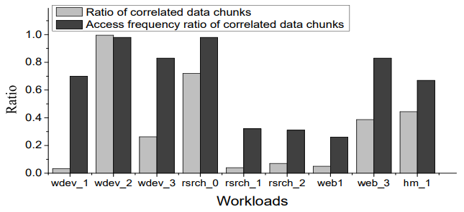
Trace Analysis
Request Format: read/write, access range, timestamp value
Rule: Two chunks are considered “correlated” if they are accessed within a timestamp value at least twice
98.2%
70.0%
32.0%
3.3%
Observation #1: Ratio of correlated data chunks varies significantly across workloads
Observation #2: Correlated data chunks receive large amount of data accesses
Notes:
We first analyze real-world traces selected from MSR Cambridge traces. Each workload records the access data at a timestamp value.
We call two chunks are correlated if they are accessed within a given timestamp value at least twice.
We have two findings. First, …. For example, in the workload wdev_1, the ratio of correlated data is only 3.3%, while the ratio of correlated data in wdev_2 is 98.2%.
Second, correlated data receive a considerable number of data accesses. For example, the correlated data in wdev_1 receive 70% of data accesses.

Slide 6
Motivating Examples
What if the correlated data chunks are put into the same stripe?
Baseline Stripe Organization. Updating D1 and D5 should access all the four parity chunks
D1 and D5 are placed across different stripes
New Stripe Organization. Updating D1 and D5 should access only two parity chunks
Finding: Putting correlated data into same stripe reduces parity updates
D1 and D5 are placed in the same stripe
Notes:
Our motivation is that since correlated data chunks can be accessed in a short period of time with large probability, what if they are organized into the same stripe?
We illustrate two examples, in which we let D1 and D5 be two correlated data chunks. The first method organizes data in a round-robin fashion and organizes D1 and D5 across different stripes. The an update to them will access all the four parity chunks.
If we put D1 and D5 in the same stripe, then a update to them will only renew two parity chunks.

Slide 7
Our Contribution
Correlated-Aware Stripe Organization (CASO)
Capture data correlation
Different stripe organization methods for correlated and uncorrelated data
Correlated data: correlation-aware stripe organization algorithm
Uncorrelated data: organization in the round-robin fashion
CASO reduces write time, thereby improving system reliability by reducing probability of data vulnerability in writes
Notes:
Motivated by this example, our objective is to design a new correlated-aware stripe organization methodology. To this end, we should first capture data correlation and then design different stripe organization methods for correlated and uncorrelated data respectively.
In particular, we use correlation graph to capture data correlation. For correlated data, we propose a correlation-aware stripe organization algorithm, while for uncorrelated data, we propose to organize them in round-robin fashion.

Slide 8
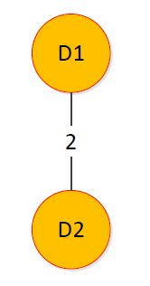
Correlation Graph
Capture data correlation
Correlation Graph
Constructed over a set of correlated data chunks
The weight between two chunks denotes the number of times when they are accessed together in a given time distance
D1 and D2 are correlated
Number of times when D1 and D2 are accessed together in a given time distance reaches two
Notes:
We first introduce the definition of correlation graph.
The correlation graph is constructed over a set of correlated data chunks.
The weight value of the edge is called correlation degree, which indicates the times when D_i and D_j are requested in the same time distance.

Slide 9
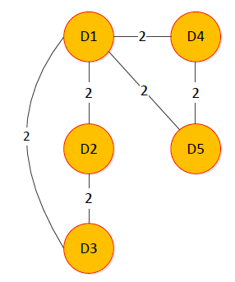
Correlation Graph
How to derive a correlation graph from an access stream?
Incoming Access Stream
TD1
D1
D2
D3
TD2
D1
D4
D5
TD3
D1
D2
D3
D4
D5
Rule: Two chunks are considered “correlated”, if the number of times when both of them are accessed within a given time distance at least twice
Notes:
So how to derive the correlation graph based on an incoming access stream?
We show an example here. Suppose the access stream has three periods of data access requests. D_1 and D_2 are requested in both period 1 and period 3, then their correlation degree is 2.
Following this method, we can first construct a correlation graph over five chunks.

Slide 10
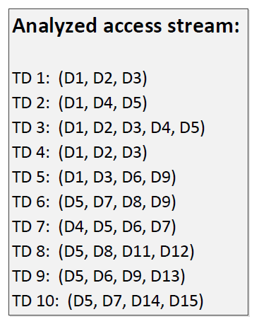
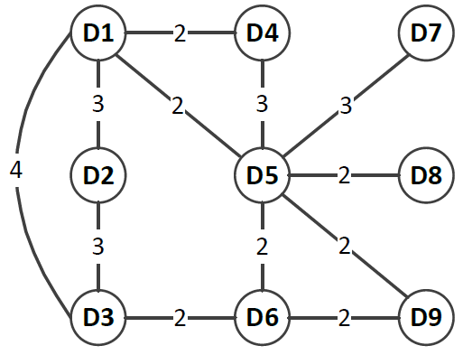
Correlation Graph
Derive a correlation graph from an access stream
Derive
Correlation Graph
Notes:
Based on the above method, we can derive a correlation graph given an access stream. This access stream records the data accesses in ten periods and we can extract night correlated data chunks and their correlation degrees.

Slide 11
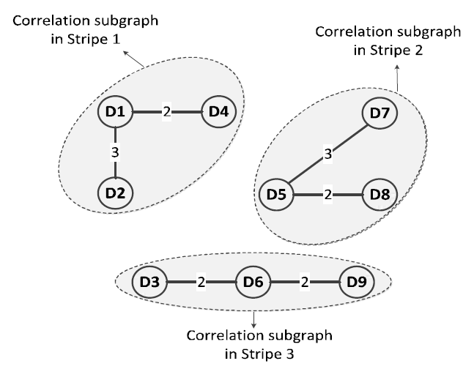
Stripe Organization for Correlated Data
Grouping correlated data chunks partitions the correlation graph
We use graph partitioning to organize data into stripes
Partition (k=3)
How to find the optimal graph partitioning that can reach the maximum correlation degree in resulting subgraphs?
Correlation Graph
Data chunks in a subgraph are placed in a stripe. (sum of CD = 14)
Notes:
Grouping the correlated data chunks into stripes will accordingly partition the correlation graph.
Given the derive correlation graph in the last slide, suppose a stripe consists of three data chunks. Then the night data chunks in the graph will be organized into three subgraphs.
Therefore, the stripe organization of correlated data chunks is equivalent to the graph partition problem. So our question is how to …

Slide 12
Stripe Organization for Correlated Data
Finding optimal graph partition is non-trivial
Enumeration needs $C\left(n_{c}, k\right)⋅C\left(n_{c}−k,k\right)⋯C(n_{c}−\left(λ−1\right)k,k)$ tests
We propose a greedy approach
Step 1: Select a pair of data chunks (e.g., D1 and D2) with maximum correlation degree (e.g., 4)
Step 2: Select a data chunk (e.g., D2) with maximum correlation degree (e.g., 6) with those that have been selected
Notes:
The finding of optimal graph partition is non-trivial. Directly using enumeration needs a large number of tests.
Therefore, we propose a greedy approach.
At the beginning, we first select a …. For example, suppose k is 3, meaning that a stripe consists of three data chunks. In this figure, D_1 and D_4 have the maximum correlation degree of 4. They are first located.
Second, we then determine another data chunk that has the maximum correlation degree …. For example, in this figure, the data chunk D_2 has the largest correlation degree with D_1 and D_3 which are selected in the last step.

Slide 13
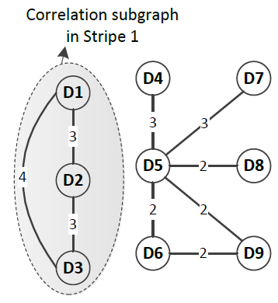
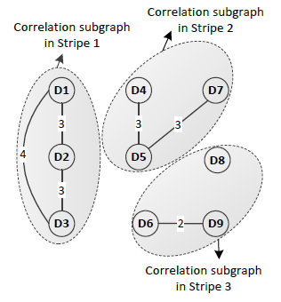
Stripe Organization for Correlated Data
Suppose k=3
Step 3: Remove the connections between the selected data chunks and those that are not included in any subgraph yet
Finally, we obtain three subgraphs after partition (sum of CD = 18)
Notes:
After the number of selected data chunks reaches three, we remove ….
Follow this method, we can obtain three subgraphs.

Slide 14
Stripe Organization for Uncorrelated Data
Two observations
Uncorrelated data chunks account for a large proportion (e.g., 96.7% in wdev1, 95.0% in web_1) good sequentiality
Spatial locality is effective in sequential access patterns
Organize uncorrelated data chunks in round-robin fashion
Use chunk identity to index uncorrelated chunks
Make identities of sequential data chunks contiguous → spatial locality
In direct-attached storage, identity is based on logical address
In distributed storage, chunks in the same file have sequential identities

Slide 15
Performance Evaluations
Traces
Nine real-workloads selected from MSR Cambridge Traces
Testbed Machine
Linux Server: an X5472 processor and 8GB memory
Disk Array: 16 Seagate/Savvio 10K.3 SAS disks, each of which owns 300GB storage capability and 10,000rmp
Comparison
Baseline stripe organization (BSO) : round-robin organization
CASO (proposed in this paper)
Notes:
We finally evaluate the performance of CASO by using eight real-world traces selected from MSR Cambridge traces released by Microsoft Cooperation.
The experiment is run on a linux server connected with a disk array that consists of 16 SAS disks.
We select baseline stripe organization as our reference.

Slide 16
Evaluation Method
Correlation Analysis
For each trace, select a small portion of access requests for analysis
Definition of analysis ratio
Improvement Demonstration
Replay remaining access requests that are NOT used for analysis
Notes:
As referred above, CASO needs to analyze a portion of access requests to identify correlated and uncorrelated data for stripe organization. So for each workload, we extract a small portion of data for analysis. After stripe organization, we replay the remaining access requests that are not used for analysis.
We also propose a definition called analysis ratio, which is represented by the ratio of the number of analyzed access requests in CASO and the total number of access requests in a workload.

Slide 17
Impact of Different Parameters
Reduce 10.4% of parity updates on average
Reduce up to 25.0% of parity updates
Work for most workloads and parameters
Notes:
We first measure the number of parity updates incurred in different workloads for CASO and BSO. The analysis ratio is set as 0.5 and we select three erasure codes with different parameters. We can derive two findings.
First, …. This is because CASO packs correlated data chunks into the same stripe, so an update to them will only renew their common parity chunks.
Second, …

Slide 18
Impact of Analysis Ratios
wdev_1
0.1 | 0.215202
0.2 | 0.216518
0.3 | 0.251596
0.4 | 0.254786
0.5 | 0.250444
wdev_2
0.1 | 0.143328
0.2 | 0.16228
0.3 | 0.153959
0.4 | 0.161476
0.5 | 0.167563
web_1
0.1 | 0.010802
0.2 | 0.012953
0.3 | 0.014022
0.4 | 0.014775
0.5 | 0.017
rsrch_1
0.1 | 0.044955
0.2 | 0.072444
0.3 | 0.088165
0.4 | 0.116093
0.5 | 0.114766
Analysis ratio
Reduce more parity updates for a larger analysis ratio
Chunk size: 4KB
k=4, m=2
Notes:
We also focus on the impact of analysis ratio. We vary the analysis ratio from 0.1 to 0.5, and measure the number of resulting parity updates in (4,2) RS code for CASO and BSO. The result shows that CASO generally reduces more …
For example, for the workload wdev_1, CASO can reduce 21.5% of parity updates when the analysis ratio is 0.1. The reduction will increase to 25.1% when the analysis ratio increases to 0.5.

Slide 19
Average Write Speed
Increase 9.9% of the write speed on average for different configurations and workloads
Improvement of write speed can reach up to 28.7%
Analysis ratio: 0.5
Chunk size: 4KB
Three configurations
Notes:
We further measure the average write speed in CASO and BSO.
We can observe that by mitigating parity updates, CASO can increase 9.9% of write speed on average for different parameter configurations and workloads.

Slide 20
Additional I/Os in Degraded Reads
CASO can even decrease 4.2% of additional I/Os on average for the selected workloads
Analysis ratio: 0.5
Chunk size: 4KB
Three configurations
Notes:
We also study the performance of degraded read in CASO. Degraded reads usually appear when there are some unavailable data in the request.
To serve degraded reads, the storage systems usually attach additional data according to the recovery policy of erasure coding, thereby causing additional i/os. We can find that CASO will not downgrade degraded read efficiency.

Slide 21
Conclusion
[Contributions] Correlation-Aware Stripe Organization
Data classification: Correlated and uncorrelated data chunks
Separate organization for different branches of data chunks
[Effectiveness] Improve partial stripe write performance, and does not downgrade the degraded read efficiency
[Future Work] Expect more findings of CASO for the workloads, in which the correlated data chunks are read-only and non-sequential
Notes:
Finally, we make a conclusion about this presentation. We propose CASO, a correlated-aware stripe organization scheme, which classifies data into correlated and uncorrelated data, and accordingly designs different organization methodologies for these two branches of data.
Through practical workloads, we demonstrate that CASO can effectively improves …
In our next work, we expect to investigate the effectiveness of CASO when being deployed over the workloads with non-sequential read operations.

