Slide 1
Coupling Decentralized Key-Value Stores with Erasure Coding
Liangfeng Cheng¹, Yuchong Hu¹, Patrick P. C. Lee²
¹Huazhong University of Science and Technology ²The Chinese University of Hong Kong
SoCC 2019

Slide 2
Introduction
Decentralized key-value (KV) stores are widely deployed
Map each KV object deterministically to a node that stores the object via hashing in a decentralized manner (i.e., no centralized lookups)
e.g., Dynamo, Cassandra, Memcached
Requirements
Availability: data remains accessible under failures
Scalability: nodes can be added or removed dynamically

Slide 3
Erasure Coding
Replication is traditionally adopted for availability
e.g., Dynamo, Cassandra
Drawback: high redundancy overhead
Erasure coding is a promising low-cost redundancy technique
Minimum data redundancy via “data encoding”
Higher reliability with same storage redundancy than replication
e.g., Azure reduces redundancy from 3x (replication) to 1.33x (erasure coding) → PBs saving
How to apply erasure coding in decentralized KV stores?

Slide 4
Erasure Coding
Divide file data to k equal-size data chunks
Encode k data chunks to n-k equal-size parity chunks
Distribute the n erasure-coded chunks (stripe) to n nodes
Fault-tolerance: any k out of n chunks can recover file data
Nodes
A
A
B
B
A
C
C
File
divide
encode
D
D
B
C
A+C
A+C
D
B+D
B+D
A+D
A+D
B+C+D
B+C+D
(n, k) = (4, 2)

Slide 5
Erasure Coding
Two coding approaches
Self-coding: divides an object into data chunks
Cross-coding: combines multiple objects into a data chunk
Cross-coding is more appropriate for decentralized KV stores
Suitable for small objects
e.g., small objects dominate in practical KV workloads [Sigmetrics’12]
Direct access to objects

Slide 6
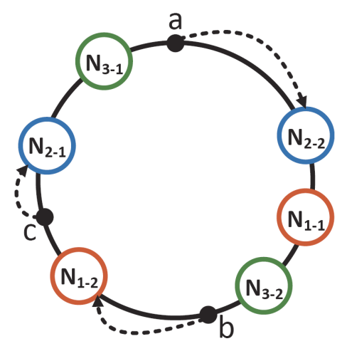
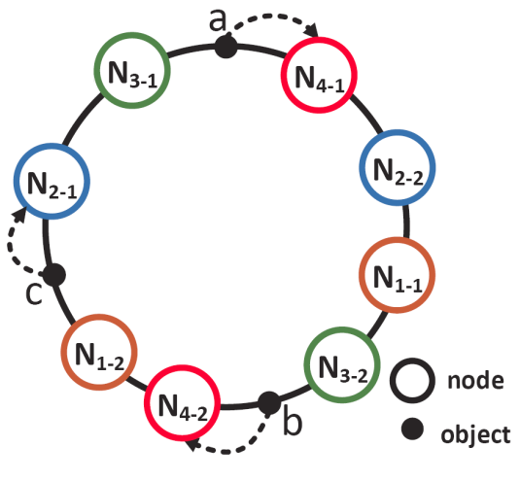
Scalability
Scaling is a frequent operation for storage elasticity
Scale-out (add nodes) and scale-in (remove nodes)
Consistent hashing
Efficient, deterministic object-to-node mapping scheme
A node is mapped to multiple virtual nodes on a hash ring for load balancing
Add N₄

Slide 7
Scalability Challenges
Replication / self-coding for consistent hashing
Replicas / coded chunks are stored after first node in clockwise direction
Cross-coding + consistent hashing?
Parity updates
Impaired degraded reads

Slide 8
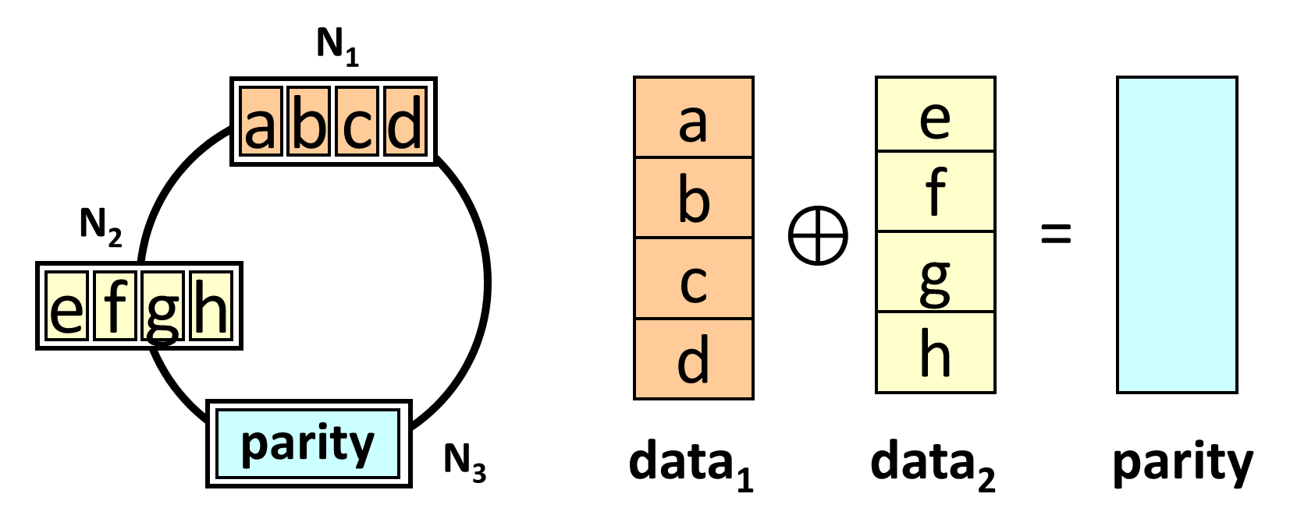
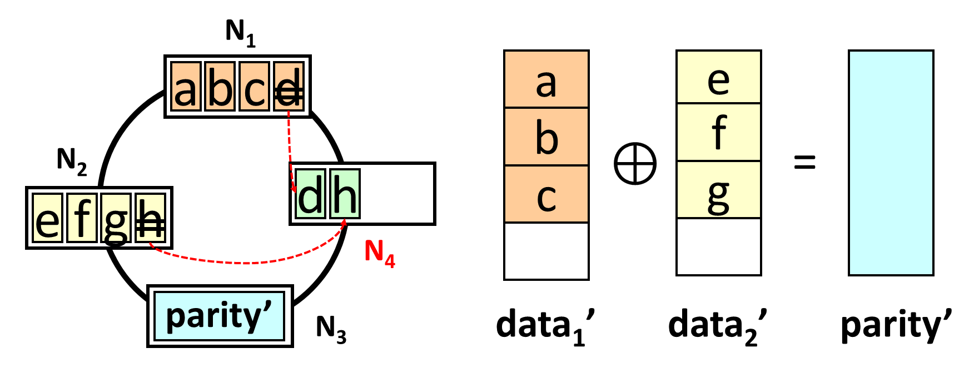
Challenge 1
Add N₄
Data chunk updates → parity chunk update
Frequent scaling → huge amount of data transfers (scaling traffic)

Slide 9
Challenge 2
N₁
fail
a
b
c
d
Read to d fails until d is migrated
N₂
d
h
N₄
e
f
g
h
fail
Degraded read to d doesn’t work if h is migrated away from N₂
N₃
parity
success
Coordinating object migration and parity updates is challenging due to changes of multiple chunks
Degraded reads are impaired if objects are in middle of migration

Slide 10
Contributions
New erasure coding model: FragEC
Fragmented chunks → no parity updates
Consistent hashing on multiple hash rings
Efficient degraded reads
Fragmented node-repair for fast recovery
ECHash prototype built on memcached
Scaling throughput: 8.3x (local) and 5.2x (AWS)
Degraded read latency reduction: 81.1% (local) and 89.0% (AWS)

Slide 11
Insight
A coding unit is much smaller than a chunk
e.g., coding unit size ~ 1 byte; chunk size ~ 4 KiB
Coding units at the same offset are encoded together in erasure coding
Coding units at the same offset are encoded together
…
Coding unit
n chunks of a stripe
“Repair pipelining for erasure-coded storage”, USENIX ATC 2017

Slide 12
FragEC
Allow mapping a data chunk to multiple nodes
Each data chunk is fragmented to sub-chunks
Decoupling tight chunk-to-node mappings → no parity updates

Slide 13
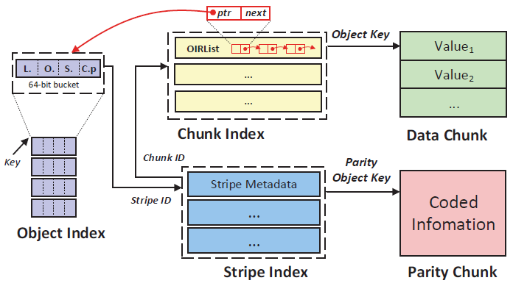
FragEC
OIRList lists all object references and offsets in each data chunk
OIRList records how each data chunk is formed by objects, which can reside in different nodes
Notes:
Object Index -> object -> stripe
Stripe Index -> chunks in each stripe
Chunk index -> all object references in each data chunk

Slide 14
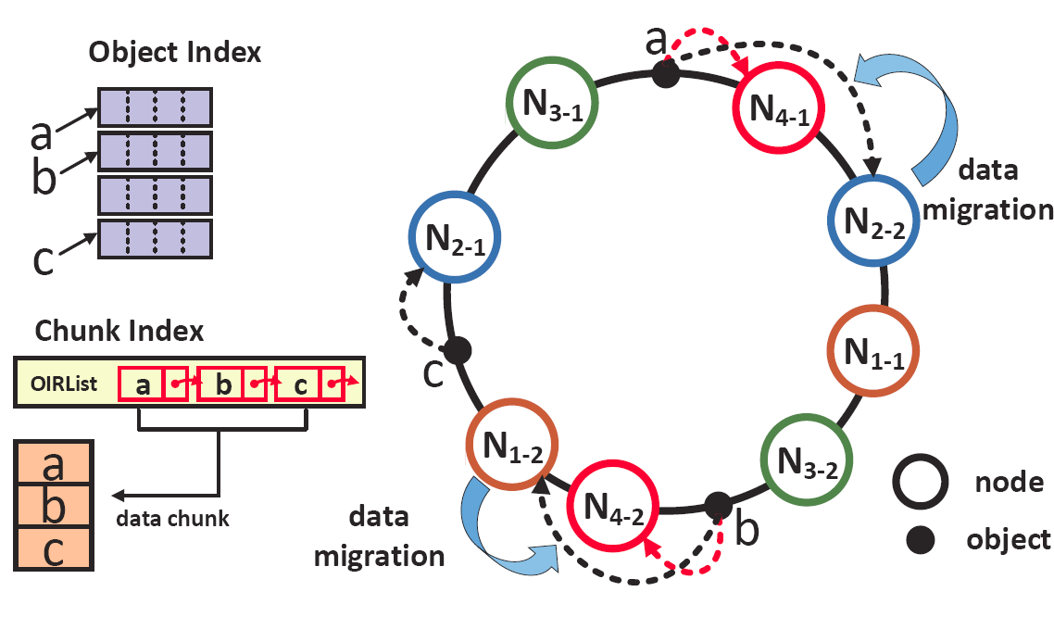
Scaling
Traverse Object Index to identify the objects to be migrated
Keep OIRList unchanged (i.e., object organization in each data chunk unchanged)
→ No parity updates

Slide 15
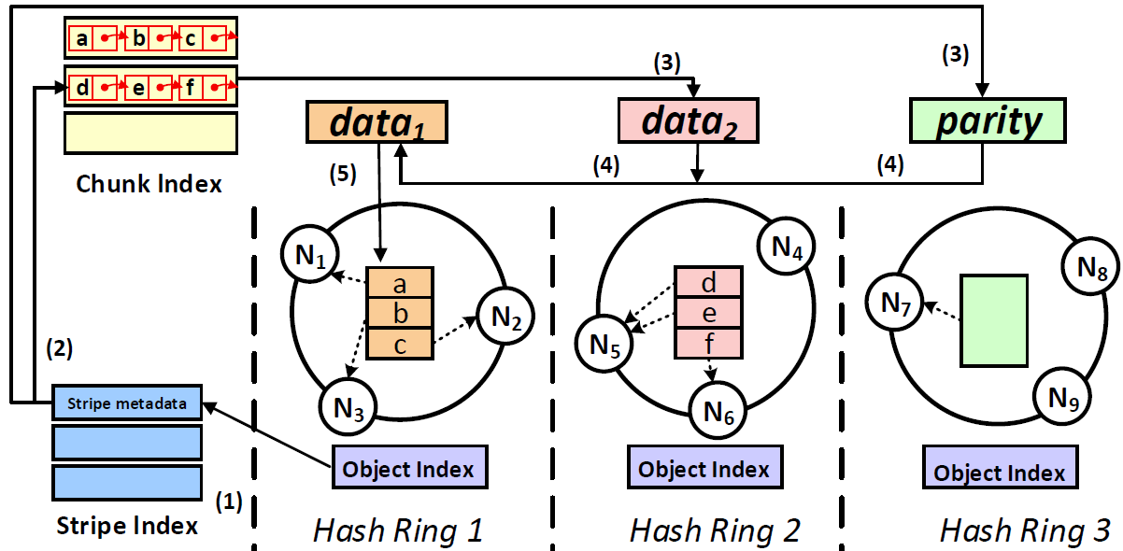
Multiple Hash Rings
Distribute a stripe across n hash rings
Preserve consistent hashing design in each hash ring
Stage node additions/removals to at most n-k chunk updates → object availability via degraded reads

Slide 16
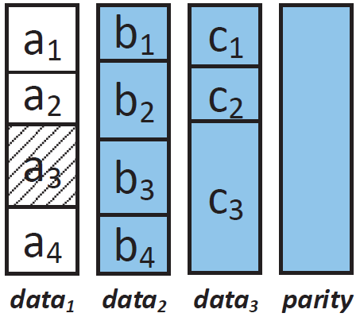
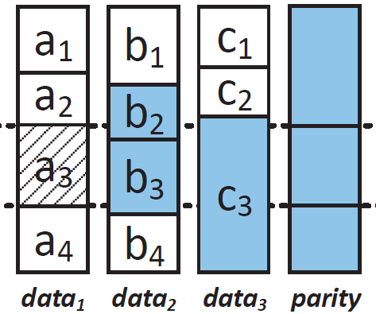
Node Repair
Issue: How to repair a failed node with only sub-chunks?
Decoding whole chunks is inefficient
Fragment-repair: perform repair at a sub-chunk level
Downloads:
data₂: b₂, b₃
data₃: c₃
parity
Downloads:
data₂: b₁, b₂, b₃, b₄
data₃: c₁, c₂, c₃
parity
Reduce repair traffic
Chunk-repair
Fragment-repair

Slide 17
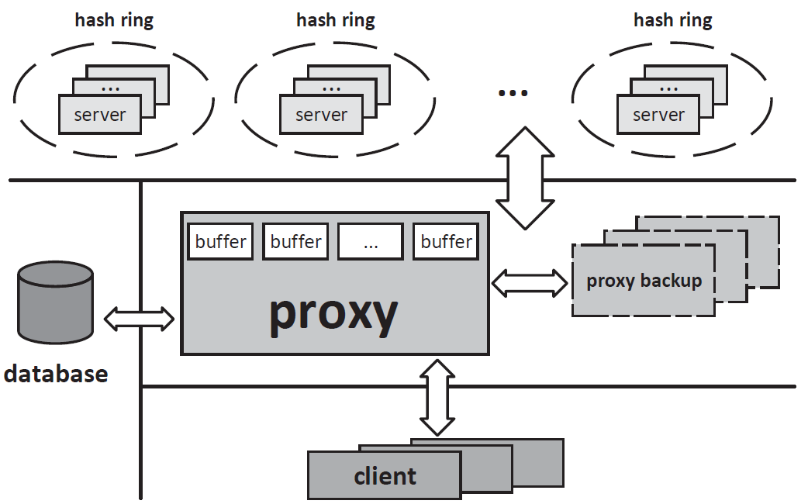
ECHash
Built on memcached
In-memory KV storage
3,600 SLoC in C/C++
Intel ISA-L for coding
Limitations:
Consistency
Degraded writes
Metadata management in proxy

Slide 18
Evaluation
Testbeds
Local: Multiple 8-core machines over 10 GbE
Cloud: 45 Memcached instances for nodes + Amazon EC2 instances for proxy and persistent database
Workloads
Modified YCSB workloads with different object sizes and read-write ratios
Comparisons:
ccMemcached: existing cross-coding design (e.g., Cocytus [FAST’16])
Preserve I/O performance compared to vanilla Memcached (no coding)
See results in paper

Slide 19
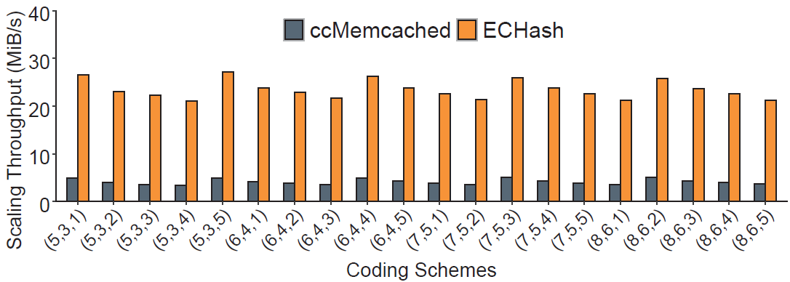
Scaling Throughput in AWS
Scale-out: (n, k, s), where n – k = 2 and s = number of nodes added
ECHash increases scale-out throughput by 5.2x

Slide 20
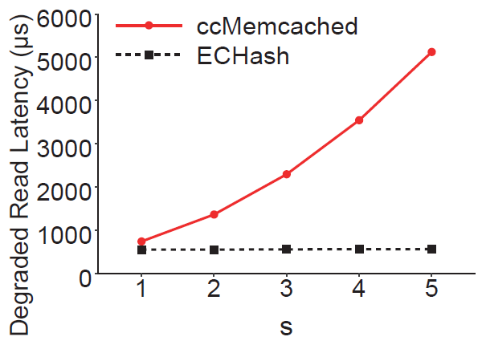
Degraded Reads in AWS
Scale-out: (n, k) = (5, 3) and varying s
ECHash reduces degraded read latency by up to 89% (s = 5)
ccMemcached needs to query the persistent database for unavailable objects

Slide 21
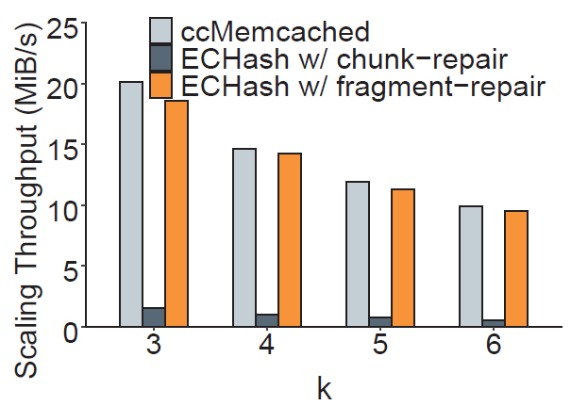
Node Repair in AWS
Scale-out: (n, k) = (5, 3) and varying s
Fragment-repair significantly increases scaling throughput over chunk-repair, with slight throughput drop than ccMemcached

Slide 22
Conclusions
How to deploy erasure coding in decentralized KV stores for small-size objects
Contributions:
FragEC, a new erasure coding model
ECHash, a FragEC-based in-memory KV stores
Extensive experiments on both local and AWS testbeds
Prototype:
https://github.com/yuchonghu/echash

