Slide 1
Stochastic Modeling of Large-Scale Solid-State Storage Systems: Analysis, Design Tradeoffs and Optimization
Yongkun Li, Patrick P. C. Lee and John C.S. Lui
The Chinese University of Hong Kong, Hong Kong
Sigmetrics’13

Slide 2
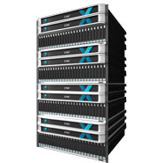
SSD Storage is Emerging
Solid-state drives (SSDs) are widely adopted in data centers
Examples: EMC XtremIO Array, NetApp Sandisk, Micron P420m
Pros of SSDs:
High I/O throughput, low power, high reliability
Cons of SSDs:
Wear-out
EMC XtremIO [Source: http://www.crn.com]

Slide 3
How SSDs Work?
Organized into blocks
Each block has 64 or 128 pages of size 4KB each
Three basic operations: read, write, erase
Read, write: per-page basis
Erase: per-block basis
Out-of-place write for updates:
Write to a clean page and mark it as valid
Mark original page as invalid

Slide 4
How SSDs Work?
Garbage collection (GC) needed to reclaim clean pages
Choose a block to erase
Move valid pages to another clean block
Erase the block
Challenges:
Blocks can only be erased a finite number of times
SLC: 100K; MLC: 10K; 3-bit MLC: several K to several hundred
When a block reaches the limit, it wears out
Bit error rates increase as blocks wear down
2. erase
Block A
0
1
2
Block A
1. write
Block B
0
2
Block B
Before GC
After GC

Slide 5
Motivation
Design tradeoff of GC algorithms
Minimizing cleaning cost
reclaim the block with smallest number of valid pages
improve I/O throughput and minimize write amplification
Maximizing wear-leveling
erase all blocks as evenly as possible
improve durability
Problems
How to model the performance-durability tradeoff of GC algorithms?
How to parameterize a GC algorithm to adapt to different tradeoff requirements?

Slide 6
Our Work
Develop a Markov model to characterize I/O dynamics
Use mean-field analysis to derive asymptotic steady state
Develop an optimization framework to analyze the tradeoff
Propose a tunable GC algorithm which operates along the optimal tradeoff curve
Conduct trace-driven simulations on DiskSim with SSD add-ons
Construct an analytical model that characterizes tradeoff between cleaning cost and wear-leveling for a general class of GC algorithms

Slide 7
Related Work on GC
Empirical analysis:
Agrawal et al. (USENIX ATC08) addressed tradeoff between cleaning cost and wear-leveling in GC
Theoretical analysis on GC: focus on write amplification
Hu et al. (SYSTOR09), Bux et al. (Performance10), Desnoyers (SYSTOR12): model different greedy algorithms on GC
Benny Van Houdt (Sigmetrics13) also models write amplification of GC algorithms using mean field technique
Our work analyzes performance tradeoff of different GC algorithms, with more general access pattern and address mapping; also conducts trace-driven simulations

Slide 8
Markov Model
Consider an SSD containing $N$ physical blocks, each with $k$ pages
Classify blocks into different types
$X_{i}(t)$: type of block $i$ at time $t$
A block is of type $j$ iff it has $j$ valid pages ($0≤j≤k$)
System state: $X^{N}\left(t\right)=(X_{1}\left(t\right),X_{2}\left(t\right),…,X_{N}(t))$
Transformation: $n^{N}\left(t\right)=(n_{0}\left(t\right),n_{1}\left(t\right),…,n_{k}(t))$
$n_{i}\left(t\right)$: number of type $i$ blocks at time $t$
Block $i$
0
1
2
$2$ valid pages → $X_{i}\left(t\right)=2$

Slide 9
I/O Dynamics
Read
Does not change $n^{N}\left(t\right)$
GC
Always reallocate valid pages to a new (clean) block
Does not change $n^{N}\left(t\right)$
2. erase
Block A
0
1
2
Block A
1. write
Block B
0
2
Block B
Before GC
After GC
Notes:
Note: In our work, we assume that when reclaim a block, the valid pages in the block are reallocated to a NEW block
PS: For page level address mapping, even if there is a write frontier, and all writes are
directed to the frontier, which makes the system evolves in a deterministic way, in a long term, we can still analyze it in probabilistic way.

Slide 10
I/O Dynamics
Program (write data to flash)
Changes a block from type $j$ to $j+1$
Invalidate (mark the data as invalid)
Changes a block from type $j$ to $j−1$
Before
0
1
2
After
0
1
2
3
$$X_{i}\left(t\right)=2$$
$$X_{i}\left(t\right)=3$$
Before
0
1
2
After
0
1
2
$$X_{i}\left(t\right)=2$$
$$X_{i}\left(t\right)=1$$
Notes:
We focus on the flash level I/O here

Slide 11
State Transition
Only consider program and invalidate requests
Arrive as a Poisson process with rate $λ$
Uniform access pattern:
each block has the same probability of being accessed
probability of the requested page being invalidated is proportional to number of valid pages in the block
What about the state transition of an SSD?
State transition of a block
Notes:
We consider accesses in physical address space.

Slide 12
State Transition
State space of $n^{N}\left(t\right)$ is huge
Cardinality = $\left(\begin{matrix}N+k \\ k\end{matrix}\right)$
For 256GB SSD, $N≈{10}^{6}, k=64$ → huge state space!
Resort to mean-field analysis to make the model tractable
Occupancy measure $M^{N}\left(t\right)=(M_{0}\left(t\right),M_{1}\left(t\right),…,M_{k}(t))$
$M_{i}\left(t\right)=\frac{n_{i}(t)}{N}$: fraction of type $i$ blocks at time $t$
Stochastic process
Notes:
NOTE:
The state space of n^N(t) is large, so it is difficult to derive n^N(t), we use mean field analysis.
When we use mean field analysis, our goal is to derive the occupancy measure
M^N(t) instead of n^N(t). The occupancy measure M^N(t) is a continuous vector.

Slide 13
Mean Field Analysis
Stochastic process $M^{N}\left(t\right)$ converges to a deterministic process (mean field limit) $s\left(t\right)=(s_{0}\left(t\right),s_{1}\left(t\right),…,s_{k}(t))$ as N is large
$s_{i}(t)$: fraction of type $i$ blocks at time $t$
ODEs:
Proof in technical report.

Slide 14
Steady-State Solution
Deterministic process $s\left(t\right)$ converges to a steady-state solution (fixed point)
$π_{i}=\frac{\left({k \atop i}\right)}{2^{k}}, 0≤i≤k$ (uniform case)
$π$ approximates the steady-state solution of the occupancy measure $M^{N}\left(t\right)$
The SSD contains $π_{i}$ fraction of type $i$ blocks in steady state
Proof in technical report.

Slide 15
General Access Pattern
Define $p_{i,j}$ as the transition probability of a type $i$ block being transited to state $j$ for each request
ODEs:
Fixed point $π$can be derived accordingly
See our validation results in the paper

Slide 16
Performance Metrics
Formalize GC algorithms
Define $w_{i}$ as the weight of selecting a type $i$ block for each GC
Constraint: $\sum_{i=0}^{k}{\frac{w_{i}}{N}\left(Nπ_{i}\right)=\sum_{i=0}^{k}{w_{i}π_{i}=1}}$
Performance metrics
Cleaning cost: $𝒞=\sum_{i=0}^{k}{iw_{i}π_{i}}$
Average number of valid pages that are reallocated
Wear-leveling: $𝒲=\frac{{\left(\sum_{i=0}^{k}{\frac{w_{i}}{N}Nπ_{i}}\right)}^{2}}{N\left(\sum_{i=0}^{k}{{\left(\frac{w_{i}}{N}\right)}^{2}Nπ_{i}}\right)}={\left(\sum_{i=0}^{k}{w_{i}^{2}π_{i}}\right)}^{−1}$
How evenly each block is reclaimed
Prob. of choosing a particular type $i$ block
Prob. of choosing any type $i$ block
Notes:
Using pi as input, choose w_i that minimizes cleaning cost or maximizes wear leveling

Slide 17
Tradeoff Analysis
Maximizing wear-leveling
$\max{ 𝒲={\left(\sum_{i=0}^{k}{w_{i}^{2}π_{i}}\right)}^{−1}}$
$s.t. \sum_{i=0}^{k}{w_{i}π_{i}=1},$
$w_{i}≥0.$
Solution
$w_{i}=1$ for all $i$
$𝒲=1, 𝒞=\frac{k}{2}$ (for uniform case)
Choose every block with the same probability $\frac{1}{N}$ in each GC
Random algorithm

Slide 18
Tradeoff Analysis
Minimizing cleaning cost
$\min{ 𝒞=\sum_{i=0}^{k}{{iw}_{i}π_{i}}}$
$s.t. \sum_{i=0}^{k}{w_{i}π_{i}=1},$
$w_{i}≥0.$
Solution
$w_{0}=\frac{1}{π_{0}}, w_{i}=0$ for all $i>0$
$𝒞=0, 𝒲=\frac{1}{2^{k}}≈0$ (for uniform case)
Choose the block with smallest number of valid pages in each GC
Greedy algorithm

Slide 19
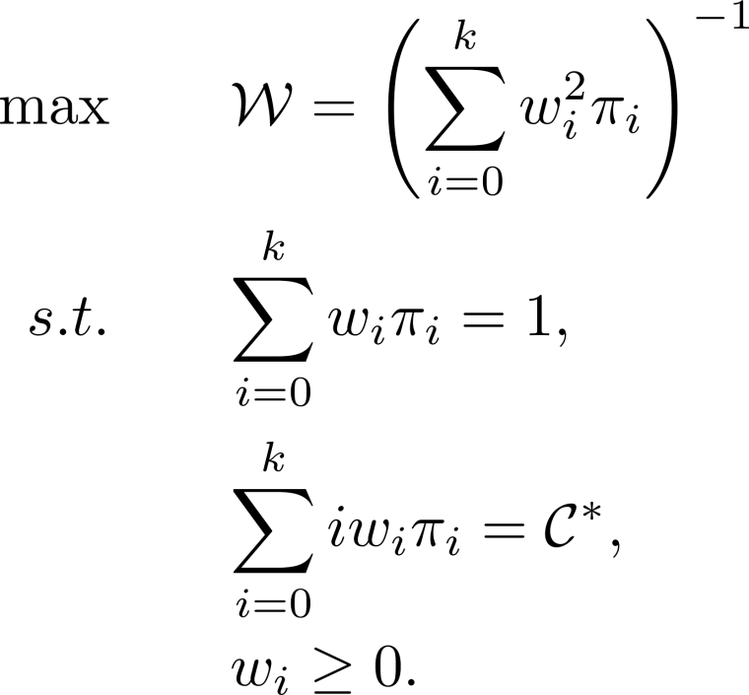
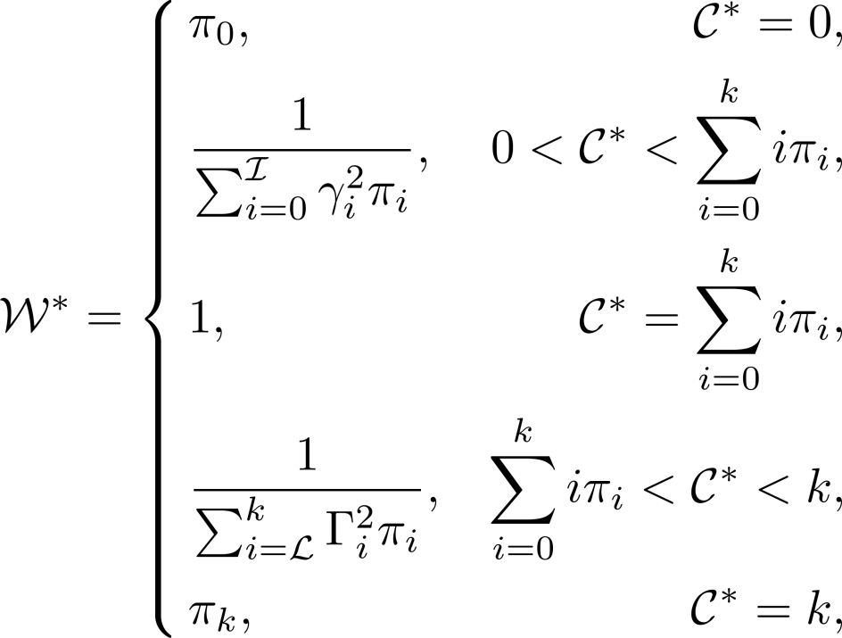
Tradeoff Analysis
Optimal tradeoff
Solution
tradeoff
Greedy algorithm
minimizes cleaning cost
Random algorithm
maximizes wear-leveling
Notes:
Identify the full design space of GC algorithms
NOTE: Due to the symmetric nature, we are not interested in the cases when C^* > \sumi\pi_i . So random and greedy stand for two extreme points in the tradeoff curve.
The symmetric phenomenon can be viewed from the figure shown in our paper.

Slide 20
Randomized Greedy Algorithm
Randomized Greedy Algorithm (RGA)
Random step: Randomly choose $d$ (window size) blocks
Greedy step: Choose the block that has the smallest number of valid pages among the $d$ blocks for GC
If $d=1$: random algorithm
If $d=N$: greedy algorithm
Performance
Cleaning cost:
Wear-leveling:
MD Mitzenmacher, “The Power of Two Choices in Randomized Load Balancing”, 1996

Slide 21
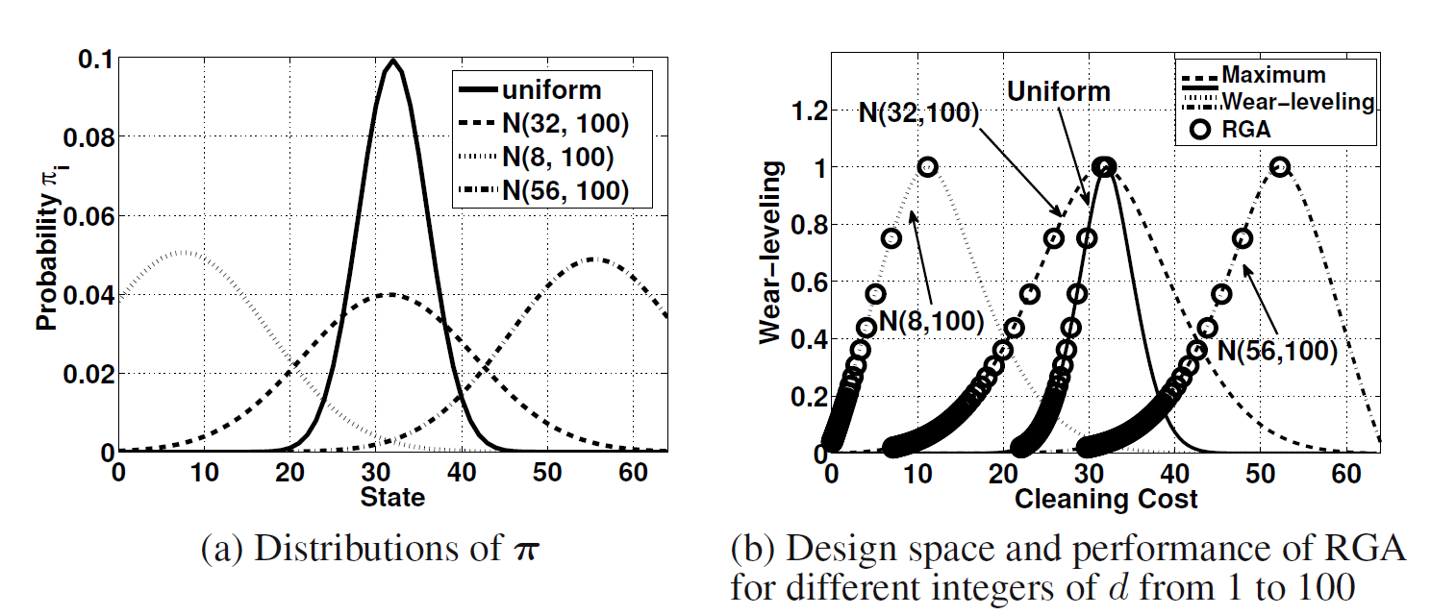
Numerical Results
Performance tradeoff
Tradeoff indeed exists for GC algorithms
RGA operates along the optimal tradeoff curve

Slide 22
Experimental Results
Environment: DiskSim with SSD add-ons
System configuration
32GB SSD with 8 flash chips, with 16,384 physical blocks each
GC is performed independently in each chip
Each block has 64 pages of size 4KB each
15% storage space preserved
Threshold for triggering GC: free blocks less than 5%
Datasets
Financial, Webmail, Online and Webmail+Online
Write intensive (around 80% write requests)

Slide 23
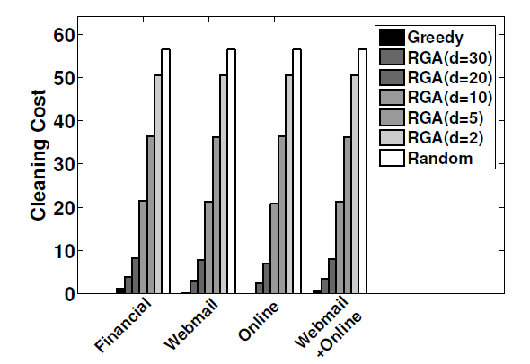
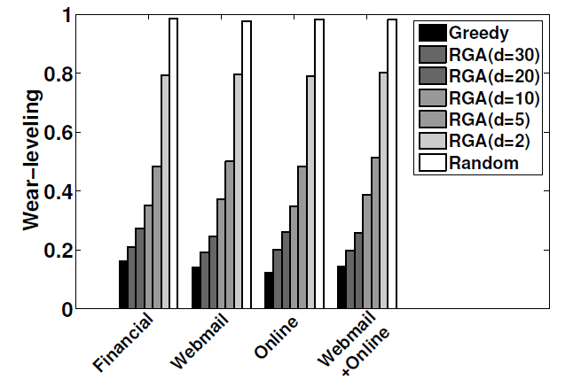
Cleaning Cost & Wear-leveling
Greedy algorithm has the lowest cleaning cost and random algorithm achieves the highest wear-leveling
RGA balances the tradeoff
See our paper for I/O throughput and durability results
Notes:
Note: Reason why the cleaning cost could be so small: In this simulation, the address space is much smaller than the SSD capacity (the whole logical space), and the locality of the workload is also high (which means that only a small fraction of addresses are
accessed very frequently), so when GC is triggered every time, the block which is selected by GC contains very small number of valid pages (0 in many times).
Workload statistics:
All are write intensive (around 80% write requests).
Financial is random write dominant (sequential ratio is less than 1%)
Other three are sequential write dominant (sequential ratio is bigger than 70%)

Slide 24
Summary
Propose a stochastic model that characterizes tradeoff between cleaning cost (performance) and wear-leveling (durability) of GC algorithms in SSDs
Random algorithm and greedy algorithm stand for the two extreme points in the tradeoff curve
Propose a randomized greedy algorithm that operates on the optimal tradeoff curve
Conduct extensive trace-driven simulations
Future work:
Hot/cold separation, address mapping, RAID reliability

