Slide 1
SketchLearn: Relieving User Burdens in Approximate Measurement with Automated Statistical Inference
Qun Huang, Patrick P. C. Lee, Yungang Bao

Slide 2
Typical Approximate Measurement
Expected errors
Query thresholds
Network traffic
Query
Measurement
Algorithm
Measurement
Results
Configuration
Domain knowledge
Network statistics
Our goal: identify and relieve user burdens for approximate measurement

Slide 3
User Burden 1
1: Hard to specify
Expected errors
Query thresholds
Network traffic
Query
Measurement
Algorithm
Measurement
Results
Configuration
Domain knowledge
Network statistics
Errors need to be specified:
bias: an answer deviates true answer by ε
failure probability: fail to produce small-error answer with a probability δ

Slide 4
User Burden 2
1: Hard to specify
2: Hard to know in advance
Expected errors
Query thresholds
Network traffic
Query
Measurement
Algorithm
Measurement
Results
Configuration
Domain knowledge
Network statistics
Large-threshold configurations fail to work for small-threshold queries
No guideline for sufficiently small threshold
Vary across management operations and traffic characteristics

Slide 5
User Burden 3
1: Hard to specify
2: Hard to know in advance
Expected errors
Query thresholds
Network traffic
Query
Measurement
Algorithm
Measurement
Results
Configuration
Domain knowledge
Network statistics
3: Hard to follow theory to tune
Domain knowledge is not always available
Theories usually show worst-case results
Configuration for worst case not practically efficient

Slide 6
User Burden 4
1: Hard to specify
2: Hard to know in advance
4: Hard to redefine flow-keys
Expected errors
Query thresholds
Network traffic
Query
Measurement
Algorithm
Measurement
Results
Configuration
Domain knowledge
Network statistics
3: Hard to follow theory to tune
Algorithm works on a particular flow-key
Flow-key definition must be fixed in deployment

Slide 7
User Burden 5
1: Hard to specify
2: Hard to know in advance
4: Hard to redefine flow-keys
Expected errors
Query thresholds
Network traffic
Query
Measurement
Algorithm
Measurement
Results
Configuration
Domain knowledge
Query Results
3: Hard to follow theory to tune
5: Hard to quantify actual errors
Infeasible to track errors for a particular flow
Configuration only tells worst-case and overall errors

Slide 8
All User Burdens
1: Hard to specify
2: Hard to know in advance
4: Hard to redefine flow-keys
Expected errors
Query thresholds
Network traffic
Query
Measurement
Algorithm
Measurement
Results
Configuration
Domain knowledge
Query Results
3: Hard to follow theory to tune
5: Hard to quantify actual errors

Slide 9
Our Work
SketchLearn: Sketch-based measurement system with limited user burdens
Relieve five user burdens
Performance
Catch up with underlying packet forwarding speed
Memory efficiency
Consume only limited memory
Accuracy
Preserve high accuracy of sketches
Generality
One design and one configuration for multiple tasks
Deployable in both software and hardware

Slide 10
Root Cause: Resource Conflicts
Previous work: perfect configuration to eliminate conflicts
Determined by many factors
Input data
Configuration
Query parameters
Algorithm
Flow definition
Resource conflicts

Slide 11
High-Level Idea
Not pursue perfect configurations to mitigate resource conflicts
Hard to identify right trade-offs
Characterize resource conflicts in an “imperfect” configuration
Expected errors
Query parameters
Data structure with
imperfect configuration
Statistical
Properties
Conflict model
Domain knowledge
Flow definitions
Not necessary
Network queries

Slide 12
How to Realize?
Data structure with
imperfect configuration
Statistical
Properties
Conflict model
Network queries

Slide 13
Design Data Structure
Data structure with
imperfect configuration
Statistical
Properties
Conflict model
Network queries

Slide 14
Multi-level Sketch [Cormode, ToN 05]
L: # of bits considered
Data structure: L+1 levels (from 0 to L), each of which is a counter matrix
Level 0 is always updated
Level k is updated iff k-th bit in a flowkey is 1
All levels share same hash functions

Slide 15
Statistical Properties of Resource Conflicts
Multi-level
Sketch
Statistical
Properties
Conflict model
Network queries

Slide 16
Properties
Does a flow update level k?
Depends on inherent distribution of flow keys
Does a flow update bucket (i, j)?
Depends on hash functions of sketch
A theory should characterize the above two factors

Slide 17
Main Theorem
p[k]: probability that k-th bit is 1
$V_{i,j}\left[0\right]$: counter of bucket (i,j)
$V_{i,j}\left[k\right]$ : counter of bucket (i,j)
random variable $R_{i,j}\left[k\right]=\frac{V_{i,j}\left[k\right]}{V_{i,j}\left[0\right]}$
Main Theorem: if no large flows, $R_{i,j}\left[k\right]$ follows Gaussian distribution with mean p[k]

Slide 18
Build Conflict Model
Multi-level
Sketch
Main
Theorem
Conflict model
Network queries

Slide 19
Statistical Model Inference
Goals
Extract all large flows
Guarantee remaining flows in sketches are small
Estimate Gaussian distributions for each level
Challenges
No guidelines to distinguish large and small flows

Slide 20
Self-Adaptive Inference Algorithm
Multi-Level
Sketch
Estimate Gaussian distributions
Remove extracted large flows （Flow extracted）
Use smaller threshold （No flow extracted）
Imperfect
Gaussian Distribution
Large Flows
Extract large flows

Slide 21
Self-Adaptive Inference Algorithm
Multi-Level
Sketch
Estimate Gaussian distributions
Remove extracted large flows （Flow extracted）
Use smaller threshold （No flow extracted）
Imperfect
Gaussian Distribution
Large Flows
Extract large flows

Slide 22
Large Flow Extraction
Intuition: a large flow
(i) results in extremely (large or small) $R_{i,j}\left[k\right]$ , or
(ii) at least deviates $R_{i,j}\left[k\right]$ from its expectation p[k] significantly
Key idea: examine $R_{i,j}\left[k\right]$ and its difference from p[k], then
Determine k-th bit of a large flow (assuming it exists)
Estimate frequency
Associate flow confidence
More details in paper!

Slide 23
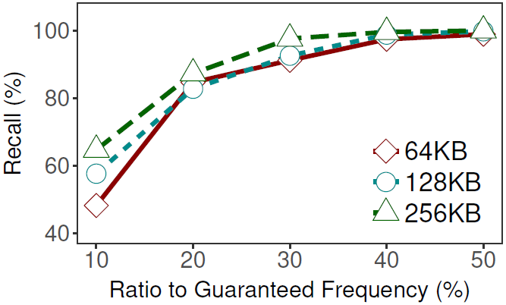
Guarantee
Theorem: w is sketch width, flows exceeding 1/w of total must be extracted
Empirical results: even flows that are smaller than 1/w can also be extracted！
64KB: flows above 0.6% of total traffic can be extracted (by theorem)
Practice: >99% flows exceeding 0.3% are also extracted with 64KB

Slide 24
How to Perform Network-wide Queries?
Multi-level
Sketch
Decoupled
Components
Conflict Characteristics
Main
Theorem
Self-adaptive
Model Inference
Extracted Large Flows
Flow
Confidence
Residual
Sketch
Gaussian
Distributions
Network queries

Slide 25
Supported Network Queries
Per-flow byte count
Heavy hitter detection
Heavy changer detection
Cardinality estimation
Flow size distribution estimation
Entropy estimation

Slide 26
Extended Query Model
Allow query for arbitrary flowkeys
Only use corresponding levels
Estimate actual query errors
Use attached errors for each large flow
Use Gaussian distributions

Slide 27
Putting It Together
Multi-level
Sketch
Decoupled
Components
Conflict Characteristics
Main
Theorem
Self-adaptive
Model Inference
Extracted Large Flows
Flow
Confidence
Residual
Sketch
Gaussian
Distributions
Network-wide
Query Runtime

Slide 28
(Slight) User Burdens
Users now just need to configure the multi-level sketch
Multi-level
Sketch
Expected errors
One row suffices
Query parameters
Domain knowledge
Flow definitions
Not necessary
Columns: based on minimum flow or memory budget
Example:
400 KB memory
Require flows exceeding 0.1%
1000 columns

Slide 29
Implementation
Challenge: updating L+1 levels is time consuming
Solution: parallel updating
L+1 levels are independent
Software
Based on OpenVSwitch + DPDK
Parallelism with SIMD
Hardware
Based on P4 programmable switches
Parallelism with P4 pipeline stages

Slide 30
Evaluation
Platforms
Software: OpenVSwitch + DPDK
Hardware: Tofino swtich
Large-scale simulation
Traces
Caida 2017
Data center traffic (IMC 2010)

Slide 31
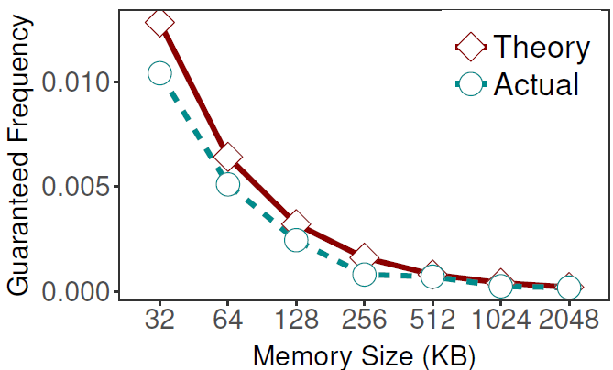
Fitting Theorem
Guaranteed boundary of flow extraction
Flows that are guaranteed to be extracted
Flows that are not guaranteed (but are likely) to be extracted

Slide 32
Arbitrary Flow Keys
Query for three flow keys
Heavy hitter detection
Traffic size distribution

Slide 33
More Experiments
Resource consumption
Generality for various measurement tasks
Efficiency of attached query errors
Network-wide measurement

Slide 34
Conclusion
Analyze 5 user burdens in existing approximate measurement
SketchLearn framework
Multi-level data structure design
Theory: counters follow Gaussian distributions when no large flows
Self-adaptive model inference algorithm
Extended query models
Prototype and evaluations
Source code available at: https://github.com/huangqundl/SketchLearn

Slide 35
Limitations and Future Work
Less pipeline consumptions
Quantify Gaussian distributions and convergence rate
More applications

