Slide 1
CloudVS: Enabling Version Control for Virtual Machines in an Open-Source Cloud under Commodity Settings
Chung-Pan Tang, Tsz-Yeung Wong, Patrick P. C. Lee
The Chinese University of Hong Kong
NOMS’12

Slide 2
Using Cloud Computing
Cloud computing is real…
But many companies still hesitate to use public clouds
e.g., security concerns
Open-source cloud platforms
Self-manageable with cloud-centric features
Extensible with new functionalities
Deployable with low-cost commodity hardware
Examples:
Eucalyptus, OpenStack

Slide 3
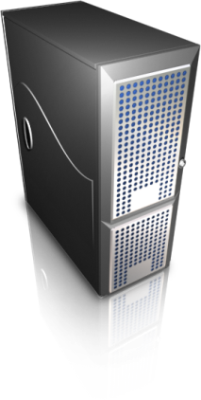
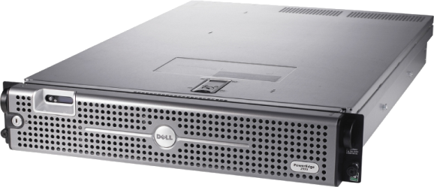
Private Cloud Deployment
In most private cloud systems,
virtual machines (VMs) are created on demand, and disposed when finished
i.e., work without persistent storage
Create
Terminate
VM
VM
VM image storage

Slide 4
Reliability of VMs
The disposable assumption may not be adequate:
Accidental VM crashes
Temporary VM termination for resource rearrangement
Question: How to ensure the reliability of VMs toward failures with low-cost commodity hardware?
One option: version control

Slide 5
What is Version Control?
User’s point of view
0
A.1
B.1
A.2
A.1
B.1
Idea. Manage changes to files, documents.
A.2

Slide 6
Challenges
Design challenges of enabling version control for VMs in an open-source cloud platform:
Can it scale to many VM versions?
e.g., maintain a large volume of VM versions within a cloud
Can it work with limited network bandwidth?
e.g., huge transmission overhead of VM images
Can it work with low-cost commodity configurations?
e.g., a few GB of RAM, 32/64-bit CPU, standard OS

Slide 7
Related Work
VM management:
VM checkpointing
e.g., [Nicolae, HPDC'11]
VM migration
e.g., CloudNet [Wood, VEE '10]
VM image storage
e.g., Mirage [Reimer, VEE '08], LiveDFS [Ng, Middleware’11]
Limited studies on open-source cloud systems

Slide 8
Our Work
CloudVS: an add-on system of VM version control in an open-source cloud
Design goals of CloudVS:
Target open-source clouds deployed on low-cost commodity hardware and OS
Provide version control operations, while minimizing the overhead during versioning and restore processes

Slide 9
Our Work
Design features of CloudVS:
Versioning with redundancy elimination: only process the changed part of each VM snapshot version
Tunable delta storage: trade between the restore performance and storage overhead
I/O Optimization: minimize interferences to co-resident VM instances during versioning

Slide 10
Our Work
VM Image Storage
Deploy CloudVS on Eucalyptus testbed
CloudVS serves as a storage layer between compute nodes and VM image storage
Evaluate versioning operations and compare with full image approach
CloudVS
Pool of Compute Nodes

Slide 11
Basics: Snapshot
A VM snapshot is a read-only copy of the disk, at a particular point of time
To preserve states of VM,
Snapshots are taken regularly and sent to persistent storage
Inefficient to store and transfer the raw snapshots
Solution: use redundancy elimination to exploit content similarity

Slide 12
Basics: Fingerprints
How to compare VM snapshots?
Solution: Divide a VM snapshot into chunks and use cryptographic hashes (or fingerprints)
Hash-based comparisons
Same content ➔ same hash
Different content ➔ different hashes with high probability
Pros: block comparison reduced to hash comparison
Cons: collision may occur, but with negligible probability [Quinlan & Dorward, ’02]
4K Bytes
New block
MD5 or SHA-1
MD5
SHA-1
16 Bytes
20 Bytes

Slide 13
Basics: Delta
17
18
Merge
Base file
Delta file
Target file
A delta is an object that specifies the content differences between a base file and a target file
A + Delta(A,B) = B

Slide 14
Basics: Deltas in Versions
Two common approaches to version series:
Incremental deltas
Delta(version 1, version 2),
Delta(version 2, version 3), ……
Delta(version i-1, version i)
Differential deltas
Delta(version 1, version 2),
Delta(version 1, version 3), ……
Delta(version 1, version i)
There is storage overhead to store version series by differential delta

Slide 15
Incremental Deltas?
Storage with incremental deltas
To restore n-th version,
We need to all deltas from 1 to n
i.e. Delta(1,2) ; Delta(2,3) ; Delta(3,4) ;…
and merge delta one-by-one
Problem:
Incurs lots of disk seeks due to fragmentation
1st
2nd
3rd

Slide 16
Tunable Delta Storage
Our heuristic design uses a single parameter α
trade between fragmentation and storage overhead
explore intermediates between extremes of storing incremental and differential deltas
Main idea: extract non-sequential parts and store them sequentially
The top proportion α (in term of no. of seeks) will be stored as differential deltas
α = 1 → only differential delta is stored
α = 0 → only incremental delta is stored

Slide 17
Tunable Example
Version 1
Version 2
Metadata
1
2
3’
4
5’
6’
7’
1
2
3’
4
5’’
6’
7’
1
2
3
4
5
6
7
3’
5’
6’
7’
5’’
Data chunks
To restore versions, we need chunks:
For version 1: {3’, 5’}, {6’, 7’}
For version 2: {3’, 5’’} (most seeks!), {6’, 7’}

Slide 18
Tunable Example
Version 1
Version 2
Metadata
1
2
3’
4
5’
6’
7’
1
2
3’
4
5’’
6’
7’
1
2
3
4
5
6
7
3’
5’
6’
7’
3’
5’’
Data chunks
For α = 0.5, chunk size = 2
Trade storage for the restore performance

Slide 19
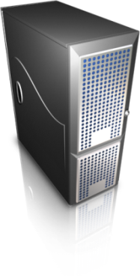
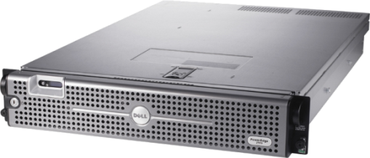
CloudVS Design
Base VM
images
Tunable Delta Storage
Differential deltas
Incremental deltas
Compute Nodes
VM Image Storage
Taking snapshot by LVM
Redundancy elimination: fixed-size chunking
Several I/O Optimizations
pre-declaring access patterns, rate limiting of disk reads
Details in the paper

Slide 20
Experiments
Eucalyptus deployment
4 compute node
1 storage node
Gigabit switch connection
Datasets
90 daily-snapshot VM images of Fedora 14
Each VM image is of size 5GB
VM operations via euca2tools:
Launch VM instances
Terminate VM instances
VM Image Storage
CloudVS

Slide 21
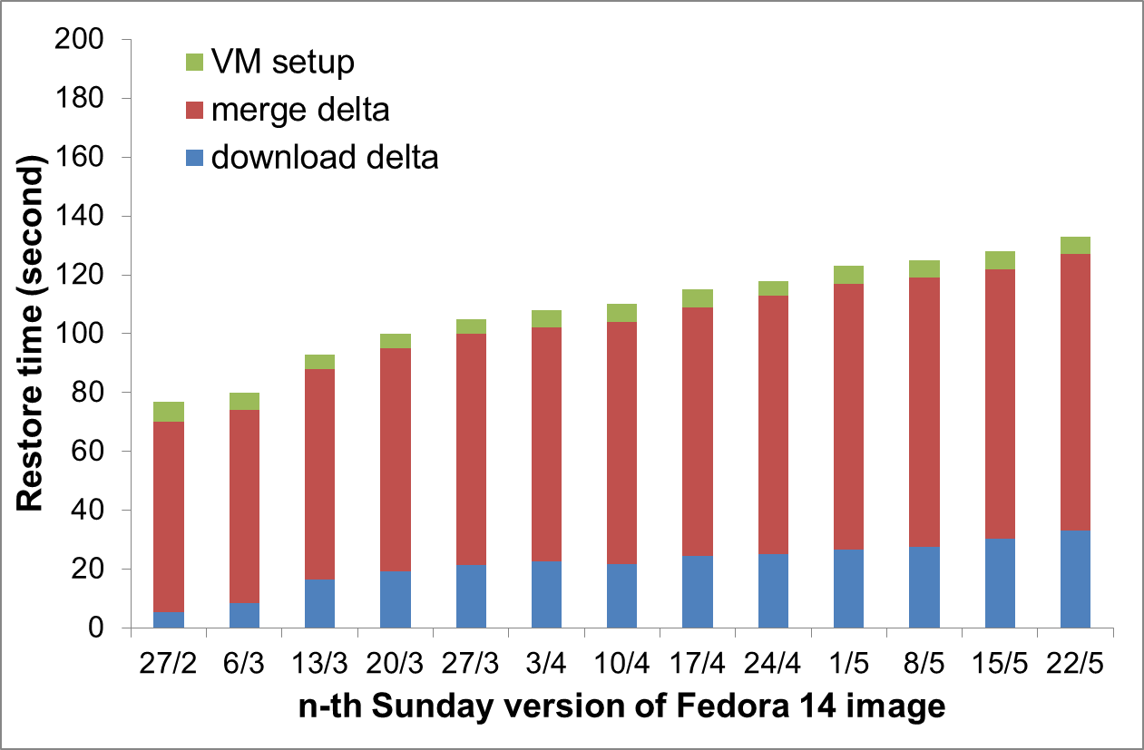
Restore Performance
Full image download: 162s
CloudVS saves 25-51% time over whole image restore
Notes:
We observe that the startup time
ranges from 79s to 122s, then the total startup time is about 162s.

Slide 22
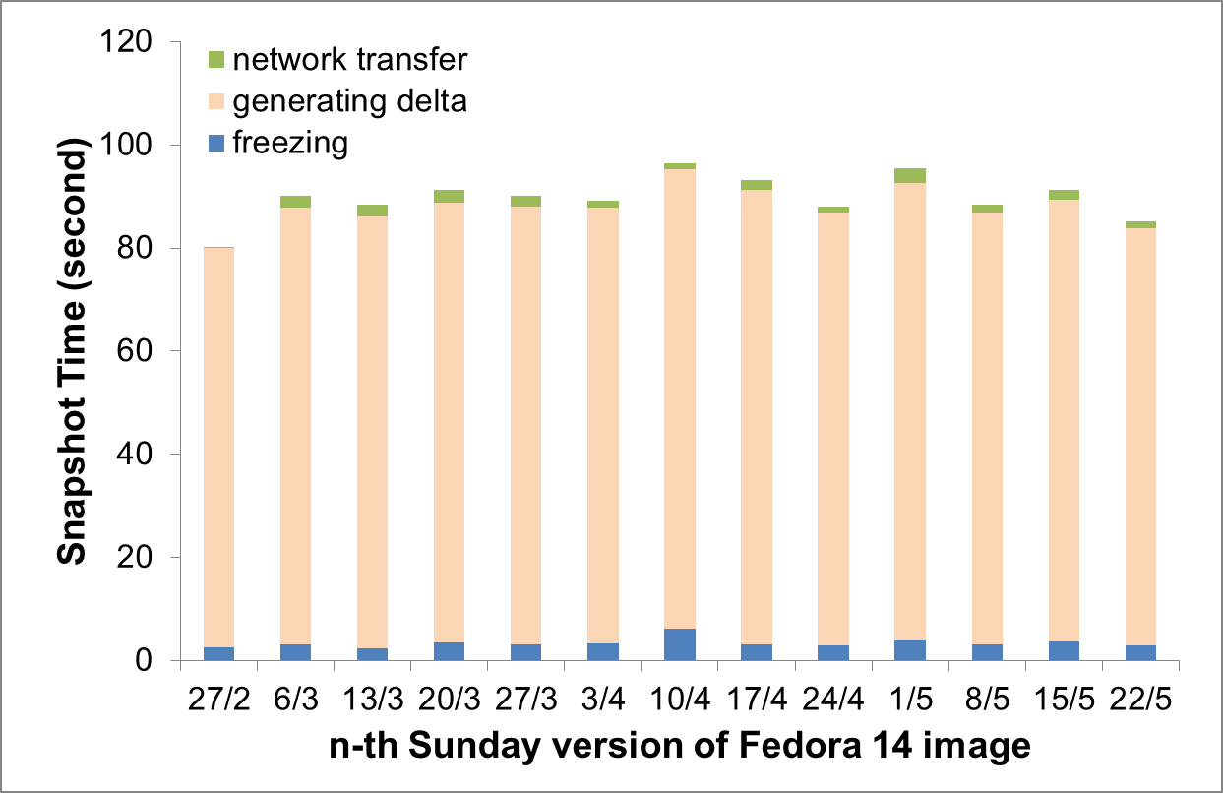
Versioning Performance
Versioning takes 80-100 seconds, which costs only < 5 seconds for VM freezing

Slide 23
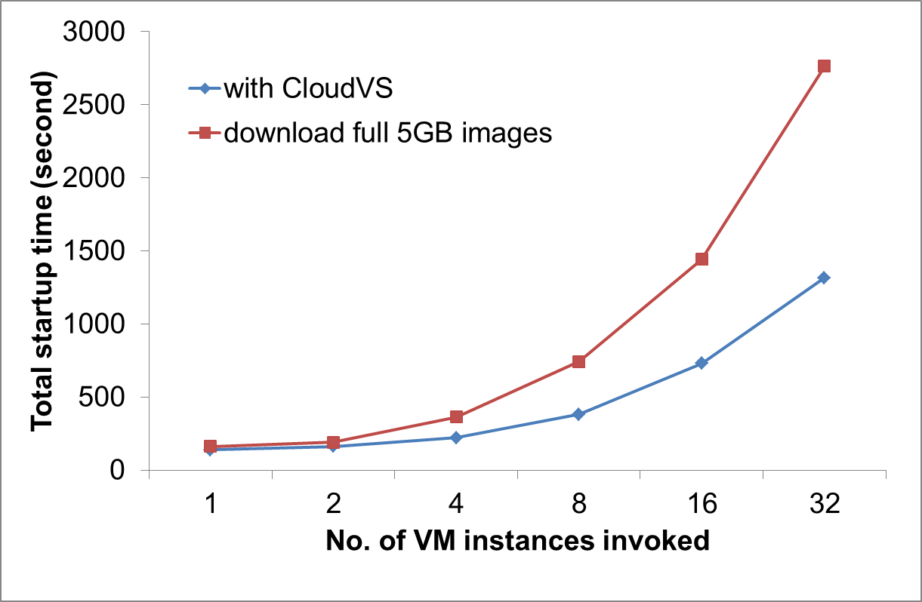
Multiple Restore Performance
CloudVS use 50% less startup time then that of full base images, for example, when N= 32

Slide 24
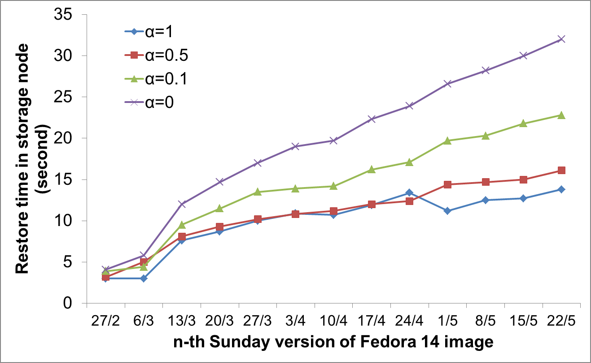
Effect of Tunable Storage
The smaller α leads to more restore time Eg. α = 0.5, the restore time is 3 seconds more than the α = 1 (purely differential deltas)

Slide 25
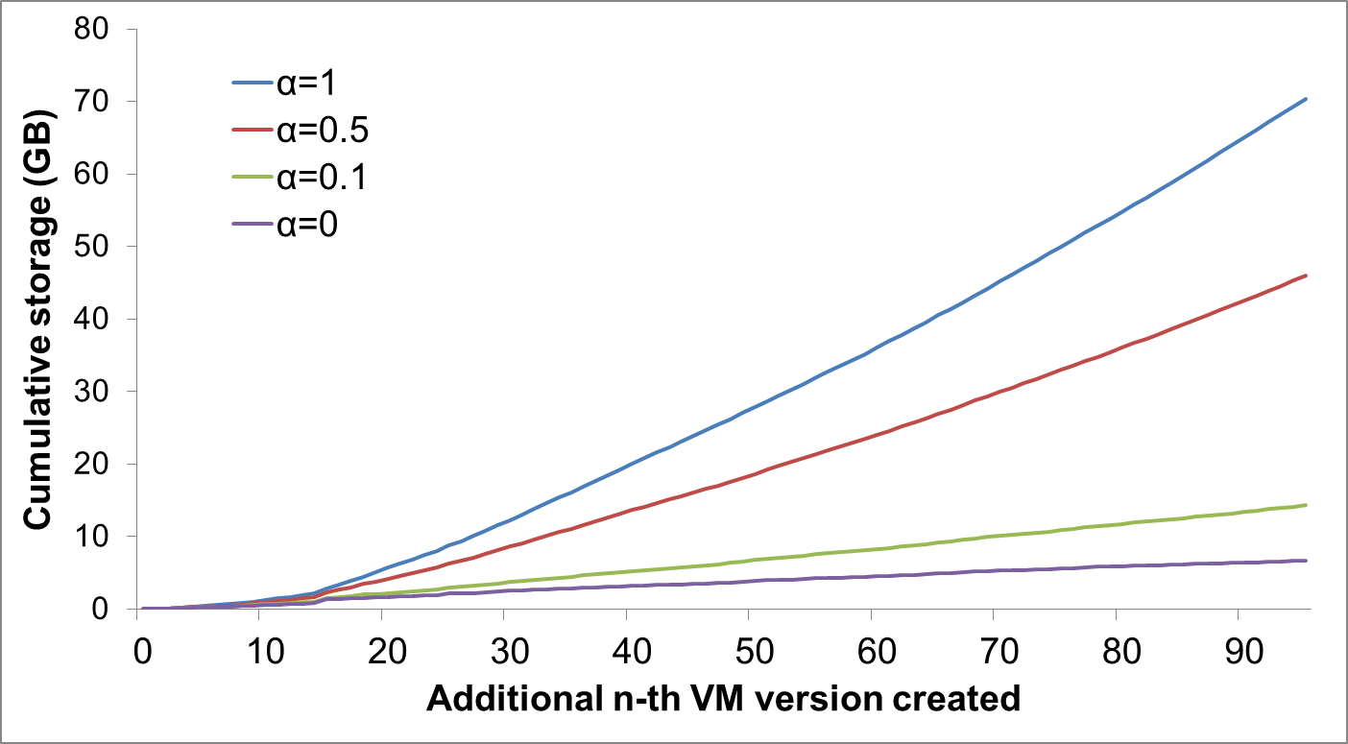
Storage Usage
But the smaller α leads to less storage space. e.g., α = 0.5, the storage consumes 35% less storage than the α = 1 (purely differential deltas)

Slide 26
Summary of Results
CloudVS saves both bandwidth and storage by redundancy elimination
CloudVS trades between the restore performance and storage overhead
Microbenchmark experiments to study impact of each design features
See details in paper

Slide 27
Conclusions
Deploy VM version control in an open-source cloud platform with commodity settings
Propose CloudVS, an add-on system
Versioning with redundancy elimination
Tunable delta storage trading between the fragmentation and storage overhead
Several I/O optimizations to improve performance on commodity setting
Source code:
http://ansrlab.cse.cuhk.edu.hk/software/cloudvs

