Slide 1
CellPAD: Detecting Performance Anomalies in Cellular Networks via Regression Analysis
Jun Wu*, Patrick P. C. Lee#, Qi Li*, Lujia Pan$, Jianfeng Zhang$
*Tsinghua University #Chinese University of Hong Kong $Huawei Noah’s Ark Lab
IFIP Networking 2018

Slide 2
Motivation
Performance anomalies can disrupt cellular networks
e.g., outages, malfunctions, disconnections, performance drops, etc.
Key Performance Indicators (KPIs)
Time-series measurements for network elements and resource usage
KPI anomalies:
e.g., unexpected patterns at specific time instants or over a period of time
Goal: Detecting KPI anomalies
Maintain network dependability
Improve subscribers’ quality-of-experience

Slide 3
Challenges
Anomaly detection is challenging:
No “best” algorithms for all problems
Labeling (i.e., identifying ground truths) is labor-intensive
Differentiating normal and abnormal points is hard
Anomalies are rare
Specific challenges in cellular networks that must be addressed:
Internet traffic exhibits both periodic and trend patterns
Factors may be correlated
e.g., Data transmission and radio resource usage

Slide 4
Our Contributions
Trace-driven analysis on a large-scale KPI dataset from a metropolitan LTE network in China
CellPAD, a KPI anomaly detection tool
Detect drop and correlation anomalies
Support various prediction algorithms (incl. statistical and ML regression)
Account for seasonality and trends
Provide a feedback loop for model retraining
Insights from evaluation of CellPAD on the KPI dataset
Source code: http://adslab.cse.cuhk.edu.hk/software/cellpad

Slide 5
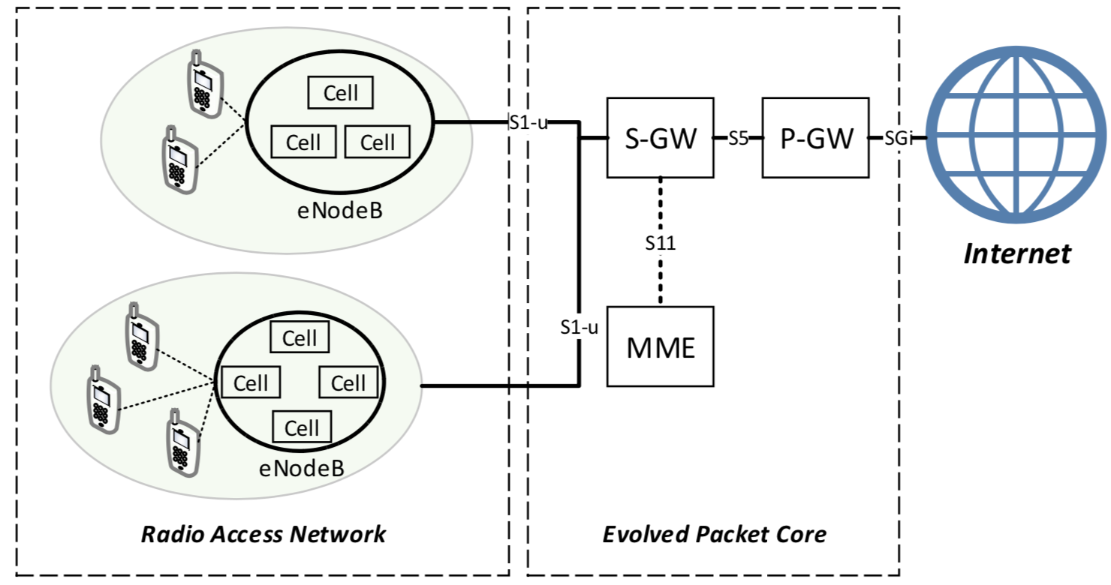
Dataset
Long-duration: 17 weeks, hourly basis
November 7, 2016 to January 8, 2017
February 13, 2017 to March 12, 2017
April 10, 2017 to May 7, 2017
Large-scale: 12,463 cells with 6 KPIs
User population (USER)
Radio resources (RRC, ERAB, and PRB)
Data transmission load (THR and DUR)
LTE network

Slide 6
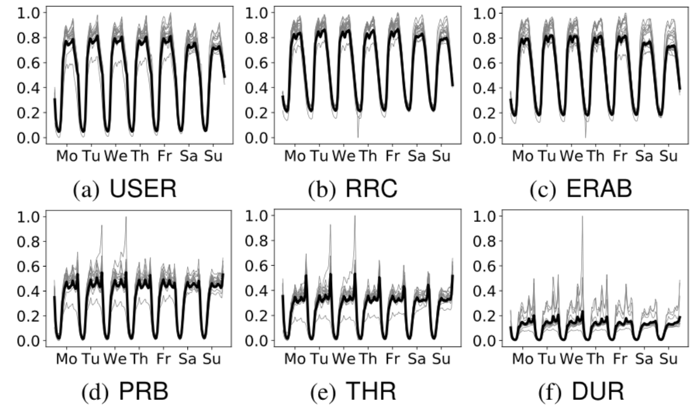
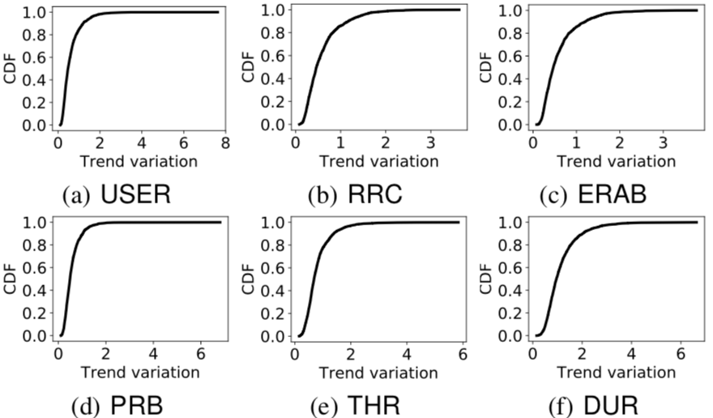
Seasonality and Trend
Seasonality
Trend
Seasonality: stable diurnal pattern
Trends: high trend variation pattern in some cells
Trend variation captures the change of the averages of sliding windows

Slide 7
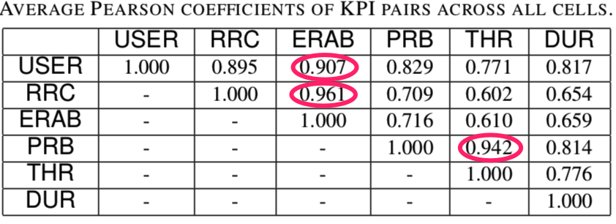
Correlation
KPIs are positively correlated

Slide 8
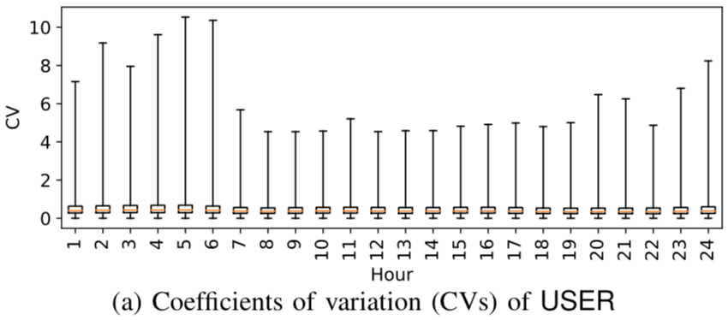
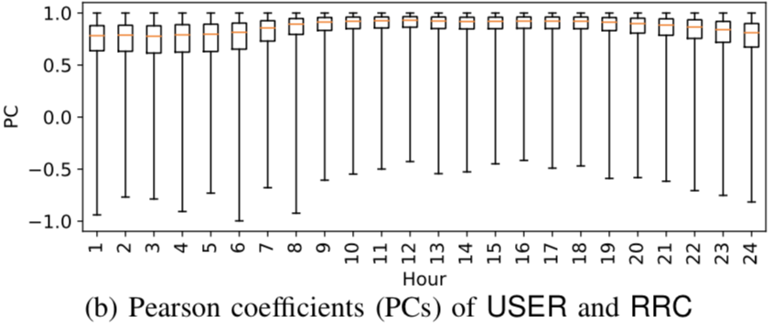
Variations
High variances of KPI values and KPI correlations in some cells
Indicators of anomalies

Slide 9
Anomalies
Sudden drops: sudden performance degradation of KPI
e.g., a sudden drop in number of users → disconnections of many users
Correlation changes: sudden deviations of two correlated KPIs
e.g., more RRC request attempts but same number of users → cell failure
Assumptions:
Per-cell anomaly detection
Root causes unknown

Slide 10
CellPAD Architecture
KPI Streams
Feature Engineering
Predictors
Anomaly Detection
Retrain
Sudden Drop
Normal
Instances
N
Anomaly?
Y
Correlation Change
Input: stream of KPI instances
Output: normal instances or anomaly instances

Slide 11
Predictors
Each predictor returns a predicted value for each hour based on the underlying prediction algorithm
Prediction algorithms:
Simple statistical modeling
Exponentially weighted moving average (EWMA); Weighted moving average (WMA); Holt-Winters (HW); Local correlation score (LCS)
Linear regression
Simple linear regression (SLR); Huber regression (HR)
Tree-based regression
Regression tree (RT); Random forest (RF)

Slide 12
Feature Engineering
Features
Sudden drops: one predictor for a KPI
indexical features: hour (0-23) and day (0-6) indexes
numerical features: numerical operations <win, oper>
Correlation changes: two predictors for KPIs
Predictor of one KPI takes the value of another KPI as feature
Hour and day indexes for tree-based models
Trend removal
Compute the average over a sliding window of 168 hours
Divide the raw value by the computed average

Slide 13
Anomaly Detection
Sudden drops
Drop ratio: $D= \frac{{KPI}_{a}−{KPI}_{p}}{{KPI}_{p}}$
Correlation changes
Change ratio: $C_{1}= \frac{{KPI1}_{a}−{KPI1}_{p}}{{KPI1}_{p}}, { C}_{2} = \frac{{KPI2}_{a}−{KPI2}_{p}}{{KPI2}_{p}}$
N-sigma rule
Sudden drop if $D<μ −N∗σ$
Correlation change if $C_{1\left(2\right)}<μ −N∗σ$ or $C_{1\left(2\right)}>μ+N∗σ$

Slide 14
Evaluation
Goal: evaluate accuracy of CellPAD on the KPI dataset
How to label anomalies?
Synthetic anomalies:
Select a fraction of KPI instances and change their values by 30-100%
Rule-based anomalies:
Identify the KPI instances whose raw values have obvious deviations
Results: 3-4% anomalies in total
Bootstrap the models with first two weeks of KPI instances
Randomly select 80 cells for our evaluation

Slide 15
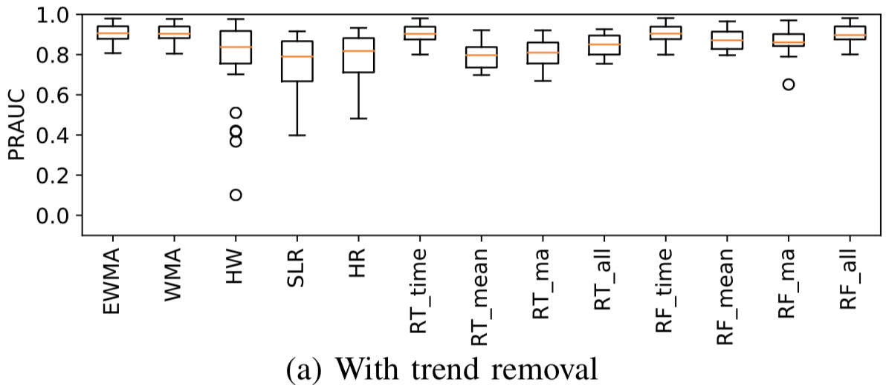
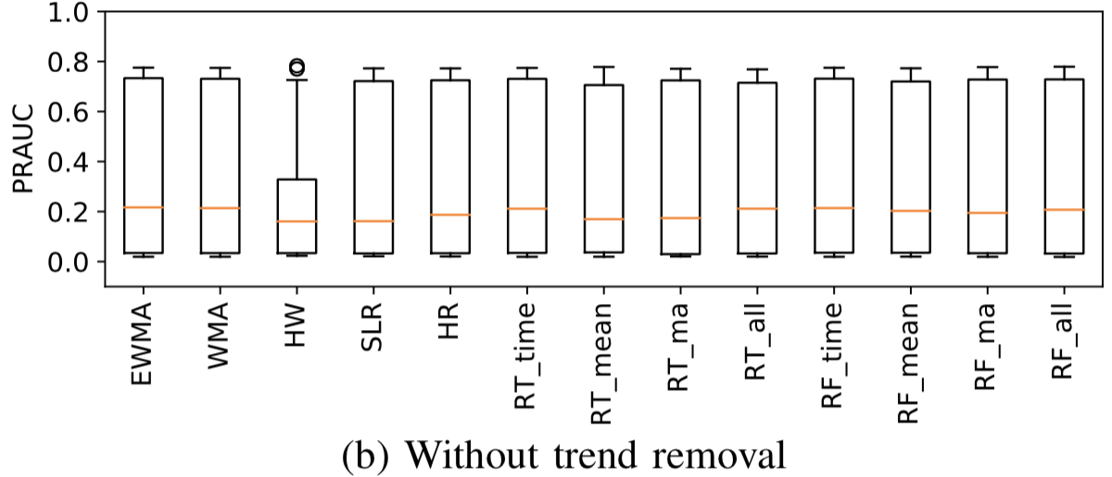
Sudden Drop Detection
Simple statistical modeling
Random forest
Trend removal is critical for improving accuracy
Random forest with trend removal is most accurate
Simple statistical modeling (e.g., EWMA, WMA) can also be accurate

Slide 16
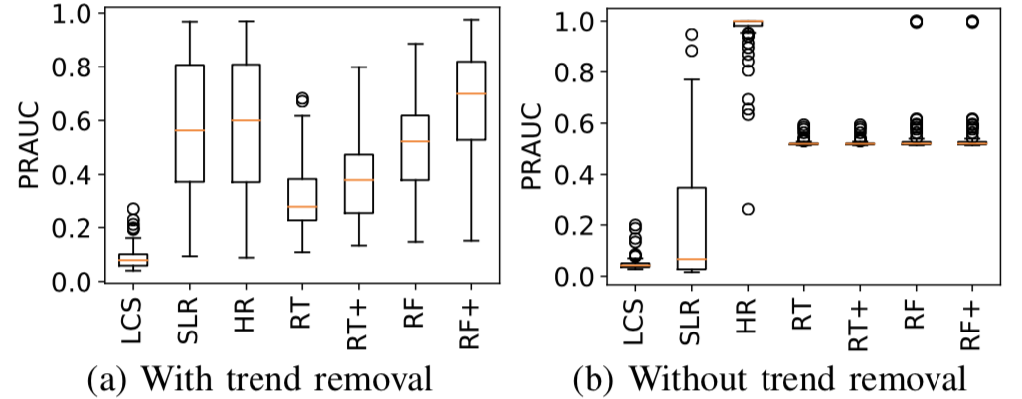
Correlation Change Detection
Trend removal doesn’t necessarily improve accuracy
Correlated KPIs with different trends imply correlation change
Huber detection without trend removal is most accurate

Slide 17
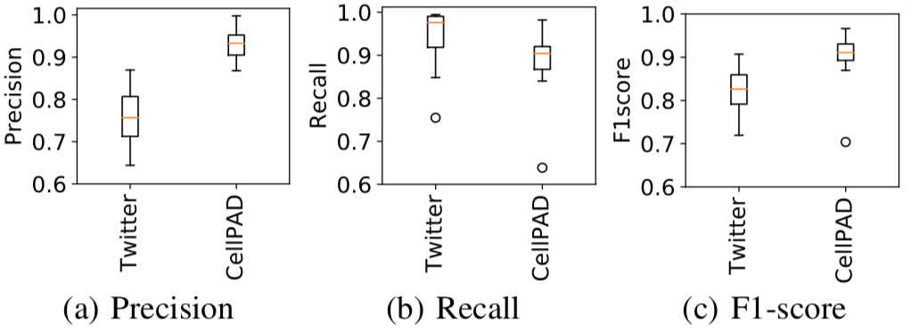
Comparisons with Twitter’s Detector
CellPAD (using random forest) achieves higher accuracy
Twitter’s detector builds on statistical modeling

Slide 18
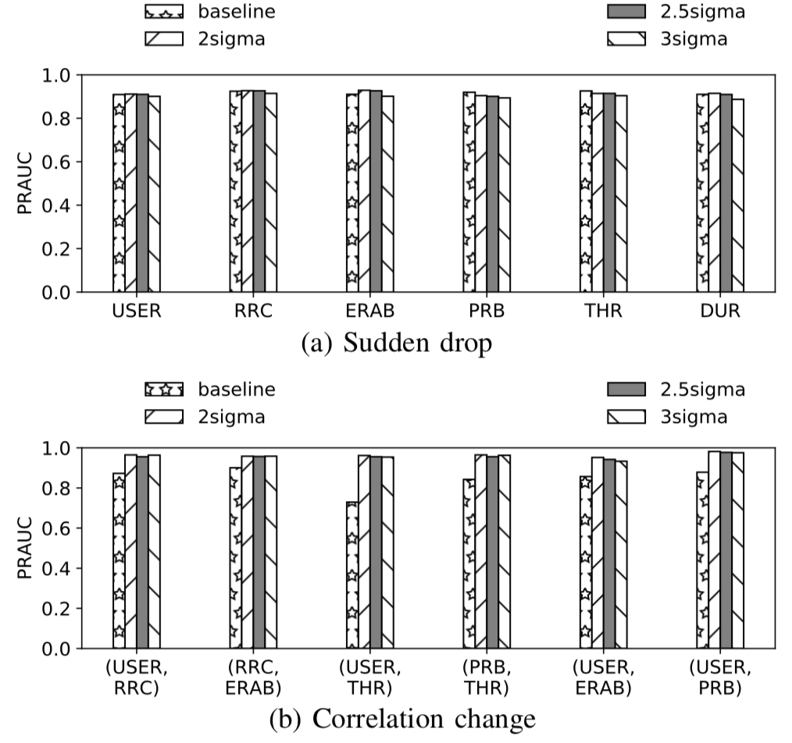
Effects of Model Retraining
Effects of feeding back normal instances for model retraining:
Sudden drop: similar
Correlation change: improved
No significant differences for different thresholds

Slide 19
Conclusions
Trace-driven analysis
Design of CellPAD
Detect sudden drops and correlation changes
Support various statistical and ML-based regression algorithms
Address seasonality and trends in anomaly detection
Provide a feedback loop for prediction model retraining
Trace-driven evaluation on accuracy of CellPAD
No single prediction algorithm is an absolute winner in both sudden drop and correlation change detection

