Slide 1
A Panoramic View of 3G Data/Control-Plane Traffic:
Mobile Device Perspective
Xiuqiang He¹, Patrick P. C. Lee²,
Lujia Pan¹, Cheng He¹ and John C. S. Lui²
¹Noah’s Ark Lab, Huawei Research, China
²The Chinese University of Hong Kong, Hong Kong

Slide 2
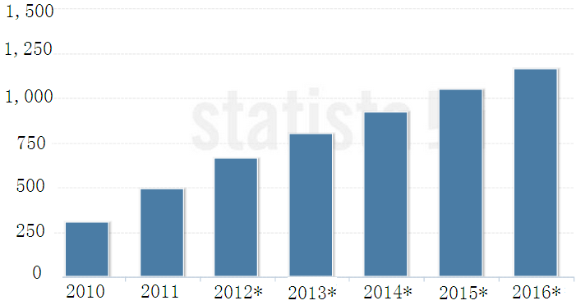
Motivation
Smart phone shipments forecast
In million units
Smartphones, tablet computers, and datacard attached to laptops/PCs increase rapidly
tremendous growth of mobile Internet access worldwide
bring great challenges to the data/control plane of 3G/4G network
1.2billion
<<Source: IDC, 2012>>
Questions:
What are the traffic patterns of different device types?
How traffic patterns of different device types influence the performance of cellular data networks in both data/control plane?
Notes:
With the wide deployment of 3G/4G wide-area cellular data networks, and rapid expansion of smart phone, tablet computers and datacard, there have been tremendous growth of mobile internet access worldwide, and will bring great challenge to the data/control plane of 3G/4G network.
From the perspective of network operators, it’s necessary to understand the traffic patterns of different device types and how they influence the performance of network in both data/control plane, and thus they can provide differentiated pricing or priority services across different device types or applications in order to maximize their profits.
In this work, we conduct an in-depth measurement study on the impact of different device types on the data/control plane performance of a 3G UMTS network.

Slide 3

3G UMTS Network
We collected data/control-plane traffic from a commercial 3G UMTS network deployed in a metropolitan city in China.
Iu
SGSN
Server
RNC
R
IP Bearer
R
router
router
Switch
Internet
Gn
GGSN
RNC
SGSN
Gi
Iub
RRC record logs
data/control plane traffic
Time span | Nov.25 - Dec.1 2010 (7*24 hours)
Total size | 13TB
No. packets | 27.6 billion
No. flows | 383 million
No. devices | 60K
RRC records | 168 million
Data summary
Notes:
We collected data/control-plane traffic from a commercial 3G UMTS network deployed in a metropolitan city in China.
The figure illustrates a simplified topology of a 3G network we considered. The data path between a user equipment (UE) and the internet traverses a base station, a ratio network controller (RNC), and the core network, which includes the SGSN and GGSN. Our capture point resides in the integrated interface (Iu-Ps) that connects 16 RNCs and the CN. We also collected the RRC connection record logs from the RNCs.
In summary, we collected a 7*24 hours span of traces from Nov.25-Dec.1, 2010. The trace have a total size of 13TB, with 27.6 billion packets and 383 million flows, 168 million RRC connection records. We also identify over 60K 3G devices in the network.

Slide 4
Related work
Measurement studies of 3G network
  Round-trip times of TCP flow data (GPRS/UMTS network) [Kilpi_Networking2006]
  Compare similarity and difference with wireline data traffic (CDMA2000) [Ridoux_INFOCOMM2006]
  TCP performance and traffic anomalies (GPRS/UMTS network) [Ricciato_CoNext2005] [Alconze_Globecom2009]
Control-plane performance of 3G network
  Signaling overhead from security perspective
  [Lee_computer networks2009]
  Infer RRC state transition from data-plane traffic
  [Qian_IMC2010]
Notes:
There have been measurement studies of 3G network focusing on in-network data traffic collected inside 3G network.
The following 3 papers focus on the data-plane traffic.
Some recent studies analyze the control-plane performance of 3G networks. Lee study the signaling overhead from the security perspective, and Qian infer RRC state transition from data-plane traffic, and mainly focus on power consumption of mobiles.
In contrast, our work focus on distinguishing different device types and analyzing each of their data/control-plane performance.

Slide 5
Related work
Data traffic behavior of different types of devices
  Compare handheld and non-handheld devices in campus WiFi network [Gember_PAM2011]
  Study smart phone traffic and differences of user behaviors based traces of individual devices [Falaki_IMC2010]
  3GTest, a tool generate probe traffic to measure the 3G network performance [Huang_MobiSys2011]
Notes:
Several studies analyze the data traffic behavior of different types of handheld devices.

Slide 6
Our Work
Characterize both data- and control-plane performance and their interactions of different device types in a 3G cellular network in China
Contributions:
  Propose a methodology of correlating data- and control-plane traces based on 3G standards
  Conduct extensive measurement study on 24 hours of data/control-plane traces
    ~60K devices, ~1.9TB of data
Notes:
Our work is distinct from all the previous work.
Firstly, we study both data and control performance, as well as their interaction of different device types.
Secondly, we collected the packets with full IP payload information, with the help of commercial DPI module, we can accurately identify more user application and infer their impact to network.
Finally, we proposed a methodology to correlate the data-plane and control-plane traffic according to the standard 3G specifications.

Slide 7

Workflow
Extracting signaling messages
Performance
1. Over 90% of the traffic can be identified by DPI
Over 99% of the devices can be identified
Raw data preprocessing
…
DPI module from a commercial product
DPI Analysis
Identify the data/control traffic for each RRC connection
Data-Signaling Correlation
All steps are implemented as Map-Reduce programs and run on a Hadoop platform
In-Depth Analysis
Notes:
This figure illustrates the workflow in which we perform the analysis of 3G data/control plane traffic:
One task of raw data preprocessing is to extract the signaling messages from the data plane traffic, and later they will be used in data/signaling correlation.
The next step is the DPI (Deep Packet Inspection) analysis. With the help of the DPI module of a commercial product, we can identify the application to which each data packet belongs.
The third step is to perform the data-signaling correlation in order to identify the data/control traffic for each RRC connection.
After all the previous steps, we will perform in-depth measurement study of the data/control plane traffic and figure out the impact of different device types on the data/control plane performance of the 3G network we considered.
There are some statistical summary of the performance of the workflow: over 90% of the traffic can be identified by DPI, and over 99% of the devices can be identified.
Also due to the huge amount of the data/control traffic, we conducted all the steps on a Hadoop platform.

Slide 8
RRC Connection Setup
UE
RNC
CN
RRC connection setup
RANAP: Initial UE message
SCCP CC (Success/Failure)
RANAP: Common ID (IMSI)
RAB Assignment Request
RAB Setup
RAB Assignment Response
SCCP CC
Timestamp | RNC-LR | SGSN-LR
Common ID
Timestamp | RNC-LR | IMSI
RAB Assignment request
Timestamp | RNC-LR | SGSN IP | SGSN TEID
RAB Assignment response
Timestamp | SGSN-LR | RNC IP | RNC TEID
Notes:
Abbreviation:
SCCP: signaling connection control part
SCCP CC: SCCP connection conform
RAB: Radio Access Bearers
When the UE wants to send or receive data, the RNC ﬁrst makes a SCCP (Signaling Connection Control Part) connection request with the CN, which replies a SCCP Connection Conﬁrm (CC) message, where SCCP can be viewed as the transport protocol for RANAP. The CN also replies a Common ID message, which contains the IMSI of the UE. The RNC associates the IMSI with the
RRC connection for the UE and keeps this association throughout the RRC connection. Note that a single RRC connectionmay consist of one or multiple Radio Access Bearers (RABs) assigned for data communications. Each RAB assignment deﬁnes the actual radio resources for transmitting data trafﬁc between the UE and the CN. The CN sends a RAB Assignment Request message to the RNC, which then executes the RAB setup protocol with the UE. Finally, the RNC replies a RAB Assignment Response message to the CN. From this onwards, the UE can send or receive data. (from the paper)
We are interested in the four signaling messages (within the red box), and the red items contains the useful information as the key to correlate with data packets.

Slide 9
Data-Signaling Correlation
SCCP CC
Timestamp | RNC-LR | SGSN-LR
Within 15 seconds
Common ID
Timestamp | RNC-LR | IMSI
RAB Assignment request
Timestamp | RNC-LR | SGSN IP | SGSN TEID
RAB Assignment response
Timestamp | SGSN-LR | RNC IP | RNC TEID
Signaling packets
Timestamp | IMSE | SGSN IP | SGSN TEID | RNC IP | RNC TEID
Within 150 seconds
Within 150 seconds
IMSE | IMEI | RRC Connection Info.
Timestamp | RNC IP | SGSN IP | SGSN TEID | Data-plane info.
RRC logs
Data plane packet
IMEI | Terminal type
IMEI Library
Correlation results
Timestamp | Data plane info | RRC Connection Info | Terminal type
Notes:
This figure illustrates the data-signaling correlation methodology. There are 4 groups of datasets:
Signaling packets.
Data plane packets, collected at the IuPs interface between RRCs and CN.
RRC connection record logs (RRC logs), collected from the RNC logs.
IMEI library, obtained from the Internet.
The correlation process is similar to the relational join operation by correlating the common fields in different datasets.
1. firstly, we join the four signaling messages that have identical RNC-LR and SGSN-LR values; RNC-LR and SGSN-LR are the local reference of the RNC and SGSN associated with the RRC connection.
2. Secondly, we join the output and RRC connection logs that have identical IMSI, similarly, we join the output with IMEI library records that have identical IMEI.
3. Thirdly, we join the output records with data packets. Each correlated data packet must have the same RNC IP, SGSN IP and TEID fields as in the RRC record.
Finally, we get the correlation result.
Since the data/control traffic and the record logs are obtained at different capture points that have loosely synchronized system clocks with around 60-150 second difference. Thus we need to allow tolerance of such capture time differences in our correlation. We allow the time difference of 15 seconds in joining the signaling packets and 150 seconds for both step 2 and step 3.

Slide 10
Applications/Terminals
Applications
  Web browsing, Streaming, File Access, Instant
  Messaging (IM), Email, P2P,
  Network Admin, Tunneling, and others.
Device types
  iPhone, Android, Symbian, Windows Phone
  Black Berry, Bada, Linux, iPad, Datacard
  Feature Phone
Notes:
The categories of applications that we focus in our analysis;
The device types we considered in our analysis.
Customer privacy is preserved,

Slide 11
Overview
Focus on the 1-day traces on Nov. 28, 2010
Notes:
The top figure plots the IP traffic volume (per minute) over time in 7-day traces. The distribution of each day are fairly stable: the trough of the traffic volume appears at around 2-3am, and peak traffic appears at around 9-10pm.
The below figure shows the number of devices identified on each day.
In the following analysis, we only focus on the 1-day traces on Nov. 28, 2010.

Slide 12
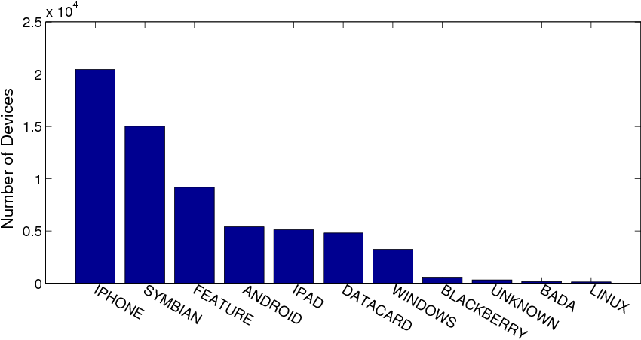
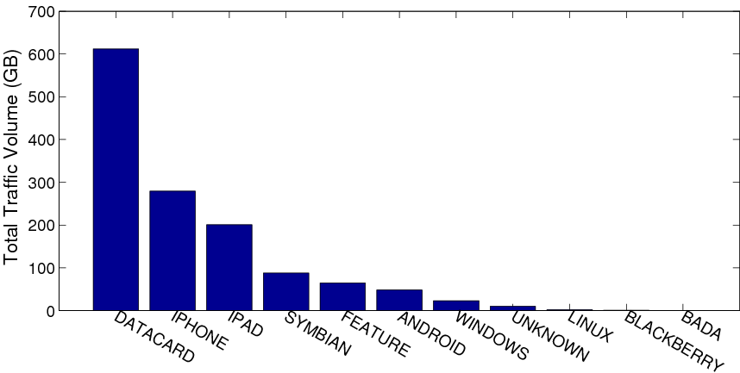
Device Distributions
No. of devices for each terminal type
iPhone leads all devices with a portion of 32%, and Symbian 23%, Feature phone 15%, Android 8%, windows phone 5%, datacard 8%
Total traffic volume of each device type
Datacard contributes 46% of the total traffic, iPhone 23%, iPad 12%, Android 4%, Windows phone 2%
Notes:
These two figures show the No. of devices for each terminal type and total traffic of each device type.

Slide 13
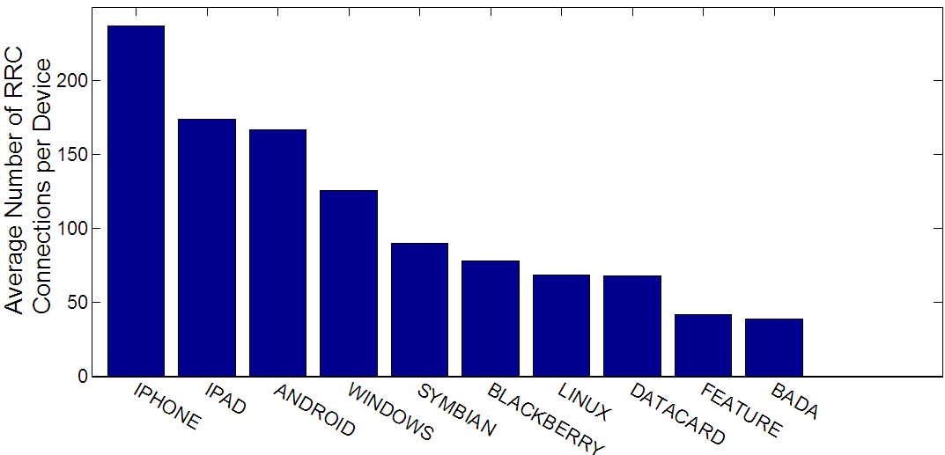
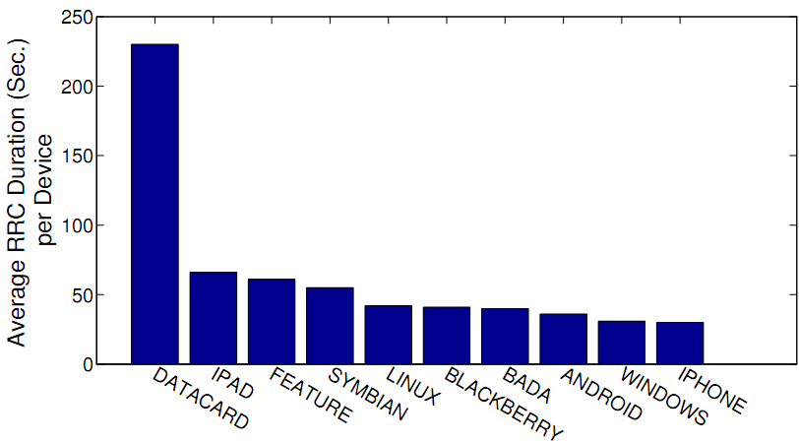
Control-Plane Performance
Average number of RRC connections per device
iPhone triggers the most RRC connections of 237 times, iPad 174, Android 167, Windows Phone 126, and datacard only 68 .
iPhone brings large signaling overhead of an RNC
Average RRC Duration per device
iPhone has the smallest duration 30 seconds, Windows Phone 31, Android 26, and datacard with the longest duration of 230.

Slide 14
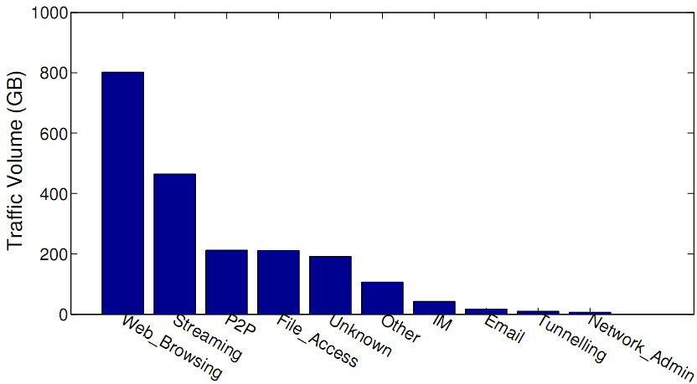
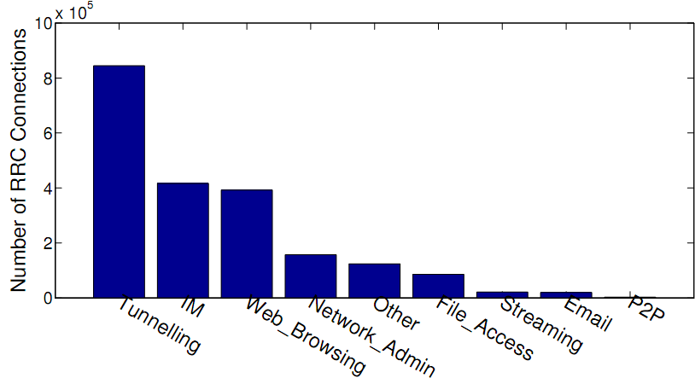
Applications Overview
Web browsing 38%, streaming 21%, P2P 10%, and file access 10% are ranked top four most used applications
IM contributes 2% of the total traffic
Traffic volume of applications
Tunneling triggers the most RRC connections (43%),
IM triggers 21% of all connections
P2P triggers only 0.1% of all RRC connections
Total number of RRC connections of applications
Notes:
We define that an application triggers an RRC connection if the first data packet transmitted in the RRC connection belongs to the applications

Slide 15
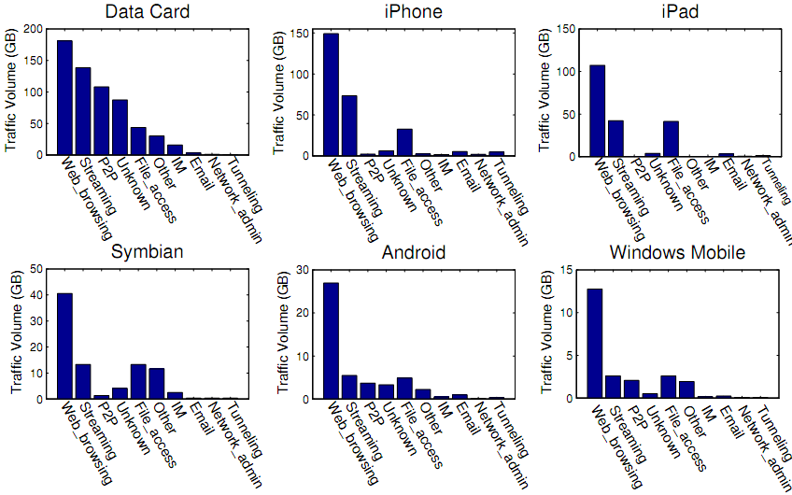
Applications on terminals
Datacard contributes 85% and 48% of all P2P and streaming traffic
Web browsing, streaming and file access are the top 3 applications that accounts for the most traffic on smartphones.

Slide 16
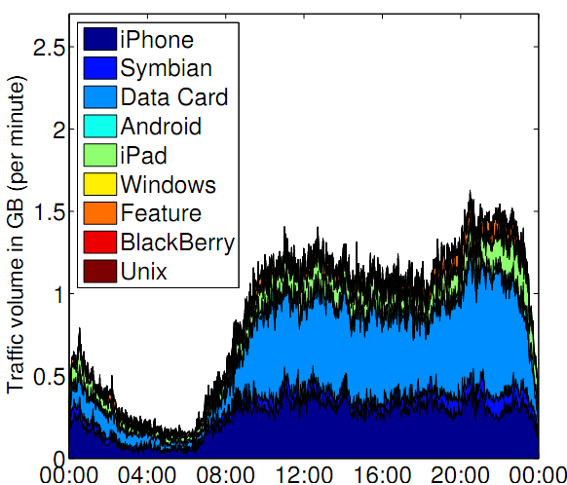
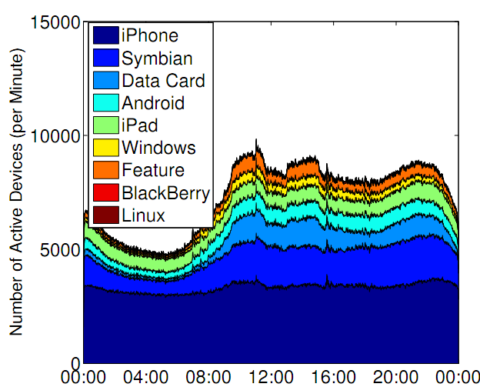
Active devices
Traffic volume (per minute) dist.
No. of active devices (per minute)
52%↓
93%↓
The number of active devices of iPhone and iPad remain stable during the 24-hour period, distinct from other devices which have obvious peak-trough pattern.
Possible reason: Internal heartbeat mechanism of iPhone and iPad.
Notes:
Active device definition:
We say a device is active within time [t1, t2] if starts and release a RRC connection at time t1 and t2, respectively.
The left figure shows the stacked area chart of total traffic volume of each terminal type, the traffic volume peak appears in day time, and traffic trough appears at late night.
The right shows the distribution of active devices for different types. It shows a similar pattern to the left one, however, the traffic volume at the trough is 93% less than the peak traffic volume in left figure, while the number of of active devices at the trough is 52% less than the peak value.
After further investigation, we find that iPhone and iPad have a very similar pattern that is distinct from other device types, i.e., the number of active devices of iPhone and iPad remain stable during the 24-hour period.
The possible reason is due to the internal heartbeat mechanimsm of iPhone and iPad.

Slide 17
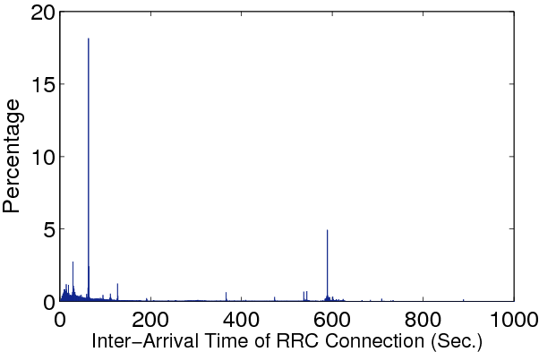
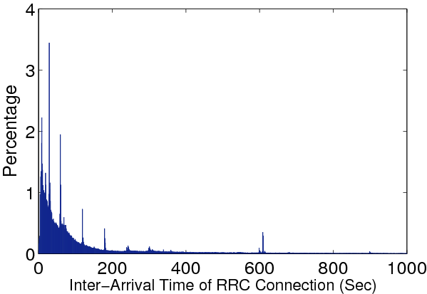
Heartbeat Mechanism
PDF of inter-arrival times of RRC connections
iPhone
Android
The inter-arrival times of RRC connections of iPhone occur more often at 60 seconds (18.1%) and 589 seconds (5%), similar for iPad.
iOS device generates heartbeat packets every 60 seconds and triggers an RRC connection.
No explicit heartbeat patterns in Android
Notes:
The left one show the probability density of the inter-arrival times of RRC connection setups of iPhone, while the right one shows that of Android.
The results: iPhone 60 seconds (18%), 589 (5%), not hold for other types of smart phone, like Android.
The heartbeat packets that we observe in the iPhone/iPad devices introduce many RRC connection setups/releases, which could lead to high signaling overhead in the network core.

Slide 18
Summary
Datacard devices contribute almost 50% of the total traffic, accounting for only 7% of the device population.
iPhone/iPad account for around 40% of the devices, and contribute nearly 40% of the total traffic due to their large market shares.
Web browsing, streaming and file access are the mostly used applications on smart phones, and they together contribute more than 90% of iPhone/iPad traffic.
IM contributes only 2% of the traffic, but triggers over 21% of the RRC connections (signaling resource)
iPhone/iPad triggers significantly more RRC connections than any other device type, and increase signaling overhead to the network

Slide 19
Future work
Limitations of our work:
  Our dataset was collected nearly 1.5 years ago. There is dramatic growth of data/control-plane traffic.
  There are regular version updates for smartphone OS. Data transmission behavior may have changed.
Future work:
  Validate our findings for latest dataset
    Our methodology remains applicable for today’s 3G networks

Slide 20
Q&A
Thanks for your time

