Slide 1
Characterization of 3G Control-Plane Signaling Overhead from a Data-Plane Perspective
Li Qian¹, Edmond W. W. Chan¹,
Patrick P. C. Lee² and Cheng He¹
¹Noah’s Ark Lab, Huawei Research, China
²The Chinese University of Hong Kong, Hong Kong

Slide 2
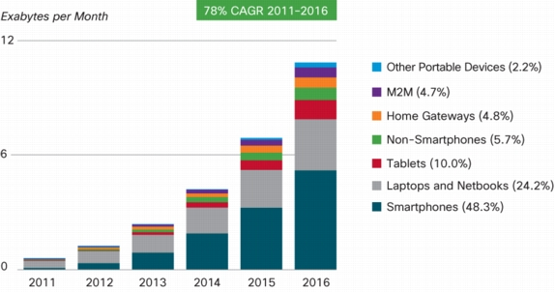
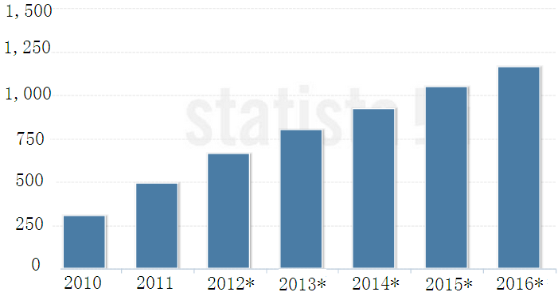
Motivation
Explosive growth of mobile devices and mobile application traffic
Problem
  Massive signaling messages triggered by data transfer increase processing and management overheads within 3G networks.
Smart phone shipments forecast
In million units
1.2billion
<<Source: IDC, 2012>>
<<Source: Cisco VNI Mobile, 2012>>

Slide 3
Our Work
Goal: To characterize 3G control-plane signaling overhead due to initiation/release of radio resources with only raw IP data packets
Contributions:
  Using national 3G network traces/logs to validate a data-plane approach for control-plane signaling overhead inference
  First extensive measurement study of signaling loads induced by different transport protocols and network applications

Slide 4
Related Work
Measurement studies of 3G network
  Round-trip times of TCP flow data (GPRS/UMTS network) [Kilpi_Networking2006]
  Compare similarity and difference with wireline data traffic (CDMA2000) [Ridoux_INFOCOMM2006]
  TCP performance and traffic anomalies (GPRS/UMTS network) [Ricciato_CoNext2005] [Alconze_Globecom2009]
Control-plane performance of 3G network
  Signaling overhead from security perspective
  [Lee_computer networks2009]
  Infer RRC state transition from data-plane TCP traffic to quantify energy consumption [Qian_IMC2010] [Qian_ICNP2010] and application resource usage [Qian_Mobysis2011]
Notes:
There have been measurement studies of 3G network focusing on in-network data traffic collected inside 3G network.
The following 3 papers focus on the data-plane traffic.
Some recent studies analyze the control-plane performance of 3G networks. Lee study the signaling overhead from the security perspective, and Qian infer RRC state transition from data-plane traffic, and mainly focus on power consumption of mobiles.
In contrast, our work focus on distinguishing different device types and analyzing each of their data/control-plane performance.

Slide 5
Related Work
Data traffic behavior of different types of devices
  Compare handheld and non-handheld devices in campus WiFi network [Gember_PAM2011]
  Study smart phone traffic and differences of user behaviors based traces of individual devices [Falaki_IMC2010]
  3GTest, a tool generate probe traffic to measure the 3G network performance [Huang_MobiSys2011]
  Study of data/control-plane performance of different mobile terminals [He_Networking2012]
Notes:
Several studies analyze the data traffic behavior of different types of handheld devices.

Slide 6

3G UMTS Network
Collect data/control-plane traffic from a commercial 3G UMTS network deployed in a metropolitan city in China
Analyze 24-hour IP packet traces collected on Dec 1, 2010
  ~306M IP packets
  ~682K user equipment (UE) sessions
Also obtain radio resource control (RRC) log files to validate our data-plane signaling profiling approach
Time span | Nov 25-Dec1, 2010
Total size | 13TB
# packets | 27.6 billion
# flows | 383 million
# devices | 65K
# RRC records | 168 million
Iu
RNC
SGSN
Server
R
IP Bearer
R
Internet
router
router
Switch
RNC
Gn
GGSN
SGSN
Gi
Iub
RRC record logs
data/control plane traffic
Notes:
We collected data/control-plane traffic from a commercial 3G UMTS network deployed in a metropolitan city in China.
The figure illustrates a simplified topology of a 3G network we considered. The data path between a user equipment (UE) and the internet traverses a base station, a ratio network controller (RNC), and the core network, which includes the SGSN and GGSN. Our capture point resides in the integrated interface (Iu-Ps) that connects 16 RNCs and the CN. We also collected the RRC connection record logs from the RNCs.
In summary, we collected a 7*24 hours span of traces from Nov.25-Dec.1, 2010. The trace have a total size of 13TB, with 27.6 billion packets and 383 million flows, 168 million RRC connection records. We also identify over 60K 3G devices in the network.

Slide 7
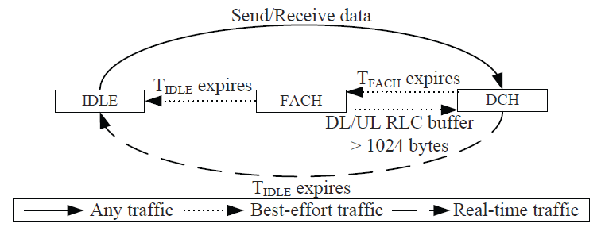
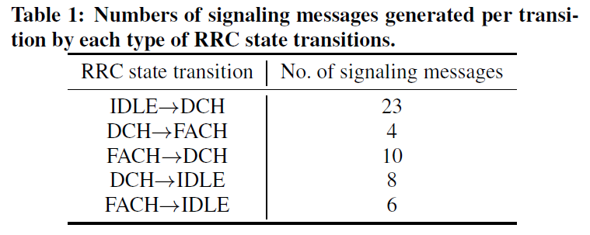
RRC State Machine
The RRC protocol associates with each UE session a state machine to control ratio bearer resources for data transfer.
  Two inactivity timers (T_{IDLE} and T_{FACH}) and service type govern state transitions.
Each state transition triggers radio network controller (RNC) to exchange signaling messages with UE in the control plane.

Slide 8
3G Signaling Profiling
Apply a data-plane signaling profiling method built on [Qian_IMC2010] and UMTS standard to study signaling load
  Simplify the complexities of correlating control-plane signaling messages and data-plane packets
Information extraction
Extract all IP packets for each UE session and obtain the following data
  Inter-arrival times (IATs) of adjacent IP packets
  Application type of each packet
    Using a commercial DPI tool
  Transport-layer info (e.g., up/downlink, src/dst ports, TCP flag) of each TCP/UDP packet
    Uplink: from UE to remote destination
  Session service type (i.e., real-time or best-effort)
…
State transition inference
…
Root cause analysis
…

Slide 9
3G Signaling Profiling
Apply a data-plane signaling profiling method built on [Qian_IMC2010] and UMTS standard to study signaling load
  Simplify the complexities of correlating control-plane signaling messages and data-plane packets
Information extraction
Apply IATs and session service type to the known RRC state machine and per-transition signaling message numbers to infer
  A sequence of state transitions
  Corresponding numbers of signaling messages
…
State transition inference
…
Root cause analysis
…

Slide 10
3G Signaling Profiling
Apply a data-plane signaling profiling method built on [Qian_IMC2010] and UMTS standard to study signaling load
  Simplify the complexities of correlating control-plane signaling messages and data-plane packets
Information extraction
Identify the first IP packets right after one of the following three state transitions, and their application types/transport-layer info
  IDLE→DCH (or I→D)
  FACH→DCH (or F→D)
  DCH→FACH (or D→F)
  Ignore DCH→IDLE and FACH→IDLE which are only resulted from inactivity timer expiries
…
State transition inference
…
Root cause analysis
…

Slide 11
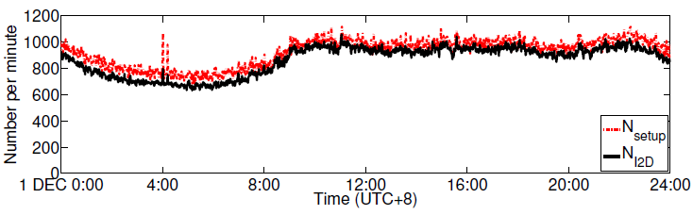
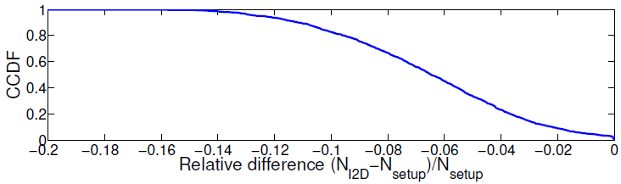
Validation
Ground truth: Measure number of RRC connection setups (N_{setup}) from a 24-hour RRC log on Dec 1, 2010
Our signaling profiling method: Infer number of IDLE→DCH states (N_{I2D}) from IP packets in the same period
Compute relative difference (N_{I2D}-N_{setup})/N_{setup}

Slide 12
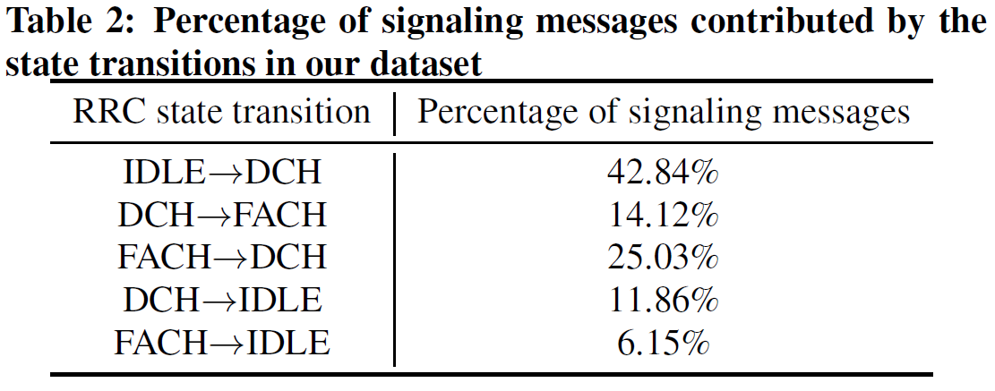
Distribution of Signaling Messages
IDLE→DCH contributes >40% of the signaling messages.
DCH→IDLE and FACH→IDLE altogether contribute only 18% of the total messages.

Slide 13
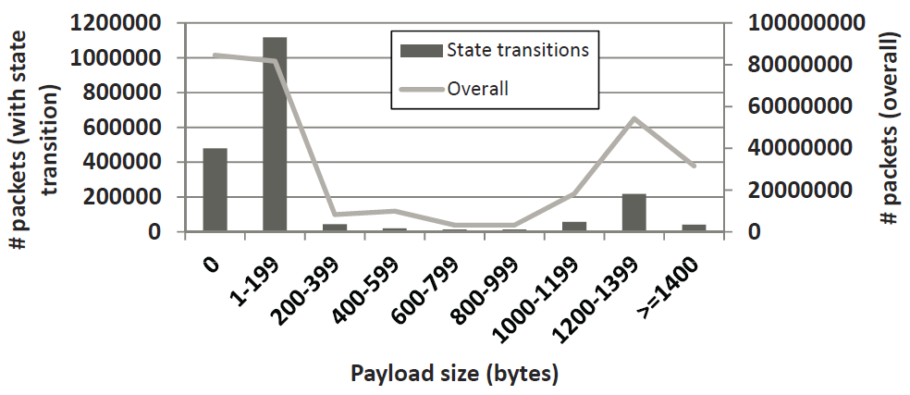
Effect of Payload Size
56.4% of all packets are small (<200B) and induce the most state transitions.
Packets with zero-payload induce 23.9% of the transitions and are all TCP control messages (e.g., pure ACKs, SYN, RSTs, FINs).

Slide 14
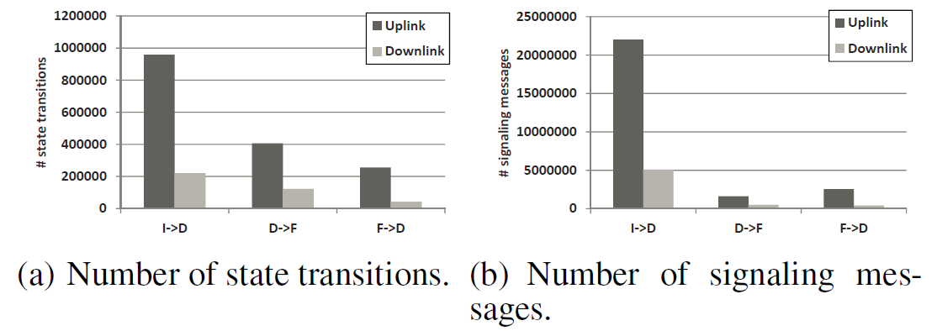
Uplink (UL) vs. Downlink (DL) Packets
Majority (>80%) of the transitions are induced from UL.
I→D contributes the most transitions and signaling messages for both UL and DL directions.

Slide 15
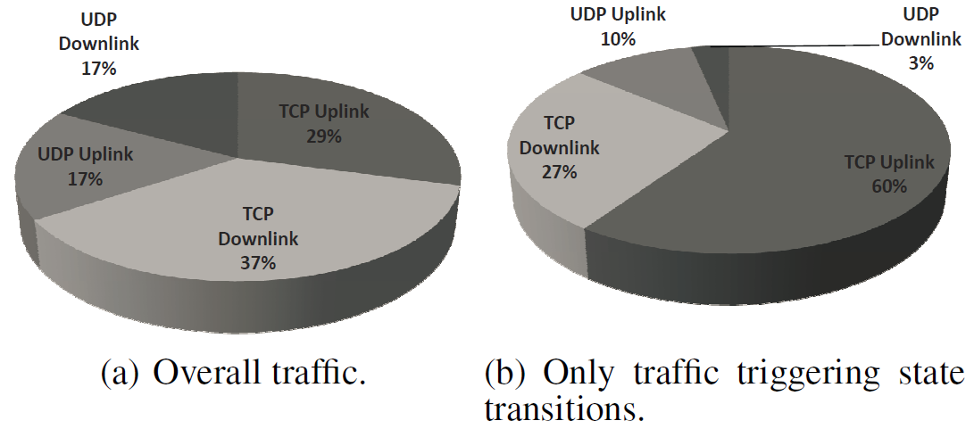
TCP vs. UDP
Majority of packets that trigger state transitions are due to TCP from the UL direction.
UDP traffic triggers only a small proportion (13%) of the transitions.

Slide 16
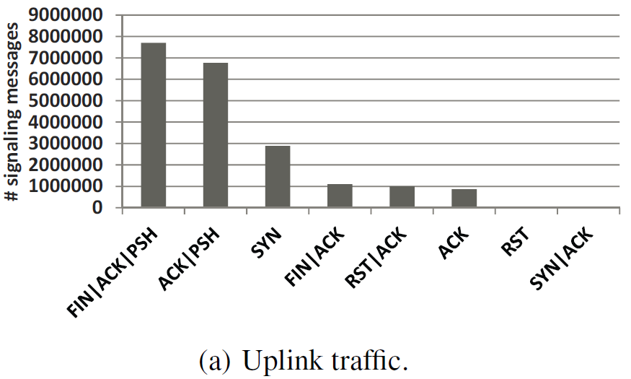
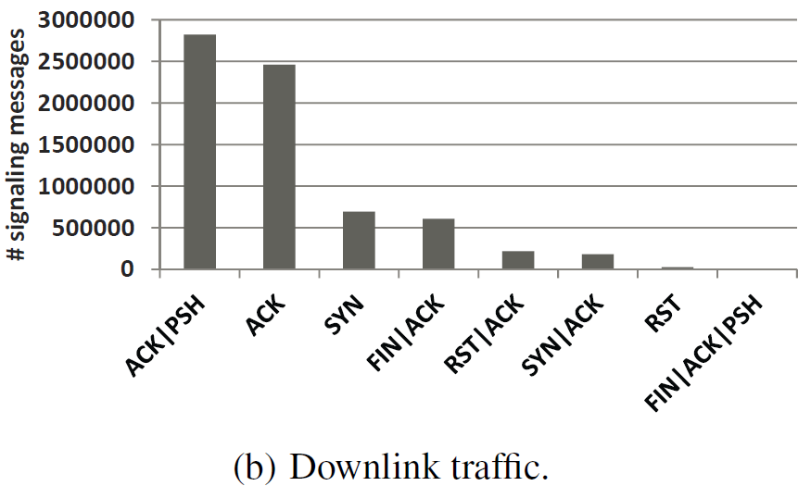
TCP Flag Analysis
Top 8 types of TCP packets in each direction
UL packets with SYN, FIN, or RST flags contribute a significant proportion of messages.
  Majority of their message are due to I→D (not shown in the figure).

Slide 17
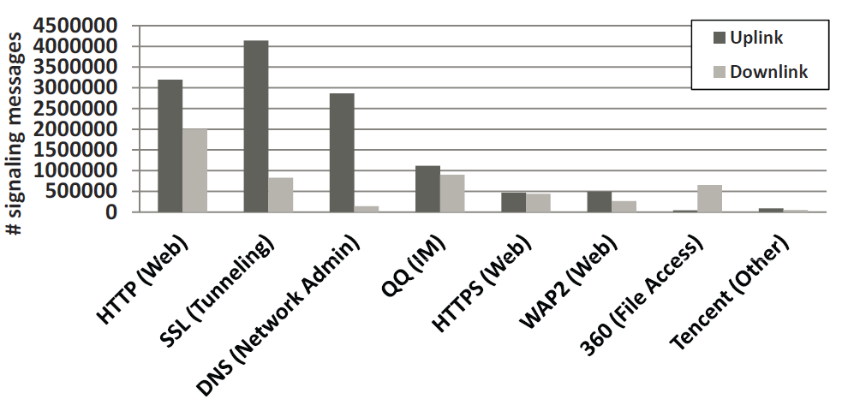
Application-Induced Signaling Loads
Top 8 applications inducing the most signaling messages are all interactive applications, e.g., Web, Tunneling, Network Admin, and IM.
SSL and HTTP in general introduce the most signaling messages from UL and DL, respectively.

Slide 18
Signaling-prone vs. Signaling-averse Applications
Define signaling density Φ=N_{trans}/N_{packets} of each application
  N_{trans}: Total # of induced transitions
  N_{packets}: Total # of packets
Signaling-prone applications: large Φ
Signaling-averse applications: small Φ

Slide 19
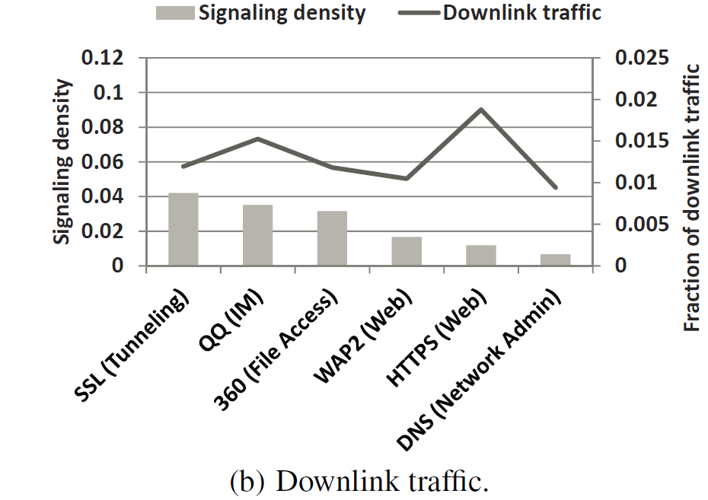
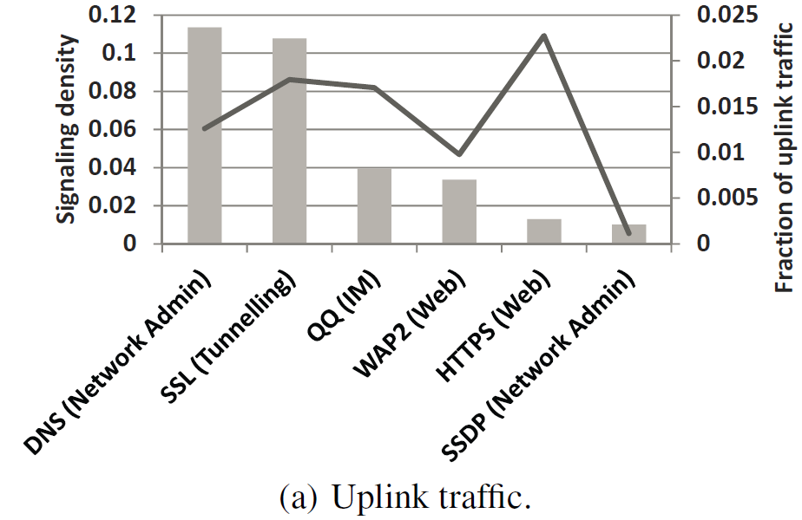
Signaling-Prone Applications
SSL/QQ are signaling-prone in both DL and UL.
Network admin applications like SSDP are signaling-prone on only UL.

Slide 20
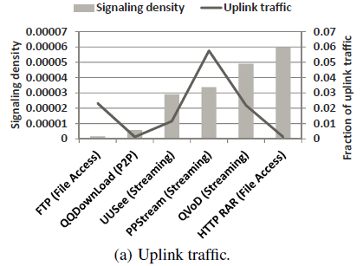
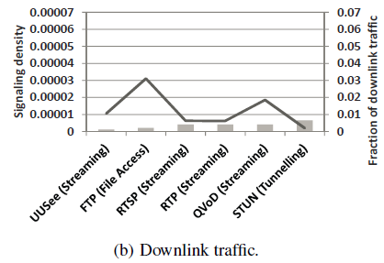
Signaling-Averse Applications
Bulk transfer applications, e.g., streaming, P2P, and file access, are signaling-averse on both directions.

Slide 21
Conclusions
Show that the pure data-plane signaling profiling approach can accurately infer state transitions due to RRC connection setups
Conduct the first comprehensive measurement in a city-wide 3G network to study the impact of raw data packets, transport protocols, and network applications on signaling loads
Observe that most signaling messages are attributed to I→D
  Possible solution: apply protocol/application-specific inactivity timers to avoid spurious RRC connection re-establishments

Slide 22
Q&A
Thanks for your time

Slide 23
Future work
Limitations of our work:
  Our dataset was collected nearly 1.5 years ago. There is dramatic growth of data/control-plane traffic.
  There are regular version updates for smartphone OS. Data transmission behavior may have changed.
Future work:
  Validate our findings for latest dataset
    Our methodology remains applicable for today’s 3G networks

Slide 24
3G Signaling Profiling
Apply a data-plane signaling profiling method built on [Qian2010IMC] and UMTS standard to study signaling load
  Simplify the complexities of correlating control-plane signaling messages and data-plane packets
Extract all IP packets for each UE session and obtain the following data
  Inter-arrival times (IATs) of adjacent IP packets from the session
  Application type of each IP packet with a commercial DPI tool
    DB, Email, File Access, Game, IM, Network Admin, Network Storage, P2P, Remote connectivity, Stock, Streaming, Tunneling, VoIP
  Session service type (i.e., real-time or best-effort)
  Transport-layer info (e.g., uplink/downlink, src/dst ports, TCP flag, payload size) for each TCP/UDP packet
    Uplink: from UE to remote destination

Slide 25
3G Signaling Profiling
Apply IATs and session service type per UE session to the known RRC state machine and per-transition signaling message numbers to
  Infer a sequence of state transitions and corresponding numbers of signaling messages
  Identify the first IP packets and their application types/transport-layer info right after one of the three state transitions:
    IDLE→DCH (or I→D)
    FACH→DCH (or F→D)
    DCH→FACH (or D→F)
    Ignore DCH→IDLE and FACH→IDLE which are only resulted from inactivity timer expiries

