Slide 1
Toward I/O-Efficient Protection Against Silent Data Corruptions in RAID Arrays
Mingqiang Li and Patrick P. C. Lee
The Chinese University of Hong Kong
MSST ’14

Slide 2
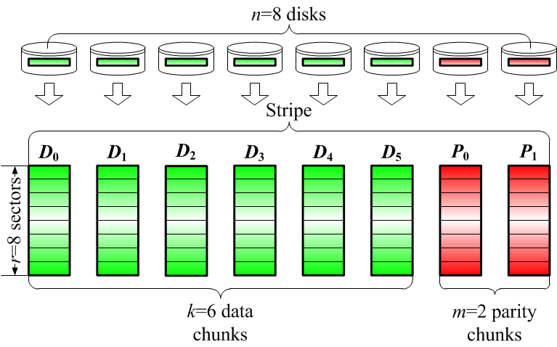
RAID
[Patterson et al., SIGMOD ’88]
RAID is known to protect data against disk failures and latent sector errors
How it works? Encodes k data chunks into m parity chunks, such that the k data chunks can be recovered from any k out of n=k+m chunks

Slide 3
Silent Data Corruptions
Silent data corruptions:
Data is stale or corrupted without indication from disk drives → cannot be detected by RAID
Generated due to firmware or hardware bugs or malfunctions on the read/write paths
More dangerous than disk failures and latent sector errors
[Kelemen, LCSC ’07; Bairavasundaram et al., FAST ’08; Hafner et al., IBM JRD 2008]

Slide 4
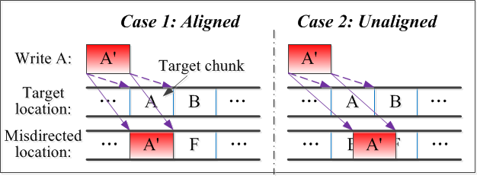
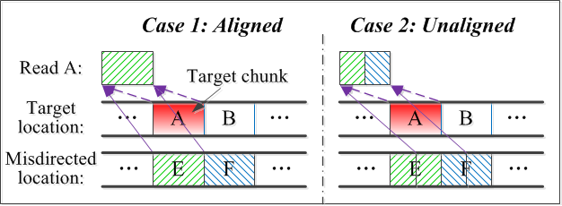
Silent Data Corruptions
Lost write:
Torn write:
Misdirected writes/reads:
Stale
updated
Stale
(a) Misdirected writes
(b) Misdirected reads

Slide 5
Silent Data Corruptions
Consequences:
User read:
Corrupted data propagated to upper layers
User write:
Parity pollution
Data reconstruction
Corruptions of surviving chunks propagated to reconstructed chunks

Slide 6
Integrity Protection
Protection against silent data corruptions:
Extend RAID layer with integrity protection, which adds integrity metadata for detection
Recovery is done by RAID layer
Goals:
All types of silent data corruptions should be detected
Reduce computational and I/O overheads of generating and storing integrity metadata
Reduce computational and I/O overheads of detecting silent data corruptions

Slide 7
Our Contributions
A taxonomy study of existing integrity primitives on I/O performance and detection capabilities
An integrity checking model
Two I/O-efficient integrity protection schemes with complementary performance gains
Extensive trace-driven evaluations

Slide 8
Assumptions
At most one silently corrupted chunk within a stripe
If a stripe contains a silently corrupted chunk, the stripe has no more than m-1 failed chunks due to disk failures or latent sector errors
Otherwise, higher-level RAID is needed!
m-1=1
D₀
D₁
D₂
D₃
D₄
D₅
P₀
P₁

Slide 9
How RAID Handles Writes?
Full-stripe writes:
Parity chunks are computed directly from data chunks to be written chunks (no disk reads needed)
Partial-stripe writes:
RMW (Read-modify-writes) → for small writes
Read all touched data chunks and all parity chunks
Compute the data changes and the parity chunks
Write all touched data chunks and parity chunks
RCW (Reconstruct-writes) → for large writes
Read all untouched data chunks
Compute the parity chunks
Write all touched data chunks and parity chunks

Slide 10
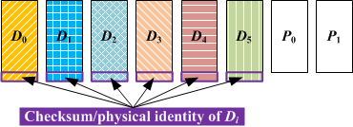
Existing Integrity Primitives
Self-checksumming / Physical identity
[Krioukov et al., FAST ’08]
Data and metadata are read in a single disk I/O
Inconsistency implies data corruption
Cannot detect stale or overwritten data

Slide 11
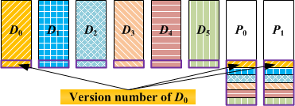
Existing Integrity Primitives
Version Mirroring
[Krioukov et al., FAST ’08]
Keep a version number in the same data chunk and m parity chunks
Can detect lost writes
Cannot detect corruptions

Slide 12
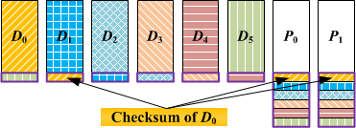
Existing Integrity Primitives
Checksum Mirroring
[Hafner et al., IBM JRD 2008]
Keep a checksum in the neighboring data chunk (buddy) and m parity chunks
Can detect all silent data corruptions
High I/O overhead on checksum updates

Slide 13
Comparisons
No additional I/O overhead
Additional I/O overhead
Question: How to integrate integrity primitives into I/O-efficient integrity protection schemes?

Slide 14
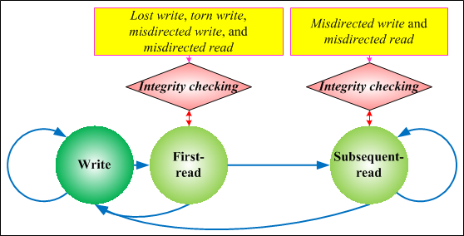
Integrity Checking Model
Two types of disk reads:
First read: sees all types of silent data corruptions
Subsequent reads: see a subset of types of silent data corruptions
Observation: A simpler and lower-overhead integrity checking mechanism is possible for subsequent-reads

Slide 15
Checking Subsequent-Reads
Seen by subsequent-reads
No additional I/O overhead
Subsequent-reads can be checked by self-checksumming and physical identity without additional I/Os
Integrity protection schemes to consider:
PURE (checksum mirroring only), HYBRID-1, and HYBRID-2
15

Slide 16
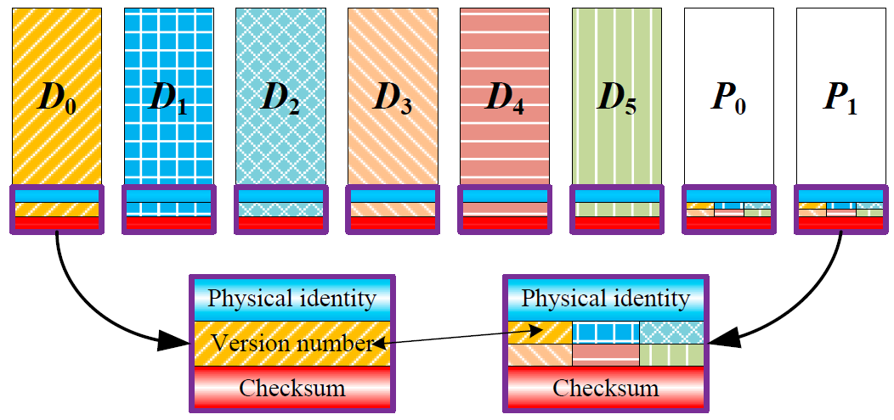
Integrity Protection Schemes
Hybrid-1
Physical identity + self-checksumming + version mirroring
A variant of the scheme in [Krioukov et al., FAST ’08]

Slide 17
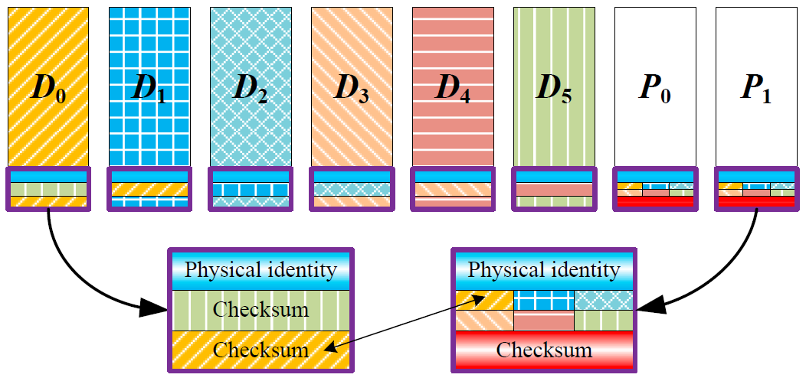
Integrity Protection Schemes
Hybrid-2
Physical identity + self-checksumming + checksum mirroring
A NEW scheme

Slide 18
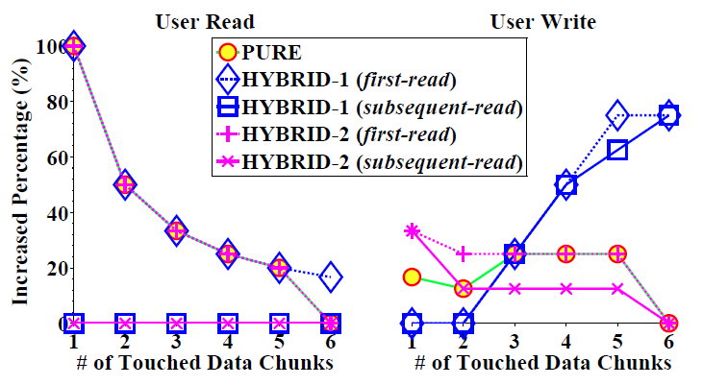
Additional I/O Overhead for a Single User Read/Write
Switch point:
Both Hybrid-1 and Hybrid-2 outperform Pure in subsequent-reads
Hybrid-1 and Hybrid-2 provide complementary I/O advantages for different write sizes

Slide 19
Choosing the Right Scheme
If choose Hybrid-1
If choose Hybrid-2
= average write size of a workload (estimated through measurements)
= RAID chunk size
The chosen scheme is configured in the RAID layer (offline) during initialization

Slide 20
Evaluation
Computational overhead for calculating integrity metadata
I/O overhead for updating and checking integrity metadata
Effectiveness of choosing the right scheme

Slide 21
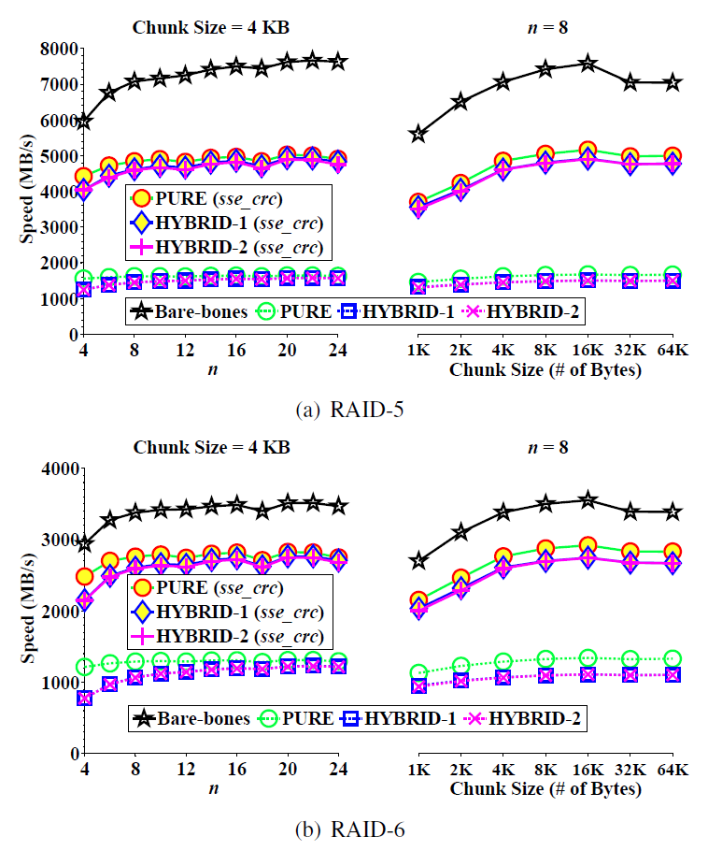
Computational Overhead
Implementation:
GF-Complete [Plank et al., FAST’13] and Crcutil libraries
Testbed:
Intel Xeon E5530 CPU @ 2.4GHz with SSE4.2
Overall results:
~4GB/s for RAID-5
~2.5GB/s for RAID-6
RAID performance is bottlenecked by disk I/Os, rather than CPU

Slide 22
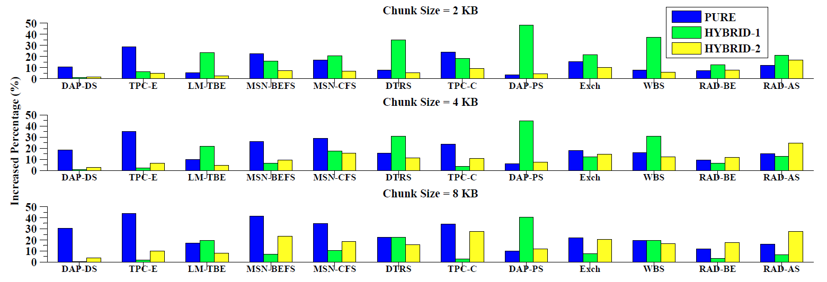
I/O Overhead
Trace-driven simulation
12 workload traces from production Windows servers
RAID-6 with n=8 for different chunk sizes
[Kavalanekar et al., IISWC ’08]

Slide 23
I/O Overhead
Pure can have high I/O overhead, by up to 43.74%
I/O overhead can be kept at reasonably low (often below 15%) using the best of Hybrid-1 and Hybrid-2, due to I/O gain in subsequent reads
More discussions in the paper
43.74%

Slide 24
Choosing the Right Scheme
Accuracy rate: 34/36 = 94.44%
For the two inconsistent cases, the I/O overhead difference between Hybrid-1 and Hybrid-2 is small (below 3%)

Slide 25
Implementation Issues
Implementation in RAID layer:
Leverage RAID redundancy to recover from silent data corruptions
Open issues:
How to keep track of first reads and subsequent reads?
How to choose between Hybrid-1 and Hybrid-2 based on workload measurements?
How to integrate with end-to-end integrity protection?

Slide 26
Conclusions
A systematic study on I/O-efficient integrity protection schemes against silent data corruptions in RAID systems
Findings:
Integrity protection schemes differ in I/O overheads, depending on the workloads
Simpler integrity checking can be used for subsequent reads
Extensive evaluations on computational and I/O overheads of integrity protection schemes

