Slide 1
Live Deduplication Storage of Virtual Machine Images in an Open-Source Cloud
Chun-Ho Ng, Mingcao Ma, Tsz-Yeung Wong, Patrick P. C. Lee, John C. S. Lui
The Chinese University of Hong Kong
Middleware’11

Slide 2
Using Cloud Computing
Cloud computing is real…
But many companies still hesitate to use public clouds
e.g., security concerns
Open-source cloud platforms
Self-manageable with cloud-centric features
Extensible with new functionalities
Deployable with low-cost commodity hardware
Examples:
Eucalyptus, OpenStack

Slide 3
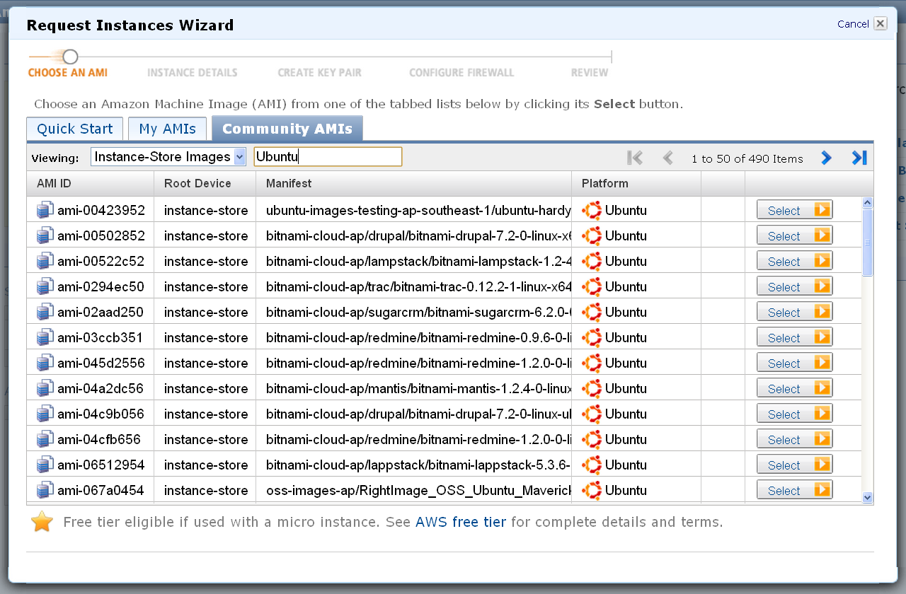
Hosting VM Images on the Cloud
A private cloud should host a variety of virtual machine (VM) images for different needs
Common for commercial clouds
Example:
Amazon EC2

Slide 4
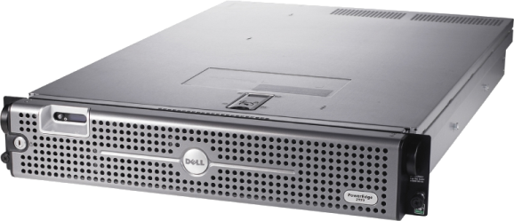
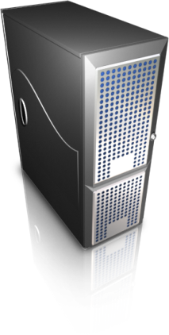
Private Cloud Deployment
Huge storage space needed to host all VM image files
Each VM image has few GB of storage
Question: How to scale up storage with low-cost commodity hardware?
One option: deduplication
VM Image Storage
Pool of Compute Nodes

Slide 5
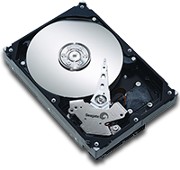
What is Deduplication?
User’s point of view
Traditional
File system
copy
copy
Idea. Eliminate storage of data with same content
Deduplication
copy
No new blocks!

Slide 6
What is Deduplication?
Block-level deduplication
Example: storage space reduced by 5/12 = 42%!

Slide 7
Challenges
Deployment issues of deduplication in VM image storage in an open-source cloud:
Can we preserve the performance of VM operations?
e.g., inserting VM images, VM startup
Can we support general file system operations?
e.g., read, write, modify, delete
Can we deploy deduplication on low-cost commodity systems?
e.g., a few GB of RAM, 32/64-bit CPU, standard OS

Slide 8
Related Work
Deduplication backup systems
e.g., Venti [Quinlan & Dorward ’02], Data Domain [Zhu et al. ’08], Foundation [Rhea et al. ’08]
Assume data is not modified or deleted
Deduplication file systems
e.g., OpenSolaris ZFS, OpenDedup SDFS
Consume significant memory space, not for commodity systems
VM image storage
e.g., Lithium [Hansen & Jul ’10], mainly on fault tolerance, but not on deduplication

Slide 9
Our Work
LiveDFS: a live deduplication file system
tailored for VM image storage
Design goals of LiveDFS:
Target open-source clouds deployed on low-cost commodity hardware and OSs
Support basic file system operations, while allowing inline (on-the-fly) deduplication while data being written

Slide 10
Our Work
Design features of LiveDFS:
Spatial locality: store partial metadata in memory, while storing full metadata on disk with respect to file system layout
Prefetching metadata: store metadata of same block group into page cache
Journaling: enable crash recovery and combine block writes in batch
Kernel-space design: built on Ext3, and follow Linux file system layout

Slide 11
Our Work
Deploy LiveDFS on OpenStack testbed
LiveDFS serves as a storage layer between compute nodes and VM image storage
Evaluate the performance of VM operations and compare with Ext3
VM Image Storage
LiveDFS
Pool of Compute Nodes

Slide 12
Basics: Layout
File system layout of LiveDFS
Layout of an inode
metadata
…
block pointers
…
Layout of a block group
Super block
Inode bitmap
Block bitmap
Inode
Layout of a partition
Group 0
Group 1
Group 2
LiveDFS uses a block-level design
Organizes data into fixed-size blocks
Blocks are organized into block groups, as in Linux file system

Slide 13
Basics: Layout
Deduplication operates on fixed-size blocks
Saves one copy if two fixed-size blocks have the same content
For VM image storage, deduplication efficiencies similar for fixed-size blocks and variable-size blocks [Jin & Miller, ’09]

Slide 14
Basics: Fingerprints
How to compare blocks?
Solution: Use cryptographic hashes (or fingerprints)
Hash-based comparisons
Same content ➔ same hash
Different content ➔ different hashes with high probability
Pros: block comparison reduced to hash comparison
Cons: collision may occur, but with negligible probability [Quinlan & Dorward, ’02]
4K Bytes
New block
MD5 or SHA-1
MD5
SHA-1
16 Bytes
20 Bytes

Slide 15
Basics: Reference Counts
How to know if a block is deleted?
Solution: Keep a reference count for each block. Zero means the block is no longer referenced.
New block
3
2
2
2
1
1
2
1

Slide 16
Inline Deduplication
How to check if a block being written and can be deduplicated with existing blocks?
Solution: maintain an index structure
Keep track of fingerprints of existing blocks
Goal: design of index structure must be efficient in space and speed
Two options of keeping an index structure:
Putting whole index structure in RAM
Putting whole index structure on disk

Slide 17
Option 1: Index Structure in RAM
How about putting whole index structure in RAM?
Used in existing dedup file systems (e.g., ZFS, OpenDedup)
Challenge: need large amount of RAM
Example: per 1TB of disk content
Block Size | 4KB
Using MD5 checksum | 16 bytes per block
Size of Index | 1TB / 4KB x 16 bytes = 4GB.

Slide 18
Option 2: Index Structure on Disk
How about putting whole index structure on disk?
Challenge: updating each data block and its index keeps the disk head moving, which hurts performance.
Indexing
Structure
Remaining File System
For each write request…
1
Search for duplicated block.
2
If not found, write to file system.

Slide 19
LiveDFS Design
Store partial fingerprints in memory
Infer if same block exists, and where it is “potentially” located
Incoming
write
request
Checksum of incoming block
N Bits
Current Implementation
N=43, error rate = 2⁻¹⁵
i.e., on average every 128MB of data, one partial hash mapped to two block locations.
Per 1TB of disk, reduce memory usage from previous 4GB to 1.6GB
Partial hash
matching
Partial hash 0
Block #
Fingerprint
filter
Partial hash 1
Block #
......
Partial hash n
Block #

Slide 20
LiveDFS Design
Store full fingerprints on disk, with spatial locality
Verify whether the same block is actually located
I
N
D
E
X
Data
I
N
D
E
X
Data
I
N
D
E
X
......
I
N
D
E
X
Data
Full checksum
Reference Count
Partition index structure according to block groups
Each block group has a fingerprint store
Each fingerprint store keeps fingerprints and reference counts for the respective data blocks in the same block group
Writing with close proximity incurs minimal seeks

Slide 21
LiveDFS Design
Take-away: LiveDFS arranges fingerprints in memory and on disk according to underlying file system layout on disk
Other features:
Prefetching of fingerprint store:
load entire fingerprint store of same block group into page cache
subsequent writes updates fingerprint store directly in page cache.
Journaling:
follow Linux file system journaling design
enable crash recovery and enhance write performance by combining block writes in batch
Details in the paper

Slide 22
Experiments
OpenStack Deployment
1 compute node
1 storage node
Gigabit switch connection
Datasets
42 VM images of diff. dists (e.g., Fedora, Ubuntu) compliant with Amazon EC2
Each VM image is of size 2GB
VM operations via euca2tools:
Inserting VM images
Launch VM instances
VM Image Storage

Slide 23
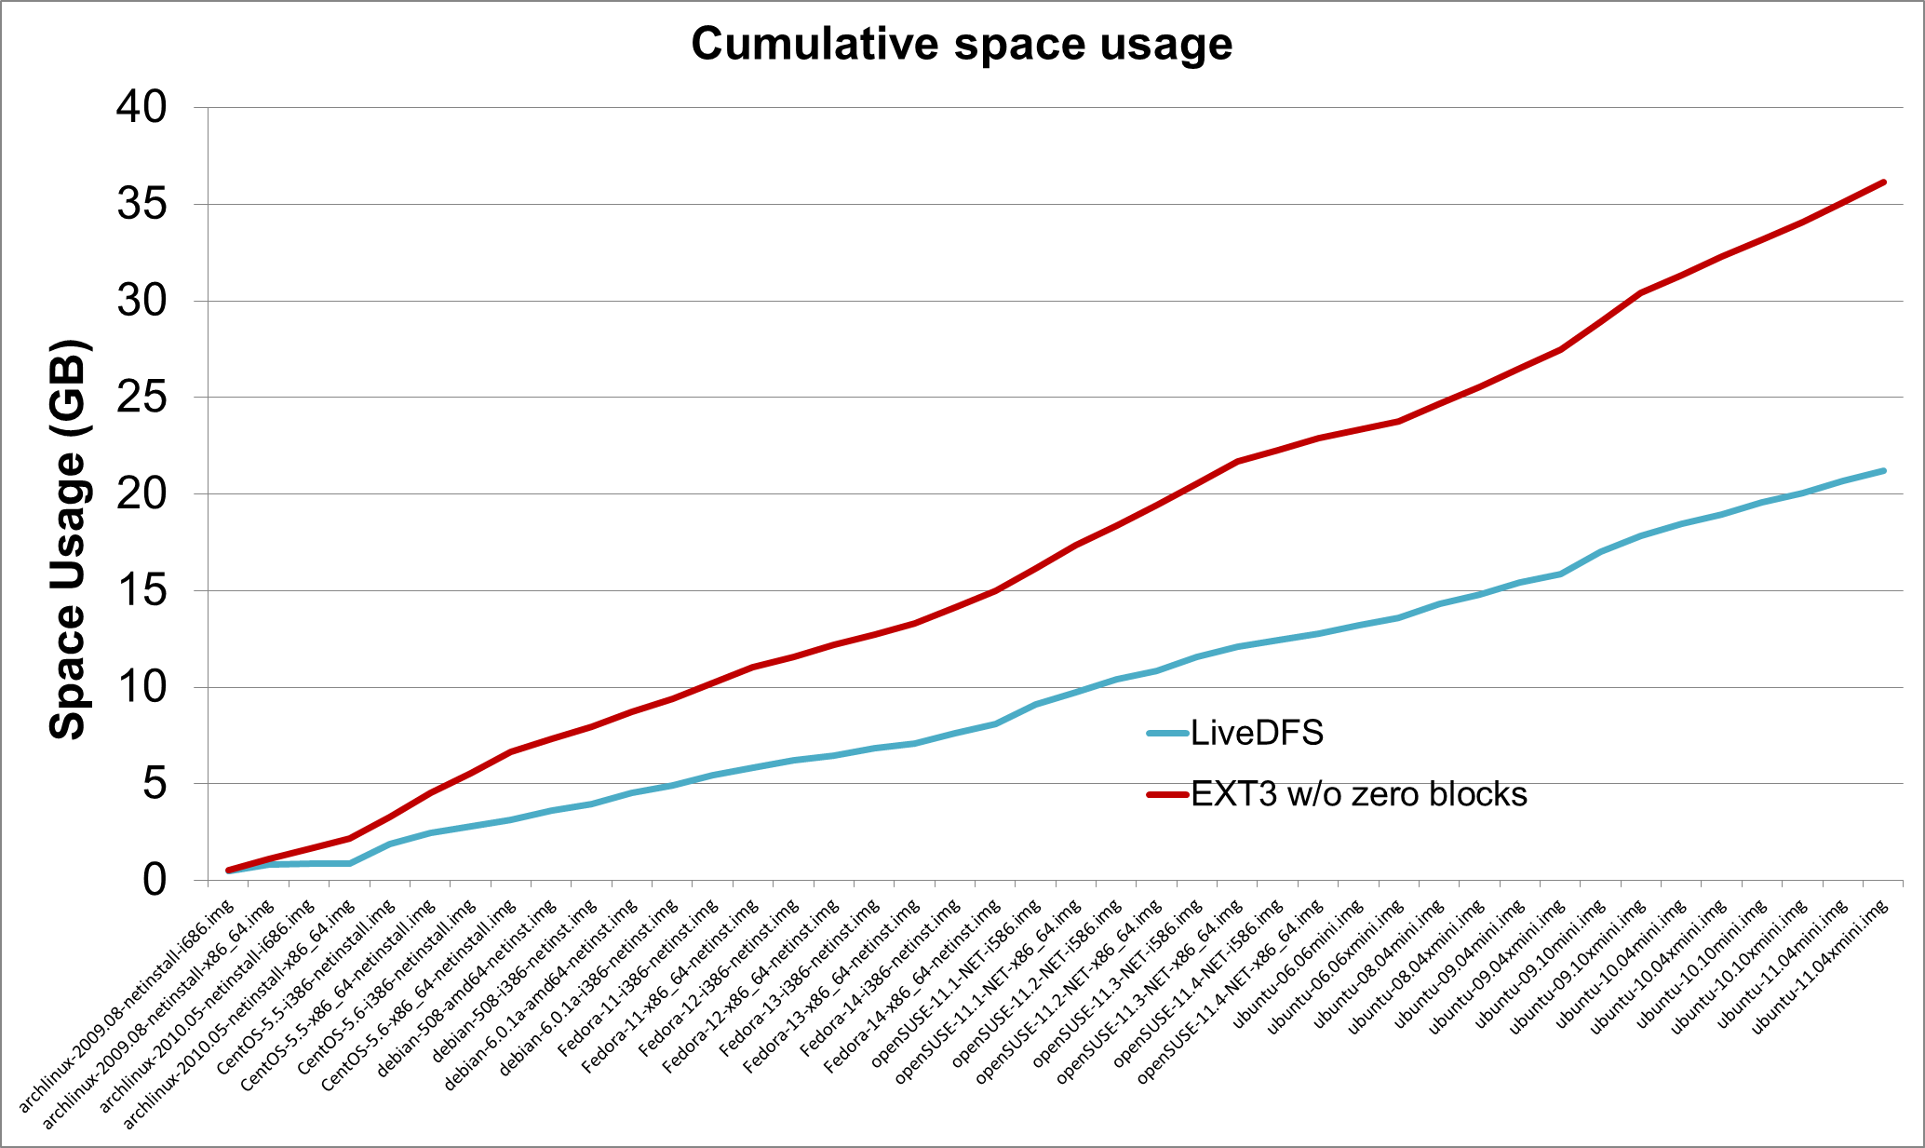
Space Usage
LiveDFS saves 40% storage over Ext3

Slide 24
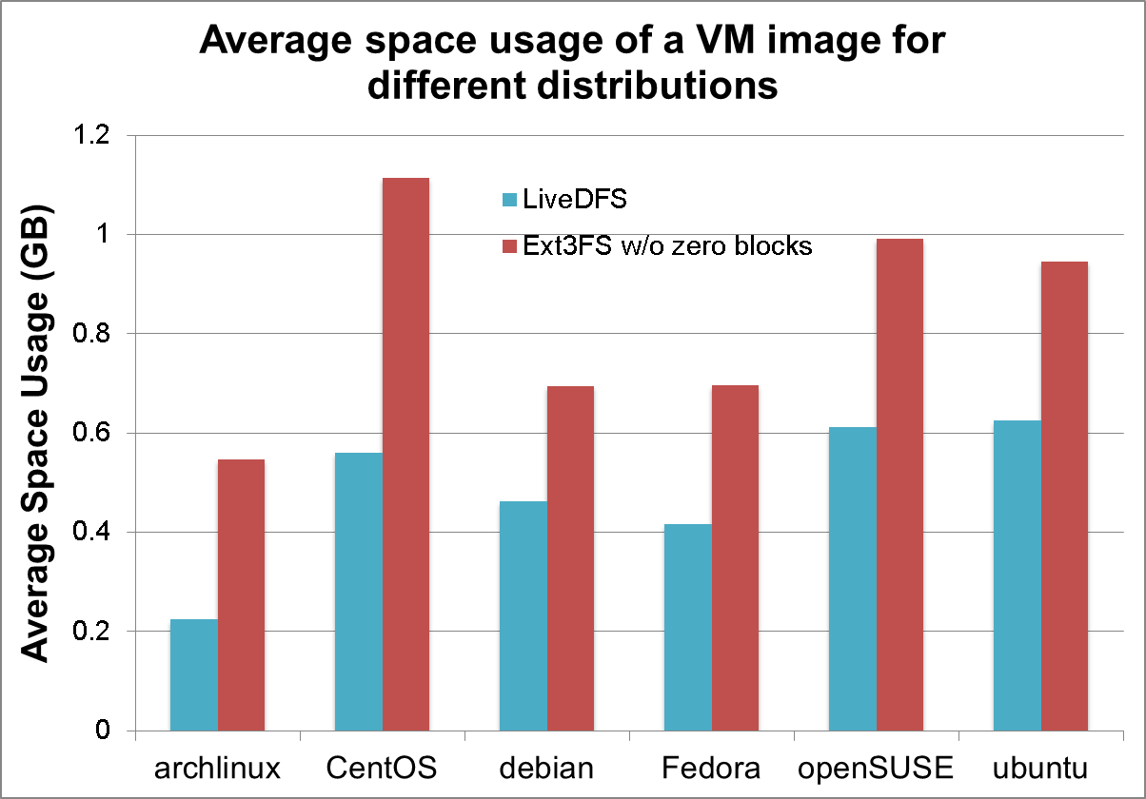
Space Usage
Space saving ranges from 33% to 60% from each Linux distribution

Slide 25
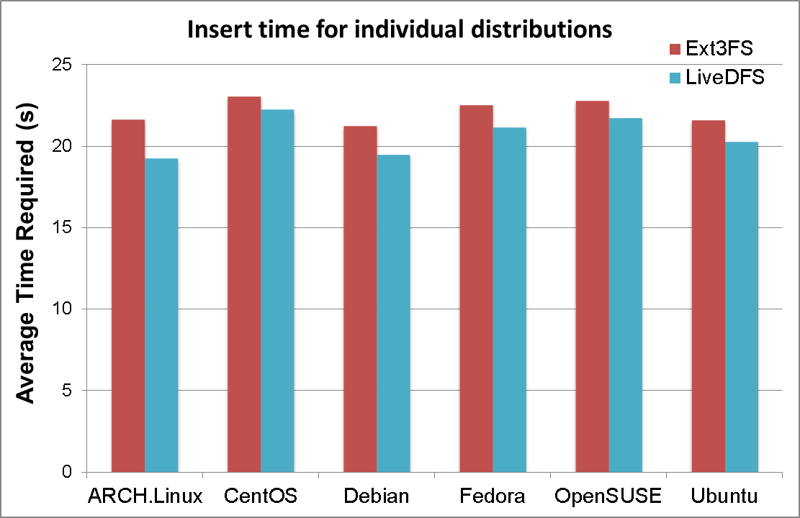
Inserting VM Images
LiveDFS uses less insertion time than Ext3, mainly because it doesn’t write duplicate blocks

Slide 26
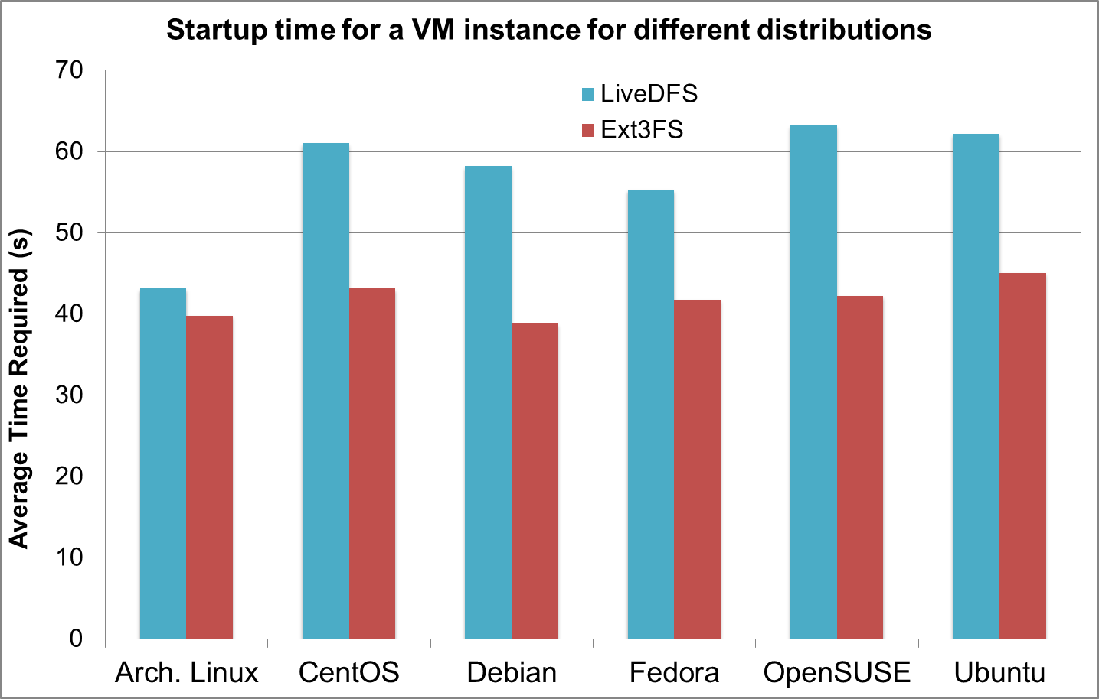
VM Startup
Tradeoff: LiveDFS uses 30% more startup time
Main reason: internal fragmentation due to deduplication (read may access duplicate blocks in different locations)

Slide 27
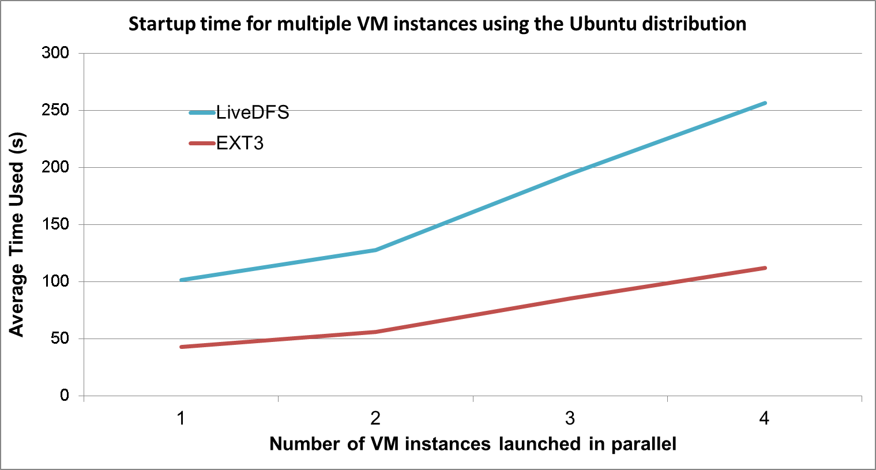
VM Startup
Overhead remains at the same percentage even when multiple instances started in parallel

Slide 28
Summary of Results
LiveDFS saves 40% storage via deduplication
LiveDFS uses less VM insertion time, with a tradeoff of more VM startup time
Microbenchmark experiments to study impact of each design features
See details in paper

Slide 29
Future Work
Reduce read time due to fragmentation introduced by deduplication?
e.g., read cache to cache duplicate blocks
Compare LiveDFS with other deduplication file systems (e.g., ZFS, OpenDedup SDFS)?
Explore other storage applications

Slide 30
Conclusions
Deploy live (inline) deduplication in an open-source cloud platform with commodity settings
Propose LiveDFS, a kernel-space file system
Spatial locality of fingerprint management
Prefetching of fingerprints into page cache
Journaling to enable crash recovery and combine writes in batch
Source code:
http://ansrlab.cse.cuhk.edu.hk/software/livedfs

